Slide 1
Towards construction of a novel nm resolution MeV-STEM for imaging thick biological samples
Xi Yang
on behalf of BNL UEM team
in collaboration with Cornell university
10/04/2023

Slide 2
Outline
Introduction
Review of scientific case for conventional TEM/STEM and UED
Promise of MeV- microscopy
History of MeV- microscopy
Review of the state-of-art in the field
Physics & engineering challenges & solutions in reaching nm resolution
Ultrabright MeV electron source
Interaction of MeV-electrons to sample
Detector & instrumental stability
Conclusion

Slide 3
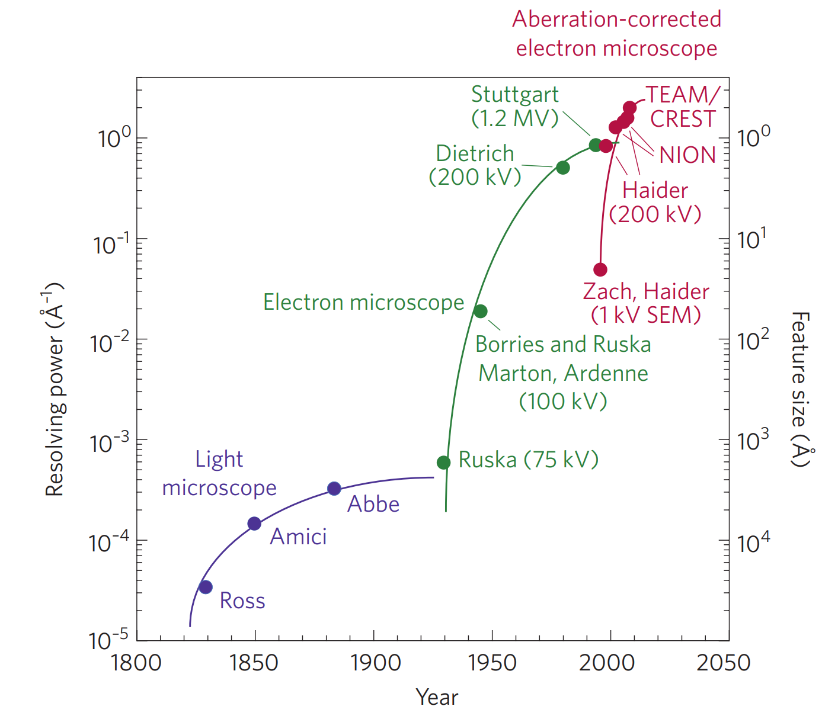
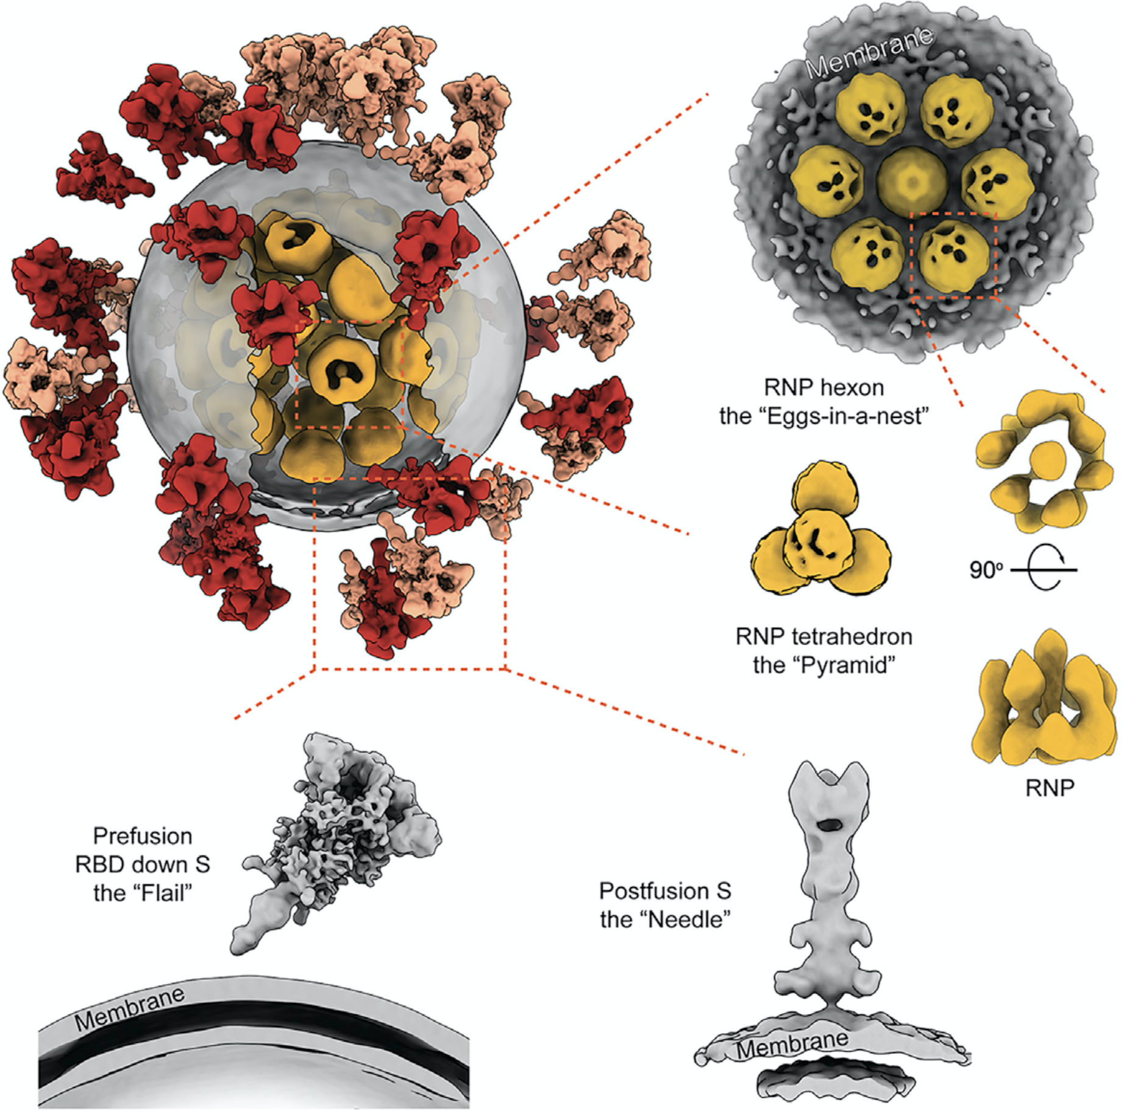
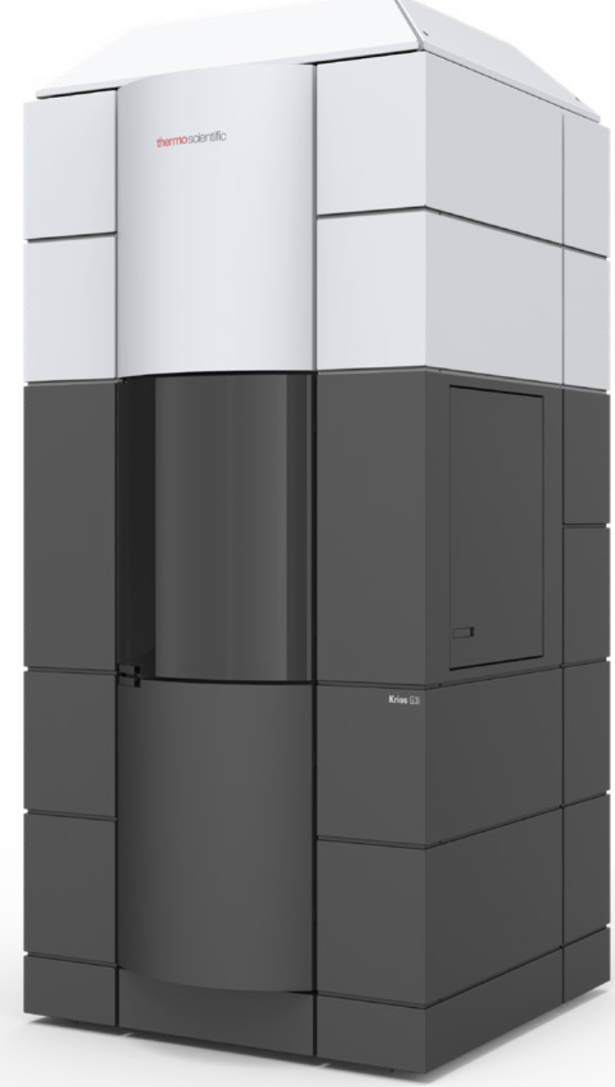
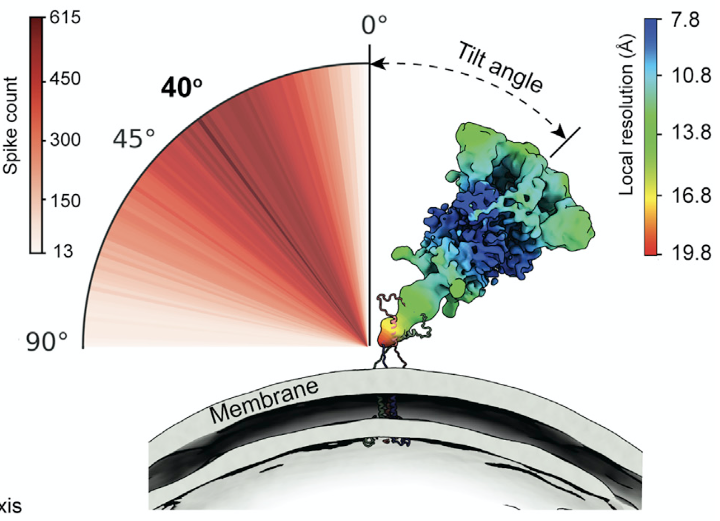
Transmission electron microscopy
Imaging tool for materials science, chemistry, physics, biology, and industry
Atomic resolution with aberration correction
I
An intact virus to fight against covid-19
Cryo-TEM
Soil bacterium
D. A. Muller, Nat. Mater. 8, 263 (2009)
Adapted from H. H. Rose (2009)
Intact virus applied to EM grids
Yao, H. et al. Cell 183, 730 (2020)

Slide 4
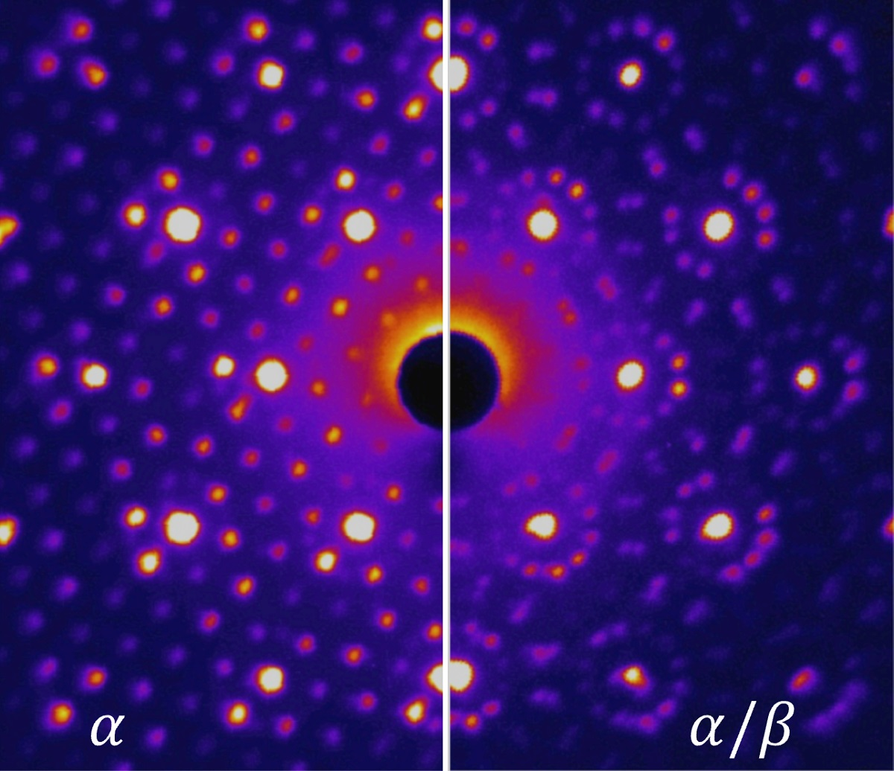
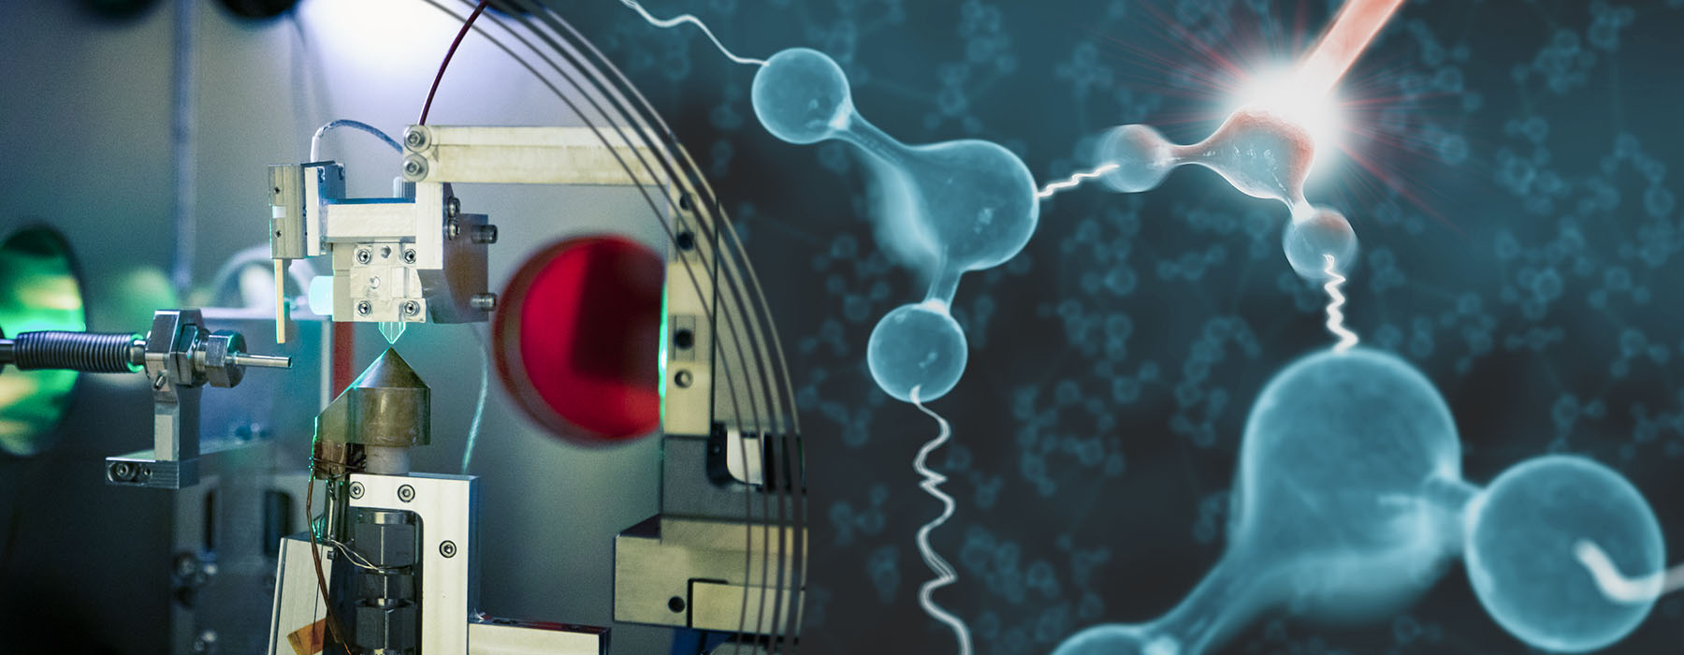
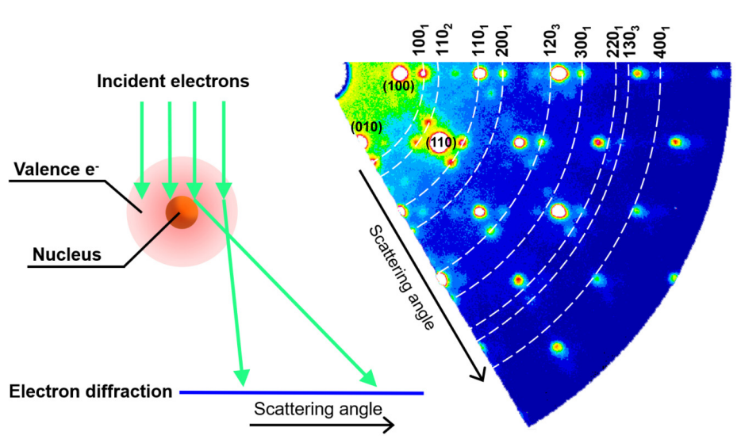
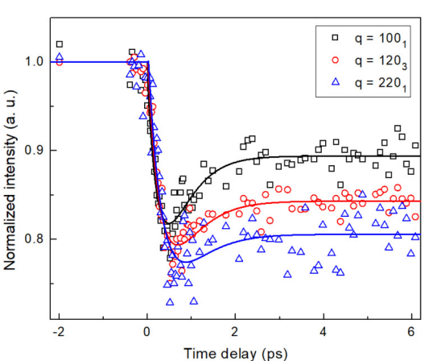
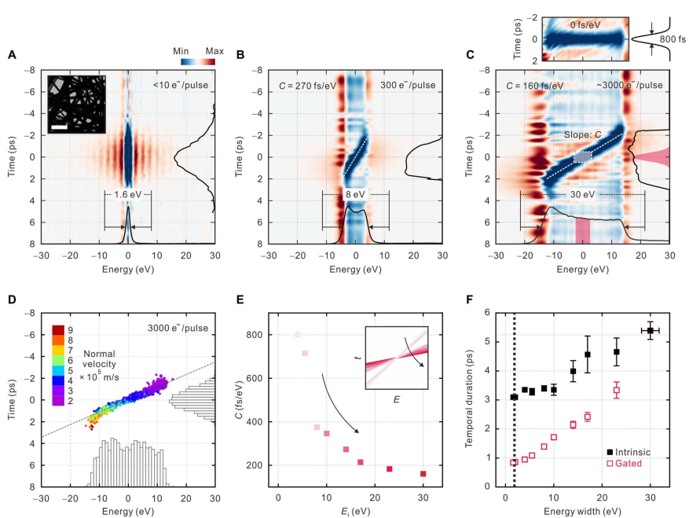
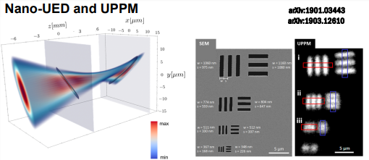
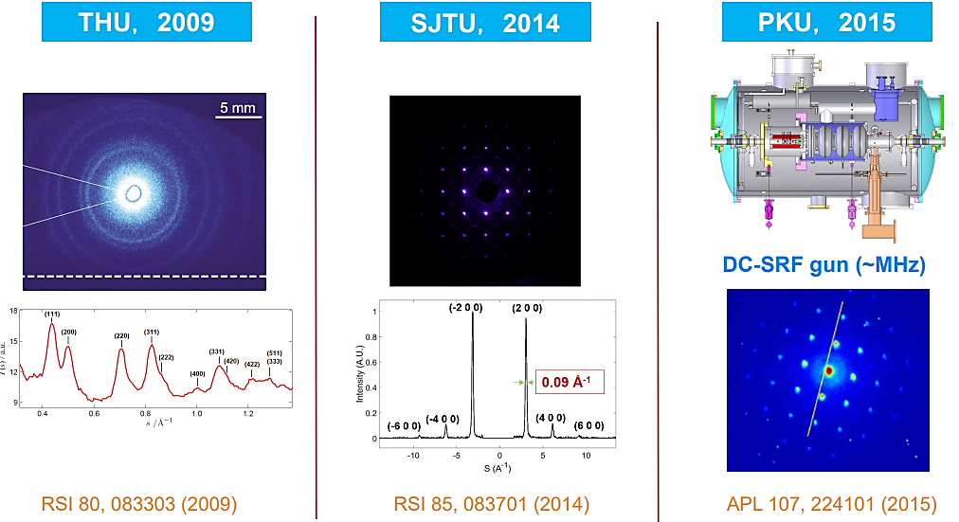
Ultrafast science enabled by MeV UED
Toward real space imaging enabled by MeV Microscopy
Courtesy of Xiaozhe Shen
Concurrent probing electron-lattice dephasing (BNL)
SLAC
Phase switch with a single flash of light (Sci. Adv. 4, eaau5501 (2018)).
Resolving ultrafast phase transitions (Science 360 1451–1455 (2018))
Ultrafast hydrogen bond strengthening in liquid water(Nature. 596, 531(2021)).
Li et al., Phys. Rev. B 101, 100304(R) (2020)
High repetition rate electron scattering beamline (HiRES) LBNL
F. Ji, et al., Commun. Phys. 2, 54 (2019)
fs-resolved imaging of grain boundary dynamics in energy-filtered ultrafast electron microscopy (UNIST)
(Sci. Adv. 9, eadd5375 (2023))

Slide 5
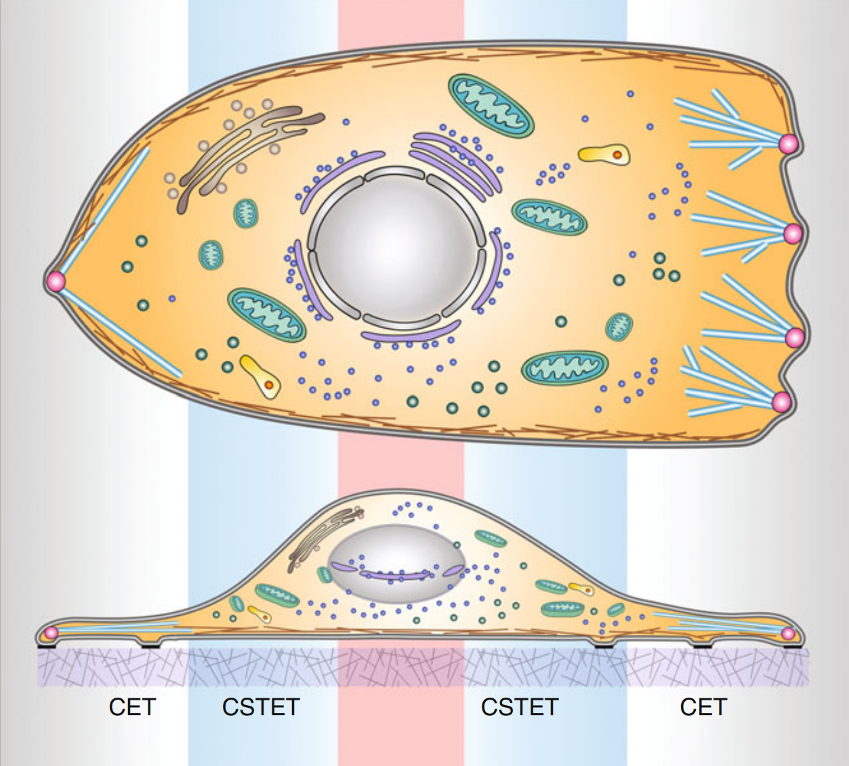
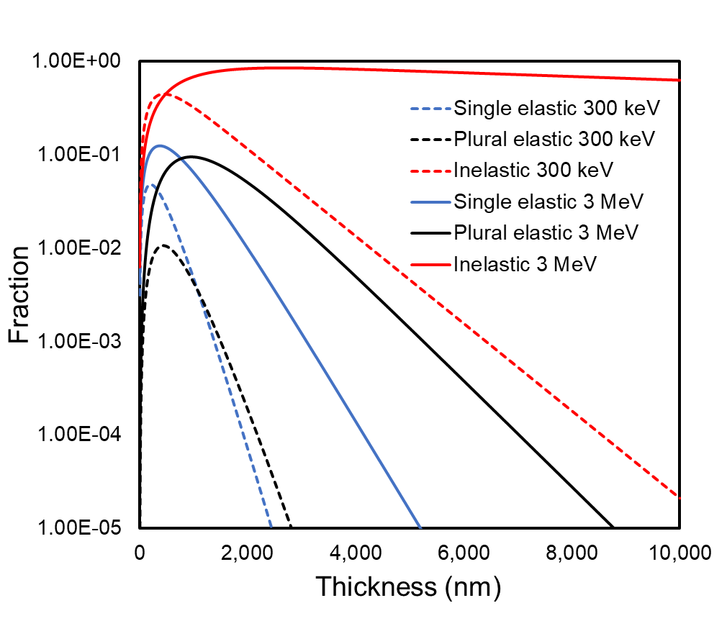
Promise of MeV Microscopy
Benefit of increasing electron energy to MeV
Life science application: 3D image intact thick bio-samples
studying cell-biology and microbiology in cellular context
No need of cryo-FIB (focused ion beam) slicing thick cells
Limit to 10-20 lamellae/day, “blindly” select target
Speed up discovery
I
Why MeV? Phase contrast (TEM) & amplitude contrast (STEM)
300 keV
Single-elastic drop <1% after 1-µm ice layer
Inelastic drop <1% after 4-µm
3 MeV
Single-elastic drop <1% after 2-µm ice layer
Inelastic stays 63% after 10-μm
3 MeV STEM/UEM
Signal for 3 MeV-STEM
300 keV-STEM
Signal for 3 MeV-UEM
300 keV-UEM
Top
Nucleus
Side
cryo-electron tomograph
cryo-scanning transmission e- tomograph
300 keV
Top and side views of a eukaryotic cell.
S.G. Wolf, et al., Cellular Imaging, Springer

Slide 6
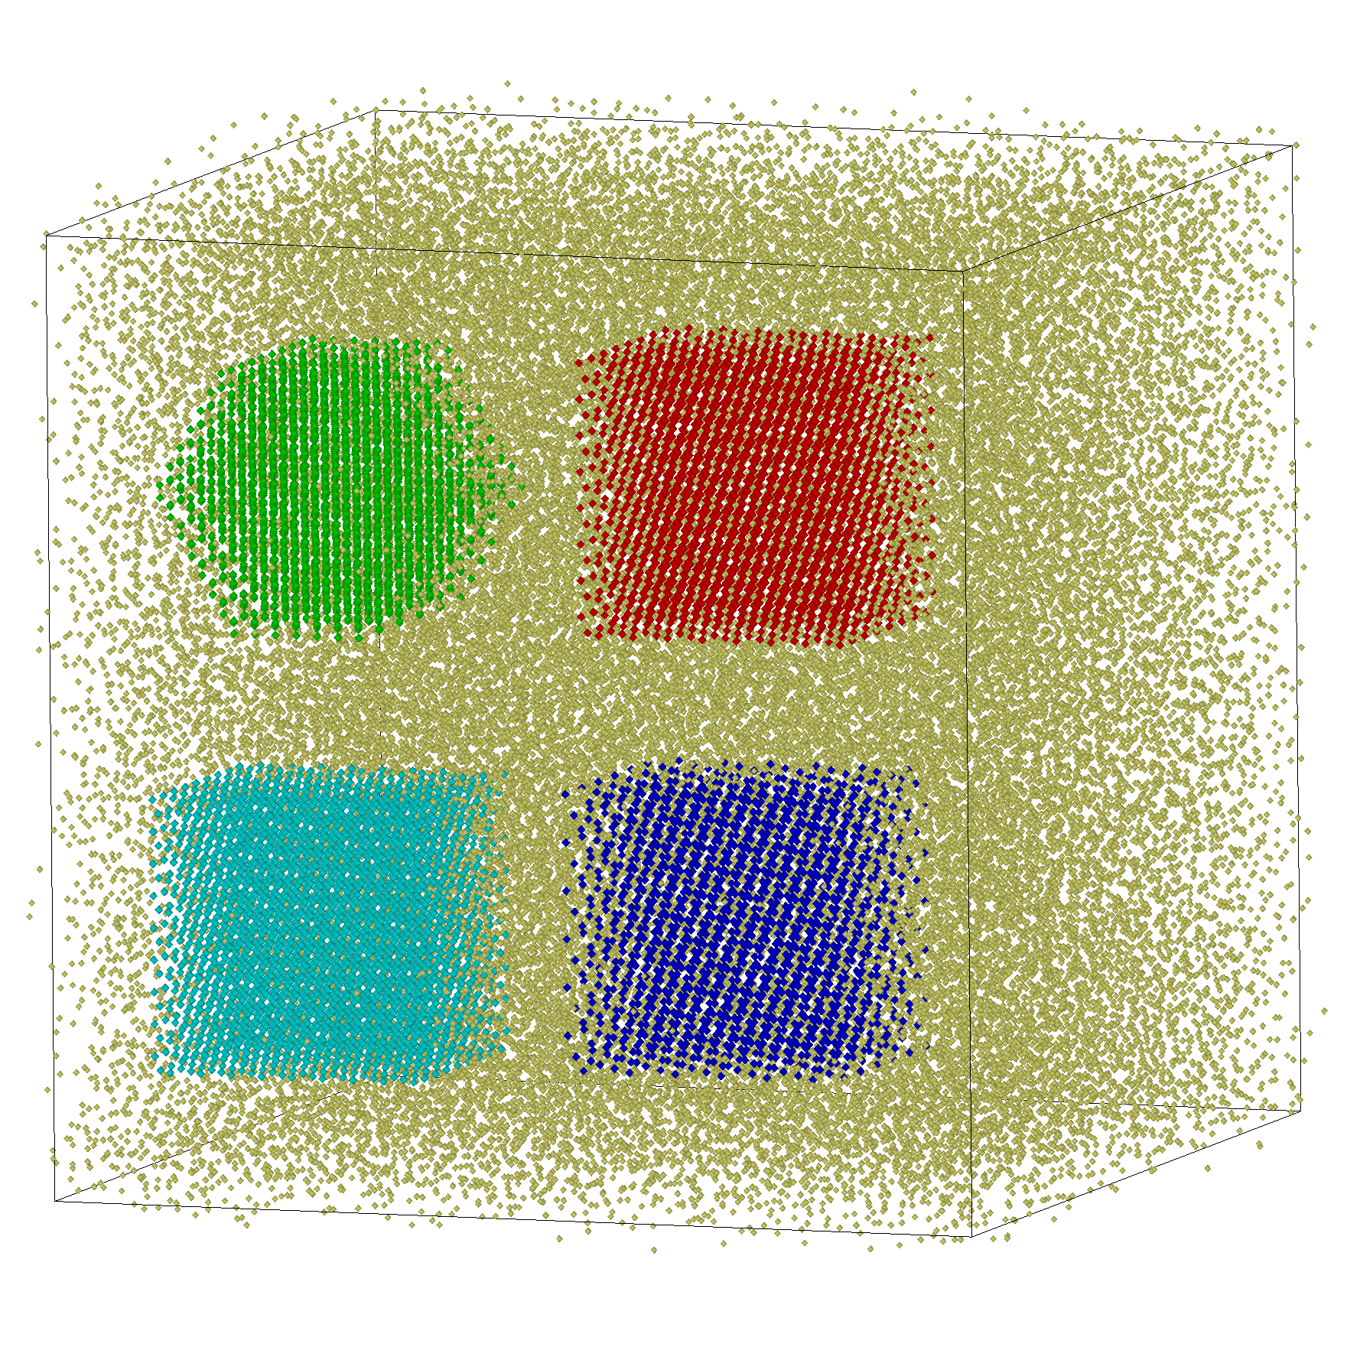
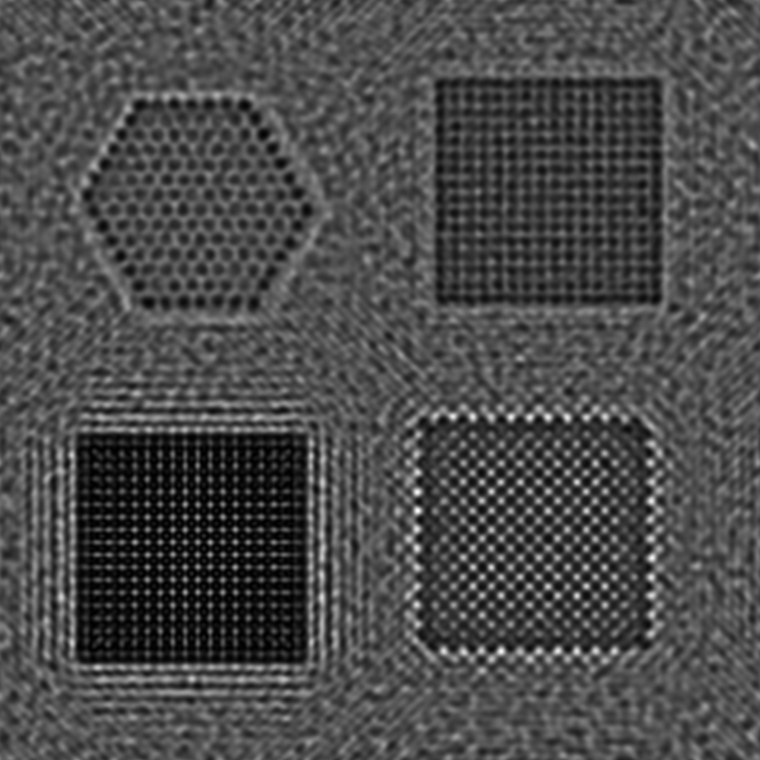
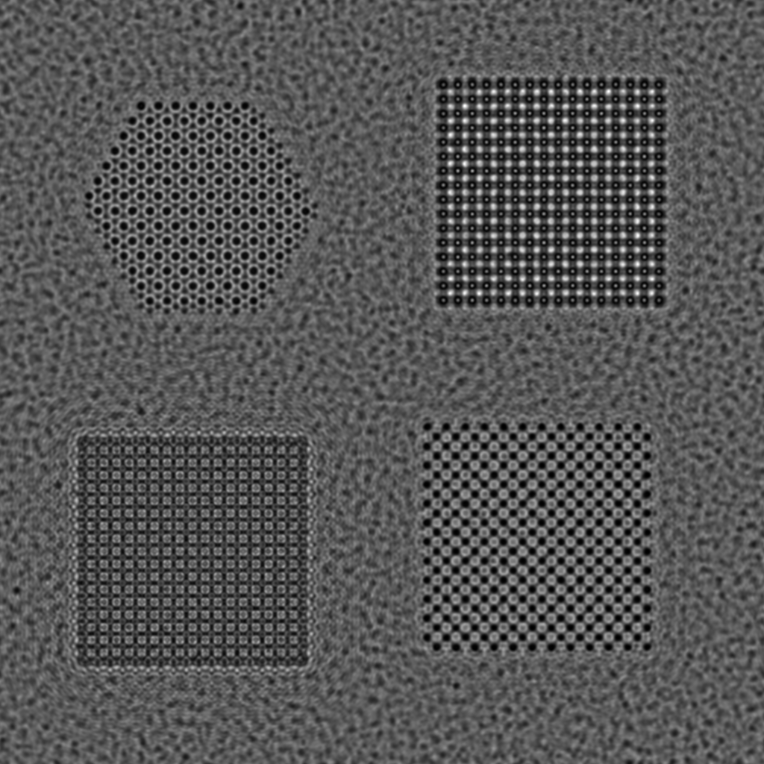
Benefit from increasing electron beam energy to MeV
Nanoparticle in amorphous ice
UEM Imaging at different beam energies
200 KeV
2 MeV
Amorphous ice
graphite
Fe
Graphite
Fe
e-
10nm
LiOH
3 nm
Dry-ice
(CO₂)
LiOH
CO2
3nm
6 nm
10nm
10nm
Graphite, Fe, LiOH and Dry ice (CO₂) with size of ~ 3 nm in-plane and 6 nm thick are embedded in amorphous ice.
The product of C_{s} and λ is kept constant, we choose Cs=0.5 mm for 200 KeV and Cs=2.5 mm for 2 MeV.
Δ₀=5 nm. Here $∆_{0} =C_{c}∙{∆E}/E$.
BNL capability: Electrons and sample interaction simulation by Lijun Wu’s multislice wave optics code

Slide 7
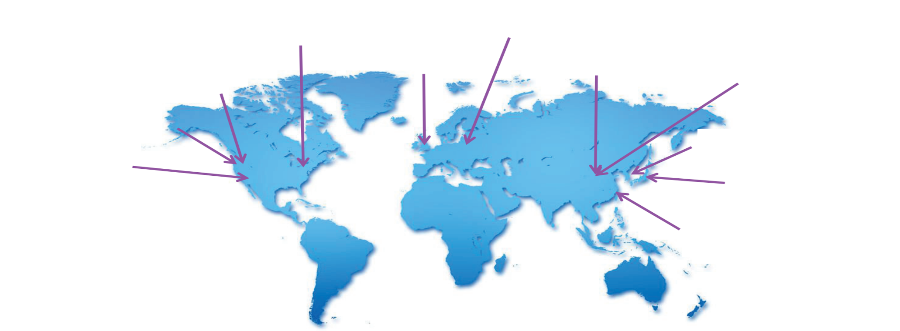
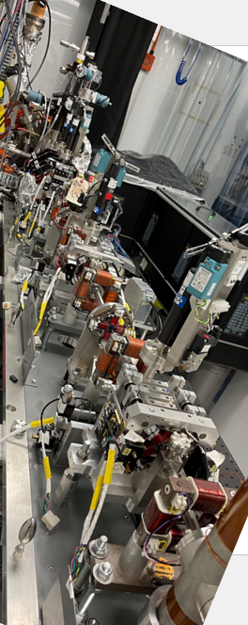
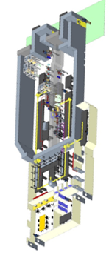
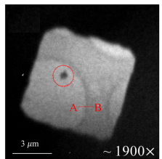
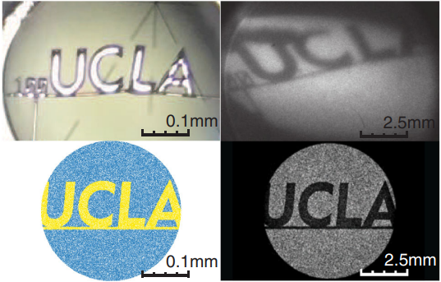
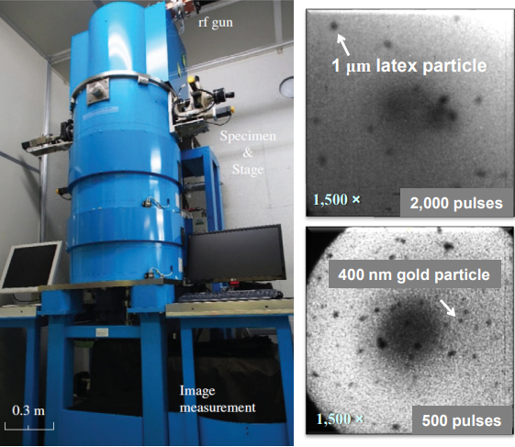
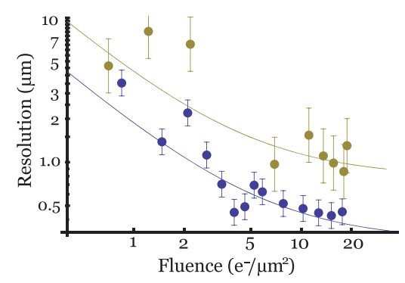
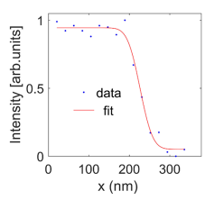
State of art MeV UEM/UED: world-wide efforts
BNL
DESY
Diamond
PKU
THU
LBNL
RUEDI
SLAC
KAERI
BNL
UCLA
OSAKA
RUEDI
SJTU
SJTU
Nano-particle
UCLA
OSAKA
Beam
Single shot
Spatial resolution ~50 nm
$$E=3MeV, \frac{∆E}{E}=5∙{10}^{−4}$$
proposed UK National User Facility
halfway through design stage
Temporal resolution 180 fs
Wait for beam testing
PRL 118, 154802 (2017)
Microscopy 67, 291 (2018)
Appl. Phys. Lett. 112, 113102 (2018)

Slide 8
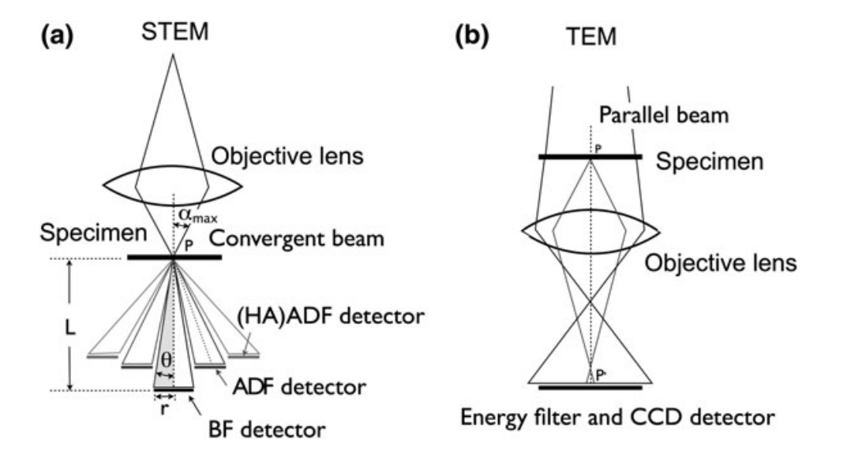
Critical parameters and components for MeV UEM/STEM
Beam requirement for single-shot UEM / raster STEM
Number of electrons $107$ /shot $103$ $\left(\#\right)∙106$(f_{req})
Imaging area $0.01 −100 μm2 0.01−$ 100 $μm2$
Beam divergence $≤1 mrad$ $≤1 mrad$
t - resolution $≥1 ps no require$ment
Energy spread $\sim 1×{10}^{−5}$ $<$10⁻⁴
More challenging for STEM
$≤$ 10 pm nor. emittance with current of 0.1-1 nA
Both need flattened longitudinal phase space for
$<{10}^{−4}$ energy spread
Four main building blocks of MeV UEM
High brightness photoinjector
Photocathode, high gradient rf gun, drive laser
Bright beam transportation
Condenser, aperture, imaging lens system
Electrons and sample interaction
Time-resolved applications, life science (e.g., bio-samples with up to 10 μm thickness)
Detector
Scintillating, single electron counting
Reciprocity: STEM column from e- source to sample
is the reverse of that of a TEM column from sample to detector

Slide 9
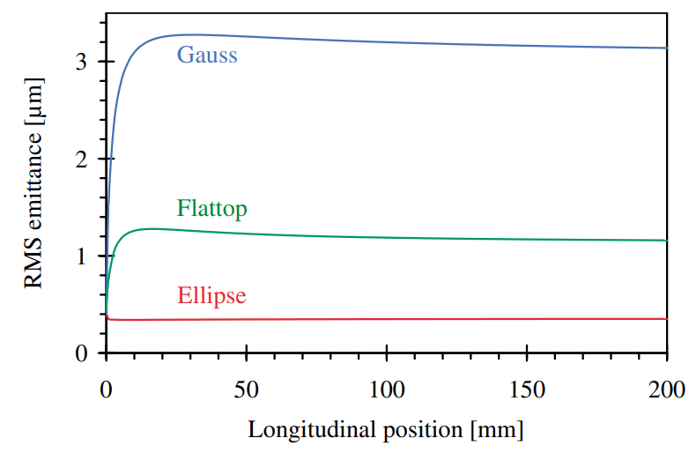
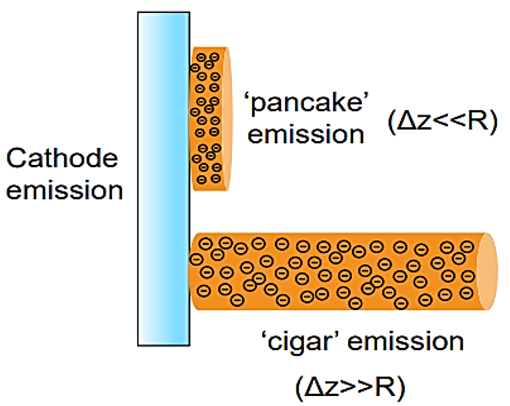
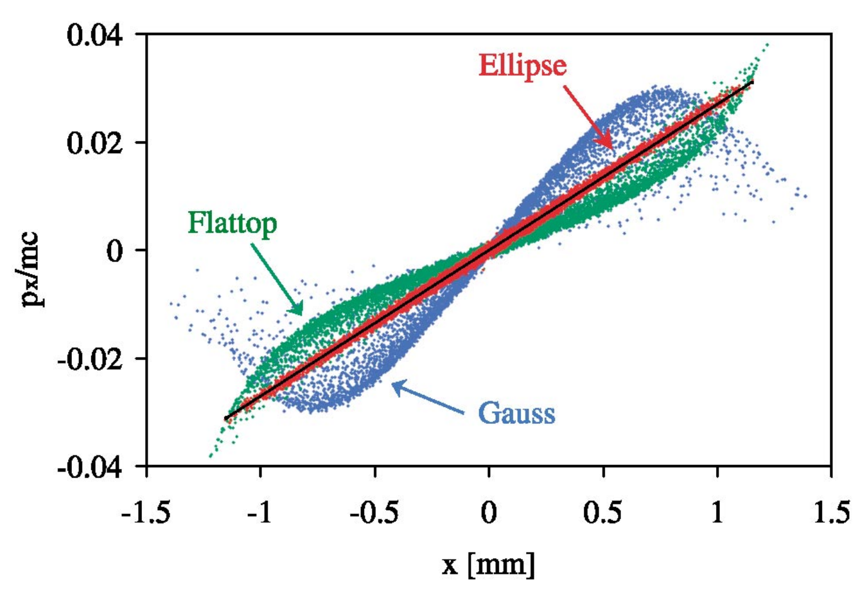
High brightness photoinjector
Two types of photoinjectors
DC gun (up to 10 MV/m)
RF gun (higher gradient up to 250 MV/m)
Normal conducting
Superconducting
I
Laser shaping affects tran. & long. dynamics
Uniformly filled ellipsoidal
Linear self-field
High field → High brightness
electron bunch
Emittance is preserved during beam transportation with an initial ellipsoidal profile
I. V. Bazarovet al., PRL 102, 104801 (2009)
D. Filippetto et al., PRAB 17, 024201 (2014)
J. Rosenzweig et al., PRAB 22, 023403 (2019)
O.J. Luiten, et al., Phys. Rev. Lett. 93(9), 094802 (2004)
P. Musumeci al., PRL 100, 244801 (2008)
Qian and Vogel, IPAC21

Slide 10
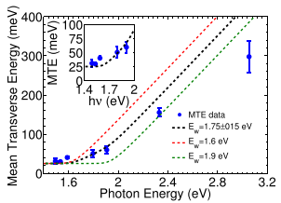
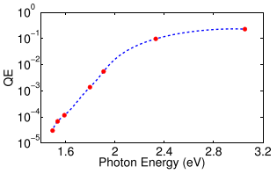
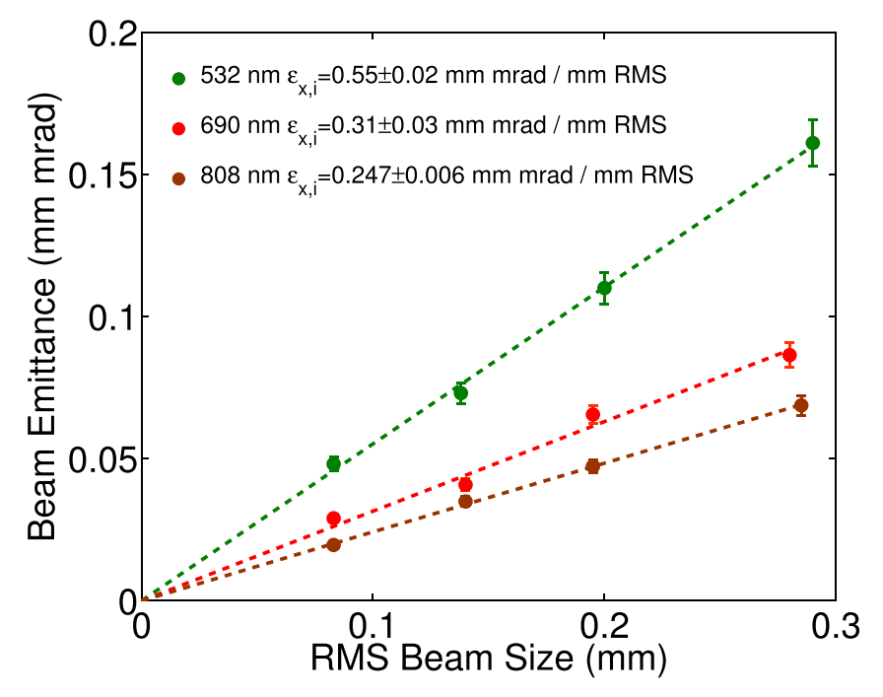
Challenges of MeV UEM/STEM
1. Reduce beam emittance to < 10 / 0.01 nm for UEM/STEM
Δr = C_{s}α³; Δr = C_{c}αΔE/E; $ε∝σ_{x}σ_{x′}$
Reduce thermal emittance (minimize MTE & spot size & cool cathode)
Reduce space charge induced emittance growth
I
$$ε_{nx}=\frac{σ_{x}σ_{p_{x}}}{mc}=σ_{x}\sqrt{\frac{MTE}{mc^{2}}}$$
QE > 10⁻⁵
Choose low emittance photocathode (e.g., alkali antimonide)
Cool the cathode to cool the electrons & increase E_{z}
0.25 μm/mm rms emittance is close to the limit set by e- finite T=300 k
0.12 μm/mm rms emittance when T=90 k
L. Cultrera et al., Phys. Rev. ST – Acc. Beams 18 (2015) 113401
H. Lee et al., Rev. Sci. Instrum. 86 (2015) 073309
Notes:
$$R_{12}=0$$
$C_{c}=T_{126}$
$C_{s}=U_{1222}$

Slide 11
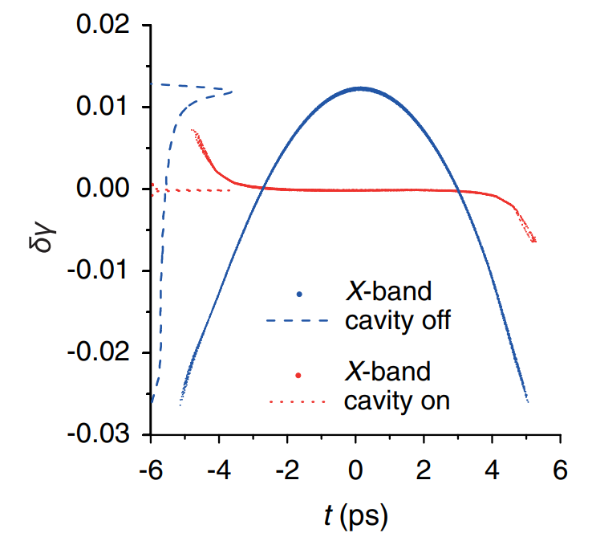
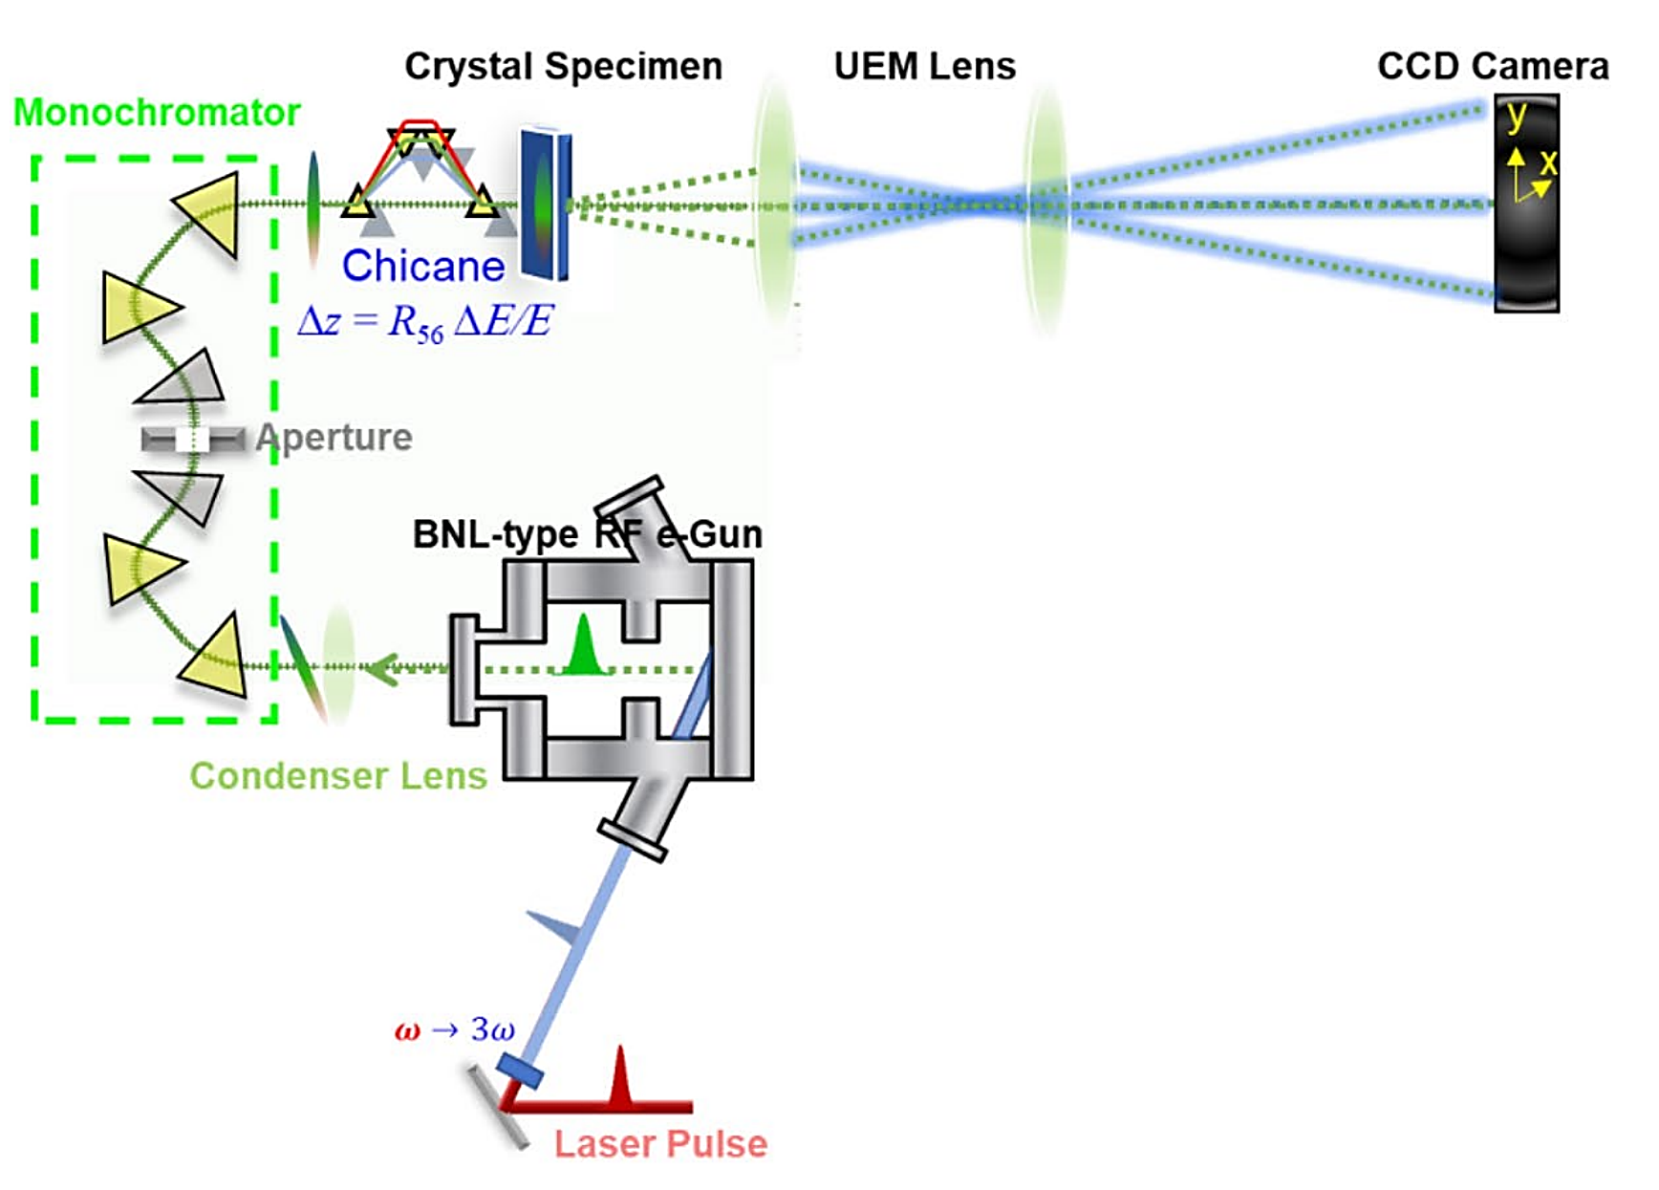
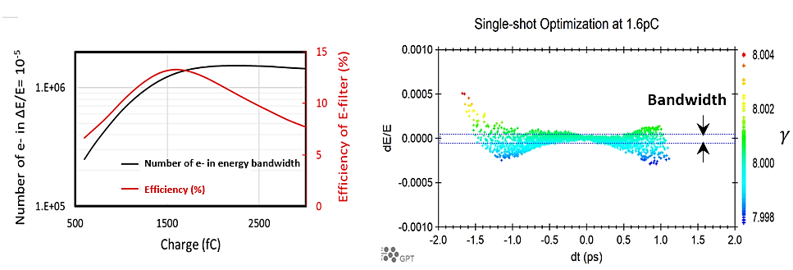
Challenges of MeV UEM/STEM
2. Reduce beam energy spread to < 10⁻⁴
Remove quadratic energy chirp with a harmonic cavity (single shot)
Remove off-energy electrons with a monochromator (single- and multi- shot)
Excellent RF and Low-level RF system
I
Reduce beam energy spread
with a harmonic cavity
Reduce beam energy spread
with a MeV-monochromator
Li and Musumeci, Phys. Rev. Applied, 2, 024003 (2014)
Yang, et al., Sci. Rep. 10, 16171 (2020)

Slide 12
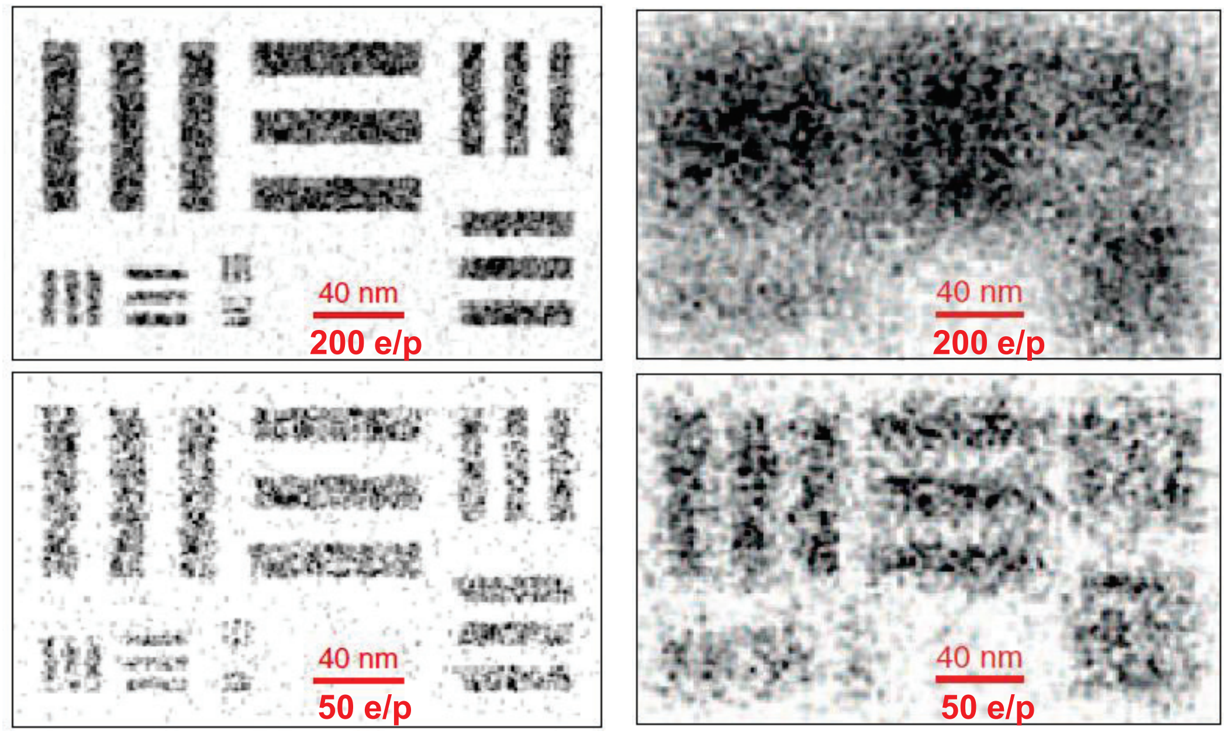
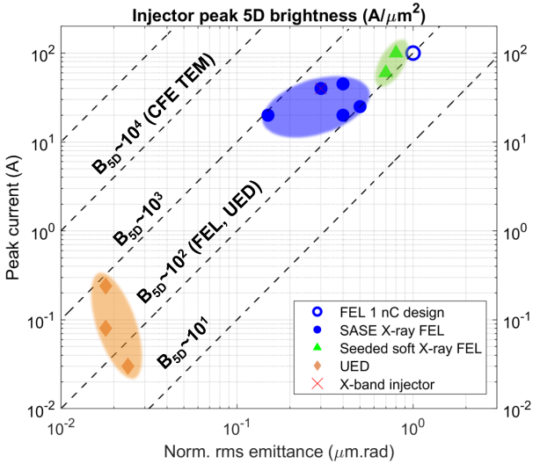
Challenges of MeV UEM/STEM
3. High beam density and space charge effect
Rose theorem: >100 electrons/pixel to make a useful image
Single shot UEM: B_{6D} 10²-10³ A/(keV*μm²*rad²)
Ultimate beam density (e-/nm³) limited by space charge (SC) effect
Spatial resolution also limited by stochastic space charge effect
Single-electron per bucket avoids SC effect →enable MeV-STEM
I
No SC
With SC and IBS
Qian and Vogel, IPAC21
Li and Musumeci, Phys. Rev. Applied, 2, 024003 (2014)

Slide 13
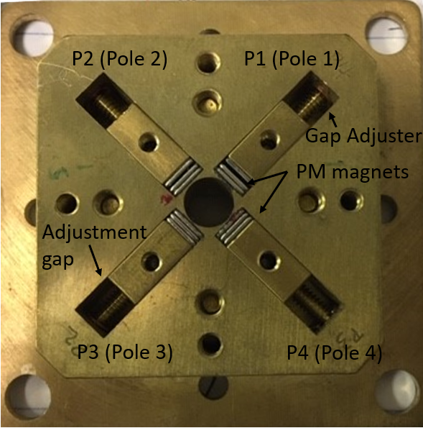
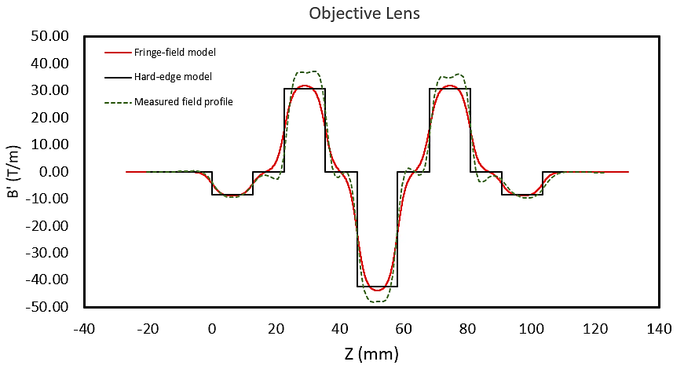
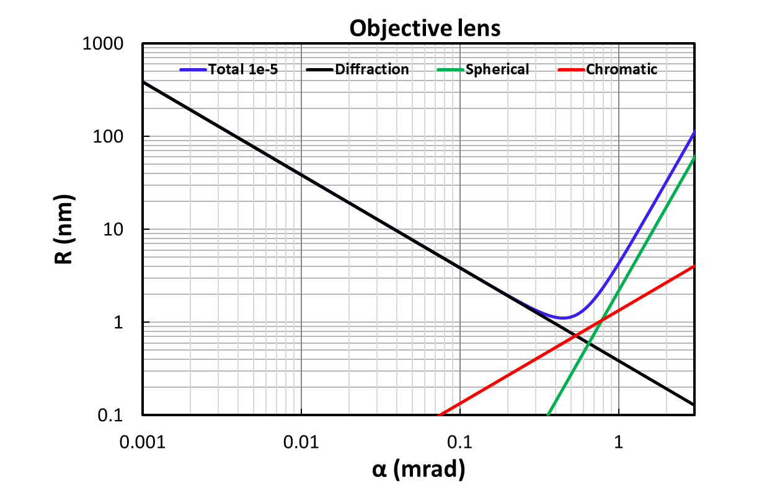
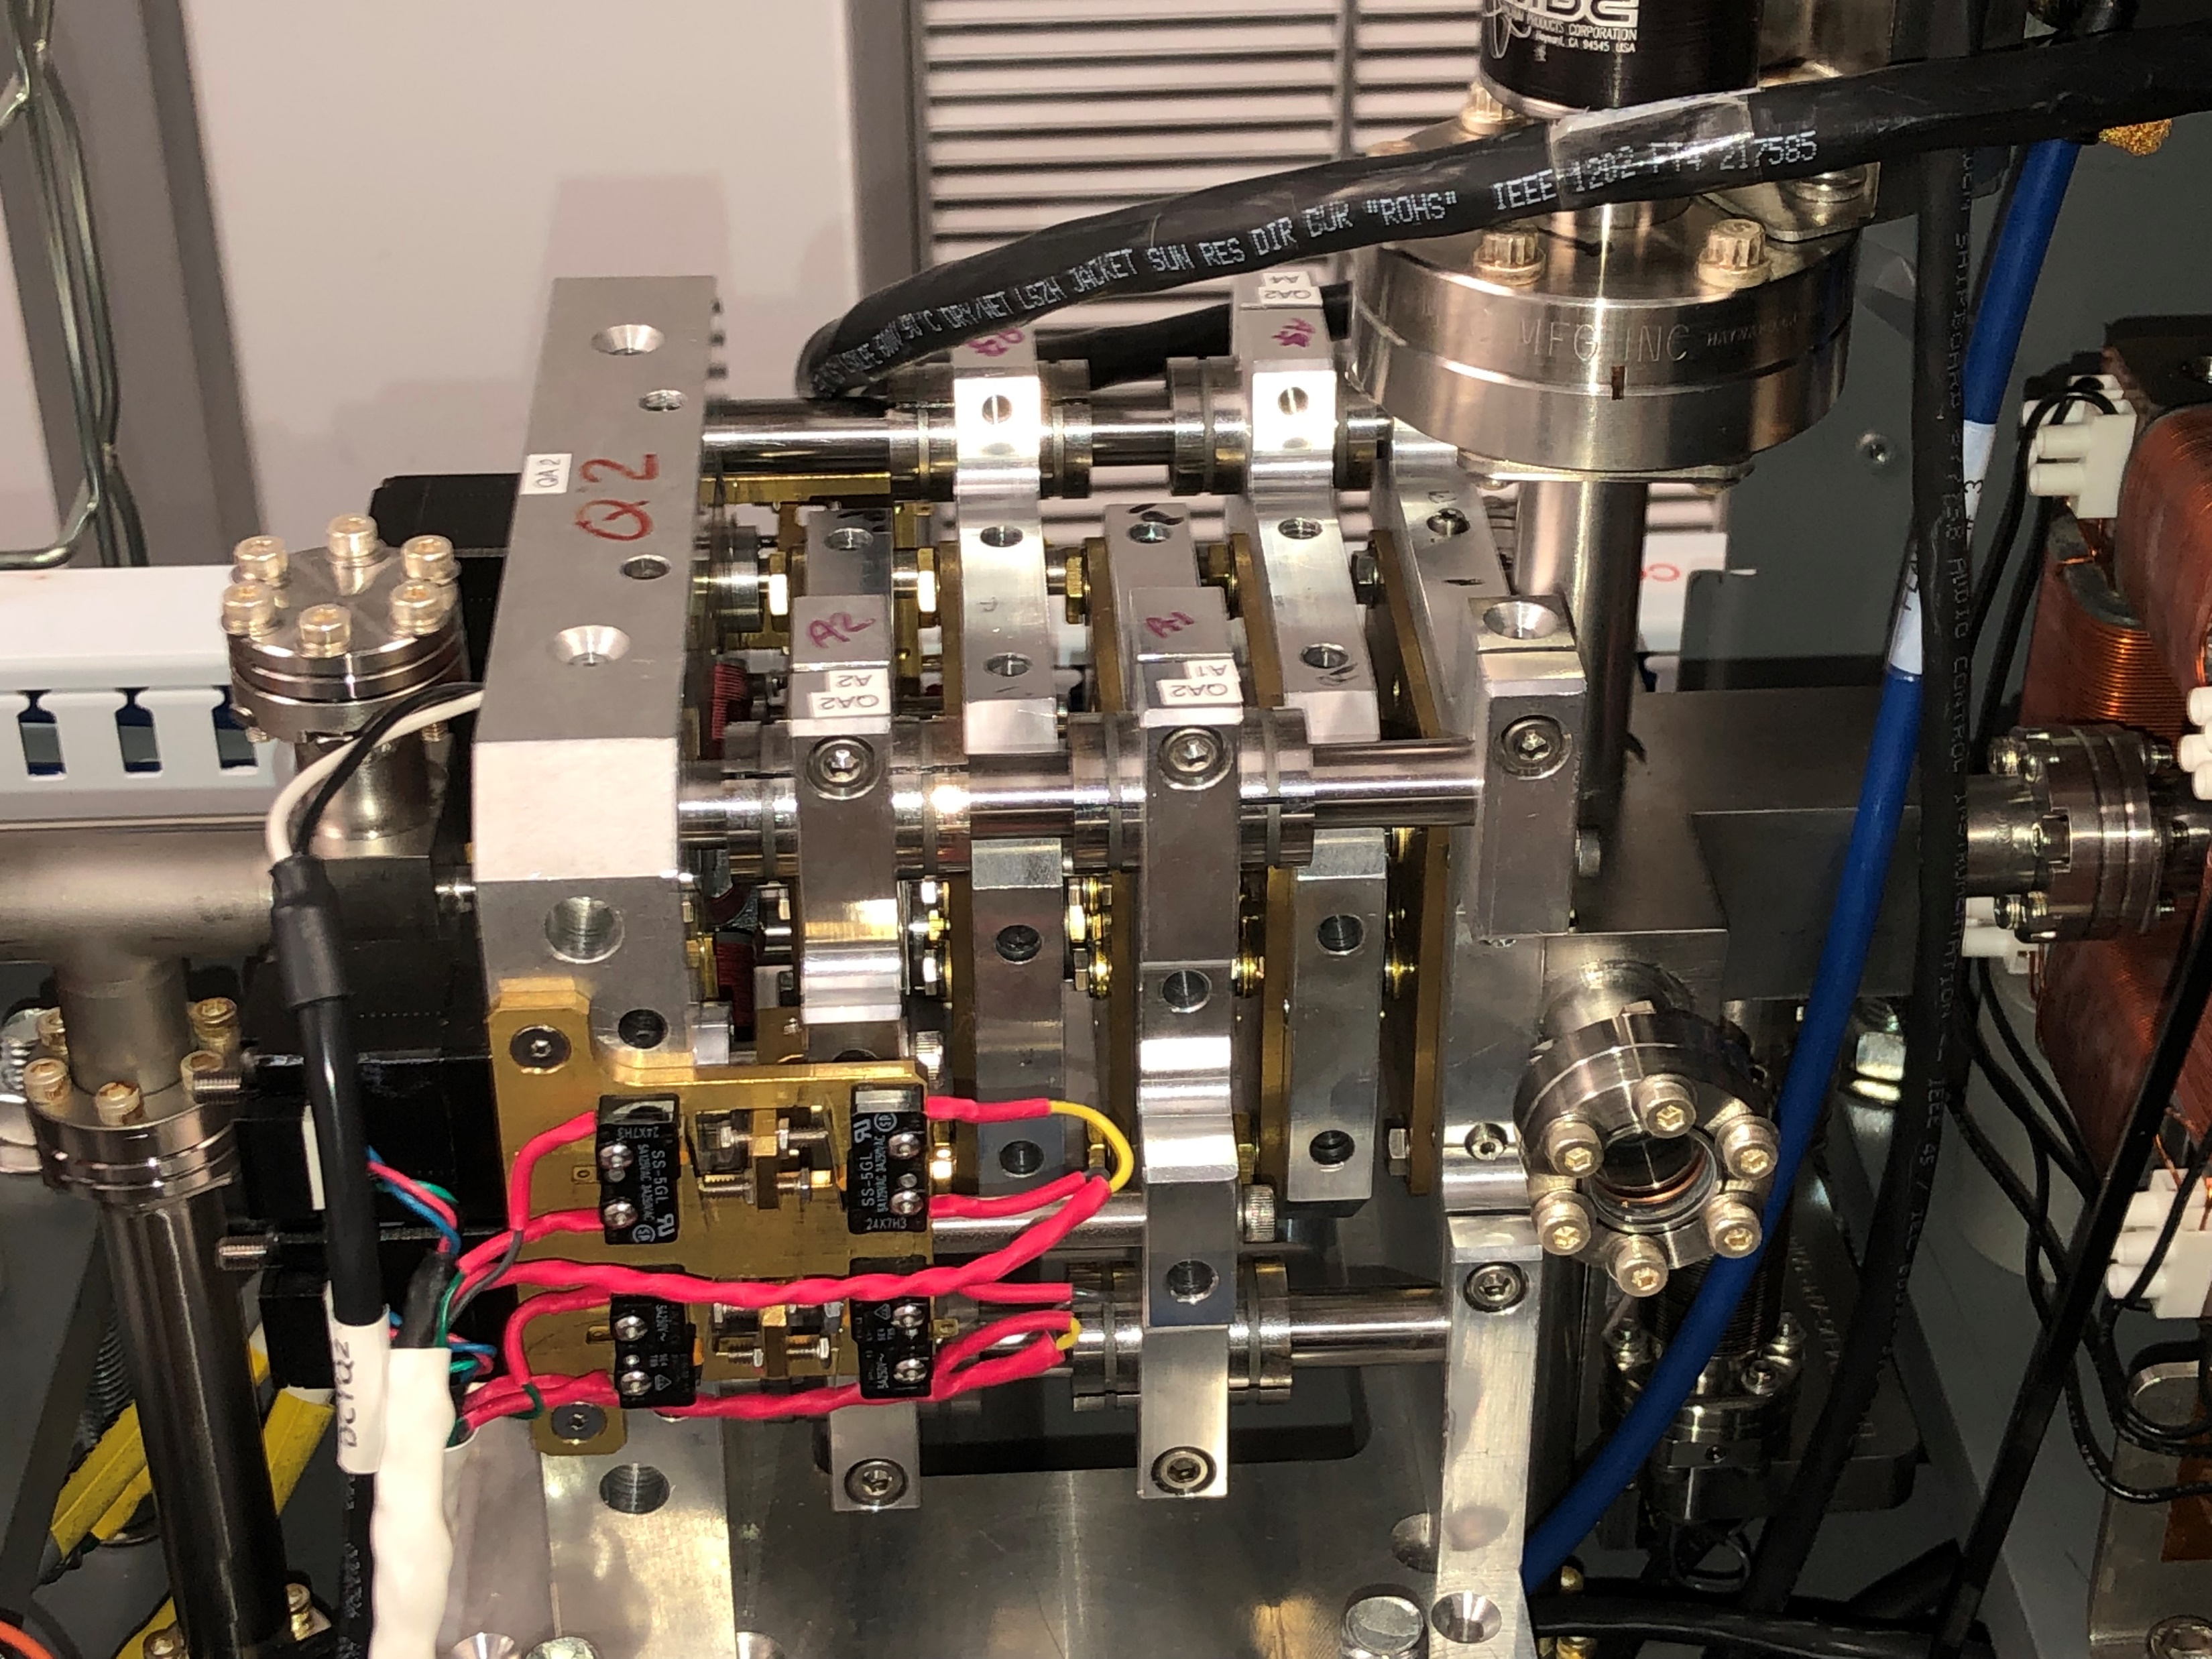
Challenges of MeV UEM/STEM
4. Build low-aberration strong lenses for MeV UEM at BNL
Novel approach: compact low-cost imaging lens based on PMQ quintuplets.
Minimum aberrations: strong lens with the highest achievable gradient and shortest focal length.
Tunability of the magnification: +/- 5% by adjusting drift spaces between magnets and trim quadrupole.
$α=0.5 mrad$
Diffraction
Trim-Q
Q₄ Q₂Q₁
Focal length f and main aberrations C_{s} and C_{c}
Q₅ Q₃
Chromatic
Spherical
Beam
Wan, W., Chen, F. & Zhu, Y., Ultramicroscopy. 194 143-153 (2018).

Slide 14
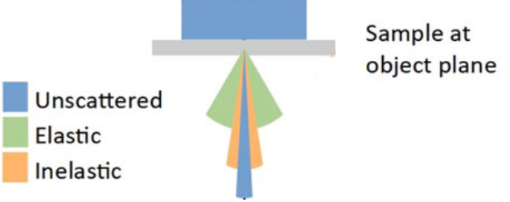
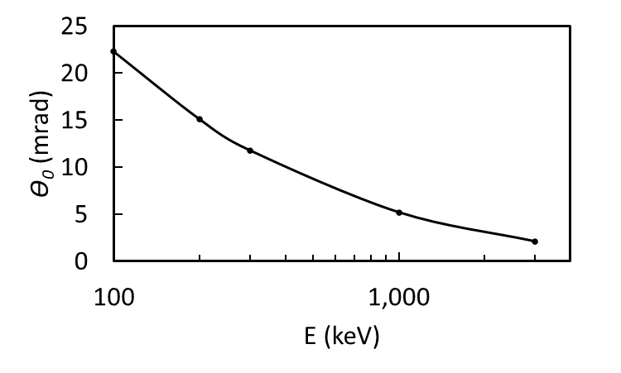
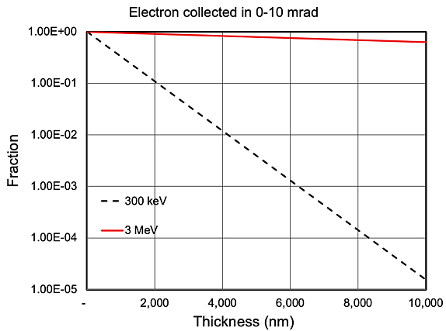
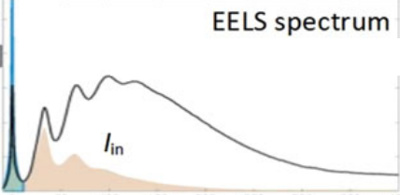
Challenges of MeV UEM/STEM
5. Electron sample interaction
Illustration of 5 electron categories
I₀ = I_{noscat} + I_{1el} + I_{el,plural} + I_{inel} + I_{out}
I
Why MeV? Critical angle $θ0$ decreases with the increase of beam energy
Mean energy loss: <∆E> $\sim$ (t/λ_{i})$∙$($∆E\text{i}$). t (thickness), λ_{i} (MFP), $∆E\text{i}$(=40 eV, single inelastic energy loss for amorphous ice)
I₀
thicker
Sample
θ₀
Single elastic
(TEM)
STEM
I_{inel}
(STEM)
TEM
I_{1el}
I_{el,plural}
I_{noscat}
I_{out}
STEM signal
Signal (a.u.)
0 1 2 3 ……… n
Energy loss $(∙∆E\text{i})$

Slide 15
Energy loss data taken with beam energy 200 keV at CFN
For thick samples (e.g., t > 1.2 um), mean energy loss is almost linearly proportional to the sample thickness
Left plot is electron energy loss spectrum (EELS) at 2, 3, 4 um thick samples
Right plot is peak position as a function of sample thickness, which fits well with the linear relationship
Chromatic aberration affect gets worse for thick sample → e.g., energy filter + TEM
Courtesy Sooyeon, Yimei and Lijun
Sample is a wedged silicon

Slide 16
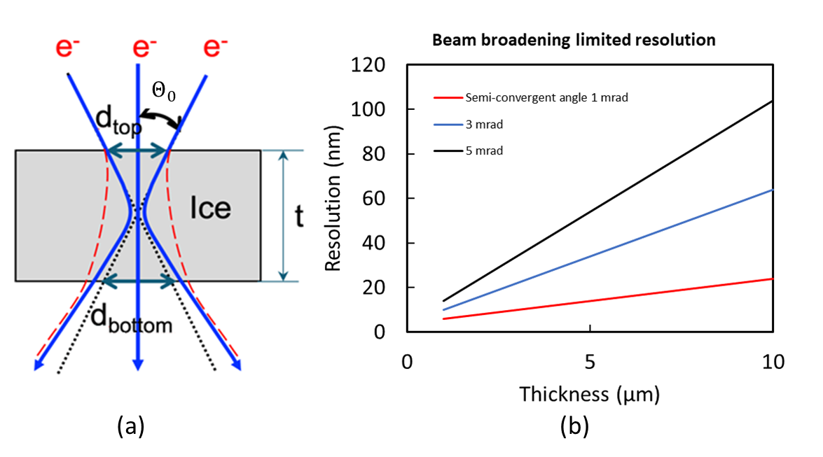
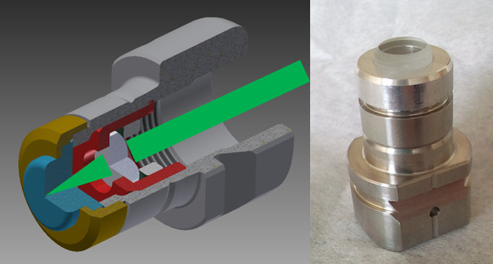
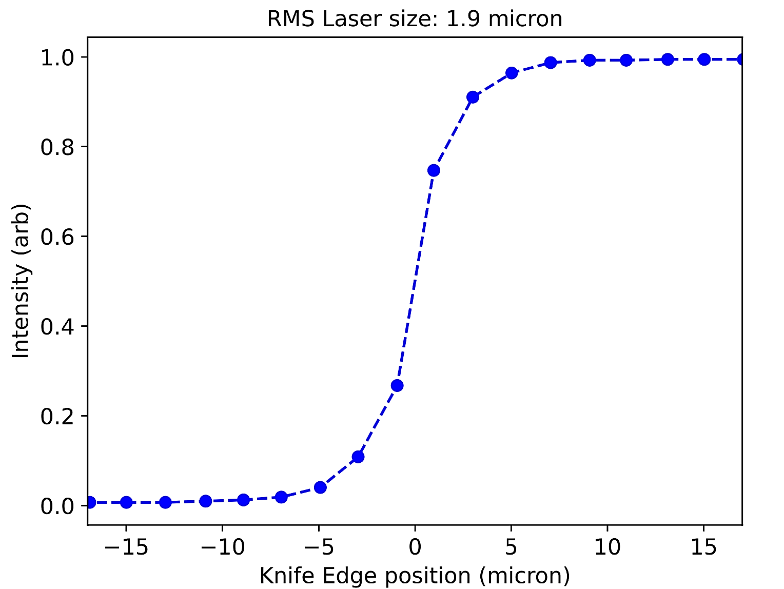
MEV STEM to visualize intact thick cells
Solution: combination of high penetration inelastic signal and lens-less between sample and detector
makes MeV-STEM an appropriate microscope for 10 μm or thicker bio-samples with nm resolution
Requirement
Beam size and converging angle on sample determines resolution.
To achieve nanoscale resolution with up to 10 µm sample thickness:
Electron dose: 200 e⁻/nm² / μs
Probe on sample: 2-5 nm
Beam convergence angle: 1 mrad
Beam flux: 200 - 5,000 e⁻/ μs
Scanning accuracy: 1 nm
Photocathode (e.g., alkali antimonide)
In transmission mode, there is a micron laser size and MTE 35 meV
Beam emittance of nm
H. Lee, L. Cultrera, and I. Bazarov, Appl. Phys. Lett. 108, 124105 (2016).
H. Lee, et al., Rev. Sci. Instrum. 89, 083303 (2018).
J. Maxson, et al.
E | d_{sam} | α | I | ∆E/E | ∆x_{cen} | ϵ_{geo}
MeV | nm | mrad | nA |  | nm | pm·rad
3.0 | 2 | 1 | 0.1-1 | <10⁻⁴ | 1 | 2
Notes:
Combine with slide 5

Slide 17
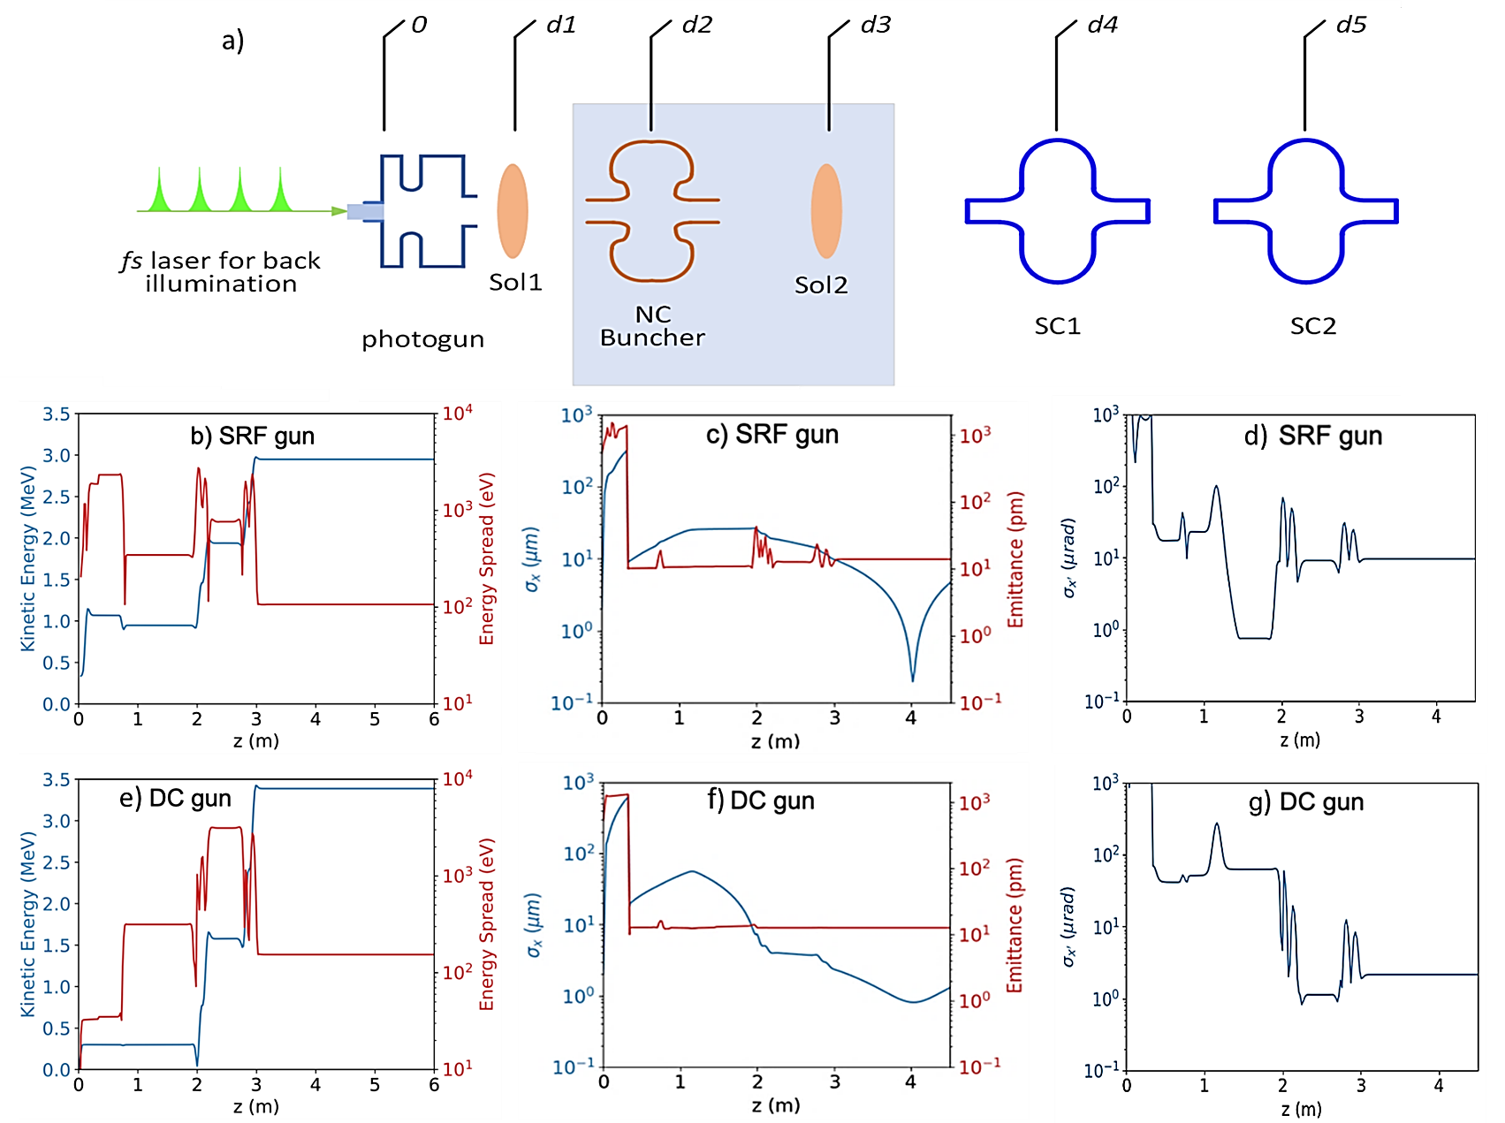
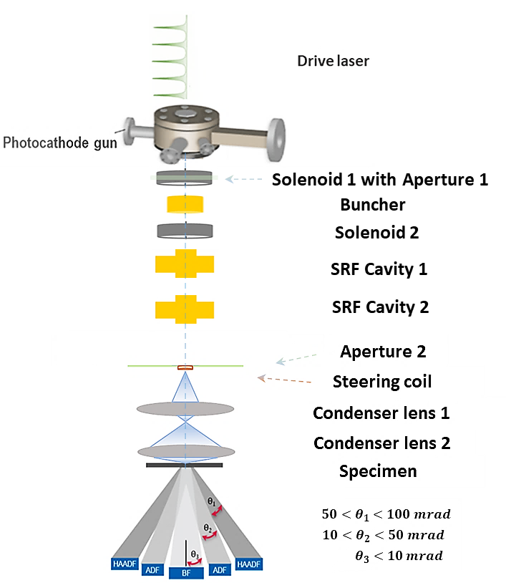
Challenges of implementing MeV STEM
Reduce beam emittance to ~ 2 pm with current of 30 – 750 pA
Photocathodes & beam dynamics need to improve brightness by >1000
Probe size: $σ_{d}=2 nm$; divergence: $σ_{θ}≤1 mrad$; emittance: $εgeo \text{≤}$ $2 pm$
Reduce laser spot size and MTE from photocathode
Increase QE $≥$10⁻⁵
Beam dynamics come hand in hand with improved emittance
Apply aperture to increase both transverse and longitudinal brightness
I
Preliminarily MeV-STEM column design (reversal of TEM column)
Assume 2 μm spot at cathode
Dose rate 200 to 5k e-/μs
I
5-6 m
Detector collection angles
J. Maxson and A. Bartnik

Slide 18
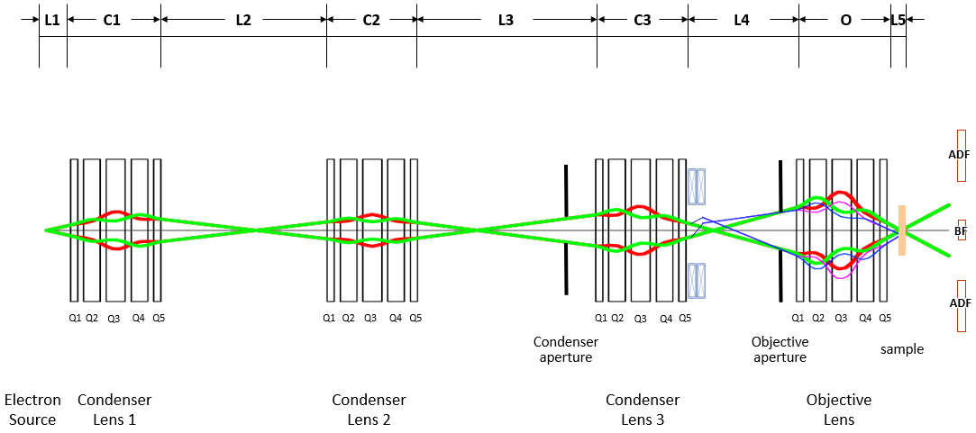
Challenges of implementing MeV STEM
Design lowest aberration strongest lenses for MeV STEM
Probe size: $σ_{d}=2 nm$ and divergence: $σ_{θ}≤1 mrad$
STEM column
Focus the beam onto the sample with a few nanometers
Freedom of varying the probe beam size
Variation of aperture and magnetic field of trim quadrupoles can change the beam size from 2 nm - 60 µm (to find ROI)
I
The final probe beam size in RMS (green)
$$σ_{tot}=\sqrt{{σ_{d}}^{2}+{σ_{s}}^{2}+{σ_{c}}^{2}+{σ_{emit}}^{2}}$$
The theoretically minimum resolution (purple)
$${ δ}_{th}=\sqrt{{σ_{d}}^{2}+{σ_{s}}^{2}+{σ_{c}}^{2}}$$
 | f (cm) | C_{s,x} (cm) | C_{s,y} (cm) | C_{s,xy} (cm) | C_{c,x} (cm) | C_{c,y} (cm)
Probe forming Lens (SRF) | 1.00 | 16.2 | 15.0 | 35.3 | 1.78 | 1.44
probe forming Lens (DC) | 1.00 | 16.2 | 15.0 | 35.3 | 1.80 | 1.46

Slide 19
Summary
Accelerator based MeV UEM/STEM hold great potential to solve the challenges in probing matter at ultrafast-temporal ultrasmall-spatial scales and studying life science
Expect better performance than low-energy UEM/STEM for thick samples
Several MeV UED user facilities are being built and deliver high impact results
MeV UEM efforts are ramping up
MeV STEM developments are just in the beginning
A great complement to XFELs
Inter-discipline collaboration generates creative idea

Slide 20
Acknowledgements
Special thanks to
Cornell: Jared Maxson and Adam Bartnik
SLAC: Xiaozhe Shen
BNL UED/UEM Team
Xi Yang, Victor Smaluk, Timur Shaftan, Liguo Wang, Sean McSweeney, Lihua Yu, Ganesh Tiwari, Yoshiteru Hidaka, Guimei Wang, Lewis Doom, Jim Rose, David Bergman, Michael Fulkerson, George Ganetis, Bernard Kosciuk, Danny Padrazo, Belkacem Bacha, Charles Spataro, King Wilson, Mikhail Fedurin, Marcus Babzien, Robert Malone, Karl Kusche, Christian Cullen, Junjie Li, Lijun Wu, Yimei Zhu, Luca Cultrera, Qun Liu, Weishi Wan

Slide 21
Thank you!

