Slide 1



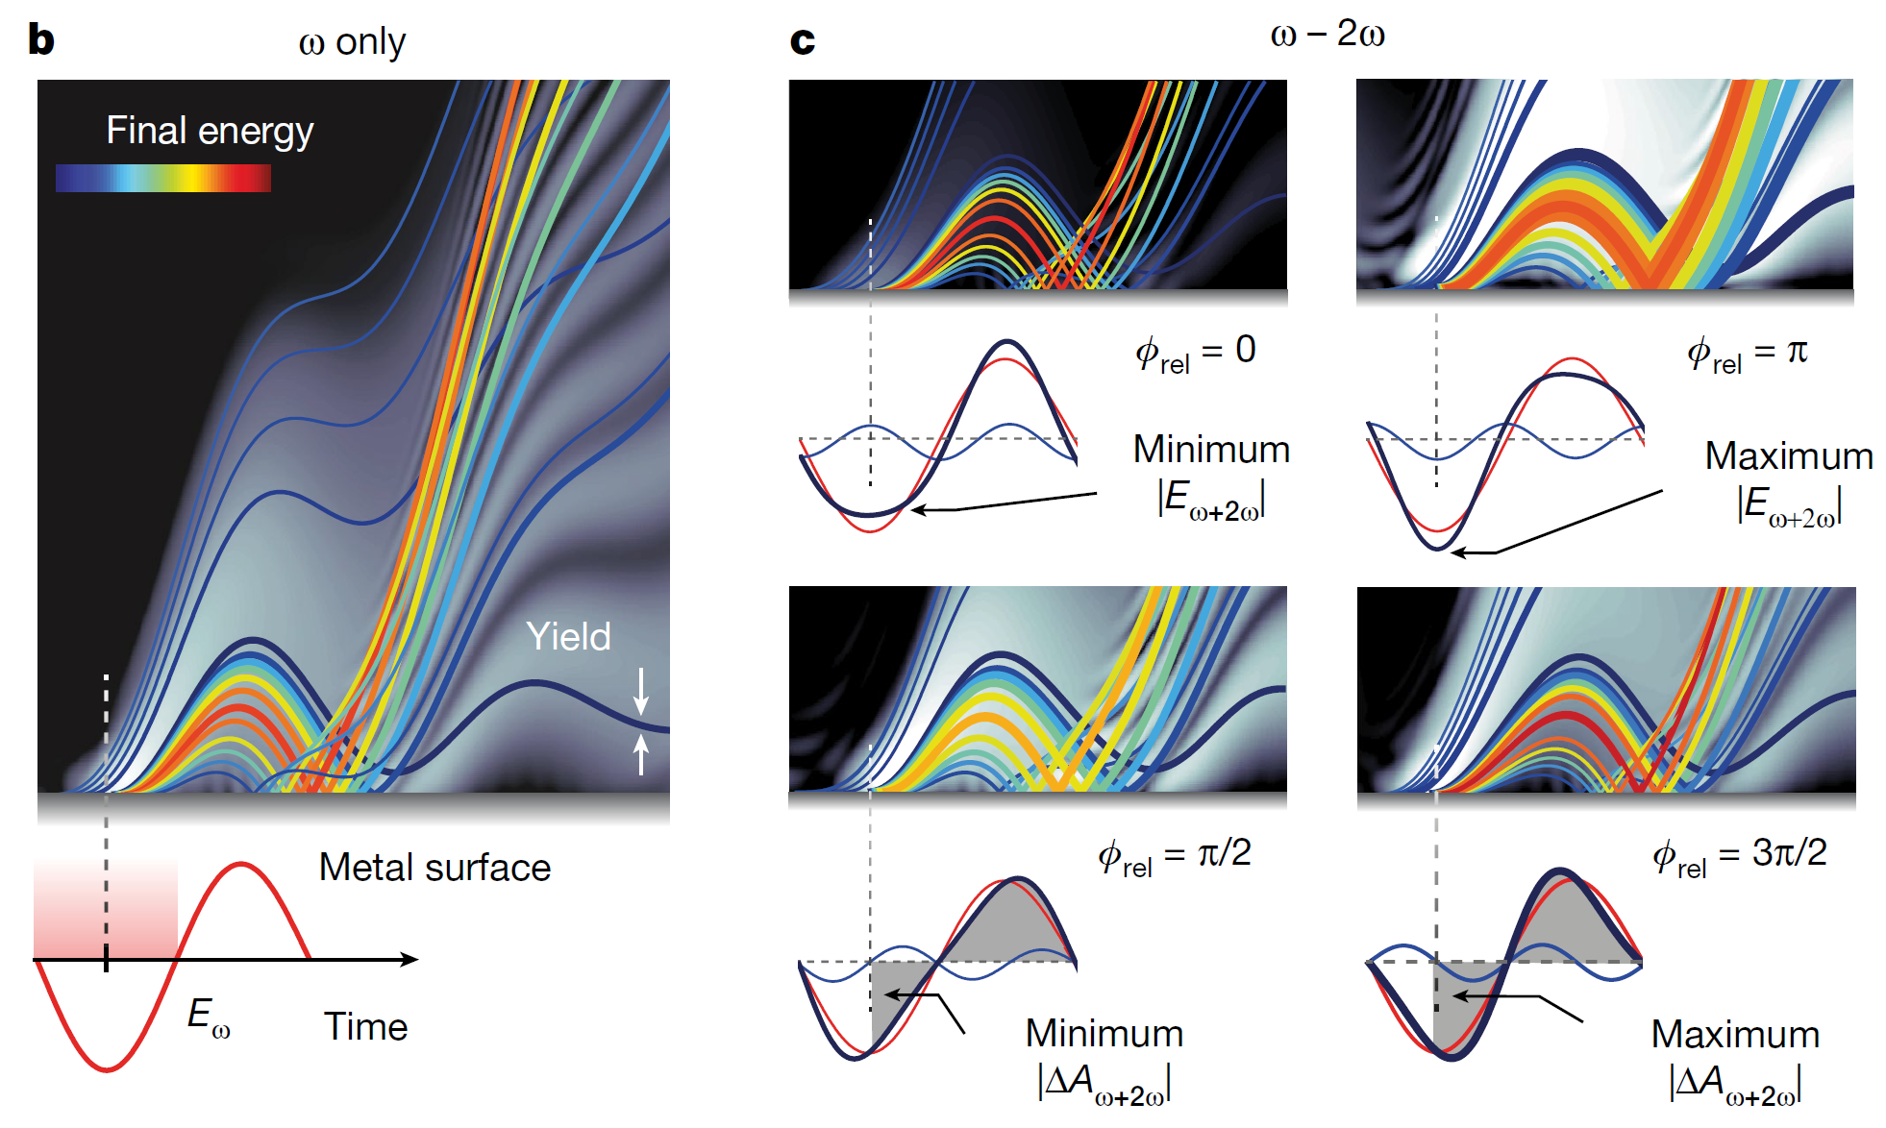
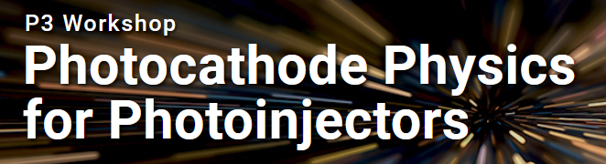
Tracing attosecond dynamics of electron emission from metallic nanotip
Tomáš Chlouba, Philip Dienstbier, Lennart Seiffert, Timo Paschen, Andreas Liehl, Alfred Leitenstorfer, Thomas Fennel and Peter Hommelhoff
Friedrich-Alexander-Universität Erlangen-Nürnberg (FAU)
www.laserphysik.nat.fau.de
tomas.chlouba@fau.de

Slide 2
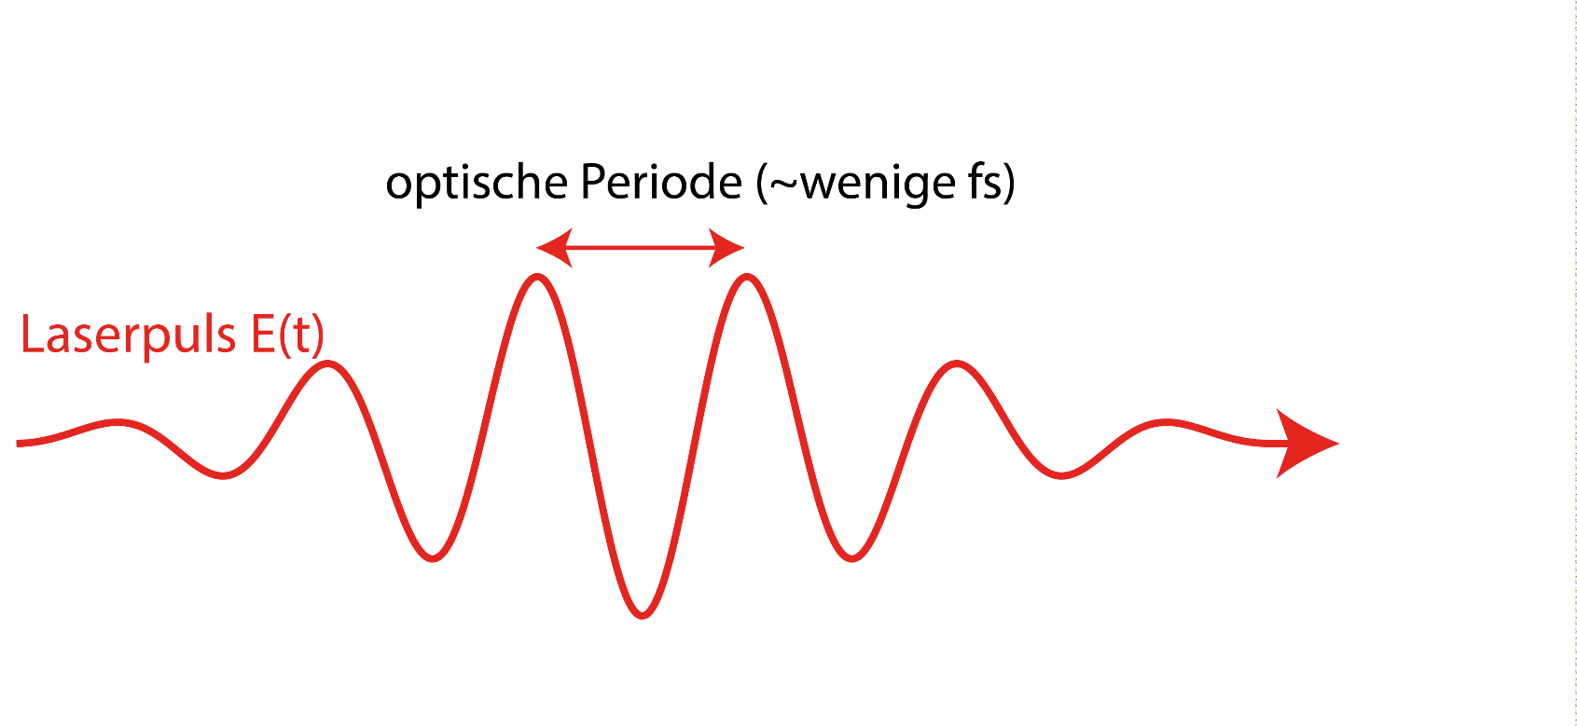
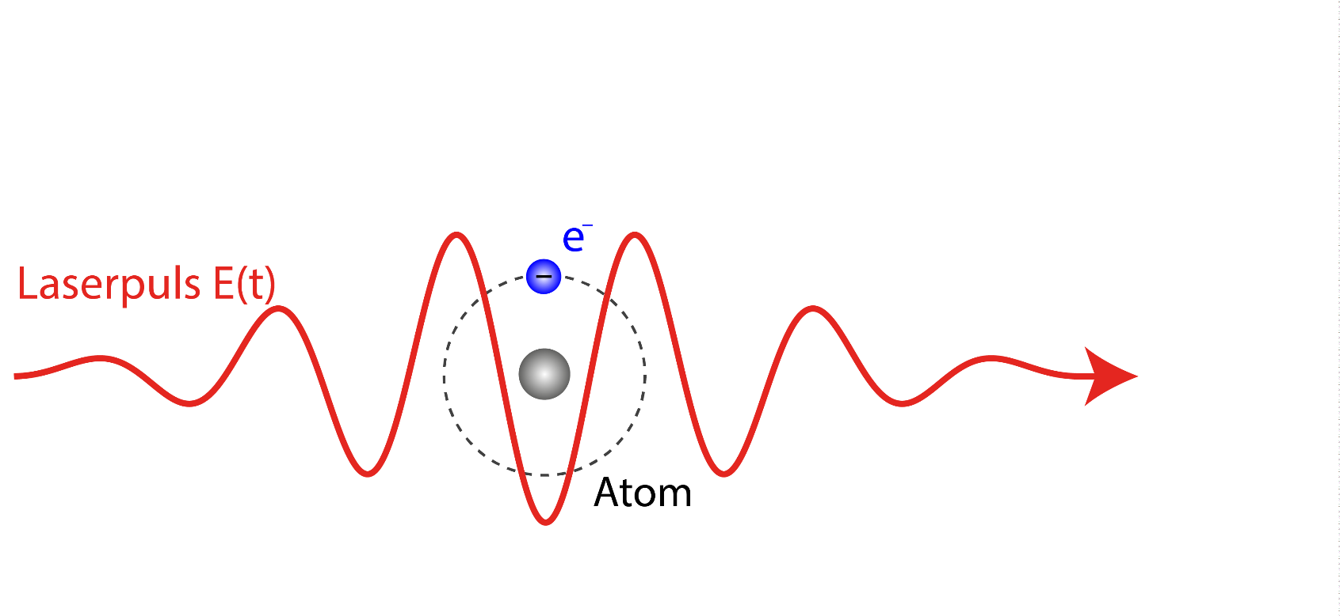
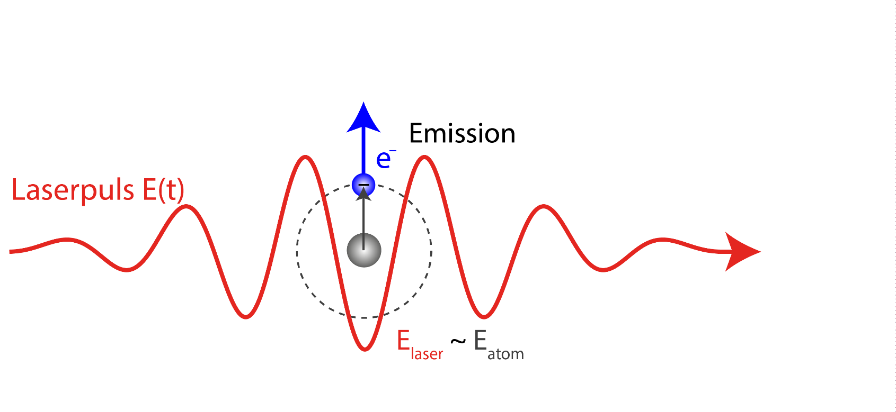
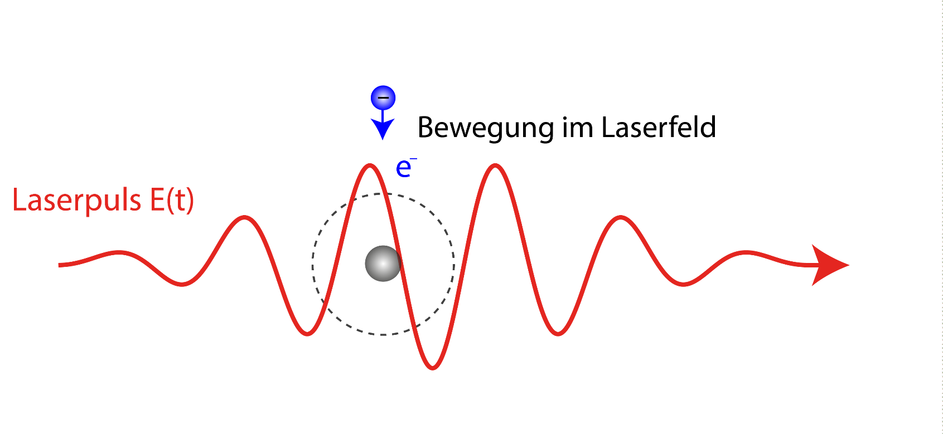
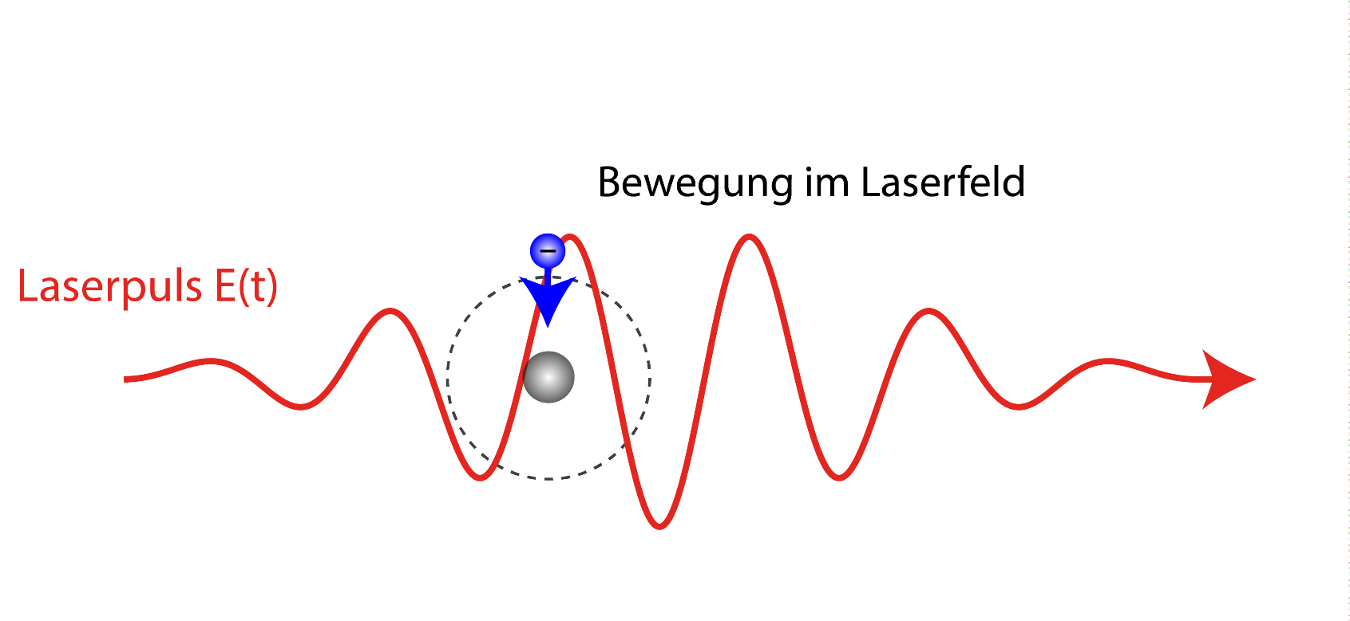
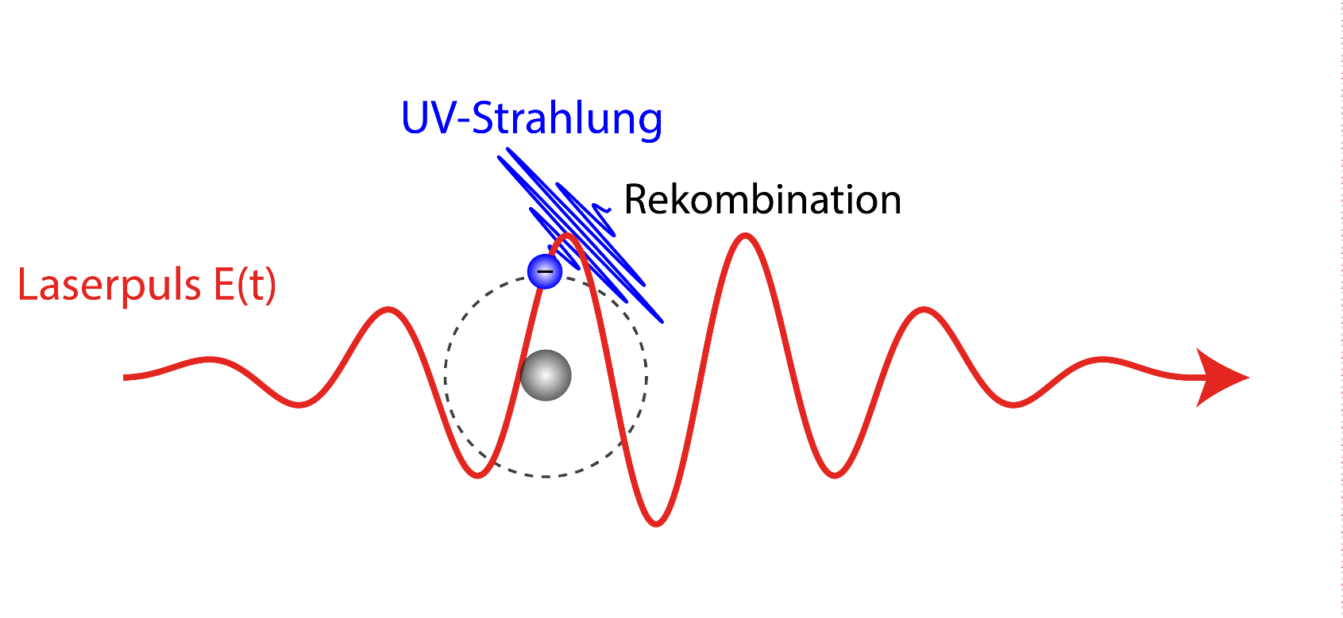
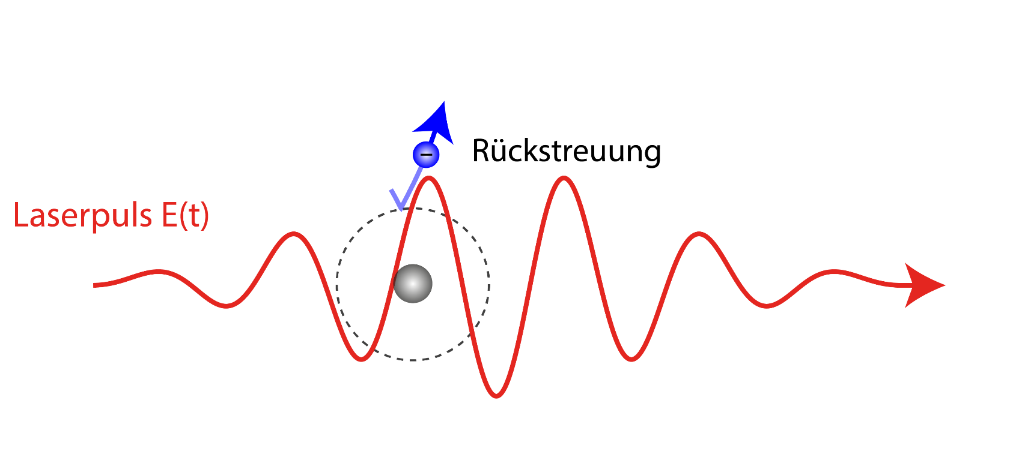
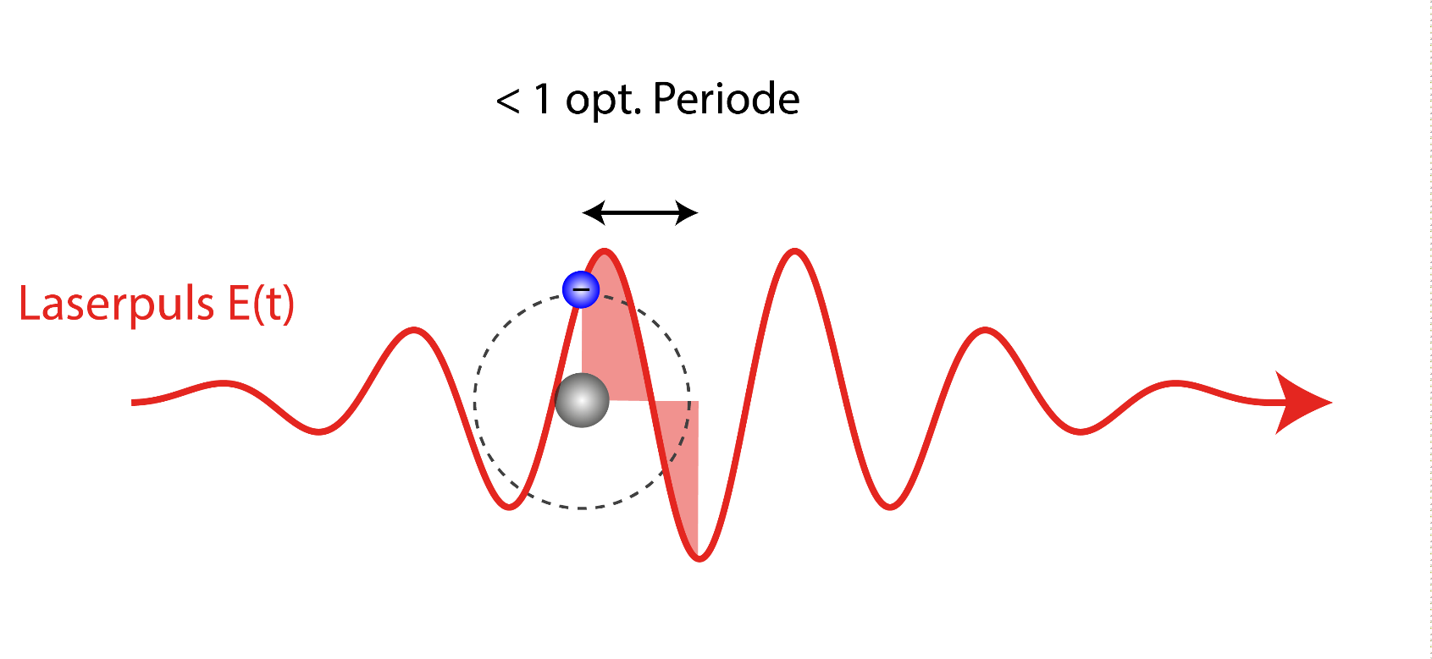


What is strongfield physics?
< 1 opt. period
(X)UV radiation
Optical period (few fs)
movement in laser field
movement in laser field
emission
recombination
Re-collision
Laser pulse E(t)
Strongfield physics $=$ Interaction between matter (electrons in particular) and strong optical fields on ultrashort time scales ($10^{−15} − 10^{−16}$seconds).

Slide 3


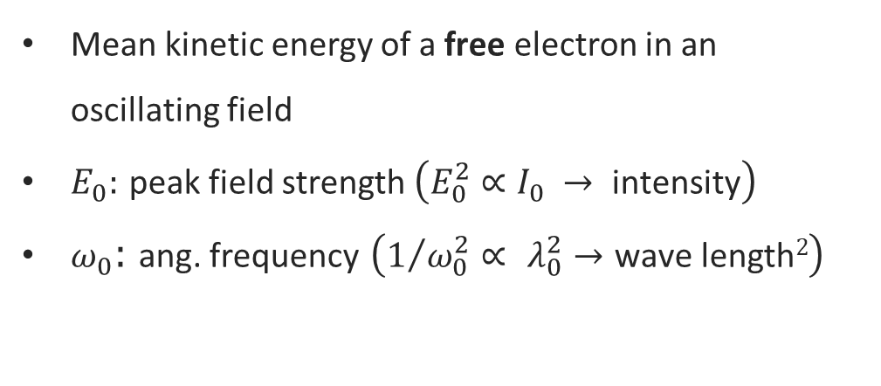

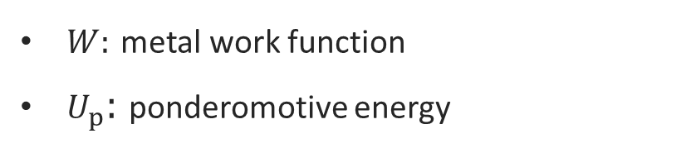
Emission process classification
Keldysh parameter $γ$
$$γ= \sqrt{\frac{W}{2U_{p}}}$$
$W:$ metal work function
$U_{p}$: ponderomotive energy
Mean kinetic energy of a free electron in an oscillating field
$E_{0}:$ peak field strength $\left(E_{0}^{2}∝I_{0} → \text{intensity}\right)$
$ω_{0}$: ang. frequency $\left(1/{ω_{0}^{2}}∝ λ_{0}^{2}→\text{wave} \text{length}2\right)$
$$U_{p}= \frac{e^{2}E_{0}^{2}}{4mω_{0}^{2}}$$
L. Keldysh Soviet Physics JETP 20, 1307–1314 (1965).

Slide 4
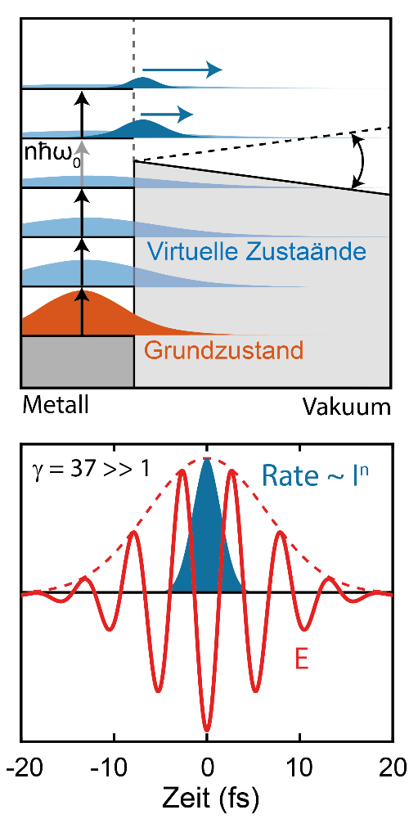
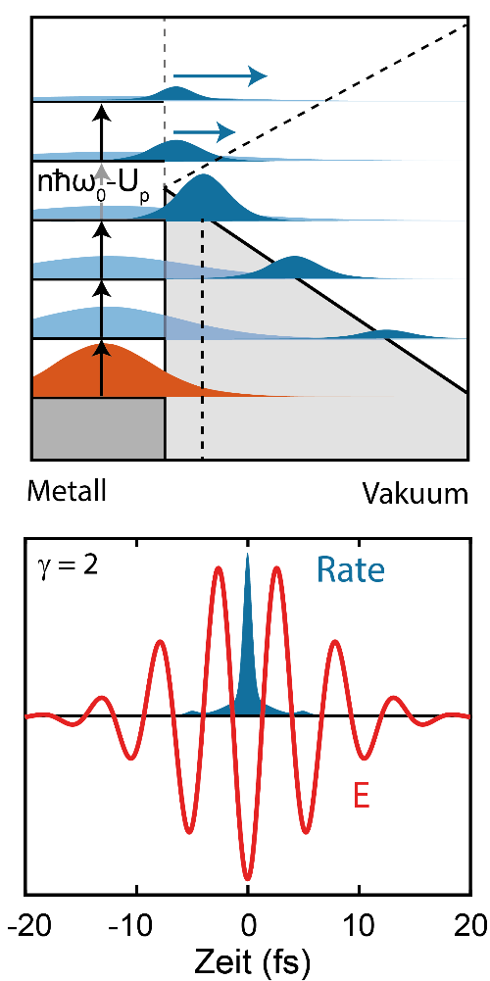
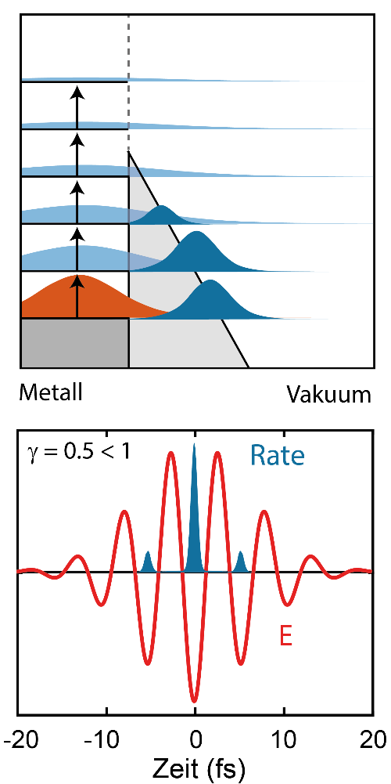

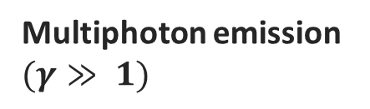
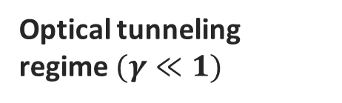
Electron emission processes – time-resolved
Multiphoton emission $(γ≫ 1)$
Non-adiabatic regime $(γ≈1)$
Optical tunneling regime$(γ≪1)$
Virtual states
Ground state
Time (fs)
Time (fs)
Time (fs)
Yudin, G. L. & Ivanov, M. Y. Phys. Rev. A 64, 013409 (2001).

Slide 5
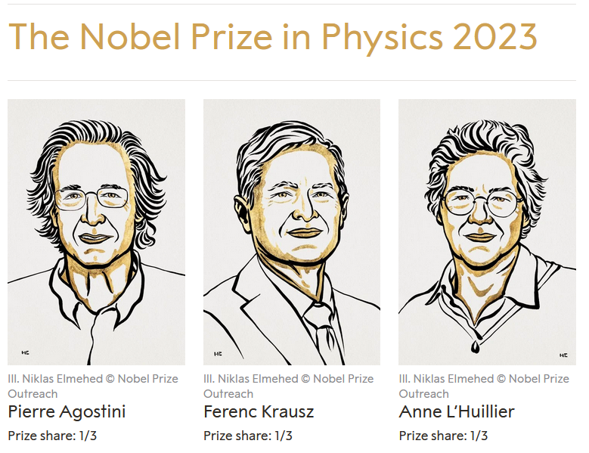
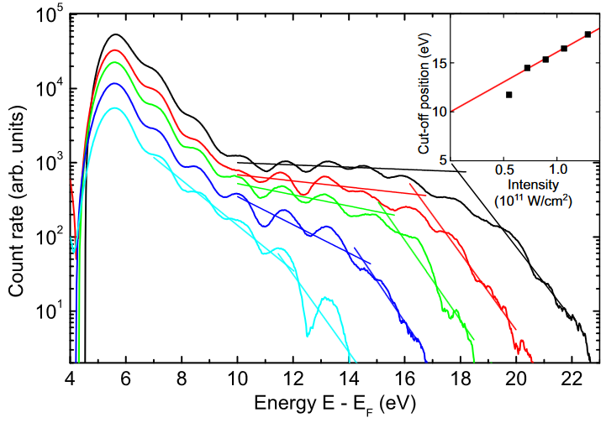
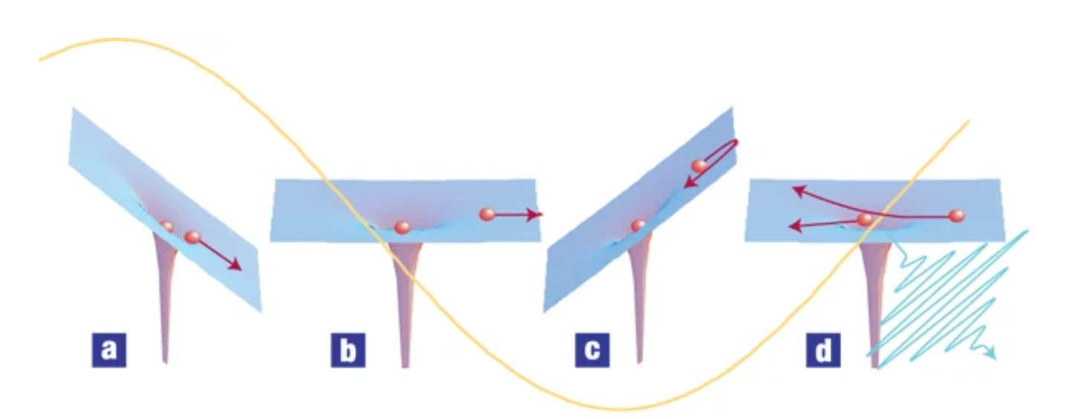
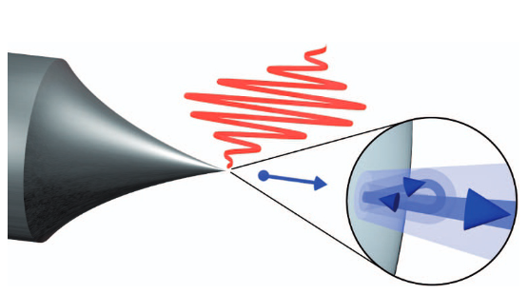
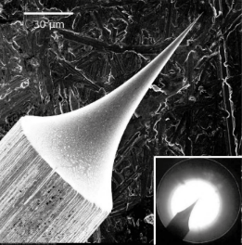
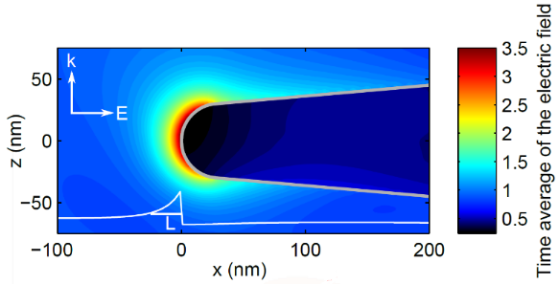
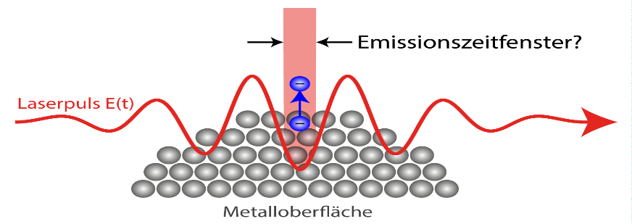
Electron photoemission from solids/gases
Electrons emitted from metal needle tips by femtosecond laser pulses
High harmonic generation (HHG) in gases:
Three step model– electrons driven in strong laser fields
M. Krüger et al. 475, 78–81 (2011)
M. Krüger et al., NJP 14, 085019 (2012),
G. Herink et al., Nature 483, 190–193 (2012),
B. Piglosiewicz, Nat. Photon. 8, 37–42 (2014)
M. Krüger et al., J. Phys. B. 51, 172001 (2018)
A. L´Huillier & Ph. Balcou, Phys. Rev. Lett. 70 6 (1992)
P. B. Corkum, Phys. Rev. Lett. 71, 1994 (1993)
K. J. Schafer et al., Phys. Rev. Lett. 70 1599 (1993)
P. Corkum & F. Krausz, Nat. Phys. 3, 381 (2007.
Near-field enhancement
emission time window?
laser pulse E(t)
M. Krüger et al., NJP 14, 085019 (2012).
S. Thomas et al., Nano Lett. 13, 4790-4794 (2013).
metal surface

Slide 6
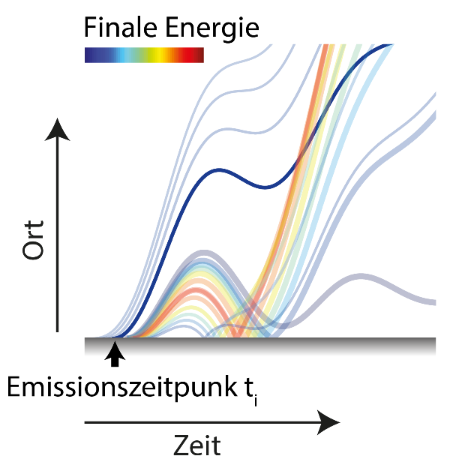
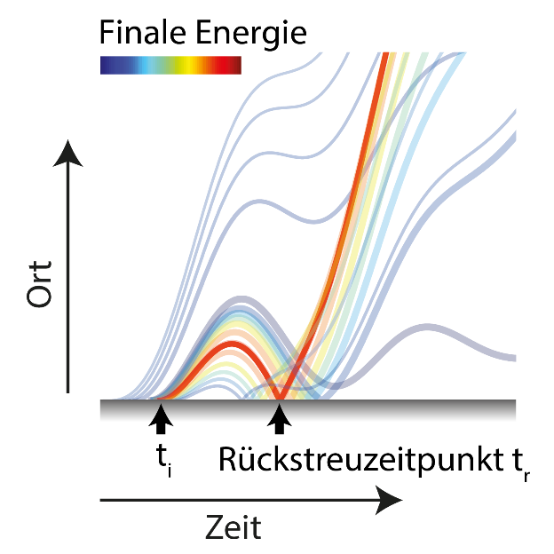



Extra feature of electron dynamics in SF regime
Direct emission
Re-collision
Final energy
Final energy
space
space
Emission time t_{i}
re-collision time t_{r}
time
time
$$E_{d}\left(t_{i}\right)≤2U_{p}$$
$$E_{r}(t_{i},t_{r})≤10 U_{p}$$
Becker, W., Goreslavski, S., Miloševic, D. & Paulus, G. J. Phys. B 51, 162002 (2018).

Slide 7
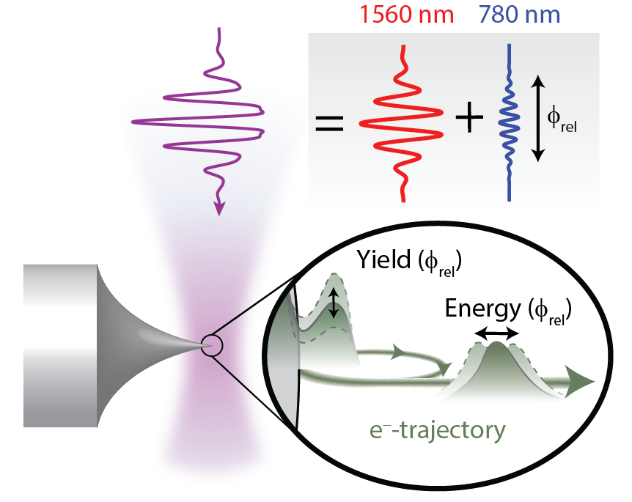

How about attosecond precision physics at the surface of a solid?
Krüger et al., Nature 475, 78 (2011)
Thomas et al., NanoLett. 13, 4790 (2013)
Krüger et al., J. Phys. B. 51, 172001 (2018)
Work by groups of Ropers (Göttingen), Kasevich (Stanford), Lienau (Oldenburg), Dombi (Budapest), Berggren & Keathley (MIT), Brida (Luxemburg), Chalopin (Toulouse) …
$ω−2ω$ field with variable relative phase
Needle tip (gold, tungsten) with radius of curvature $\sim 10−40$ nm
Nearfield intensities $10^{11}−10^{13} W/cm^{2}$

Slide 8
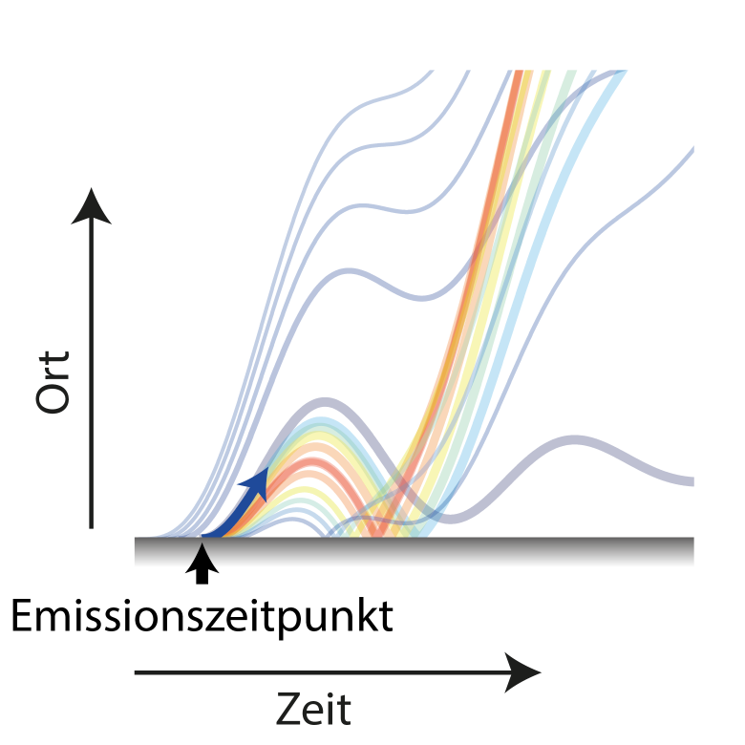
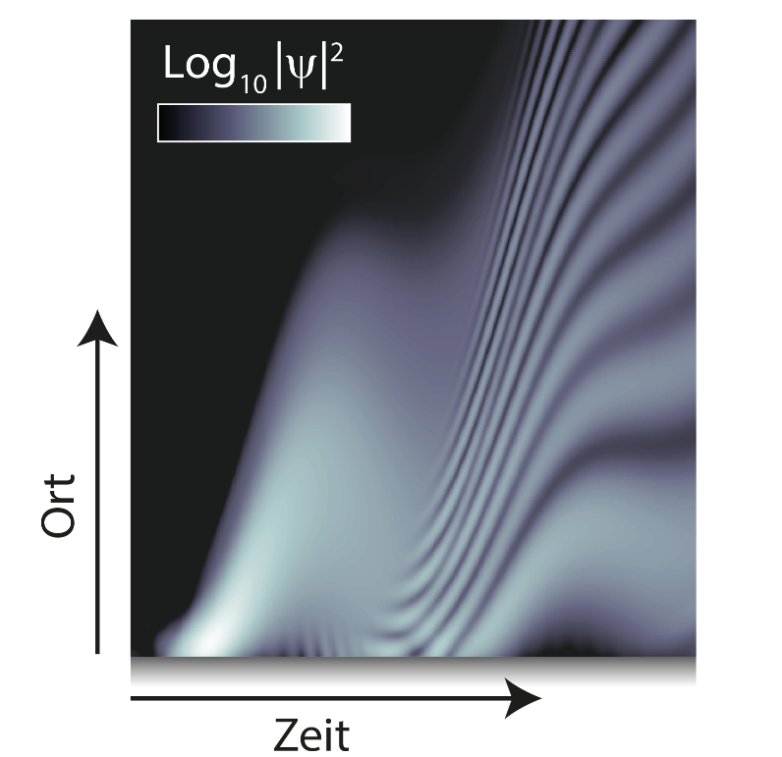
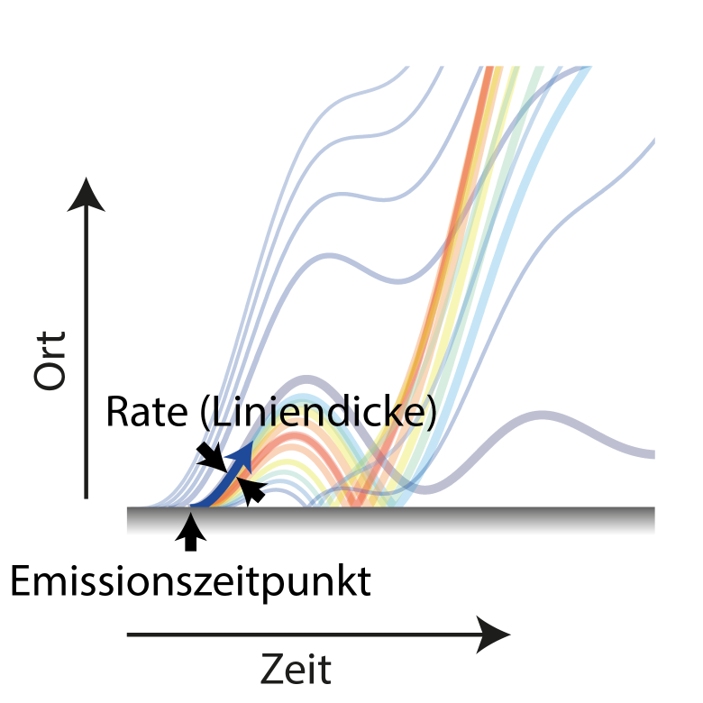
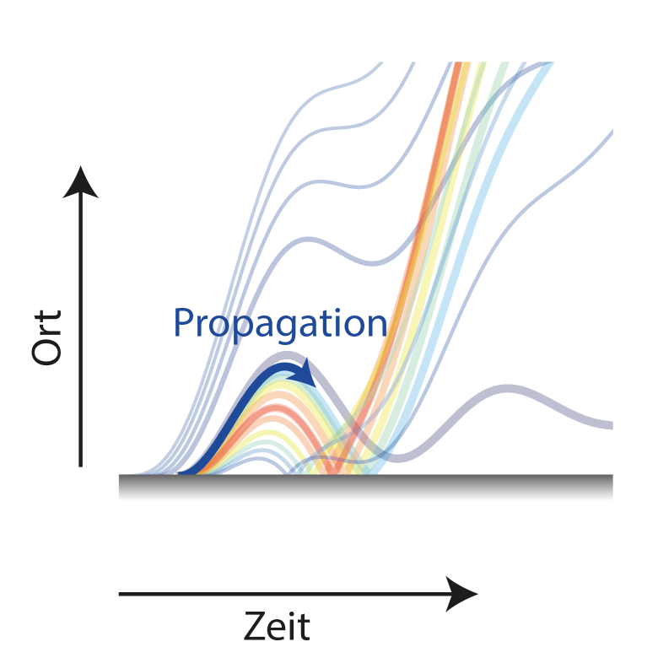
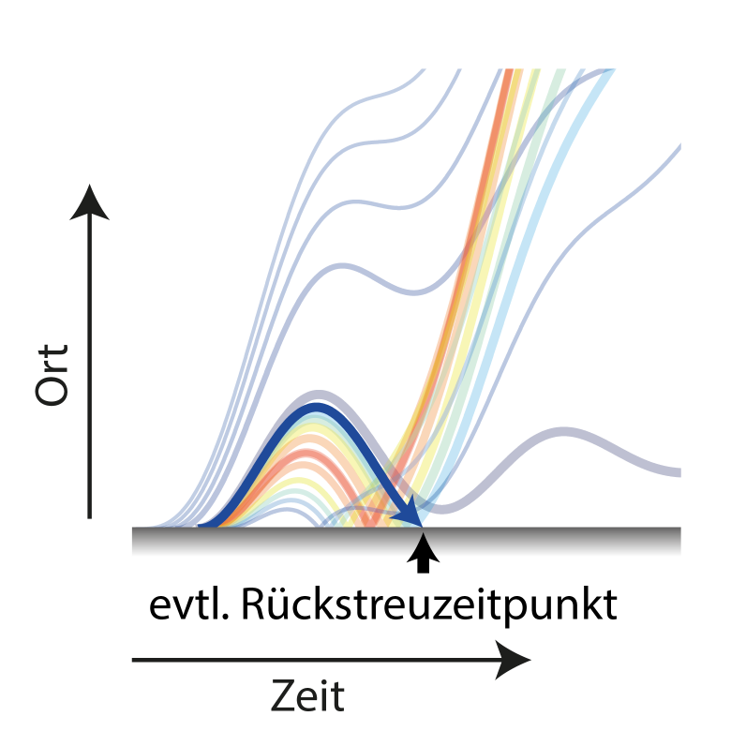
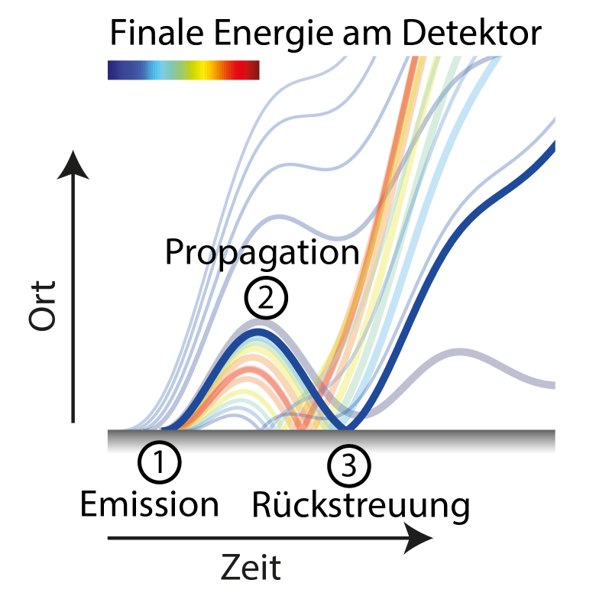
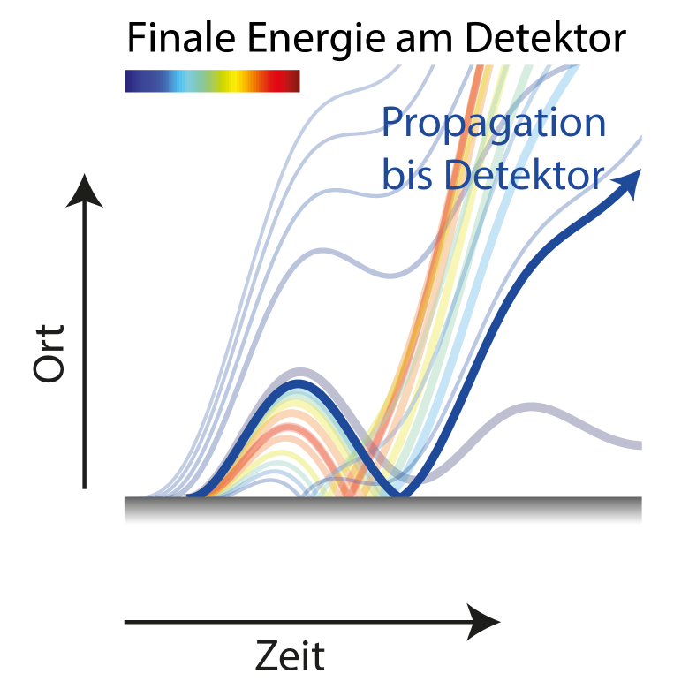
Modeling
Trajectory picture
Quantum mechanical
Final energy at detector
Final energy at detector
Propagation to detector
space
propagation
Rate (line thickness)
space
recollision time
Emission point
Re-collision
time
time
3-step model ¹ (emission, propagation, re-collision)
(Numerical) solution of the time-dependent Schrödinger equation (TDSE)
Corkum, P. B. Phys. Rev. Lett. 71, 1994 (1994).

Slide 9
Electron trajectories

Slide 10
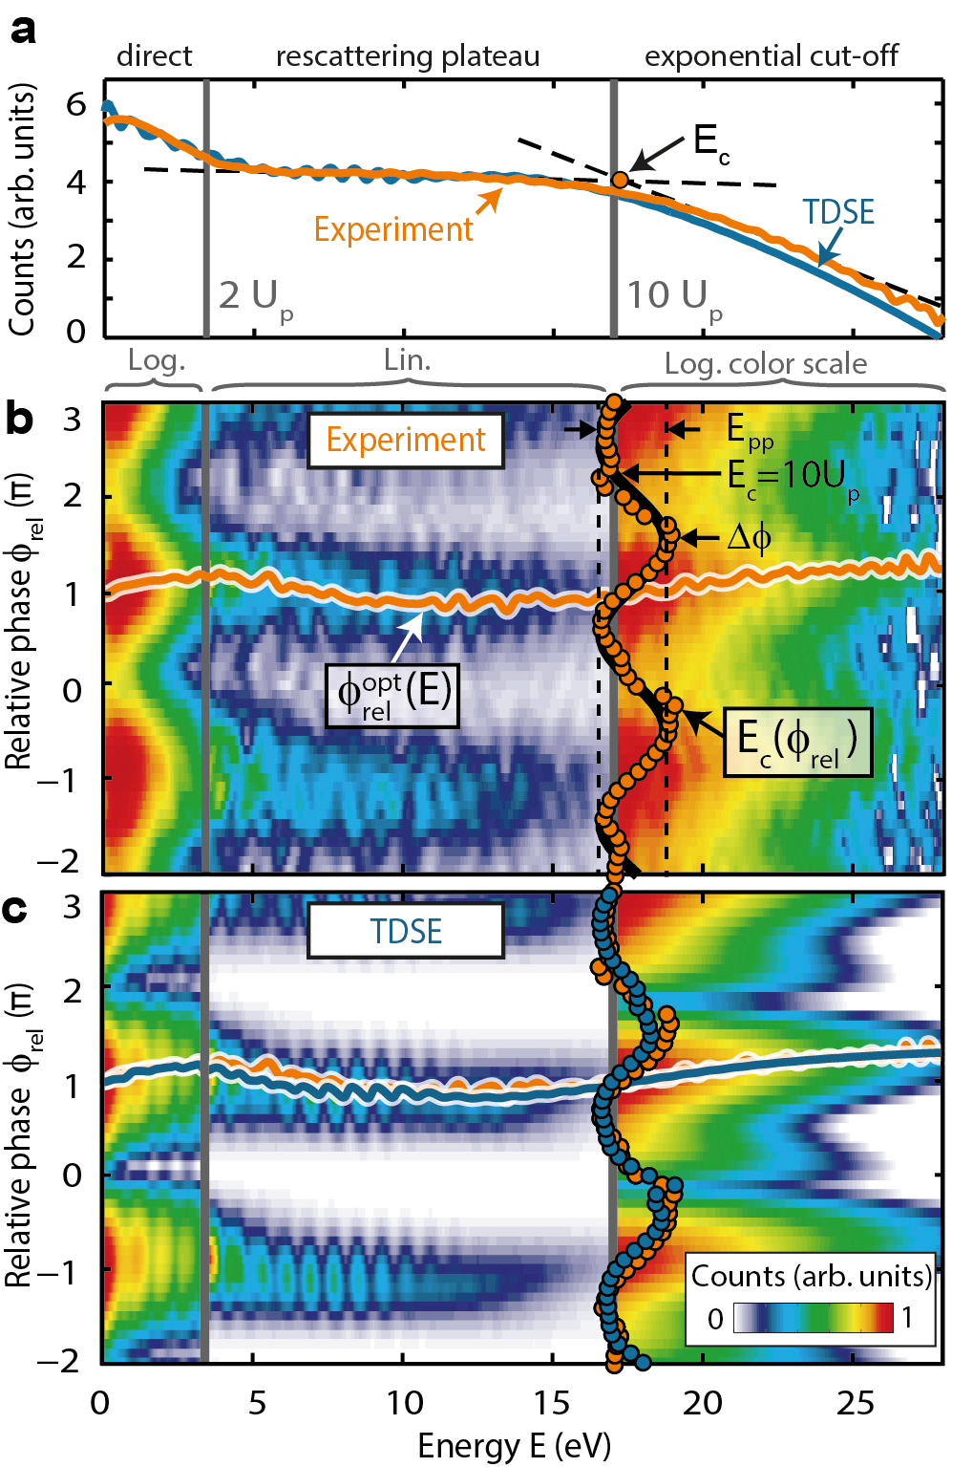
Measurement and simulation results
Optimal phase
Cut-off modulation

Slide 11
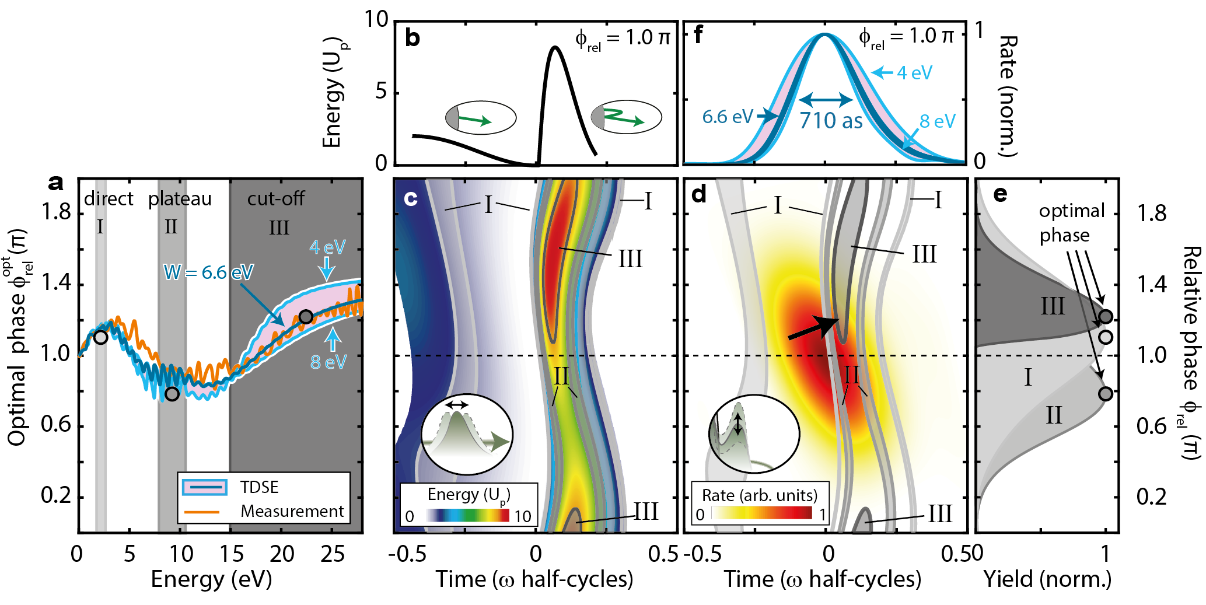
Precision attosecond physics at a needle tip
Emission duration of 710 +/- 30 attoseconds
Excellent news for lightwave electronics (MIT, Konstanz, Luxembourg… groups)
Ph. Dienstbier¹, T. Paschen¹, L. Seiffert², A. Liehl³, A. Leitenstorfer³, Th. Fennel², P. Hommelhoff, Nature 616, 702 (2023)
1: FAU Erlangen, 2: U Rostock, 3: U Konstanz

Slide 12
What are these tips good for?
High quality (pulsed) electron beams

Slide 13
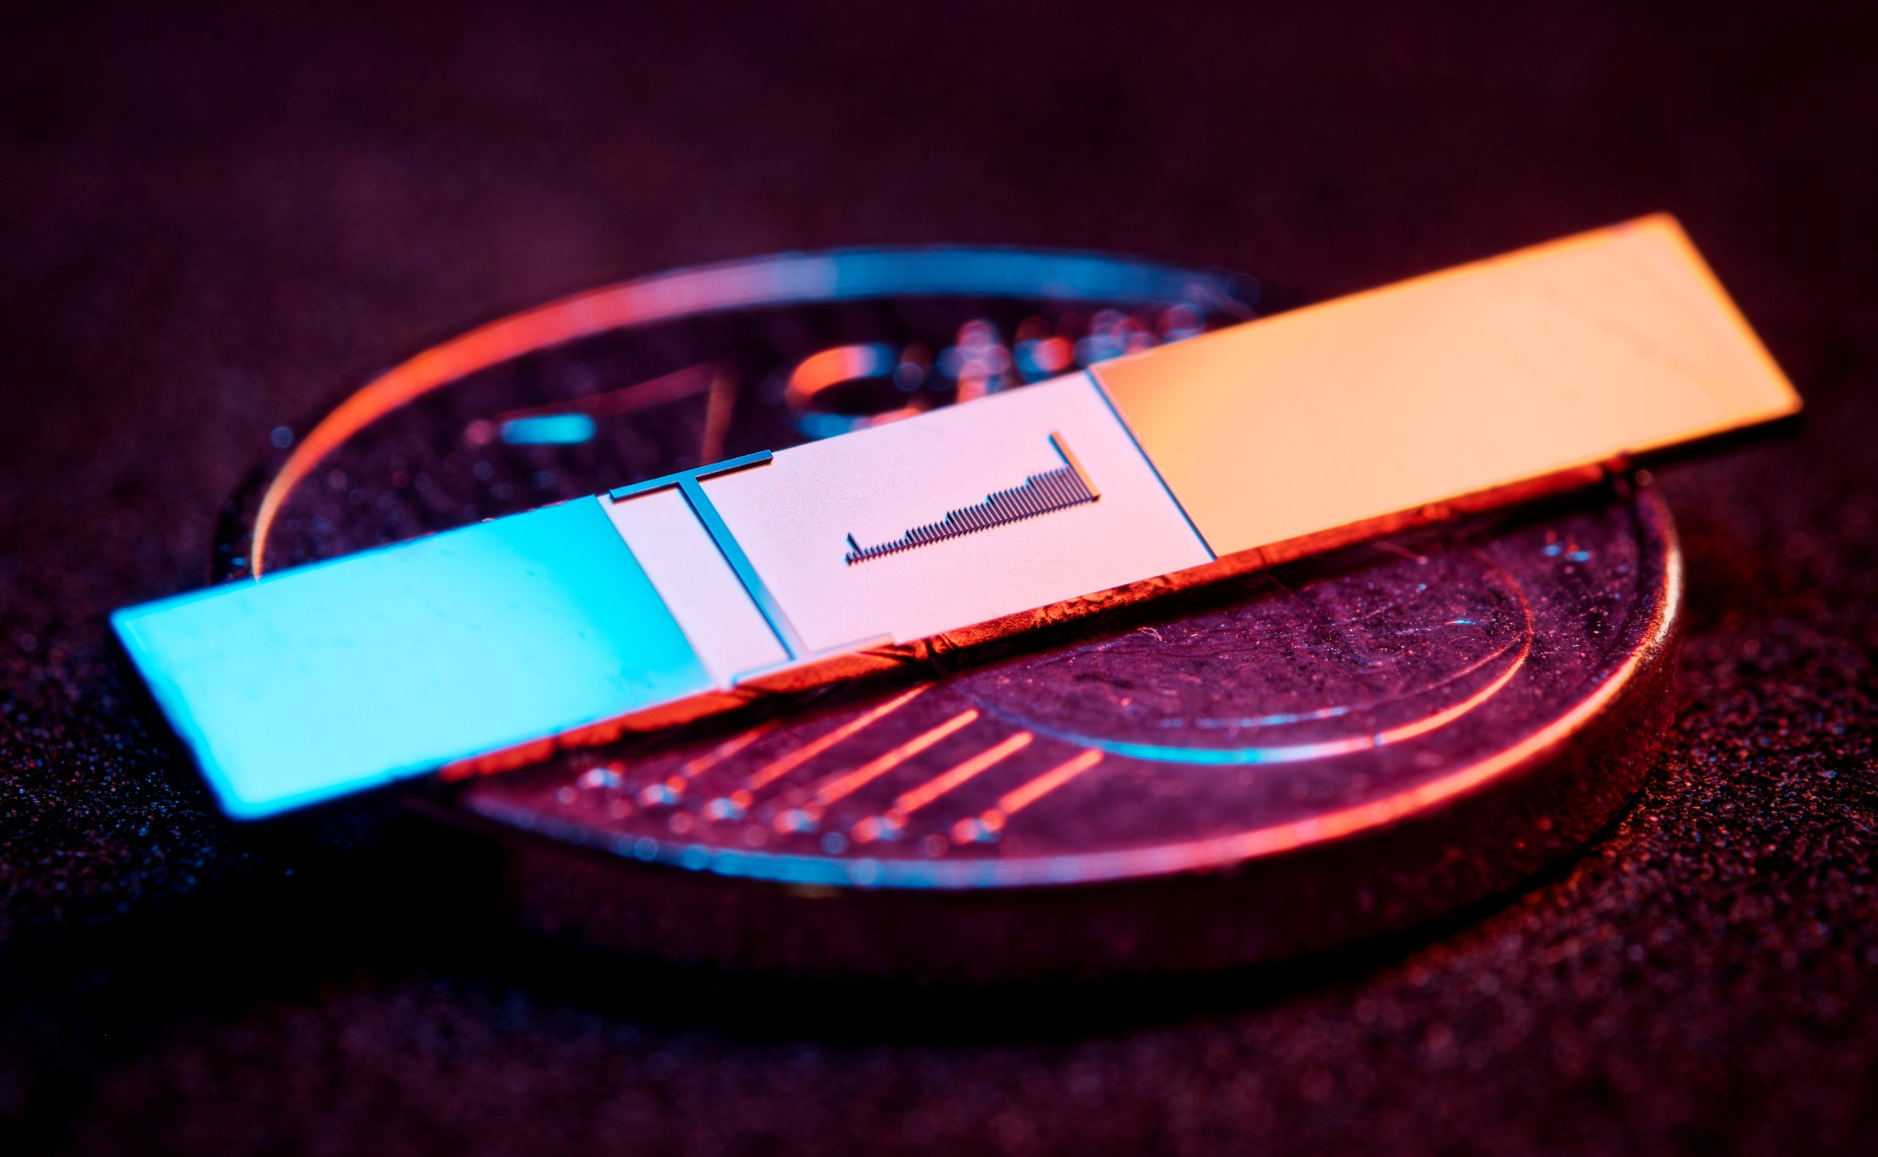
Laser driven accelerators on chip

Slide 14
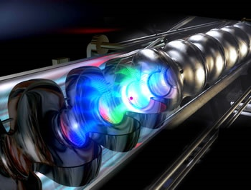
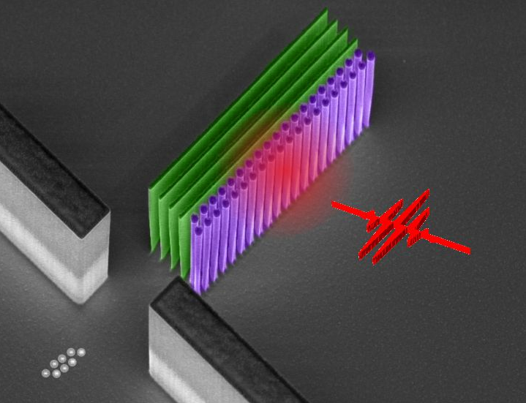
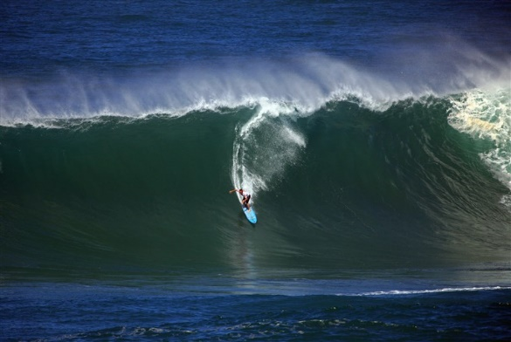
Laser particle accelerators: from RF to laser drive – based on the same operating principle: “structured vacuum”
RF cavity (TESLA, DESY)
Conventional linear
accelerator (RF)
Laser-based dielectric
accelerator (optical)
Based on
(Supercond.) RF cavities
Quartz grating structures
Surface breakdown:
200 MV/m
Damage threshold:
10 GV/m
Peak field limited by
Max. achievable
gradients
100 MeV/m
= 0.1 GeV/m
5 GeV/m
= 5 000 MeV/m
Principle: a nearfield scheme generates the required electromagnetic mode to continuously accelerate charged particles in vacuum – the particle is surfing the mode

Slide 15
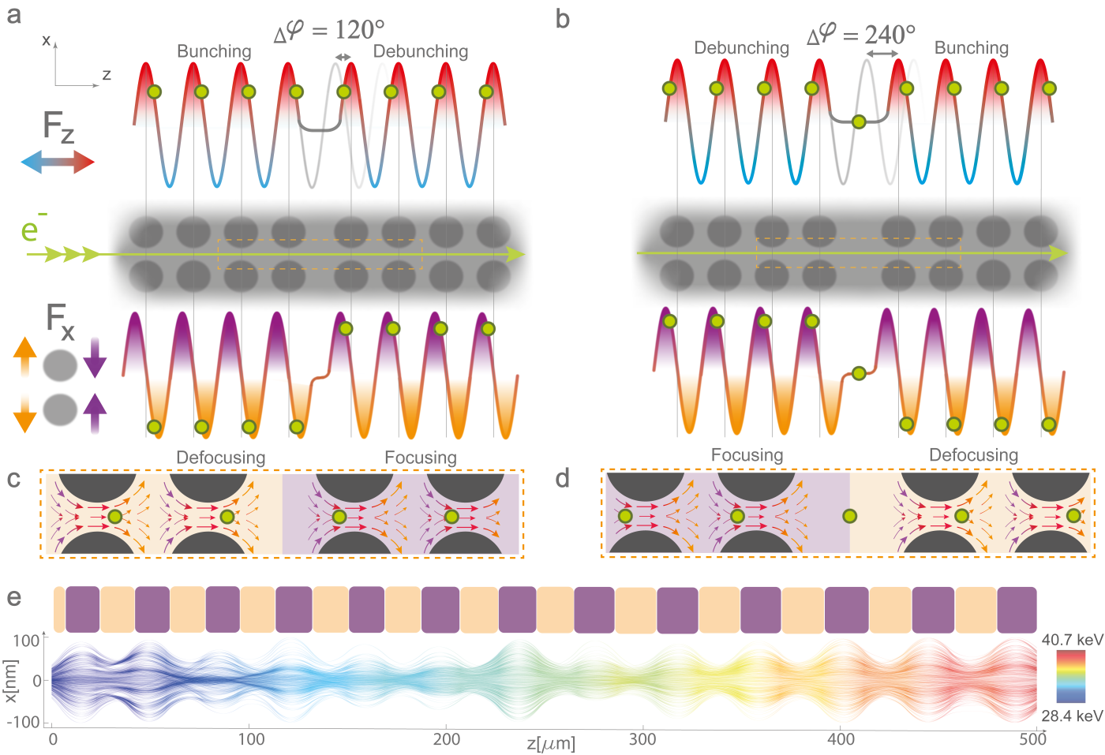
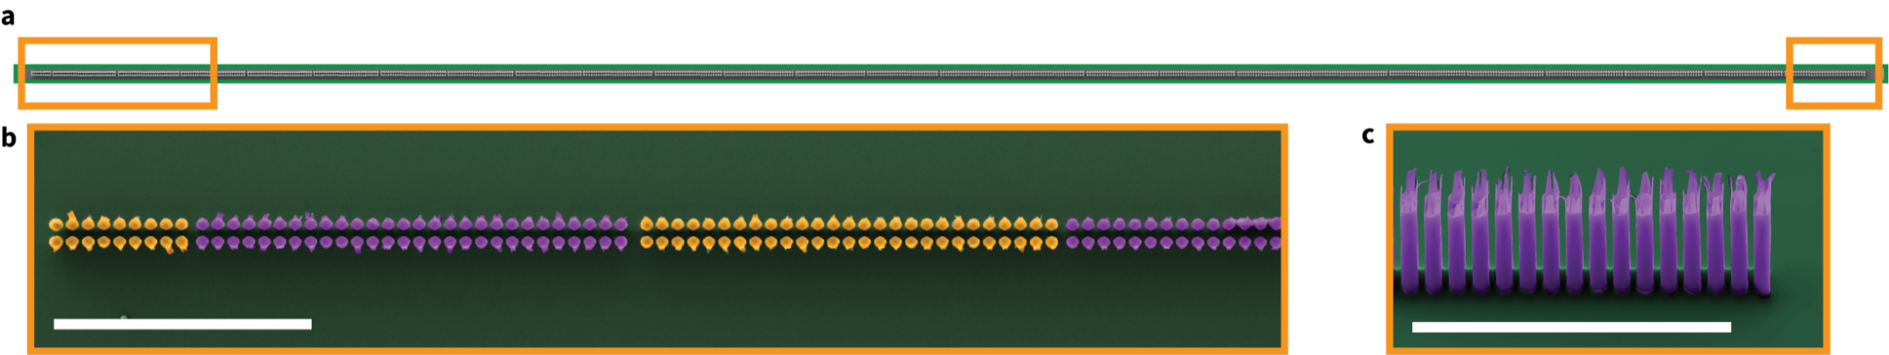
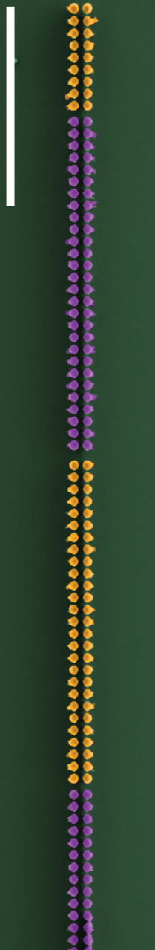
Acceleration with Alternating phase focusing
T. Chlouba*, R. Shiloh*, S. Kraus*, L. Brückner*, J. Litzel, P. Hommelhoff,
Coherent Nanophotonic Electron Accelerator,
Nature (2023), in press.

Slide 16
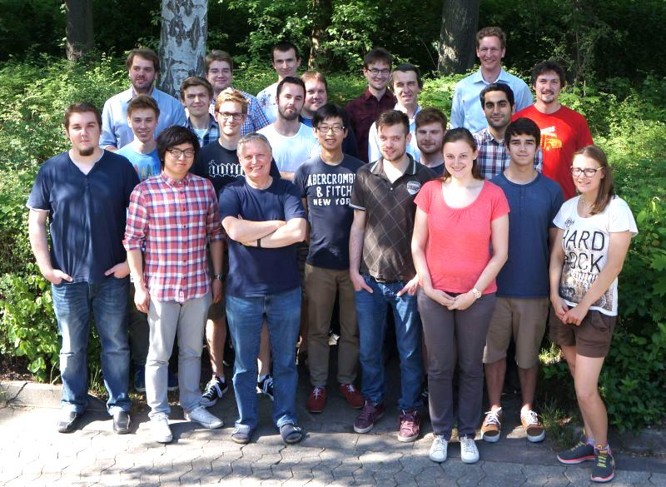
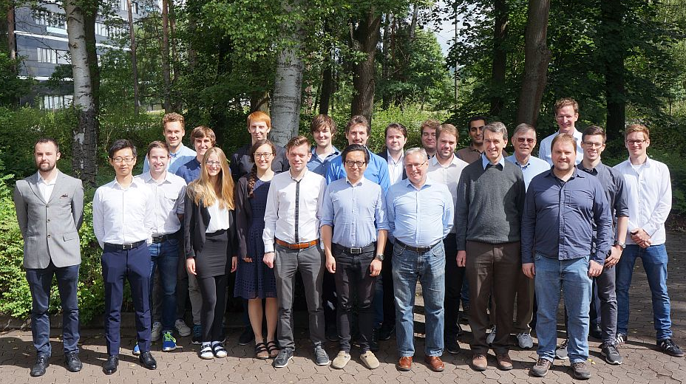
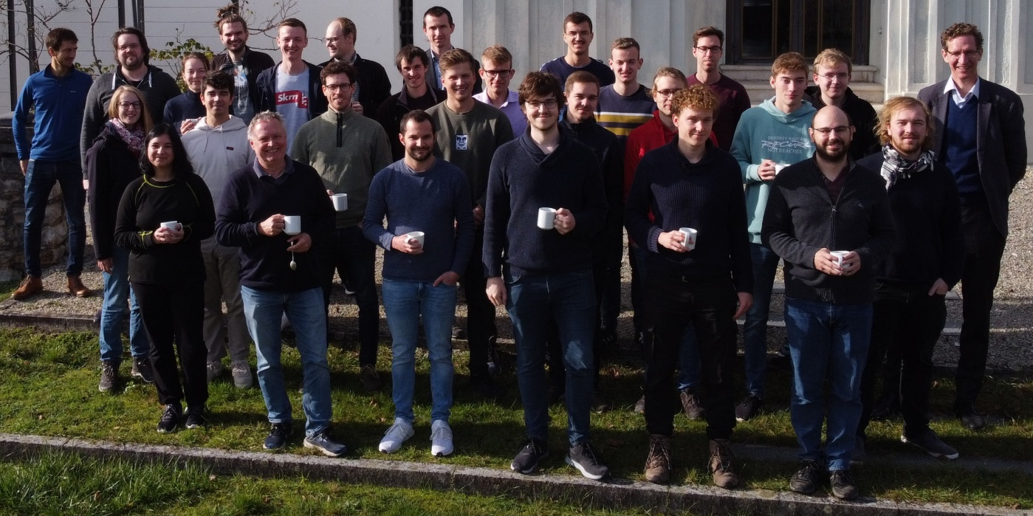
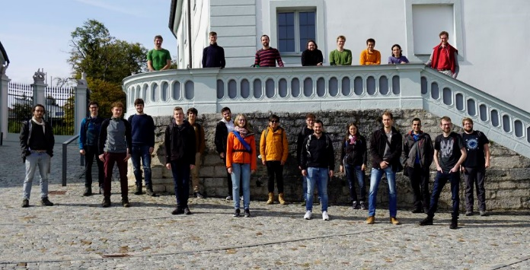














.
Tobias Boolakee
Leon Brückner
Tomás Chlouba
Julian Freier
Jonas Heimerl
Martin Hundhausen
Johannes Illmer
Manuel Konrad
Stefanie Kraus
Julian Litzel
Bastian Löhrl
Felix Lopéz Hoffmann
Matthias Meier
Stefan Meier
Annika Michalak
Jonathan Pölloth
Jürgen Ristein
Roy Shiloh
Franz Schmidt-Kaler
Timo Wirth
Simon Wittigschlager
Open
PhD student and postdoc positions! Pls. get in touch.
FAU’s Laser Physics
Partners/
collaborations:
ACHIP collaboration
iQCE collaboration
J. Rosenzweig, UCLA
I. Franco, Rochester
I. Kaminer, Technion
Ph. Russell, MPL
Th. Fennel, Rostock
A. Leitensdorfer, Konstanz
FAU Applied Physics: H. Weber
M. Kling, LMU/MPQ
R. L. Byer + coll., Stanford / SLAC
C. Lemell, J. Burgdörfer, TU Vienna
M. Stockman^{Ϯ}, Georgia State
G. G. Paulus, Jena
Former members:
PhDs: J. Breuer Ph. Dienstbier M. Förster C. Gerner J. Hammer C. Heide J. Hoffrogge M. Krüger Ang Li M. Schenk M. Seidling T. Paschen A. Tafel N. Schönenberger S. Thomas (Ph. Weber) P. Yousefi R. Zimmermann M. Sirotin
Postdocs: A. Aghajani-Talesh P. Dombi M. Kozák J. McNeur Y. Morimoto T. Higuchi
Master students: D. Ehberger T. Eckstein M. Eisele R. Fröhlich U. Häusler R. Heinreich S. Heinrich H. Kaupp A. Kirchner M. Knauft A. Liehl L. Maisenbacher J. Martinek A. Mittelbach F. Najafi C. Nauk H. Ramadas T. Sattler E. Schmidt J.-P. Stein H. Strzalka Y.-H. M. Tan Di Zhang
Former members (master thesis, PhDs; postdocs):
A. Aghajani-Talesh J. Breuer P. Dombi D. Ehberger M. Eisele M. Förster R. Fröhlich J. Hammer S. Heinrich J. Hoffrogge H. Kaupp M. Kozák M. Krüger A. Liehl J. McNeur
L. Maisenbacher F. Najafi H. Ramadas T. Sattler Ella Schmidt M. Schenk L. Seitz J.-P. Stein H. Strzalka Y.-H. M. Tan S. Thomas Di Zhang
achip.fau.de

