Slide 1
S-band photocathode based injector plan for Korea-4GSR 2023-10-4 Chang-Ki Min on behalf of Korea-4GSR linac group Pohang Accelerator Laboratory Special thanks to -4GSR linac advisory committee, Hiroshi Matsumoto (KEK), Takahiro Inagaki (RIKEN SPring-8 Center), John Smedley (SLAC) - MOGA simulation, Chanmi Kim, Chong Shik Park, Eun-San Kim, Seung Hwan Shin, Seong Hee Park at Korea Univ.

Slide 2
Contents
Introduction to Korea-4GSR (4th generation storage ring) project
S-band photocathode experiences in PAL-XFEL
Requirements for Korea-4GSR injector
Benefits using photocathode instead of thermionic gun
Open question for physicist?
Summary
2

Slide 3
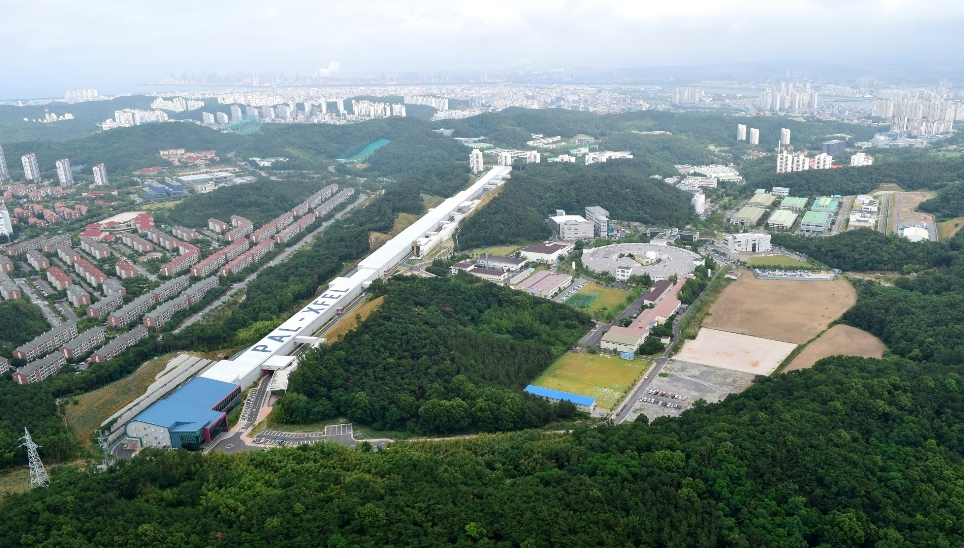
PAL-XFEL (2011~2015)
10 GeV, 60 Hz, 1.1km
Normal conducting
Based on S-band photocathode
PAL-PLS II (2009~2011)
3 GeV, 400 mA, 282 m
Thermionic gun + Full energy linac

Slide 4
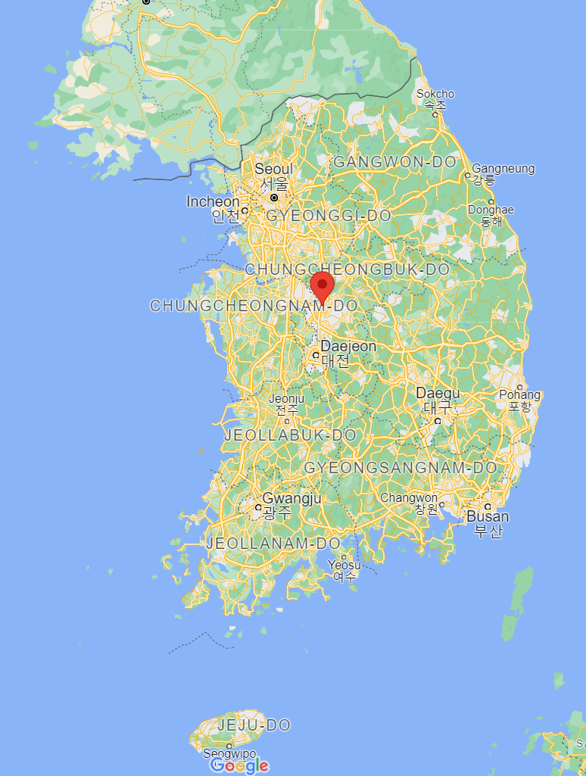
Korea-4GSR project
High photon beam performance from storage ring.
‐ The best performance in the range of 10 ~ 30 keV.
‐ Capability to generate photon beam up to 100 keV.
Considering well demonstrated technologies for the design.
- Normal conducting cavity
Synergy with PLS‐II and PAL‐XFEL.
‐ Supporting full range of synchrotron radiation application.
Seoul
Ochang
Chungcheongbuk-do
Pohang
Multipurpose Synchrotron Radiation Construction Project
CDR
TDR
Accelerator & Beamlines
Site Construction
Building & Facility Construction
Test Run
Operation
4

Slide 5
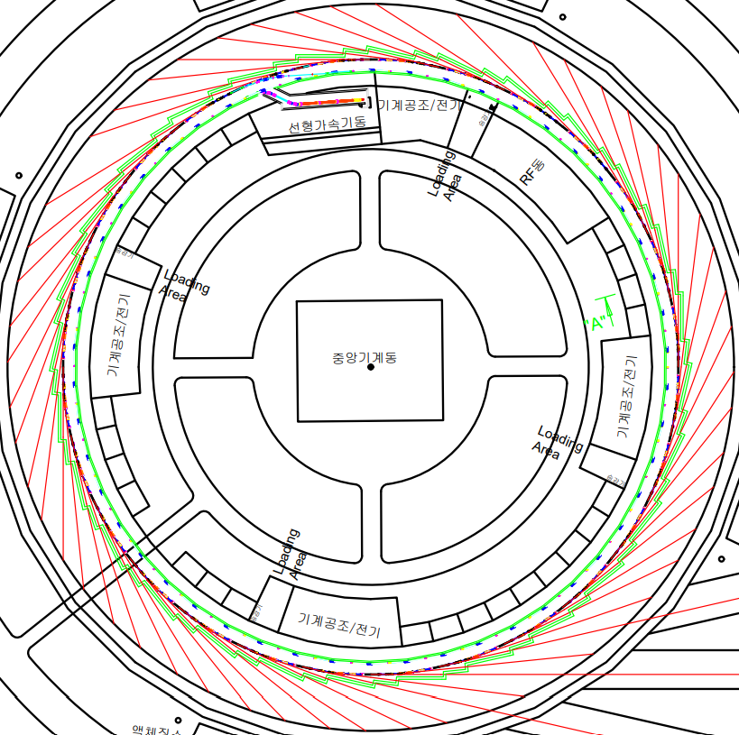
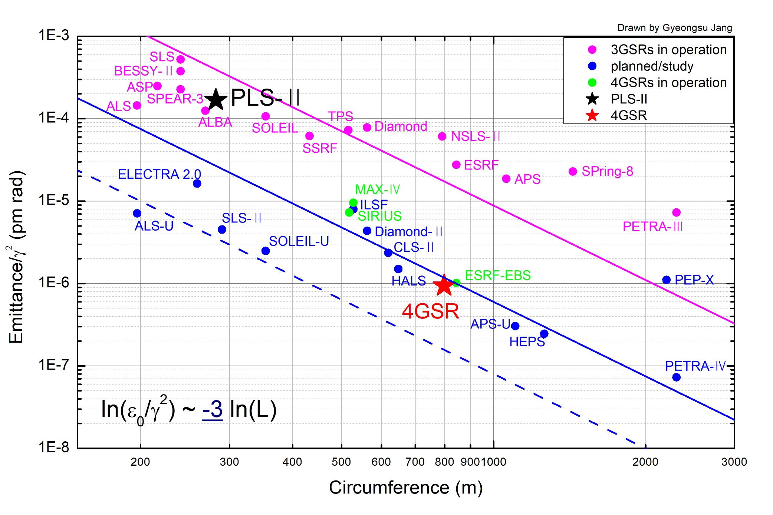
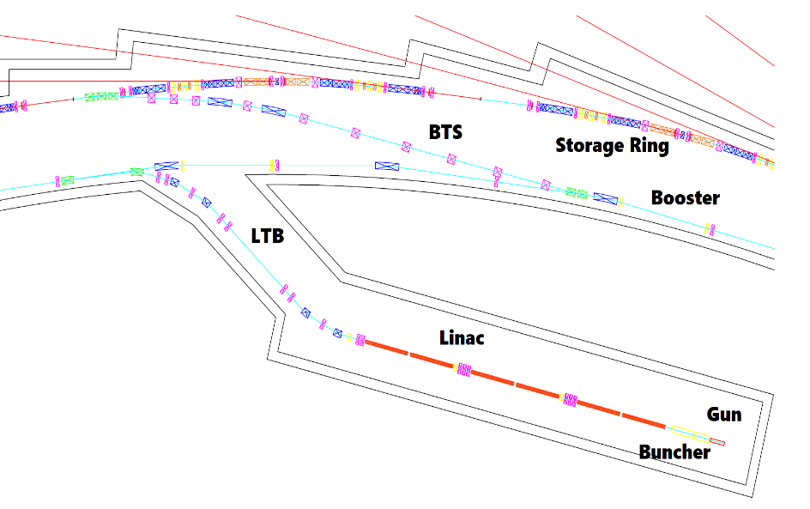
4GSR in worldwide storage rings
Off-axis injection scheme
Parameter | Units | PLS-II | Korean 4GSR
Electron energy | GeV | 3 | 4
Horiz. Emittance | pm | 5800 | 58 (RB: 39 )
Vert. Emittance | pm | ~ 58 | ~ 5.8 (RB: 39 )
Bunch length (rms) | ps | 20 | 13 (50 with HC)
Circumference | m | 280 | 800
Harmonic # |  | 470 | 1332
RF frequency | MHz | 500 | 500
Beam stability @ ID (x/y) | $μm$ | < 4 / 2 | < 2.5 / 0.45
Injection mode |  | Top-up | Top-up
5

Slide 6
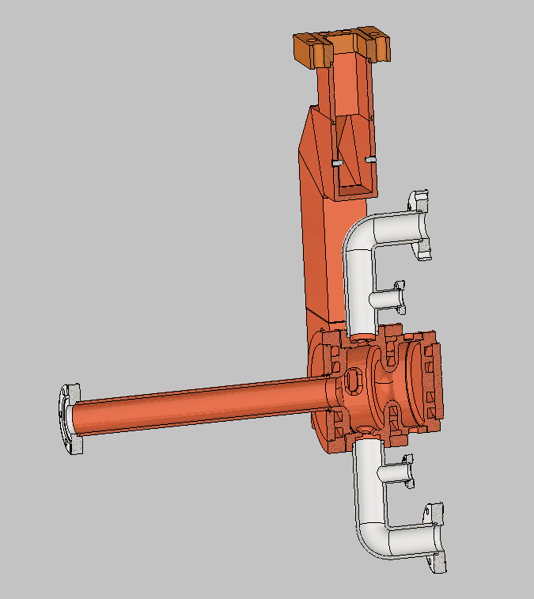
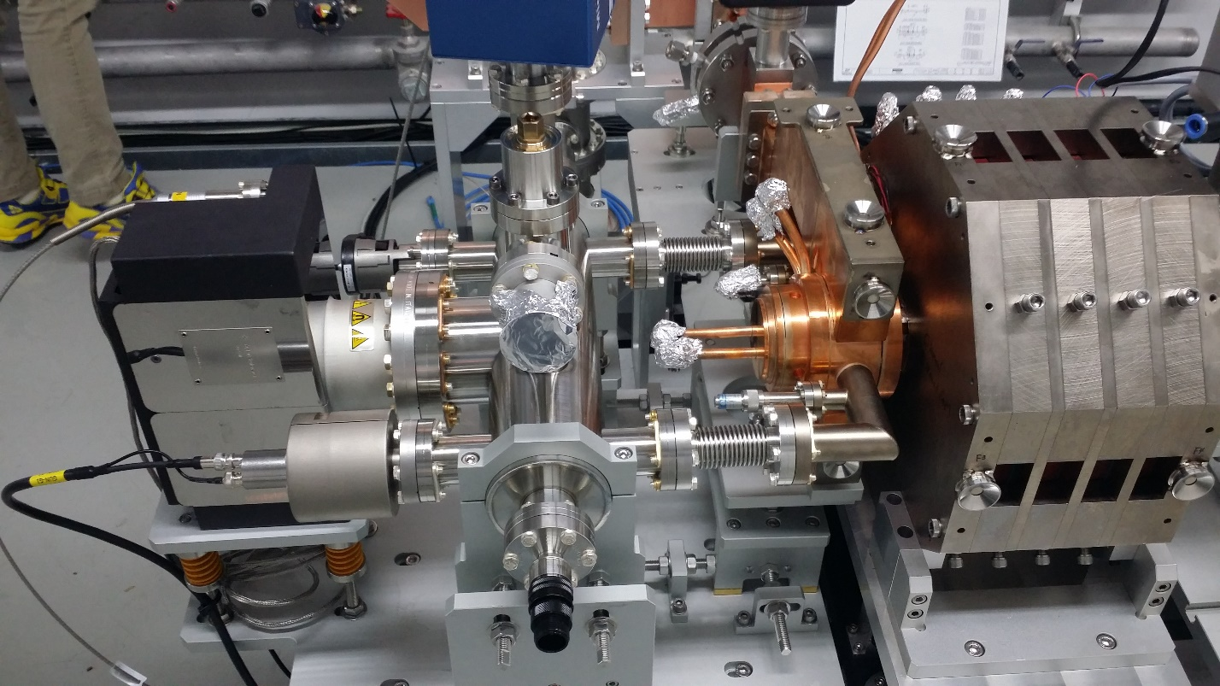
PAL-XFEL s-band photocathode gun and injector
RF dual coupler
Matured technology in PAL : S-band photocathode
‐ 10 years R&D + 10 years operation experience
‐ 6 MeV, 250 pC, 60 Hz routine operation since 2016
Best stability at gun : energy and time
- CCPS + PFN + sagnoc based sync.
+saturation operation at Klystron provides
~ Phase stability 0.01 (~10fs), RF power stability 10⁻⁴
Stable Injector operation
‐ e- beam energy stability : 5x10⁻⁵
- beam based feedback provides phase space conservation
Vacuum
dual port
e- bunch arrival time at GUN, ~11 fs rms, 1 hour
2

Slide 7
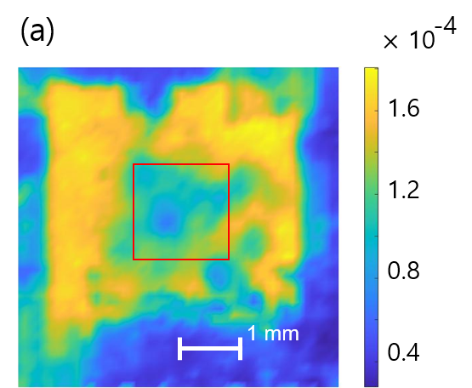
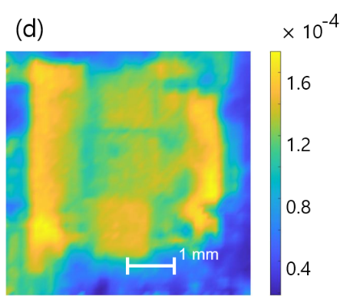
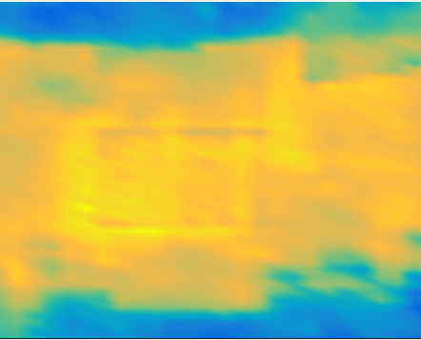
PAL-XFEL s-band photocathode gun and injector
Maintaining the normalized emittance at 135 MeV
‐ Average 0.4 u at 250 pC (variations between 0.35~0.45u)
QE at 253 nm, 1~2x10⁻⁴, Vacuum 2x10⁻¹¹ mbar
- Twice laser cleaning since 2016 and 2022,
- Low surface damage using ~300 ps long IR laser cleaning
- Half a day cleaning and operation right away
Center QE hole
Laser cleaning
1 month
Maintenance
65ºC → 25ºC
2x10⁻⁴
10⁻⁴
7

Slide 8
4GSR vs PAL-XFEL
 | 4GSR | PAL-XFEL
RF frequency | 2997.56 ± 0.1 MHz, variable | 2856 MHz fixed
Trigger timing | Depending on booster injection timing | fixed
Bunch charge | Multi, 1 to 3 nC Single, 0.01 to 1 nC | 250 pC fixed
Pulse duration (number of bunch) | ≈200 ns (102 or 17 bunches) 6~7 ps (single bunch) | 3 ps FWHM (single bunch)
Repetition rate | 2 Hz (60 Hz) Multi- or single- bunch | ≤ 60 Hz Single bunch (two bunch in the future)
8

Slide 9
4GSR Linac parameters
 | Multi-bunch | Single-bunch
Energy | 200 MeV | 200 MeV
Frequency | 2997.56 ± 0.1 MHz | 2997.56 ± 0.1 MHz
Emittance (at 200 MeV) | ≦ 10 nm | ≦ 10 nm
Relative energy spread (rms) | ≦ 0.3 % | ≦ 0.3 %
Pulse to Pulse energy jitter(rms) | ≦ 0.2 % | ≦ 0.2 %
Bunch charge (charge stability) | 1 to 3 nC (5%) | 0.01 to 1 nC (2%)
Pulse duration | ≈200 ns (102 or 17 bunches) | 6-8 ps FWHM
Repetition rate | 2 Hz | 2 Hz (60 Hz)
LCW parameters
• Acceleration tube : 25 ∼ 30 ℃ (copper 50 KHz/ ℃)
• Photocathode gun : 25 ∼ 50 ℃
Timing Synchronization System
• Pseudo Sync. operation (in the same way as SACLA) → synchronous operation
9

Slide 10
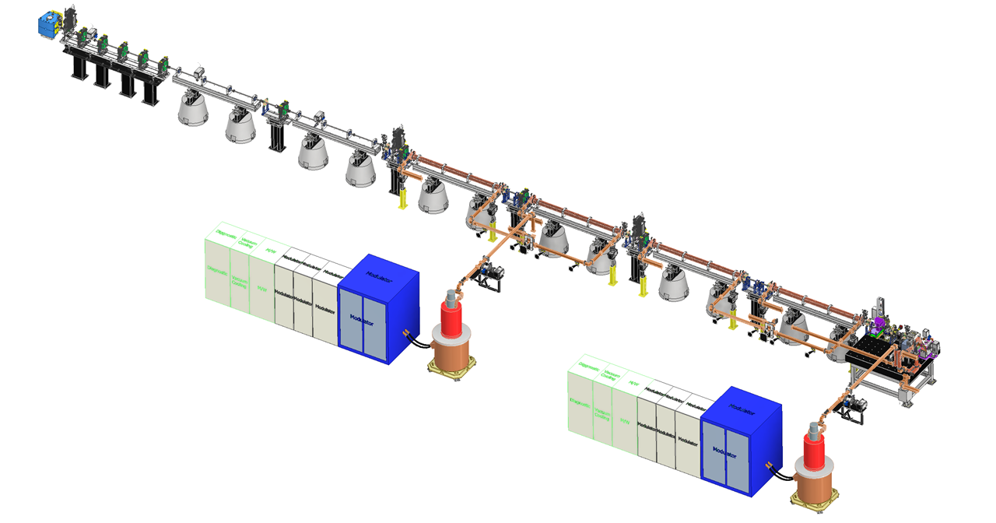
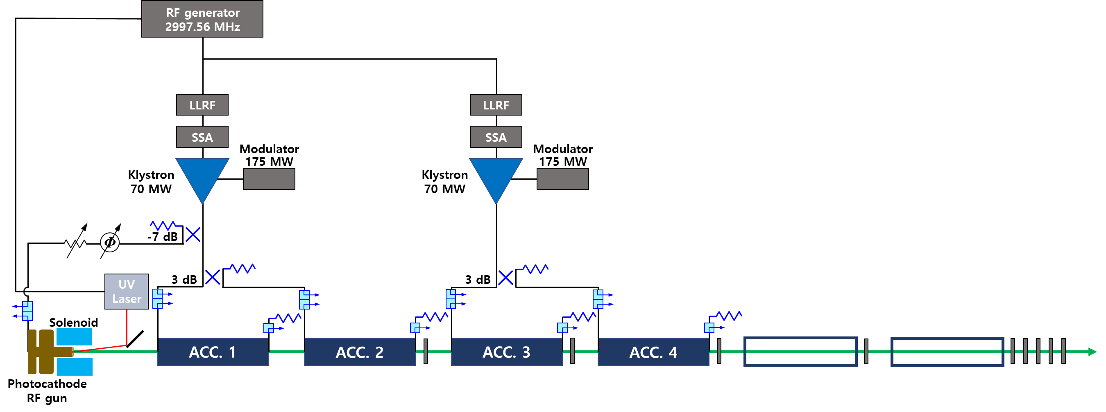
Adapted s-band photocathode gun and injector for 200 MeV 4GSR linac
10

Slide 11
Optimization for the beam dynamics simulation
Weights
 | Energy spread | Emittance X | Emittance Y
Case1 | 0.5 | 0.25 | 0.25
Case2 | 0.8 | 0.1 | 0.1
case3 | 0.3 | 0.35 | 0.35
MOGA optimization paraters
Optimization | Beam charge
Single bunch mode | 1 nC | Maximum charge at single bunch mode
Multi bunch mode | 176 pC | Maximum charge at multi-bunch mode (3nC : #17)
RF Gun
Optimization point (16.2m)
Accelerating structure
Quadrupole
solenoid
2.900m
1.810 m
0.90046m
0.90046m
0.90046m
Variables (6) | range | unit
RF gun phase | -20~20 | degree | Auto phase
Acc1&2 phase | -20~20 | degree
Acc3&4 phase | -20~20 | degree
Solenoid | 0.15~0.21 | T
Quad 1&2 | 1~3(-4~-1) | T/m
Objectives (3) |  | Unit
Normalized rms emittance X&Y | Minimization | mm-mrad
rms energy spread | Minimization | keV
Constraint (7) |  | Unit
Beam size X &Y (rms) | < 0.3 | mm
X&Y angle | < 0.2663 | mrad
Bunch length | < 1.0 | mm
Number of particle | >9999
Average energy | >200 | MeV

Slide 12
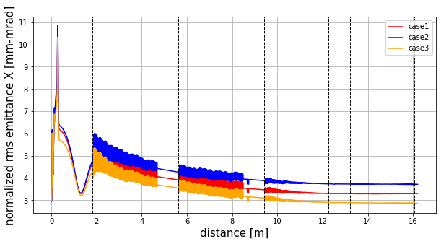
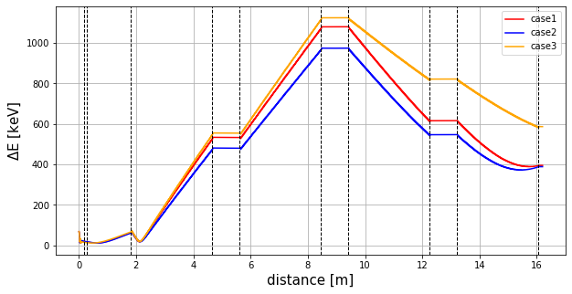
beam parameters in linac (1 nC)
구간 별 emittance X and energy spread
Beam parameters exited linac (16.2m)
mode | Erms | emittanceX | Unnormalized | emittanceY | Unnormalized | Xrms | Yrms | L_bunch | Transmission rate | average E
 | [keV] | [mm-mrad] | [nm] | [mm-mrad] | [nm] | [mm] | [mm] | [mm] | [%] | [MeV]
Case1 | 381.50 | 3.2990 | 8.44 | 3.2145 | 8.18 | 0.21760 | 0.26149 | 0.96584 | 100 | 200.16
Case2 | 372.17 | 3.7122 | 9.52 | 3.8144 | 9.71 | 0.29162 | 0.29447 | 0.95932 | 100 | 200.61
Case3 | 411.98 | 2.8520 | 7.37 | 2.8147 | 7.21 | 0.28593 | 0.28566 | 0.98924 | 100 | 200.92
<1MeV(0.3%)
<10nm
<10nm
< 8ps

Slide 13
beam optics error study (1 nC)
Beam parameters (16.2m)
mode | Erms | emittanceX | Unnormalized | emittanceY | Unnormalized | Xrms | Yrms | L_bunch | particle | average E
 | [keV] | [mm-mrad] | [nm] | [mm-mrad] | [nm] | [mm] | [mm] | [mm] |  | [MeV]
Case1 | 381.50 | 3.2990 | 8.44 | 3.2145 | 8.18 | 0.21760 | 0.26149 | 0.96584 | 10000 | 200.16
Case2 | 372.17 | 3.7122 | 9.52 | 3.8144 | 9.71 | 0.29162 | 0.29447 | 0.95932 | 10000 | 200.61
Case3 | 411.98 | 2.8520 | 7.37 | 2.8147 | 7.21 | 0.28593 | 0.28566 | 0.98924 | 10000 | 200.92
parameters |  | sigma
RF gun | gradient | 0.2 | %
 | input phase | 0.2 | degree
accelerating cavity | gradient | 0.2 | %
 | input phase | 0.2 | degree
solenoid | strength | 0.1 | %
quadrupole | strength | 0.1 | %
target
Energy spread | 0.5 | %
Average energy | 0.2 | %
Position x,y | 10 | %
Error cutoff : 2 sigma (gaussian)
Random number : 500

Slide 14
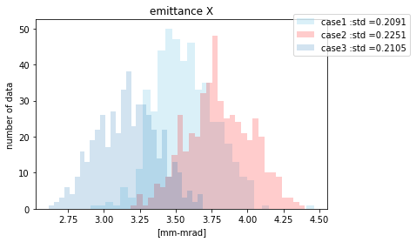
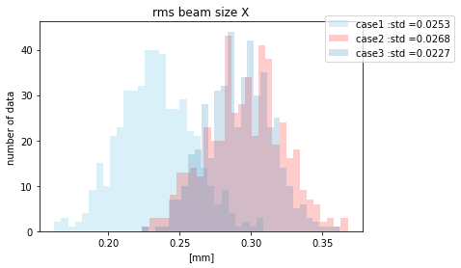
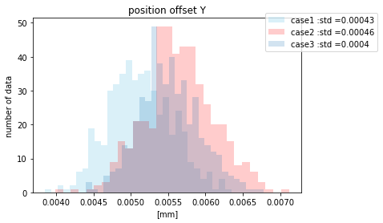
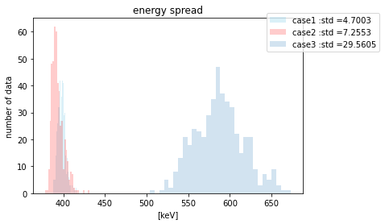
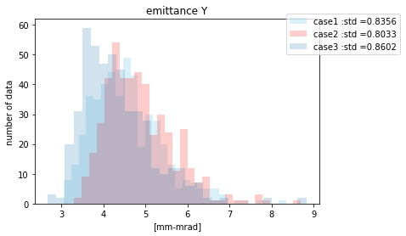
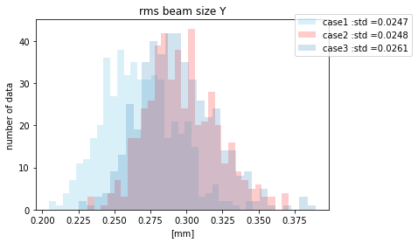
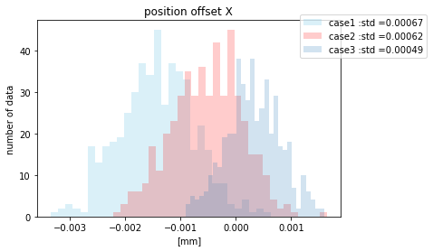
beam optics error study (1 nC)
Standard deviation
mode | Energy spread | emittanceX | emittanceY | Xrms | Yrms | Offset X | Offset Y | L_bunch | average E
 | [keV] | [mm-mrad] | [mm-mrad] | [mm] | [mm] | [mm] | [mm] | [mm] | [MeV]
Case1 | 4.7003 | 0.2091 | 0.8356 | 0.0253 | 0.0247 | 0.00067 | 0.00043 | 0.0044 | 0.1762
Case2 | 7.2553 | 0.2251 | 0.8033 | 0.0268 | 0.0248 | 0.00062 | 0.00046 | 0.0043 | 0.1749
Case3 | 29.5605 | 0.2105 | 0.8602 | 0.0227 | 0.0261 | 0.00049 | 0.0004 | 0.0045 | 0.1756

Slide 15
Photocathode laser for Cu
Laser for photoelectron generation
: Ti:S, Regen(~800 nm), 7 mJ, 3rd or 4th harmonic
: Yb, Multipass(~1030 nm), 0.5mJ, 4th or 5th harmonic
: Yb, Regen(~1030 nm), 2+2mJ, 4th or 5th harmonic
Single/Burst mode convert
- Convert time (<1 min)
Burst mode
N=100
N=100
…… ……. …… ……
~2ns
~0.5 sec (Ext. triggered)
time
15

Slide 16
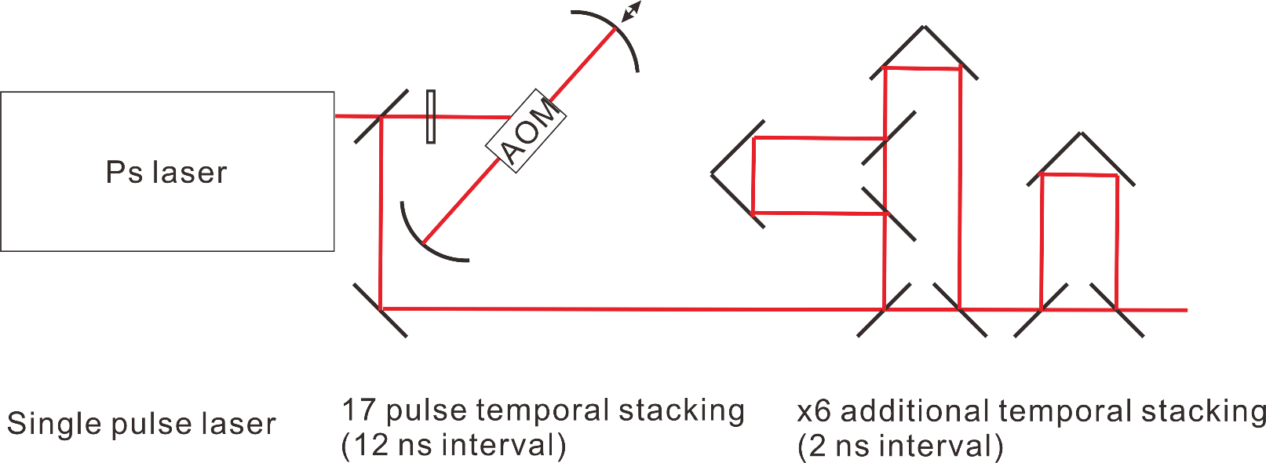
Burst mode, Regen + cavity stacker scheme
Biburst mode, Light Conversion
16

Slide 17
photocathode vs. thermionic gun
 | S-band photocathode | Thermionic (DC or RF)
Emittance | O | ∆
Complexity | ∆ or O with simpler laser | ∆
Clean well defined bunch | O | ∆
Low emittance provides headroom for injection and readiness for the lower emittance storage ring upgrade
Higher QE is preferred, then low power laser is easy to handle, more flexible to bunch patterns
Transform-limited laser pulses ensure the well-defined bunch profile
17

Slide 18
Open question for physicist?
What happened during the one month and with 65ºC → 25ºC ?
18

Slide 19
Thank you!

