Slide 1
LEReC high current experience with alkali cathode
Xiaofeng Gu, Alexei Fedotov, Dmitry Kayran, Jorg Kewisch, Sergei Seletskiy
Brookhaven National Laboratory
Oct 3-5, 2023
Photocathode Physics for Photoinjectors Workshop
Stony Brook University
1

Slide 2
Outline
LEReC and High Current DC gun
The multi-alkali cathode
High-current Experience
Summary
2

Slide 3
1) LEReC Introduction
LEReC is fully operational electron cooler which:
  utilizes RF-accelerated bunched electron beams
  uses non-magnetized electron beam
  stable 24/7 running of high-current electron accelerator and stable cooling of ion bunches was provided over many months of collider operation in 2020 and 2021.
  Contributed a significant luminosity improvement for RHIC operation at low energies
  provided electron beam for some studies which required by the EIC project, such as the cooling studies and high current beam in 2022.
3

Slide 4
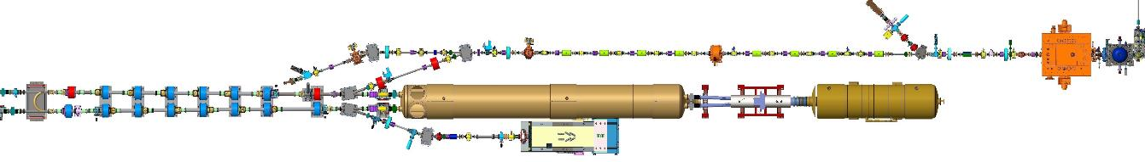


1) LEReC Layout
704 MHz
Cu Deflector Cavity
704 MHz SRF
Booster Cavity
RF Diagnostic Beamline
704 MHz
Cu Cavity
2.1 GHz
Cu Cavity
9 MHz
Cu Cavity
e⁻
e⁻
RHIC TRIPLET
RHIC DX
DC
e⁻ Gun
e⁻
LF solenoid
HF solenoid
Transport solenoid
ERL solenoid
Quad corrector
Trim corrector
Corrector 3.8 ID
Corrector 6.0 ID
BPM 2.4 ID
BPM 4.8 ID
Bellows
Ion pump
180°
Bending
Magnet
High-Power Beam Dump
* NOT to scale
4

Slide 5
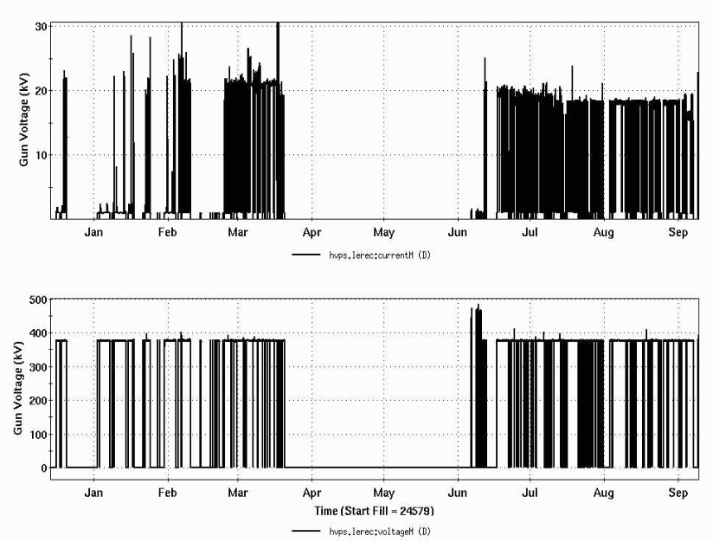
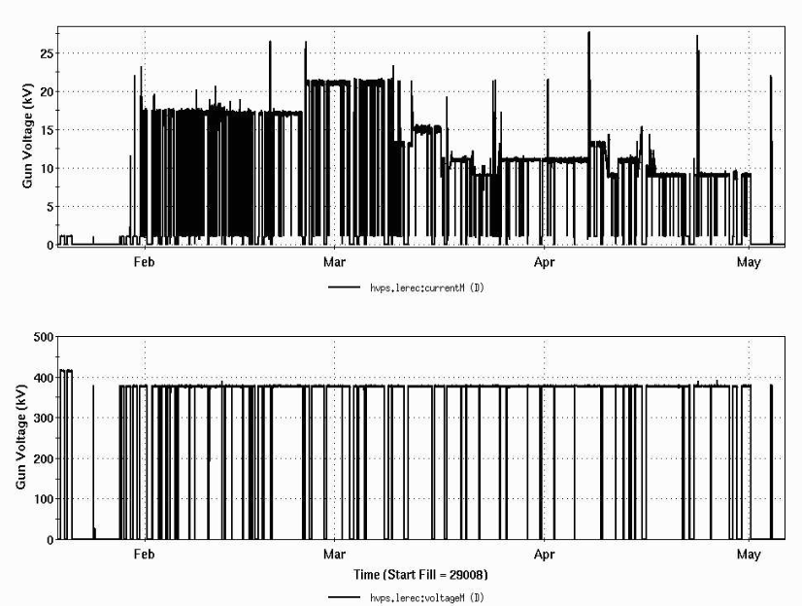
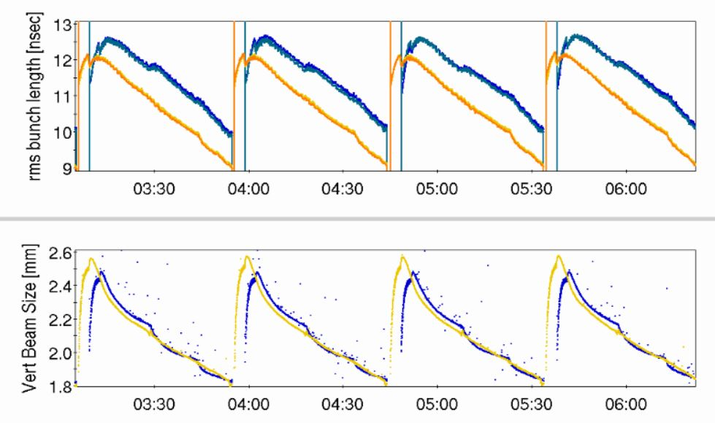
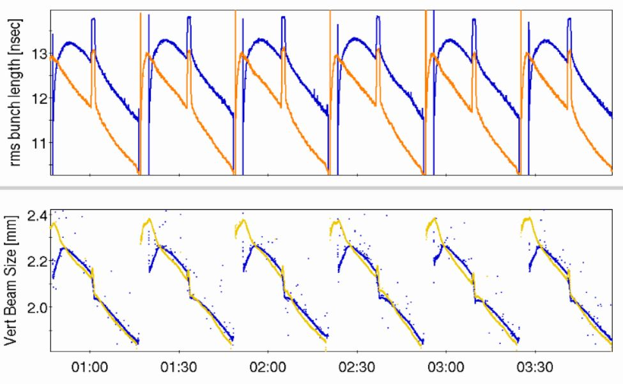
1) Operation Overview
  provided stable 24/7 running of high-current electron accelerator and stable cooling of ion bunches was provided over many months of collider operation in 2020 and 2021.
Current
Voltage
Bunch Length
Beam Size
5

Slide 6
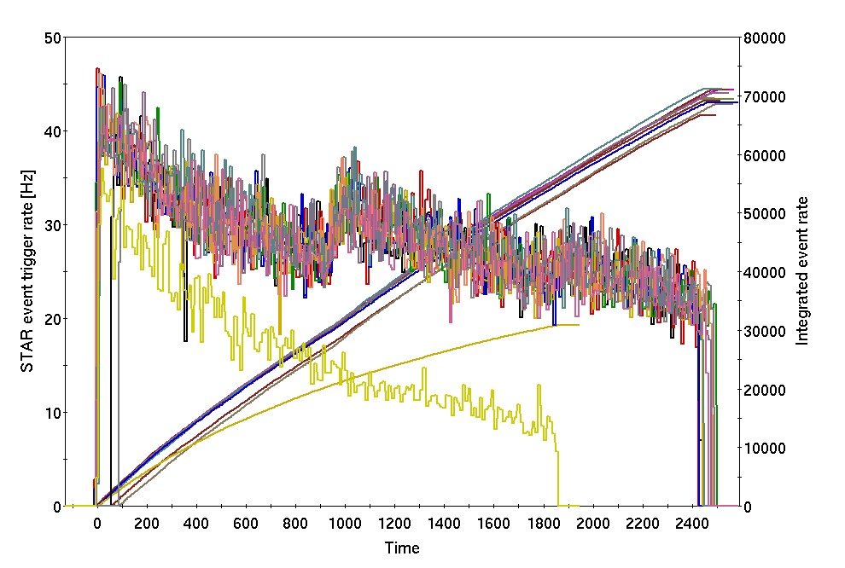
provided significant luminosity improvement for RHIC operation at low energies
Several physics stores at 4.6 GeV/nucleon with cooling (2MeV): vertical axis: events rate [Hz] (left); store integrals (right)
1) RHIC Performance Improvement
With cooling
Without cooling
Time [sec]
Higher initial events rate.
Longer stores with cooling.
Beta* squeeze is possible after the ion beam transverse sizes are cooled.
Gains in integrated luminosity from cooling:
  2020 (4.6 GeV/n): about factor of 2
  2021 (3.85 GeV/n): 30-50%
6

Slide 7
1) LEReC cathode operational experience
Stable 24/7 running of high-current electron accelerator and stable cooling of ion bunches was provided over many months of collider operation in 2020 and 2021.
Reliable operation was ensured by implementation of laser position feedbacks, intensity feedback, energy feedback, automatic cooling section orbit correction and feedback.
Operational optimum electron beam current based on luminosity optimization between cooling and other effects, including ion beam lifetime effects, was: 16-20 mA (using 2 MeV electrons to cool Au ions at 4.6 GeV/n in 2020) and 10-20 mA (using 1.6 MeV to cool Au ions at 3.85 GeV/n in 2021).
Very robust CsK₂Sb photocathodes with initial Quantum Efficiency: 8-9%
Cathode lifetime: 6-10 days
7

Slide 8
1) Stable high-current operation (2018)
No Gun trips
In September 2018, a stable Gun operation at 30mA current was achieved by:
1) 3 kV anode bias to prevent ion back bombardment (without it, the DC gun tripped every 20-30min or so).
2) Using off-center small-area active cathode.
3) Laser feedback, including intensity feedback, RF-laser timing.
8

Slide 9
1) LEReC electron beam parameters
Electron beam requirement for cooling |  |  | Measured*
Kinetic energy, MeV | 1.6* | 2 | 1.6, 2.0
Laser pulse duration, psec | 40 | 40 | 40
Bunch duration in cool. sect, psec | 400 | 400 | 400
Electron bunch (704MHz) charge, pC | 130 | 170 | 50-200
Bunches per macrobunch (9 MHz) | 30 | 30 | 30
Charge in macrobunch, nC | 4 | 5 | 1-6
RMS normalized emittance, um | < 2.5 | < 2.5 | 1.6-2
Average current, mA | 36 | 47 | 14-30
RMS energy spread | < 5e-4 | < 5e-4 | <2e-4
RMS angular spread in cooling section | <150 urad | <150 urad | 100-200 urad
9

Slide 10
Outline
LEReC and High Current DC gun
The multi-alkali cathode
High-current Experience
Summary
10

Slide 11
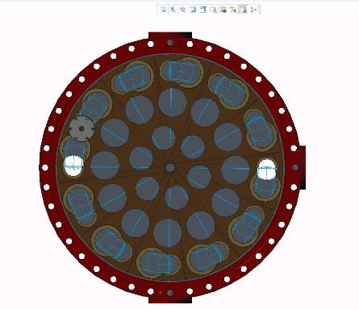
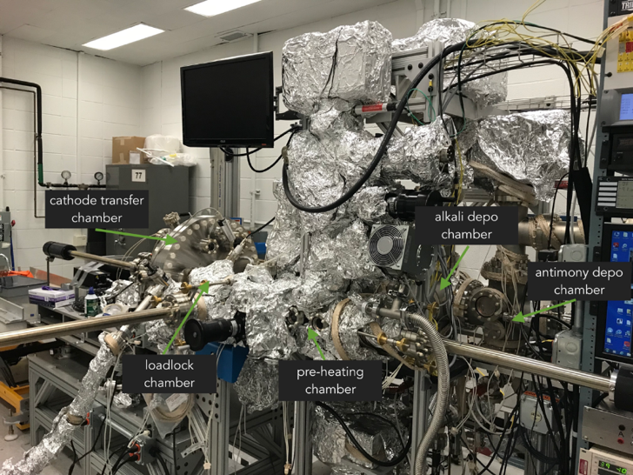
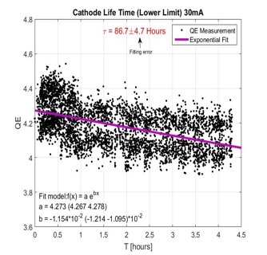
2) Photocathodes production
To support 24/7 operations, cathode production and exchange systems were developed which include two cathode deposition systems, three multi-cathode (up to 12 cathodes) vacuum suites and a mechanism allowing for cathode exchange in RHIC tunnel in about 1 hour.
DC gun with high QE cathodes and stable laser provided reliable beam operation during 2019 – 2021
Off center by 4 mm small active area (6mm), used at the end of 2018 and 2019-2022.
Cathode transfer camera can hold up to 12 cathodes pucks
30 mA beam current
11

Slide 12
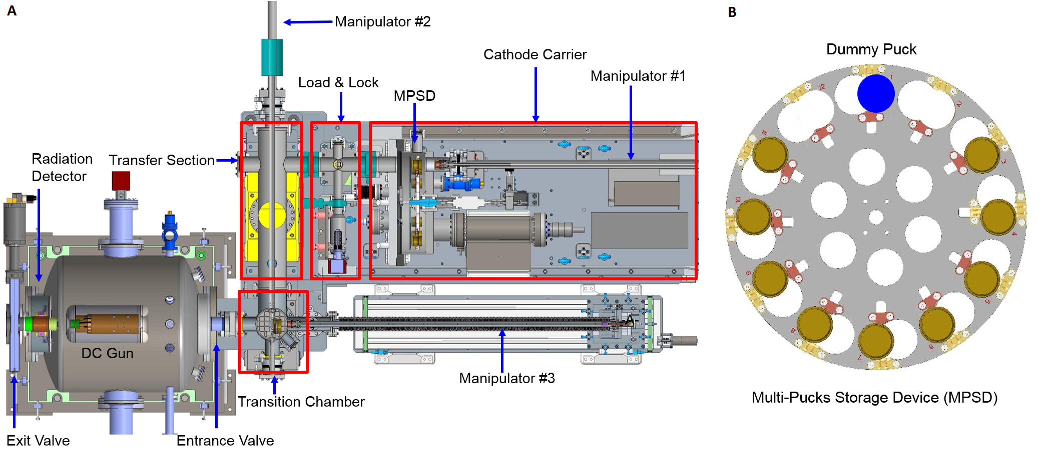
2) Cathode Insertion System
During RHIC operation with cooling, the LEReC machine needs to run continuously with little interruption the physics program.
The cathode lifetime was estimated as low as one day for high current operation. Therefore, the photocathode needs to be exchanged frequently.
To minimize the cathode exchange time, and to ensure that the LEReC electron beam can be continuously operated with little interruption, a rapid cathode puck insertion system (A) including a MPSD (B) were built.
The total time for a cathode exchange is about 45 minutes with total 12 cathodes in the MPSD (B).
12

Slide 13
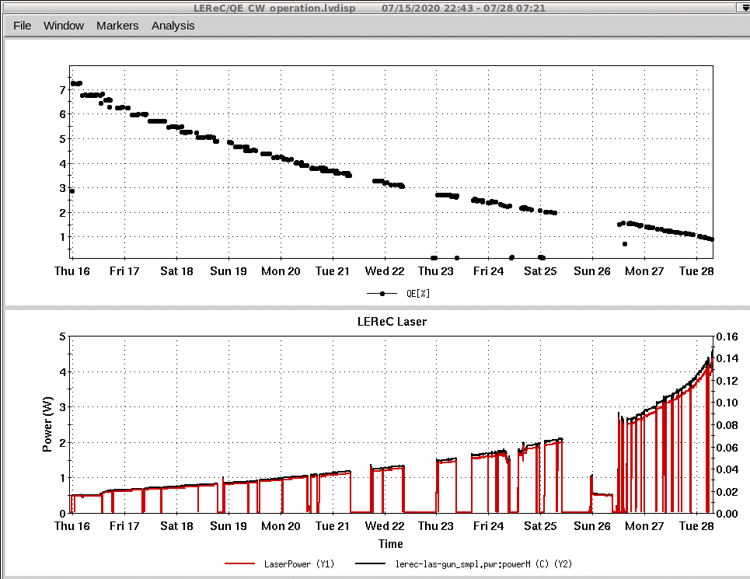
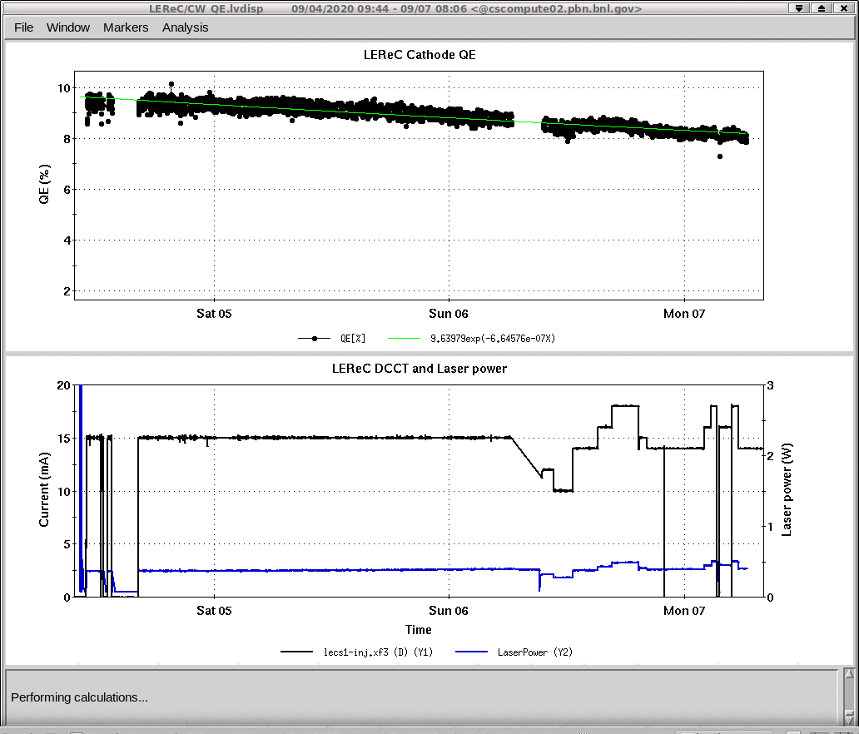
2) Cathode lifetime
Cathode QE from 7% to 1%
Cathode QE: from 9.5% to 8%
12 days
3 days
Laser power 0.5W-4W
Laser power ~0.5W
At low laser power the main suspect of the QE drop is vacuum in the gun
Typical LEReC operation with current scan for luminosity optimization.
Typical cathode exchange: once every 2 weeks

Slide 14
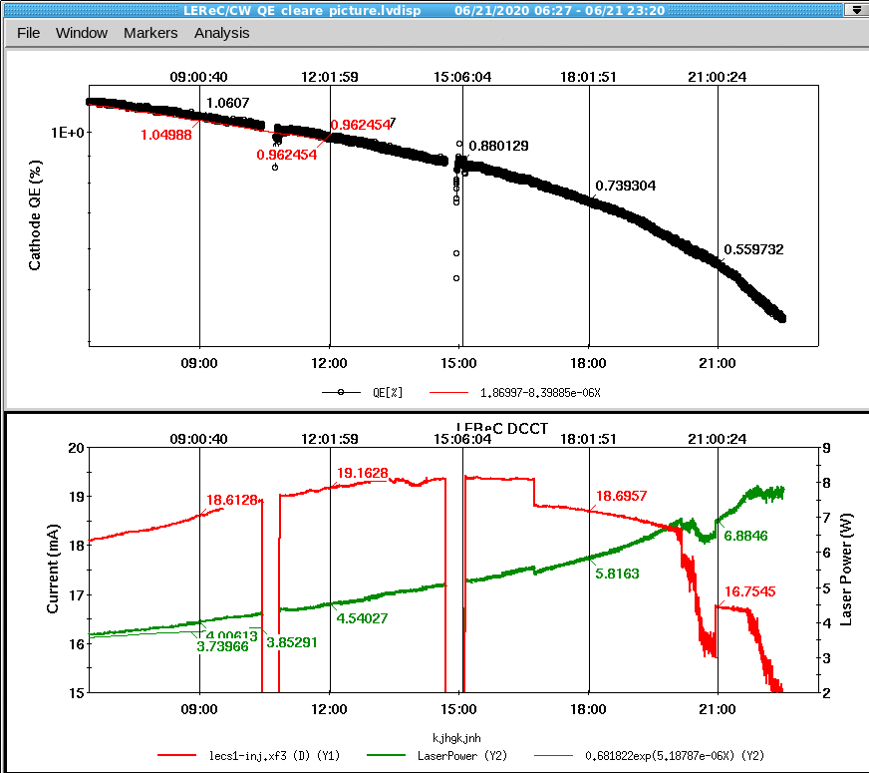
2) Cathode QE with high laser power
Cathode QE lifetime significantly dropped once laser power on the cathode went above 5W.
It could be a result of already low cathode QE (QE<1%). Typically,
cathodes were exchanged once
QE approached 1% level.
More studies of the QE drop at high laser power are planned.
R&D to develop and test
in-gun cathode active cooling system
at Stony Brook University/EIC project has some very promising results.
Cathode QE
Beam current I=16-19 mA
Laser power P=4-8 W
A. Fedotov, May 5, 2022

Slide 15
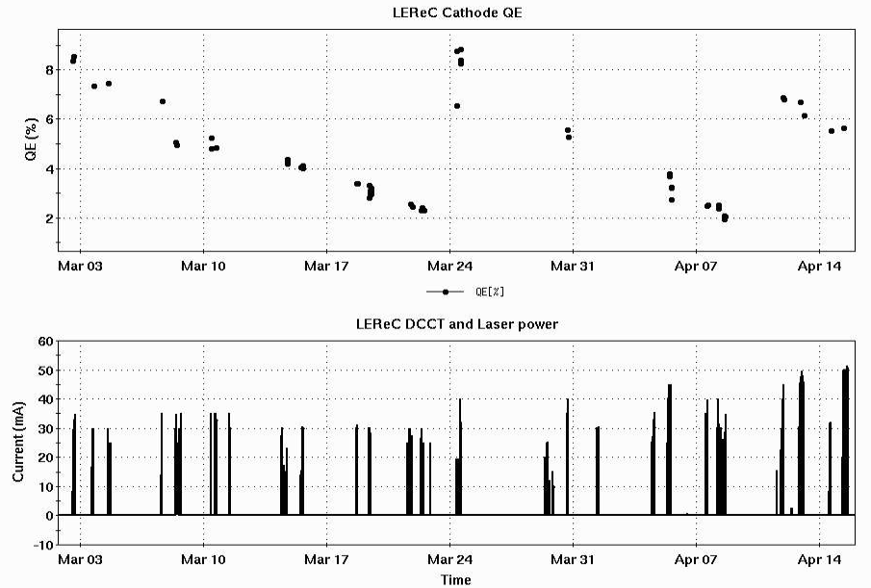
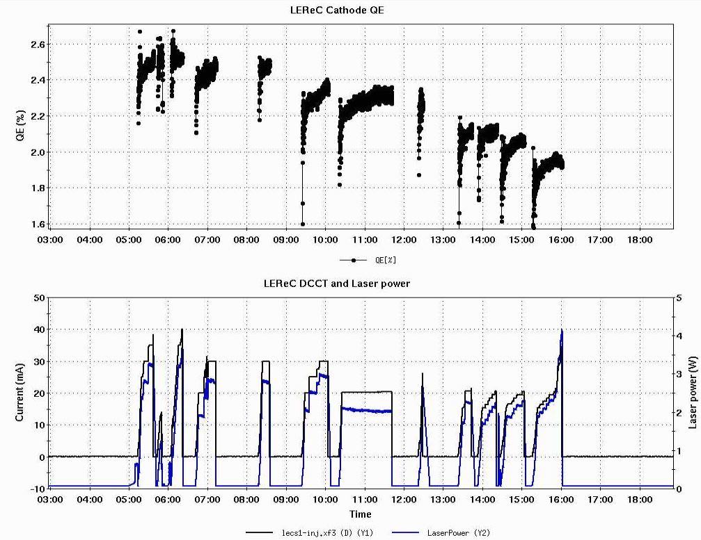
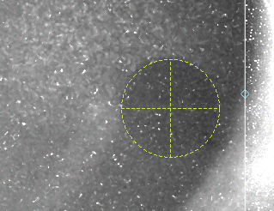
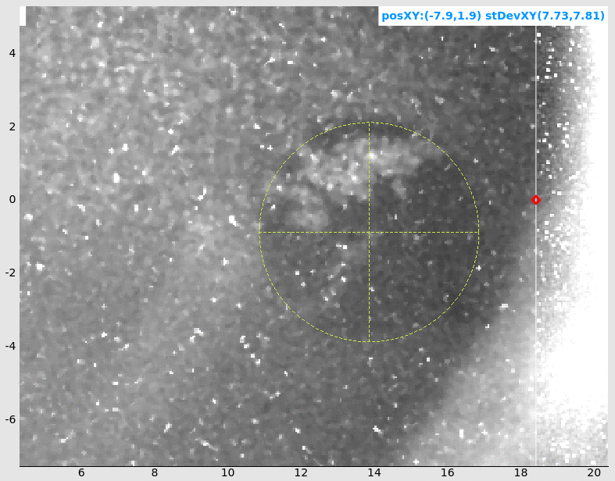
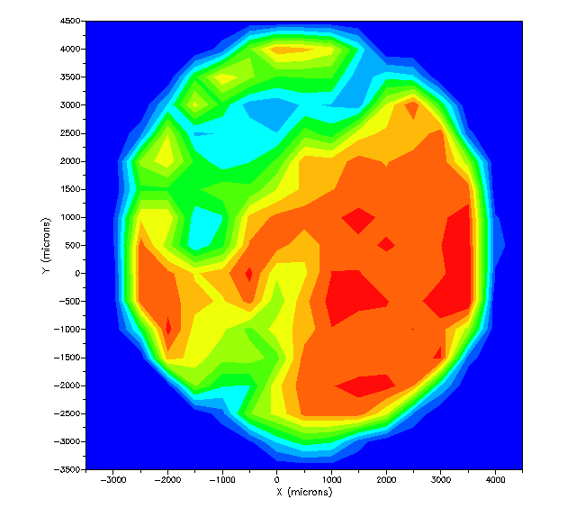
2) QE Drops Because of Gun Trip
Cathode 1 2 3
QE drop
QE degradation.
HVPS Gun Trips
DCCT Current
NO Gun Trips
Several Gun Trips
Arbitrary units

Slide 16
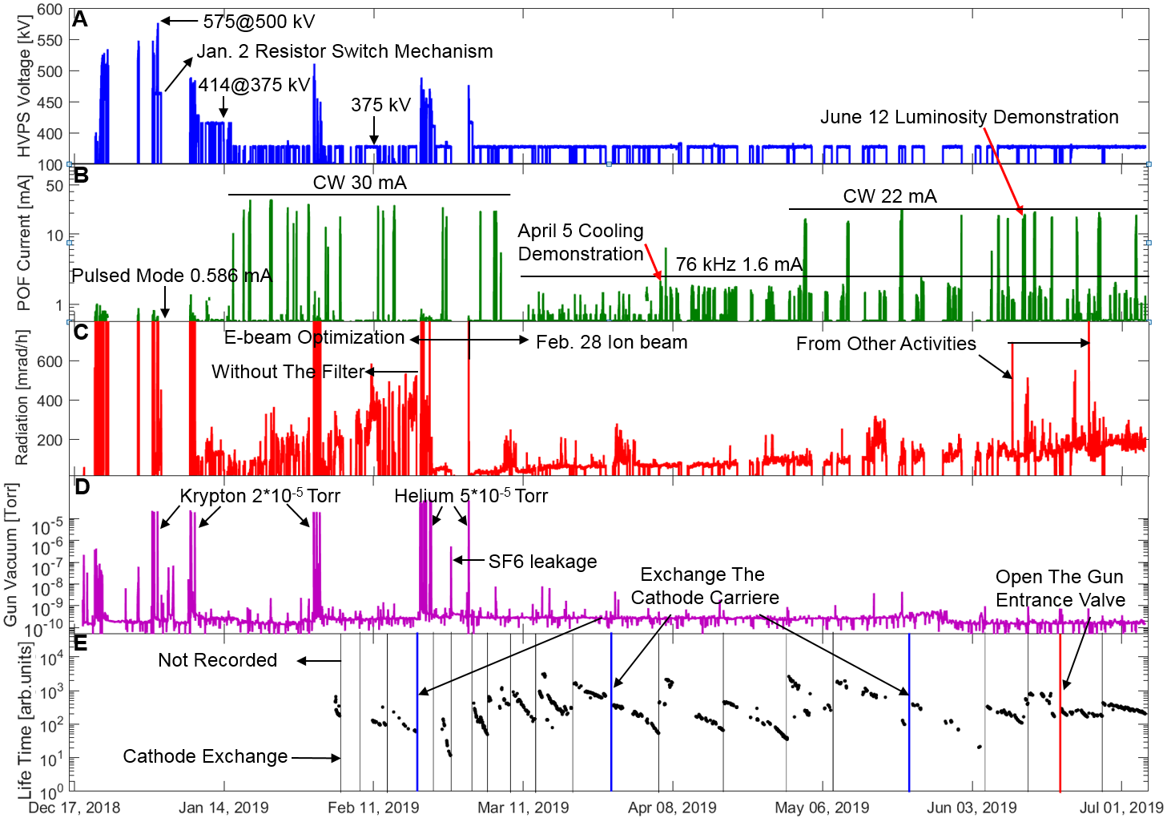
2) Operation Overview in 2019
krypton and the gas filter
The residual Helium/Krypton gas affects the cathode life-time.
16

Slide 17
Outline
LEReC and High Current DC gun
The multi-alkali cathode
High-current Experience
Summary
17

Slide 18
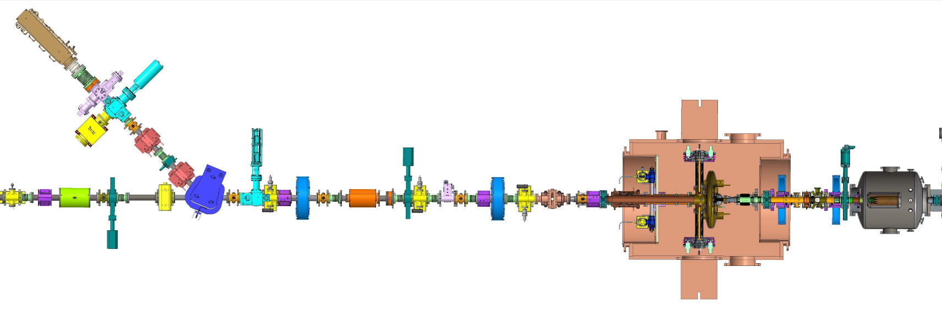
3) The Injection Beam Line
Explore Gun operation at high current in the present LEReC configuration for EIC pre-Cooler:
Running e-beam to high-power beam dump (140kW): requires dedicated RHIC time
Running in parallel to RHIC operations to injection dump (25kW) – limited by dump power
BPM7
BPM6
BPM5
Solenoid
Corrector
Energy Change: BPM7
Bias BPM (5&6): ± 200V
Beam Loss Spiks: PMT(1&2)
DCCT: Smallest Aperture
Temperature Sensors
25kW Dump
Dipole
PMT2
DCCT
2.1GHz Cavity
Booster Cavity
PMT1
DC Gun
7 m
18

Slide 19
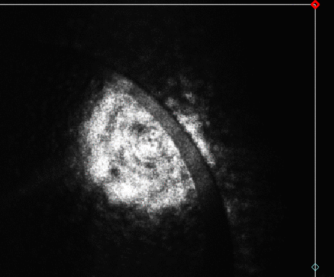
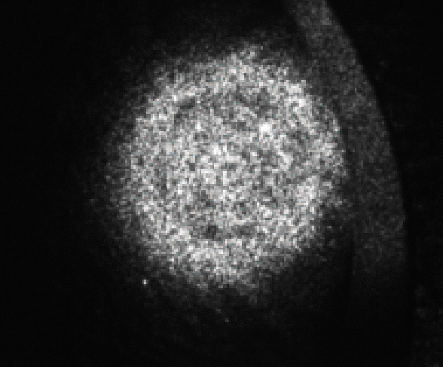
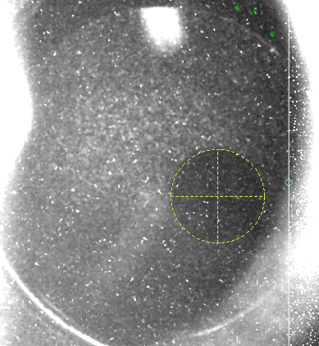
3) The Configuration for High Current
Laser Frequency: 9MHz -> full 704MHz; less space charge effect, focusing on the DC gun.
Laser Micro-Bunch Length: 26ps (40ps or 80ps in the future)
Laser Size: 4 mm -> 3mm (diameter); a better laser propagation from the gun to the gun exit table.
HVPS Voltage: 375kV, 350kV, 320kV; to avoid the possible inverter fault (375kV) and the over-current HVPS fault (350kV).
Booster Cavity: 125kV->165kV; the e-beam energy should be less than 500kV for 50mA, because of the 25kW injection dump.
The offset activated cathode area: 3 mm radius, 4 mm offset.
Anode Bias: 3000 V.
Bias BPM (5&6): ± 200V.
Many experiences from Cornell high current test.
The laser image on the exit table.
4mm
3mm

Slide 20
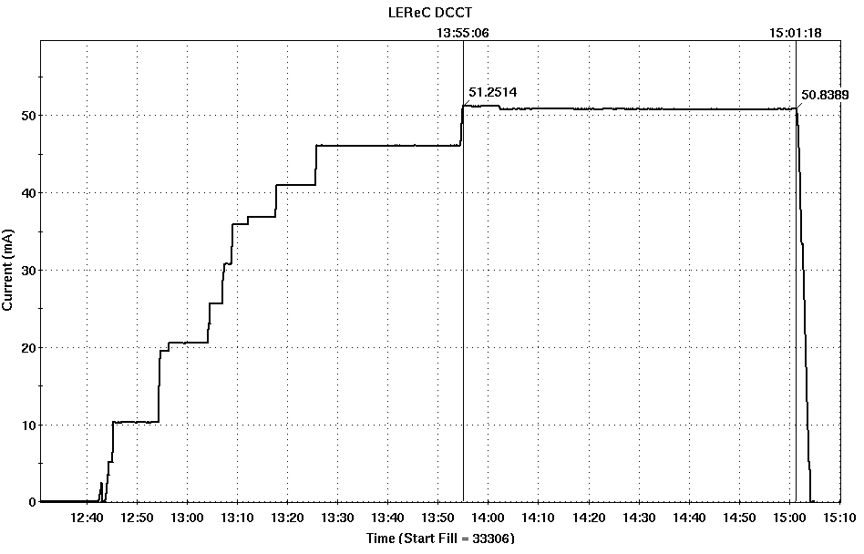
3) Higher Current Test
320kV: if the HVPS Faults are not caused by the voltage, could try 350kV later.
66 minutes: The current was ramped down prior to next polarization measurements in RHIC which typically results in high losses in the location of the Gun.
50 mA: limited by the injection dump power (25kW);
66 minutes
Ramp down

Slide 21
4) Summary
A state-of-the-art electron accelerator was built, commissioned and successfully provided stable high-current high-quality beam for electron cooling, which helped with luminosity improvement during RHIC operations.
The DC gun provided high-current electron beam during 24/7 RHIC operations in 2020-2021. Present and future focus is on dedicated electron cooling experiments and high current R&D.
A very robust CsK₂Sb photocathode with initial QE of 8-9% and Cathode lifetime of ~10 days make these possible.
4. Cathode lifetime is driven by the vacuum in the Gun. And our gun vacuum was 1E-10 Torr level, didn’t reach 1E-11 level.
21

Slide 22
Acknowledgement
LEReC success would not be possible without team effort and expertise of many people from the BNL and Cornell University.
Thank you!
22

Slide 23
Recent LEReC peer-review publications
A. Fedotov et al., ” Experimental demonstration of hadron beam cooling using radio-frequency accelerated electron bunches”, Physical Review Letters 124, 084801 (2020).
D. Kayran et al., ” High-brightness electron beams for linac-based bunched beam electron cooling”, Phys. Rev. Accel. Beams 23, 021003 (2020).
S. Seletskiy et al., ” Accurate setting of electron energy for demonstration of first hadron beam cooling with rf-accelerated electron bunches”, Phys. Rev. Accel. Beams 21, 111004 (2019).
X. Gu et al., ”Stable operation of a high-voltage high-current dc photoemission gun for the bunched beam electron cooler in RHIC”, Phys. Rev. Accel. Beams 23, 013401 (2020).
H. Zhao et al., ”Cooling simulation and experimental benchmarking for an rf-based electron cooler”, Phys. Rev. Accel. Beams 23, 074201 (2020).
S. Seletskiy et al., ”Obtaining transverse cooling with non-magnetized electron beam”, Phys. Rev. Accel. Beams 23, 110101 (2020).
C. Liu et al., “Gold-gold luminosity increase in RHIC for a beam energy scan with colliding beam energies extending below the nominal injection energy”, Phys. Rev. Accel. Beams, vol. 25, 051001 (2022).
23

Slide 24
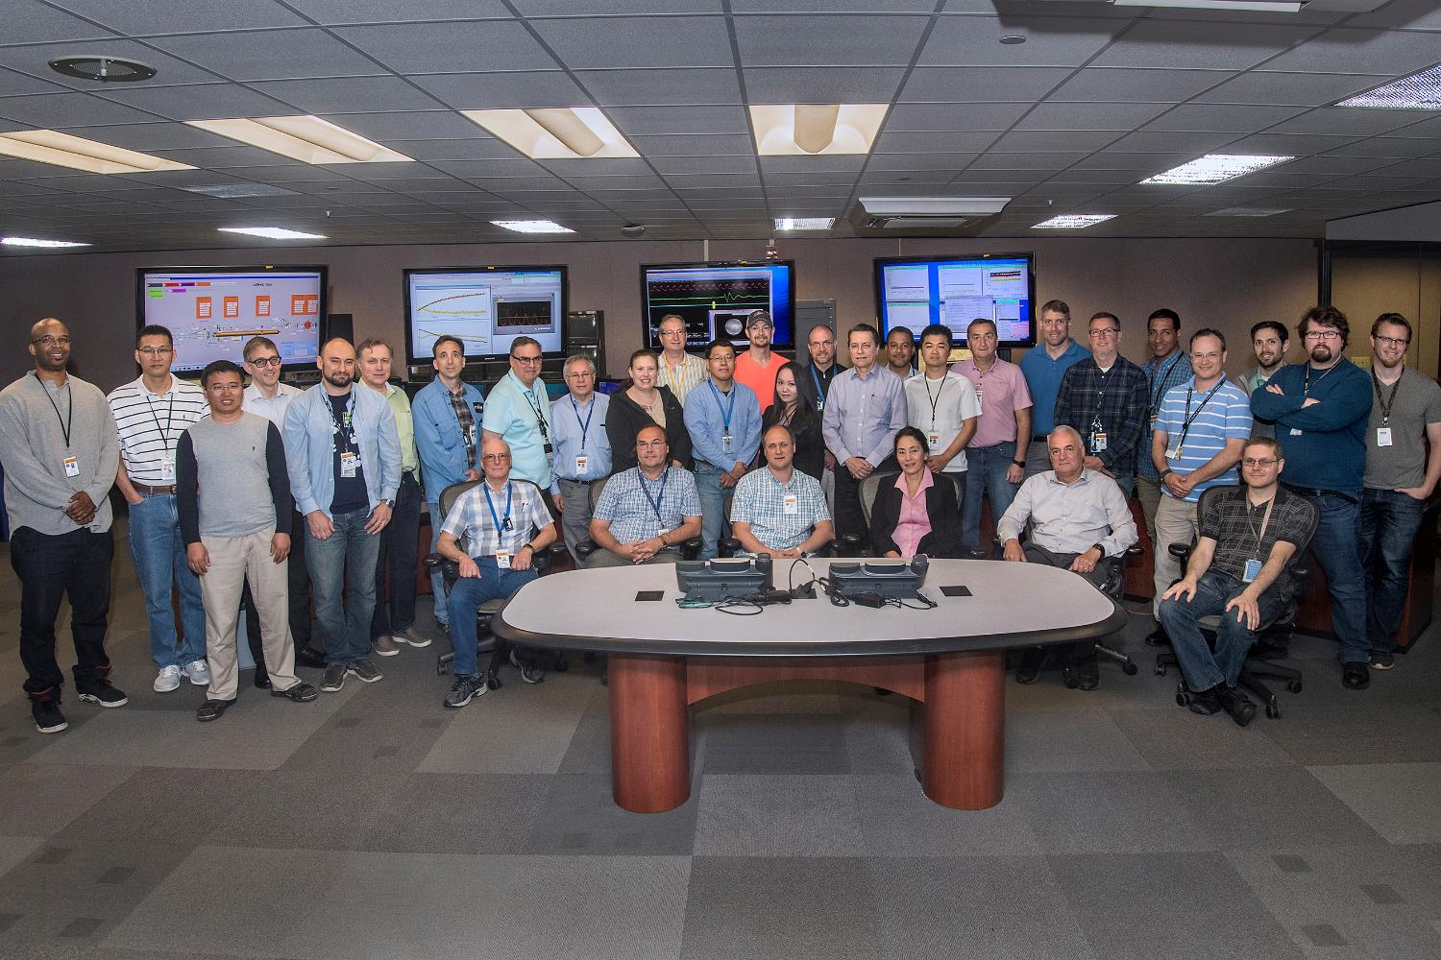
LEReC team
https://www.bnl.gov/newsroom/news.php?a=215585
24

