Slide 1
Potential applications and requirements of photoelectron sources for metrology
Gil Delgado
VP of Adv Tech

Slide 2

Nova is a leading innovator and a key provider of metrology solutions for advanced process control used in semiconductor manufacturing

Slide 3

1993 | Date Founded | Dually Traded
>1100 | Employees
Presence | Israel HQ , Global Offices
KEY Facts
>5000 | Active Systems
>200 | Customer Sites
R&D | Israel, USA, Germany

Slide 4
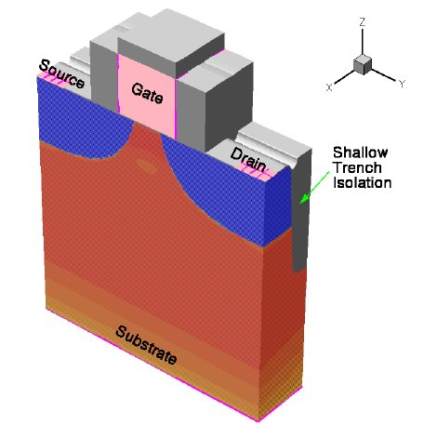
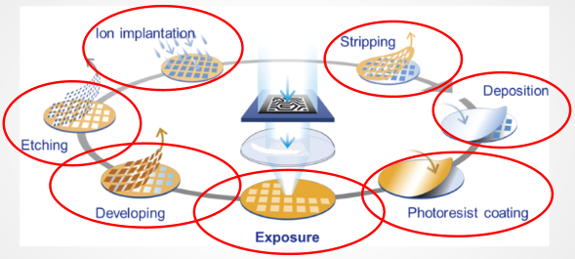
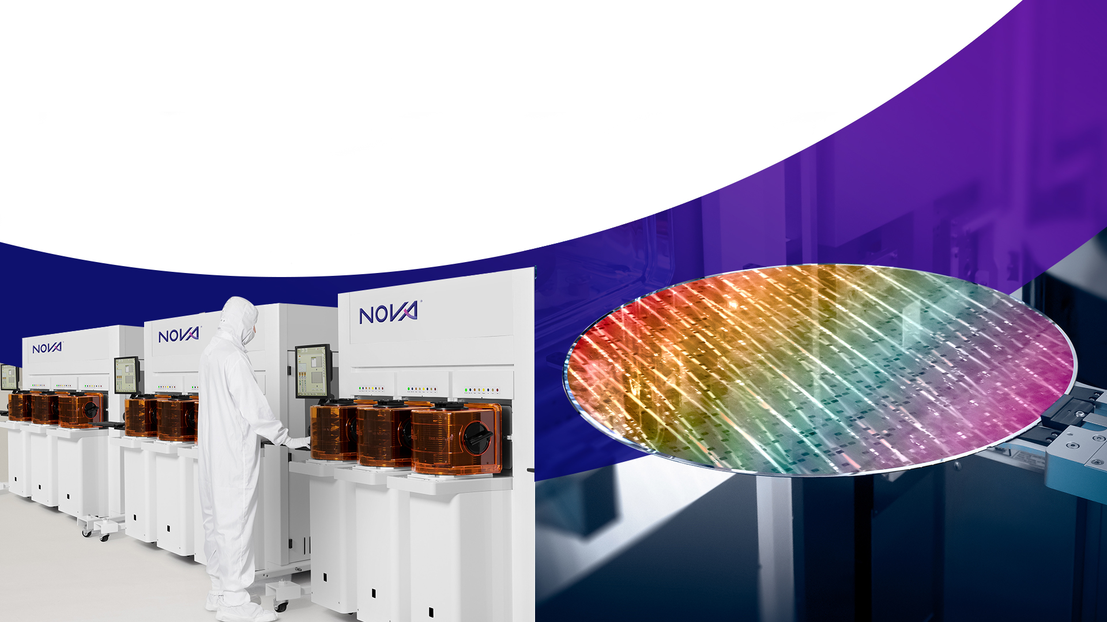
Semiconductor Process
Current chip manufacturing:
Over 1,000 process steps are needed to make transistors and connections! Ideally you want to monitor every step.
Specialized materials and processes use
up to 62 different elements
Front End of Line
etch
dev
Litho
etch
dep
etch
dep
CMP

Slide 5
Importance of Inline Process Control
Wafer metrology tools are used to carefully control the film properties, dimensions, and potential defect levels in order to optimize the manufacturing process of these devices. Using lab tools can take a long time to resolve issues.
~ 100,000, 300 mm wafers per month are produced by an advanced fab
Cost of a single wafer for standard process ~ $15,000
$ 15,000 X 100,000 = $1.5 B
Cost per wafer x Wafers per month
Process Control:
Metrology
is essential for Chip Manufacturing success

Slide 6
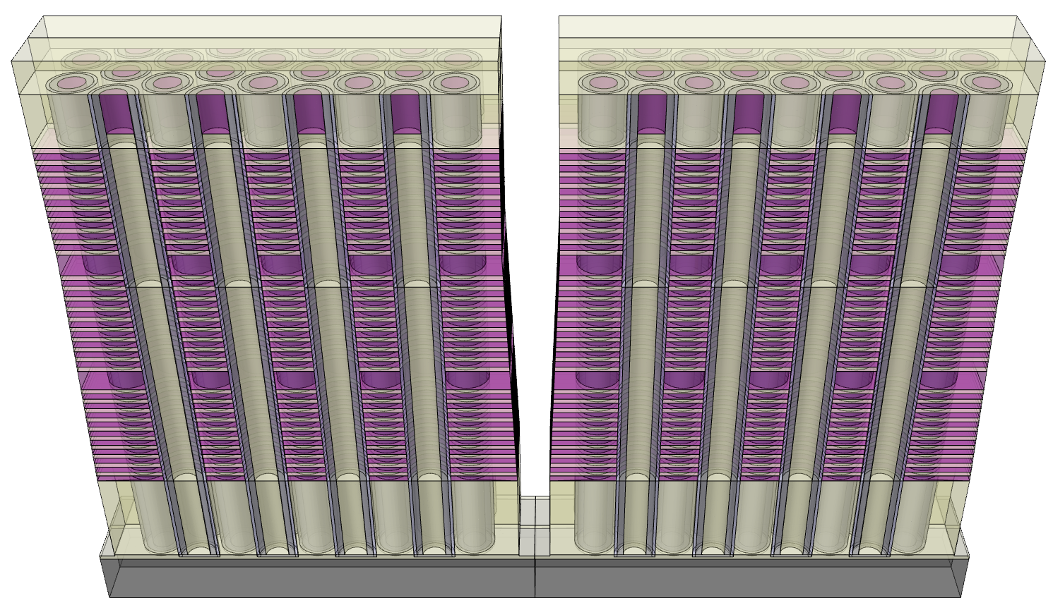
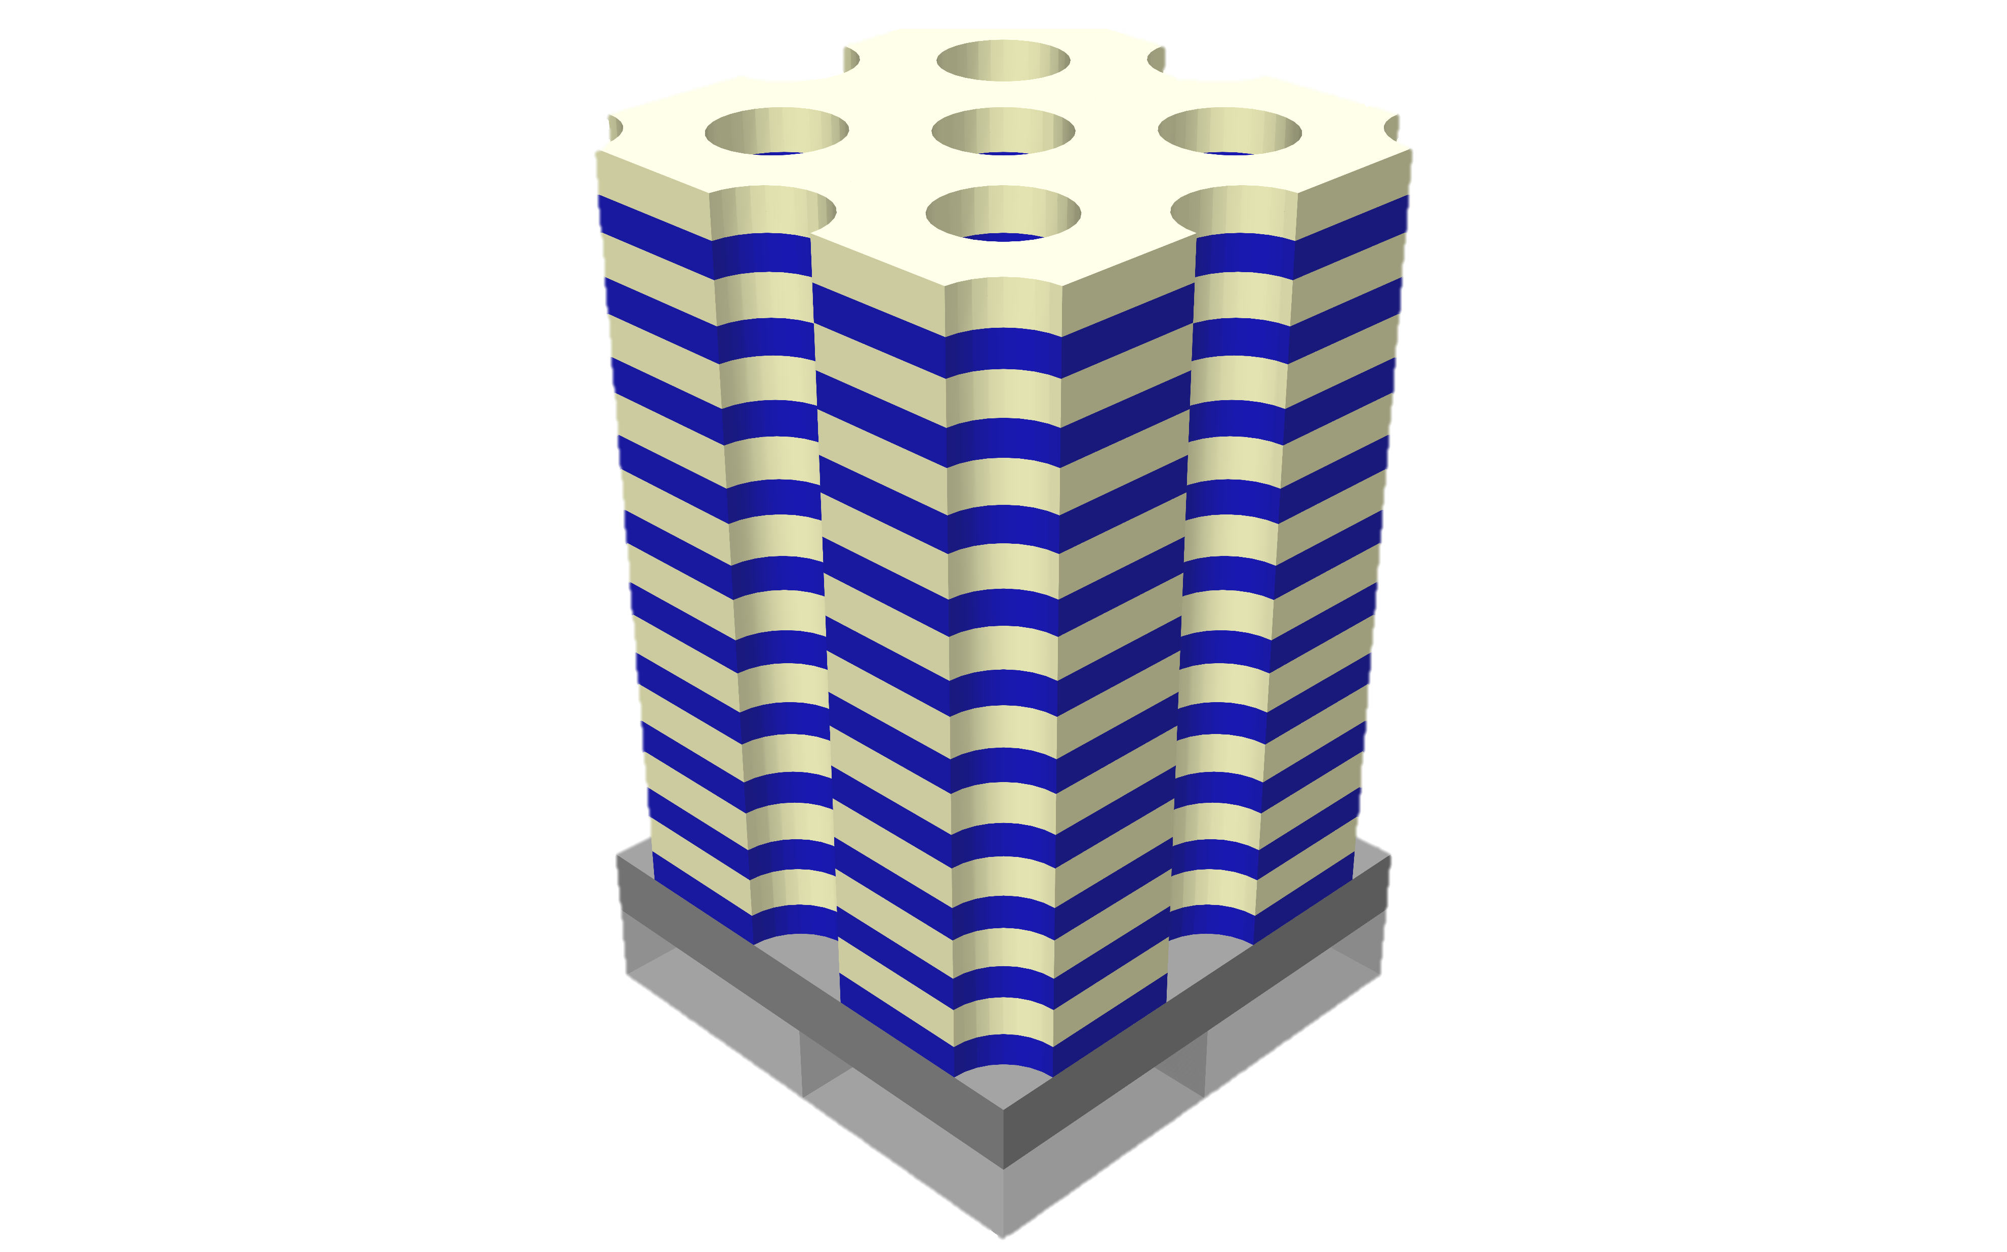

Memory –
3D NAND Process Challenges
3D NAND
Single Deck
Triple Deck
Overlay
5
Dimensional
Full profile – per deck and in total
Logic under Memory cell
Bottom parameters
Tiers and liner thickness
Tilt and Overlay between decks
3
Slit
TCD
> 400 Tiers
> 20um thickness
Logic under Memory
7,8,9
1
Slit
MCD
4
6
Slit
BCD
3
3
2
Material
Dielectric composition & thickness control
Channel Poly Si crystallinity & grain size
Channel sidewall
Chemical residues
Stress management
From Single Deck to Multi Deck

Slide 7
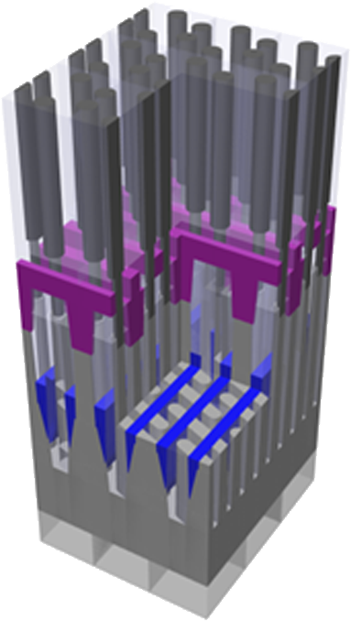
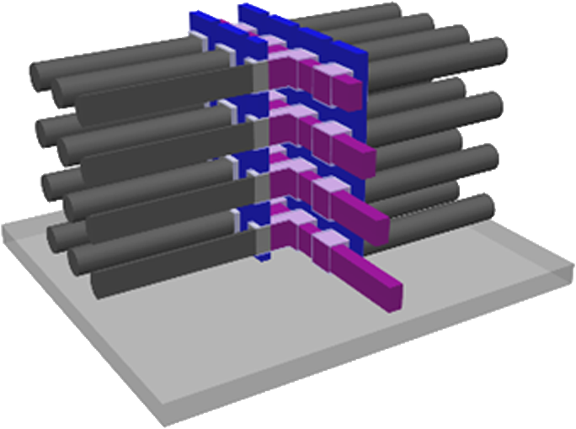
Memory –
3D DRAM Process Challenges
3D DRAM
2D DRAM
2D scaling is not enough
Move to 3D DRAM-
Same path as NAND
1,3
1,6
Capacitor
Dimensional
High-Aspect Ratio
capacitor holes & supporters
Bottom gate parameters
Tight contact holes
Lateral selective etches
for thinner capacitors
Bit Line
Word Line
4
2
5,6,7
Material
Dielectric composition & thickness control
Higher dielectric constants
Material residues
Moving from 2D DRAM to 3D DRAM

Slide 8
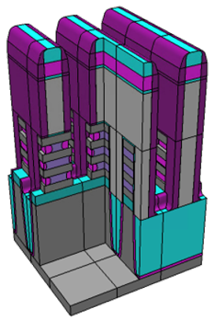
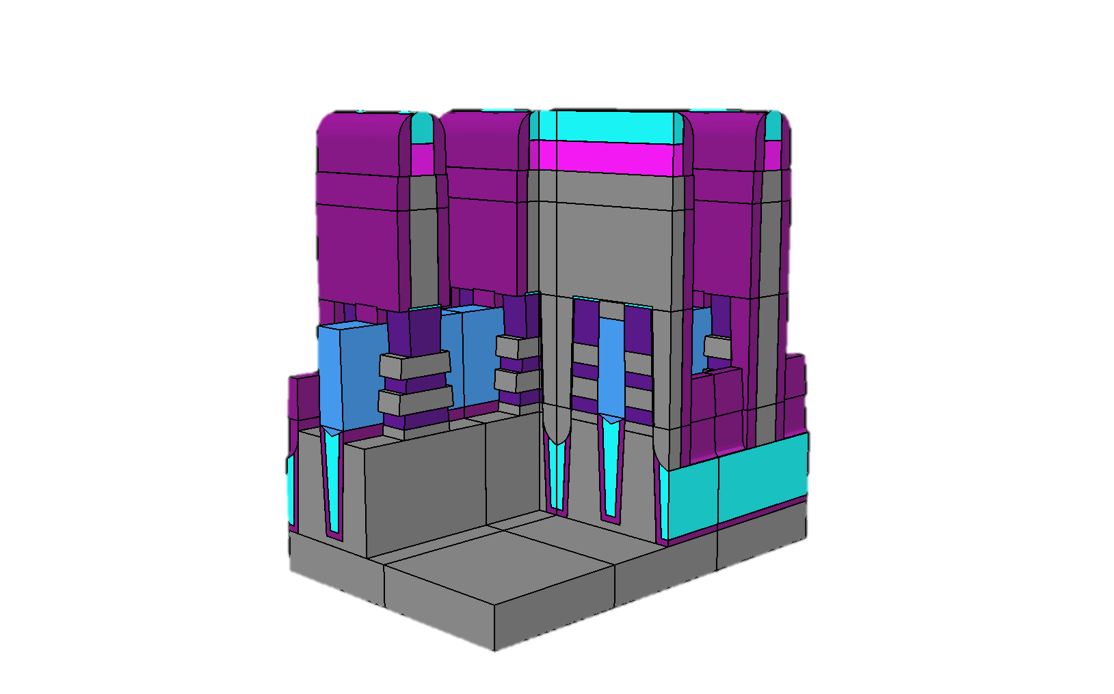
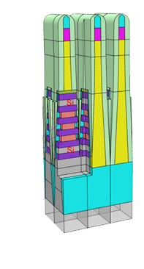
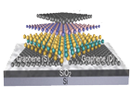
Logic Architecture - Process Challenges
Logic Architecture Evolution – Increased Complexity
Nanosheet
Forksheet
Complementary FET
2D Materials
<10nm
4
Dimensional
Multiple nanosheets – shapes, spacing & thickness
Thin deposition surrounding nanosheets
Buried structures
Local topography variations
1,2,5,6,7
3
Adding a dielectric wall between NFet and PFet
True 3D
NFet over PFet
2D Atomic Channel
Material
Si / SiGe uniformity
SiGe residues
Stress & strain on multiple nanosheets
Doping control
Growing dimensional and material complexity
Source: Nova, American Chemical Society

Slide 9
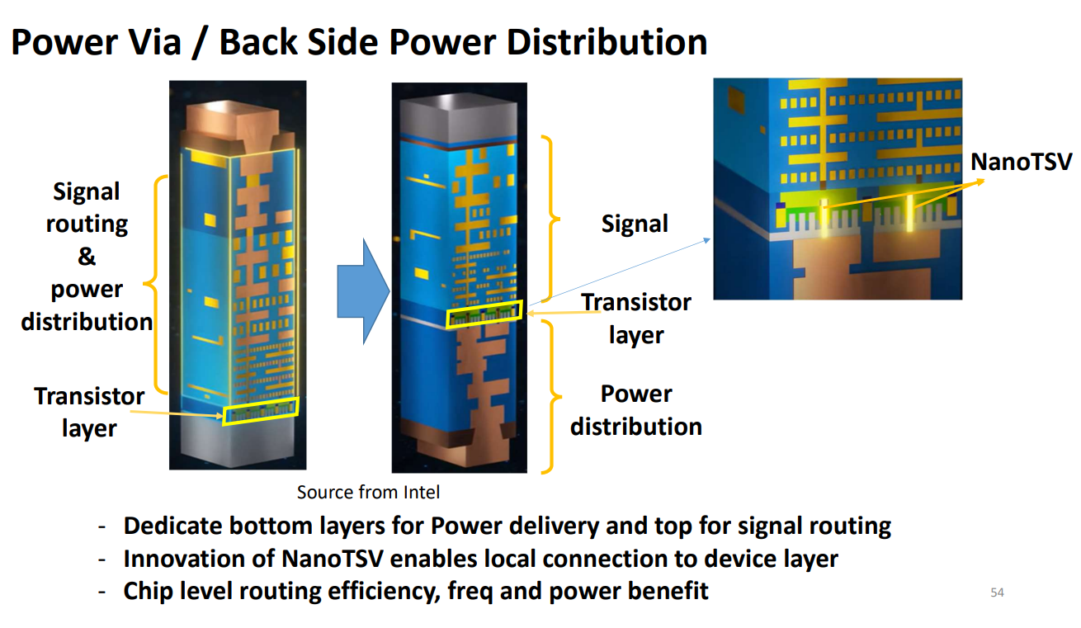
Interconnect - Process Challenges
New Architecture
Backside Power Delivery Network & Hybrid-Bonding with Nano-TSVs
7,8
Dimensional
HAR Cu nano-TSV profile control
Topography for Wafer-to-Wafer bonding
Voids & Delamination
Surface roughness
1,3,5
Material
Via Pitch and CD too narrow for plated copper
Cobalt etch - Single damascene
Cu fill - Buried Power Rails
Cu, Ru & Co interconnects plating
2,4
New architectures are also being adapted in the Back-End or interconnect of wafer manufacturing.
Source: Intel

Slide 10
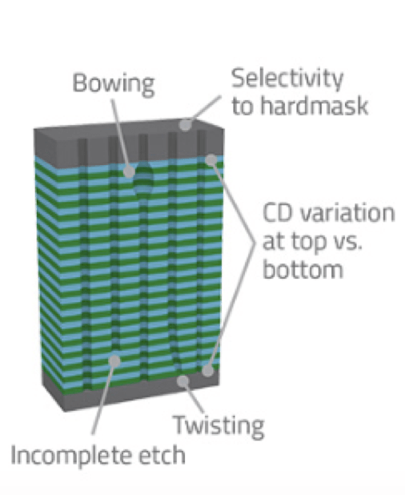
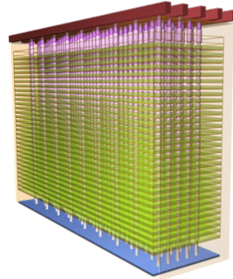
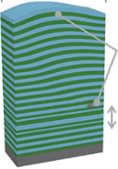
Smaller Dimensions, and Depth Pitch Pose Challenges in For Metrology
Some Examples:
1) 3D NAND
Impact of defects magnified
Non uniform layers
Metrology technologies need to have depth and sensitivity to these
small defects
Source: https://semiengineering.com/3d-nand-flash-wars-begin/

Slide 11
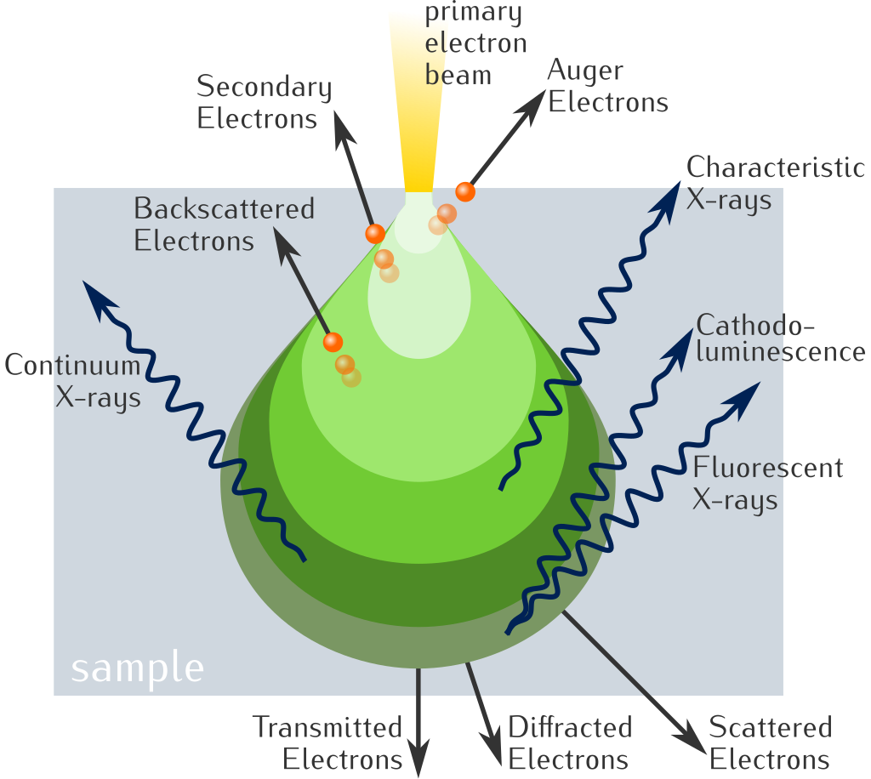
Electron Beams Have Many Capabilities to Address Many of The Needs For Metrology and Inspection
Electron penetration depth->LE
~ 10’s um
Depending on
LE and material
Adapted from Wikipedia

Slide 12
Electron Beams Have Many Capabilities to Address Many of the Needs For Metrology and Inspection
Auger Electrons
Surface Sensitive
Compositional Info
Secondary electrons
Good for topographic imaging
Backscattered electrons
Atomic Number and topography info
X-rays
Film analysis
Thickness and composition
Cathodoluminescence
Electrical Info
X-rays Fluorescence
Film analysis
Thickness and composition
Topographic 3D Imagining
Adapted from Wikipedia

Slide 13
Smaller Dimensions, and Depth Pitch Pose Challenges in For Metrology
Example 2: TSVs (Through-silicon vias )
TSVs are vertical interconnects that enable 3D stacking and integration of chips. They allow high-density interconnections between stacked chips.
Important Metrology of TSVs: Geometry (diameter, depth, sidewall angle), defects (voids, incomplete filling), and insulating liner integrity.
As TSV dimensions continue to shrink, new and improved metrology/tools are needed to ensure reliability and enable further 3D integration
Open defect between TSV and metal via
Open defect between bump and upper die
Short between fine
Void formation in TSV
E-beam have the resolution and penetration depth for TSVs metrology
Photocathodes can be an important technology for TSVs metrology
Source: Jacobs et al, 2020_IEEE TRANSACTIONS ON COMPONENTS, PACKAGING AND MANUFACTURING TECHNOLOGY, VOL. 10, NO. 9, SEPTEMBER 2020
J. Wang Applied Sciences Volume 13 Issue 14 10.3390/app13148301

Slide 14
Smaller Dimensions, and Depth Pitch Pose Challenges in For Metrology
Example 3: TSVs
TSV dielectric defects can generate leakage current between TSV and substrate (i.e., short defects). These short defects can be detected and localized by sensing the electron-induced TSV current.
Ebeams have depth and resolution for these small structures.
Figure shows the schematics of a 3-D SoC chip with two silicon wafers
Electron beams can generate in-situ electrical beam-induced current that can be used to localize dielectric shorts between TSV and substrate
Source: Jacobs et al, 2020_IEEE TRANSACTIONS ON COMPONENTS, PACKAGING AND MANUFACTURING TECHNOLOGY, VOL. 10, NO. 9, SEPTEMBER 2020
J. Wang Applied Sciences Volume 13 Issue 14 10.3390/app13148301

Slide 15
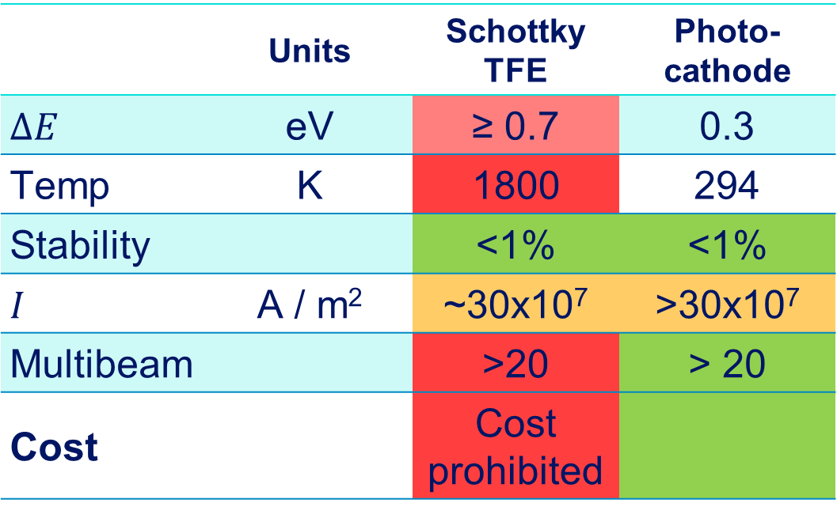
E-Beam Source Requirements for Metrology
Electron Source
  Energy Spread < 0.3 eV
  High Brightness > 10⁸A / (V m² sr)
  Focus to high current densities
  Spot Size: <100 nm²
    (or smaller for in device testing)
  Stability: <1%
  Long Lifetime
 | Units | Schottky TFE | Photo-cathode
$$∆E$$ | eV | ≥ 0.7 | 0.3
Temp | K | 1800 | 294
Stability |  | <1% | <1%
$$I$$ | A / m² | ~30x10⁷ | >30x10⁷
Multibeam |  | >20 | > 20
Cost |  | Cost prohibited
Photocathodes have some clear advantages over state-of-the-art electron sources.

Slide 16
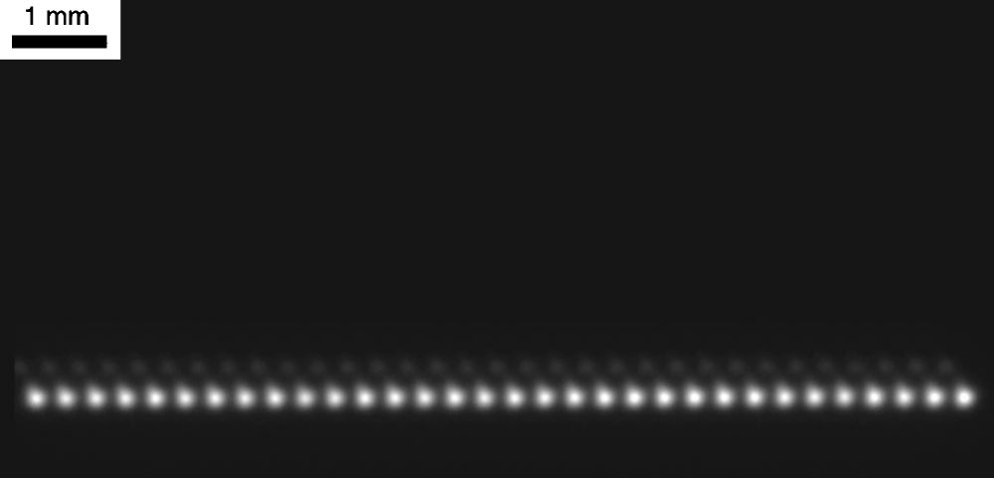
Multibeam Photocathode System can address throughput issues
Example: Etec Systems
Generated a linear array of 32 ebeams
Produced 86 nm spots
Long term stability: 1%
Energy Spread < 0.3 eV
1 mm
Prototype raster multibeam lithography tool
S. T. Coyle, J. Maldonado, et al, Journal of Vacuum Science & Technology B 20, 2657 (2002)
Ebeams were magnified and focused onto a YAG screen.
Today photocathodes with high-end electron optics can focus e-beam to spot size < 10 nm
Photocathodes can become an important technology for semiconductor metrology.

Slide 17
Metrology Future Needs
Conventional metrology is challenged to characterize the tiny features, dimensions and material composition with the required sensitivity.
Lab metrology is slow, expensive, and, often destructive. Fabs need inline metrology systems
As device structures become more complicated and require more process steps, process control becomes more critical.
  Many critical defects and metrology needs can not be addressed by optical means regardless of inspection time
  Electron beam inspection and metrology is expected to become an important part of the metrology process control
  Electron beam source technology is a limiting factor for adoption

