Slide 1
Optical Near Field Electron Microscopy
John Smedley, SLAC
Guido Stam, ULEI
Sense Jan van der Molen, ULEI

Slide 2
ONEM Goal
Optical microscopy with significantly sub wavelength resolution
Eventually fast enought to observe biological dynamics
Key inovation:
Convert scattered photons into electrons in the optical near-field
Resolution is limited by the sample to electon emitting surface distance -> need ultra-thin photocathodes!
Phys. Rev. Applied 16, 014008 (2021)

Slide 3
Timeline ONEM
ONEM
Install liquid cell
Dynamic measurements
ONEM
No liquid cell
Optical module installation
Low-workfunction (Graphene-Cs)
Growth and QE measurement set up
First image (nanostructure)
Image biostructure
Optimize resolution
Polarization control
UV-ONEM
First image (nanostructure)
Signal improvement
Bio sample
BIPEEM
Backilluminated PEEM
https://doi.org/10.1016/j.ultramic.2023.113809

Slide 4
Positioning ONEM in LEEM
Aberration correction

Slide 5
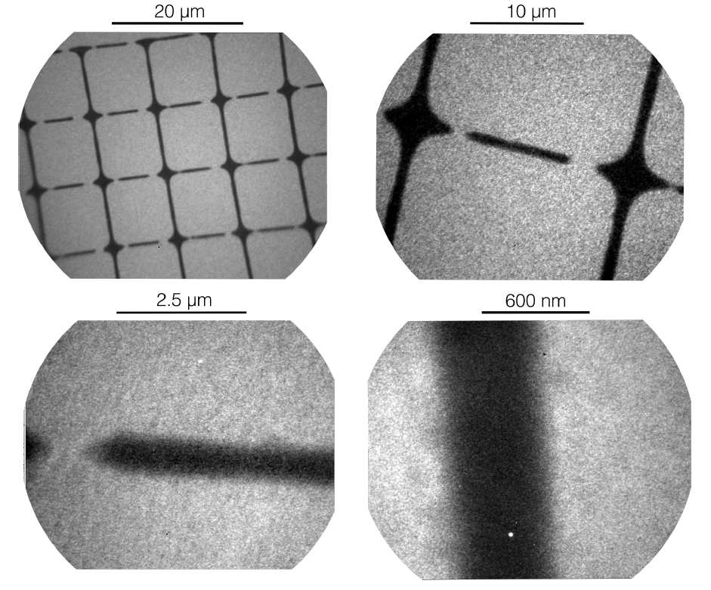

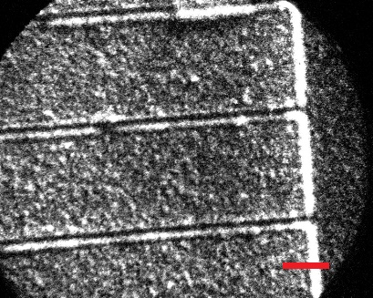
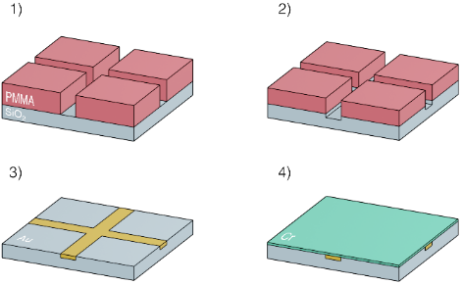
UV-ONEM using LED (275 nm)
1) Create embedded Au nanostructures
ONEM Proof of Principle!
e⁻
Ar⁺
Field of view: 150 μm
Scale bar: 500 nm
2) Cover with photocathode layer:
Chromium
Illumination time: 10-35 min.
Estimated resolution: 37 nm = λ/7

Slide 6
Vis-ONEM using laser (450 nm)
1) Create embedded Au nanostructures
First visible-light ONEM!
e⁻
Field of view: 150 μm
Scale bar: 500 nm
Ar⁺
Illumination time: 8 s
Estimated resolution: 55 nm = λ/8
(NB photocathode thickness ≈ 25 nm)
2) Cover with photocathode layer:
(amorphous) Carbon + Cs

Slide 7
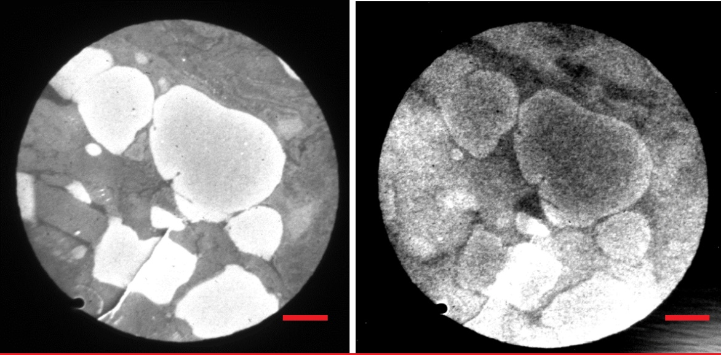
ONEM on biosamples
(Mouse tail slice)
PEEM signal (left) UV ONEM signal (right).
hv
Large field of view: scale bar is 20 microns
hv

Slide 8
ONEM on biosamples
(Mouse tail slice)
PEEM signal (left) blue light ONEM signal (right)
Field of view: 45 μm
Notes:
Right: Speckles from unwanted reflection of electron lens

Slide 9

Growing photocathodes
@Brookhaven National Lab

Slide 10
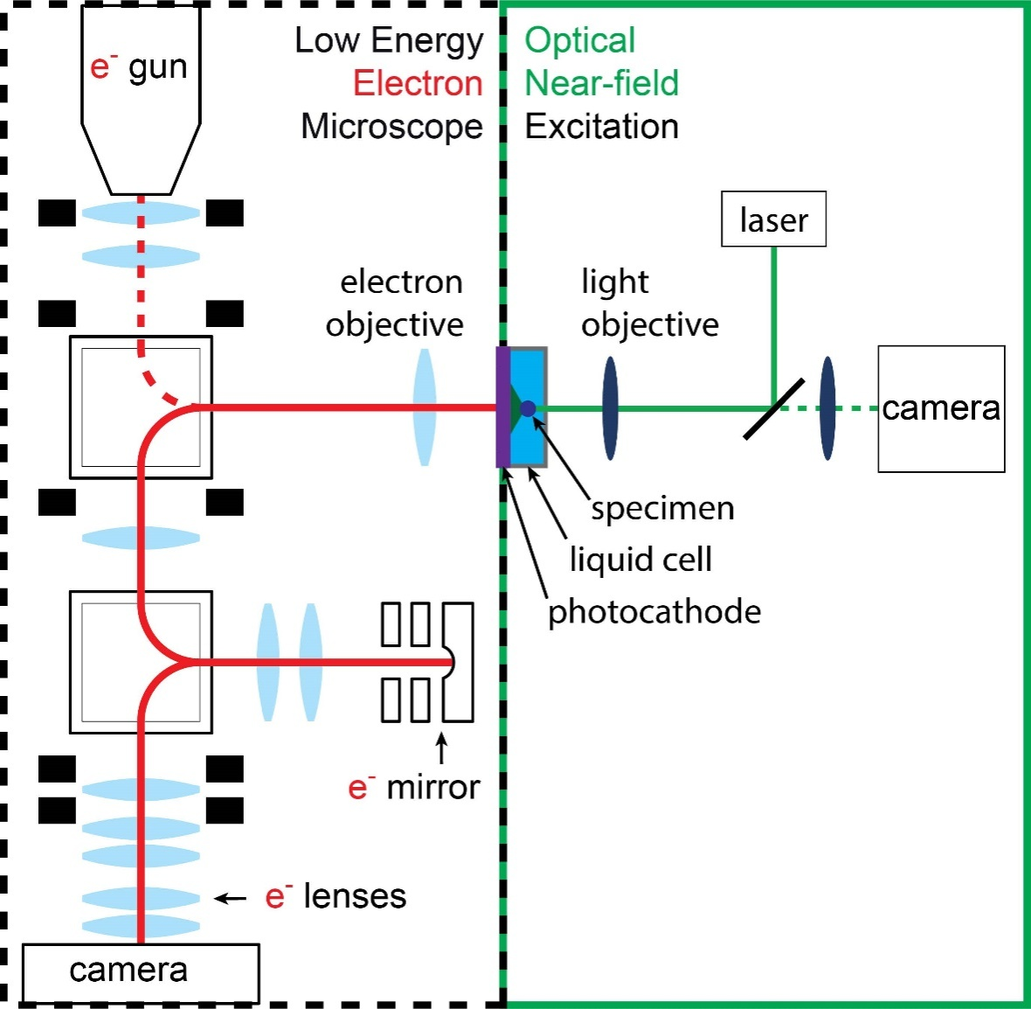
Motivation: Develop ONEM
Optical Near-field Electron Microscopy
Concept
Illuminate sample with visible light
Photons pass through ultra-thin vacuum-liquid interface
Low-work function photocathode converts photons to electrons
Electrons are imaged with LEEM
Notes:
My job is developing a crucial element of ONEM
The Low-work function photocathode converts photons to electrons

Slide 11
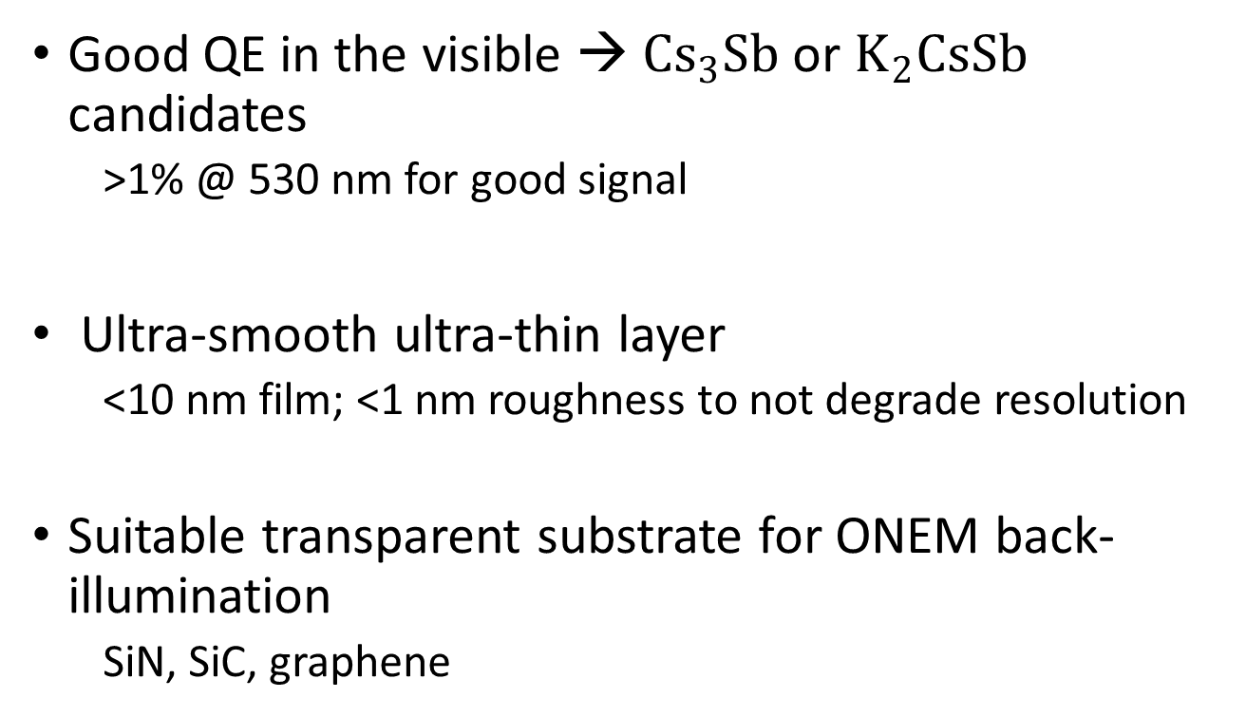
Functional requirements
Good QE in the visible → ${Cs}_{3}Sb$ or $K_{2}CsSb$ candidates
  >1% @ 530 nm for good signal
Ultra-smooth ultra-thin layer
  <10 nm film; <1 nm roughness to not degrade resolution
Suitable transparent substrate for ONEM back-illumination
  SiN, SiC, graphene
Notes:
Good signal
No degradation to resolution
Must be able to grow on transparent substrate

Slide 12
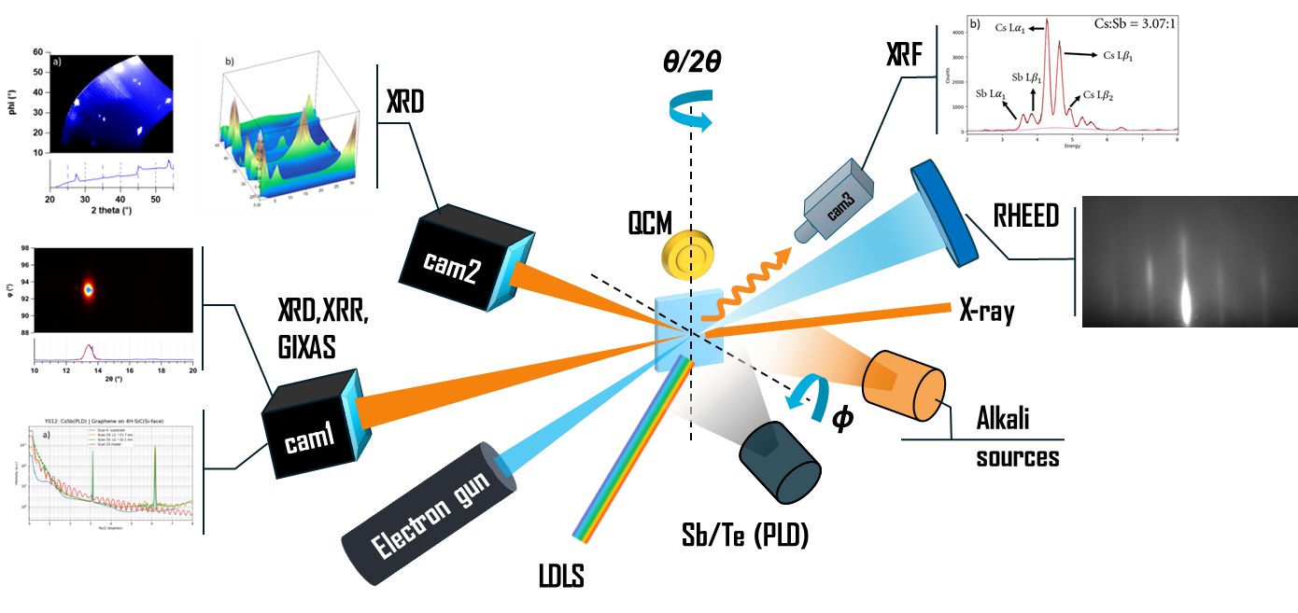
Experimental setup
Growth procedure:
Temperature
Co-deposition
Flux rates
  Cs on
  PLD freq.
Characterization:
QCM
XRD
RHEED
XRR
XRF
QE
M. Gaowei et al. Phys. Rev. Accel. Beams 22, 073401 (2019)
Feng, et al. J. Appl. Phys., 121 4, (2017)
Notes:
We do this at a synchrotron, with access to hard x-rays for x-ray characterization methods
That give us insight to the thickness, roughness and chemical composition during growth so that we can optimize growth parameters
Film is grown using thermal evaporation of the Cs and pulsed laser deposition of Sb
The recipe developed at BNL uses concurrent deposition, which yields smoother photocathodes as compared to the previous sequential deposition
We can tune the growth with the temperature of the substrate and the flux rates of Cs and Sb

Slide 13
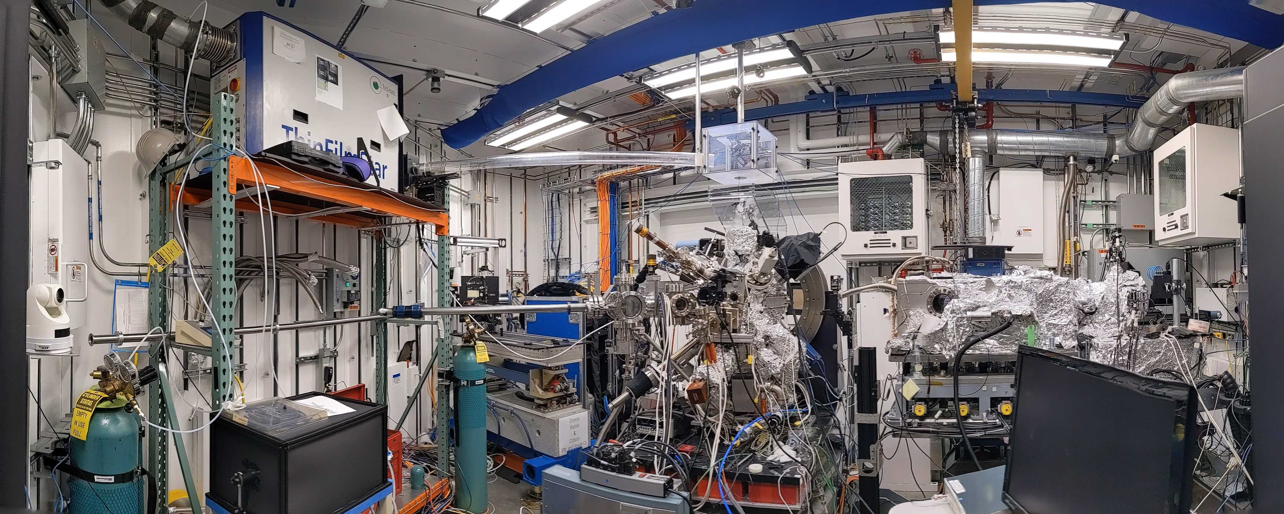
Experimental setup
Notes:
In real life the chamber looks like this:
Notably PLD laser, the chamber rotates on axis

Slide 14
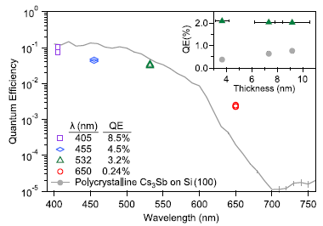
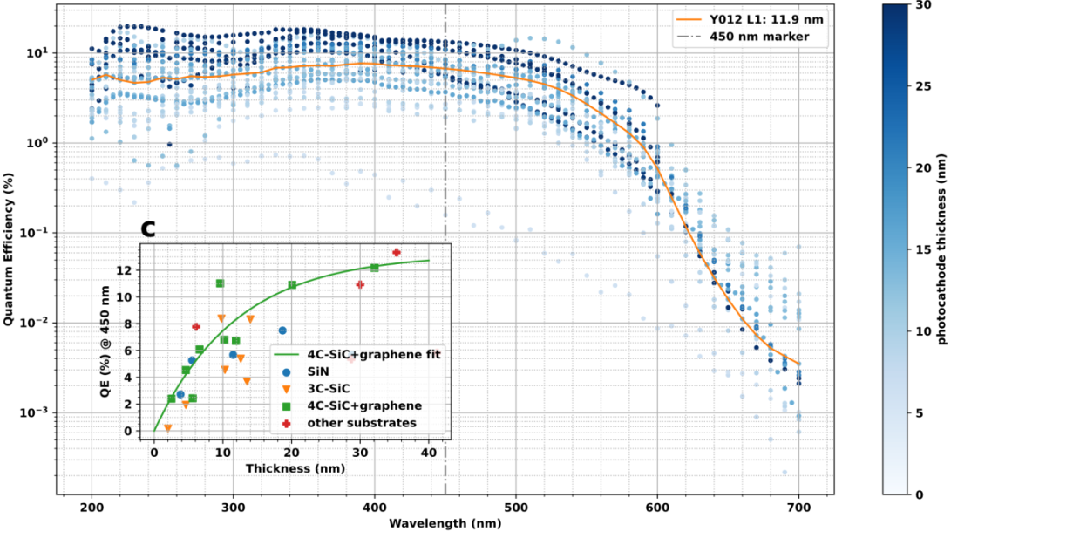
Quantum Efficiency
Very good already at very low thicknesses
Cutoff above 600 nm
Parzyck, et al., Phys. Rev. Letters 128, 114801 (2022)
New substrate - fit
New substrate
Notes:
For all growths the material gives a very good quantum efficiency
As you can see, it doesn’t really matter what substrate we use for QE
Comparable to literature

Slide 15
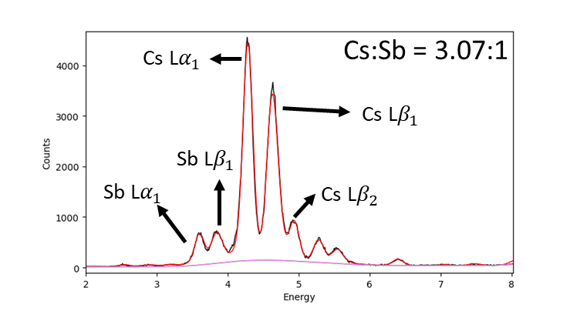
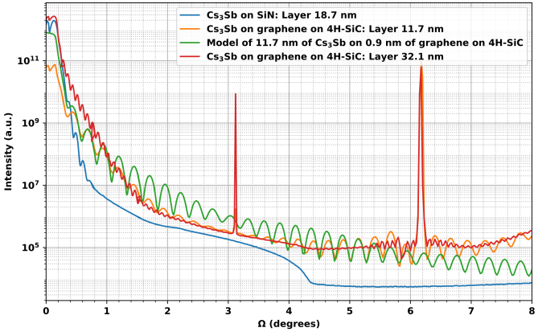
Film structure
XRR: Thickness & Roughness
XRF: Stoichiometry
New substrate
New substrate
New substrate
RHEED: Surface structure
XRD: Crystallinity
Notes:
From the X-ray and RHEED data we can draw several conclusions about the grown films
The fact that we see the oscillations so far out means that the photocathodes are very smooth! <1nm roughness
The XRF shows the stoichiometry is spot-on
RHEED and XRD tell us more about the crystal structure of the grown film
How ordered it is.
The film can grow amorphous, poly-crystalline or single crystal
What we see is that especially for the 4H-SiC-Gr substrate the films are extremely well-ordered.

Slide 16
Conclusion @ BNL
QE of Cs₃Sb is great at low thicknesses
Co-deposition method yields smooth results
Growths are crystalline,
Properties depend on (flatness) substrate
Optimal properties for a new substrate
Patent & paper in the making!

Slide 17
In Leiden
Chromium photocathode for UV-ONEM
Cesiated Carbon for (low signal) Vis-ONEM
For high signal & high resolution Vis-ONEM:
Ultra-flat Ultra-thin Cs₃Sb photocathode

Slide 18
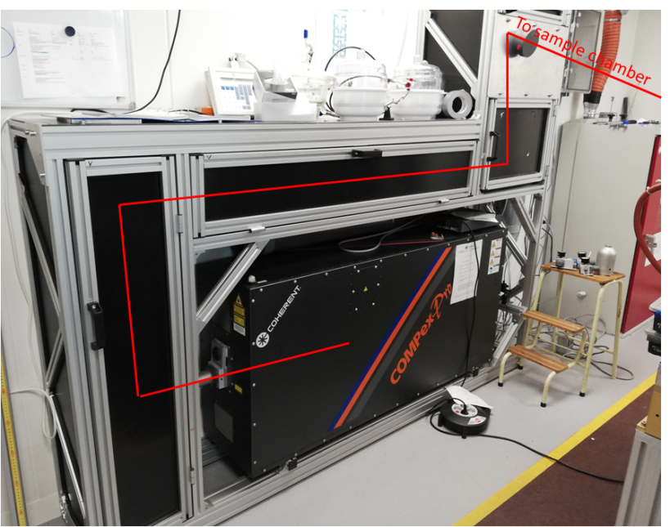
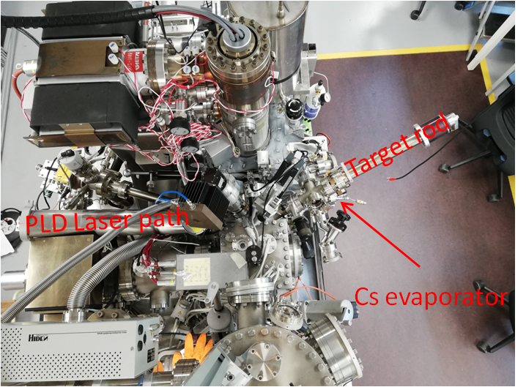
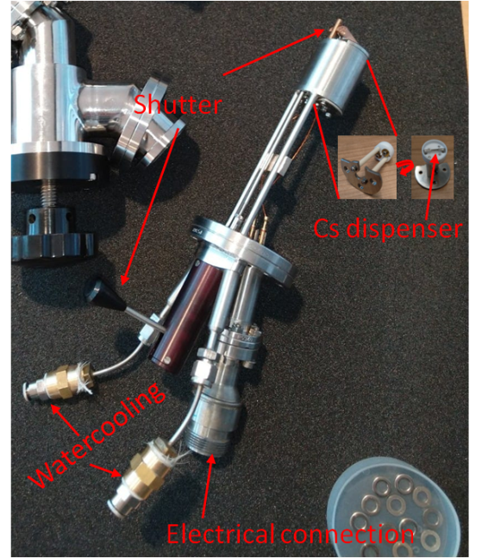
Leiden Outlook
Cs evaporator & PLD available, however:
Still need to optimize PLD parameters
Use the photocathode recipe developed @BNL
Complement photocathode research with LEEM
  (Surface) Crystal structure
  Homogeneity of photocathode

