Slide 1
Recent Advances in Superlattice GaAs/GaAsP Photocathodes for Spin-Polarized Electron Sources
Jyoti Biswas
On behalf of the collaborator
Electron Ion Collider, BNL

Slide 2
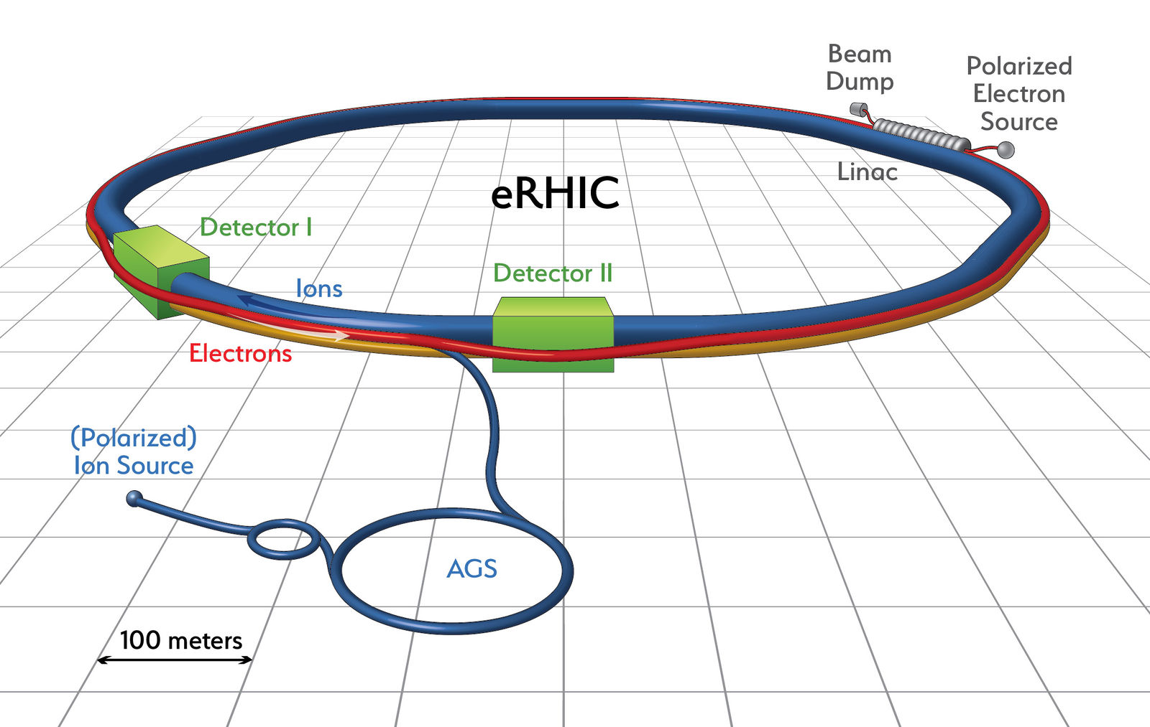
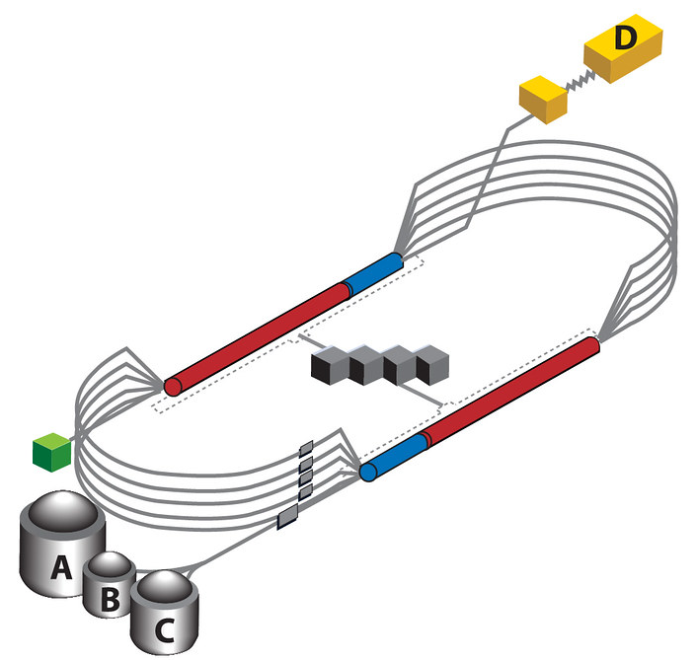
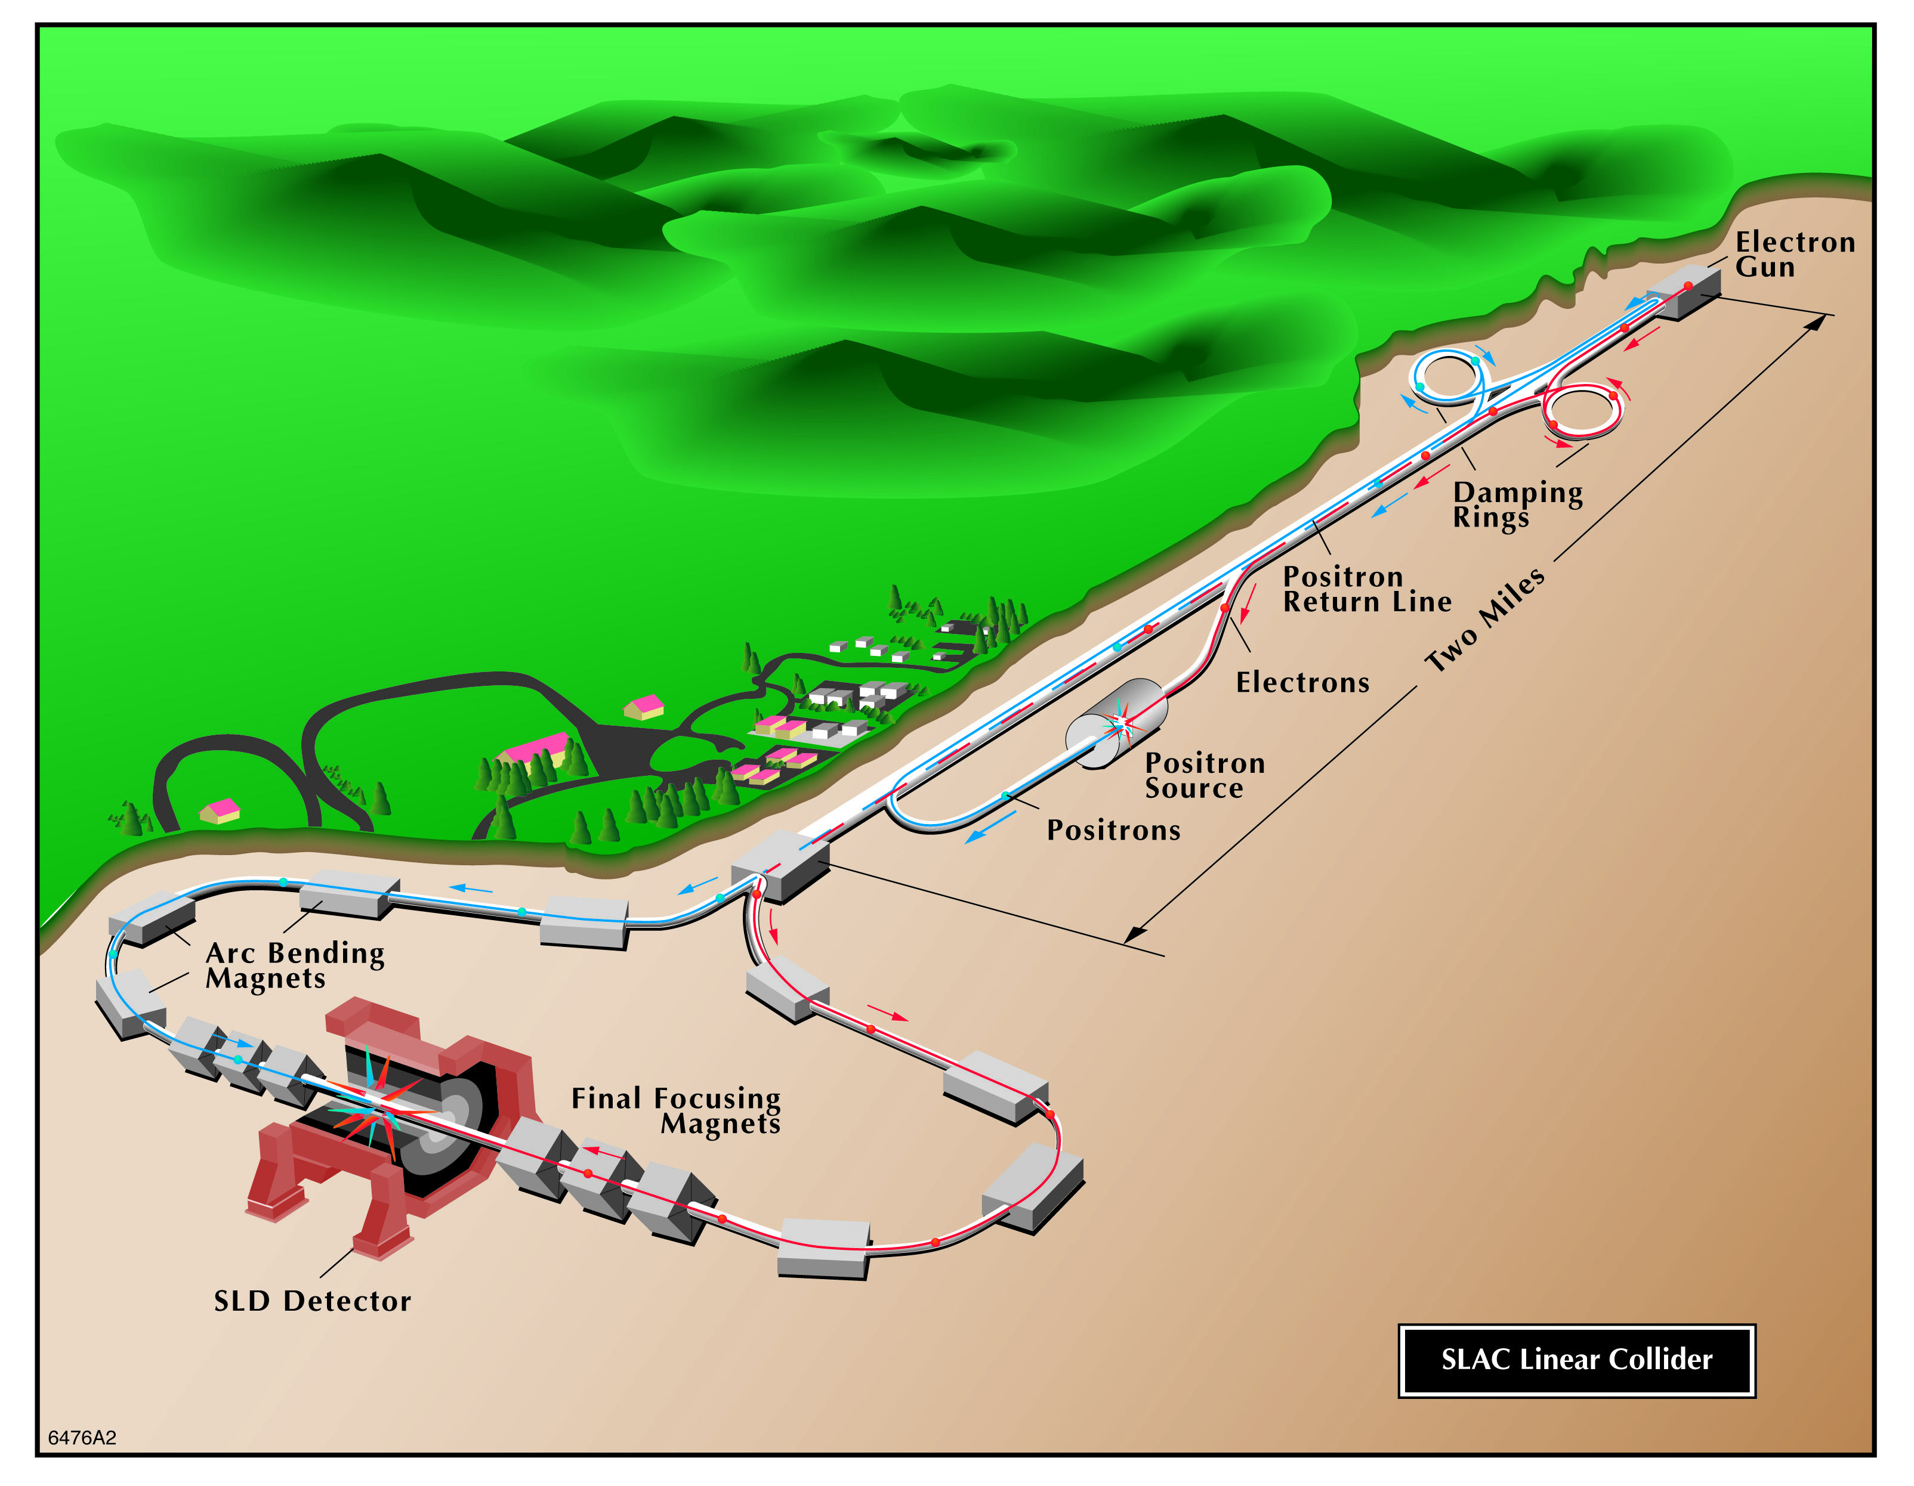
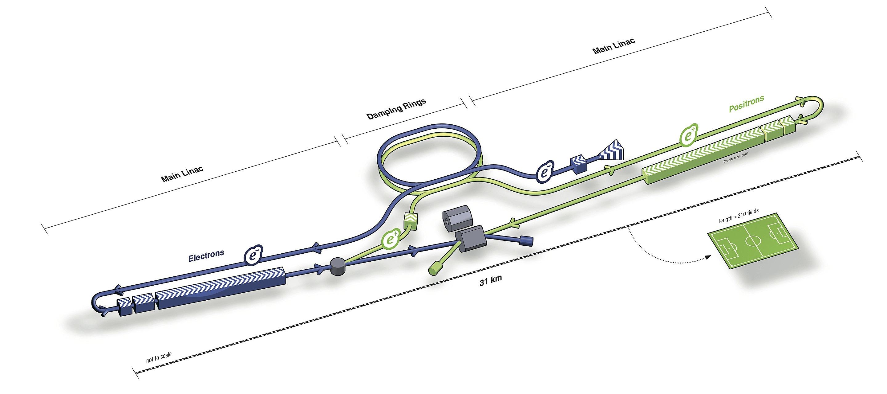
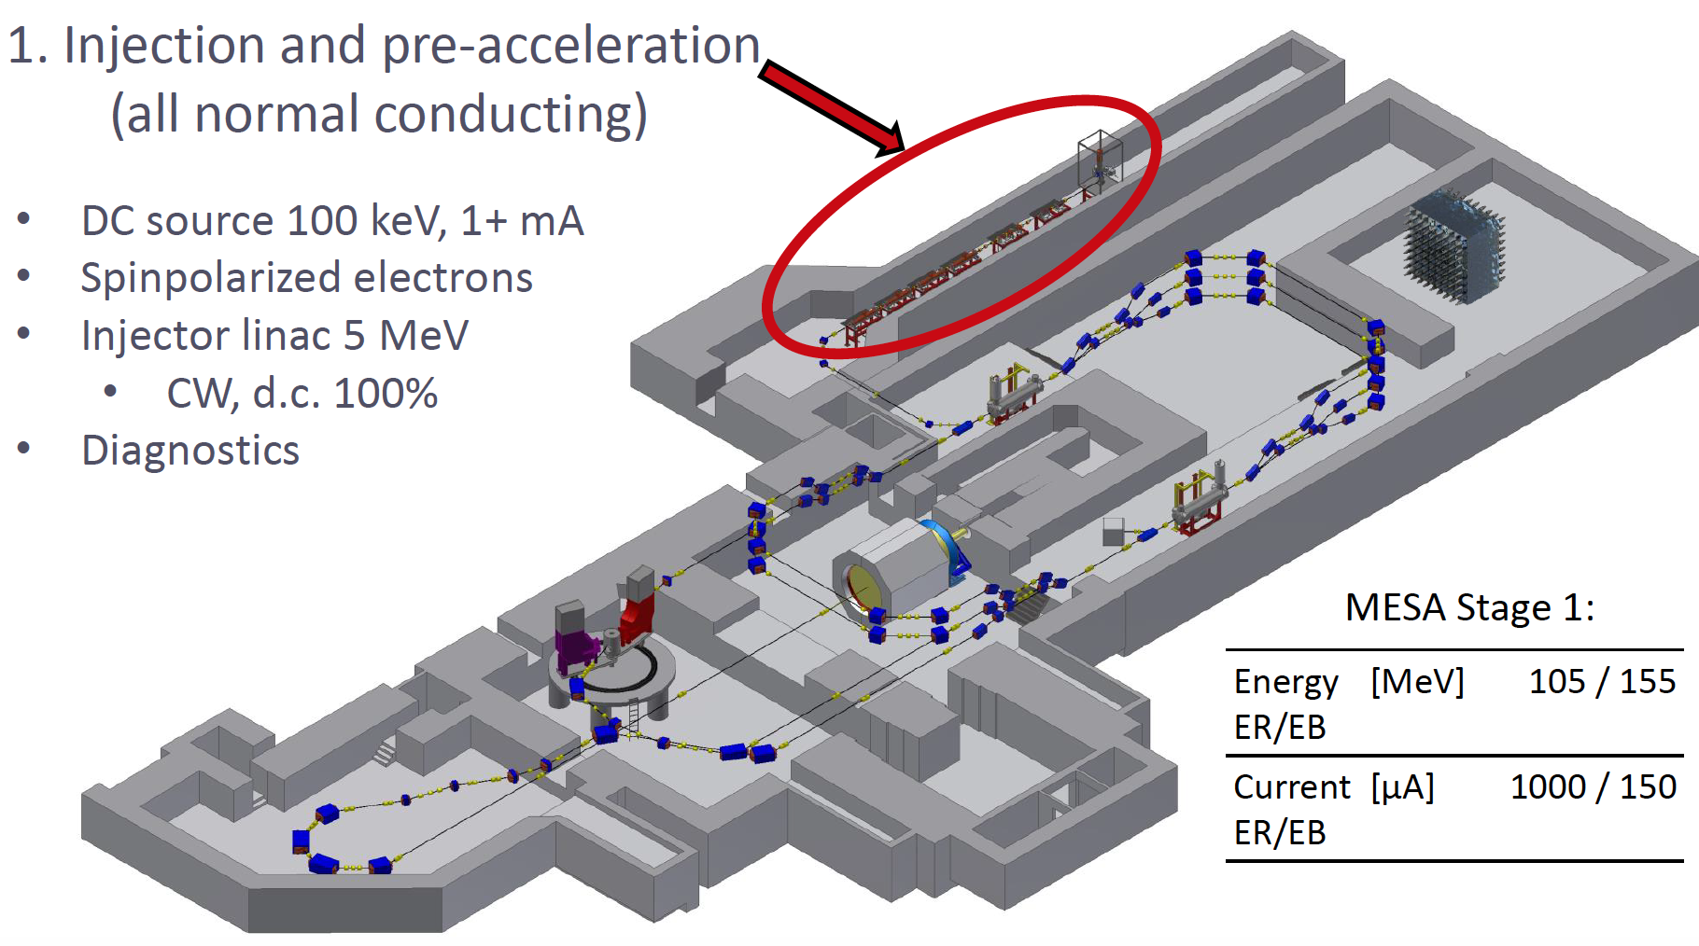
Perspective - Polarized Electron Sources
CEBAF
SLAC
EIC layout at BNL
At Jefferson Lab
International Liner Collider (Japan)
MESA Accelerator
Germany

Slide 3
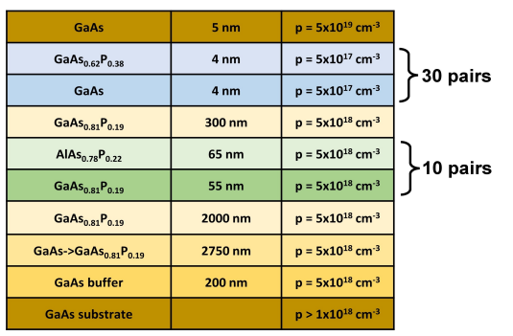
Polarized Electron Sources
Based on GaAs photocathodes
GaAsP
GaAsP
GaAs
GaAs
Superlattice GaAs
Superlattice DBR GaAs
ESP$\sim 92\% (@780nm)$
ESP$\sim 84\% (@780nm)$
Schematic of the SNL SL DBR
Q$E\sim 0.6\% (@780nm)$
Q$E\sim 6\% (@780nm)$
Cs & $O_{2}$
SL pairs
Photocurrent
Cs
DBR
Time
TEM cross section image of SL-DBR
J. Biswas et al. AIP Advances 13, 085106 (2023); https://doi.org/10.1063/5.0159183

Slide 4
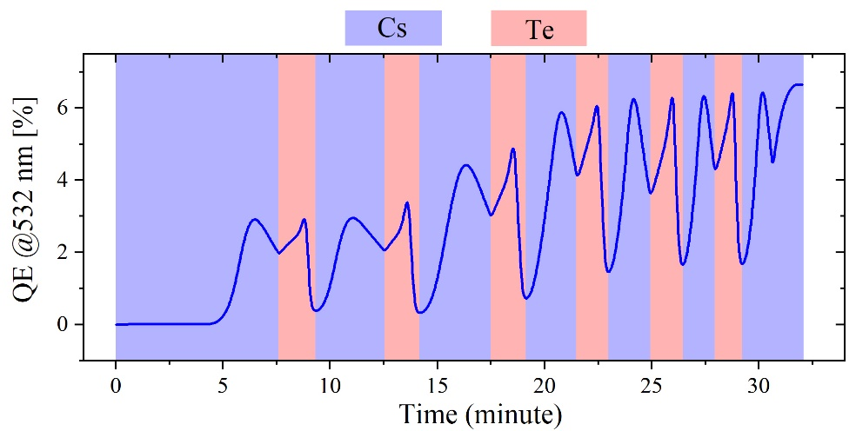
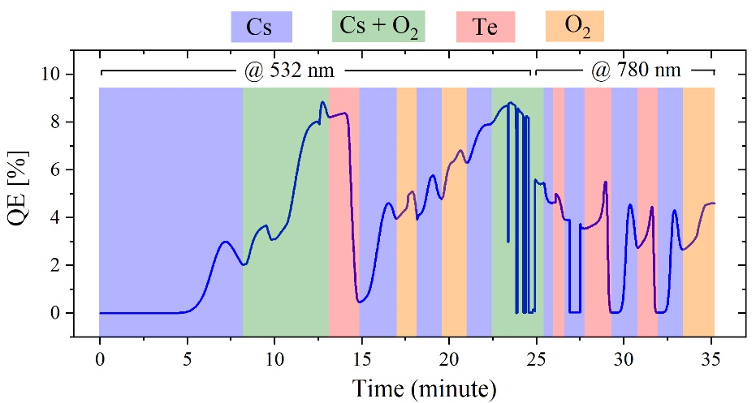
Cs-Te & Cs-Te-O based Activation of GaAs
Oxides desorbed completely
(1x1), & defused (4x6) reconstruction
Oxide desorption – LEED
Oxide desorption – SR-XPS
Cs-Te activation on GaAs
Cs-Te-O activation on GaAs
J. Biswas et al. AIP Advances 11, 025321 (2021); https://doi.org/10.1063/5.0026839

Slide 5
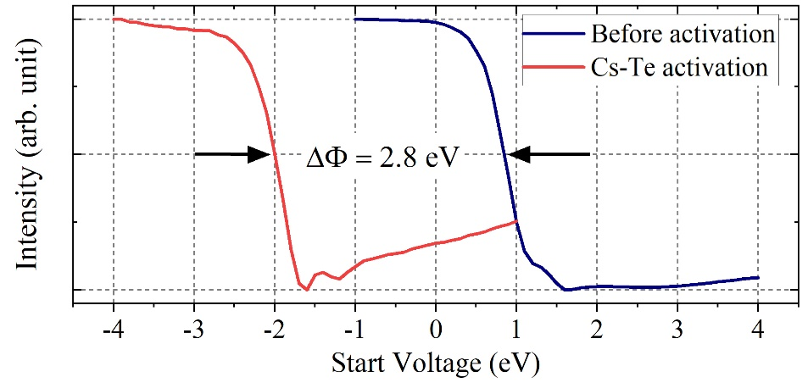
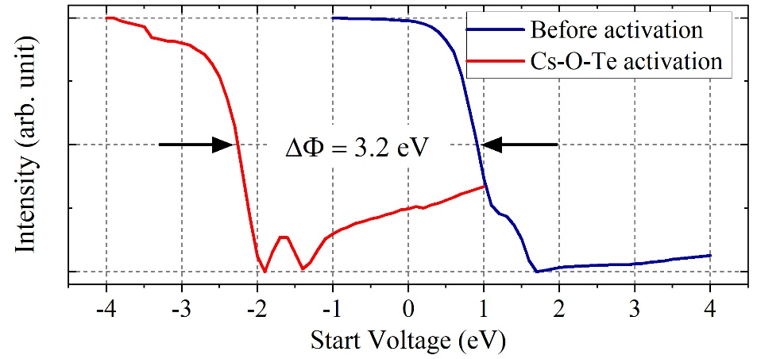
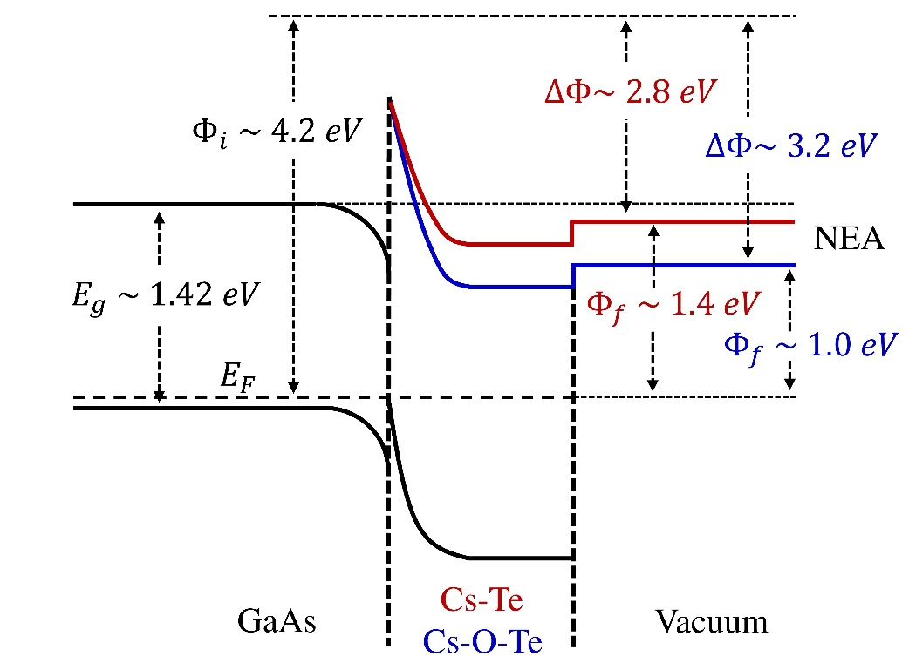
Evaluating the Negative Electron Affinity (NEA)
LEEM I/V of Cs-Te activated GaAs
LEEM I/V of Cs-Te-O activated GaAs
Cs-Te/GaAs
Final work function, $Φ_{f}=1.4 eV$
Effective NEA, $χ_{eff}=−0.02 eV$
Cs-Te-O/GaAs
Final work function, $Φ_{f}=1.0 eV$
Schematic drawing of
energy band diagram
Effective NEA, $χ_{eff}=−0.42 eV$
J. Biswas et al. AIP Advances 11, 025321 (2021); https://doi.org/10.1063/5.0026839

Slide 6
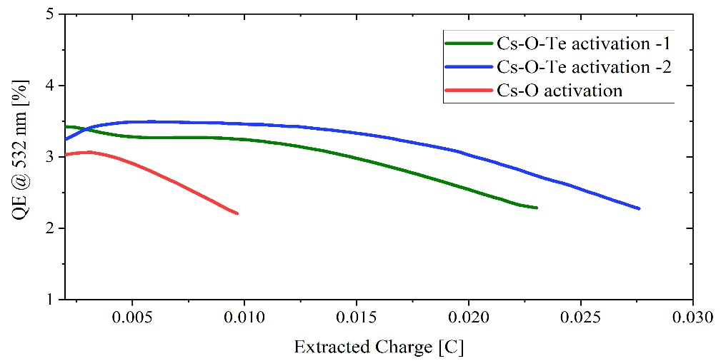
Comparing Charge lifetime of Cs-Te-O based Activation
We demonstrated 5-6 times longer charge lifetime in a test chamber as compared to Cs-O/GaAs
O. Rahman et al. , Int. Particle Accelerator Conf. IPAC2019, Melbourne, Australia

Slide 7
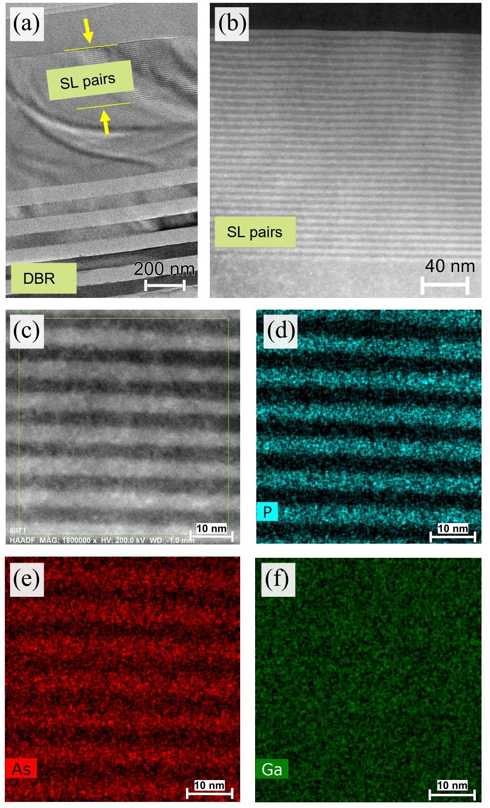
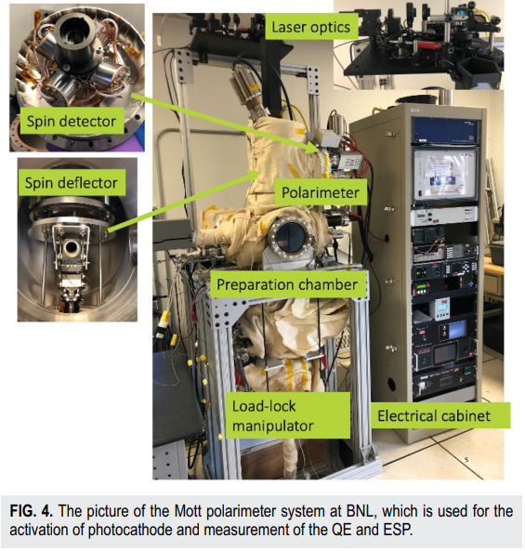
GaAs/GaAsP superlattice DBR
A commercial Mott Polarimeter located at EIC, BNL
TEM images of SNL superlattice GaAs
J. Biswas et al. AIP Advances 13, 085106 (2023); https://doi.org/10.1063/5.0159183

Slide 8
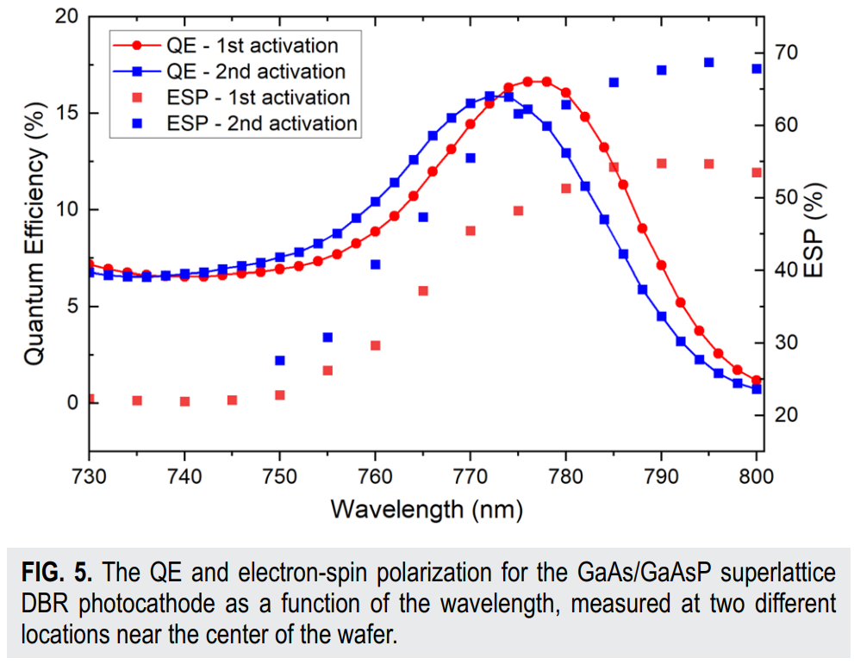
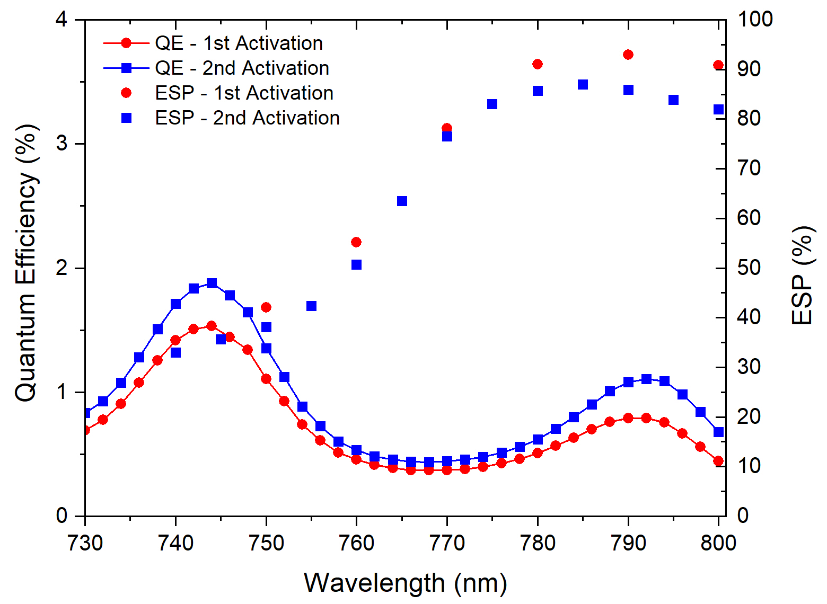
GaAs/GaAsP superlattice DBR: QE, ESP
QE and electron spin polarization (ESP) of SNL MBE grown Superlattice DBR.
Typical QE and electron spin polarization (ESP) of ODU MOCVD grown Superlattice DBR.
Q$E\sim 15\%$ESP$\sim 70\%$
Best sample: Q$E\sim 2.3\%,$ESP$\sim 92\%$
J. Biswas et al. AIP Advances 13, 085106 (2023); https://doi.org/10.1063/5.0159183

Slide 9
Problems associated with GaAs based photocathodes
Extremely sensitive to vacuum.
Needs low ${10}^{−11} or{ 10}^{−12}$ Torr Vacuum.
Laser induced heating could damage the activation.
Cathode transfer form facility to faculty is challenging.
A GaAs photocathode with a protection layer
could solve many problems!

Slide 10
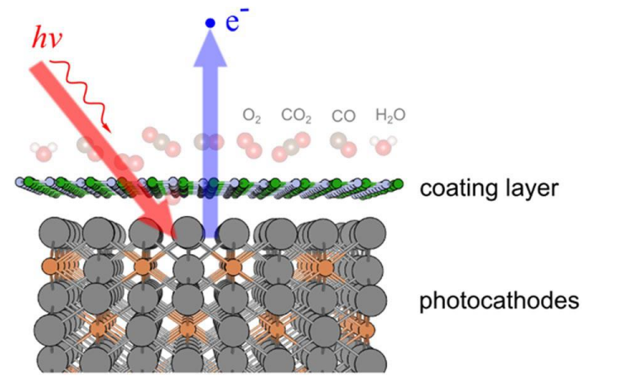
Protective layer on Spin Electron Source
G.Wang and N.Moody et al.
npj 2D Materials and Applications 17 (2018
doi:10.1038/s41699-018-0062-6
Credit: Work performed by Shashi Poddar, and Ao Liu from at Euclid Techlabs, LLC during our work on cathode encapsulation.
In terms of work function reduction, monolayer hBN is an ideal choice,
but finding a large area island free hBN is currently not feasible.
We kept our R&D work to graphene-based protection layer

Slide 11
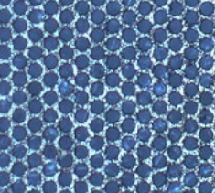
Challenges: transferring graphene onto GaAs
GaAs based photocathodes requires low ${10}^{−11} or{ 10}^{−12}$ Torr Vacuum.
Vacuum transfer of graphen3 is still not feasible
Alkali antimonide based photocathode can be grown onto graphene with TEM supported grid. (R&D at LANL)
This technique is not suitable for high gradient photo gun
Also, not suitable for GaAs photocathodes
We proposed use of intercalation of graphene to make photocathode
material underneath the 2D material (i.e., graphene)

Slide 12
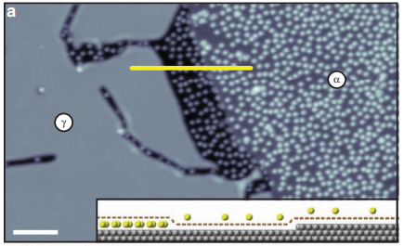
Cs Intercalation of Graphene
The mechanism of Cs intercalation through monolayer graphene
Petrović, M., Šrut Rakić, I., Runte, S. et al.
The mechanism of caesium intercalation of graphene.
Nature Communications 4, 2772 (2013). https://doi.org/10.1038/ncomms3772

Slide 13
Transfer of Graphene onto GaAs
Schematic of the graphene transfer on GaAs
Inspired by our previous work on Cesium intercalation of graphene: Biswas et al. APL Mater. 10, 111115 (2022)

Slide 14
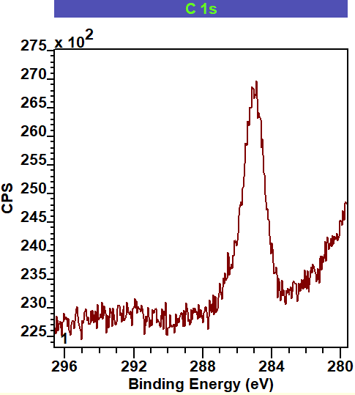
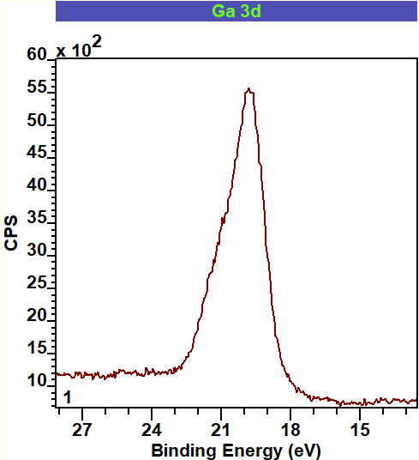
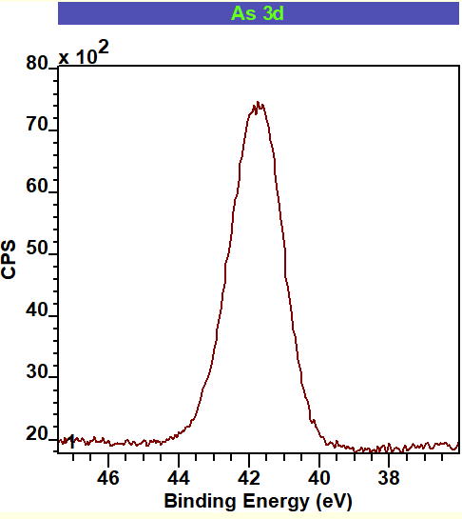
Removing cap layer or oxides through graphene
X-ray photoelectron spectroscopy after 550°C heat cleaning of SL-GaAs with a monolayer graphene on top
Similar features with heat treatment of 450°C of SL-GaAs that has As Cap
For SL-DBR that has no cap layer, it takes around 550°C to completely get rid of oxides. At 450°C it can eliminate As oxides, however, Ga oxides still remains after 450°C.

Slide 15
Verifying uniformity of graphene on SL-GaAs
200 nm
100 nm
Filled state Scanning Tunnelling Microscopy (STM) image of graphene covered SL-GaAs
after 550°C heat treatment to remove As cap. Graphene wrinkles are visible.
Successful transfer of graphene on SL-GaAs that can withstand 550°C heat treatment
Was successful in removing As cap layer from SL-GaAs without damaging the monolayer graphene protection layer.

Slide 16
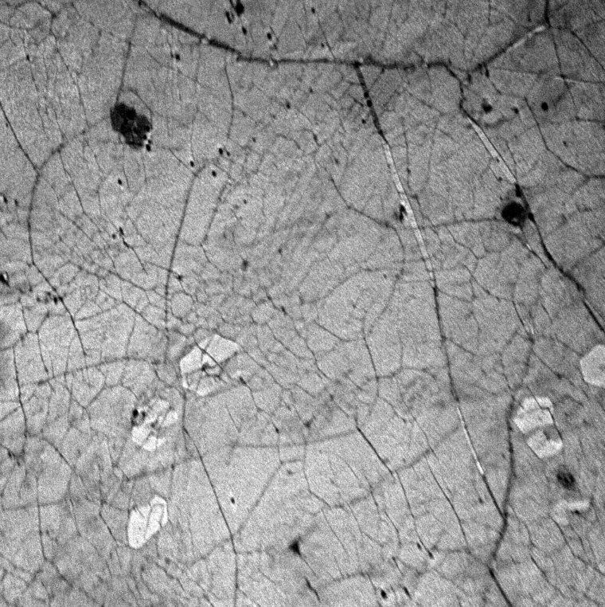
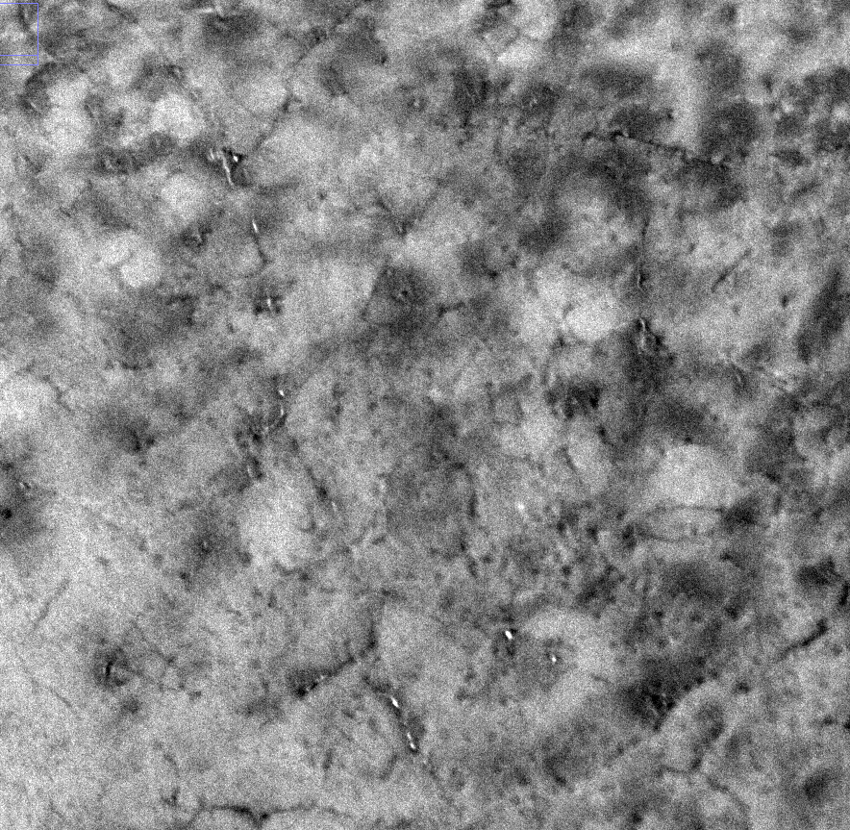
Characterizing GaAs-CsO/graphene on LEEM
LEEM image before activation
LEEM image just after activation
LEEM indicates intercalation happened.
Work function reduction of 3 eV observed, which close to work function shift of 3.2 eV on typical CsO activation on GaAs

Slide 17
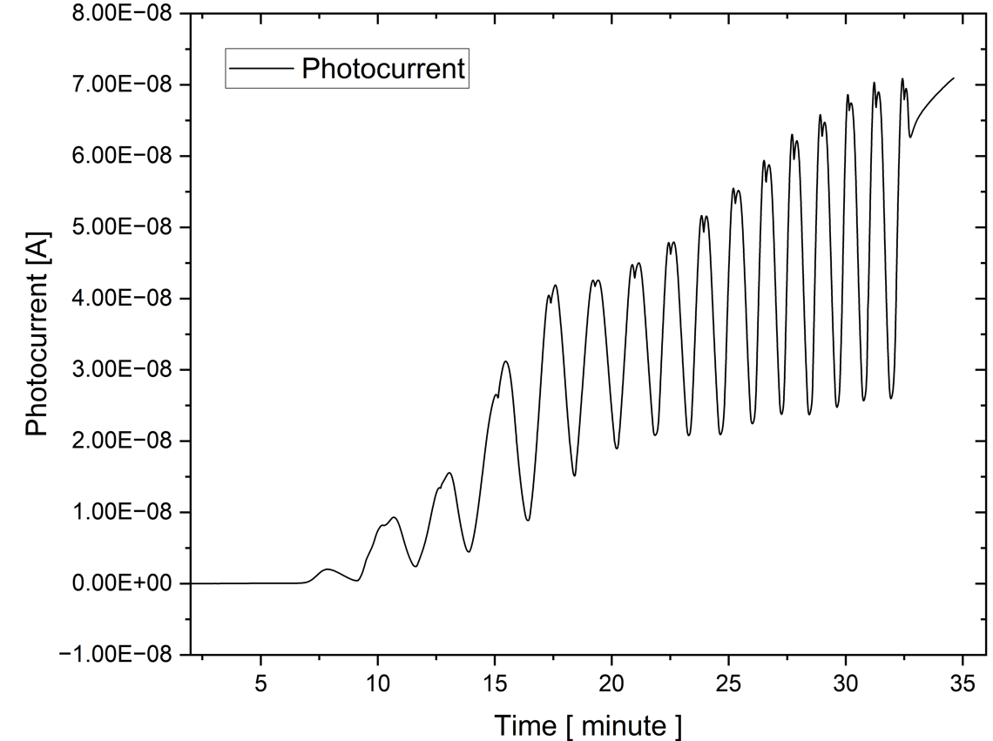
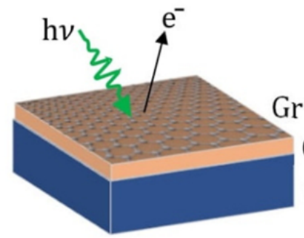
SL-GaAs activation with graphene on top
$$QE @532 nm≈0.70 \%$$
Monolayer graphene protection layer was deposited on SL-GaAs with an As cap. Heat treatment of 550°C was used to eliminate As cap layer through the graphene. And deposition of Cs and oxygen was performed using yo-yo method.
CsO
GaAs
Successful growth of SL-GaAs with CsO activation layer underneath the graphene.
Similar activation of bulk GaAs was performed. We obtained better results on SL-GaAs with a cap layer.
Removal of cap layer creates better sites for intercalation of Cs.

Slide 18
Characterizing SL-GaAs-CsO/graphene
QE> 0.014%
QE: 0.7%
QE> 0.55%
Cs start to
lose underneath
of graphene
Still Cs left
underneath
of graphene
Intercalation
& Activation
Excess top Cs
goes away
45°C
>100°C
>250°C
>500°C
We activated the cathode, heat treated sample around 500°C,
took it out into the air, and put it back in the vacuum system,
that cathode still had $≈$0.01% QE
Graphene protection layer makes the GaAs cathode less susceptible to heating.
Can sustain coarse vacuum environment with the protection layer. Meaning vacuum transfer of activated GaAs is a possibility.

Slide 19
Summary
Cs-Te-O based activation shows 5-6 times improvement of charge lifetime in a test chamber.
Both Cs-Te, Cs-Te-O based activation achieve Negative Electron Affinity and shows high QE.
Superlattice DBR from Sandia shows very high QE, with room for improvement in ESP
Superlattice DBR from Old Dominion University shows both high ESP and reasonably well QE. Suitable for EIC.
Method of Intercalation was used to grow GaAs/CsO photocathode with monolayer graphene protection layer on top.
Initial result shows, graphene protection layer makes the cathode less susceptible to heating.
Can sustain coarse vacuum environment with the protection layer. Meaning vacuum transfer of activated GaAs is a possibility.

Slide 20
Acknowledge:
Summary
Thanks to Erdong Wang, Luca Cultrera, Wei Liu, Omer Rahman, Mengjia Gaowei, Kali Mondal, John Skaritka, Xiao Tong, Jerzy Sadowski, Kim Kisslinger, Triveni Rao, Ao Liu, Shashi Poddar, John Smedley, Liliana Stan, Sylvain Marsillac, Adam Masters, Matthew Poelker
Work supported by Brookhaven Science Associates, LLC under Contract No. DE-SC0012704, DE-SC0013190 with
the U.S. Department of Energy. The use of National Synchrotron Light Source II at Brookhaven National Laboratory
is supported by U.S. Department of Energy Office of Science under Contract No. DE-AC02-98CH10886.
Thanks for your attentions!
Questions

