Slide 1
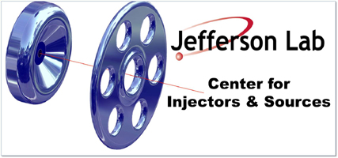
Strained superlattice InAlGaAs/AlGaAs spin-polarized photocathodes implemented with both random and digital alloying
¹Materials Dept., University of California, Santa Barbara
²Center for Injectors and Sources, Thomas Jefferson National Accelerator Facility
³Dept. of Electrical & Comp. Eng., University of California, Santa Barbara
Aaron Engel¹, Marcy Stuzman², Jason Dong¹, Christopher Palmstrøm^{1,3}
2023 P³ Workshop

Slide 2
Outline
Applications & mechanism of spin-polarized photoemission
Benefits of InAlGaAs/AlGaAs vs. GaAs/GaAsP
Initial InAlGaAs/AlGaAs results
Improving performance with digital alloying
Wafer uniformity and progress toward integration with Bragg reflector

Slide 3
Outline
Applications & mechanism of spin-polarized photoemission
Benefits of InAlGaAs/AlGaAs vs. GaAs/GaAsP
Initial InAlGaAs/AlGaAs results
Improving performance with digital alloying
Uniformity and progress toward integration with Bragg reflector

Slide 4
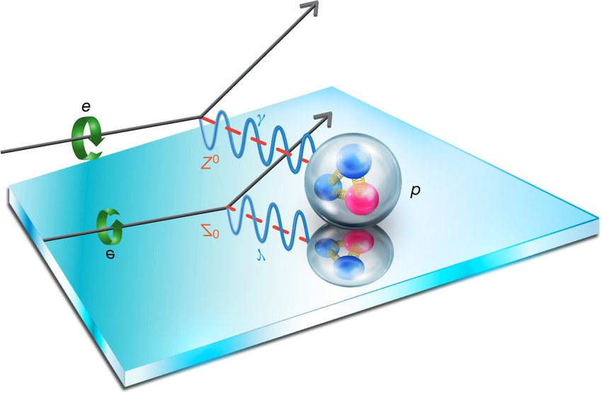
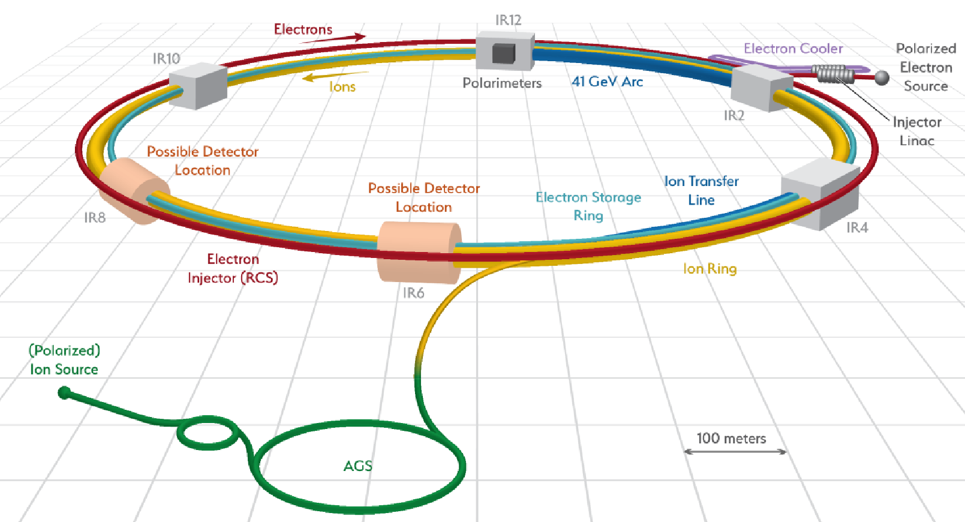

Applications of spin-polarized photoelectron beams
Particle physics (GeV beams)
  Studying subatomic particles via collision asymmetries
  Electron ion collider→high emission currents necessary
    Limited by low lifetimes
Characterization techniques for magnetic and SOC materials
  Electron microscopy/diffraction
  Inverse photoelectron spectroscopy
The Jefferson Lab Qweak Collaboration. Nature 557, 207–211 (2018)
$$Figure of Merit= η_{ESP}^{2}×QE$$
In-progress electron ion collider at Brookhaven National Lab (F. Willeke)

Slide 5
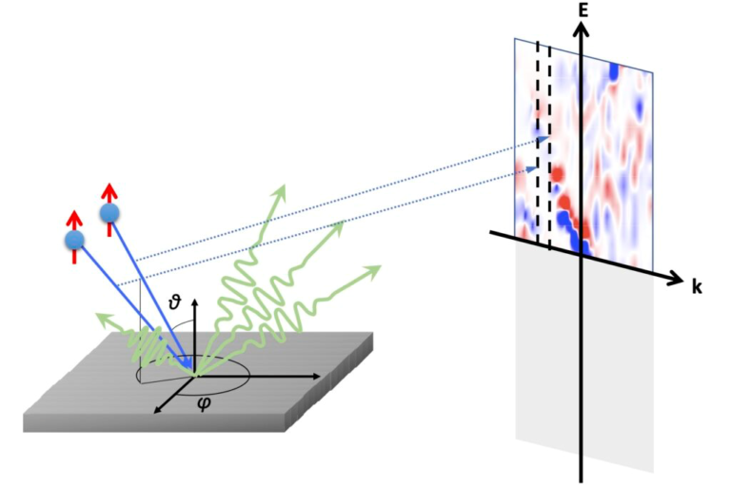
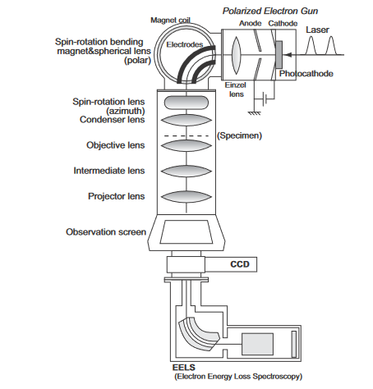
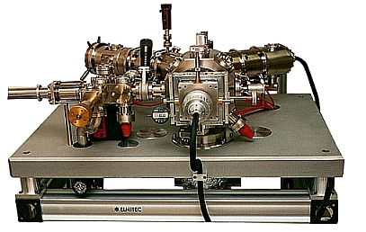
Applications of spin-polarized photoelectron beams
Particle physics (GeV beams)
  Studying subatomic particles via collision asymmetries
  Electron ion collider→high emission currents necessary
    Limited by low lifetimes
Characterization techniques for magnetic and SOC materials
  Electron microscopy/diffraction
  Inverse photoelectron spectroscopy
Spin-polarized inverse photoemission spectroscopy
Spin-polarized TEM
Spin-polarized LEEM
LUTECE—LPS Orsay
Elmitech LEEM3
J. Phys.: Conf. Ser. 371 012004 (2012)

Slide 6
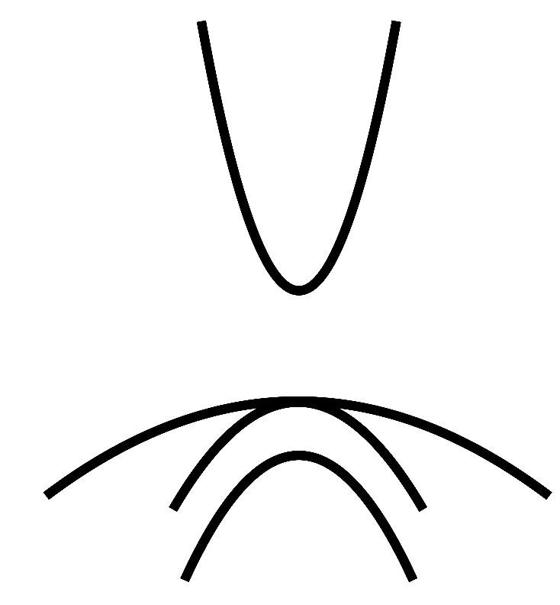
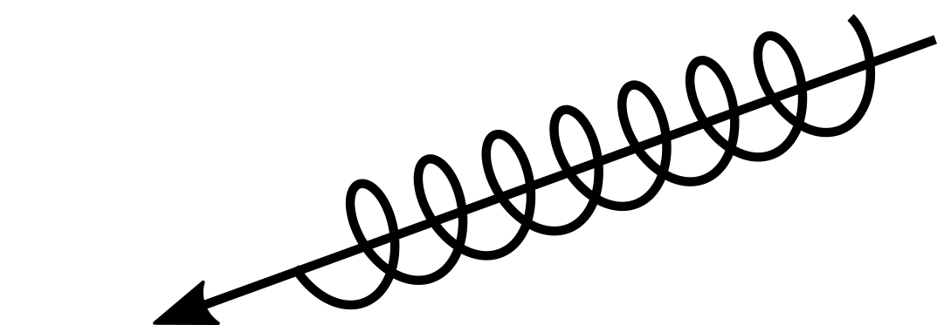

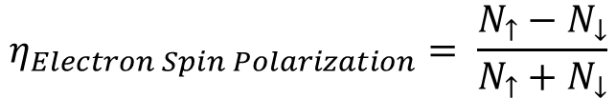
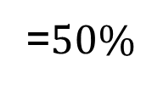
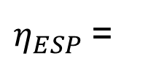
Generating spin polarization with circular polarized light
Optical selection rules via circular polarized light
Degeneracy limits the theoretical maximum spin polarization
m_{j}= -1/2
m_{j}= 1/2
$$η_{Electron Spin Polarization}= \frac{N_{↑}−N_{↓}}{N_{↑}+N_{↓}}$$
Conduction band
Δm_{j}=±1
3
1
1
S_{1/2}
hv ≈ E_{g}
3
0
$η_{ESP}$=
=$50\%$
P_{3/2}
0
Heavy hole band
3
1
m_{j}= -3/2
m_{j}= -1/2
m_{j}= 1/2
m_{j}= 3/2
P_{1/2}
Light hole band
Split-off band
m_{j}= -1/2
m_{j}= 1/2
$$Figure of Merit= η_{ESP}^{2}×QE$$
I. Žutić, J. Fabian, and S. Das Sarma, Rev. Mod. Phys. 76, 323 (2004)

Slide 7
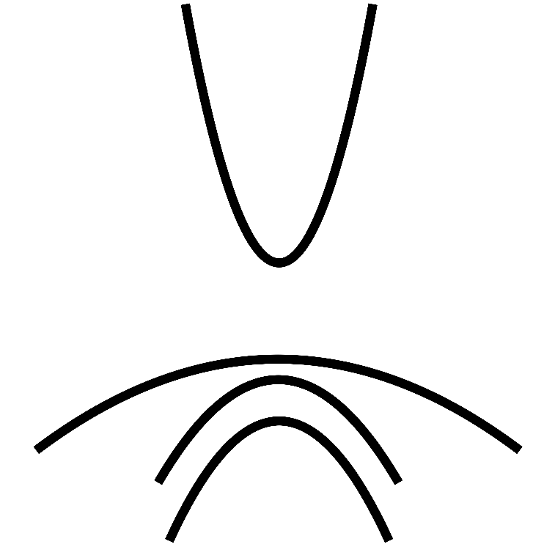
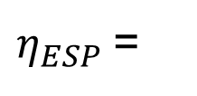

Generating spin polarization with circular polarized light
Optical selection rules via circular polarized light
Degeneracy limits the theoretical maximum spin polarization
Confinement and epitaxial strain break heavy hole/light hole degeneracy
m_{j}= -1/2
m_{j}= 1/2
$$η_{Electron Spin Polarization}= \frac{N_{↑}−N_{↓}}{N_{↑}+N_{↓}}$$
Conduction band
Δm_{j}=±1
3
1
S_{1/2}
hv ≈ E_{g}
3
0
$η_{ESP}$=
=$50\%$
P_{3/2}
0
Heavy hole band
1
3
1
m_{j}= -3/2
m_{j}= 3/2
P_{1/2}
m_{j}= -1/2
m_{j}= 1/2
Light hole band
Breaking hole degeneracy…..
Split-off band
m_{j}= -1/2
m_{j}= 1/2
3
0
$η_{ESP}$=
=$100\% !$
3
0
$$Figure of Merit= η_{ESP}^{2}×QE$$
I. Žutić, J. Fabian, and S. Das Sarma, Rev. Mod. Phys. 76, 323 (2004)

Slide 8
Outline
Applications & mechanism of spin-polarized photoemission
Benefits of InAlGaAs/AlGaAs vs. GaAs/GaAsP
Initial InAlGaAs/AlGaAs results
Improving performance with digital alloying
Uniformity and progress toward integration with Bragg reflector

Slide 9
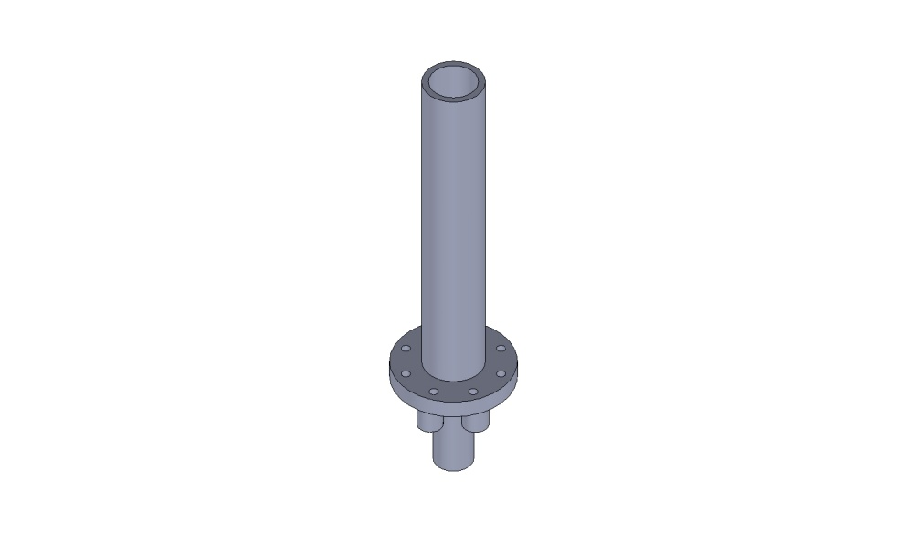
Strained well superlattices require precise epitaxial growth
Quantum well confinement and strain break heavy hole/light hole degeneracy
Superlattice enhances hole splitting and increases quantum efficiency
Molecular beam epitaxy for precise layer control during heteroepitaxy
  MOCVD suitable alternative
Molecular Beam Epitaxy (MBE)
Very complex layer stacks
Superlattice
active region
RHEED
Screen
RHEED
Gun
Superlattice Mirror
As
Al
Be
Ga
In

Slide 10
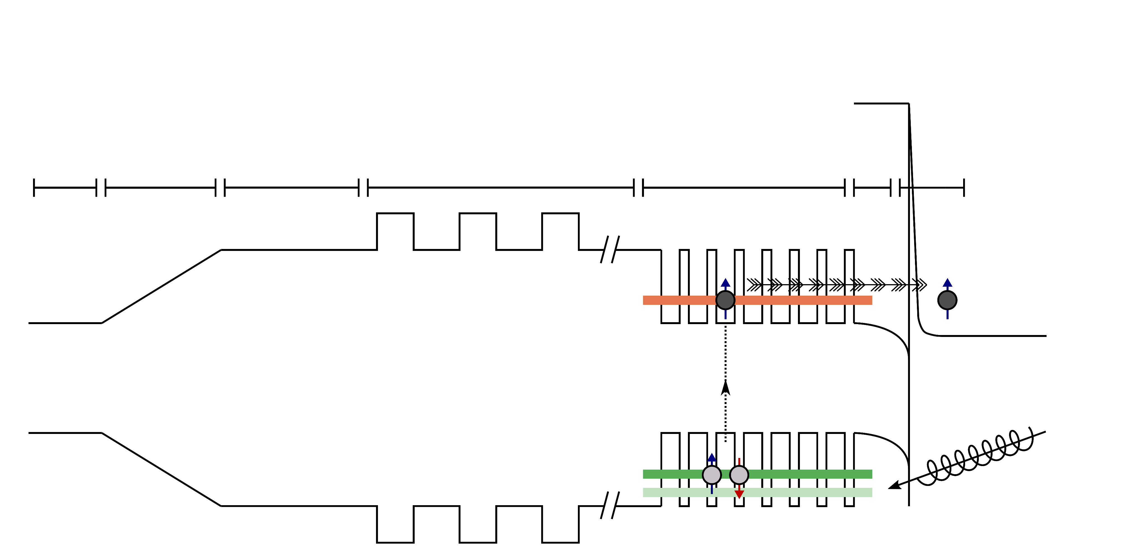
Current state-of-the-art strained well superlattice
GaAs
sub.
GaAs p++
GaAsP
graded
GaAs_{0.65}P_{0.35}
GaAsP/AlAsP
DBR and window
GaAs/GaAsP superlattice
Metamorphic “virtual” substrate
  Time-consuming
  Expensive
  High dislocation density
  Rough
Distributed Bragg Reflector (DBR) creates resonant cavity
  Enhances QE 2-8x
Difficult to grow (temperature sensitive)
  Group V composition control
  Uniformity issues
5+2 μm
2 μm
100 nm
5 nm
Shifts lattice constant
from 5.653 Å
to 5.582 Å
Must keep ternary lattice constants matched to virtual substrate
Cs,O₂/NF₃
Activation
E_{C}
FOM w/o DBR: 0.89
FOM w/ DBR: 4.52
E_{vac}
E_{V}
p-type doped throughout
W. Liu, et al., Appl. Phys. Lett. 109, 252104 (2016)

Slide 11
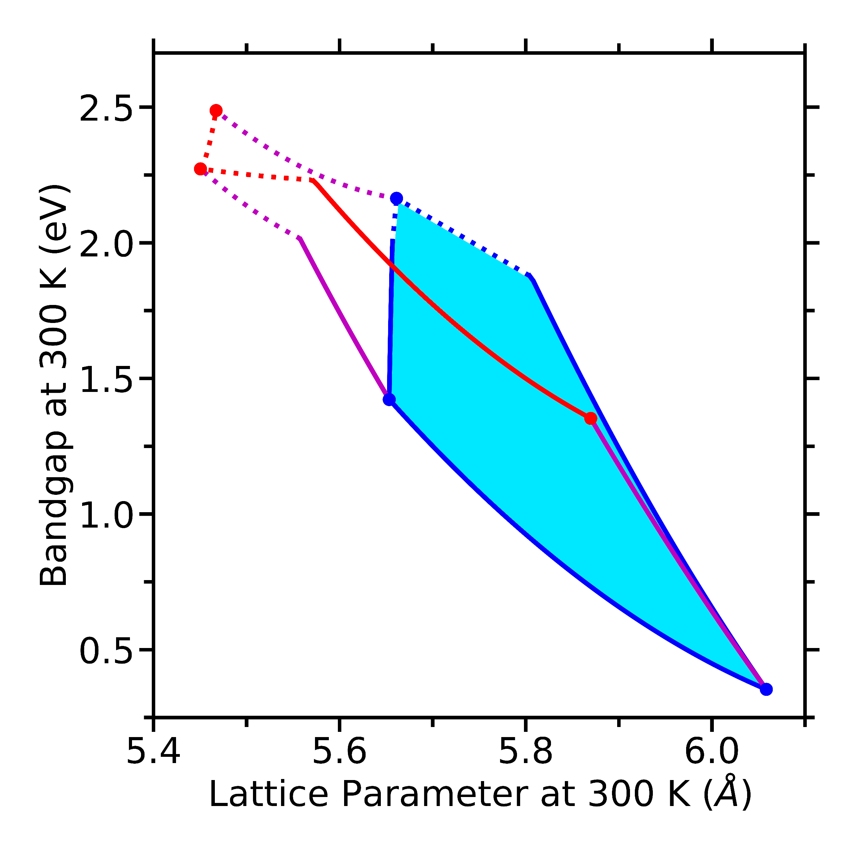
Strained well InAlGaAs/AlGaAs has more room for improvement
No virtual substrate necessary!
Easily tunable DBRs in AlAs/AlGaAs system
No group V alloying: better uniformity?
  Better for integration with DBRs
  As/P ratio
Much more band engineering possible
  Zero conduction band offset [1]
Sample quality was not consistent, but best samples were on par with GaAs/GaAsP
  Moved to GaAs/GaAsP photocathodes grown by SVT Associates
GaAs_{0.65}P_{0.35}
AlP
AlAs
Easy to lattice match
GaP
Barrier
Well
InP
GaAs
InAs
[1] L. G. Gerchikov, et al. Semiconductors 40, 1326–1332 (2006)
Mainly investigated by Gerchikov, Subashiev & Mamaev @ St. Petersburg State Polytechnic University

Slide 12
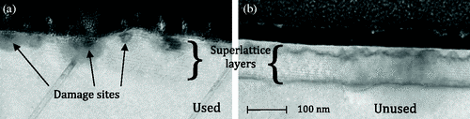
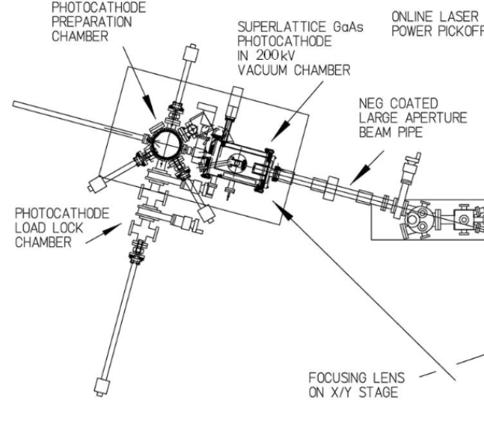
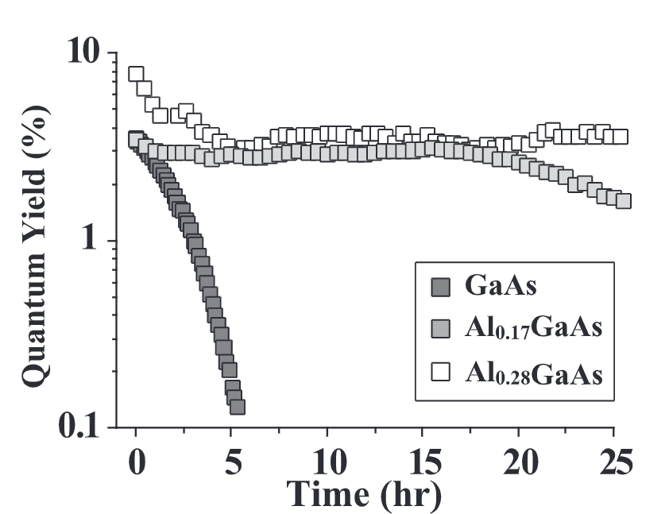
InAlGaAs/AlGaAs has further benefits
Ion back bombardment induced ion damage is a main limiter of photocathode lifetime
  High emission currents necessary at EIC
Addition of aluminum could increase lifetimes [1]
  Higher binding energies reduce ion damage
  AlAs > GaP
V. Shutthanandan, et al. Phys. Rev. ST Accel. Beams 15, 063501 (2002)
M. Bastani Nejad, …P. Adderley, CEBAF 200 kV inverted electron gun, Conf. Proc. C C110328, 1501 (2011).
[1] W. Wesch , et al. Nucl. Instrum. Methods Phys. Res. B: Beam Interact. Mater. At., 277, 58 (2012).;
H. H. Tan , et al. J. Appl. Phys. 77, 87–94 (1995);
E. Wendler AIP Conference Proceedings 680, 670–674 (2003)
T. Nishitani, et al. Jpn J. Appl. Phys. 48, 06FF02 (2009)

Slide 13
Outline
Applications & mechanism of spin-polarized photoemission
Benefits of InAlGaAs/AlGaAs vs. GaAs/GaAsP
Initial InAlGaAs/AlGaAs results
Improving performance with digital alloying
Uniformity and progress toward integration with Bragg reflector

Slide 14
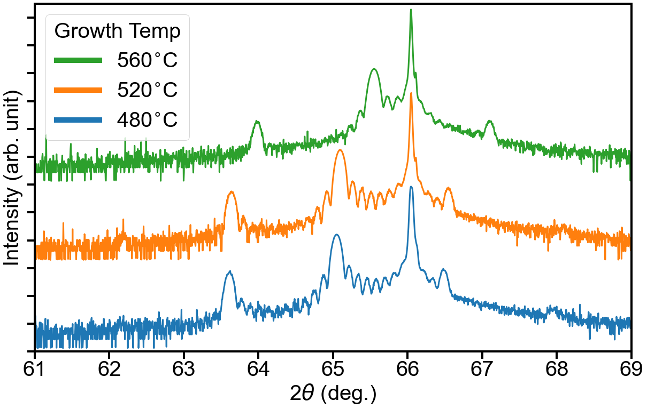
Growth optimization of photocathode structure: XRD
Diffraction occurs from superlattice periods
0 order peak corresponds to average out-of-plane lattice constant of the repeat unit
Integer spacing corresponds to total period thickness
High frequency fringes correspond to overall superlattice thickness
XRD indicates higher quality films grown at lower temperatures
More integer fringes and more intense satellite fringes indicate sharper interfaces
6 nm GaAs
Superlattice X-ray diffraction
90 nm InAlGaAs/AlGaAs strained superlattice
GaAs(004)
Undoped
500 nm GaAs buffer
1.1% compressive strain
0
GaAs(001)
(AXT Zn-doped)
-1
1
5.1 nm In_{0.16}Al_{0.23}Ga_{0.61}As
12x
-2
2
2.3 nm Al_{0.274}Ga_{0.726}As
Higher temperature

Slide 15

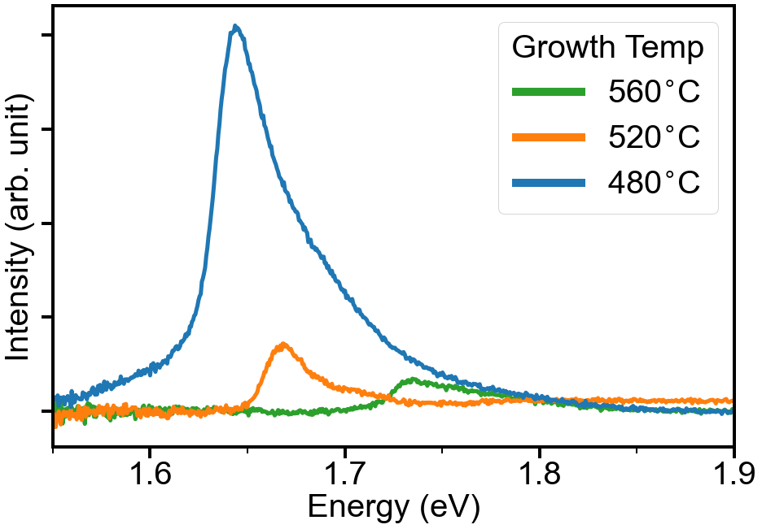
Growth optimization of photocathode structure: optical quality
Photoluminescence intensity has been shown to correlate to photocathode quantum efficiency
Lower temperature growth produces more intense PL from superlattice
Peak asymmetry potentially from HH/LH splitting
  ~50 meV
S_{1/2}
hv ≈ E_{g}
“probe”
hv > E_{g}
“pump”
P_{3/2}
P_{1/2}
RT
HH1?
LH1?
Large background from GaAs subtracted

Slide 16
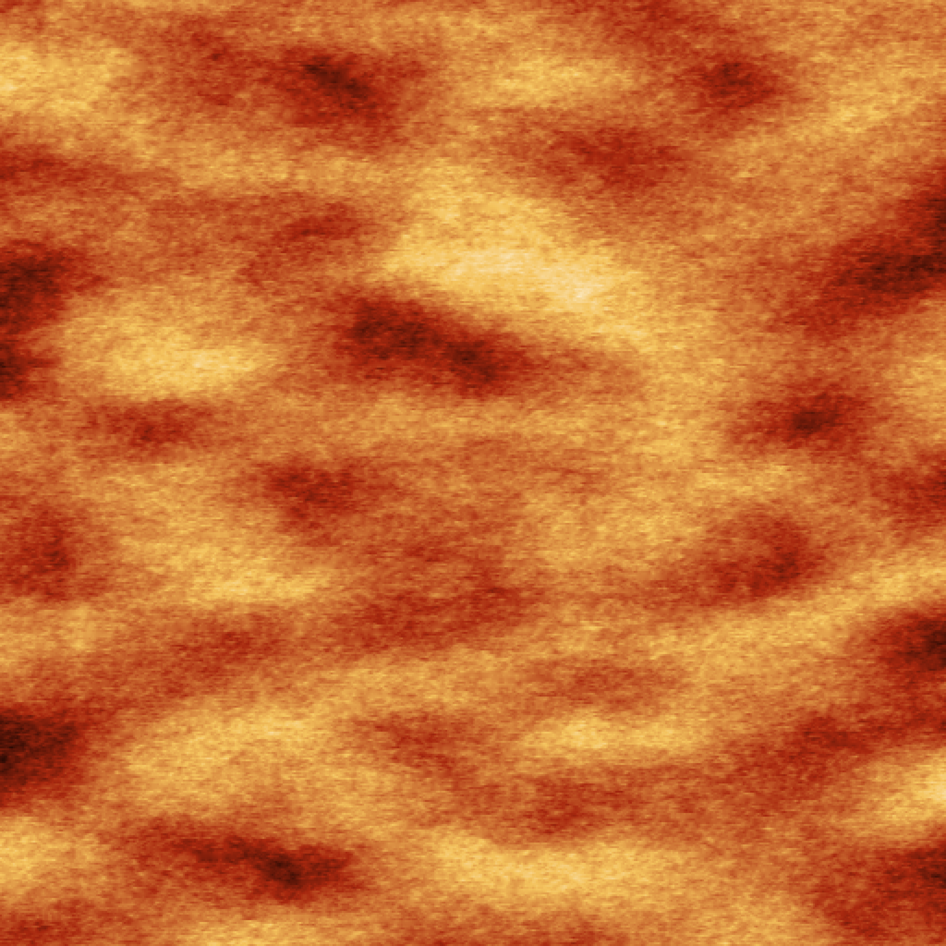
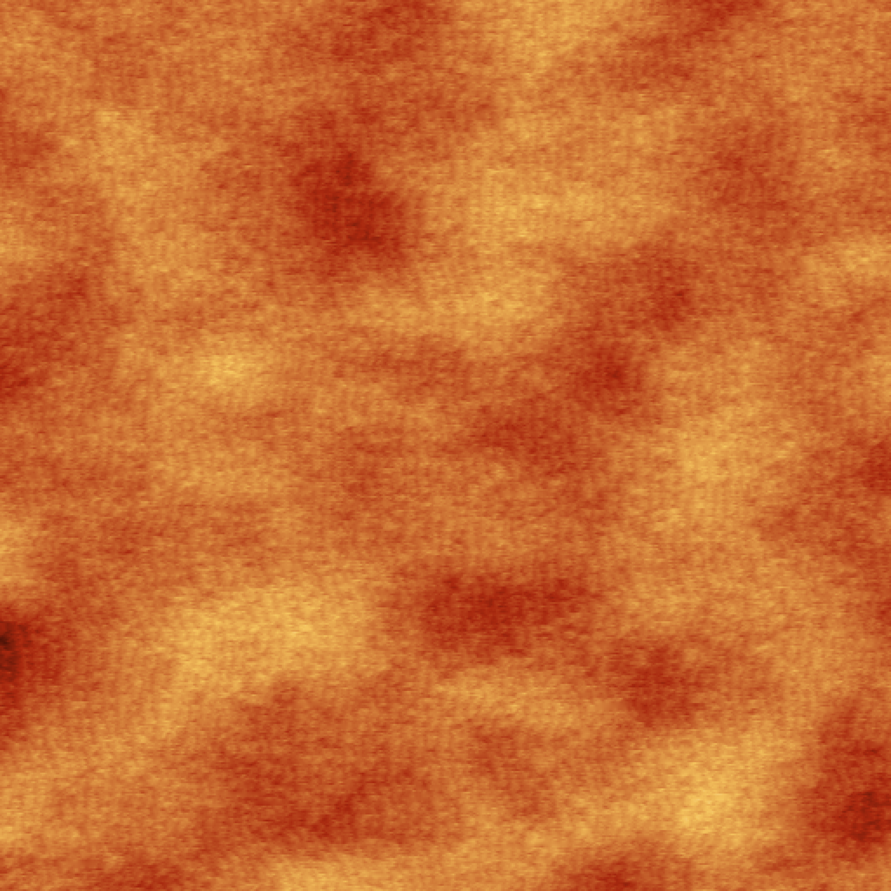
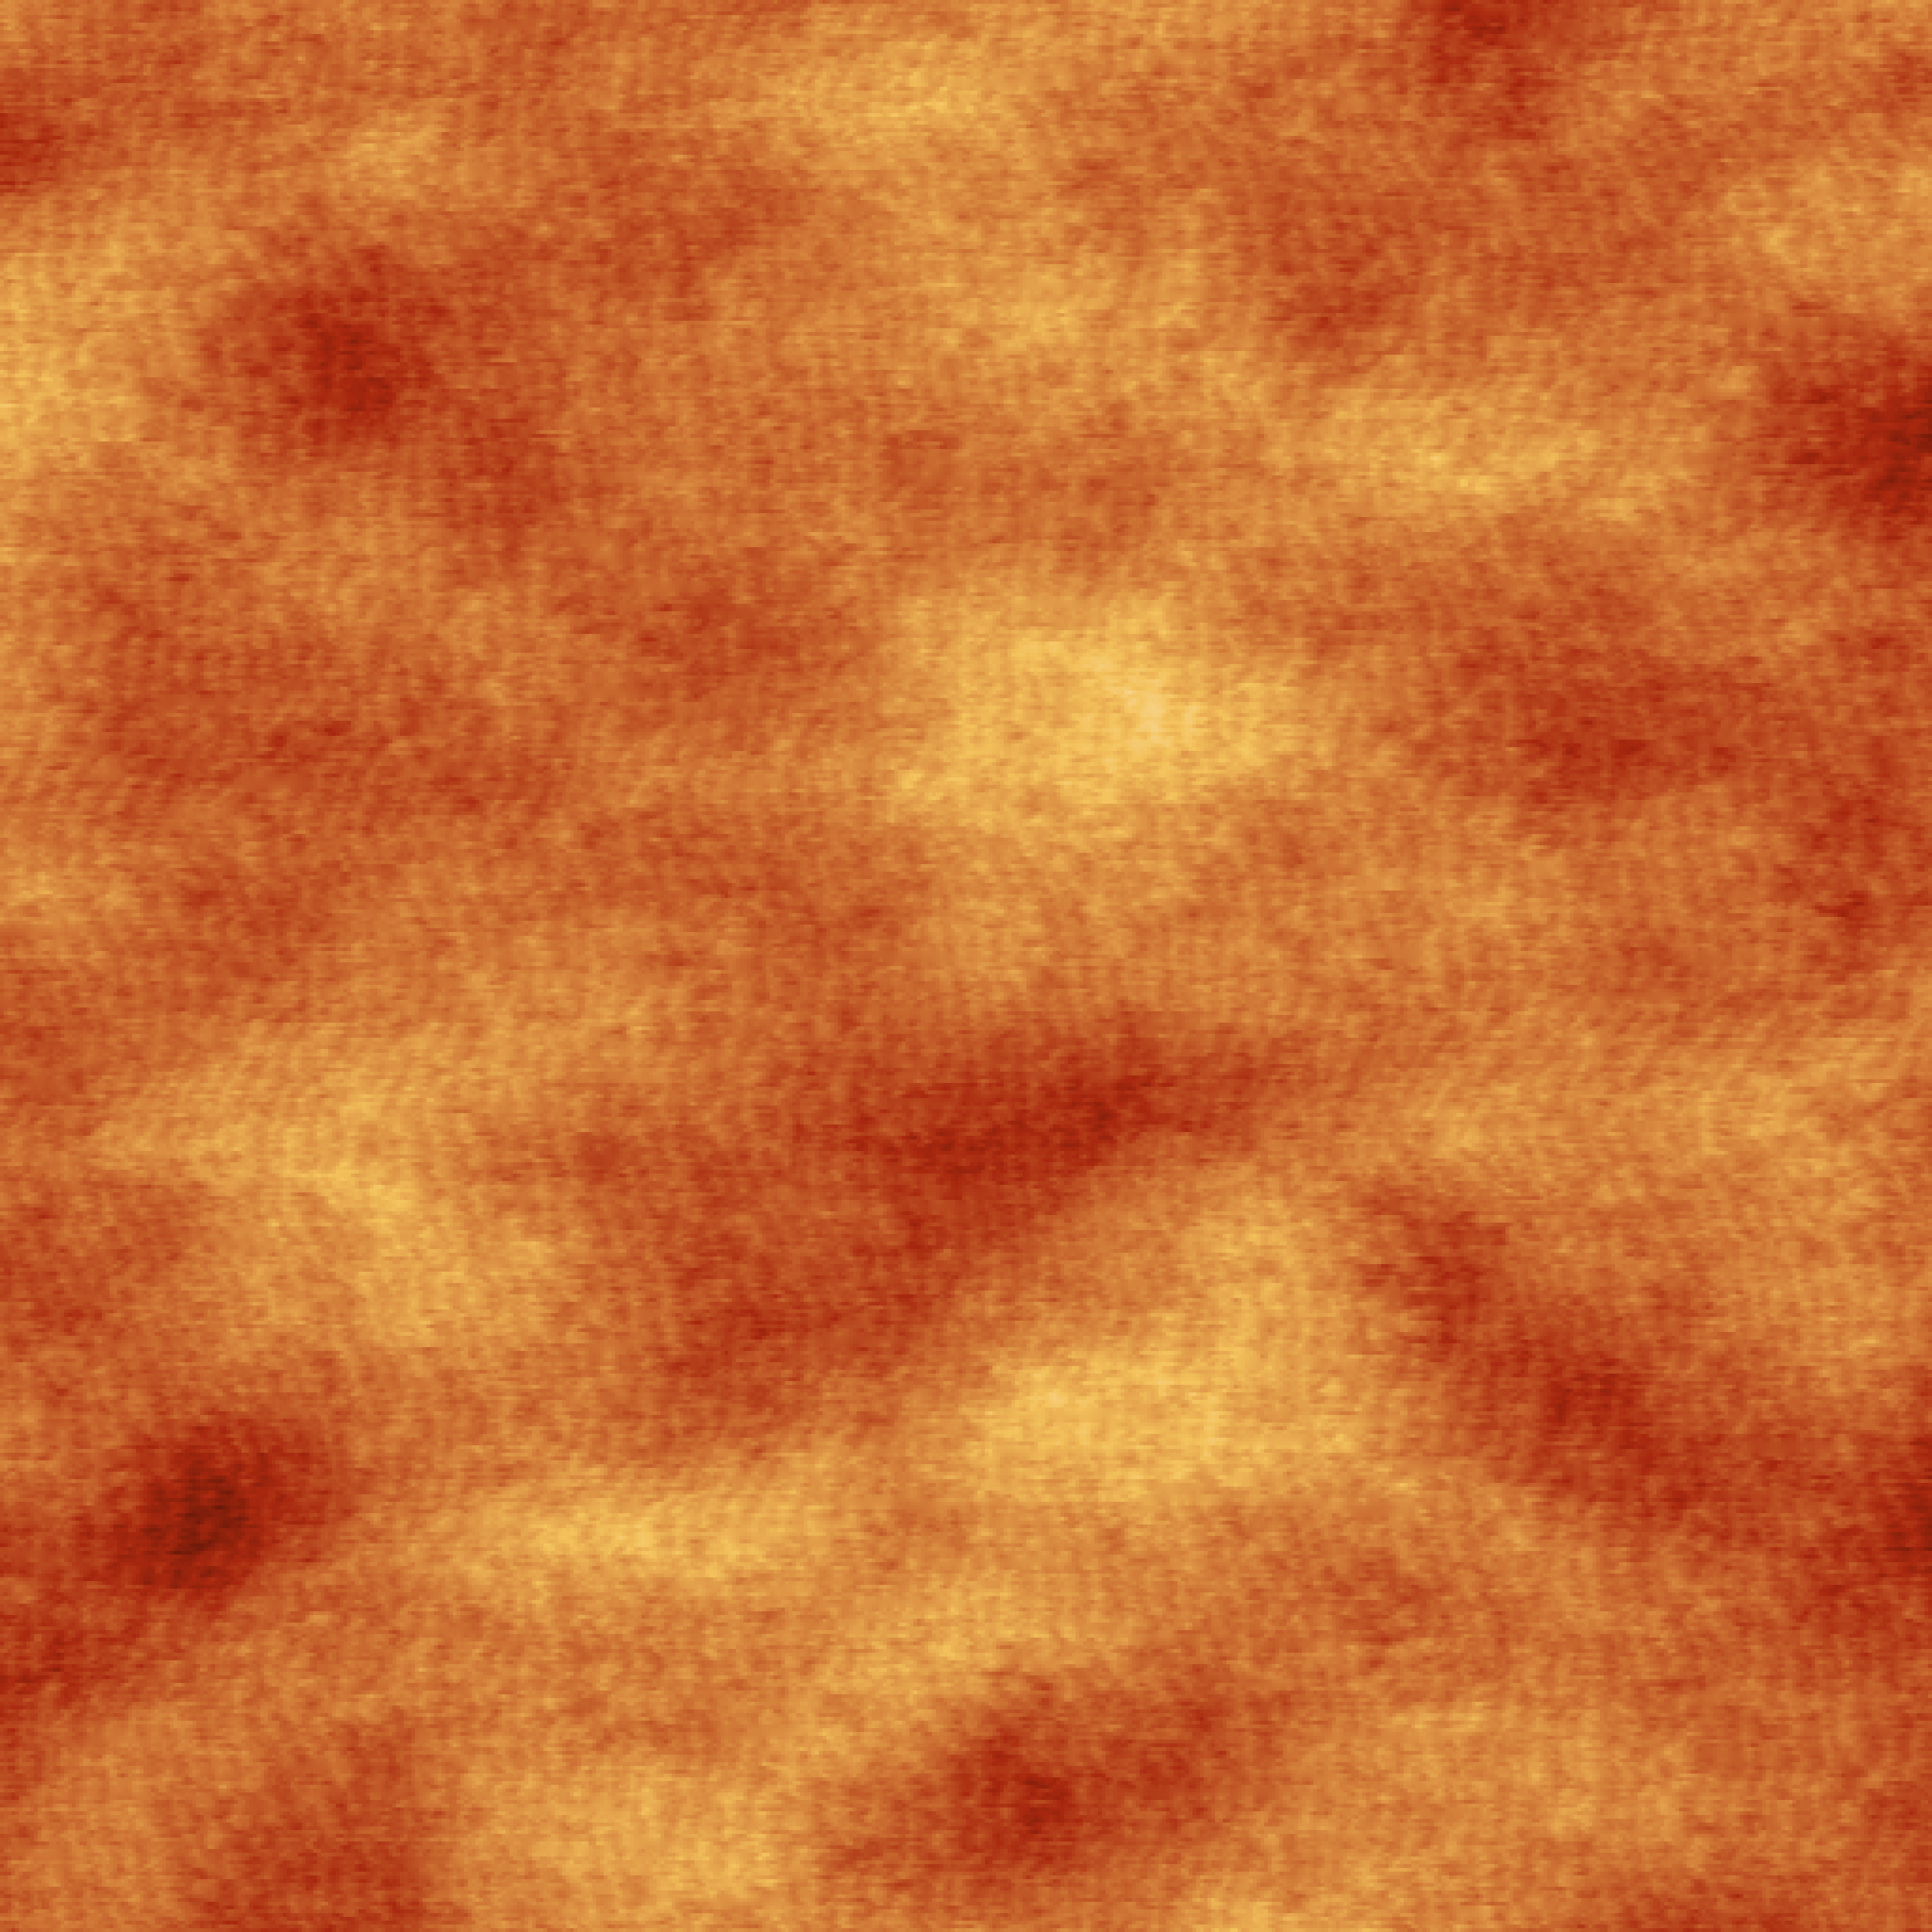
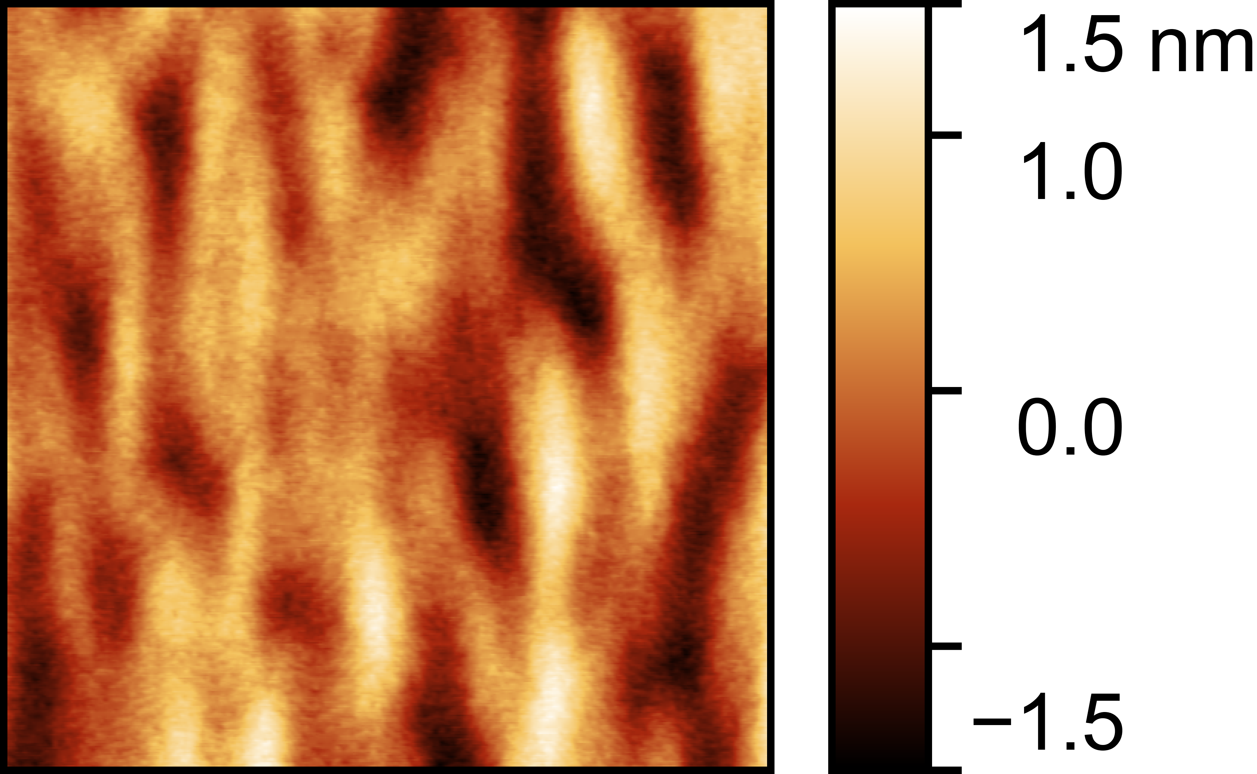
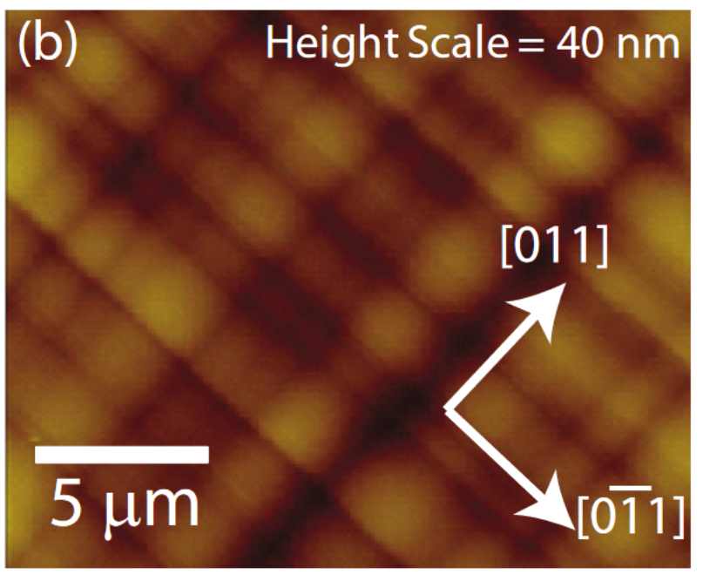
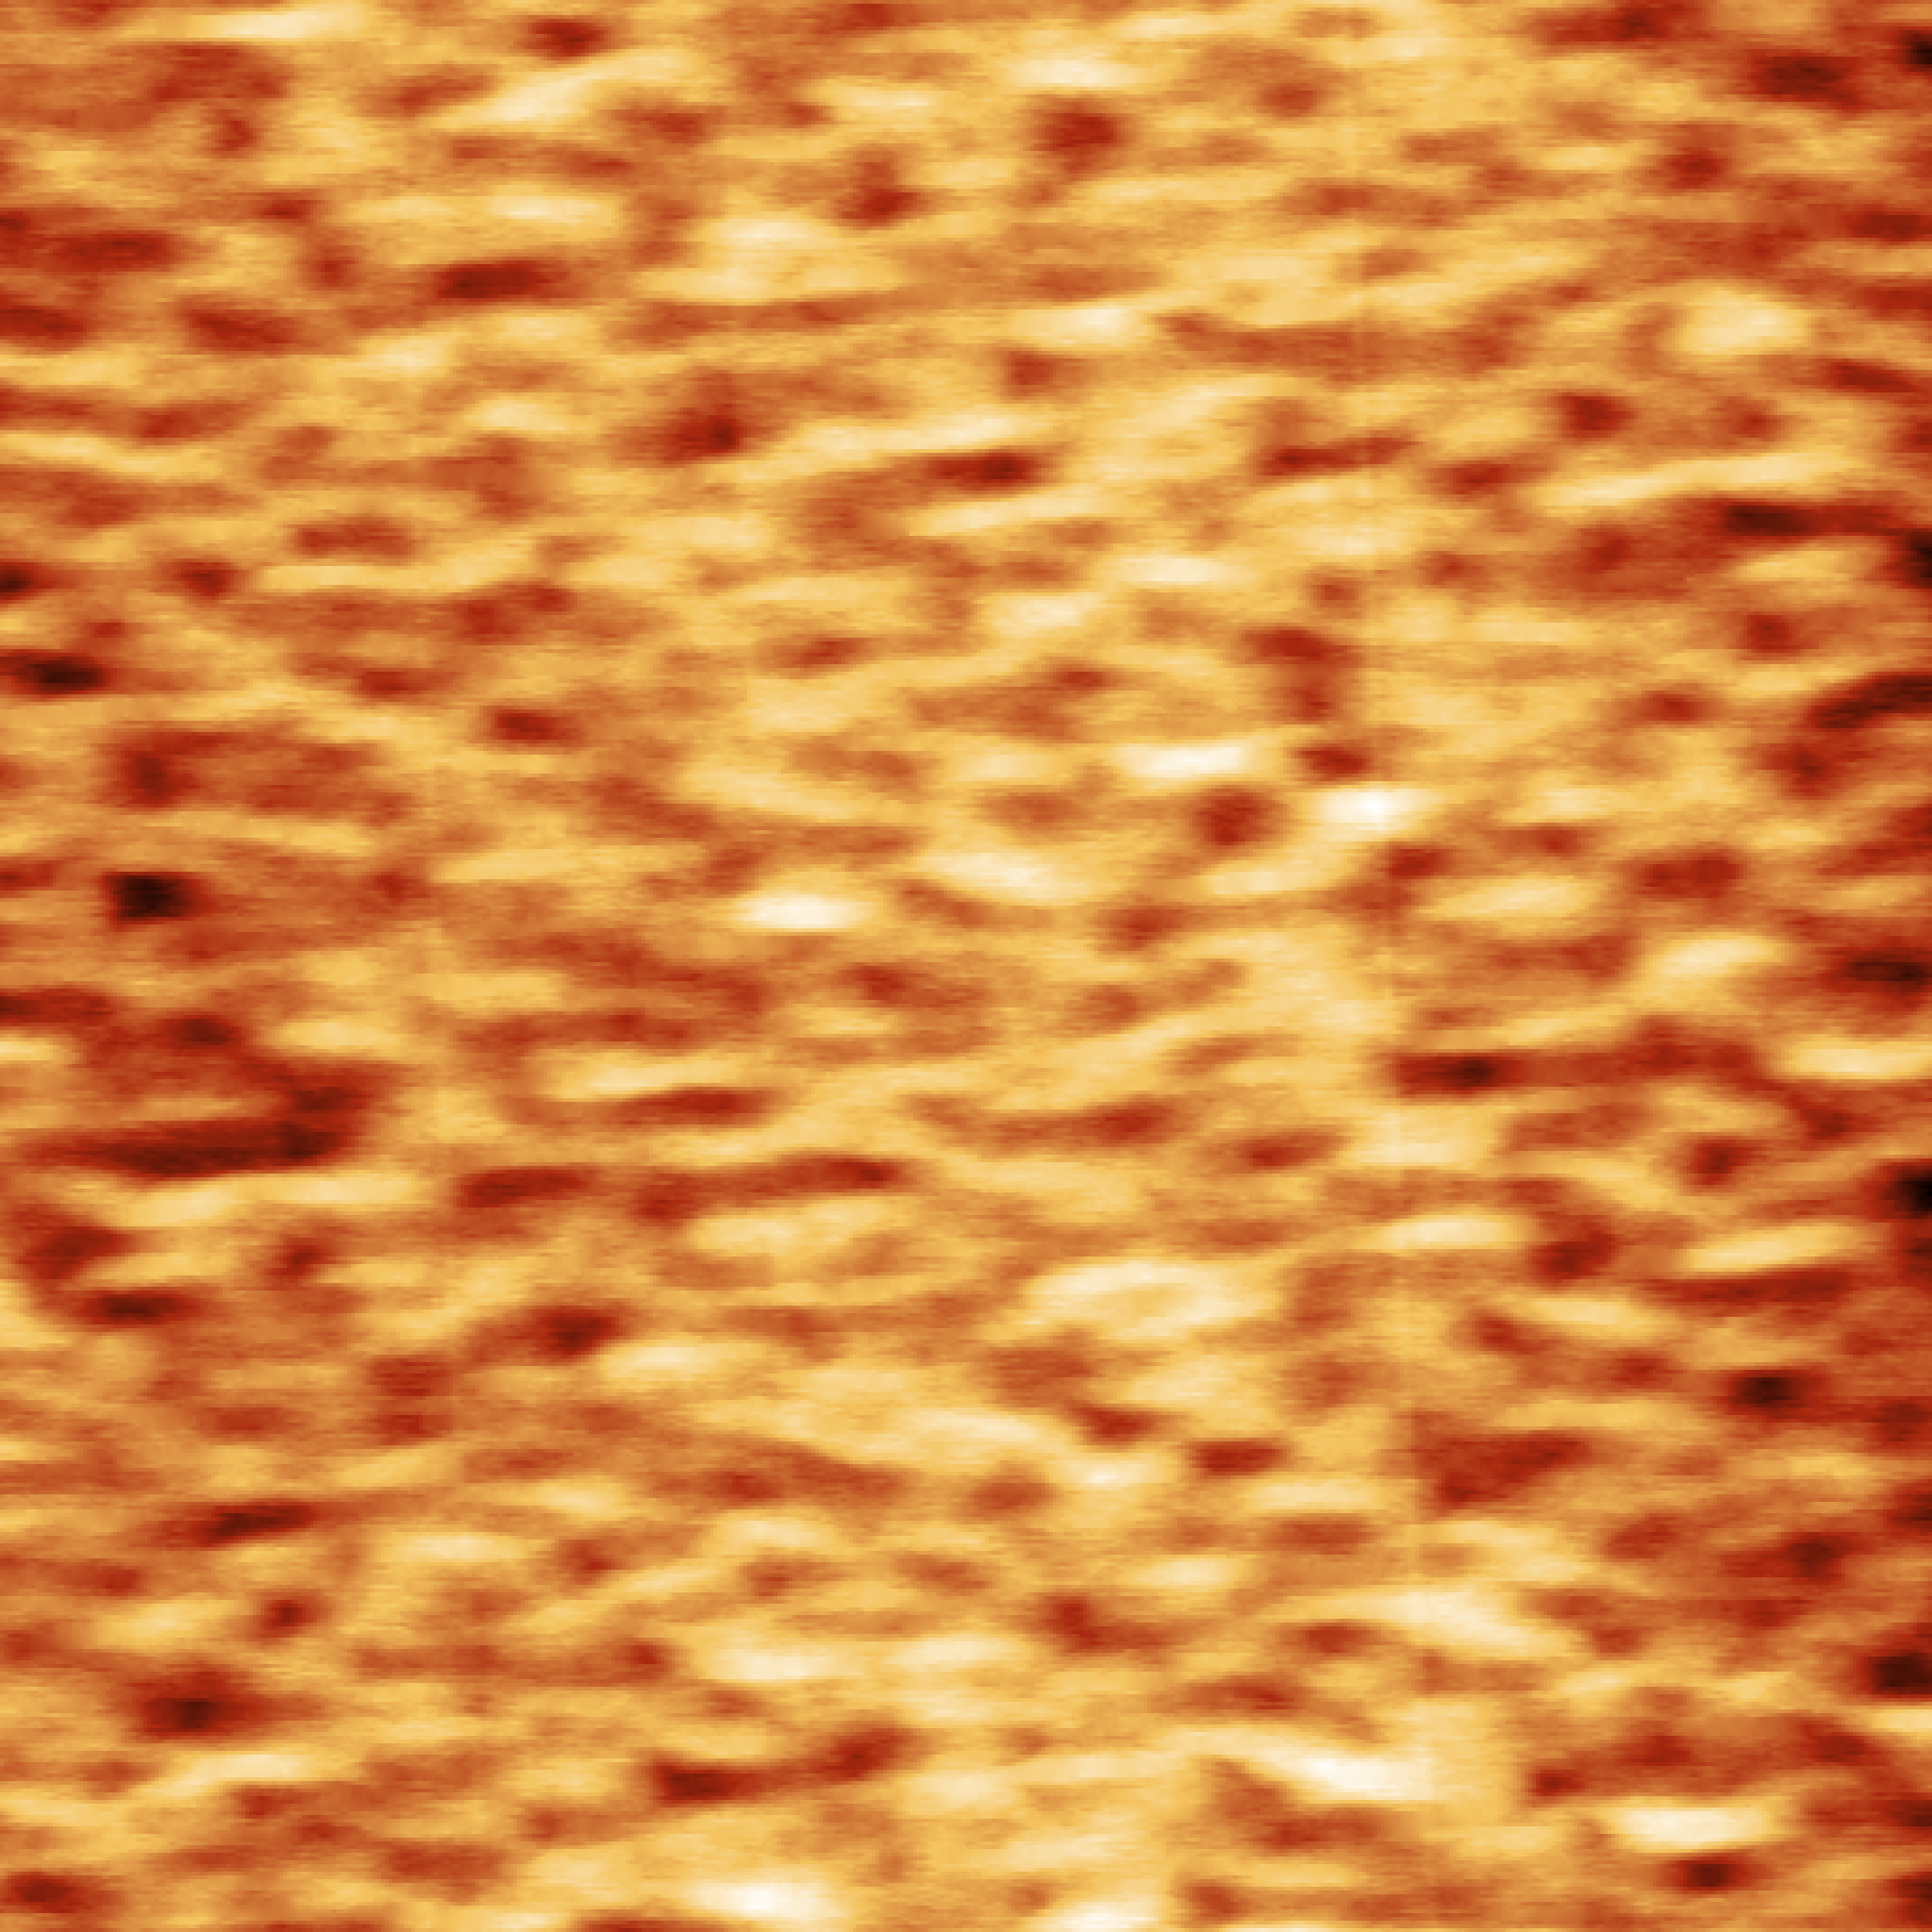
Growth optimization of photocathode structure: morphology
T_{Growth}:
480°C
520°C
560°C
1.5 nm
1 nm
0.5 nm
0 nm
-0.5 nm
-1 nm
1 µm
1 µm
1 µm
-1.5 nm
RMS 0.31 nm
RMS 0.18 nm
RMS 0.20 nm
Literature GaAsP buffer
…compared to our fully pseudomorphic sample
Atomic force microscopy
Smoothest films at higher temperatures
Smoother than typical GaAsP buffers
2 μm buffer to 20% Phosphorous
RMS 2.45 nm
Height Scale = 4 nm
RMS 0.45 nm
5 µm
Journal of Applied Physics, 109, 013708 (2011)

Slide 17
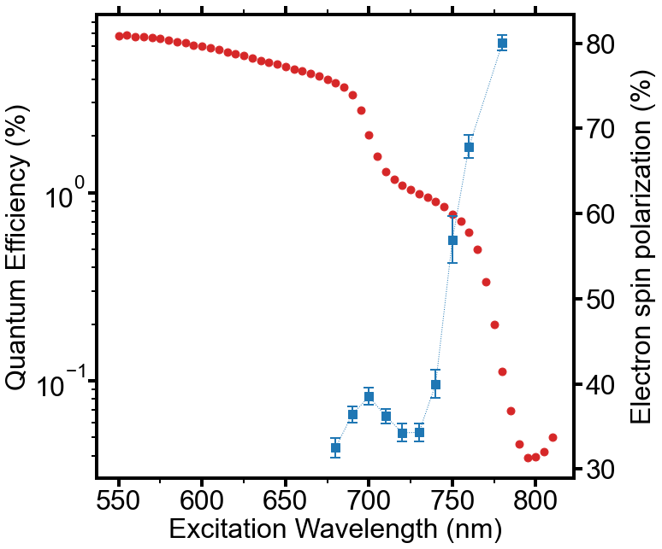
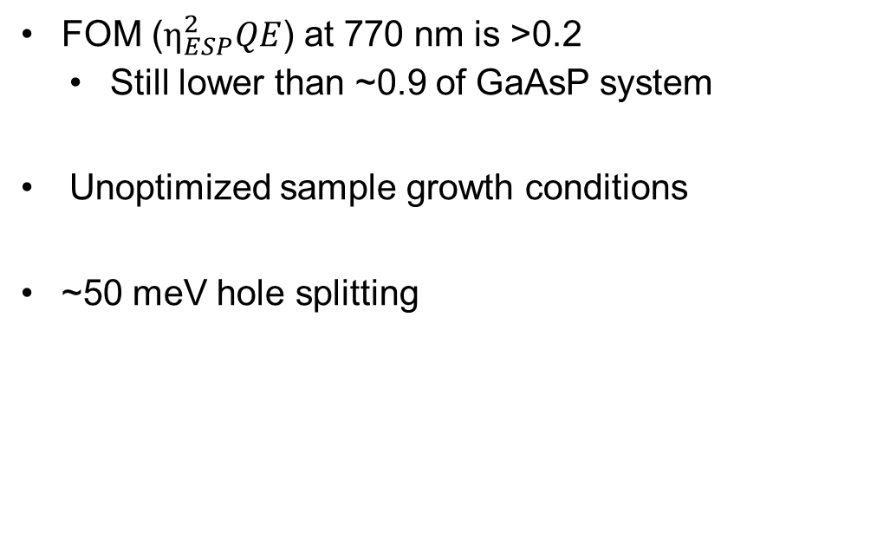
Spin polarization/QE measurements on 520°C sample
FOM ($η_{ESP}^{2}QE$) at 770 nm is >0.2
  Still lower than ~0.9 of GaAsP system
Unoptimized sample growth conditions
~50 meV hole splitting
HH2
LH1
HH1
p-type
~4E19 cm⁻³ Be
6 nm active layer GaAs
60 nm InAlGaAs/AlGaAs strained superlattice
RT
p-type
~5E17 cm⁻³ Be
AlGaAs barrier
Measured w/ JLab MicroMott
500 nm GaAs buffer
5.1 nm In_{0.16}Al_{0.23}Ga_{0.61}As
GaAs(001)
(AXT Zn-doped)
8x
2.3 nm Al_{0.274}Ga_{0.726}As

Slide 18
Outline
Applications & mechanism of spin-polarized photoemission
Benefits of InAlGaAs/AlGaAs vs. GaAs/GaAsP
Initial InAlGaAs/AlGaAs results
Improving performance with digital alloying
Uniformity and progress toward integration with Bragg reflector

Slide 19
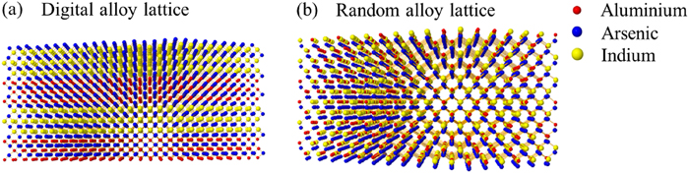
Approach to reduce alloy disorder and improve uniformity
Reduced random alloy disorder
Random alloy disorder
Random alloy
Digital alloy
LH
HH
LH
HH
J. Appl. Phys. 125, 082514 (2019)
Energy
Energy
Digital alloying minimizes random alloy disorder
  Broader high spin-polarization window
InAlGaAs digital alloys (near lattice matched to InP) should have
  Better optical emission than random alloys
  Better uniformity than random alloys
D. Song,…,Y.T. Lee J. Cryst. Growth 270, 295 (2004)
I. J. Fritz, J. F. Klem, M. J. Hafich, A. J. Howard Appl. Phys. Lett. 66, 2825 (1995)
C.S. Wang,…, A.C. Gossard, L.A. Coldren J. Cryst. Growth 277, 13 (2005)
Notes:
Sticking coefficient of In desorption mass spec.
Frank Gruenthanger JPL 1980s early 1990s.

Slide 20
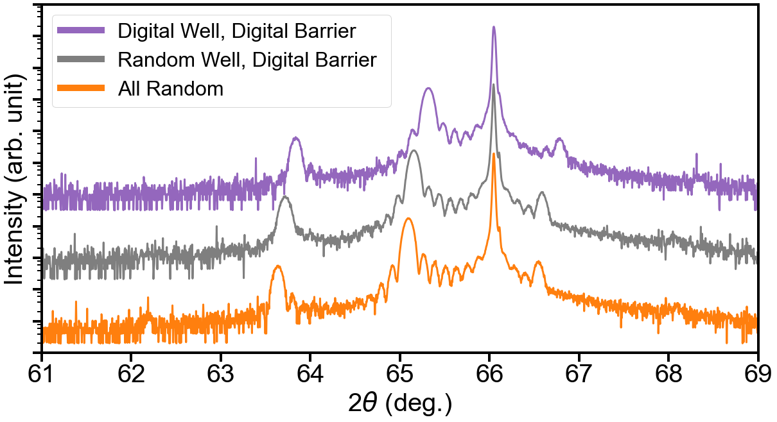
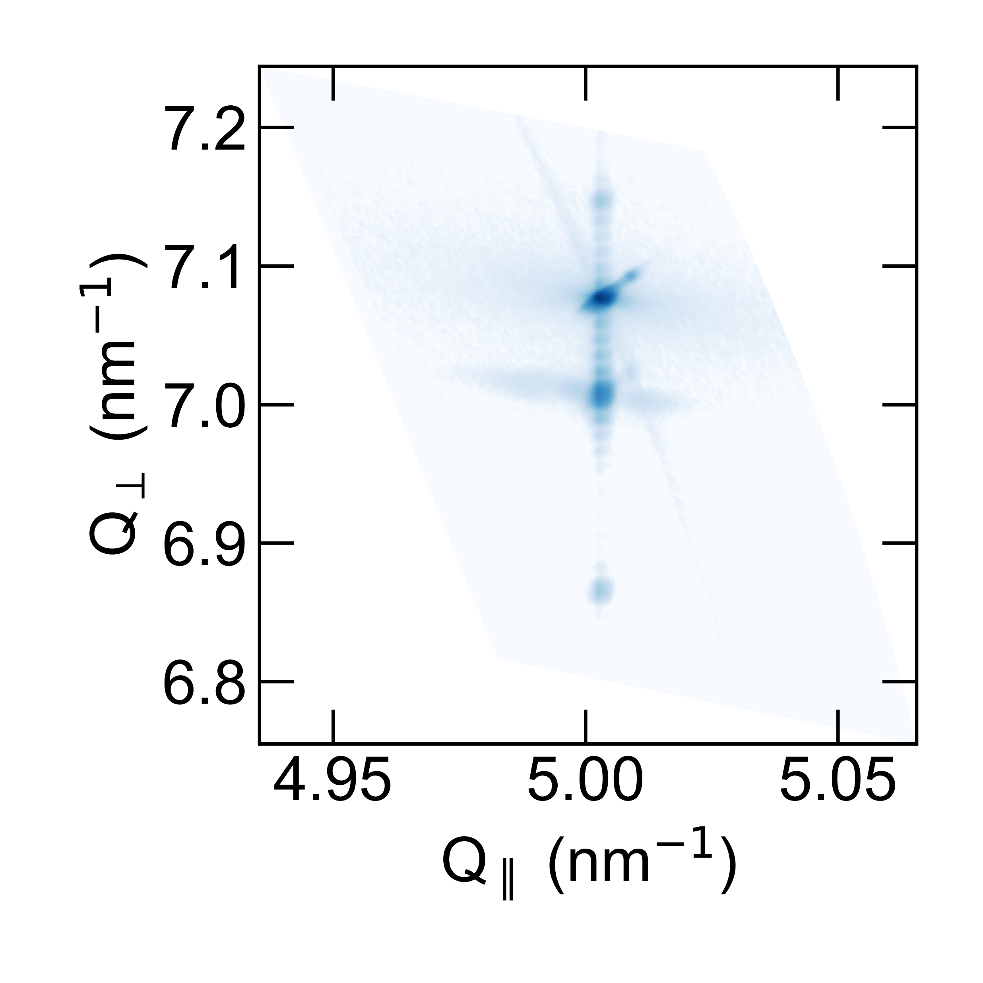
Digital alloys preserve overall superlattice structure
Fully strained to GaAs via reciprocal space map
Extra half-period added to make each well/barrier symmetric
0.6 ML In_{0.06}Al_{0.94}As
6x
6 nm GaAs
1.74 ML In_{0.22}Ga_{0.78}As
5.1 nm In_{0.16}Al_{0.23}Ga_{0.61}As
90 nm InAlGaAs/AlGaAs strained superlattice
12x
Undoped
2.3 nm Al_{0.274}Ga_{0.726}As
0.28 ML AlAs
10x
500 nm GaAs buffer
0.59 ML GaAs
GaAs(001)
(AXT Zn-doped)
On-axis XRD
GaAs(224)
Reciprocal Space Map
GaAs(004)
0
-1
1
2
-2
GaAs(224)
T_{Growth} = 520°C

Slide 21
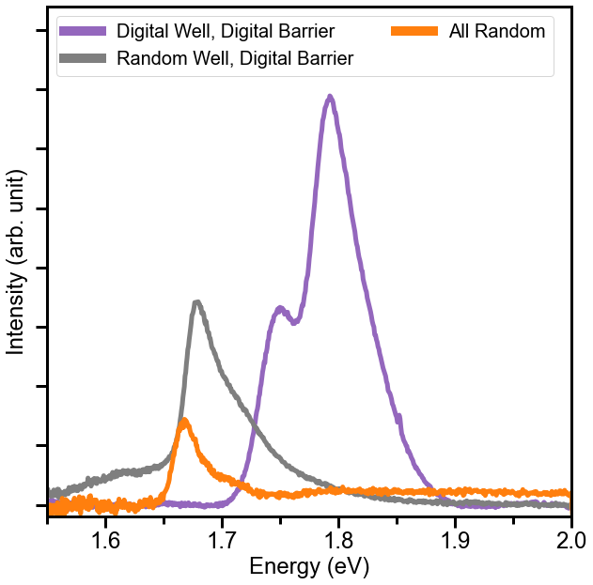
Digital alloy shows improved optical quality
Photoluminescence
Intensity of PL improves with both digital alloy barriers and digital alloy wells
PL asymmetry/splitting consistent with photoabsorption measurement
T_{Growth} = 520°C
0.6 ML In_{0.06}Al_{0.94}As
6x
1.74 ML In_{0.22}Ga_{0.78}As
HH1?
LH1?
5.1 nm In_{0.16}Al_{0.23}Ga_{0.61}As
12x
2.3 nm Al_{0.274}Ga_{0.726}As
Large background from GaAs subtracted
RT
0.28 ML AlAs
10x
0.59 ML GaAs

Slide 22
Outline
Applications & mechanism of spin-polarized photoemission
Benefits of InAlGaAs/AlGaAs vs. GaAs/GaAsP
Initial InAlGaAs/AlGaAs results
Improving performance with digital alloying
Uniformity and progress toward integration with Bragg reflector

Slide 23
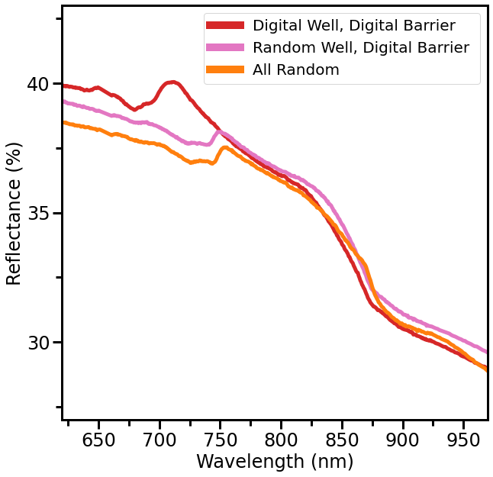
Digital alloys improve uniformity for cavity resonance
Uniformity essential for resonant cavity with DBR
Reflectance measures quality of DBR and resonance of photocathode w/ DBR

Slide 24
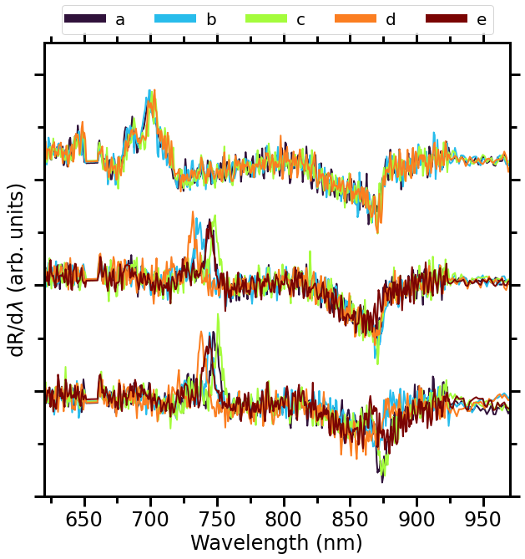
Digital alloys improve uniformity for cavity resonance
Uniformity problematic in the past
  Essential for resonant cavity with DBR
Broader features in digital alloy well
Digital alloy well + barrier makes significant improvement to uniformity
Superlattice
±3 nm
GaAs cap
All digital alloy
±8 nm
Digital alloy barrier
Random alloy well
±8 nm
All random alloy
¼ of 2” wafer
RT
Uniformity is adequate… now DBRs

Slide 25
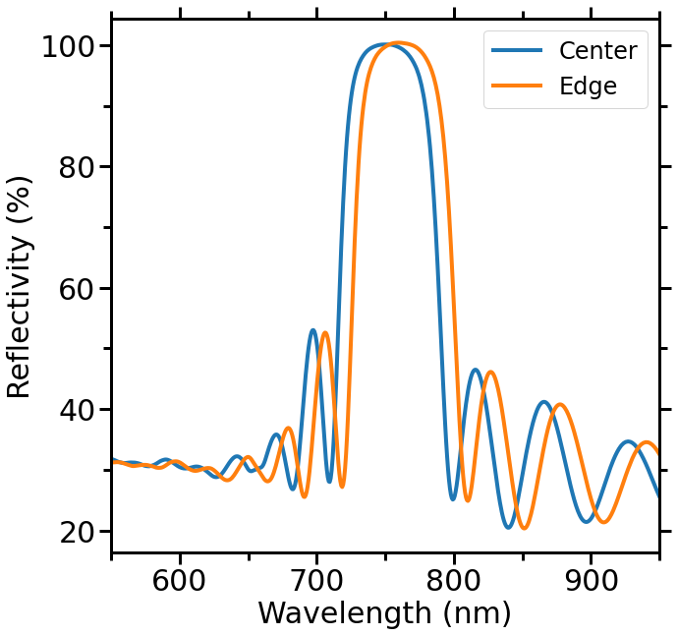
Distributed Bragg reflector test successful
AlGaAs/AlAs DBR
57 nm Al_{0.34}Ga_{0.66}As
p-type
~7E17 cm⁻³ Be
12x
65 nm AlAs
Average center linewidth ~755 nm vs. designed 780 nm
  Growth rate calibrations were slightly off…
50 nm bandwidth
Uniformity across wafer ~10 nm
  No substrate rotation during growth
Next step: integrate with optimized photocathode structure

Slide 26
Conclusions and next steps
Best InAlGaAs photocathode (to our knowledge) in this pump range
  FOM>0.2 at 770 nm
  Future samples expected to perform better
Successfully validated digital alloyed InAlGaAs/AlGaAs photocathodes for PL and uniformity
Validated DBR growth
High performance random alloy InAlGaAs/AlGaAs spin-polarized photocathode
Future work
Measure other random/digital alloys in queue
Assess lifetime of photocathodes
T_{Growth} = 520°C
26

Slide 27
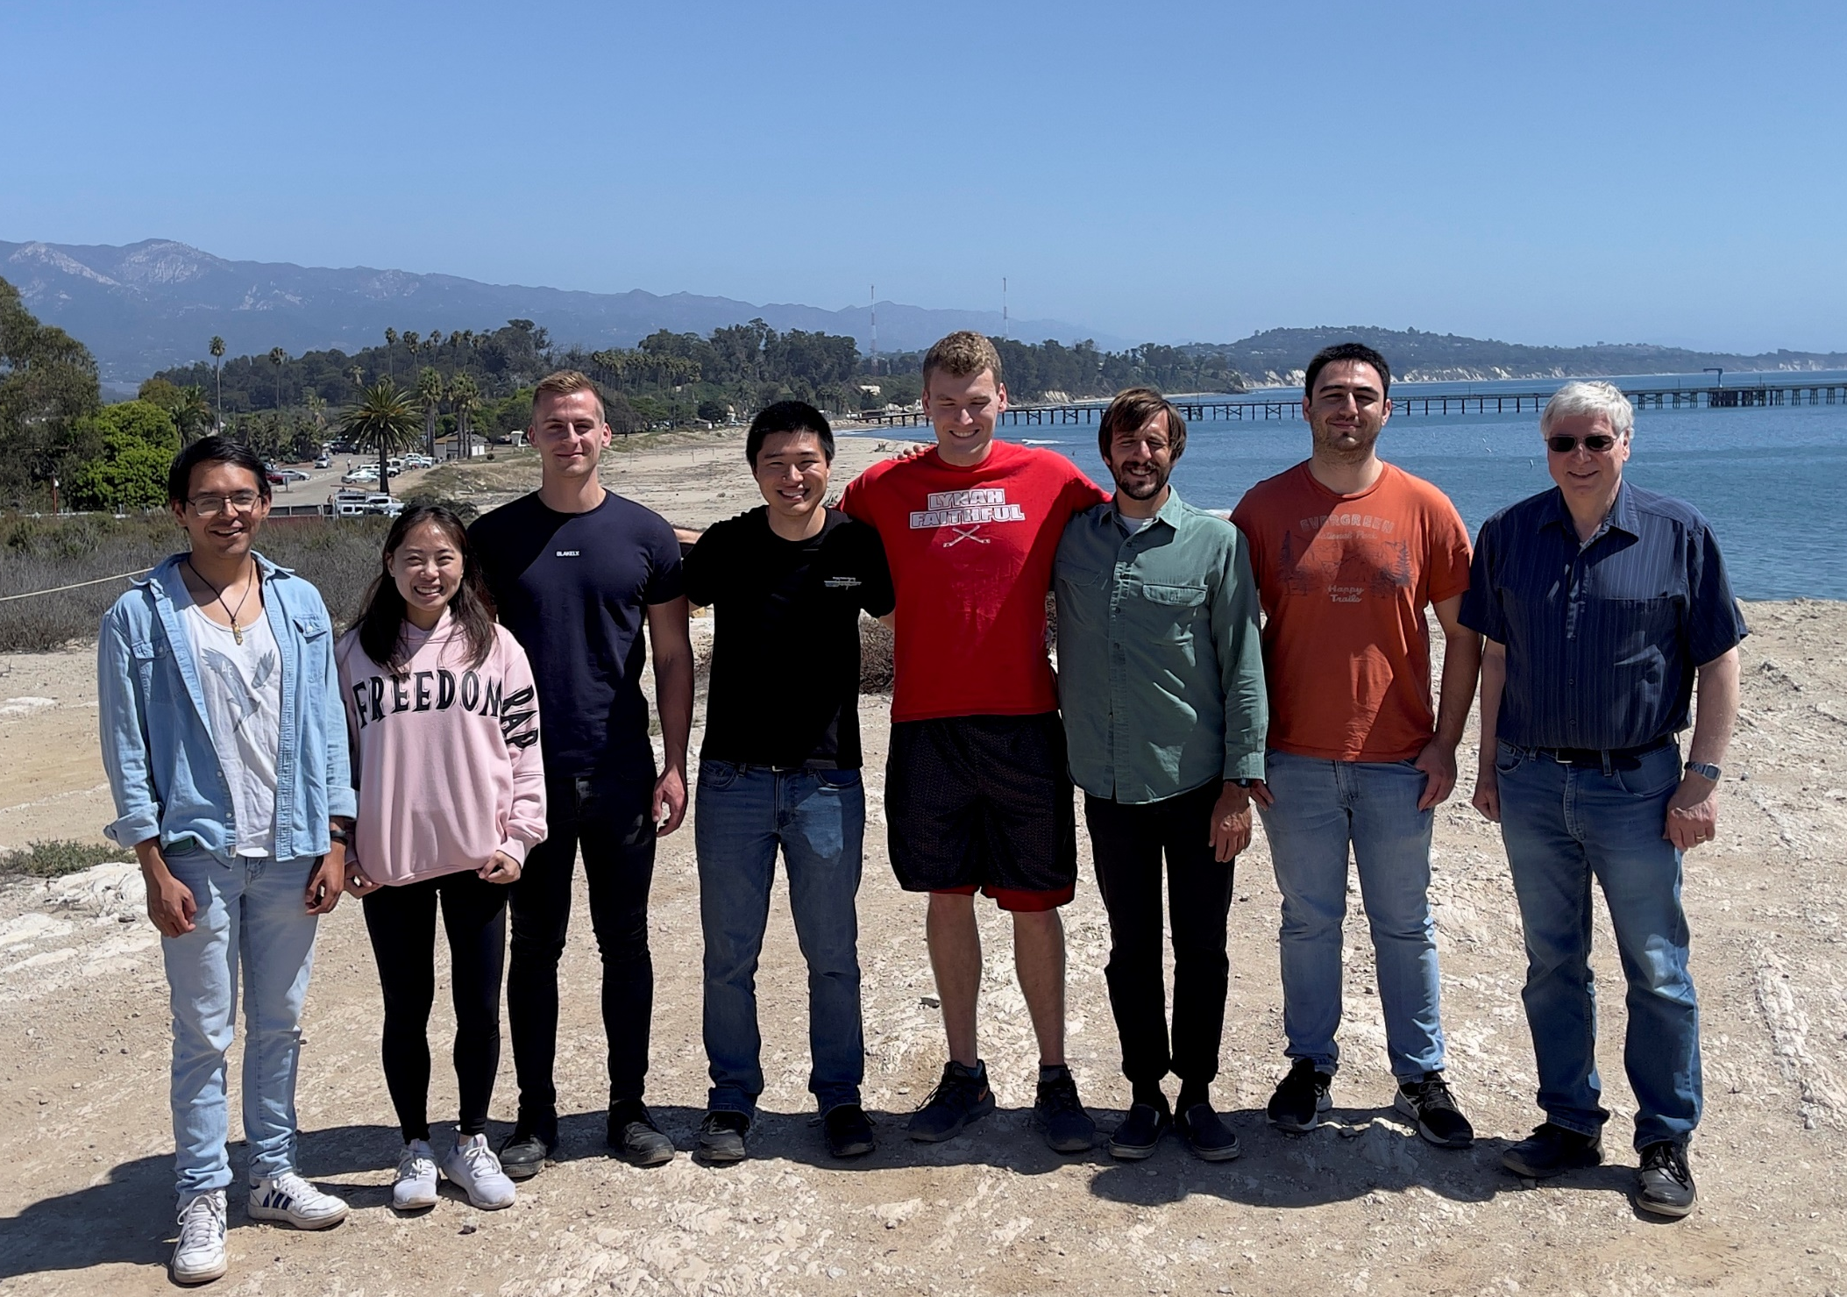




Thanks!
Questions?

Slide 28
Thanks!
Questions?
Appropriate other meanings of MBE:
Mostly Broken Equipment
Massive Beer Expenditures
Mega-Buck Evaporator
Maniac Bloodsucking Engineers
Money Buys Everything
Make Believe Experiments
Many Boring Evenings

Slide 29
Supplemental
Slides

Slide 30
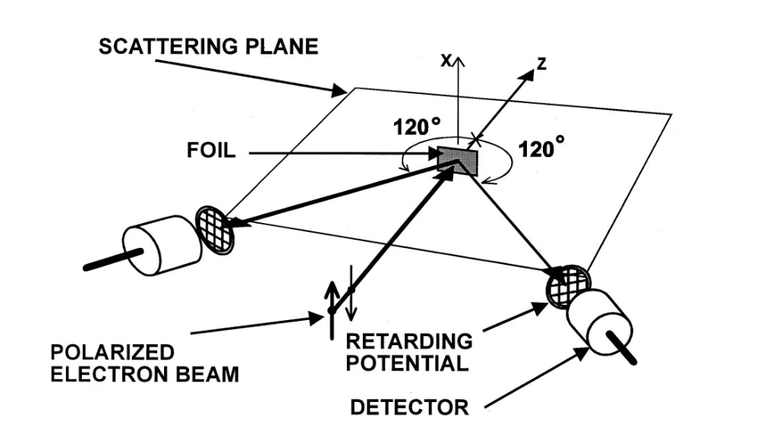

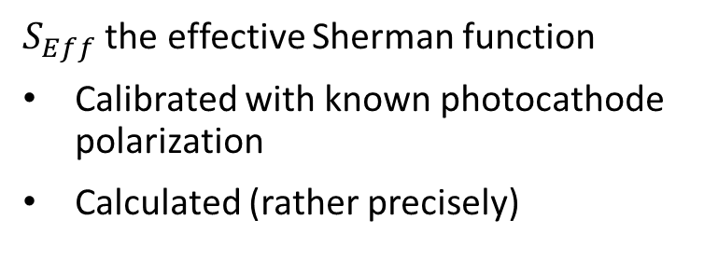
Mott polarimeter: How it works
$$η_{ESP}=\frac{1}{S_{Eff}}\frac{N_{R}−N_{L}}{N_{R}+N_{L}}$$
$S_{Eff}$ the effective Sherman function
Calibrated with known photocathode polarization
Calculated (rather precisely)
Phys. Rev. A 64, 052713 (2001)

Slide 31
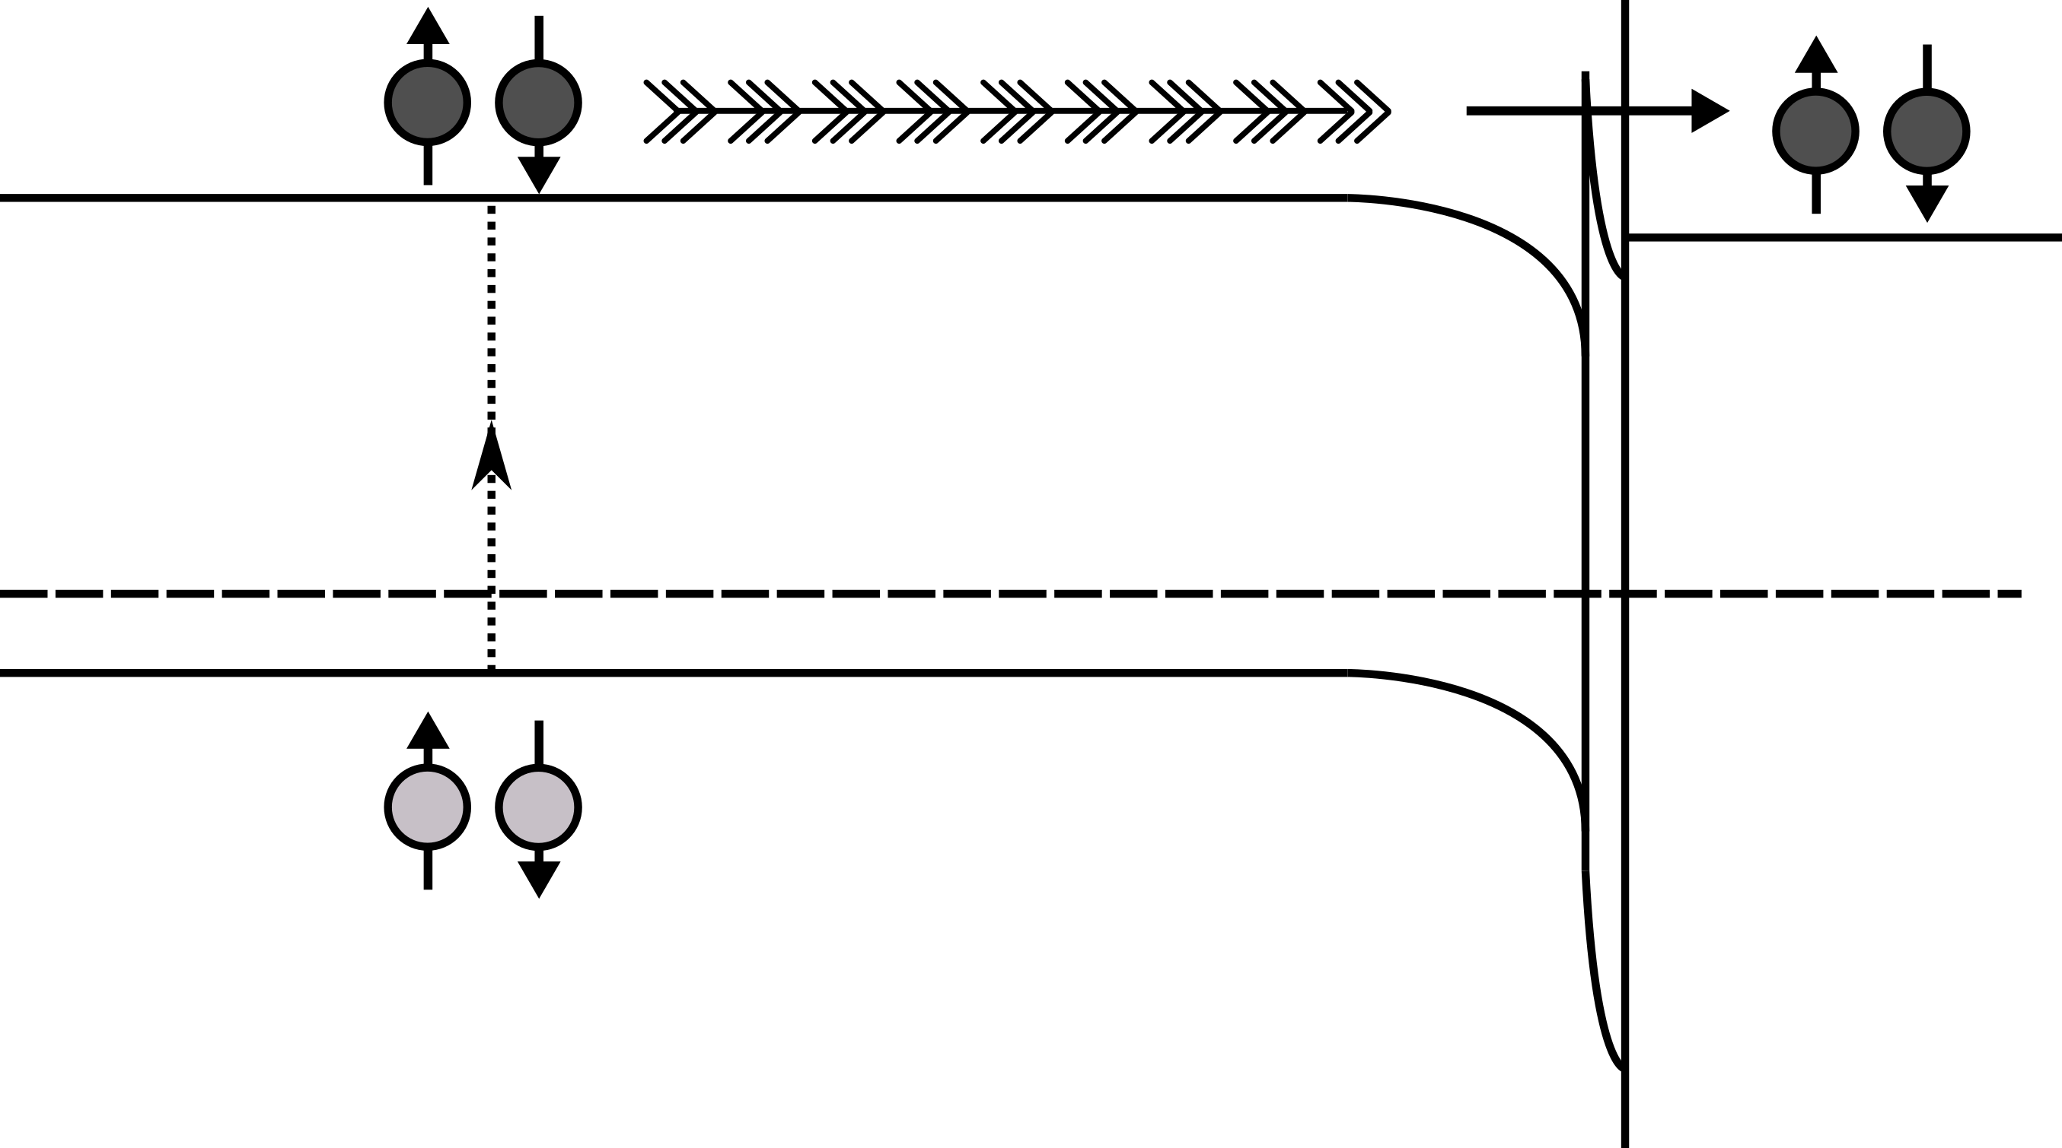

The photoemission process in a III-V photocathode
2
3
1
Excitation
E_{C}
-
-
E_{Vac}
-
Photon
-
+
2
Transport
p-type III-V
-
+
hν ≈ E_{g}
-
+
Vacuum
1
-
+
-
+
3
Emission
E_{F}
-
+
-
+
-
+
E_{V}
-
+
Cs-O functionalized surface
↓
Negative Electron Affinity
↓
QE increased by 10²-10⁴
-
+
-
+
-
+
-
+
-
+
+
$$Quantum Efficiency=\frac{Electrons Out}{Photons In}$$
+
+
+
$$=\frac{Electron Current×hc}{Laser Power×eλ}$$
W.E. Spicer, Phys Rev 112, 114 (1958)
C.N. Berglund and W.E. Spicer, Phys Rev 4A, A1030 (1964)

Slide 32
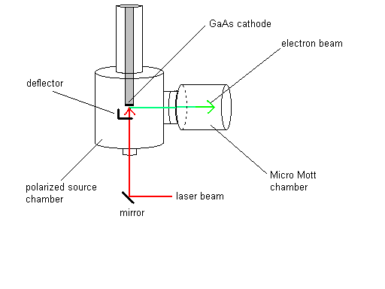
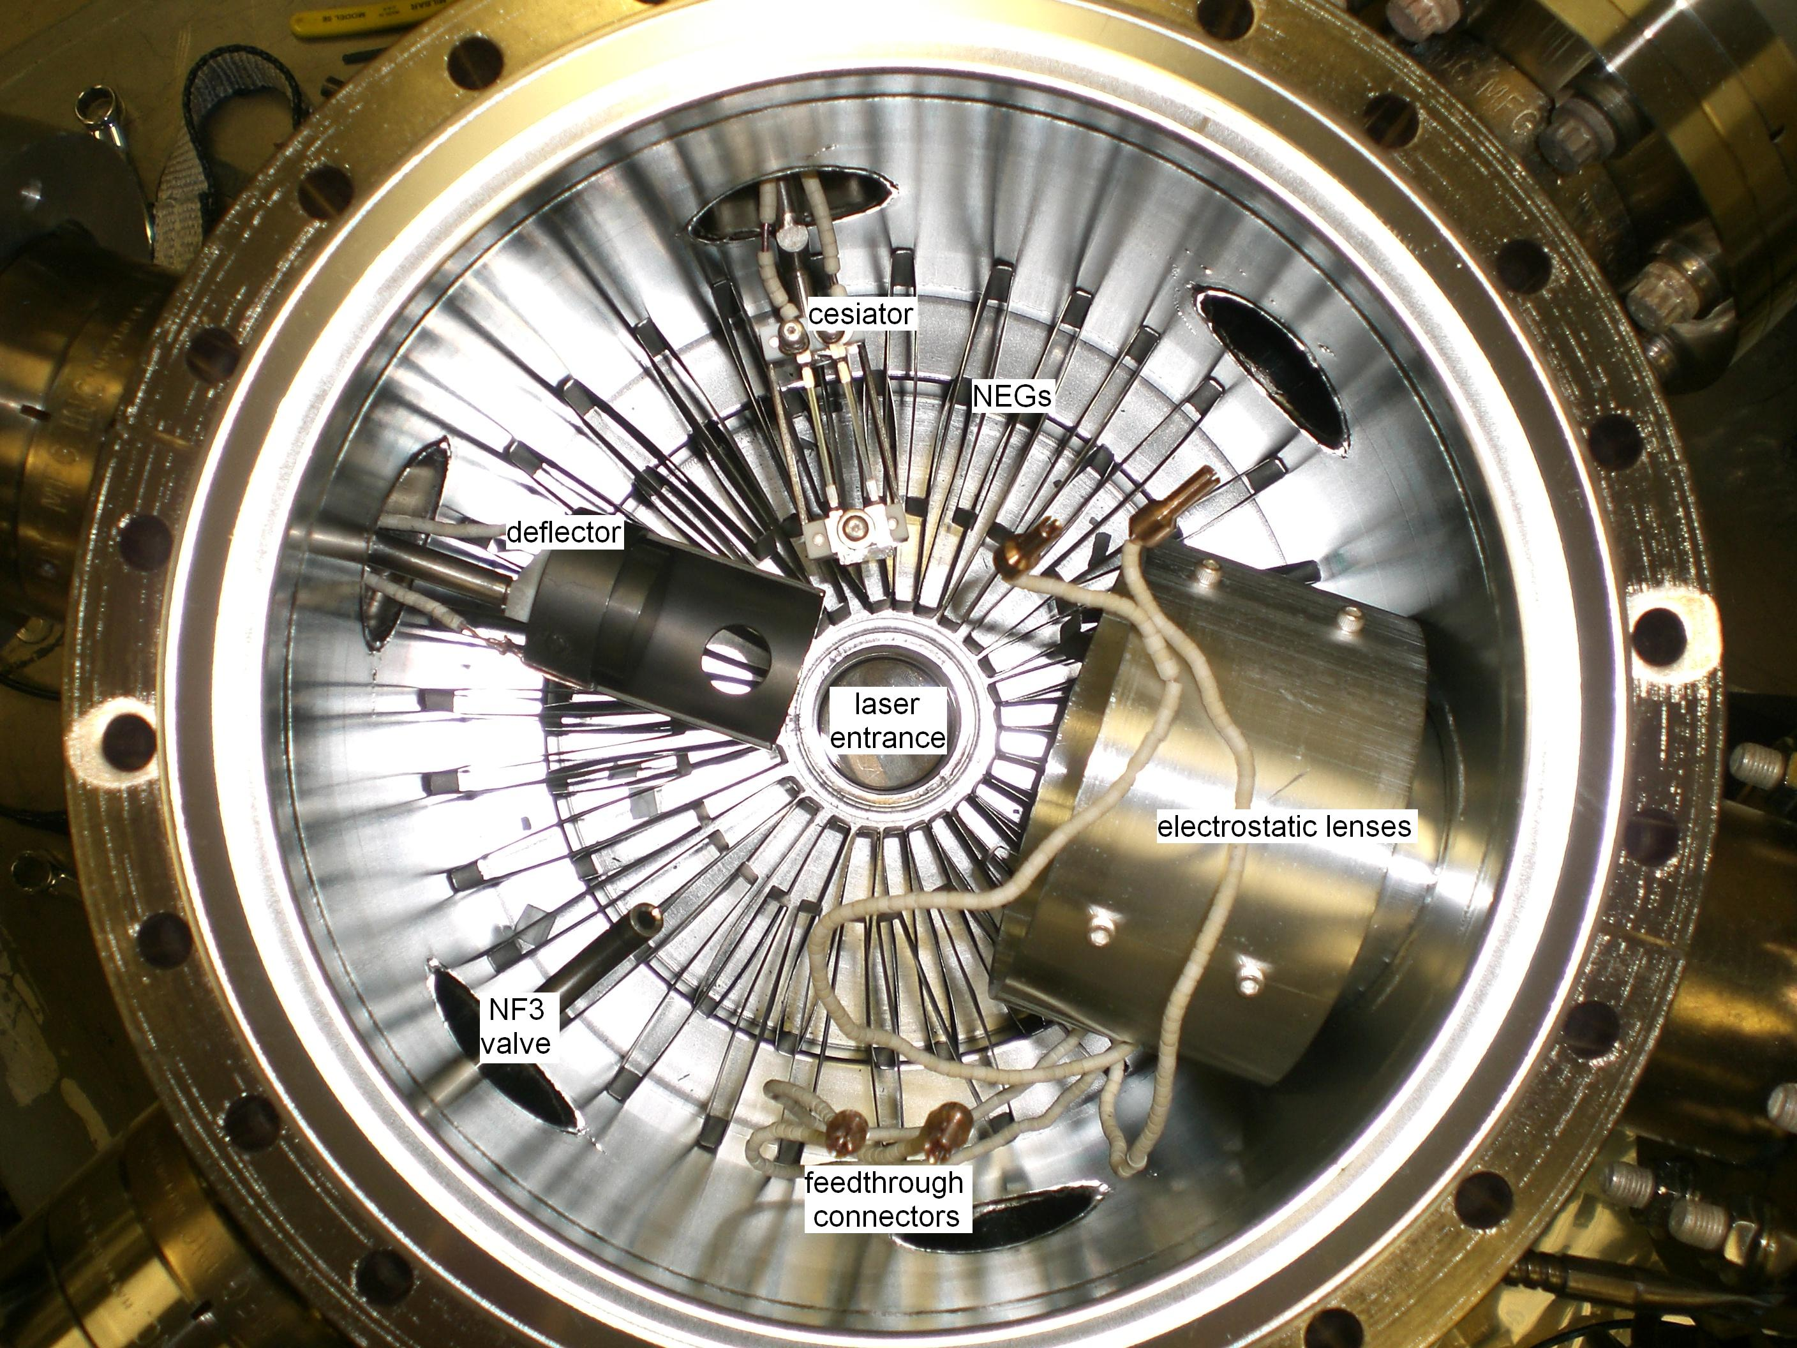
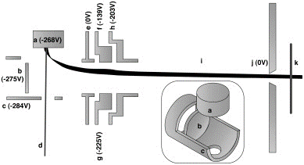
Photogun set up
April Cook, SULI JLAB
Nucl. Instr. Methods Phys. Res. A 618, 30 (2010)

Slide 33
Yo-yo NEA process
Alternating NF₃ exposure and Cs exposure
April Cook, SULI JLAB

Slide 34
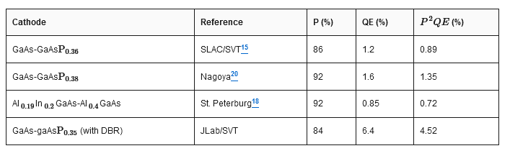
Record FOMs at peak wavelength
W. Liu, et al., Appl. Phys. Lett. 109, 252104 (2016)

Slide 35
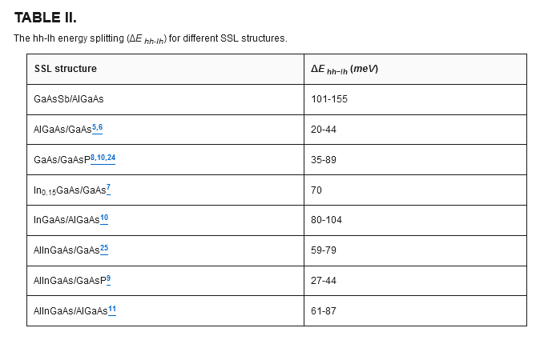
W. Liu, et al., Appl. Phys. Lett. 109, 252104 (2016)

Slide 36
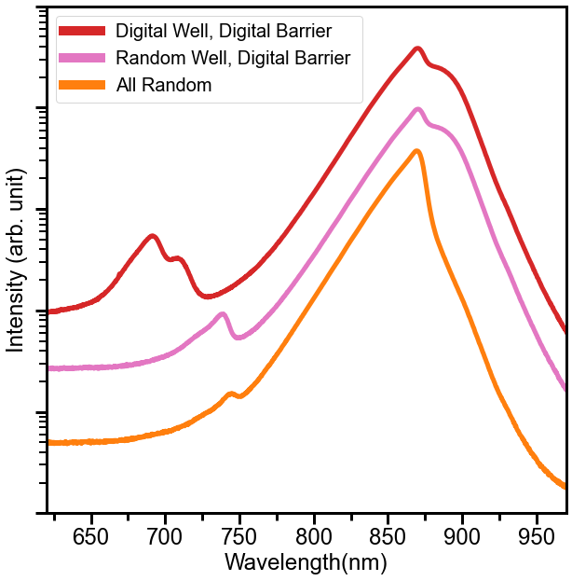
Photoluminescence shows improved optical quality using digital alloy
+GaAs in DA Barrier
Intensity of PL improves with both digital alloy barriers and digital alloy wells
PL doublet splitting consistent with spacing in photoabsorption measurement
  Potentially HH1 and LH1 transitions
Superlattice
GaAs
Substrate
Buffer
Cap
RT
T_{Growth} = 520°C
Notes:
.

Slide 37
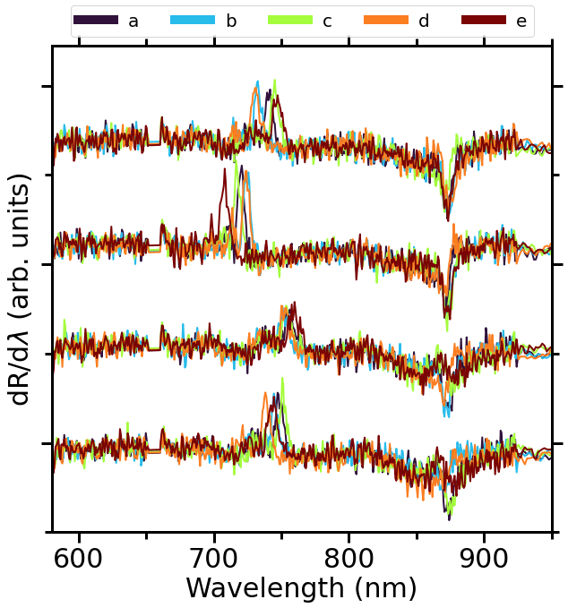
DC reflectivity shows little change in uniformity with growth conditions
V/III ratio has little effect on the uniformity
Higher(lower) temperature decreases(increases) uniformity slightly
  Non-uniform indium desorption over the wafer from a non-uniform temperature profile
Superlattice
GaAs cap
520°C V/III = 1.5
560°C V/III = 2.5
485°C V/III = 2.5
520°C V/III = 2.5
RT

Slide 38
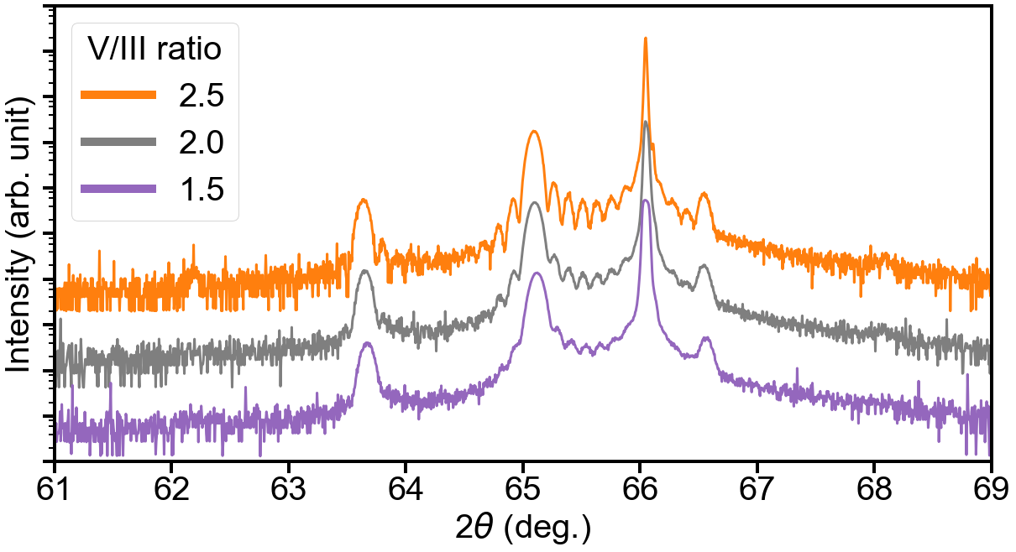
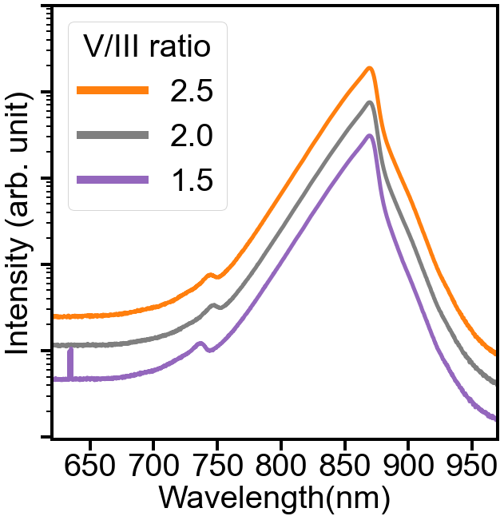
Effect of V/III ratio
Constant growth temp 520°C
GaAs(004)
0
-1
1
-2
2
XRD shows not much of a change, higher V/III ratio is better
PL shows slight blue shift with lower V/III
  No measurable change in FWHM
Superlattice
GaAs
Substrate
Buffer
Cap
RT

Slide 39







Clear terraces in all samples except cold grown
480 °C
V/III=2.5
560 °C
V/III=2.5
520 °C
V/III=2.5
520 °C
V/III=2.0
520 °C
V/III=1.5
2 µm
400 nm

Slide 40



Digital alloys improve surface morphology
Unexpected improvement in sample roughness using digital alloys
  GaAs layer in DA barrier
  InGaAs layer in DA well
GaAs/InGaAs improve morphology more than AlAs/InAlAs deteriorate it
All analog
DA Barrier
DA Well & Barrier
DA Barrier
1.5 nm
520 °C
V/III High
520 °C
V/III High
520 °C
V/III High
1 nm
0.5 nm
0 nm
-0.5 nm
-0.5 nm
2 µm
-1 nm
RMS 5.1 Å
RMS 3.7 Å
RMS 1.9 Å
-1.5 nm
1.8 Å In_{0.06}Al_{0.94}As
6x
5.2 Å In_{0.22}Ga_{0.78}As
12x
5.1 nm In_{0.16}Al_{0.23}Ga_{0.61}As
2.3 nm Al_{0.274}Ga_{0.726}As
10x
0.79 Å AlAs
10x
1.66 Å GaAs

