Slide 1
Atomic Layer Deposition (ALD) – An Enabler for Photocathodes?
Harish Bhandari, Director for Advanced Thin Films Technologies
hbhandari@rmdinc.com

Slide 2
Spicer’s 3-Step Photoemission Model
Photoexcitation
Transport to the Surface
Escape to Vacuum
L_{a} absorption depth
L,
escape depth
Photocathode
Photocathode
Substrate
Substrate

Slide 3
A case for conformal cathodes
photon
Ultrathin conformal cathodes
electron
Nanostructured Substrate
Nanostructured Substrate

Slide 4
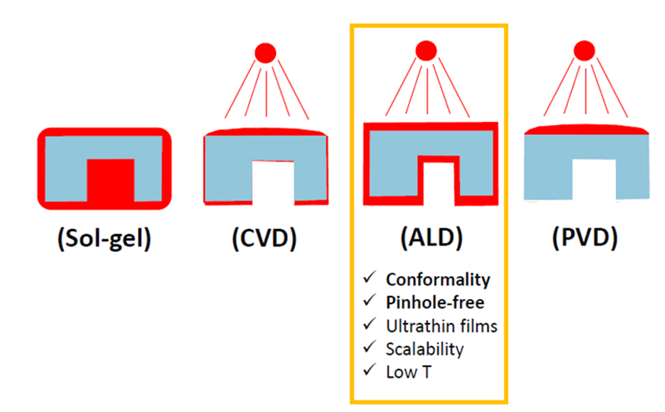
ALD – a thin film growth technique
Growth Techniques most popular for cathodes:
Thermal Evaporation
Molecular Beam Epitaxy
Pulse Laser Deposition
RF sputtering

Slide 5
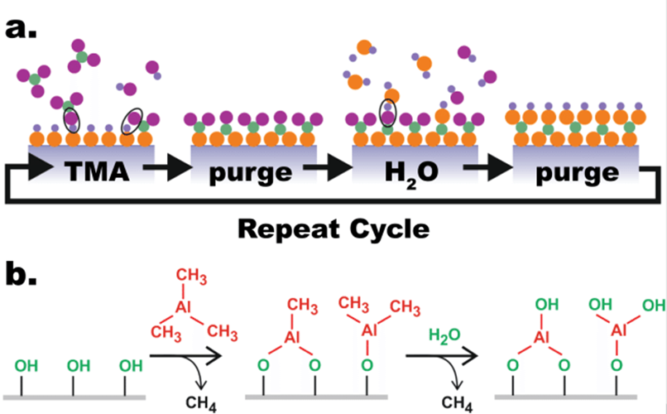
ALD – how does it work?
Case Study: Al₂O₃ by ALD

Slide 6
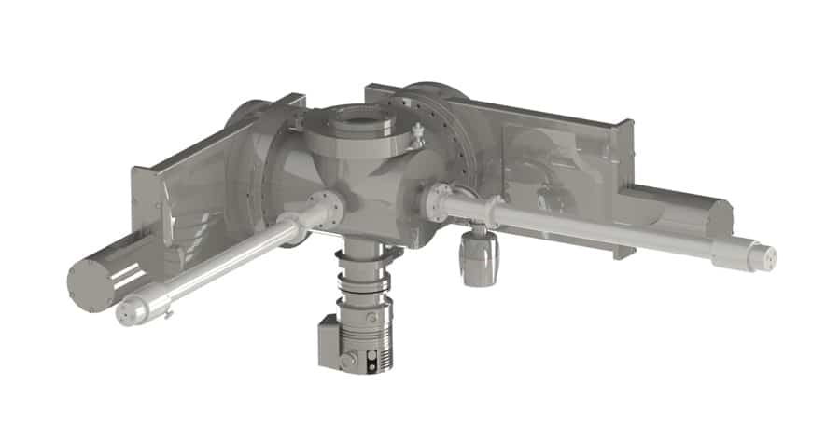
Innovations in ALD are challenging (and rewarding)
ALD is driven by surface chemistry
Self-limiting chemical reaction
Requires tailored chemical precursors
Reactivity
Predictability (reaction)
Volatility
Stability
Precursors
Cathode handoff
Loadlock
ALD
Pump
Source: www.moorfield.com

Slide 7
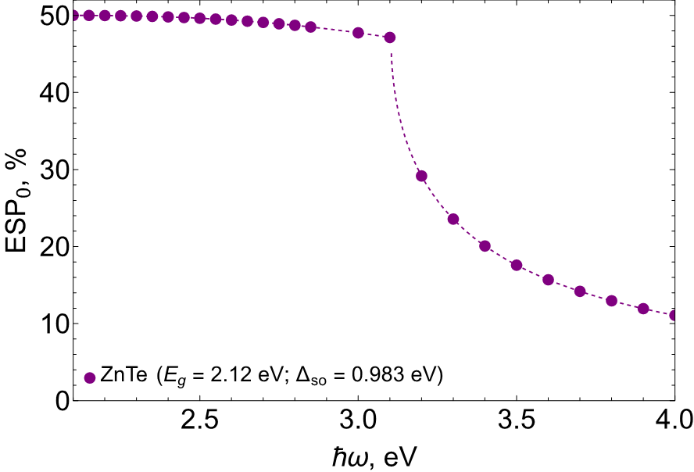
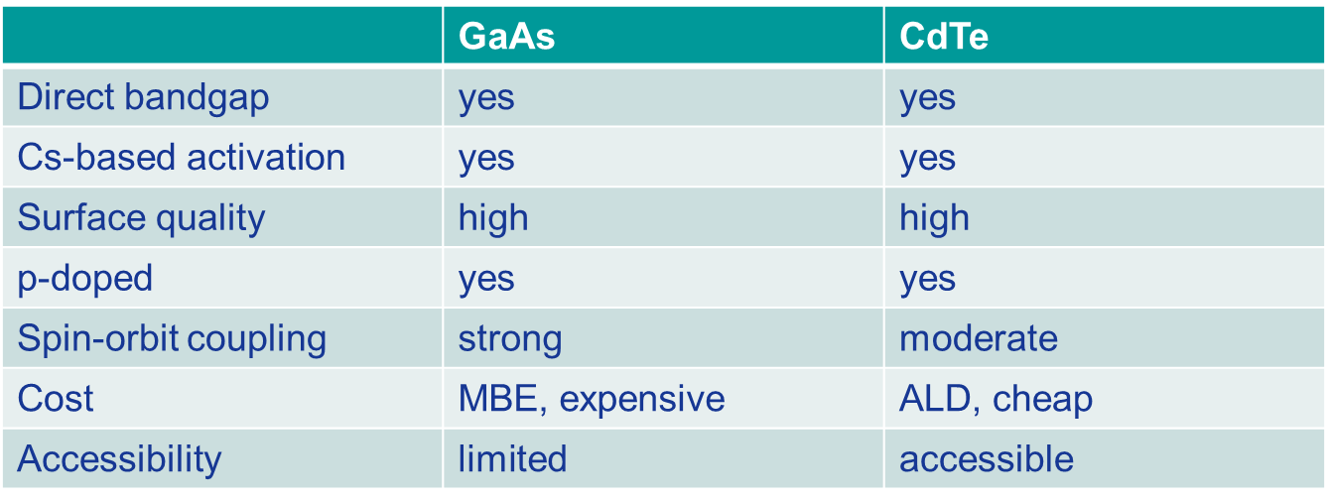
ALD for Spin Polarized Cathodes (Group II-VI)
Source: Dr. Chubenko, P3 2023
Boutaiba et al. Phys. REV. B 89, 245308 (2014):

Slide 8
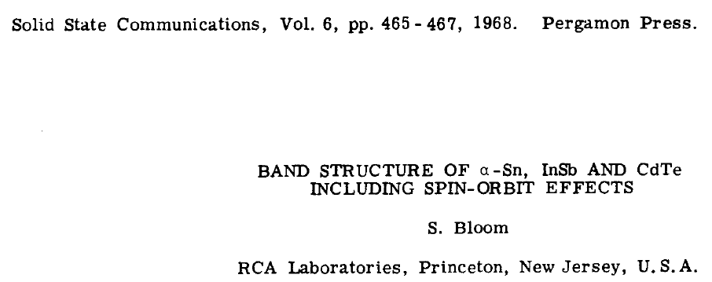

Slide 9
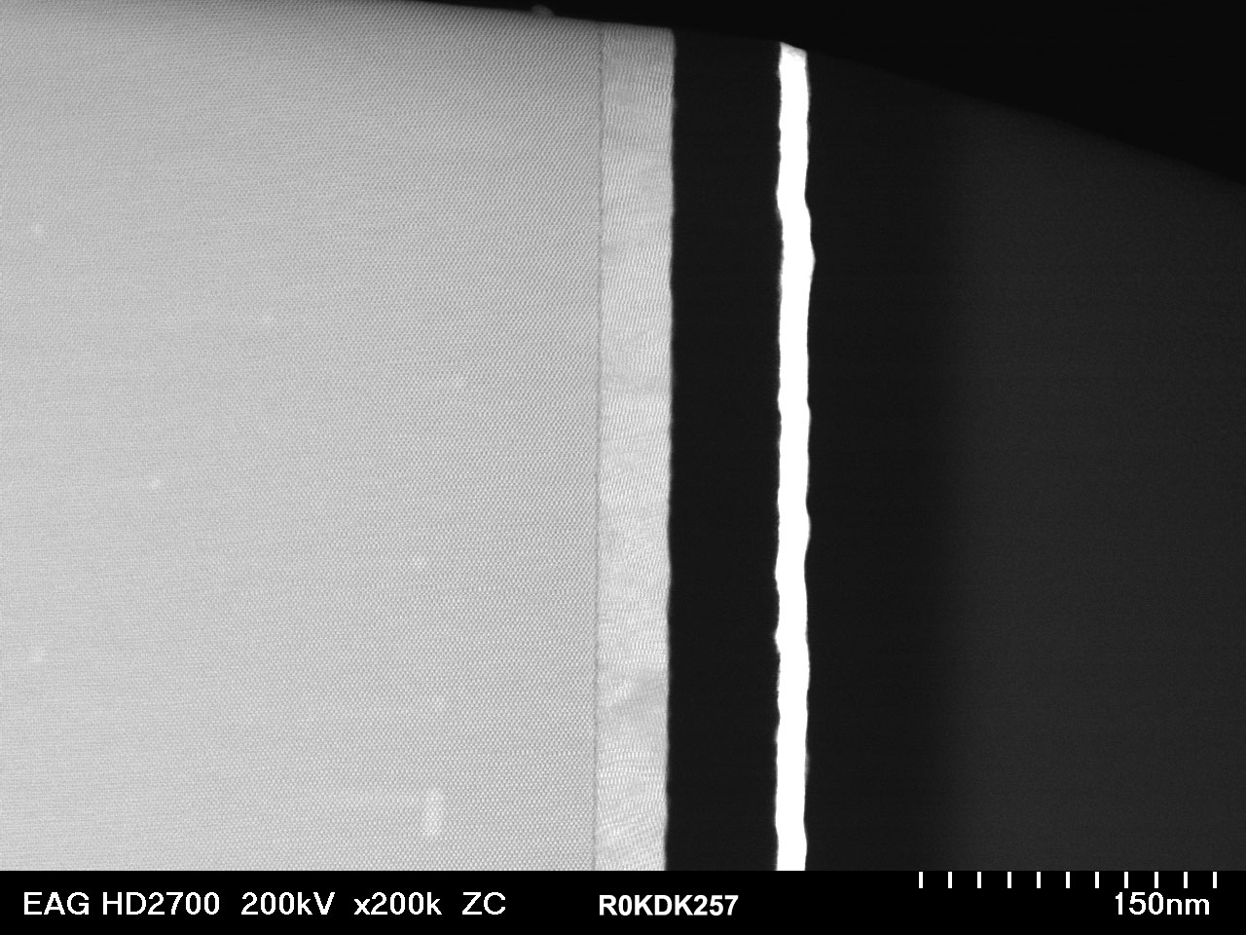
Cross-Sectional TEM Image: CdTe/InAs
ALD of CdTe @ 75 C
No pinholes
No cracks
No delamination
Abrupt interface
Smooth Morphology
CdTe
Region used for
elemental analysis
InAs

Slide 10
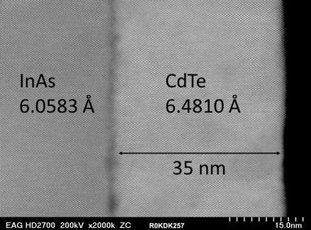
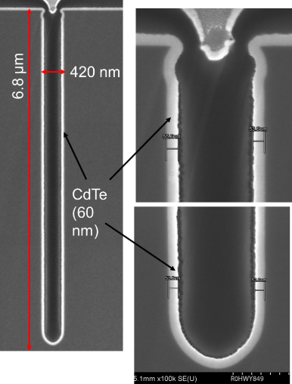
RMD is on the cutting edge of ALD!
High Step Coverage
16:1 Aspect Ratio
ALD @ 75 C
Applications: Infrared detectors, X-ray detectors, Photovoltaics, Photonic integrated circuits, microelectronics, phase-change memory, etc.

Slide 11
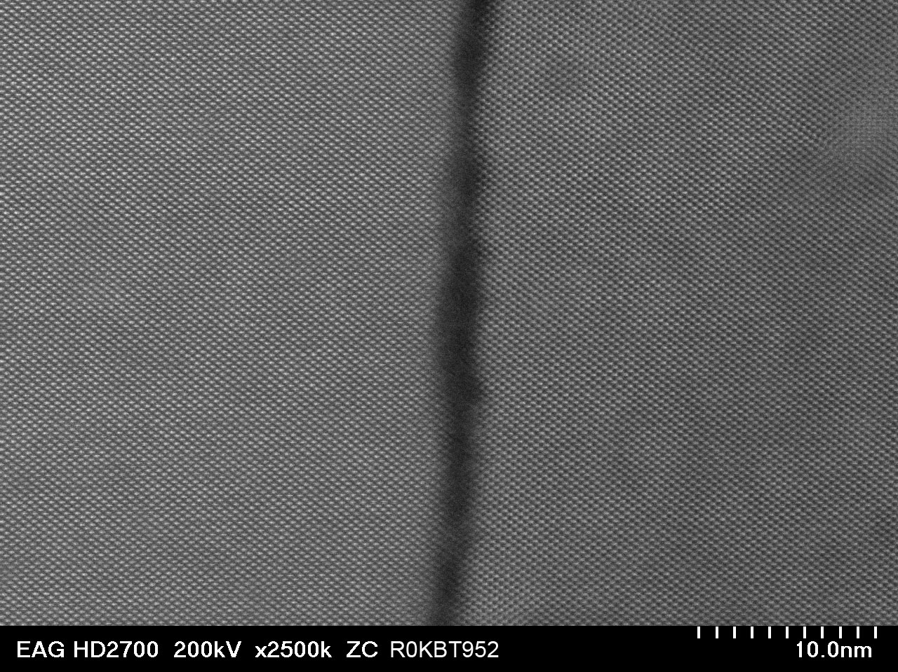
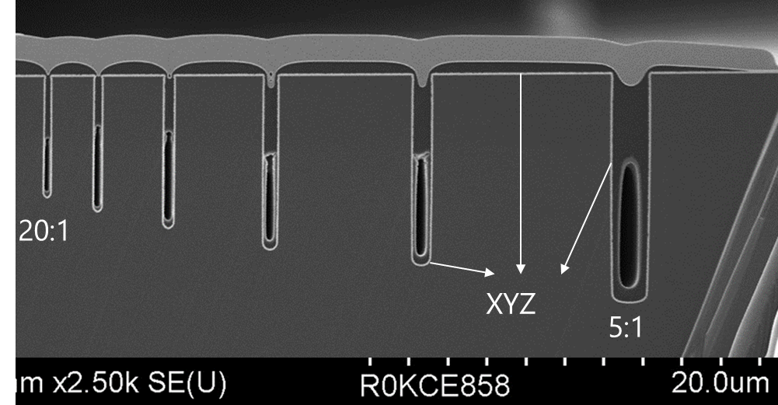
ALD of ZnTe at Low Temperature (85 C)
Possibilities
Lattice-matched passivation InAs/GaSb
Lattice-matched CZT passivation for MCT
Epi-ready layers grown on CZT crystals for MCT growth
InAs
a = 6.058 Å
ZnTe
a = 6.101 Å

Slide 12
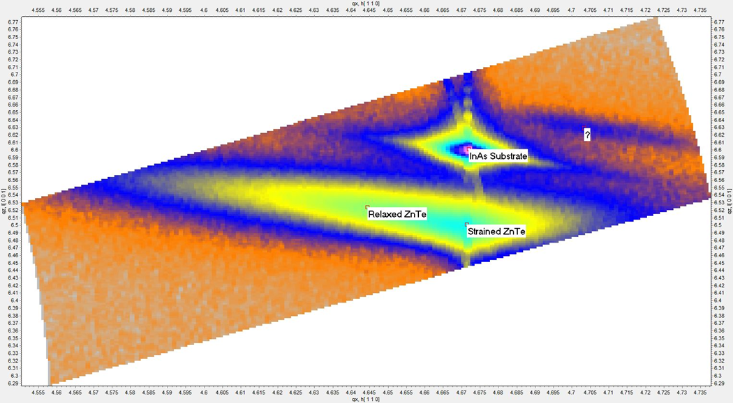
Reciprocal Space Mapping of ZnTe (60 nm) on InAs

Slide 13
Strained Layer Epitaxy CdTe/ZnTe
Preliminary investigation for CdTe indicate:
1.5eV bandgap permits excitation at 780nm;
~2% strain has the necessary valence band splitting (0.1eV) to realize 100% polarization;
p-type can be achieved with antimony/arsenic doping;
has excellent absorption and spin relaxation time;
negative electron affinity has been demonstrated with Cs-O surface treatments.
Cd_{(1-x)}Zn_{x}Te | Lattice Parameter (A) | % Strain
x=0 (CdTe) | 6.48 | 0.00
x=0.1 | 6.451 | 0.45
x=0.2 | 6.422 | 0.90
x=0.3 | 6.371 | 1.68
x=0.4 | 6.298 | 2.81
x=0.5 | 6.25 | 3.55
x=0.6 | 6.218 | 4.04
x=0.7 | 6.183 | 4.58
x=0.8 | 6.128 | 5.43
x=0.9 | 6.051 | 6.62
x=1 (ZnTe) | 6.1 | 5.86
What is needed:
DFT calculations of band structure
Monte Carlo simulations of transport properties

Slide 14
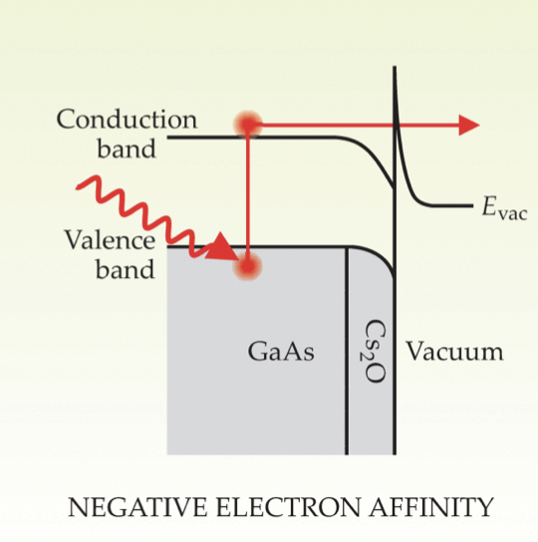
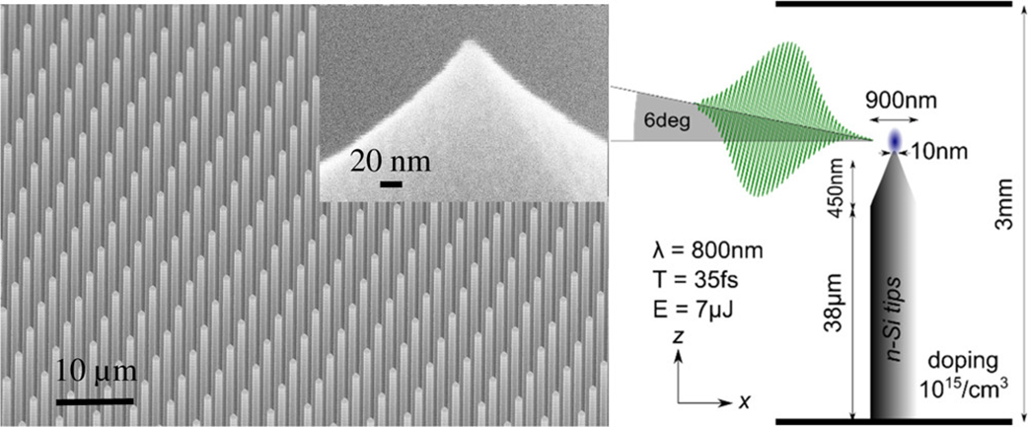
GaAs Nanotip Activation
ALD can be used for nanotip activation
RMD does have a proprietary Cs ALD precursor (metal organic)
On-site Cs2O surface activation is possible
Swanwick, Michael E., et al. "Nanostructured ultrafast silicon-tip optical field-emitter arrays." Nano letters 14.9 (2014): 5035-5043.

Slide 15
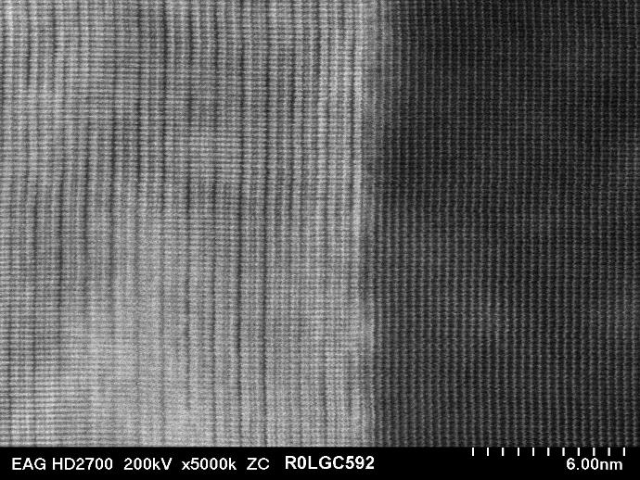
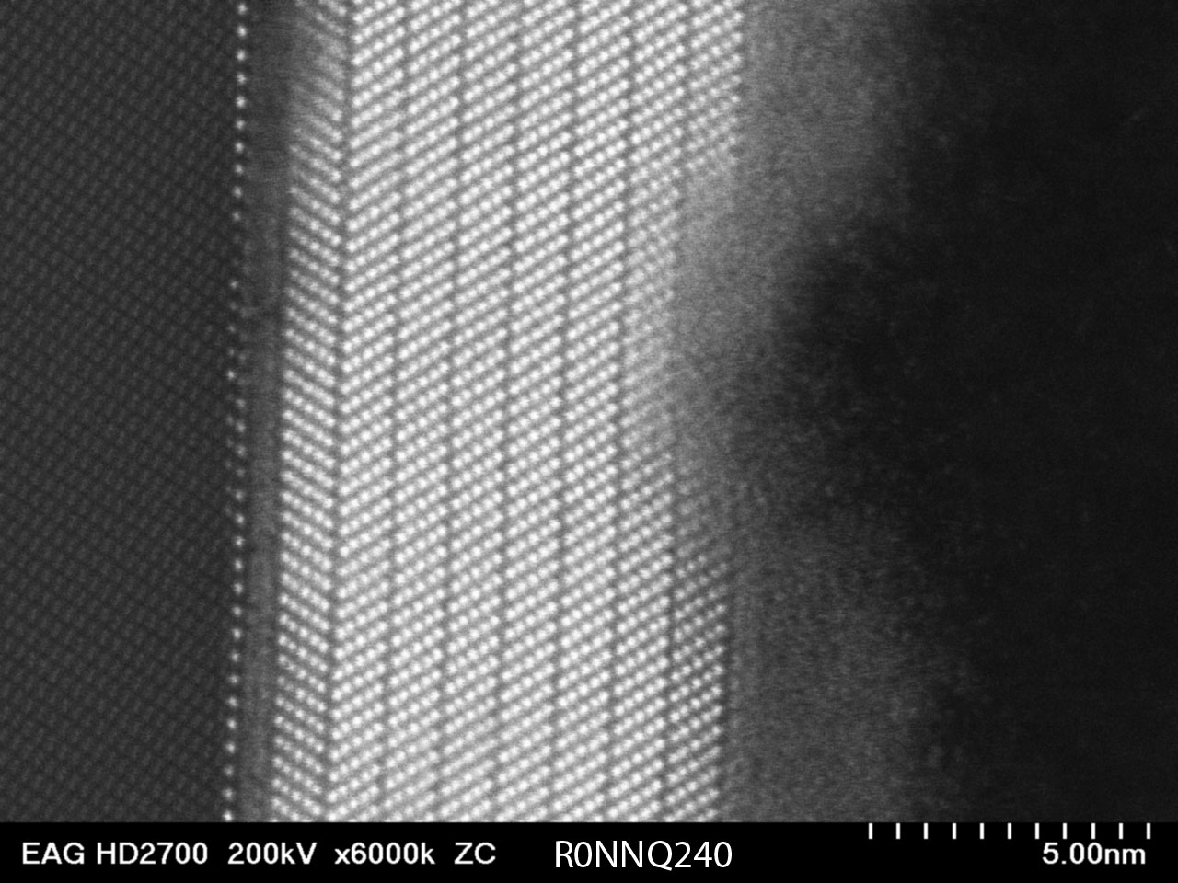
Atomic Layer Epitaxy of MnTe at 120 ^{O}C on Bi₂Te₃
Te
Te
Te
Mn
Mn
Mn
ALD Sb₂Te₃ @65 C
Sapphire
MBE (250 ^{O}C)
Bi₂Te₃
ALD MnTe @120 C
Applications: Ultra-efficient spintronic memory and transistors

Slide 16
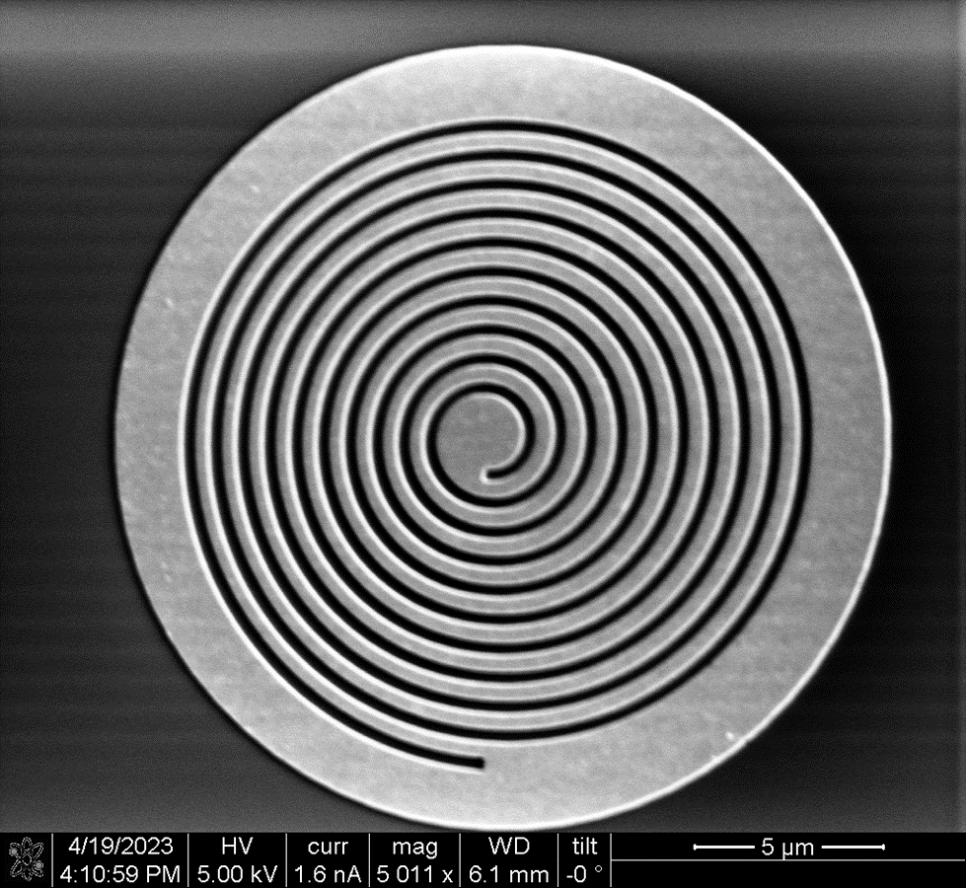
Some of the other ALD possibilities
Cs₂Te
Cs₃Sb
K₃Sb
3K₂CsSb → 2K₃Sb+Cs₃Sb
ALD of capping layers for Photocathodes
Grating coupler (Hyun Uk Chae)
Plasmonic Surface (Alimohammed Kachwala)

Slide 17
Final Thoughts…
Atomic Layer Deposition (ALD) is a versatile technique for growing high-quality thin films
Chalcogenide-based spin polarized cathodes
Alkali antimonide cathodes
Surface Activation
Capping Layers
ALD’s conformal nature can be exploited for realizing high QE cathodes
ALD’s can be a compact system that can accompany the “puck”
I am seeking collaborators on these topics
hbhandari@rmdinc.com

Slide 18
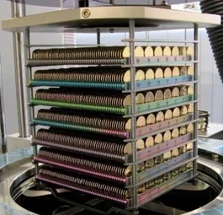
Thank you
Sincerely thank these people for valuable discussions:
Oksana Chubenko
Sid Karkare
Luca Cultrera
Dimitre Dimitrov
Rehan Kapadia (and his students)

