Slide 1

Polarized Photocathodes for Future Applications
Samuel J. Levenson
Photocathode Physics for Photoinjectors Workshop
Stony Brook, NY, USA
October 5, 2023
1

Slide 2
Acknowledgements
Accelerator Physicists
Materials Scientists
M.B. Andorf
I.V. Bazarov
J.M. Maxson
B.D. Dickensheets
D. Jena
H.G. Xing
A.C. Bartnik
A. Galdi
L. Cultrera
J. Encomendero
V. V. Protasenko
Special thanks to J.K. Bae, B.A. Carmona, N. Otto, and M. A. Reamon
2
Notes:
I would first like to acknowledge the support this project has from Cornell university, the US department of energy, the US NSF and the Center for Bright Beams. The work in my talk brought together some of the very best accelerator physicists and some of the very best materials experts, and I would like to acknowledge all the help and support they’ve given me and contributed to this project.

Slide 3
Spin-Polarized Electron Beams
3
Notes:
So, spin polarized beams.

Slide 4
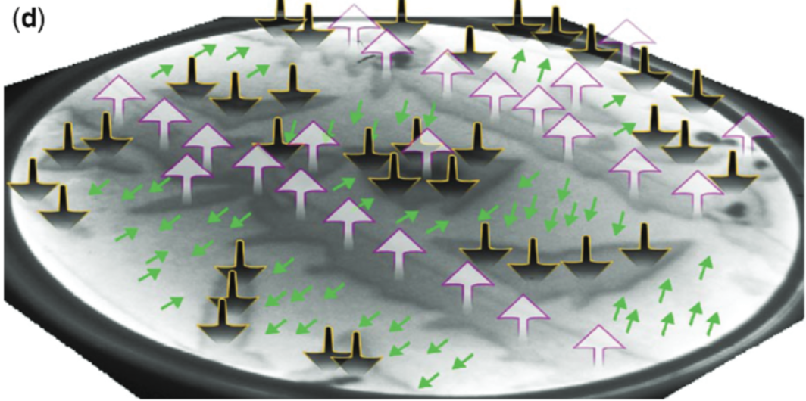
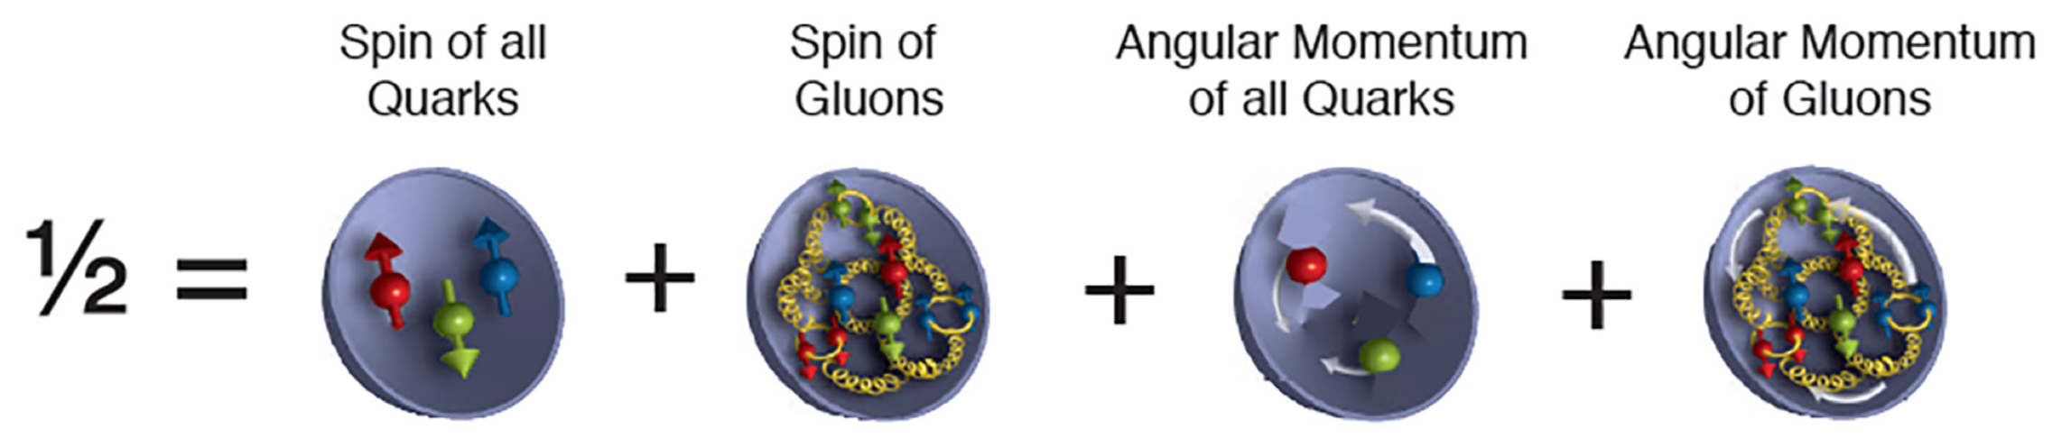

Spin-Polarized Electron Beams
Applications
Nuclear/HEP Physics
Deep inelastic scattering
Parity violating experiments
Higgs Factory
Electron Microscopy
Image magnetic structure of surface
Study spin-orbit interactions
[1]
[2]
1. D. Geesaman et al. The 2015 Long Range Plan for Nuclear Science.
2. El Gabaly et al. PRL 96, 147202 (2006)
3
Notes:
They are very useful for a number of different things - primarily in nuclear and high energy physics, teaching us things like we see in this graphic of proton spin contributions. They are also used in certain types of spin polarized electron microscopy. Here we see where spin polarization was used to show the variation in magnetization direction on a surface, as shown in El Gabaly’s work.

Slide 5
Spin-Polarized Electron Beams
Applications
Nuclear/HEP Physics
Deep inelastic scattering
Parity violating experiments
Higgs Factory
Electron Microscopy
Image magnetic structure of surface
Study spin-orbit interactions
[1]
[2]
Goals for Sources
>90% spin polarization
Spin orientation reversibility
mA-scale current delivery
Low emittance and energy spread
Long operational lifetime
1. D. Geesaman et al. The 2015 Long Range Plan for Nuclear Science.
2. N'diaye, A.T. & Quesada, A. Spin-Polarized Low-Energy Electron Microscopy (SPLEEM). In Characterization of Materials. 2012.
3
Notes:
Now, when thinking of sources of these spin polarized beams, we have some criteria that generally need to be met. Among these, we need a source that will give us a long-lasting, high polarization, bright electron beam. There are many methods to produce a spin polarized beam,

Slide 6
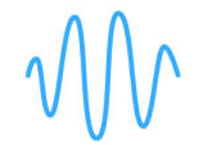


Spin-Polarized Electron Beams
Applications
Sources Used
Nuclear/HEP Physics
Deep inelastic scattering
Parity violating experiments
Higgs Factory
Electron Microscopy
Image magnetic structure of surface
Study spin-orbit interactions
Ionization/Fano Effect
[1]
[2]
Polarize alkali atoms (PEGGY) or use circularly polarized light (Fano)
Goals for Sources
>90% spin polarization
Spin orientation reversibility
mA-scale current delivery
Low emittance and energy spread
Long operational lifetime
1. D. Geesaman et al. The 2015 Long Range Plan for Nuclear Science.
2. N'diaye, A.T. & Quesada, A. Spin-Polarized Low-Energy Electron Microscopy (SPLEEM). In Characterization of Materials. 2012.
3
Notes:
starting with various ionization-based methods, where you ionize beams of alkali atoms. This was used at SLAC a long time ago. These methods can get high spin polarization but can only get nano amp scale current and typically give massive energy spreads.

Slide 7
Spin-Polarized Electron Beams
Applications
Sources Used
Nuclear/HEP Physics
Deep inelastic scattering
Parity violating experiments
Higgs Factory
Electron Microscopy
Image magnetic structure of surface
Study spin-orbit interactions
Ionization/Fano Effect
[1]
[2]
Polarize alkali atoms (PEGGY) or use circularly polarized light (Fano)
Goals for Sources
Field Emission/Spin Filter
>90% spin polarization
Spin orientation reversibility
mA-scale current delivery
Low emittance and energy spread
Long operational lifetime
EuS
Tungsten
W tip coated with EuS (spin filter) ferromagnetic thin film
1. D. Geesaman et al. The 2015 Long Range Plan for Nuclear Science.
2. N'diaye, A.T. & Quesada, A. Spin-Polarized Low-Energy Electron Microscopy (SPLEEM). In Characterization of Materials. 2012.
3
Notes:
Some methods involve a tungsten field emitting tip coated with a spin filter like europium sulfide or europium oxide. As usual of field emitters, you can get a very small emittance, but once again, you can only get nano amp scale currents, and stringent operating conditions are required.

Slide 8
Spin-Polarized Electron Beams
Applications
Sources Used
Nuclear/HEP Physics
Deep inelastic scattering
Parity violating experiments
Higgs Factory
Electron Microscopy
Image magnetic structure of surface
Study spin-orbit interactions
Ionization/Fano Effect
[1]
[2]
Polarize alkali atoms (PEGGY) or use circularly polarized light (Fano)
Goals for Sources
Photocathode
Field Emission/Spin Filter
>90% spin polarization
Spin orientation reversibility
mA-scale current delivery
Low emittance and energy spread
Long operational lifetime
EuS
Cs
Cs
Cs
Cs
Tungsten
Cs
Cs
GaAs Cathode
Cs:GaAs photocathode excited with circularly polarized light
W tip coated with EuS (spin filter) ferromagnetic thin film
1. D. Geesaman et al. The 2015 Long Range Plan for Nuclear Science.
2. N'diaye, A.T. & Quesada, A. Spin-Polarized Low-Energy Electron Microscopy (SPLEEM). In Characterization of Materials. 2012.
3
Notes:
However, you can use a photocathode. The gold standard since the 1980s is cesiated GaAs. Which can meet all of these criteria, except unfortunately the long lifetime box.

Slide 9
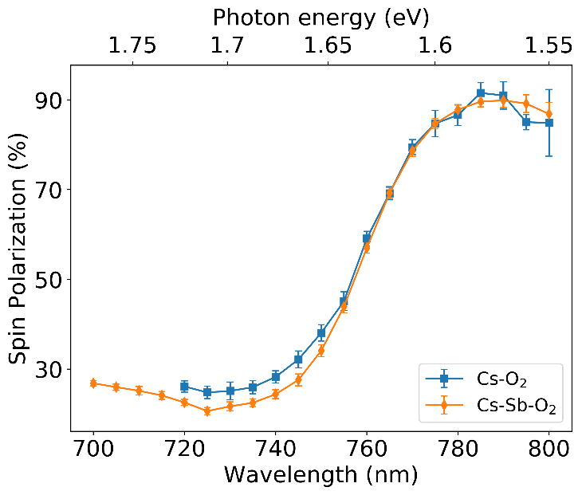
GaAs Photocathodes
>90% polarizations achievable with strained GaAs
52 mA record current (un-polarized)
<150 meV energy spread
High quantum efficiencies (QE)
Commercially available
Strained GaAs has achieved >90% spin polarizations
Journal of Applied Physics. 127, 124901 (2020)
4
Notes:
While ordinary GaAs gets around 35% polarization, GaAs photocathodes can be strained, and as shown in Bae’s work, can get 90% spin polarization. 52 mA of current was run at Cornell with gallium arsenide, note that this was not a polarized beam.

Slide 10
GaAs Photocathodes
>90% polarizations achievable with strained GaAs
52 mA record current (un-polarized)
<150 meV energy spread
High quantum efficiencies (QE)
Commercially available
Strained GaAs has achieved >90% spin polarizations
Journal of Applied Physics. 127, 124901 (2020)
Since the 1980s, GaAs photocathodes have been the state-of-the-art spin-polarized electron source, used at facilities all over the world.
4
Notes:
Low MTEs, high QEs and other convivences have made it the gold standard of spin polarized sources all over the world.

Slide 11
GaAs Photocathodes
>90% polarizations achievable with strained GaAs
52 mA record current (un-polarized)
<150 meV energy spread
High quantum efficiencies (QE)
Commercially available
Needs Cs layer, making the cathode unstable, sensitive and short-lived
Strained GaAs has achieved >90% spin polarizations
Journal of Applied Physics. 127, 124901 (2020)
Since the 1980s, GaAs photocathodes have been the state-of-the-art spin-polarized electron source, used at facilities all over the world.
4
Notes:
However, for it to work, it needs a cesium layer on its surface (I’ll explain why shortly), which leads to many issues.

Slide 12
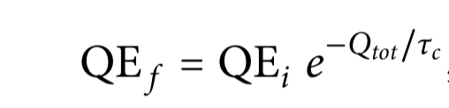

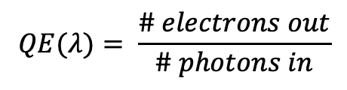
NEA GaAs has short operational lifetimes
Cs is sensitive and weakly bound to bulk
NEA layers with Te or Sb added to Cs last can give longer lifetimes.
$$QE(λ)= \frac{\# electrons out}{\# photons in}$$
QE Degradation
Chemical Poisoning
Ion Backbombardment
Thermal Desorption
+
O₂
CO₂
+
H₂O
Cs
Cs
Cs
Cs
+
Cs
Cs
Cs
Cs
Cs
+
Cathode
Cs
Cs
Cs
Cs
Cathode
Cs
Cs
Cathode
Cathode surface contaminated by residual gas, Cs is highly reactive and unstable
Emitted electrons ionize gas molecules, positive ions accelerated towards the photocathode
Temperature-dependent reduction in number of Cs bonds
5
Notes:
Unfortunately, gallium arsenide is characterized by short operational lifetimes, where the QE decreases exponentially. The state of the art is only 6 hours of 50 milliamp beam running. This is because the cesium layer on top of the cathode is very sensitive and weakly bound to the gallium arsenide bulk. This results in QE degradation by way of chemical poisoning, thermal desorption and ion back bombardment. While some improvements have been made with alternative coatings that include tellurium and antimony, the sensitivity of cesiated gallium arsenide to these QE degradation methods is why studies on new and more robust sources is needed.

Slide 13
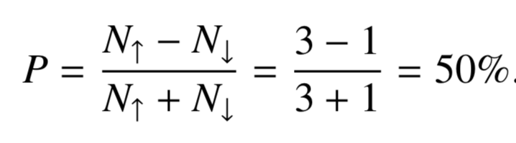
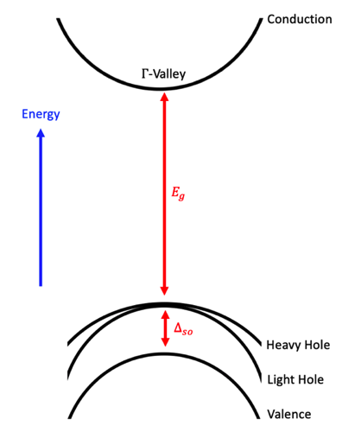




Spin Polarized Photoemission
m = -1/2
m = +1/2
$±ℏ$ Spin Angular Momentum
3
3
Opposite-handed circularly polarized light
1
1
2
2
$±ℏ$ Spin Angular Momentum
m = -3/2
m = -1/2
m = +1/2
m = +3/2
P_{3/2}
Split-off
P_{1/2}
$±ℏ$ Spin Angular Momentum
m = -1/2
m = +1/2
+1 in orange
D. T. Pierce & F. Meier. Phys. Rev. B 13, 5484.1976.
-1 in green
6
Notes:
So how do you make spin polarized electrons anyways? Let’s start with a basic semiconductor energy band diagram, where we have a valence band and a conduction band separated by a characteristic band gap energy. In S-band semiconductors, a spin-orbit splitting will cause there to be a split off band, separated by a characteristic energy, delta so. If we excite an electron from the top of the valence band, there is a degeneracy, where we can also excite from the plus or minus 3/2 states. Now, the relative probabilities of transitioning from the two ½ states below the valence band are the same, but if you calculate the relative probabilities of the degenerate states transitions, they end up as 3 to 1. Meaning the spin polarization of the emitted electrons will be 50%. In real life, you give plus or minus h bar spin angular momentum to the electrons with opposite handed circular polarized light.

Slide 14
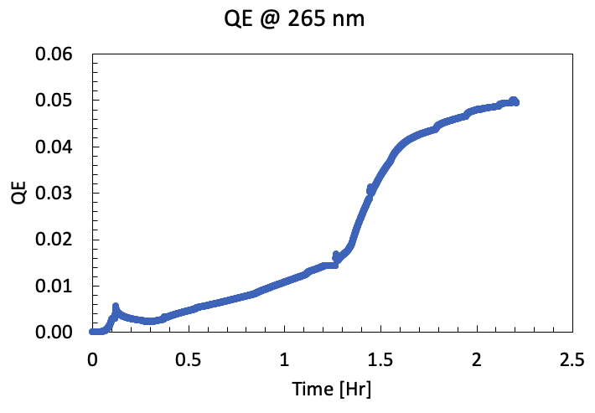
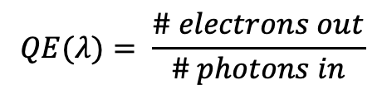
Top of Valence Band Photoemission
PEA
E_{Vacuum}
Electropositive metal, like cesium, forms a strong dipole layer that lowers the vacuum level
NEA
E_{Conduction}
E_{Electron Affinity}
E_{Vacuum}
E_{Electron Affinity}
E_{Conduction}
E_{Band Gap}
E_{Valence}
Cs Atoms
E_{Band Gap}
E_{Valence}
Cathode
Workfunction = E_{Band Gap} + E_{Electron Affinity}
NEA Cathodes E_{Band Gap}:
- GaAs* = 1.42 eV
- GaN = 3.2 eV (C), 3.4 eV (H)
Activation to NEA
$$QE(λ)= \frac{\# electrons out}{\# photons in}$$
*Also requires O₂ for NEA
7
Notes:
A requirement for us to get spin polarized photoemission is that you must photoemit from the top of the valence band. Returning to our semiconductor model, we have the vacuum energy level above the conduction band, separated by a characteristic electron affinity. Such an orientation is called positive electron affinity and our work function is defined as the electron affinity plus the band gap. Now, if we deposit an electropositive metal on the surface, like cesium, a dipole moment is created which will lower the vacuum level below the conduction band, creating a state of negative electron affinity. Now, photoemitting with photons of the bandgap energy will emit electrons from the top of the valence band. When we activate a cathode to NEA, we deposit cesium on the surface until the QE peaks, as shown here.

Slide 15
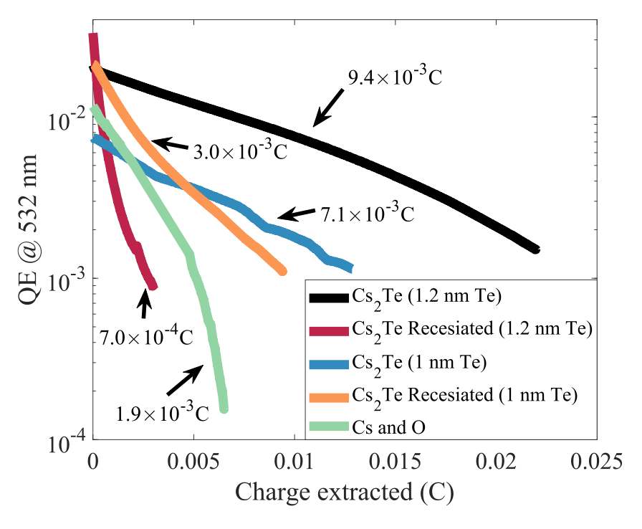
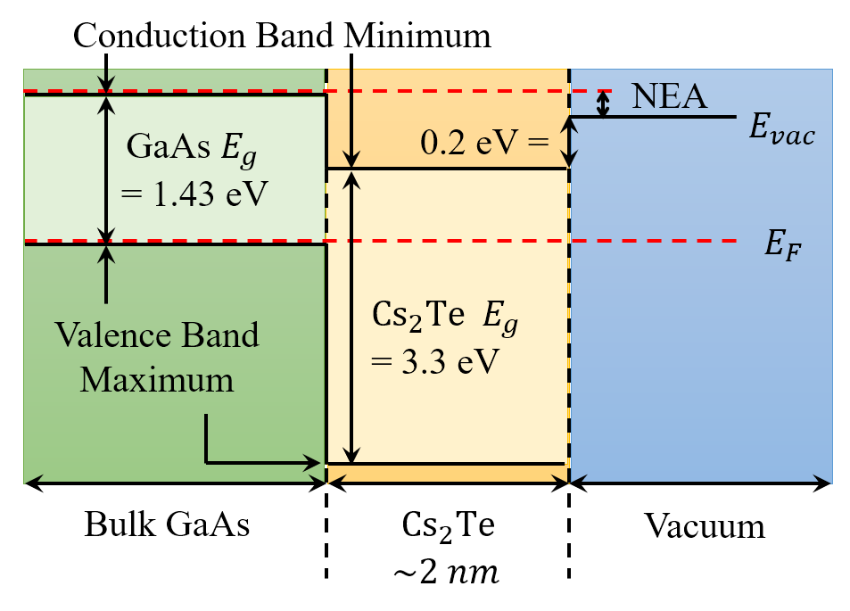
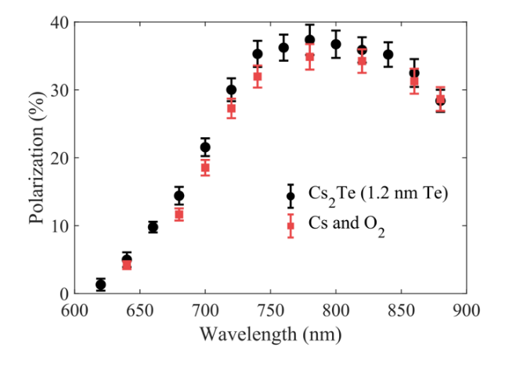
Alternative NEA Coatings: Cs-Te
GaAs activated with conventional Cs-O, then with Cs₂Te
Can use Cs-Te to activate to NEA
Cs₂Te activation gave a 5x improvement in charge extraction lifetime as opposed to Cs-O activation
Spin polarization unchanged →
8
Notes:
One alternative NEA coating to cesium and oxygen is cesium telluride, which is a robust, wide-band gap, solar-blind material. In this work done at Cornell, it was shown that a CsTe activation layer improved the charge extraction lifetime of a GaAs cathode by a factor of 5, when compared with an ordinary cesium and oxygen activation. Furthermore, it was shown that such an activation layer had no effect on the spin polarization, as we see in this plot, where the spin polarization is virtually unchanged.

Slide 16
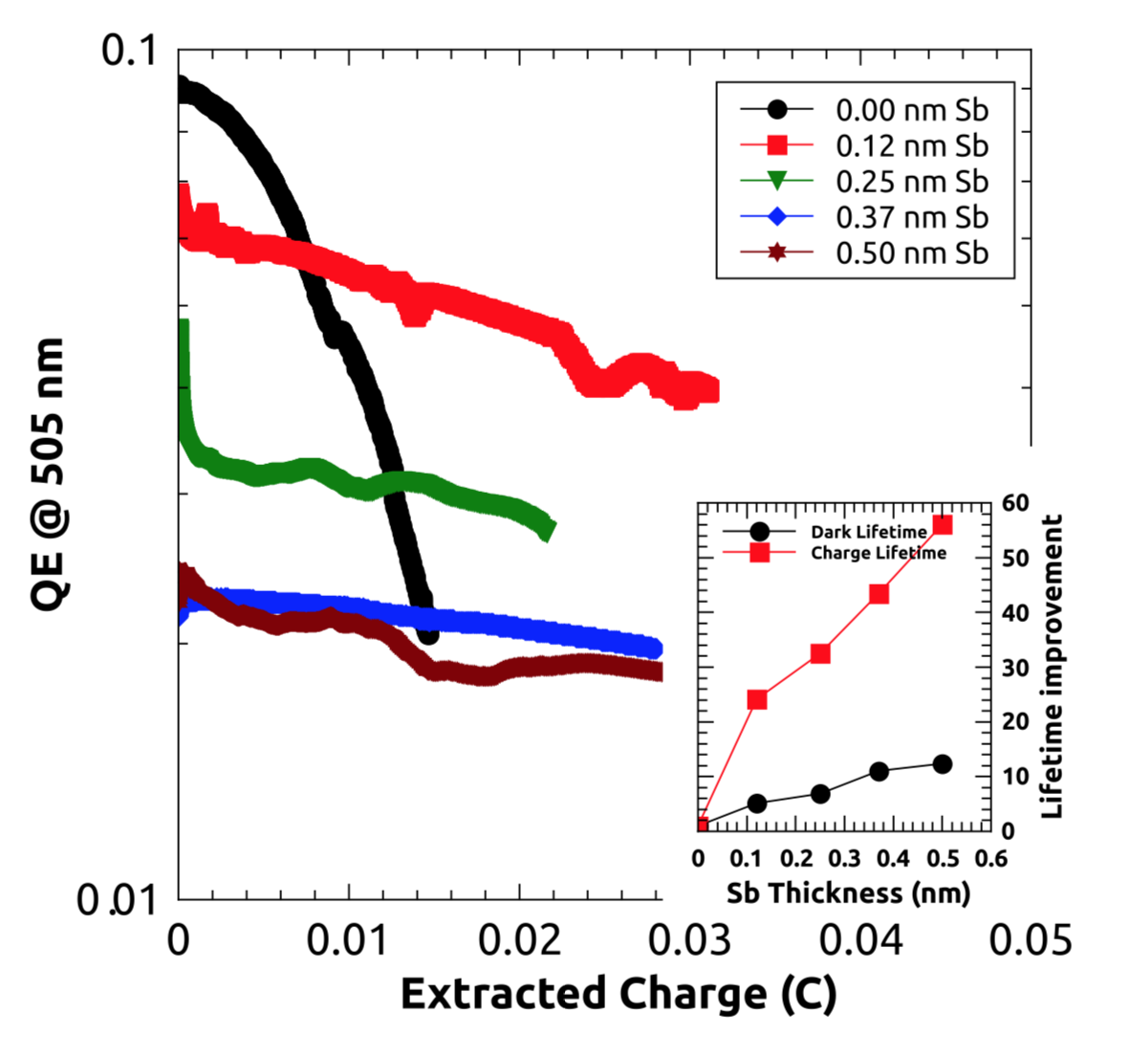
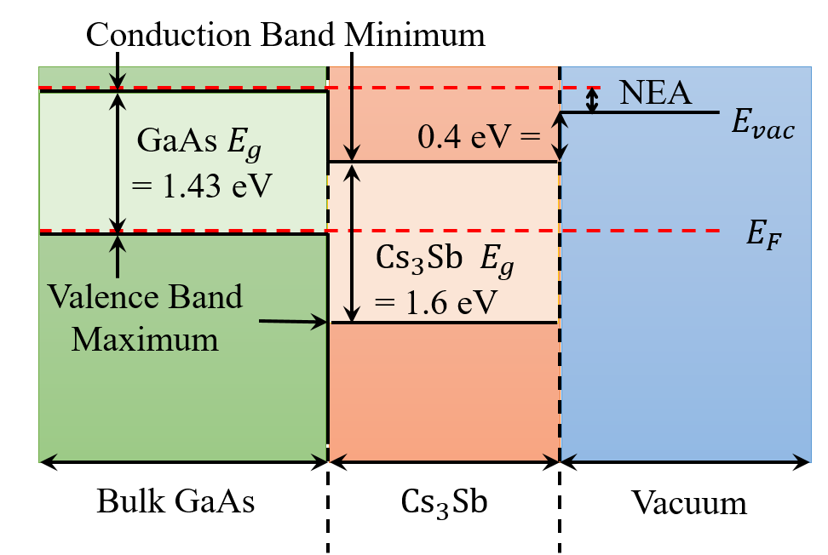
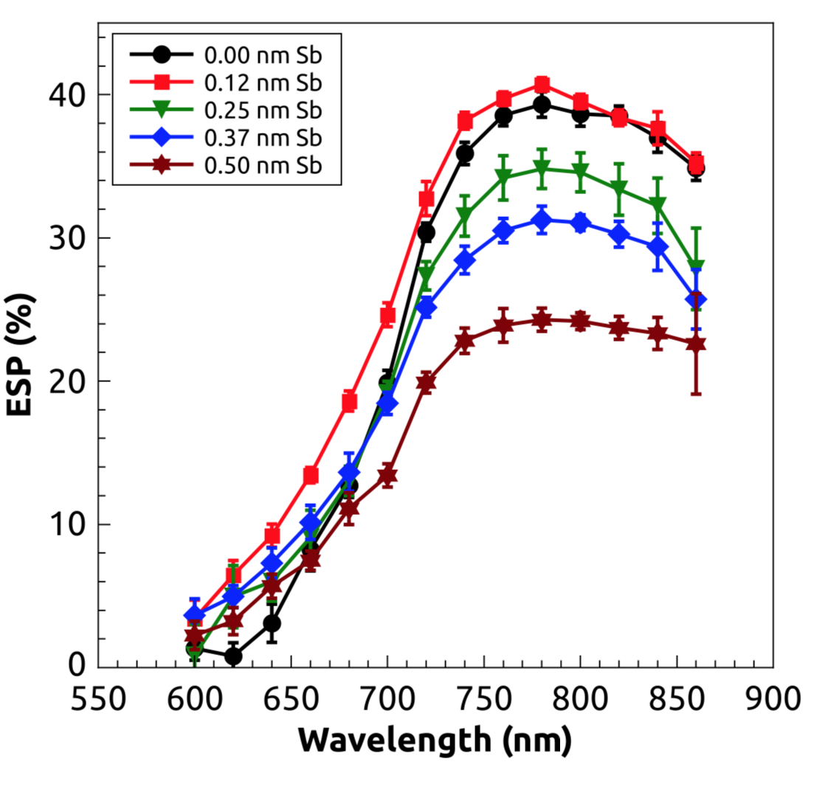
Alternative NEA Coatings: Cs-Sb-O
Can use Cs-Sb-O to activate to NEA
GaAs activated with varying Cs-Sb thicknesses
Tradeoffs with QE, lifetime and spin polarization
9
Notes:
Another alternative coating comes by way of cesium and antimony. Cesium antiminide is another robust photocathode material which, in another work at Cornell was shown to improve the NEA lifetime of a GaAs photocathode. In this study, tradeoffs with lifetime, peak QE and spin polarization were reported. Nevertheless, it was shown that around a tenth of a nm of antimony could enhance the charge lifetime by a factor of 30, with minimal losses in QE and spin polarization.

Slide 17
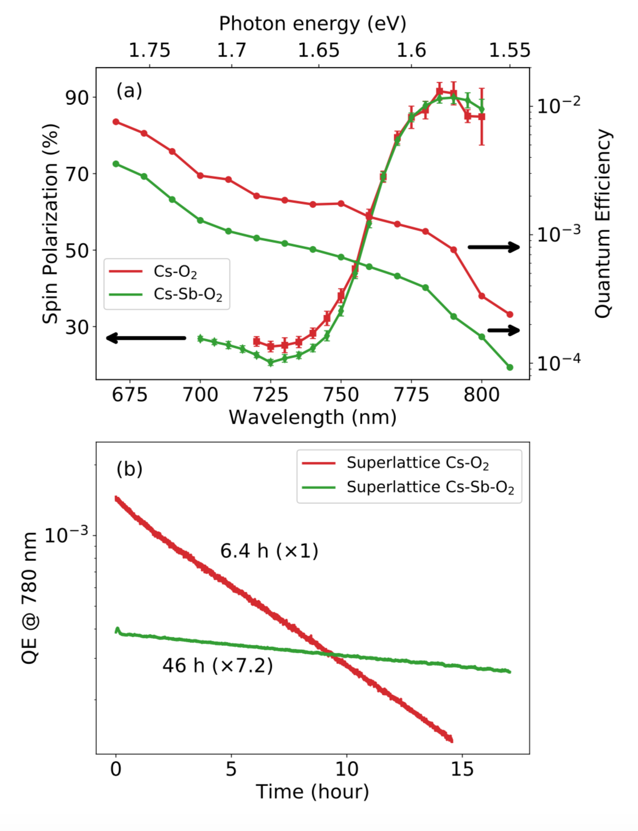
Alternative NEA Coatings: Cs-Sb-O
Superlattice GaAs activated with Cs-Sb-O
Can use Cs-Sb-O to activate to NEA
GaAs activated with varying Cs-Sb thicknesses
Tradeoffs with QE, lifetime and spin polarization
9
Notes:
It was later demonstrated that cesium, antimony and oxygen could improve the lifetime of a superlattice GaAs photocathode. In this work we see where introducing antimony to the activation process gave a factor of 7 improvement in lifetime, with no effect on the characteristic high spin polarization.

Slide 18
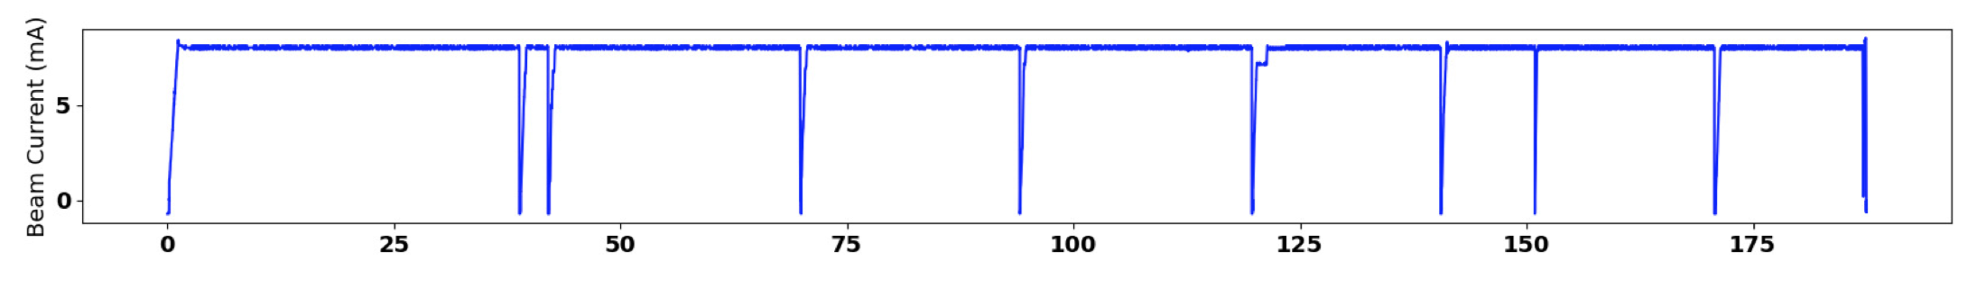

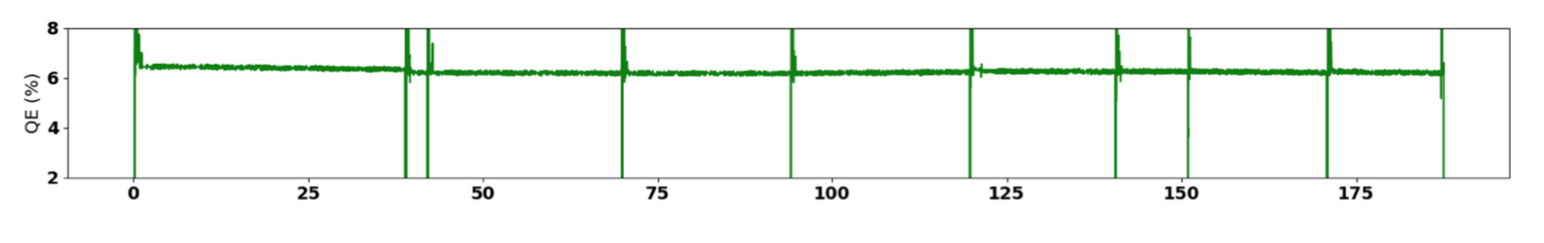
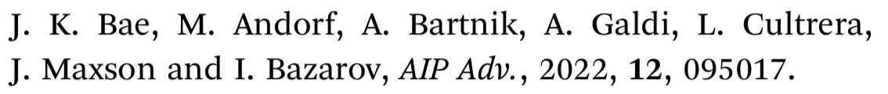
Alternative NEA Coatings: Cs-Sb-O
High current studies in the HERACLES beamline
A beamline dedicated to the study of high current beam running
200 keV electron gun at up to 10 mA average beam current
Photocathode lifetime measurement experiments: GaAs, alkali-antimonides
Unique facility: only high current test gun located on a university
campus
Ion clearing electrodes
75 kW beam dump
10
Notes:
Now that we have identified ways to improve these cathodes, we want to study their lifetimes in real-life environments. We recently commissioned our HERACLES beamline at cornell, which is a 200 keV electron gun capable of performing operational lifetime measurements of cathodes running at up to 10 mA.

Slide 19
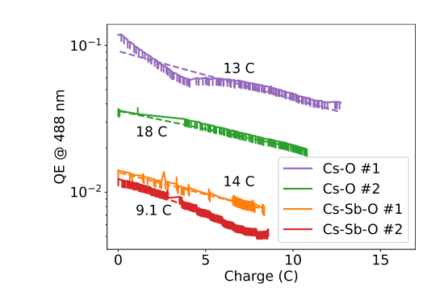
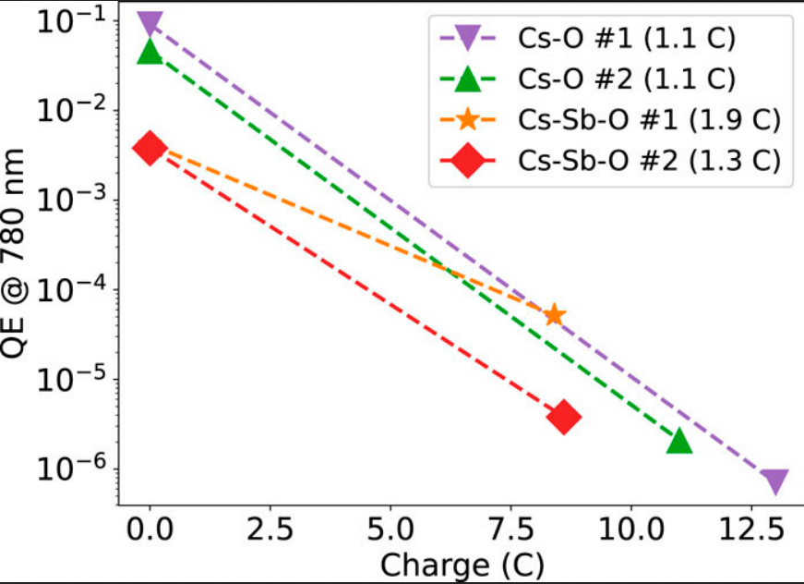
Alternative NEA Coatings: Cs-Sb-O
High current studies in the HERACLES beamline
No improvement in the charge lifetime at 488 nm, modest improvement at 780 nm
Sb improves chemical poisoning, ion back bombardment less so
  Relative QE change smaller for Cs-Sb-O samples
Now, we want to optimize the thicknesses of these activation layers w.r.t. operational lifetime
Current project: HERACLES runs with varying activation layer thicknesses
10
Notes:
In the first experiment done with the beamline, GaAs photocathodes coated with the cesium-antimony-oxygen layers demonstrated no improvement in operational lifetime at used 488 nm wavelength. However, a modest improvement at 780 nm was observed. While antimony helps with chemical poisoning, it may be less beneficial against ion back bombardment. Given that the cathodes with antimony had to be grown in a separate chamber and moved via vacuum suitcase, we have recently commissioned a growth chamber attached to the back of the gun, which will allow us to grow a series of GaAs activation layers with varying CsSb and CsTe thicknesses to further understand how we may optimize GaAs use in photoinjectors.

Slide 20
Beyond GaAs: New Materials
Is it possible we can find an alternative to GaAs that isn’t so sensitive?
Two examples being studied actively:
11
Notes:
Now, taking this a step further, is it possible that a more robust spin polarized source could be a new material altogether? There are currently two materials currently being investigated.

Slide 21
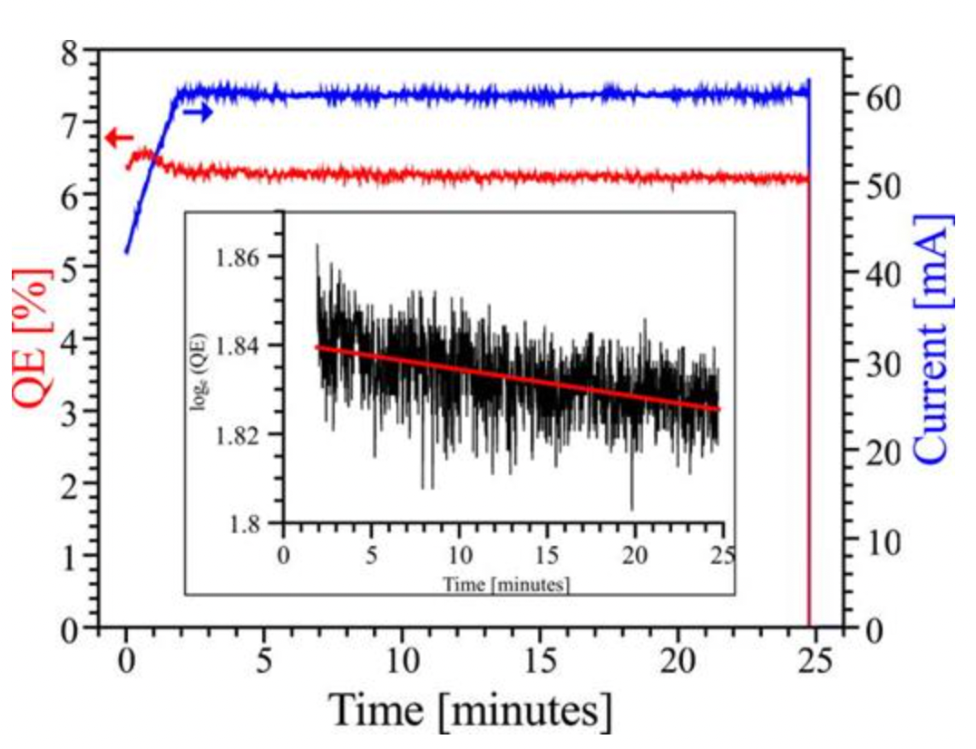
Beyond GaAs: New Materials
Is it possible we can find an alternative to GaAs that isn’t so sensitive?
Two examples being studied actively:
  Alkali Antimonides: A family of robust bulk visible
  light photoemitters
Cs-K-Sb
B. Dunham et al. Appl. Phys. Lett. 102, 034105 (2013)
11
Notes:
Alkali antimonide photcathodes are robust materials with high current capabilities, as seen in this work.

Slide 22
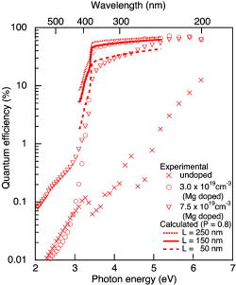
Beyond GaAs: New Materials
Is it possible we can find an alternative to GaAs that isn’t so sensitive?
Two examples being studied actively:
  Alkali Antimonides: A family of robust bulk visible
  light photoemitters
GaN: Wide Bandgap analog of GaAs
Cs-K-Sb
B. Dunham et al. Appl. Phys. Lett. 102, 034105 (2013)
S. Uchiyama et al. Appl. Phys. Lett. 86, 103511 (2005)
11
Notes:
Gallium nitride, which is a wide bandgap analog of GaAs has been extensively developed for electronics, but much less so has a photocathode. It has been shown to achieve crazy high QEs through doping, as shown here.

Slide 23
Alkali Antimonides for polarized photoemission
Alkali antimonides have cubic crystal structure, are bulk visible light photoemitters, and generally more rugged than GaAs.
Problem: All alkali antimonides grown for accelerators to date have been polycrystalline (at best)---No hope of nano-engineering.
12
Notes:
Starting with alkali antimonides, which are generally known to be more robust than GaAs.

Slide 24
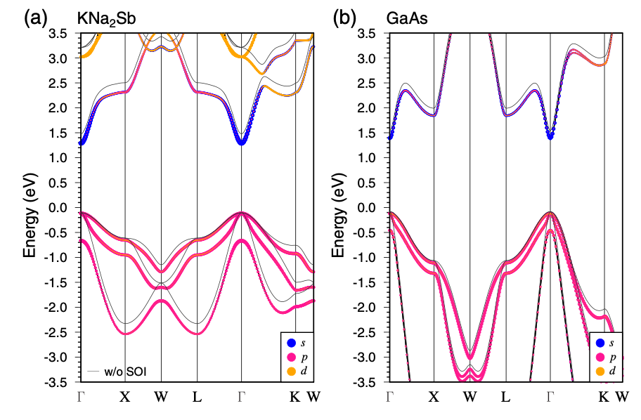
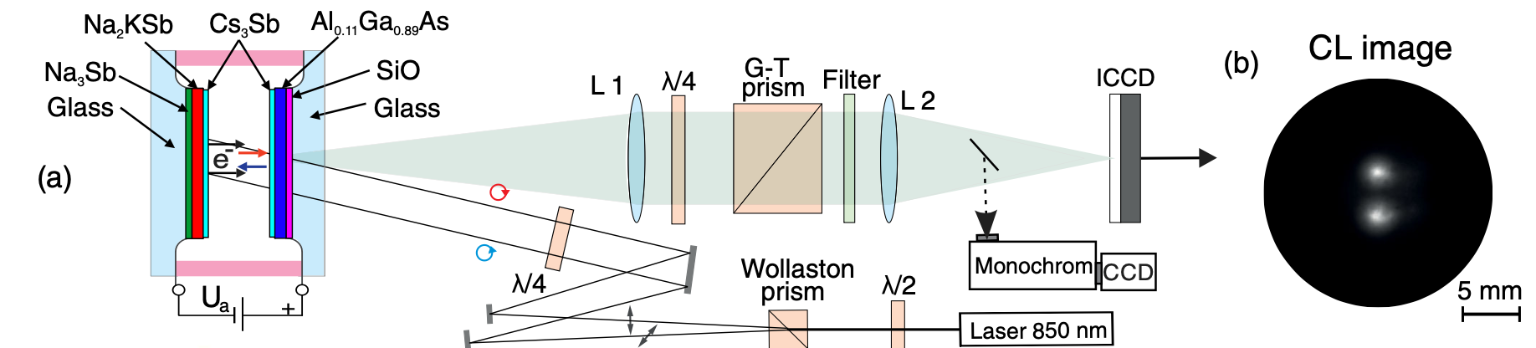
Alkali Antimonides for polarized photoemission
Alkali antimonides have cubic crystal structure, are bulk visible light photoemitters, and generally more rugged than GaAs.
Problem: All alkali antimonides grown for accelerators to date have been polycrystalline (at best)---No hope of nano-engineering.
However, recent measurement suggests polarized photoemission is possible:
Polarization inferred from degree of circular polarization of cathodoluminescence (CL). Observed similar levels of CL polarization as unstrained GaAs---- polarized electrons!
Band Structure very similar to GaAs…
Very promising result! Future study should include direct polarization measurement (eg. Mott scattering).
12
Notes:
Although typically polycrystalline, a recent work shown here, demonstrated that a potassium sodium antimonide cathode has a similar band structure to GaAs. It went on to infer from circular polarization of cathodeluminescence that the cathode could possibly produce comparable levels of spin polarization to GaAs. This result is very promising, and calls for future direct polarization measurements of the cathode.

Slide 25
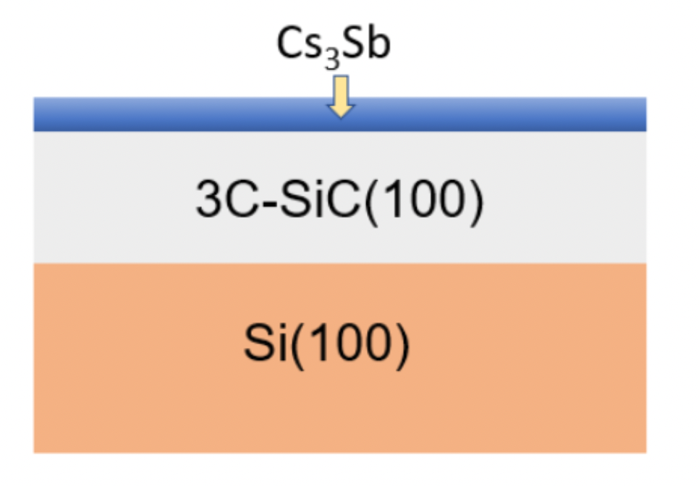
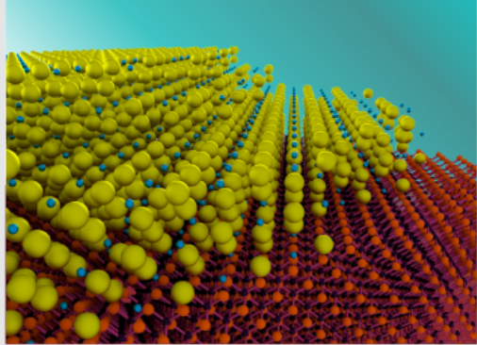
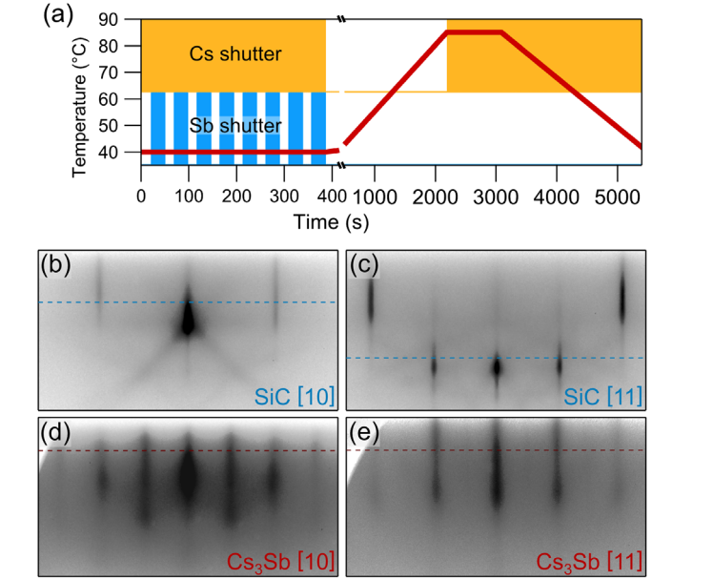
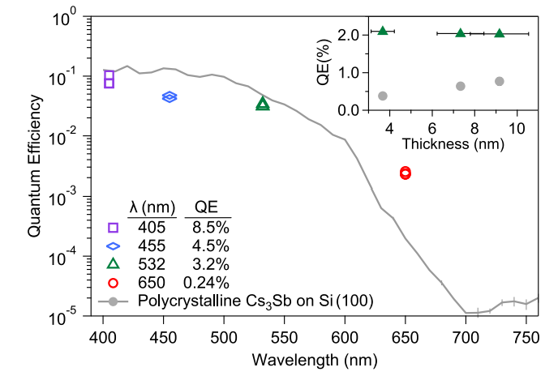
First Single-Crystal Alkali Antimonides
Atomically Ordered growth of alkali antimonides: paves the way for nanolayering
Cs3Sb
Substrate
RHEED Images:
Substrate: 3C-SiC->
Photocathode ->
Cs3Sb
13
Notes:
One problem with alkali antiminides is that they had historically always been polychristalline, meaning that they could not be nano-layered for high polarizations. However, in a recent work done at Cornell, a single-crystal epitaxially grown CsSb photocathode was grown, as shown in these RHEED images. Growth of ordered alkali antiminides is a requirement as we look to develop alternate high polarization cathodes.

Slide 26
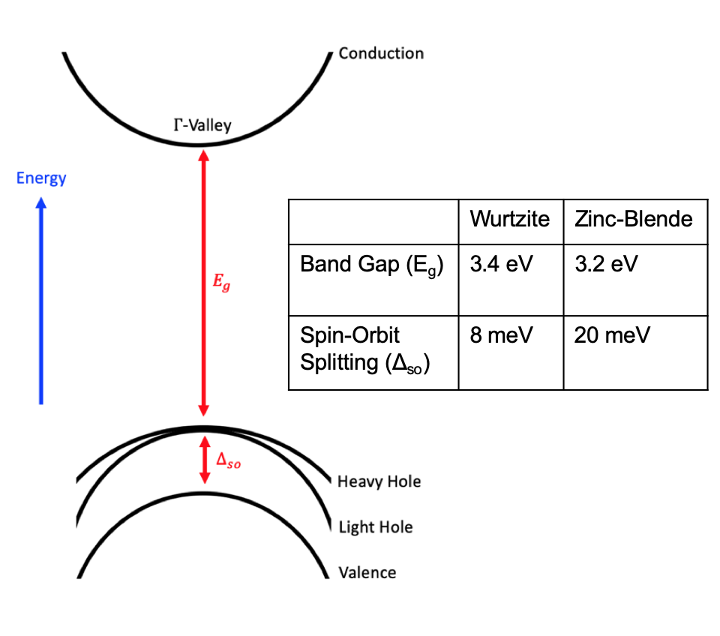
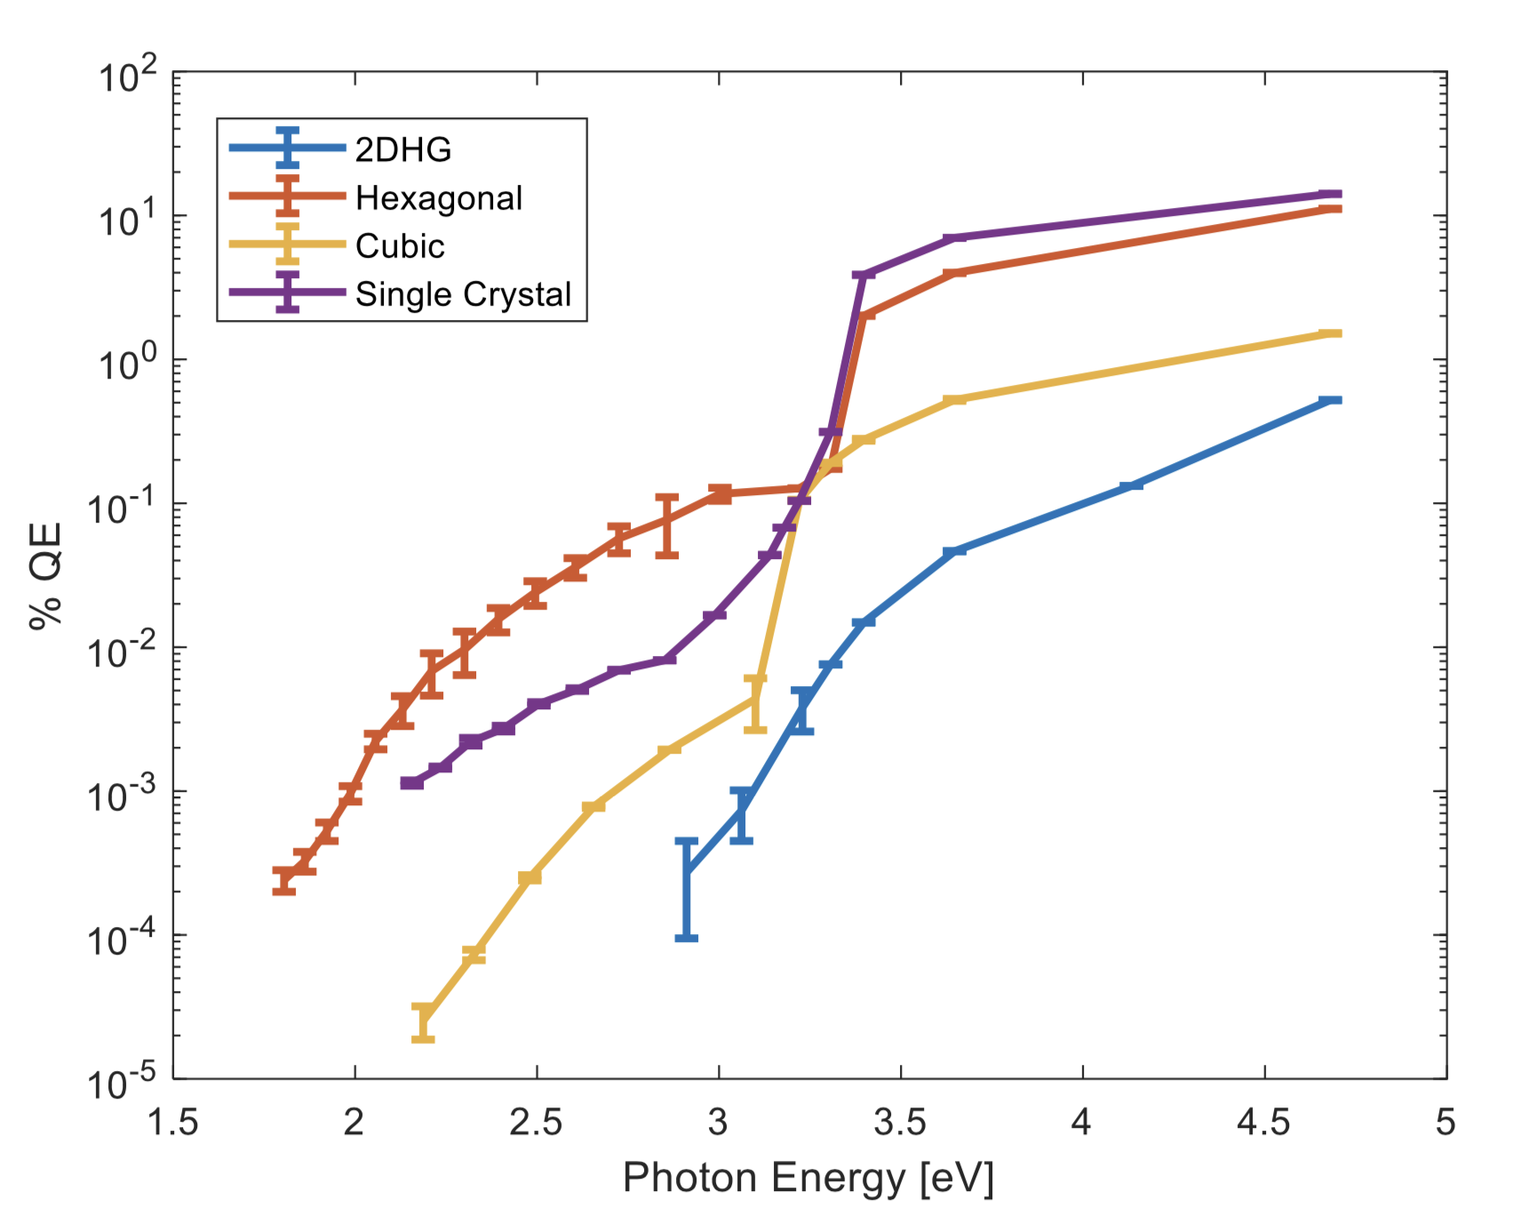
GaN as a Spin-Polarized Source
  Wurtzite or Zinc-Blende orientation
  >50% QE achievable with W-pGaN
  Comparable spin relaxation time to GaAs (~5 ns)
  Could be strained for high polarization
  3.2 eV band gap is conveniently at the second harmonic of Ti:Sapphire
  Less Cs to get to NEA→ stronger bond to Cs?
  NEA with Cs only
GaAs for comparison: ${E_{g}=1.42 eV, Δ}_{so}$ = 0.34 eV
14
Notes:
The other promising spin polarized alternative material is GaN. GaN may be grown in both cubic and hexagonal orientations as characterized in our work last year. As we showed, you can get very high QEs with p-doped hexagonal GaN. Cubic GaN is a little lower, but still percent-level with UV light. Others have reported upwards of 50% QEs with hexagonal. Cubic GaN has a 20 meV spin-orbit split and a comparable spin relaxation time with that of GaAs. Like GaAs, GaN could possibly be strained for higher polarizations, and its cubic bandgap energy corresponds to the photon energy of the second harmonic of Ti:Sapphire.

Slide 27
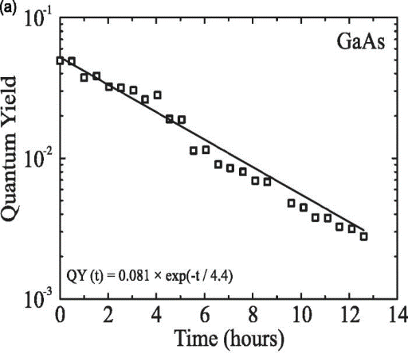
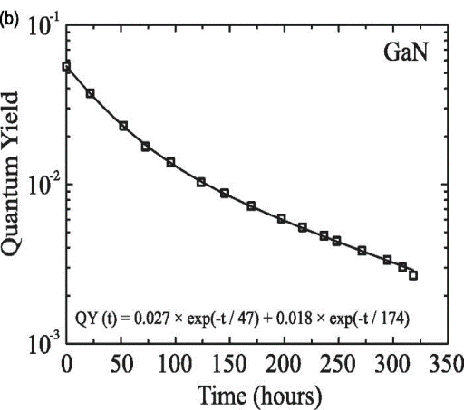
GaN as a Spin-Polarized Source
  Wurtzite or Zinc-Blende orientation
  >50% QE achievable with W-pGaN
  Comparable spin relaxation time to GaAs (~5 ns)
  Could be strained for high polarization
  3.2 eV band gap is conveniently at the second harmonic of Ti:Sapphire
  Less Cs to get to NEA→ stronger bond to Cs?
  NEA with Cs only
GaAs for comparison: ${E_{g}=1.42 eV, Δ}_{so}$ = 0.34 eV
J. Vac. Sci. & Technol. B 32, 06F901 (2014)
14
Notes:
Cesiated GaN may be a more robust photocathode than cesiated GaAs as this work demonstrated less cesium was required to bring GaN to NEA. In this work, the lifetime at threshold of a cesiated wurtzite GaN cathode was 20 times longer than that of GaAs. Growth techniques for cubic GaN are less-developed than those of hexagonal GaN and typically produce defect-rich cathodes, which we will see shorty. Should cubic GaN cathode growth techniques catch up to those of hexagonal GaN, cubic GaN may offer similar lifetimes. So, with these things in mind, we decided to try to make a spin polarized beam from a cubic GaN sample. That being said, its small spin orbit split makes a narrow-band light source a necessity.

Slide 28
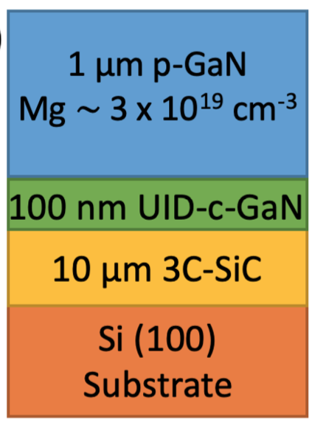
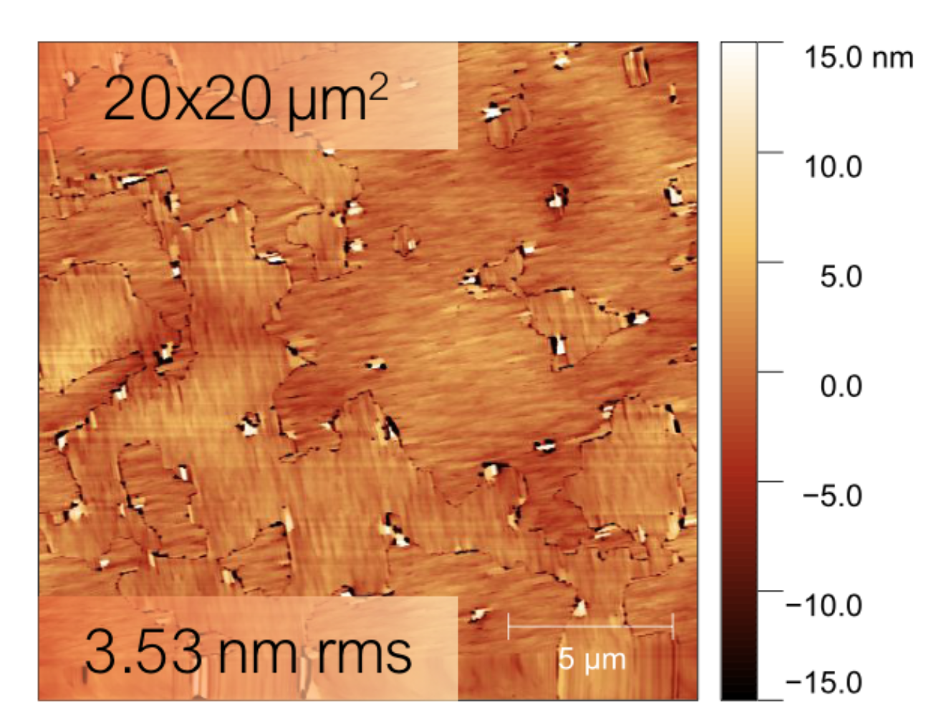
Our Cubic GaN Photocathode
Sample grown in molecular beam epitaxy growth chamber
AFM Images
15
Notes:
So, our materials science experts got to work on growing a cubic GaN photocathode. This kind of material is not commercially available and the ability to grow them is rare, so we were very lucky to get one of these samples grown for us. You start, as you do with any good cubic photocathode, with a silicon carbide substrate. You then deposit an epitaxial layer of GaN on top, followed by a highly doped p-type GaN layer. We chose this doping concentration to correspond with other works showing an optimal QE around this concentration.

Slide 29
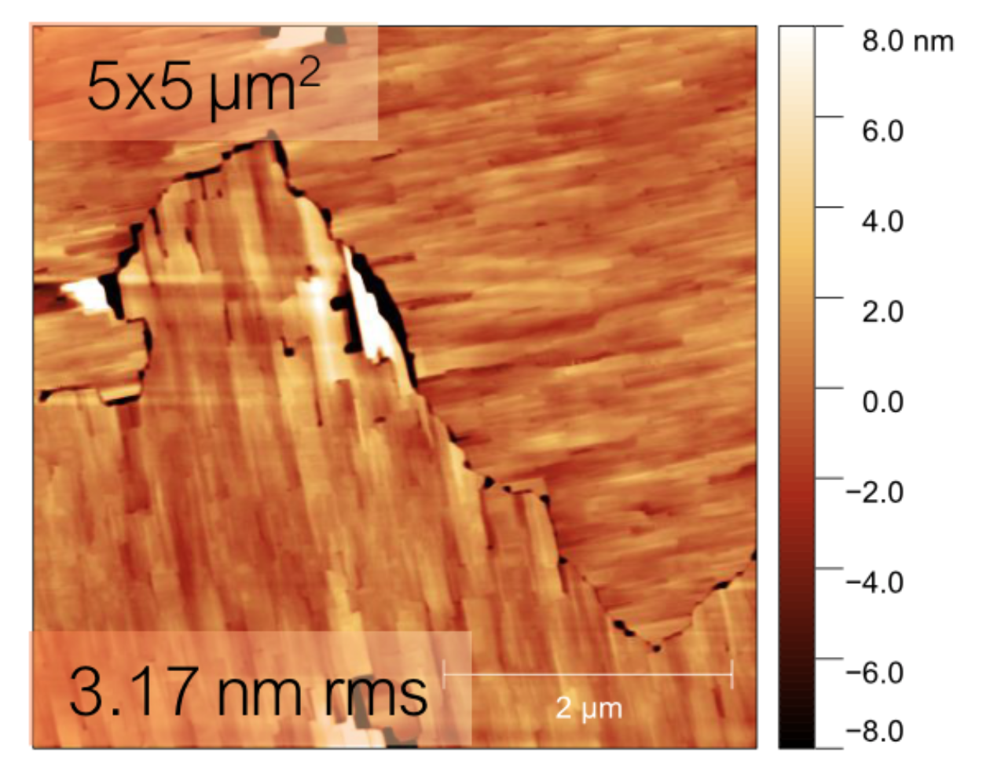
Our Cubic GaN Photocathode
Sample grown in molecular beam epitaxy growth chamber
AFM Images
Anti-phase boundary (APB) defects, characteristic of growths on 3C-SiC
15
Notes:
AFM images of the surface were taken, showing anti-phase boundary defects, which as I alluded to, are characteristic of growths on silicon carbide.

Slide 30
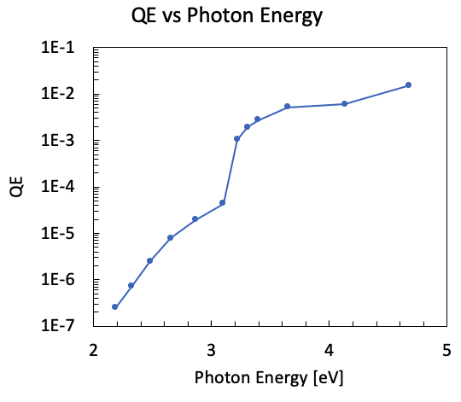
Our Cubic GaN Photocathode
Cs NEA activation
Spectral Response
16
Notes:
We then activated the cathode to NEA by depositing cesium. We monitored the QE at 265 nm which is well above the bandgap energy, until the QE peaked. A spectral response measurement was done, revealing that the cathode was in an NEA state,

Slide 31
Our Cubic GaN Photocathode
Cs NEA activation
Spectral Response
QE at the band gap (3.2 eV, 387.5 nm)
16
Notes:
as we see a bandgap around 3.2 eV. Near the bandgap, where we expect to see spin-polarized photoemission, we see a QE drop of two orders of magnitude, which is important to note as we try to do our measurements later.

Slide 32
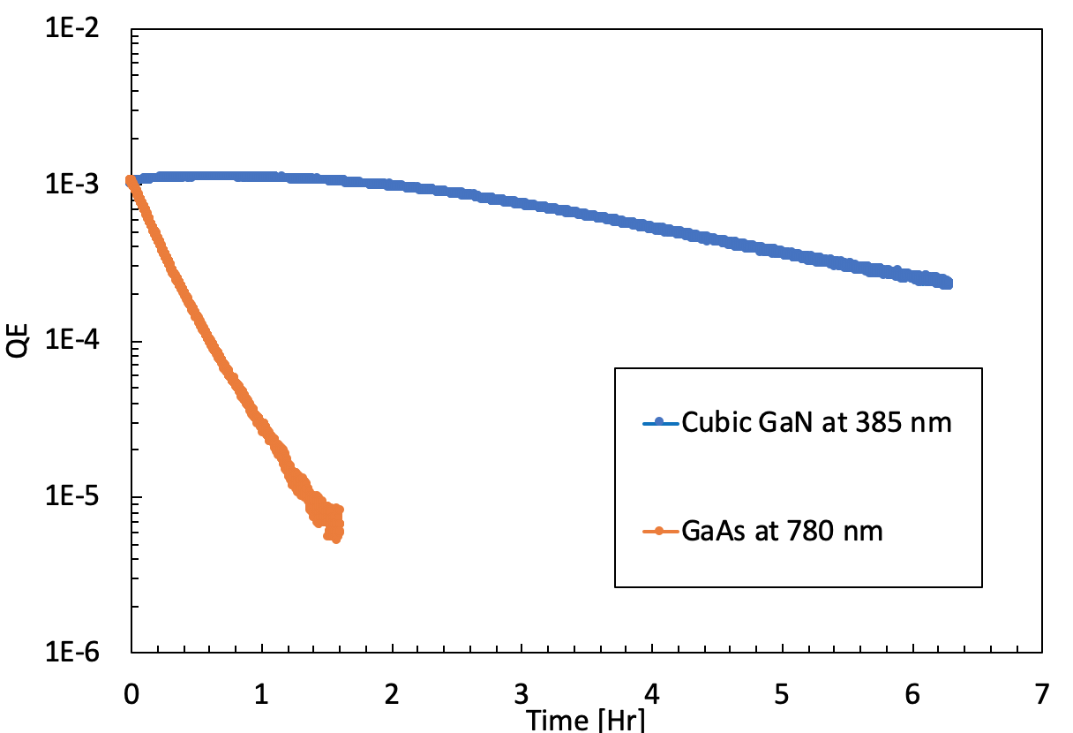
Our Cubic GaN Photocathode
Lifetime monitored at respective threshold
GaAs activated in same chamber, monitored at 780 nm for reference (factor of 12 lifetime difference)
17
Notes:
We then monitored the QE with a 385 nm LED to get an idea of the lifetime at the band gap energy. For comparison, we did the same thing with a GaAs cathode, but at 780 nm, near its emission threshold. In our activation chamber, our cubic GaN sample demonstrated a 12 times better threshold lifetime than GaAs.

Slide 33
- Design requirements:
  - Tunable from 384 nm – 390 nm
  - 1 nm bandwidth
  - 1-2 µW power at sample
  - Circularly polarized
A 20 meV SO splitting corresponds to a 2.5 nm wavelength window (385.3 nm – 387.7 nm)
18
Notes:
So we have our cathode, now we need to measure its spin polarization. A 20 meV wide spin-orbit split gives us, as we will see later, a 2.5 nm wide wavelength window to emit spin polarized electrons from. Therefore, we needed a highly tunable, very narrow band UV light source for our measurement.

Slide 34
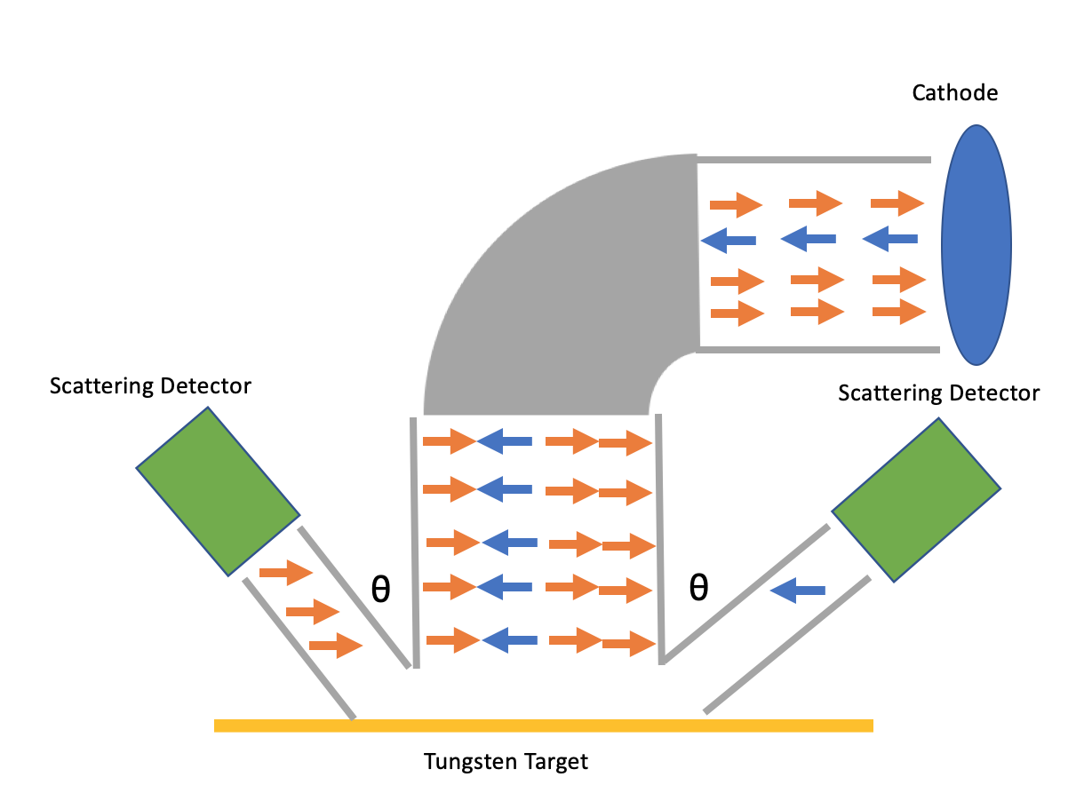
- Design requirements:
  - Tunable from 384 nm – 390 nm
  - 1 nm bandwidth
  - 1-2 µW power at sample
  - Circularly polarized
A 20 meV SO splitting corresponds to a 2.5 nm wavelength window (385.3 nm – 387.7 nm)
1032 nm pulsed femtosecond laser
20 W
Optical Parametric Amplifier
Tunable 600-800 nm
2% efficiency
Diffraction grating
Frequency-doubling
BiBO crystal
Linear polarizer and quarter-wave plate
Single-mode optical fiber
Mott Polarimeter
18
Notes:
So, starting with an OPA setup, we used a frequency-doubling BiBO crystal to get us to the right wavelength, with multiple mW of power.

Slide 35
- Design requirements:
  - Tunable from 384 nm – 390 nm
  - 1 nm bandwidth
  - 1-2 µW power at sample
  - Circularly polarized
A 20 meV SO splitting corresponds to a 2.5 nm wavelength window (385.3 nm – 387.7 nm)
1032 nm pulsed femtosecond laser
20 W
Optical Parametric Amplifier
Tunable 600-800 nm
2% efficiency
Diffraction grating
Frequency-doubling
BiBO crystal
Linear polarizer and quarter-wave plate
Single-mode optical fiber
Femtosecond pulsed laser + optical parametric amplifier + frequency doubling
  20-40 mW of UV light
  1.5 nm linewidth
  Widely tunable
Mott Polarimeter
18
Notes:
We then used a diffraction grating to tune the bandwidth of the light.

Slide 36
- Design requirements:
  - Tunable from 384 nm – 390 nm
  - 1 nm bandwidth
  - 1-2 µW power at sample
  - Circularly polarized
A 20 meV SO splitting corresponds to a 2.5 nm wavelength window (385.3 nm – 387.7 nm)
1032 nm pulsed femtosecond laser
20 W
Optical Parametric Amplifier
Tunable 600-800 nm
2% efficiency
Diffraction grating
Frequency-doubling
BiBO crystal
Linear polarizer and quarter-wave plate
Single-mode optical fiber
Nonlinear pulse distortion in optical fiber causes spectral broadening
  Lower power = less broadening
Diffraction grating + fiber launch
  Lower bandwidth
  Lower power at desired wavelength
Mott Polarimeter
18
Notes:
A problem that we had to deal with was the fiber’s “bandwidth spreading” as a function of input power.

Slide 37
- Design requirements:
  - Tunable from 384 nm – 390 nm
  - 1 nm bandwidth
  - 1-2 µW power at sample
  - Circularly polarized
A 20 meV SO splitting corresponds to a 2.5 nm wavelength window (385.3 nm – 387.7 nm)
1032 nm pulsed femtosecond laser
20 W
Optical Parametric Amplifier
Tunable 600-800 nm
2% efficiency
Diffraction grating
Frequency-doubling
BiBO crystal
Linear polarizer and quarter-wave plate
Single-mode optical fiber
Final result: 1.4 nm bandwidth at Mott Polarimeter
Mott Polarimeter
18
Notes:
So, after lowering the power, we were able to achieve 1.4 nm bandwidth light going into the Mott.

Slide 38
- Design requirements:
  - Tunable from 384 nm – 390 nm
  - 1 nm bandwidth
  - 1-2 µW power at sample
  - Circularly polarized
A 20 meV SO splitting corresponds to a 2.5 nm wavelength window (385.3 nm – 387.7 nm)
1032 nm pulsed femtosecond laser
20 W
Optical Parametric Amplifier
Tunable 600-800 nm
2% efficiency
Diffraction grating
Frequency-doubling
BiBO crystal
Linear polarizer and quarter-wave plate
Polarization Measurement
Single-mode optical fiber
Set light wavelength (λ)
Circularly polarize light:
Linearly polarizer
λ/4 Waveplate
Count scattered electrons on each detector (N_{L} & N_{R})
Bend electron trajectory for transverse spin orientation
Mott Polarimeter
18
Notes:
As the experts are aware, you measure spin-polarization in a Mott polarimeter. Let’s say we emit 3 spin down and 1 spin up electrons, longitudinal to the cathode. We then bend the electrons to orient their spins transverse to a tungsten target. They scatter off the target, with each spin going in opposite directions.

Slide 39
Cubic GaN Results
Peak: 28.9% +/- 1.4% at 386 nm (3.212 eV)
What polarizations could you expect theoretically with <1 nm bandwidth light?
19
Notes:
So, we put our cubic GaN cathode in our Mott polarimeter and did our measurements and this was the result. Here is the first ever measurement of spin polarization from a cubic GaN photocathode. We see polarization start around 384 nm culminating in a peak polarization of 28.9% at 386 nm or 3.212 eV, right where we would expect given the known and measured bandgap values of cubic GaN. However, the actual polarization is most likely higher, I will explain why over the next few slides.

Slide 40
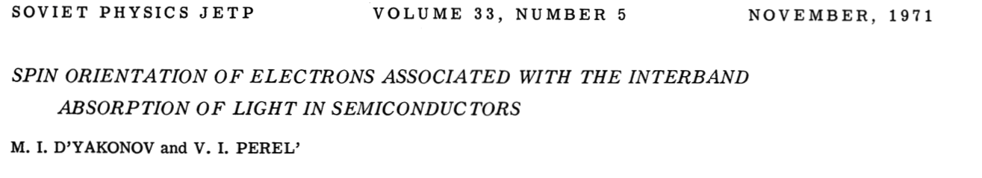

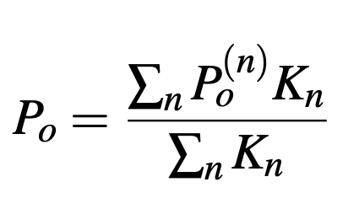
Model
Initial excited spin polarization approximated with model by D’yakonov and Perel
Excited distribution peaks at 50% maximum, as expected
Mixing of split-off band with light and heavy hold bands
20
Notes:
To model our spin polarized photoemission spectrum, we start with the D’yakonov and Perel model for excited spin polarized electrons, which takes into account the mixing of states in the split-off band with the light and heavy hole bands. Since it is the excitation distribution, it peaks at 50%.

Slide 41
Model
Scale model to approximate de-polarization effects
Peak (measurement maximum) at 33%, on par with that of GaAs
Note that the peak was scaled according to a fit with our data!
20
Notes:
Now, we approximate the depolarizing effects that happen in transport by scaling our distribution. By allowing our peak to be fitted towards data that you will see shortly, we arrive at 33% photoemitted spin polarization, which is on par with GaAs.

Slide 42
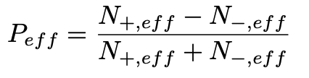
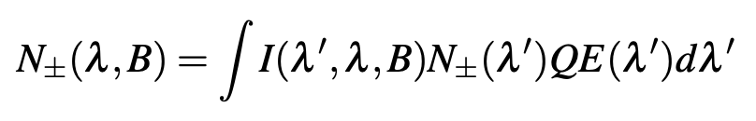
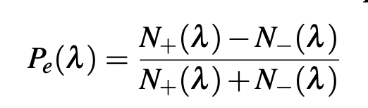

Model
Since the spin-orbit splitting is so small, need to consider measuring spectrum with incident light spectra
Calculate effective polarization based on the light bandwidth
Gaussian light spectrum with variable bandwidth (B) and center at lambda
20
Notes:
Since the spin-orbit splitting is so tiny, we need to consider the fact that we are measuring the spin polarization with finite-bandwidth light. To account for this, we count the number of spin up and spin down electrons in the excitation distribution, and count how many of them get picked up with a gaussian light spectrum scaled by the QE. We then arrive at a curve that we would expect to measure given 1.4 nm bandwidth light.

Slide 43
Model
Measurements confirm bandwidth limit
Our 1.4 nm bandwidth measurements may be close to the theoretical maximum.
20
Notes:
When looking at this with our measurement data, we see how we are close to our theoretical maximum, but at the end of the day, still need to be around 1 nm to get closer.

Slide 44
Conclusion
Many developments in NEA activation layers have produced longer-lasting GaAs photocathodes
Advances in new materials may provide a path towards more robust sources of spin-polarized sources
Thank you for your attention!
21

