Slide 1
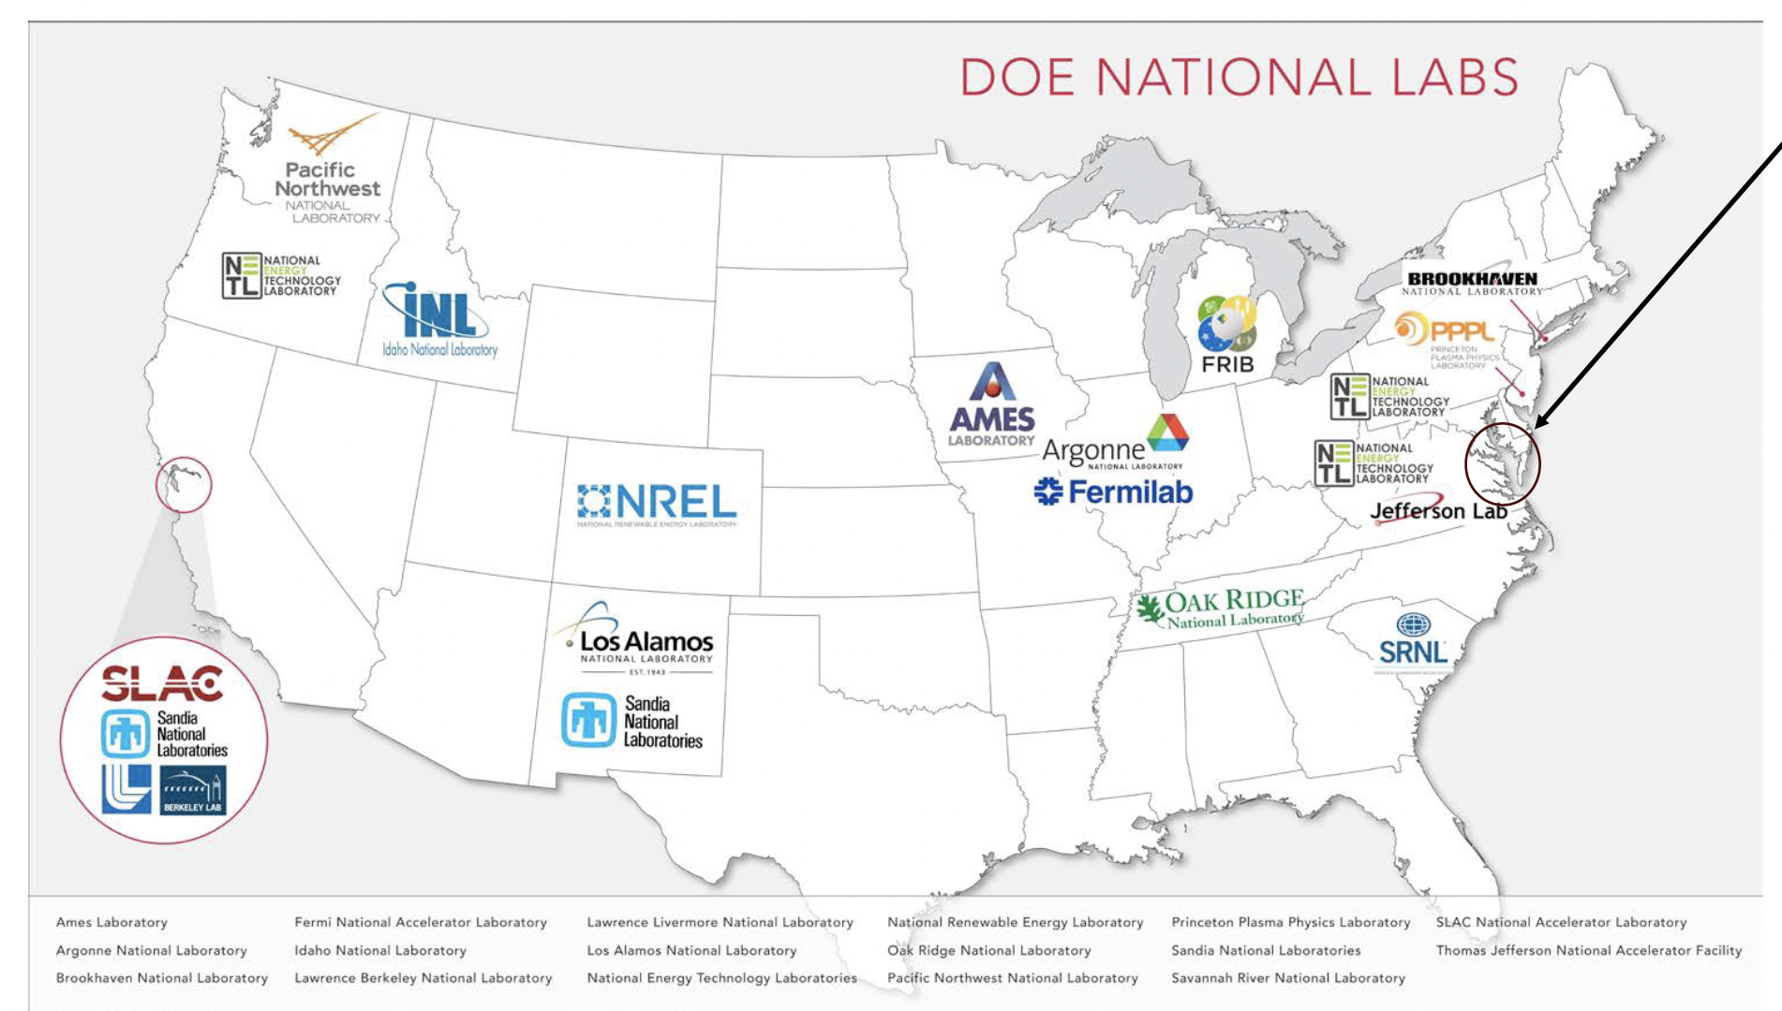
We are pleased to announce….
20th International Workshop on Polarized Sources, Targets, and Polarimetry at Jefferson Lab
(TBD September or October 2024)
Polarized targets
Polarized electron sources (photocathodes and dc/rf guns)
Polarimetry and spin manipulation
Polarized neutrons
Fundamental symmetry tests
Novel applications of spin
For more information contact Joe Grames
email: grames@jlab.org
The scientific program of this workshop includes topics related to spin phenomena in particle and nuclear physics as well as those in related fields.

Slide 2
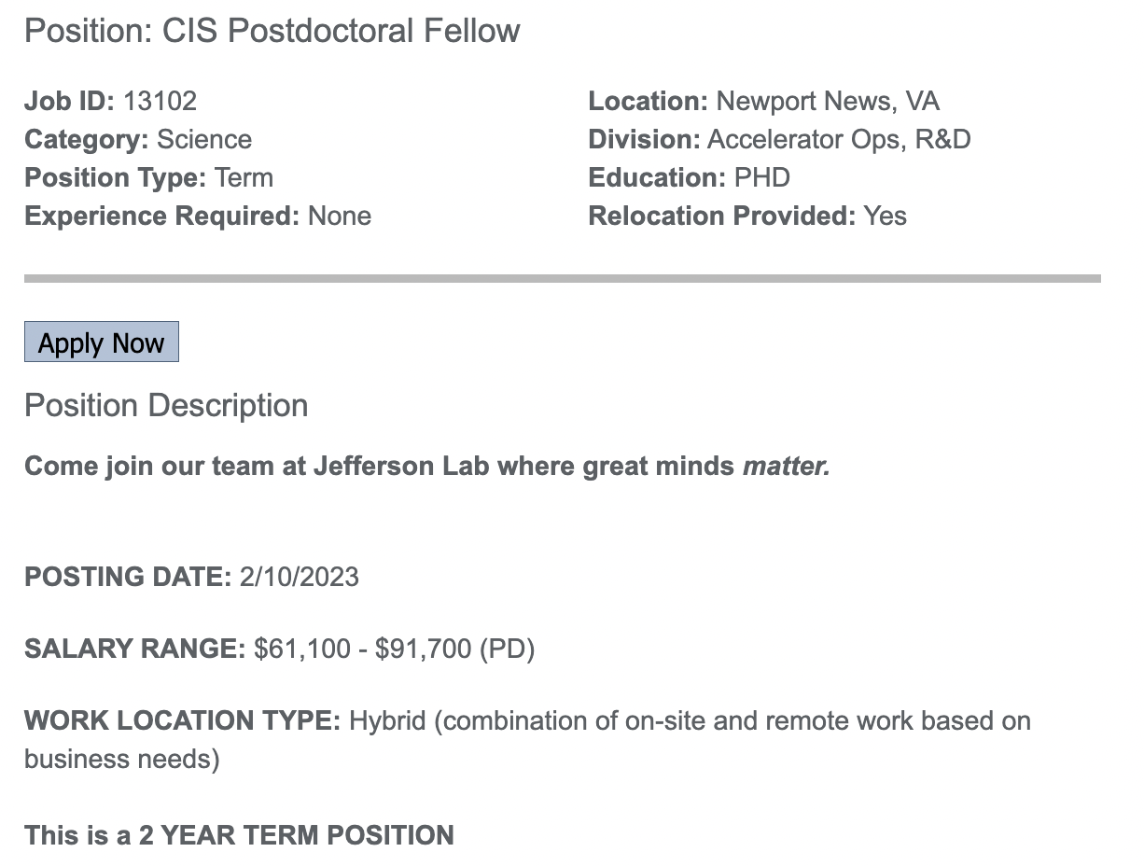
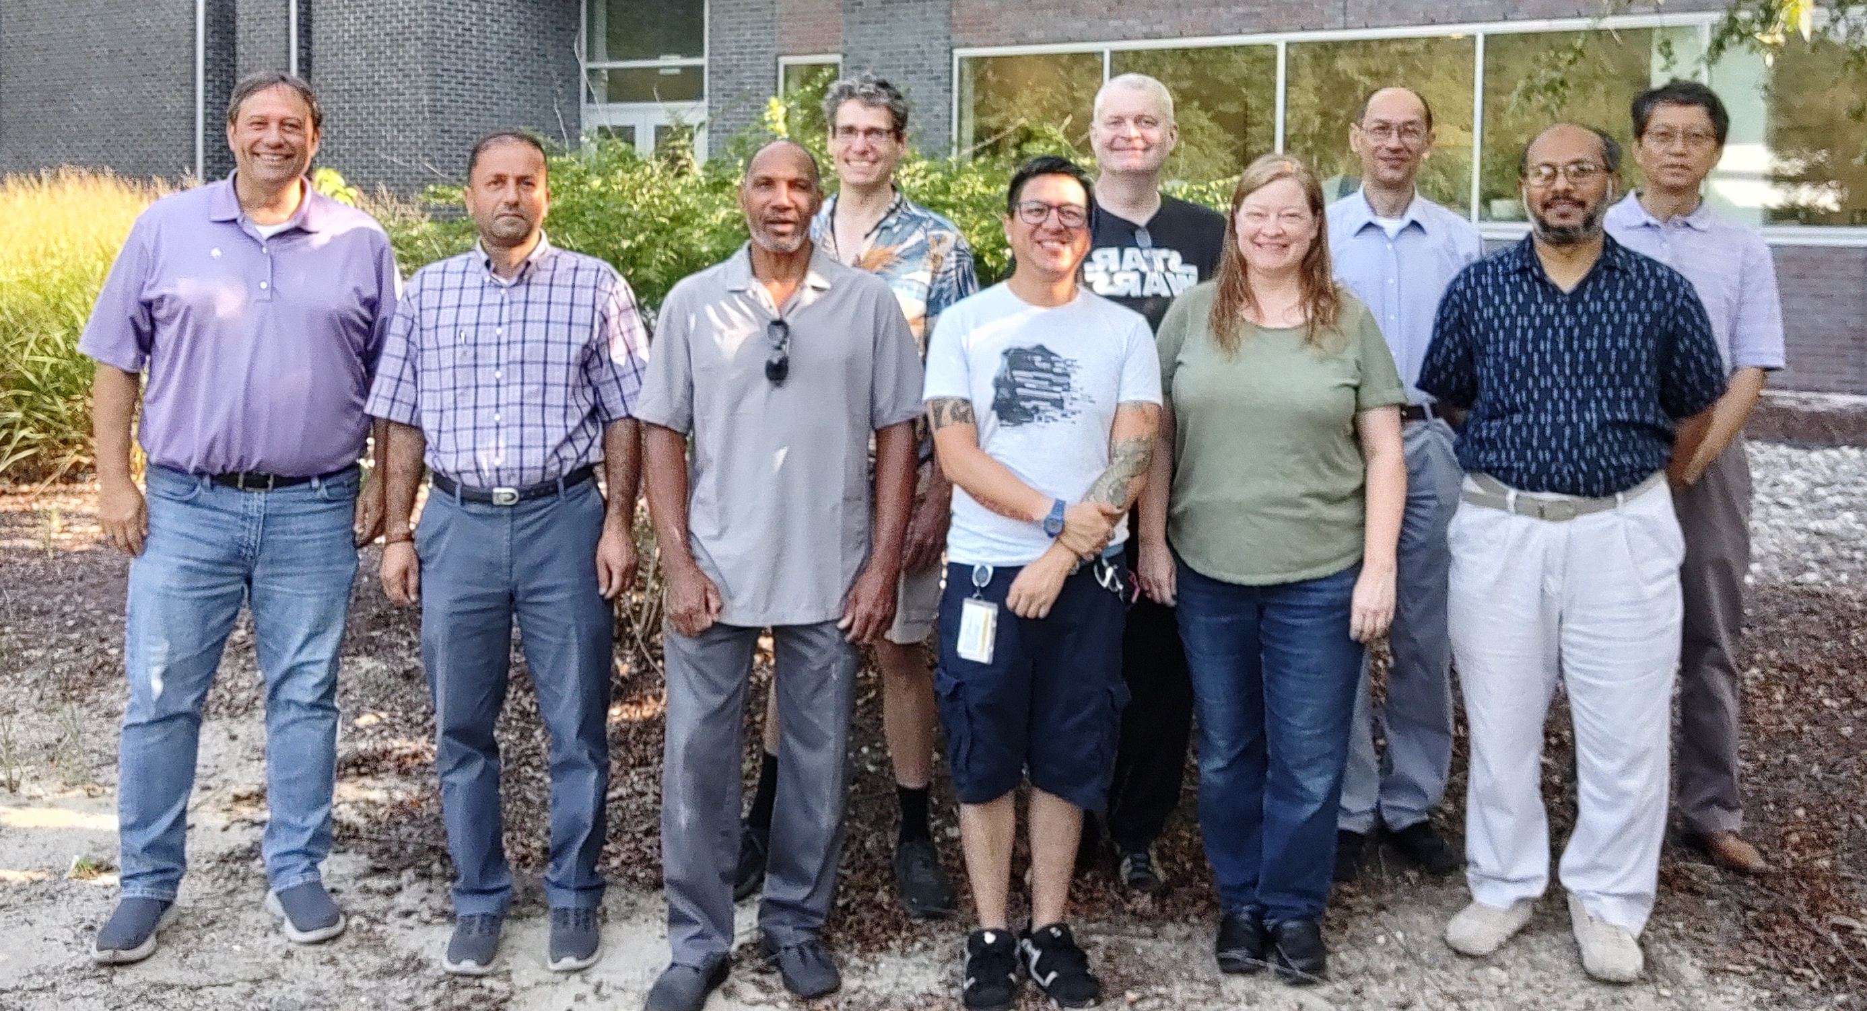
Center for Injectors & Sources at Jefferson Lab has an immediate opening for a Postdoctoral Fellow
Visit: www.jlab.org/recruiting
Job ID: 13102
Development of spin polarized photocathodes
UHV/XHV vacuum science
High voltage photoguns
Electron polarimetry
Generation of milliampere e- beams
Spin polarized e+ beam generation
Polarized Electron Source Group
For more information contact Joe Grames
email: grames@jlab.org

