Slide 1
Closeout of the 7th “Photocathode Physics for Photoinjector” workshop 2023 (P3 2023)
Oct 3-5, 2023
Photocathode Physics for Photoinjectors Workshop
Stony Brook, NY
1

Slide 2
P3 workshop 2023, BNL
75 Registered participants
7 sessions, 37 talks
15 posters

Slide 3
Special Thanks
Local Organizing Committee
L. Cultrera (co-Chair)
M. Gaowei (co-Chair)
S. Capp
Support staff
C. Weaver
D. Basozmen
Scientific Committee
Luca Cultrera
Oksana Chubenko
Dimitre Dimitrov
Mengjia Gaowei
Carlos Hernandez-Garcia
Kevin Jensen
Siddharth Karkare
Jared Maxson
Nathan Moody
Pietro Musumeci
John Smedley
Marcy Stutzman
Theodore Vecchione

Slide 4
Introduction session
EWPPA 2022 Summary: Quite complete summary of the talks presented during the last EWPPA event help in Milano (Italy). Announcement of the next European event that will be hosted by HZDR in Dresden (Germany) in 2024.
Snowmass: Is the community driven process to discuss, collect and organize the Priority Research Direction to meet the need of the planned experiment in the next decades. An exhaustive summary of the photoinjector technology currently available was completed by indicating the proposed PRD for the next two decades on the development of electron sources to meet the needs of future experiments and facilities.
4

Slide 5
High charge, high average current
Epitaxial Cs₃Sb and K₂CsSb are achieved with high QE
Fiber textured Cs₁Sb₁ layer is flat, with visible light QE and high resistance towards vacuum contamination.
Cs₃Sb film on STO exhibits150 meV MTE at RT with green laser and ~30meV at threshold.
Na-K-Sb shows potential for long operational lifetime in SRF gun.
Successful high current operation in PKU DC-SRF II gun and BNL LEREC gun with K₂CsSb cathodes.
5

Slide 6
Free Electron Laser
AWA: <= 400 MV/m gradients have been achieved in an X-band 1.5 cell gun. Schottky scans of copper photocathode (back wall) point to some interesting photoemission physics. No dark current observed due to short pulse duration. Future plans involve a removable plug.
SHINE: Successful commissioning of a 217 MHz gun at Tsinghua. 30 MV/m achieved with < 1 uA dark current. 0.4 um emittance @ 50 pC from Cs2Te. Really impressive results. Future work is to relocate and beam test at SHINE.
PITZ/INFN: Demonstration of a robust feedback diagnostic for K2CsSb photocathode grown based on multi-wavelength reflectivity. Comparison with theory seems quite good, may provide method for electronic structure analysis. Future plans are to test new photocathodes in PITZ gun.
LANL - Photoinjector plans for 250 MV/m cathode gradient (cryogenic c-band), with CsTe. Focus on the difficulties of introducing a plug at this gradient
PAL - New 4th gen storage ring based synchrotron planned, at 4 GeV. Will use a photoinjector based injector, due to flexibility and ease of use. Explored laser cleaning of cathode.
SLAC - LCLS-II lased! CsTe cathode has lasted for two years. Plan to build a next generation injector for LCLS-II HE, based on a 1/4 wave SRF gun.
6

Slide 7
Spin polarized photocathodes
Overall: SSL GaAs photocathodes remain the standard, best MOCVD GaAs/GaAsP have achieved EIC goal, and MBE InAlGaAs/AlGaAs being explored as P free alternative. Alternative activation protocols including CsTe or CsSbO show improved low voltage lifetime. Transfer of graphene monolayer and photocathode activation demonstrated. Other semiconductors that should emit polarized electrons are being explored, with potential for ALD deposition discussed, and polarized emission from GaN demonstrated.
Talk 1 (Biswas): Cs-Te-O based activation of GaAs resulted in NEA surface and showed 5-6 times improvement of low voltage charge lifetime as compared to Cs-O activation. DBR SSL GaAs/GaASP photocathodes tested - some samples have excellent QE and polarization. GaAs photocathode with monolayer graphene can be activated with Cs or have As cap removed through graphene with goal of reducing vacuum requirements, and some QE was retained after air exposure.
Talk 2 (Engel): Compared GaAs/GaAsP growth challenges for MBE to InAlGaAs/AlGaAs. Showed results of InAlGaAs/AlGaAs spin-polarized photocathode near 780 nm. DBR structures, digital alloys, and growth optimization ongoing.
7

Slide 8
Spin polarized photocathodes
Talk 3 (Bhandari): Proposed Atomic Layer Deposition (ALD) to enable cost-effective photocathode growth, particularly for non-planar structures. Potential polarized materials like doped CdTe are now possible with ALD.
Talk 4 (Levenson): Discussed improvement in GaAs lifetimes at low voltage when activated with CsTe or CsSbO. CsSbO activation tested at 200 kV test stand, no improvement in HV lifetime yet, studies ongoing. Explored novel candidates for future spin-polarized photocathodes (crystalline alkali antimonides, GaN), GaN polarization results of 33% at demonstrated at 385 nm.
Talk 5 (Wang): Succesful conditioning up to 350 KV of an EIC prototype High Voltage DC polarized electron gun with excellent vacuum and cathode cooling capability. Best DBR SL-GaAs photocathodes exceed EIC specs. Issues with surface charge limitations and wavelength shifting with DBR structures are being addressed.
8

Slide 9
UED/UEM
Exiting developments at Tsinghua: New photocathode growth system for Cs-Te and alkali antimonides, delivering % scale quantum efficiency. Also two new guns: an s-band gun for very high field AND very good vacuum pumping, as well as a DC gun for ultrafast and conventional TEM utilizing photocathodes with onboard laser focusing.
The TESS system to measure spectrally resolved MTE and QE delivers very high quality data on cathodes both at room and cryogenic temperatures. Several novel studies performed. Notably, some of the first data on MTE of the Cs-Te system as a function of oxygen dose, showing both an increase in MTE and a decrease in QE, as oxygen dose is increased.

Slide 10
UED/UEM
Plasmonic spiral photocathodes deliver extremely small spot sizes via plasmonic focusing and 5th order photoemission, yielding a source size of roughly 100 nm, and a normalized emittance of 30 picometers, a record for a photocathode source without collimation. Intensity dependent effects on MTE were observed, and nontrivial momentum distributions measured, which may arise from electron interaction with the plasmonic fields--an exciting question for future study.
Photoemission from needle tips with precision coincidence detection at the level of single electrons show in detail the effects of coulomb interactions, which generate a correlation between the energies of two electrons emitted closely in space and time. Exploiting such a correlation opens the door to electron beams that have sub-poissonian noise for advanced imaging.

Slide 11
Photocathode theory
Modeling optical interference effects can be used to optimize quantum efficiency in thin film photocathodes using an extension of a three step model of QE evaluation. The mode can be used to optimize QE as a function of thin-film thickness and photon wavelength, leading to a factor of two or higher QE compared to seminfinite slabs.
3 step model for calculating QE and MTE in the presence of surface roughness: sub-nm scale roughness treated as a diffraction grating. Takes into account density of states and temperature effects for polycrystalline materials.
Influence of Franck-Condon effect on QE and MTE (accounts for quantization effects in QE in multiples of optical phonon frequencies, and optical phonon assisted emission). Has implications for ultra-low intrinsic emittance photocathodes especially operating at room temperature.
11

Slide 12
Photocathode theory
Monte Carlo study of spin-polarized electron emission from p-doped GaAs with an NEA surface. Good agreement with experimental data for bulk NEA GaAs at room temperature.
Precision attosecond dynamics of electron emission from metallic nanotips: allows measurement of emission duration of 710 attosceconds. Good for high quality pulsed electron beams.
Method to evaluate tunneling time duration based on finding exact eigenstate solutions for barriers in wells that allows extension to time dependent barriers and conditions.
Determination of manufacturing assembly sensitivies by using charged particle 2D axisymmetric beams in electron gun sources. "Adjoint method" enables fine sensitivies to be captured, including relativistic corrections for high beam energies.

Slide 13
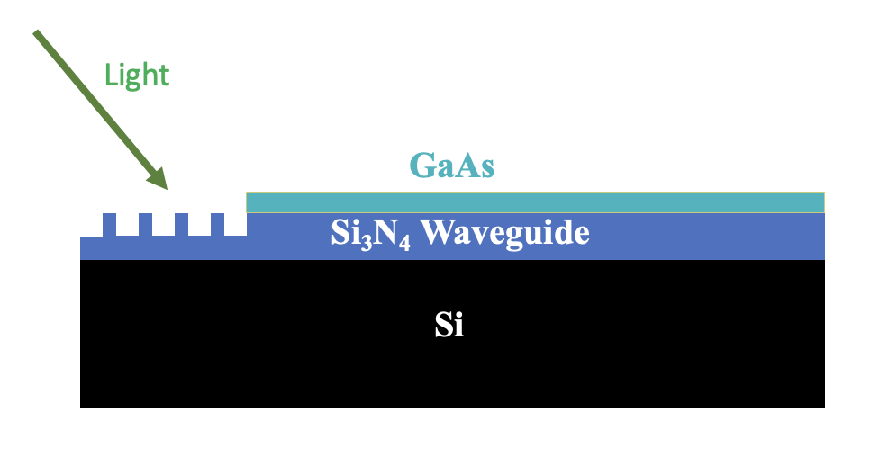
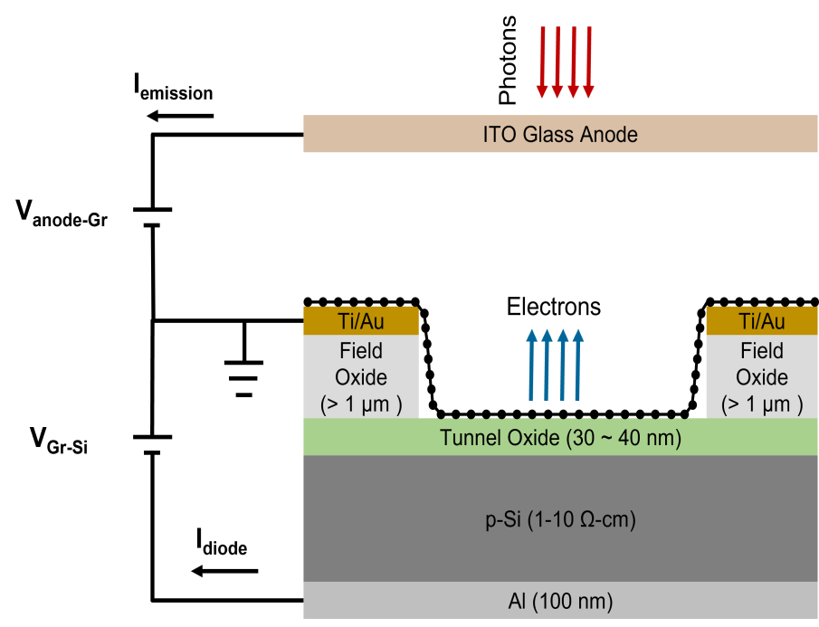
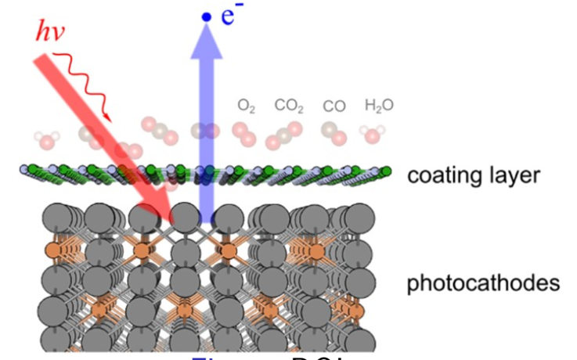
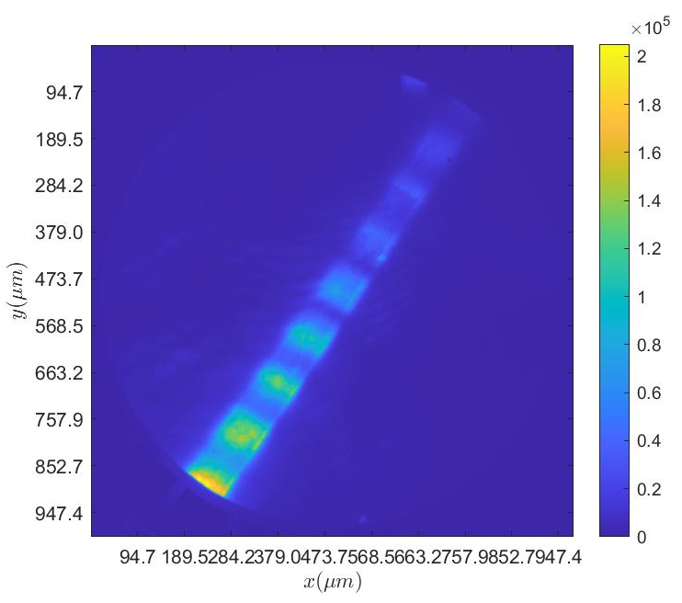
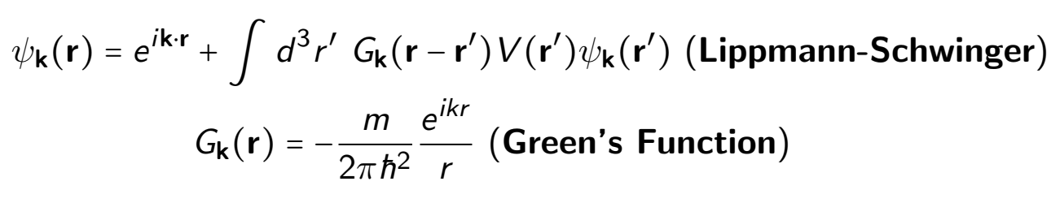
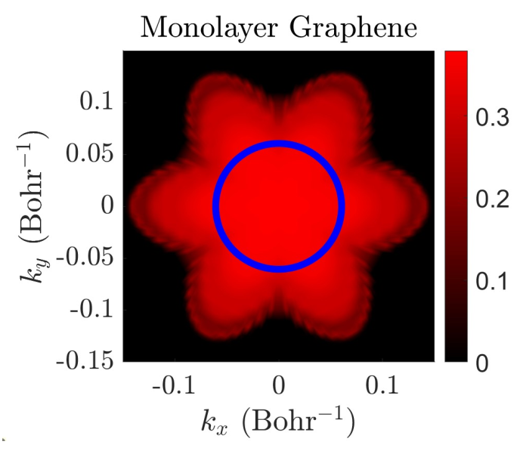
Novel Electron Sources and Applications
Photonics Integrated Cathodes
Electronically Tunable Negative Electron Affinity
Physics of Capping Layers and Lippman-Schwinger based photoemission modelling
Absorber
Air-stable adsorbate-free NEA
Photocurrent using visible light from an air-stable device
Can be tuned by applying an electronic voltage
Transverse momentum distribution for graphene transmission
Confined emission using photonics waveguides on cathode substrates
Potential for brighter beams
New way of beam shaping
13

Slide 14
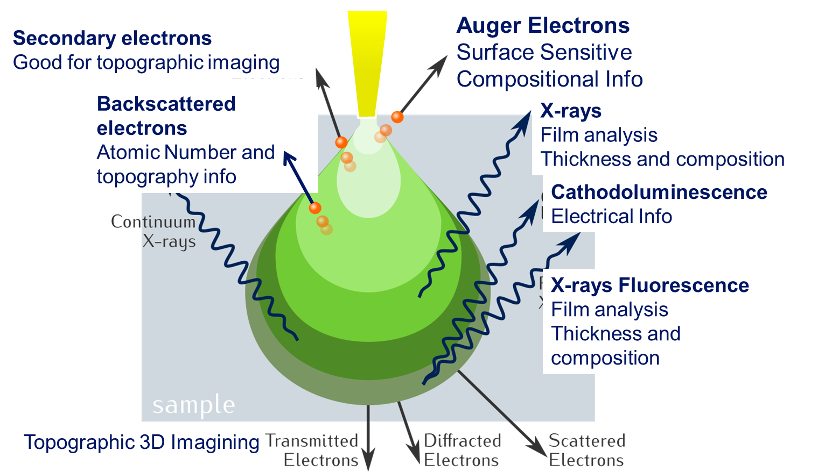
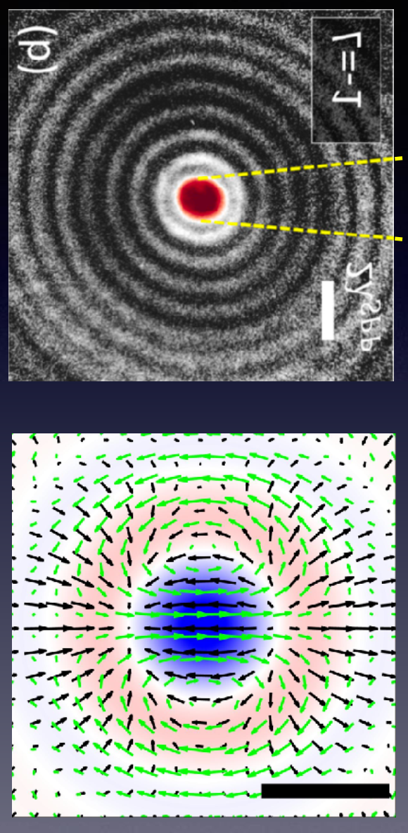
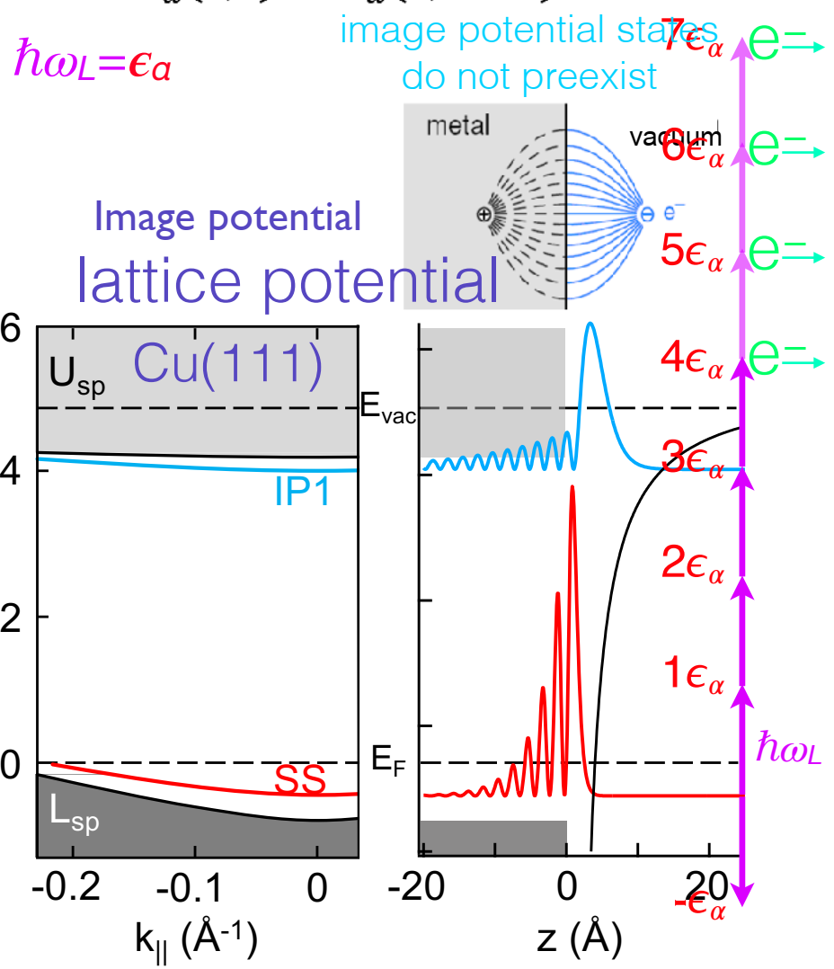
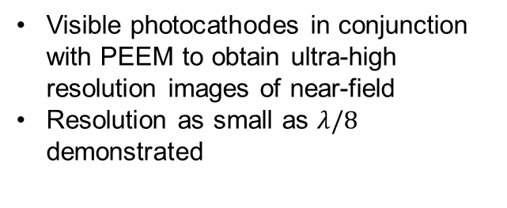
Novel Electron Sources and Applications
Plasmonic Vortices for Angular Momentum Electron Beams
Photoemission Sources for Metrology Applications
Optical Near Field Electron Microscopy
Use of structures light to obtain structured electrons with orbital angular momentum
Can use such plasmonic structures to study Axion physics for dark matter detection
Floquet engineering of metal surfaces affecting non-linear emission
Visible photocathodes in conjunction with PEEM to obtain ultra-high resolution images of near-field
Resolution as small as $λ/8$ demonstrated
Potential use of electron beams for metrology
Photoemission sources have distinct advantages over thermionic sources
14

Slide 15
Job fair!
Post doc position, hired through ASU, working at BNL as a part of ASU’s robust spin-polarized cathodes project: https://apply.interfolio.com/130266
Post doc position @ Center for Injectors & Sources at Jefferson Lab, Visit: www.jlab.org/recruiting,
15

Slide 16
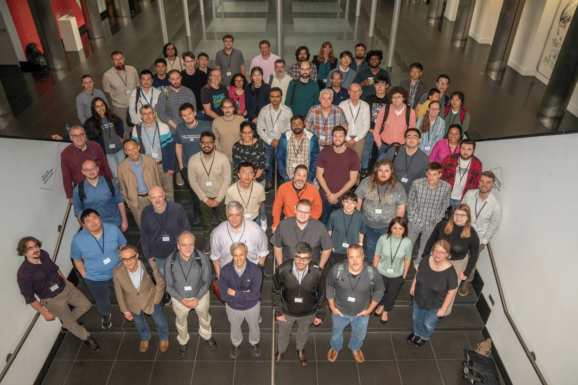
P3 workshop 2023, BNL
Thank you all for coming!

Slide 17
Next P3!

