Slide 1
eRD104: “SVT Readout Services” Updates
Joachim Schambach
ORNL

Slide 2
Simplified Overview
FELIX

Slide 3
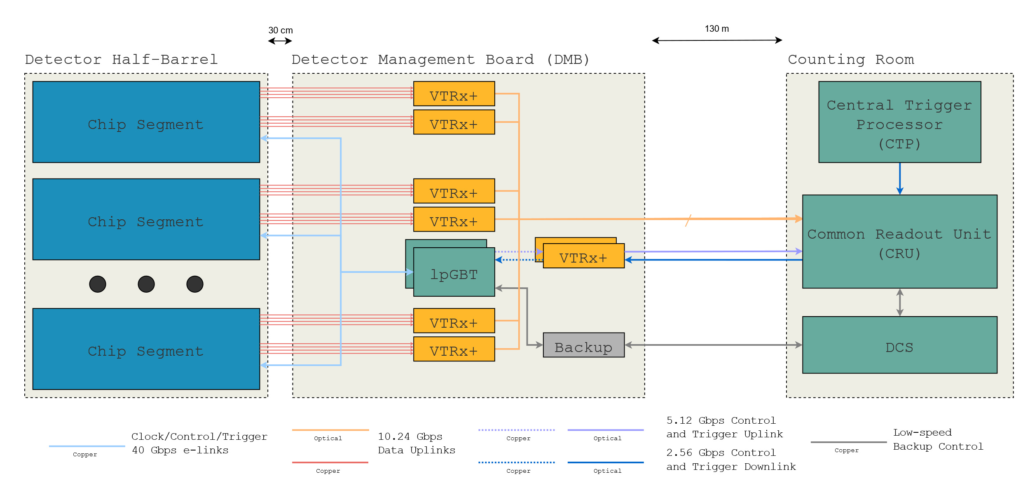
ITS-3 Detector Management Board (DMB) – Data and Control
Direct connection between detector and optical transceiver (VTRx+)
    - No data processing
    - lpGBT encoding
Slow control via lpGBT
    - E-links to detector
Multiple boards with board-to-board connections for control and power
    - A master board for control
Radiation qualified COTS or CERN-developed components
Backup control link
    - CANbus, RS-485, …
FELIX

Slide 4
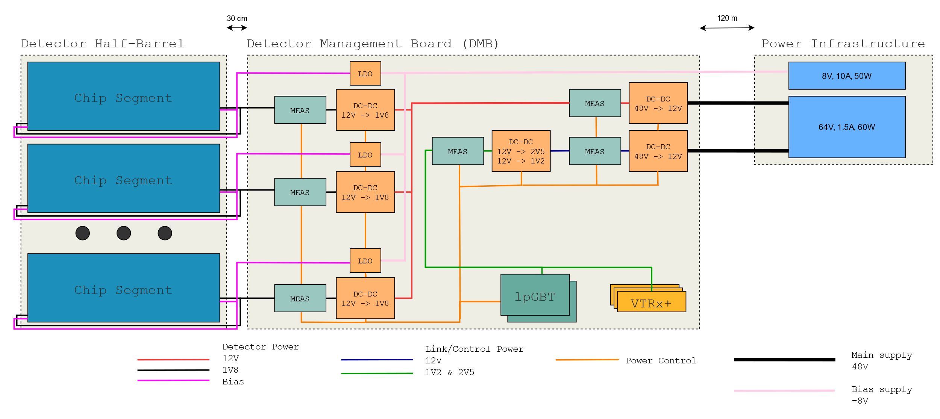
Detector Management Board (DMB) - Power
Based on DC-DC converters
  CERN bPols (48V->12V, 12V->1.8V)
Supply detector on both A- and C-side
  Need load balancing to avoid skewed v-drop
Main power separated between detector and link/control
  Allow tripping of detector power at various levels without affecting link/control
Low current towards infrastructure
Self monitoring, controlled by lpGBT

Slide 5
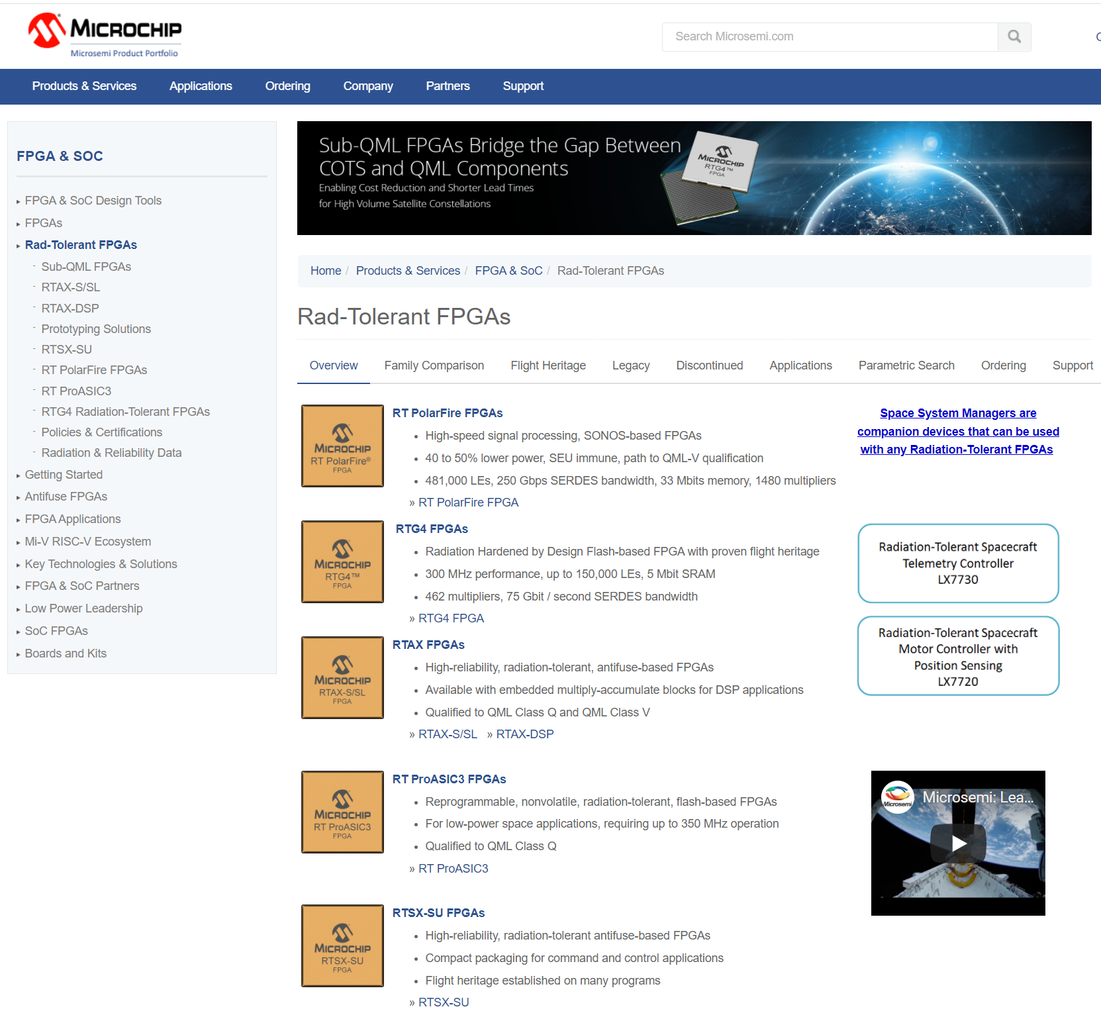
Radiation Tolerant FPGAs
e.g.:

Slide 6
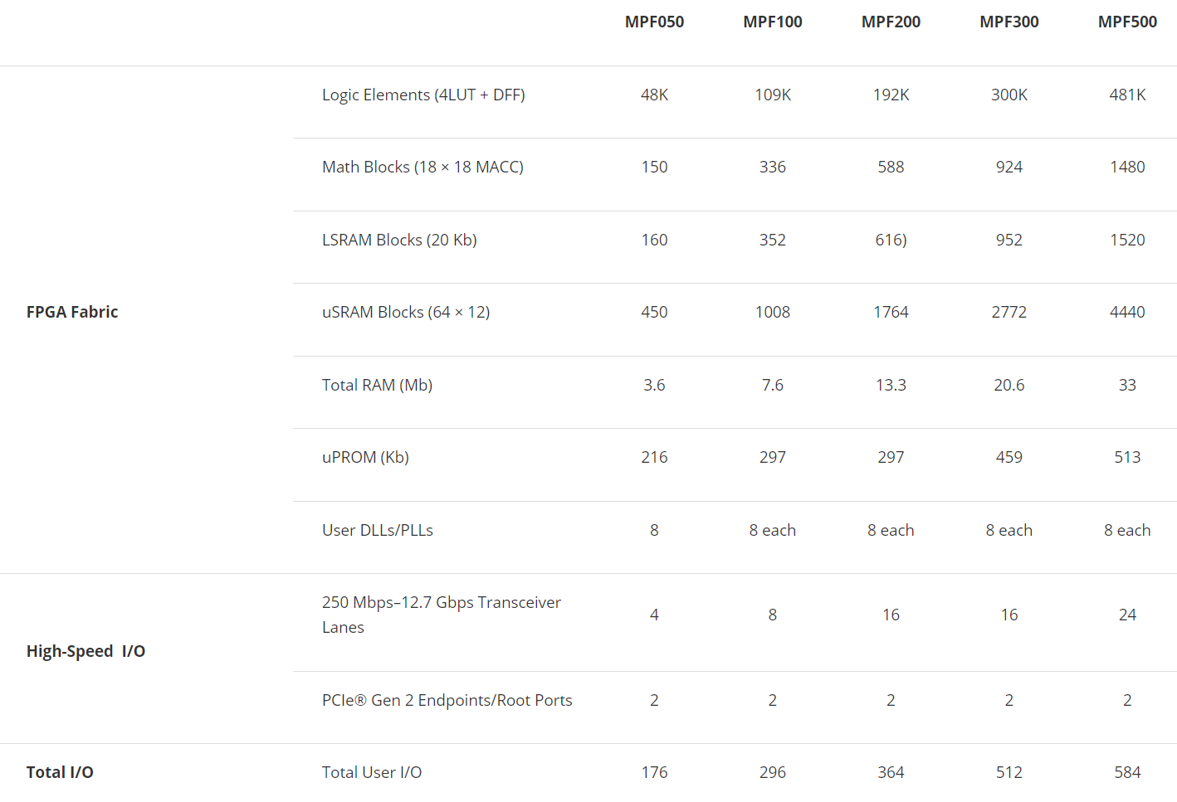

Microchip PolarFire FPGA

Slide 7
Rad-Hard Optical Interconnect: “lpGBT”

Slide 8
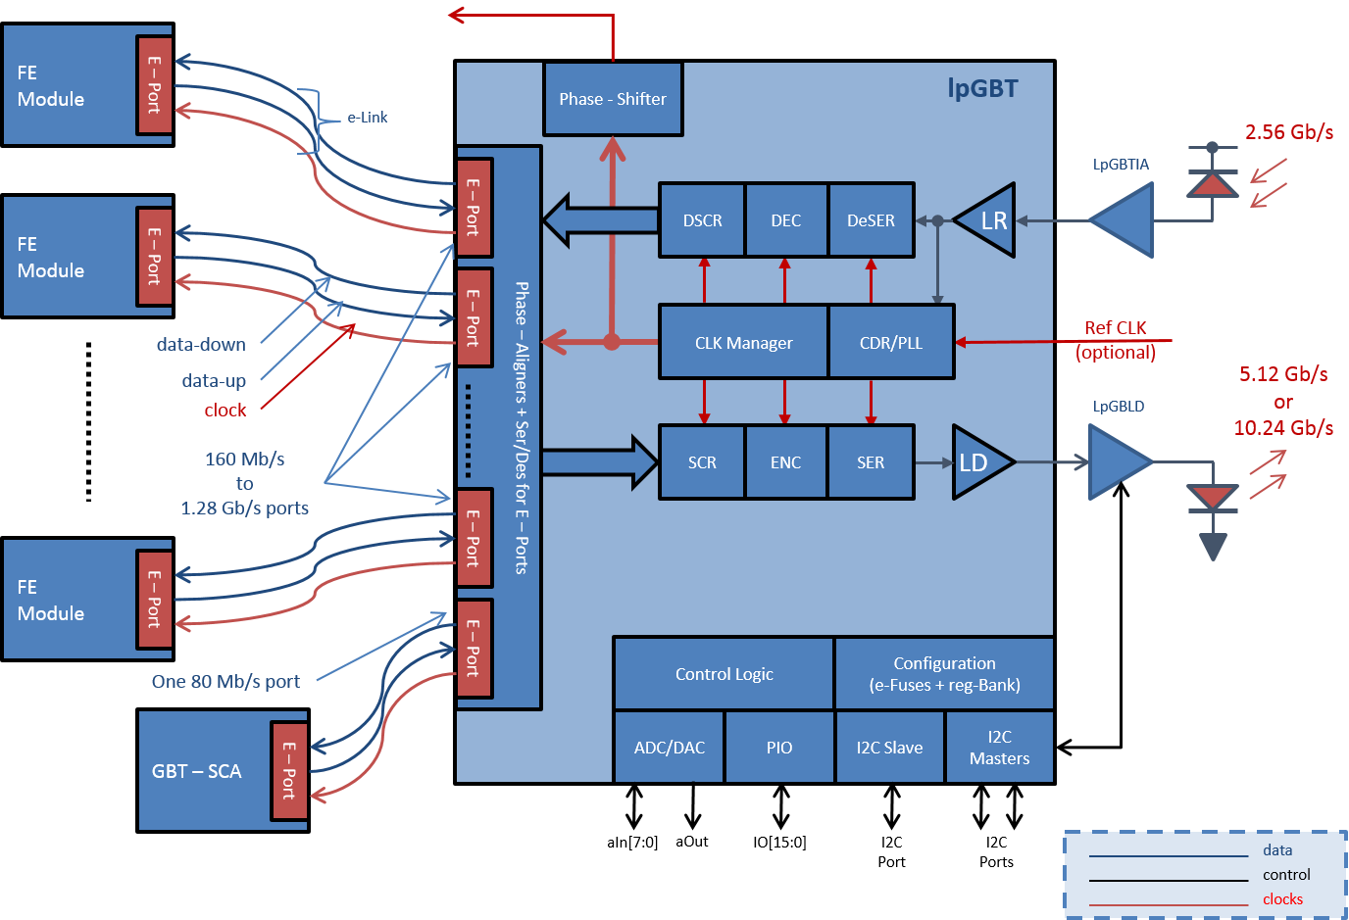
lpGBT Capabilities

Slide 9
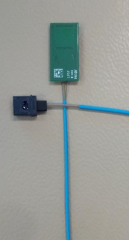

Slide 10
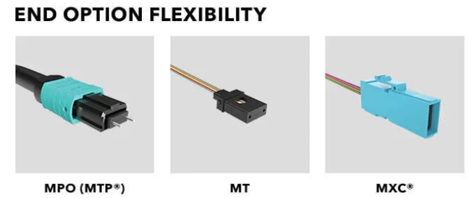
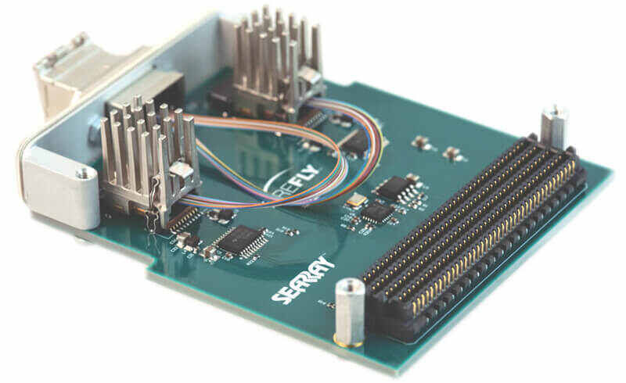
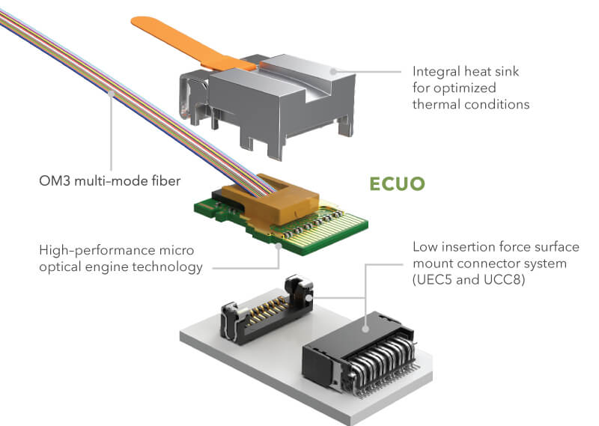
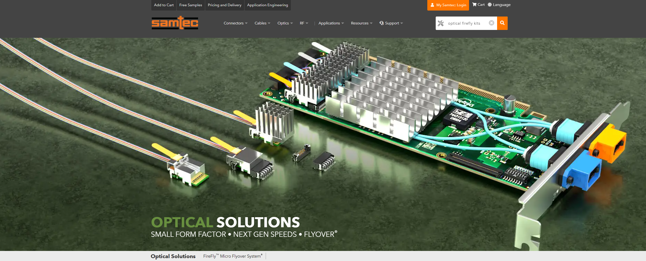
Samtec High-Speed Interconnects
Supports up to 10 high-speed, multi-gigabit transceivers (TX and RX) operating at up to 14 Gbps per channel
14G Firefly FMC Development Kit

