Slide 1
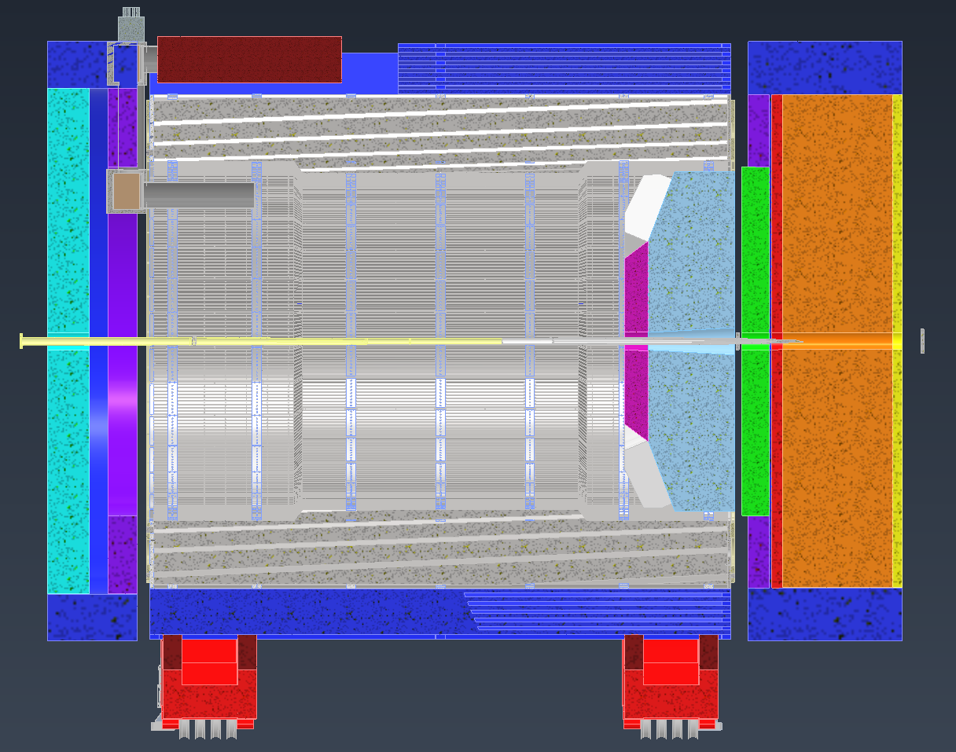

Slide 2
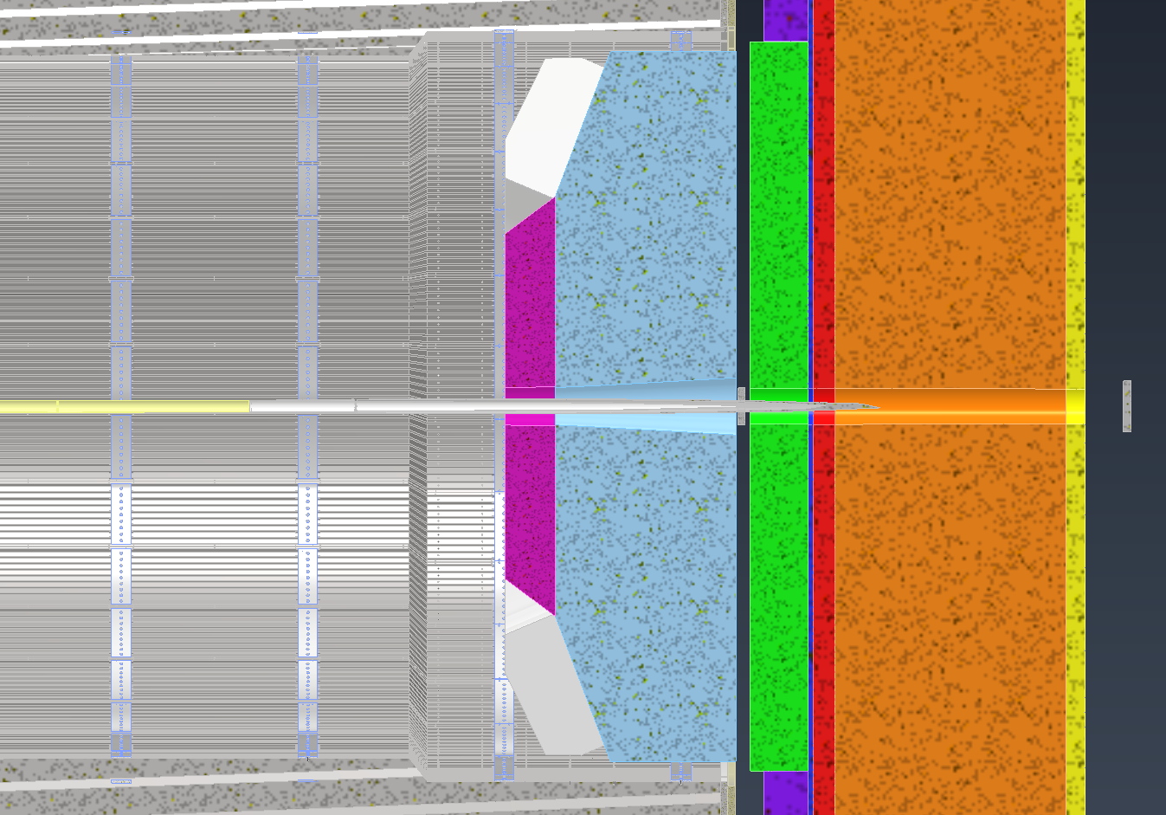
IP to start of Em_Cal 327.6 cm
Em_Cal 30 cm thick
IP to back of dRICH 320 cm
IP to start of flange 321.3 cm
Plate 1” thick
dRICH to Em_Cal 7.62 cm gap
dRICH 185 cm radius
Em_Cal 190 cm radius shown

Slide 3
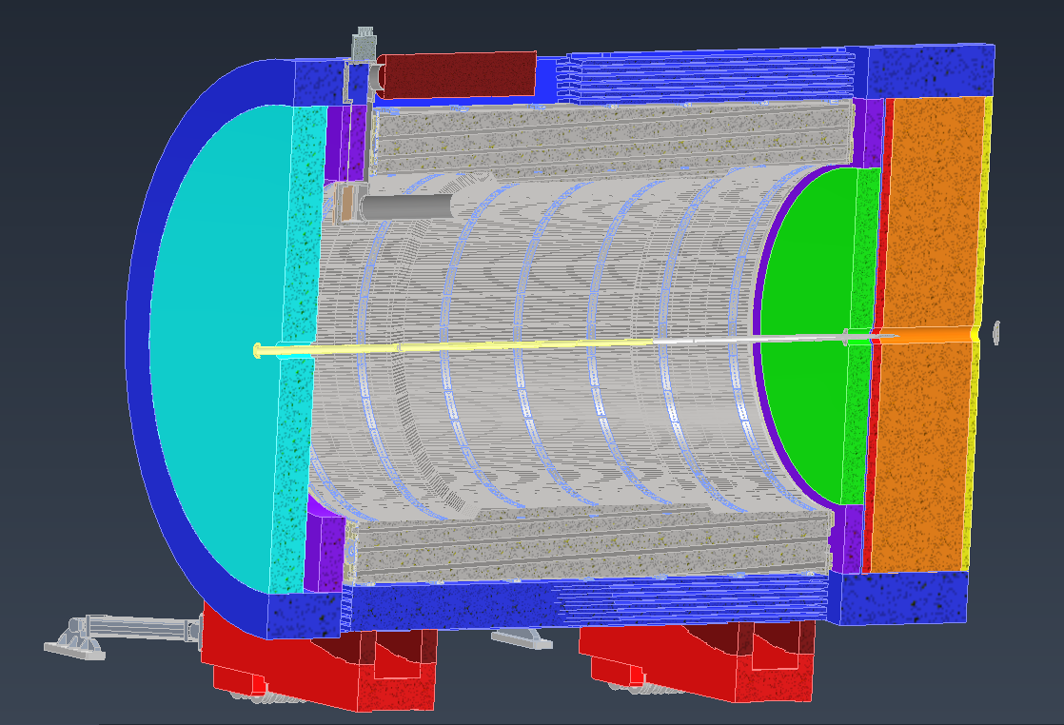

Slide 4
