Slide 1
Homework! Choose one (or more) of the following:
1. The time for an event to arrive can be modeled in a simulation by letting x be a random number between 0 and 1, and applying the formula:
Where r is the average rate. Convince yourself this is true!
Hints: a. assume a constant probability per bunch crossing
b. use
for small x, large xn, to get the probability distribution for the time
between events
c. Think about the curve under the probability distribution as a
set of boxes numbered from t=0. Integrating to time t gives the
an index for that time
d. Solve for the time...
$$t=−\frac{1}{r}log\left(1−x\right)$$
$${\left(1−x\right)}^{n}=e^{−xn}$$
$$P\left(t\right)dt=re^{−rt}dt$$

Slide 2
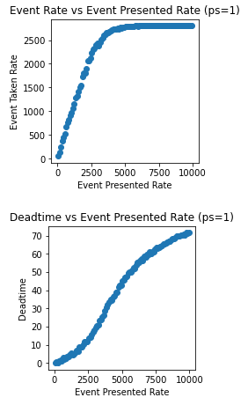
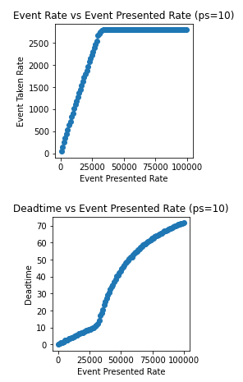
Small Event Simulation of STAR DAQ TPC DAQ
2. Using the small event simulation:
What is the source of the linear deadtime below 1500hz?
What is the source of the curved deadtime above 1500hz?
Why are the curves for ps=10 sharper?
What would the happen if the number of TPC buffers were increased or decreased?

Slide 3
3. Data transfers typically are modeled as taking time:
TransferTime = Latency + ThroughputRate * sz
Choose a parameter:
Disk write speed
Disk read speed
Ethernet transfer speed
Memcpy() speed
Write a program to measure the speed of any of these and plot transfer time vs transfer size!
Do the results fit this model, if not can you figure out why?

Slide 4
Choose a STAR run and describe what is being done
Ask me for a good run!
Study and understand the web pages
Ask me!
https://online.star.bnl.gov
-> Trigger Versioning
-> DAQ Monitoring
-> Online QA Histograms

