Slide 1
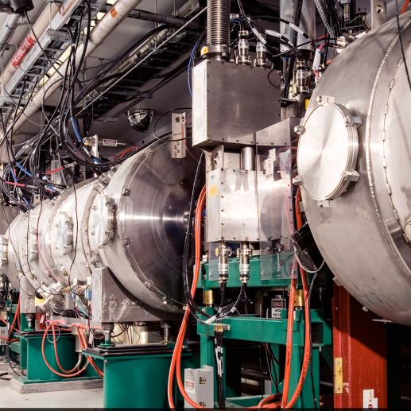
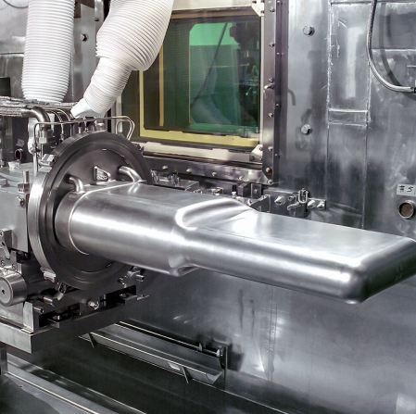
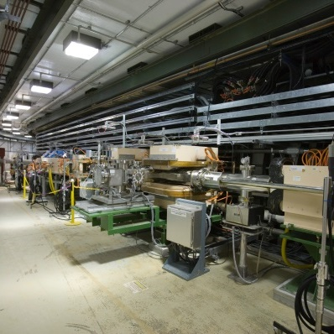
EPIC - Forward HCal
fHCAL Structure / Insert Update
Eliott Fountain
June 5, 2023

Slide 2
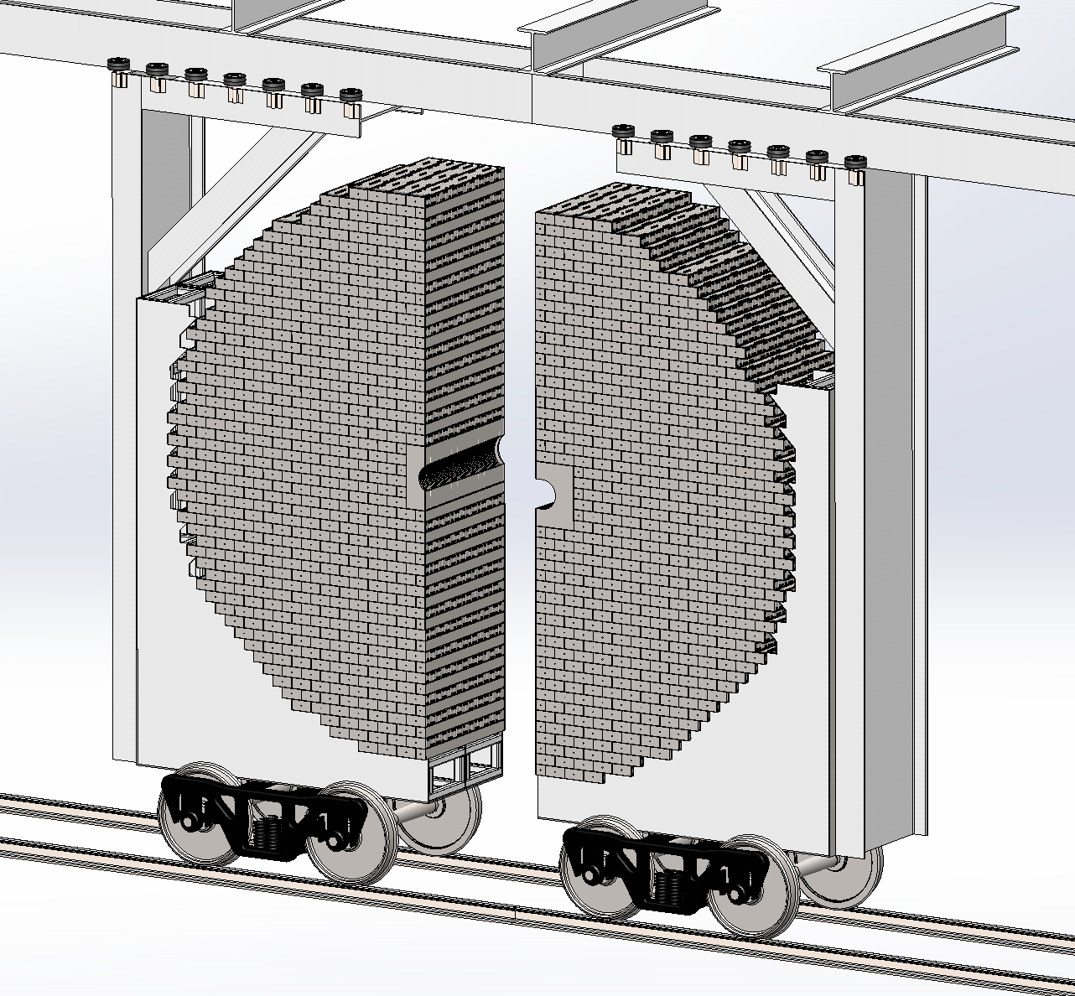
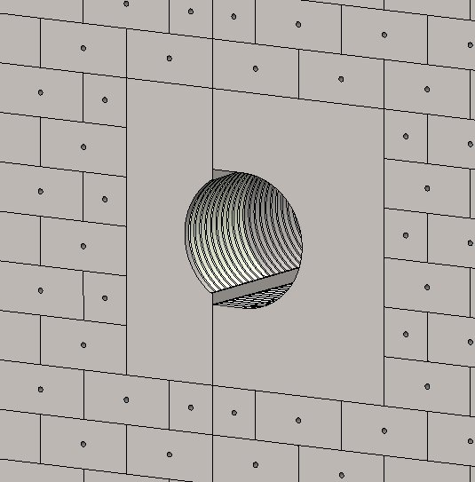
fHCAL Structure with Insert
Left
Right

Slide 3
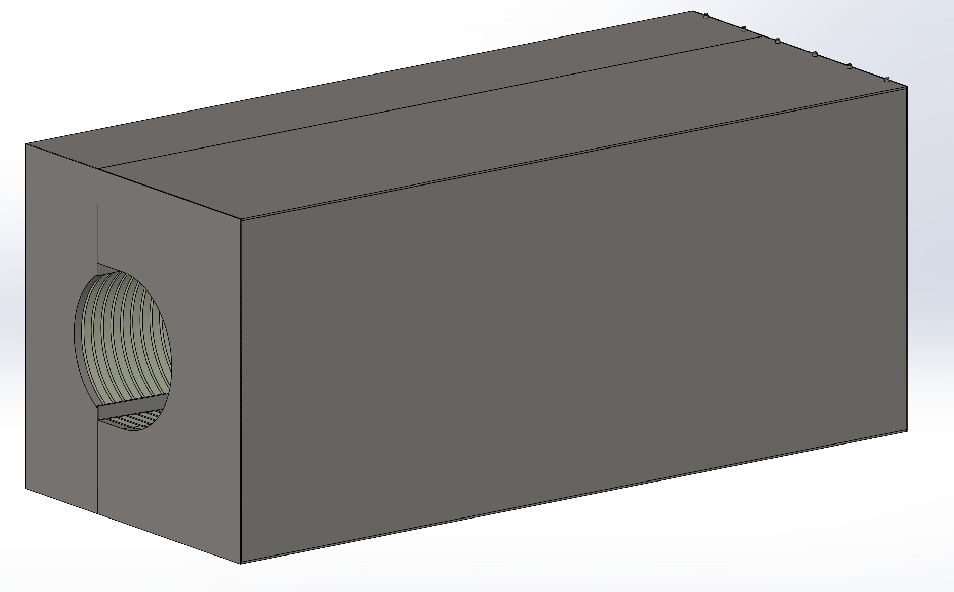
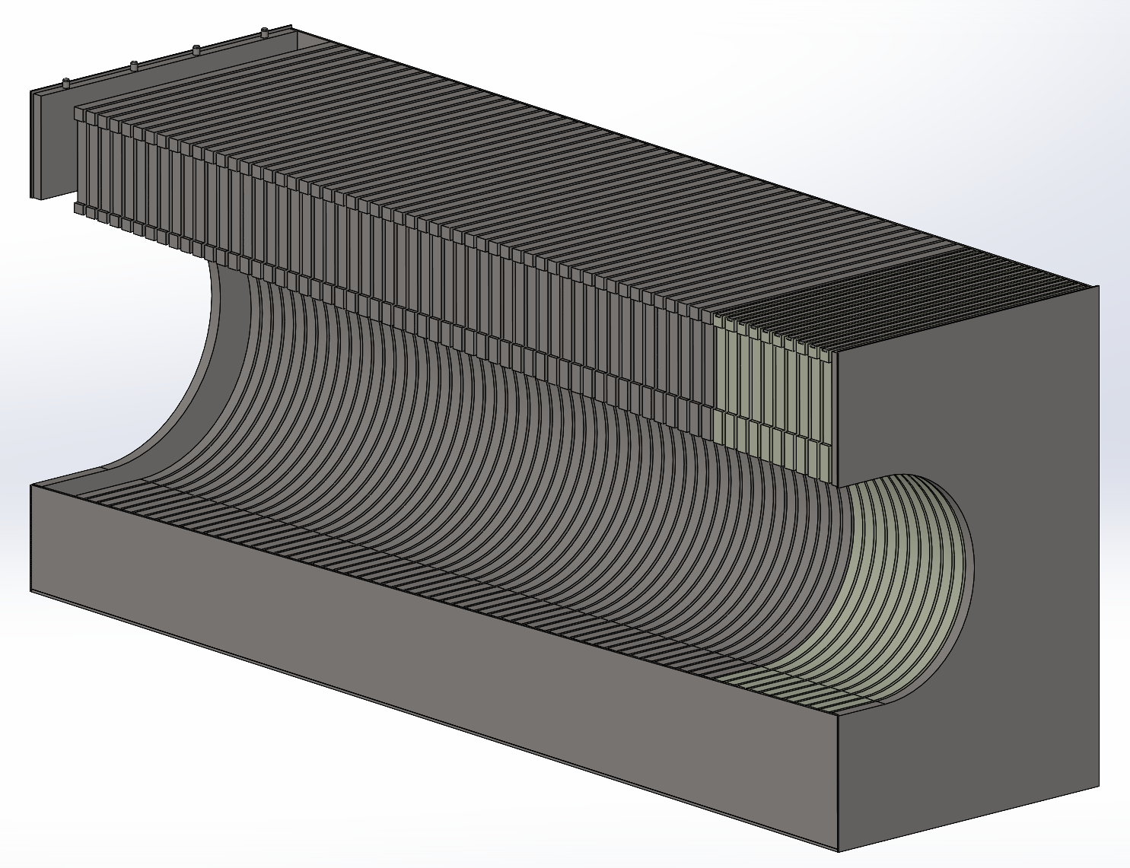
Insert Assembly
Alignment Pins match Tower pattern
PCB Covers (screwed on)
Steel Absorber Plates (54x)
60 x 60 x 140 cm
3 cm spacing from beam pipe
Similar construction to Tower design (e-beam welding)
2700 kg without electronics
3.4 mm sheet metal on all sides
Cuts (top and bottom) for PCB Connectors
Tungsten Absorber Plates (10x)

Slide 4
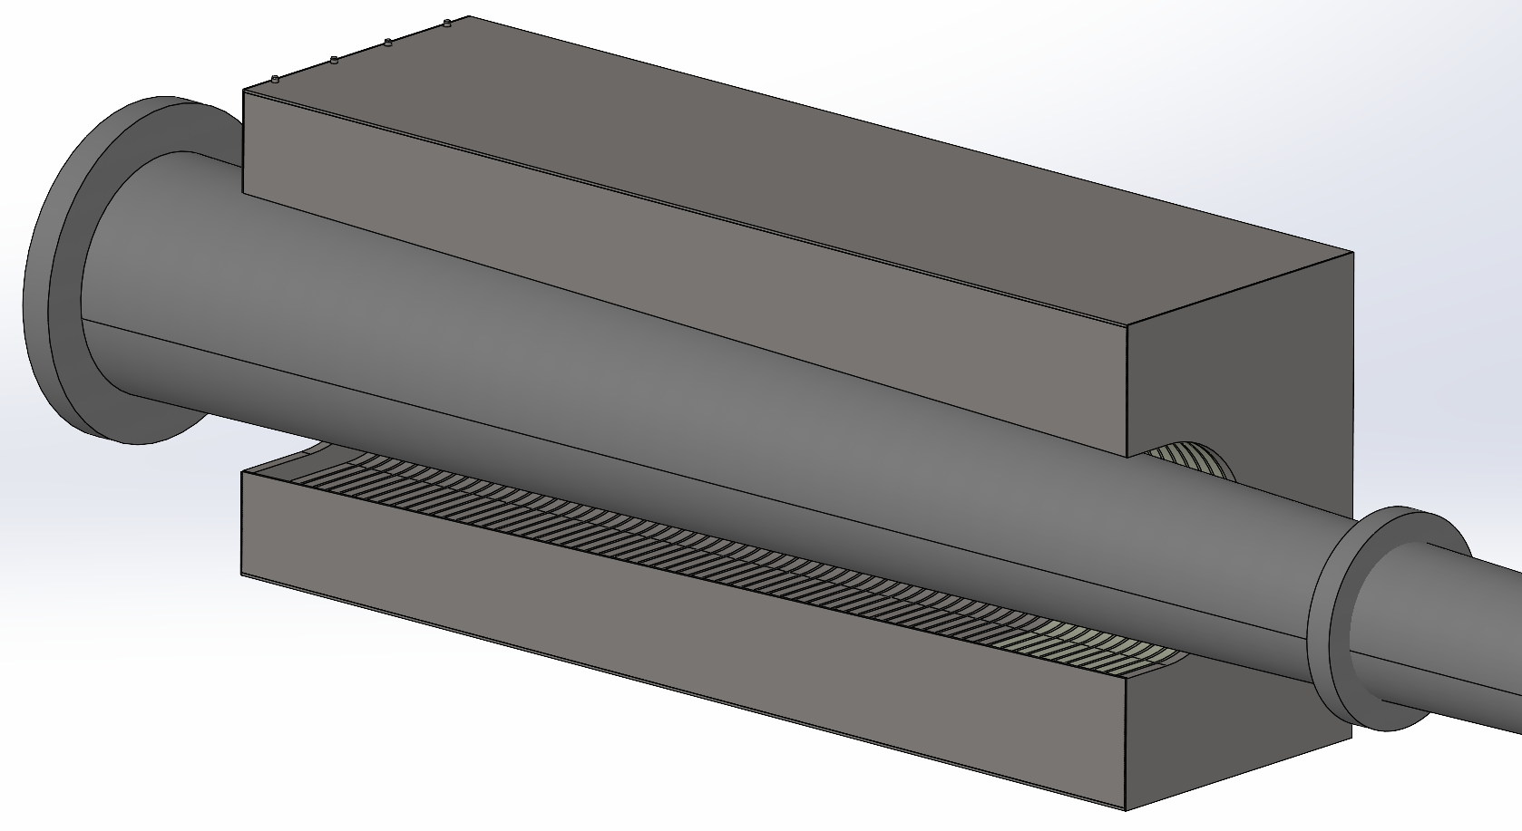
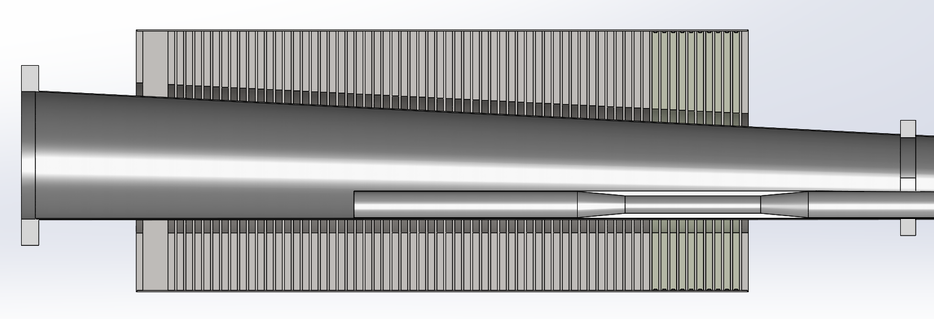
Insert with Beampipe
Top View
Isometric
(left side hidden)
Top View (cut)

Slide 5
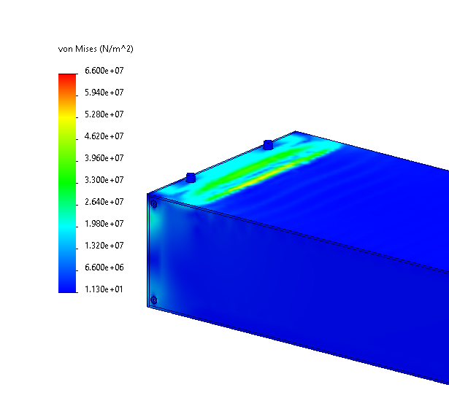
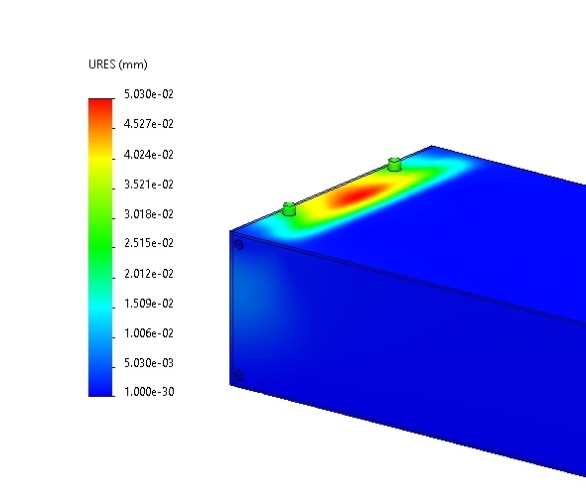
8M Tower Static Analysis (update)
Load: 51x Stack (10,200 kg)
Evenly applied load to top face (bottom face is held fixed)
Max deflection and stress near rear of Tower in the unsupported space.
Yield Stress of 1020 Steel ≈ 350 MPa, Max observed 66.0 MPa.
Max deflection is roughly 0.05 mm.

