Slide 1
EIC Project Update – Ongoing Integration Activities
Elke Aschenauer and Rolf Ent
Co-Associate Directors for the Experimental Program
ePIC General Meeting
June 23rd 2023

Slide 2
Focus of Recent Activities
Finalize solenoid design
  flux return layout
  cryo-can design
Tracker optimization
optimizing PID detectors
  optimizing installation procedure to ease design
Integrating barrel imaging calorimeter
continued optimization of far-forward and far-backward region
generating as much room for services as possible with keeping acceptance maximized → live demo

Slide 3
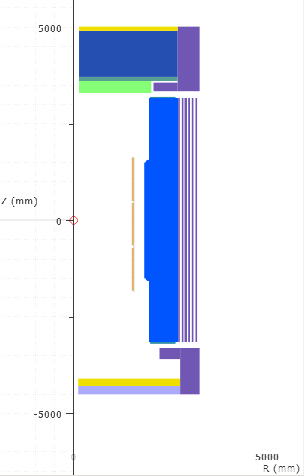
Layout of Magnetic Materials now given
(courtesy Valerio, Renuka et al)
Parameter | V7.6.2.2.7 | V7.6.2.2.8 | V7.6.2.2.9 | V7.6.2.2.10a |  | Units
Current | 3924 |  |  |  |  | A
# turns | 1668
B₀ | 2.000 | 2.008 | 2.007 | 2.007 |  | T
Bpeak MOD 1 | 2.672 | 2.657 | 2.638 | 2.660 |  | T
Bpeak MOD 2 | 2.476 | 2.478 | 2.478 | 2.478 |  | T
Bpeak MOD 3 | 2.651 | 2.670 | 2.656 | 2.671 |  | T
Energy | 45.294 | 45.369 | 45.352 | 45.524 |  | MJ
Inductance | 5.8839 | 5.8929 | 5.8907 | 5.877 |  | H
Fz MOD 1 | 11.98 | 11.86 | 11.94 | 11.92 |  | MN
Fz MOD 2 | 458 | 45238 | 52776 | 58.4 |  | kN
Fz MOD 3 | -11.98 | -12.00 | -12.06 | -12.00 |  | MN
Fz tot | -5.6 | -104.376 | -63.7 | -29.3 |  | kN
B5300 | 14.3 | 17.9 | 16.9 | 15.8 |  | G
B7200 | 8.7 | 11.5 | 11.5 | 11.0 |  | G
B3400 | 1.0 | 2.0 | 2.2 | 2.8 |  | G
Remaining deltas to fringe field specifications (10G) we will fix locally (as needed)

Slide 4
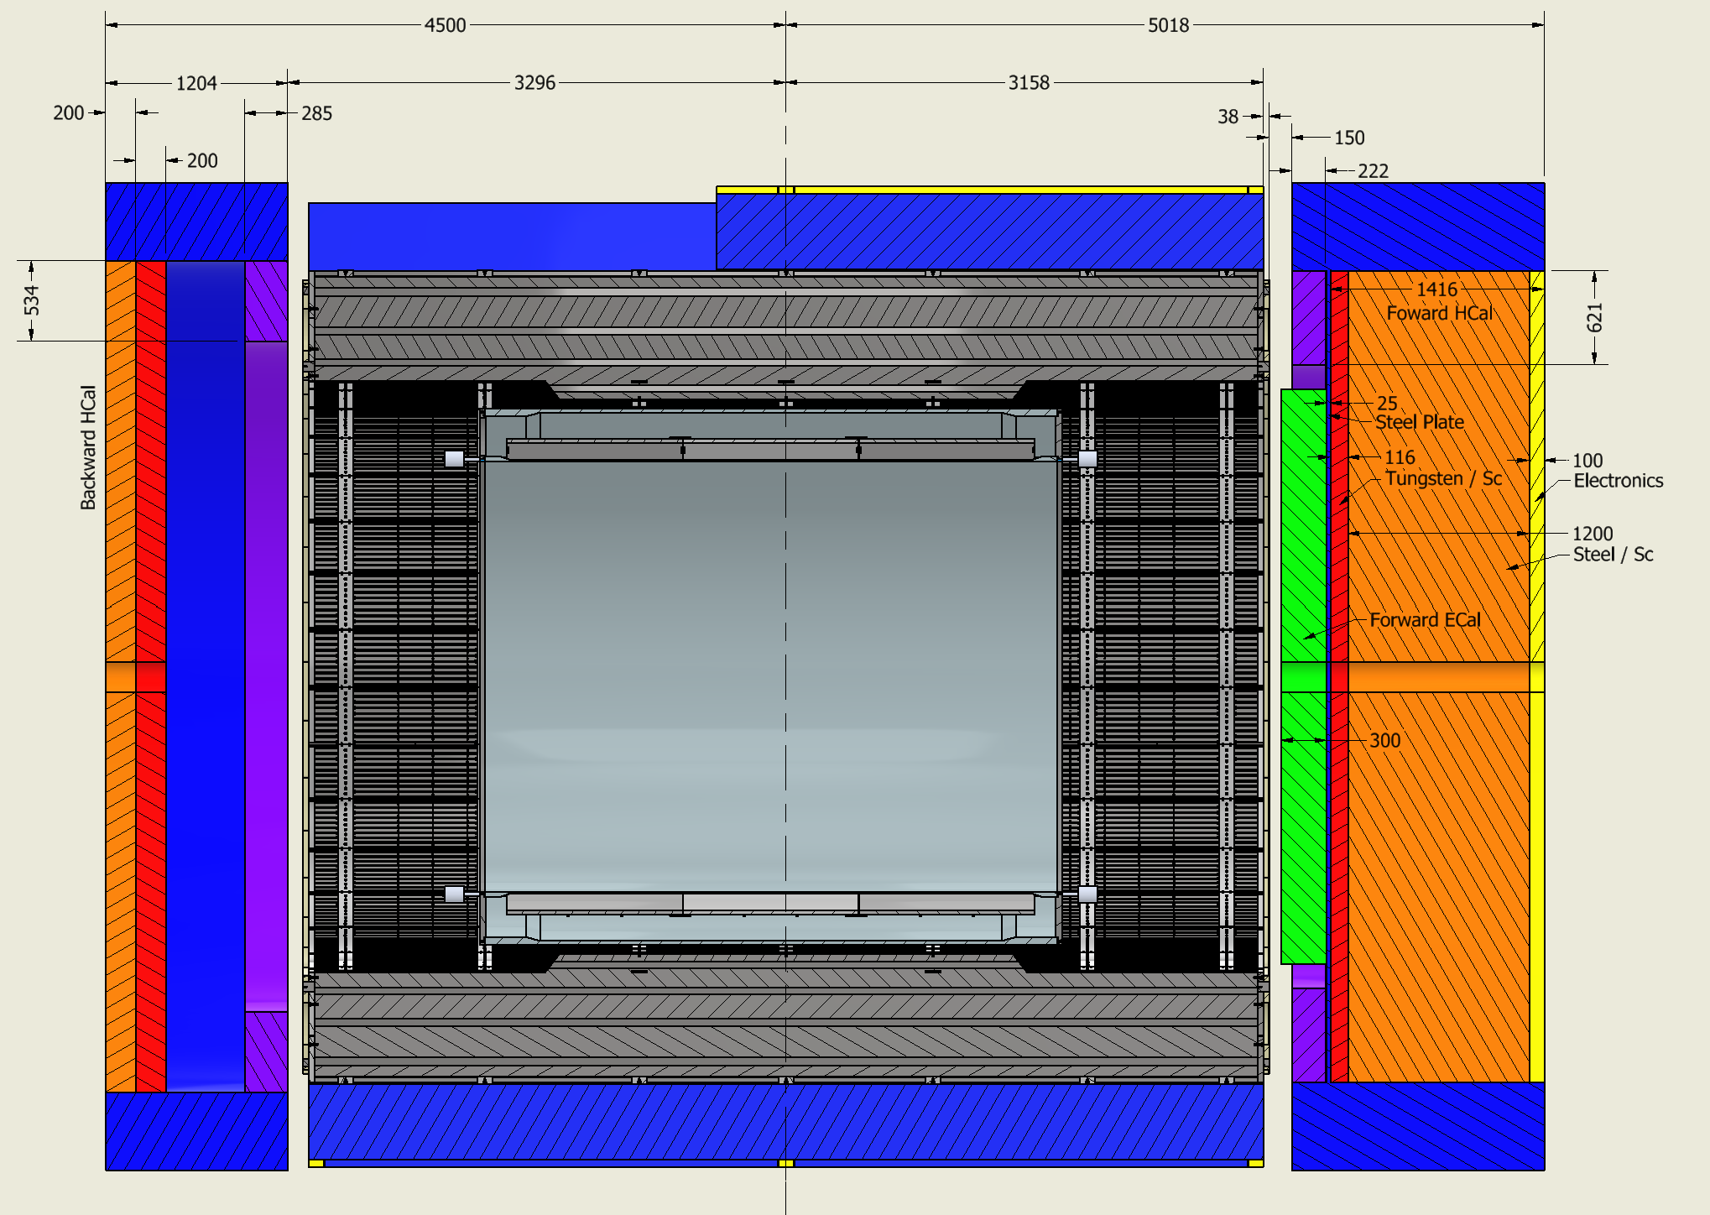
Final Layout of Flux Return and HCals
Note: detector is aligned with electron beam → 8mrad rotation also for endcaps
Steel
Stainless Steel
Steel
backward HCal can be
further optimized to pro vide better overlap with barrel Hcal, by
separating the magnetic materials providing the flux-return from the bHCal detector itself using stainless steel.

Slide 5
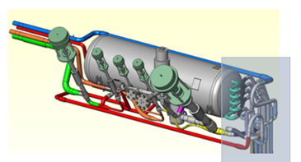
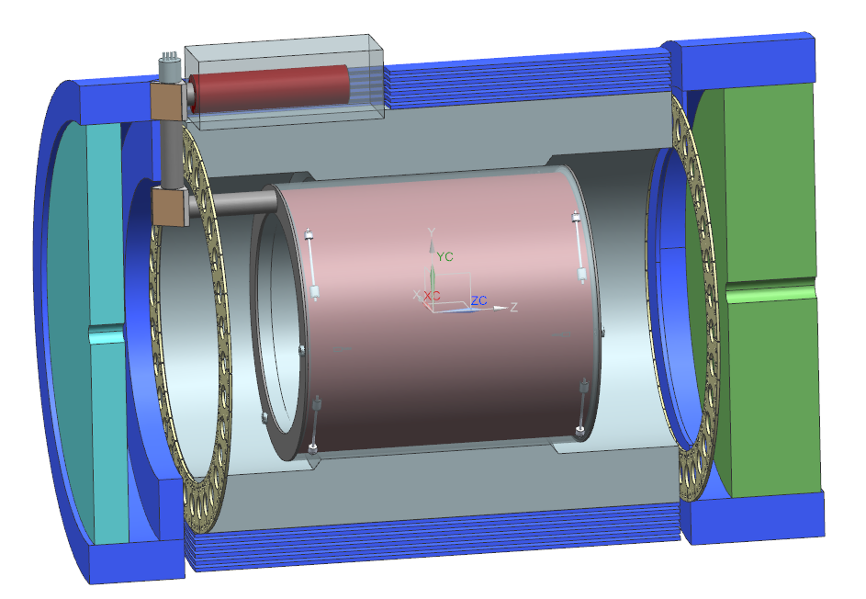
Cryo-Can Layout
Phase Separator
Phase Separator envelope for tubing and valves
No need to modify any barrel HCal sectors
will need to integrate cut-out in the backward endcap shielding

Slide 6
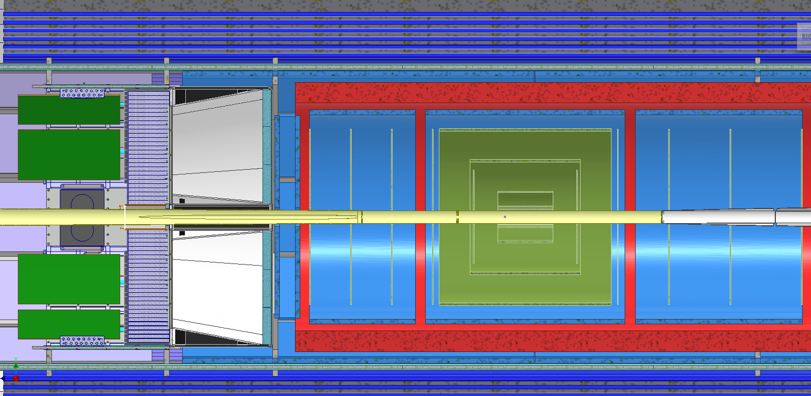
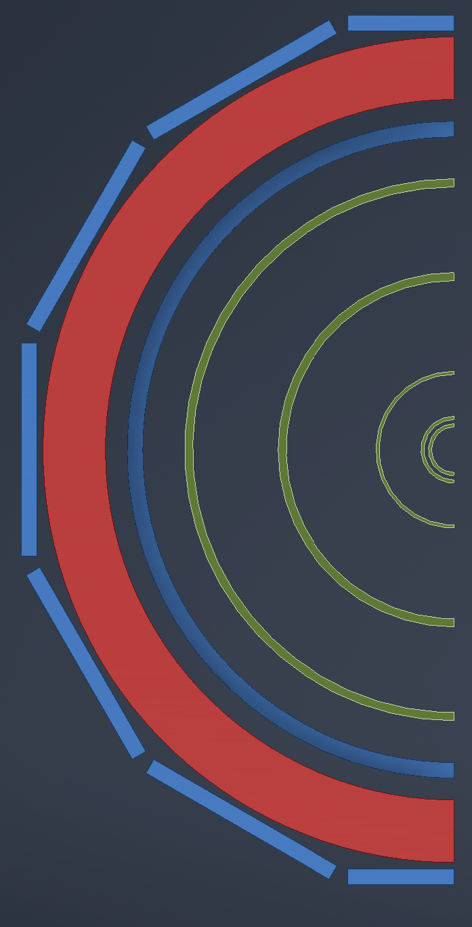
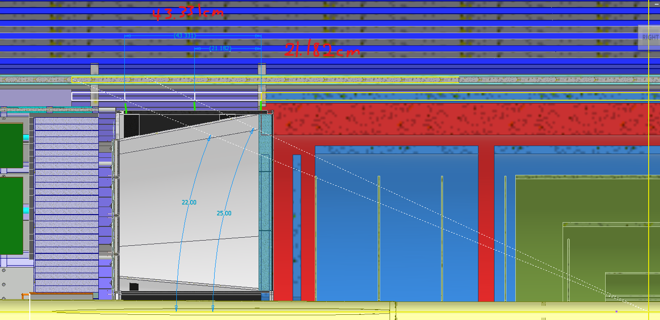
Integration of optimized tracking
For details on the why see Ernst and Matt’s talk
https://indico.bnl.gov/event/19854/contributions/77603/attachments/48017/81517/20230615%20-%20ePIC%20Tracking%20WG.pdf
MPGD
Outer-MPGD Barrel extended to cover active region of DIRC → will be integrated in DIRC support
Outer MPGD barrel is composed from flat detectors following the DIRC segmentation
Inner MPGD Barrel and ToF will have one support also supporting all Discs and MAPS barrels

Slide 7
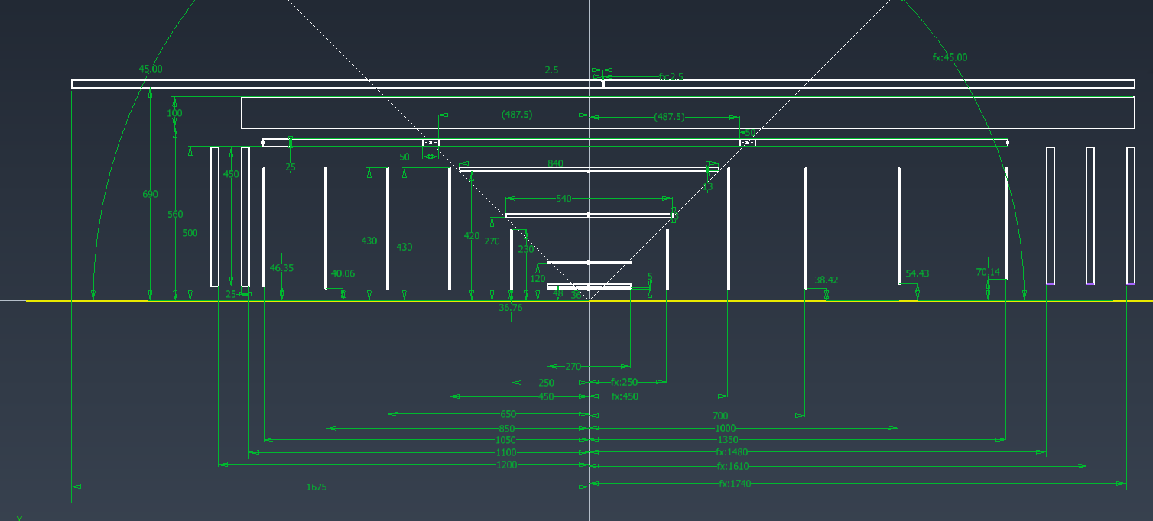
Integration of optimized tracking
We plea for help to get the service information
ePIC.Interface Control Document for Services.052023.xlsx

Slide 8
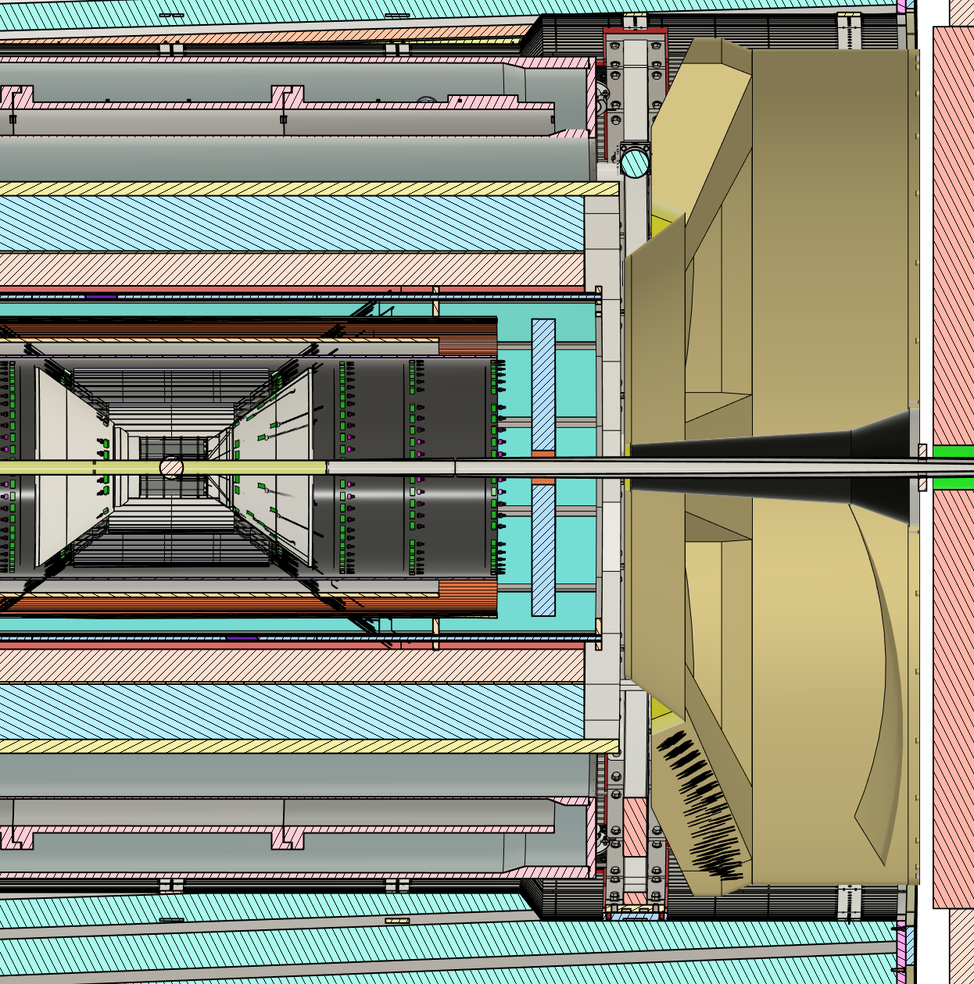
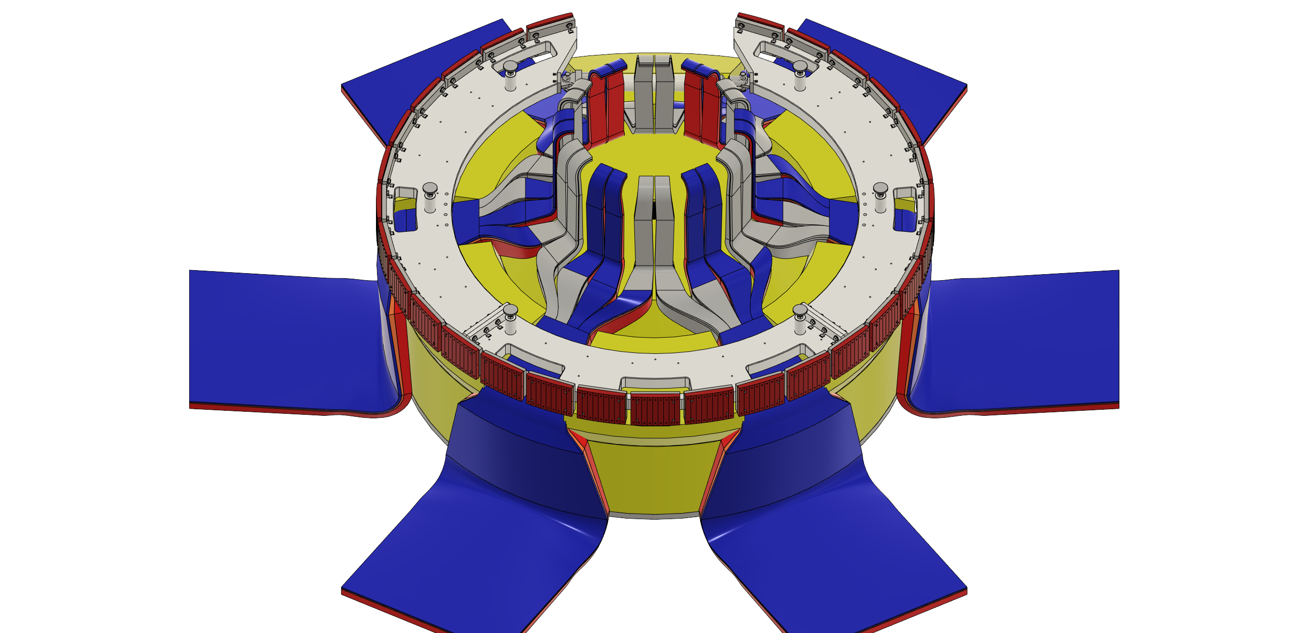
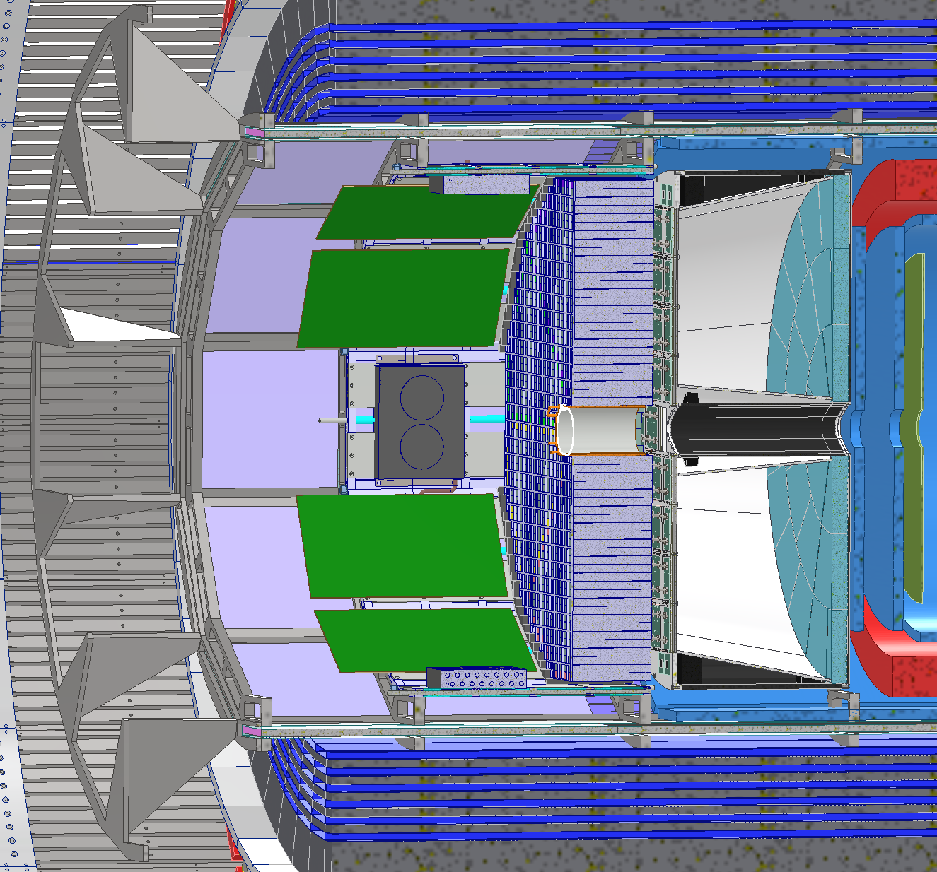
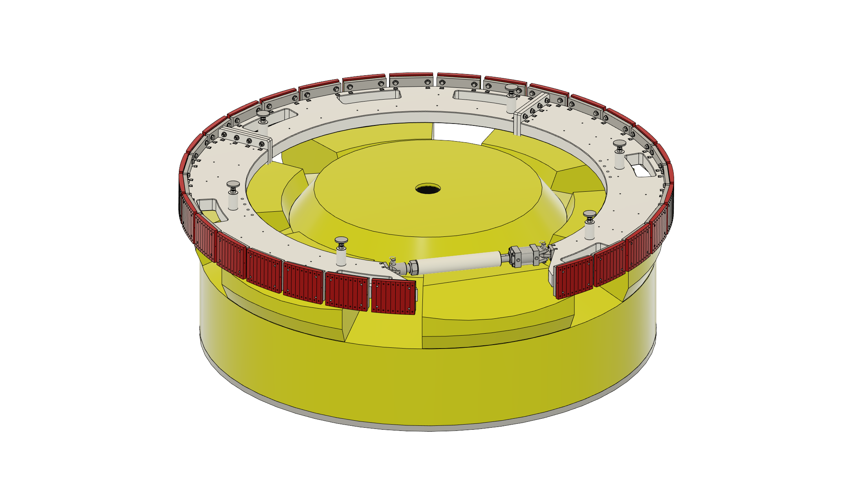
PID Detectors
pfRICH needed to be shortened in
expansion volume by 5cm to accommodate the 2 new MPGD disks
dRICH was moved 5cm in z to minimize interference with support rings
Remaining small interference still needs to be resolved → modify rings and/or optimize sensor boxes

Slide 9
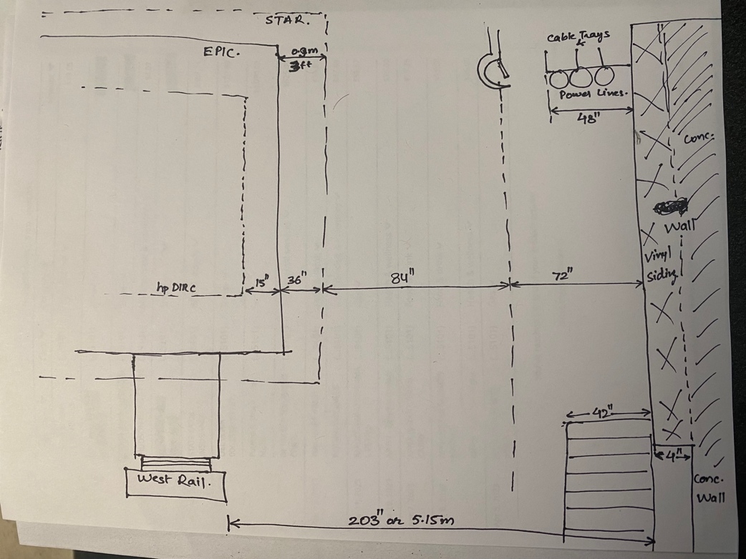
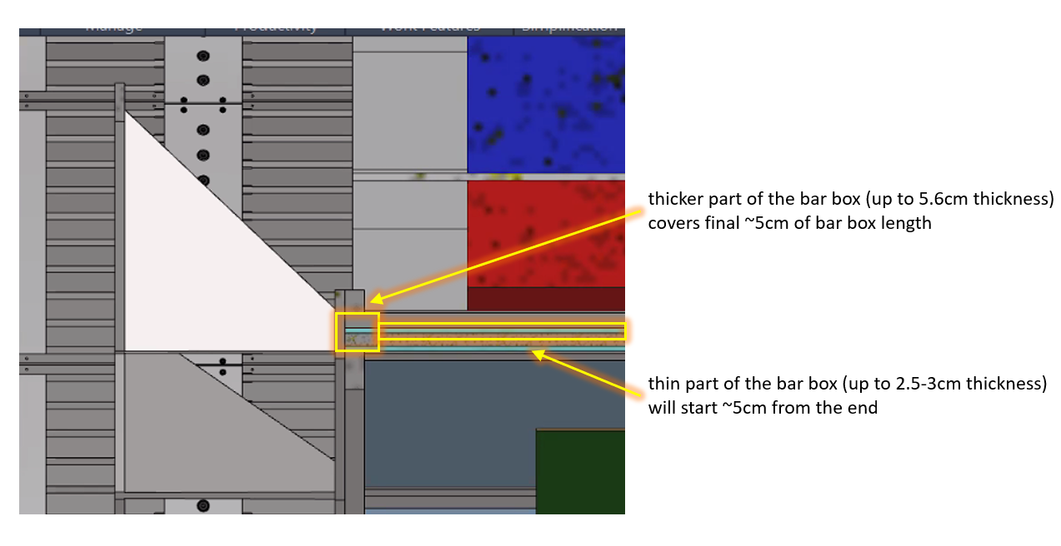
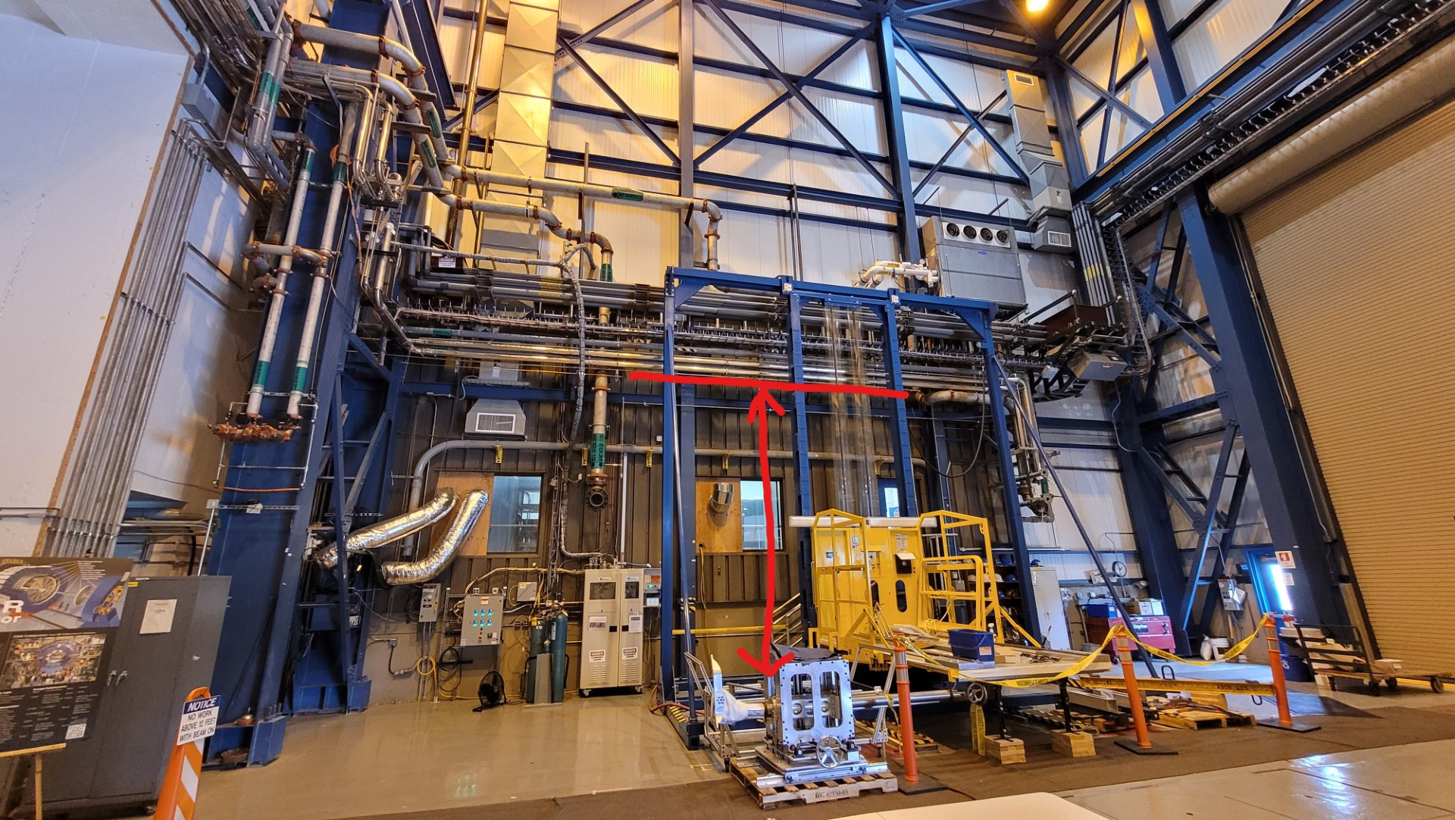

Optimize DIRC Installation
Original plan was to install DIRC from the hadron side due to asymmetric space availability in assembly hall
→ in conflict with the idea to have the lense integrated at the lepton side of the bar boxes
→ this would require a ~5cm big space all through the detector
→ integrate lens with readout of the DIRC → potential performance issues
Modify installation plan
→ after careful evaluation found the
place to install from the lepton side
tight but perhaps doable
→ some small issues to resolve
with water lines
→ everybody happy

Slide 10
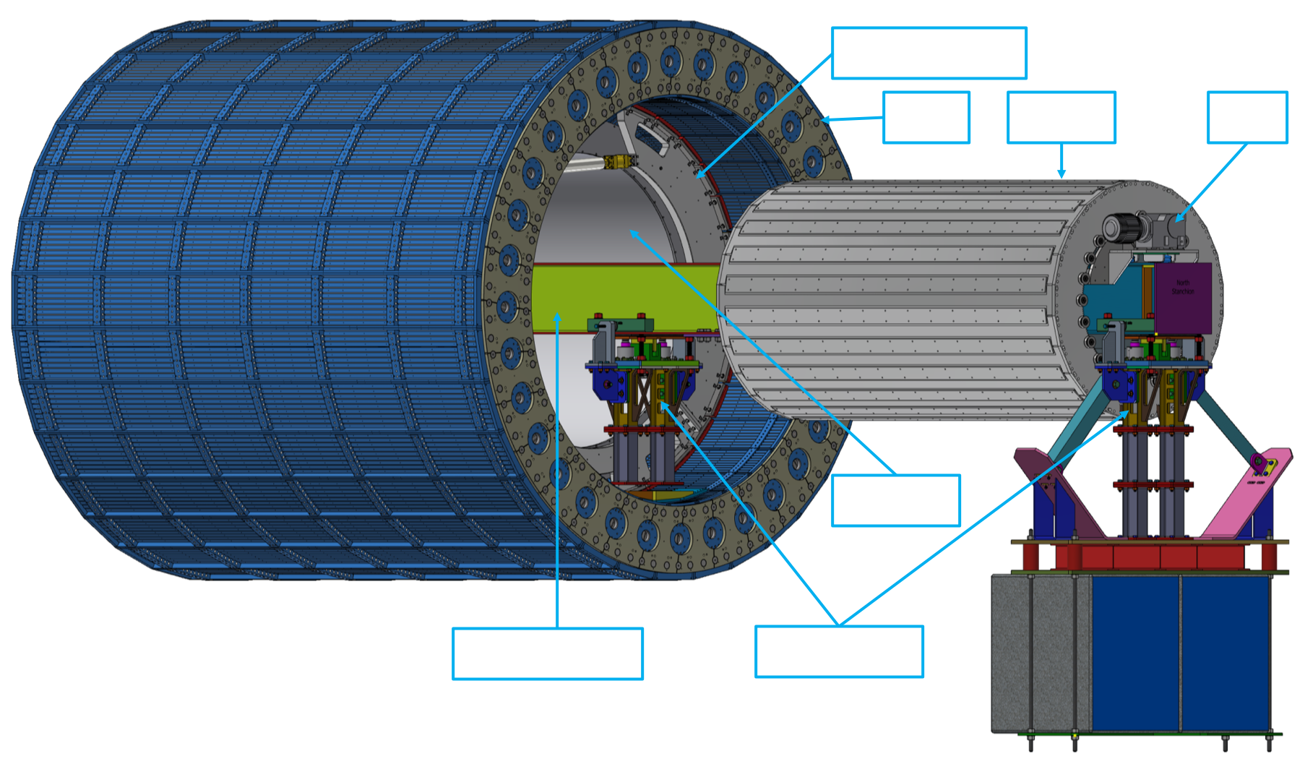
Barrel ECal Integration
Great progress on the mechanical engineering, integration and first installation ideas during Barrel ECal focus week
A lot more work to be done, but of to an excellent start
exact radial position will be fixed after next iteration of DIRC support structure and next all service iteration is done

Slide 11
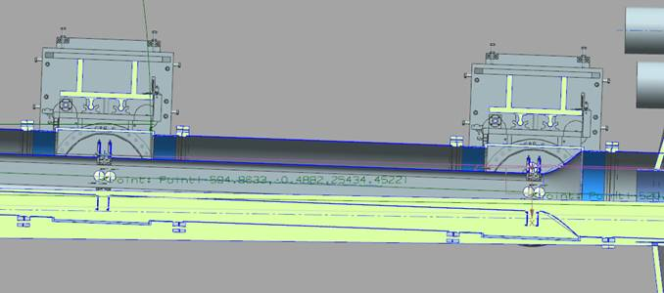
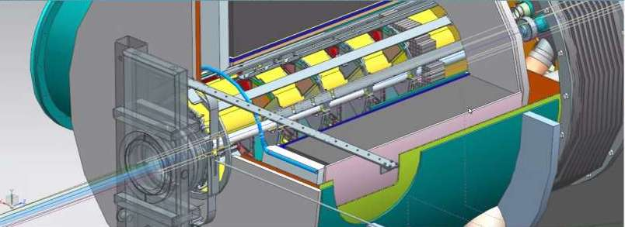
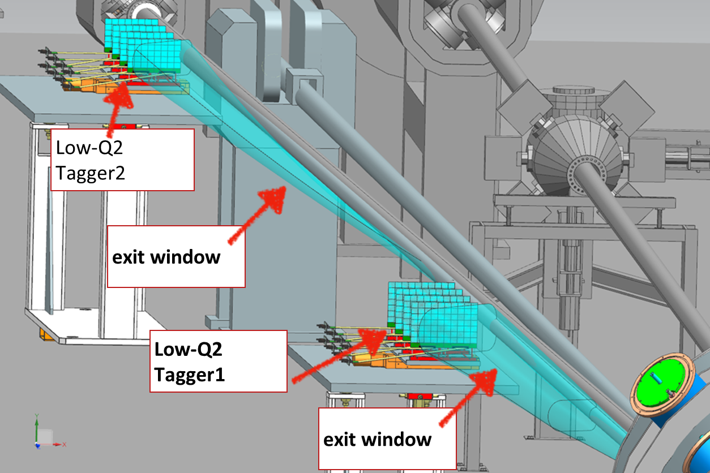
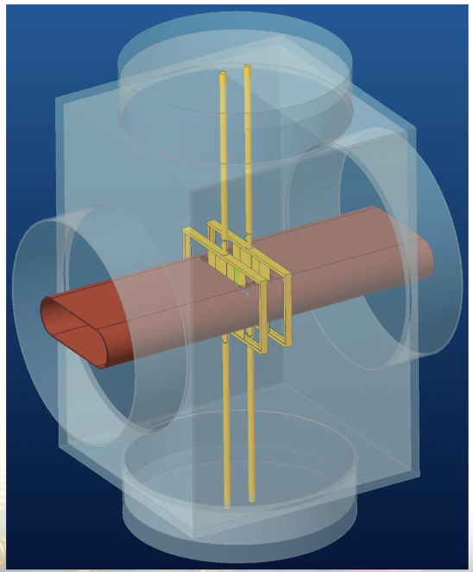
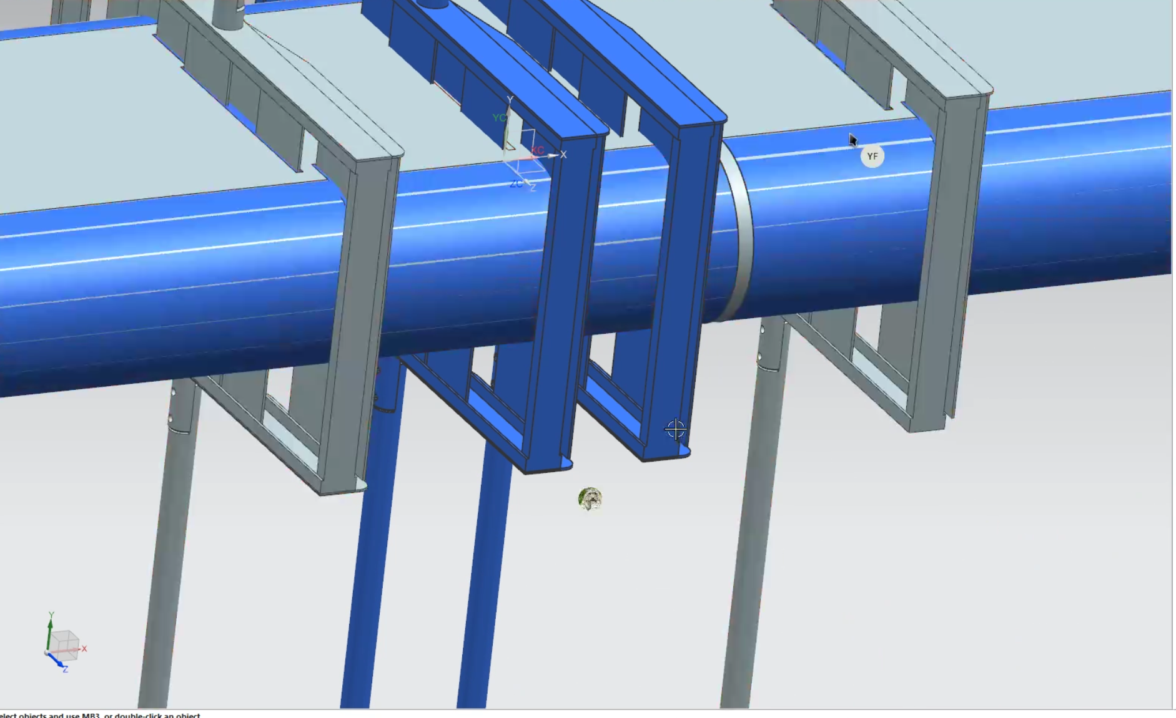
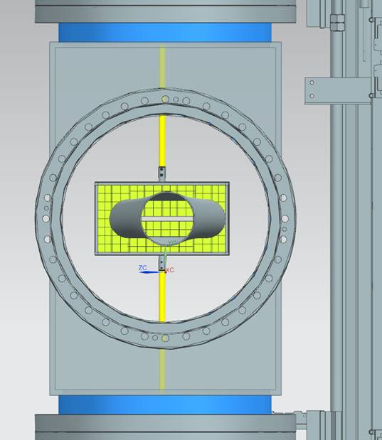
Far-forward/far-backward integration
Integration with accelerator/RF / impedance calculations
  hadron line : Roman Pots/Off-Momentum detectors
  electron line: exit window for low-Q2 taggers
B0-detectors support and installation (only 13cm in front!)
Detector placement (accelerator design is still a bit in flux): ZDC
Off-Momentum detectors (OMD) and the neutron cone
(courtesy Yulia)
OMD
OMD
B0 installation
p
n
Negative side of OMD
Only 13 cm (!) space for installation
Roman Pots integration

Slide 12
Next Steps
Optimize DIRC support structure to the new inner detector layout
Design support for Barrel-ToF and inner MPGD barrel including support for inner tracker barrels and disks
integrate ROBs in the detector volume → needed now locking down design
layout racks on south platform and DAQ room
optimize how to open endcaps and provide full access to collider equipment in the tunnel also during operation
update geometry data base, all figures and provide 2d space allocation plots → see next slide
will organize meetings with sub-systems per category, i.e. calorimetry, PID, to discuss services, readout chain, requirements, …
  ”finalize” as much information as possible before DAC design review in late August/early September

Slide 14
Big Thanks to the ME engineering team
Alex, Andy, Avishay, Chinmay, Dan, Elliot, Julien,
Jonathan, Josh, Karim, Kevin, Peter, Roland, Rahul,
Ron, Tom
and to the collaboration for all the help

Slide 15


Slide 16


