Slide 1
Modular RICH Detector Simulation – Rayleigh Scattering inside Aerogel
Cheuk-Ping Wong
Georgia State University
04-01-2016

Slide 2
Overview
Transmission of aerogel with updated material definitions
Aerogel thickness : 3cm→3.3cm
Rayleigh scattering length : rescaled w/ factor 1.5
Cherenkov Photon spectrum measured at the back of aerogel

Slide 3
Simulation 1: Transmission of aerogel
Transmission of aerogel after modifying aerogel properties
Aerogel from Marco
3.3cm thick
Refractive index 1.028 – 1.034
Rescaled Rayleigh Scattering length (x1.5)

Slide 4
Simulation Setup
100K optical photons beam
Launched perpendicularly at (x,y)=(0,0)mm, and right in front of the aerogel
Momentum: 1.7-6.2 eV (200-730 nm)
No Fresnel Lens
Rayleigh Scattering On

Slide 5
Transmission of Aerogel
Normalized by the wavelength distribution of incident photons
Aerogel has a better transmission through out the whole spectrum after rescaled Rayleigh Scattering length

Slide 6
Transmission of Aerogel
Clarity of aerogel reaches ~56 (desired value) after rescaled Rayleigh Scattering length

Slide 7
Simulation 2: Wavelength Distribution of Cherenkov Photon
Measure Wavelength Distribution of Cherenkov Photon at the back of aerogel
Survived -- those can make it to the Fresnel lens, regardless of unscattered or scattered: all non-reflected (p_{z}>0) photons that hits at the back of the aerogel
The rest -- those cannot make it to the Fresnel , regardless of unscattered or scattered (shown on back up slides) : all the photons that hits inside the aerogel, or reflected (p_{z}<=0) photon
No additional cuts (e.g. mother pid cut, vertex cut)

Slide 8
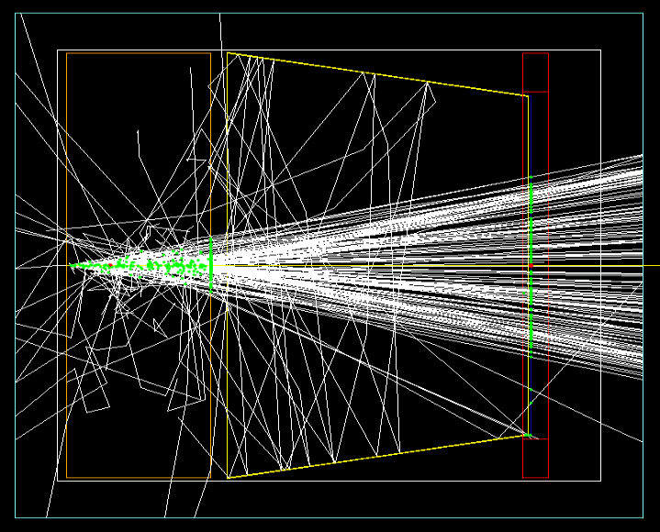
Survived Cherenkov Photons
Before Normalization
Measure at the back of the agel
RS on, 150k entres
RS off, 210k entries
Rayleigh Scattering On
2GeV single pion-
Normalized by total number of events
1Gev single pi-
Back of aerogel

Slide 9
Simulation Setup
1000 kaons and 1000 Pions
Launched perpendicularly at (x,y)=(0,0)mm, and right in front of the aerogel
Momentum: 3 GeV, 6 GeV, 9 GeV, 12 GeV, 15 GeV
Rayleigh Scattering On (right), Off (left)
Aerogel from Marco
3.3cm thick
Refractive index 1.028 – 1.034
Rescaled Rayleigh Scattering length (x1.5)

Slide 10
Normalized Wavelength Distribution of Survived Cherenkov Photon (Pion-)
Rayleigh Scattering Off
Rayleigh Scattering On
Count is normalized by number of events (1000 events)
Rayleigh Scattering lowers the count especially in shorter wavelength region as expected
Peak value shifts to the longer wavelength region

Slide 11
Normalized Wavelength Distribution of Survived Cherenkov Photon (Kaon-)
Rayleigh Scattering Off
Rayleigh Scattering On
Number of Cherenkov photons increases with momentum of incident particle (see back up slide)

Slide 12
Summary
Transmission plots from updated agel properties are shown
Better clarity (~56) → better transmission
Wavelength Distributions of Cherenkov Photon with both Rayleigh Scattering On and Off are shown
Rayleigh Scattering lower the rate of Cherenkov photon hits as expected
Peak value of Cherenkov photons shifts to longer (~60nm longer) wavelength region

Slide 13
Num. of Photon Hits per Event vs Kaon Momentum
2cm thick aerogel
3cm thick aerogel
Num. of photon hit saturate as momentum increases
See more on p.20-21 of Progress Report 2015 -- https://drive.google.com/file/d/0Bxt90nyX6kjaWFE3UnYtM3k5NEE/view?pref=2&pli=1

Slide 14
Normalized Wavelength Distribution of the Rest of Cherenkov Photon (Pion-)
Rayleigh Scattering Off
Rayleigh Scattering On

Slide 15
Normalized Wavelength Distribution of the Rest of Cherenkov Photon (Kaon-)
Rayleigh Scattering Off
Rayleigh Scattering On

