Slide 1
Correlation among different felixs
Maya Shimomura
Nara Women’s Univ.

Slide 2
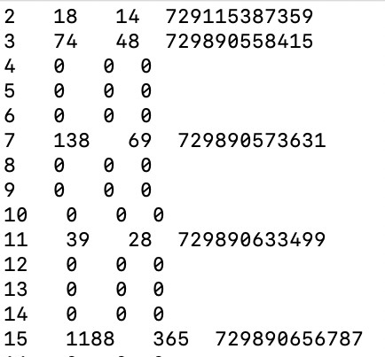
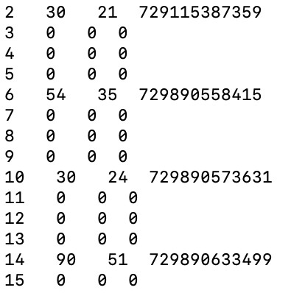
Inside of the data run9328
Intt2
evtSeq, #of hits, #of clusters, BCO_full
Intt3
evtSeq, #of hits, #of clusters, BCO_full

Slide 3
Inside of the data run9328
Intt2
evtSeq, #of hits, #of clusters, BCO_full
Intt3
evtSeq, #of hits, #of clusters, BCO_full
Same BCO_full
Same BCO_full
Same BCO_full

Slide 4
What I did. (1)
Intt2
evtSeq, #of hits, #of clusters, BCO_full
Intt3
evtSeq, #of hits, #of clusters, BCO_full
Remove the events which have bco_full == 0

Slide 5
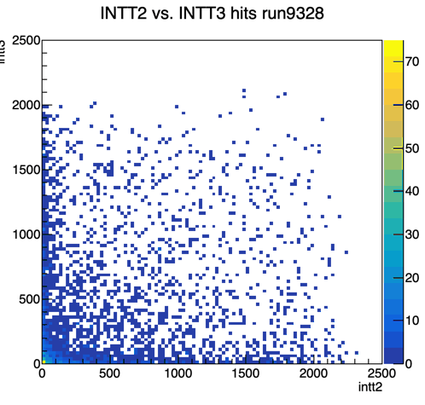
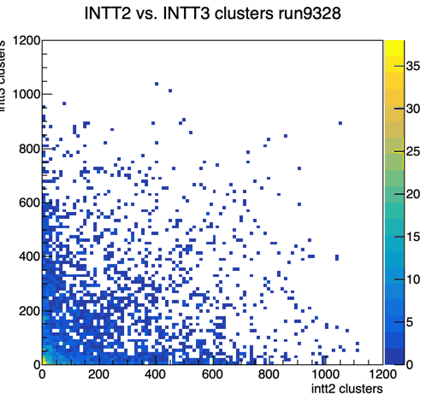
Comparison between intt0 and intt1 without bco_full ==0 data
Remove the events which have bco_full == 0 and take correlation between intt2 and intt3
No correlation is seen.

Slide 6
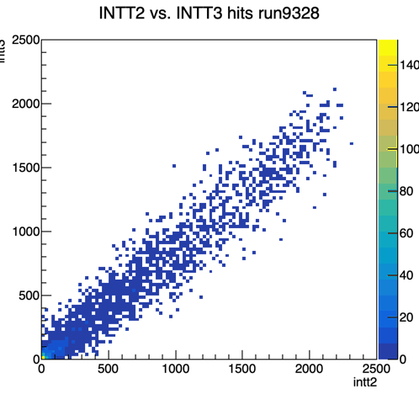
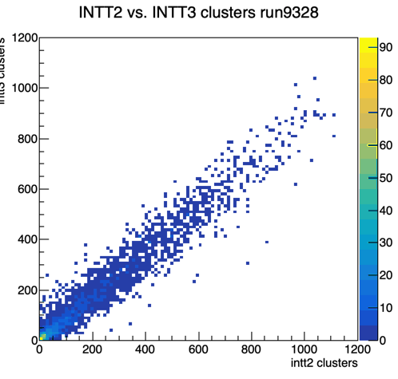
Comparison between intt2 and intt3 requiring the same bco_full
Clear correlation is seen on #of hits and #of clusters between intt2 and intt3

Slide 7
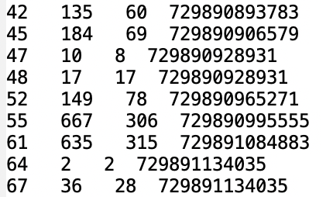
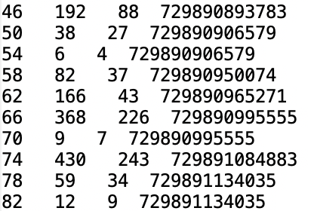
Look into data closer
* After removing the events with bco_full ==0
Intt2
evtSeq, #of hits, #of clusters, BCO_full
Intt3
evtSeq, #of hits, #of clusters, BCO_full

Slide 8
Look into data closer
BCO_full match
Same BCO
* After removing the events with bco_full ==0
Intt2
evtSeq, #of hits, #of clusters, BCO_full
Intt3
evtSeq, #of hits, #of clusters, BCO_full
There are two bco_full = 72980928931 events in intt2 and no intt3.
There is no bco_full = 729890950074 in intt2.

Slide 9
Questions (to be fixed ? )
1. Why are there a lot of events which bco_full is zero and number of hits is zero ?
2. Why are there some bco_full which appear only either intt2 or intt3?
3. Why are there two series of the events which have same bco_full and different hits info?

Slide 10
Back Up

Slide 11
BCO Issues
Maya SHIMOMURA, Itaru Nakagawa, Takashi Hachiya

Slide 12
bco_full – bco distribution on a felix (Run#9328)
Plot : run#9328, intt2, n_collision=4
Subtracting “bco” from the lower 8 bits of “bco_full”
What we expect is 1 BCLK peak.
3BCLK
Although we confirmed 1BCLK time resolution when we timed in intt-2 on May 31st, the peak is composed by 3BCLK size in Run#9328. Inconsistent.
MBD phase timing change can only explain only 2BCLK.
Satellite shoulder may be invisible in the time-in plot made on May 31st.

Slide 13
bco_full – bco distribution on other felixs (Run#9328)
n_collision=4
Intt-0
Intt-2
Intt-3
Intt-6
Intt-4
Intt-5
Same tendency.
Different number of events between different felixs which should not be.

Slide 14
Intt-7 BCO Peak with zoomed up
4BCLK
Most of the peaks are ~3 BCLK. Some felix has even more than 4BCLK.

Slide 15
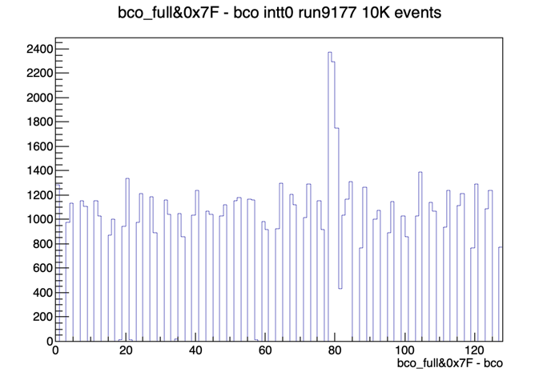
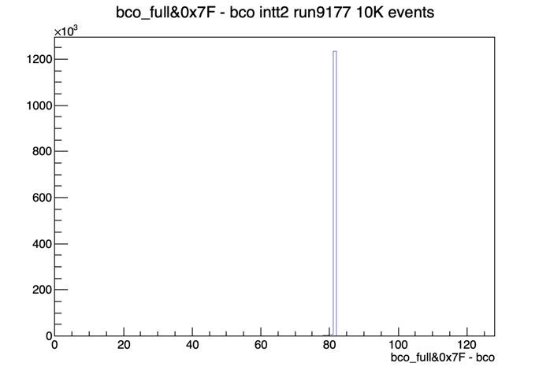
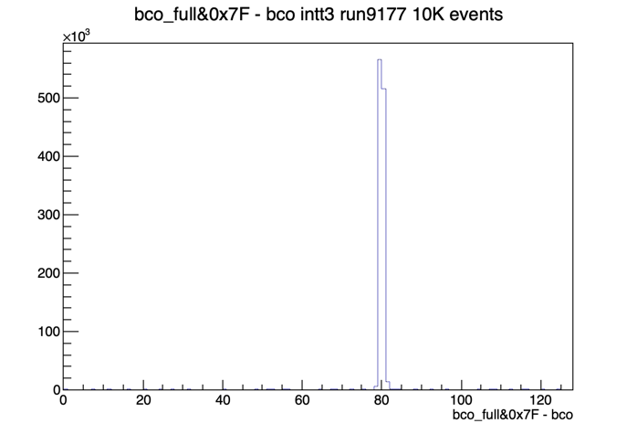
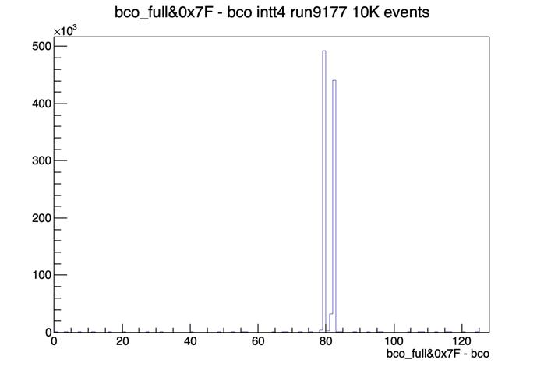

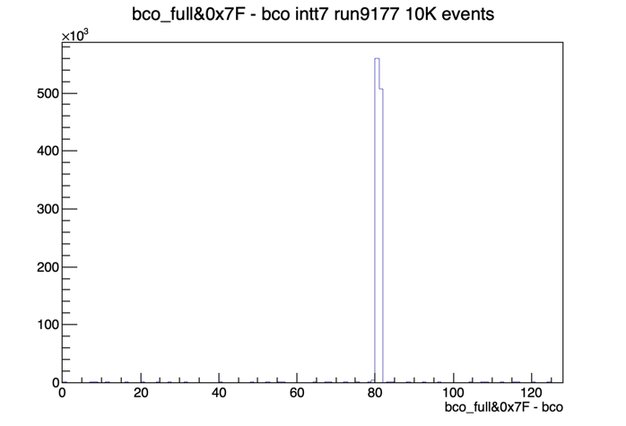
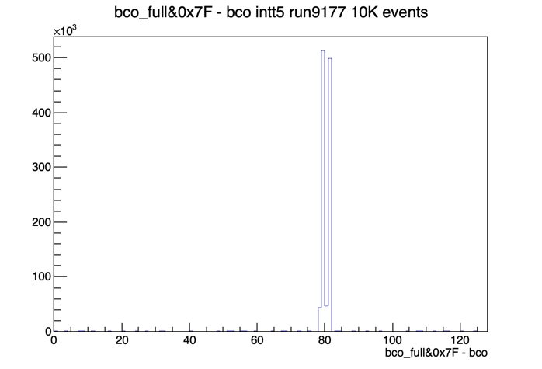
bco_full – bco distribution on other felixs (Run#9177)
n_collision=1
Intt-0
Intt-2
Intt-3
Intt-4
Intt-5
Intt-6
Intt-7
Narrower peaks (~2 BCLK) for intt2, 3, 6 and 7 than the run with n_collision =4.

Slide 16
Run#9177 intt2 n_collision=0, modebit 76:0x35
A lot of bco are 0.
Run #9328 shows same tendency.

Slide 17
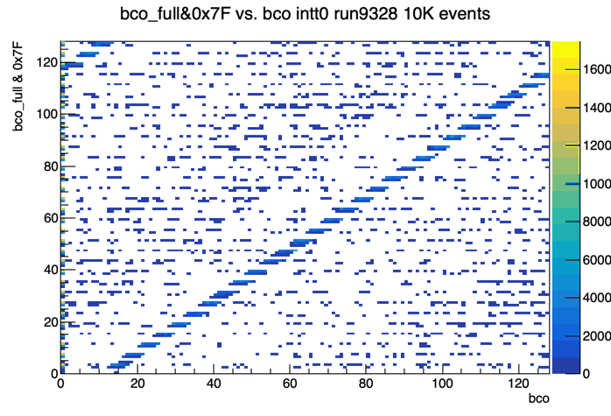
Correlation of bco_full and bco
Run 9328
n_collision = 4
Intt0
# of events =10K
The correlation can be seen.
A lot of background there.

Slide 18
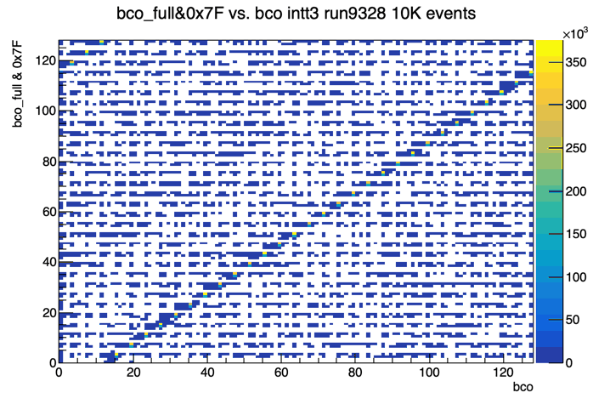
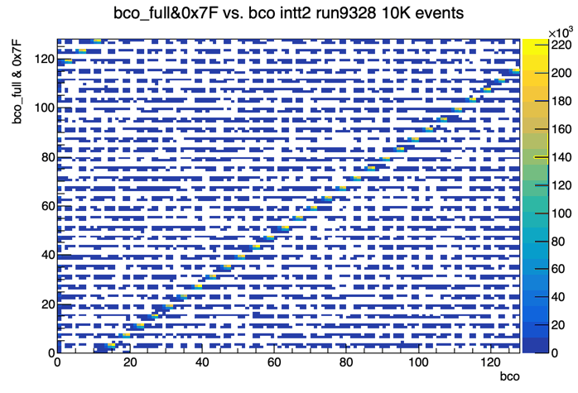
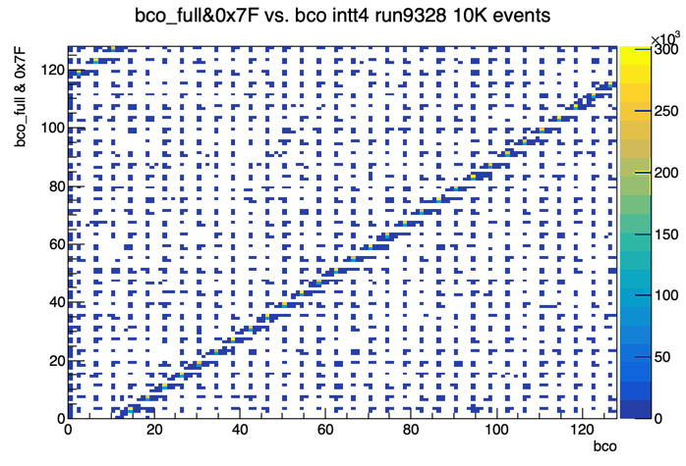
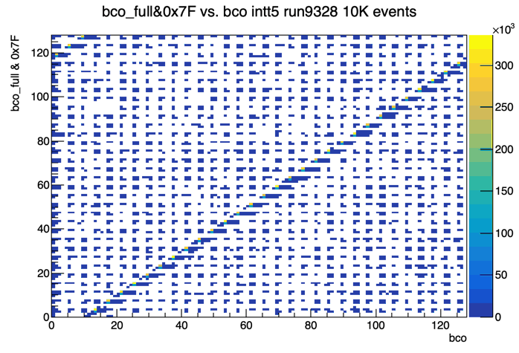
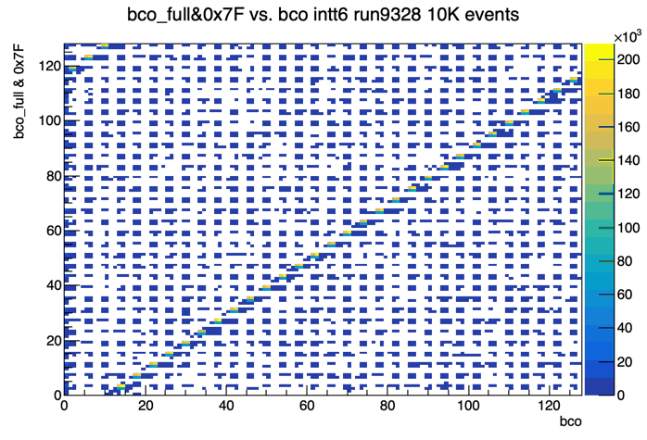
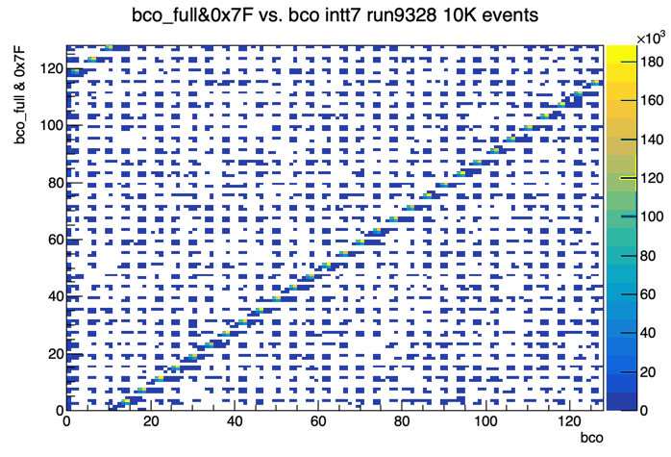
Correlation of bco_full and bco Run 9328 n_collision =3
Intt-0
Intt-2
Intt-3
Intt-4
Intt-5
Intt-6
Intt-7

Slide 19
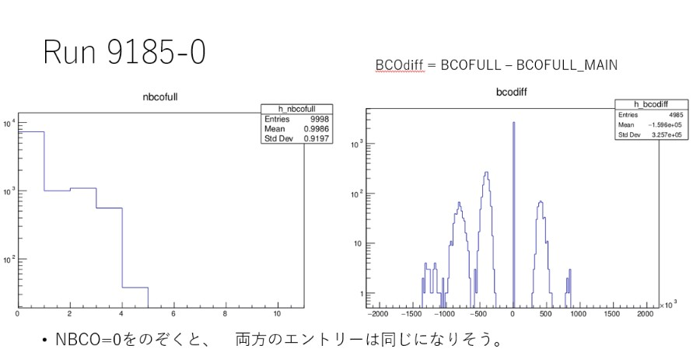
bco_full distribution at the same events.
Studied and plotted by Takashi
Notes:
左が1イベントに何種類のBCO_FULLがふくまれているか、を示す分布です。 0はヒットがないイベント。
1はBCO_FULLが１つだけ、2，3は複数のBCO_FULLがふくまれているイベントです。
多くのヒットはとあるBCOFULLに属していますが、時々、ちがうBCOFULLのヒットがあるようすです。

Slide 20
BCO Structure in a Given Event

Slide 21
Multpilpe BCO hits in a given event
Timed-in, n_collision=4
Split into multiple peaks somehow.
# of events in INTT are factor of 3~4 larger than these of MBD.
Run#9328
evtSeq ==7 of intt2

Slide 22
FPHX-BCO and Full-BCO Correlation
Main and sub-peaks fraction varies
log
19
Linear
Linear
-109
Run#9177: L1Delay=25,n_collision=0, open time=35, 76:0x35
Run#8059: L1Delay=25,n_collision=54,open time=35, 2:0x33

Slide 23
FPHX-BCO and Full-BCO Correlation
ADC
log
19
Linear
Linear
-109
Run#8020: L1Delay=0,n_collision=127, open time=120
Run#8059: L1Delay=25,n_collision=54,open time=35
Plot by Takashi

