Slide 1






UK activities and plans
Georg Viehhauser for the UK ePIC SVT collaboration

Slide 2
Funding
Currently funded through UKRI Preliminary Infrastructure Fund
  Oct ‘21 – Mar ’24, 2.97M£ for MAPS, Timepix, and Polarimetry (29.2 FTE)
  This award is a Preliminary Activity or Scoping Project
Future funding: EIC Full Phase Infrastructure Fund
  Starting in ’25 for 7 y, for remaining R&D and construction
  5 WPs (WP1 – Silicon Tracker, WP2 – Electron Tagger, WP3 – Luminosity Monitor, WP4 – Accelerator, WP5 – Project Management)
  Has been prioritised by STFC SB/TAAB, Council and EB to go forward to Wave 3 of the UKRI Infrastructure Fund
  Have until June 30 to submit the final pro-forma application and costings for sign-off by EB before submission to Infrastructure Advisory Committee
Bridging funds from ‘24 to start of Full Phase Infrastructure Fund
  Under negotiation with UKRI

Slide 3
What we are currently doing
Sensor design
  Contributions to MLR and ER1 submissions
    High speed data transmission blocks, I2C on-chip transmission, library redesign for DFM
Sensor characterisation
  Full characterisation of two APTS process splits at BHM and LIV, plots under approval by ITS
  DTPS setups to be received at RAL and DL in the next few weeks
SVT layout
  Tiling study at BHM and initial work on CAD model at DL
Powering
  Work on serial powering regulator, architecture, services
Detector and physics simulations
  Parametrisation of momentum and vertex resolutions
  Studies of beam spot effect on the tracking performance
  Acceptance at large η
    Barrel MPGD layer contribution to tracking
      New method developed for reconstruction of DIS kinematic variables

Slide 4
Programme to be funded
Funding for 7 years, starting form 2025
  The schedule is based on CD4A (transition into operation) in Apr ‘32 with detector delivery one year earlier in Apr ’31
We requested 153 FTEs for 7 years (70% of cost of UK project)
  25 FTE academics, 30 FTE PDRAs, 56 FTE engineers and 42 FTE techs
For silicon submissions we costed
  A contribution of 37% to the mask/NRE costs of the EIC LAS V2 and EIC LAS production
  A contribution of 37% to production of the EIC LAS V2 wafers
  Entire production of wafers for the sagitta layers
  We assumed mask/NRE at 10 M£, wafers at 10 k£ each, and a yield factor 2
Also consumables, equipment and travel to support the proposed programme

Slide 5
What we would like to do
If compatible with preferences of the rest of the SVT community,
We would like to supply the complete barrel sagitta layers (SL)
  Sensors, local and global support structures, powering, and on-detector services (cooling, cables and/or bus tapes, etc.)
  Including QA and QC during design and construction, incl. final acceptance of complete package
Tentative sharing of tasks
Task during R&D phase | Institute
Sensor design | RAL-TD
Sensor characterisation | BHM, BRU, DL-TD, LIV, LAN
On-detector electrical services (i.e. FPC) | DL-TD, OX
Powering | BHM, OX, RAL-PPD
Local supports incl. cooling (i.e. staves) | OX, DL-TD
SW/FW DAQ (EIC LAS/system test) | BRU, DL-TD, LAN, RAL-PPD
Tooling (module assembly, stave loading) | BHM, RAL-PPD, OX
Global support (mechanics) | OX, DL-TD, LIV
Task during construction phase | Institute
Sensor QC/QA | BHM, BRU
Module assembly & testing (QC/QA) | BHM, BRU, RAL-PPD, LIV
On-detector electrical service production | DL-TD, OX
Local support production | OX, DL-TD
Loading modules onto staves + system test | DL-TD, RAL-PPD, BHM
Full layer(s) assembly + system test | OX, RAL-PPD, BHM
Shipping to BNL | OX, RAL-PPD
BHM – Birmingham, BRU – Brunel, DL – Daresbury Lab, LAN- Lancaster, LIV – Liverpool, OX – Oxford, RAL – Rutherford Appleton Lab

Slide 6
Contacts and next steps
Contacts: Peter Jones (overall UK project)
  Laura Gonella, Iain Sedgwick, Georg Viehhauser (UK WP1, SVT)
Planned next steps:
  F2F meeting of UK SVT groups on June 28th in Liverpool
  Develop set of requirements and specifications for SVT and specifically SL
  In close collaboration with international SVT collaboration

Slide 7
Further Material

Slide 8






ePIC Collaboration and UK leadership
Jones (Birmingham)
Teodorescu (Brunel)
Montgomery (Glasgow)
Dainton (Lancaster)
Chartier (Liverpool)
Gwenlan (Oxford)
Zachariou (York)
Lemmon (STFC Daresbury)
Sedgwick (STFC RAL)
Gonella (Birmingham)
Jones (Birmingham)
Sedgwick (STFC RAL)
Gwenlan (Oxford)
Newman (Birmingham)
Gonella (Birmingham)
Zachariou (York)
Gardner (Glasgow)
Montgomery (Glasgow)
Sokhan (Glasgow/Saclay)

Slide 9
Effort sharing
Task | Effort (FTE)
Sensor design | 7
Sensor characterisation and testing | 23
Flexible printed circuits, modules and DAQ (incl. powering) | 50
Staves production, global mechanical support and integration | 29
FTE for tooling and assembly (including installation and commissioning) | 41
Performance studies | 3

Slide 10
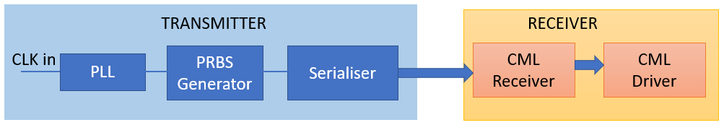
WP1.1 – Sensor Design
MLR1 Designs from RAL (Q4 2020)
  First submission in TPSCo 65 nms
  Scoped within CERN EP R&D WP1.2 Significant drive from ITS3
  Contributions from several groups
  RAL: LDVS receiver and CML transmitter
  Scope: Technology exploration and prototype circuit blocks for future sensors
  Large number of test structures; including Analogue and Digital Pixel Test Structures
ER1 Designs from RAL (Q4 2022)
  Functional blocks for high-speed data transmission
    PLL dual mode 1 GHz/ 7 GHz
    PRBS Generator
    CML Receiver
    I²C block for on-chip data transmission
  Plus, redesigned standard cells for DFM
    Buffers, AND gates, NAND gates, inverters, Filler cells, Flipflops
✓
✓
✓
✓

Slide 11
WP1.1 – Sensor Design
ER2 Plans
  RAL is now part of the ITS3 ER2 designers team contributing
    New logic libraries
    Fast driver/receiver blocks
    On-chip regulation
  In parallel, RAL is working on the design of a Shunt-LDO regulator for the serial powering scheme specific to the ePIC detector
    Specifications captured
    Bandgap circuit design advanced
    Shunt-LDO schematics design started
    Technology choice under consideration

Slide 12
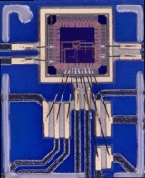
WP1.2 Sensor Characterisation
MLR – RAL IP Block
  New MLR test setup for RAL IP block: LVDS receiver and CML transmitter
  Chips bonded to carrier boards at Birmingham and Liverpool
  X-ray irradiations carried out at CERN up to 9900 krad at two dose rates (Sep 22)
  Tests performed at Daresbury before/after irradiation
  Chips survived irradiation up to target dose ~10 MRad (Full results in: 20221021-XrayIrradReportV1-rep-2021a05.pdf, e.g. plots in slide 13 if needed)
RAL chip in new test system by DL/BHAM/LIV

Slide 13
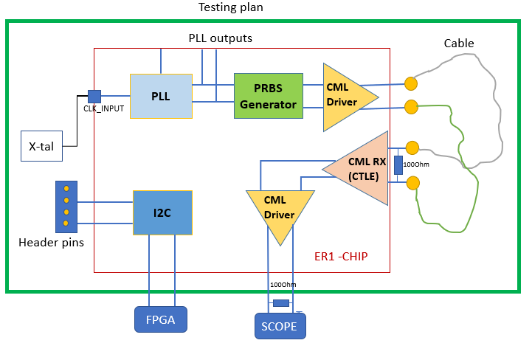
WP1.2 Sensor Characterisation
MLR - APTS / DPTS
  MLR contains Analogue Pixel Test Structures (APTS) and Digital Pixel Test Structures (DPTS) designed by ITS3 groups
  Birmingham and Liverpool fully integrated in the ITS3 WP3 group
    Full characterization of 2 out of 4 process splits with APTS, preparing plots for June approval session
    Contribution to APTS test beam data analysis
  DPTS setups for RAL and DL expected in June
ER1 – RAL IP block
  The ER1 sensor and test structures received from manufacturing in March.
  Setup for RAL blocks testing in preparation (RAL TD, DL)

Slide 14
WP1.3 – Modules and System Tests
ALICE – ITS3
  Wafer-scale sensor: L = 280 mm
  Each layer composed of 2 sensors
  L0 = 2 x (3 x 9 reticles)
  L1 = 2 x (4 x 9 reticles)
  L2 = 2 x (5 x 9 reticles)
EPIC – SVT
  Will use same 3 sensor formats
  Each layer composed of 4 or 8 sensors
  L0 = 4 x (3 x 9 reticles)
  L1 = 4 x (4 x 9 reticles)
  L2 = 8 x (5 x 9 reticles)
  Note: 5 mm gap for beam pipe bake out

Slide 15
WP1.3 – Modules and System Tests
EPIC sagitta layers
L3 – 50 staves
  2 sensors wide = 37.7 mm
  2 sensors long = 540 mm (2 x 9 reticles)
  Mean radius = 268.4 mm
  Rφ overlap = 3.5 mm ~ 10%
  4 sensors per stave; 5 sensors per wafer
  Require 200 1x9 sensors (40 wafers)
L4 – 78 staves
  2 sensors wide = 37.7 mm
  4 sensors long = 840 mm (4 x 7 reticles)
  Mean radius = 418.5 mm
  Rφ overlap = 3.5 mm ~ 10%
  8 sensors per stave; 10 sensors per wafer
  Require 624 1x7 sensors (63 wafers)

Slide 16
WP1.3 – Modules and System Tests
Disk tiling strategy
  Investigate sensor formats needed
  Two designs studied:
  Design #1 = vertical tiles/sensors
  Design #2 = herringbone pattern (alternating vertical and horizontal tiles)
  No sensor overlap on same side of disk
  Sensor variants are assumed to be 1 reticle width by up to 9 reticle lengths
Disk 2 – restricting sensor size
148 sensors
896 reticles
Fewer, longer sensors
T4 – T9
192 sensors
892 reticles
More, shorter sensors
T1 – T6

Slide 17
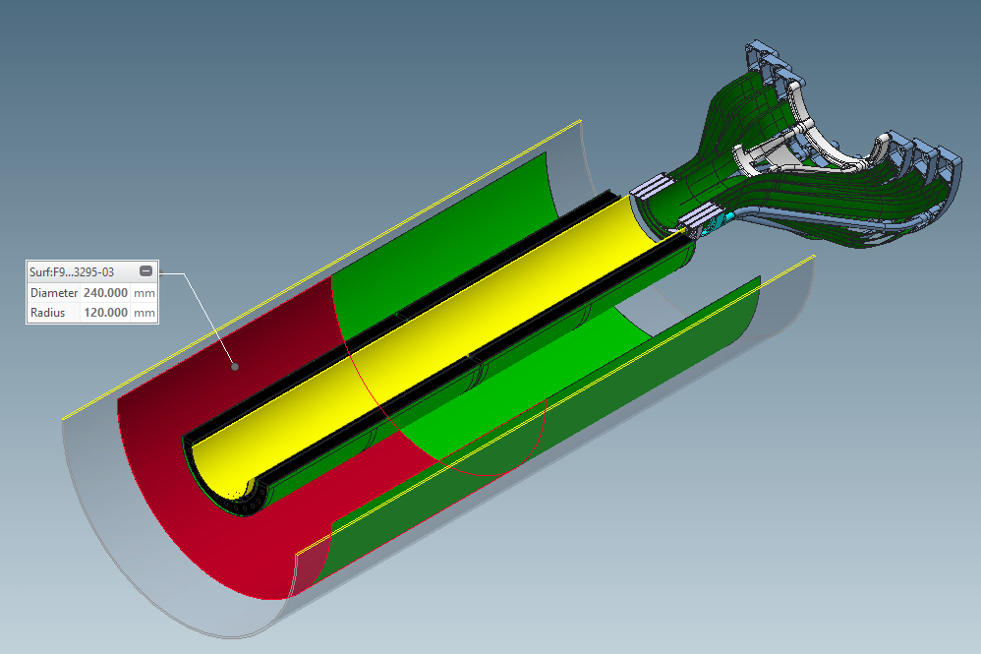
WP1.3 – Modules and System Tests
Mechanical design
  Work has started on modifying ITS3 mechanical design for the vertex layers
  Need to address cable routing, cooling and compatibility with EPIC support cone

Slide 18
WP1.3 - Modules and System Tests
Serial powering scheme chosen as baseline for the ePIC SVT
  Provides lowest material option
Shunt-LDO placement on a dedicated powering chip outside the sensor
  Allows re-using of ITS3 sensor on-chip power distribution; Does not require modification of sensor periphery; Can be prototyped and fabricated in cheaper technology
SP scheme drafted for sagitta layers
  Current flowing between sensors on each side of the stave
  Factor 4 current reduction for L4, factor 2 current reduction for L3
Number of sensor low voltage and bias cables estimated and provided to EIC project engineers for integration exercise
I_{in}
I_{out}
L4 serial powering scheme;
top – stave top view, bottom – stave side view

Slide 19
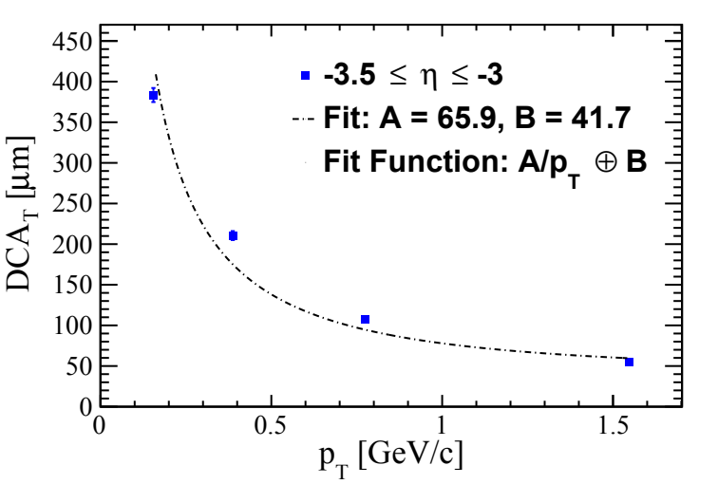
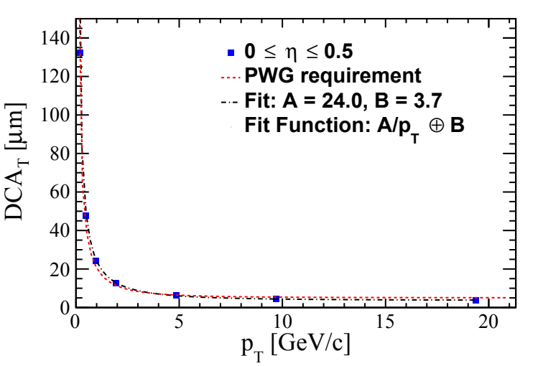
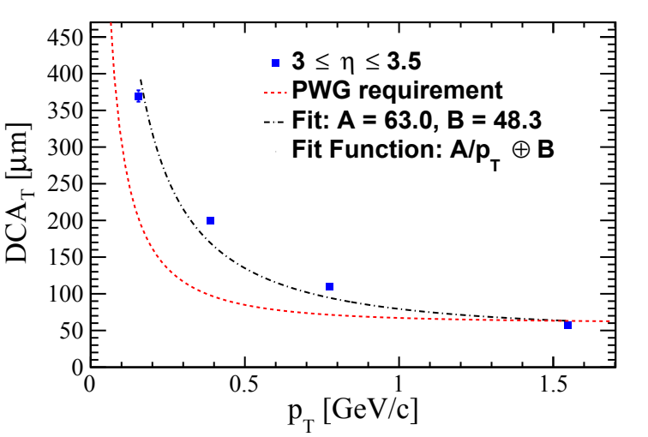
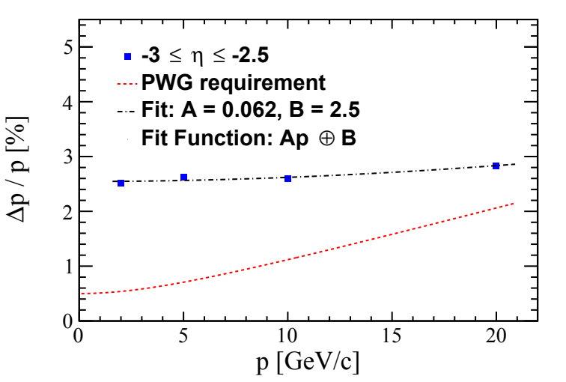
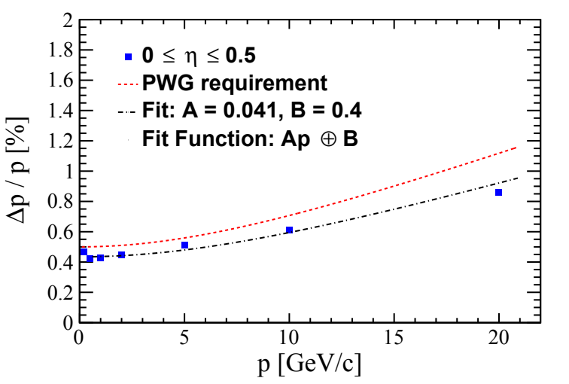
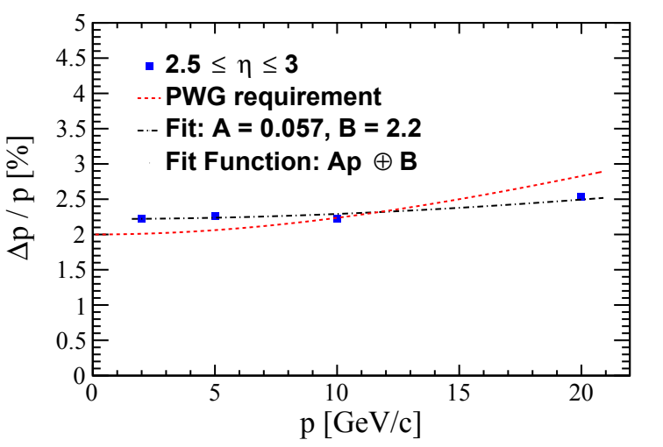
WP1.4 - Detector layout simulations
Parametrised momentum and vertex resolutions with the latest ePIC tracker configuration

Slide 20
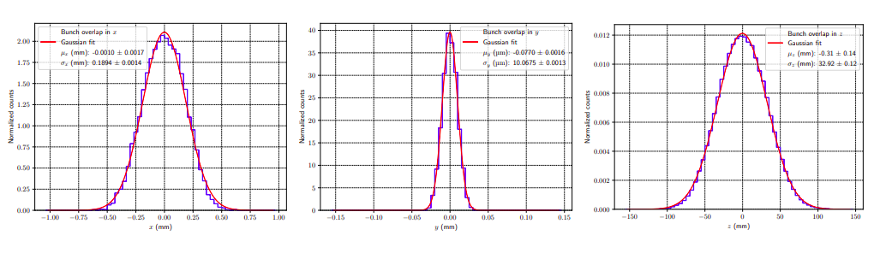
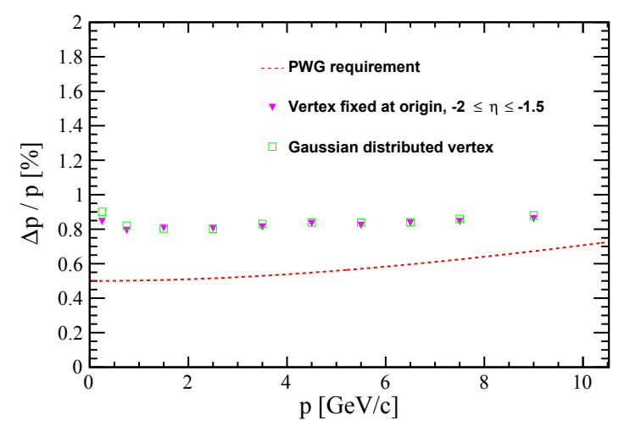
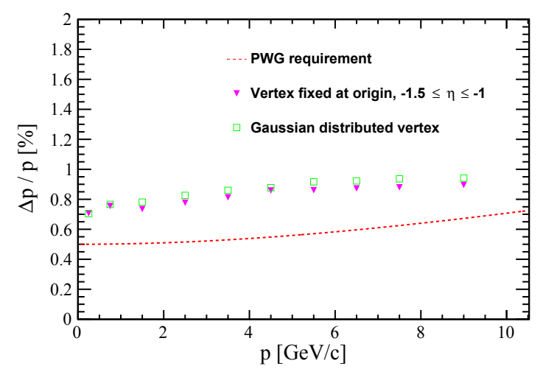
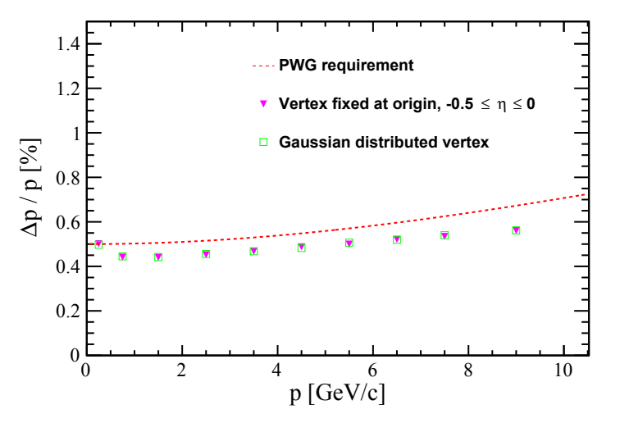
WP1.4 - Detector layout simulations
Study of beam spot effect on the tracking performance
  Minimal degradation of momentum resolution in specific pseudorapidity intervals where particles traverse support material; no effect on the vertex resolution.
Same trend at forward pseudorapidity

Slide 21
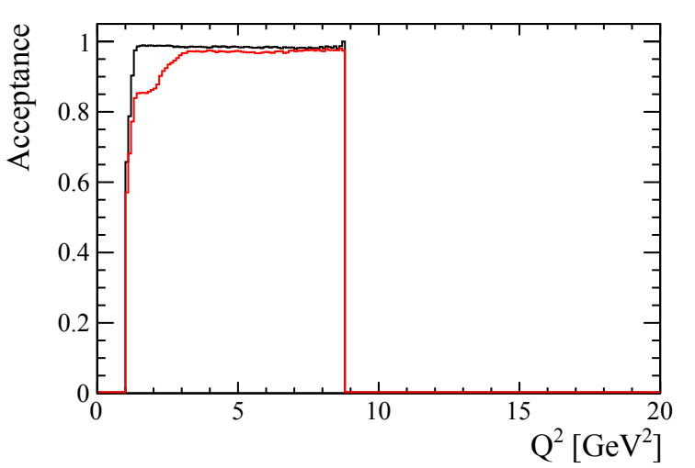
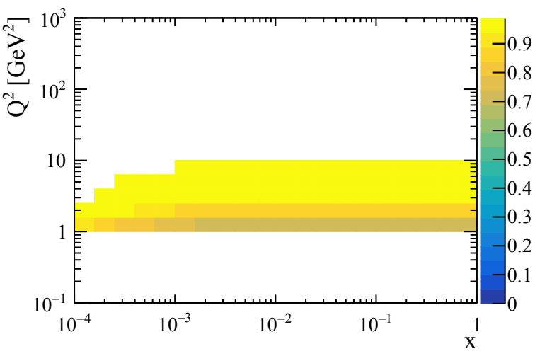
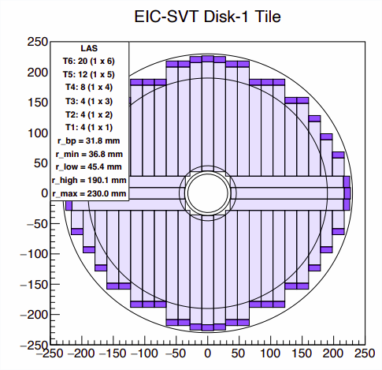


WP1.4 - Detector layout simulations
Study of acceptance at large eta
Realistic disk design implemented in simulation
Higher x lower Q² bins lose acceptance
Acceptance > ~80% for all bins Q2>1GeV² for 100% efficient disks
95% efficient disks
Example of disk configuration in tiling study
Disk implementation in simulation
100% efficient disks

Slide 22
WP1.4 - Detector layout simulations
Study of barrel MPGD layer contribution to tracking
  Different combinations of active silicon, MPGD and Time of Flight (TOF) layers
  Momentum and vertex resolution fully defined by SVT, with small improvement by TOF layer; no recovery in performance with the MPGD layer active in case of failure of one silicon layer; barrel MPGD layer contribution in pattern recognition only

