Slide 1
ePIC DAQ System Overview
Streaming Readout
David Abbott
Jefferson Lab
L3 CAM for EIC Detector Project
July 5-6, 2023

Slide 2
ePIC DAQ/Online Computing Overview
The EIC Streaming Readout (SRO) Consortium was formed in 2018 with the goals of engaging the nuclear physics community in exploring the advantages, challenges and requirements to implement a 100% streaming readout architecture for the EIC detectors.
  Series of ten workshops between 2018 and 2022.
  General agreement in the Yellow Report, that the adoption of SRO would maximize the impact of the physics program for EIC.
Talk Outline
  General DAQ architecture
  Expected technology choices
  Interface with Detector Systems – PID focus
  Relative schedule wrt to the EIC Detector project

Slide 3
EIC Streaming Readout Community
ePIC Electronics/DAQ Working Group
  J. Landgraf (BNL), F. Barbosa (JLab), J. Huang (BNL)
  Regular meetings to focus on design and requirements specifically for the new ePIC detector
  Interface to detectors, readout, DAQ, online processing, monitoring and control.
ePIC Software/Computing Working Group
  M. Diefenthaler (Jlab), S. Joosten (ANL), T. Wenaus (BNL), W. Deconinck (UM)
  Coordinating software development for EIC physics
  Analysis Frameworks, Reconstruction, Simulation, AI & ML
  Online Filtering (e.g. event ID, calibration)
EIC Project L3 CAMs (DAQ/Online, Electronics)
  D. Abbott (JLab), J. Landgraf (BNL), F. Barbosa (JLab)
  Project management (cost/schedule)
  Coordination between relevant EIC working groups (including Detectors)

Slide 4
Streaming Readout Architecture
  No hardware-based trigger (well just optional…)
    Elimination of dedicated hardware and ability to select events based upon the full detector are the main advantages.
    Exposure to background and noise is the main challenge
    All front-ends are free-running (or self-triggered)
    Data flow (congestion) is managed at individual sources
  Streaming requires a robust and accurate distributed clock delivered and synchronized to all the front-ends
    All data are characterized by detector/channel ID and a time-stamp
  Real time filtering, processing and reconstruction
    Online vs Offline tasks become blurred
    Adds requirements such as the need for event identification & quasi-real time monitoring/calibration for filtering and physics results
    This is the focus of the EIC Software and Computing Group

Slide 5
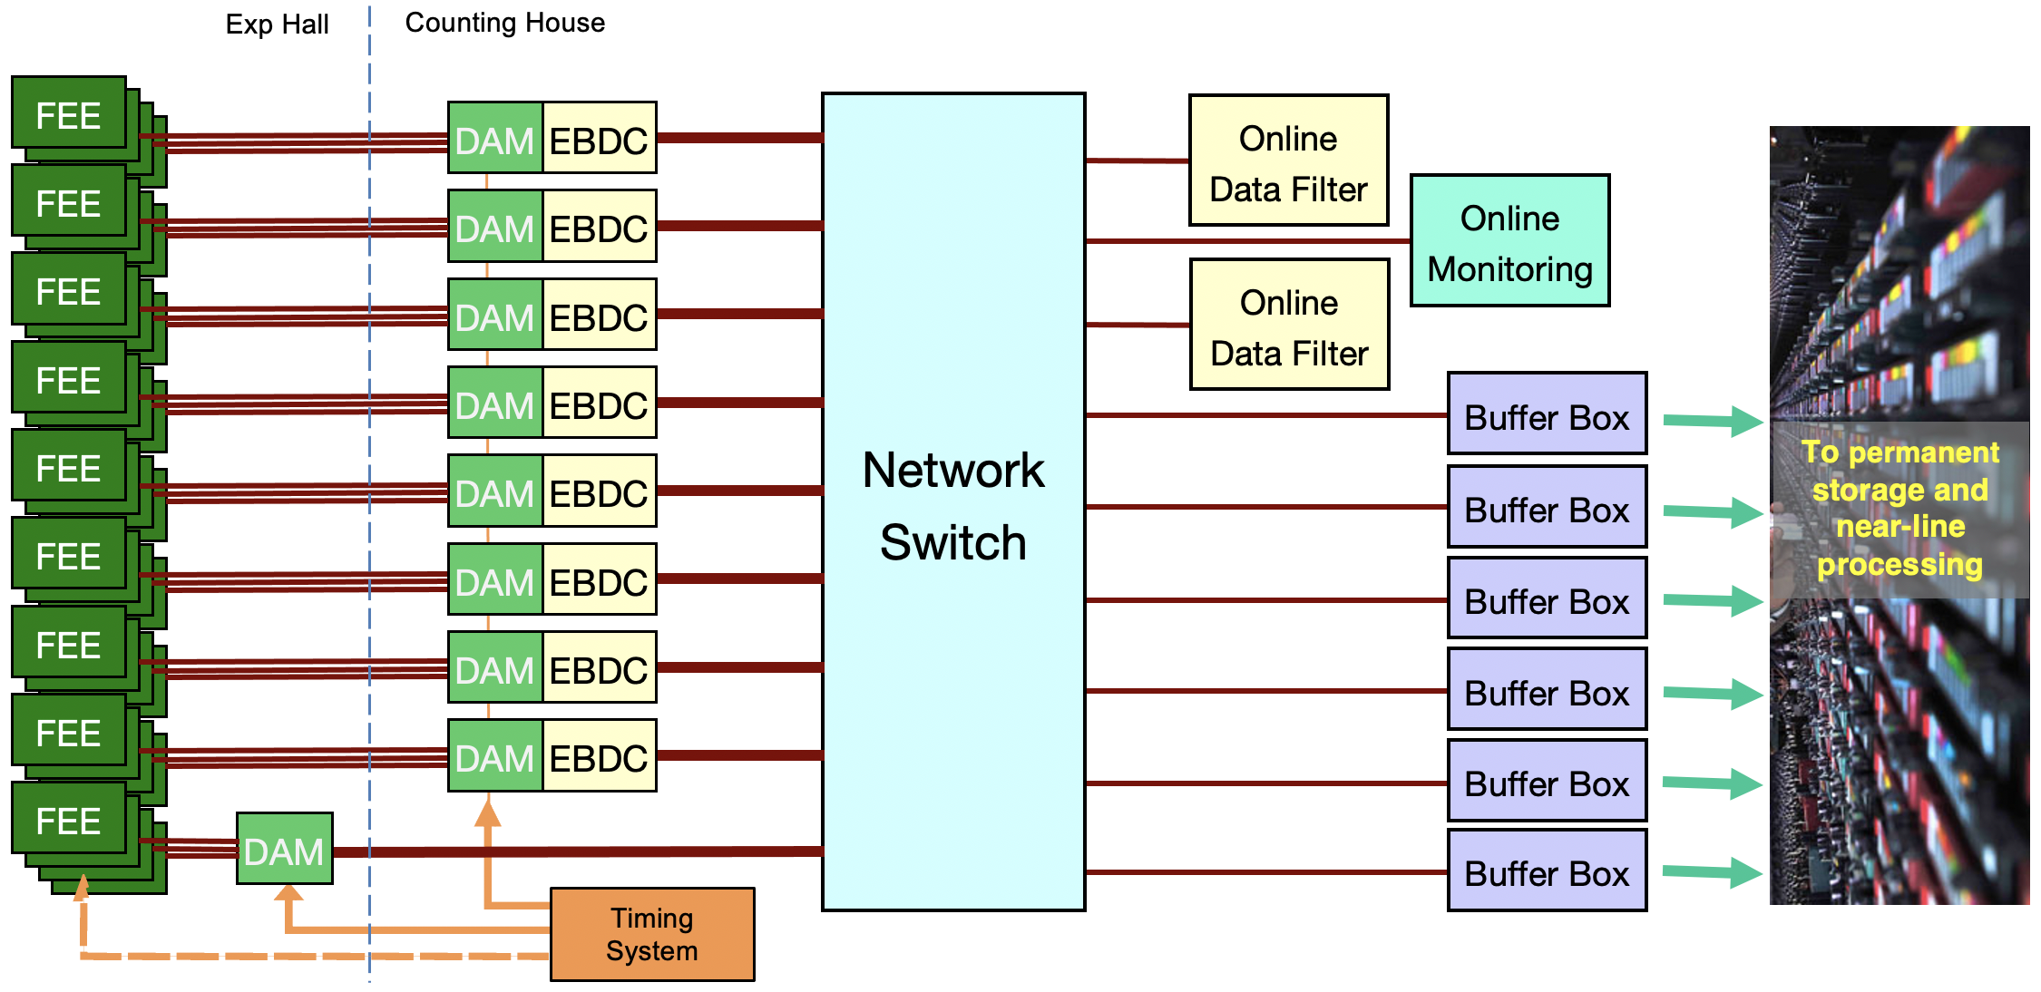
ePIC Streaming DAQ/Computing Architecture
Bunch Crossing ~ 10.2 ns/98.5 MHz
Interaction Rate ~ 2 us/500 kHz
Low occupancy.
BW O(100Tbps)
RDO
RDO
RDO
RDO
ePIC DETECTOR
BW O(10Tbps)
RDO
RDO
RDO
BW O(100Gbps)
RDO
RDO
Distributed clock
jitter ~5ps

Slide 6
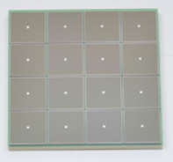
ePIC Readout Chain
Global Timing Unit (GTU)
-Interfaces to Collider, Run Control & DAM
-Config & Control
-Clock & Timing
On Detector
SMT BGA
Name
Design
Function
Attributes
Sensor
Detector Specific
-Multi-Channel Sensor
-MAPS
-AC-LGAD
-MPGD
-MCP-PMT
-SiPM
-LAPPD/HRPPD
Adapter
Detector Specific
-HV/Bias Distribution
-HV divider
-Interconnect Routing
-Sensor Specific
-Passive
Front End Board
(FEB)
Detector Specific
-Amplification
-Shaping
-Digitization
-Zero Suppression
-Bias Control & Monitoring
-ASIC/ADC
-Discrete
-Serial Link
Readout Board
(RDO)
Few Variants
-Communication
-Aggregation
-Formatting
-Data Readout
-Config & Control
-Clock & Timing
-FPGA
-Fiber Link
Data Aggregation Module (DAM)
Common
-Computing Interface
-Aggregation
-Software Trigger
-Config & Control
-Clock & Timing
-Large FPGA
-PCIe
-Ethernet
Computing
Common
-Data Buffering and Sinking
-Calibration Support
-QA/Scalers
-Collider Feedback
-Event ID/Building
-Software Trigger
-Monitoring
-COTS
-Ethernet

Slide 7
DAQ Interface to the Detector Systems
Managing data “streams” is ideally done in a deterministic way – e.g. FPGAs
Proprietary communication with the front-end electronics.
  Bi-directional link (fiber)
  Send: clock, commands, control, config
  Receive: high speed data streams
System on Chip (SoC) facilitates DAQ/User applications to communicate with the Front-end.
  Readout, Configuration and Control
DAM (Data Aggregation Module)
SoC
DAM
FEB
RDO
Ethernet
Server
FEB
RDO
FPGA
PCIe
Server
FEB
RDO
timing

Slide 8
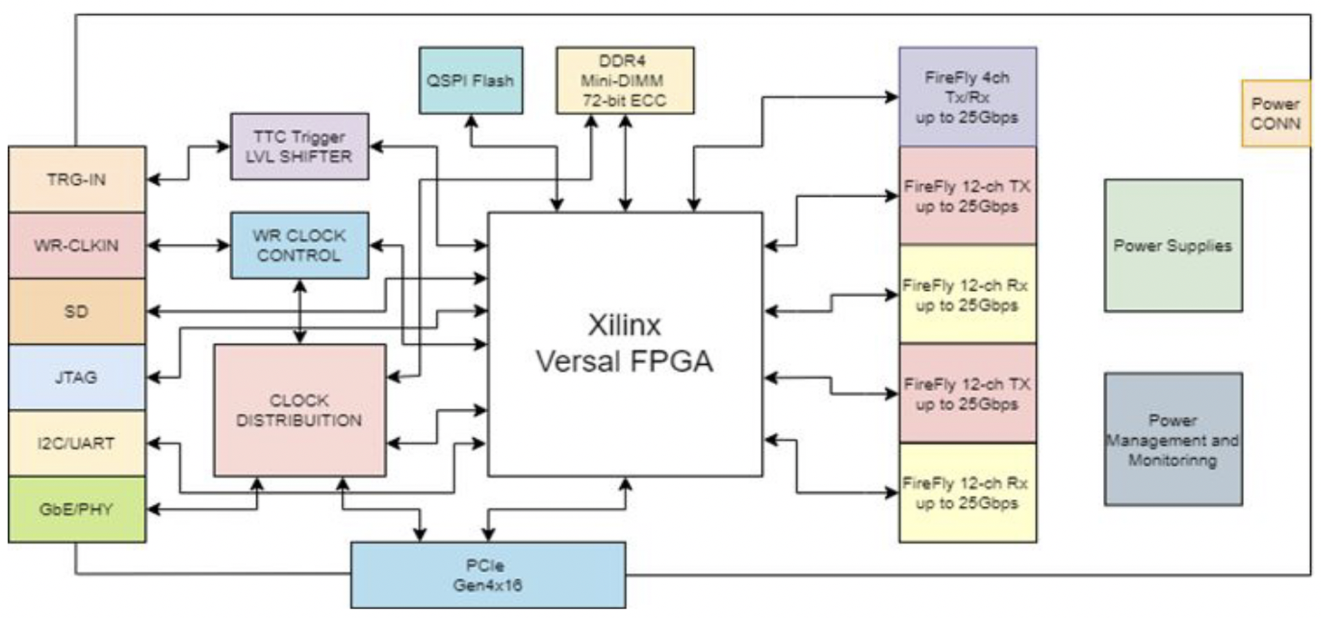
DAM Option - Front-End Link Exchange (FELIX)
Originally developed for ATLAS at CERN
Design team is based at Brookhaven
  Current version (FLX-172) in use at BNL for sPHENIX
New board being prototyped now for ATLAS HL-LHC running.
FPGA: Xilinx Versal Prime XCVM1802
PCIe Gen4 x16
24 Firefly links with 3 config options
  24 links @ 25Gbs
  24 links @ 10Gbs
  12 @ 25Gbs + 12 @ 10Gbs
4 additional Firefly links
Front Panel: Fiber I/O
  Additional 3 Inputs, 3 Outputs
1 DDR4 Mini-UDIMM
USB-JTAG/USB-UART
Block Diagram of FLX-182 Prototype
Notes: The Xilinx Versal Prime is a SoC.- Dual Core ARM Cortex
Power usage ~133W. No power through PCIe.
Can be implemented as a stand alone device (no Server)

Slide 9
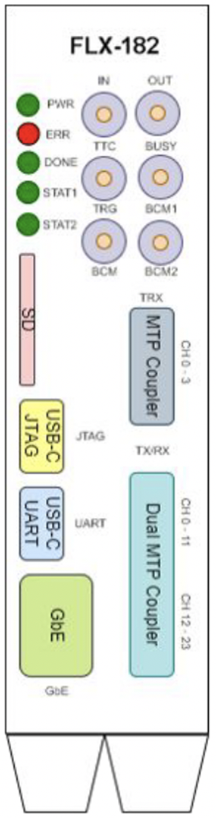
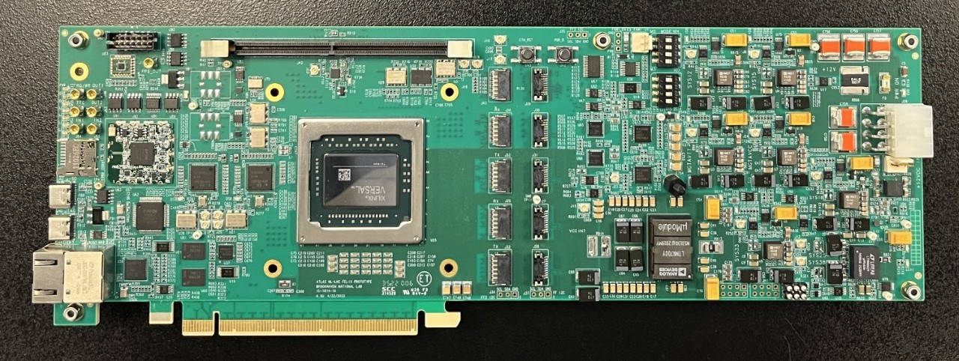
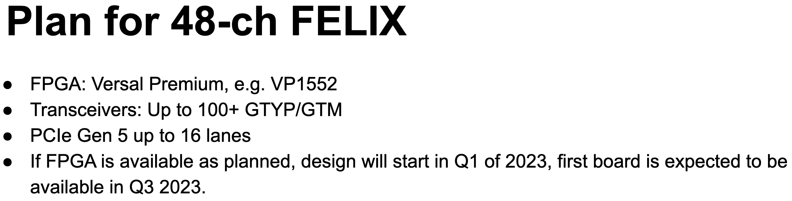
FELIX timelines
10 boards were produced in early 2023.
DAQ Working Group has recently acquired one of these boards for testing
General technical support for the FELIX Hardware should be available through the end of HL-LHC operation.
(i.e. into the late 2030s for Run 5)

Slide 10
ePIC Detector Systems: Summary of Channel Counts
Detector Group | Channels | AC-LGAD | SiPM/PMT | MPGD |  | RDOs / Fibers | DAM | Data Volume Estimate (Gb/s) | Data Volume To Tape (Gb/s)
 | MAPS | AC-LGAD | SiPM/PMT | MPGD | LAPPD
Tracking | 36B |  |  | 100k |  | 415 | 11 | 35 | 15
Calorimeters | 88M* |  | 150k |  |  | 249 | 11 | 15 | 15
Far Forward | 300M | 2.3M | 500 |  |  | 174 | 5 | 1 | 1
Far Backward |  | 1.8M | 700 |  |  | 117 | 4 | 100 | 2
PID |  | 3M-50M | 300k |  | 150k | 1117 | 49 | 1856 | 45
TOTAL | 32B | 7.1M-54M | 450k | 100k | 150k | 2072 | 80 | 2007 | 78
PID Specific Information
Detector System | Channels | Fiber pair | Data Volume | DAM Boards | Readout Technology | Notes
PID-TOF | 3M-50M | 240-500 | 6Gb/sec | 12 | AC-LGAD/ EICROC | Channel / Fiber counts depend on sensor geometry. Considering pitches of: .5mm x 1cm, .5mm x .3cm, .5mm x .5mm
PID-Cherenkov: dRICH pfRICH hpDIRC | 320k 70k 74k | 312 17 288 | 1830Gb/s (<20Gbps to tape) 15Gbps 11Gb/sec | 28 1 6 | SiPM / ALCOR LAPPD/HRPPD /EICROC LAPPD/HRPPD /EICROC | Worse case after radiation. Includes 30% timing window. Requires further data volume reduction (software trigger, or AI/ML) 12 boxes x 24 sensor x 4 asic x 64 ch

Slide 11
PID Detector Specific Integrations
Global Timing Unit (GTU)
optional
clock
On Detector
SMT BGA
Sensor
Adapter
Front End Board
(FEB)
Readout Board
(RDO)
Data Aggregation Module (DAM)
Computing
Detector | ASIC | RDO/Fiber | DAM | Data rate | Det. Tech
pfRICH | EICROC | 17 | 1 | 15Gbs | LAPPD/HRPPD
dRICH | ALCOR | 312 | 28 | 1800Gbs | SiPM
hpDIRC | EICROC | 288 | 6 | 11Gbs | LAPPD/HRPPD
TOF (B) TOF (FEC) | EICROC | 240-500 | 12 | 6Gbps | AC-LGAD

Slide 12
Scale of the Online Task
EIC minimum bias collision rate ~500kHz
  Expected real physics data from the detector < 100Gbps
Background/Noise is the wild card.
  Synchrotron radiation, Beam Gas, Detector/electronics noise
  Try to keep below the level of the physics signal.
  Online/DAQ processing will focus on Event ID and reducing the background
Front-End (DAM Boards) - will support total bandwidth O(50Tbps)
  3000+ fibers(streams) off the detector (nominally 10Gbps links)
  ~110 DAM Boards
Online DAQ/Computing (over 100/400Gbps network)
  ~200 nodes
  GPU/FPGA processing options
  Data Monitoring
  Staged disk storage (Buffer Box)

Slide 13
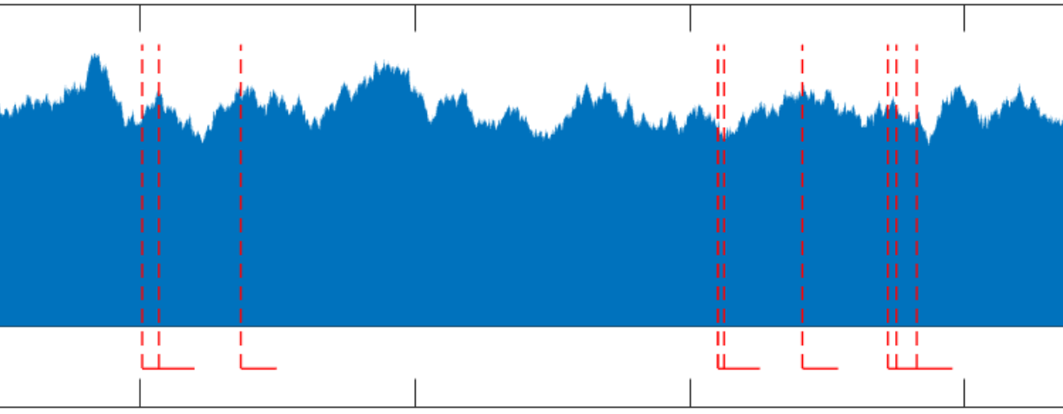
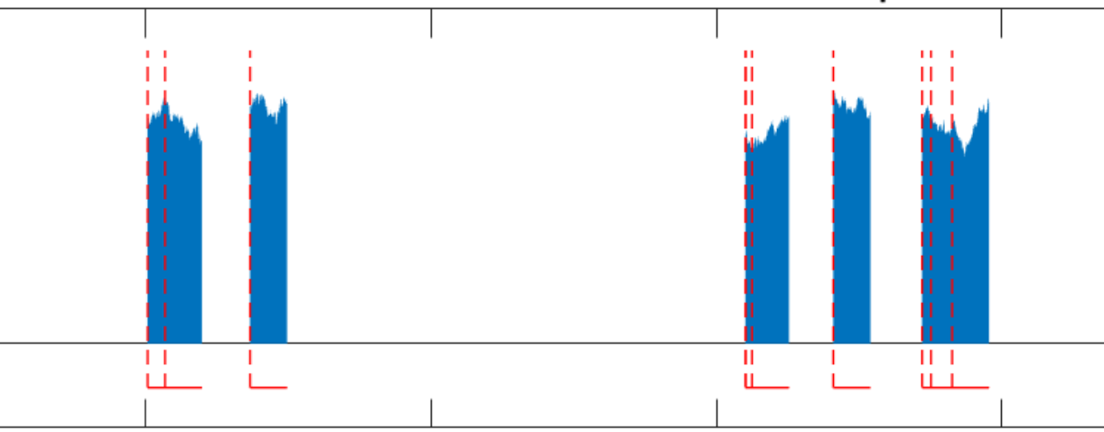
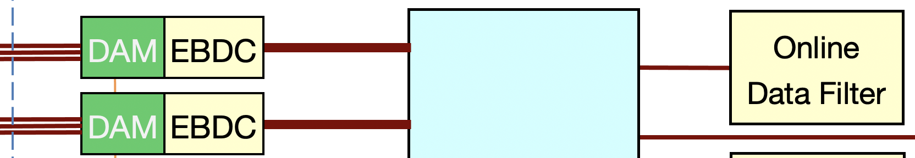
Potential “Hot spots”
In general the high fiber counts coming to the DAM boards are not bandwidth driven, but the expected numbers of RDOs needed to instrument the ePIC detector can vary for different sub-systems.
Detectors using SiPM readout at thresholds sensitive to single photons
  Dark current rates will increase over time due to radiation damage.
  E.g. dRICH could eventually generate ~1800Gbps data rates
  Example:
Use some EBDC (Event Building/DataCompression) servers as a RAM buffer until Event ID processing can identify time windows that are important. Then filter data from the high rate detector we should keep.
Network Switch
dRICH
Tracking

Slide 14
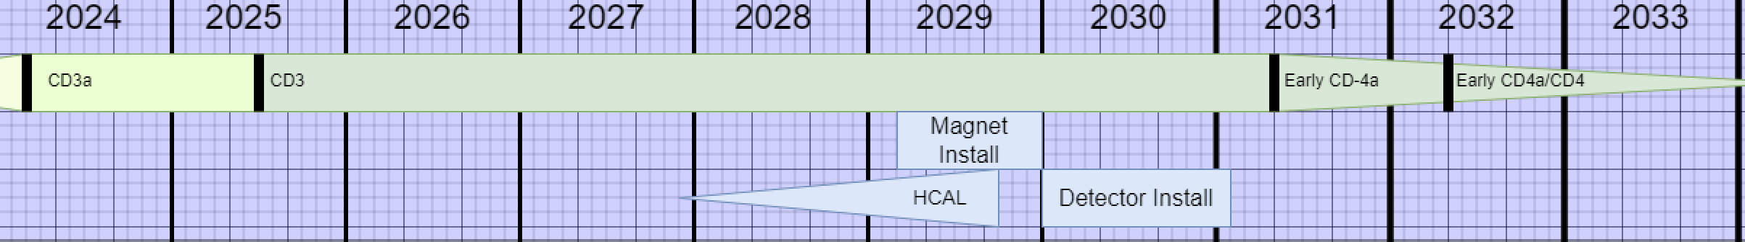
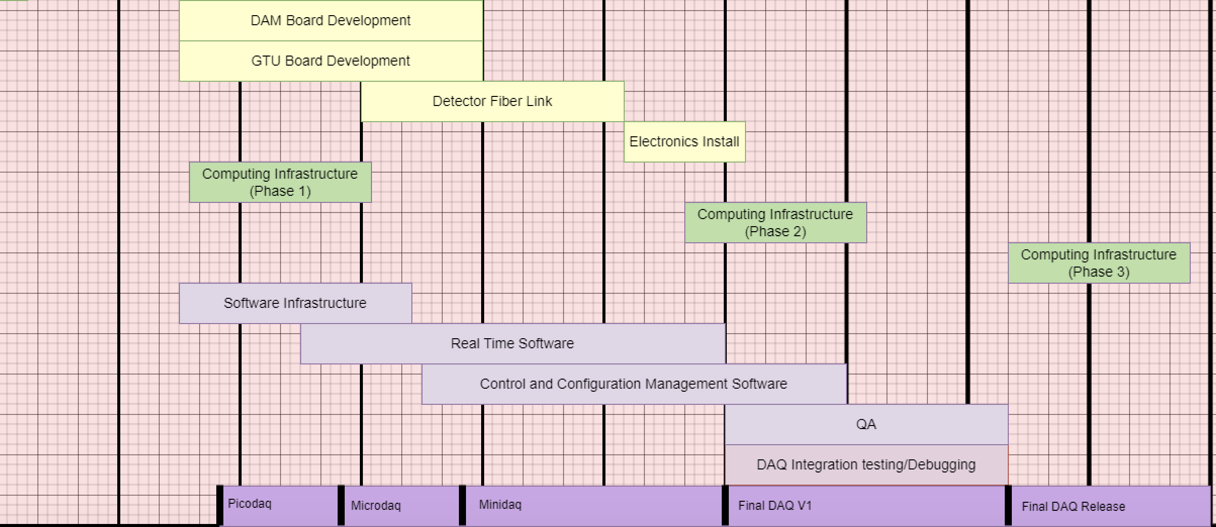
EIC DAQ/Computing schedule
The DAQ and computing schedule is planned to be somewhat accelerated in relation to the full detector construction.
A functional DAQ will be necessary for small scale detector testing as well as commissioning and pre-ops.
Hardware and software development early in the construction phase will provide a streaming DAQ system (Minidaq) well before final detector installation begins.
Final computing resources are purposely delayed to allow access to highest performing hardware available.

Slide 15
Summary
A general picture of the scope, scale and technologies we expect to need for the EIC data acquisition and online computing reasonably clear at this stage.
Most of the DAQ/Online will be COTS-based procurements
We have a viable candidate for a Front-end interface and stream management hardware (FELIX)
Integration plans and requirements for all the detector subsystems are currently being developed.

Slide 16
BACKUP

Slide 17
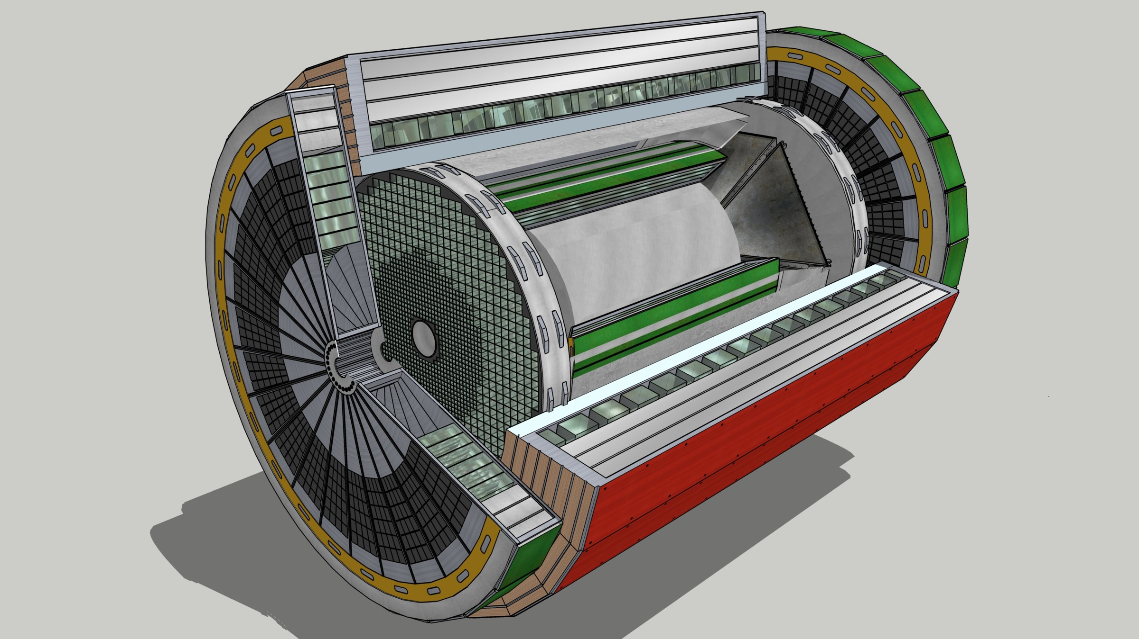
EIC Streaming Readout Architecture
Front-End Electronics
DAQ
Detector
FEB
(Front End Board)
RDO
(Readout Board)
DAM + Computing
(Data Aggregation Module)
Total
BW: O(100 Tbps)
BW: O(10 Tbps)
GTU
(Global Timing Unit)
Bunch Crossing ~ 10.2 ns/98.5 MHz
Event Rate ~ 2 us/500 kHz
Low occupancy.
L ~ 100 m
fiber
Jitter ~ 5 ps
ASIC
Goal: O(100 Gbps)
Fiber
Switch / Server / Link-Exchange:
Readout
Switch / Server: Processing
Switch / Server: Buffer
FEB
Storage
FPGA
Fiber
Monitoring
RDO
FEB
LVDS ~ 20-30 m*
Analog ~ 20m
Power Supply System
(HV, LV, Bias)
Data
Configuration & Control
Power
Cooling Systems
*LVDS – ANSI/TIA/EIA-644A standard. Maximum cable length dependent on data rate.

Slide 18
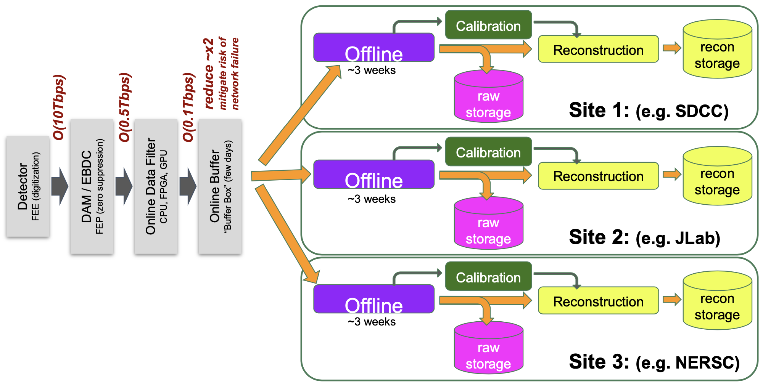
Boundary between Online and Offline
Full understanding of the Online processing responsibilities and physical make-up is still being hashed out.
We still require elements of the Offline Computing framework within the Online
Online Storage (Buffer Boxes) are intended as a “pause” and a decoupling with further Offline processing .
Offline buffering will allow several weeks for calibration and reconstruction.

Slide 19
Slow Control Integration
There will be many slow control and monitoring systems associated with the EIC collider and ePIC detector subsystems.
  BPMs, magnets, detector biases, HV, gas flows, temps, pressures, etc…
Design and implementation of these control systems driven primarily by the relevant subsystems.
  We want to coordinate ePIC slow control as much as possible with the collider approach (still not finalized) – some SCADA type system.
  sPHENIX currently supports Ignition and WinCC using UPC-UA.
DAQ/Computing has defined responsibility for SC Integration (L4 WBS 6.10.09.2)
  Databases for maintaining SC data for calibrations and online/offline processing
  Manage SC data readout to synchronize with the physics stream data
  Maintain Software tools and libraries
Also included is the development and implementation of a general network infrastructure in the experimental hall and counting house to support slow controls and other ancillary systems.

Slide 20
