Slide 1
Multiplicity correlation between inner and outer Barrels
2023/06/15
INTTMT
Mai Kano from NWU

Slide 2
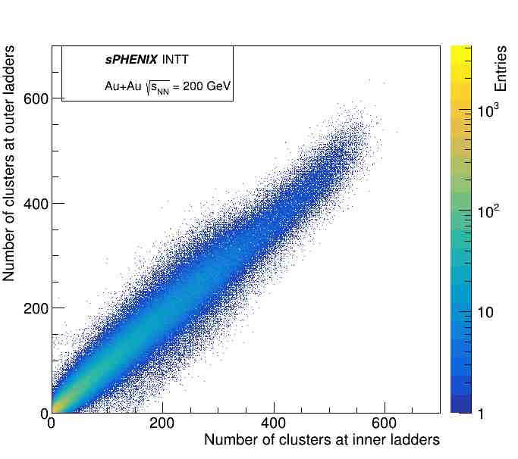
Multiplicity correlation between inner and outer Barrels Run#9328
I made a plot of the inner barrels (x-axis) and outer barrels (y-axis) of the hits clustering multiplicity using data taken with Modebit=78, and n_collision=4 in Run9328.
If we can measure the collision data, we can correlate the multiplicity because the particles pass through the inner barrel and also through the outer barrel.
Since we could see the correlation in this plot, we can say that intt7 on Run#9328 got the data for the collision.
This plot was reported at the shift change meeting and Plot Approval Session.
Correlations was found at intt2 and intt4~7.
Intt7-Run9328

Slide 3
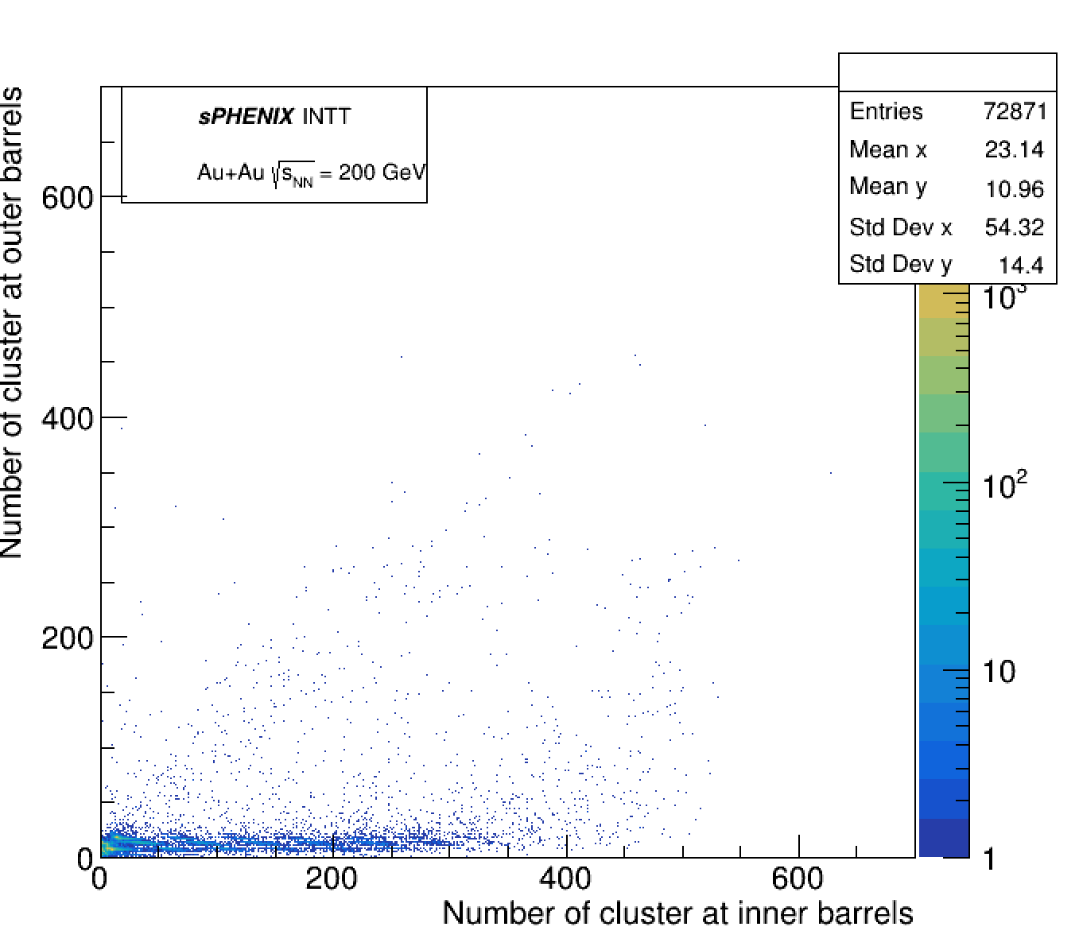
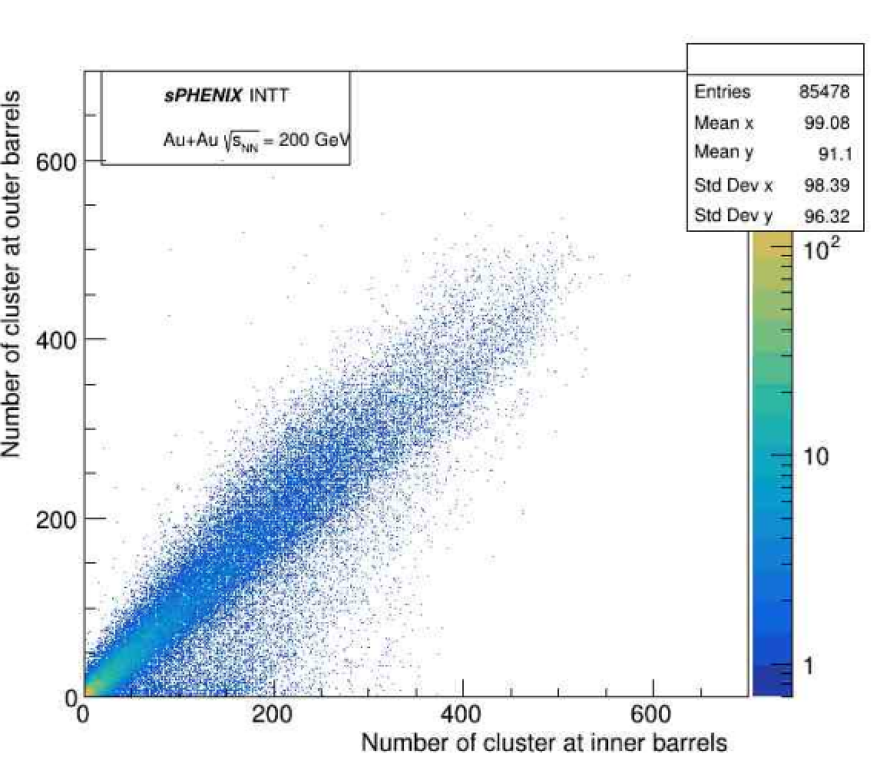
Other Felix in Run#9328
But intt0 don’t have the correlation, and Many hits were seen in inner barrels of intt3. We are investigating this issue.
And intt1 was noisy on this run, so I couldn't check the plot.
Intt0 Run#9328
Intt3 Run#9328

Slide 4
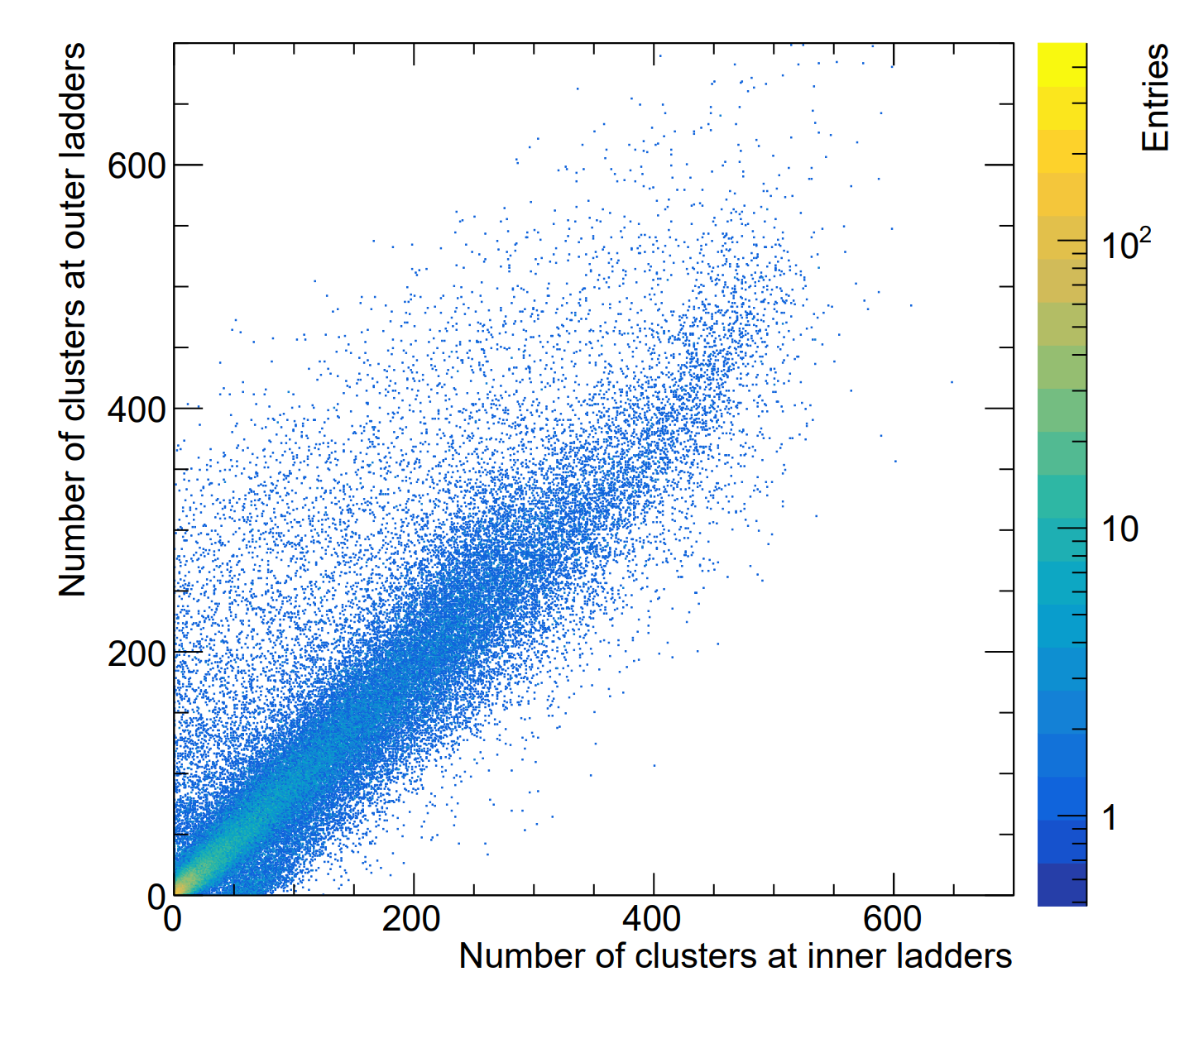
Intt1 in Run#10483 with modebit 79, n_collision=6
However, thanks to the hot channel masking file created by Jaein , we were able to get data from intt1, so I created a figure using run #10483, one of several runs in which intt1 seems to have worked correctly.
The results appear to have a lot of noise, but the correlation was confirmed.
Thus, intt1 has caught up with the other Felix servers.
Intt1 Run#10483

