Slide 1

Barrel HCAL SiPMs
J. Lajoie, C. Hughes

Slide 2
Barrel HCAL SiPM Specifications
3 x 3 mm, 15μm pitch, 40k pixels (53% fill factor)
  Matches existing sPHENIX SiPM’s
  Real advantage to match existing SiPM’s, will have a host of sPHENIX performance data to fall back on.
Hamamatsu S14160-3015PS is a good candidate (39960 pixels)
  Ten samples ordered by ORNL
V_{op} Selection:
  Groups with same V_{op} selection +/- 0.06% (sPHENIX V_{op} 67V +/- 0.04V)
  HGCROC allows individual channel voltage trim for gain adjustment
Ongoing work:
  Test signal as a function of length of μcoax cables (w/ORNL)
    Have sPHENIX SiPM’s, also test with ePIC candidate
  Develop cable plan, HGCROC locations

Slide 3


Slide 4
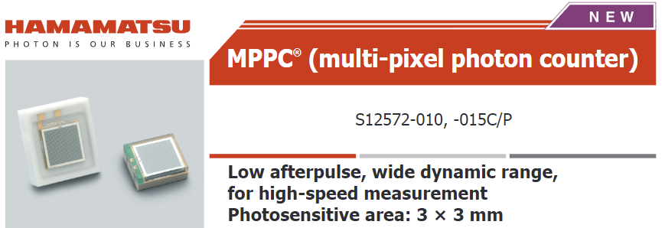
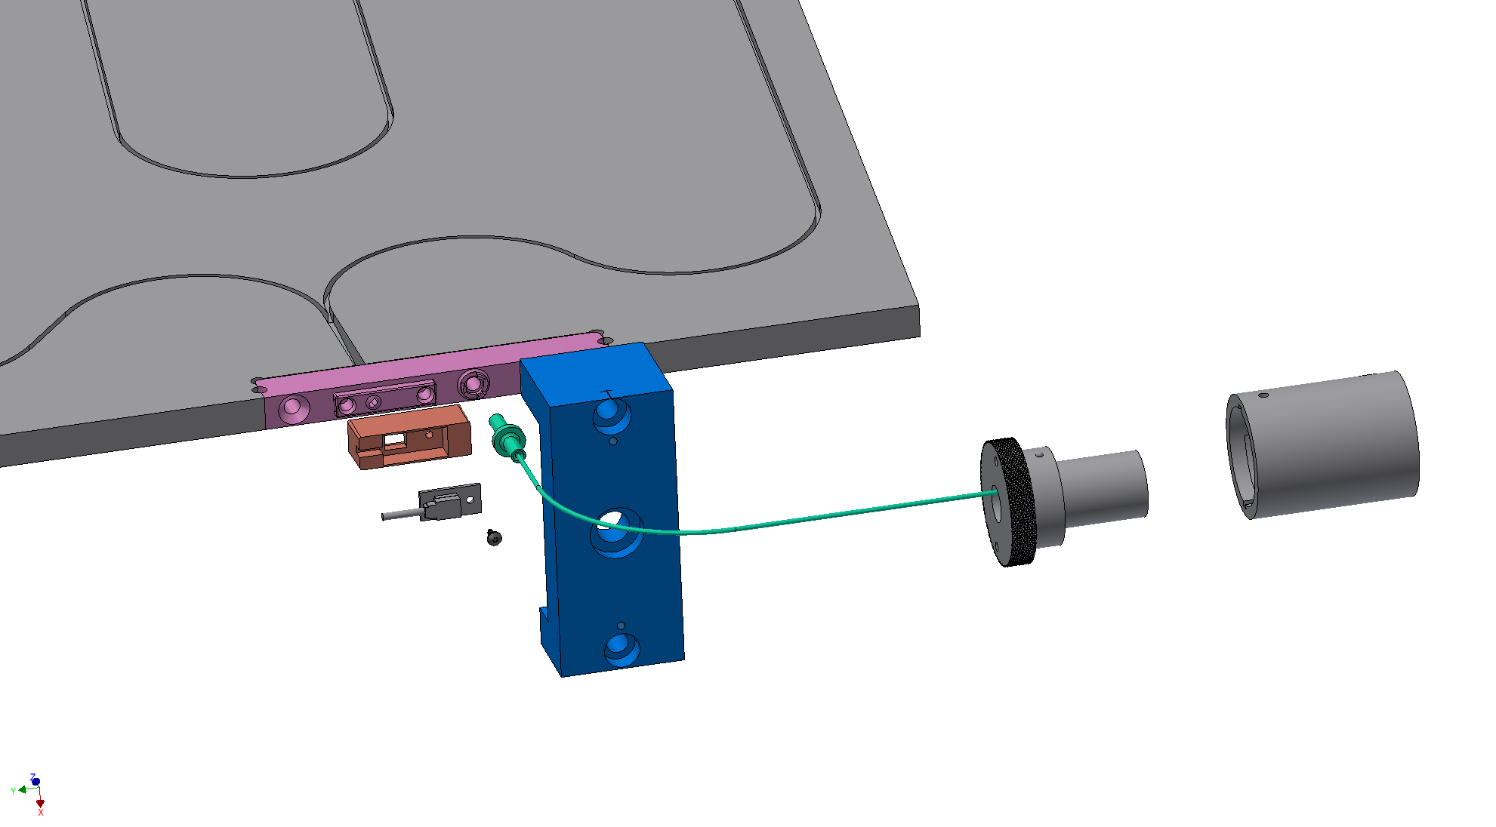
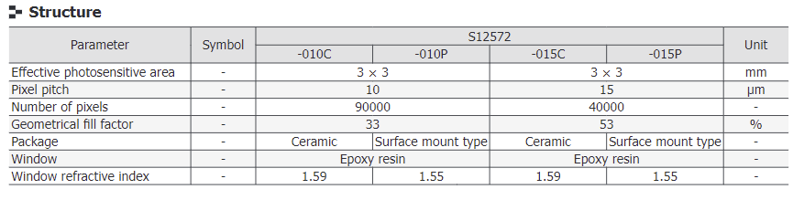
The Barrel HCAL Scintillating Tiles
Light block, SiPM mount and SiPM
(S12572-015P-02)
7680 total
Scintillating Tile
(shown unwrapped)
Calibration
Fiber
Tile Retainer
Clip

Slide 5
Questions
What is the dynamic range one needs to cover?
  sPHENIX planned on 25 MeV – 50 GeV per tower (5 scintillator tiles) @200 GeV
    5 MeV – 10 GeV per tile, or 1 – 2000 (2.5 – 5000) pixels @ 200 (500) PE/GeV
    Should look at 18x275 GeV jets at η ~ 1 to verify range, suspect OK
What is the impact of radiation damage of the SiPMs on your system?
  Expected to be negligible, at outer radius of detector. No degradation anticipated in 3 (5) years of sPHENIX operation (HI).
  Is there a standard “per N years of operation” to estimate dose?
What specs have you already determined and how? What needs still be determined
  Based on existing design, we have a fixed physical package (3x3mm)
  Designed for 40000 pixels @ 15μm. Reduced pixel count might work but needs study
How do your SiPM specs impact the readout electronics, especially the FEEs.
  Plan to use HGCROC, piggy-back on ORNL HGCROC development for LFHCAL
From sPHENIX TDR

