Slide 1
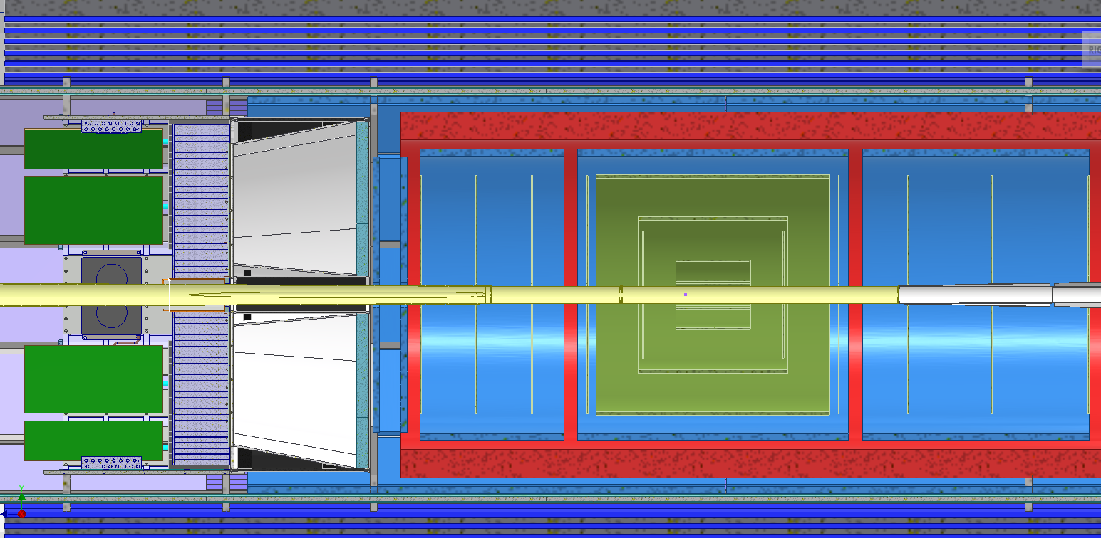
Integration of optimized tracking
For details on the why see Ernst’s and Matt’s talk
https://indico.bnl.gov/event/19854/contributions/77603/attachments/48017/81517/20230615%20-%20ePIC%20Tracking%20WG.pdf
ToF
MPGD
Outer-MPGD Barrel extended to cover active region of DIRC → will be integrated in DIRC support
Outer MPGD barrel is composed from flat detectors following the DIRC segmentation
Inner MPGD Barrel and ToF will have one support also supporting all Discs and MAPS barrels

Slide 2
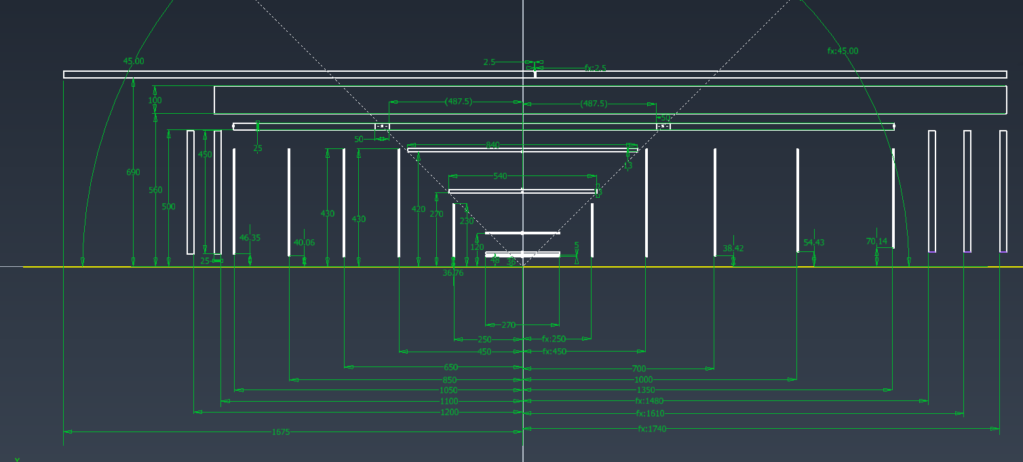
Integration of optimized tracking

