Slide 1






Electron-Ion Collider Project
Overview and Proposal Status
Peter Jones, University of Birmingham
WP1 – MAPS Institutes
Daresbury Laboratory
Rutherford Appleton Laboratory
Electron-Ion Collider Project | WP1– MAPS Meeting | 28 June 2023

Slide 2
Electron-Ion Collider (EIC)
Overview of the facility
  The EIC is to be built at the Brookhaven National Laboratory (BNL)
Uniqueness
  World’s first polarised electron,
  polarised proton/light-ion collider
  World’s first polarised electron,
  heavy-ion collider
Overarching science questions
  How does the mass and spin of the nucleon
  arise from its constituents?
  What are the emergent properties of
  dense systems of gluons?
Key features
  High Luminosity: 10³³–10³⁴ cm⁻²s⁻¹
  Highly polarised beams: 70%
  Wide range of energy: 20-140 GeV
  Wide range of ion species: p-U
US DOE Project Overview
  Total Project Cost = $2.4B
  Expected start of Construction in 2025
  Expected start of Operations in 2032
Project Detector

Slide 3
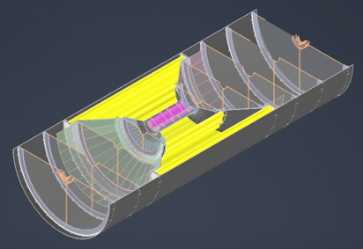
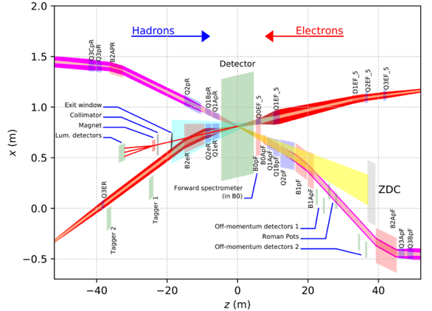
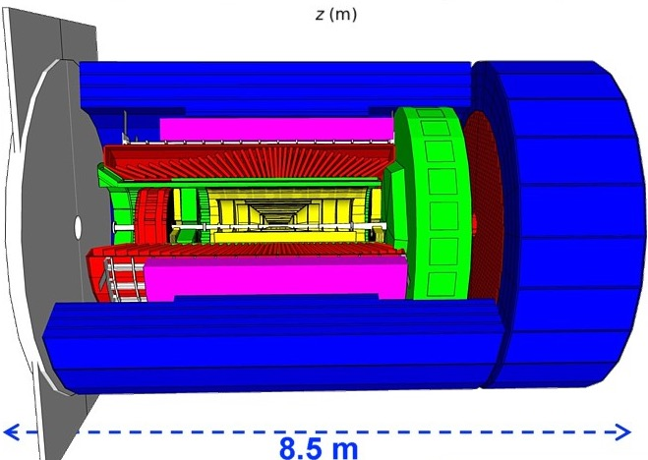
EIC Project Scope: Detector Work Packages
ePIC Central Detector and Ancillary Detectors
WP1: Silicon Tracker
WP3: Luminosity monitor
Vertex layers x3
MPGD & MAPS trackers
Disks x5
Disks x5
Barrel layers x2
Far-backward region
Far-forward region
hadronic calorimeters
WP2: Electron tagger
solenoid coils
ToF, DIRC,
RICH detectors
UK-led Detector R&D (stems from current UKRI Infrastructure Preliminary Activity)
e/m calorimeters

Slide 4
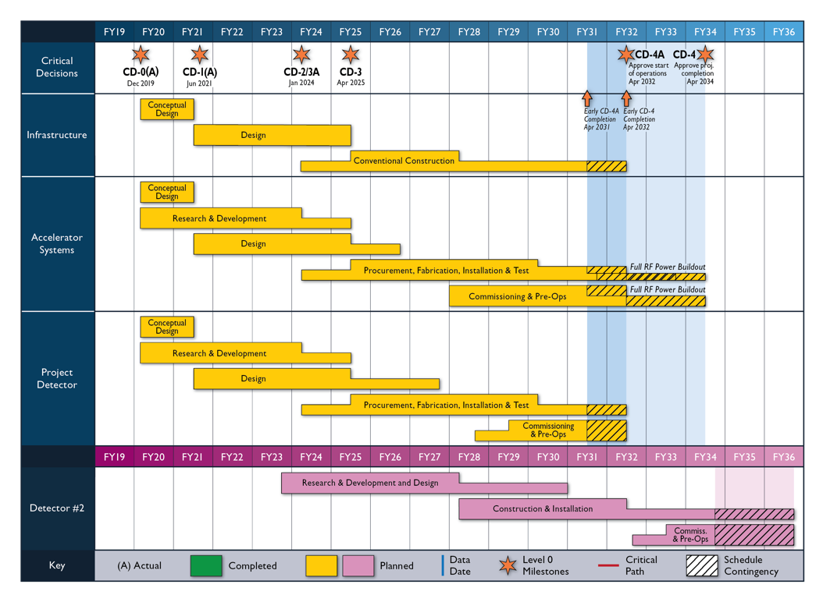
International Project Schedule and Full Infrastructure Project
2.5 y
15 m
7+1 y
NOTE: US Financial Years (FY) = Oct-Sep
Critical Decision (CD) Milestones
CD-0 Approve Mission Need
CD-1 Approve Cost Range
CD-2 Approve Baseline Performance
CD-3 Approve Start Construction
CD-4A Approve Start of Operations
CD–4 Approve Project Completion
Full Infrastructure Project
Preliminary Activity
UK-EIC Detector R&D Project
UK-EIC Detector Construction Project

Slide 5
EIC Full Infrastructure Project – Deliverables
WP1 – Silicon Tracker: Precision tracking and vertexing in the central detector
  Novel 65 nm stitched (wafer-scale) monolithic active pixel sensors; developed in partnership with CERN/ALICE-ITS3. Deliverable: Build ~33% of central silicon tracker – 2 x barrel layers.
  Institutes: Birmingham, Brunel, Lancaster, Liverpool, Oxford, STFC RAL, STFC DL
WP2 – Electron Tagger: Precision tracking of low-Q² scattered electrons
  Low-Q² tagger using pixel sensors. Deliverable: Build two tracking stations in the far backward region. Timepix4 is the baseline technology.
  Institutes: Glasgow, STFC DL + Lancaster (beam impedance studies)
WP3 – Luminosity Monitor: Bunch-by-bunch measurement of collision luminosity
  Design of the luminosity monitor comprising a pair spectrometer (PS) and photon detector (PD). Deliverables: Build the two calorimeters needed for the PS and half the modules needed for the PD.
  Institutes: York
WP4 – Accelerator Deliverables:
  WP4.1 Cavity design and cryomodules for the ERL
  WP4.2 Design of crab cavity LLRF feedback system
  WP4.3 Design and delivery of EO-BPM instrumentation
  WP4.4 ERL simulation and design
  Institutes: Cockcroft Institute (Lancaster, Liverpool, ASTeC), John Adams Institute (Oxford, Royal Holloway) and STFC DL

Slide 6
EIC Full Infrastructure Proposal – Timeline
Peer Review
  Submitted standard proposal and cost justification – submitted 10th February
  Peer Review Meeting – 22nd March
  Feedback received – 31st March
STFC Prioritisation
  UKRI Proforma application (last year’s version) – submitted 19th April
  Internal Review by STFC departments (Estates, Digital Research Infrastructure, Finance, Impact, Sustainability)
  Review by SB/TAAB followed by STFC Council and STFC Executive Board
  Feedback received – 1st June
UKRI Infrastructure Process
  Preparation of final proposal using this year’s UKRI Proforma
  Submission to STFC EB – 30th June
  Submission to UKRI IF – 24th July
  Decision from UKRI IAC expected – November 2023

Slide 7
EIC Full Infrastructure Project – Feedback
Peer Review
  Criteria: 1– Community Support and Demand; 2 – Research and Innovation Excellence; 3 – Impact Potential; 4 –Capability to Deliver; 5– Added Value; 6 – Budget Justification
  Rated very highly against criteria: 2 – Research and Innovation Excellence; 3 – Impact Potential; 5– Added Value
  Against criteria 1 – Community Support and Demand, panel commented on small community but recognized potential to grow.
  Main concerns fell within criteria 4 – Capability to Deliver and 6 – Budget Justification, largely due to the UK committing funding at a very early stage in the project.
  Main points: concern over level of contingency, uncertainty around future governance (e.g., subscription costs) and access arrangements affecting ability of new groups to join.
STFC Prioritisation
  Descope accelerator work package to maximise fit to scope of Infrastructure Fund.
  Ensure sufficient provision for open access data and other computing requirements is costed into the proposal.
  Increase level of contingency to mitigate the risk of slippage in the international project schedule.

Slide 8
EIC Full Infrastructure Project – Costs
Updated Costing Model
  STFC Overheads now appear under Other UKRI Funding and is not a cost to the UKRI IF
  HEIs will be funded at 100% FEC
  After descoping WP4, total project cost has gone down from £59.6m to £51.8m
  For WP1, the cost has gone down from £30.3m to £27.9m (Note that institute costs have gone up!)

Slide 9
EIC Full Infrastructure Project – Contingency
Contingency is work-in-progress
  Currently, contingency includes: 1 – Extra year of staff effort; 2 – Indexation on the extra effort; 3 – Flat rate of 20% on Equipment and Consumables; 4 – 50% on silicon wafer costs; 5 – An extra percentage point on inflation
  The US Project carries about 35% as contingency
  UKRI will award half of the contingency as WA; half will be held by STFC
  Profiling contingency is important: needs to appear where needed
  Note: early CD-4A is April 2031, CD-4A is April 2032; project ends July 2032; with contingency July 2033
  Adding an additional 6 months contingency, grants end in March 2034 (CD-4 + 2 years)

Slide 10
Backup

Slide 11
Full Infrastructure In-kind Contribution
Detector partnerships ~30% in-kind (project detector)
  GPD estimated cost = $300m
  Project cost = $200m; in-kind contribution = $100m
ATHENA costing
  $7.3m material, $13.7m staff effort = $21m total (with indexation $9.1m + $17.1m = $26.2m)
  At todays exchange rate ($1 = £0.78), ATHENA indexed cost is £7.1m + £13.3m = £20.4m
  UK bid appears high by comparison: £9.5m + £18.4 = £27.9m plus contingency

Slide 12
Project Delivery (Academics and Senior Research Fellows)
Birmingham (NP/PP)
  Peter Jones (co-PI, WP1)
  Paul Newman (WP1)
  Laura Gonella (WP1)
Brunel (PP)
  Liliana Teodorescu (WP1)
Glasgow (NP)
  Daria Sokhan (co-PI, WP2)
  Ken Livingston (WP2 leader)
  Derek Glazier (WP2)
Lancaster (PP/AP)
  Harald Fox (WP1)
  Graeme Burt (WP4 leader)
  Robert Apsimon (WP2)
Liverpool (NP)
  Marielle Chartier (WP1)
Oxford (PP)
  Georg Viehhauser (WP1 leader)
  Todd Huffman (WP1)
  Claire Gwenlan (WP1)
York (NP)
  Dan Watts (WP3 leader)
  Nick Zachariou (WP3)
  Mikhail Bashkanov (WP3)
STFC RAL (PP)
  Ian Sedgwick (WP1)
  Fergus Wilson (WP1)
STFC DL (NP/AP)
  Roy Lemmon (WP1)
  Marcello Borri (WP1)
  Richard Smith (PM)
  Niklas Templeton (WP4)
Key
NP = Nuclear Physics
PP = Particle Physics
AP = Accelerator Physics
PM = Project Manager

Slide 13
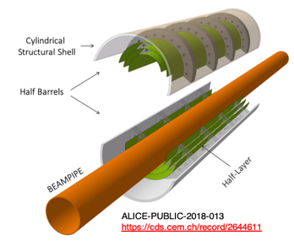
WP1– Silicon Tracker (BHM, BRU, LAN, LIV, OXF, STFC DL, STFC RAL)
Central tracking and vertexing
  Approximately 10 m² detector comprising vertex layers, barrel layers and disks
  65 nm MAPS technology driven by physics requirements and validated with simulations
  Proposed ITS3 sensor meets EIC needs
  Partnership with CERN minimises risk
  EIC will use same concept for vertex layers:
  Wafer-scale, stitched sensors, thinned and bent around the beam pipe
  EIC specific development needed for the barrel layers and disks:
  large area stitched sensor (not wafer scale), and “conventional” low mass support structures
ALICE-ITS3 development
ePIC-SVT Vertex and Barrel layers
ePIC-SVT Vertex layers

Slide 14
Project Delivery (Project Organisation)

Slide 15
Cost Estimation – WP1 – Definition of Tasks/Responsibilities

Slide 16
Cost Estimation – WP1 – Schedule

Slide 17
Gantt Chart

