Slide 1
EIC-UK WP1 Face-to-face Meeting
James Glover, Laura Gonella, Peter Jones, Stephen Maple, Li Long, Eve Tse
Wednesday, 28th June 2023

Slide 2
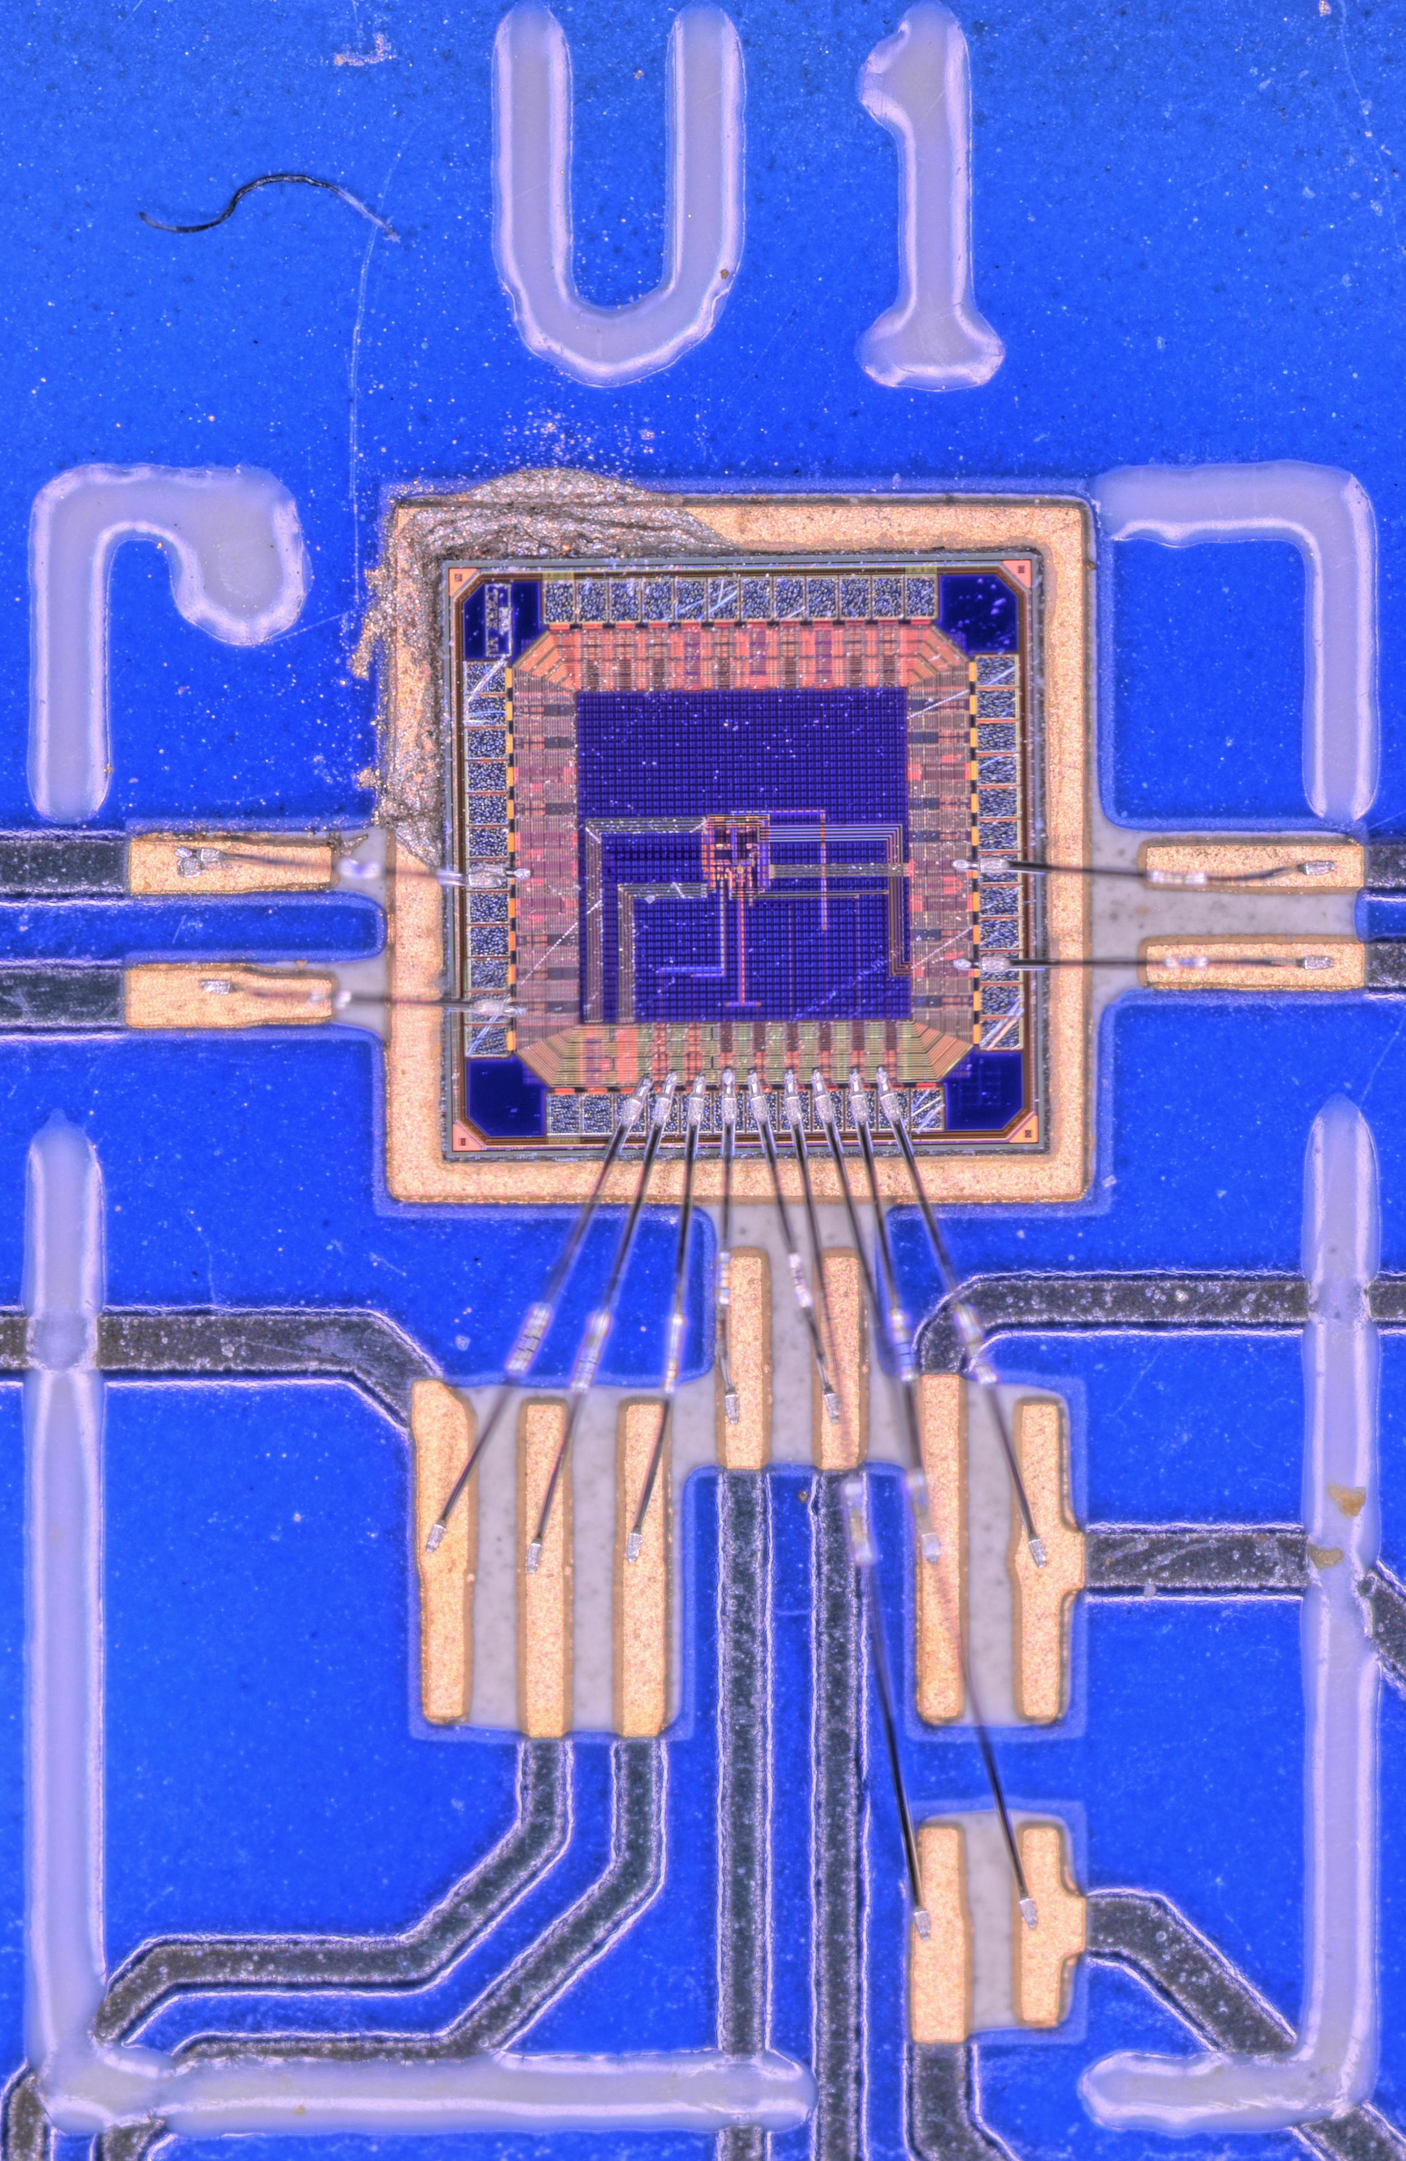
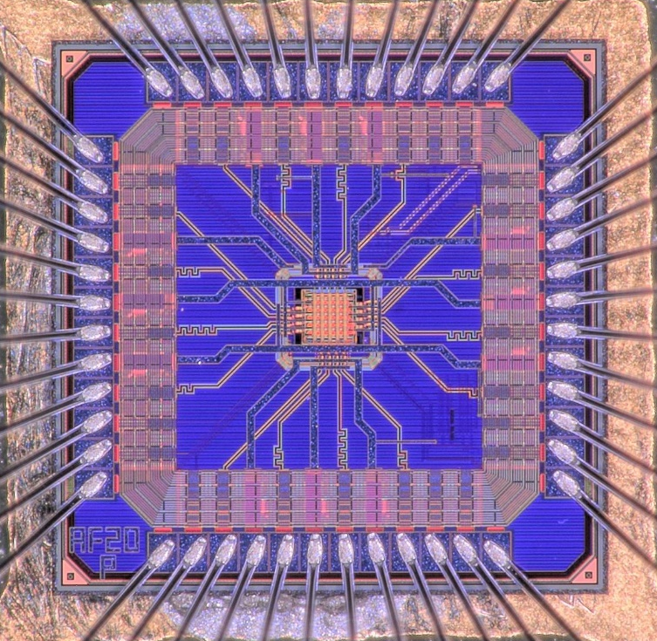
Recap: The last F2F
MLR1 APTS-SF DAQ system obtained & commissioned. – link (old EIC-UK WP1 indico area, not public)
MLR1 LVDS/CML test structures obtained, DAQ system commissioned (via Xilinx's Vivado suite). – link (old EIC-UK WP1 indico area, not public)
Mounting and wire bonding procedures set up
for both the above structures.
2

Slide 3
Since the last F2F
Birmingham has been 1 of 4 APTS-SF chip mounting/bonding sites (others being CERN, Strasbourg & Liverpool).
Characterising chips prior to mounting (resistance measurements, probed chips in GelPak).
  Minimises chip failures post-bonding.
Non-conductive chip mounting options (to reduce radiation length of test structures) have been explored in collaboration with CERN colleagues.
Test site for APTS-SF split 2 & 3 devices.
  Pulsing tests performed at B’ham, majority of Fe-55 testing performed at L’pool.
Contributed split 1, 2, 3 & 4 comparison plots to the pool of plots approved for publication by ITS3.
Options for serial powering scheme for the EIC-LAS.
Detector layout simulations.
3

Slide 4
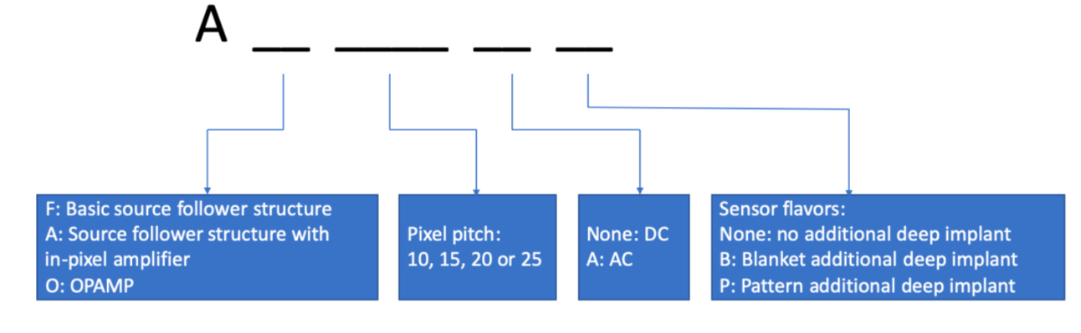
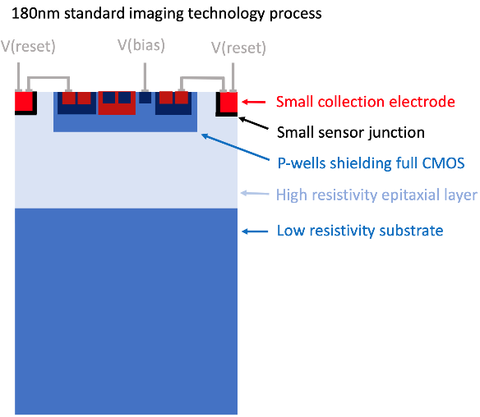
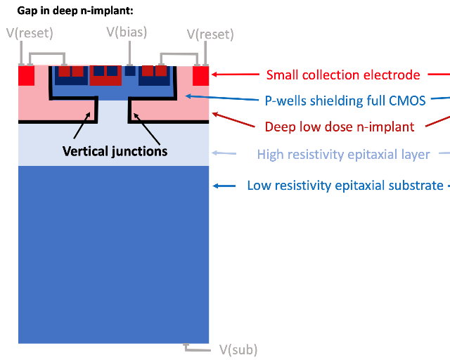
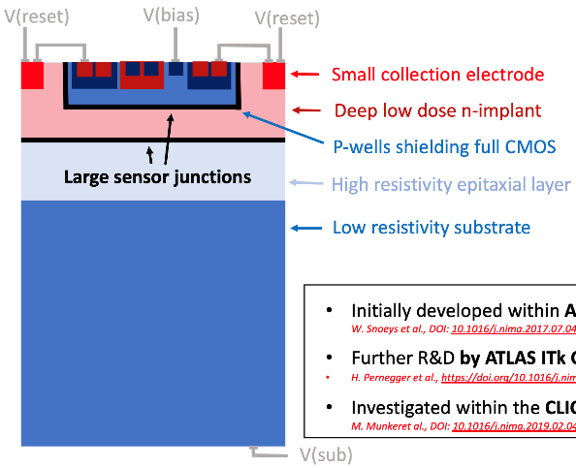
Characterisations of APTS - 1
MAPS constructed in 65nm CMOS technology.
3 APTS structures: F (source follower), A (in-pixel amp) & O (OpAmp).
4 pixel pitches (in 4×4 pixel array).
Both DC and AC coupled versions.
3 “flavors” of deep implant: None, B & P.
Additionally, there have been 4 different wafers (“splits”) with small variations to the doping of the P-well and N-implant.
APTS flavours:
None (standard type, no implant) B (blanket implant) P (patterned implant)
4

Slide 5
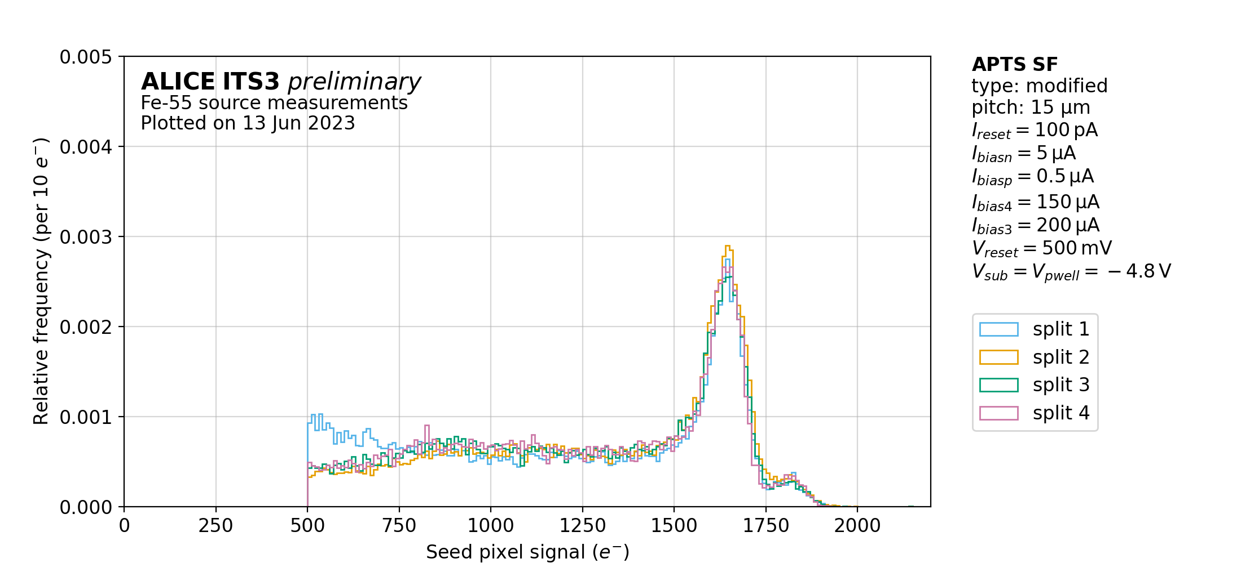
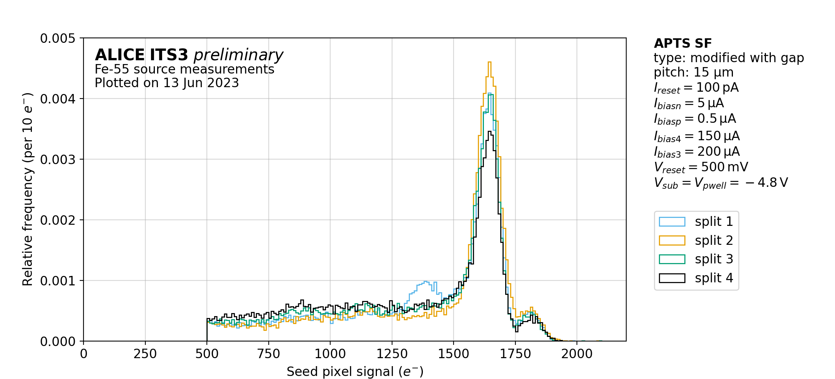
Characterisations of APTS - 2
Birmingham has investigated pitch, flavour and split variations of DC-coupled, source follower structures.
Plots approved for publication during ITS3 June ‘23 approval session.
AF15B (split comparison) AF15P (split comparison)
5

Slide 6
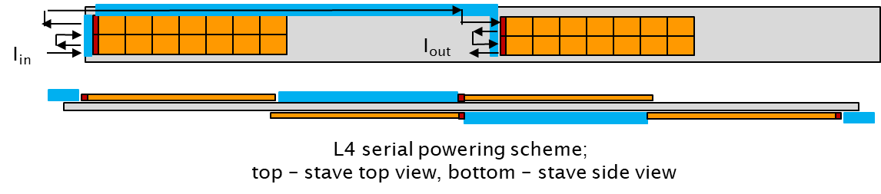
Serial powering
Serial powering scheme chosen as baseline for the ePIC SVT
  Provides lowest material option
Shunt-LDO placement on a dedicated powering chip outside the sensor
  Allows re-using of ITS3 sensor on-chip power distribution; Does not require modification of sensor periphery; Can be prototyped and fabricated in cheaper technology
Serial powering scheme drafted for sagitta layers
  Current flowing between sensor segments on each side of the stave
  Factor 4 current reduction for L4, factor 2 current reduction for L3
Number of sensor low voltage and bias cables estimated and provided to EIC project engineers for integration exercise
6

Slide 7
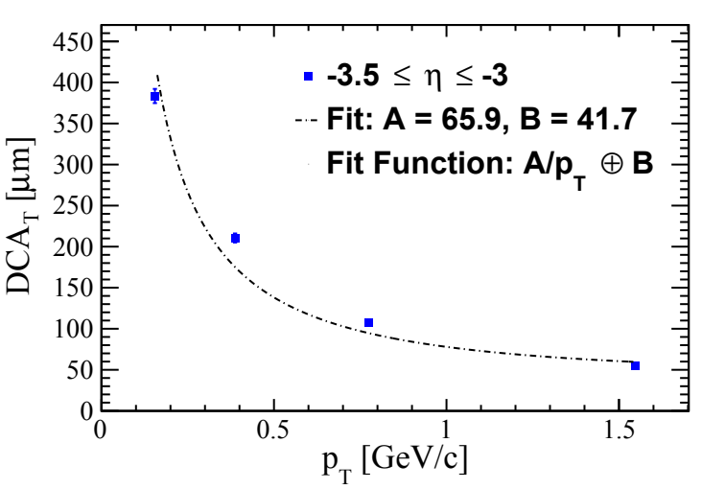
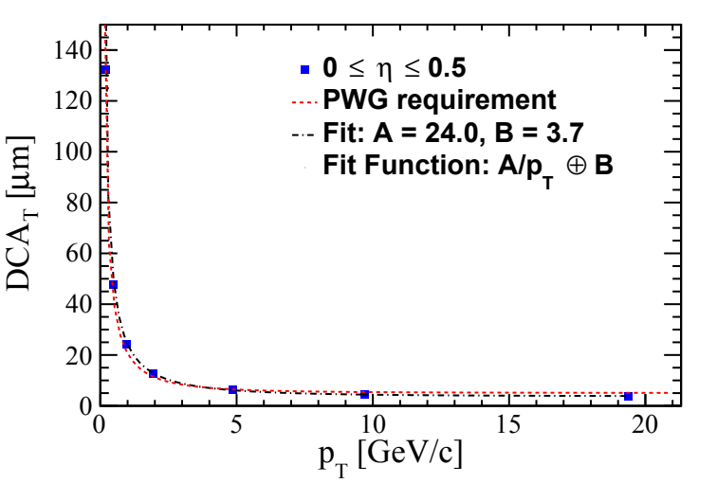
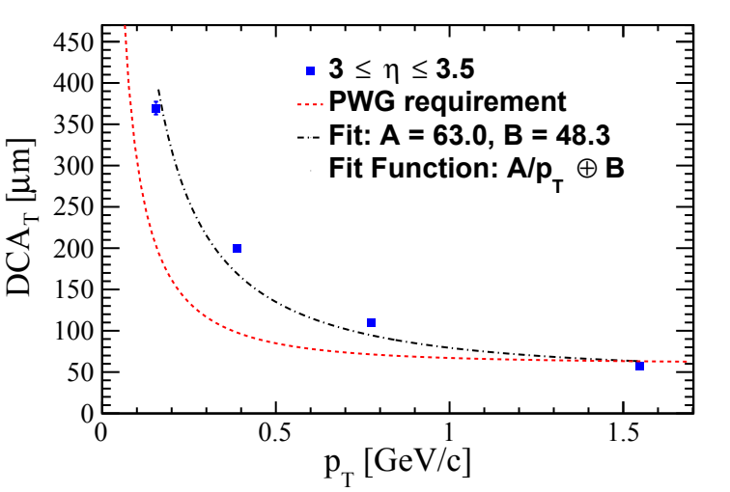
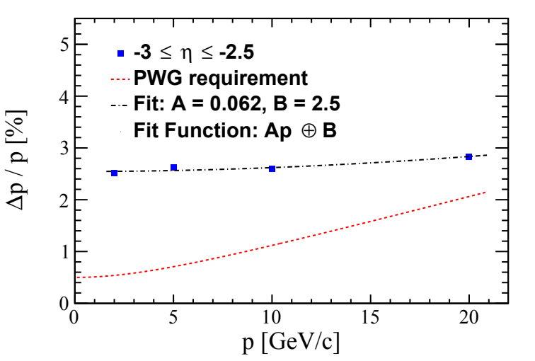
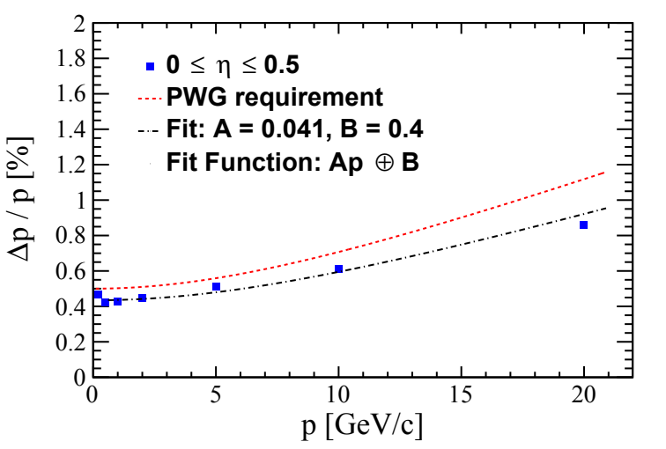
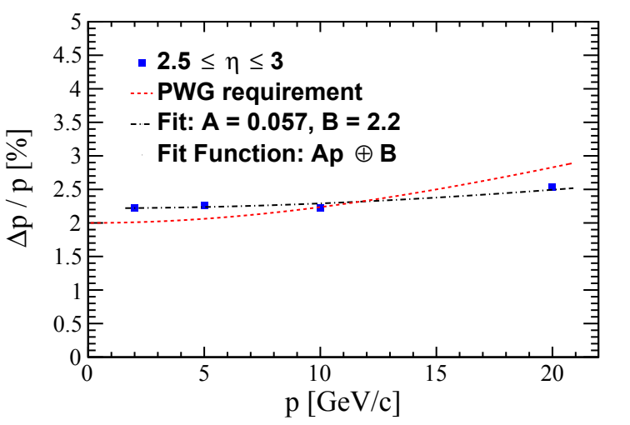
Detector layout simulations - 1
Parametrised momentum and vertex resolutions with ePIC tracker configuration*.
*Brycecanyon 22.11.2 (juggler)
7
Notes:
Brycecanyon 22.11.2 (juggler).

Slide 8
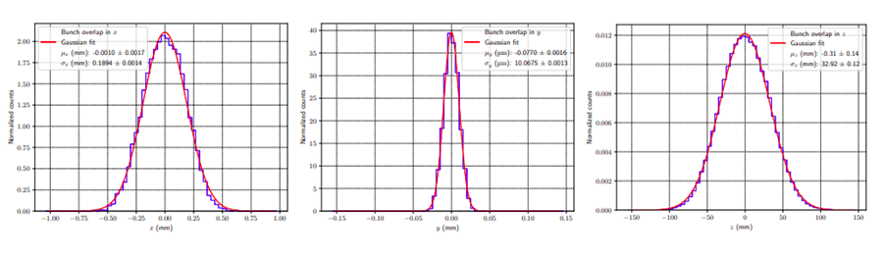
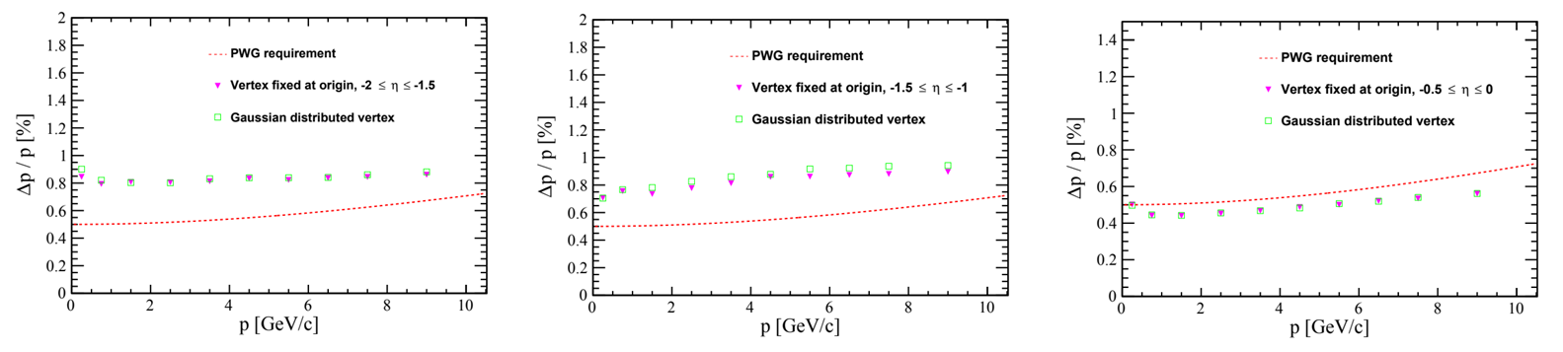
Detector layout simulations - 2
Study of beam spot effect on the tracking performance .
  Minimal degradation of momentum resolution in specific pseudorapidity intervals where particles traverse support material; no effect on the vertex resolution.
8
Notes:
Fun4all
Degradation is minimal but best to keep low

Slide 9
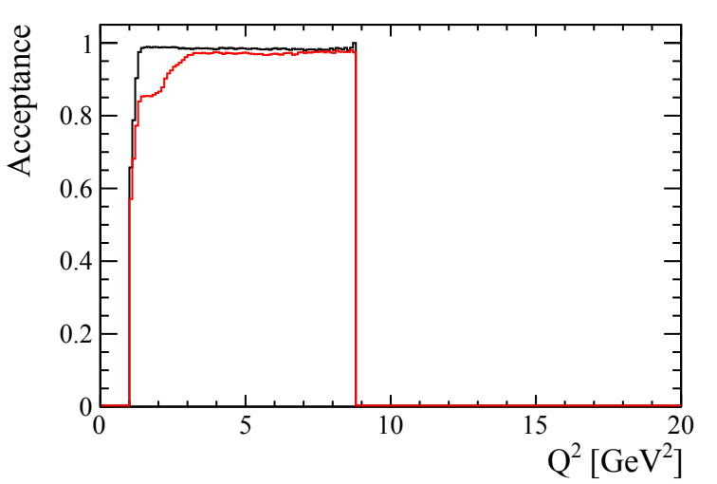
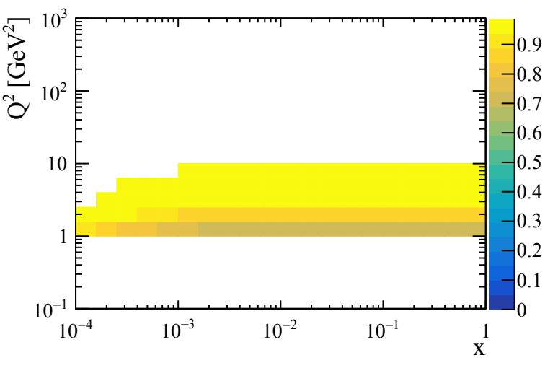
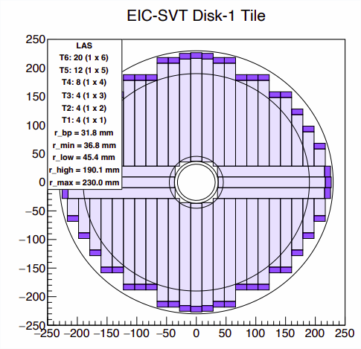


Detector layout simulations - 3
Study of acceptance at large eta.
Realistic disk design implemented in simulation.
Higher x lower Q² bins lose acceptance.
Acceptance > ~80% for all bins Q² > 1GeV² for 100% efficient disks.
Example of disk configuration in tiling study
95% efficient disks
Disk implementation in simulation
100% efficient disks
9

Slide 10
Detector layout simulations - 4
Study of barrel MPGD layer contribution to tracking.
  Different combinations of active silicon, MPGD and Time of Flight (TOF) layers.
  Momentum and vertex resolution fully defined by SVT, with small improvement by TOF layer; no recovery in performance with the MPGD layer active in case of failure of one silicon layer; barrel MPGD layer contribution in pattern recognition only.
10

Slide 11
Going forward – short term plan
Continue with MLR1 APTS-SF comparisons.
  Look at leakage current comparisons (already started).
Await ER1 chips.
  Offer to help with chip mounting/wire-bonding again.
  Commission ER1 DAQ set-up.
Await ER1 RAL LVDS/CML test structures.
  Again, happy to help mounting, bonding and testing.
    Is KCU105 still to be used as the PRBS generator?
Continue with conceptualisation of serial powering scheme.
  Focus on Outer Barrel Layers (UK focus) but will also consider options for the disks.
  Added complexity with the ER2 design confirmation of power required on both left and right endcaps.
Detector layout simulations to continue/develop.
11

Slide 12
Going forward – final R&D and construction
Areas where B’ham wants to contribute:
Sensor characterisation:
  ITS3 ER2 and ER3
  EIC LAS v1 and v2
  Production testing QC/QA (incl. wafer probing)
Modules (an assembly of sensors on an FPC):
  Prototypes: assembly & testing
  Pre-Production: assembly & testing
  Production: assembly & testing (QC/QA)
Tooling:
  Module assembly tooling: prototypes, pre-prod, prod
Powering (SP = Serial Powering):
  Regulator characterisation
  Data and grounding schemes development
  Current source development and testing
  Prototypes SP chain testing
  Pre-production SP chain testing
  Production SP chain validation
DAQ (SW/FW/HW needed for testing of various objects) – in connection to SP:
  Electrical staves: prototype testing
  Electrical staves: pre-production testing
  Electrical staves: production testing
  L3 and L4 testing (after integration)
12

Slide 13
Additional slides
13

