Slide 1
Oxford ePIC Activities
Babak Abi, Claire Gwenlan (EIC inclusive physics working group convenor), Sam Henry, Todd Huffman, Georg Viehhauser (WP1 coordinator), Roy Wastie,

Slide 2
Oxford Funding
Oxford not on current UKRI Preliminary Infrastructure Fund
But we will be granted access the bridging funds from middle ‘24
We need to get funding from now until next year
We have applied for 50k£ from the Oxford-internal John Fell Fund
Funding for engineering effort, no equipment/material
Decision should be published within the next two weeks
We will also ask for about 50k$ from ePIC eRD/PED proposals
UK has been part of these for a few years, but so far contributions have been in-kind, first time we ask for money
We are in the process of writing this
Once this is on the way we will try to also obtain funding through one of the Oxford colleges

Slide 3
Planned work on mechanics/integration
The next step is clarifying system requirements/specifications
Once this is done we would like to start developing a concept for the local supports of the outer tracker (L3 and L4)
Too early to discuss a specific design, but we want to explore beyond an ALICE-type truss structure
Allow for gas cooling
Compatibility with service connections on both ends of a sensor and more than one sensor along the length of one L4 local support
Not likely to be workable, but still want to think a bit about the potential use of inclined (in η) modules
Then think about the global support for the outer tracker
This should achieve a compact system that allows for transport of the outer tracker to BNL
All that will include service management (including DSBs)

Slide 4
Planned work on Serial Powering/DAQ
Potential projects of interest
Serial powering
Al bus/signal tapes
Will multi-drop Command, Clock, and Control be needed?
VTRx or other optical systems
Huffman, Weidberg part of original development team
Radiation qualification – (If needed)
System tests in concert with services and supports

Slide 5
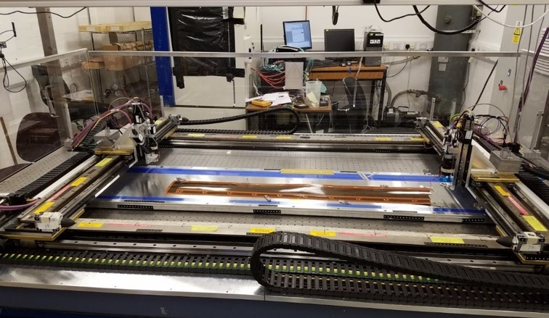
Planned work on Serial Powering/DAQ
Understand current design thinking and requirements documentation
Lab Bench is being prepared
Electron beam (Oxford)
Bus tape qualification robot
Engineers (P. Hastings, R. Wastie) and Post-doc (Babak Abi) already interested.
Department supported for the moment
What we would like short term:
Something to start working with
LDO shunt regulators to test
Sensor signal systems (if makes sense)

Slide 6
Background simulation - aims
Estimate radiation fluence in silicon detector to assess radiation hardness requirements
Set up software to allow radiation simulations to guide further detector work
Build expertise in running simulation code Oxford to provide student projects and further contributions to ePIC

Slide 7
Background simulations - strategy
Simulate particle production from e + p collisions using Pythia 6 (Pythia 8 not complete for e + p)
Simulate further interactions and particle production in ePIC detector using geant 4
All possible using EIC software available through singularity shell with documented tutorials
Further contributions to background:
Beam gas interactions
Synchrotron radiation

Slide 8
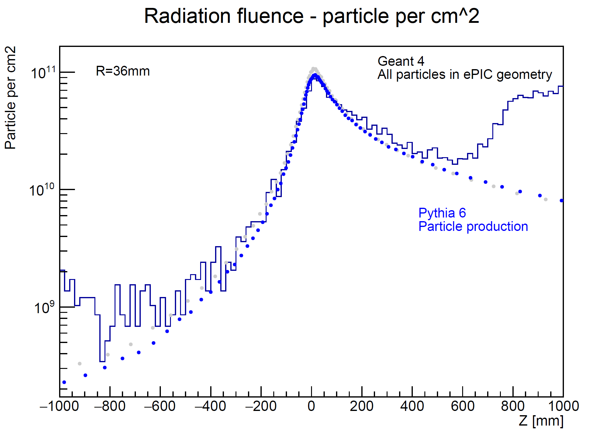
Background simulations - results
Preliminary

Slide 9
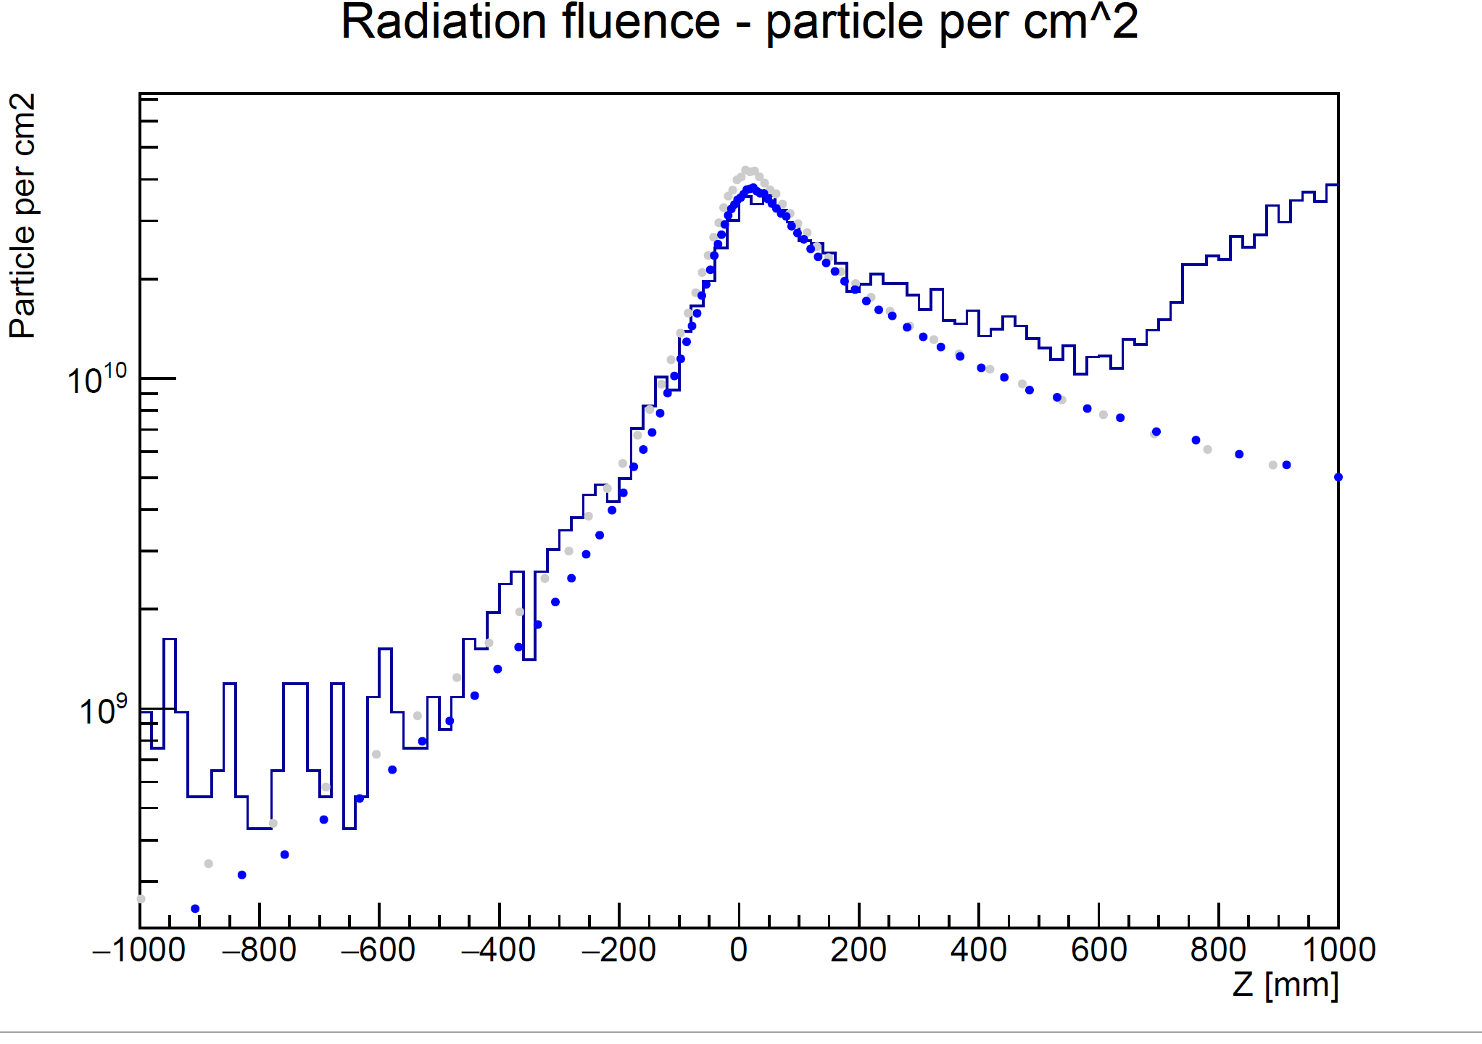
Background simulations - results
Preliminary
R=57mm
Geant 4
Pythia 6

Slide 10
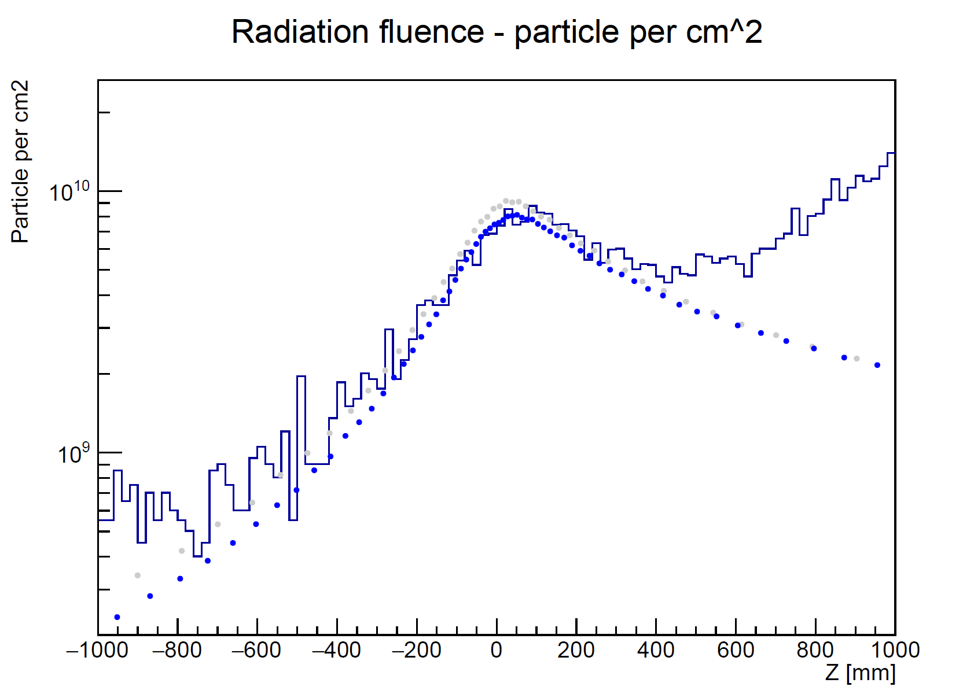
Background simulations - results
Preliminary
R=123 mm
Geant 4
Pythia 6

Slide 11
Background simulations – next steps
Include beam gas interactions
Use input files from collaboration?
Synchrotron radiation simulations
Synrad+ ?
What other parameters are useful?
Neutron flux? Radiation dose?
Understand uncertainty on key parameters
Total e+p cross section
Summer student starting 3 July

