Slide 1
Agenda
(https://indico.bnl.gov/conferenceDisplay.py?confId=1990)
Low field Test Analysis from Bob Lambiase et. al.
Force variations at various currents (1 slide)
High-Field Test
Bob’s plan/steps
Disconnecting the Valvebox etc. and building the basement (see Dave’s location diagram)
AOB

Slide 2
MT01 ~29 K and
Sonny switched off the 1A power supply
MT01 ~10 K
Jump from superconducting to normal conducting ~1.5 mV at 1 A
1.5 mΩ
Measured last Apr. (2015), total resistance ~ 2.53 Ω
⇒ RRR ~ 2.53 × 1000 / 1.5 ~ 1687 .

Slide 3
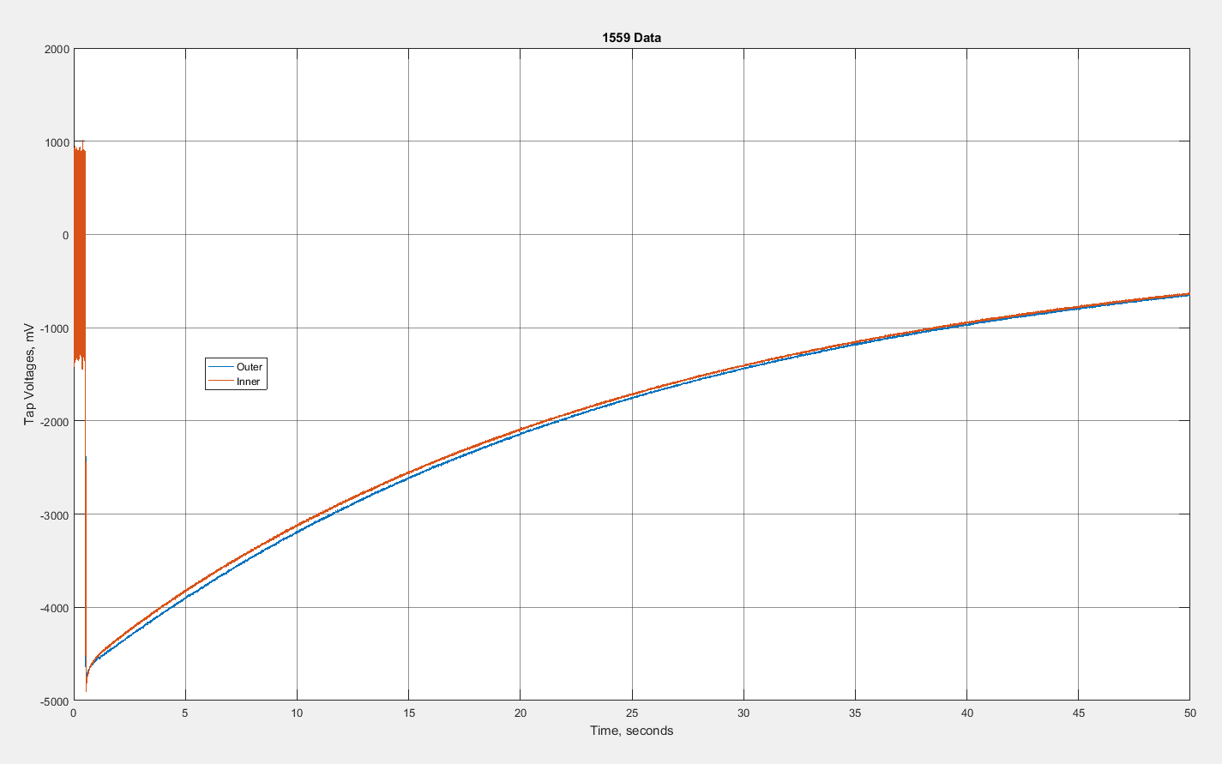
~e^{-t/τ} , τ = L/R

Slide 4
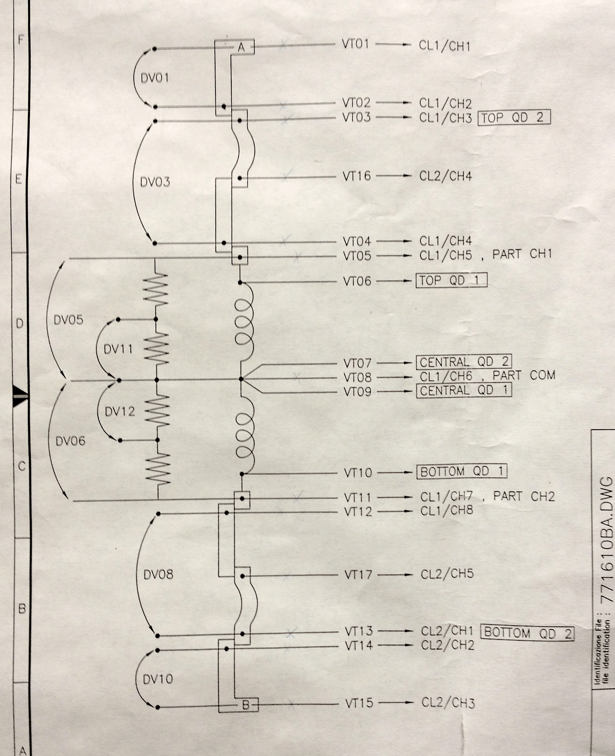
Outer VT 6-7
Inner VT 9-10
Total VT 6-10

Slide 5
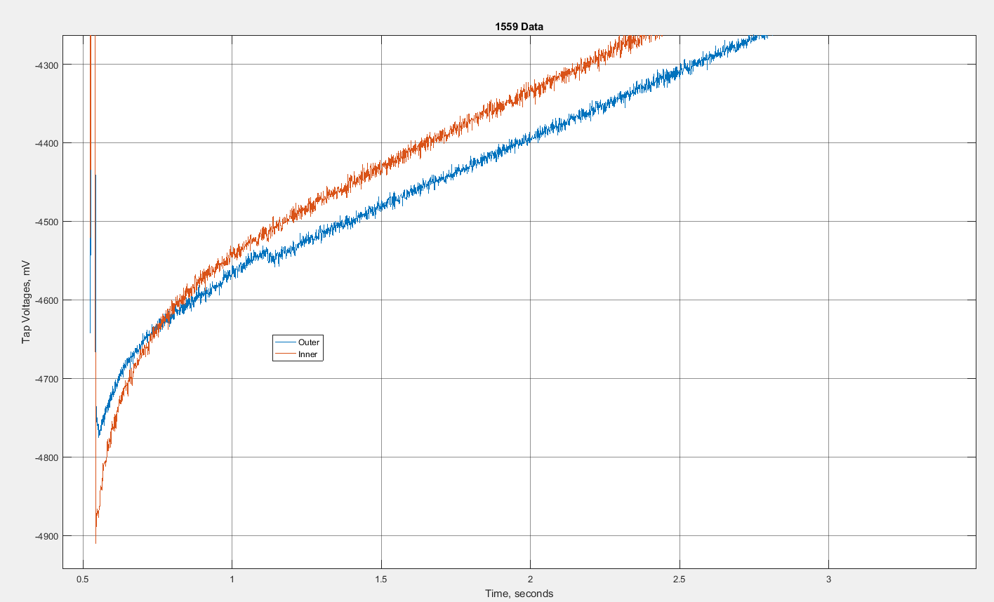

Slide 6
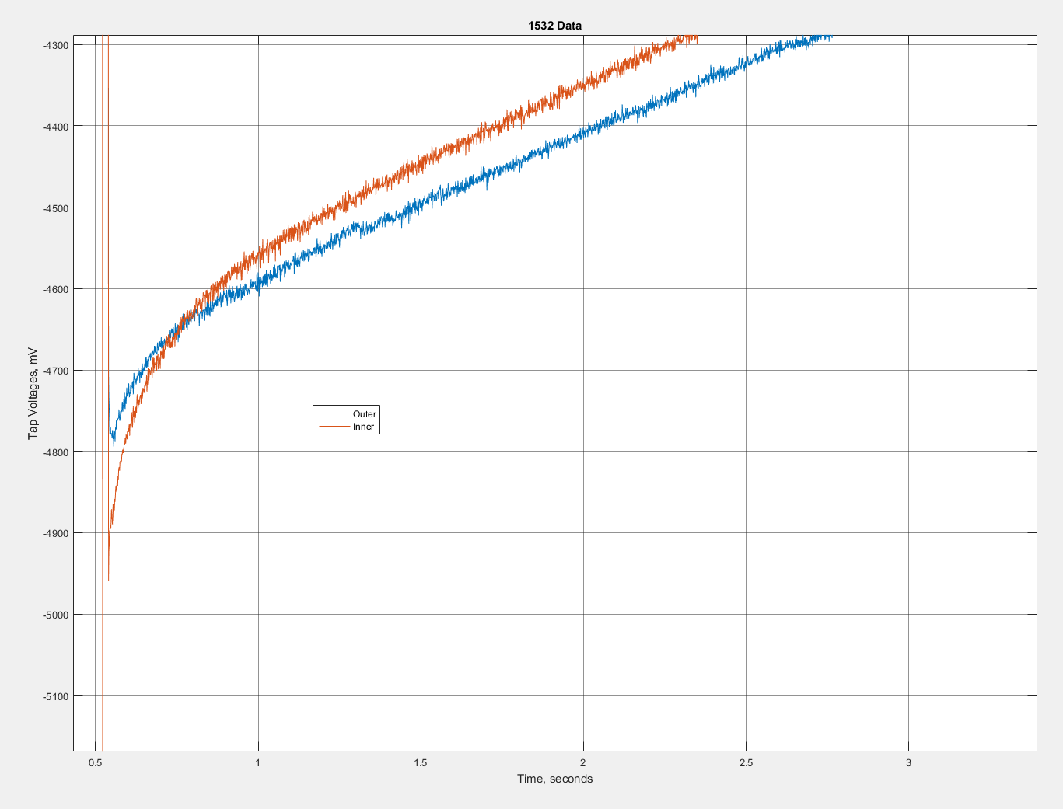
A different one

Slide 9
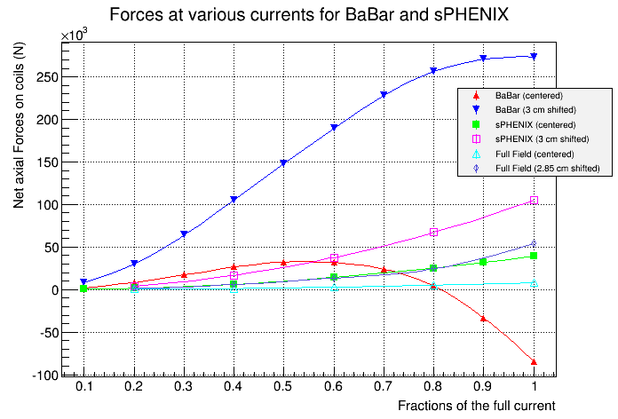
I’ve added the Full Field Test Model (Wuzheng’s ) at various currents.
Walter Sondheim has also made Opera models for sPHENIX/Full-Test at full current (with or without asymmetry). Probably, those shifts towards the non-lead end are more useful ….

Slide 10
Bob Lambiase’s steps for power supply :
Determine the costs to make the system and make those funds available
Purchase all the hardware (Zeynep A.)
Document fully the software present in the existing system, so it can be understood by C-AD
Understand the results gathered by the 100 Amp test and make modifications, if necessary.
Assemble and wire together the new system and its interface to the solenoid
Interface the new system with the upgraded 4.6kA power supply and energy extraction system
Test everything.
Now, we also have P. Rosas / Carl Schultheiss / Zeynep Altinbas (in C. Theisen’s group) to help us with the power supply and the DAQ/Quench Detection.

