Slide 1
The INFN Computing Infrastructure
Streaming Computing Model WG Meeting

Slide 2
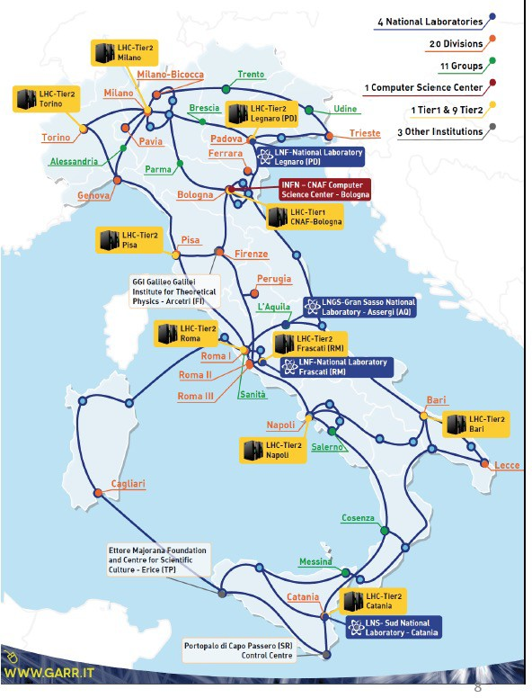
INFN and Computing / Big Data
A long tradition in state-of-the-art distributed IT technologies and solutions, from the first small clusters to Grid and Cloud-based computing.
INFN operates Grid and Cloud services based on its own:
9 medium size centers
1 large national center, at CNAF (Bologna) – with an area certified ISO/IEC 27001, 27017, 27018
All the INFN centers are connected through 10-100 Gbit/s dedicated links via the GARR network.
Collectively, our distributed infrastructure currently offers about 140,000 CPU cores, 120PB of enterprise-level disk space, 100PB of tape storage.

Slide 3
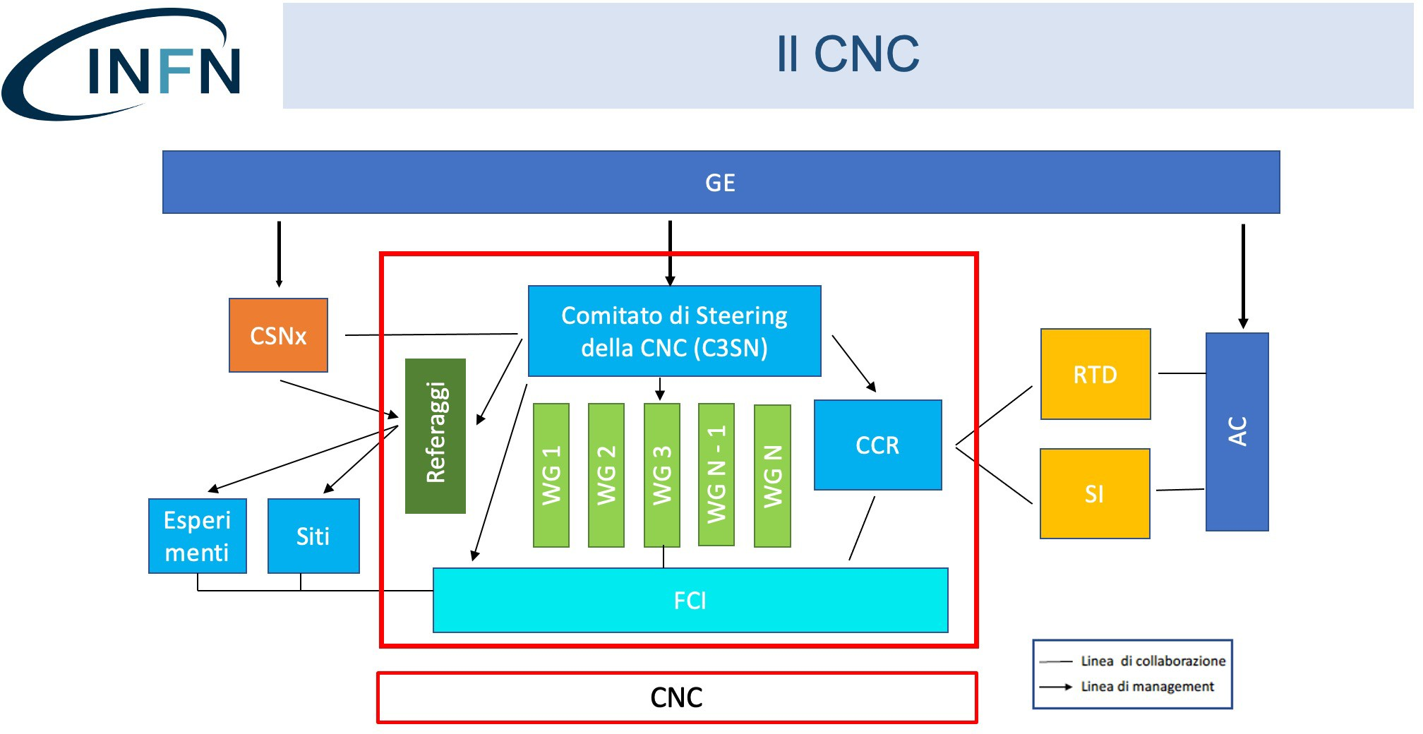
The New INFN Computing Structure
One of these WGs is the WG Infrastruttura, extending and evolving the current INFN Cloud project.

Slide 4




The WG Infrastruttura (Infrastructure)
WG Infrastruttura
WG Progetti
WP1: Operations
WP2: User & Project Support
WP3: Resources, Data Lake, Sustainability
WG HPC
WG Nuove Tecnologie
WP4: Security, Policies
WP5: Middleware, New services
WP6: R&D, Testbed, Use cases
Altri WG
External activities (DOMA,
WLCG AuthZ, etc.)
WP7: Integrated management systems and Legal Compliance

Slide 5
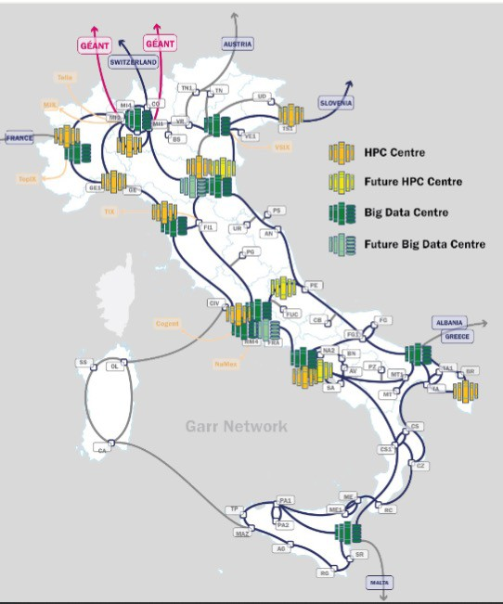

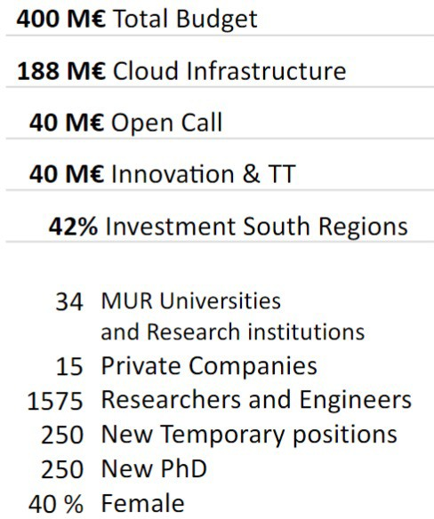



The Cloud national infrastructure for supercomputing
7

Slide 6
Main drivers for the next 10 years of SC
Infrastructure
Renew infrastructures to be ready for the High Luminosity-LHC (HL-LHC) era, up to ~2035 or more
Use more compact computing (from today’s ~20 kW/rack to 80 or more)
Lower the PUE (power usage effectiveness), be greener
Extend and expand networking for a future-proof infrastructure
Foster and simplify the utilization of more viable technologies (Eur/task or J/task), like GPUs, FPGA, ... down to Quantum when available
Be more efficient, elastic and resilient
Pervasive use of geographically distributed storage (“the datalake”)
Abstract from physical machines, and form a national pool of resources and services (“the Cloud”)
Extend elastically to external providers such as HPC@CINECA or other cloud providers (via “dynamic federations”)

Slide 7
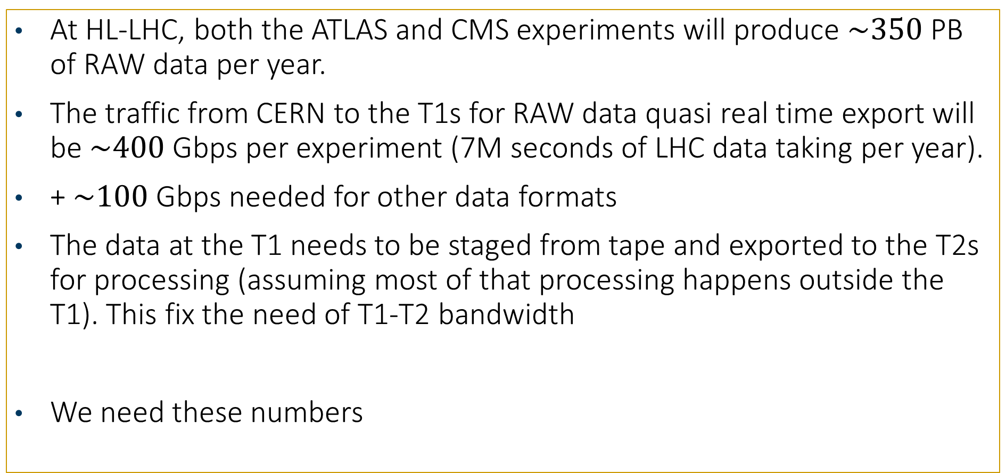
RAW DATA mirroring for HL-LHC (as example)
At HL-LHC, both the ATLAS and CMS experiments will produce $\sim 350$PB of RAW data per year.
The traffic from CERN to the T1s for RAW data quasi real time export will be $\sim 400$Gbps per experiment (7M seconds of LHC data taking per year).
+ $\sim 100$Gbps needed for other data formats
The data at the T1 needs to be staged from tape and exported to the T2s for processing (assuming most of that processing happens outside the T1). This fix the need of T1-T2 bandwidth
We need these numbers

