Slide 1
EIC-UK WP1 Serial Powering Thoughts
James Glover
Wednesday, 19th July 2023

Slide 2
Previous serial powering thoughts
As mentioned at the Liverpool F2F and previous ePIC SC meetings:
Serial powering scheme chosen as baseline for the ePIC SVT.
Provides lowest material option.
Shunt-LDO placement on a dedicated powering chip outside the sensor.
Allows re-using of ITS3 sensor on-chip power distribution; Does not require modification of sensor periphery; Can be prototyped and fabricated in cheaper technology.
Serial powering scheme drafted for sagitta layers (prior to ITS3’s ER1 delivery).
Current flowing between sensor segments on each side of the stave.
Factor 4 current reduction for L4, factor 2 current reduction for L3.

Slide 3
ER1 made things more complicated
It was previously assumed that a wafer-scale, stitched sensor would have a single periphery (endcap) for all power and data connections.
This turned out not to be the case; IR-drop across wafer diameter is too great.
A 2nd endcap is needed to power repeated sensor units (RSUs) from both ends (only account for IR-drop across half the RSUs). Data still be read from 1 endcap.
From Gianluca’s ITS3 Upgrade slides

Slide 4
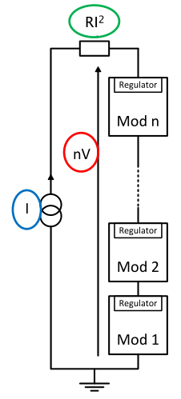
Things to remember.
From Gianluca’s ITS3 Upgrade slides
Serial powering (SP) requires all modules in the SP chain to have a different ground reference to the other modules in the chain (GND of Mod_{N} becomes V_{in} of Mod_{N+1}), with only the final module in reference to the power supply ground.
Each RSU in the MOSS is not electrically isolated, therefore the whole MOSS must have the same GND reference.
∴ The 2 endcaps cannot be in series to each other!
How do you get power to both endcaps (in a SP scheme)?
From Laura’s EIC SC slides

Slide 5
What may be easiest
Including half the RSUs per stitched sensor segment would remove the need for 2 endcaps.
May need to include more segments in a single SP loop to keep material low.
However:
Segments are not long enough for current layout plans.
L0, L1 & L2 would require 2 of these segments; L3 needs 4 segments; L4 needs 8 segments.
This doubles the data connections as fewer RSUs are read-out as one segment.
The power+data endcap is bigger the only power endcap.
∴ 2 “half” segments are longer then 1 “full” segment. Is the wafer real-estate big enough the keep the at least as many RSUs on one wafer?
~14 cm

Slide 6
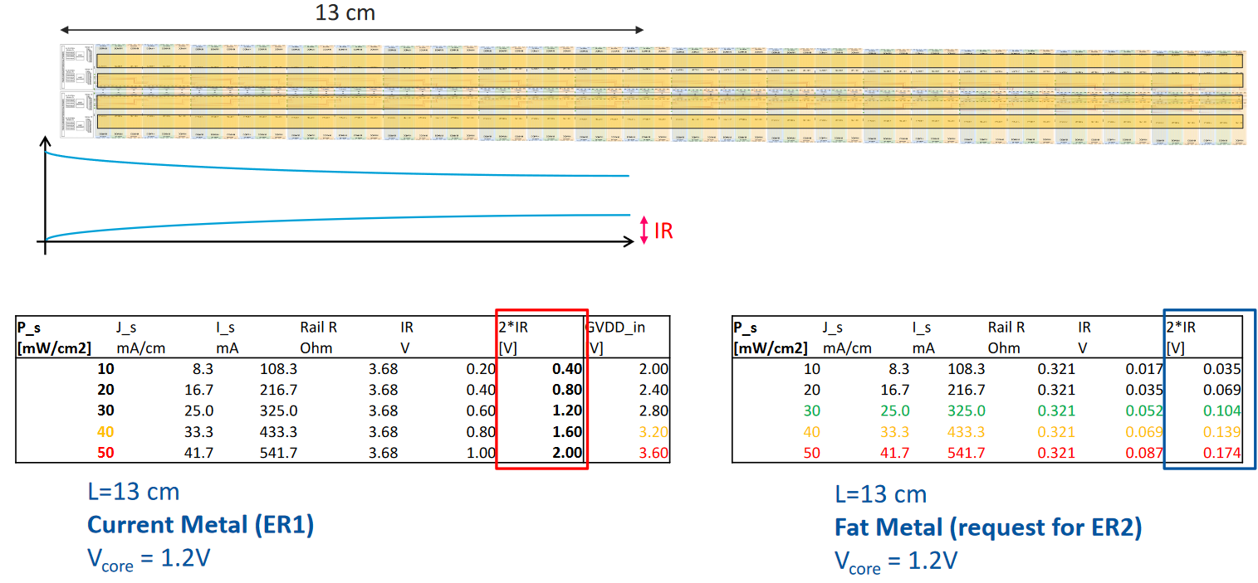
Additional considerations
SUPPLIES
SEGMENT
RSU
SUPPLIES
I/Os
The design for ER2 keeps changing. As of last ITS3 plenary (30/06/2023):
Number and dimensions of RSUs; now 12 RSUs of 19.564×21.666 mm.
Endcap depth also changes; Left endcap now 4.5 mm and Right endcap is 1.5 mm.
May require extra fat metal traces to reduce IR-drop further (extra, nonuniform material within the segment, not such a SP issue).
From Gianluca’s ITS3 Plenary slides

Slide 7
ePIC – Oxford Serial Powering update
B. Todd Huffman

Slide 8
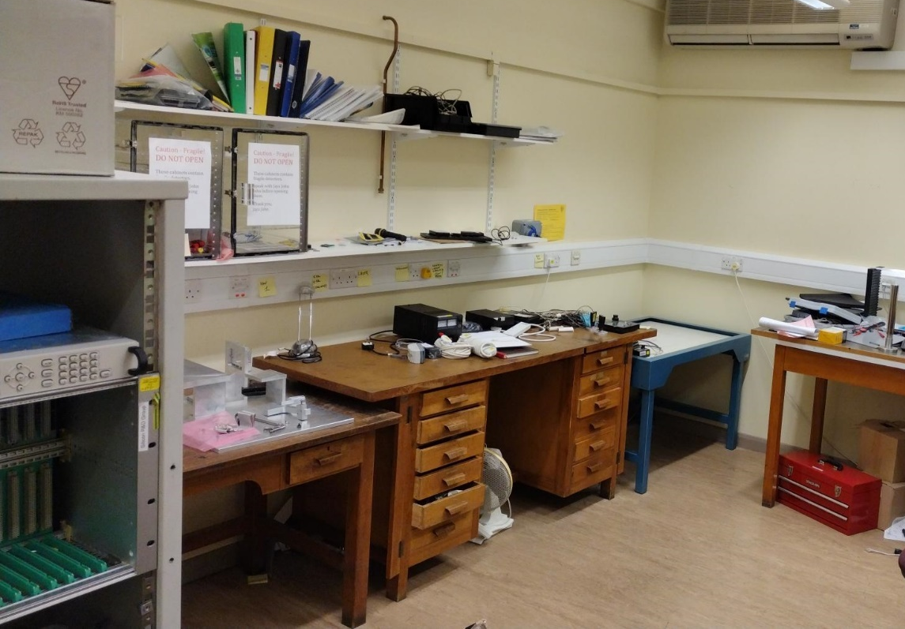
Serial powering test lab
Lab is close to ready
Not a clean room
Bench and rack and power supplies
Some items to be removed (and moved … next week)
New Computer
Test controls of power supplies (three weeks?)

Slide 9
Other items
Babak and I to meet with Soniya Matthews at RAL 9 August
Purpose
Get lessons on Shunt-LDO regulator design
Understand schedule
Establish test plan that makes sense and fits with the project.
Get work for our Engineers that we can fire up the moment we obtain some funding!!!
Beg for anything we can get!

Slide 10
Additional slides

Slide 11
Lots of extra info from the 30th June plenary
Many things relating to the current state of the ER2 design will have an effect of the EIC-LAS design.
Not just relating to serial powering!
It is highly recommended that people have a look through Gianluca’s slides:
https://indico.cern.ch/event/1298672/contributions/5460852/attachments/2676382/4641778/20230630-WP2-Report.pdf

