Slide 1
EIC Project Detector – Welcome and Overview
Elke-Caroline Aschenauer (BNL) Rolf Ent (JLab)
Co-Associate Directors for the Experimental Program
5th & 6th of July 2023

Slide 2
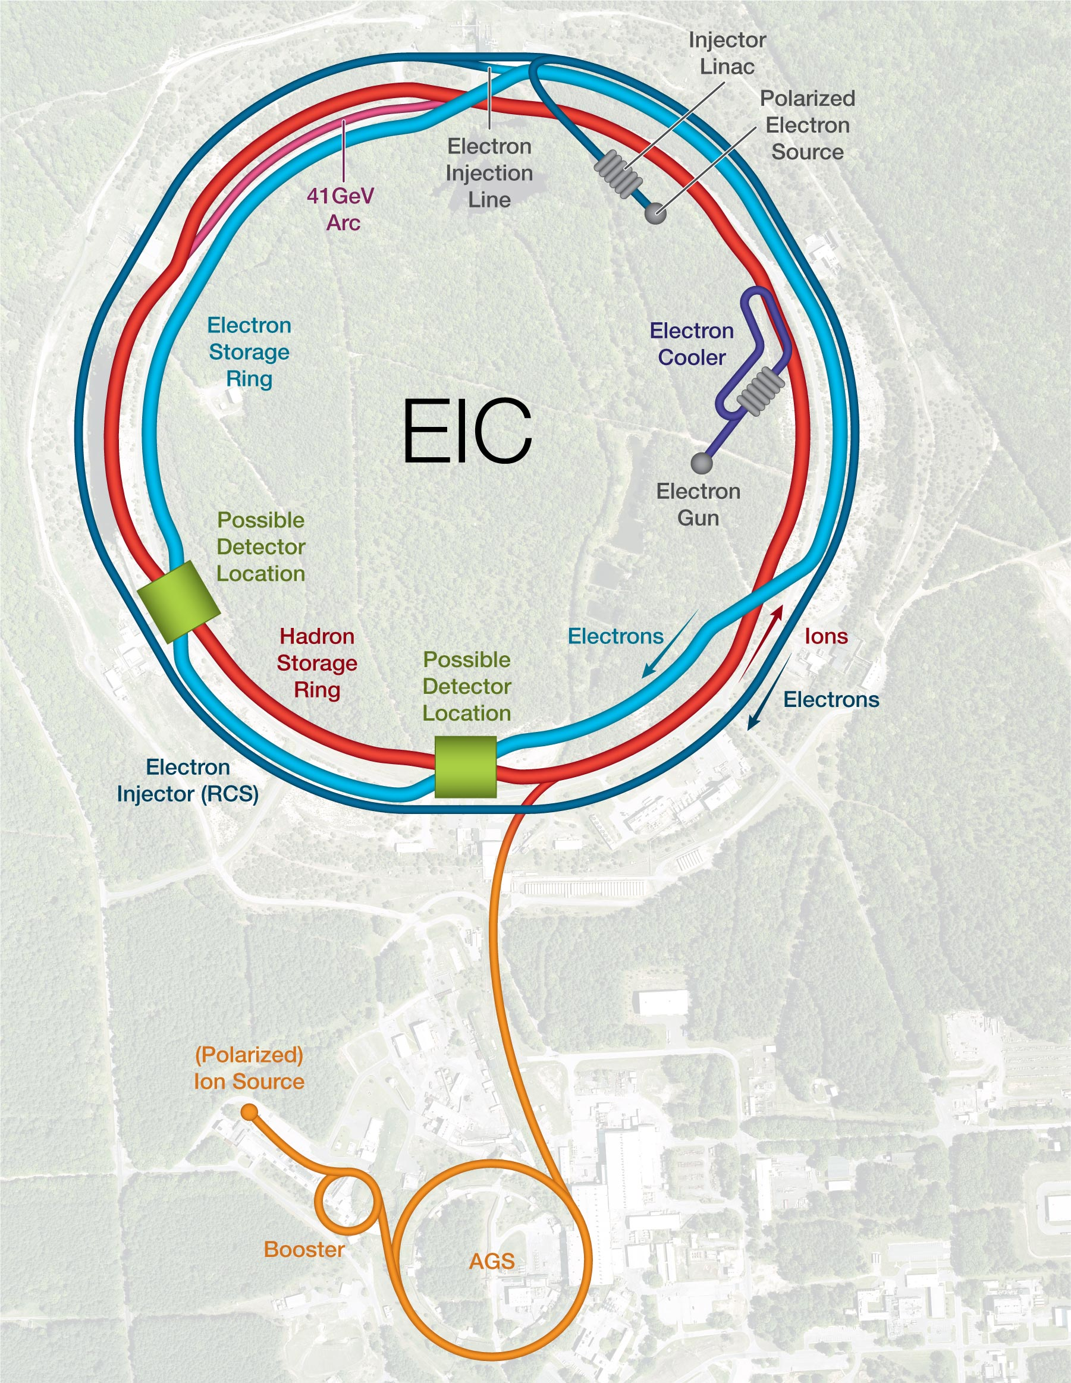

What is the EIC Facility?
What is the EIC:
A high luminosity (10³³ – 10³⁴ cm⁻²s⁻¹) polarized electron proton / ion collider with √s_{ep} = 28 – 140 GeV
What is special:
EIC is the ONLY new collider in foreseeable future. Allows to remain at frontier of Accelerator S&T.
factor 100 to 1000 higher luminosity as HERA
both electrons and protons / light nuclei polarized,
nuclear beams: d to U
Fixed Target Facilities i.e.:
at minimum > 2 decades increase in kinematic coverage in x and Q²
Science Program: An EIC can uniquely address three profound questions about nucleons — neutrons and protons — and how they are assembled to form the nuclei of atoms:
State of the art general purpose collider detector
Possible
2nd Detector
Location
IR-8
Project
Detector
Location
IR-6

Slide 3
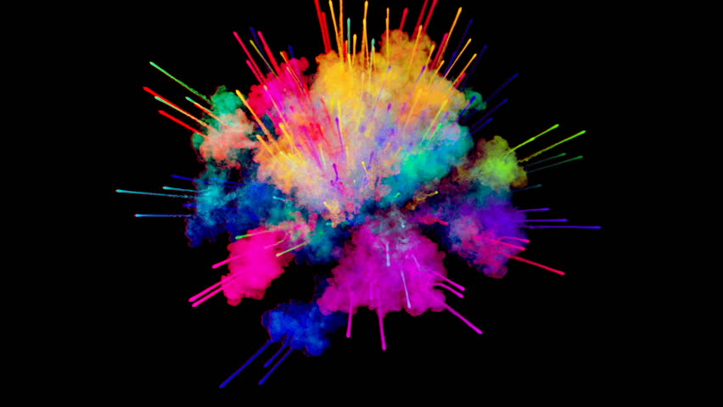
High Level EIC Scope
Project Design Goals
High Luminosity: L= 10³³ – 10³⁴cm⁻²sec⁻¹, 10 – 100 fb⁻¹/year
Highly Polarized Beams: 70%
→ requires high precision polarimetry
Large Center of Mass Energy Range:
E_{cm} = 29 – 140 GeV
→ Large Detector Acceptance
Large Ion Species Range: protons – Uranium
→ Requires forward detectors integrated in beam lattice
Good Background Conditions
Accommodate a Second Interaction Region (IR) → IR-8
Possible
2nd Detector
Location
IR-8
Project
Detector
Location
IR-6
p/A beam
e beam
p: 41 GeV, 100 to 275 GeV
e: 5 GeV to 18 GeV

Slide 4
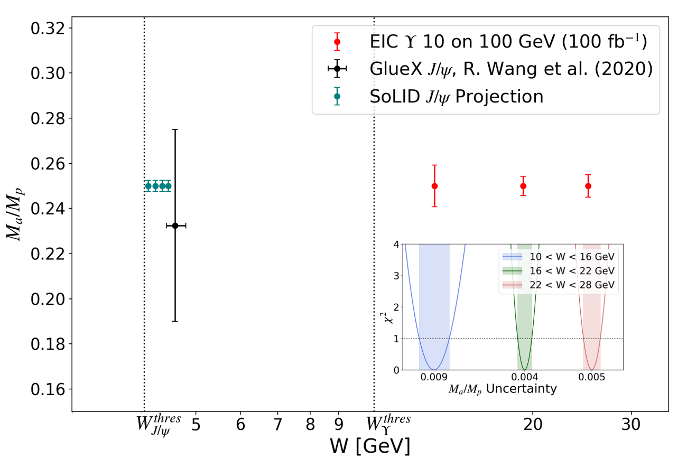
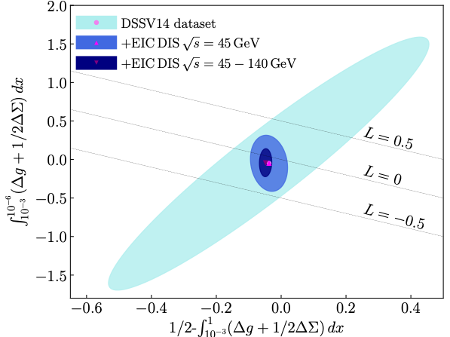
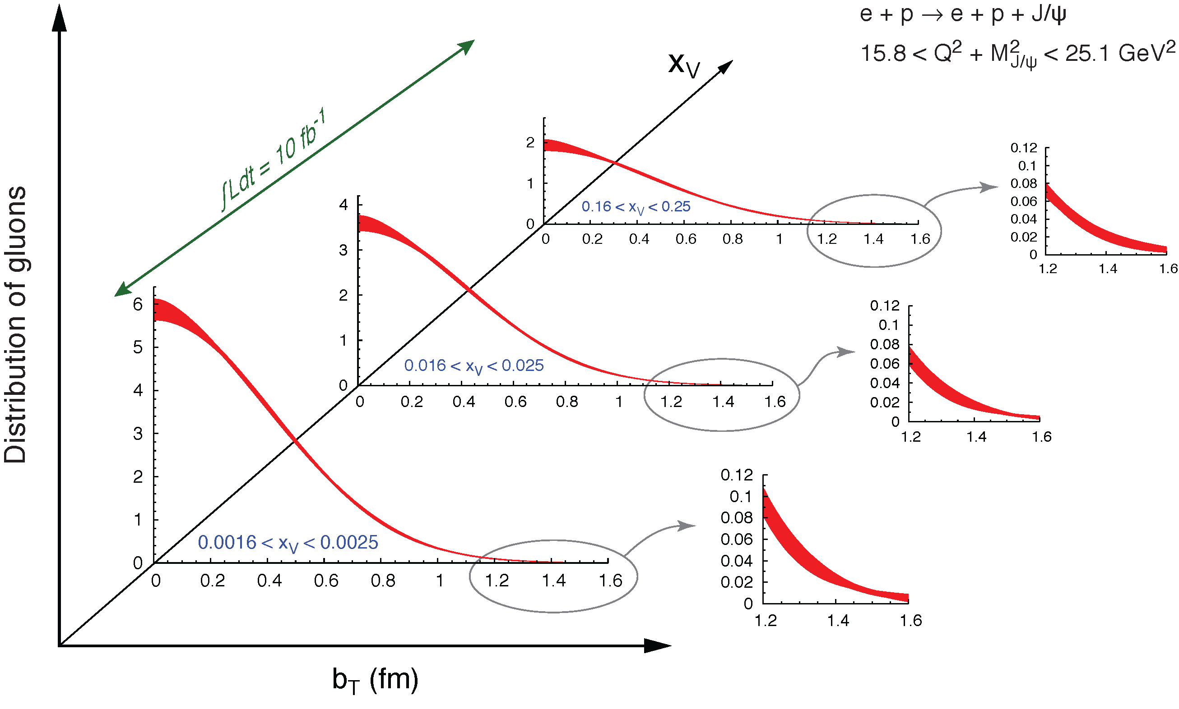
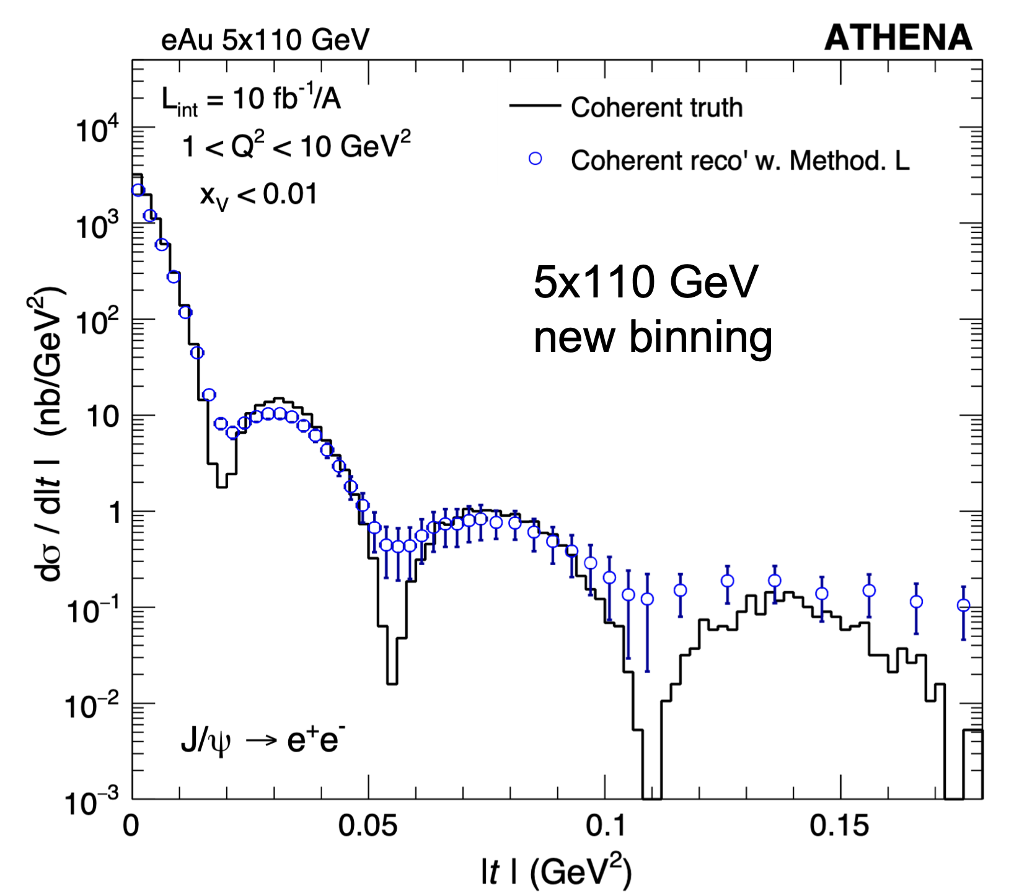
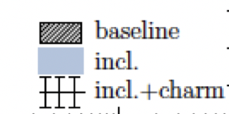
EIC Science Highlights
Proton:
momentum
space
3d-Imaging
coordinate space
Mass
Spin
Nuclei:
3d-Imaging
of nuclei
nPDF
√s < 90 GeV
non-linear QCD effects
→ Saturation

Slide 5
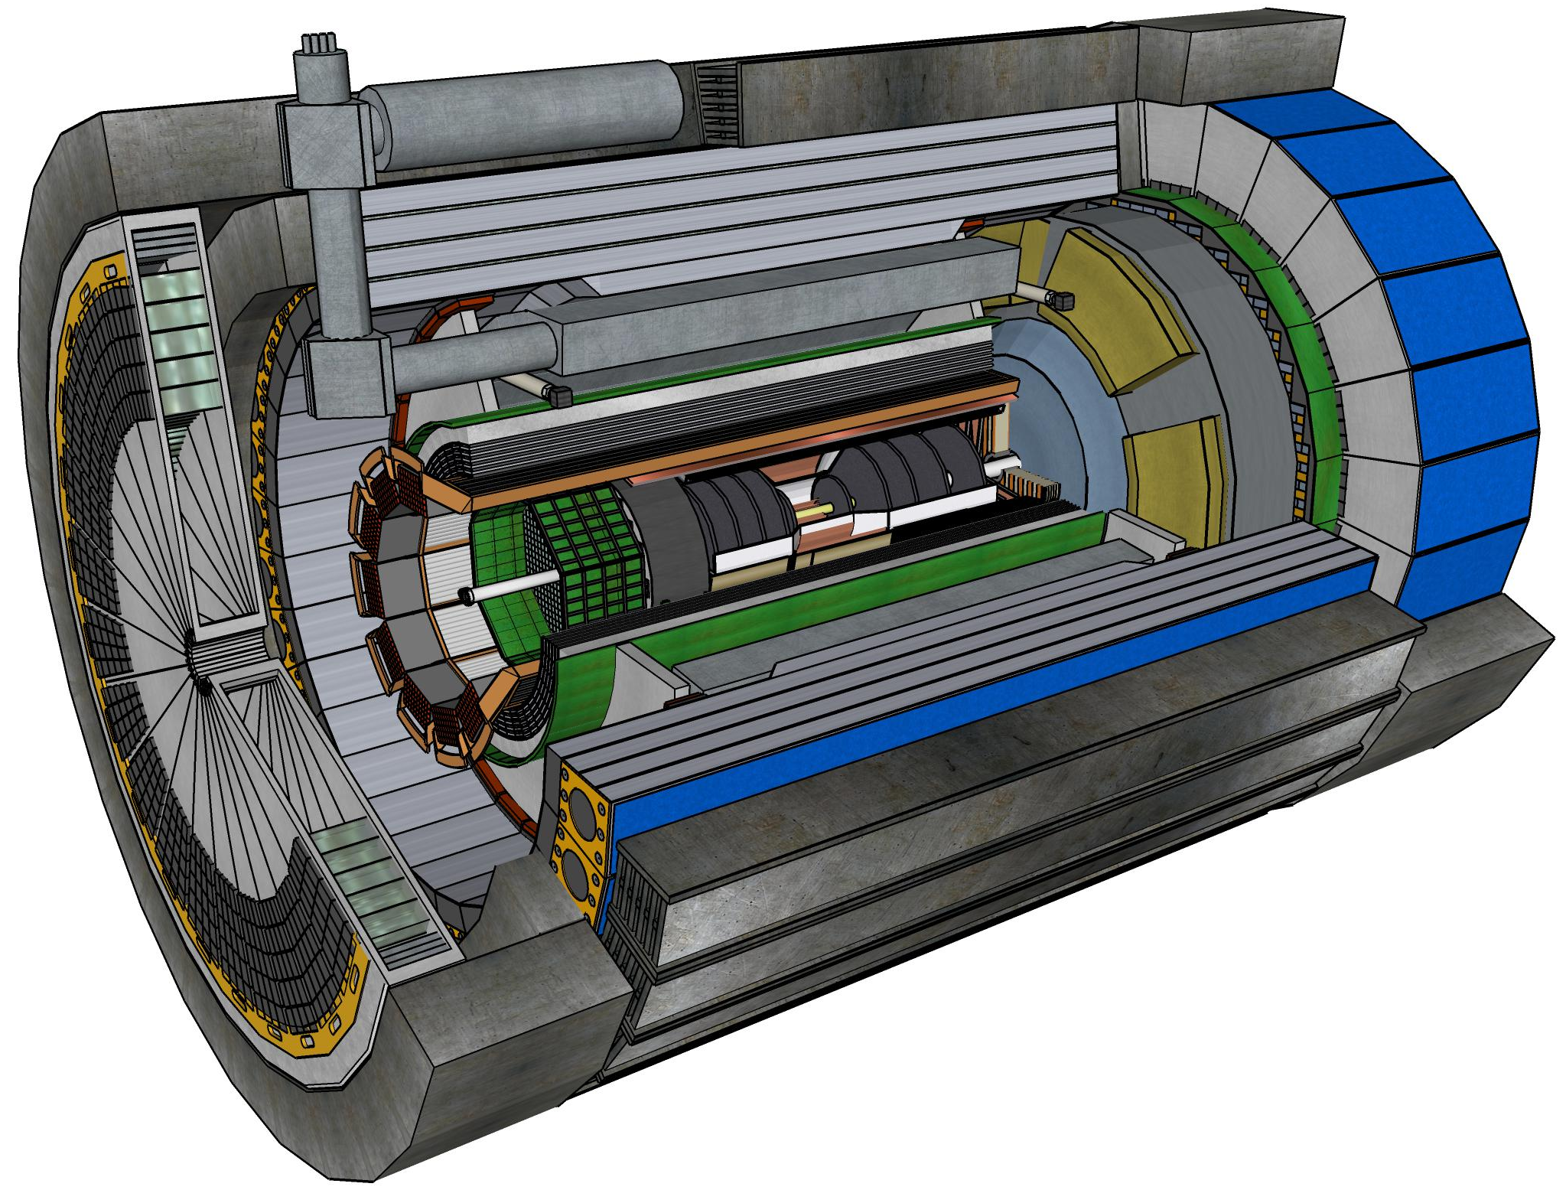
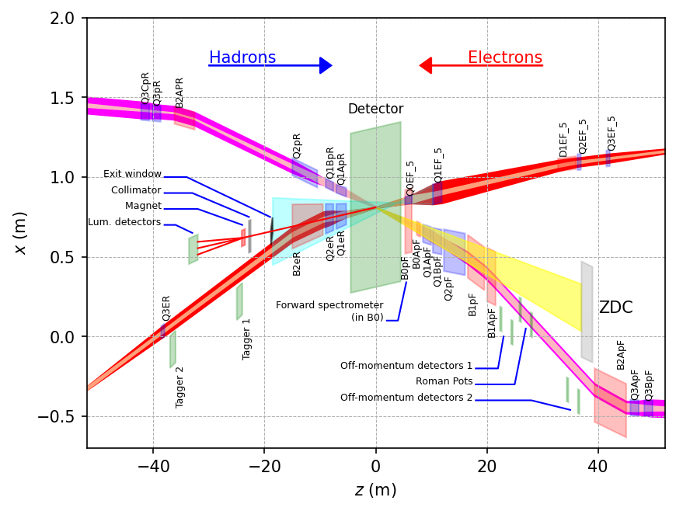
ePIC Detector
Asymmetric beam energies
→ require an asymmetric detector Barrel
with electron and hadron endcap
→ 9.5 m
→ Tracking, particle identification, EM
calorimetry and hadronic calorimetry
functionality in all directions
→ very compact detector Integration
will be key
Imaging science program with protons and nuclei
→ requires specialized detectors
integrated in the Interaction Region
over 80 m
Science program required momentum resolution
→ requires a large bore 2T magnet
(1.7 T magnet operation point, stretch goal 2T)
that has same geometry as the BaBAR magnet.
Streaming readout electronics model
  → highest scientific flexibility
9.5 m

Slide 6
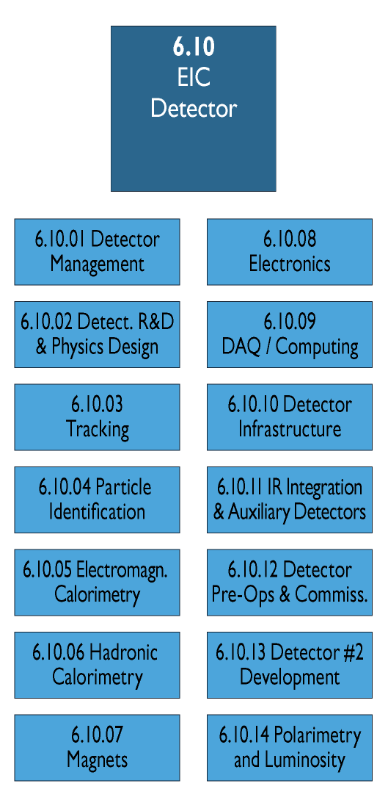
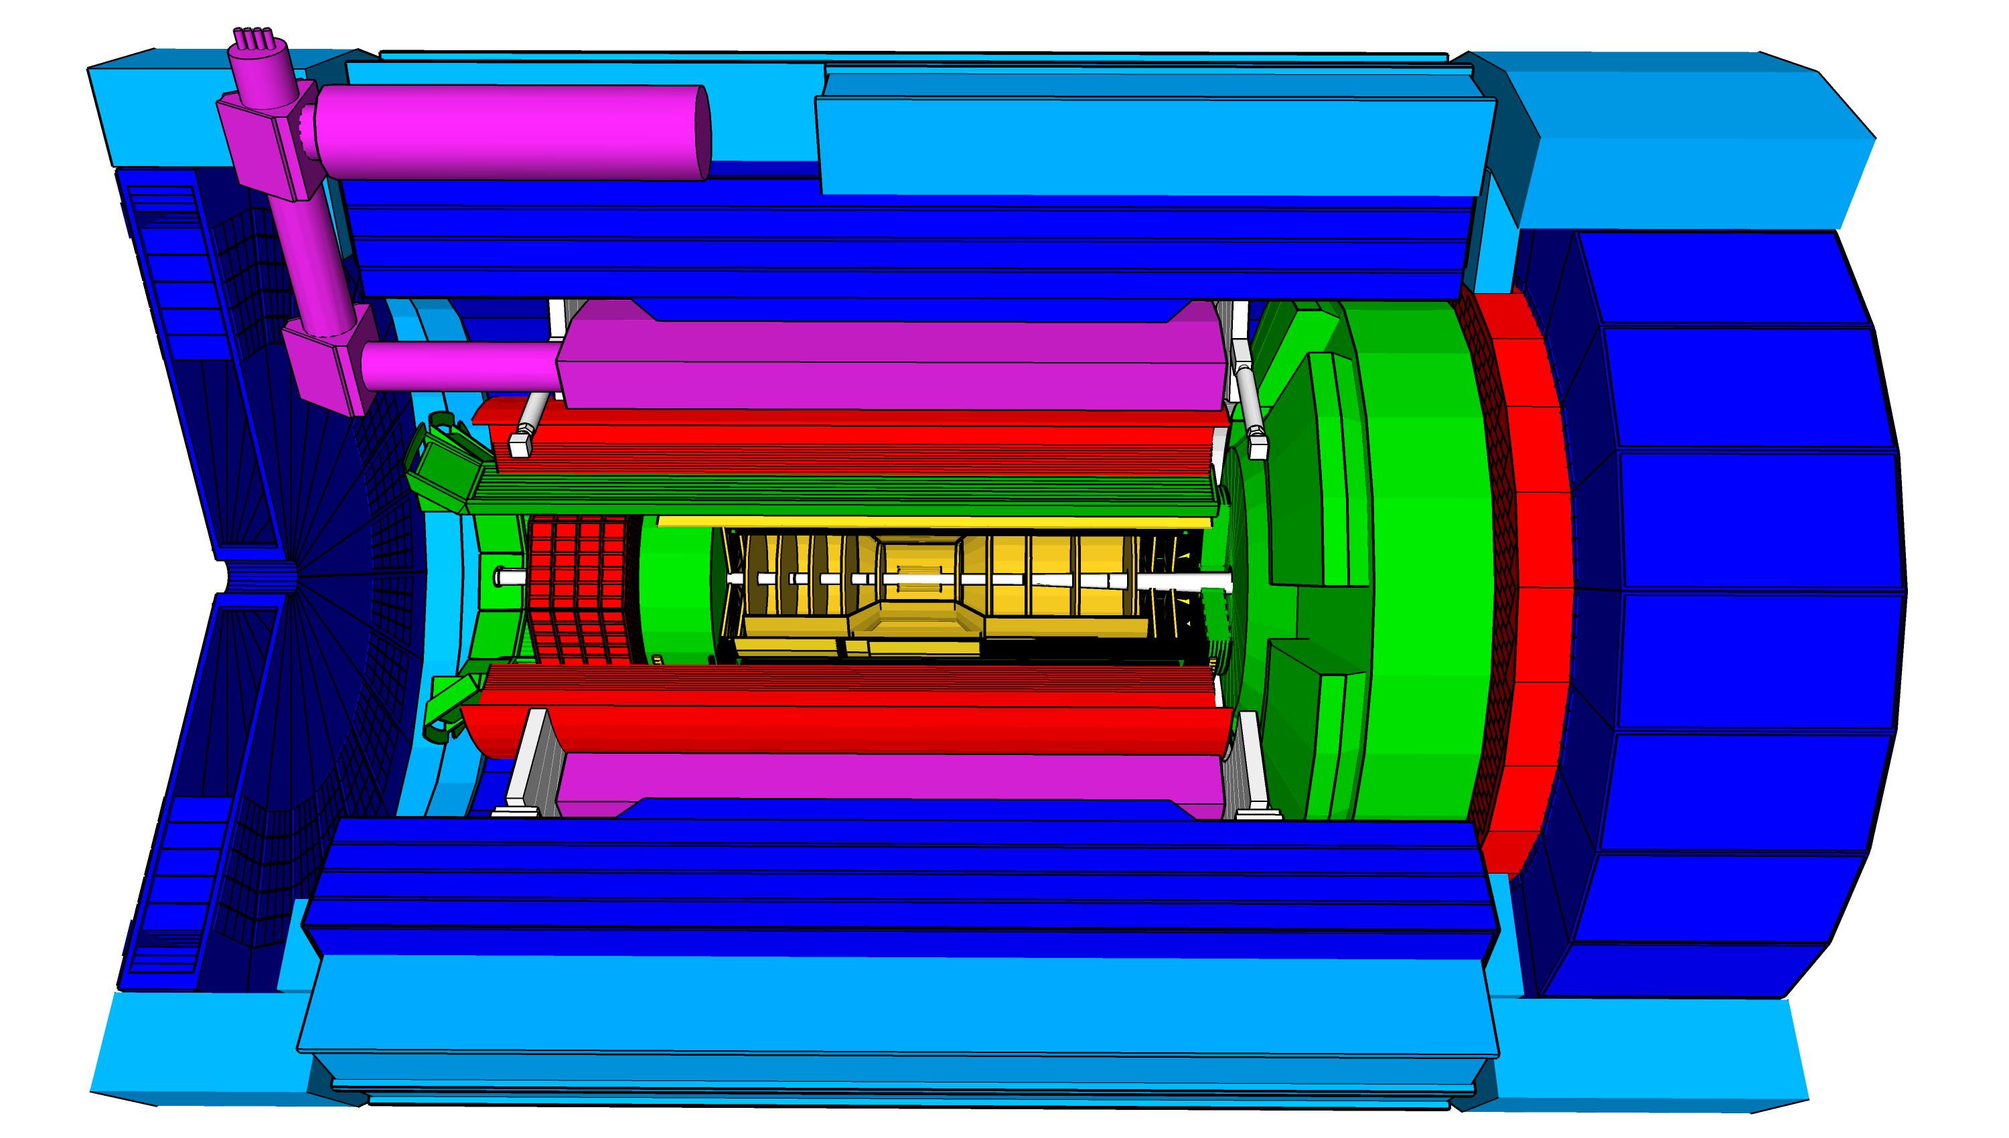
Scope Experimental Equipment
hadronic calorimeters (HCAL)
Solenoidal Magnet
e/m calorimeters (ECal)
Time.of.Flight (ToF), DIRC,
RICH detectors
MPGD trackers
9.5m
MAPS tracker
23 Subdetectors
incl. Polarimeters
+ Data Acquisition
provides coordination that
2nd detector remains possible
Experiment Equipment fully integrated
in EIC Project (WBS 6.10)
→ schedule, risk and cost
→ current total cost: $285M

Slide 7
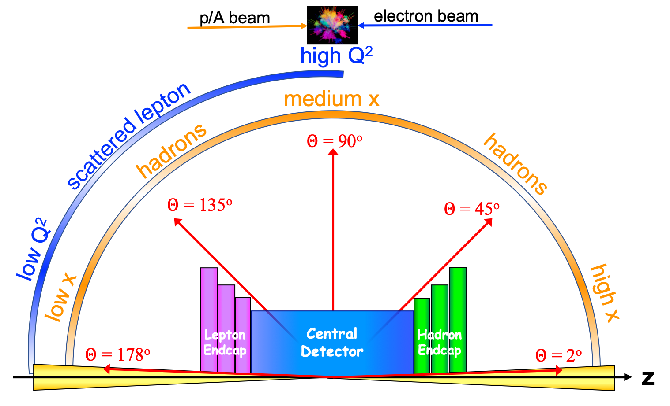
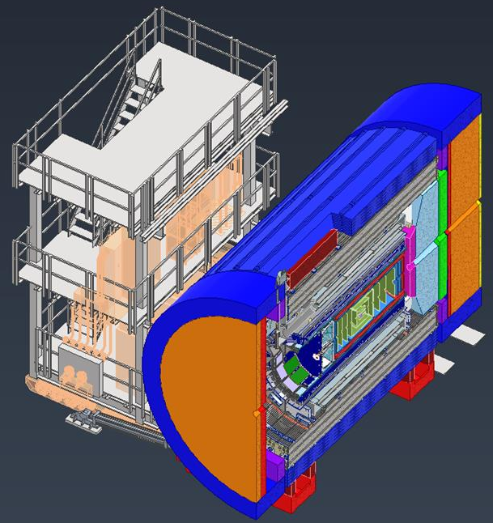

The ePIC Detector
Detailed CAD model of central detector and extended IR region continuously refined as design progresses

Slide 8
The ePIC Detector
Defined:
subdetector envelops
geometry database for users and GEANT simulations: https://eic.jlab.org/Geometry/
Requirements and Interfaces: https://eic.jlab.org/Requirements/

Slide 9
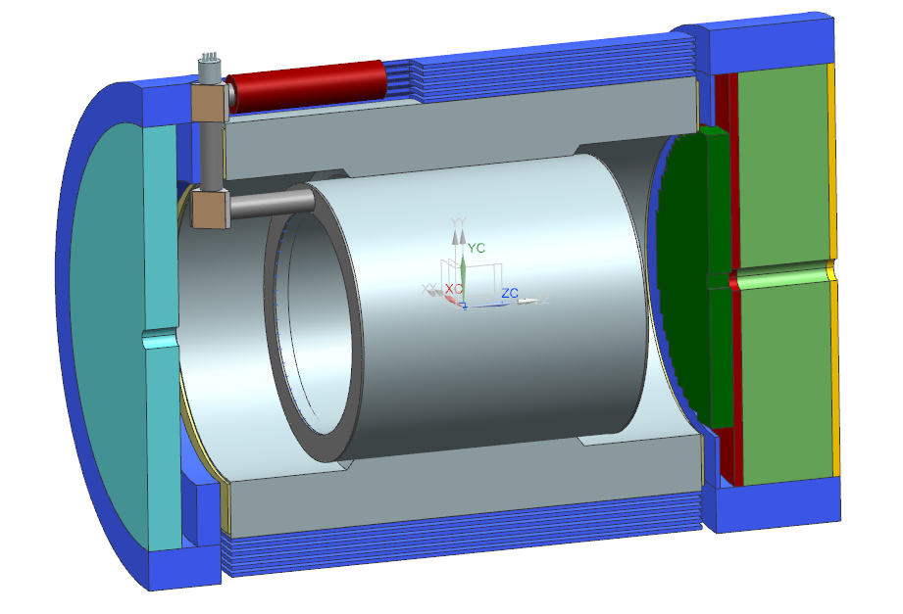
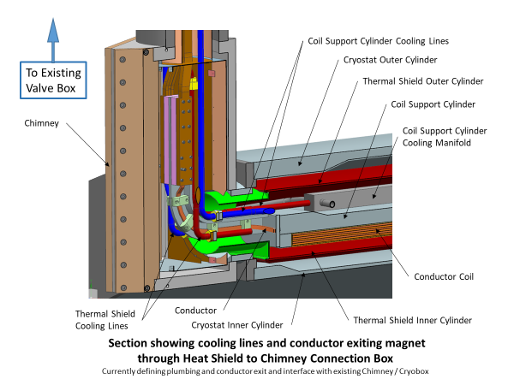
EIC Detector Solenoidal Magnet - MARCO
Joint CEA-Saclay-JLab-BNL effort
Magnet status:
  CD-1 Approval June 2021
  3T Detector solenoid preliminary design report December 2021
  Incremental (30%) Design and Safety Review February 2022
  DPAP closeout report – led to reduced field (< 3 T) March 2022
  Contract for 60% Design Review April 2022
  60% design team formation and kick off meeting May 3, 2022
  Mid-Project Progress meeting (@BNL, hybrid meeting) June 28, 2022
  Point design adjusted to stretch goal of 2 T (operation at 1.7 T) August 10, 2022
  60% Design and safety Review October 18, 2022
  90% Design contract in place December 2022
  Found qualified vendor willing to make conductor January 2023
  RFI out March 2023
  Sample Conductor contract March 2023
  Progress meeting (@JLab, hybrid meeting, ~75% design point) April 18, 2023
Magnet planning:
  90% Design completion September 2023 (90% design completion is 100% - final design - for “Vendor Design-Build” procurement).
  Final Design Review (FDR) October 5-6 2023
→ Magnet is ready for procurement at CD-3A date (expected January 2024)
9

Slide 10
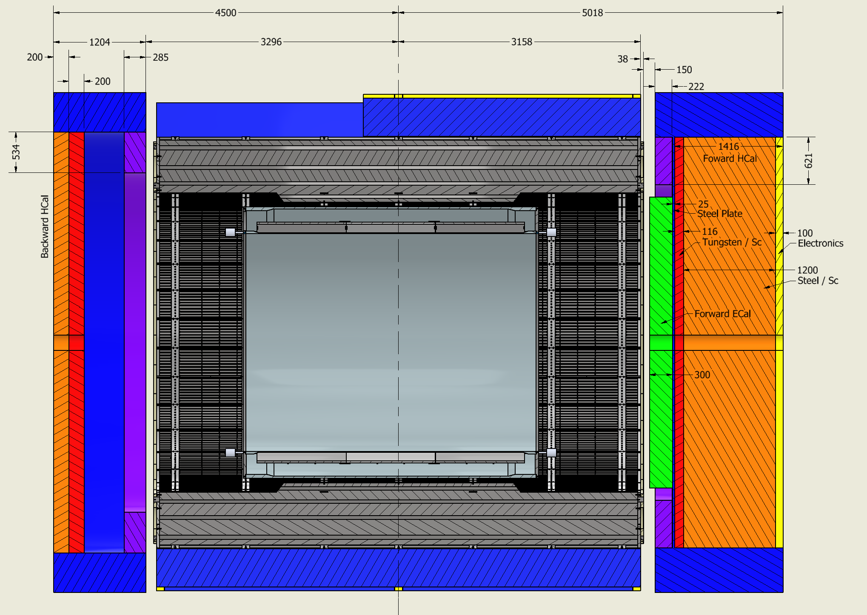
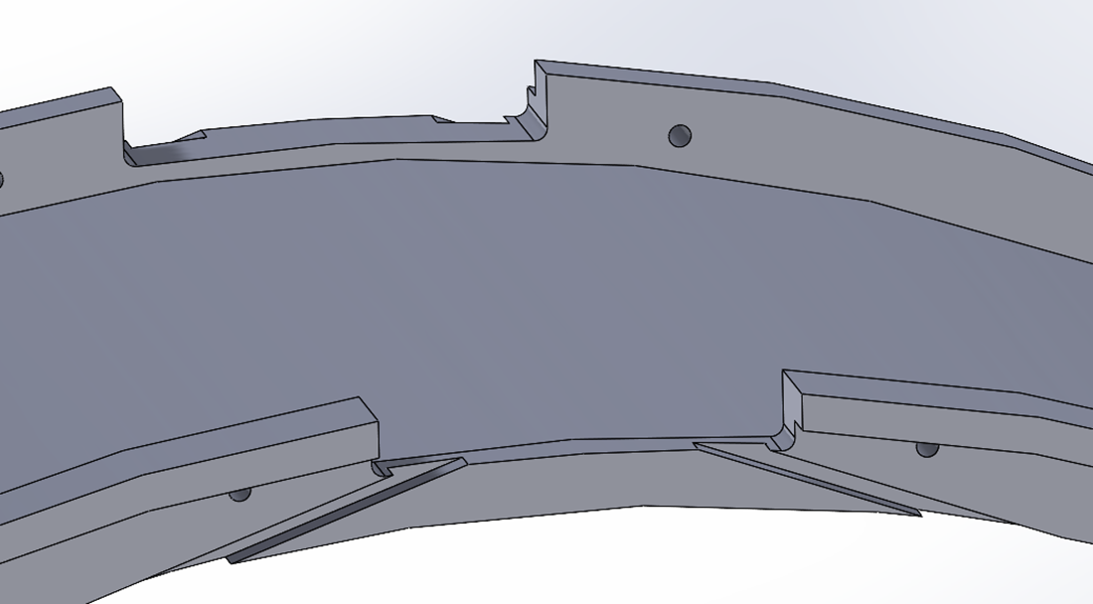
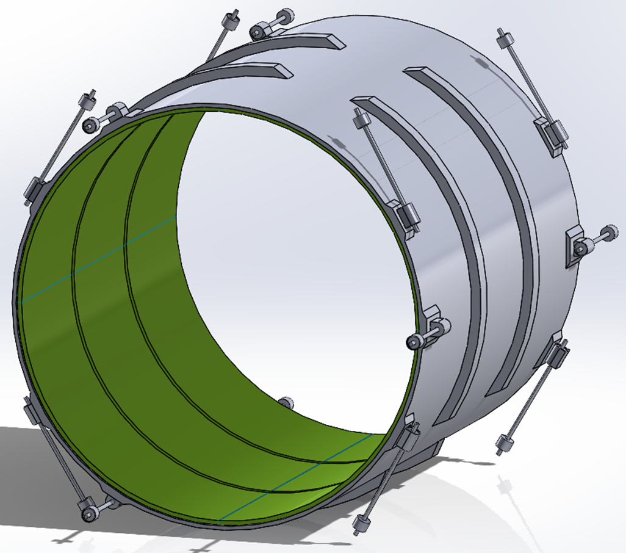
MARCO Magnet Design Details
Steel
Conductor is based on CEA-Saclay experience as used for previous magnets.
Contract for conductor test samples in place with viable vendor.
Coil is divided in 3 modules with 557 Turns each. This is done mainly to accommodate possible conductor length.
Flux return steel layout fully defined to minimize forces and fringe fields (~10G)
The two most important design parameters are conservative: large temperature margin and large critical current margin
Conductor exits
Mechanical analysis undergoing final checks

Slide 11
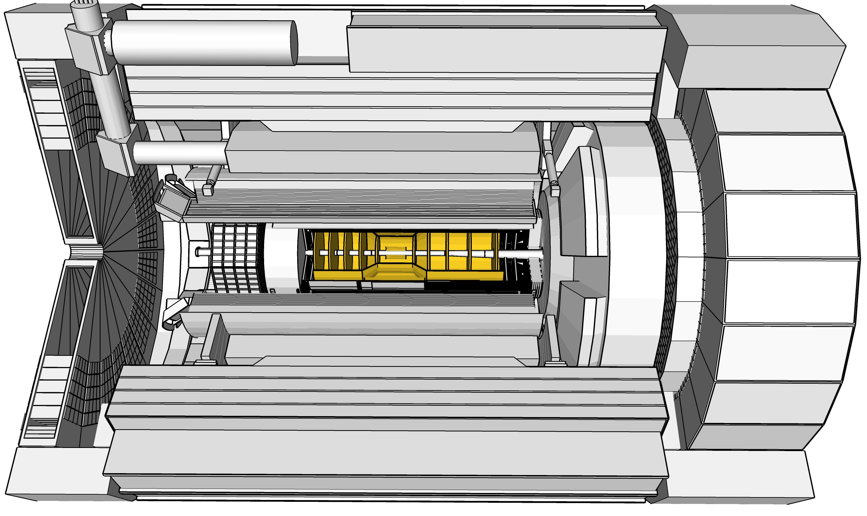

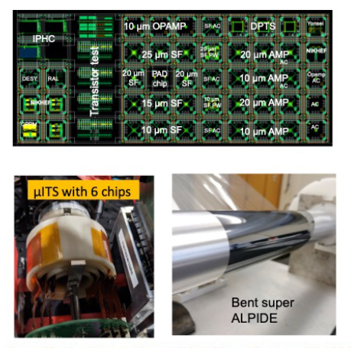
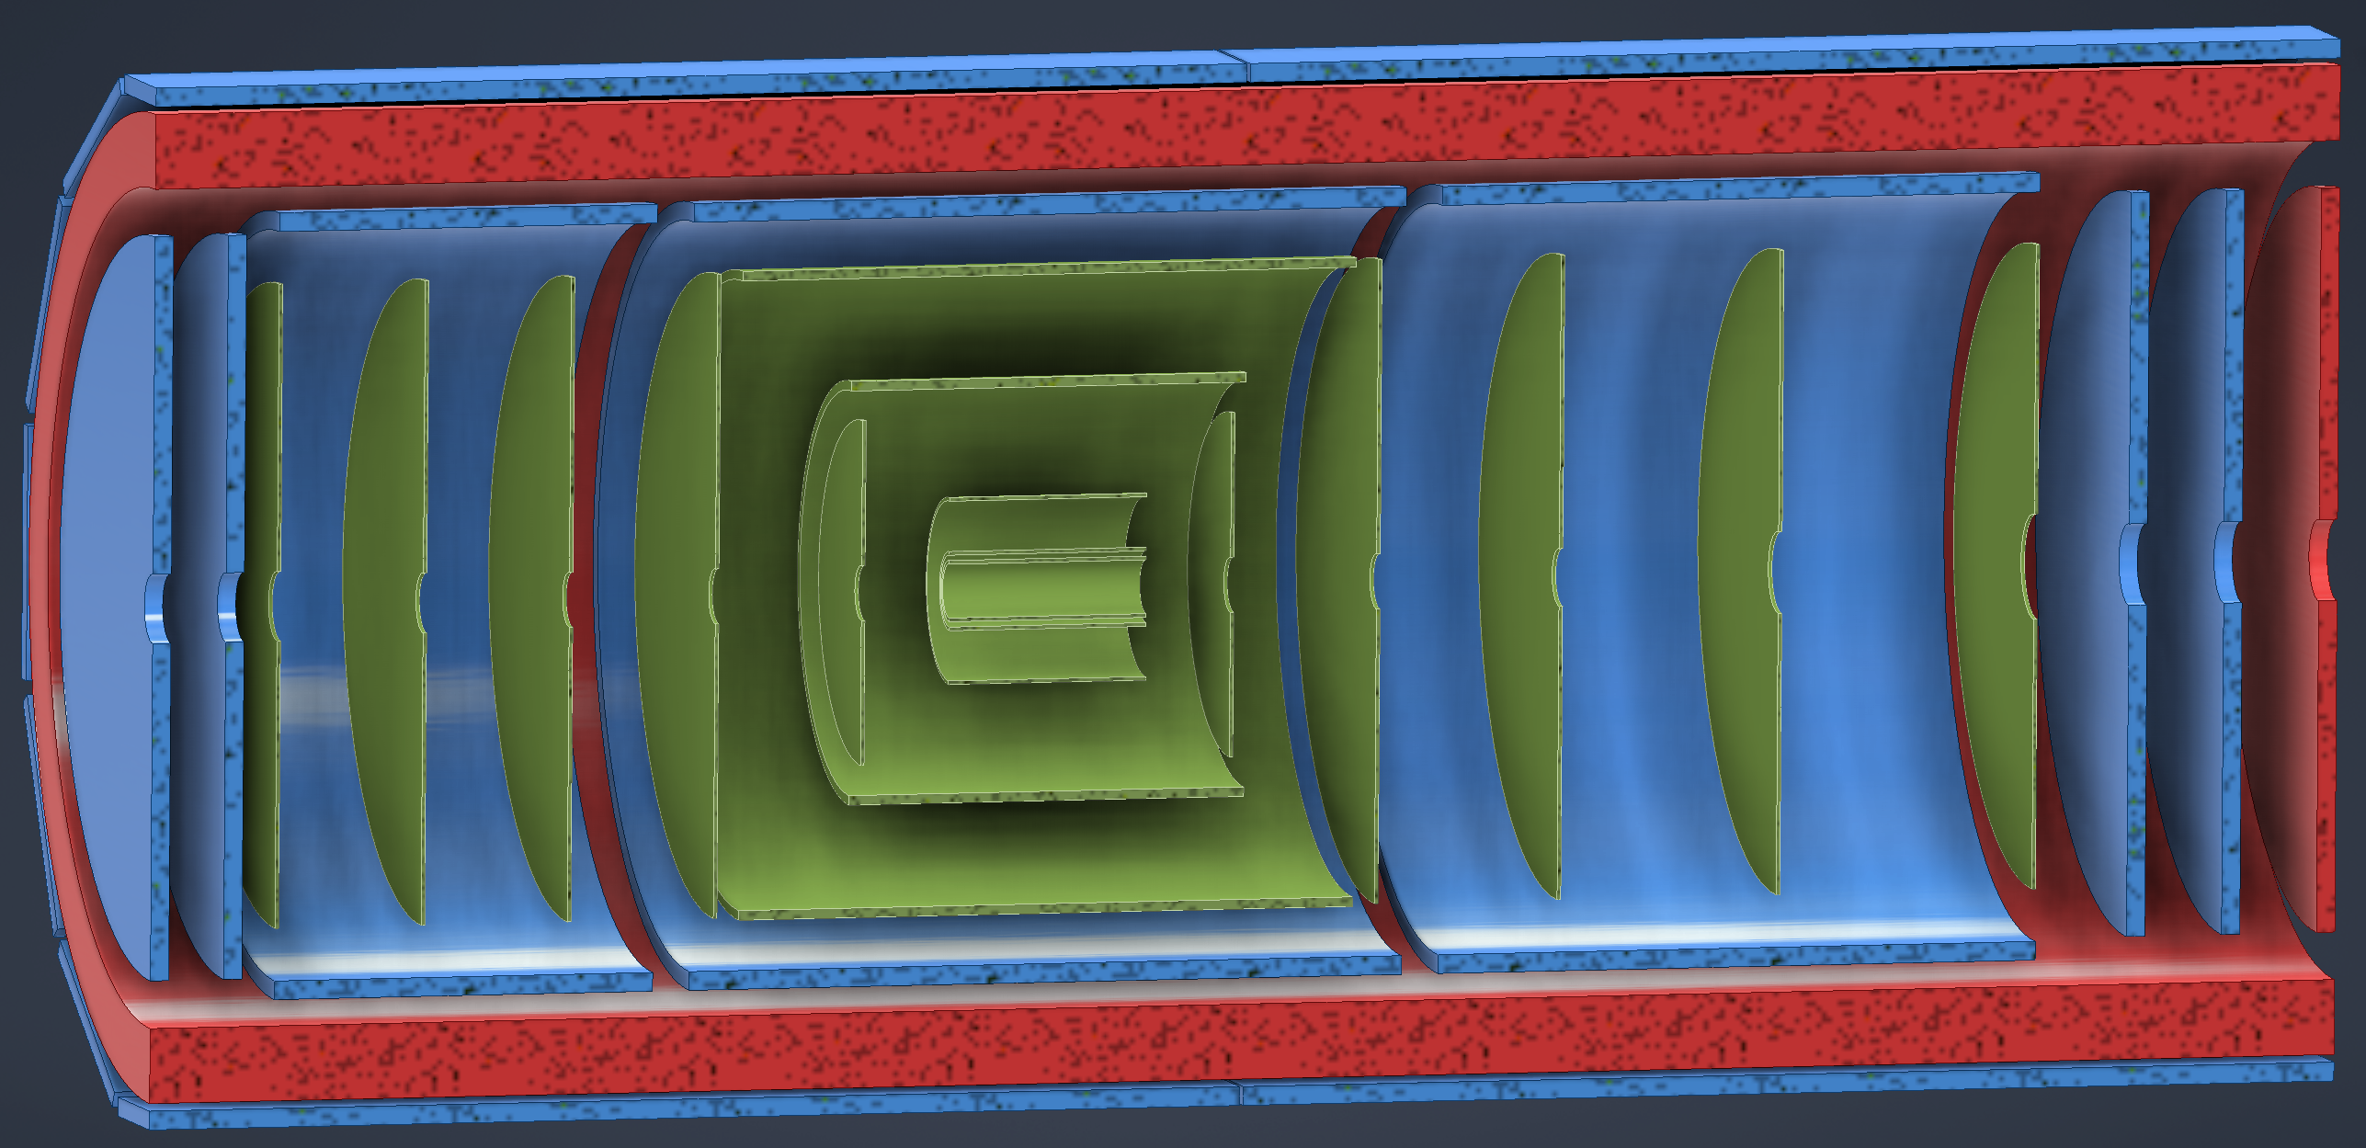
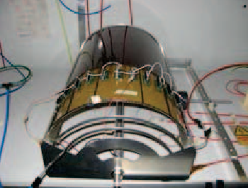
ePIC Tracking Detectors
Monolithic Active Pixel Silicon Tracker:
1 single technology: 65-nm MAPS
  small pixels (10 μm) and power
  consumption (<20 mW/cm²)
  low material budget
  (0.05% to 0.55% X/X₀ / layer)
  based on ALICE ITS3
  development
  MAPS Vertex layers
  MAPS Barrel, forward and
  backward disks
Multi Pattern Gas Detectors:
additional space points at large radii
Cylindrical microMEGAS
→ Additional space point for
pattern recognition / redundancy
→ Ongoing geometry
optimization
μRWELL planar layer
just before hpDIRC
→ Impact point and direction for the
ring seeding of hpDIRC
→ Additional space point for pattern
recognition / redundancy
Two MPGD disks each beyond Si disks in forward and backward direction
→ To provide sufficient hits under
large backgrounds to compensate
for large Si time integration frame
world’s first
at
world’s first
at
MAPS Barrel + Disks
MPGD Barrels + Disks
AC-LGAD based ToF

Slide 12
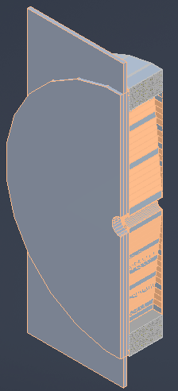
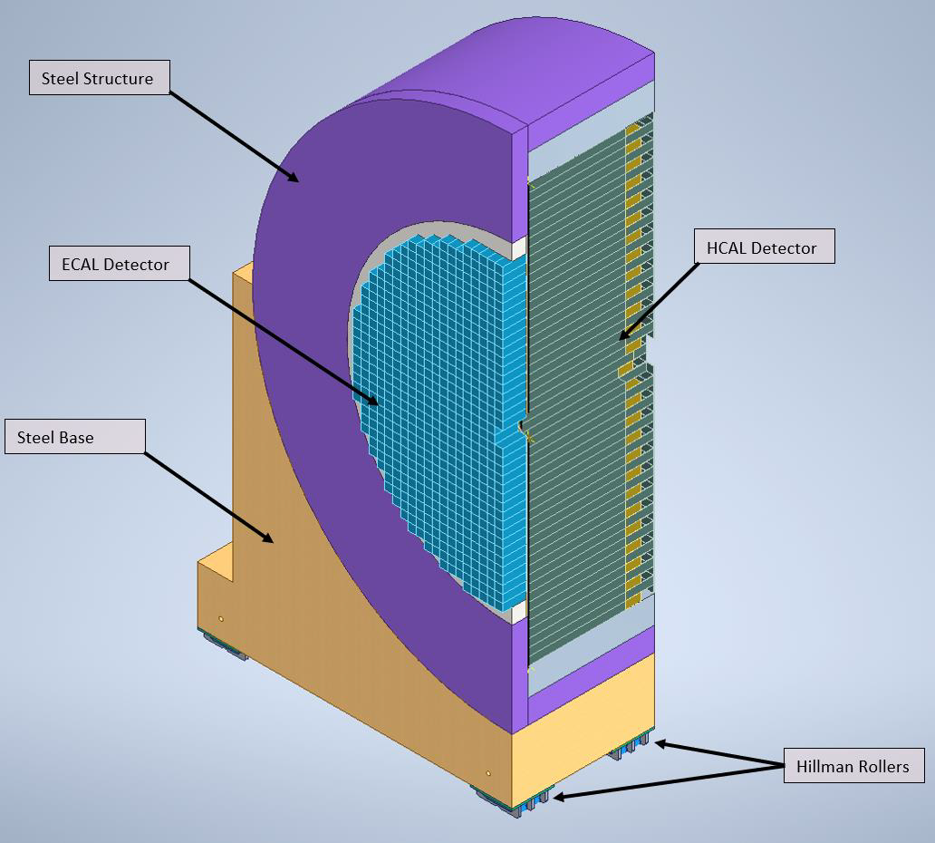
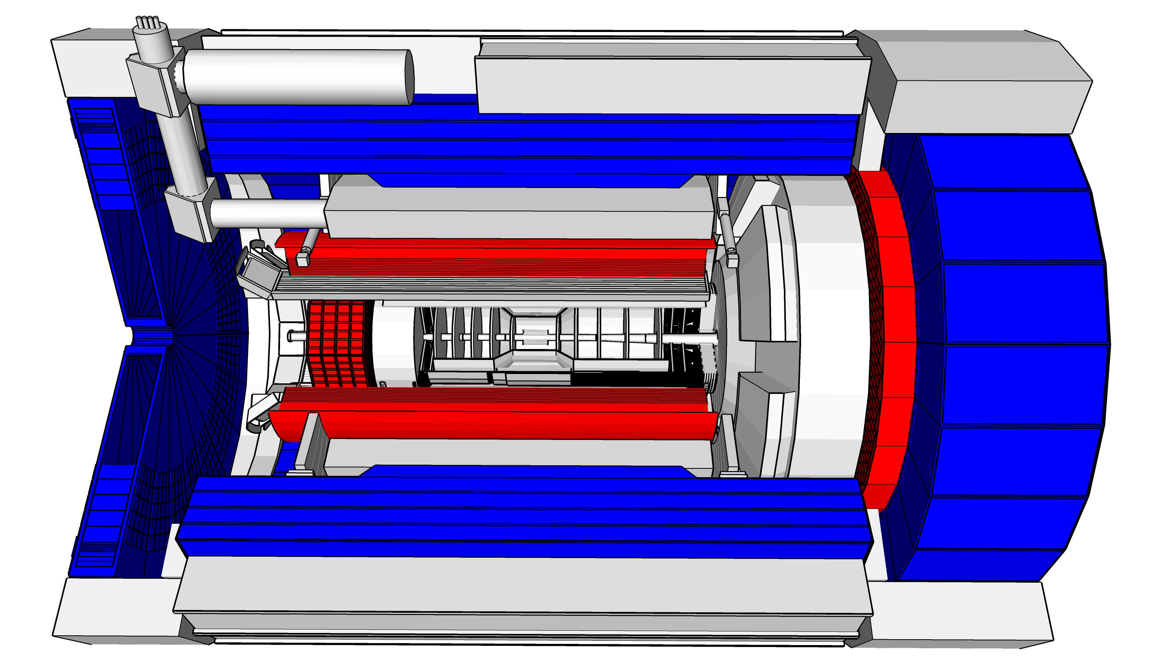
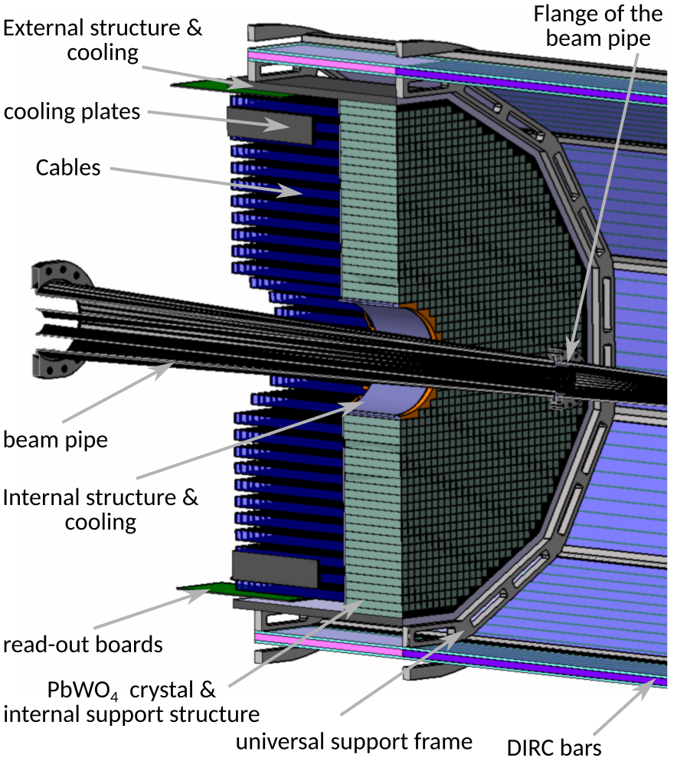
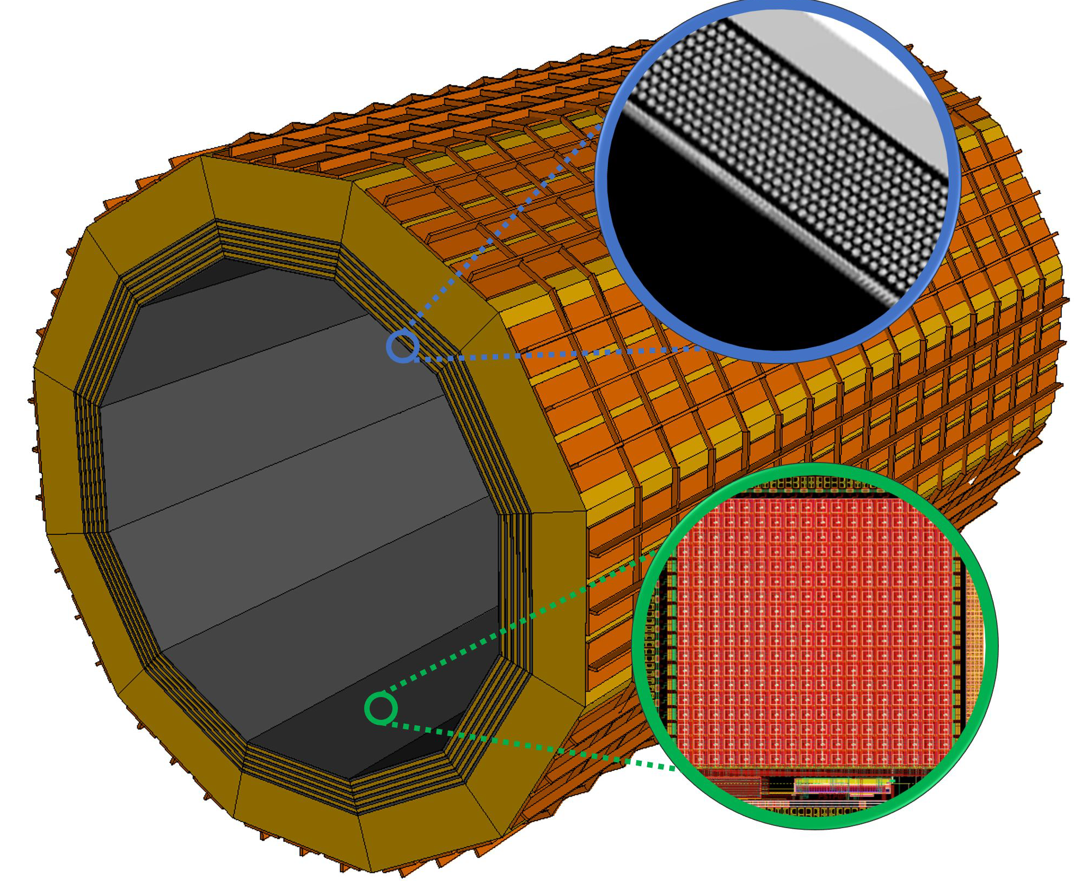
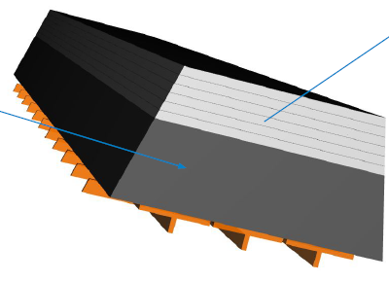
ePIC Calorimetry
Backwards HCal
Steel/Sc Sandwich
tail catcher
Barrel HCAL
(re-used from sPHENIX)
Forward ECal
High granularity
Tungsten/SciFi matrix
SiPMs as photonsensors
ForwardHCAL
Longitudinally separated Steel/Sc & W/Sc sandwich
with SiPMs embedded in Scintillator
world’s first
at
world’s first
at
Backward Ecal
High-precision, PbWO4
SiPMs as photonsensor
Pb/SciFi
world’s first
at
Barrel ECal: Pb/SciFi with a
hybrid imaging part (using 6 layers of ASTROPIX)
Recent Technology Choice
Review 03/14/23, ePIC Decision 04/21/23

Slide 13
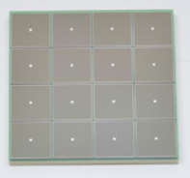
Electronics
We have 23 different detector technologies in the ePIC detector
It would be intractable if all have different readout electronics
→ the goal is to minimize the number of different ASICs and use common readout solutions
Global Timing Unit (GTU)
-Interfaces to
Collider Run Control & DAM
-Config & Control
-Clock & Timing
Electronics Readout Chain
On Detector
SMT BGA
Sensor
Adapter
Front End Board (FEB)
Readout Board (RDO)
Data Aggregation Module (DAM)
Computing
Detector Group | Channels | AC-LGAD | SiPM/PMT | MPGD
 | MAPS | AC/DC-LGAD | SiPM/PMT | MPGD
TOTAL | 32 B | 7.1M-54M | 370k | 100k
ASIC | ITS-3 | EICROC FCFD HPsOC ASROC FAST | Discrete/COTS HGCROC3 ALCOR-EIC | SALSA
We expect to need ITS-3, Astropix, Timepix, and 4 different ASICs
Based on existing ASICs → reduce cost & time
Much synergy with international efforts

Slide 14
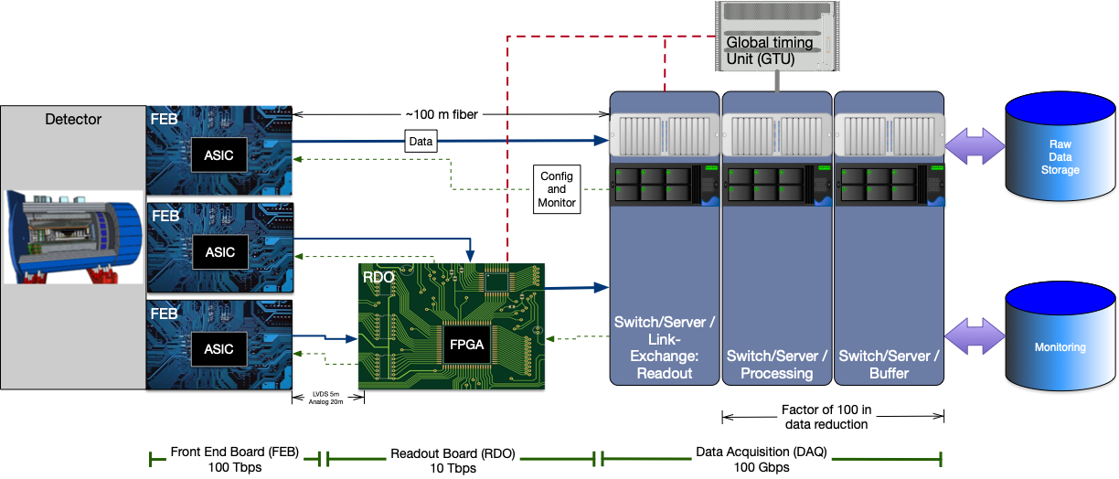
Streaming Readout Architecture
Triggerless streaming architecture gives much more flexibility to do physics
Rates quoted are at output of each stage
Integrate AI/ML as close as possible to subdetectors → cognizant Detector

Slide 15
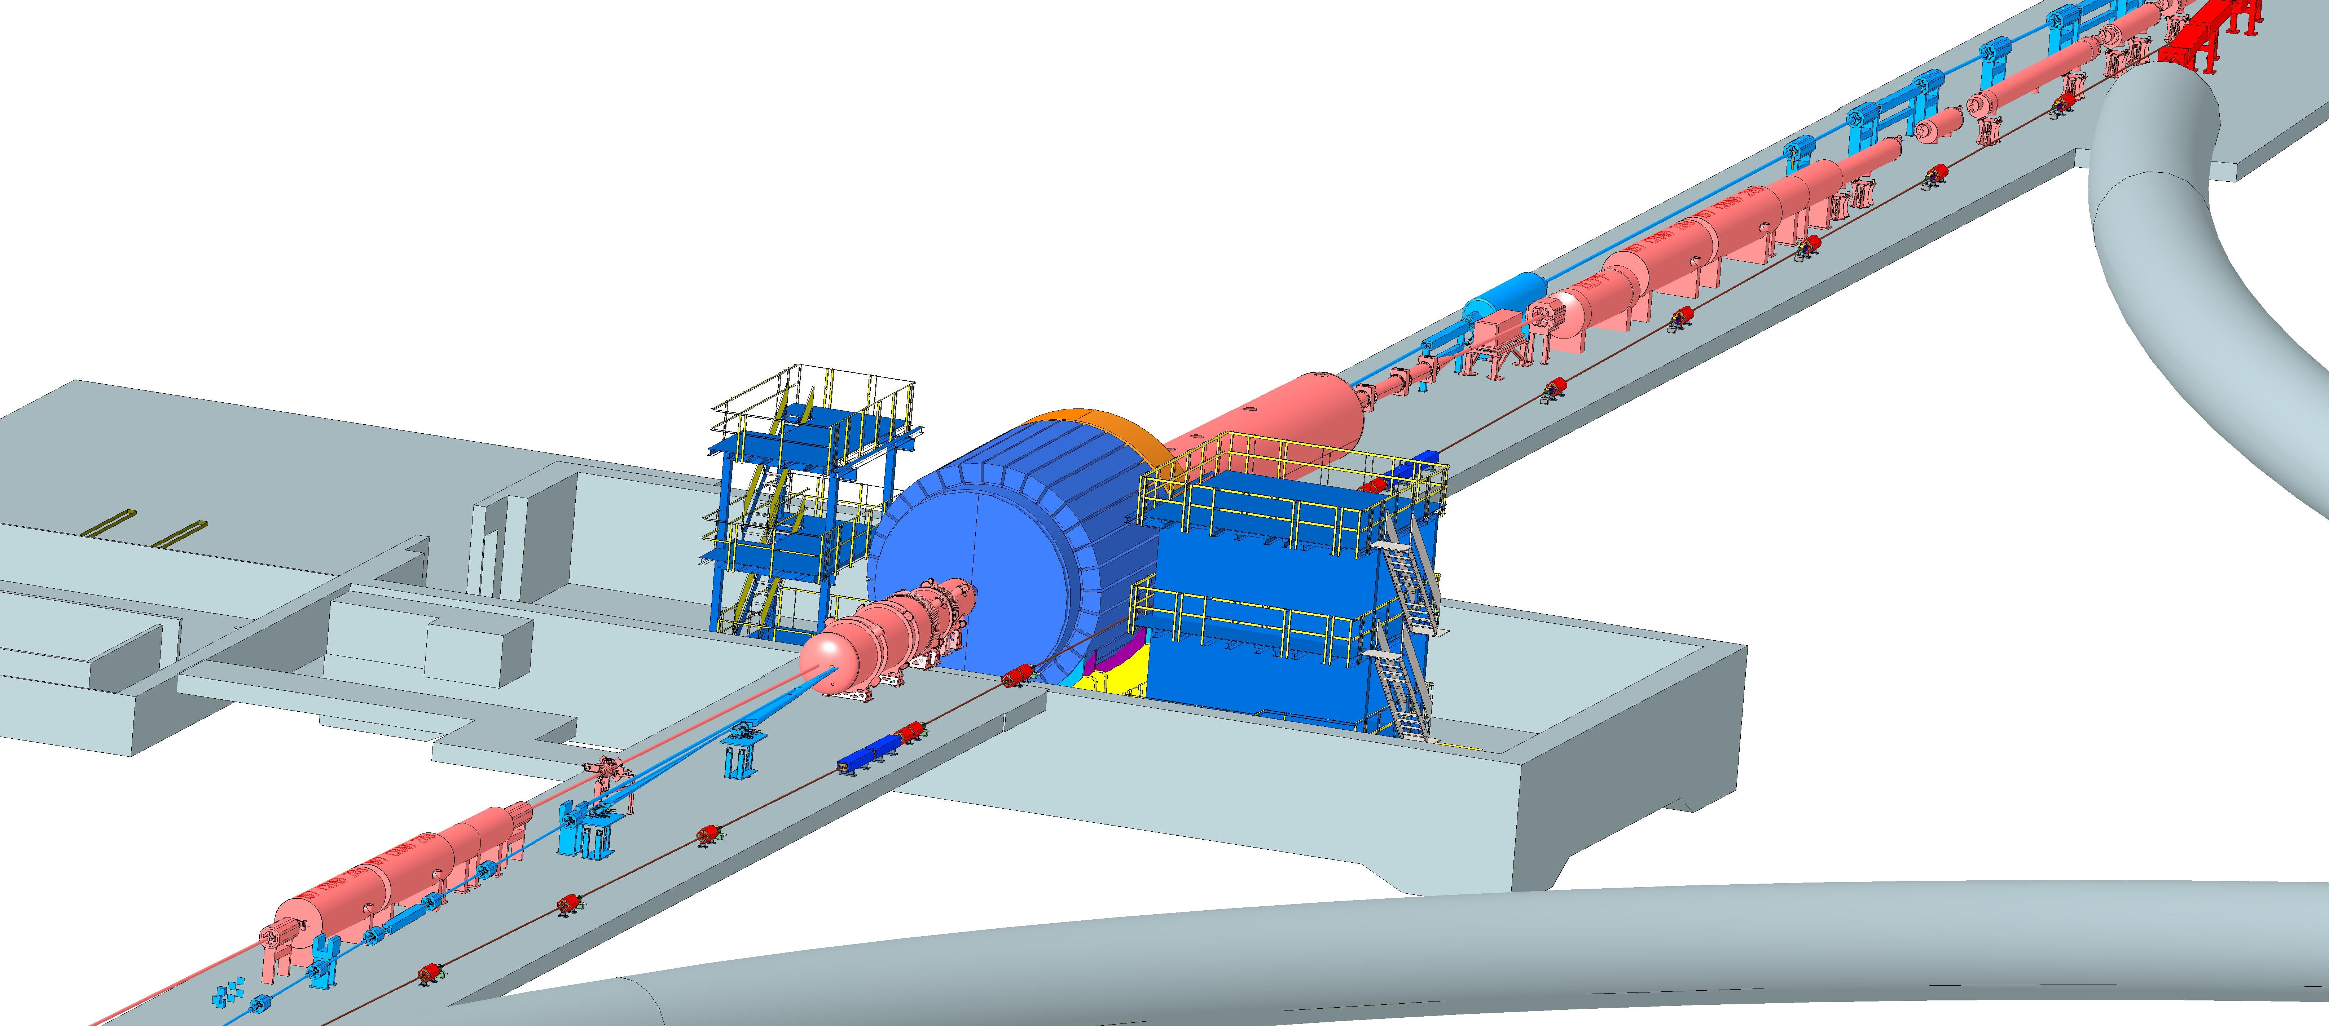
Interaction Region Layout
ESR Forward side
Forward Side
SC Magnet Cryostat
HSR Injection Line
Central Detector
Rear Side
SC Magnet Cryostat
HSR Forward Side
HSR: Hadron Storage Ring
ESR: Electron Storage Ring
RCS: Rapid Cycling Synchrotron
SC: Superconducting
HSR
Rear Side
RCS
With Detector Bypass
ESR Rear side
every cm counts → integration and communication with accelerator team is crucial

Slide 16
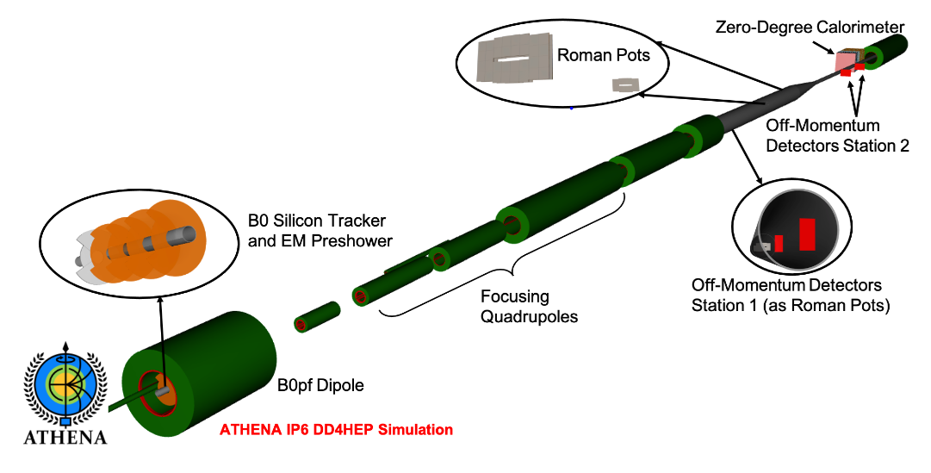
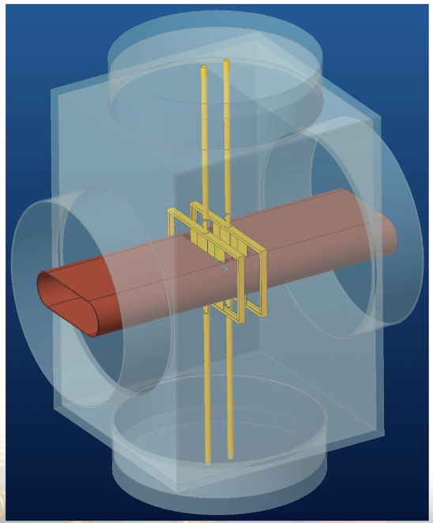
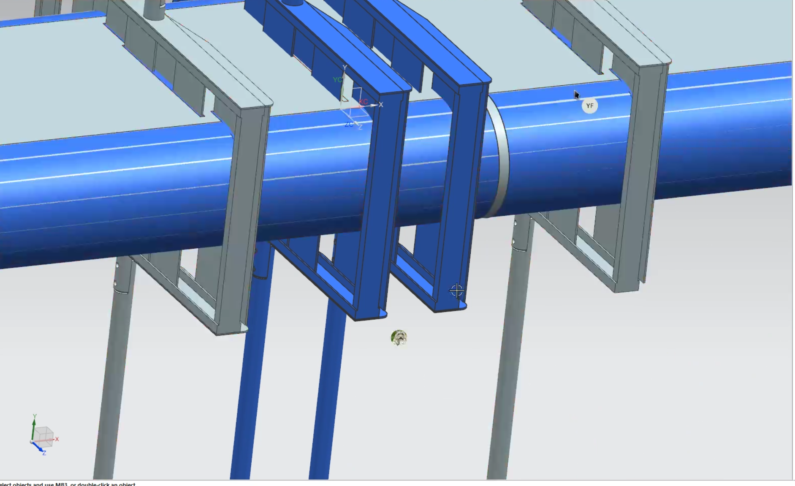
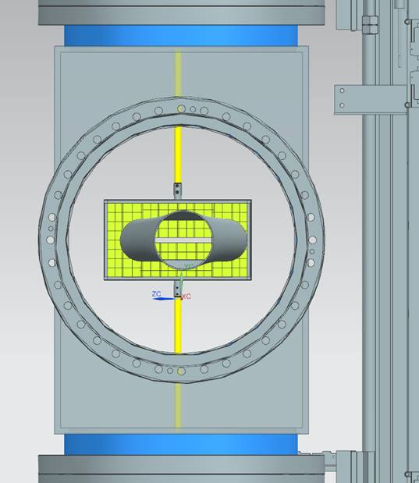
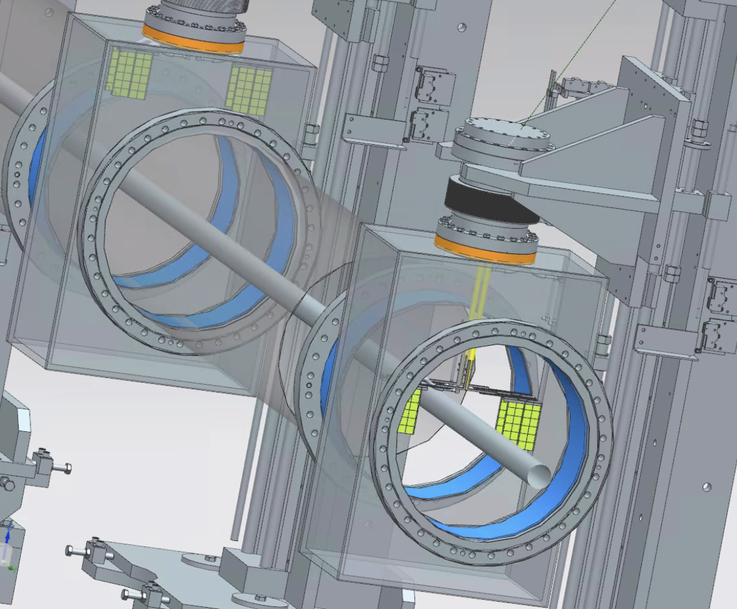
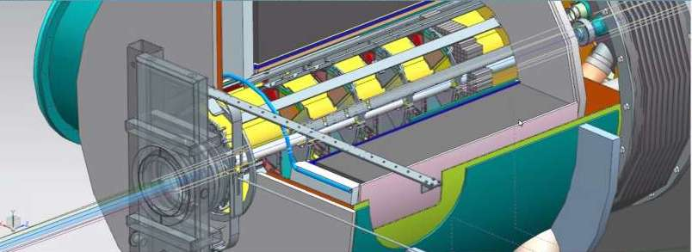
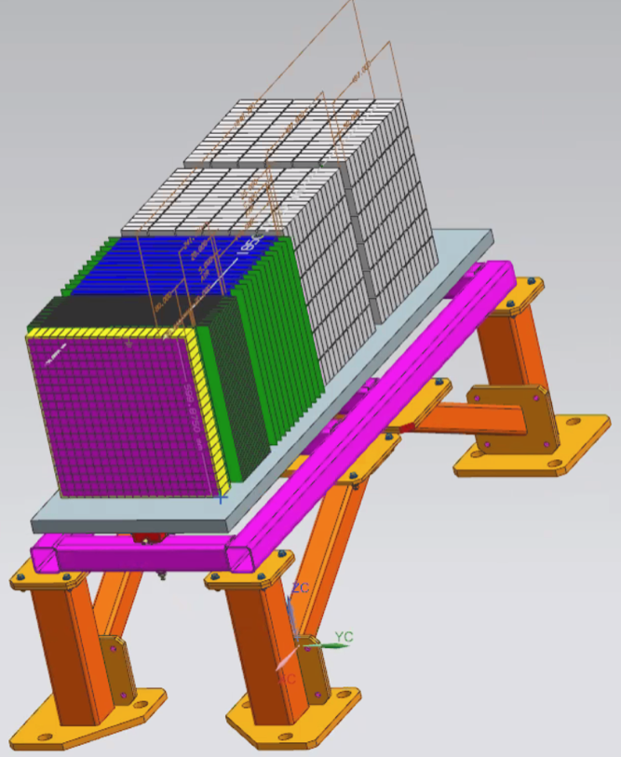
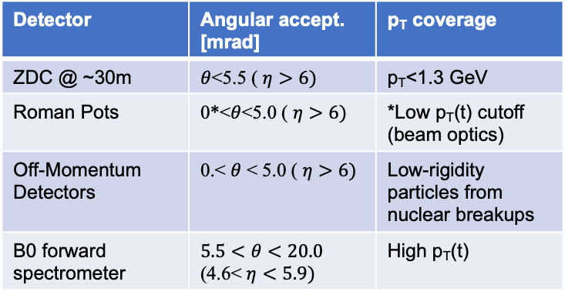
Far-Forward Ancillary Detector Integration
Roman Pots integration
Roman Pots
Off-momentum
detectors
IP magnets & ancillary detectors fully simulated in GEANT including all beam effects
Technologies defined
Silicon: AC-LGAD & MAPS
Zero Degree Calorimeter:
  ECAL (PbWO4)
  HCAL (PbSi + PbScint)
Detector | Angular accept. [mrad] | p_{T} coverage
ZDC @ ~30m | $θ$<5.5 ( $η>6)$ | p_{T}<1.3 GeV
Roman Pots | 0*<$θ$<5.0 ( $η>6)$ | *Low p_{T}(t) cutoff (beam optics)
Off-Momentum Detectors | 0.< $θ$ < 5.0 ( $η>6)$ | Low-rigidity particles from nuclear breakups
B0 forward spectrometer | $$5.5<θ<20.0$$ (4.6< $η<5.9)$ | High p_{T}(t)
ECAL
PbW0₄
PbSi PbSc

Slide 17
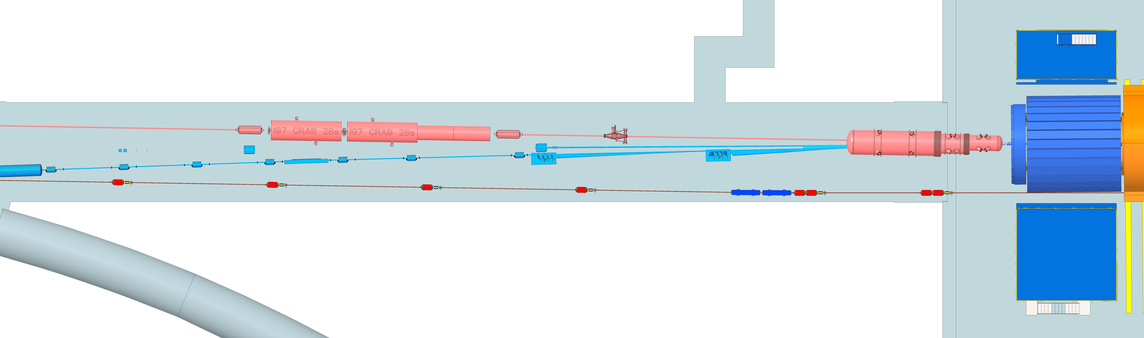
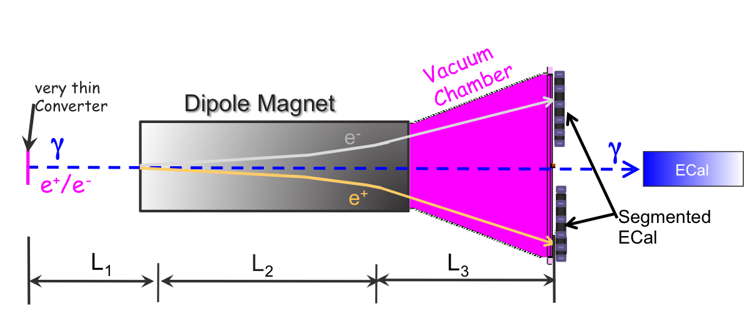
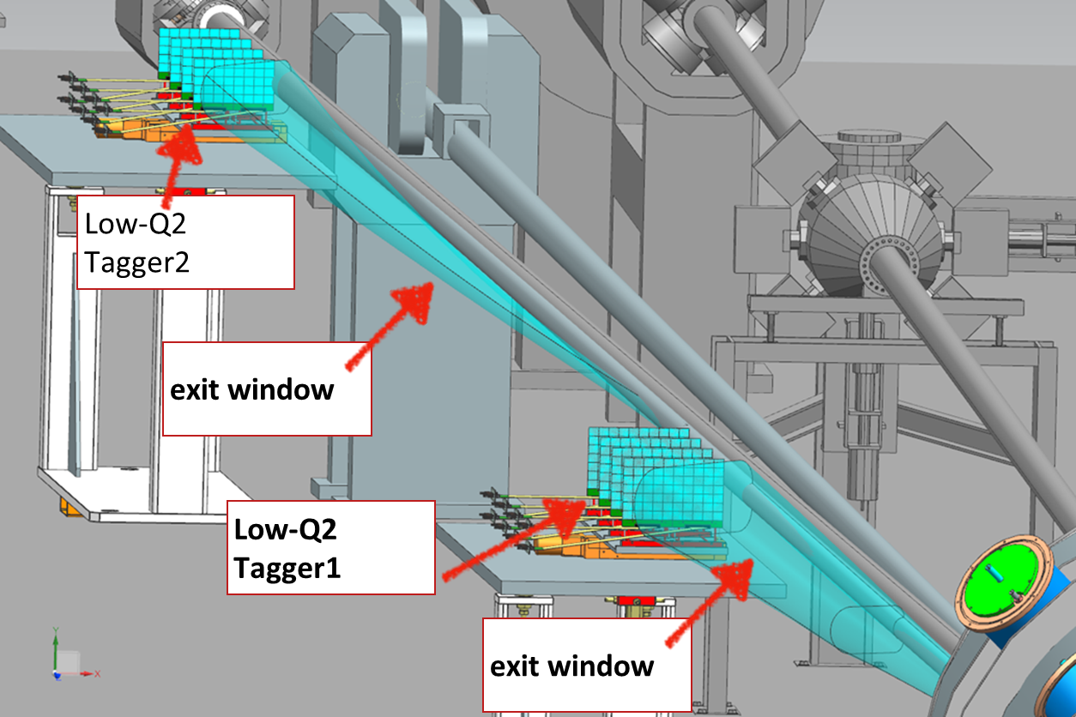
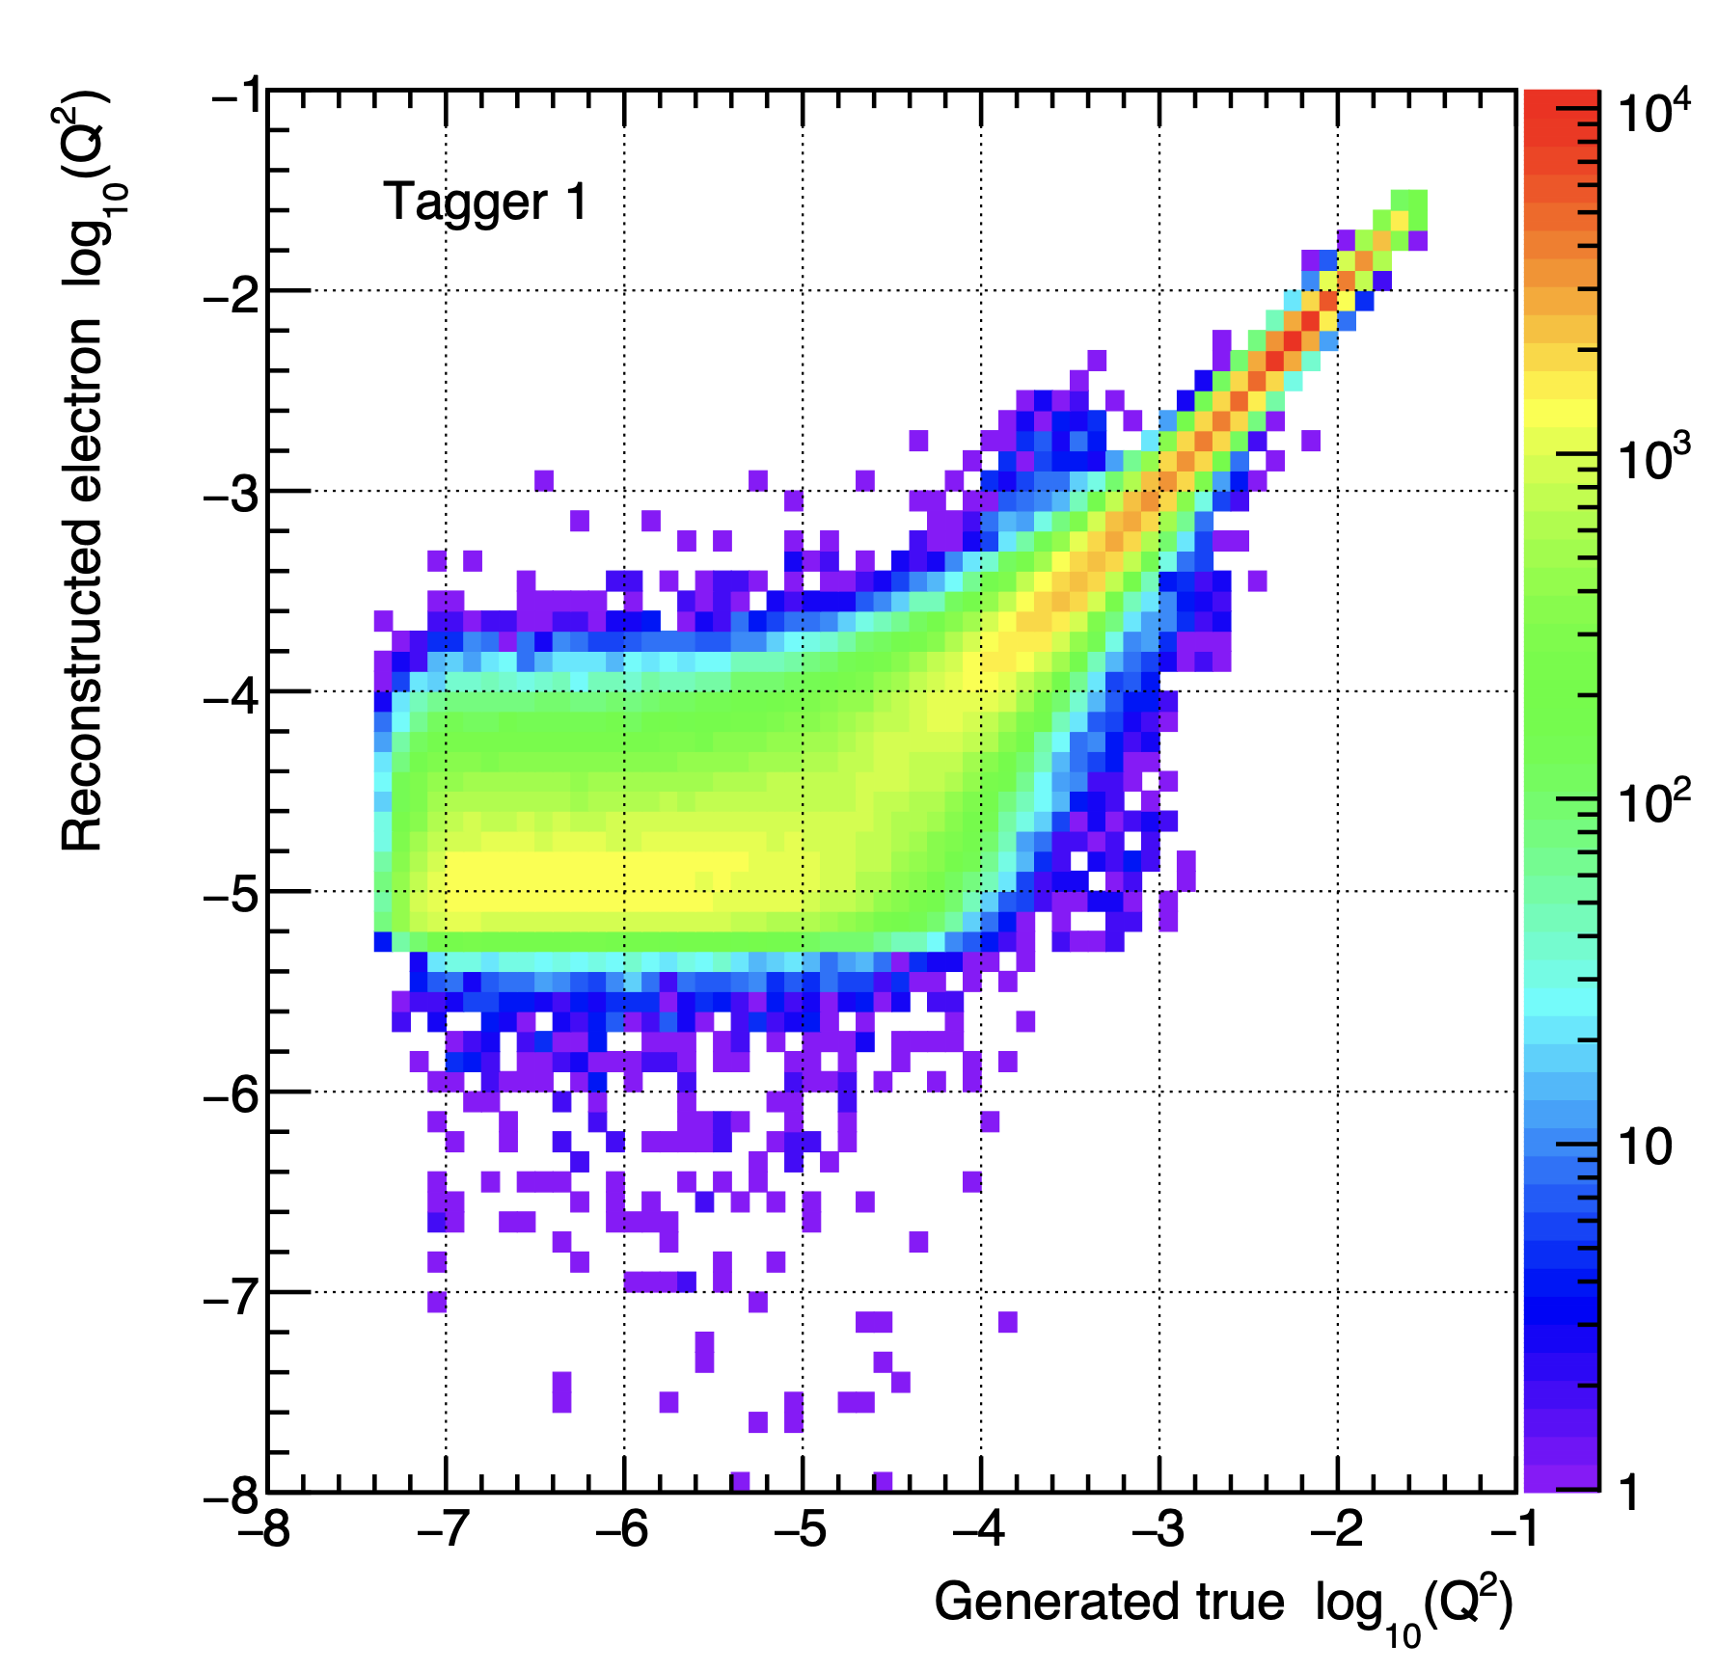
Far-Backward Detectors
Luminosity Detector and Low Q² Tagger
local hadron
polarimeter
luminosity detector
low Q²-tagger
Luminosity Detector Concept:
Use Bremsstrahlung ep → epγ as reference cross section
Goals for Luminosity Measurement:
Integrated luminosity with precision δL/L< 1%
Measurement of relative luminosity:
physics-asymmetry/10 → ~10⁻⁴ – 10⁻⁵
IP magnets, Lumi & low-Q² detectors fully simulated in GEANT including all beam effects and CAD layout
Low Q²⁻Tagger:
Purpose:
Detection of scatter electron for Q² < 0.1 GeV²
Critical for calibration of Lumi-detector
Beam divergence and energy spread impact performance
Technology:
Electromagnetic calorimetry with Si-tracking
→ strong synergy with luminosity detector
Combine
pair spectrometer → high precision
with
zero degree photon calorimeter
→ fast feedback for collider
Technology:
Electromagnetic calorimetry with Si-tracking

Slide 18
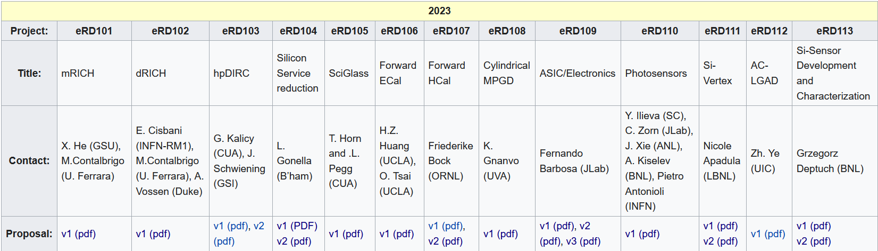
EIC Project Detector R&D Program & In-Kind
https://wiki.bnl.gov/conferences/index.php/ProjectRandDFY23
INFN-Ferrara, Glasgow
INFN-Roma1, INFN-Ferrara
GSI
IJCLab-Orsay, INFN-Genova, AANL/Armenia
Valparaiso
IJCLab-Orsay, CEA Saclay, INFN-Torino
IJCLAB/Omega/
Saclay/NCKU
International
Partners
Birmingham, Brunel, RAL, INFN-Bari, INFN-Trieste, IMP, CCNU
Nurnberg, GSI, INFN-Bologna, Cosenza, Ferrara, Genova, Trieste
Birmingham, Brunel, RAL, INFN-Bari, INFN-Trieste, IMP, CCNU
Chinese EMCal
Consortium
CEA Saclay
Strong synergies with CERN
CERN – EIC R&D Day November 2021 https://indico.cern.ch/event/1063927/
MAPS: ALICE-3 – ITS-3 development
PID: LHC-b and ALICE-3
Photon-sensors: LAPPDs with LHC-b
MPGD: long-term CERN R&D program RD51
DAQ: strong developments on streaming DAQs for all LHC experiments
AI/ML and high-performance distributed computing

Slide 19
High Level Installation Schedule
Oct 2028
Jan 2029
early
CD-4A
04/2031
early CD-4
CD-4A
04/2032
CD-3
04/2025
April 2029
Dec 2029
CD-4
04/2034
June 2030
Oct 2030
Jan 2031
Construction
IR-6 ready
for installation
Transition into
Operations
Start of
Operations
&
Science
lower half
barrel Hcal
installed
Solenoid
delivered
Endcap HCals
completed
Solenoid
Field mapping
done in beam position
Hadron Endcap
Detectors
installed
Trackers, dRICH
ECal
done in IP-6 Assembly Hall
Barrel Ecal
ready
for installation
Barrel Hcal
& Solenoid
installed
followed by low
power test
Lepton Endcap
Detectors
installed
Trackers, bRICH
ECal
Barrel Detectors
installed
ECal, DIRC,
ToF, Trackers
Take Away:
Solenoid and Barrel HCal need to be ready by Jan 2029
all other subdetectors need to be ready between 06/29 to 06/30 depending on their location in the detector
→ 1st DIRC & barrel and disc ToF, 2nd dRICH and 3rd backward RICH

Slide 20
Requirements: Beam Background at IR
electron beam:
Synchrotron radiation
  Backscattering
  Photo desorption
  → degradation of vacuum
Beam gas interactions
  Off momentum electrons
Higher order mode losses
  Local heating at injection and ramp (short bunches)
  degradation of vacuum
background due to de-excitation of beam if bunches are replaced
proton beam:
Low beam lifetime during
injection and ramping
Beam gas interactions, large
hadronic cross section
  Secondary interactions with
  aperture limitations, i.e. with
  magnets, beam pipe, masks
Requirement:
Keep beam backgrounds as low as possible
→ Careful design of interaction region, beam-pipe masks and photon beam dump
→ Excellent vacuum system
Important to note:
low multiplicity per event: < 10 tracks
No pileup from collisions 500 kHz @10³⁴ cm⁻²s⁻¹ → DIS event every 200 bunches
radiation environment much less harsh than LHC → factor 100 less

Slide 21
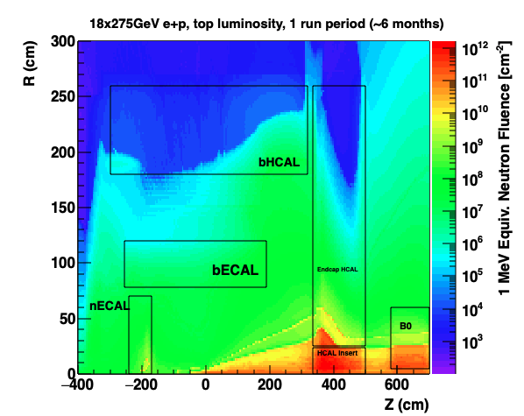
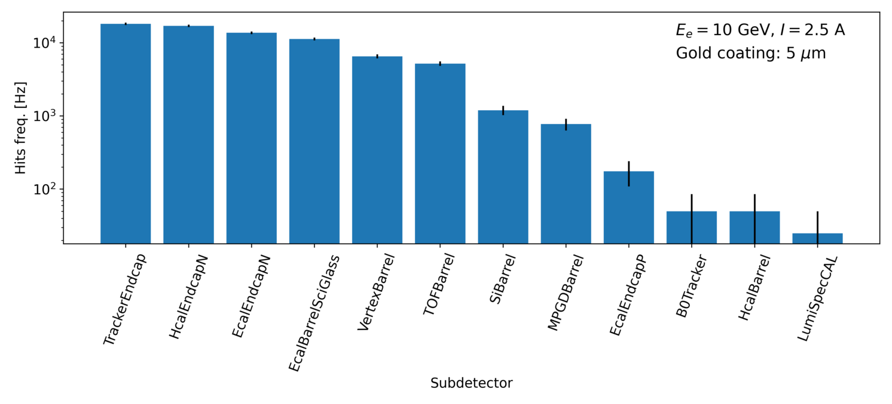
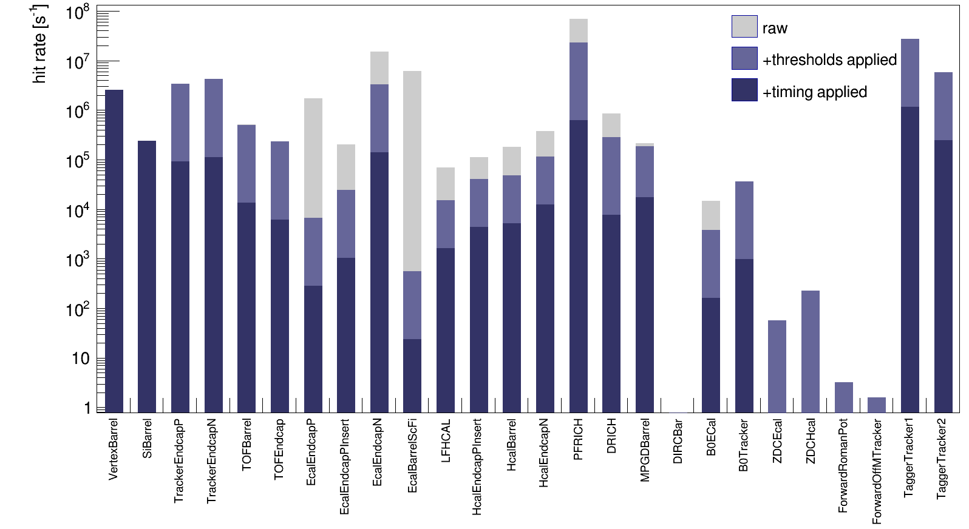
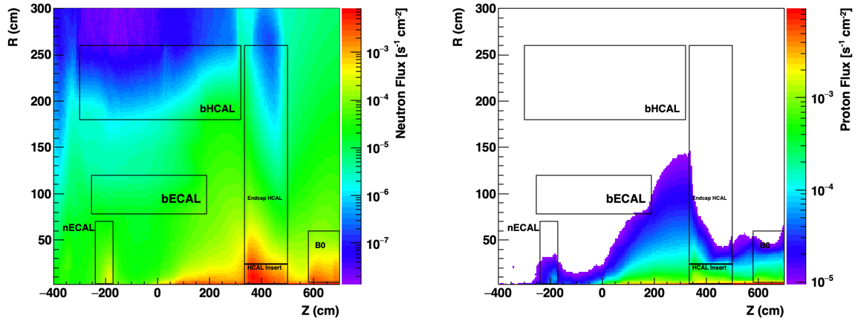
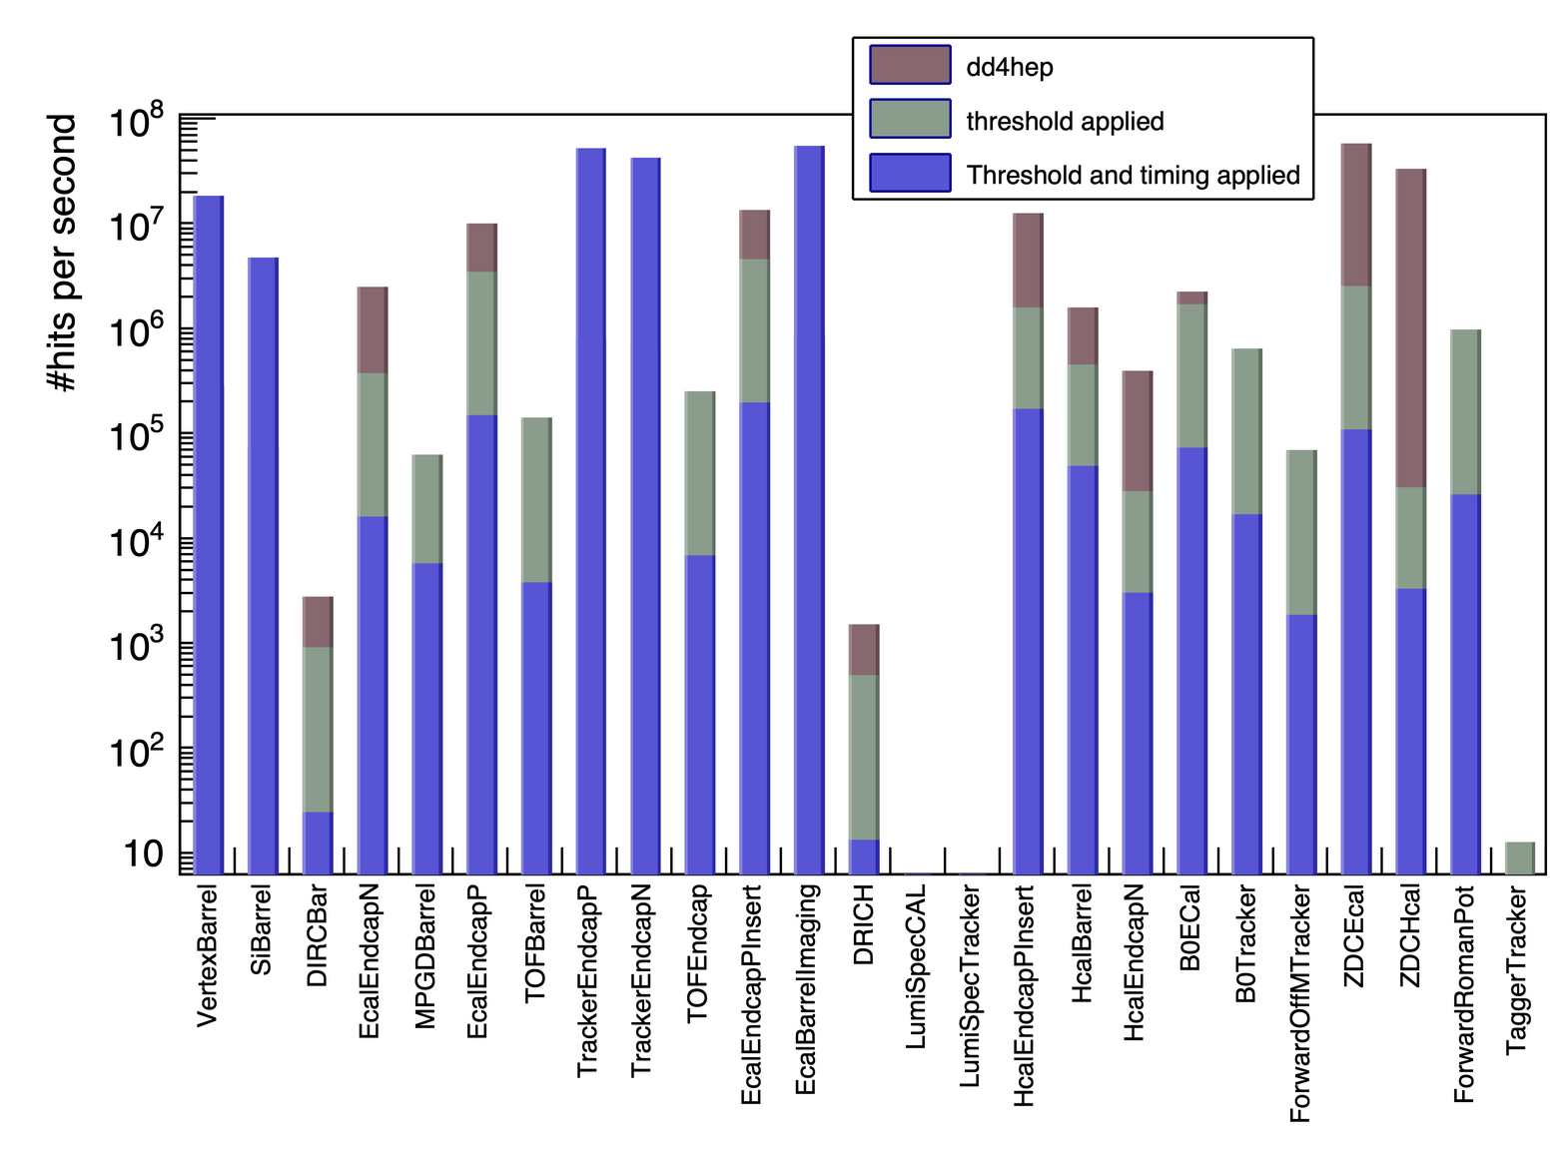
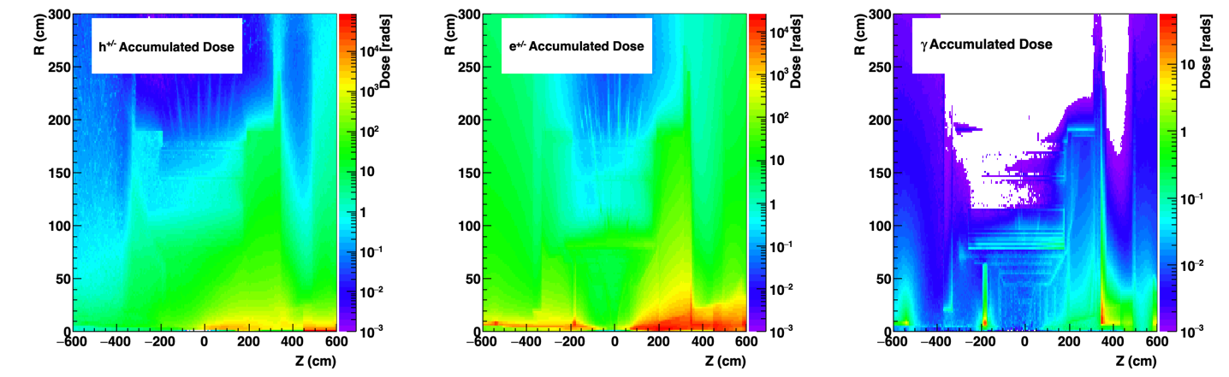
Background/Radiation Simulations
Details: https://wiki.bnl.gov/EPIC/index.php?title=Background
Synchrotron Radiation:
1 MeV Neutron fluence at top luminosity (500 kHz) for
18 GeV x 275 GeV
Electron Beam Gas:
Neutron & proton flux E_{kin}>250 MeV to determine single event upsets
top luminosity & 18 GeV x 275 GeV
Hadron Beam Gas:
Radiation doses at 18 GeV x 275 GeV for top luminosity 500 kHz

Slide 22


Slide 23


Slide 24


Electron and Hadron Polarimetry
Electron Polarimeter:
Method: Compton Backscattering
longitudinal polarization → Energy Asymmetry
transverse polarization → Energy dependent position asymmetry
Requirement:
Need to measure both polarization components
beam is only at IP fully longitudinal polarized
Beamline integration
Backscattered photon cone clearance through quads
Electron detector will need to be ~5 mm from electron beam
  Investigating a Si in vacuum ala off-momentum
  detectors can be used?
In close contact with Accelerator group for SR simulations
and beam backgrounds
Hadron Polarimeter:
Method: RHIC H-Jet and pC Polarimeters
measure polarization through left-right asymmetries in CNI region
Requirement:
Need to measure
absolute polarization → H-jet (slow)
need to measure polarization lifetime, profile and fast feedback to collider
Beamline integration
new location at IP-4
H-Jet and pC fully integrated in lattice, including taggers for He-3 polarimetry
Challenge
make RHIC polarimeters work for the different EIC beam conditions

Slide 25
Current Detector Costs (@January OPA Review)
CD-1 cost estimates updated June 2022 folding in costs estimated as part of the proposal process
further refinements through the recent month
  Status January 2023 including escalation and burdens
Cost, schedule and risks will be further refined in collaboration with ePIC for CD-3A
Total Cost: $283.9M
Cost: $29.72M
Cost: $8.83M
Cost: $12.32M
Cost: $31.44M
Cost: $29.56M
Cost: $36.48M
Cost: $14.73M
Cost: $38.02M
Cost: $9.05M
Cost: $36.74M
Cost: N/A
Cost: $20.71M
Cost: $9.74M

Slide 26
EIC Project Detector R&D
Photon-Sensors:
WBS 6.10.04 & 05 & 06
Assess current state of LAPPD performance. Improve design through iterations to fulfill EIC specifications
  Spatial resolution for Cherenkov imaging applications
  Timing resolution in a single photon mode
  Timing resolution for Time-of-Flight purposes
  Performance in a strong (inhomogeneous) magnetic field
  QE & PDE spectrum optimization
  Geometric form factor optimization
MAPS-Tracker:
Development of a full tracking detector solution composed of 65 nm MAPS sensors Modules from stitched sensors, barrel & discs, mechanics, integration & cooling
reduce the services material load
→ Improved powering and readout system
Development of the EIC sensor: design & characterization
MPGDs:
Development of prototypes of cylindrical MPGDs & planar thin gap MPGDs
AC-LGAD:
Develop system including sensors, ASIC & services for auxiliary detectors and ToF
Electronics & DAQ/Computing
Development of readout solutions for
calorimeters with SiPMs, ASIC based & ADC based
dRICH with SIPMs based on ALCOR
AC-LGAD readout chain with EICROC & FCFD
MPGD readout based on SALSA-ASIC
PID-Detectors:
DIRC: focus on Cosmic ray telescope (CRT), validation of BaBar bars reuse option, and completion of cost optimized hpDIRC design
mRICH: optimize photonsensors + electronics; testbeam of improved prototype
dRICH: Characterize mirror & aerogel; Assessment of dRICH prototype performance with the EIC detection plane
HCals:
Prototype SC-tile production using machining & injection molding & detailed characterization
Sensor board development
first prototype of one full segment
ECals:
bECAL: Full characterization of full SciGlass block designed for EIC by beam test
fECAL: construct 64 channel prototype to optimize light uniformity, light guides, verify performance by test beam
Hadron Polarimetry:
R&D through Accelerator
validate concepts to veto breakup of He-3
new targets for pC-polarimeters

Slide 27





The Scientific Foundation for an EIC was Built Over Two Decades
Electron-Ion Collider..absolutely central to the nuclear science program of the next decade.
2002
“a high-energy high-luminosity polarized EIC [is] the highest priority for new facility construction following the completion of FRIB.”
2007
The science questions that an EIC will answer are central to completing an understanding of atoms as well as being integral to the agenda of nuclear physics today.”
2009
2010
Gluons and the Quark Sea at High Energies
2012
2013
2015
Major Nuclear Physics Facilities for the Next Decade
2018
NSAC
2021
“…essential accelerator and detector R&D [for EIC] should be given very high priority
in the short term.”
“We recommend the allocation of resources …to lay the foundation for a polarized Electron-Ion Collider…”
March 14, 2013
“..a new dedicated facility will be essential for answering some of the most central questions.”
“The quantitative study of matter in this new regime [where abundant gluons dominate] requires a new experimental facility: an Electron Ion Collider..”

Slide 28
EIC Experimental program preparation
Year-long EIC User Group driven EIC Yellow Report activity (December 2019 – February 2021
  Science Requirements and Detector Concepts for the EIC
  arXiv:2103.05419 & Nucl. Phys. A 1026 (2022) 122447 – 554 citations (06/22/2023)
BNL and TJNAF Jointly Leading Efforts Towards Experimental Program | BNL and TJNAF Jointly Leading Process to Select Project Detector
2020 | Call for Expressions of Interest (EOI) https://www.bnl.gov/eic/EOI.php | May 2020
 | EOI Responses Submitted | November 2020
 | Assessment of EOI Responses | On-going&
2021 | Call for Collaboration Proposals for Detectors https://www.bnl.gov/eic/CFC.php | March 2021
 | BNL/TJNAF Proposal Evaluation Committee | Spring 2021
 | Collaboration Proposals for Detectors Submitted | December 2021
2022 | Decision on Project Detector – baseline “ECCE” | March 2022
 | Process to consolidate ECCE & ATHENA to the EIC Project Detector | Spring 2022
 | ePIC Collaboration* Formed – 160 institutions | July 2022
2023 | ePIC Charter ratified & elected Leadership Team | February 2023
 | 1st Resources Review Board Meeting | April 2023
 | ePIC Detector remaining technology choices made | April 2023
&Remains ongoing until formal agreements are in place – it originally led to confirmation that in-kind level assumed for the EIC detector was in range.

Slide 29

High-Level EIC Reference Schedule
Construction Phase
Science Phase
Conclusion of RHIC Operations
The thinner bars indicate that R&D and design
can continue at a small level beyond CD-2 and CD-3
for LLP construction
starts at CD-3A

Slide 30


What is new/special for an EIC Detector
Vertex detector → Identify primary and secondary vertices,
  Low material budget: 0.05% X/X₀ per layer;
  High spatial resolution: 10 μm pitch CMOS Monolithic Active Pixel Sensor
Central tracker → Measure charged track momenta
  MAPS – tracking layers in combination with micro pattern gas detectors
  MPGD: μ-RWell or MicroMegas
electron and hadron endcap tracker → Measure charged track momenta
  MAPS – disks in combination with micro pattern gas detectors
Particle Identification → pion, kaon, proton separation on track level
  RICH detectors (modular and dual radiator RICH, DIRC) & Time-of-Flight
  high resolution timing detectors (LAPPS, LGAD) 10 – 30 ps
  novel photon sensors: MCP-PMT / LAPPD
Electromagnetic calorimeter → Measure photons (E, angle), identify electrons
  PbWO₄ Crystals (backward), W/SciFi Spacal (forward)
  Barrel: Pb/SciFi+imaging part
Hadron calorimeter → Measure charged hadrons, neutrons and K_{L}⁰
  challenge achieve ~50%/√E + 10% for low E hadrons (<E> ~ 20 GeV)
  Fe/Sc sandwich with longitudinal segmentation
DAQ & Readout Electronics: trigger-less / streaming DAQ
  Integrate AI into DAQ → cognizant Detector
Very forward and backward detectors → scattered particles under very small angles
  Silicon tracking layers in lepton and hadron beam vacuum
  Zero – degree high resolution electromagnetic and hadronic calorimeter
Polarimetry
  Lepton: integrated transverse and longitudinal Compton polarimeter
  Hadron: absolute and relative hadron polarimetry in the CNI region
Radius/Distance from IP

Slide 31

DOE Reference Funding Plan
DOE Inflation Reduction Act funding of $138M allocated in September 2022. Actual FY2023 funding is $70M. DOE request for FY2024 is $98M.
RHIC shut down planned for June 2025. Significant RHIC Operations funding will be redirected to EIC construction starting in FY2025 and reaching ~$150M/year in FY2026.
Current funding supports DOE CD-3A, Long Lead Procurement Approval, in January 2024. Long lead procurement mitigate risks: technical, supply chain, inflation, and schedule.
In-kind contributions anticipated at 5% of accelerator and 30% of the detector, in addition to $100M from NY State (in green).

