Slide 1
Incremental Design and Safety Review of the EIC Particle Identification Detectors
Elke Aschenauer and Rolf Ent
Co-Associate Directors for the Experimental Program
July 05 2023

Slide 2
Review Committee
Peter Krizan (U Ljubljana), Chair
Floris Keizer (CERN)
Ana Amelia Machado (UniCamp)
Koji Nakamura (KEK)
Justin Stevens (W&M)
Many thanks!!!!
We may also have several observers:
DOE/NP representatives
Members of the ePIC Collaboration Leadership Team
ePIC Collaboration Members working on Particle Id systems

Slide 3

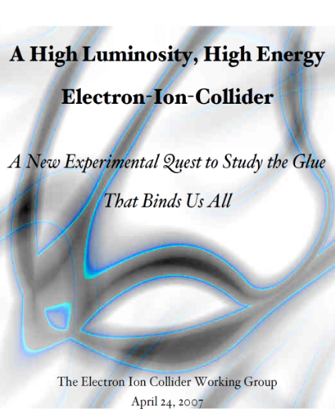



The Scientific Foundation for an EIC was Built Over Two Decades
Electron-Ion Collider..absolutely central to the nuclear science program of the next decade.
2002
“a high-energy high-luminosity polarized EIC [is] the highest priority for new facility construction following the completion of FRIB.”
2007
The science questions that an EIC will answer are central to completing an understanding of atoms as well as being integral to the agenda of nuclear physics today.”
2009
2010
Gluons and the Quark Sea at High Energies
2012
2013
2015
Major Nuclear Physics Facilities for the Next Decade
2018
NSAC
2021
“…essential accelerator and detector R&D [for EIC] should be given very high priority
in the short term.”
“We recommend the allocation of resources …to lay the foundation for a polarized Electron-Ion Collider…”
March 14, 2013
“..a new dedicated facility will be essential for answering some of the most central questions.”
“The quantitative study of matter in this new regime [where abundant gluons dominate] requires a new experimental facility: an Electron Ion Collider..”
Science Requirements and Detector Concepts for the EIC – Drives the requirements of EIC detectors

Slide 4



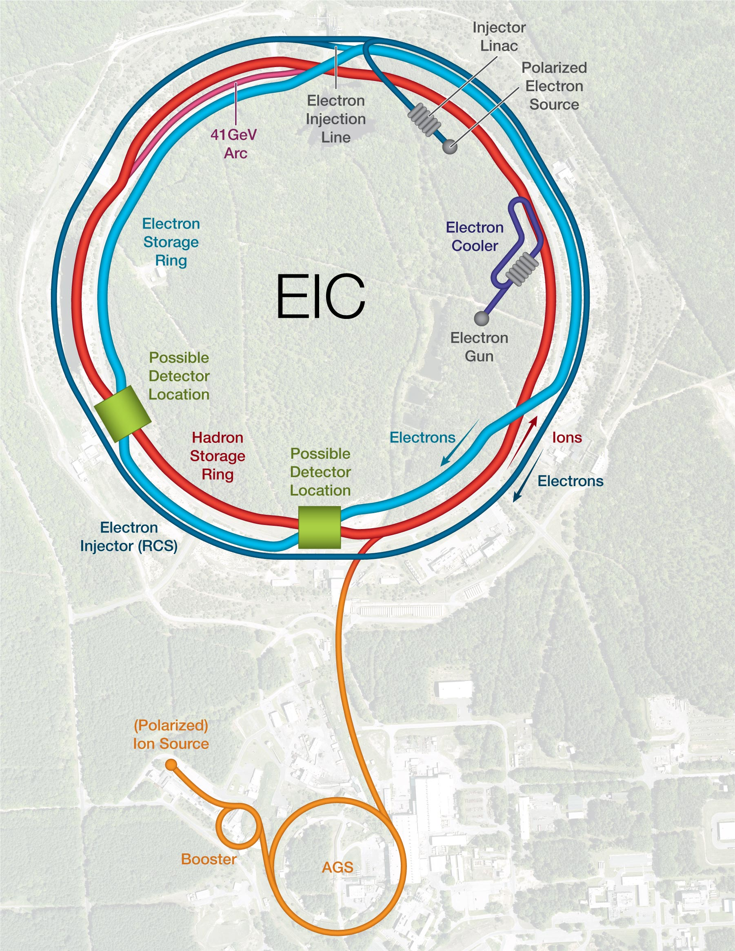

EIC Scope
Project Design Goals
High Luminosity: L= 10³³ – 10³⁴cm⁻²sec⁻¹, 10 – 100 fb⁻¹/year
Highly Polarized Beams: 70%
Large Center of Mass Energy Range: E_{cm} = 29 – 140 GeV
Large Ion Species Range: protons – Uranium
Large Detector Acceptance and Good Background Conditions
Accommodate a Second Interaction Region (IR)
Possible
2nd Detector
Location
Project
Detector
Location
IR-8
IR-6
IR-8
p/A beam
e beam
p: 41 GeV, 100 to 275 GeV
e: 5 GeV to 18 GeV

Slide 5
EIC Detector - Background
The community-driven Yellow Report, an activity from December 2019 thru February 2021) drives the science requirements and detector concepts of EIC.
Science Requirements and Detector Concepts for the EIC
arXiv:2103.05419 & Nucl. Phys. A 1026 (2022) 122447 – 554 citations (06/22/2023)
BNL and TJNAF Jointly Leading Efforts Towards Experimental Program | BNL and TJNAF Jointly Leading Process to Select Project Detector
2020 | Call for Expressions of Interest (EOI) https://www.bnl.gov/eic/EOI.php | May 2020
 | EOI Responses Submitted | November 2020
 | Assessment of EOI Responses | On-going&
2021 | Call for Collaboration Proposals for Detectors https://www.bnl.gov/eic/CFC.php | March 2021
 | BNL/TJNAF Proposal Evaluation Committee | Spring 2021
 | Collaboration Proposals for Detectors Submitted | December 2021
2022 | Decision on Project Detector – baseline “ECCE” | March 2022
 | Process to consolidate ECCE & ATHENA to the EIC Project Detector | Spring 2022
 | ePIC Collaboration* Formed – 160 institutions | July 2022
2023 | ePIC Charter ratified & elected Leadership Team | February 2023
 | 1st Resources Review Board Meeting | April 2023
 | ePIC Detector remaining technology choices made | April 2023
&Remains ongoing until formal agreements are in place – it originally led to confirmation that in-kind level assumed for the EIC detector was in range.

Slide 6
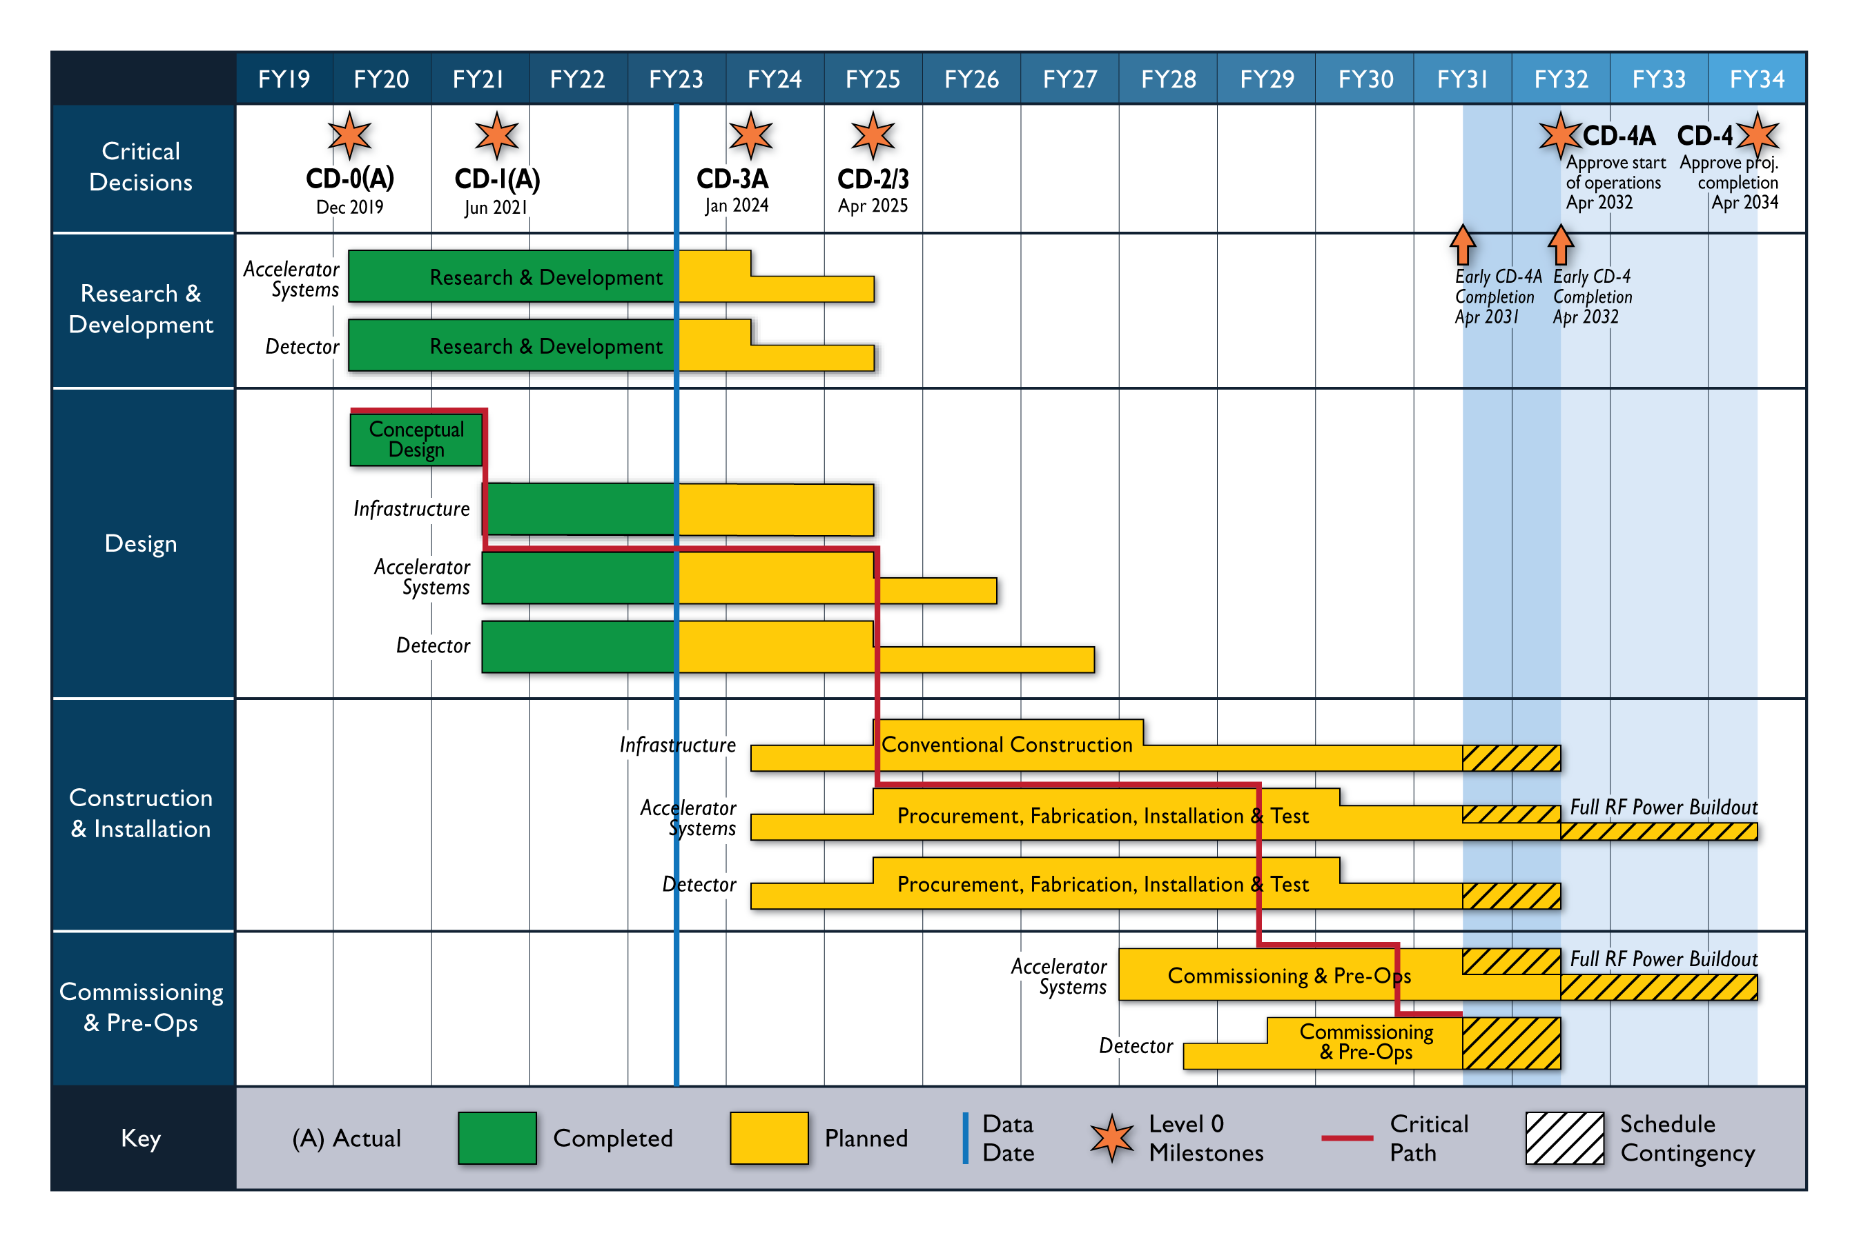
High Level EIC Reference Schedule
Construction Phase
Science Phase
Conclusion of RHIC Operations
The thinner bars indicate that R&D and design
can continue at a small level beyond CD-2 and CD-3
for LLP construction
starts at CD-3A

Slide 7
EIC Particle Id Detectors Review – Context for Status
CD-2: “CD-2 is an approval of the preliminary design of the project and the baseline scope, cost, and schedule. What is most relevant is that CD-2 means there is now a definitive plan that the project will be measured against in cost, schedule and technical performance.”
This means that at CD-2 one requires a Preliminary Design to be completed. Read this as the design is at about 50-60% complete.
CD-3: “CD-3 is an approval of the project’s final design and authorizes release of funds for construction.”
This means a Final Design has to be completed. Read this as the design is about 90% complete as for some systems it may still require detailing, or design changes during vendor construction, etc.
At this stage one needs a Final Design Report. Read this as a Technical Design Report for European projects.
Given that CD-2 and CD-3 are essentially at the same time, with their DOE review expected ~January 2025, we need a final design and a Technical Design Report in 1.5 years.

Slide 8
Incremental Design and Safety Review of the EIC Particle Identification Detectors – Scope
Scope:
The scope of this review includes all aspects of particle identification detectors (but not those that are calorimetry-based) in the central EIC detector, which includes the barrel, the forward endcap, and the backward endcap regions. This includes five detector systems. In particular, a proximity-focusing RICH in the backward region, a high-performance DIRC and AC-LGAD to augment particle identification with TOF in the barrel region, and a dual RICH and AC-LGAD in the forward region. The review may include design and fabrication choices and their cost-effectiveness, the construction schedule, considerations for safety and quality assurance, levels of redundancy, front-end electronics and interface to the data acquisition system, commissioning and calibration procedures, considerations for materials and labor, operational reliability and longevity, and any other considerations that may influence the construction, maintenance and operation of these particle identification detectors.*
*The reason why we give this long list is not that we want you to address all of this, but more to indicate that we welcome your advise in all areas.

Slide 9
Incremental Design and Safety Review of the EIC Particle Identification Detectors – Charge
You are asked to address the following questions:
Are the technical performance requirements appropriately defined and complete for this stage of the project?
Are the plans for achieving detector performance and construction sufficiently developed and documented for the present phase of the project?
Are the current designs and plans for detector and electronics readout likely to achieve the performance requirements with a low risk of cost increases, schedule delays, and technical problems?
Are the fabrication and assembly plans for the various particle identification detector systems consistent with the overall project and detector schedule?
Are the plans for detector integration in the EIC detector appropriately developed for the present phase of the project?
Have ES&H and QA considerations been adequately incorporated into the designs at their present stage?
Please address the above questions point-by-point.
Please note that the formal charge is general-written, this is such that we can keep some consistency of the charges both for other subsystem reviews (electronics/DAQ, calorimetry, polarimetry, etc.) and at subsequent preliminary and final design reviews that we need on the path to completing the EIC Project Detector designs.

Slide 10
Incremental Design and Safety Review of the EIC Particle Identification Detectors – Report
We will work with you to make the report of this review as easy as possible: we do not want to take up more of your time beyond this review.
Often US reviews work with findings (statements of fact, what was presented), comments (what your opinion is and possible suggestions on what things to further consider) and a set of formal recommendations (what you strongly feel the project should address) – you can follow this but do not have to. The main result of these status reviews is to collect your feedback and suggestions.
In principle, we can add a front page, the review committee listing, the charge and agenda to whatever you use at the closeout and call that the report. The minimum we need is a short answer to each of the charge elements, and what you see as suggestions for further work and as formal recommendations.
Three earlier status review used the summaries of the closeout, two opted for one more round of editing to this material. In either case, we need to agree with you what the formal recommendations are (they are added to a project recommendation tracker).
Formal recommendations are usually high level and critical. Questions and discussion during the Review and comments in the closeout and report will already be taken to heart by the EIC project CAMs and the ePIC collaboration for progress.

Slide 11
Agenda
Timing: 2 days, each day from 8 am to 2 pm EDT.
Closeout tentative at 13:40 pm of second day.
(Each talk time was instructed to assume more than 1/3 of time for questions and discussion)
July 5
8:00 (30 min) Executive Session (Closed Session)
8:30 (30 min) Welcome and Introduction (introduce the general project status) – Elke/Rolf
9:00 (30 min) Particle Identification Systems Overview and Requirements – Beni Zihlmann (JLab)
9:30 (30 min) Detector Integration Status and CAD Design – Alex Eslinger (JLab)
10:00 (20 min) Flow of Requirements, Interfaces and system engineering – Walt Akers (JLab)
10:20 (20 min) Break
10:40 (50 min) Backward Region: proximity-focusing RICH – Alexander Kiselev (BNL)
11:30 (50 min) Forward Region: dual RICH – Marco Contalbrigo (INFN Ferrara)
12:20 (50 min) Barrel Region: high-performance DIRC – Greg Kalicy (CUA)
13:10 (50 min) Executive Session – Discussion
July 6
8:00 (40 min) Barrel and Forward TOF: AC-LGAD – Zhenyu Ye (UIC)
8:40 (20 min) AC-LGAD readout systems – Dominique Marchand (IJCLab) & Tonko Ljubicic (BNL)
9:00 (20 min) Readout and Sensors Status SiPMs – Roberto Preghenella (INFN Bologna)
9:20 (20min) Readout and Sensors Status LAPPD/HRPPD – Alexander Kiselev (BNL)
9:40 (20 min) DAQ streaming readout Overview – David Abbott (JLab)
10:00 (20 min) Break
10:20 (60 min) Discussion as needed, Follow-ups, or start of Executive Session
11:20 (140 min) Executive Session
13:40 (20 min) Closeout

Slide 12


Slide 13


Slide 14
Schedule – What Do the CD Milestones Mean?
CD-0 – Approve mission need: this documents that a scientific goal or a new capability, requiring material investment exists.
CD-1 – Approve Alternative Selection and Cost Range: serves as a determination that the selected alternative and approach is optimized to meet the mission need defined at CD-0. What is perhaps most relevant is that CD-1 allows for release of Project Engineering and Design (PED) funds, which means the next phases of design of accelerator and detector can begin.
CD-2 – Approve Performance Baseline: CD-2 is an approval of the preliminary design of the project and the baseline scope, cost, and schedule. What is most relevant is that CD-2 means there is now a definitive plan that the project will be measured against in cost, schedule and technical performance.
CD-3 – Approve Start of Construction: CD-3 is an approval of the project’s final design and authorizes release of funds for construction. What is most relevant is that projects can now proceed with construction related procurements and activities. CD-3 is sometimes split in CD-3A in a tailored approach to approve start construction for long-lead procurements.
CD-4 – Approve Start of Operations or Project Completion: CD-4 provides recognition that the project’s objectives have been met. CD-4 is sometimes split in CD-4A that allows, after agreed-upon criteria for technical success have been met, for transition into operations, and CD-4B that provides the formal closeout of the project.

