Slide 1
Results from STA/ITL Fully Depleted CCDs for LSST
Michael Lesser & David Ouellette
University of Arizona
Imaging Technology Laboratory
Steward Observatory
lesser@itl.arizona.edu

Slide 2
Overview
Sensor Description
STA3800 Science Sensors
STA4400 Wavefront Sensors
Electro-Optical Characterization
Measurement Processes
Results
Metrology Characterization
Measurement Processes
Results
Sensors developed for LSST during multiple project phases
Test specifications defined by LSST project

Slide 3
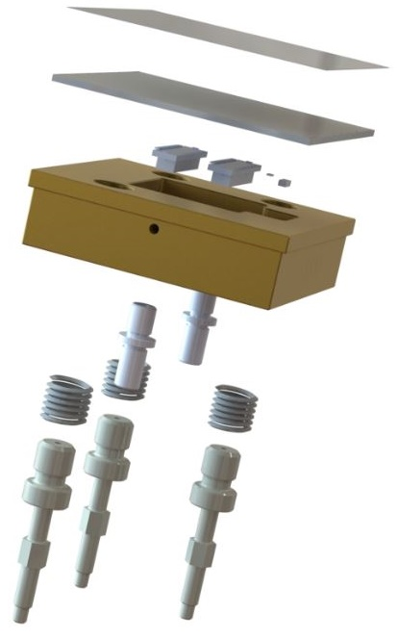
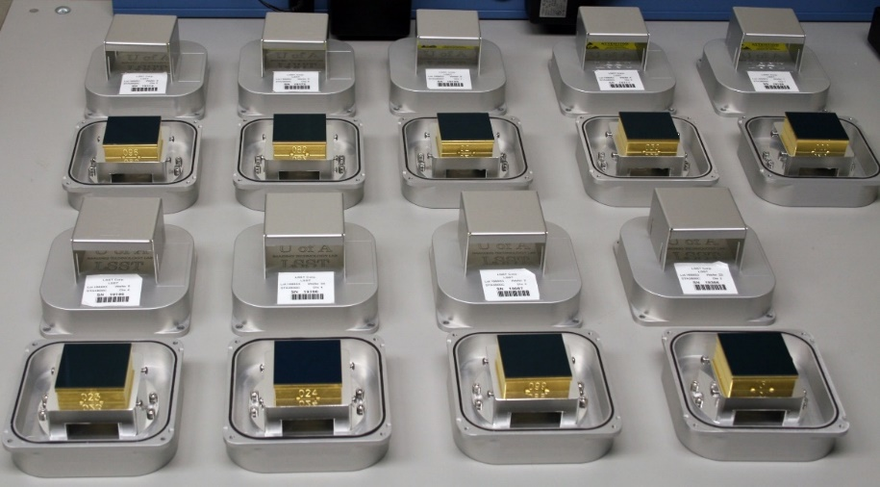
STA3800 Science Sensors
4072 x 4000 10 um pixels
16 video channels (8x2)
Custom package for LSST
sensor hybridized to AlN ceramic with connectors, RTD, 1-wire LAN
hybrid mounted to CE5 Al-Si allow
alignment pins and studs installed in CE5
packaged sensor exploded view
STA3800 sensors in shipping containers

Slide 4
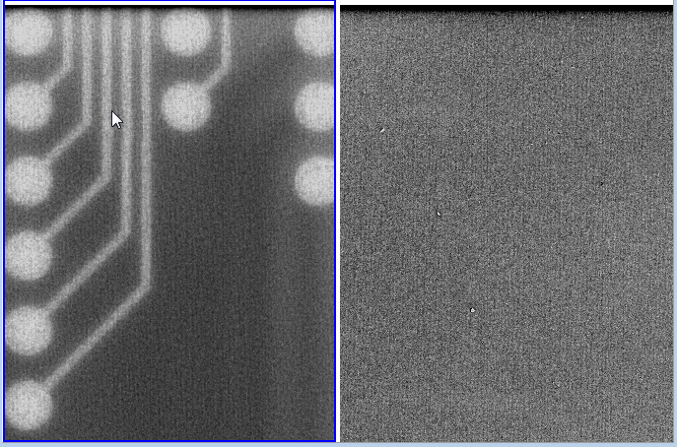
STA3800 Science Sensors
“Lithoblack” added to wafer frontside to reduce IR “print-thru” reflections off ceramic metal films
Select masks rewritten using the highest resolution mask writer available to reduce fixed patterns
without/with “Lithoblack” - 1000 nm
without/with high-res masks

Slide 5
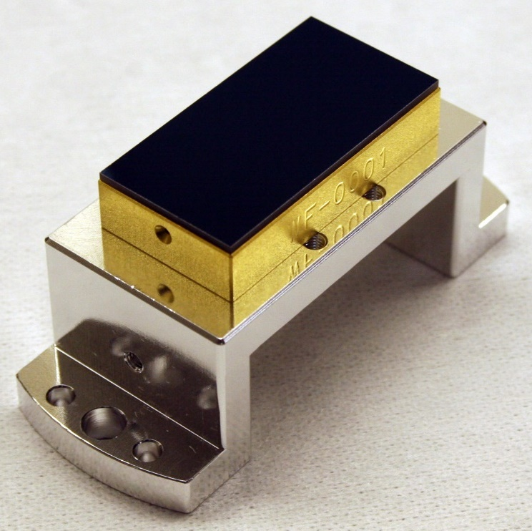
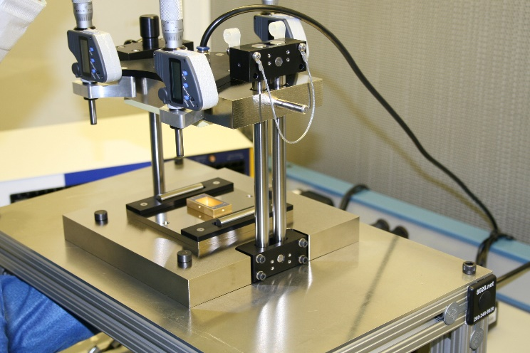
STA4400 Wavefront Sensors
4072 x 2000 10 um pixels
8 video channels (8x1)
Custom package for LSST
High resolution masks used
Lithoblack applied to wafers
STA4400 packaged sensor on test tower
packaging jig

Slide 6
Electro-Optical Characterization
Three LSST production systems and one test system
All operate STA3800 or STA4400 sensors
LN₂ for rapid cooling
Internal heaters for rapid heating
Internal Fe55 x-ray sources for calibration
Receives LSST test tower without dismounting sensor
Dedicated lab for LSST
Main ITL characterization lab also available for tests/development
Arc lamp, filters, fiber optic light pipe, integrating sphere with reference diode, baffled tube, CryoCon temperature controllers, dewar dock
Fully automated acquisition using Python scripts

Slide 7
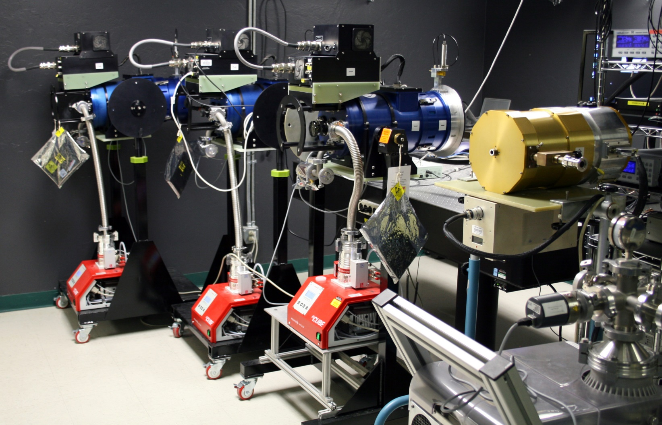
Electro-Optical Characterization
STA Archon controllers
ARC Gen3 controller
turbo pumps
LN₂ dewars on carts

Slide 8
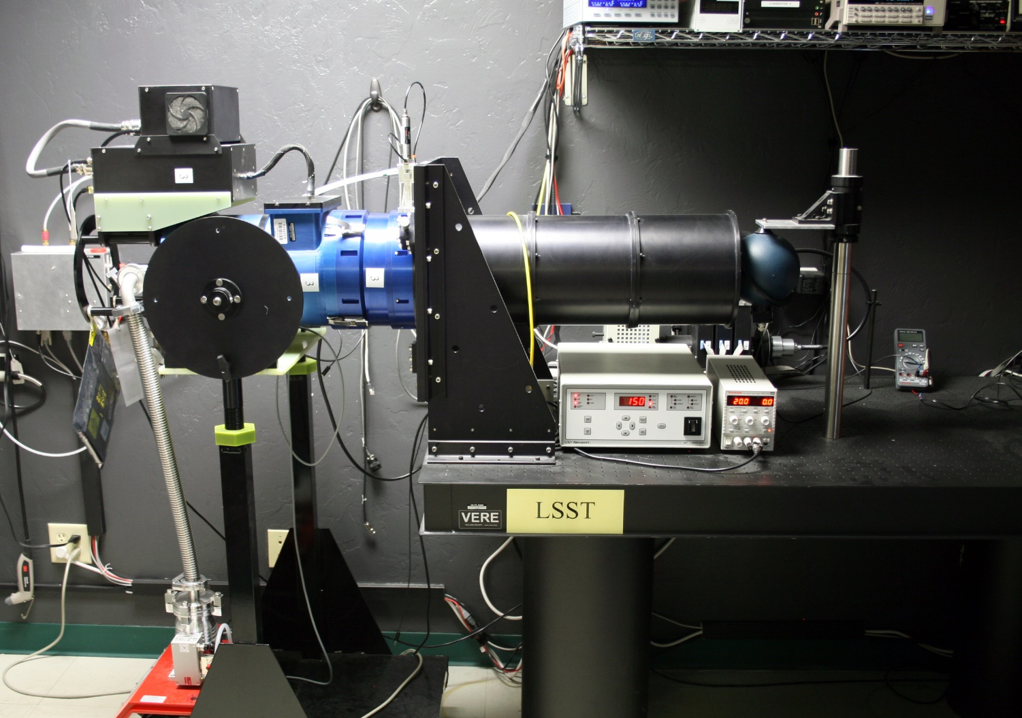
Electro-Optical Characterization
Integrating sphere + baffled tube
Light source + filters
LSST Testing Lab

Slide 9
Electro-Optical Characterization
Three STA Archon controllers
Internal -100 V backside bias control
530 kHz operation
Code file delivered with each sensor (typically not changed)
One Gen III ARC controller
Used for development, testing, calibrations
Acquisition script (automated)
Sets bias levels
Calibrates flux at each test wavelength
Waits for final temperature
Acquires data
Emails
Begins warm-up process
~1 TB of data analyzed for following slides…

Slide 10
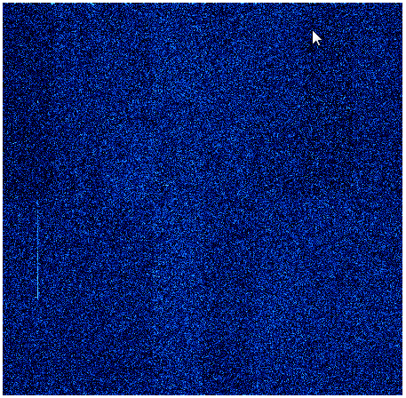
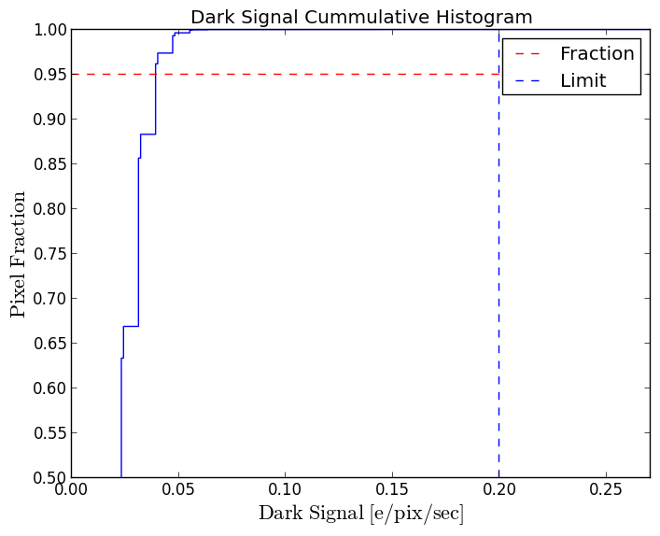
Electro Optical Results
Dark Signal
Five 10 minute darks per sensor
Dominate issue is bright column due to defects after etching
Very small number of sensors have “glows” at serial register sides
Very small number of sensors have “edge glows” related to backside bias
Dark Signal (-95 C) : 54 sensors
Fraction < 0.05 e⁻/pix/sec | σ
95.6 | 0.6
LSST spec: 95% pixels ≤ 0.2 e⁻/pix/sec

Slide 11
Electro Optical Results
Quantum Efficiency
Data acquired with 10 nm band-pass filters
Wavelengths: 330, 350, 370, 450, 500, 620, 750, 870, and 1000 nm
QE reported for bands: u, g, r, i, z, y
500 nm
 | Quantum Efficiency – 48 sensors @ -95C
Band | u | g | r | i | z | y
Mean QE | 0.639 | 0.886 | 0.904 | 0.970 | 0.920 | 0.328
σ | 0.070 | 0.040 | 0.016 | 0.000 | 0.013 | 0.011

Slide 12
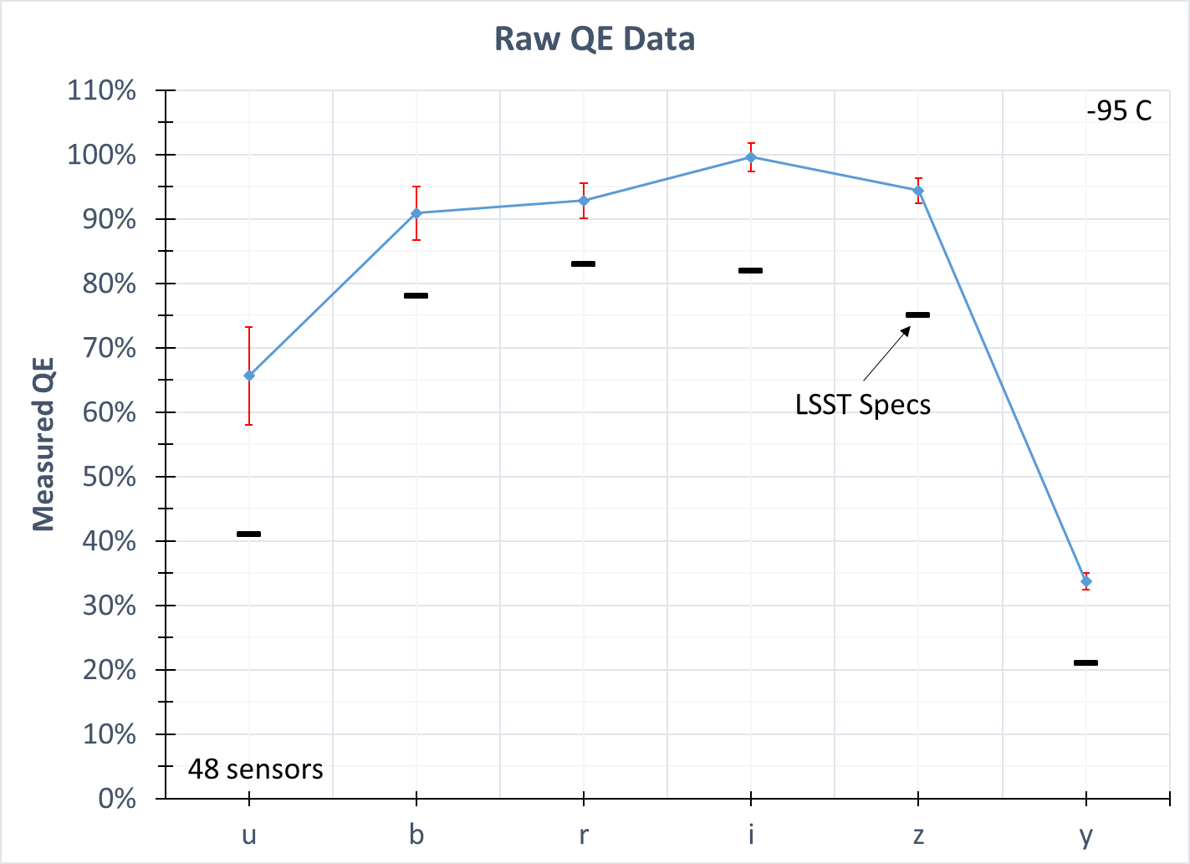
Electro Optical Results
500 nm

Slide 13
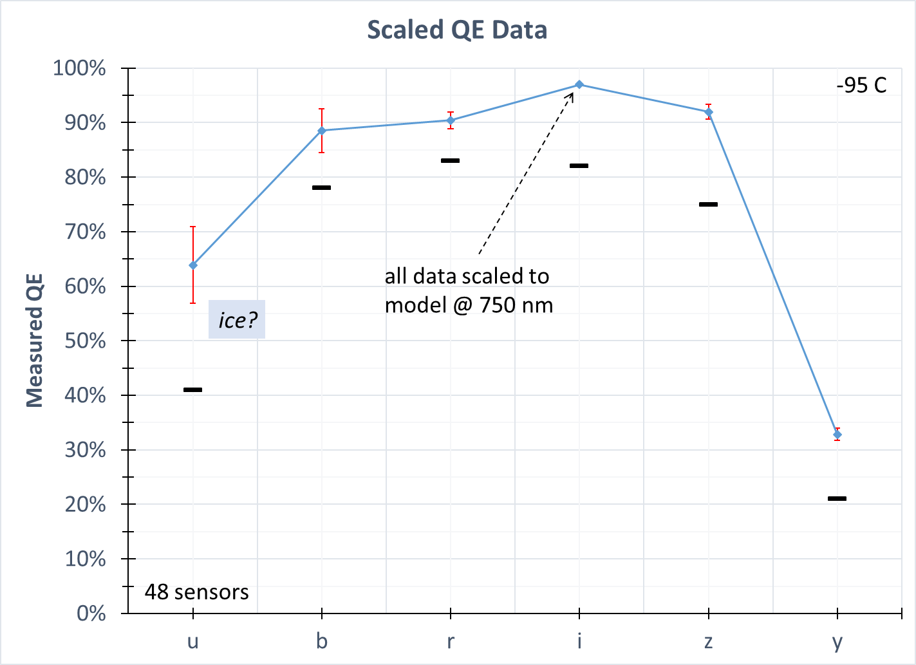
Electro Optical Results

Slide 14
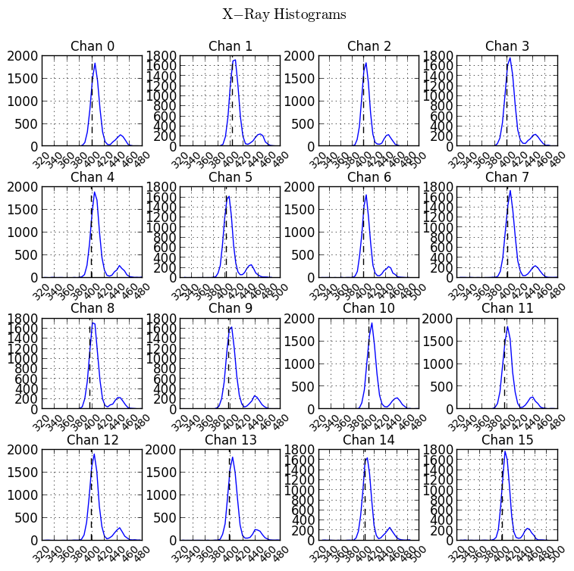
Electro Optical Results
Charge Diffusion
60 second Fe-55 images
Each amplifier section analyzed
Some software confusion from defects
Backside bias -35 to -50 V
increased bias may increase defects
Charge Diffusion “sigma” : 56 sensors
Mean sigma (µm) | σ
4.73 | 0.4
LSST spec ≤ 5 µm

Slide 15
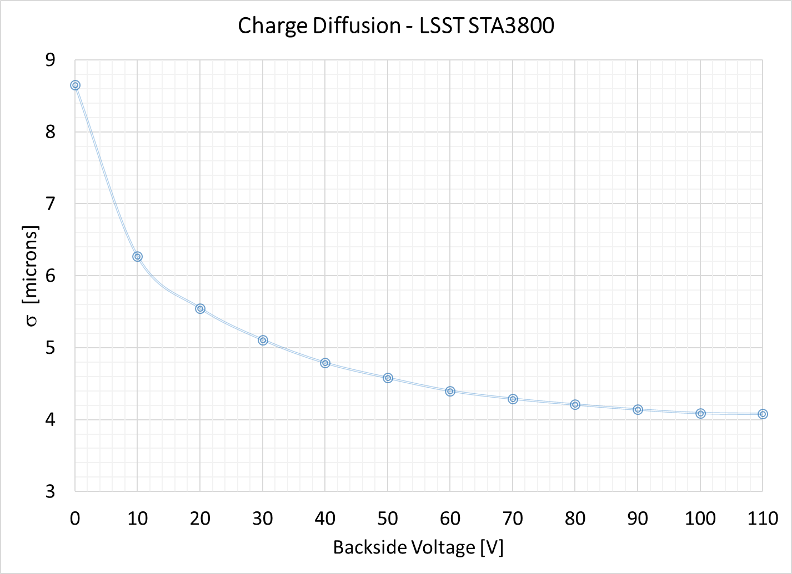
Electro Optical Results
$$σ=\frac{FWHM}{2\sqrt{log⁡(2)}}$$

Slide 16
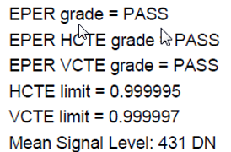
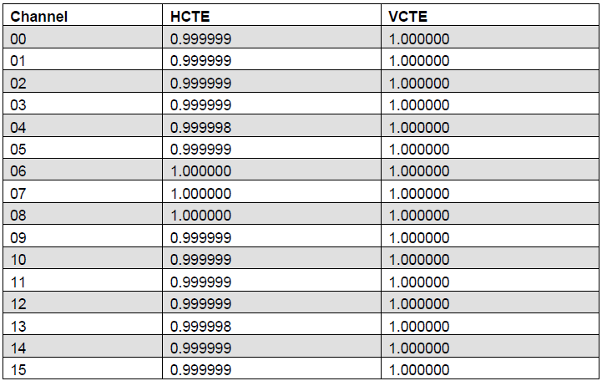
Electro Optical Results
Charge Transfer Efficiency
Measured with Extended Pixel Edge Response (EPER) method
High and low level flats (combined)
5 x 50k e⁻ and 50 x 1k e⁻ images
No VCTE issues seem
Some HCTE issues…

Slide 17
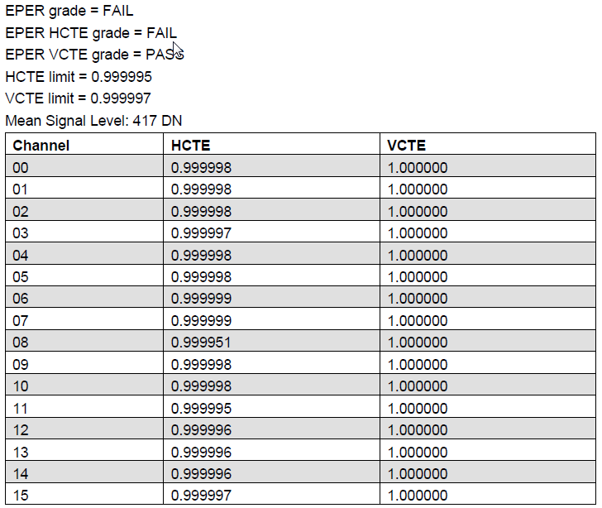
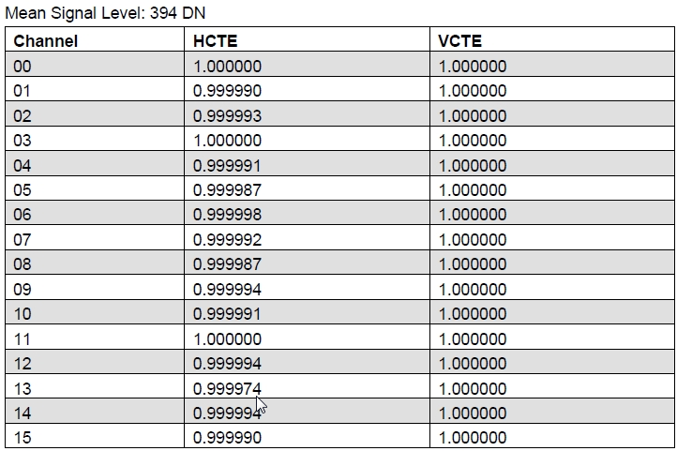
Electro Optical Results
Some batches have shown poor HCTE (0.9999x)
Suspect process issue by a vendor
Poor HCTE channels also have “sloped” lead-in bias level
single channel fail
serious HCTE fail

Slide 18
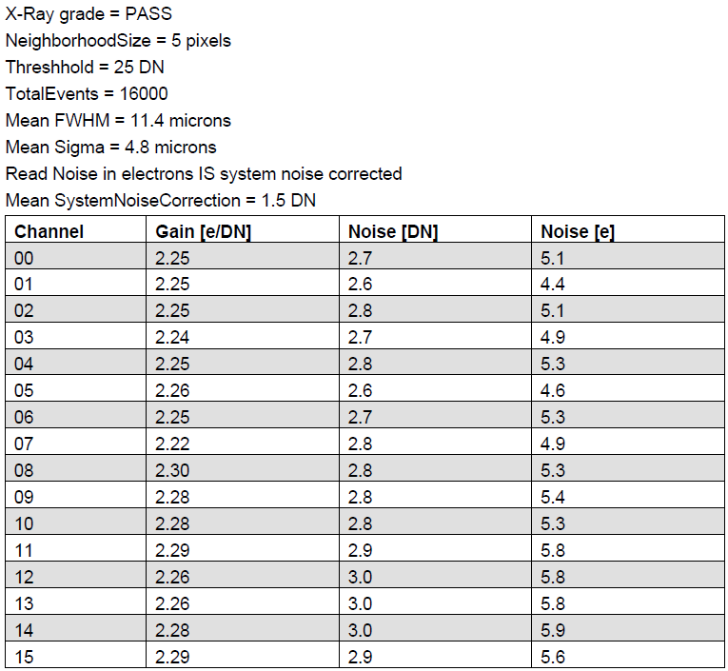
Electro Optical Results
Read Noise
Measured twice per sensor
PTC @ ~1600 e⁻
Fe55 overscan noise using Fe55-derived system gain
noise PASS
LSST spec < 8 e⁻ rms

Slide 19
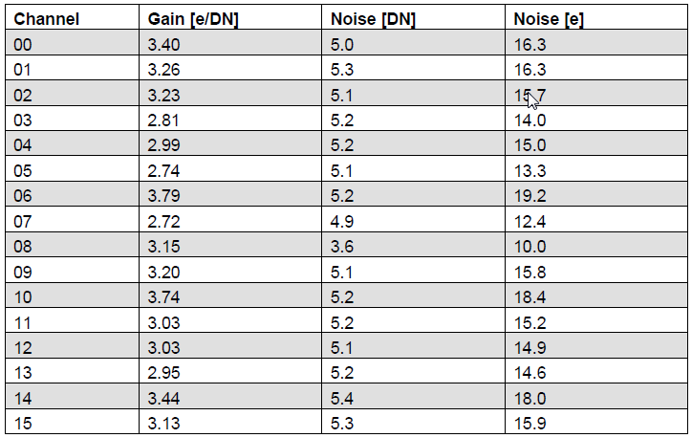
Electro Optical Results
Read Noise
Sensors with poor HCTE usually have higher noise (~15 e⁻)
noise FAIL

Slide 20
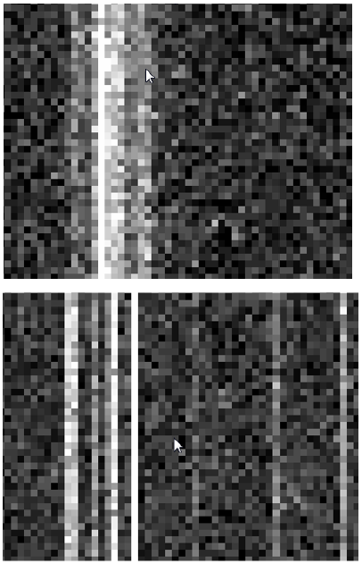
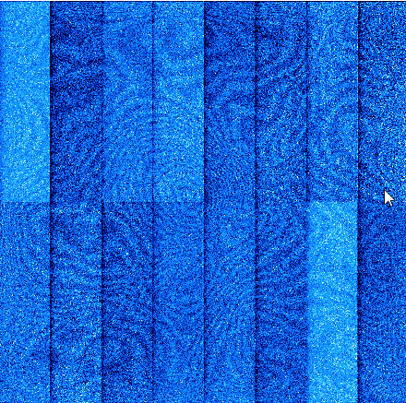
Electro Optical Results
gauge on
gauge off
Miscellaneous
Backside
column defects
Frontside
No phosphorescence or radioactivity found in AlN but vacuum gauge glow detected (no lithoblack)
low bias: -5V bias
fringing seen only @ 973 nm ± < 5 nm (internal lithoblack/epoxy)

Slide 21
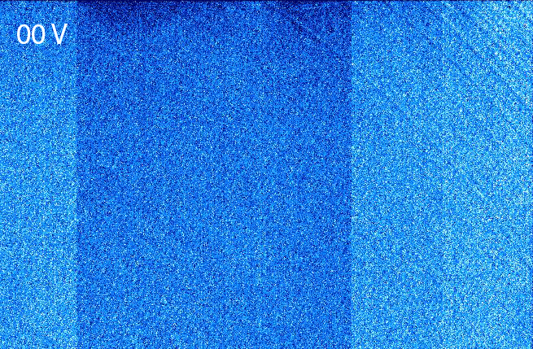
Electro Optical Results
“Tree Rings”
Backside bias voltage:
0 V to -70 V

Slide 22
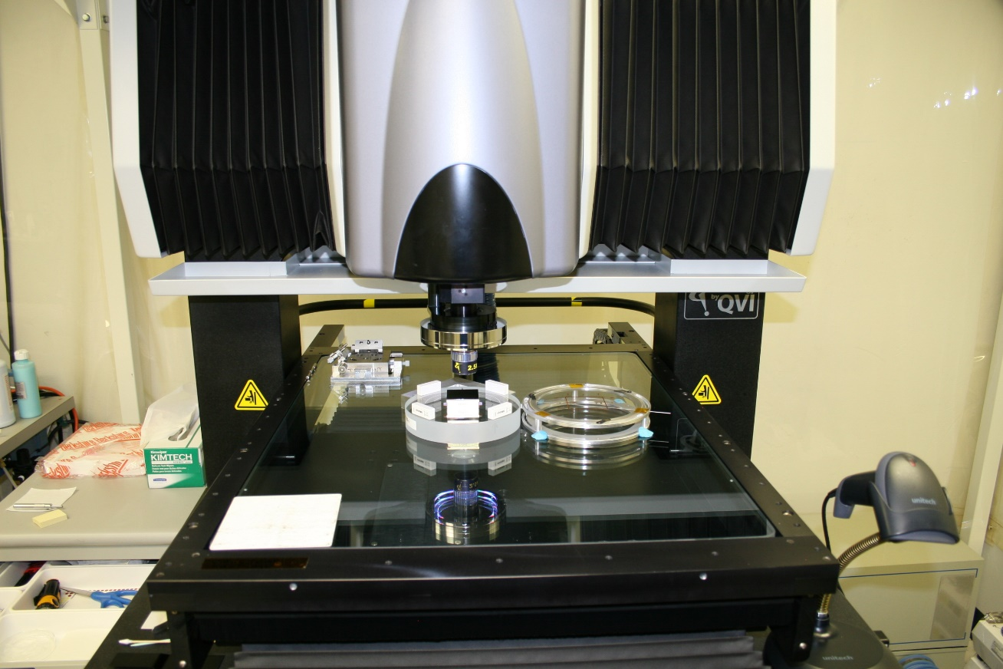
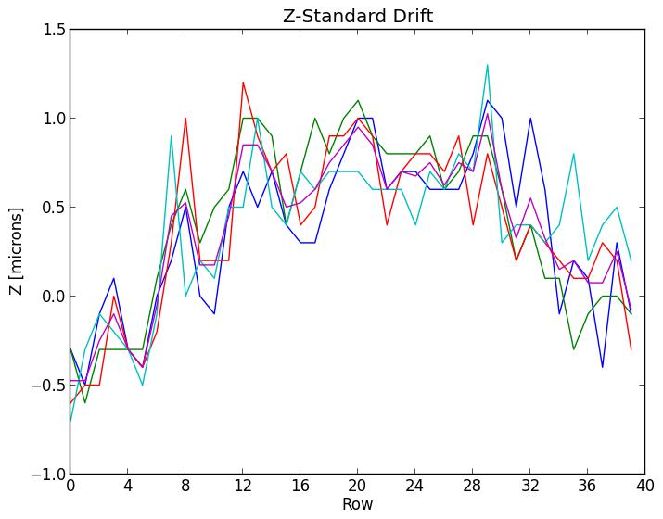
Metrology Characterization
VIEW Summit 600 CMM
Machined-glass mounting jig
Mounting torque of sensor important
Added correction for equipment/lab temperature drift by measuring four standards on each “line” scan throughout sensor measurement process

Slide 23
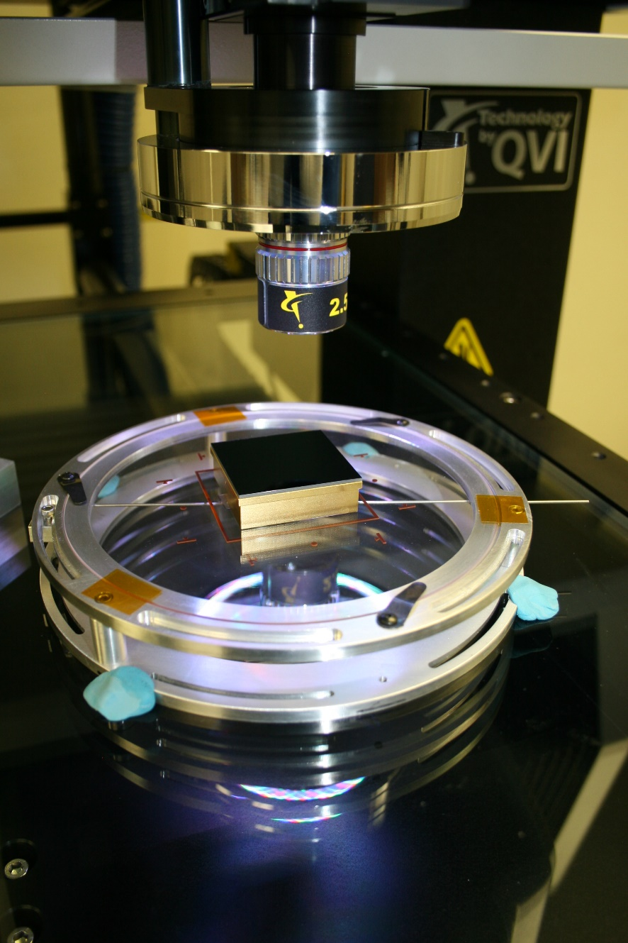
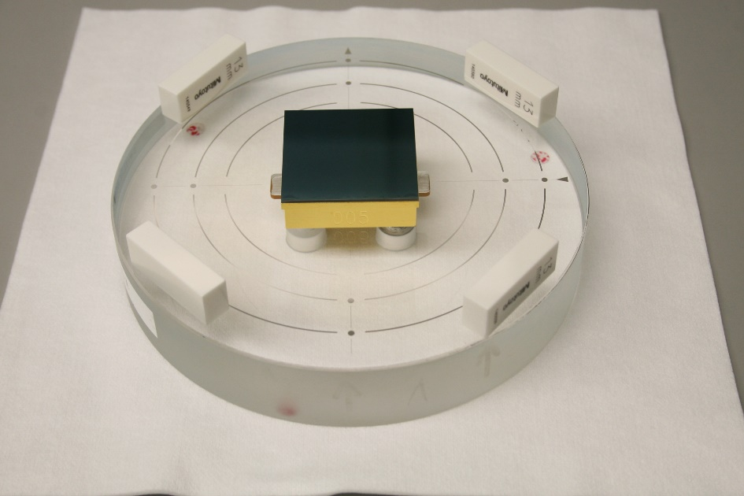
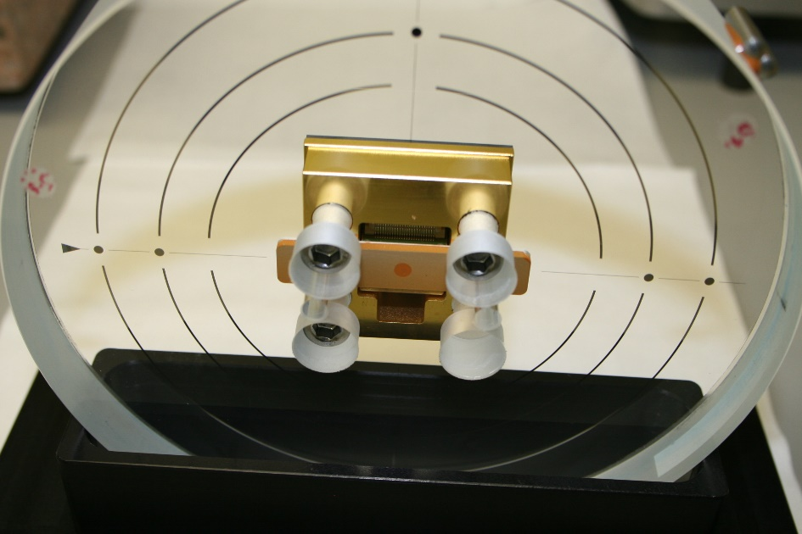
Metrology Characterization
Machined glass mounting jig

Slide 24
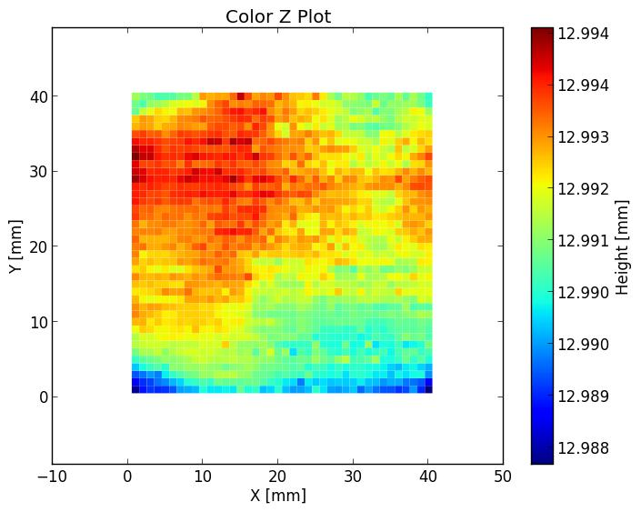
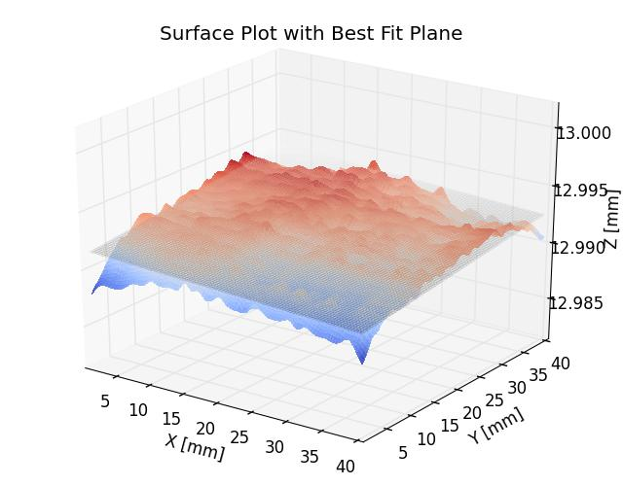
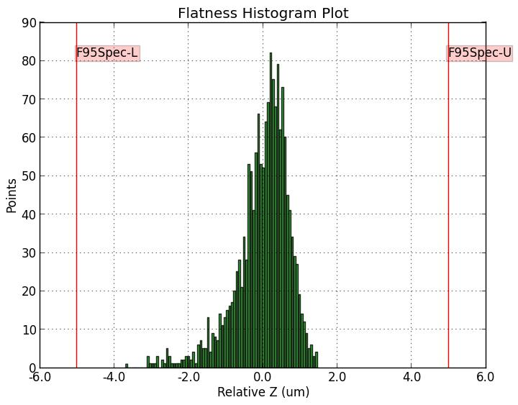
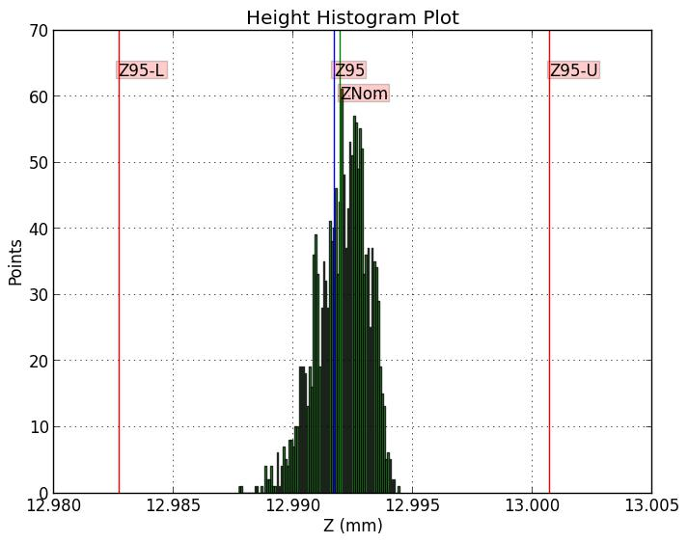
Metrology Characterization
data products

Slide 25
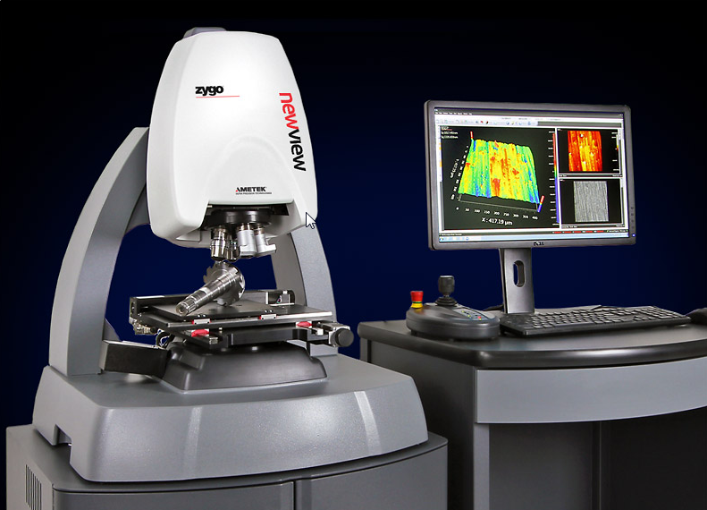
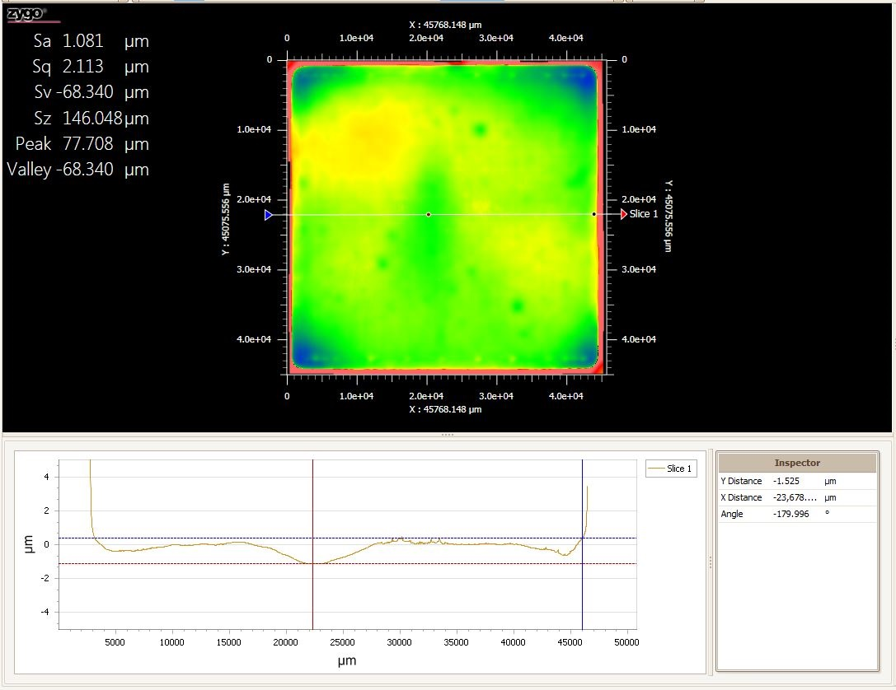
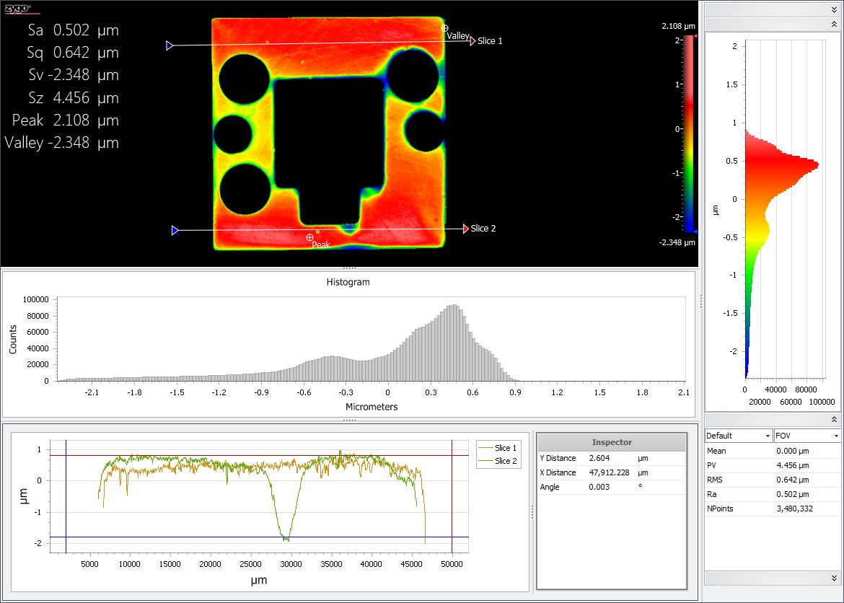
Metrology Characterization
Zygo NextVIEW 8000 3D Optical Surface Profiler
surface studies & calibrations
< 1 nm – 20 mm height
Analysis of sensors during processing
image area ±1 µm
cold surface flatness < 1 µm

Slide 26
Metrology – Room Temp
STA3800 – means of a sample of 59 sensors
Height
Mean (mm) | Median (mm) | Z-95 (mm) | σ (µm)
12.9923 | 12.9924 | 12.9918 | 1.2
Flatness
F-95 (µm) | F-Range (µm) | σ (µm)
1.80 | 6.28 | 0.8
F-95 is flatness half-band (spec ± 5 µm)
Z-95 is height half-band (spec ± 9 µm)
F-Range is full range (max-min)

Slide 27
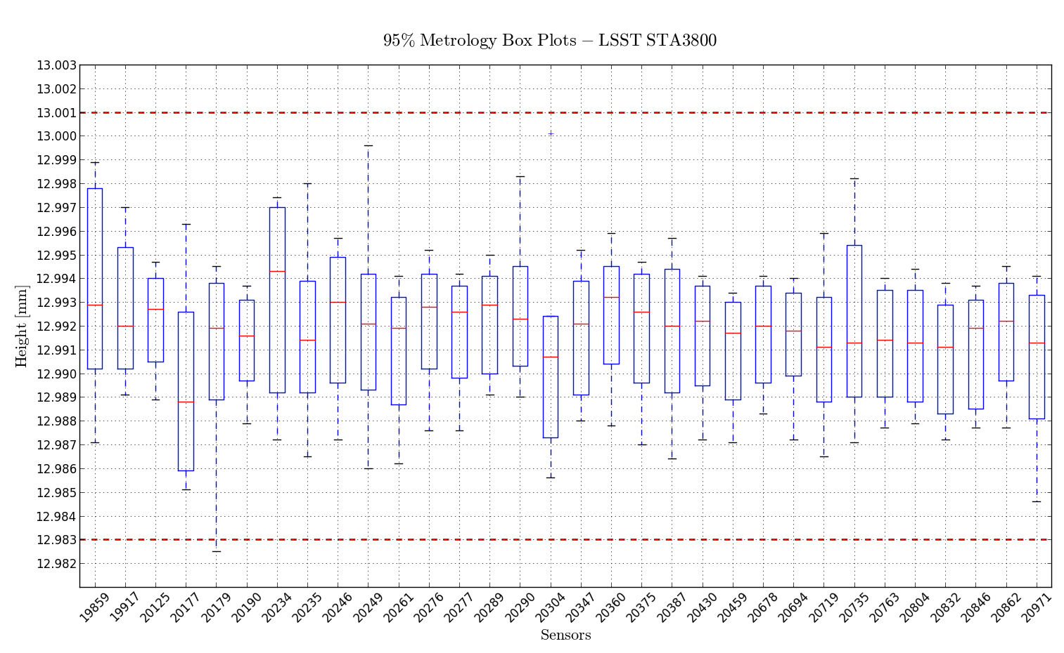
Metrology – Room Temp
95% limits
95% data (boxes) and 100% data (lines) – 32 sensors

Slide 28
Metrology – Room Temp
STA4400 – means of a sample of 14 sensors
Height
Mean (mm) | Median (mm) | Z-95 (mm) | σ (µm)
9.0036 | 9.0037 | 9.0034 | 1.3
Flatness
F-95 (µm) | F-Range (µm) | σ (µm)
1.69 | 4.77 | 0.8
F-95 is flatness half-band (spec ± 5 µm)
Z-95 is height half-band (spec ± 9 µm)
F-Range is full range (max-min)

Slide 29
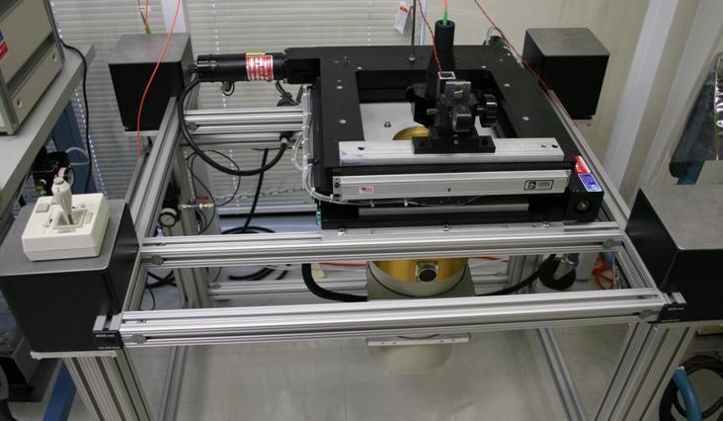
Metrology - Cold
Nanovea chromatic confocal optical pens mounted on large area X-Y scanner
0.9 µm and 3.0 µm accuracy
LN₂ cooled dewar
Sample spacing 1 mm
Edge distance issue due to larger beam size and large working distance
Lab air/equipment temperature compensation included
ITL “CryoScanner”

Slide 30
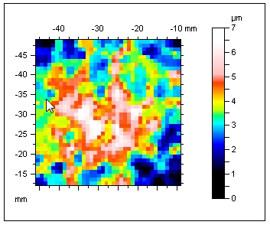
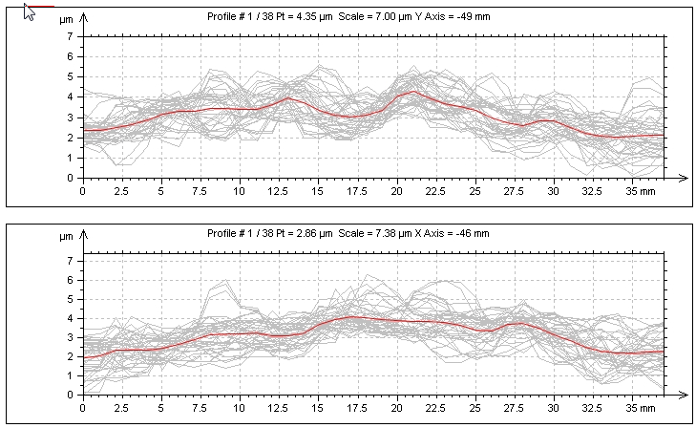
Metrology – Cold
When cooled from +23 to -95 C surface bows < 5 µm (center high)
STA3800

Slide 31
Summary
Characterization systems allows testing two sensors per day
Major issue is water vapor removal with short duty cycle
Active heaters for warm-up are very helpful
STA3800 (16 channel) and STA4400 (8 channel) provide essentially identical performance – STA Archon controllers
~5 electrons @ 530 kHz
Full well > 175,000 electrons (10 micron pixels)
QE close to model
Metrology specification has been consistently met
Precision packaging jig development and automated measurement critical
Cold metrology shows <5 micron change @ -95 C
Processing difficulties
Bright columns from defects after thinning
Excessive noise/poor HCTE which was batch-specific
Occasional damage (ESD?) by vendor processes such as backside grinding and the multiple “lithoblack” applications steps

Slide 32
Acknowledgements
Thanks to entire staff of UA Imaging Technology Lab
Special thanks to Semiconductor Technology Associates, Inc.
R. Bredthauer, K. Bredthauer, K. Boggs
Funding provided by SLAC/DOE/BNL/UofA

