Slide 1
Intrapixel Effects of CCD and CMOS Detectors
Hu Zhan, Li Cao, & Xin Zhang
National Astronomical Observatories
Chinese Academy of Sciences
PACCD, Dec 1-2, 2016, BNL

Slide 2
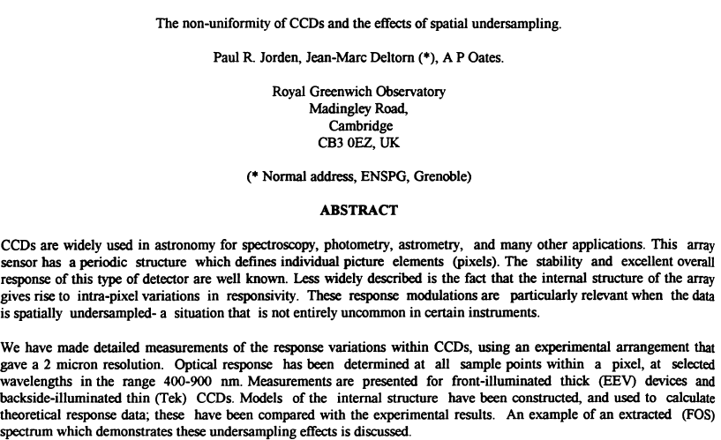
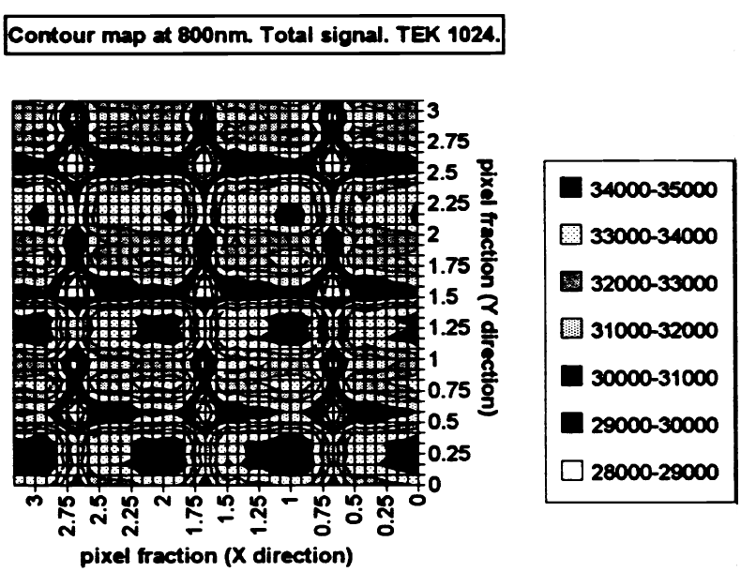
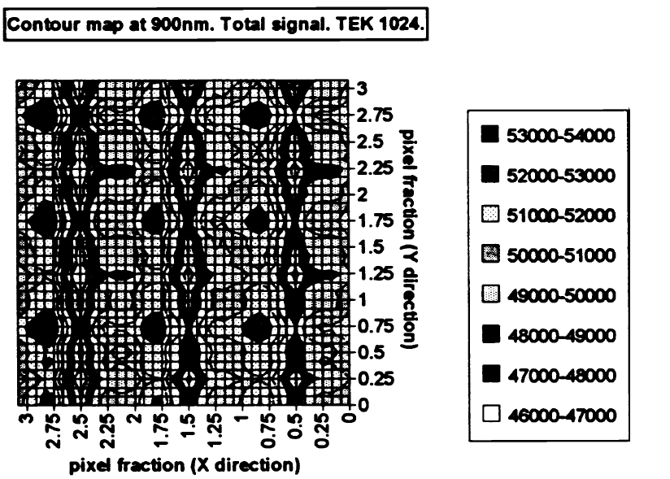
The non-uniformity of CCDs and the effects of spatial undersampling
SPIE 1994, 2198, 836
BSI

Slide 3
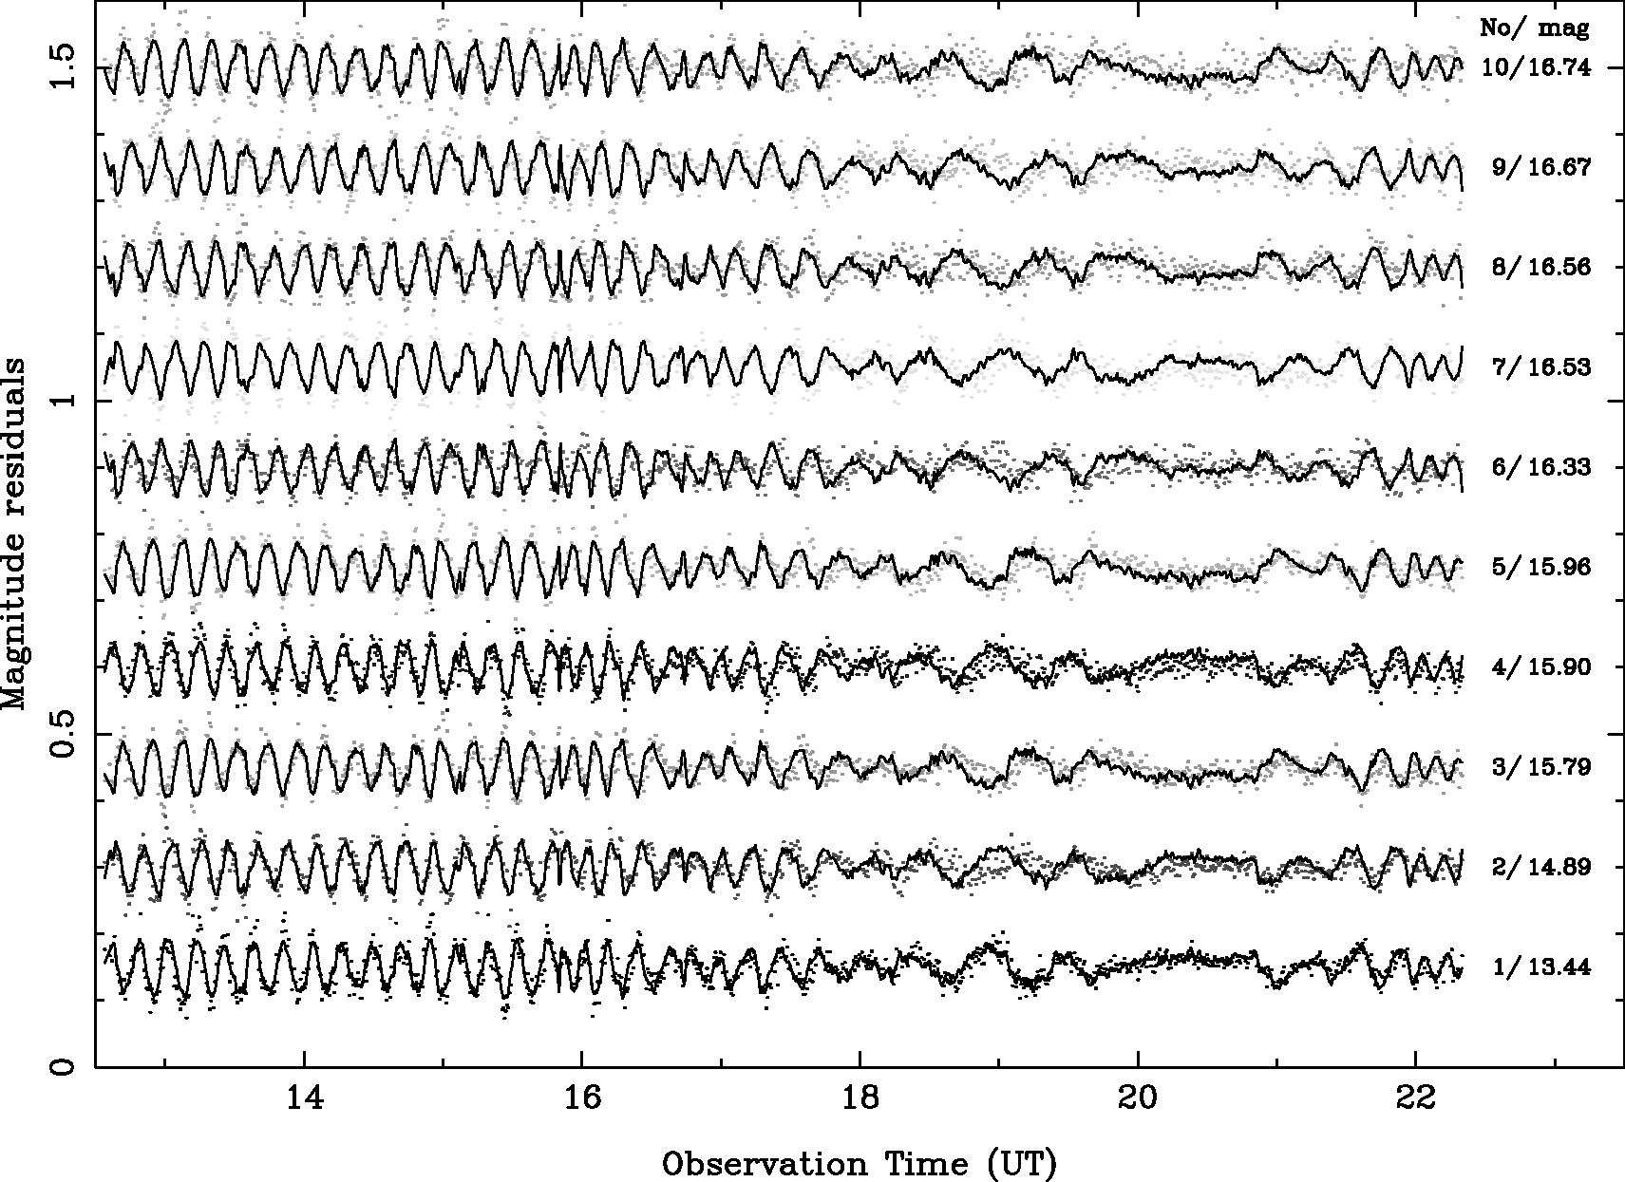
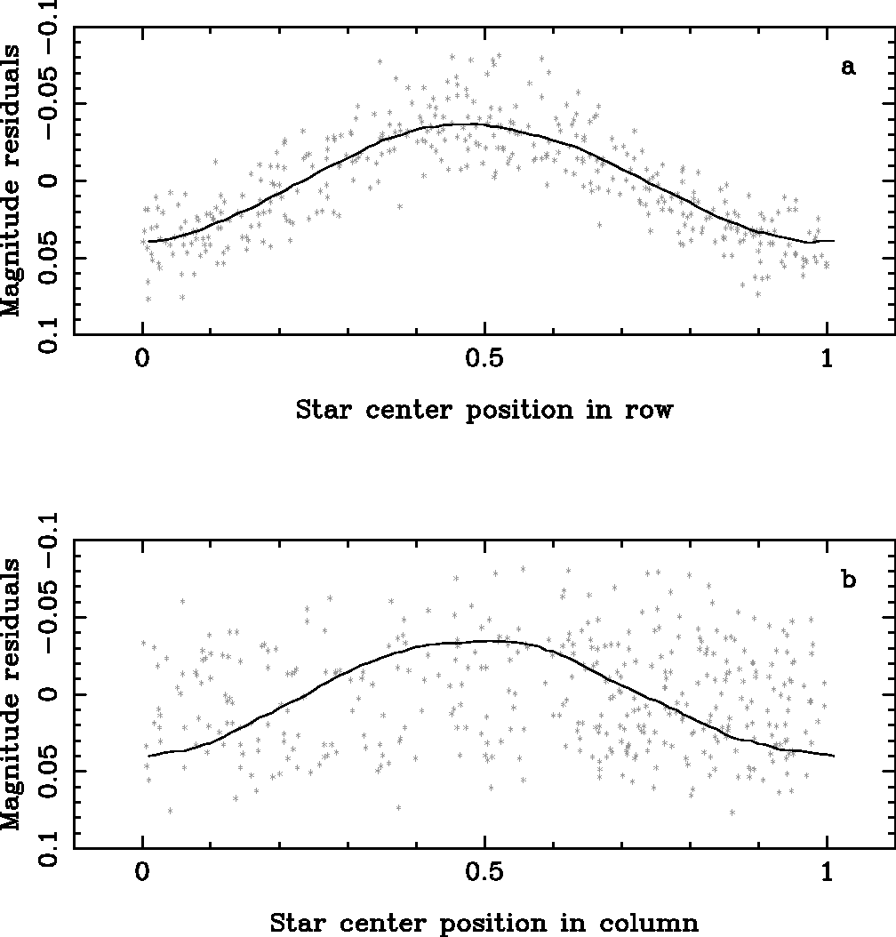
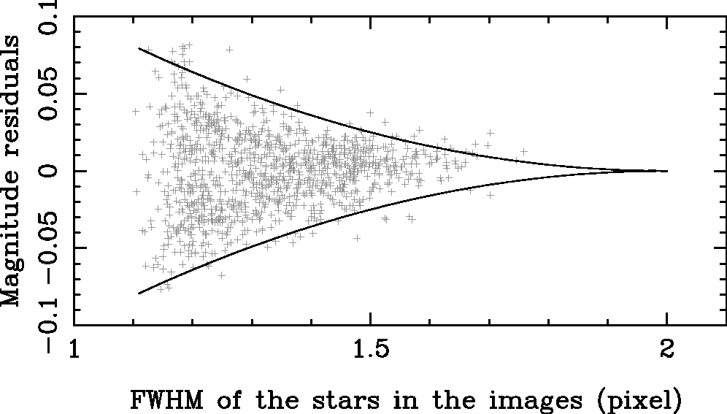
Intrapixel Effects and Undersampling
Zhou, X., et al., Modeling the CCD Undersampling Effect in the BATC Photometric System, PASP 2005, 117, 86
Ford Aerospace 2k×2k CCD FSI
pixel size: 15μm square
pixel scale: 1.7″/pix
Mag. residuals of bright stars, unguided, one night

Slide 4
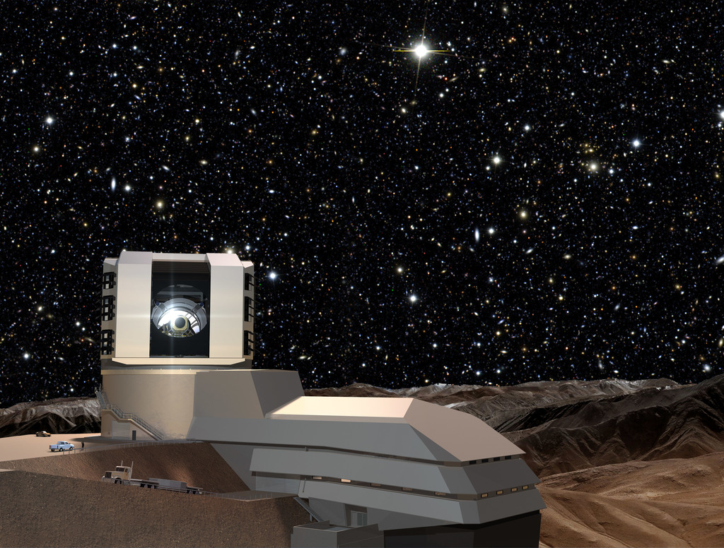
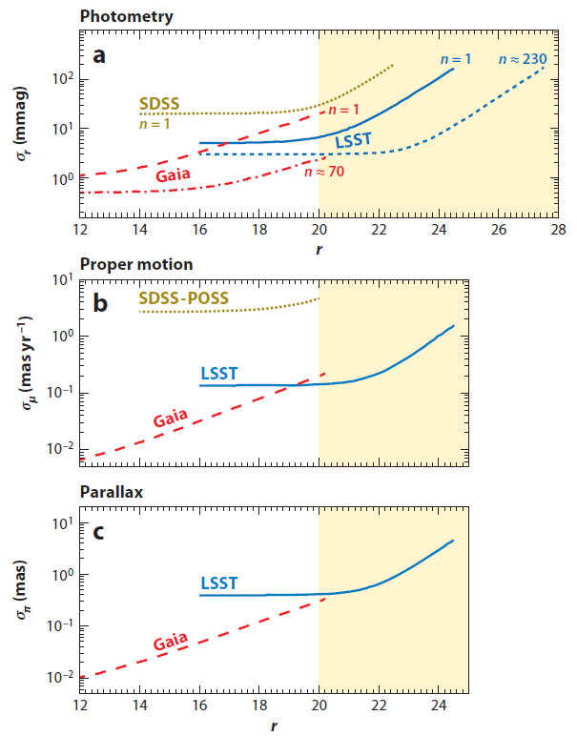
New Context: Precision Astronomy
Precision goal
  Photometry ∼0.005 mag
  Astrometry ∼0.5 mas
Ivezic et al., ARAA 2012, 50, 251

Slide 5
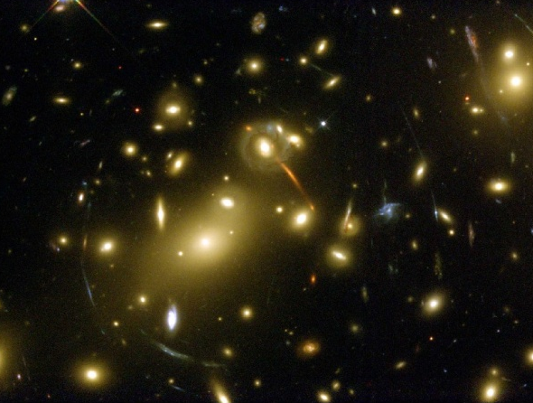
New Context: Precision Astronomy
Weak lensing shear
  Induced ellipticity: 10⁻³ -10⁻²
  Mult. shear error: 10⁻³
  Add. shear error: 3×10⁻⁴

Slide 6
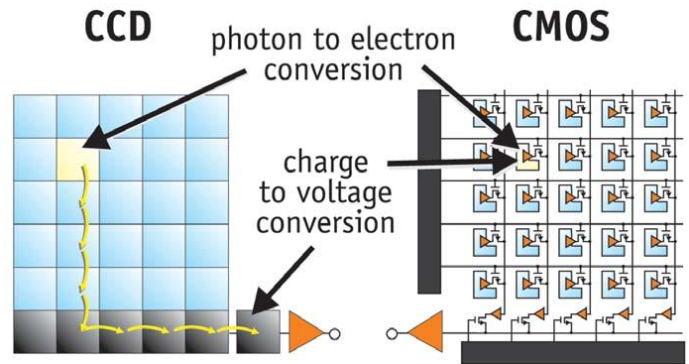
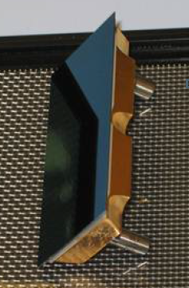
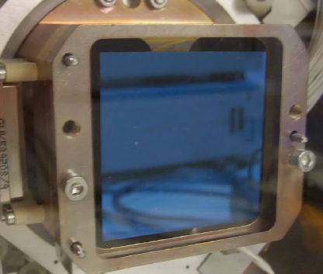
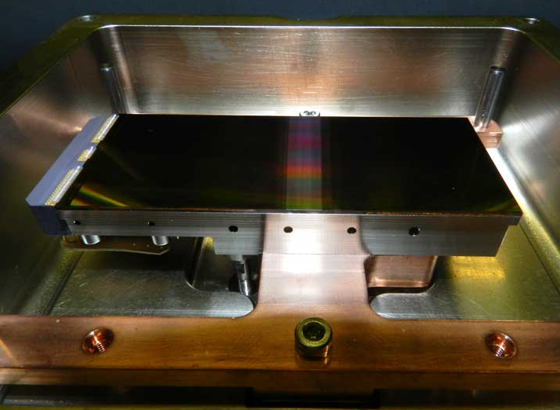
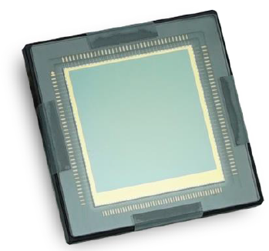
New Dev’t: Thick CCDs & BSI CMOS-APS
Precision astronomy places demanding requirements on detectors. Previously negligible effects need closer examination.
DES CCD 250μm
LSST CCD 100μm
TAOS II BSI CMOS
GSENSE400 BSI CMOS

Slide 7
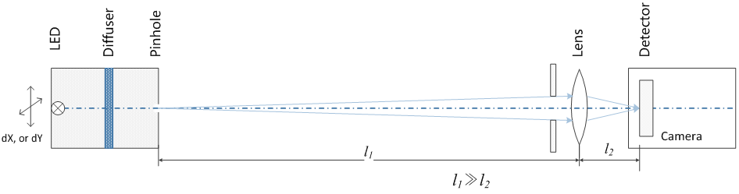
Measuring Intrapixel Effects
Source on X-Y stages
Device | Model
LED light source | Thorlabs M365L2、M850L3
X-Y precision stages | Thorlabs LTS150、LTS300
Lens | Schneider-KREUZNACH XENON-E 2.2/50 AF Nikkor 50mm f/1.8D
Notes:
可以把像斑放大的照片放在这里，我没找到。

Slide 8
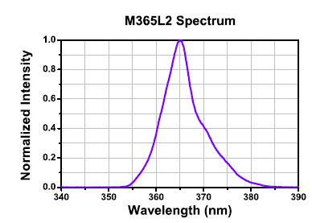
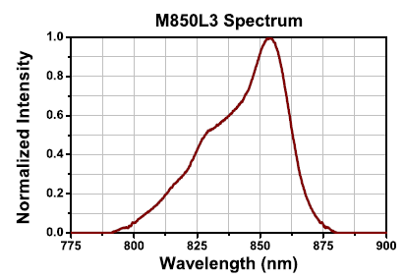
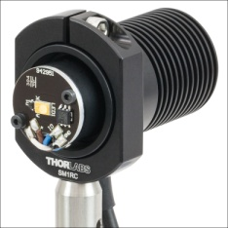
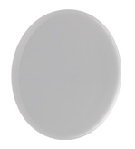
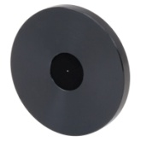
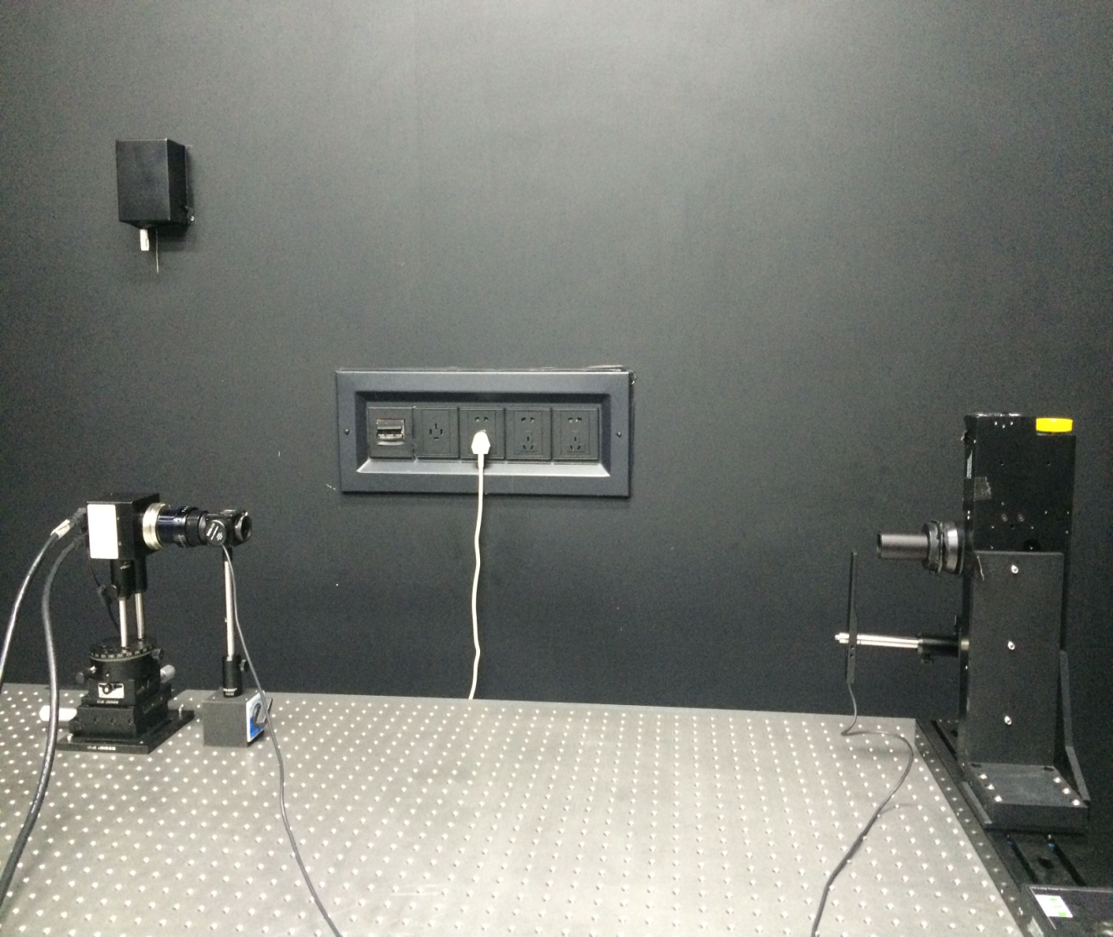
Measuring Intrapixel Effects
LED
model | M365L2 | M850L3
Peak Wavelength | 365nm | 860nm
Bandwidth (FWHM) | 7.5nm | 30nm
Lens f=50mm
LED Diffuser Pinhole
Precision Stage
Travel Range | 150 mm，300 mm
Minimum step size | 0.1 µm
Bidirectional Repeatability | 2 µm
Backlash^{e} | 2 µm
Cameras/detectors tested:
GSENSE400 BSI CMOS
Andor DV435 (CCD)
Andor Neo sCMOS
Andor DU934 (CCD)
Notes:
可以把像斑放大的照片放在这里，我没找到。

Slide 9
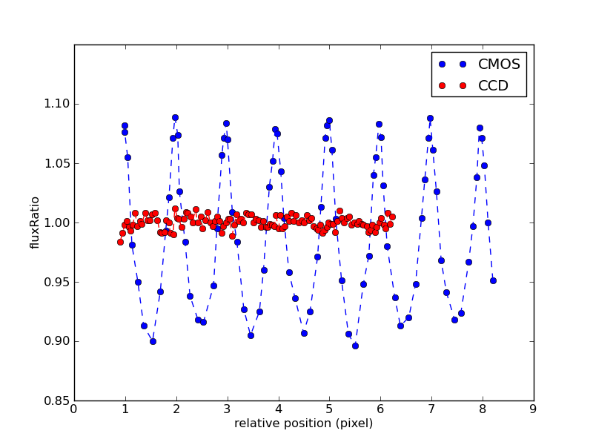
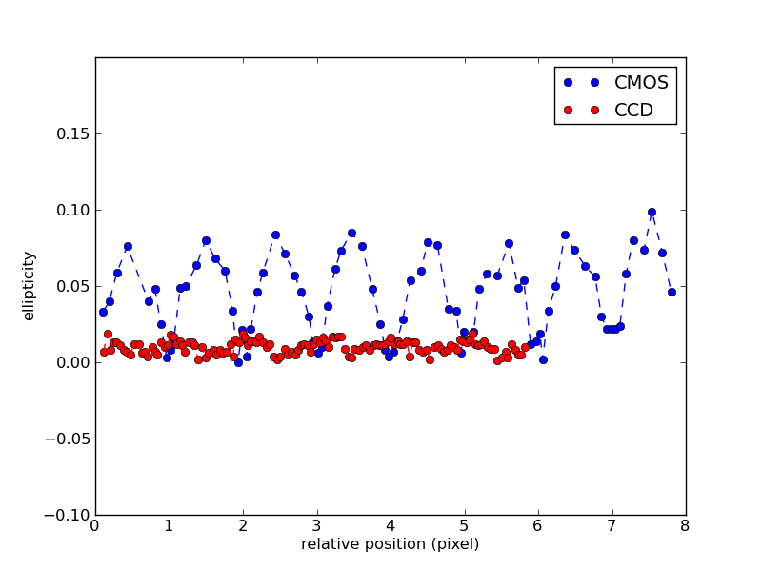
Results for Neo sCMOS & DU934
Flux variation
Ellipticity variation
 | Andor Neo sCMOS | Andor DU934
 | Front illuminated CMOS | e2v CCD 47-10
FWHM | 2.0 pix | 1.7 pix
Flux variation PV | 28% | 2.2%
Ellipticity var PV | 0.084 | 0.017
Notes:
“CCD与CMOS20140403詹.docx”中以下描述是什么一丝？光阑在什么位置？像斑大小？CCD的流量变化达到2.2%和3% rms
使用sCMOS时，光阑大小设置为3μm（像元大小是光阑直径的2.2倍），平台沿sCMOS的y方向移动。像斑x方向的变化在一个像元内（0.12~0.24像元内），y方向移动了约6个像元。
使用CCD进行实验时，光阑大小设置为5μm（像元大小是光阑直径的2.6倍），平台分别沿x、y方向移动进行测试。

Slide 10
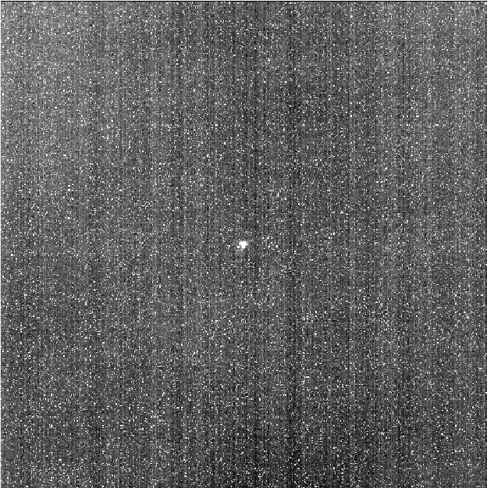
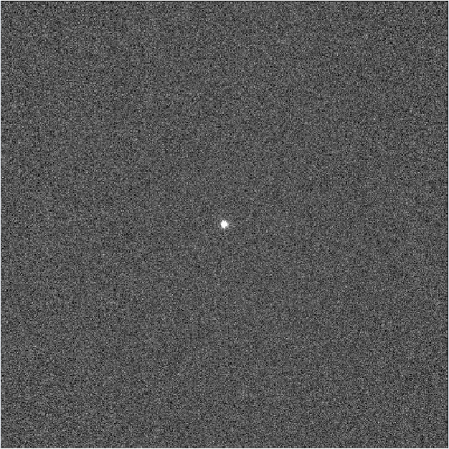
GSENSE400BSI & DV435
Camera | GSENSE400 Evaluation Board (G400) | Andor DV435
Sensor | GSENSE400BSI Back illuminated CMOS | e2v CCD 47-20 Back illuminated CCD
Shutter model | Rolling | Mechanical shutter
Active pixels | 2048×2048 | 1024×1024
Pixel Size | 11μm×11μm | 13μm×13μm
Well depth | 32,000e- | 80,007e-
Readout Noise | 1.73 e-/pix | 3.02 e-/pix
Temperature | Room temperature | -40℃
CMOS spot image
16 frames combined
FWHM ≈ 2.6 pixels
Step size: 1/8~1/10 pix
Length of scan: 4~5 pixels
CCD spot image
10 frames combined
Notes:
PSF size the radius enclosing 80% flux ≈2pixels——defocus
Step：1/8~1/10 pix
distance: 4~5 pixels

Slide 11
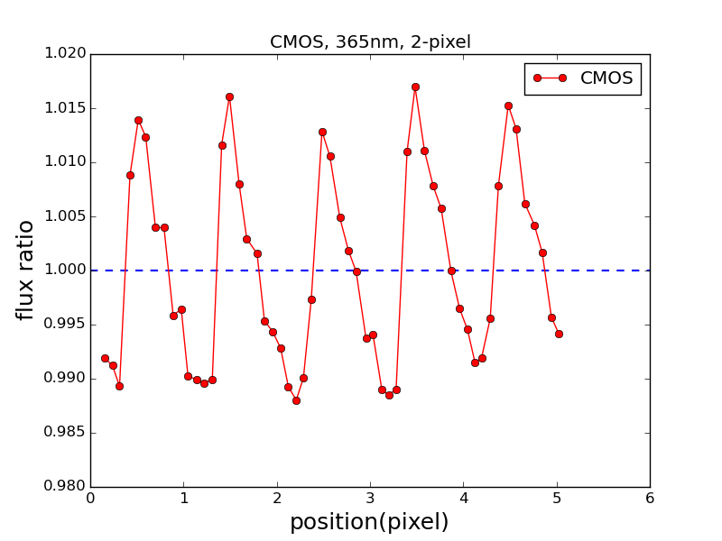
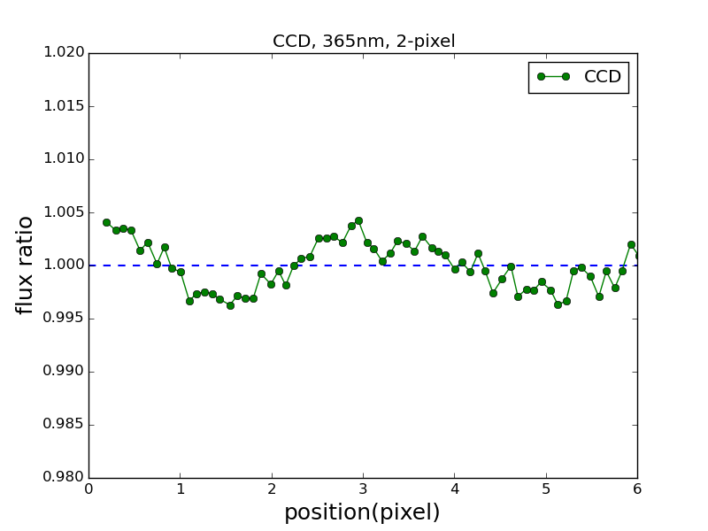
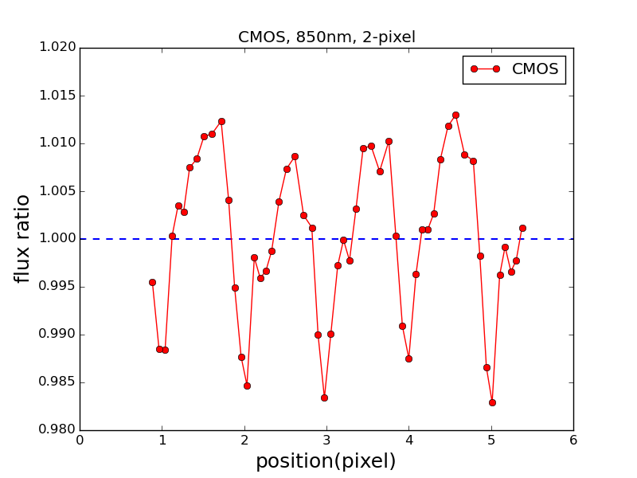
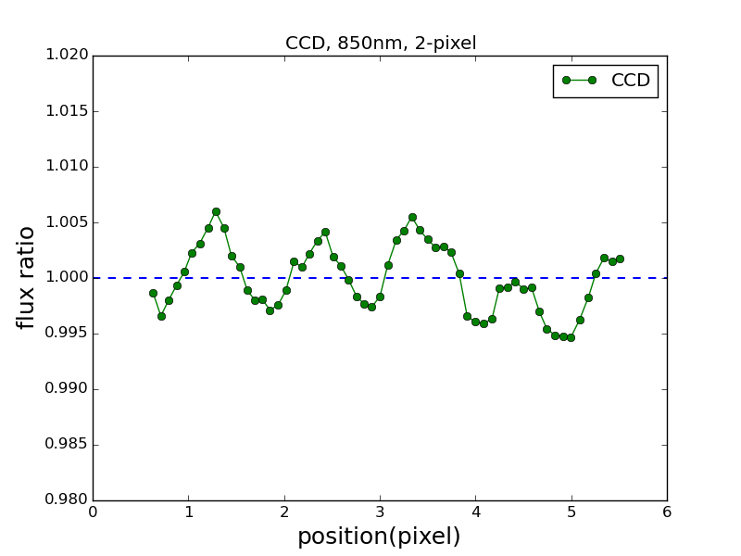
Flux Variations for G400 & DV435
GSENSE400BSI
DV435: CCD47-20
365nm
RMS：0.89%
RMS：0.22%
850nm
RMS：0.80%
RMS：0.20%
Notes:
张鑫：CMOS 850nm shot noise=1.2‰（16帧合并）， CCD 850nm shot noise=0.8‰(10帧合并)
右侧：CCD，365nm上，850nm下

Slide 12
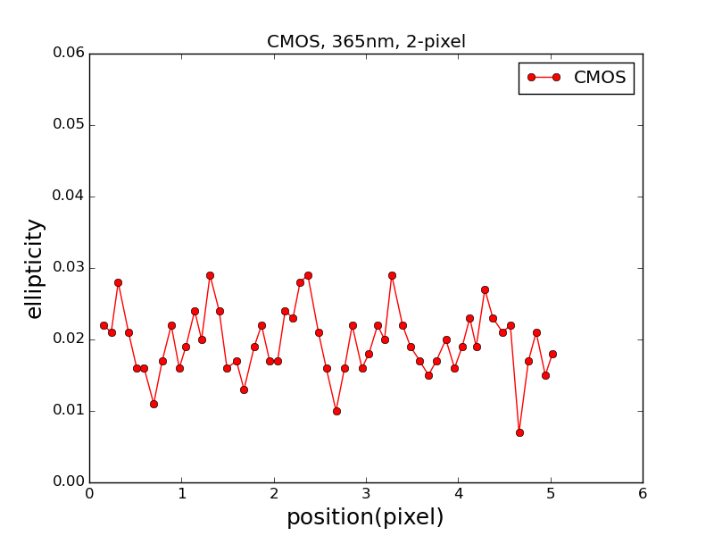
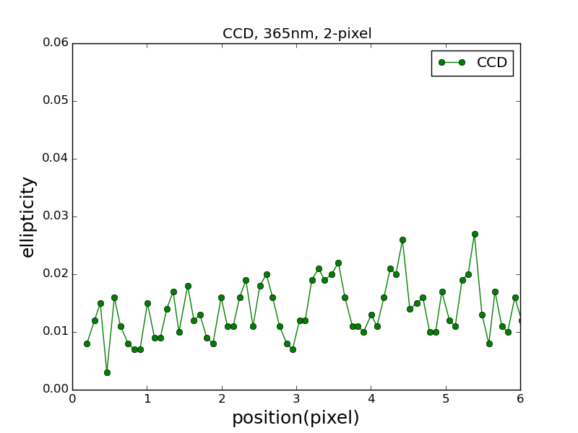
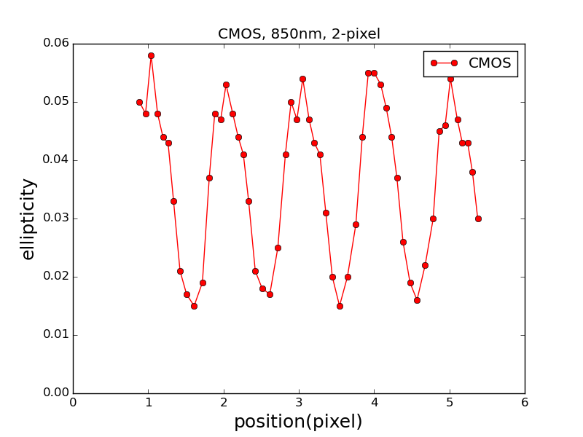
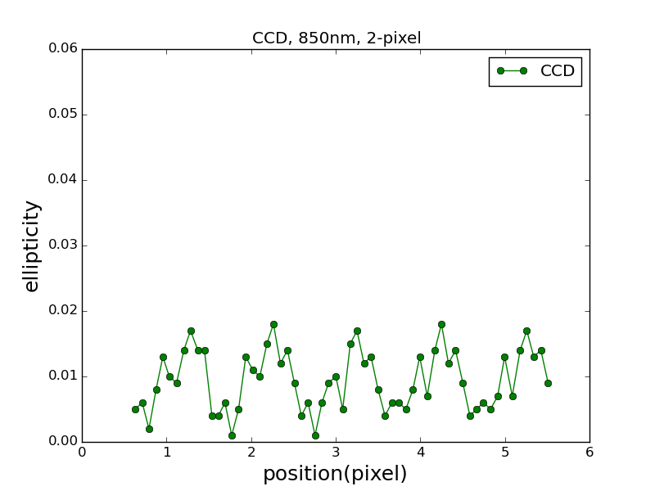
Ellipticity Variations for G400 & DV435
GSENSE400BSI
DV435: CCD47-20
365nm
mean：0.020
RMS：0.0047
mean：0.014
RMS：0.0048
850nm
mean：0.038
RMS：0.0129
mean：0.010
RMS：0.0045

Slide 13
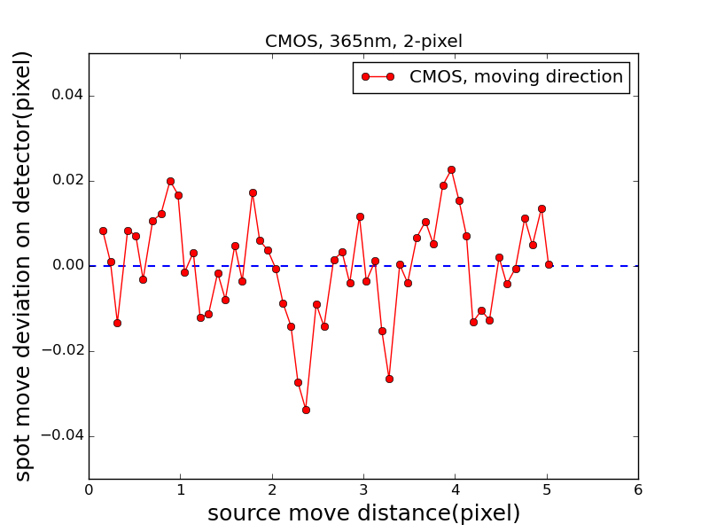
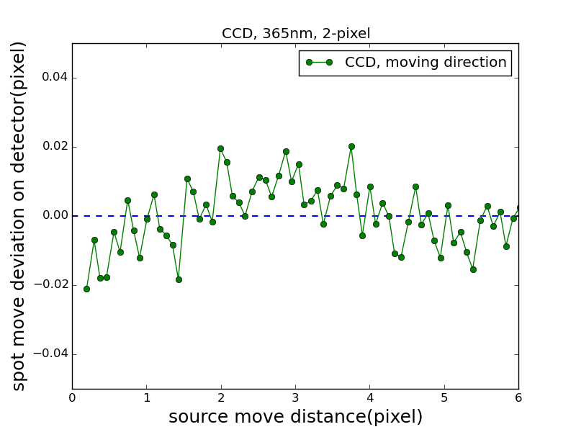
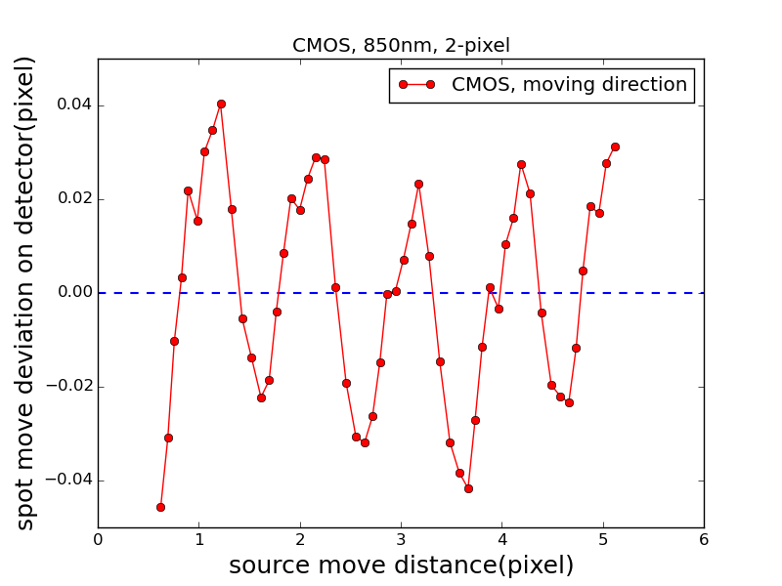
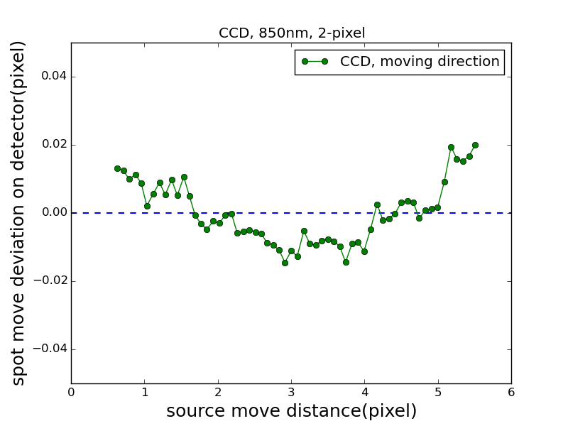
Centroid Variations for G400 & DV435
GSENSE400BSI
DV435: CCD47-20
365nm
RMS：0.012pix
RMS：0.009pix
850nm
RMS：0.022pix
RMS：0.009pix
Notes:
左侧：CMOS，365nm上，850nm下
右侧：CCD，365nm上，850nm下

Slide 14
Recap for G400 & DV435
 |  | Unit | GSENSE400BSI |  | DV435: CCD47-20
 |  |  | 365nm | 850nm | 365nm | 850nm
Flux variation (RMS) |  | % | 0.89 | 0.80 | 0.22 | 0.22
Ellipticity | Mean |  | 0.020 | 0.038 | 0.014 | 0.010
 | RMS |  | 0.0047 | 0.0129 | 0.0048 | 0.0045
Centroid variation (RMS) |  | pixel | 0.012 | 0.022 | 0.009 | 0.009
  Photometry ∼0.005 mag
  Astrometry ∼0.5 mas
  Shear ∼1% signal to 0.1%

Slide 15
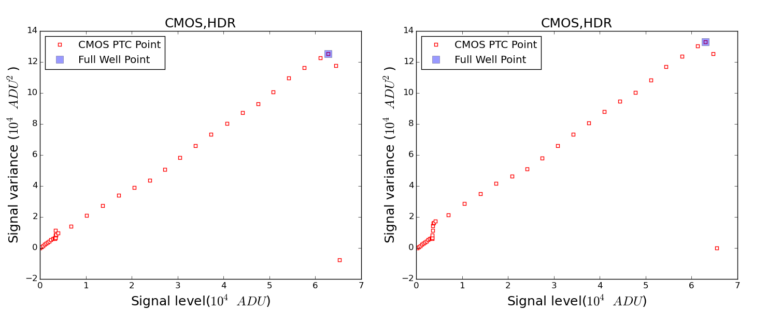
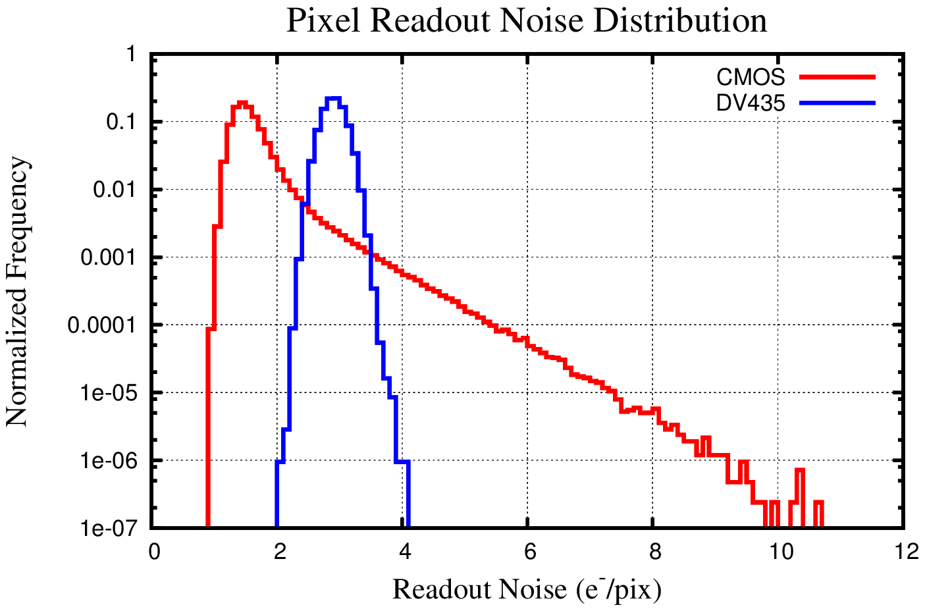
Other Issues with CMOS
CMOS detectors sometimes combine two 12bit A/D channels, one high gain and the other low gain, to achieve a 16bit dynamic range. The jump of the readout noise at the end of the high-gain channel is clearly seen. How does it affect astronomical measurements?
GSENSE400BSI: lower readout noise but wide distribution
DV435: higher readout noise and narrow distribution

Slide 16
Summary
The level of CCD and CMOS intrapixel effects on spot (PSF) flux, centroid, and ellipticity are relevant to precision astronomy.
The CMOS detectors tested exhibit worse intrapixel effects than CCDs do.
Intrapixel effects depend very much on the detailed pixel structure and the pixel scale (PSF sampling). Therefore, one has to quantify the effects for each project.
Need for intrapixel effect correction!

