Slide 1
Germanium CCDs for Large-Format SWIR and X-Ray Imaging
DISTRIBUTION A. Approved for public release; distribution unlimited.
C. Leitz, S. Rabe, I. Prigozhin, B. Burke, K. Ryu, M. Zhu, M. Cooper, K. Johnson, W. Hu, B. Felton, M. Cook, C. Stull, V. Suntharalingam
1 December 2016
This work was sponsored by the Assistant Secretary of Defense (ASD) for Research and Engineering (R&E) under Air Force Contract No. FA8702-15-D-0001. Opinions, interpretations, conclusions, and recommendations are those of the authors, and do not necessarily represent the view of the United States Government.

Slide 2
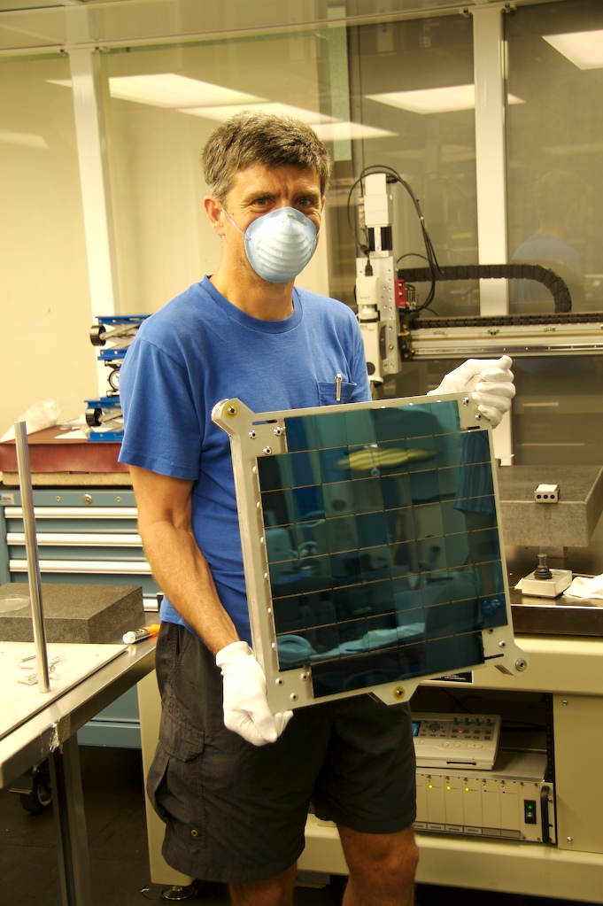
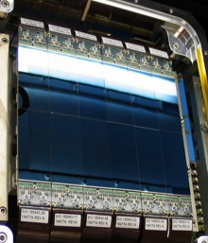
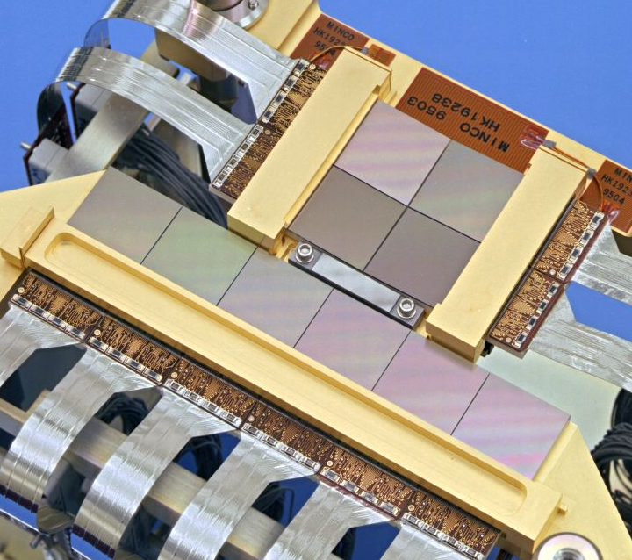
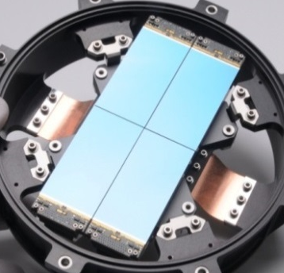
MIT-LL Silicon Charge-Coupled Devices (CCDs)
Exquisite sensitivity and dynamic range
Single electron read noise
Noiseless, efficient charge transfer enables time delay integration (TDI) operation, pixel binning
High spatial uniformity enables large-format imagers
Chandra (1999)
TESS (2015)
PS1-2 (2007, 2015)
SST (2011, 2015)
Can we realize these advantages in other bands?

Slide 3
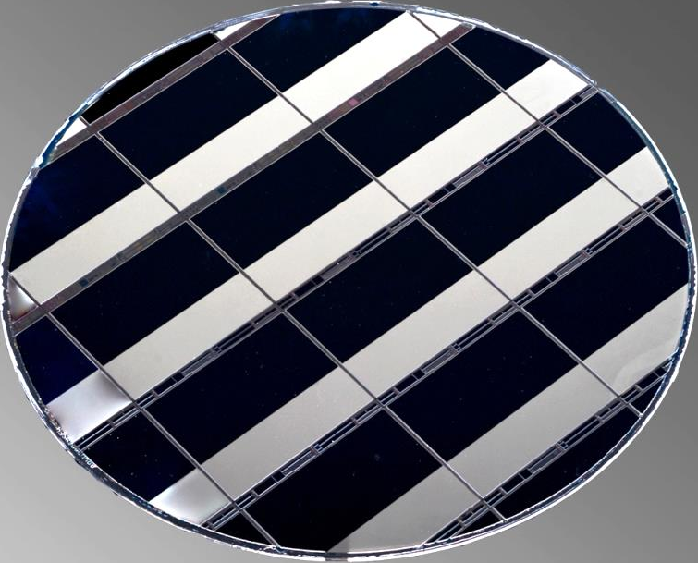
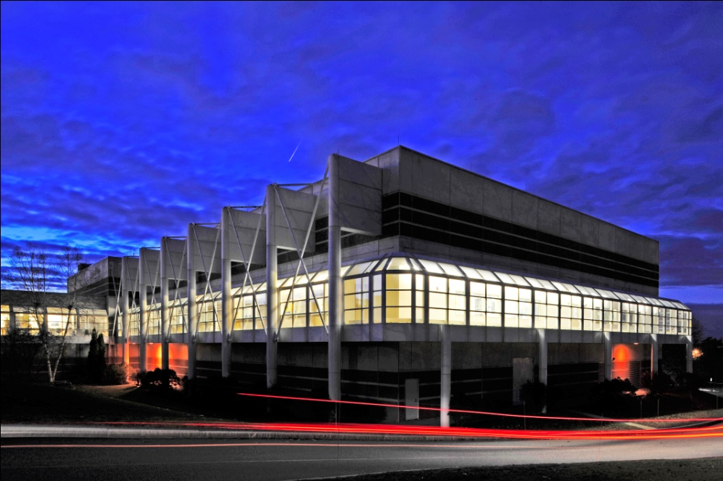
Advanced Imager Technology and MIT-LL Microelectronics Laboratory
Advanced Imager Technology
Suite of imaging technology spanning both Si and compound semiconductors
  Si CCDs, Geiger-mode APD arrays, and APS
  InGaAs linear- and Geiger-mode APDs
  Digital focal planes
In-house capabilities from design through sub-system fabrication
Microelectronics Laboratory
Class-10 clean room
Production-class sub-90-nm toolset on 200-mm-diameter wafers
Lithography capabilities including large fields (50 × 50 mm field), fine features (e-beam)

Slide 4
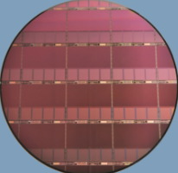
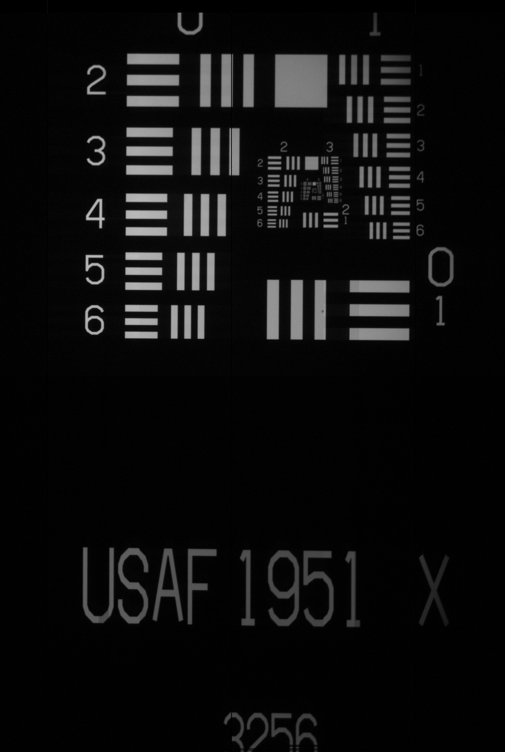
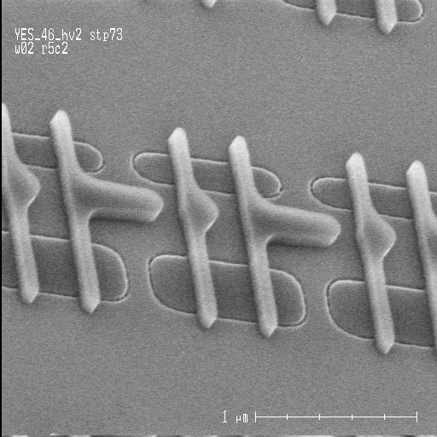
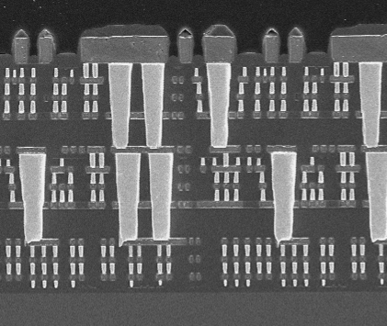
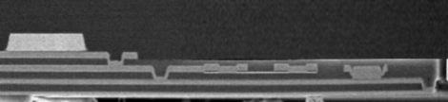
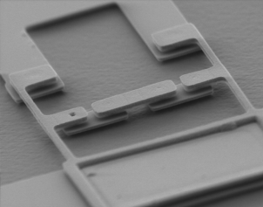
Unique Positioning of MIT-LL Microelectronics Laboratory (ML)
100M’s Devices
Foundry Processes
Range of ML
Fabrication Processes
90 nm
Extreme-Low-Power CMOS
Process Maturity
Large-Format CCDs
& APD Arrays
1 μm
Bond line
University Research
Superconducting Electronics
20 μm
2 μm
Single Devices
3D-Integrated Devices
Mature Device Understanding
Experimental Devices
Innovation
Microelectronics Laboratory, with its unique capabilities, is ideally suited for development of germanium imaging devices.
Notes:
VIPER ROIC = 500M transistors!

Slide 5
Advantages of Germanium for Imagers
Strong absorption from UV through short-wave infrared (SWIR)
X-ray absorption to 30 keV and beyond for high-energy imaging
Visible + SWIR Quantum Efficiency Comparison [1-3]
X-Ray Sensitivity Comparison
[1] T. Martin & P. Dixon, Laser Focus World (11/2004); [2] MIT-LL measured; [3] average from Nakano et al., J. Non-Cryst. Sol. 358 (2012) 2249 & N. Posthuma et al., Proc. 3rd World Conf. Photo. Ener. Conv. (2003), scaled to 45 µm.

Slide 6
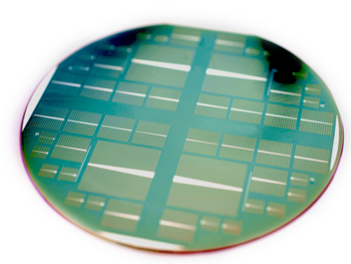
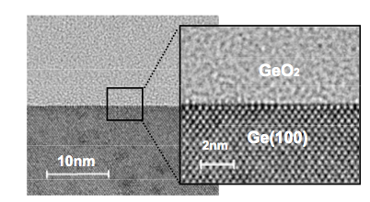
Advances in Germanium Process Technology
Build on recent advances in complementary fields
  Next-generation electronics
  Concentrator photovoltaics and thermophotovoltaics
  Material quality – 200-mm bulk wafers commercially available
Enables fabrication of high-quality devices not possible in recent past
High-Quality Gate Stacks [1]
Low-Temperature Surface Passivation [2]
GeO₂
2 nm
Ge (100)
10 nm
[1] T. Sasada, et al. J. Appl. Phys. 106 (2009) 073716[2] J. van der Heide, et al. Sol. Energ. Mat. Sol. Cells 93 (2009) 1810; http://www2.imec.be/be_en/press/imec-news/tpvcell.html.

Slide 7
Comparison to Compound Semiconductor Imagers
The Ge CCD represents a potentially significant improvement over compound semiconductor imagers in terms of format, pixel size, and capability
  More advanced processes to enable larger formats, small pixel sizes
  No bump bonding required
One disadvantage: Germanium must be cooled due to high intrinsic carrier concentration
Wafer Size Comparison
Sensor Size Comparison
InGaAs (SWIR)
InGaAs (1.3 Mpix)
NuSTAR
(1 kpix)
CZT (X-ray)
Germanium
Germanium
(> 20 Mpix expected)
200 mm
5 cm

Slide 8
Path to a Germanium CCD
Started with isolated components for quick-turn insights into CCD performance
CCD Viewed Along Charge-Transfer Direction
Output
V_{low}
V_{high}
V_{low}
V_{low}
V_{high}
V_{low}
V_{OG}
Metal
1
2,3
Al₂O₃
GeO₂
4
Germanium
100 nm
 | Device Component | Status
1 | Metal-Insulator-Semiconductor (MIS) capacitor | Surface state density rivaling that of silicon electronics, low gate leakage
2 | P-N junction diodes | Low dark current
3 | MOSFET | Functional output circuits
4 | Buried channel | Imagers being analyzed

Slide 9
Metal-Insulator-Semiconductor (MIS) Capacitor Analysis
Excellent quality MIS capacitors realized
Capacitance-Voltage
Gate Leakage
Surface State Density
Room-temperature measurements on MIS capacitors confirm basic properties of Ge suitable for CCDs
Low surface state density
Gate leakage < 10 pA/cm² for +/- 10V gate swing

Slide 10
Diode Dark Current Analysis
Diodes yield insights into CCD dark current
Contact Metal
Estimate of Dark Current Sources
GeO₂/Al₂O₃
2
n-Ge
1
5
p-Ge
3
4
Dark current sources in a diode [1]
Depletion
Front surface
Diffusion
Back surface
Peripheral
Sources can be isolated by varying relevant dimensions
Dominant in a CCD
Dark current sources most relevant to CCD are small
[1] D.K. Schroder, Sol.-State Electron. 27 (247) 1984.

Slide 11
Diode Dark Current Analysis
Diodes yield insights into CCD dark current
Contact Metal
Dark Current vs. Temperature
GeO₂/Al₂O₃
2
n-Ge
1
5
p-Ge
3
4
Fitting Equation:
J_{dark} = AT ³exp(-E_{g}/kT)
Dark current sources in a diode [1]
Depletion
Front surface
Diffusion
Back surface
Peripheral
Temperature dependence indicates mechanism
Dominant in a CCD
Dark current extrapolates to
1 pA/cm² at 150K, validating material and device quality
[1] D.K. Schroder, Sol.-State Electron. 27 (247) 1984.

Slide 12
Estimating Dark Current in a Germanium CCD
Used measurements on building blocks to estimate dark current noise
Key variables that govern device performance are nearly equivalent to silicon
Germanium CCDs require cooling to achieve low dark current because of high intrinsic carrier concentration
Dark current target of < 10 pA/cm² at 150K
(40 e⁻/pixel/s for an 8-µm pixel)

Slide 13
Germanium CCD Fabrication Challenges
Silicon CCD
Germanium CCD
Silicon Dioxide
Poly 1
Poly 2
Poly 3
Metal Gate Electrode
Gate Dielectric
Gap Between Phases
Gap Between Phases
Process Challenge | Mitigation Plan | Other Alternatives
Cannot use overlapping poly process to define phases | Single-level CCD | Low-temperature fabrication processes
Charge transfer inefficiency due to large gap between phases | 248-nm lithography to define sub-250 nm gap | 193-nm or e-beam lithography
Low sensitivity in front illumination due to metal shading | Back illumination | Engineered substrate for rapid prototyping

Slide 14
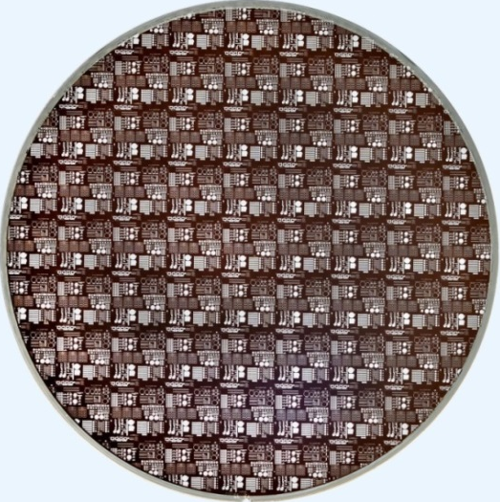
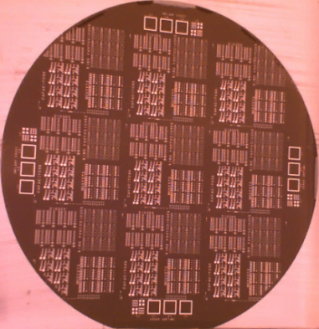
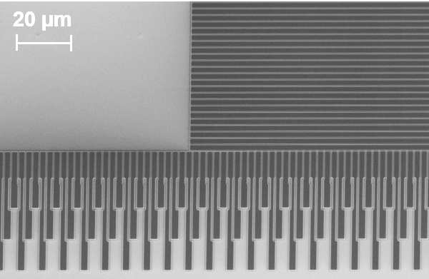
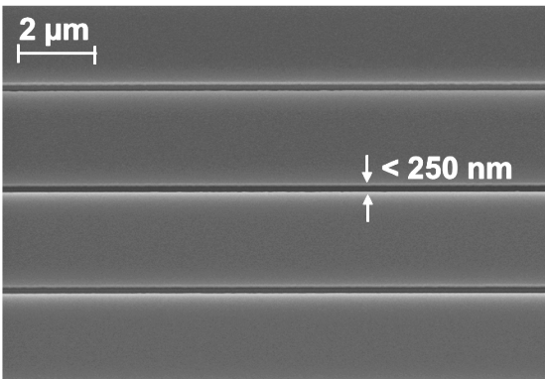
Recent Fabrication Accomplishments
Transitioned to standard 200-mm wafer processing tools, first light this fall
200-mm Wafer
Discrete Devices
200-mm Wafer
Imagers
150-mm Wafer
Discrete Devices
Metal Gate Detail

Slide 15
Output Transistor Comparison
Buried Channel MOSFETs
Germanium PMOSFET
W = 10 µm, L = 2 µm
Silicon NMOSFET
W = 20 µm, L = 2 µm
Both plots normalized by gate width and plotted over same range of |V_{g}-V_{T}|
Slightly higher off-state current in Ge due to nonoptimized peripheral isolation
Higher current in germanium PMOSFET due to combination of higher carrier mobility and higher gate capacitance
Potential for lower read noise in Ge CCDs

Slide 16
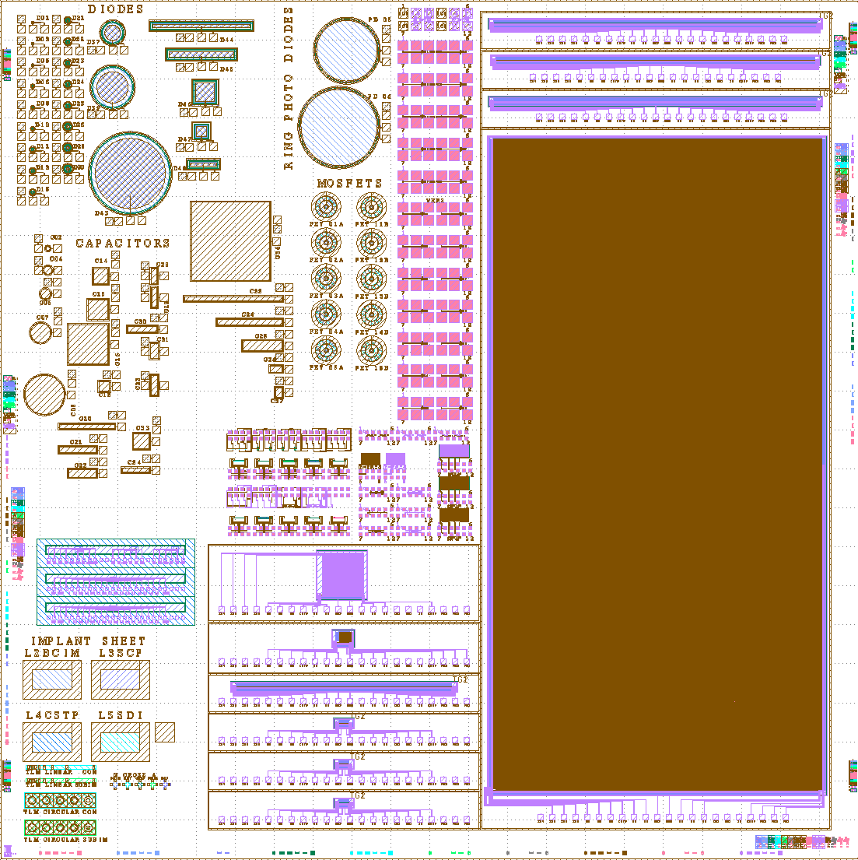
Germanium Imager Designs
Reticle Layout
OTCCD Pixel Detail
  Shift registers
  128 × 128 x 8 µm OTCCD
  1k × 2k × 8.1 µm frame transfer CCD
Single pixel
  32 × 32 × 8.1 µm full-frame CCD
  Shift registers
30 µm

Slide 17
Summary
Germanium CCDs offer numerous advantages for X-ray and SWIR imaging
  Wide response
  Able to fabricate large-format CCDs on this material
Our work to date has validated the potential of germanium as a low-noise CCD material
Our first (front-illuminated) imaging devices are in fabrication
  Includes 128 × 128 OTCCD, 1 Mpixel frame transfer CCD

