Slide 1
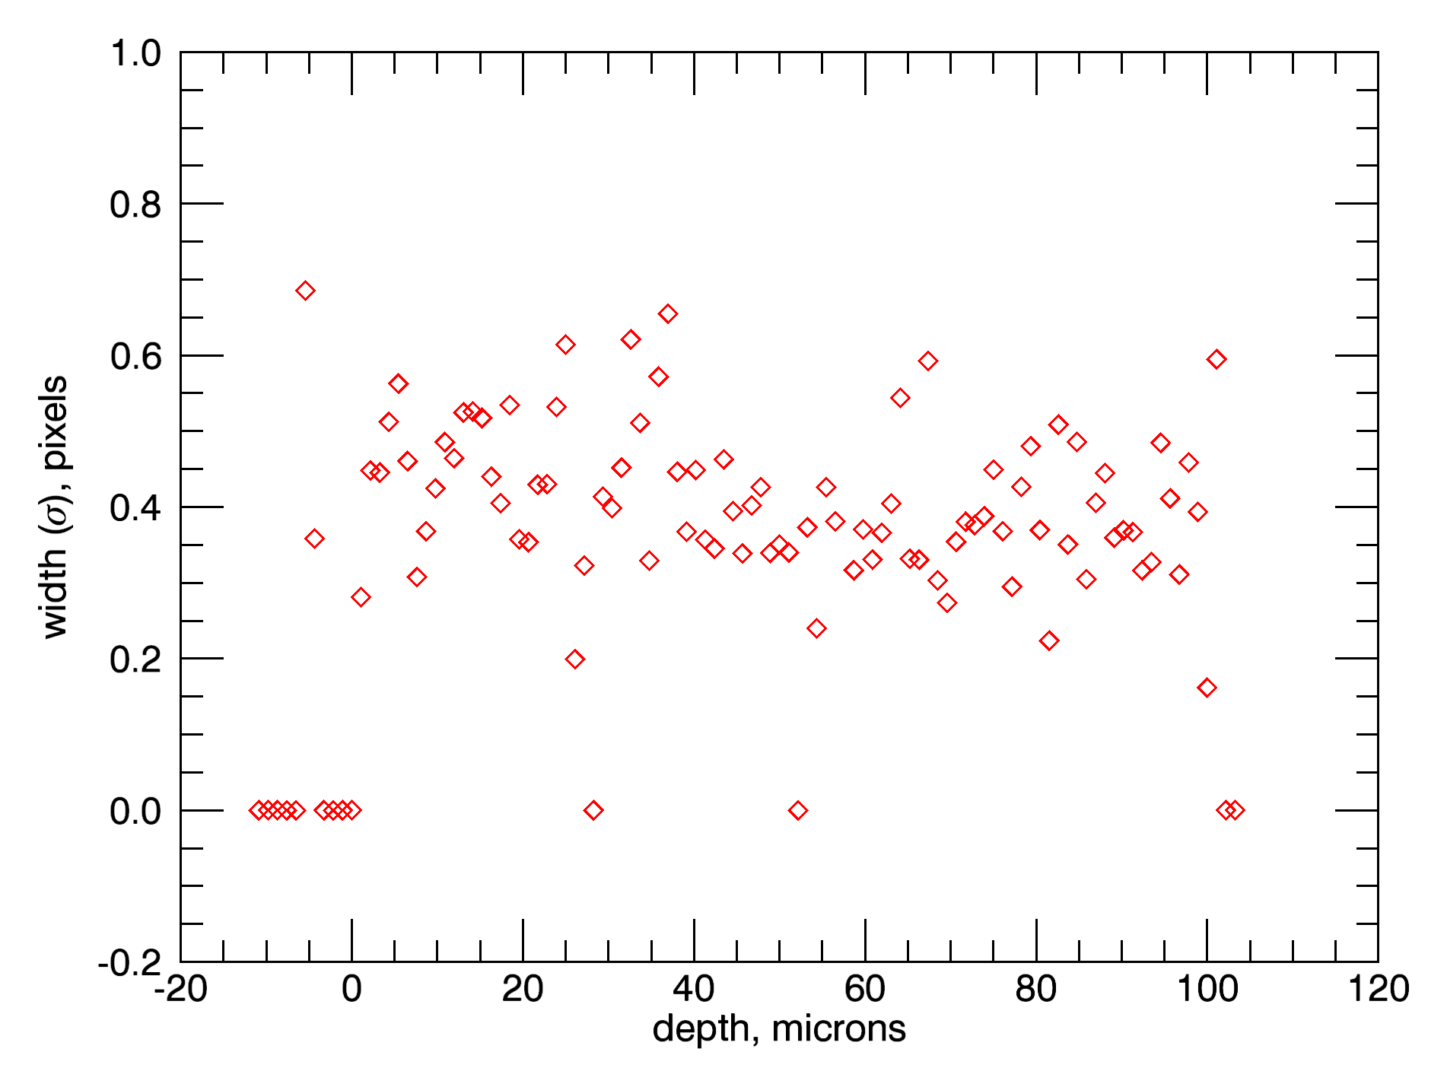
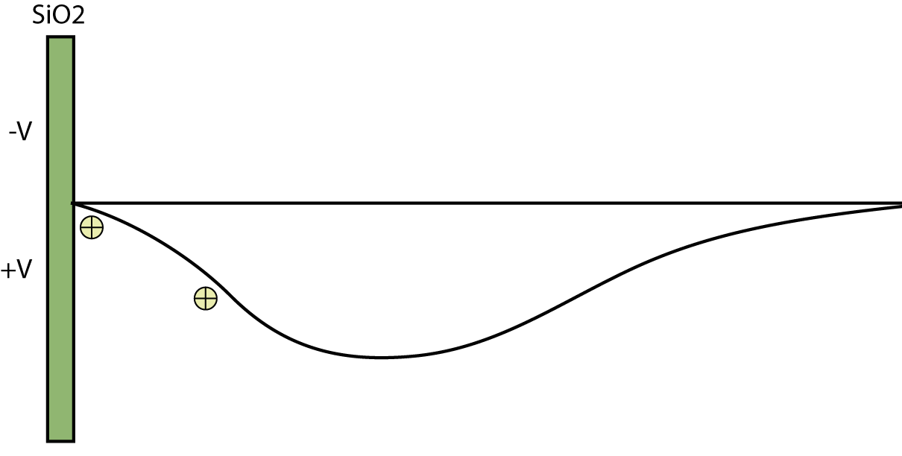
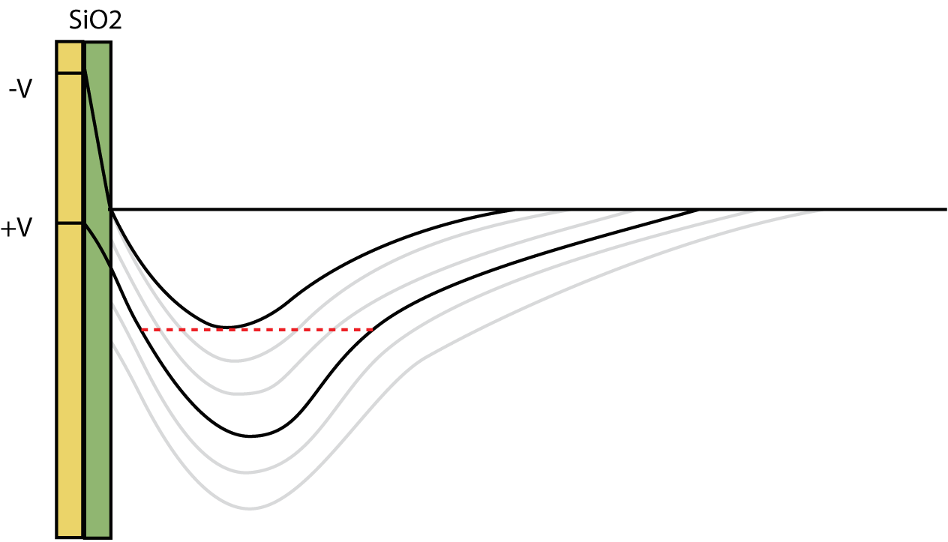
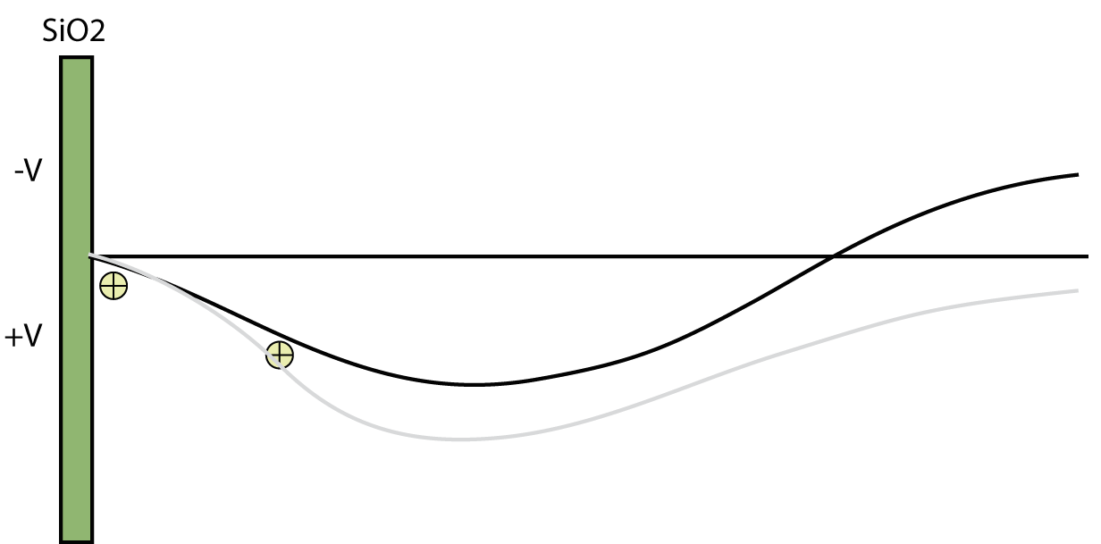
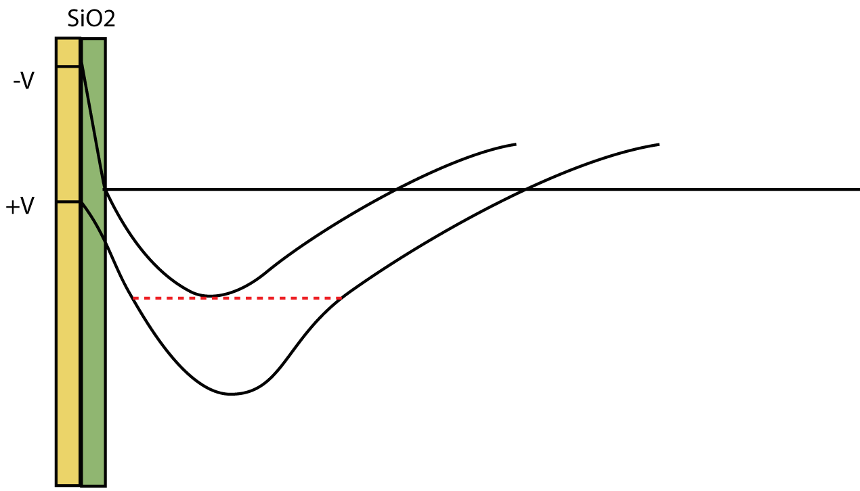
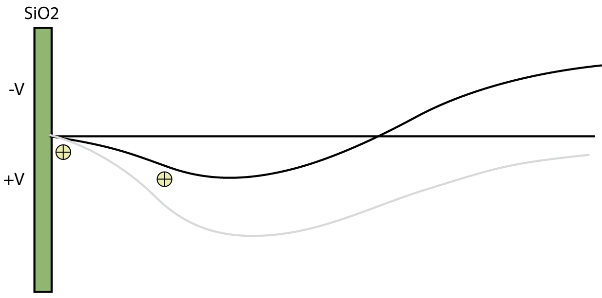
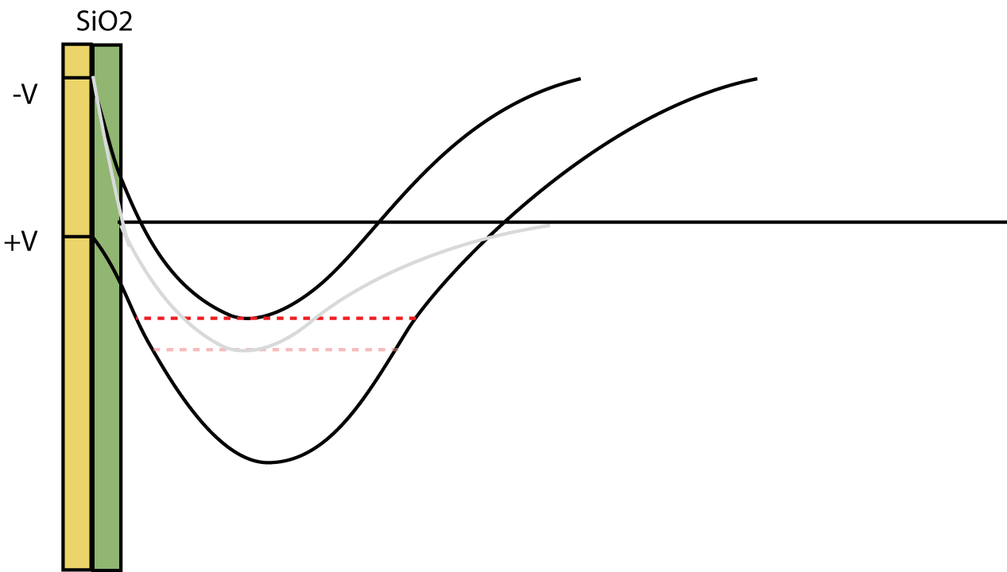
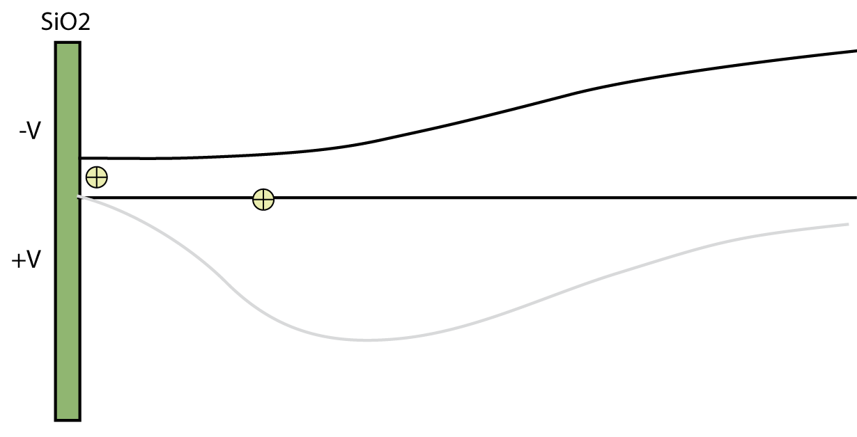
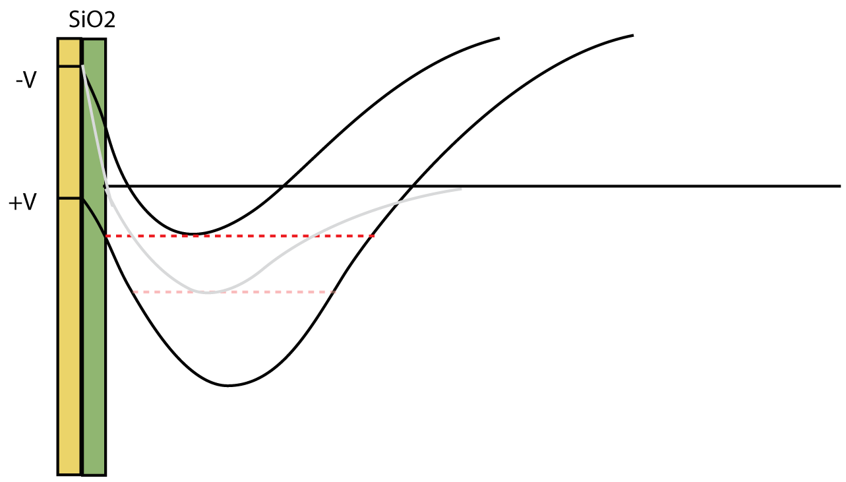
Reach-through Effect in Deep Depletion TESS CCDs
J. Villaseñor¹, G. Prigozhin¹, B. Burke², J.P. Doty¹, S. Yazdi¹, G. Ricker¹, R. Vanderspek¹
MIT Kavli Institute for Astrophysics and Space Research
MIT Lincoln Laboratories
Abstract
TESS CCDs are deep depletion devices made on a 100 micron-thick high resistivity p-type silicon substrate^{(1,2)}. In order to fully deplete the substrate and increase the near-IR efficiency, we apply a bias voltage to the back side of the device. A bias of -25V is sufficient to fully deplete this device, but overdepletion is desirable to minimize lateral diffusion which can blur images and in turn affect the photometric precision⁽³⁾. Hence, much larger negative bias voltages have been applied⁽⁴⁾. We achieved sharper images with larger negative substrate voltage, but we also discovered an unexpected dramatic increase of the full well capacity beyond a threshold voltage. Large full well above 200,000e- is accompanied by poor charge conservation in the bloomed well condition. Both phenomena can be explained by backside voltage reaching through the substrate volume, eliminating the barrier for holes, and dragging the floating channel stops to a more negative potential.
Anomalous behavior of the amount of charge in the full well as a function of substrate bias
Proposed explanation: reach-through effect
Analysis of the diffusion clouds caused by cosmic ray trails show that a bias voltage of -25V is sufficient to deplete the 100 micron thick layer.
Virtual Knife Edge⁽⁵⁾ measurements confirm the -20-25V range, and also show continued decreasing charge diffusion cloud radii at more negative substrate voltage.
We believe that the observed behavior can be explained by a reach-through phenomenon.
Normally, once the substrate is fully depleted, the backside p+ layer is insulated from the frontside p+ channel stops by a potential barrier that prevents holes from flowing across the substrate. As the backside bias becomes more negative, this barrier is lowered, and eventually disappears (reach-through); holes from channel stops may now flow to the backside contact.
The channel stops in TESS CCDs are floating, since the presence of upper serial registers in the device prevented direct grounding. As a result, after reach-through, channel stops are pulled by the backside bias to a more negative potential, thus changing inversion potential in the CCD buried channel area.
The inversion potential shifts under the gates, leading to a less positive minimum in the barrier phase. This effectively increases the full well capacity.
At the same time the shift also allows the full well charge to get closer to the SiO2 interface, leading to surface charge loss when device is in blooming condition.
Fig.1 High energy cosmic rays passing through the substrate produce charge clouds at all possible depths, and can be used to estimate depletion depth of the device⁽⁶⁾. Above is a trace at V=-25V.
Fig.2 Measurement of the diffusion cloud radius using the Virtual Knife Edge Method.
A
B
Increasing the substrate voltage results in a substantial increase of the CCD full well capacity. The start of the increase depends on the gate voltage.
Charge conservation in the bloomed wells declines as the effect of the substrate voltage increases the full well capacity past 200,000 e-.
A
B
A
B
Fig. 3: Full well as a function of substrate voltage. Here, the vertical low voltage was kept at a constant value of -8.0V, while the vertical high voltage was increased at half volt intervals.
Fig. 4: Charge conservation plots for Vsub = -30V and -45V. Shown are the residuals from a linear fit of signal versus intensity, with downward deviations indicating surface charge loss.
Fig. 7 Potential profiles across the substrate passing through channel-stop center, showing the sequence as substrate bias is increased.
Fig. 8 Cross section of the CCD gate structure schematic, along the horizontal direction and depicting a pixel gate between two channel stops.
Fig. 9 Barrier and collection phase potentials in the middle of the transfer channel with increasing bias.
An experimental confirmation: substrate current behavior
Summary
We measured the current flowing into the substrate while performing the substrate voltage scans.
A sharp increase in the current draw is observed coincident with the full well rise, continuing to rise with increasing negative substrate voltage.
This current is due to the bias supply drawing the holes from the grounded channel stops at the device periphery, fully consistent with the proposed reach-through model.
The discovered phenomenon to our knowledge has not been reported before, the reason could be a thinner substrate than most other deep depletion devices.
The TESS CCDs will be operated below the reach-through voltage.
Computational 3D analysis is necessary to confirm the proposed model (planned).
References
_{Isubstrate}
Ricker, G.R. Winn, J.N., Vanderspek, R. et al. “Transiting Exoplanet Survey Satellite.” J. Ast. Inst. Sys., 1, 014003 (2015)
Suntharalingam, V., Prigozhin, I., Young, D. et al, “Deep depletion CCD detectors for the Traniting Exoplanet Survey Satellite,” Proc SPIE 9915, 9915-28 (2016)
LSST Camera Preliminary Design Report (LCA-10756-A)
Thayer, C. Villasenor, J, Lamarr, B.. et al, “Testing and Characterization of the TESS CCDs”, Proc. SPIE 9915 (2016)
Takacs, P.Z., Kotov, I. et al, “PSF and MTF measurements for Thick CCD Sensor Characterization,” Proc SPIE 7742 774207-1 (2010)
Prigozhin et al, “The Depletion Depth of High Resistivity X-ray CCDs”, IEEE Trans. On Nuclear Sci., vol.45, #3, p.903, 1998
l
Fig. 5 Bias schematic. Photons arrive from the bottom, creating charge clouds which expand as they are collected at the gates.
Fig. 6 Current draw on the substrate bias supply as a function of the substrate voltage.
Work Supported by NASA grant NNG 14FC03C

