Slide 1
Sensor Effects in Stellar Radial Velocity Measurements
Some things to worry about when trying to measure spectral line centroids on your focal plane to +/-1 nm
Cullen Blake UPenn

Slide 2
Outline
Detecting exoplanets via the Doppler wobble method
A modern Doppler spectrometer
Spectroscopic challenges related to CCDs
The motivation for employing thick CCDs
Suggestions/comments/questions from you, the CCD experts!

Slide 4
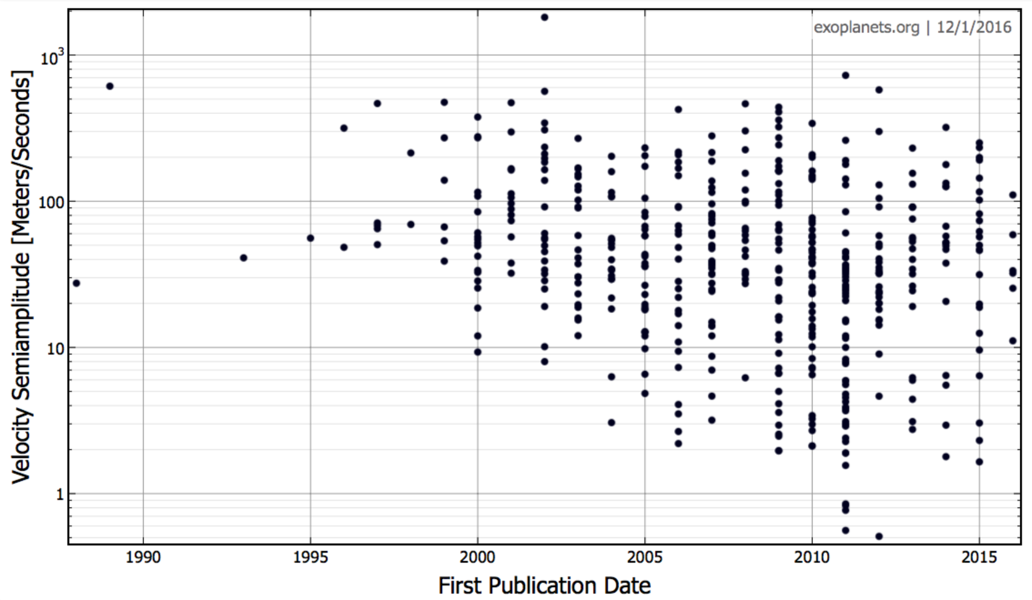
RV Planet Detections Over Time
We have gotten a lot better at this over 20 years!

Slide 5
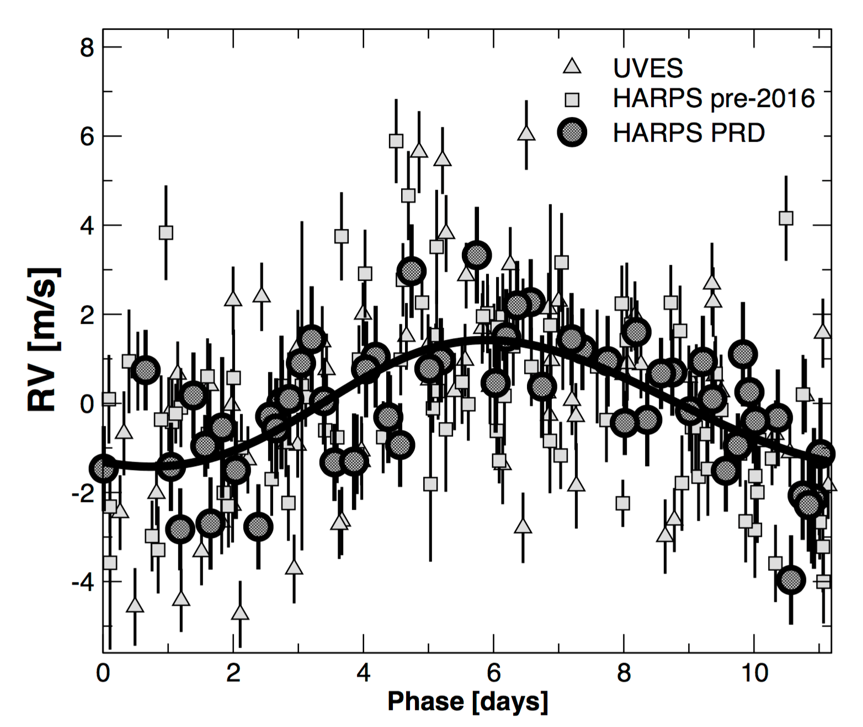
RMS residuals: <1.2 m/s
K=1.3 m/s
Proxima Cen b (Anglada-Escude+ 2016)

Slide 6
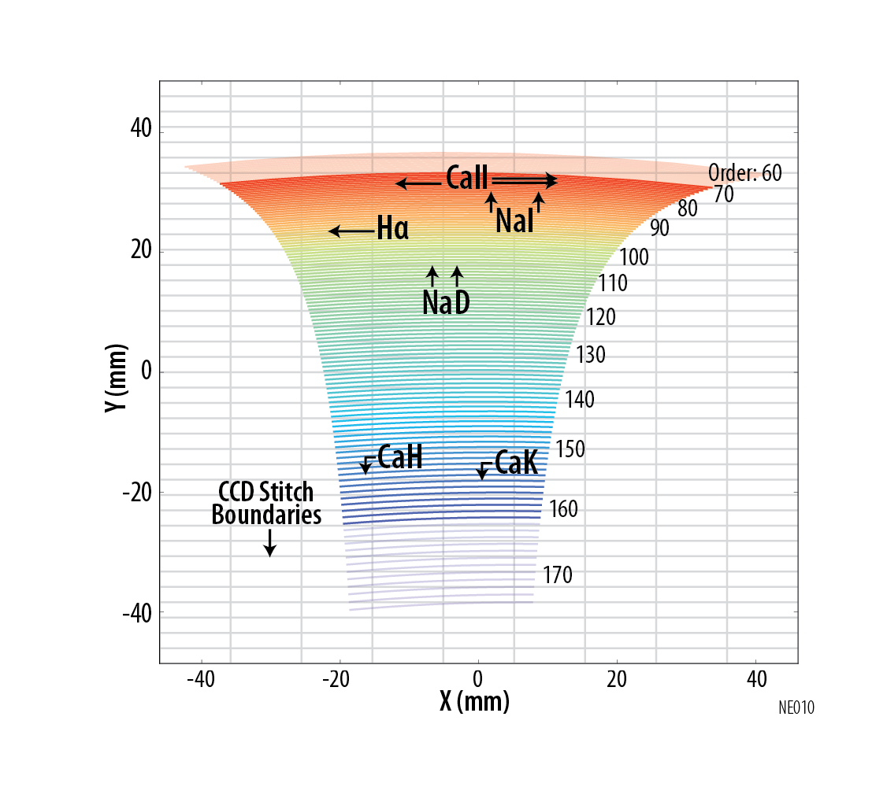
This is Hard
10cm/s corresponds to 1/6,000th of a 10 micron pixel

Slide 7
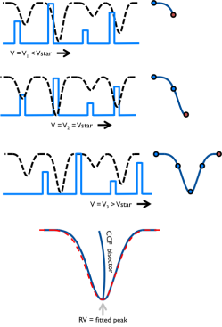
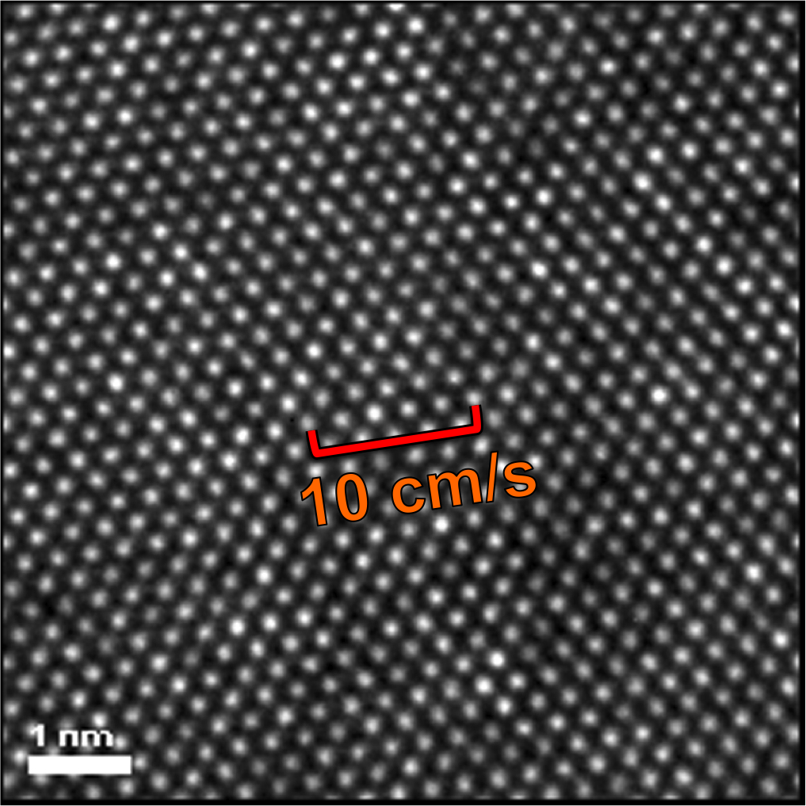
This is Hard
Silicon Lattice: High Resolution TEM Image of individual Si atoms.
Ki Bun Kin, SPIE 2012
Measure Radial Velocity:
Cross-correlate 1D spectra with a mask

Slide 8
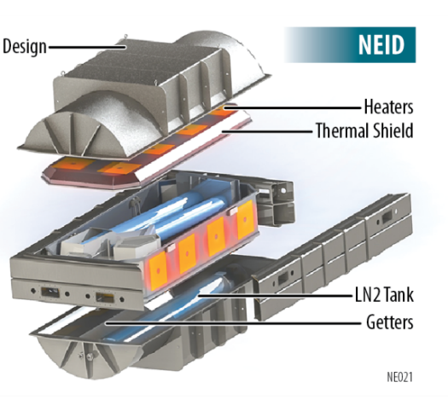
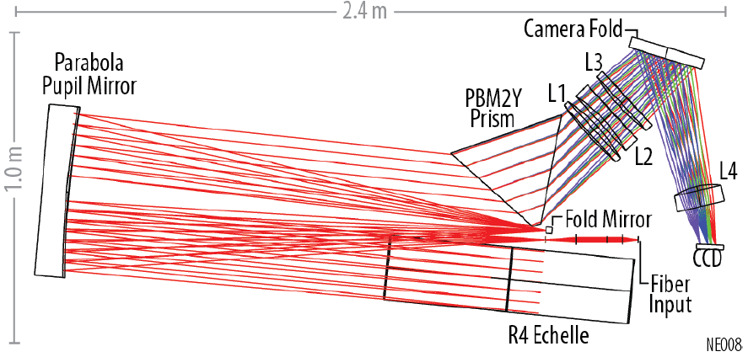
Spectrometer resides inside highly stable vacuum chamber, thermal stability better than 1 mK
Fiber coupled to telescope
Cross dispersed echelle spectrometer
Large wavelength coverage on 2D array

Slide 9
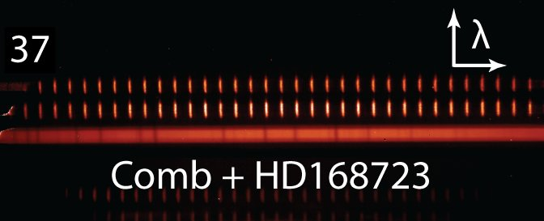
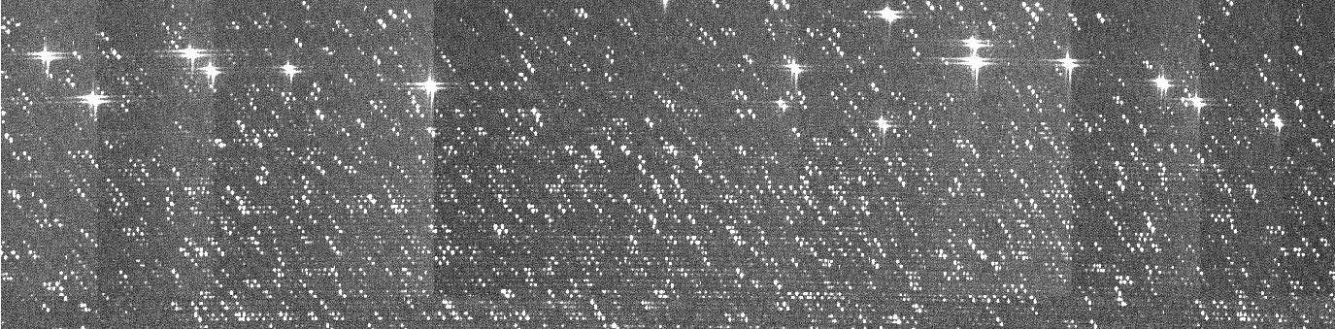
Calibration
Mapping of Wavelength to Pixel
What is the wavelength of the light falling right there?
For full credit, please give your answer to +/- 0.0000000000000001 m
Laser Frequency Comb
Stabilized Fabry-Perot etalons
UNe or ThAr cathode lamps

Slide 10


Doppler Error Budgets
Important terms – Planning for < 30 cm/s:
Wavelength calibration (relatively small)
Earth’s atmosphere (microtelluric lines – yikes)
Instrument stability (thermal expansion – not too bad)
Systematic errors related to optical fibers (manageable)
Systematic errors related to the detector (double yikes)
Many of these are calibratable to a large extent

Slide 11
Things to Worry About
Pixel-to-pixel sensitivity variations
Charge Transfer (in) Efficiency
“Stitching” errors
Sub-pixel structure (nice talk by Zhan yesterday)
Charge diffusion (can’t loose nice stellar lines in blue)
Thermal warping of the detector
Gremlins we haven't even thought of?

Slide 12
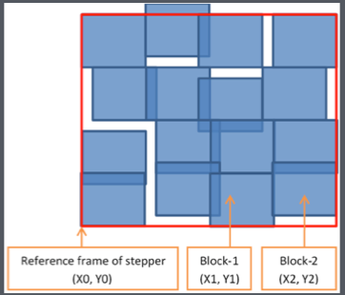
CCD Stitching
Some CCDs are “written” using a lithographic mask that is stepped. Chip could have 16 separate blocks, for example
Result: pixels are not exactly evenly spaced
Grossly exaggerated. Actual offsets are < 1/100 of a pixel
Dispersion solutions are discontinuous
Stellar lines moves across stitch boundaries

Slide 13
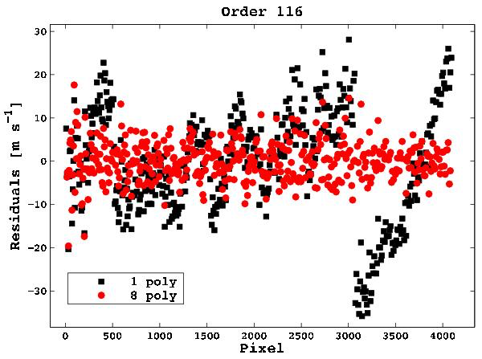
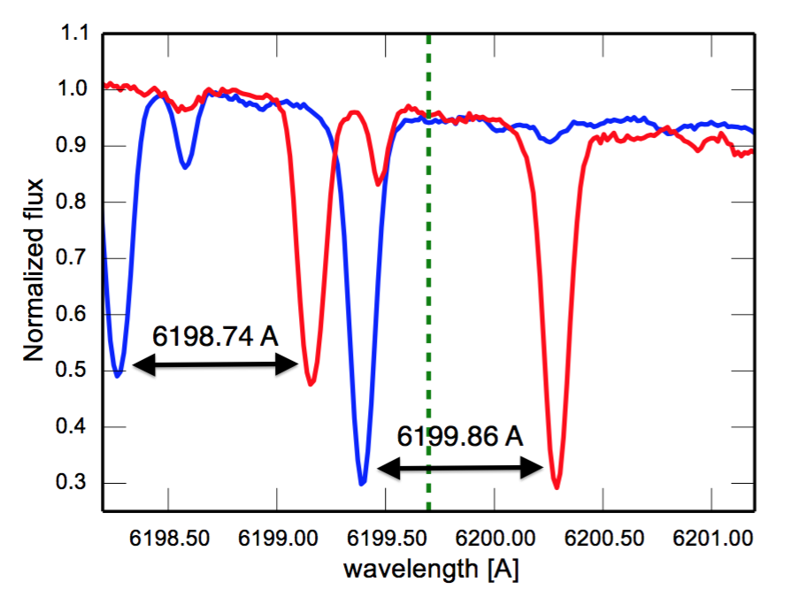
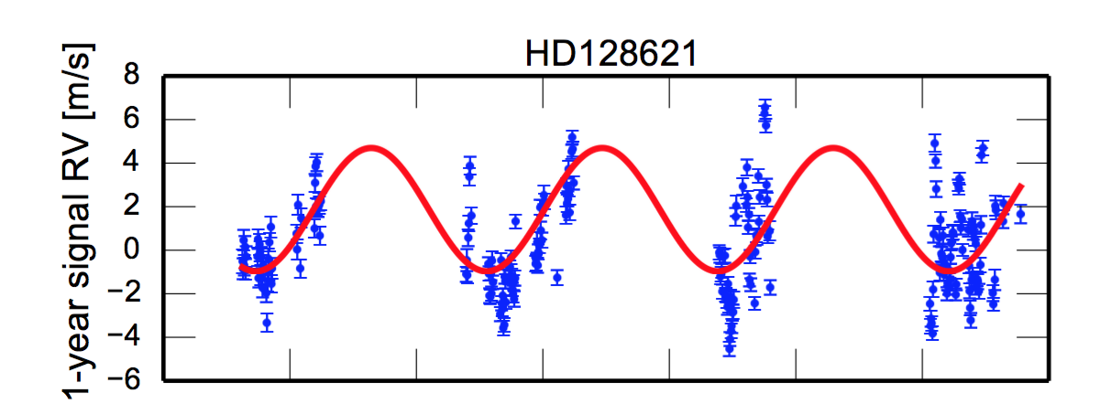
Dispersion Solution Residuals (RV units)
+/- 30 km/s motion of Earth moves some stellar lines across stitch boundaries
From Dumusque – HARPS data
Stitching errors result in discontinuities in the wavelength solutions
This effect should be stable in time and calibratable
with a Laser Frequency Comb
Dumusque et al. 2015
This can produce spurious RV signals with a period of 1 year
(Dumusque et al. 2015)

Slide 14
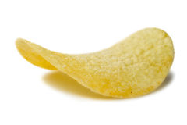
CCD Thermal Distortions
Stuff that produces heat sometimes
CCD
Stuff that produces heat sometimes
Stuff that produces heat sometimes
Stuff that produces heat sometimes
Heat dissipation on chip is not constant in time
A 5 nm displacement of the chip in the primary dispersion direction:
~30 cm/s Doppler shift – Yikes!

Slide 15
CCD Thermal Distortions
What can be done to even out heat dissipation over the integrate/read cycle?
Add heat in a precise way?
Clock registers during integration?
Wait for thermal transient to decay between science observations? What is the thermal decay time of the device?
Stuff that produces heat sometimes
CCD
Stuff that produces heat sometimes
Stuff that produces heat sometimes
Stuff that produces heat sometimes

Slide 16
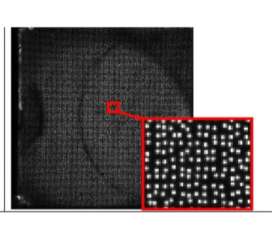
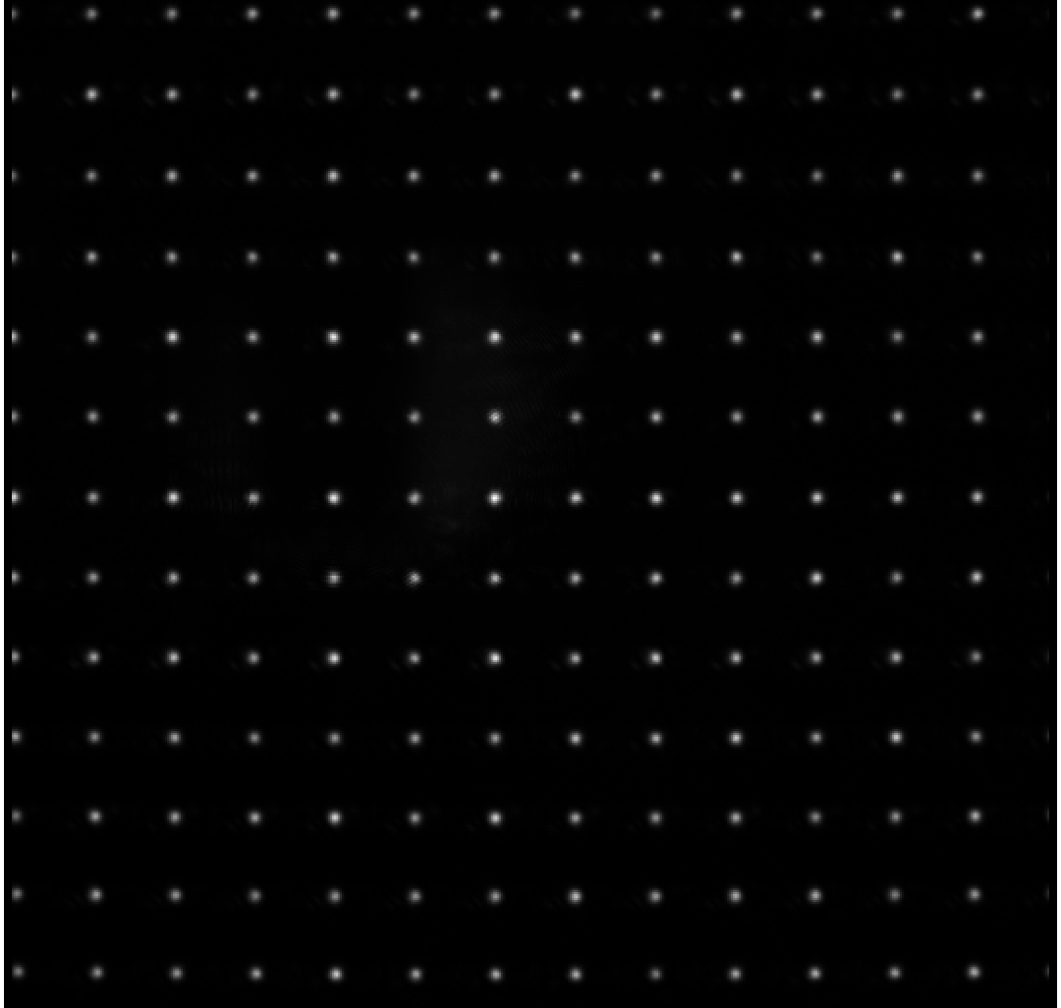
CCD Thermal Distortions
It would be nice to be able to measure these distortions in the lab, or in the instrument
Olaf Iwert and collaborators have demonstrated a projected spot constellation approach
(Lizon et al. 2016)
Diffractive Optical Element:
Laser-coupled structured
light generator
Penn State
Also, see talk yesterday by Andres Plazas
Other ideas for measuring monitoring changes in the shape of the CCD at the 1 nm level?

Slide 17
Charge Transfer Inefficiency
Parallel (or serial) transfer direction →
Some electrons get left behind
Electrons trapped, maybe released later
Charge Transfer Efficiency > 0.99999 (typically “five nines and zero” or maybe “and a five”)
CTI (=1-CTE) < 1x10⁻⁵ (typically < 5x10⁻⁶)
Those are small numbers, BUT large-format CCDs can involve a lot of transfers
Example: 10⁴ parallel transfers means up to 5% of charge could be lost/deferred
Why do we care for precision radial velocity measurements?

Slide 18
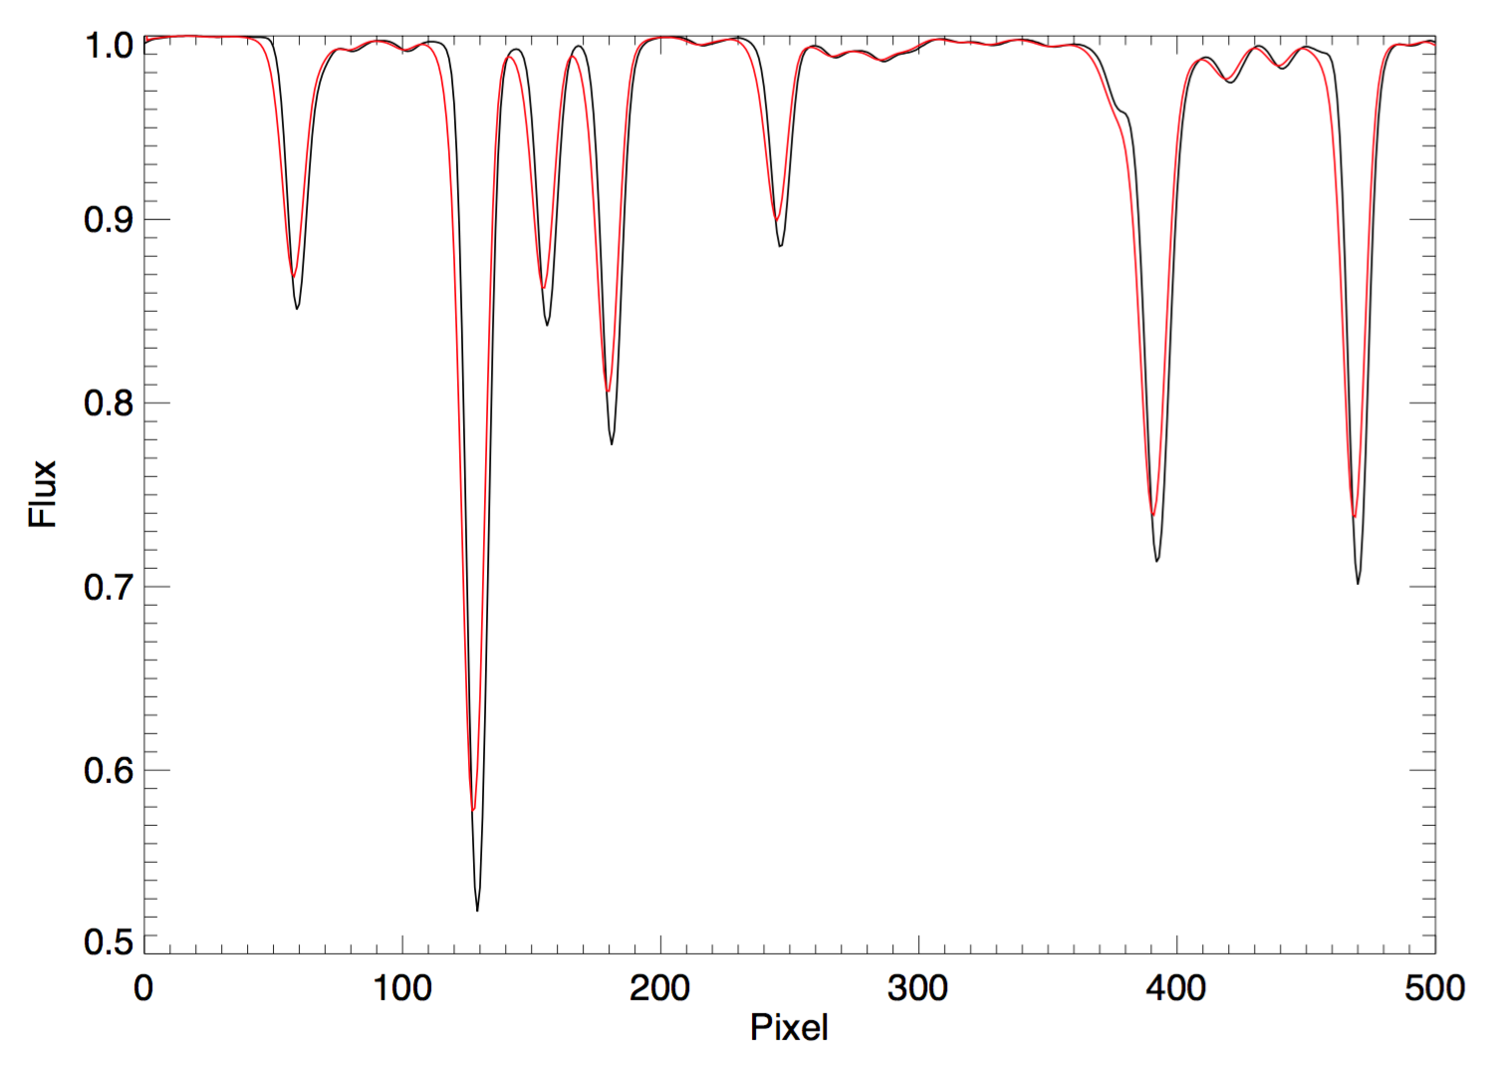
Charge Transfer Inefficiency
CTI effectively induces a skewness in the spectral lines.
This is bad…looks just like a Doppler shift
to a cross-correlation algorithm
But…do we care, if it is constant in time?

Slide 19
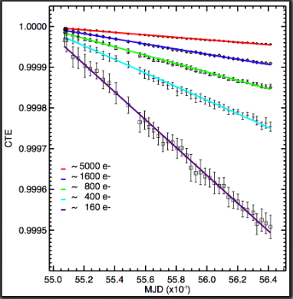
Charge Transfer Inefficiency
High S/N
Low S/N
Time → (years)
CTI may be worse at low flux levels – above from HST WFC3 on-orbit measurements
So, unless you can maintain very tight control of S/N … CTI is changing at some level

Slide 20
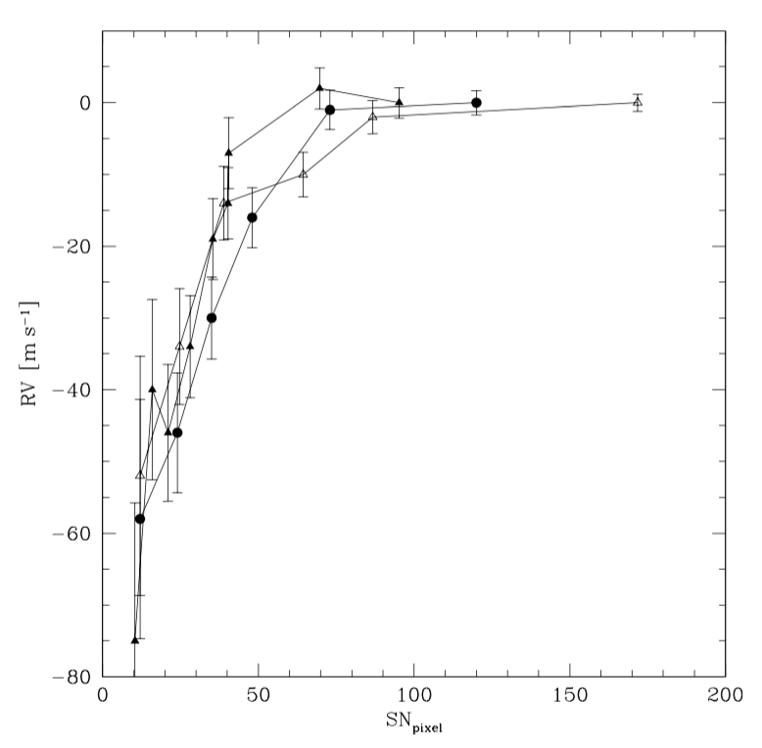
Charge Transfer Inefficiency
Bouchy et al. 2009
This effect is HUGE in older-generation instruments (SOPHIE at OHP shown above)
But…can be modeled and spectra corrected very well

Slide 21
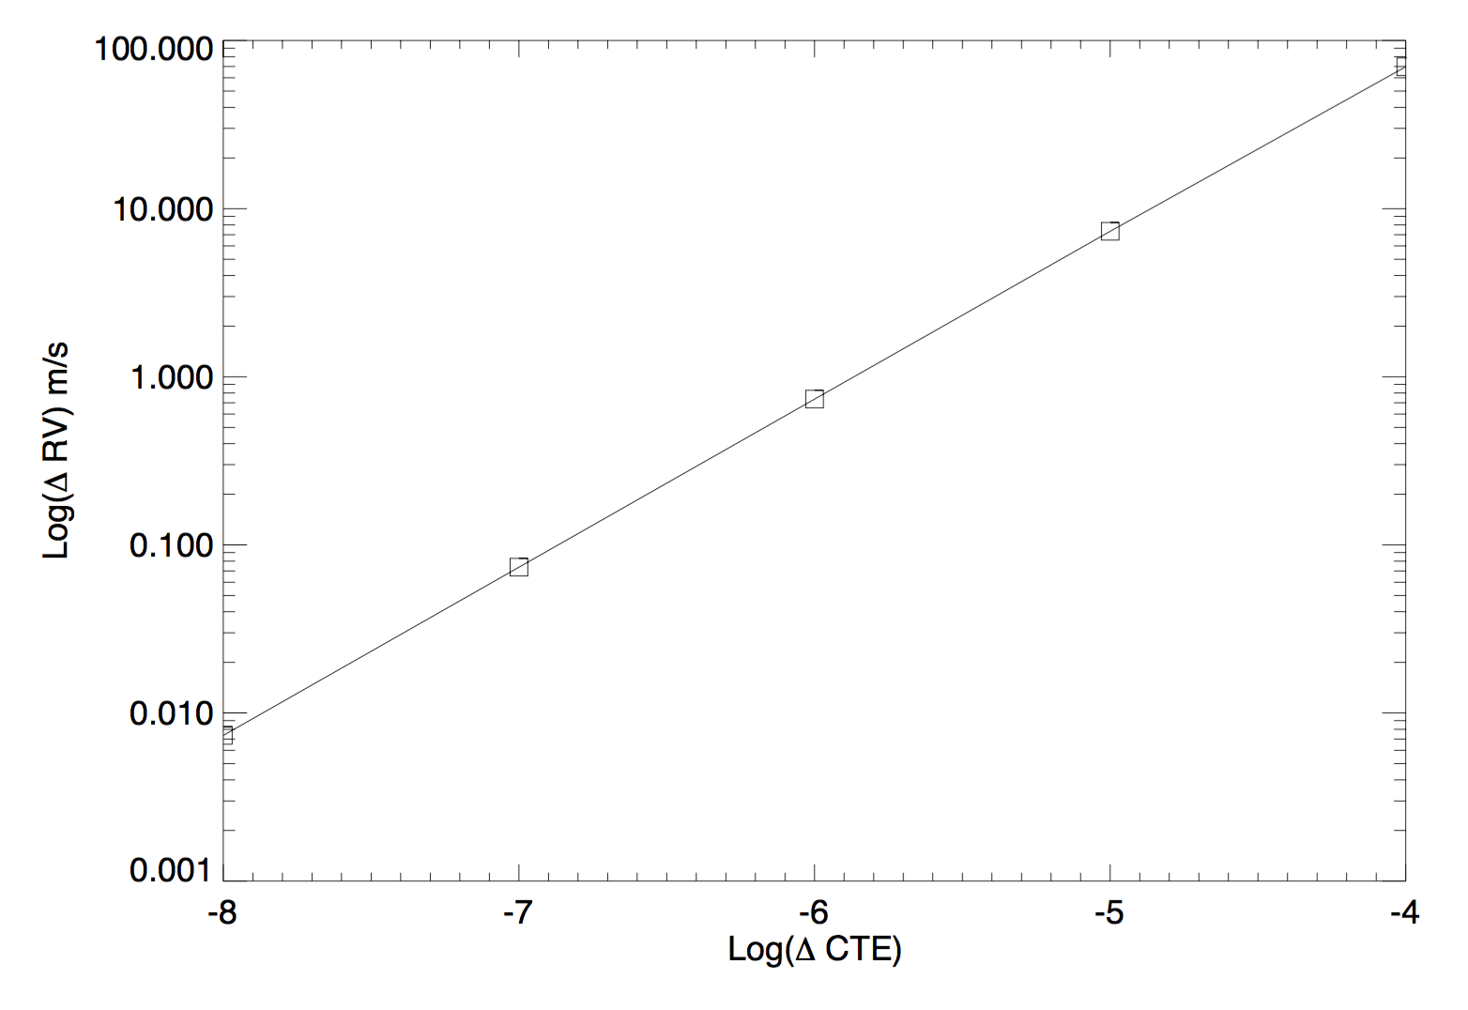
Charge Transfer Inefficiency
What happens to RV when I tweak CTE?
If we change CTE by 10⁻⁷, we get a 5 cm/s RV bias
Bottom line (for this specific detector):
1) CTI < 10⁻⁷ at all flux levels (sounds tough)
2) CTI difference over relevant range of flux levels < 10⁻⁷ (maybe possible)
3) Measure CTI to +/- 10⁻⁷ across range of flux levels and model it out

Slide 22
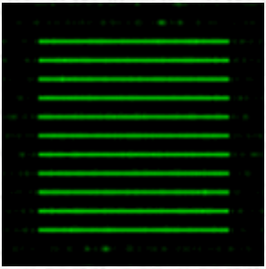
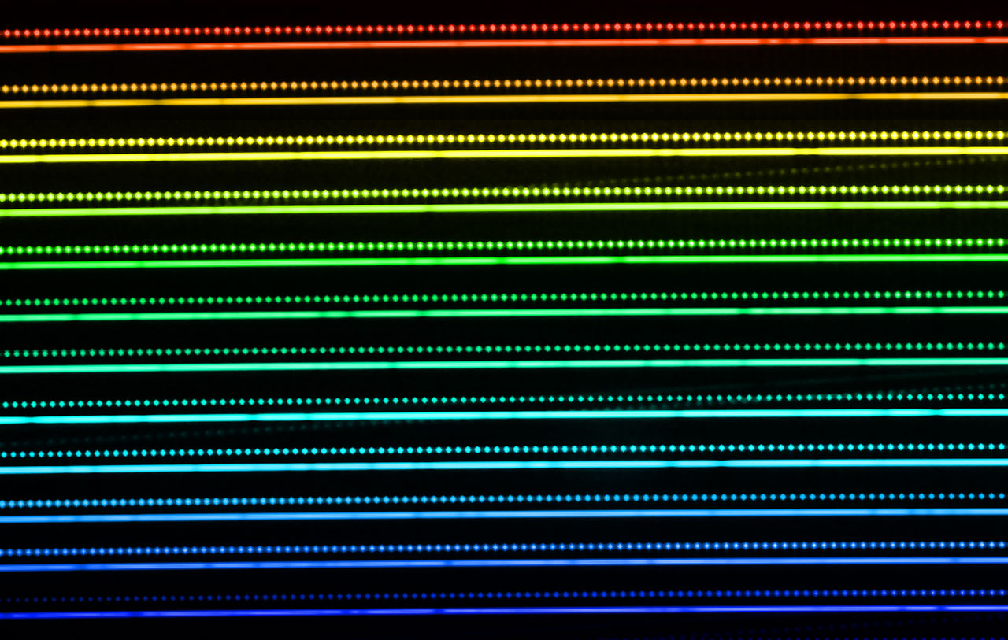
Charge Transfer Inefficiency
New approaches to measuring CTI?
Structured light generator in fused silica coupled to a super- stable light source - measure CTI vs. flux level in the lab?
Use a Laser Frequency Comb with modulated intensity - measure CTI vs. flux level in situ

Slide 23
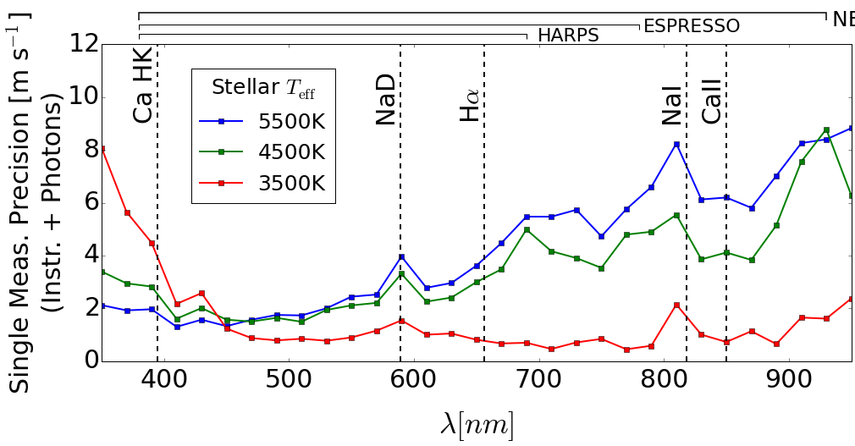
Redder is Better
HARPS
Simulated RV precision vs. central wavelength of spectral order

Slide 24
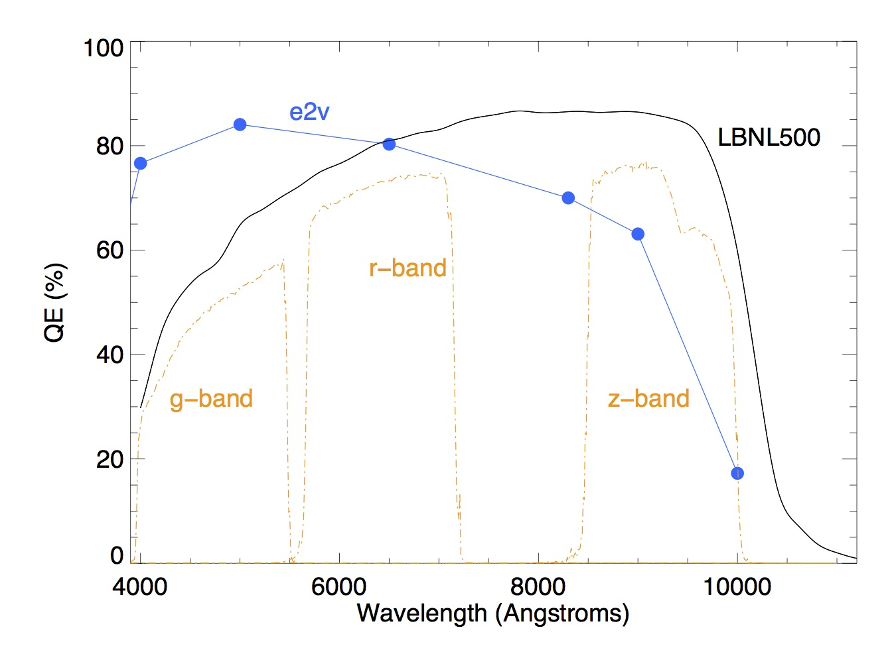
Redder is Better
NIR Doppler spectrometers are being built (CARMENES, HPF, IRD, iLocator)
These instruments are expensive, and Hirata is scarred of the detectors...for photometry!
Extending CCD-based spectrometer sensitivty in the 850-900 nm to >1000 nm ranges very attractive option

Slide 25
Redder is Better
NEID and ESPRESSO will both employ 40 micron thick devices
Are precise Doppler measurements possible with a 250+ micron thick device?
What are the key systematics that might limit
Would charge diffusion preclude high specral resolution at blue wavelengths on the same device?

Slide 26
Conclusions
For the next generation of Doppler spectrometers, subtle CCD effects are important
We believe that most of these effects are understandable and/or calibratable
Some new approaches to measuring CCD performance may be required
Suggestions…what haven’t we thought of?
Thanks!

Slide 27
Redder Is Better

Slide 28
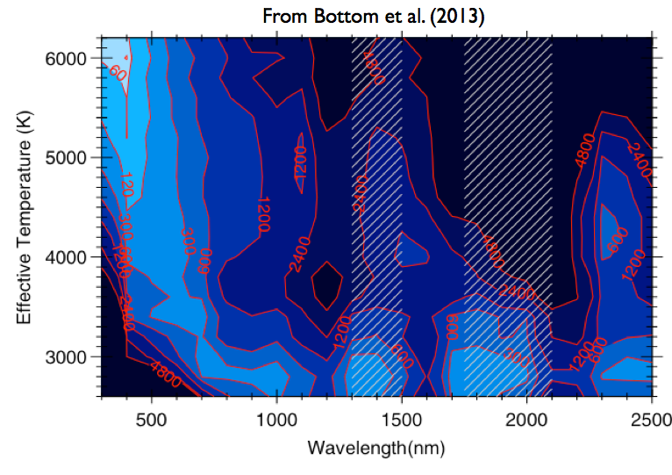
Redder is Better
Contours of relative integration time required to detect planets of fixed mass in host star’s liquid water habitable zone – vs. spectral order central wavelength

Slide 29
Redder is Better
Contours of relative integration time required to detect planets of fixed mass in host star’s liquid water habitable zone

Slide 30
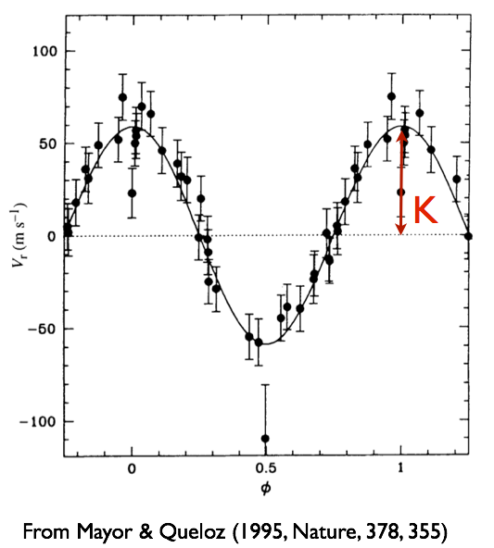
RMS residuals – 13 m/s
K=59 m/s

