Slide 1
Status of the CCD Development for the Dark Energy Spectroscopic Instrument
C.J. Bebek, J.H. Emes, D.E. Groom, S. Haque,
S.E. Holland, A. Karcher, W.F. Kolbe, J.S. Lee,
N.P. Palaio, and G. Wang
Dec 2nd, 2016
Lawrence Berkeley National Laboratory

Slide 2
Outline of the talk
Overview of the Dark Energy Spectroscopic Instrument and CCD requirements
4k x 4k CCD development for DESI
“Tree rings”
Use of very high resistivity silicon
Fixed pattern noise from CCD fabrication
Quantum Efficiency improvements
Noise improvements

Slide 3
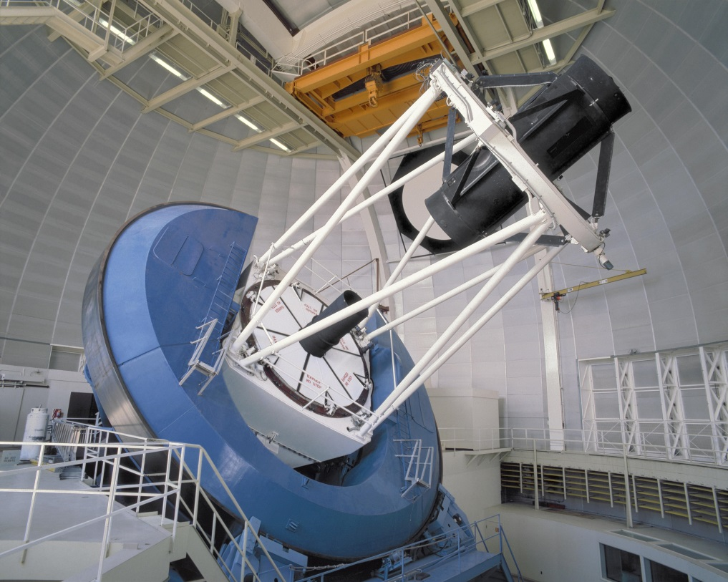
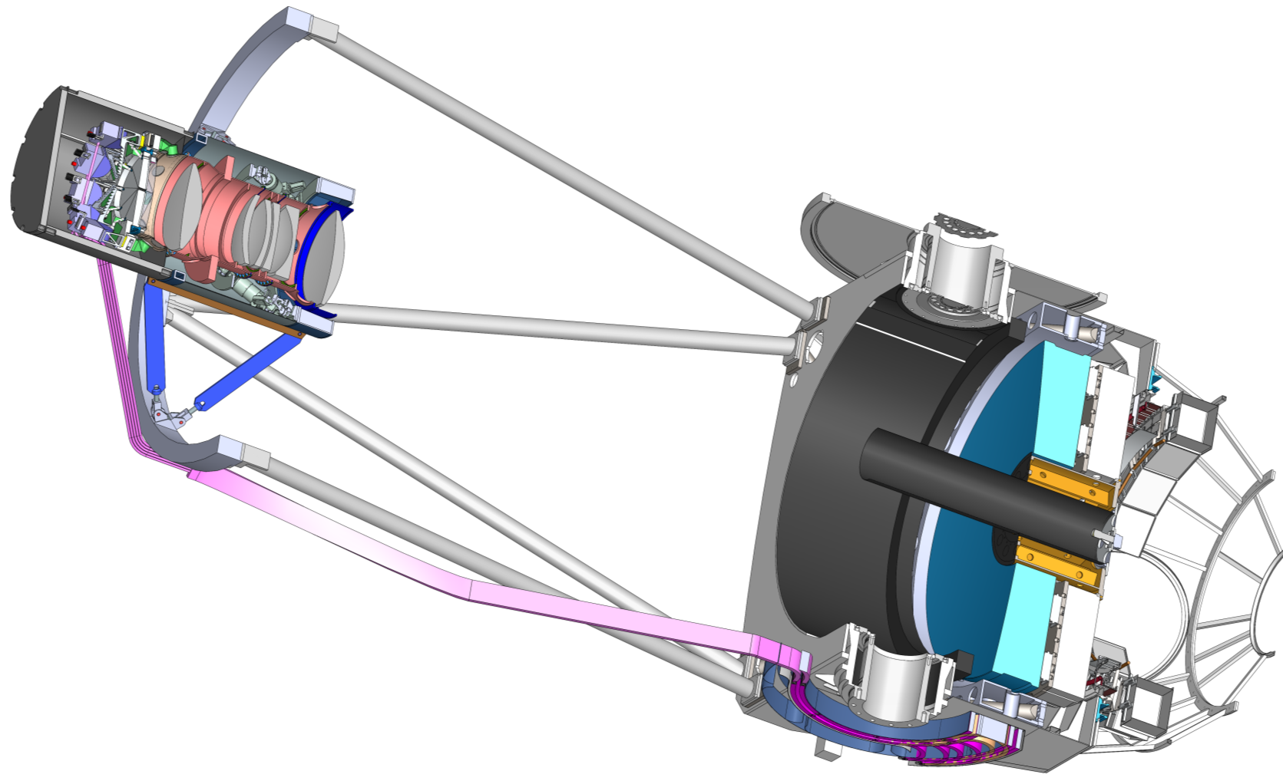
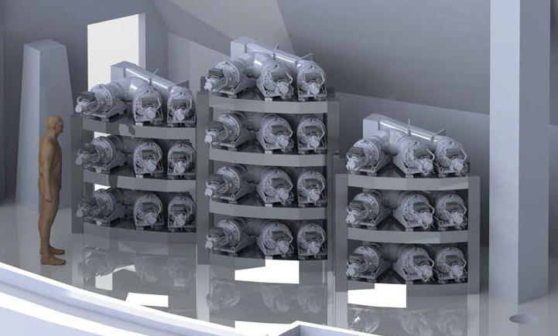
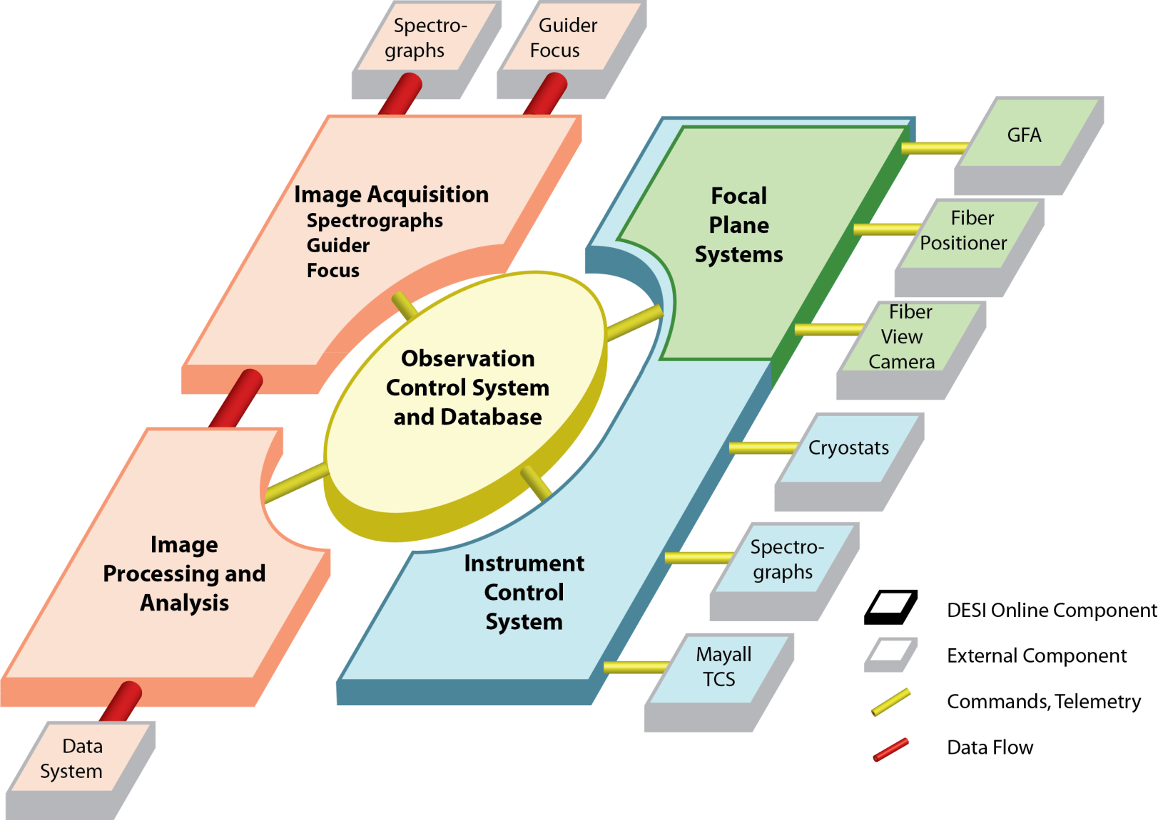
DESI Overview
Robotic positioners with fiber optic tips to collect light from 5000 objects simultaneously
Fibers transmit the light to 10 spectrographs each containing 3 4k x 4k, 15 µm pixel CCDs
Measure ~ 30 million redshifts using 4 classes of objects (LRGs, ELGs, QSOs, Lyman-α forest)
Begin operations 2019 (Kitt Peak Mayall 4-m)
Corrector
Focal Plane
System
Fiber View Camera
Readout & Control
Primary Mirror
Spectrographs
Fiber System

Slide 4
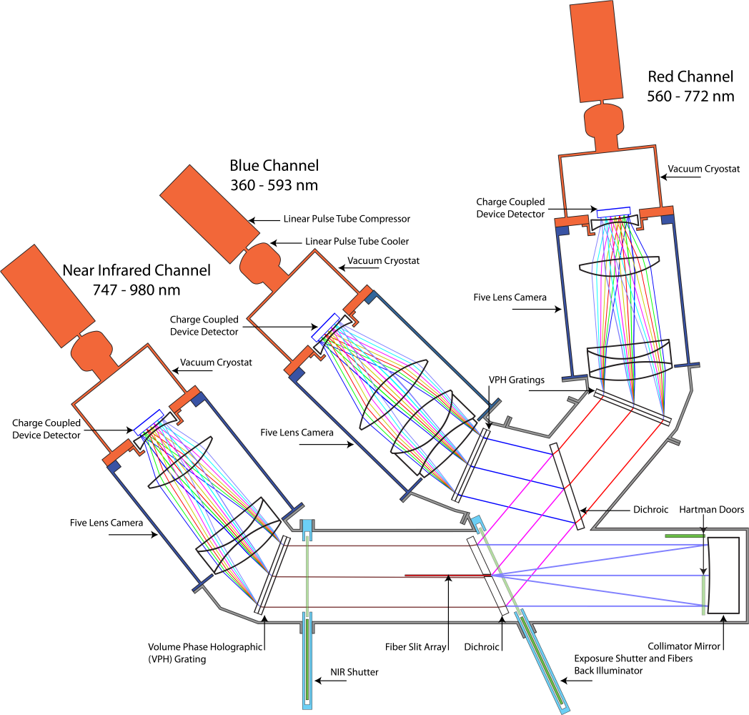
DESI Spectrograph Design
3 CCDs per spectrograph
Blue channel 360 – 593 nm (thinned CCD)
Red channel 560 – 772 nm (250 µm thick fully depleted CCD)
Near Infrared 747 – 980 nm (250 µm thick fully depleted CCD)
10 systems each with 500 simultaneous spectra
One Camera
One CCD
Collimator
Fiber Slit

Slide 5
CCD requirements
CCD’s | Requirement | Achieved
Pixel size | 15µm | complies
Array size | > 4096 x 4096 pixels | complies
Dark Current | < 10 e⁻/pix hr | < 10 e⁻/pix hr
Read Noise | < 3e⁻ | < 3 e⁻
BLUE CCD
QE 360-400 nm | 75% | 83 – 98%
QE 400-600 nm | 90% | 90 – 97%
Flatness P-P | <20µm | complies
RED/NIR CCD
QE 600-900nm | >90% | 91 – 98%
QE 900-980nm | >60% | >66 – 98%
Flatness P-P | <15µm | complies
10 each Blue, Red, Near Infrared (NIR)
~ 15 minute exposures, 2 e⁻ read noise goal (spec 3 e⁻)
-100 / -140 C operation

Slide 6
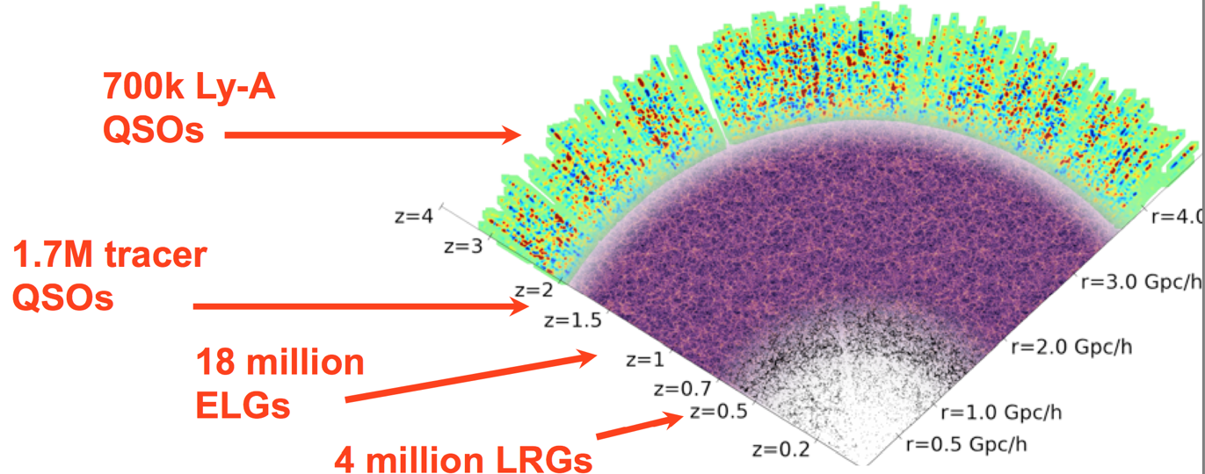
DESI Overview
Target objects
Luminous Red Galaxies
Emission Line Galaxies
Bright Galaxy Sample
Quasars
10 million BGS
Slide courtesy R. Wechsler (SLAC)

Slide 7
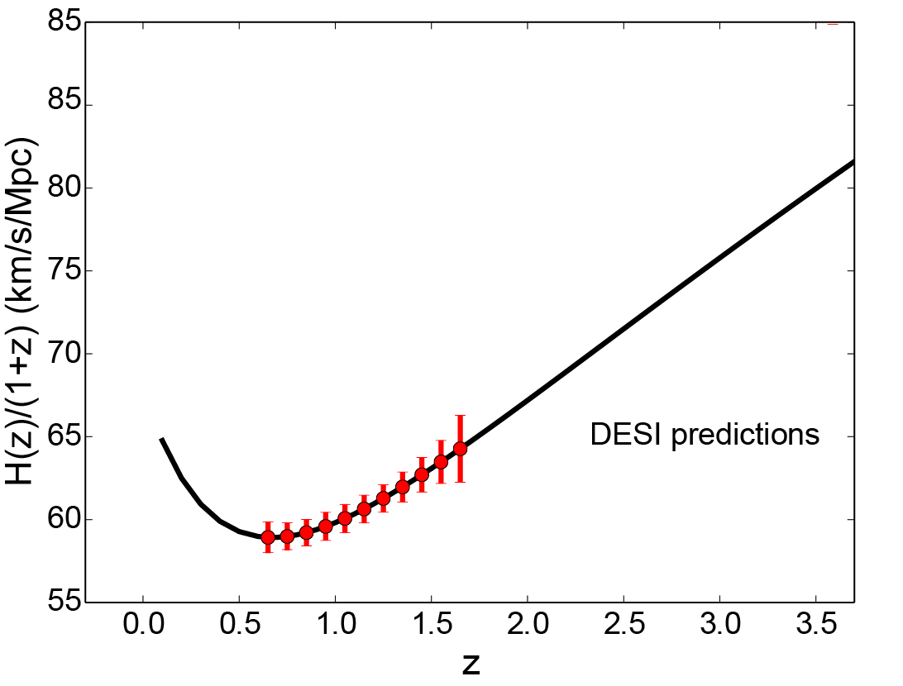
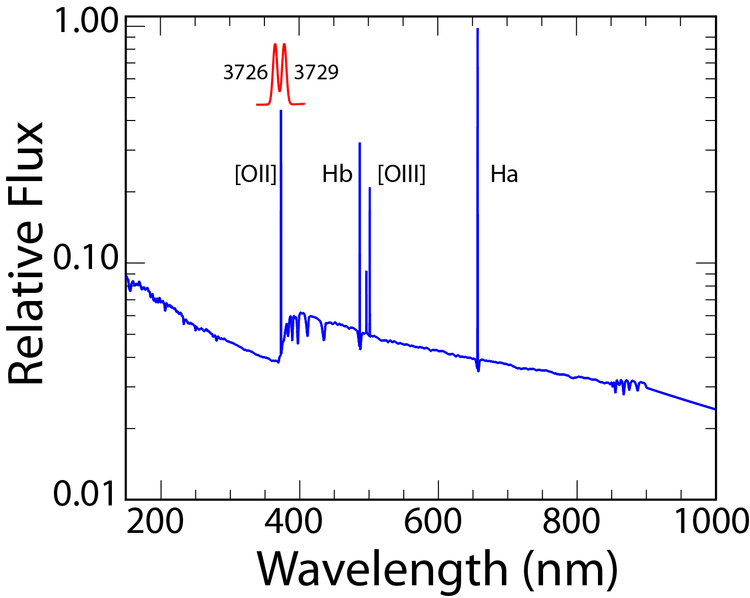
Emission Line Galaxies
1280/sq. degree
0.6 < z < 1.6
17.9 M
>90% completeness
Expansion Rate
Slide courtesy R. Wechsler (SLAC)
0.6 < z < 1.6 corresponds to 596 nm < λ < 969 nm (OII doublet)

Slide 8
Emission Line Galaxies
1280/sq. degree
0.6 < z < 1.6
17.9 M
>90% completeness
Requires thick, fully depleted CCD
Expansion Rate
Slide courtesy R. Wechsler (SLAC)
0.6 < z < 1.6 corresponds to 596 nm < λ < 969 nm (OII doublet)

Slide 9
Outline of the talk
Overview of the Dark Energy Spectroscopic Instrument and CCD requirements
4k x 4k CCD development for DESI
“Tree rings”
Use of very high resistivity silicon
Fixed pattern noise from CCD fabrication
Quantum Efficiency improvements
Noise improvements

Slide 10
Tree rings
“Tree rings” arise from resistivity variations that develop during crystal growing and float-zone refining
Impurity segregation between liquid and solid phases
Spherical melt (growth) surface leads to radial resistivity variations
From Topsil product note: http://www.topsil.com/media/142192/pfz_product_note_september2014.pdf

Slide 11
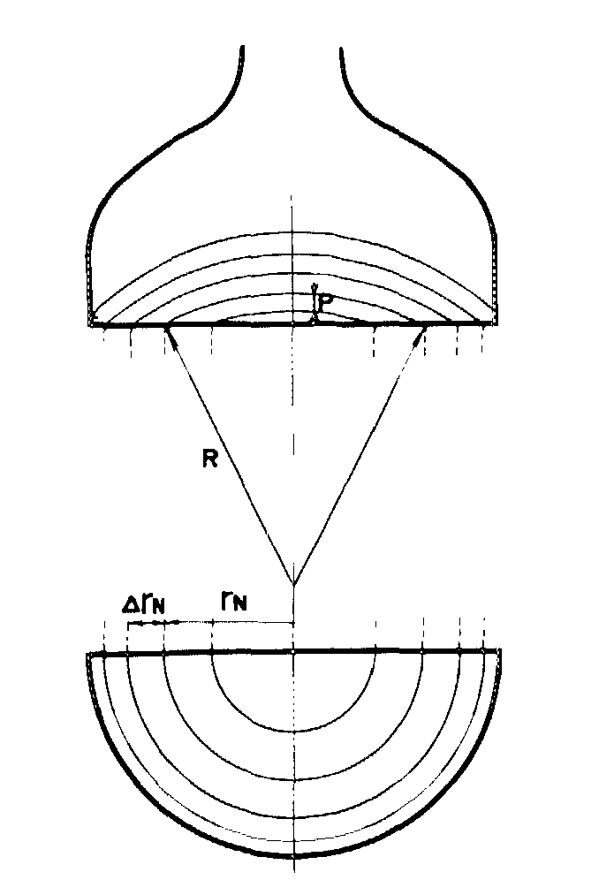
Tree rings
Silicon ingot
Regions of varying resistivity due to impurity segregation (liquid / solid segregation)
Radial variation in resistivity due to slicing into wafers
K. Senda et al., “Fixed pattern noise in the solid-state imagers due to the striations in Czochralski silicon crystals”, J. Appl. Phys. 57 (1985) 1369.

Slide 12
Tree rings
Resistivity variations lead to space charge that generate lateral electric fields E_{x} that deflect the charge during transit

Slide 13
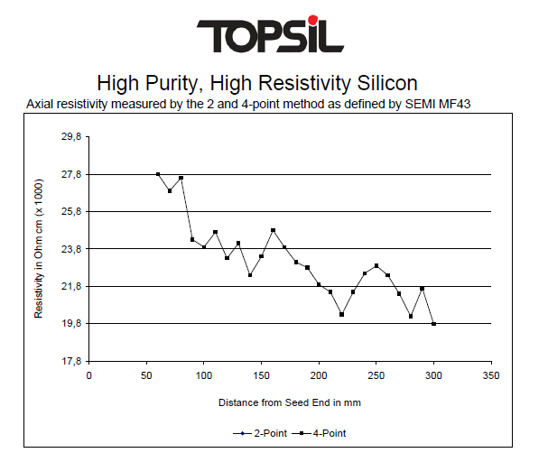
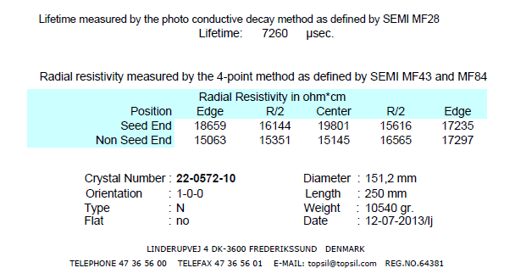
Tree rings
Reduce the effect of the resistivity variations by using very high resistivity silicon
Material used for DESI CCD production to date

Slide 14
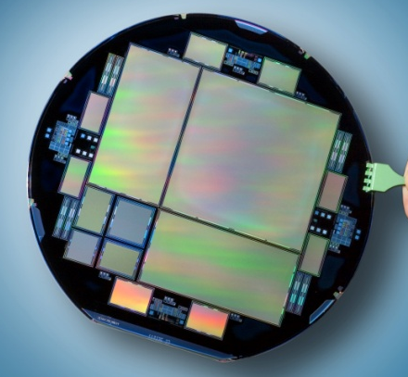
Tree rings
The following slides compare results for a
BOSS CCD fabricated on 5 kohm-cm silicon
DESI CCD fabricated on > 15 kohm-cm silicon
Both 250 microns thick
BOSS: 127298-22-4 DESI: 169186-7-4

Slide 15
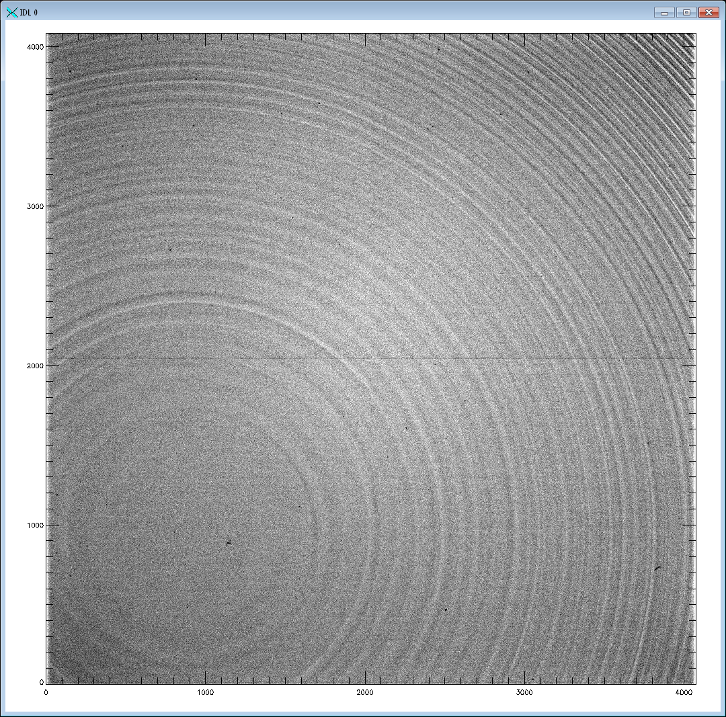
Tree rings: 5 vs 15 kohm-cm Si (20V)
Use very high resistivity silicon to suppress tree rings
Less space charge due to ionized dopants / less lateral field
~ 5 kohm-cm resistivity (e.g. DECam)
> 15 kohm-cm resistivity (DESI)

Slide 16
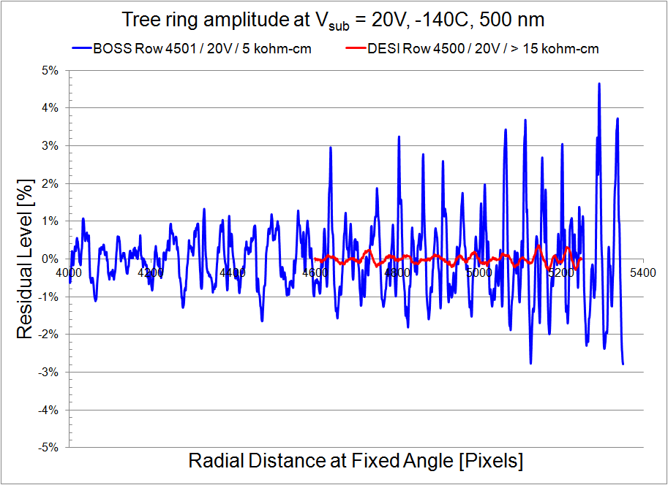
Tree rings / experimental data (20V)

Slide 17
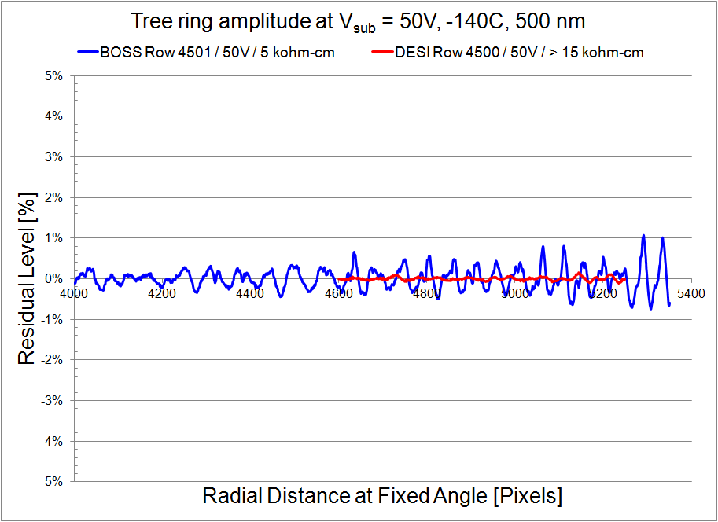
Tree rings / experimental data (50V)

Slide 18
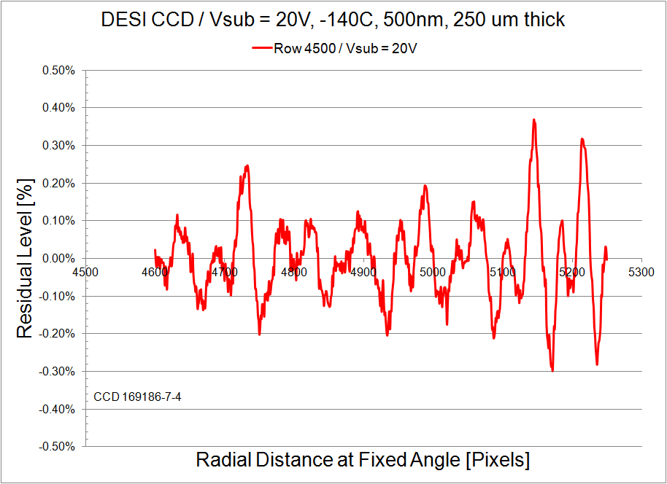
Tree rings / DESI CCD (20V)

Slide 19
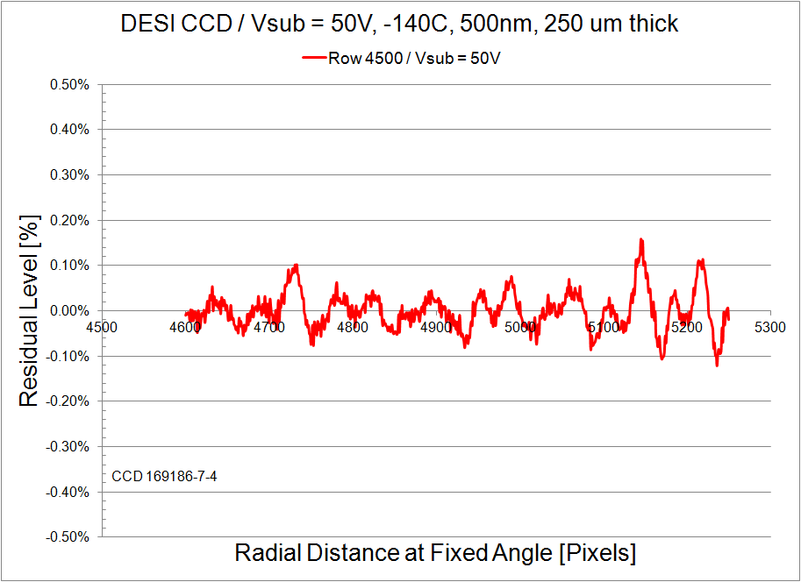
Tree rings / DESI CCD (50V)

Slide 20
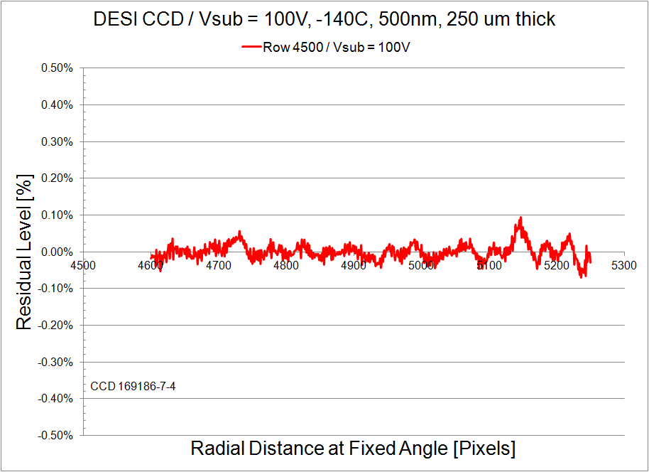
Tree rings / DESI CCD (100V)

Slide 21
Outline of the talk
Overview of the Dark Energy Spectroscopic Instrument and CCD requirements
4k x 4k CCD development for DESI
“Tree rings”
Use of very high resistivity silicon
Fixed pattern noise from CCD fabrication
Improved photomask fabrication
Noise improvements
Quantum Efficiency improvements

Slide 22
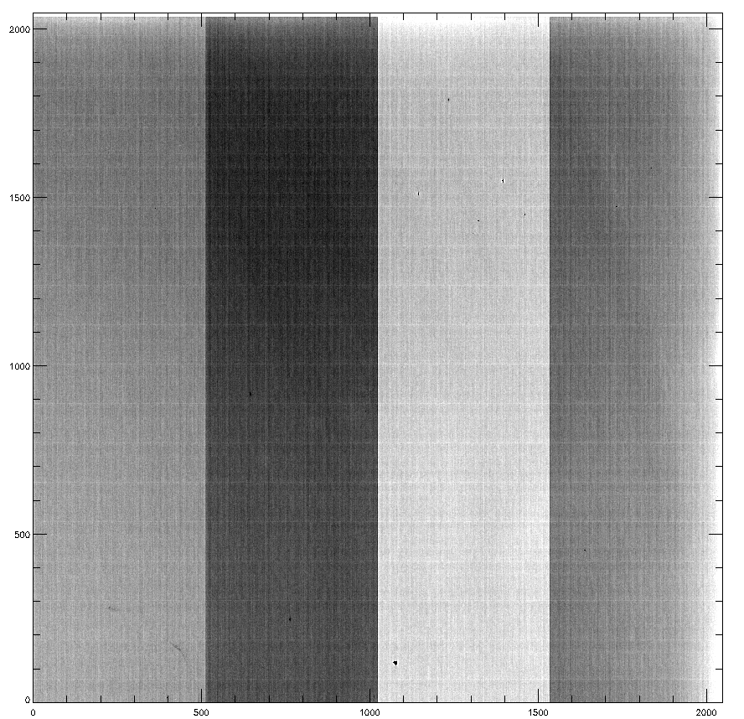
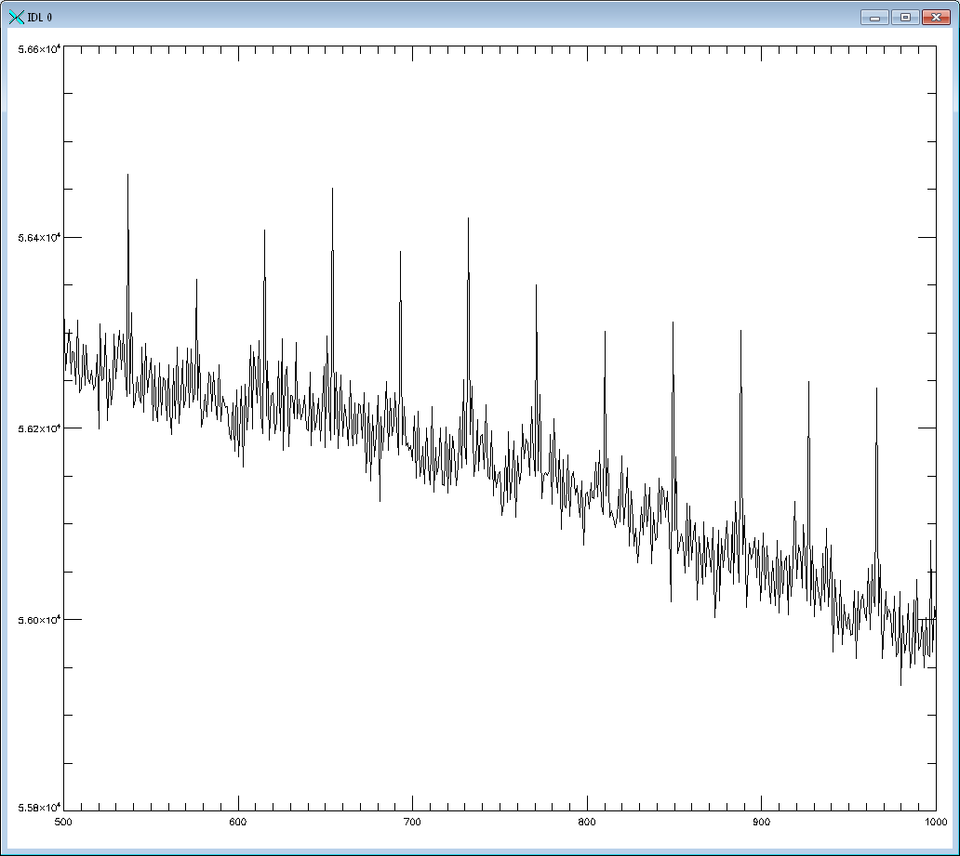
Fixed pattern noise / photomasks
The 1x photomasks used in the Teledyne CCD process use step and repeat systems that result in periodic, pattern-placement errors
56.6k
56.4k
56.2k
ADU
56.0k
Column plot:
Average of 200 cols centered at col 250
~ 0.5 % with ~ 38 pixel period (~ 400 µm)
~ 50 nm for 10.5 µm pixel
55.8k
600
700
800
900
165771-12-4_S13to16_unsc_flat100V1_med_fits-f_flipy_no_oscan_53500_4500.png
Row number

Slide 23
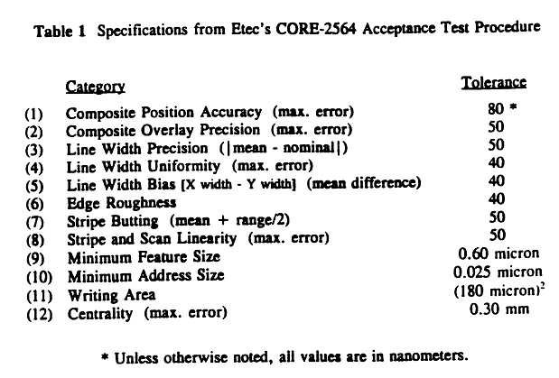
Fixed pattern noise / photomasks
Use more advanced masks for DESI levels 1-6
CORE 2564 used previously superceded by ALTA 3000, 3100, 3500, 3900, etc
ALTA 3500 used for DESI
Franks et al, Proc. SPIE, 1809, 1992
Hamaker and Buck, Proc. SPIE, 3236, 1997

Slide 24
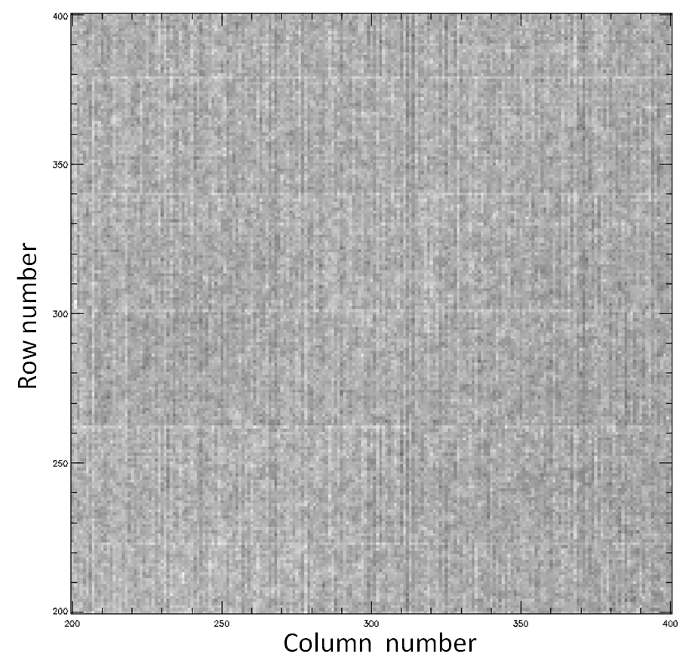
Fixed pattern noise / photomasks
16 channel CCD using CORE 2564 mask maker
Uniform illumination / 50V Vsub

Slide 25
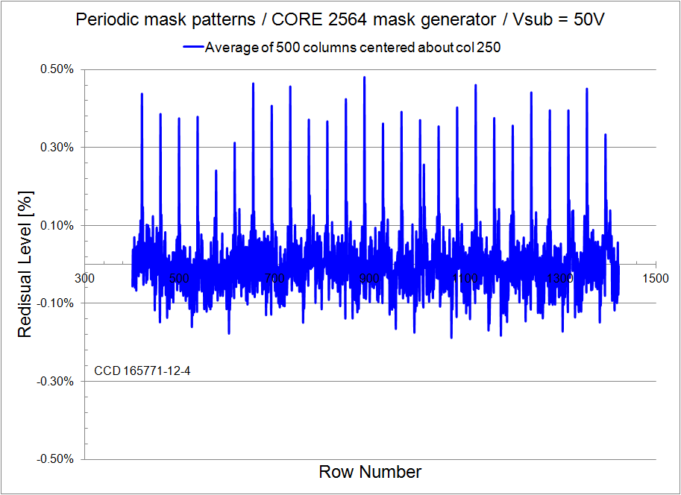
Fixed pattern noise / photomasks
16 channel CCD using CORE 2564 mask maker
Residuals in the column direction

Slide 26
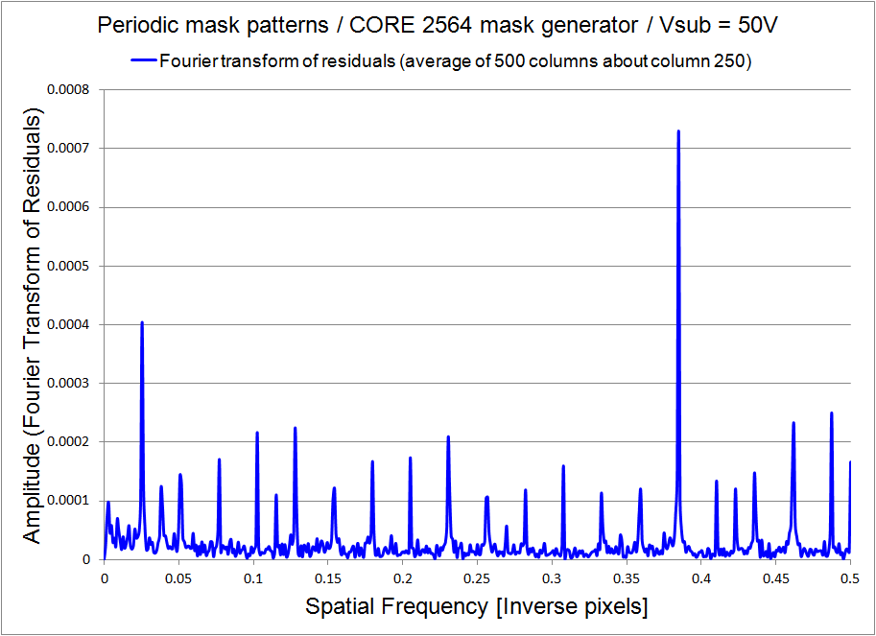
Fixed pattern noise / photomasks
16 channel CCD using CORE 2564 mask maker
Fourier Transform of residuals (column direction)
1/F ~ 39.4 pixels
1/ΔF ~ 39.4 pixels

Slide 27
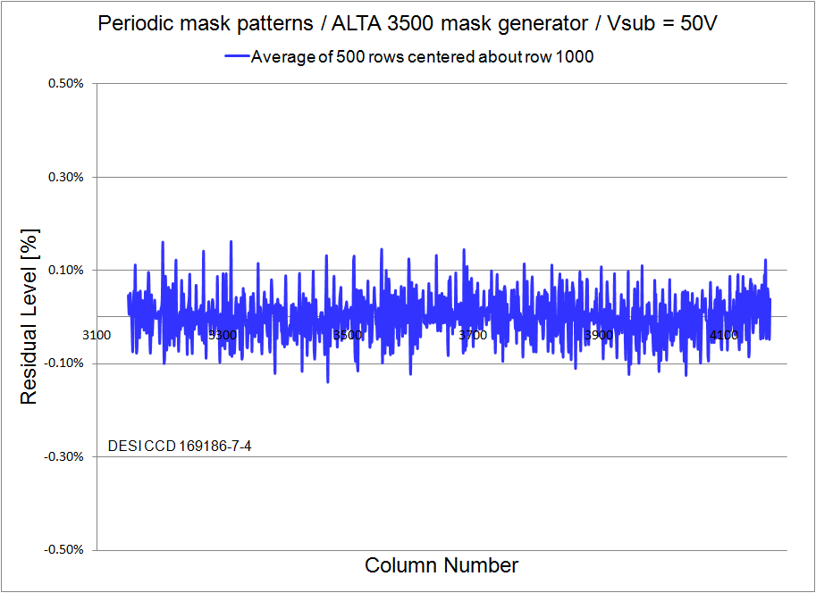
Fixed pattern noise / photomasks
DESI CCD using ALTA 3500 mask maker
Residuals in the row direction

Slide 28
Fixed pattern noise / photomasks
CORE 2564 vs ALTA 3500 mask maker (DESI)
16 channel CCD (10.5 um pixels) CORE 2564
DESI CCD (15 um pixels)
ALTA 3500

Slide 29
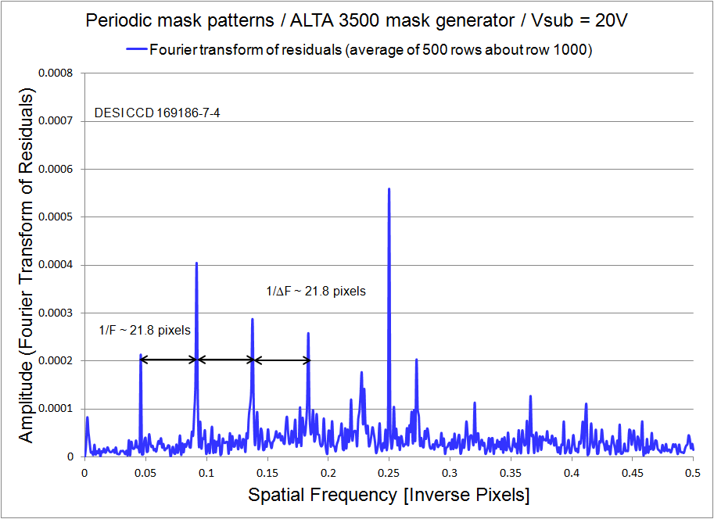
Fixed pattern noise / photomasks
DESI CCD using ALTA 3500 mask maker
Periodic pattern still detected on DESI CCDs

Slide 30
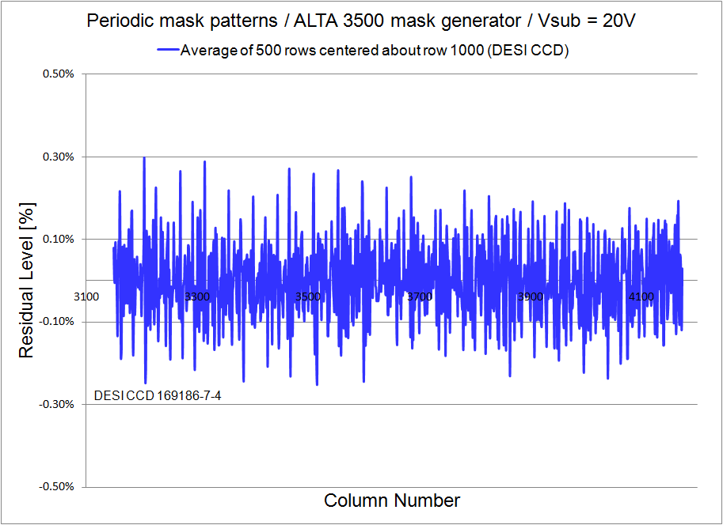
Fixed pattern noise / photomasks
DESI CCD using ALTA 3500 mask maker
Residual level depends on Vsub (20V)

Slide 31
Fixed pattern noise / photomasks
DESI CCD using ALTA 3500 mask maker
Residual level depends on Vsub (50V)

Slide 32
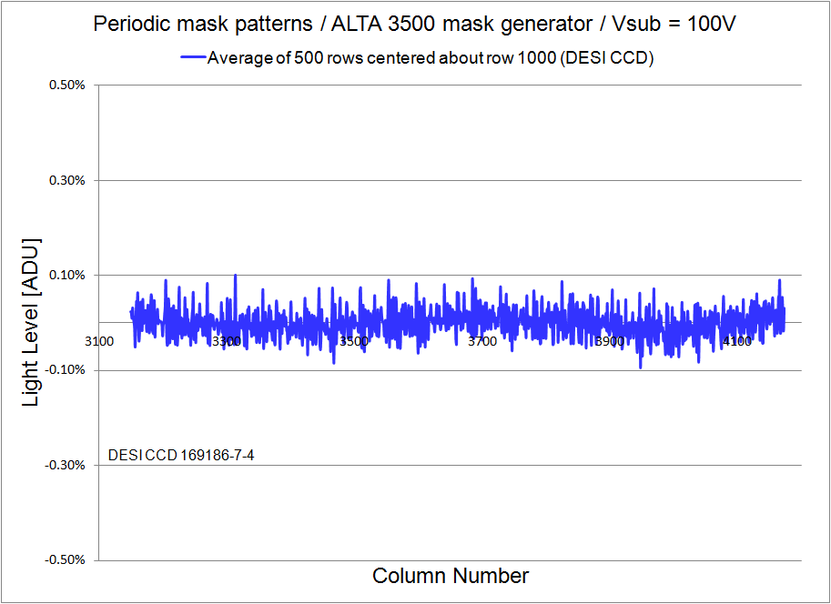
Fixed pattern noise / photomasks
DESI CCD using ALTA 3500 mask maker
Residual level depends on Vsub (100V)

Slide 33
Fixed pattern noise / photomasks
DESI CCD using ALTA 3500 mask maker
Substrate bias voltage dependence (20V)

Slide 34
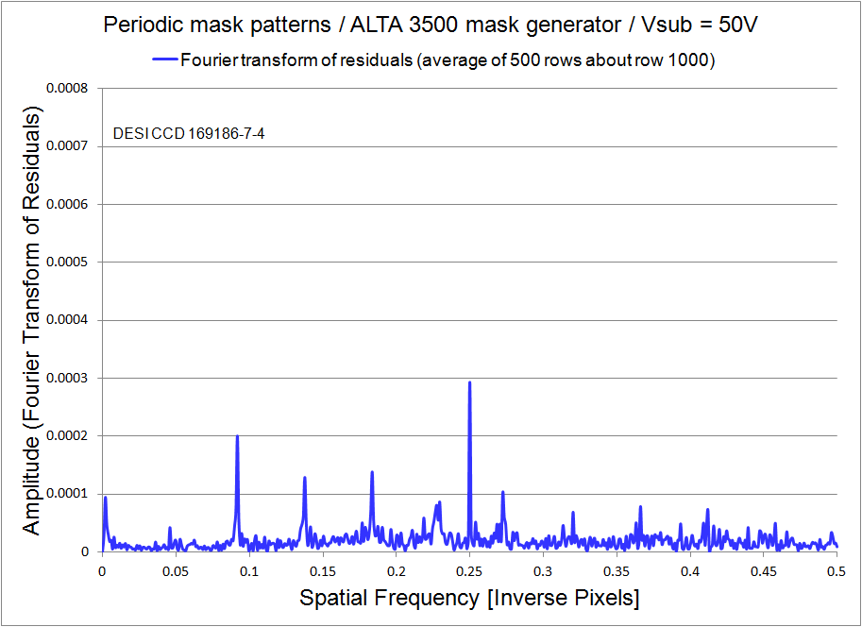
Fixed pattern noise / photomasks
DESI CCD using ALTA 3500 mask maker
Substrate bias voltage dependence (50V)

Slide 35
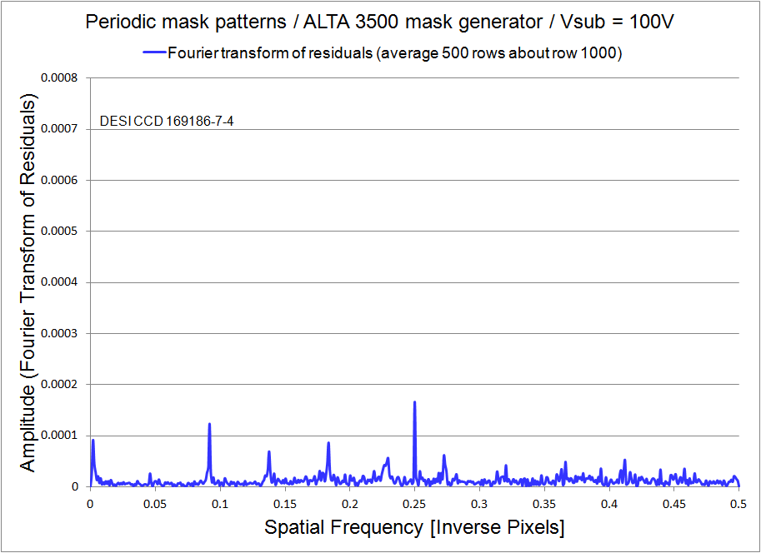
Fixed pattern noise / photomasks
DESI CCD using ALTA 3500 mask maker
Substrate bias voltage dependence (100V)

Slide 36
Fixed pattern noise / photomasks
DESI CCD using ALTA 3500 mask maker
Pattern shown in previous slides in direction normal to wafer flat, also in #5 column direction
Next set of slides show results in the direction parallel to the wafer flat
Column
direction
#4
#3
Column
direction
#5
Column
direction

Slide 37
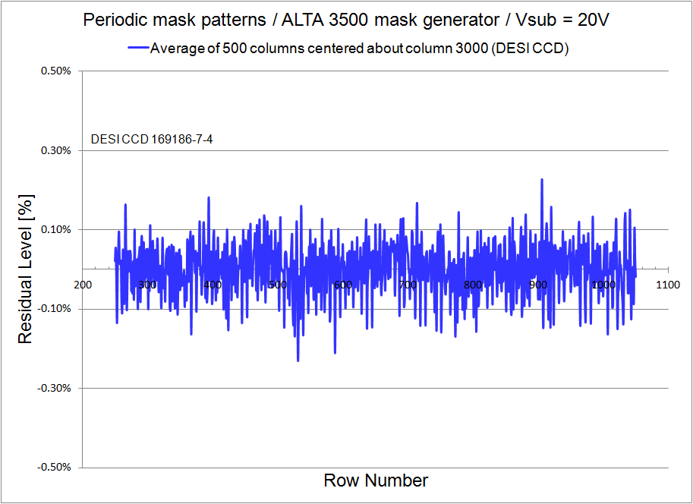
Fixed pattern noise / photomasks
DESI CCD using ALTA 3500 mask maker
Residuals in the column direction (20V)

Slide 38
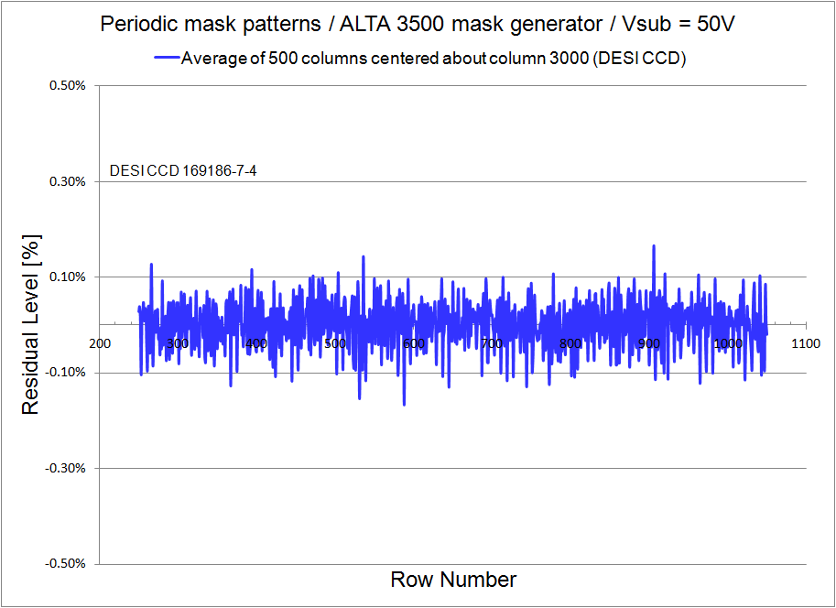
Fixed pattern noise / photomasks
DESI CCD using ALTA 3500 mask maker
Residuals in the column direction (50V)

Slide 39
Fixed pattern noise / photomasks
DESI CCD using ALTA 3500 mask maker
Residuals in the column direction (100V)

Slide 40
Outline of the talk
Overview of the Dark Energy Spectroscopic Instrument and CCD requirements
4k x 4k CCD development for DESI
“Tree rings”
Use of very high resistivity silicon
Fixed pattern noise from CCD fabrication
Quantum Efficiency improvements
Noise improvements

Slide 41
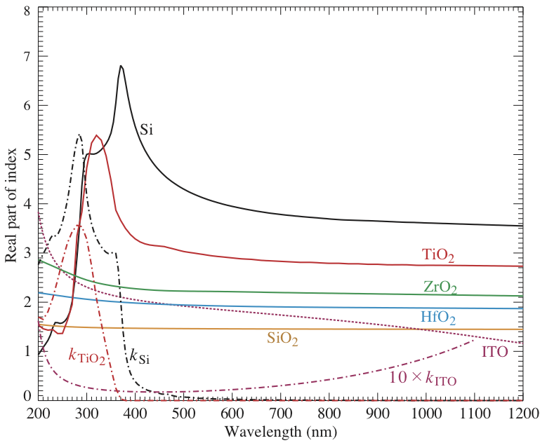
Quantum Efficiency
New anti-reflection coating material used in the DESI CCDs to address ITO performance
ITO index decreasing with λ
Looks like single AR coating at long λ when used with SiO₂^{Ɨ}
Replace most of the ITO with ZrO₂
^{Ɨ} Pointed out originally by Don Groom

Slide 42
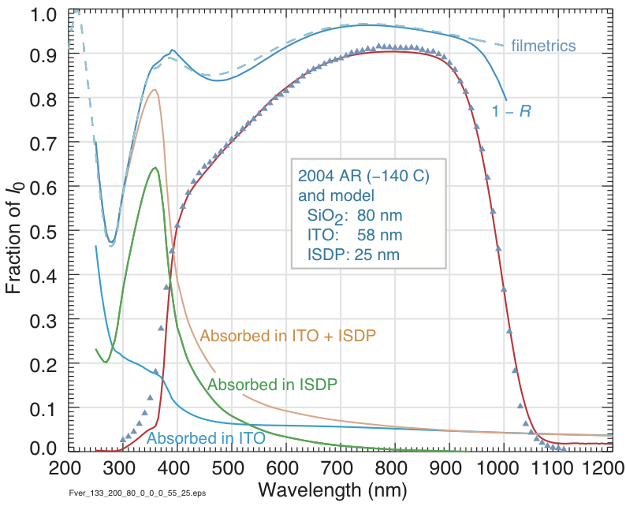
Quantum Efficiency
QE results with old ITO SiO₂ AR coating

Slide 43
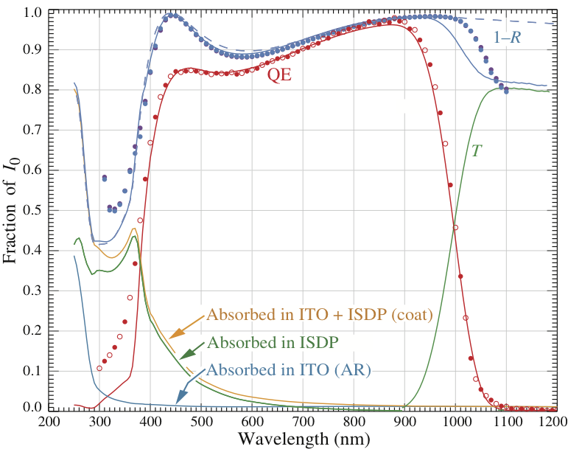
Quantum Efficiency
QE results with ITO / ZrO₂ / SiO₂ AR coating

Slide 44
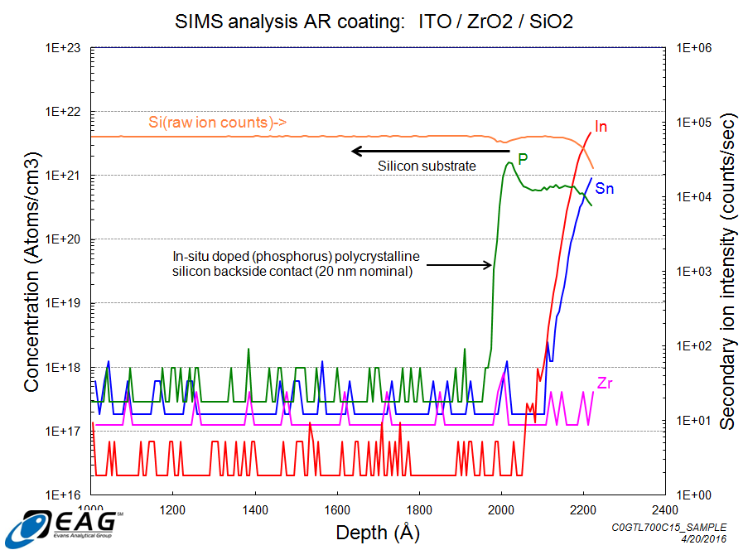
ITO / ZrO₂ / SiO₂ AR coating
Secondary Ion Mass Spectroscopy (SIMS) to check for unwanted impurity diffusion / mixing

Slide 45
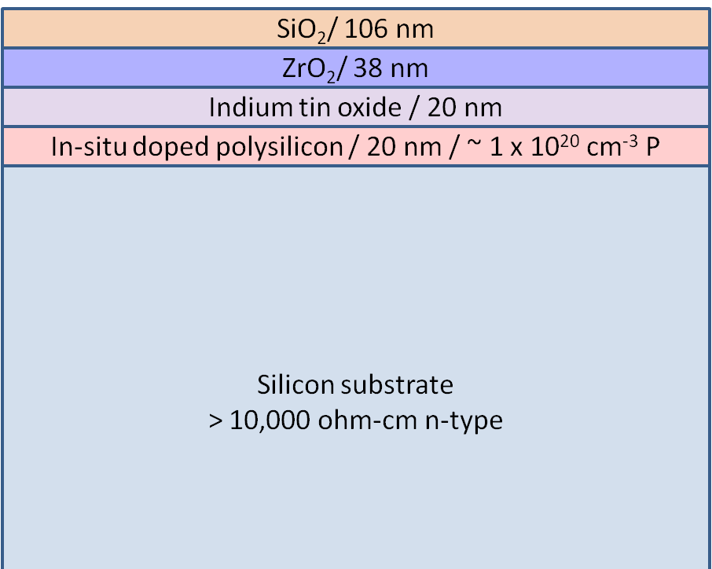
ITO / ZrO₂ / SiO₂ AR coating
TEM cross-sectional image
SiO₂
ZrO₂
ITO
In-situ doped polysilicon
Silicon substrate

Slide 46
Outline of the talk
Overview of the Dark Energy Spectroscopic Instrument and CCD requirements
4k x 4k CCD development for DESI
“Tree rings”
Use of very high resistivity silicon
Fixed pattern noise from CCD fabrication
Quantum Efficiency improvements
Noise improvements

Slide 47
CCD Noise
Read noise reduction
Technology development with Teledyne DALSA Semiconductor
Conventional amplifier with aluminum connection to source follower transistor
Direct connection of source follower polysilicon gate to sense node and an output transistor with reduced width

Slide 48
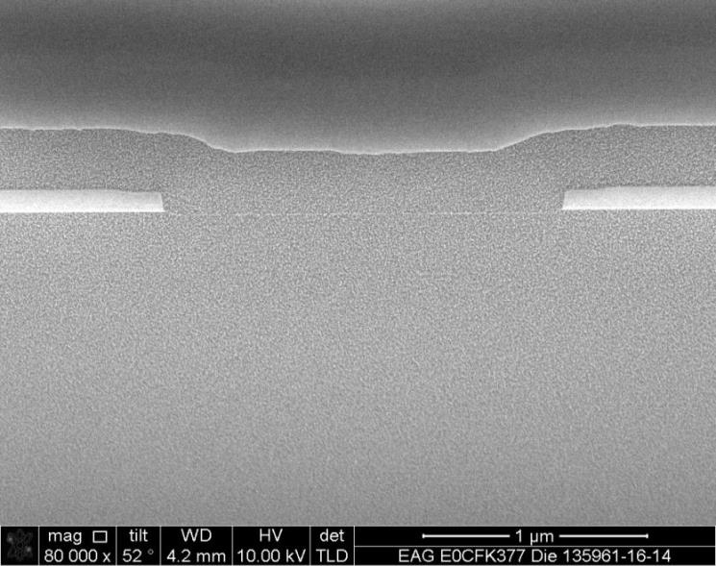
CCD Noise
Read noise reduction
Technology development with Teledyne DALSA Semiconductor
Polysilicon
SiO₂
Direct connection of source follower polysilicon gate to sense node and an output transistor with reduced width
Cross-sectional SEM
Conventional with aluminum connection to source follower transistor
Silicon substrate
Cross-sectional SEM

Slide 49
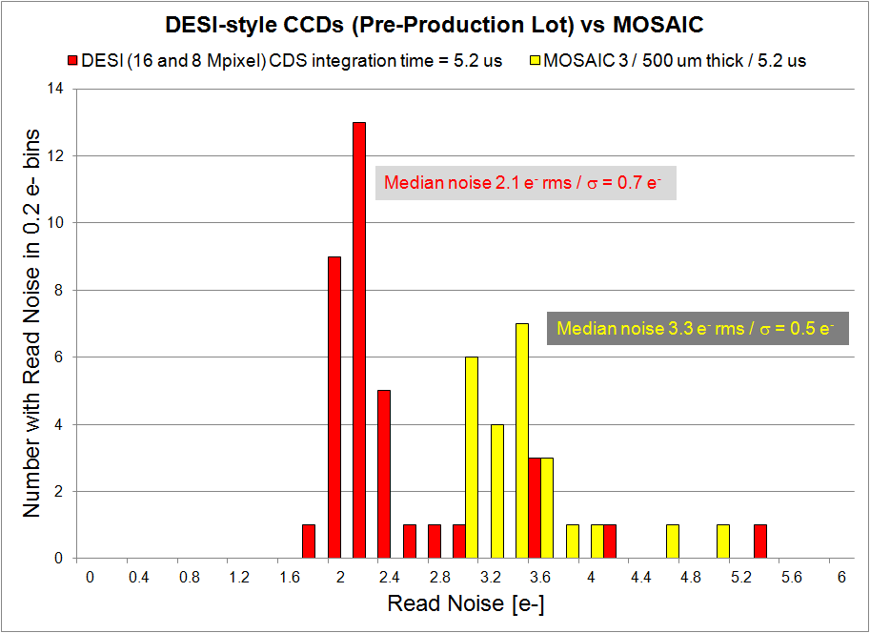
CCD Noise
DESI vs MOSAIC noise results
MOSAIC is a new camera installed at Kitt Peak

Slide 50
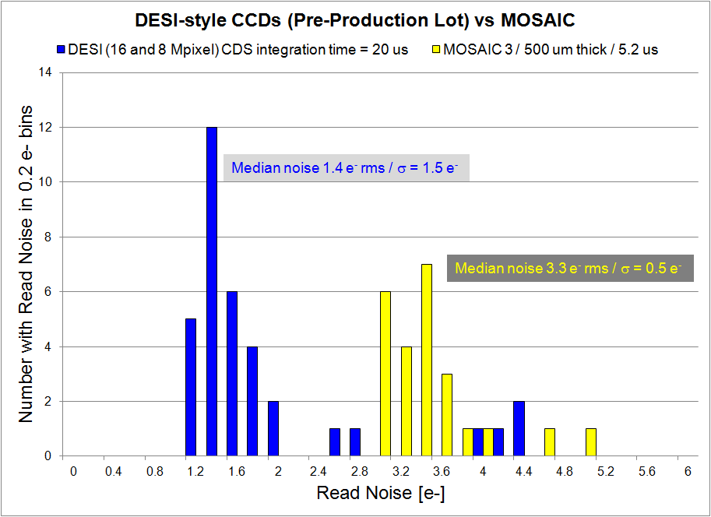
CCD Noise
DESI vs MOSAIC noise results
Possible systematic effect in Pre-production lot

Slide 51
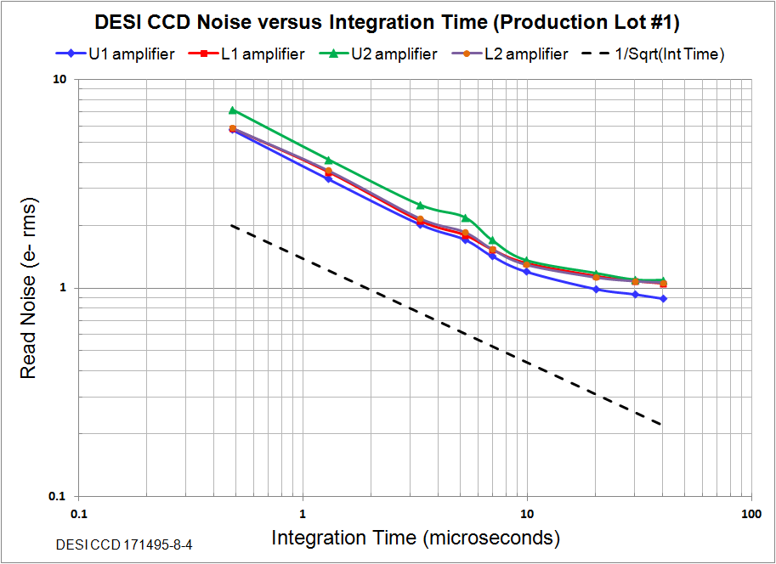
CCD Noise
DESI CCD noise (Production lot #1)
Noise vs Integration Time (good example)

Slide 52
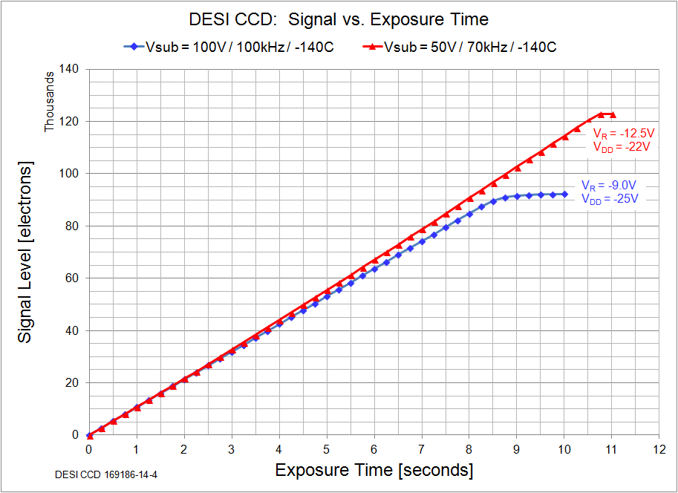
CCD Full Well
DESI CCD full well (production lot #1)
Signal Level vs Exposure Time

Slide 53
Summary
Tree rings artifacts are greatly reduced with the use of very high resistivity silicon
Improvements in periodic pixel size effects by the use of more advanced photomasks
New AR coating and lower noise amplifiers implemented in DESI
Status
Preproduction lot completed
Fabricating production lots now
3 lots complete at Teledyne DALSA
Finishing at LBNL in progress

Slide 54
Back up slides

Slide 55
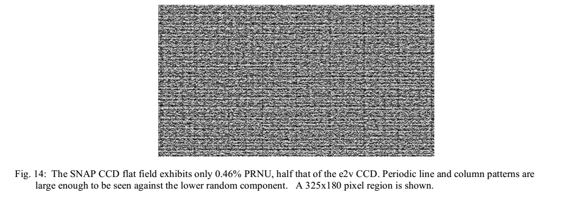
Fixed pattern noise / photomasks
Repetitive pattern from errors in the photomask manufacturing process
200 µm thick, FD CCD (10.5 µm pixel)

Slide 56
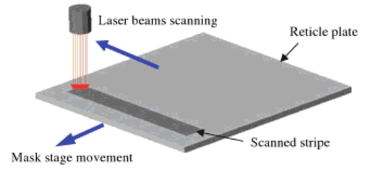
Laser mask writer (CORE, ALTA)
Parallel beams write mask a pixel at a time
Scan direction – rotating mirror “paints” pattern
Stripe direction – stage movement controlled by laser interferometer
Errors due to stage placement and the need for butting of stripes in x and y lead to periodic errors in feature size

Slide 57
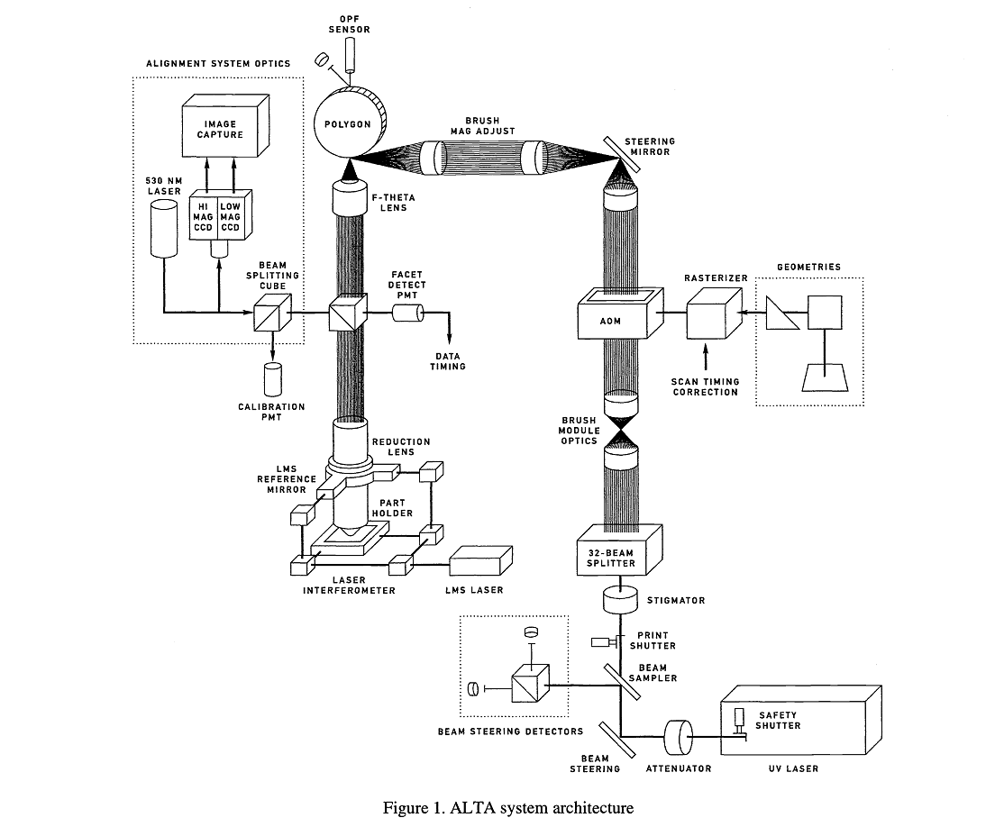
Fixed pattern noise / photomasks

Slide 58
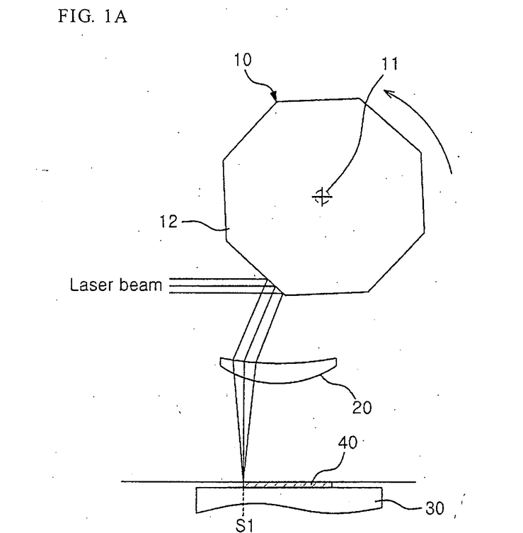
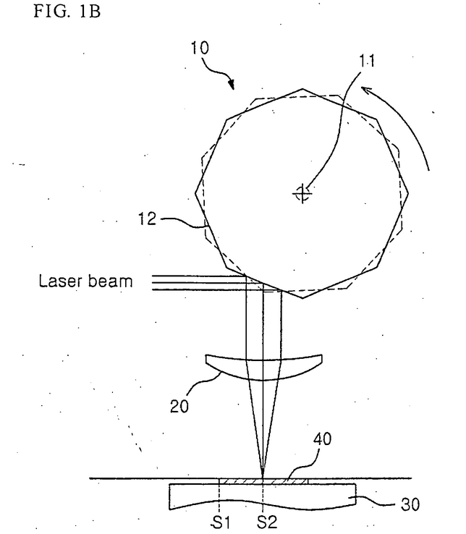
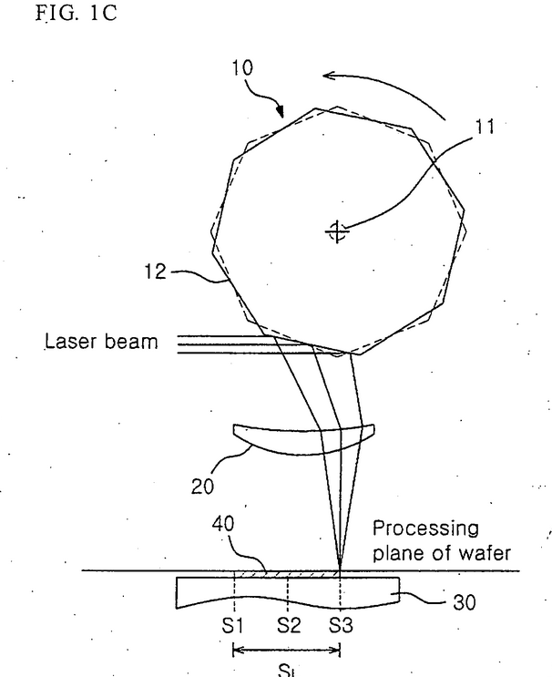
Fixed pattern noise / photomasks
Scan direction (rotating mirror)
Stage motion
(Stripe writing)

Slide 59
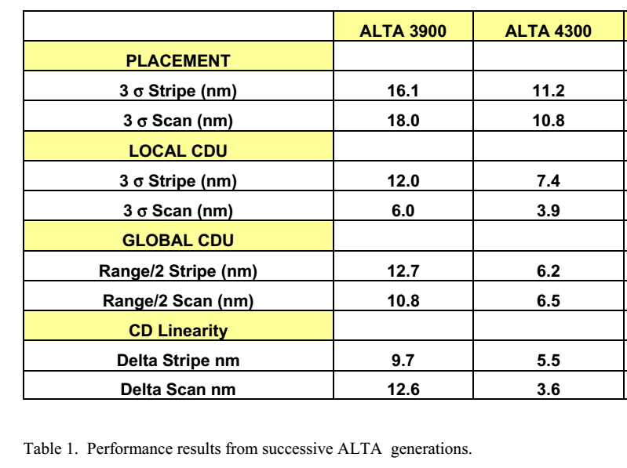
Fixed pattern noise / photomasks
Use more advanced masks for DESI levels 1-6
CORE 2564 used previously superceded by ALTA 3000, 3100, 3500, 3900, etc
ALTA 3500 used for DESI
Franks et al, Proc. SPIE, 1809, 1992
Allen et al, Proc. SPIE, 5567, 2004

