Slide 1
LSST sensors and electronics characterization
Paul O’Connor BNL
PACCD 20161202

Slide 2
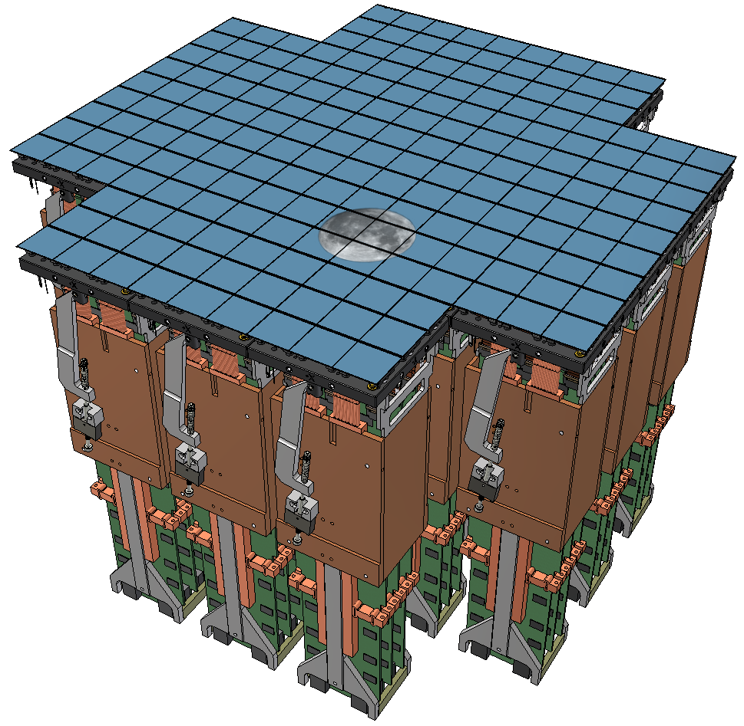
LSST focal plane and readout
9.6 sq. degrees, 3e9 pixels
189-CCD mosaic
21 rafts
3024 video channels
Photons in – photons out
Focal plane thermal control
System health monitoring
1155 W total power
  380mW/channel
170 l volume
Vacuum operation
Notes:
here is LSST’s 3 billion pixel focal plane sampling 9.6 square degrees of sky. It is a mosaic of 189 CCDs, organized into 21 rafts of 3x3. Each raft has an accompanying electronics package making it an autonomous 144Mpixel camera, which takes sky photons as input and data photons as output. The rafts are being built here at BNL in a cleanroom that some of you saw yesterday; we receive the sensors and electronics and qualify them before they go into raft assembly. And in this talk I’ll take you through the qualification test program. This is the work of too many people to name, many of them are here.

Slide 3
Sensors
Performance
  Minimize throughput/sensitivity loss
    High broadband QE
    High packing fraction
    Low readout time
    Low noise
  Minimize impact on point spread function
    Low charge diffusion spreading
    Tight control of image height (flatness and mosaic coplanarity)
Manufacturability
  Allow sufficient time for design/process development
    2005 RFP funded by private donations to LSST Corp.
    Follow-in prototype contracts through 2012
    Production contracts 2015-2018
  Multiple vendors
    Enforce plug-compatible designs
    Explicit, contractually agreed-to acceptance criteria
  Test and analysis automation

Slide 4
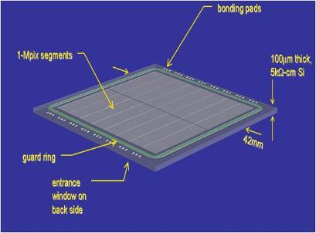
LSST CCD sensor
100μm-thick, high resistivity p-silicon CCDs, fully-depleted, back-illuminated
  for broadband QE and small PSF
4K x 4K format
  4 die sites/6”wafer
16-fold parallel output
  for low noise readout at 2s frame read time
10μm pixels
  for optimum sampling at LSST plate scale
Buttable, thermally-matched packaging
  >92% fill factor
Flatness and alignment tolerance to bring image surface of all CCDs coplanar to ±9μm
  for use in fast f/1.2 beam
Mechanical mounting and alignment features and electrical interface specified
  Interchangeability between vendors

Slide 5
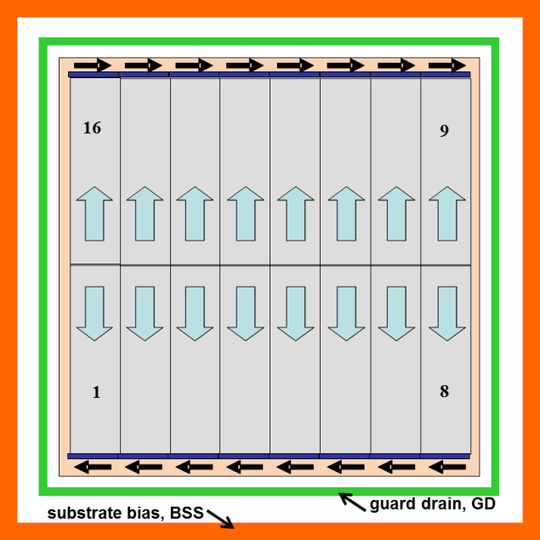
LSST CCD sensor
100μm-thick, high resistivity silicon CCDs, fully-depleted, back-illuminated
  for broadband QE and small PSF
4K x 4K format
  4 die sites/6”wafer
16-fold parallel output
  for low noise readout at 2s frame read time
10μm pixels
  for optimum sampling at LSST plate scale
Buttable, thermally-matched packaging
  >92% fill factor
Flatness and alignment tolerance to bring image surface of all CCDs coplanar to ±9μm
  for use in fast f/1.2 beam
Mechanical mounting and alignment features and electrical interface specified
  Interchangeability between vendors

Slide 6
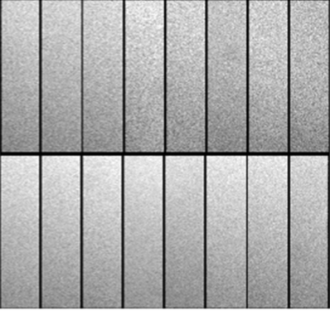
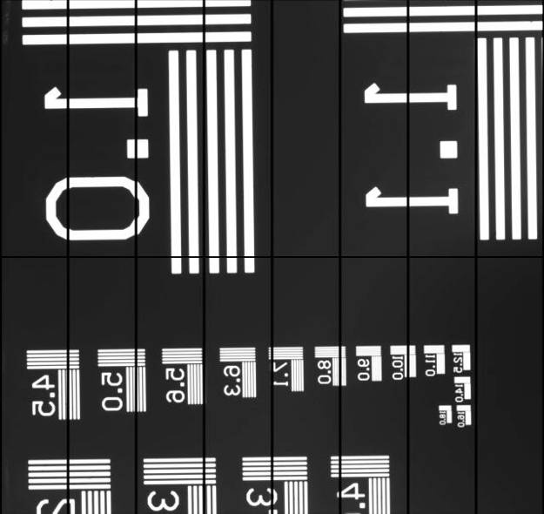
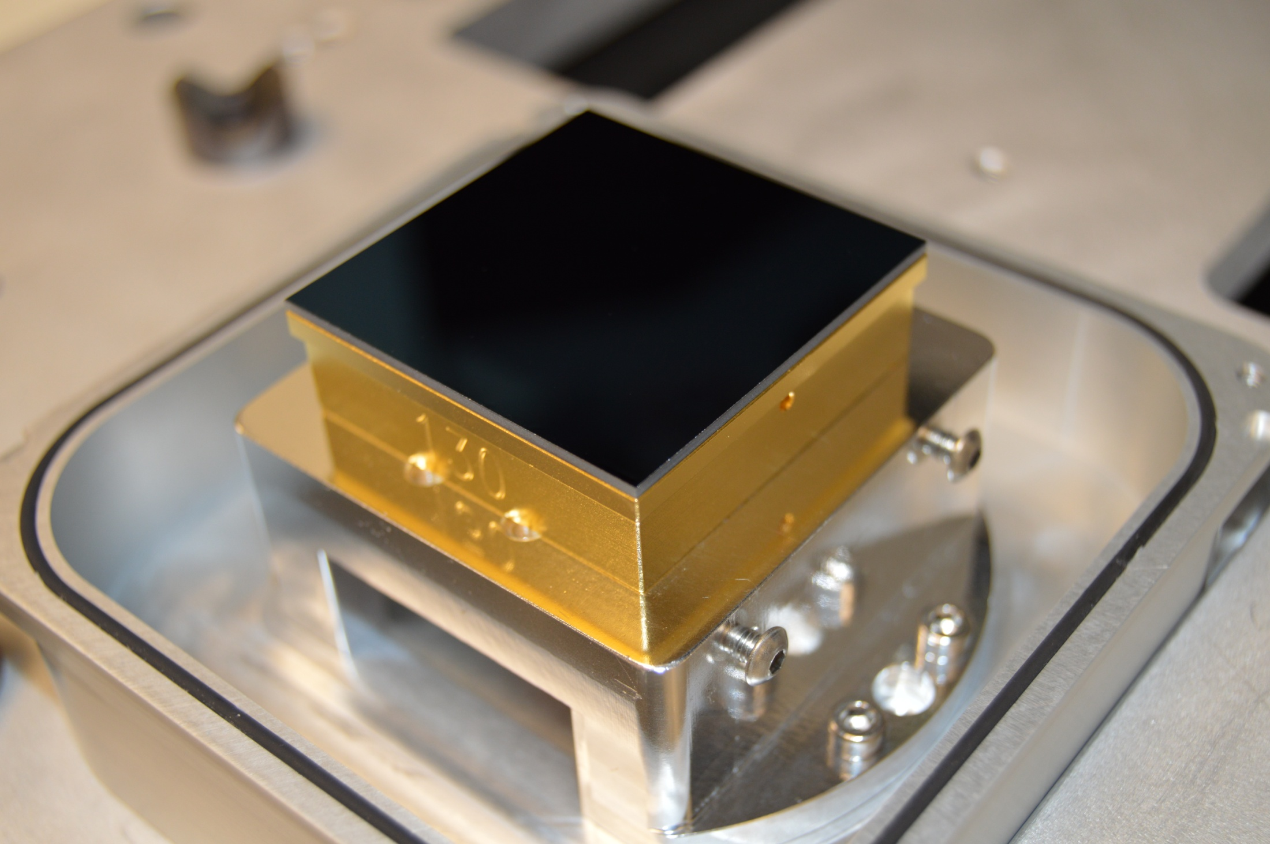
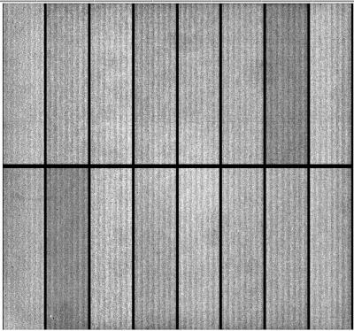
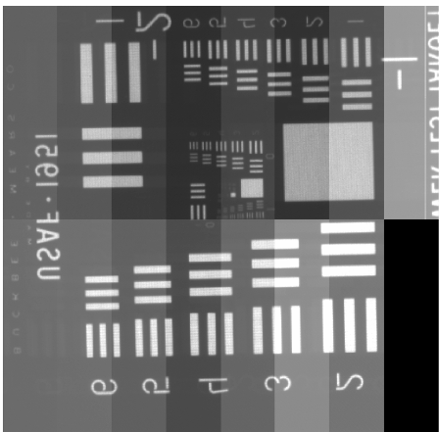
Sensor pre-production prototypes
CCD in test fixture
Uniform illumination
Test target image
E2v CCD250
ITL STA3800C
(overscan displayed)
(overscan suppressed)

Slide 7
Requirements and verification matrix
Parameter | Req’t. | Meas. | unit
QE u | 41 | 65 | %
QE g | 78 | 83 | %
QE r | 88 | 90 | %
QE i | 81 | 94 | %
QE z | 75 | 88 | %
QE y | 21 | 25 | %
Diffusion | 5.0 | 3.6 | μm rms
Dark current (95%) | 0.2 | 0.02 | e⁻/pix/s
Defects | 0.5 | 0.002 | %
Frame read time (16Mpix) | 2 | 2.0 | sec
Read noise/pixel | 8 | 4.5 | e- rms
CTI (ser/par) at 1ke⁻ signal | 5/3 | 3/0.7 | ppm
Nonlinearity | 2 | 0.6 | %
Video crosstalk | 2 | 0.08 | %
Pixel size | 10 | 10 | μm
Flatness (95%) | ± 5 | 1.9 | μm
Coplanarity (95%) | ± 9 | 6.3 | μm
Inactive area | 8 | 8 | %
Notes:
Here are the main sensor requirements and I’m showing measured results on production devices. Note that in addition to the electro-optic performance we also need devices to adhere to very stringent mechanical properties due to the shallow depth of focus in LSST’s f/1.2 optical beam.

Slide 8
Requirements and verification matrix
Parameter | Req’t. | Meas. | unit
QE u | 41 | 65 | %
QE g | 78 | 83 | %
QE r | 88 | 90 | %
QE i | 81 | 94 | %
QE z | 75 | 88 | %
QE y | 21 | 25 | %
Diffusion | 5.0 | 3.6 | μm rms
Dark current (95%) | 0.2 | 0.02 | e⁻/pix/s
Defects | 0.5 | 0.002 | %
Frame read time (16Mpix) | 2 | 2.0 | sec
Read noise/pixel | 8 | 4.5 | e- rms
CTI (ser/par) at 1ke⁻ signal | 5/3 | 3/0.7 | ppm
Nonlinearity | 2 | 0.6 | %
Video crosstalk | 2 | 0.08 | %
Pixel size | 10 | 10 | μm
Flatness (95%) | ± 5 | 1.9 | μm
Coplanarity (95%) | ± 9 | 6.3 | μm
Inactive area | 8 | 8 | %
Notes:
All of the EO specs except crosstalk can be measured in a test stand capable of projecting monochromatic flat fields and xrays onto the CCD.

Slide 9
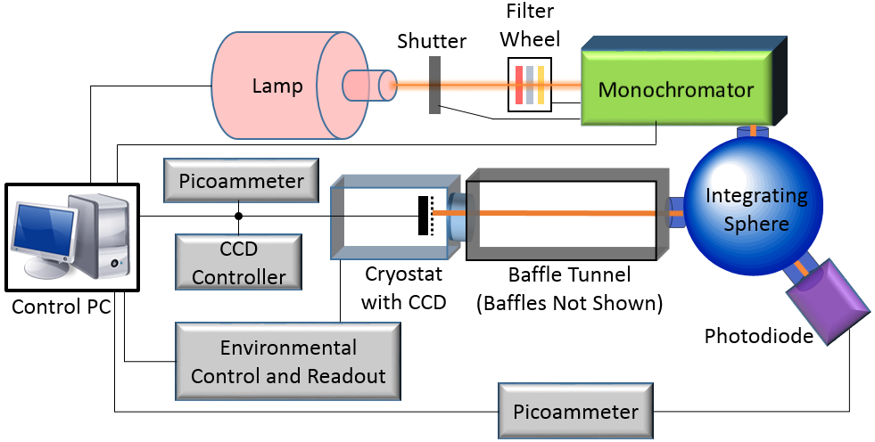
Electro-optic test stand for individual CCDs
Closed-cycle cryostat
Temperature controller
CCD controller (STA Archon)
Illumination system:
  Hg(Xe) lamp
  shutter
  filter wheel
  dual-grating 1/4m monochromator
  6” integrating sphere with 2.5” port
  baffle tunnel
In-vacuum retractable ⁵⁵Fe source
Calibrated photodiode + picoammeter
Vacuum gauge
Turbo pump + dry scroll pump
Residual gas analyzer
Power distribution system
UPS

Slide 10
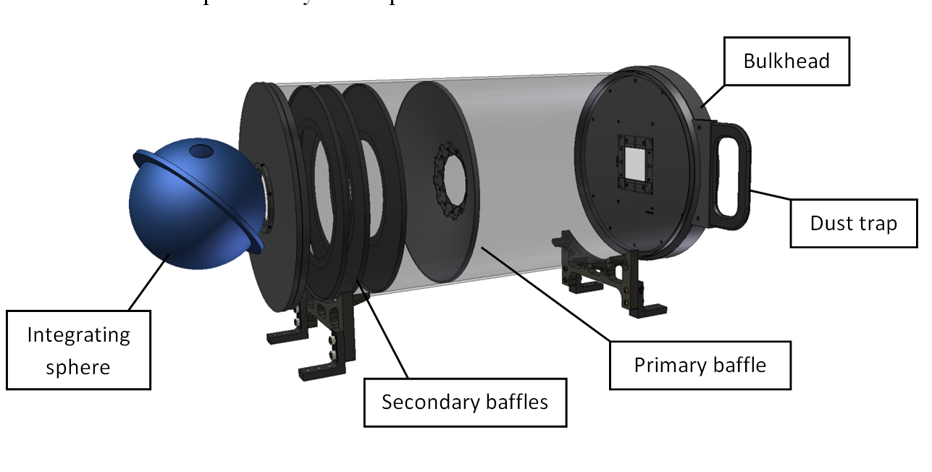
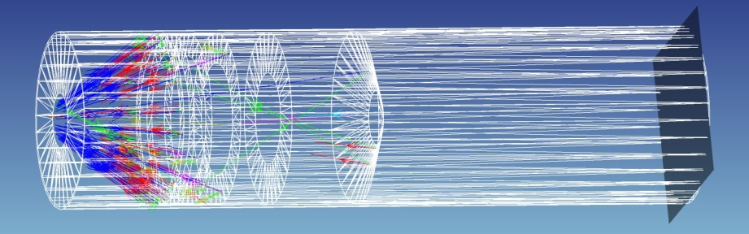
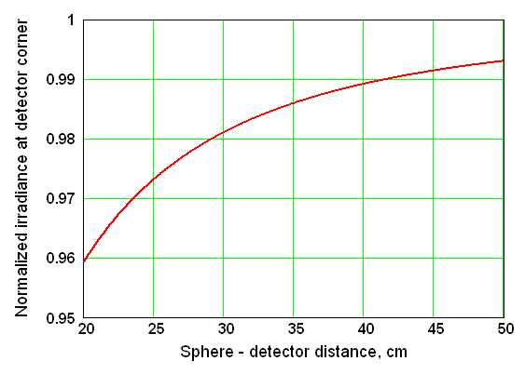
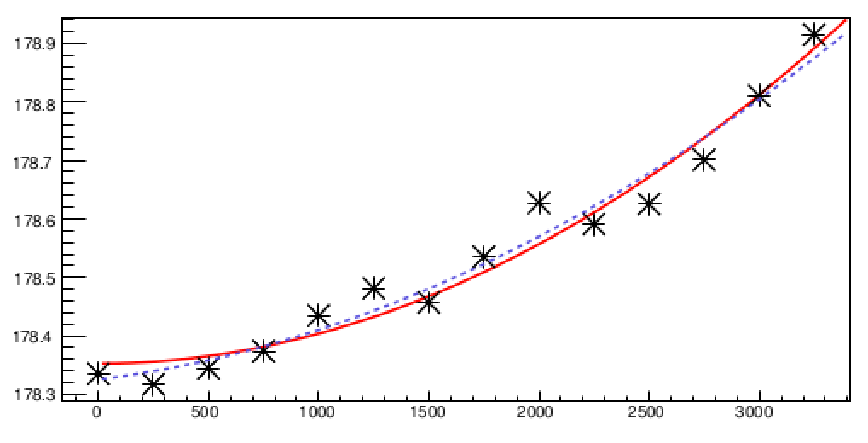
Illumination transport to CCD
Baffle tunnel between sphere and Dewar window
Stray light analysis
Illumination uniformity vs. tunnel length
Measured illumination uniformity
99.7%
CCD center
CCD corner

Slide 11
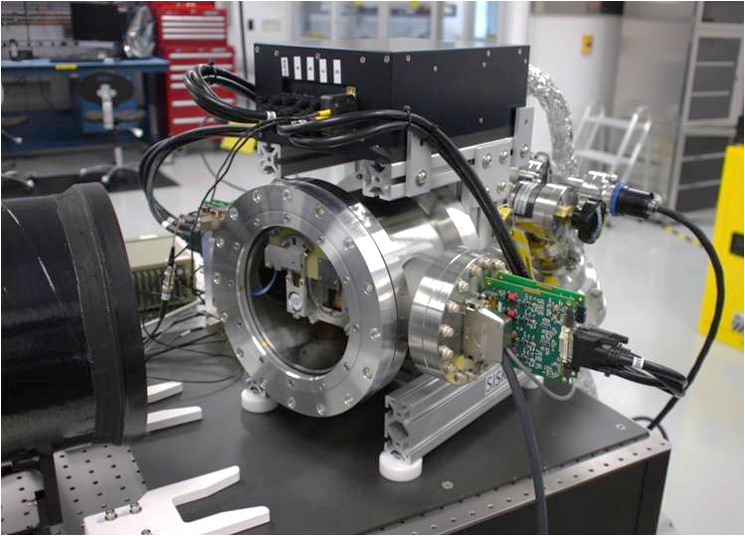
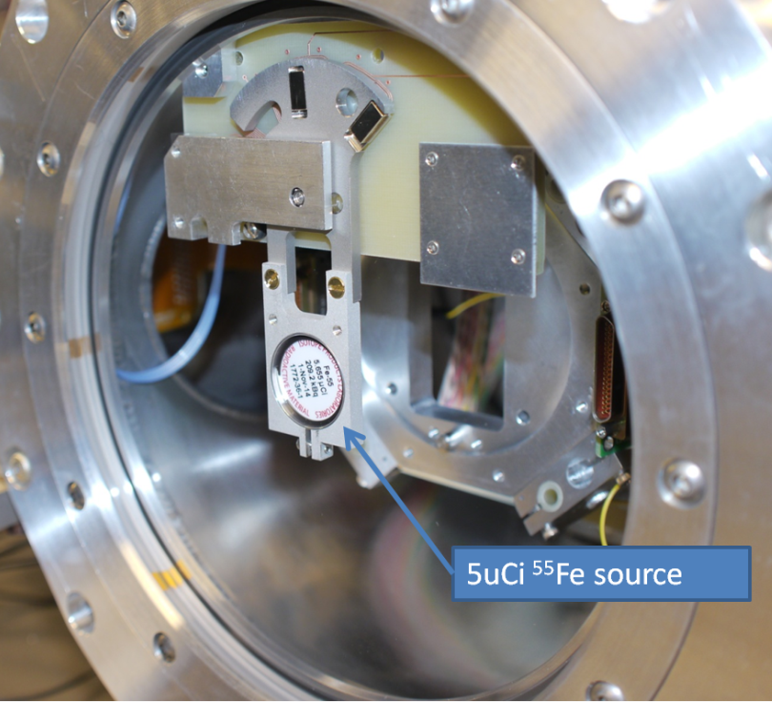
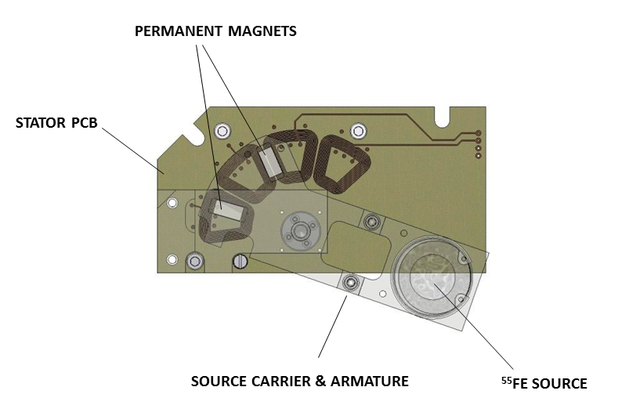
Single-CCD EO cryostat
STA Archon controller
turbopump
Baffle tunnel
Quad preamps

Slide 12
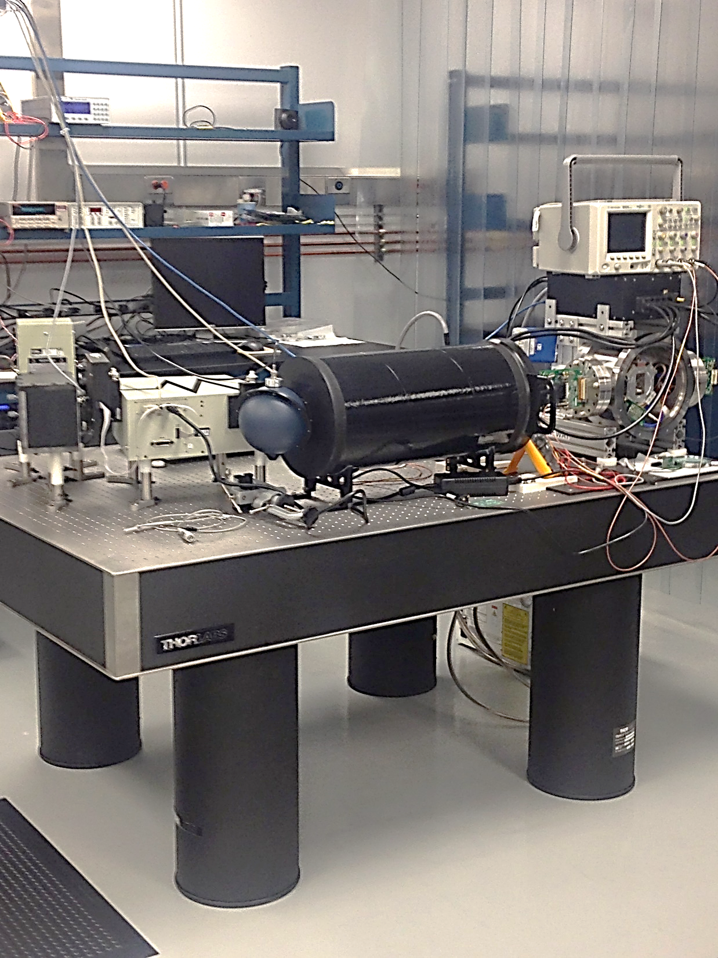
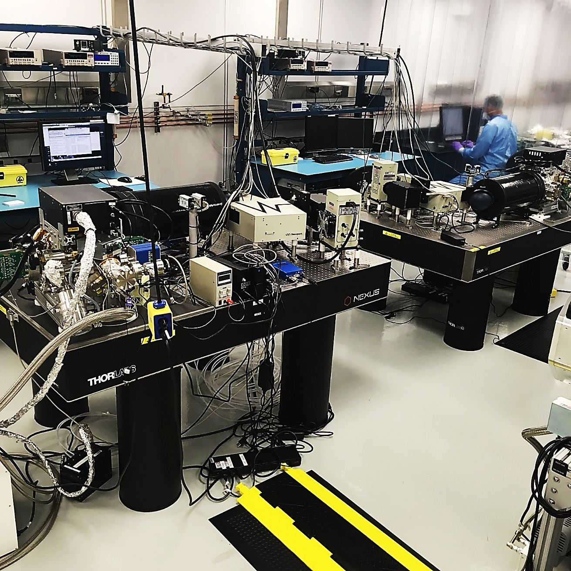
Single-CCD EO test stand

Slide 13
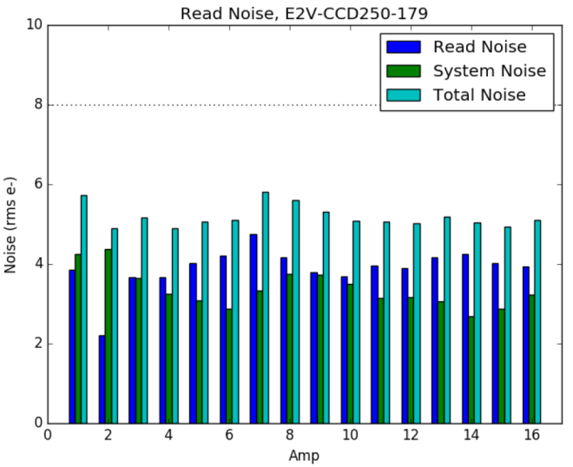
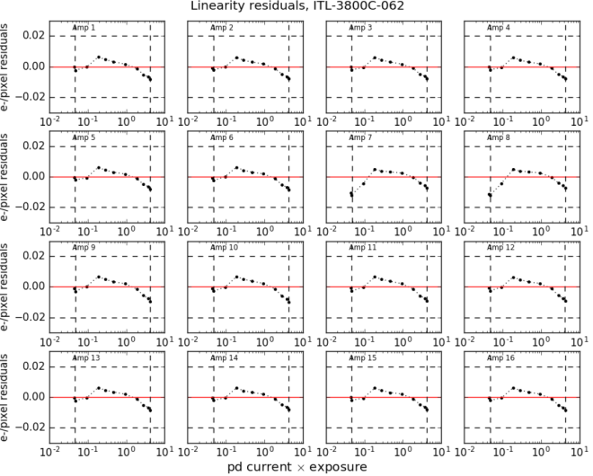
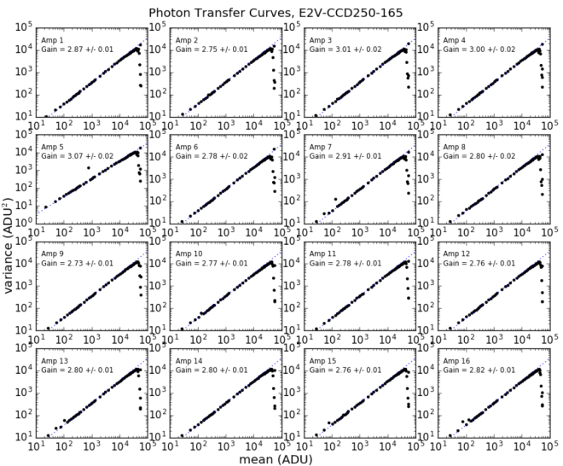
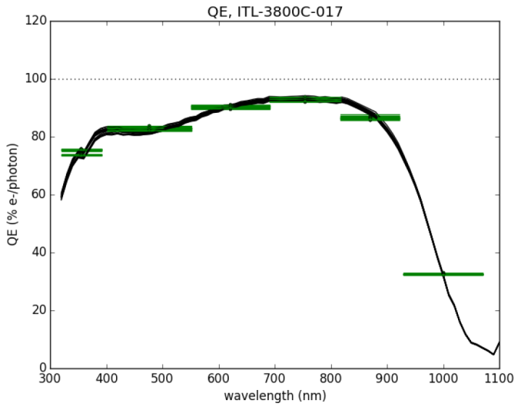
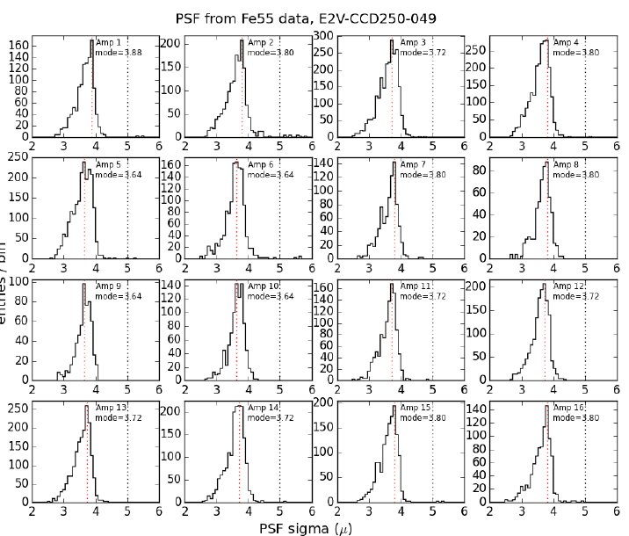
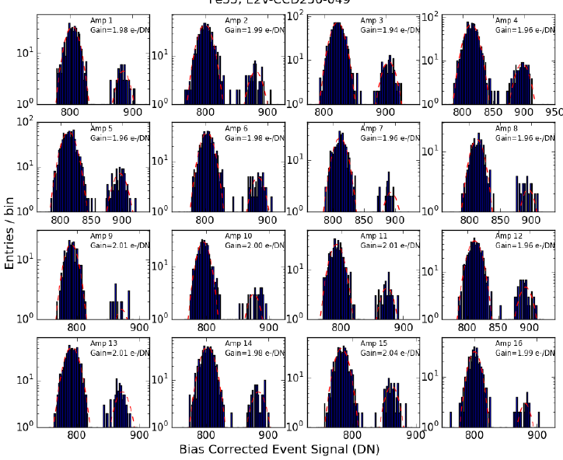
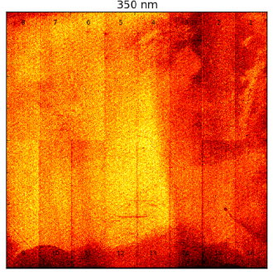
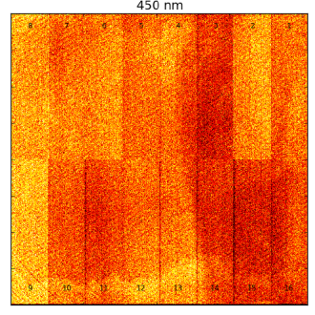
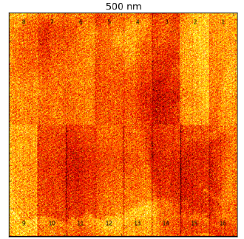
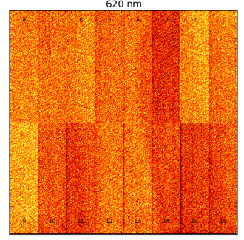
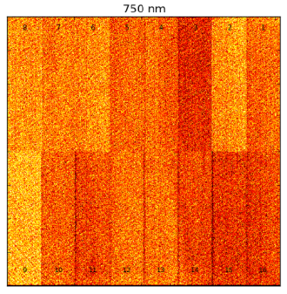
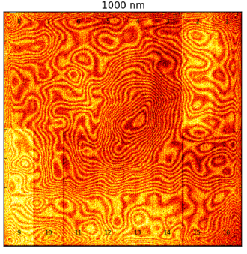
Fe55 spectra
Fe55 spectra
Flatfields
Notes:
The test execution is fully automated and runs overnight unattended. A 39-page report human-friendly is generated and it along with about 30GB of image data is archived in an electronic traveler.

Slide 14
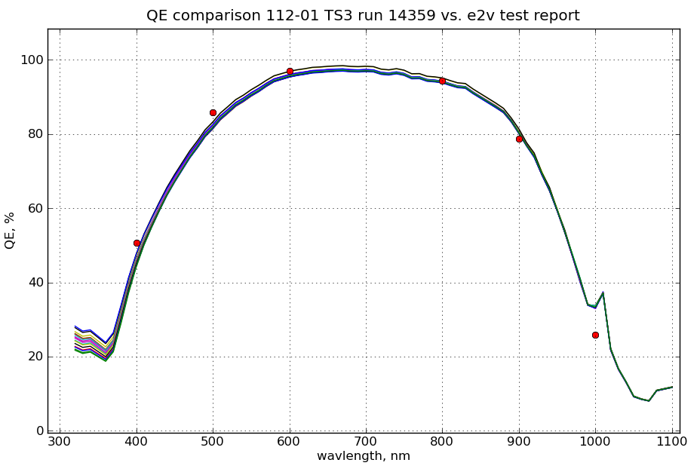
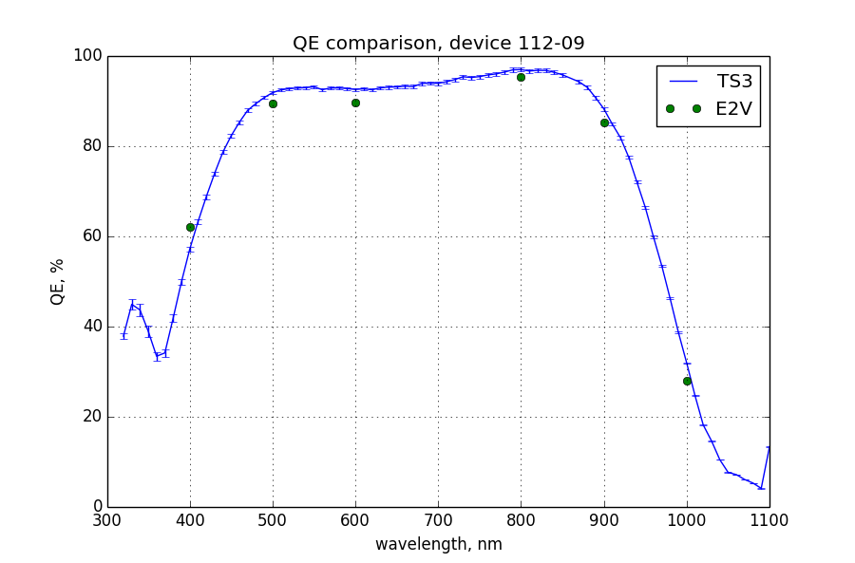
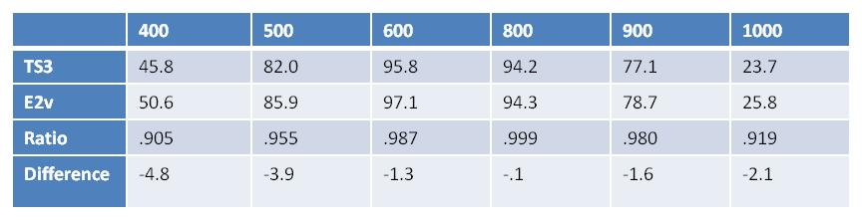
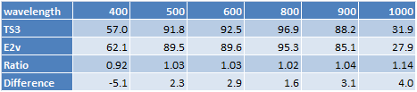
QE comparison with vendor measurement

Slide 15
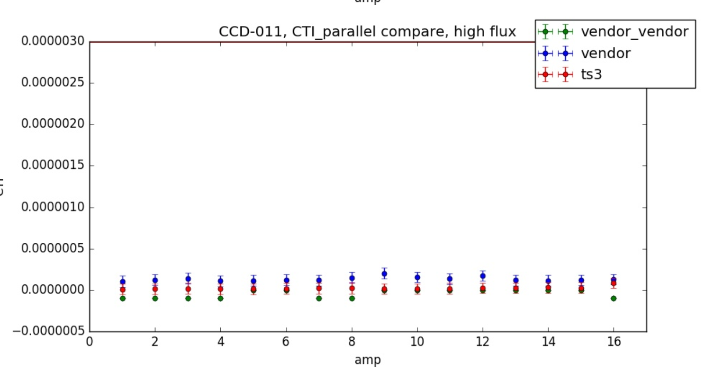
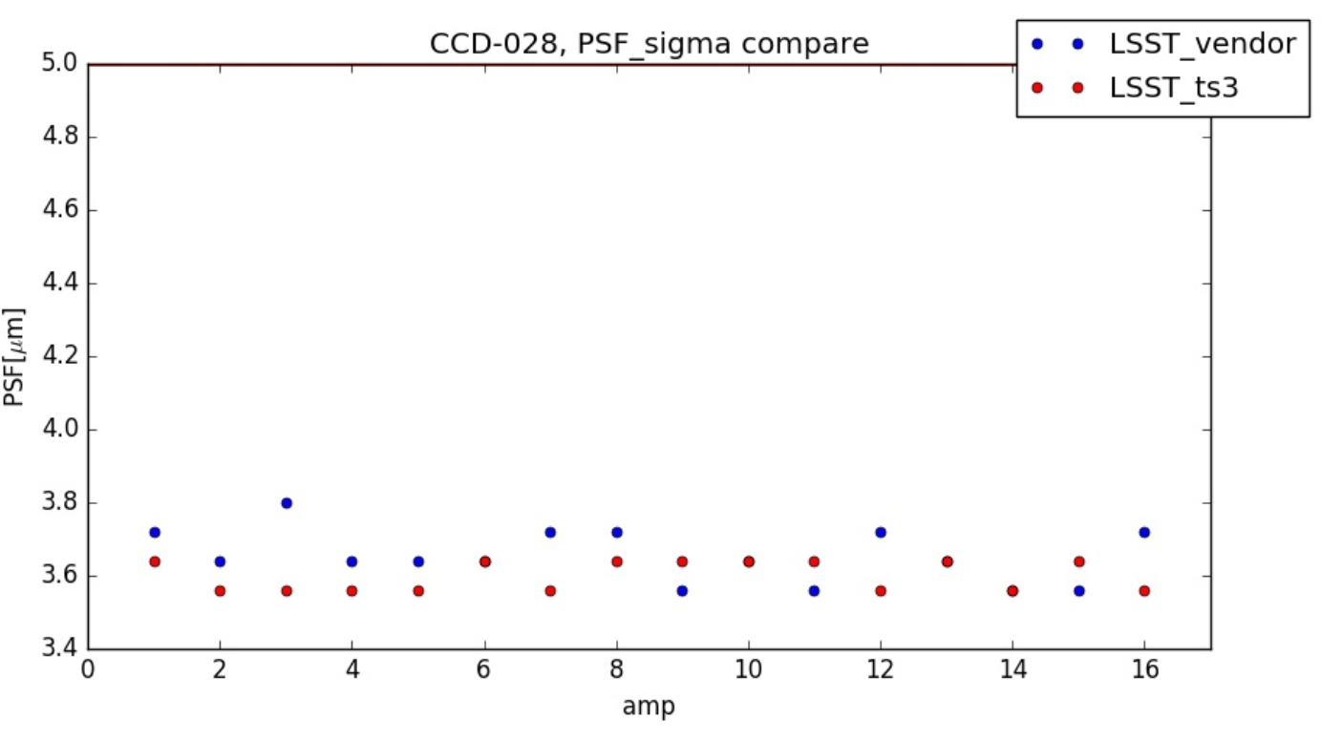
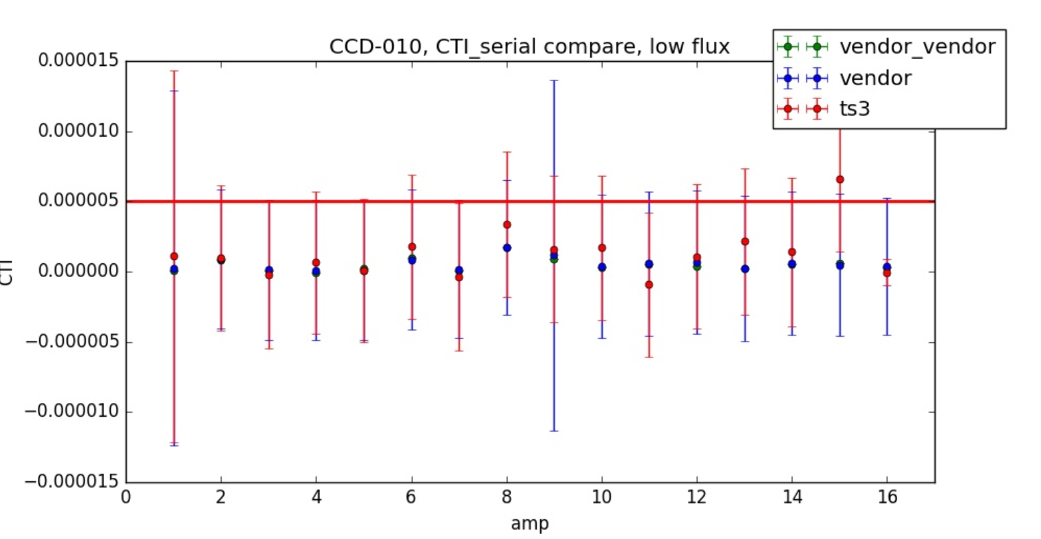
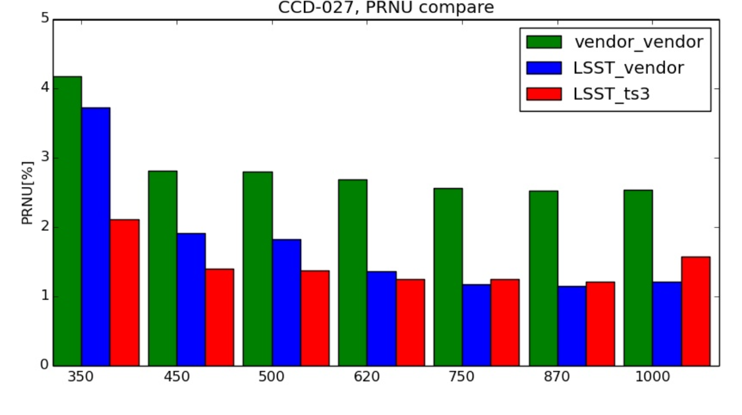
CTI, PSF, PRNU comparison with vendor

Slide 16
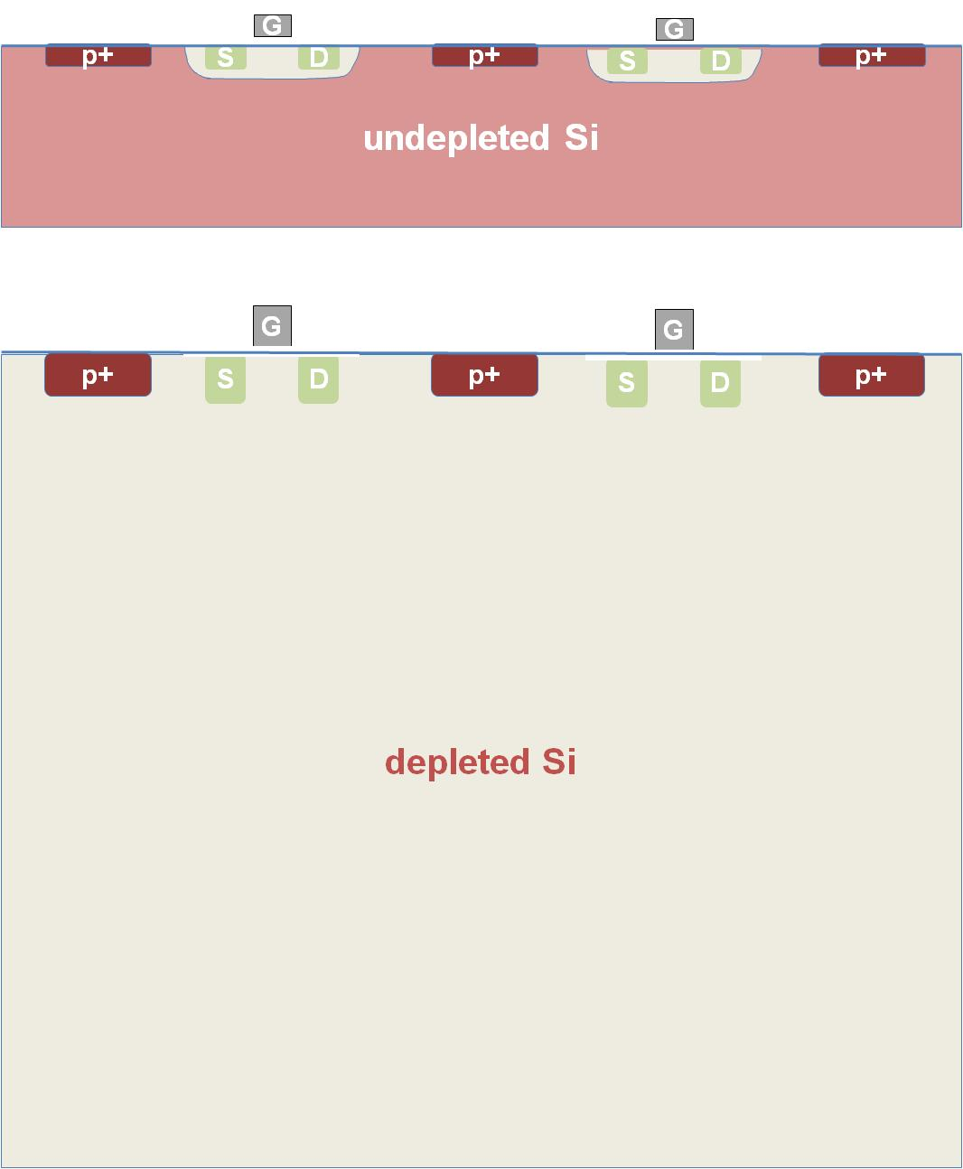
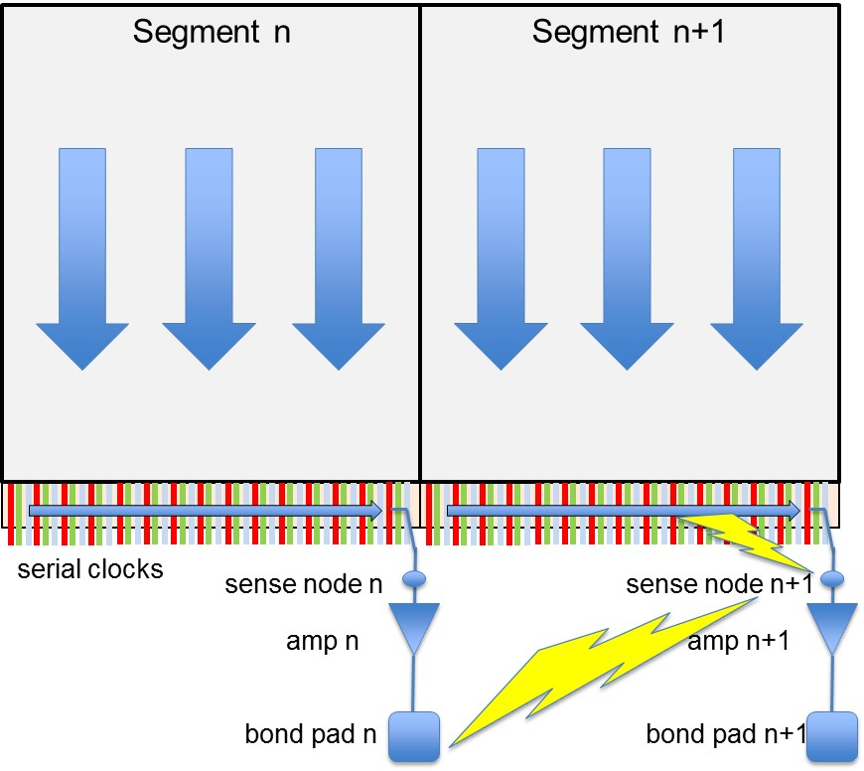
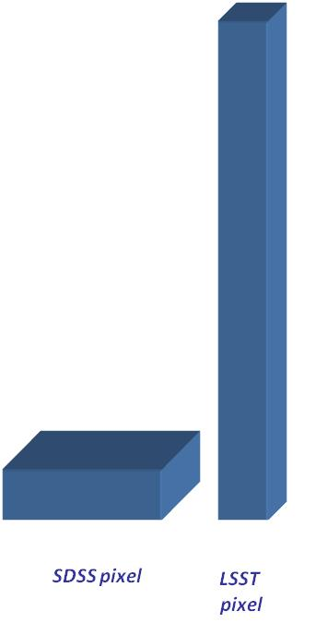
“Beyond the Spec Sheet” Behaviors
1. pixel aspect ratio
2. amps on high-rho Si
3. serial register adjacency
Notes:
Non-spec sheet behaviors are observed in these devices, stemming from the electrostatics of the tall pixels, signals coupling through depleted silicon, and the need for awkward geometries where registers abut. Investigating these isn’t part of the DOE construction project and is being pursued here and at our partner laboratories.

Slide 17
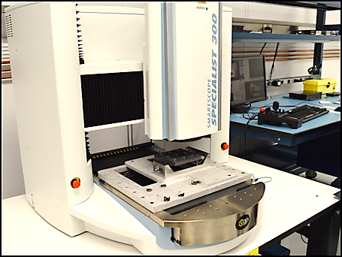
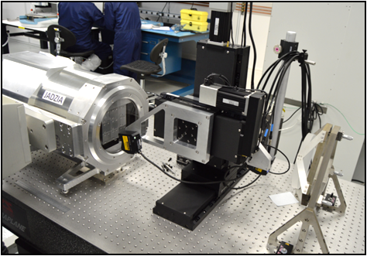
Metrology tools
Notes:
Room temperature metrology can be done using a commercial non-contact CMM. For cold metrology we constructed a test stand using Keyence point displacement sensors one looking through a dewar window the other at a reference flat and rastered.

Slide 18
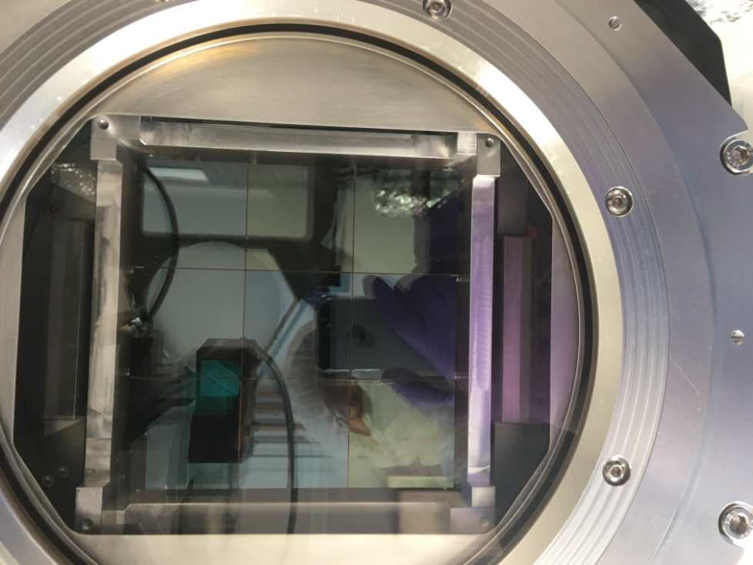

Slide 19
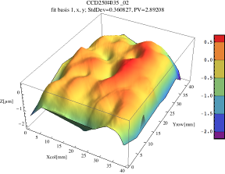
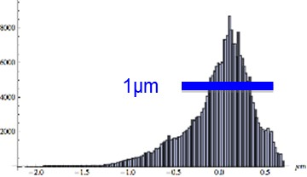
Single-sensor warm metrology
FLATNESS
ABSOLUTE HEIGHT
pv95=0.88μm
pv95=3.39μm
pv95=6.32μm

Slide 20
Raft-sensor assembly thermal cycling
warm initial
cold
(cycle 4X)
warm final
warm final - initial
pv95=11.9μm
pv95=15.7μm
pv95=13.3μm
stdev=0.65μm

Slide 21
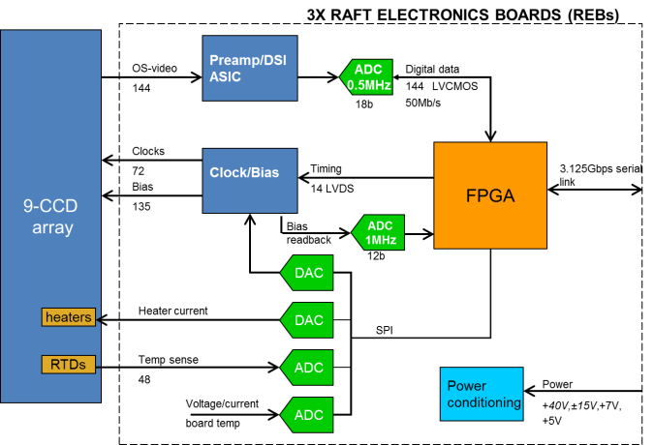
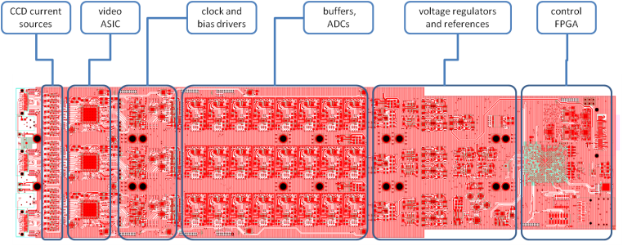
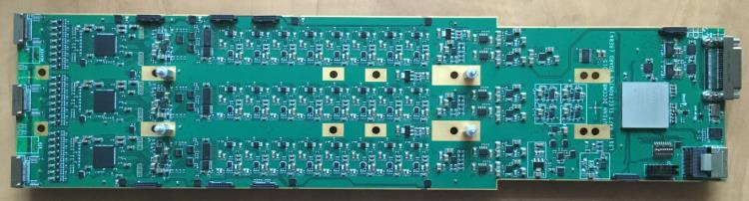
Raft electronics
Functions:
Video CDS processing, dual-slope integration
18-bit digitization and serialization
HV clock and bias generation
CCD temperature monitoring and control
Onboard diagnostic features including waveform recorder
Implementation:
Three 4” x 16”, 14-layer boards
Video processing in CMOS ASIC
144 video channels
Performance:
72 Mpixels/s readout rate, 1.4Gbits/s
7e- read noise
0.08% crosstalk
380mW/channel total power dissipation
Russo, S., et al. "The LSST Science Raft Electronics." RT2014-19th Real-Time Conference. 2014.
Notes:
It has the functionality of a 144-channel CCD controller plus diagnostics and thermal control, but it operates in vacuum with a size power dissipation about an order of magnitude less than state-of-the-art multichannel controllers. This is largely due to the use of analog CDS implemented in a CMOS ASIC.

Slide 22
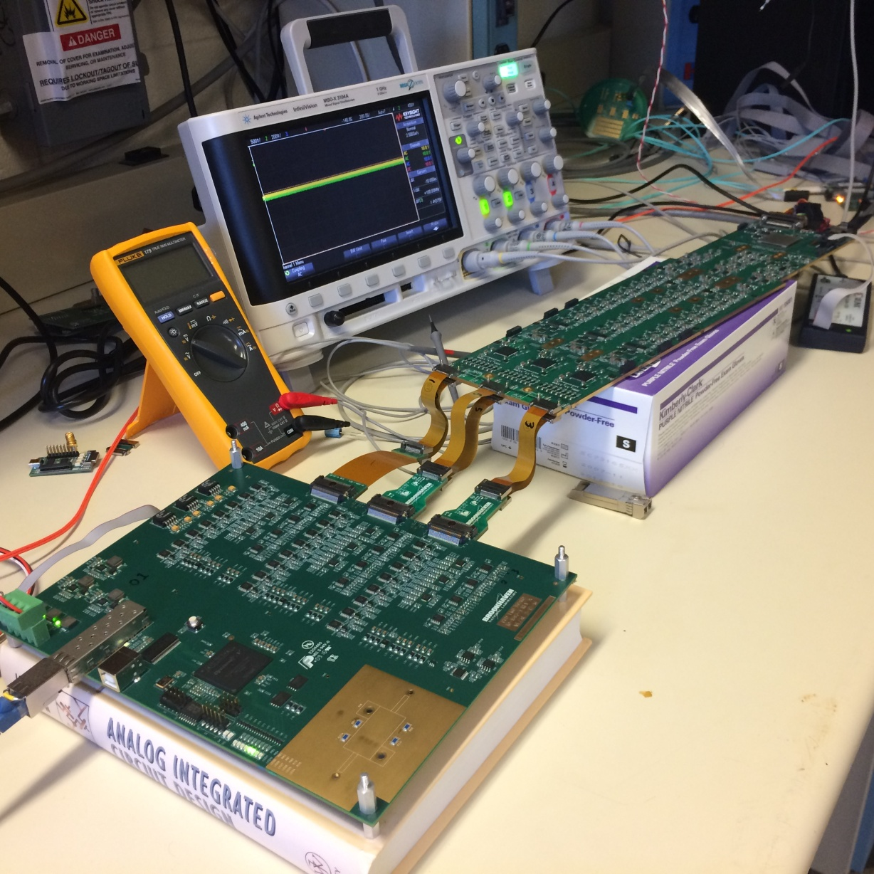
Automated REB test
Checks 100% of board functionality
Emulator simulates 3 CCDs and raft thermal instrumentation
Checks clock and bias levels, timing
Generates 48 channel video output from pattern memory
Automated 2-minute test with report generation
REB
CCD EMULATOR
W. Lu et al., “CCD Emulator design for LSST Camera”,. SPIE 9915-100, 2016
Notes:
We built a CCD emulator to make an automated test of the REBs. This was described in a poster at this year’s SPIE. 100% of the board functionality is tested in a few minutes.

Slide 23




Virtual sampling scope mode of video digitizer
Arrange a repetitive CCD output waveform (i.e. dark, flat)
Acquire one sample per pixel period, incrementing the ADC sampling clock 10ns per pixel
Combined with “transparent mode” feature of DSI ASIC, creates virtual 100MHz, 18b oscilloscope for probing video channels
(a) ASPIC DSI mode
(b) ASPIC Transparent mode – amplified CCD output

Slide 24



Virtual sampling scope
Transparent mode
Integration windows
Reset feedthrough
Reset level
Video level
2μsec
Time

Slide 25
Virtual sampling scope
Transparent and DSI modes
Transp.
DSI
2μsec
Time

Slide 26






End-to-end signal chain test
R&D Cryostat 1
R&D Cryostat 2
Production cryostat
POC Proc. SPIE 9915August 5, 2016 doi:10.1117/12.2232729

Slide 27

Summary
Sensors:
  Production deliveries have started
  Electro-optic and metrology test stands are operational
Electronics
  Final version of readout board is in hand
  Fully-automated functionality test
Rafts
  First engineering-test unit is assembled and basic operation is confirmed
  Materials are in hand for 2 ETU’s and first 2 science rafts
ETU#1
First warm image 11/2016

Slide 28
backup

Slide 29






Sensor prototype performance
QE
Dark current
Charge transfer inefficiency
Height of image surface
PSF
Read noise
Usable pixel fraction > 99.99%

Slide 30

Electrostatics in thick, fully-depeleted CCDs
Most previous cameras have used silicon CCDs made on 10-20 microns epi, with pixels in the range of 15 - 25 microns square. LSST pixels have 10:1 aspect ratio.
Lateral electric fields (from broken symmetry at edges of array, doping inhomogeneities in the silicon bulk, or collected photocharge) cause paths of photogenerated electrons in a thick sensor to bend.
Collected charge may not reproduce the optical intensity field.
SDSS pixel
LSST
pixel

Slide 31

Electronics organization
Science Raft Electronics is 63 Raft Electronics Boards (REBs) each serving three 16-channel CCDs
Three REBs per Raft Tower module
Provide all electronic functions to control and readout 189 CCDs

Slide 32
G
G
p+
S
D
p+
S
D
p+

Slide 33

“Beyond the Spec Sheet” Behaviors
1. pixel aspect ratio
2. amps on high-rho Si
3. serial register adjacency

Slide 34
G
G
p+
S
D
p+
p+
undepleted Si
S
D
G
G
p+
S
D
p+
p+
depleted Si
S
D

Slide 35
G
G
p+
S
D
p+
p+
undepleted Si
S
D
G
G
p+
S
D
p+
p+
depleted Si
S
D

Slide 36
G
G
p+
S
D
p+
p+
depleted Si
S
D

Slide 37


undepleted Si serves as shield
fully depleted

Slide 38
Segment n

Slide 39
Segment n
Segment n+1
serial clocks
sense node n
sense node n+1
amp n
amp n+1
bond pad n
bond pad n+1

Slide 40
Segment n
Segment n+1
serial clocks
sense node n
sense node n+1
amp n
amp n+1
bond pad n
bond pad n+1

Slide 41




Effects of lateral fields
Flatfield illumination (laboratory)
(c) Radial resistivity variation
LSST prototype, 100um, n-channel
DECam, 200um, p-channel
Astrometric residuals (sky)
Dark Energy Survey (A. Plazas et al.)
PanSTARRS (G. Magnier)

Slide 42


Slide 43

Raft tower modules
Autonomous, testable 12K x 12K imager
9 CCDs, 3 Readout Electronics Boards (REBs)
50 W power dissipation
12.7 x 12.7 x 42 cm³

Slide 45
Raft tower modules
Autonomous, testable 12K x 12K imager
9 CCDs, 3 Readout Electronics Boards (REBs)
50 W power dissipation
12.7 x 12.7 x 42 cm³
Photons in – bits out
O'Connor, P., et al. "Development of the LSST raft tower modules." SPIE Astronomical Telescopes+ Instrumentation., 2012.

Slide 46
Sensor prototype performance
QE
Dark current
Charge transfer inefficiency
PSF
Read noise
Height of image surface
Usable pixel fraction > 99.99%
Radeka, V., et al. "LSST sensor requirements and characterization of the prototype LSST CCDs." Journal of Instrumentation 4.03 (2009): P03002..

Slide 47

LSST science focal plane
3.5° diameter
0.2” (10μm) pixels
189 4K × 4K CCDs
21 “rafts”
Fully-butted mosaic (90% fill factor)
WFS
guider
N. Kurita., et al. " Large Synoptic Survey Telescope camera design and construction." SPIE 2016, 9912-28.

Slide 48
LSST sensor EO requirements
Description | Specification | Measurement
Read noise | <8e- | 4.7 -5.0e-
Blooming full well | <175 ke- | 115-120 ke-
non-linearity | <2% | max deviation 1.7%
cross talk | <1.9*10-3 | 8*10-4
PRNU | <5% | Max variation 4.2% @ 350 nm
u band QE | >41% | 55.4%
g band QE | >78% | 87.4%
r band QE | >83% | 92.1%
i band QE | >82% | 95.5%
z band QE | >75% | 91.9%
y band QE | >21% | 35.4%
Bright pixels |  | 60
Dark pixels |  | 486
Bright columns |  | 0
Dark columns |  | 6
Traps >200 e- |  | 0
Cosmetic, sum of above | <0.5% defective pixels | 0.08%, 12504 pixels
Dark current 95-th percentile | <0.2 e-/s | 0.02 e-/s
Serial CTE | >0.999995 | 0.999947+/-9*10-6
Parallel CTE | >0.999997 | 0.9999995+/-6*10-6
Point spread function, sigma | <5 micron | 3.64 micron
*
*
electrical
*
*
optical
cosmetic
*
charge transport
*
*
* ^{per amplifier}

