Slide 1
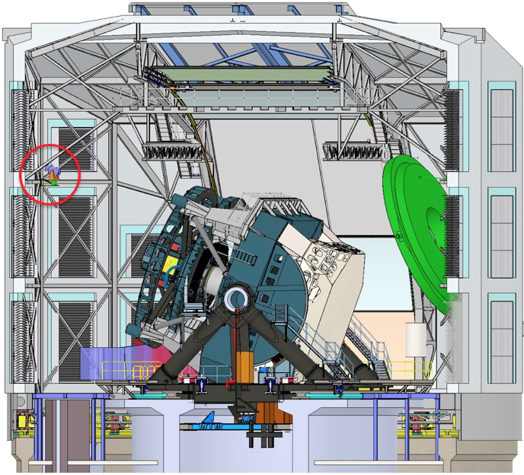
Flattening your flats or: How I learned to stop worrying and love the CBP
Merlin Fisher-Levine - Princeton

Slide 3
Why do we flat-field / what does it do?
Corrects for amplifier-to-amplifier gain variation & pixel-to-pixel QE
i.e. deals the conversion between ADU and incident photons
Quick history of flat-fielding:
Twilight flats
Nighttime sky flats
Conventional dome flats
What comes next?
Wide field camera → large gradients.
And what about the spectrum?
Time variable night-to-night
Time variable night-to-night
Night sky spectrum
Alt/az telescope + stray/scattered/ghosted light
→ flat-fields depend on rotator position, >5% difference
Typically incorrect input spectrum, + lamp variability
Merlin Fisher-Levine - PACCD - BNL - Dec. 1st 2016

Slide 4
Why do we flat-field / what does it do?
Corrects for amplifier-to-amplifier gain variation & pixel-to-pixel QE
i.e. deals the conversion between ADU and incident photons
Quick history of flat-fielding:
Twilight flats
Nighttime sky flats
Conventional dome flats
What comes next?
Flat-fields with monochromatic illumination + a CBP
Wide field camera → large gradients.
And what about the spectrum?
Time variable night-to-night
Time variable night-to-night
Night sky spectrum
Alt/az telescope + stray/scattered/ghosted light
→ flat-fields depend on rotator position, >5% difference
Typically incorrect input spectrum, + lamp variability
Merlin Fisher-Levine - PACCD - BNL - Dec. 1st 2016

Slide 5
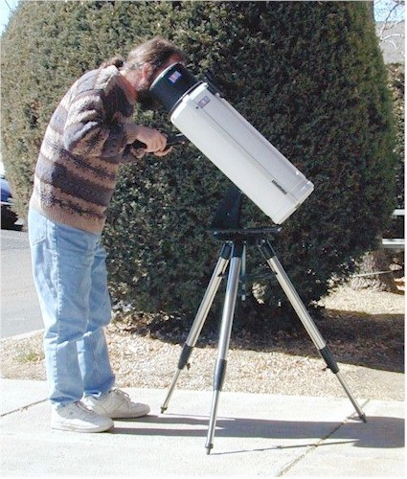
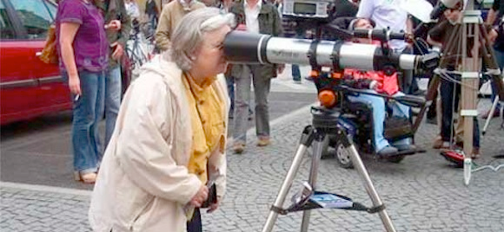
What is a CBP
Please note that despite the ponytail
and inept use of a telescope,
that is not Robert!
(You can tell from the shoes)
CBP stands for Collimated Beam Projector
Essentially, it’s a telescope “run backwards”
A telescope is a device which maps angles to positions
So reversing this…
A CBP is a telescope which takes a mask at what would have been its focal plane, and projects light through it.
Merlin Fisher-Levine - PACCD - BNL - Dec. 1st 2016

Slide 6
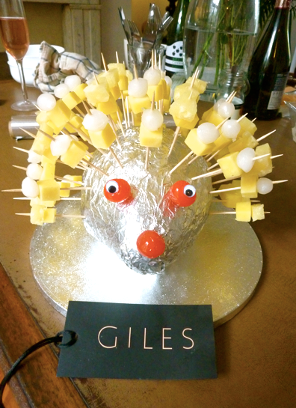
What is a CBP
CBP stands for Collimated Beam Projector
Essentially, it’s a telescope “run backwards”
A telescope is a device which maps angles to positions
So reversing this…
This results in multiple “pencil-beams” of light coming out of the CBP
The angles at which these beams exit the CBP are defined by the position of the holes in the mask
(see Giles the cheese hedgehog)
Merlin Fisher-Levine - PACCD - BNL - Dec. 1st 2016

Slide 7
What is a CBP
CBP stands for Collimated Beam Projector
Essentially, it’s a telescope “run backwards”
A telescope is a device which maps angles to positions
So reversing this…
The mask pattern is therefore re-imaged by the observing telescope onto its focal plane
Meaning we can place spots of our choosing at will
Merlin Fisher-Levine - PACCD - BNL - Dec. 1st 2016

Slide 8
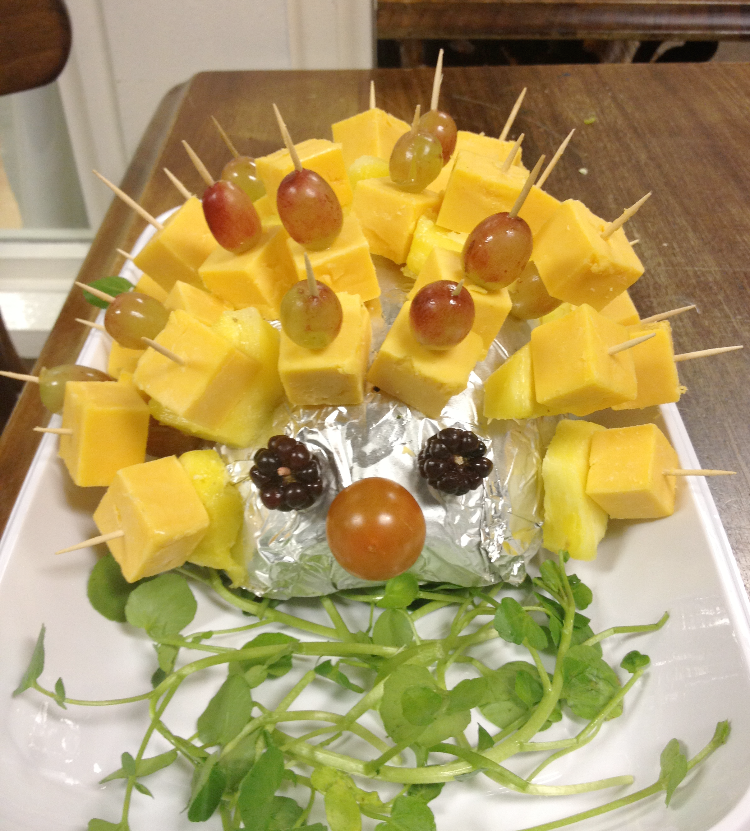
But why?
Because it mimics a (monochromatic) source at infinity
And because the diameter of these output beams == the diameter of the CBP telescope (~30cm)
it’s finite (unlike the planar wavefront from stars)
and therefore only samples a portion of the optics of the main telescope (primary mirror, filters etc.)
These properties mean it can be used for all sorts of fun things…
Merlin Fisher-Levine - PACCD - BNL - Dec. 1st 2016

Slide 9
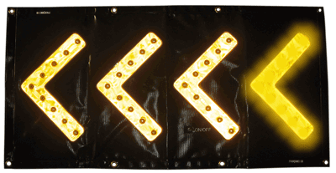
Like what?
A Collimated Beam Projector allows us to:
Make ‘photometric flat-fields’
And also, as an aside:
Monitor the filter transmission profiles, including as a function of position on the filter
Although we are assured that the LSST filter edges won’t move over time (unlike every filter ever made previously), it is probably prudent to confirm/measure this.
Provides a convenient alternative method to differentiate between between electronic crosstalk and optical ghosting, i.e. without relying on cosmics (low signal) or bleed trails (messy)
Measure absolute throughput (?!?!)
Merlin Fisher-Levine - PACCD - BNL - Dec. 1st 2016

Slide 10
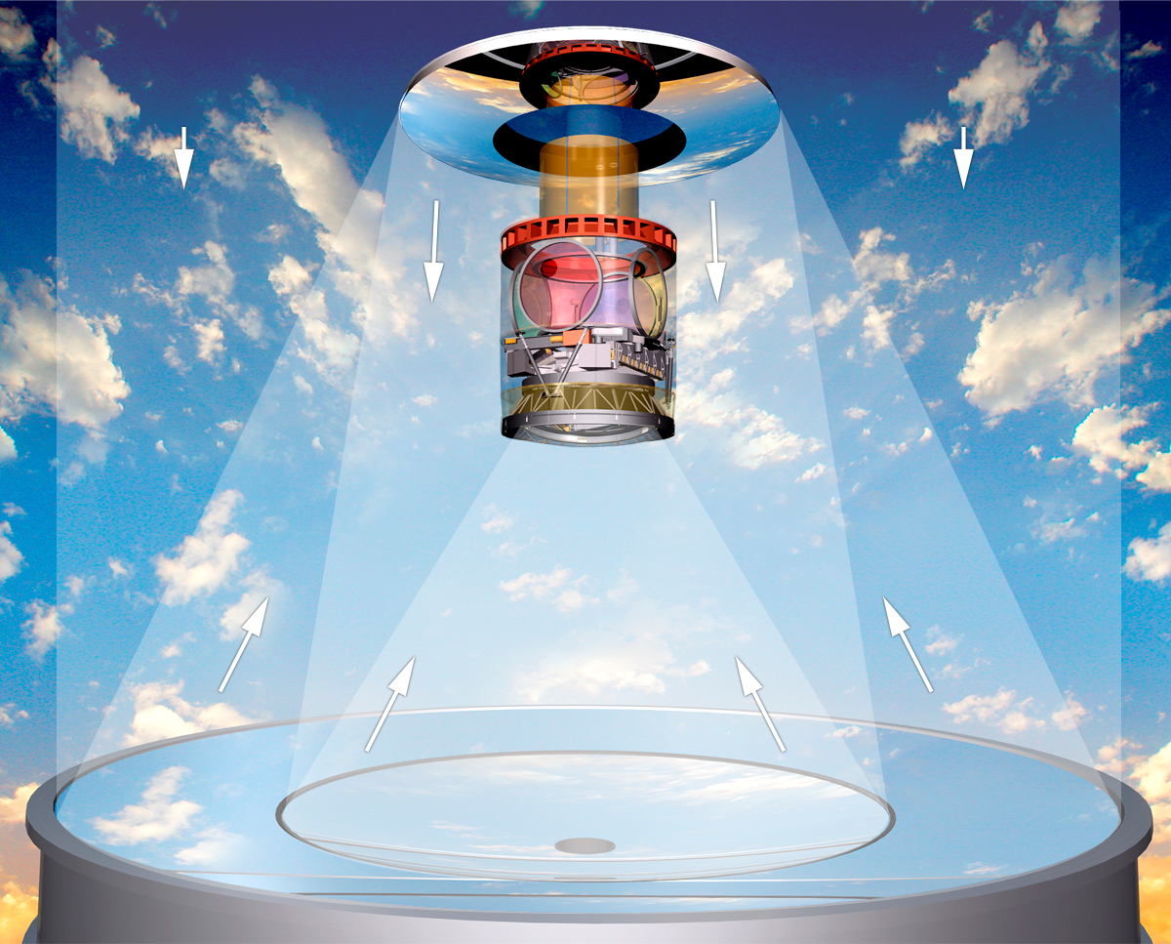
CBP
CBP

Slide 11
Variable definitions
System response function
Flat-field observation
Ssys = SQE Spixel Soptical
F = ( 1 + i + A ) Ssys
SQE = System response due to quantum efficiency
Soptical = System response from optical distortions
(Different pixels subtend different areas on the sky)
Spixel = (static) pixel size variations: intrinsic variation, tree-rings
i = non-uniformity in the flat-field screen illumination
A = ghosting/scattered light from the flat-field screen
Other effects:
Vignetting - flat in λ, but degenerate with QE, opposite in sign to Soptical
Multiplicative
Multiplicative
Additive
Additive
Merlin Fisher-Levine - PACCD - BNL - Dec. 1st 2016

Slide 12
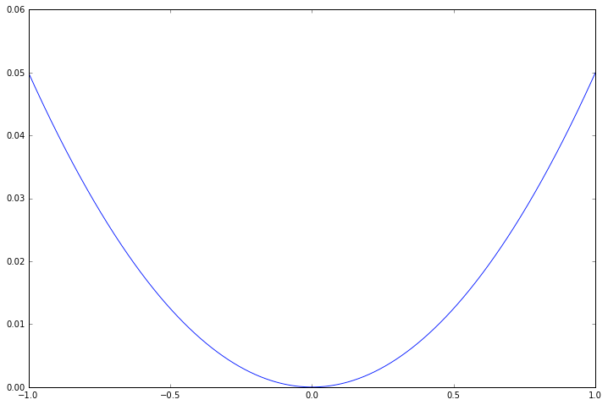
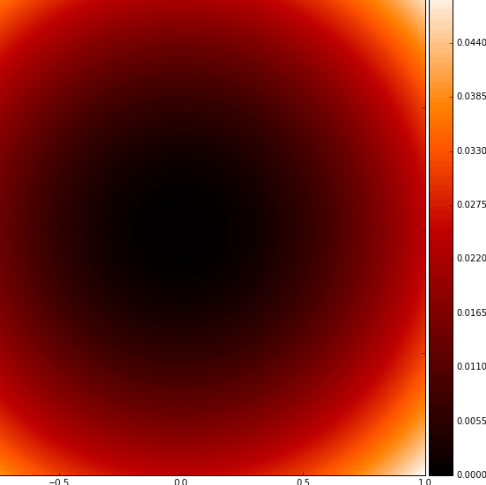
Flat-field Illumination (i)
i = 0.05x²
i = 0.05x² + 0.05y²
Figure credit: R. Lupton
1D
2D
Merlin Fisher-Levine - PACCD - BNL - Dec. 1st 2016

Slide 13
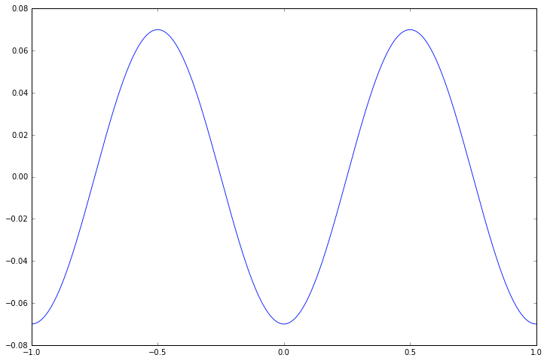
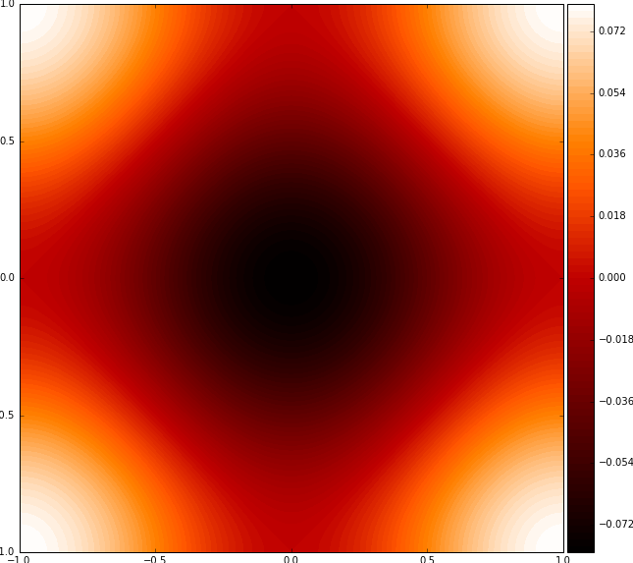
Ghosting (A)
A = -0.07 cos (2πx)
A = - (0.04 cos (πx) + 0.04 cos (πy))
Figure credit: R. Lupton
|range| = 0.08
1D
2D
Merlin Fisher-Levine - PACCD - BNL - Dec. 1st 2016

Slide 14
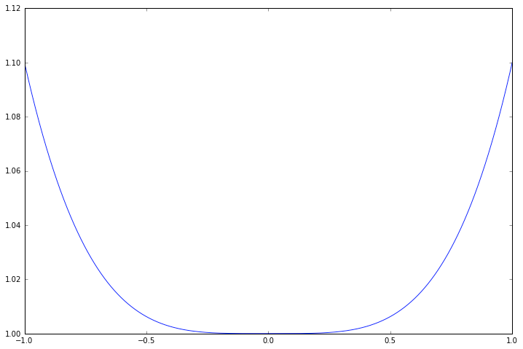
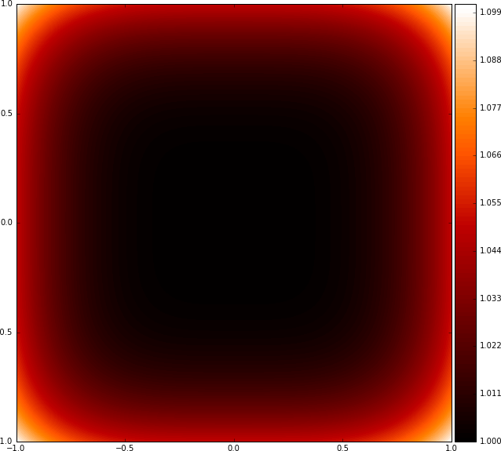
Optical Distortion (Soptical)
Soptical = 1 + 0.1x⁴
Soptical = 1 + 0.1x⁴ + 0.1y⁴
Figure credit: R. Lupton
1D
2D
Merlin Fisher-Levine - PACCD - BNL - Dec. 1st 2016

Slide 15
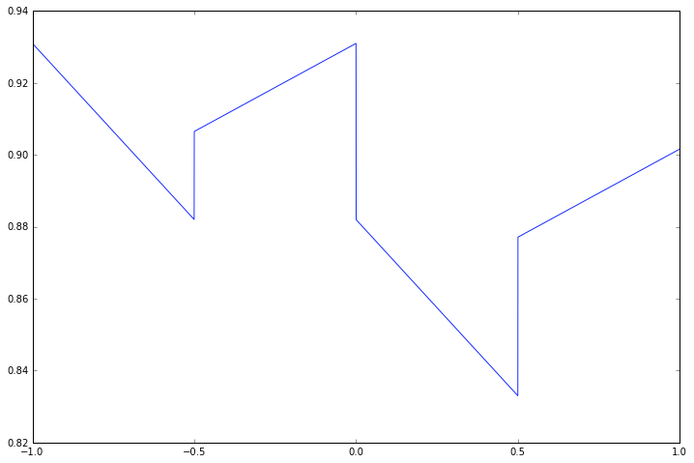
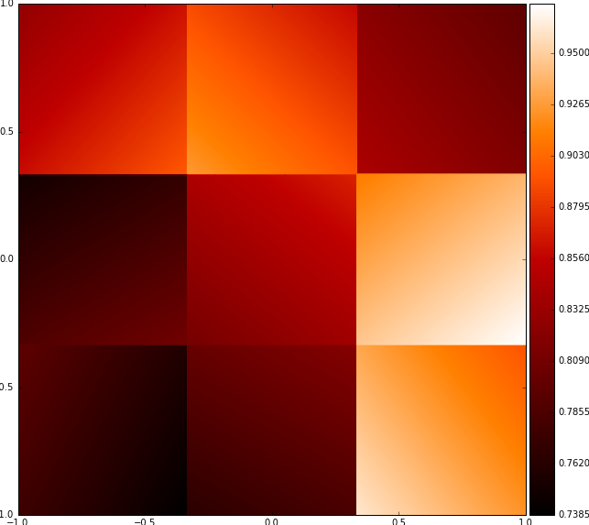
Quantum Efficiency (SQE)
SQE = piecewise linear
SQE = piecewise bi-linear
Figure credit: R. Lupton
Random gradients in x and y
Random nominal QE
range = 74-97%
(no chromaticity)
Introduces discontinuities
2D
Merlin Fisher-Levine - PACCD - BNL - Dec. 1st 2016

Slide 16
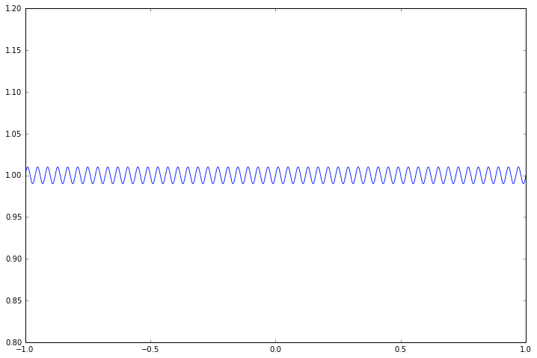
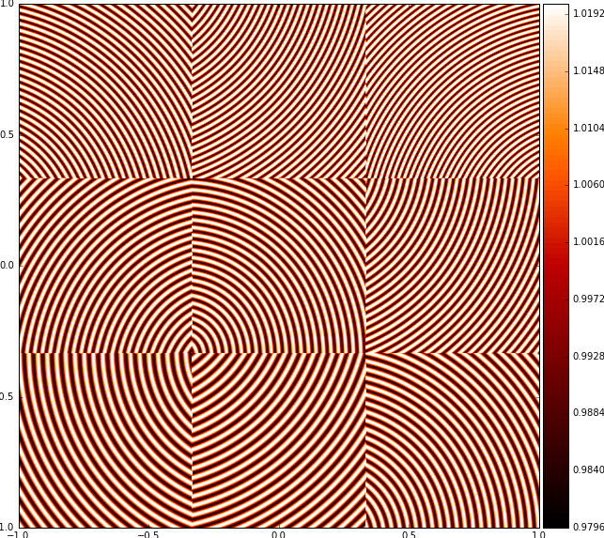
Pixel Sizes (Spixel)
Spixel = 1 + 0.01 sin(50πx)
Spixel = 1 + 0.01 sin(νi πx + ϕi)
ν = [59, 61, 67, 71, 73, 79, 83, 89, 97]
Figure credit: R. Lupton
Origins off-chip by random
amount → random phase
Incommensurate periods
Random chip orientation
1D
2D
Merlin Fisher-Levine - PACCD - BNL - Dec. 1st 2016

Slide 17
Pixel Sizes (Spixel)
Spixel = 1 + 0.01 sin(50πx)
Spixel = 1 + 0.01 sin(νi πx + ϕi)
ν = [59, 61, 67, 71, 73, 79, 83, 89, 97]
Figure credit: R. Lupton
Origins off-chip by random
amount → random phase
Incommensurate periods
Random chip orientation
1D
2D
Merlin Fisher-Levine - PACCD - BNL - Dec. 1st 2016

Slide 18
Putting these together…
Merlin Fisher-Levine - PACCD - BNL - Dec. 1st 2016

Slide 19
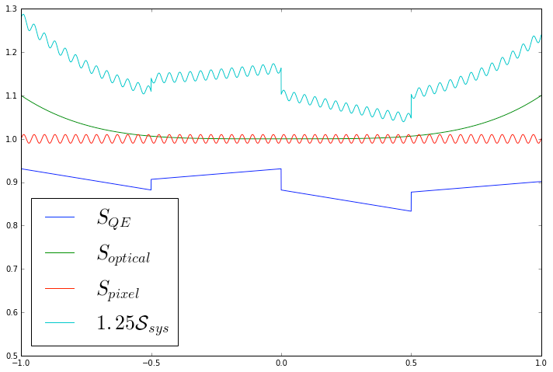
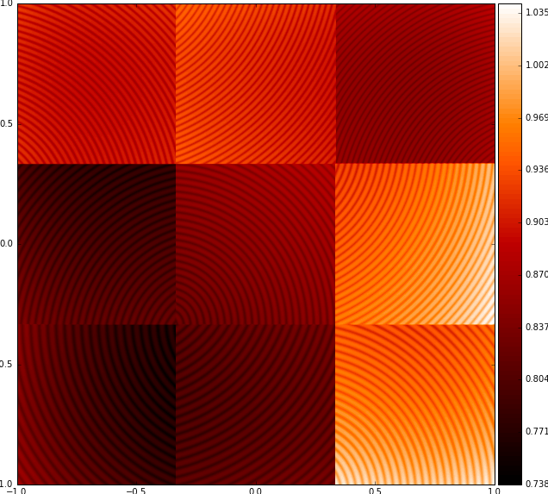
System response function
Ssys = SQE Spixel Soptical
Figure credit: R. Lupton
1D
2D
Merlin Fisher-Levine - PACCD - BNL - Dec. 1st 2016

Slide 20
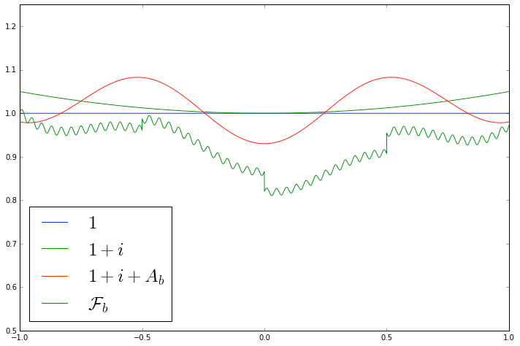
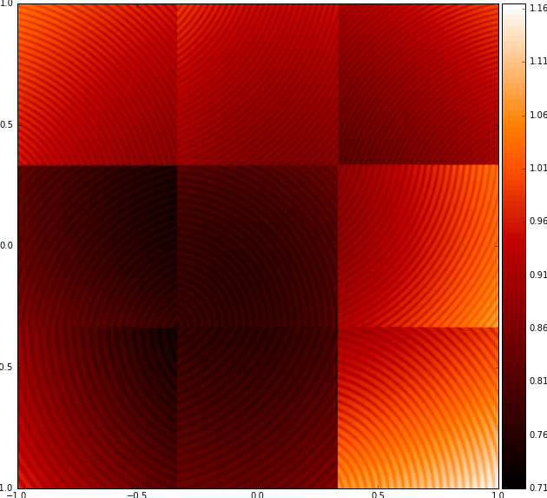
Flat-field observation
F = ( 1 + i + A ) Ssys
Figure credit: R. Lupton
1D
2D
Merlin Fisher-Levine - PACCD - BNL - Dec. 1st 2016

Slide 21
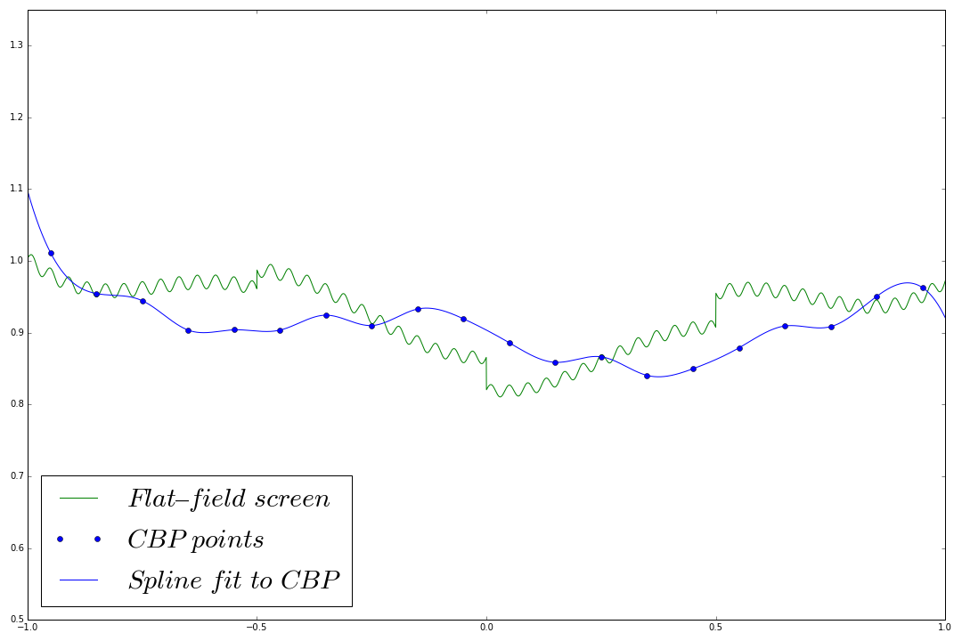
Reconstruction from CBP data (1)
1) Measure flat-field (green)
2) Take CBP samples (blue)
NB these see Ssys
but not additive parts i + A
3) Spline interpolate
Figure credit: R. Lupton

Slide 22
Reconstruction from CBP data (1)
1) Measure flat-field (green)
2) Take CBP samples (blue)
NB these see Ssys
but not additive parts i + A
3) Spline interpolate
Figure credit: R. Lupton

Slide 23
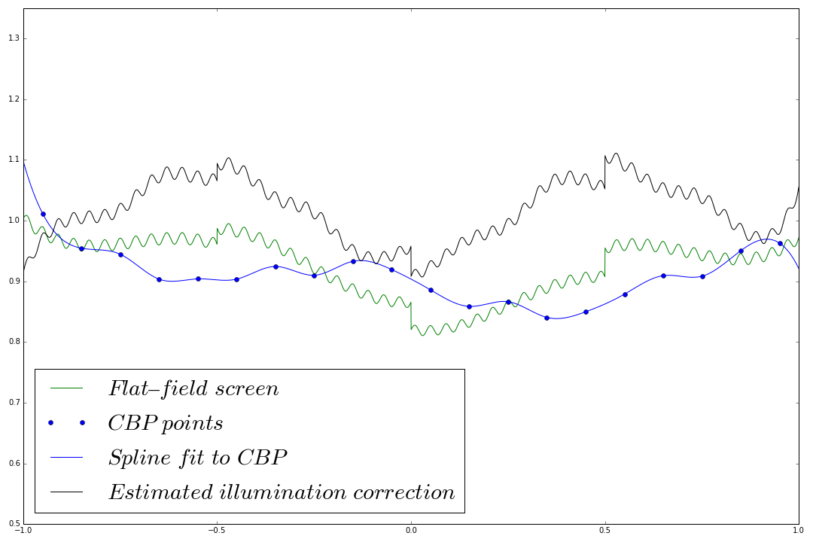
Reconstruction from CBP data (2)
4) Divide flat-field by
the spline
→ this gives an
estimate of the
illumination
Figure credit: R. Lupton

Slide 24
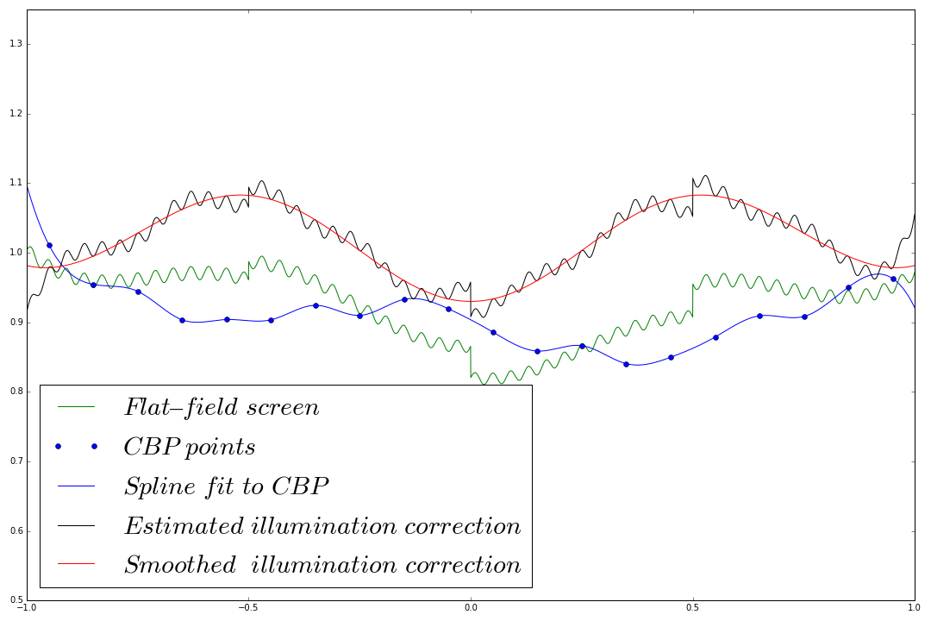
Reconstruction from CBP data (3)
5) Smooth this with a
spline
Figure credit: R. Lupton

Slide 25
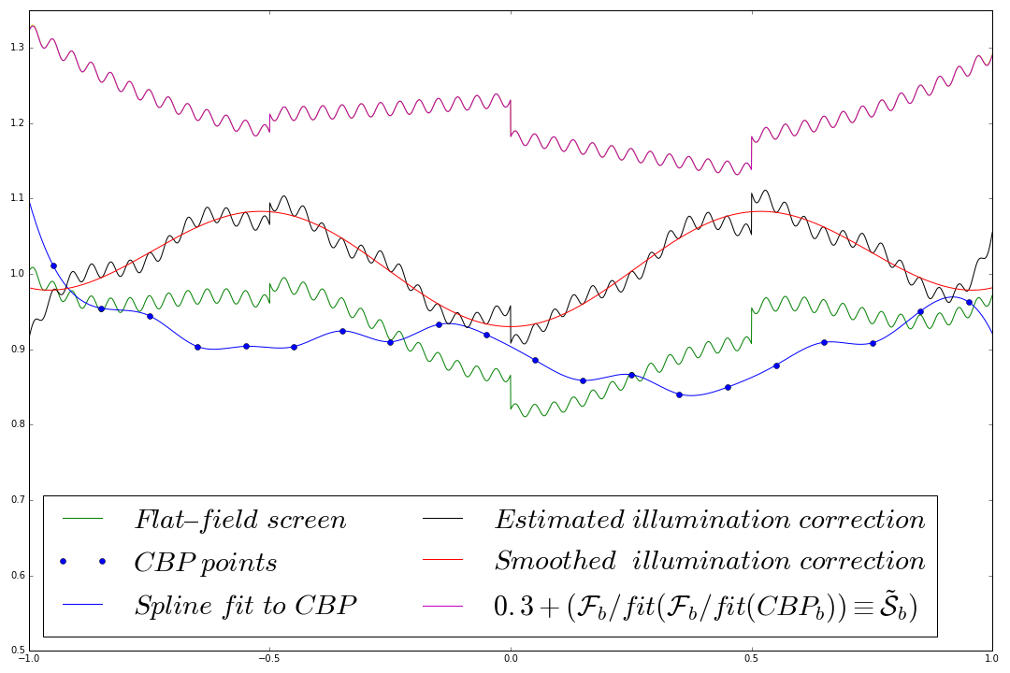
Reconstruction from CBP data (4)
Figure credit: R. Lupton
6) Divide the flat-field by the
smoothed illumination correction

Slide 26
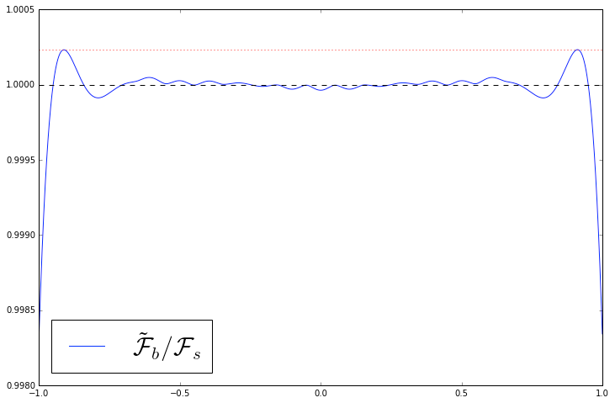
Residuals
Max = 1.00023
Figure credit: R. Lupton
Merlin Fisher-Levine - PACCD - BNL - Dec. 1st 2016

Slide 27
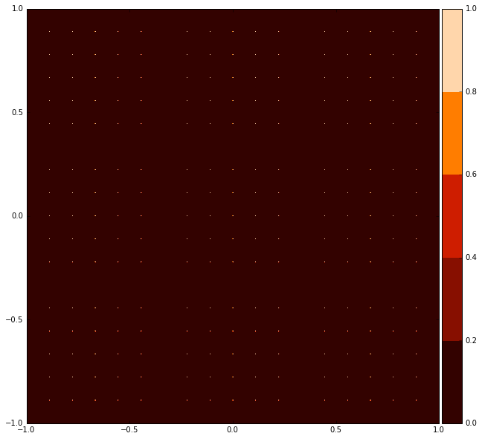
Reconstruction from CBP data (1)
Figure credit: R. Lupton
Place sample points in 2D
1D
2D
Merlin Fisher-Levine - PACCD - BNL - Dec. 1st 2016

Slide 28
Reconstruction from CBP data (1)
Figure credit: R. Lupton
Place sample points in 2D
1D
2D
Merlin Fisher-Levine - PACCD - BNL - Dec. 1st 2016

Slide 29
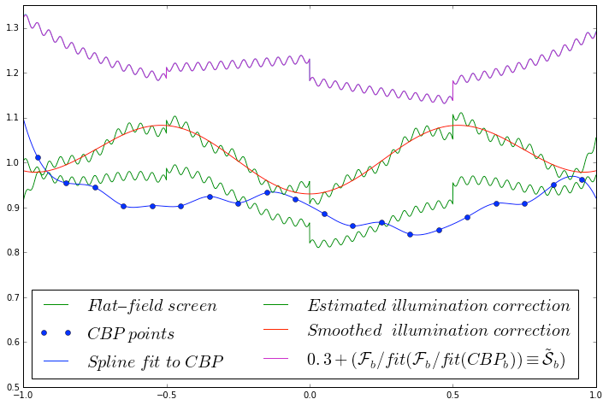
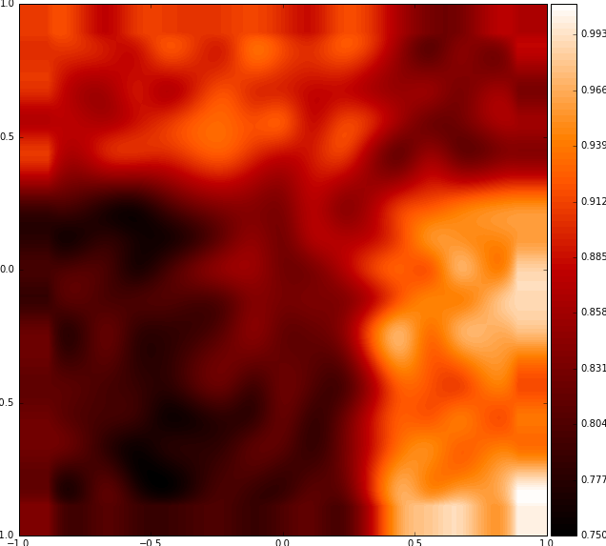
Reconstruction from CBP data (2)
Figure credit: R. Lupton
Take data at
sample points & interpolate
1D
2D
Merlin Fisher-Levine - PACCD - BNL - Dec. 1st 2016

Slide 30
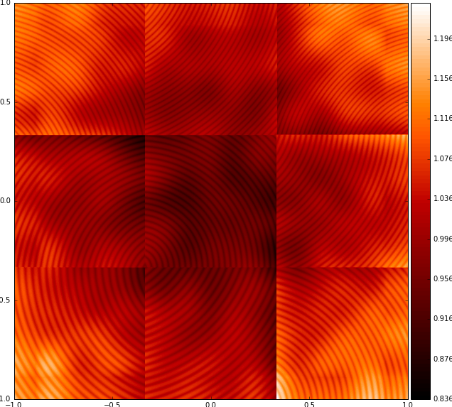
Reconstruction from CBP data (3)
Figure credit: R. Lupton
Divide flat-field by
the spline surface
and smooth
1D
2D
Merlin Fisher-Levine - PACCD - BNL - Dec. 1st 2016

Slide 31
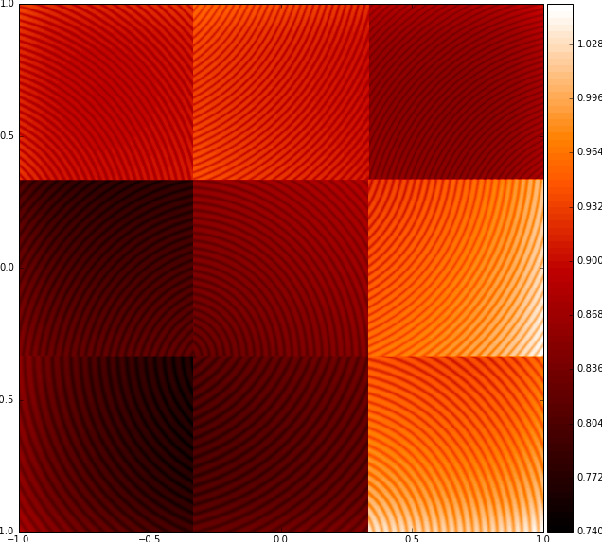
Reconstruction from CBP data (4)
Figure credit: R. Lupton
Apply derived
illumination correction
1D
2D
Merlin Fisher-Levine - PACCD - BNL - Dec. 1st 2016

Slide 32
Reconstruction from CBP data (5)
Figure credit: R. Lupton
Arrive at
system response,
plot residuals…
1D
2D
Merlin Fisher-Levine - PACCD - BNL - Dec. 1st 2016

Slide 33
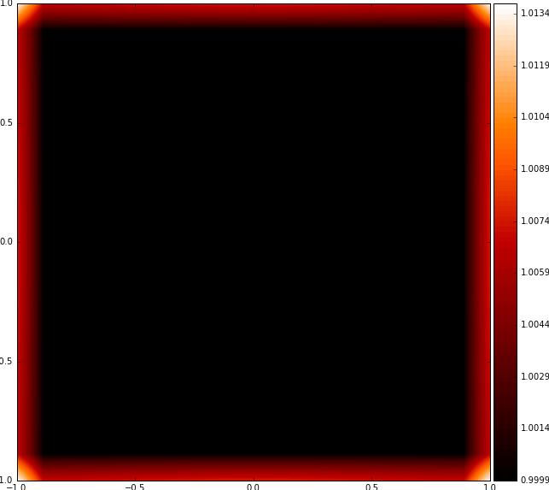
Residuals
Max = 1.00023
Figure credit: R. Lupton
Max = 1.0137
1D
2D
Merlin Fisher-Levine - PACCD - BNL - Dec. 1st 2016

Slide 34
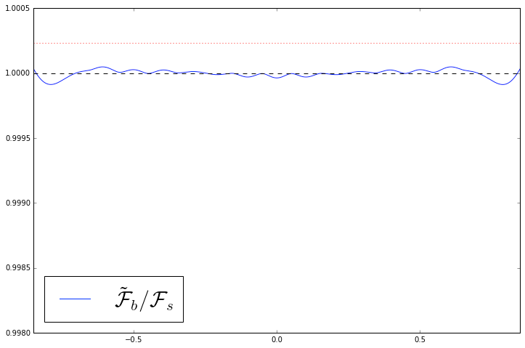
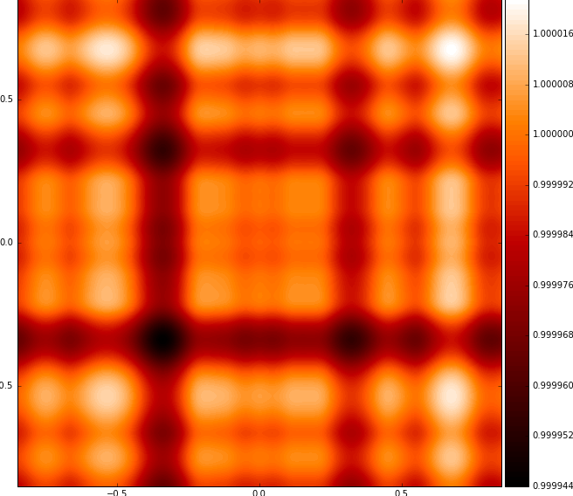
Residuals
Max = 1.000048
Figure credit: R. Lupton
Max = 1.000021
1D
2D
Merlin Fisher-Levine - PACCD - BNL - Dec. 1st 2016

Slide 35
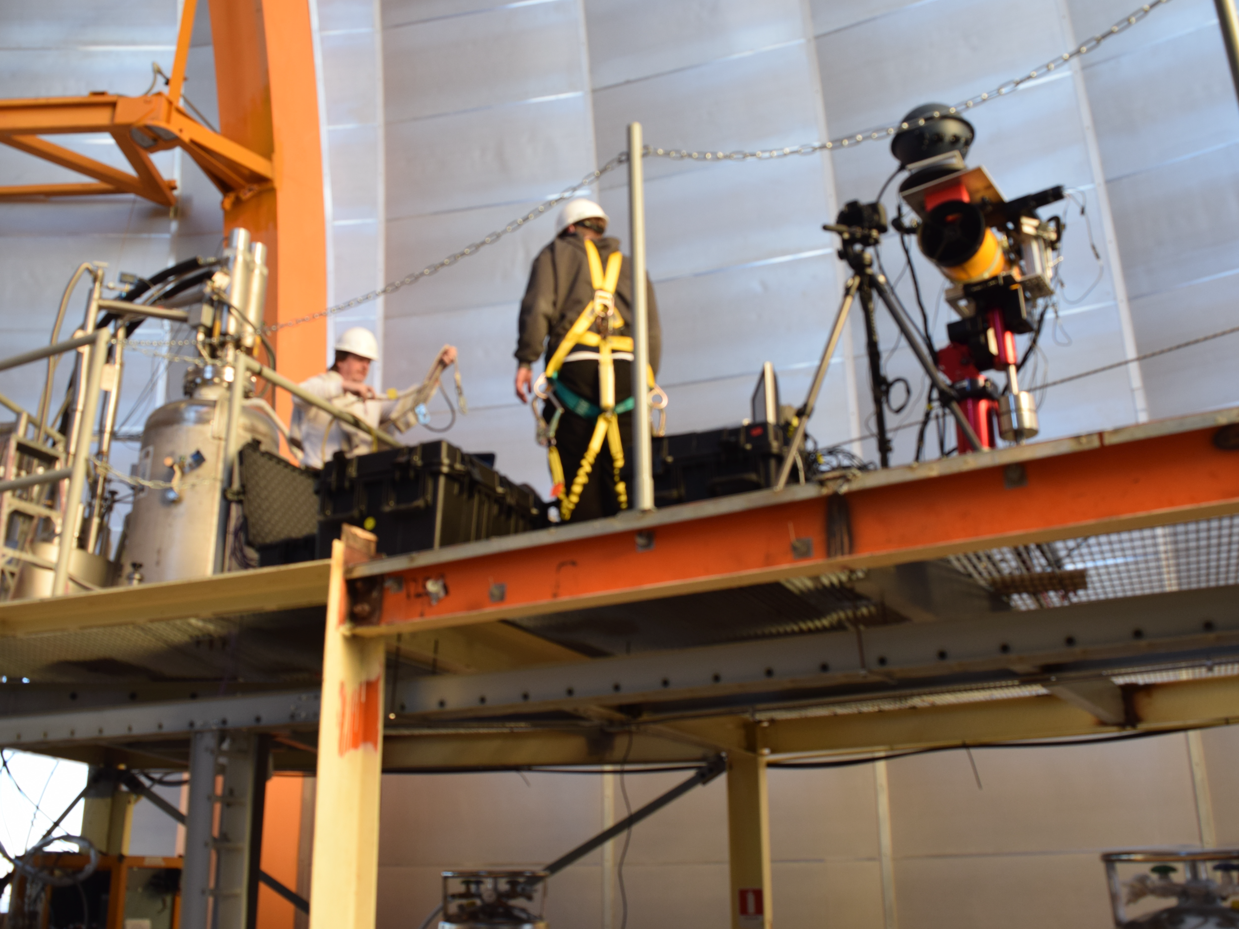
It’s real!
Photo credit: M. Coughlin
Merlin Fisher-Levine - PACCD - BNL - Dec. 1st 2016

Slide 36
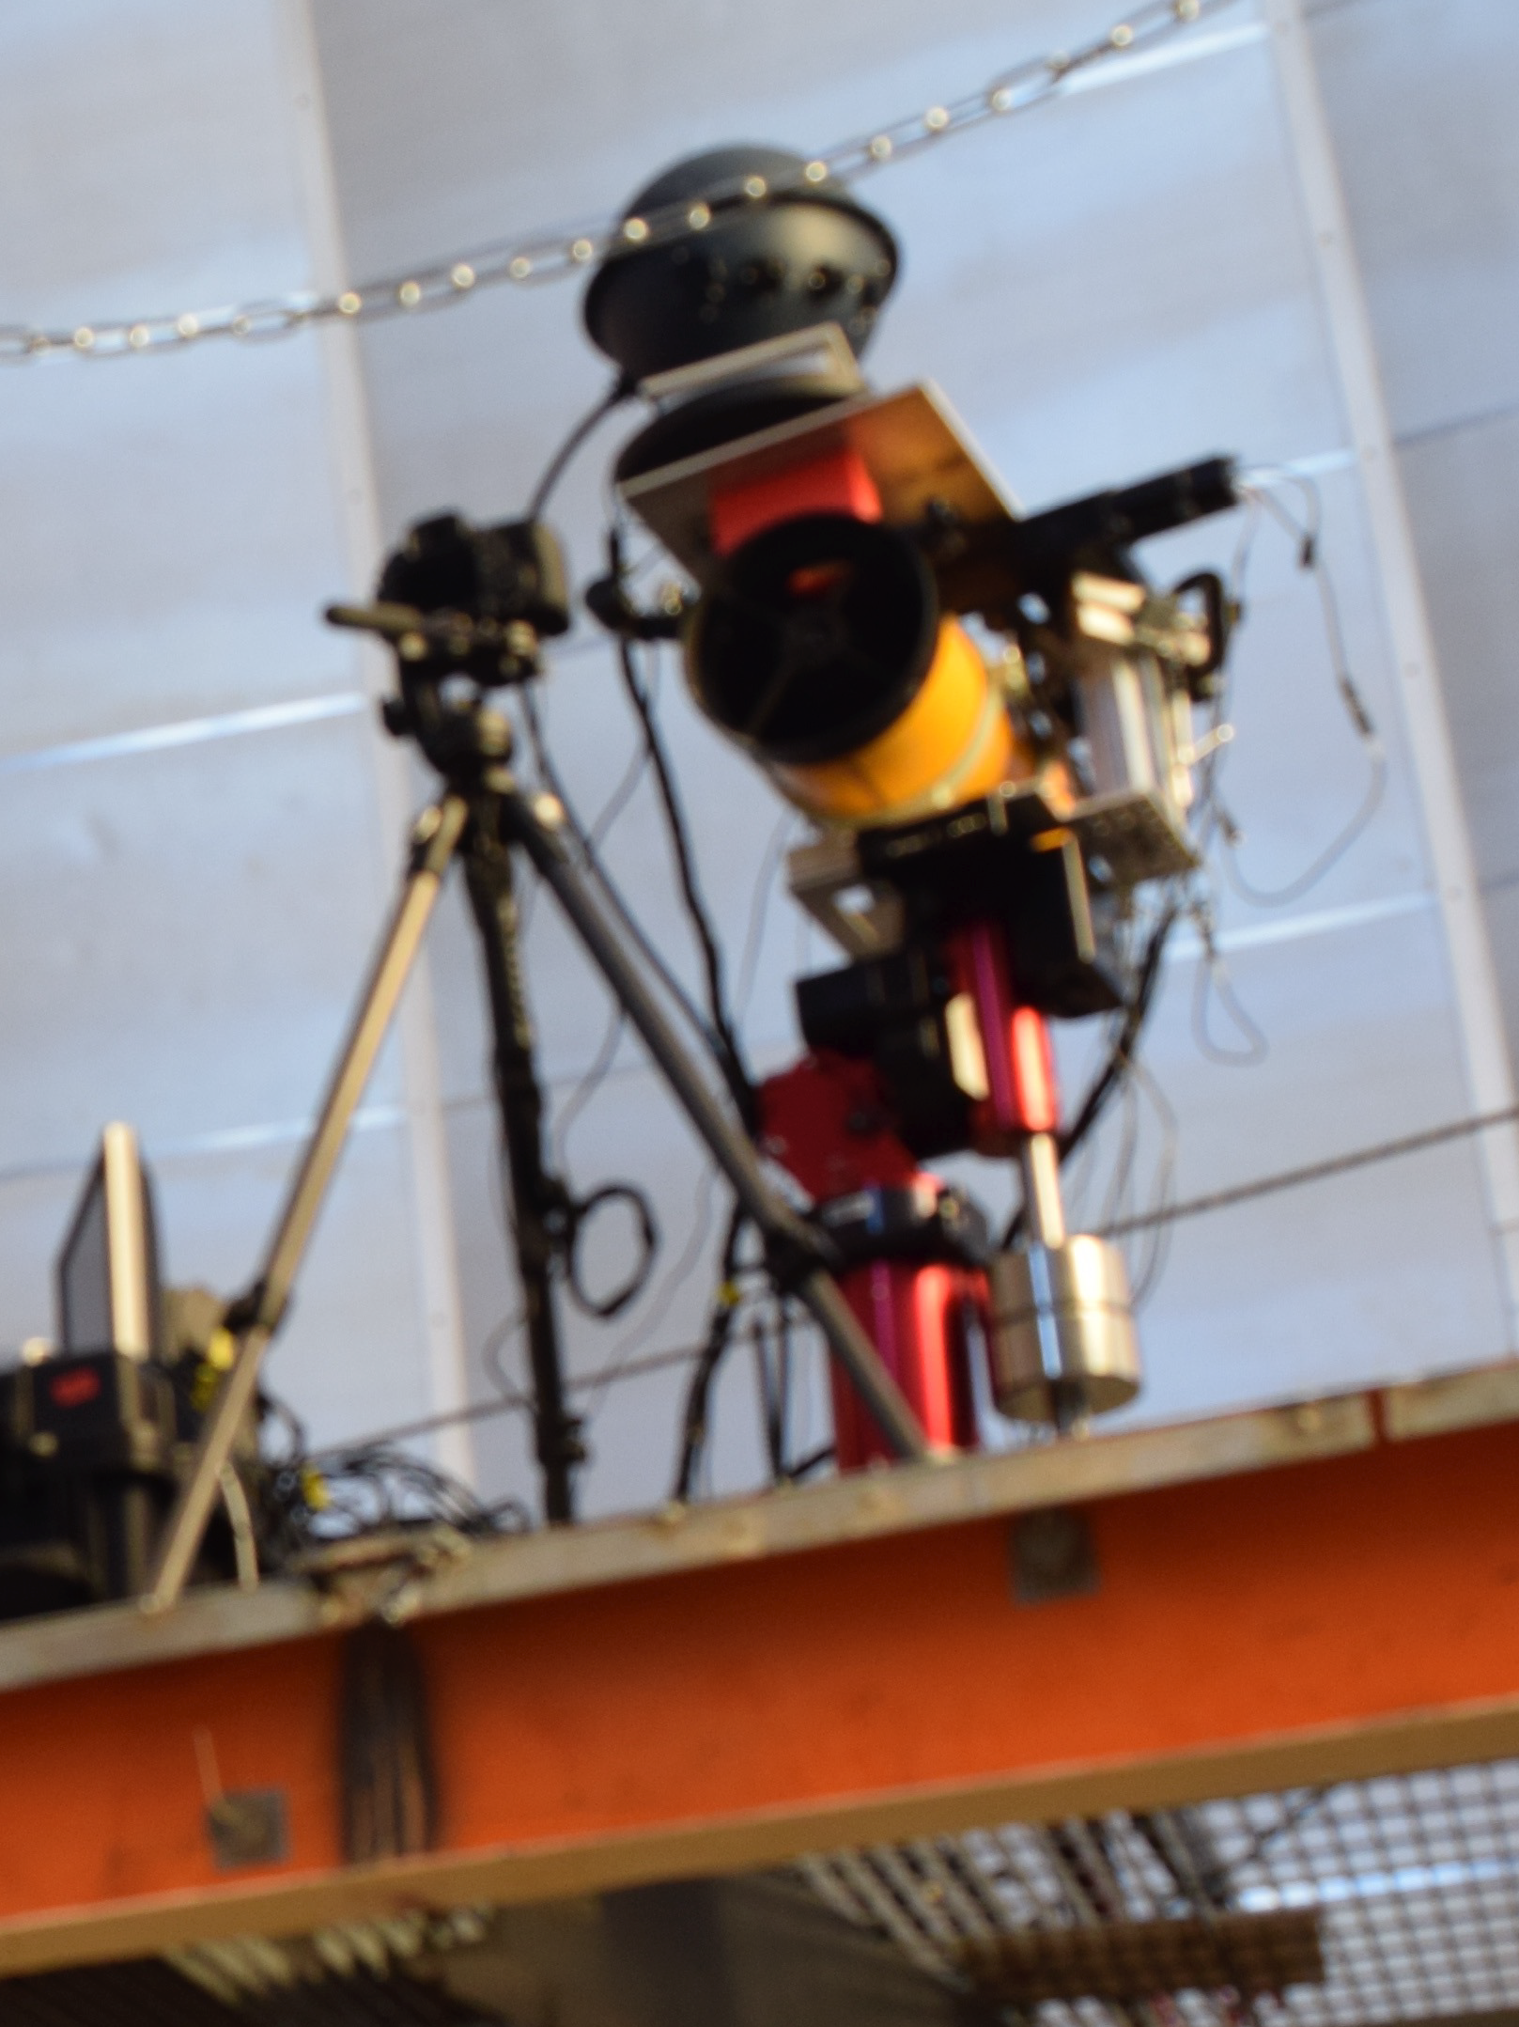
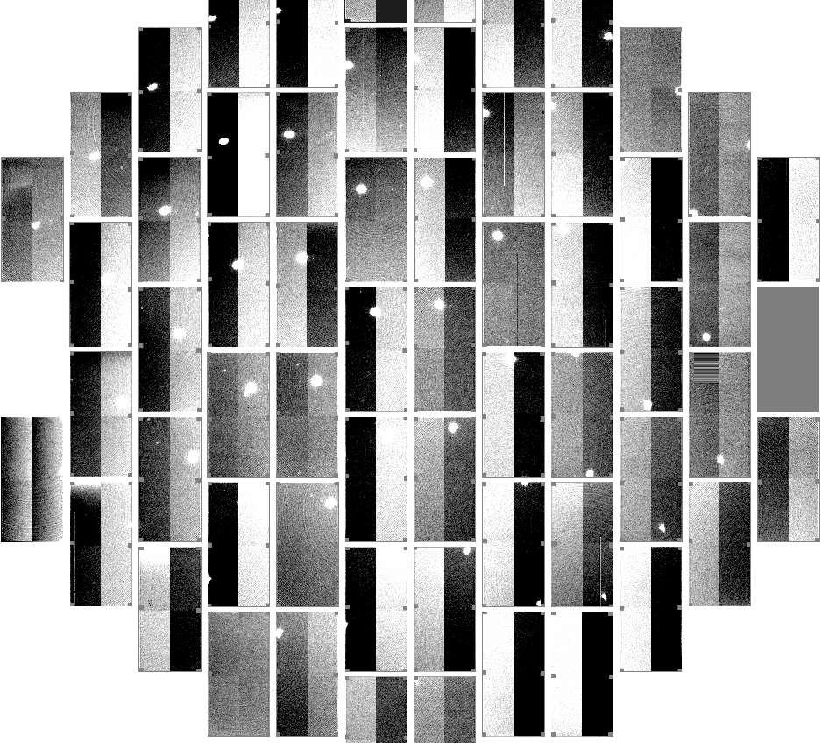
It works! (At CTIO/DECam)
DECam spot images
1st prototype
Focus was poor due
to rough transit
For a first try it worked wonderfully!
Merlin Fisher-Levine - PACCD - BNL - Dec. 1st 2016

Slide 37
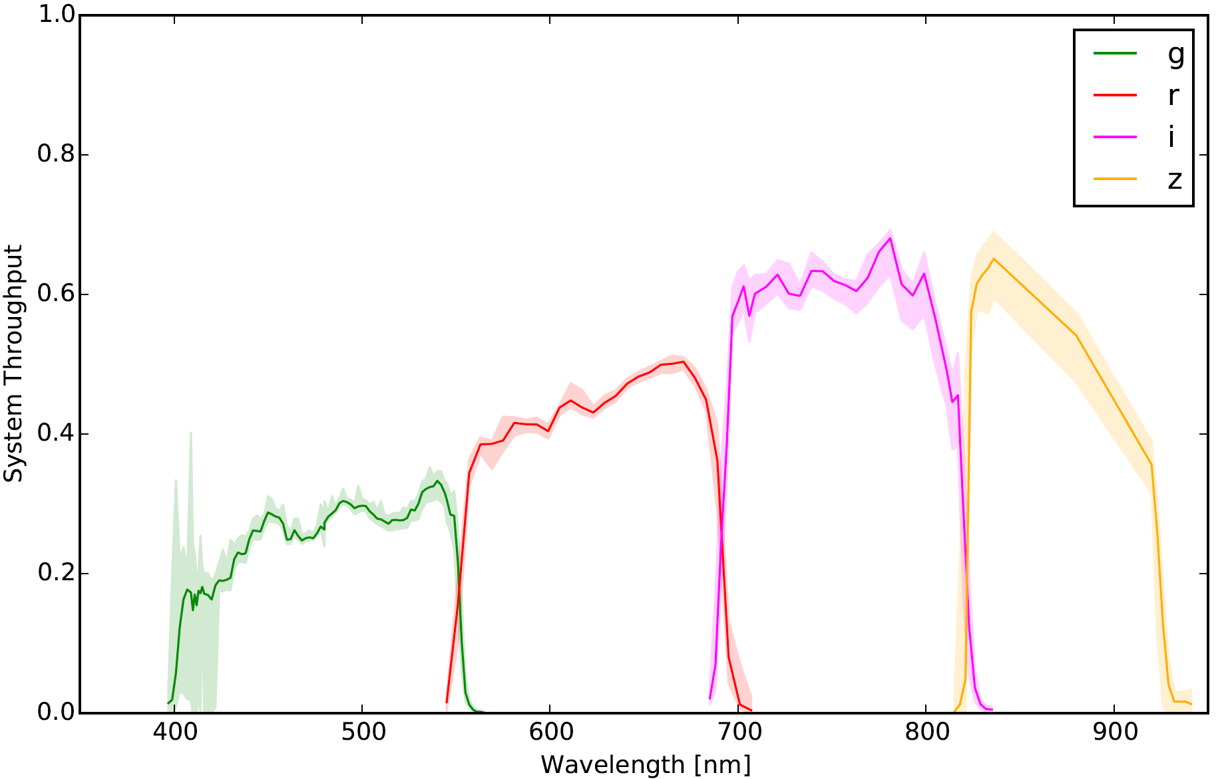
It works! (At Pan-STARRS)
Filter transmission measurement at Pan-STARRS
made with
CBP v2 !!
made with
CBP v2 !!
made with
CBP v2 !!
CBP v2:
New and improved!
Now with
smaller spots!
Figure credit: M. Coughlin, N. Mondrik, J. Tonry, C. Stubbs
Merlin Fisher-Levine - PACCD - BNL - Dec. 1st 2016

Slide 38
Conclusion
The CBP allows us to:
Calculate the system response function, Ssys, and correct for the ghosting and non-uniform illumination in dome-flats
Do this as a function of wavelength by using monochromatic light for both dome-flats and CBP illumination
Thereby accurately flat-field our images to unprecedented precision, and do so correctly for any given SED
Sample only a portion of the pupil at a time, allowing characterisation of the filter transmission as a function of position
As a bonus, we also get help with crosstalk measurements and monitoring the evolution of the filter bandpasses over time.

Slide 39
Backup slides

Slide 40
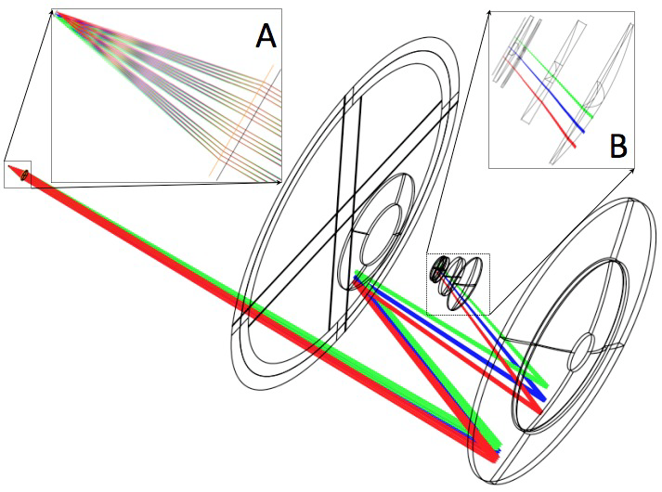
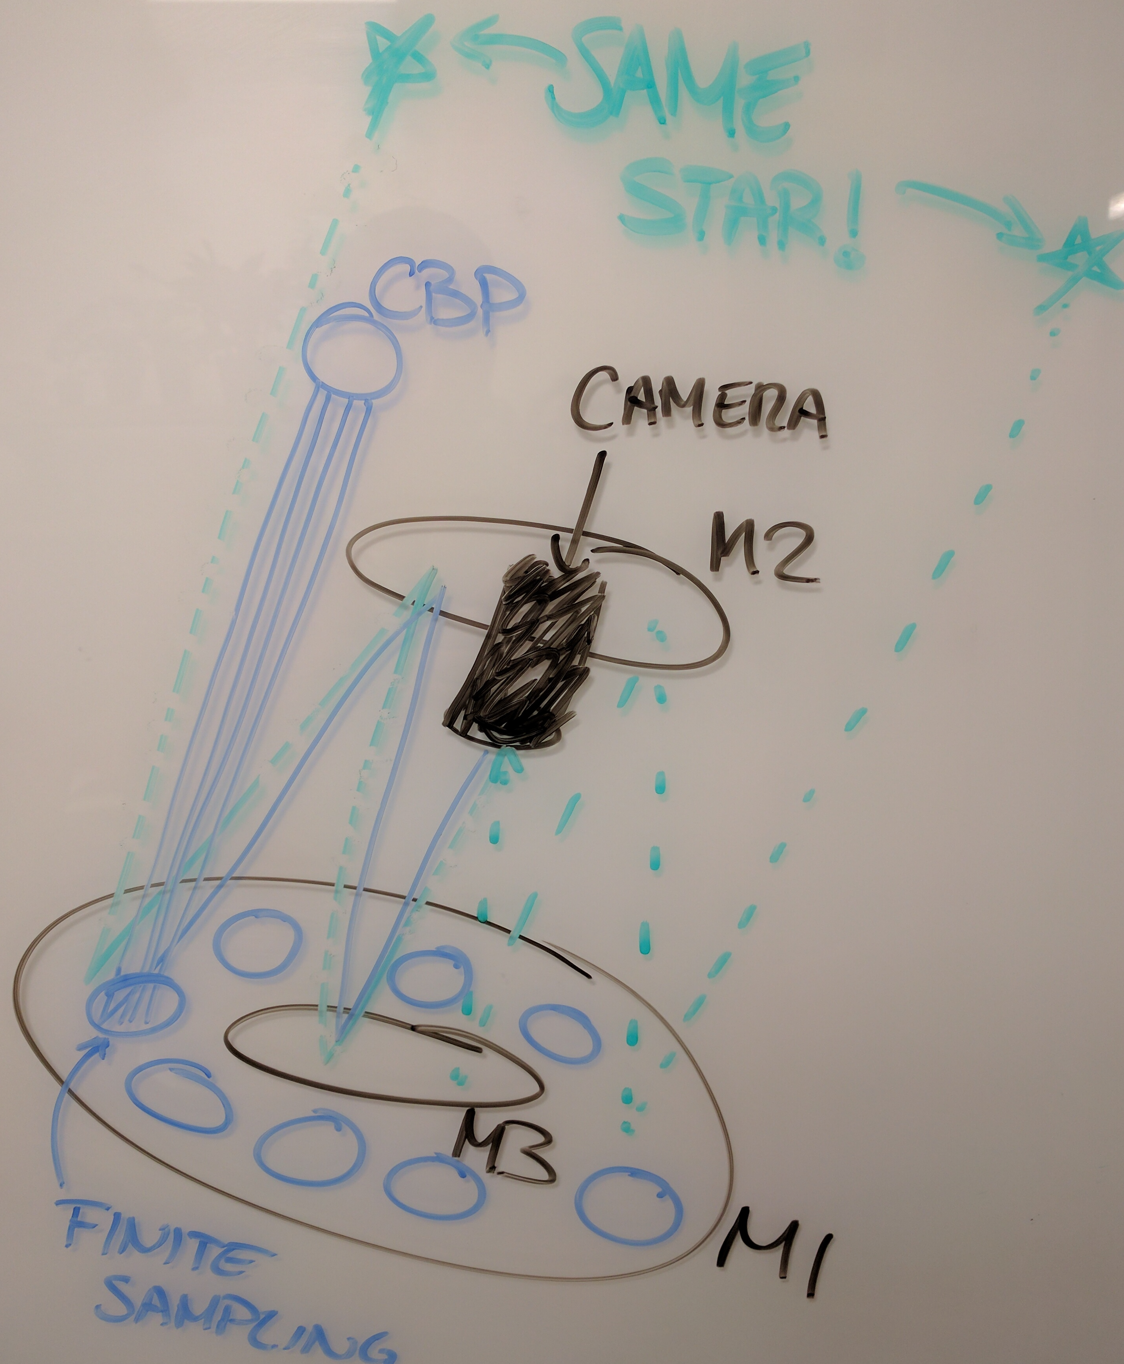

Slide 41
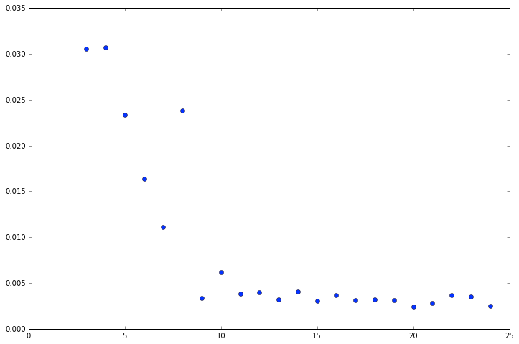
Residuals vs. CBP samples
How does the error change
with number of number of CBP
samples taken per chip?
Please ignore me, I am the product
of numerical instability…
Merlin Fisher-Levine - PACCD - BNL - Dec. 1st 2016

