Slide 1
Computing WFIRST weak lensing requirements on detector calibration
Chaz Shapiro
Jet Propulsion Laboratory, California Institute of Technology
© 2016 California Institute of Technology. Government sponsorship acknowledged

Slide 2
Requirements for the WFIRST NIR detectors flow from the science requirements of the cosmology and exoplanet surveys. Detector requirements for WFIRST weak gravitational lensing have been studied by
Detector Working Group (co-leads D. Bennet, C. Shapiro)
Cosmology Science Investigation Team (PI: O. Doré)
Outline
WFIRST recap
Nonlinearity – Andrés Plazas-Malagon (JPL→?)
Interpixel Capacitance – Arun Kannawadi (Carnegie Mellon → Leiden)
Persistence – Eric Huff (JPL)

Slide 3
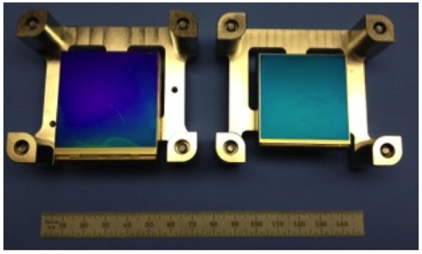
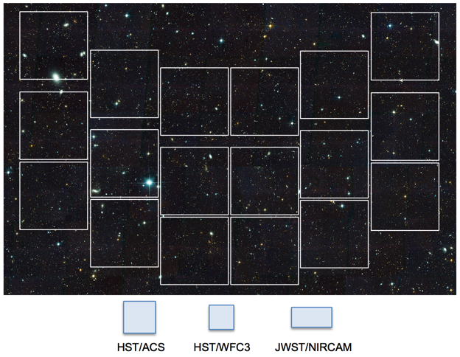
WFIRST Imager overview
2.4m telescope
f/8 imager (Wide Field Channel)
18x Hawaii-4RG detectors – 4kx4k pixels; 10µm pixel pitch
Plate scale 0.11”/pixel
Field of view (FOV) 0.8° x 0.4°
Near-infrared pass band: 0.76 - 2.3μm
6 (7?) imaging filters
5-9 dithers/source/filter (images are undersampled)
H4RG-10
H2RG-18
WFIRST FOV

Slide 4
WFC Filters
Band | Element name | Min (μm) | Max (μm) | Center (μm) | Width (μm) | R
Z | Z087 | 0.76 | 0.977 | 0.869 | 0.217 | 4
Y | Y106 | 0.927 | 1.192 | 1.060 | 0.265 | 4
J | J129 | 1.131 | 1.454 | 1.293 | 0.323 | 4
H | H158 | 1.380 | 1.774 | 1.577 | 0.394 | 4
 | F184 | 1.683 | 2.000 | 1.842 | 0.317 | 5.81
Wide | W149 | 0.927 | 2.000 | 1.485 | 1.030 | 1.44
GRS | Grism | 1.0* | 1.89* | 1.445 | 0.890 | 461λ(2pix)
Slide adapted from WFIRST Project report

Slide 5
WFIRST galaxy shape measurement requirements
Baseline: 2000 deg² with 45 galaxies/arcmin²
Extended mission: 10k deg²
(Nominal) knowledge requirements for shear measurement error: δg_{i} = (1+m)g_{i} + c
Multiplicative error: m ~ 0.001
Additive error: c ~ 0.0003
PSF knowledge requirements (rms):
c → Ellipticity ~ 0.0005 ; m → Size (dσ/σ) ~ 0.0009
Images are undersampled in J, H, F184 bands
Image: GREAT08 Handbook
Notes:
Anyone need shear review?

Slide 6
The effect of detector nonlinearity on WFIRST PSF profiles for weak gravitational lensing measurements
A. A. Plazas, C. Shapiro, A. Kannawadi, R. Mandelbaum, J. Rhodes, & R. Smith
(arXiv:1605.01001. Submitted to PASP)

Slide 7
Nonlinearity in the signal chain
We study the
impact of this
type of nonlinearity
(NL) on weak lensing
Image credit: R. Smith

Slide 8
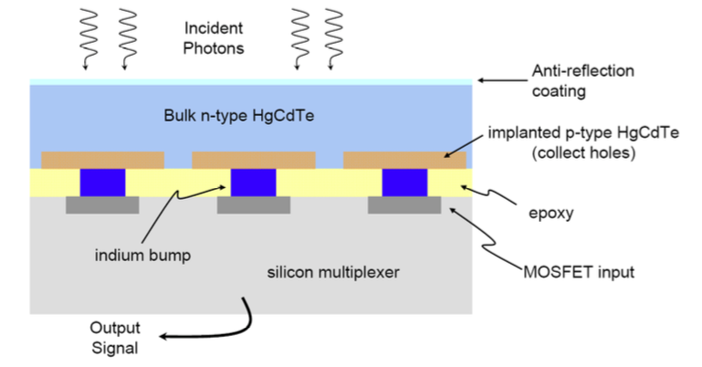
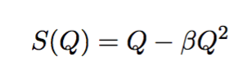
NL in hybrid CMOS detectors
p-n junction (charge collection region).
p-n junction acts as capacitor
Signal ΔV=ΔQ/C
IF junction capacitance varies as charge accumulates
→ nonlinear V(Q)
If the main source of nonlinearity is the junction capacitance, the correction to the inferred signal is well-approximated by a quadratic function
Additional parameters can improve calibration but are highly degenerate – we stick with 1 for simplicity
β ~ 5e-7 (WFC3, Hilbert 2014), varies per pixel and detector

Slide 9
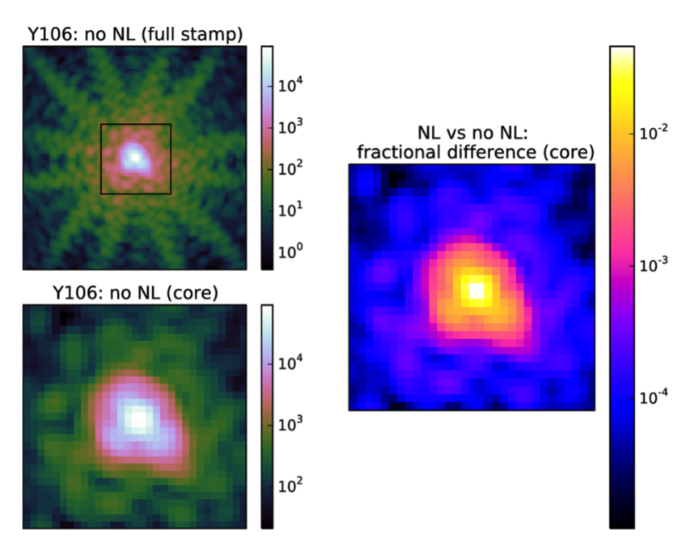
Image simulations with GalSim
We use the WFIRST module (Kannawadi +15) in GalSim (Project-funded) to simulate PSF profiles for WFIRST bands J, Y, H, F
Pixel scale = 0.11 arcsec/pixel; images are drawn at 3x resolution to mimic reconstruction from dithers (avoids aliasing)
Centroids randomized within native pixel
Considered AB magnitudes down to 18.3, which fills a H4RG pixel to 90% of full well (~1.1k e⁻) in 168 seconds (Y band, PSF centered on a pixel)
NL applied to each pixel according to:
NL depresses PSF peak
→ size measurement bias
No ellipticity bias unless
PSF has |e|>0 (it does)

Slide 10
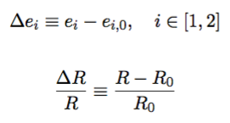
PSF size and shape measurements
For weak lensing, the PSF sampled from nearby bright stars (affected more by NL) must be deconvolved from observed galaxy shapes
The error in the galaxy ellipticity measurement is given by a linear combination of fractional PSF size error and absolute PSF ellipticity error (e.g, Paulin-Henriksson et al. 2008, Massey et al. 2013)
Nominal WFIRST error tolerances:
relative size to ~ 1e-3 ; absolute ellipticity to ~4.5e-4
We use adaptive moments (HSM method) to measure
PSF size (R) and ellipticity (e_{i}) before and after NL is applied.
Total signal
Center pixel
“R”
Baseline WFIRST PSFs

Slide 11
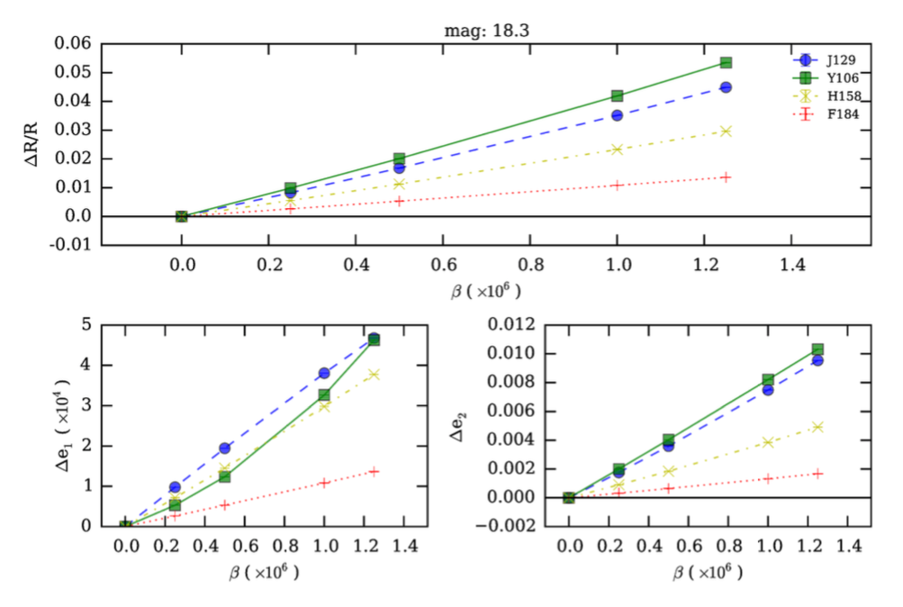
Biases in size and ellipticity (uncorrected for NL)
relative size tolerance ~ 1e-3
ellipticity tolerance ~ 4e-4
Since errors are approximately linear in β, we can condense information by plotting the slope of each curve as a function of magnitude.

Slide 12
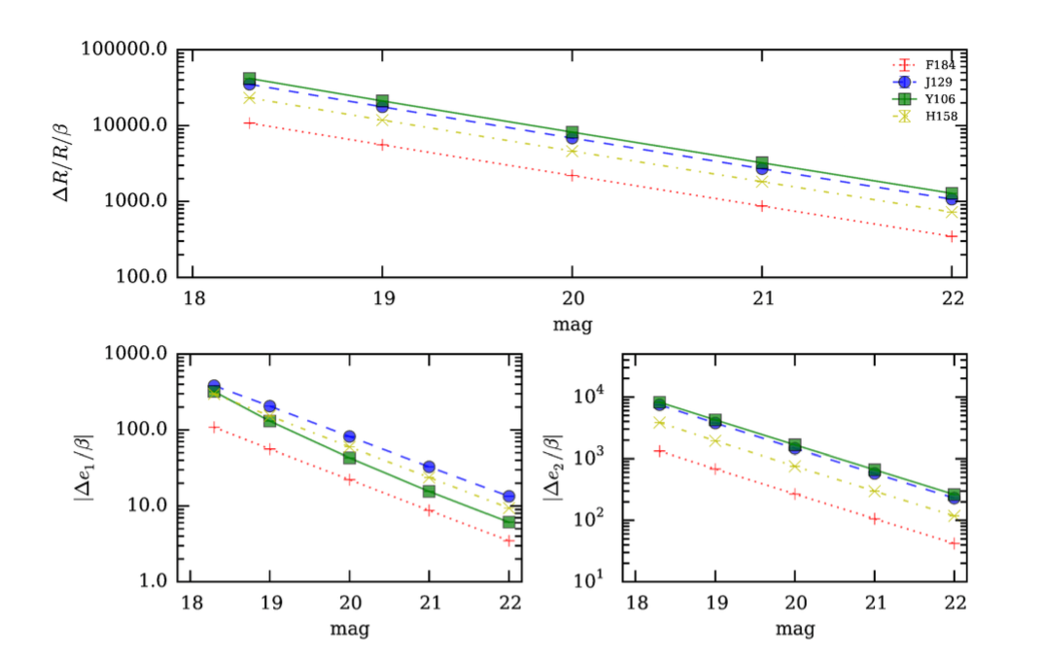
Biases in size and ellipticity after NL calibration
Replacing β with the error Δβ, we can use this plot to convert between star magnitudes, PSF error tolerances, and calibration precision on β (given 2, predict the 3rd one)
For example, to use 18.3 mag stars (H-band) while limiting PSF biases to 10% of WFIRST tolerances, β must be known to
~1% for R
~2.4% for e_{i}
Assumption:
β₀ =5e-7
→ Set requirements on Δβ or set mag cutoffs (or ramp cutoffs if sampling up the ramp)

Slide 13
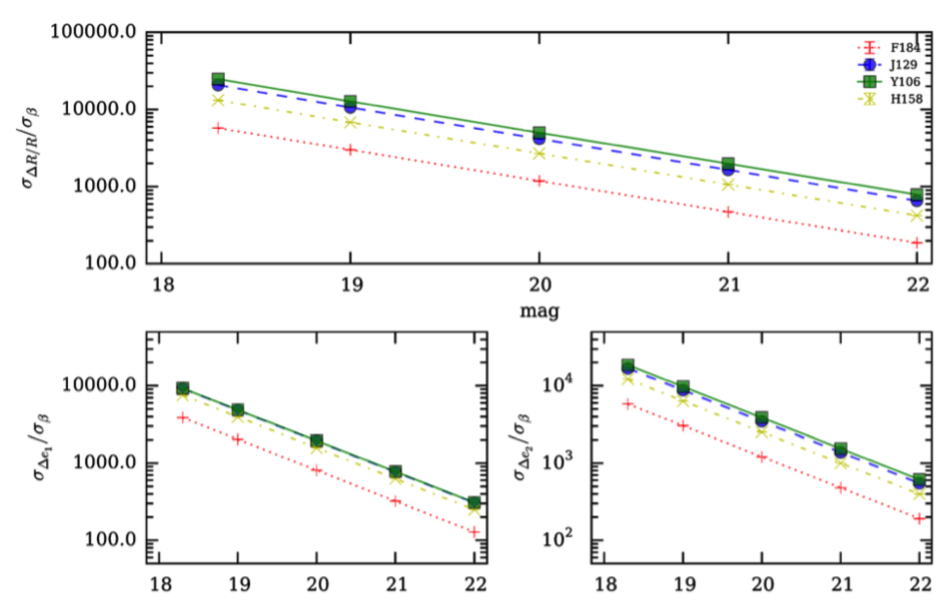
Spatial variability of β
We then assume each pixel has a different β, drawn from a gaussian distribution. We plot stddev of PSF errors vs. stddev of β (M=100 realizations).
→ Set requirements on σ_{β}
Linearity in β allows us to condense information as before.
Bias when NL is uncorrected is insensitive to the nominal β, so σ_{β} can also be interpreted as an error on β estimation

Slide 14
Interpixel Capacitance effects on weak lensing shape measurement
Arun Kannawadi (CMU), Charles Shapiro (JPL), Rachel Mandelbaum (CMU), Chris Hirata (OSU), Jeff Kruk (GSFC) & Jason Rhodes (JPL,Caltech)

Slide 15
Slide stolen from B. Rauscher

Slide 16
IPC effects on shape measurement
Charge collected on a pixel induces voltage change on neighbor pixels; charge does not move
Generally makes the PSF appear larger
Isotropic IPC makes the PSF and galaxies appear rounder
Anisotropic IPC induces spurious ellipticity
IPC correlates shot noise
Correcting IPC at the pixel level correlates read noise
Inter-pixel capacitance (IPC) in CMOS detectors
0.002
0.02
0.002
0.02
0.912
0.02
Detector pixels
0.002
0.02
0.002
Idealized kernel showing fraction of central pixel’s signal shared among neighbors
Notes:
Finish the introduction

Slide 17
Assumed IPC model
3 degrees of freedom motivated from WFC3 measurement
Isotropic nearest neighbors α
Isotropic diagonal neighbors α’
“+” anisotropy α₊
Limitations of the model
Ignoring other possible asymmetries
Ignoring pixels beyond nearest neighbors
Ignoring IPC variations across the detector.
Kernels measured for 3 WFIRST test detectors (WFIRST Project)

Slide 18
PSF simulations with IPC
PSFs in J, H and F bands are simulated using the WFIRST module within GalSim. Assuming IPC is independent of fluence.
PSFs include diffraction spikes and aberrations but not jitter, charge diffusion or other detector effects such as nonlinearity.
To obtain oversampled images, “dithers” with uniform sub-pixel offsets are interleaved after drawing PSFs at native pixel scale (0.11”/px) and convolving with IPC kernel.
PSF shapes are measured using adaptive moments (HSM method). Half-light radius is also measured.
Notes:
Finish the introduction

Slide 19
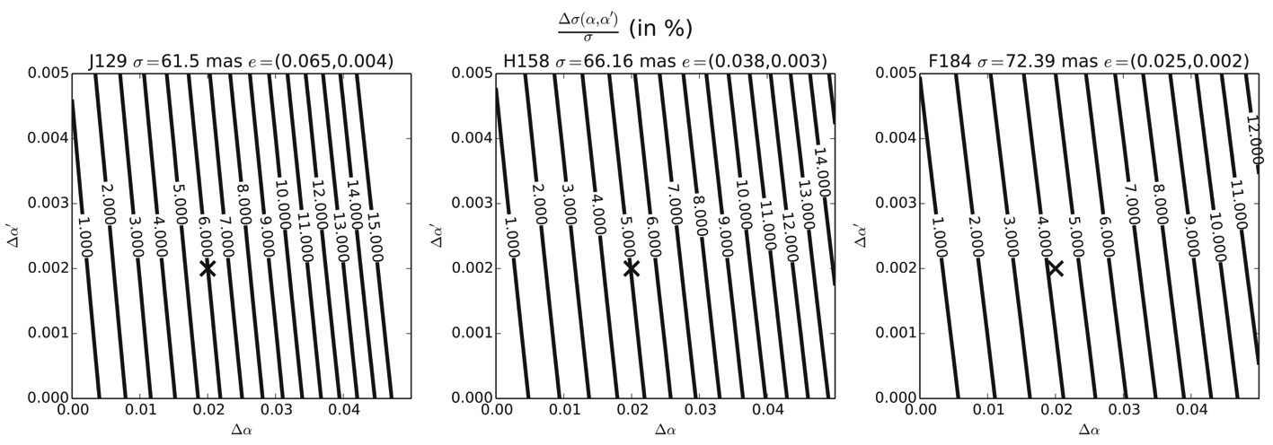
Effect of uncorrected IPC on PSF size
Kannawadi et al.
arXiv:1512.01570
Filter
Size, ellipticity without IPC
X = Nominal IPC values
Worse effect at lower wavelengths as expected
Notes:
Cross are the nominal values. Plot showing increase in PSF sizes. Size defined as determinant of moment matrix.

Slide 20
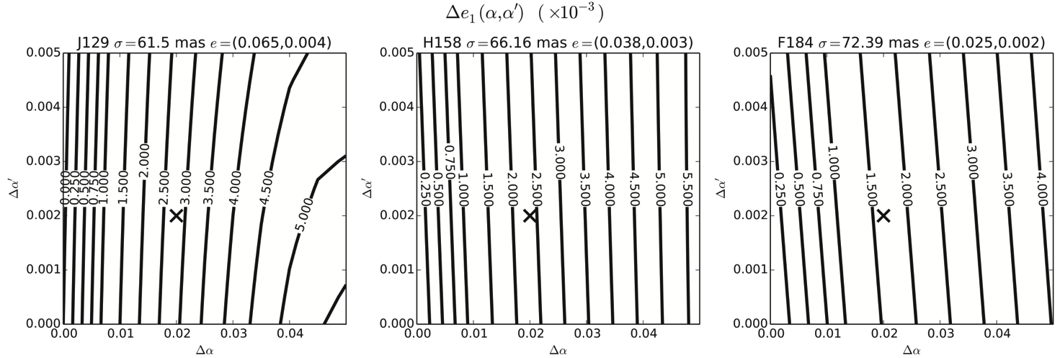
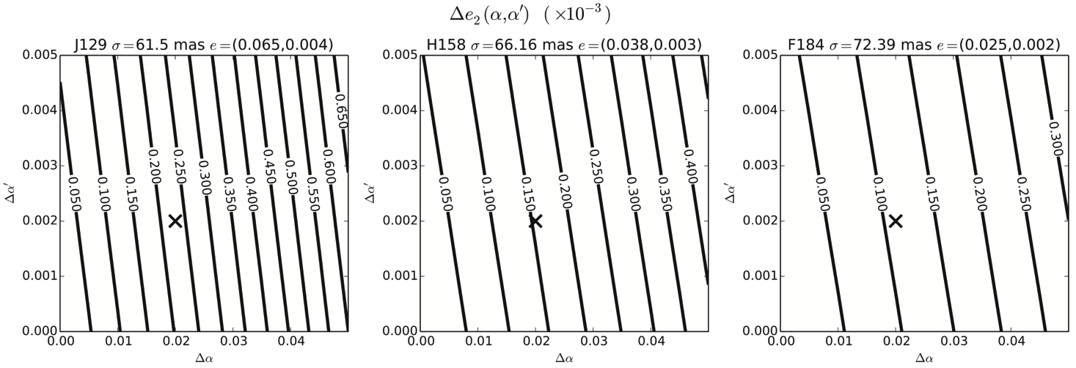
Effect of uncorrected IPC on ellipticity of PSF
Kannawadi et al.
arXiv:1512.01570
Notes:
Change of ellipticity with isotropic IPC coefficients – occurs because PSF is elliptical

Slide 21
Effect of anisotropic IPC on PSF ellipticity
Kannawadi et al.
arXiv:1512.01570
Notes:
Change of ellipticity with the dominant isotropic coefficient and the anisotropic coefficient

Slide 22
Shape measurement error from IPC calibration error
Kannawadi et al. derives fitting formulae for propagating IPC error into shape errors.
EXAMPLE: Suppose the IPC parameters are known to within absolute errors of δα=δα′=δα₊=10⁻⁴. Errors may be due to measurement or spatial variation. Modeling the WFIRST PSF with these errors, the worst PSF shape errors are in the J band: δσ/σ≈6e−4 and δe₁≈4e−4. Comparable to error budget.
In practice, a PSF model will be fit to on-sky measurements, and IPC errors will be absorbed by other parameters in the PSF model.
Ability to calibrate should not be taken for granted

Slide 23
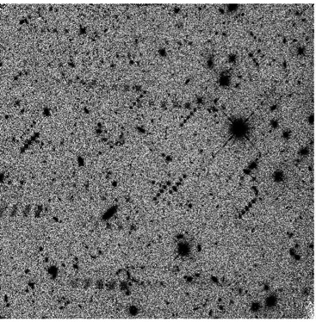
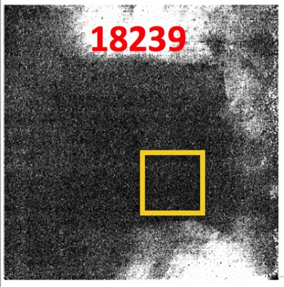
Persistence
Image contaminated by “echo” of previous exposure
Mechanism: charges building up in traps during exposure; released over time (~minutes)
Persistence amplitude and decay time vary by device as well as by pixel, exposure history, temperature, bias voltage, device age?
Difficult to model – may not be subtracted sufficiently for weak lensing. Flag pixels after exposures near full well.
WFC3 image showing persistence
Persistence in 2 WFIRST test devices, 10 min after 100ke- flats.
Scale shows ~ order of magnitude variation

Slide 24
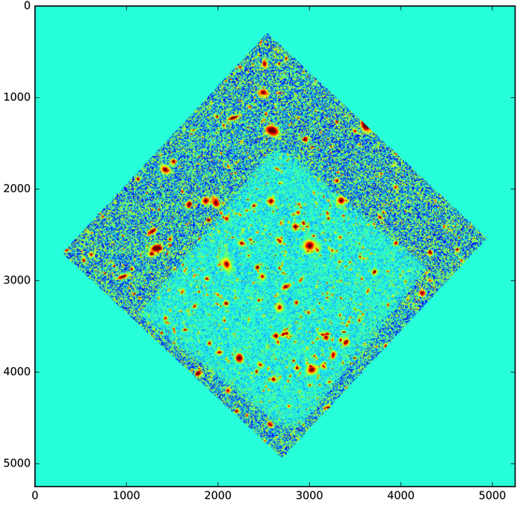
Analysis by Eric Huff (in progress): Treat persistent image as correlated noise
Estimate noise power spectrum P(k) from Hubble Extreme Deep Field (XDF)
Scale P(k) according to WFIRST persistence estimate
Input P(k) to GalSim correlated noise generator and add to simulated galaxies
Drizzled XDF image
Notes:
Drizzled pixels
F out to Nyquist

Slide 25
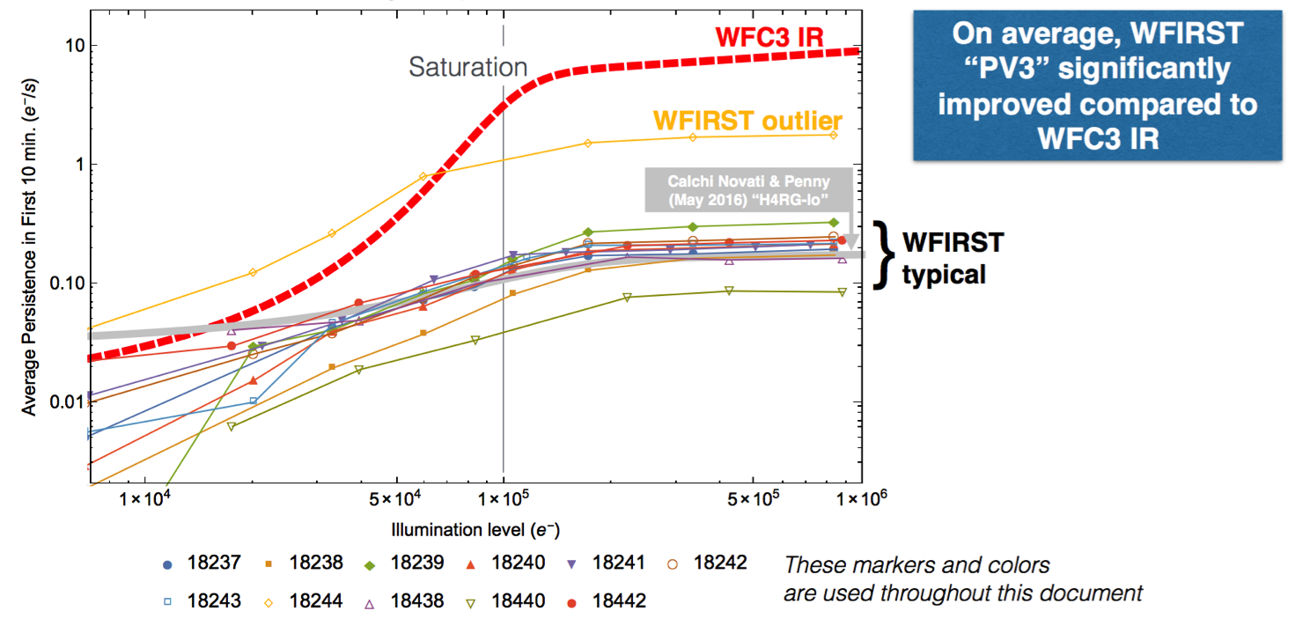
To model persistence, use measurements from WFIRST test devices (slide courtesy GSFC, DCL, B. Rauscher)
For simulations, Huff assumes grey curve (for now)

Slide 26
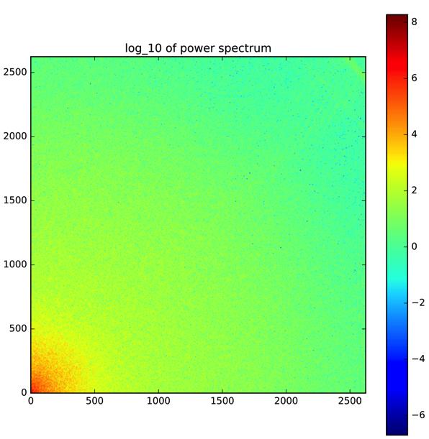
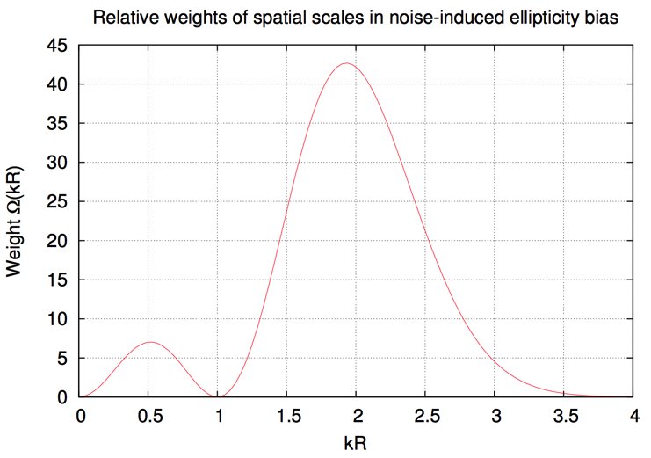
Shape measurement bias comes from scales comparable to galaxy size
C. Hirata:
R = galaxy scale radius; F = total galaxy flux (e-)
Equation based on adaptive moments shape measurement.
P(k) of XDF image
Most of weight function ^

Slide 27
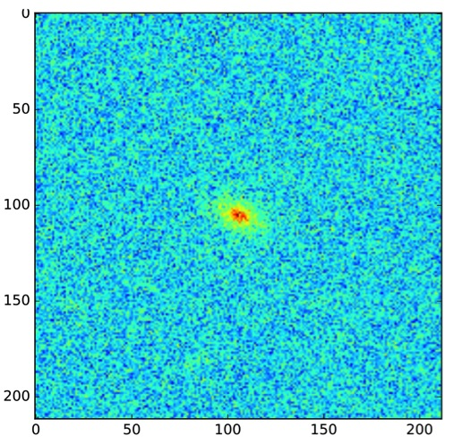
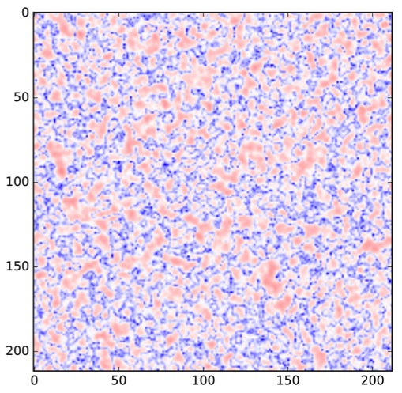
Adding persistence to GalSim images
Galaxy with white noise
Define galaxy profile (Sersic) to have unit flux
Define S/N by amount of white noise added
Scale XDF P(k) so that total variance is (1 galaxy flux)**2. (assumes domination by galaxies). Rescale again by WFIRST persistence model (1000s delay)
Add instance of noise from rescaled P(k)
Measure/compare ellipticities (g1,g2) with total noise to case with white noise only.
Noise from persistence
Notes:
Galaxy – unit total flux
White noise field S/N 25 for galaxy
Galsim takes noise image, measured Pk, generate realizations of noise with that Pk. Took Pk from HST
Take total variance on HST image to be 1 galaxy flux**2. Scale amplitude down by persistence model – Fermi formula (WFIRST wiki).
Add correlated noise to white noise and sample with toy galaxy – Sersic
Shape error measured as difference from white noise only case
Assumes most power in galaxies, but maybe it’s in bright stars.

Slide 28
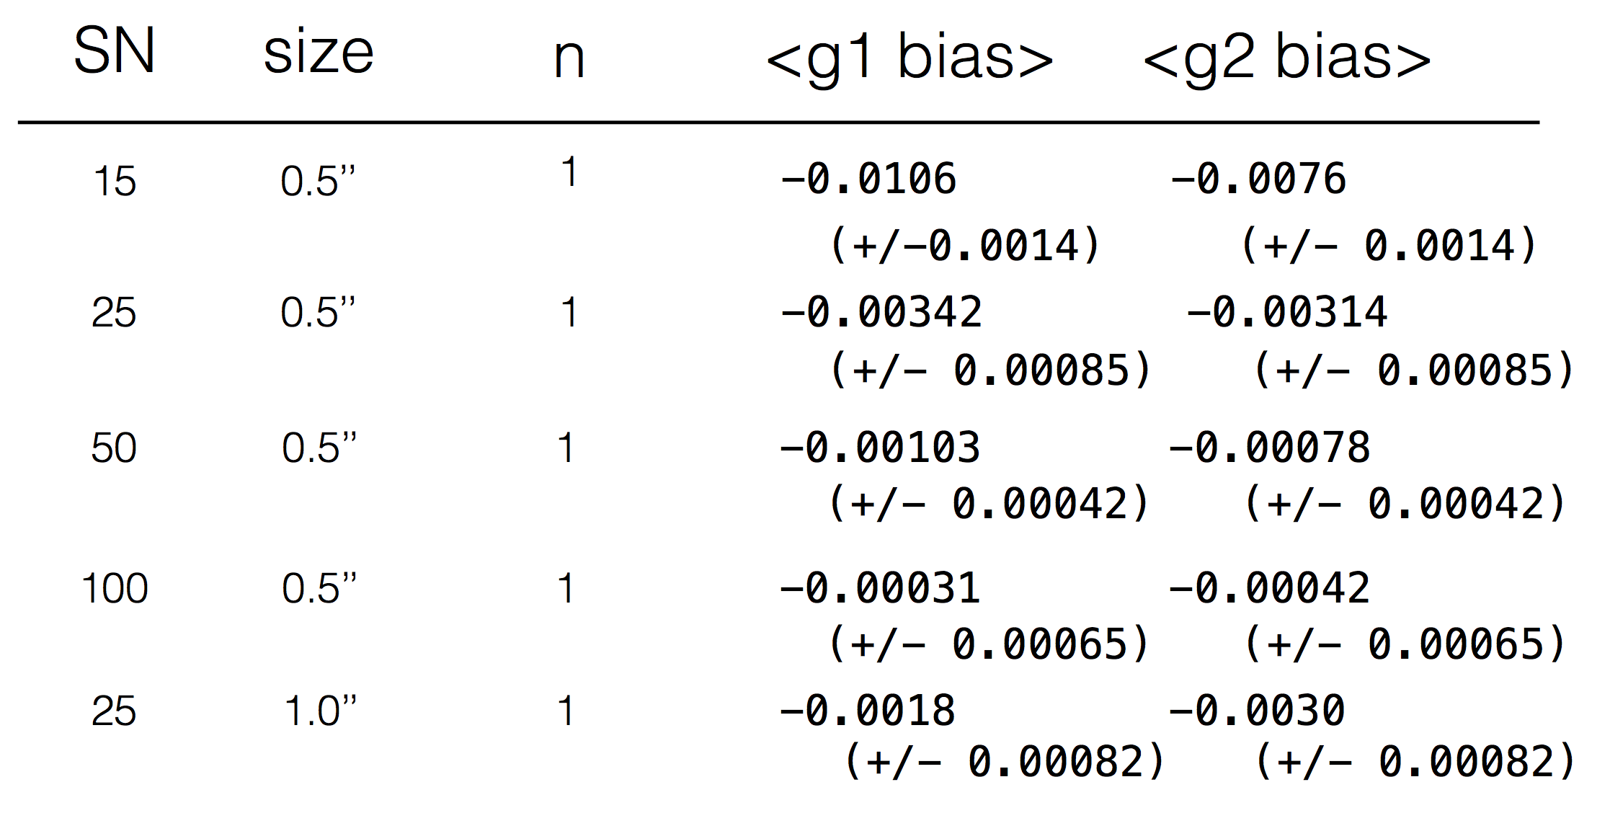
Simulated biases from persistence
PRELIMINARY! Realism still being tweaked, but these are not obviously negligible

