Slide 1
What scares me about weak lensing with NIR detectors
Christopher Hirata
Dec. 1, 2016

Slide 2
Two Key Functions
Expansion rate of the Universe
Growth of perturbations
Notes:
Need slide explaining “growth of structure”

Slide 3
Stage IV Weak Lensing
Weak lensing shear is great!
  Sensitive to both expansion history and growth of structure
  Directly connected to mass distribution
  … but a tiny signal.
3 “flagship” programs for the 2020s – LSST, Euclid, WFIRST
I’ll focus on the WFIRST weak lensing program in this talk:
  in space for stability and to avoid atmospheric effects on PSF
  multiple (~6) passes over the footprint for redundant measurements
  shape measurement in NIR (combined with photo-z imaging)
  will be embedded in LSST footprint

Slide 4
WFIRST Programs
Notional breakdown of observing programs
2.36 m primary mirror
Wide Field Channel:
  18x H4RG detectors
  3x10⁸ pix total
Also: IFC & coronagraph (not this talk)
Launch: mid-2020s
6 year nominal mission
High latitude survey (Science Investigation Team: PI Doré) includes both imaging and grism spectroscopy.

Slide 5
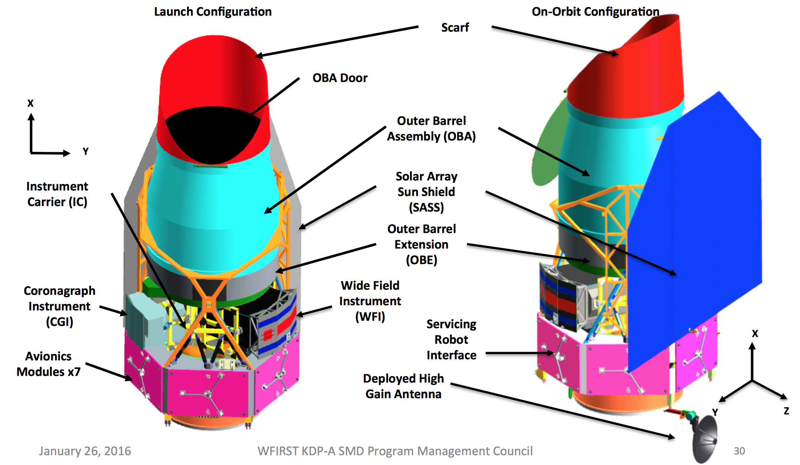
WFIRST Configuration
(WFIRST Project – KDP-A)

Slide 6
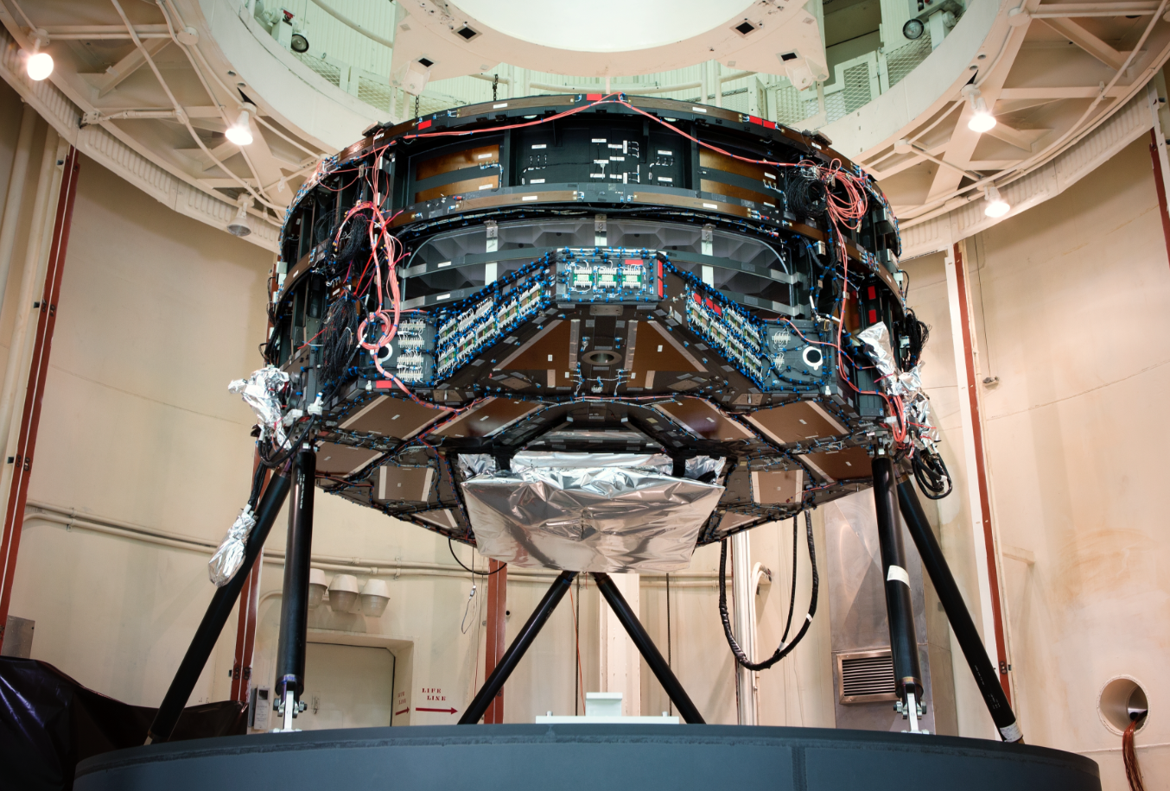
Primary Mirror Assembly
Harris Corporation / TJT Photography

Slide 7
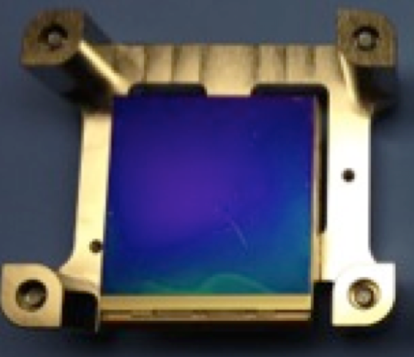
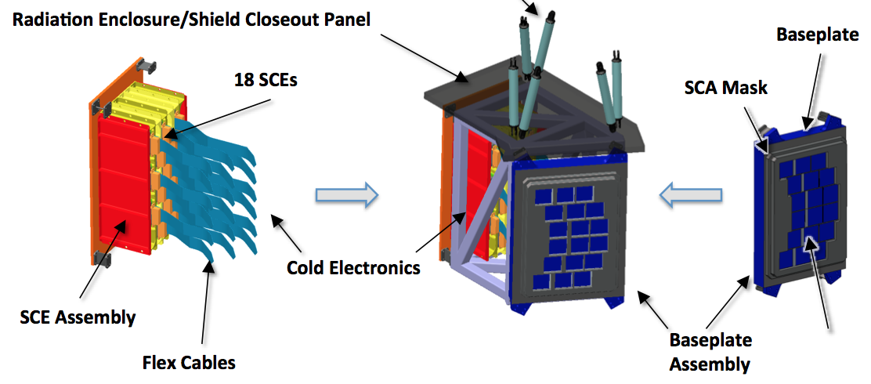
WFIRST Detectors
Sensor Chip Array:
  4k x 4k array of p-n junctions in HgCdTe
  (light sensitive material; band gap tunable, ~2.3 μm cutoff for WFIRST)
  In interconnect to Si readout circuit/multiplexer
Flex cable
Sensor Cold Electronics
  Signal is digitized here
These detectors are not CCDs
  FET on each pixel, charge not transferred, read-out is non-destructive
WFIRST SDT Report 2015

Slide 8
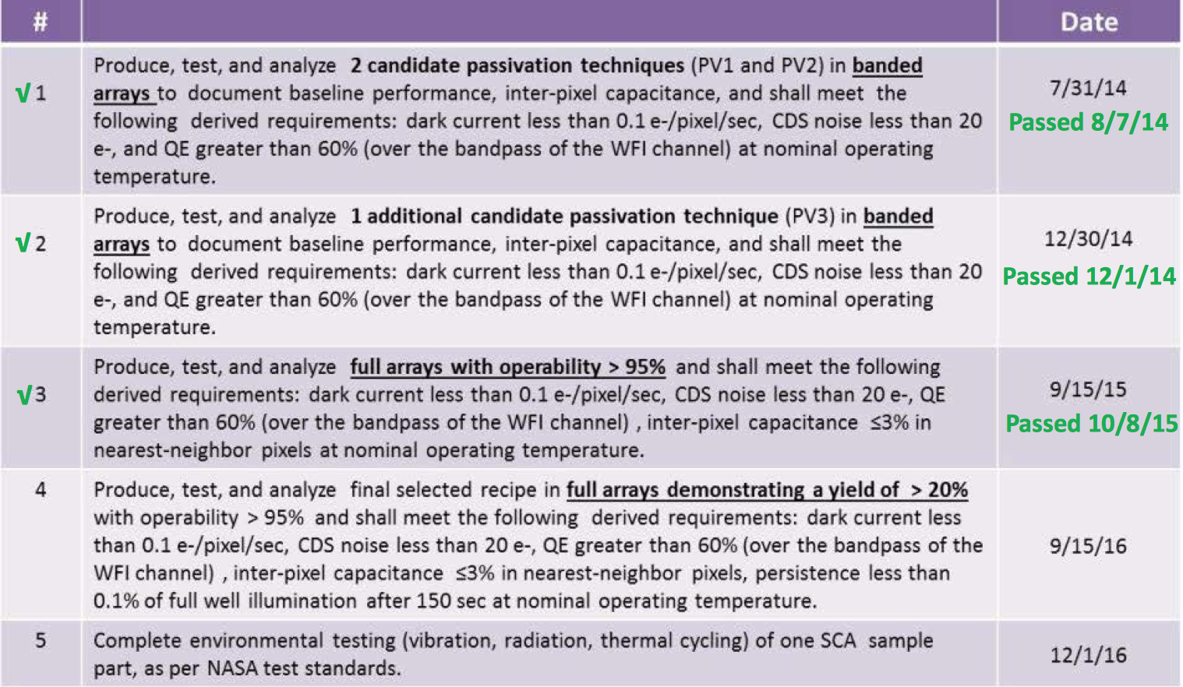
Detector Technology Milestones
Passed 9/22/16
(from the WFIRST NIR Detector Technology Report)

Slide 9
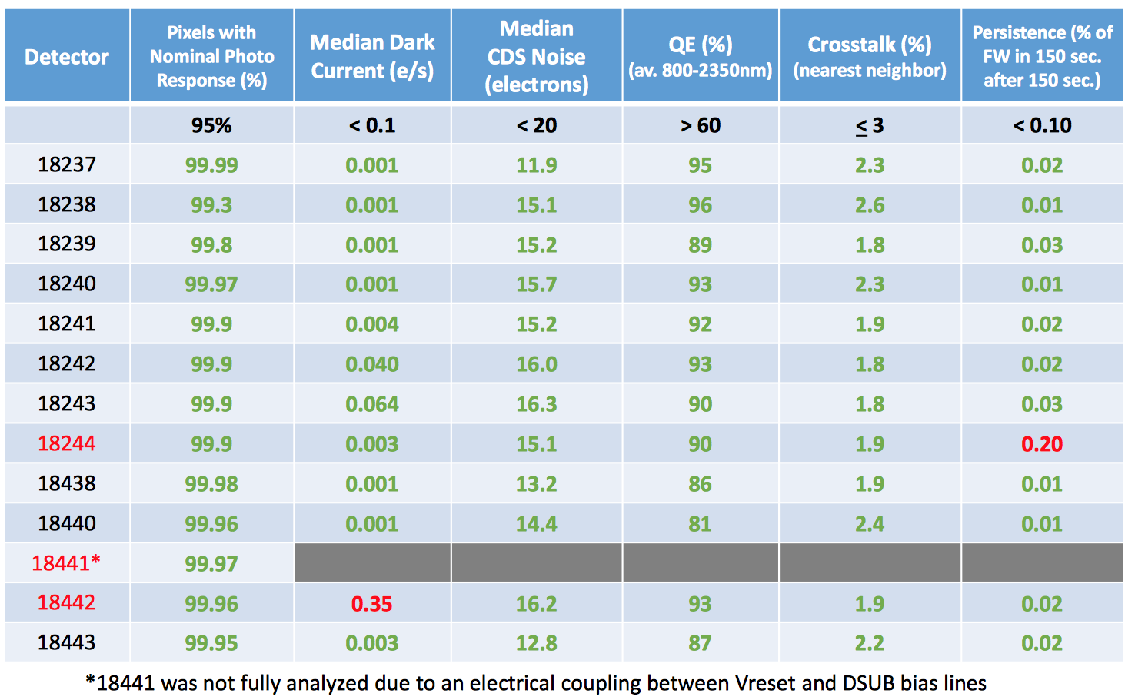
Summary from WFIRST Project NIR Detector Milestone #4 Report

Slide 10
The WFIRST weak lensing program has the raw statistical power to measure σ₈ to ±0.1%. Similar advances will be made on the other parameters relative to current weak lensing programs.
Trying to measure a 1% shear signal to 0.1% accuracy. Reliable results at this level will require 1-2 order of magnitude improvement in systematic error control in shape measurements. Other big WL programs (LSST, Euclid) face similar issues.
Improvements also needed in other areas, e.g. photo-z training → but that’s another talk

Slide 11

The WFIRST weak lensing program has the raw statistical power to measure σ₈ to ±0.1%. Similar advances will be made on the other parameters relative to current weak lensing programs.
Trying to measure a 1% shear signal to 0.1% accuracy. Reliable results at this level will require 1-2 order of magnitude improvement in systematic error control in shape measurements. Other big WL programs (LSST, Euclid) face similar issues.
Improvements also needed in other areas, e.g. photo-z training → but that’s another talk
Systematic Errors

Slide 12
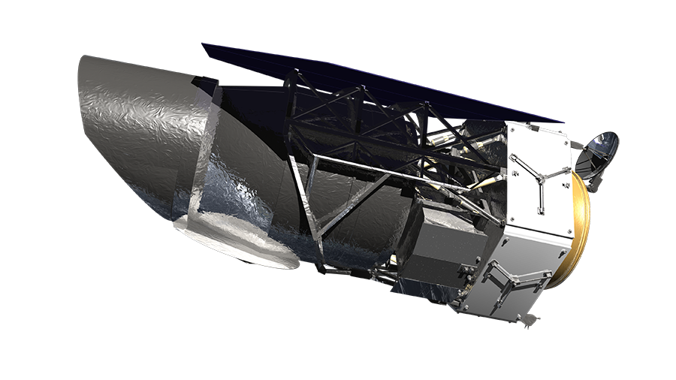
The Major Systematic Errors
Intervening matter:
Nonlinear power spectrum?
Baryonic corrections?
Higher-order lensing corrections?
Source galaxies:
Redshifts?
Intrinsic alignments?
Telescope/instrument:
Point spread function?
Flats, astrometry … ?
Detector non-idealities?
Data analysis:
Image processing algorithms?
Source selection?
Shape measurement?

Slide 13
We are sensitive to very small signals!
Trying to measure a 1% signal to 0.1% accuracy.
“Stage IV” additive systematic error requirement = 0.0003 in shear
e.g. for WFIRST:
  “Typical” galaxy radius = 1.8 pixels
  1 pixel = 10 μm
  Change in radius = 1.8 x 0.0003 x 10 μm = 54 Å
  … or the size of ~8 lattice cubes in HgCdTe!
a = 6.5 Å

Slide 14
Layers of Systematic Control
LAYER | PROCESS
1 | Eliminate the physics causing the effect (but not always possible).
2 | Develop a first-principles model (but again, not always possible).
3 | Develop an empirical model based on stars or external calibration data (may capture multiple pieces of physics simultaneously).
4 | Mask affected data (if a small number of pixels are affected, e.g. persistence, cosmic rays …).
5 | Statistical corrections based on science galaxies (e.g. de-trending with respect to position on focal plane).
6 | Cross-correlations of successive passes over the sky at different roll angles (tile 2x per filter, 3 shape measurement filters).
Different effects may be more amenable to mitigation at different layers.
Want to avoid premature reliance on layers 5 and (especially) 6 – these are there if 1—4 are not sufficient, or when (not if) unexpected problems arise.

Slide 15
Some considerations
Read-out architecture different from CCDs:
  Every pixel is (potentially) special, including its own amplifier!
    Compare to SDSS (my WL experience) – drift scan, many quantities inherently 1D
    “Point and stare” CCD – 2D array but only a few amplifiers
  Multiple reads
    WFIRST can download ~6 linear combinations per pixel per exposure
Very sensitive to environmental perturbations (e.g. thermal)
Charge traps!
  symptoms such as persistence, reciprocity failure, …
Some CCD “problems” not present
  Most notably charge transfer inefficiency
(Maybe the biggest worry?) New detectors → probably many surprises in the future!

Slide 16
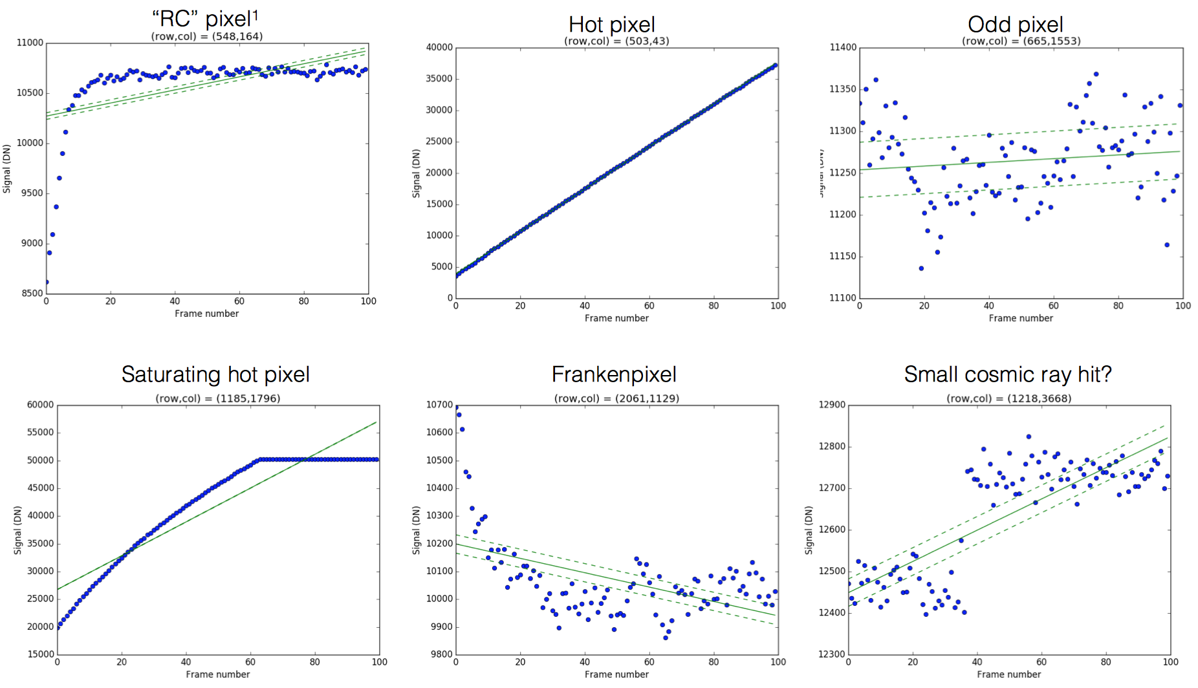
Weird Pixels
(chart from Bernie Rauscher – these are from H4RG detectors)
Would not use these for science, but need to be careful as masking can itself introduce biases!

Slide 17
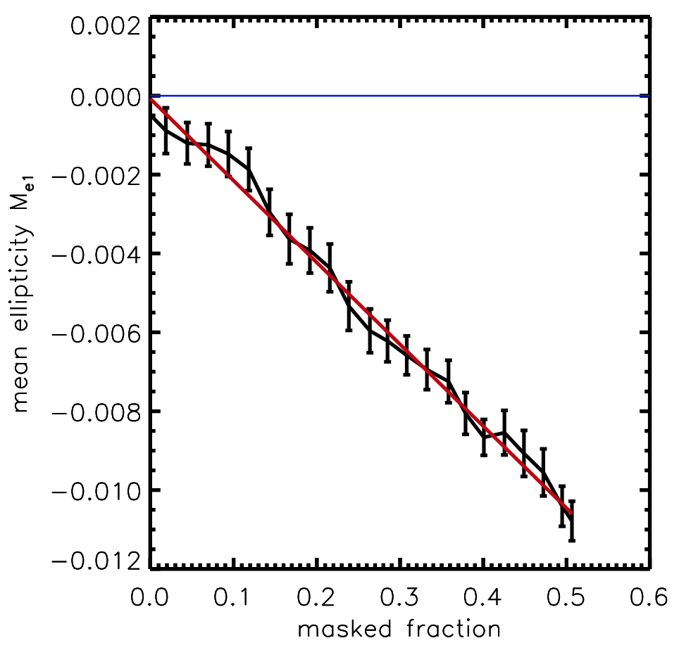
Masking bias in SDSS simulations
This was for masking bad columns in a Sloan CCD.
Masking patterns for weird pixels likely not so severe …
but requirements are much tighter!
Huff et al. (2014)

Slide 18
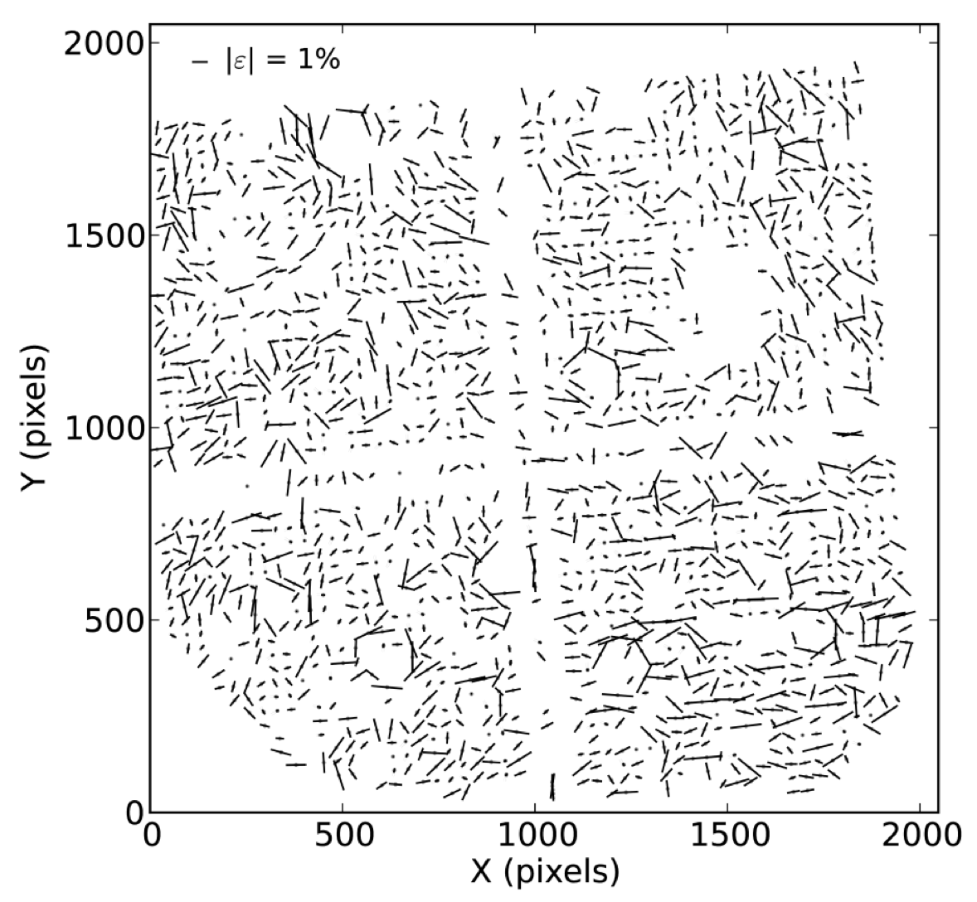
Contributions to image ellipticity
Whisker diagram for H2RG at Caltech Precision Projector Lab
(Seshadri et al. 2013)
Correlated structure is present

Slide 19
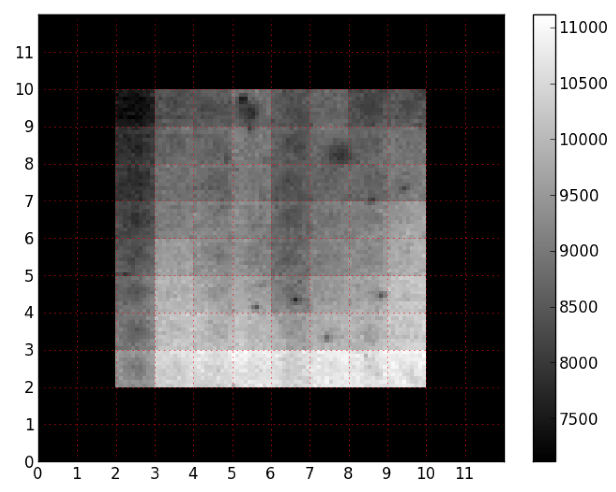
Individual Pixel Response Functions
Stars are bright, galaxies are faint
Stars have high S/N per pixel
  Pixel response functions differ from one pixel to another
    QE, area, centroids, shapes, higher moments
  Not visible in individual galaxies (at S/N=10 per image, care most about mean behavior on >1 arcmin scales)
  … but a big deal for PSF stars as we may be interpolating based on ~1000 stars each at S/N~100
    This is where the tightest requirements on high spatial frequency flats, etc. will come from on WFIRST!
Hardy et al. (2014)
SPIE 9154, 9154D-12
H1RG, 5μm cutoff

Slide 20
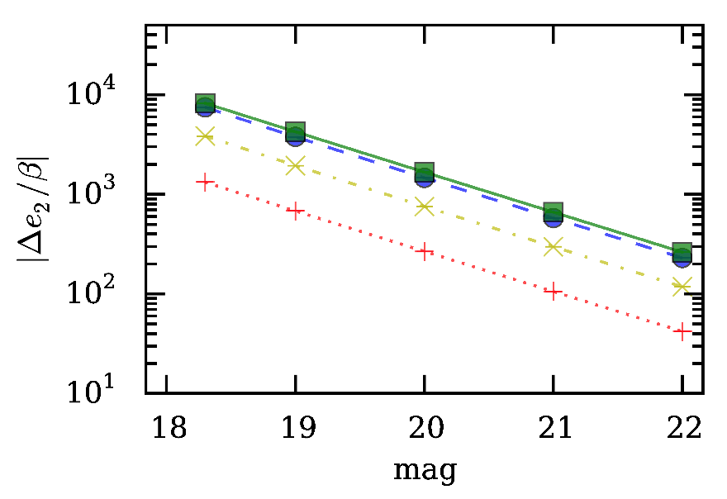

Nonlinearity effect on stars
Non-linearity both:
Changes the PSF size
→ multiplicative shear error
Couples to aberrations to modify PSF ellipticity
additive shear error
A. Plazas Malagón et al. (2016)
“Nominal”

Slide 21
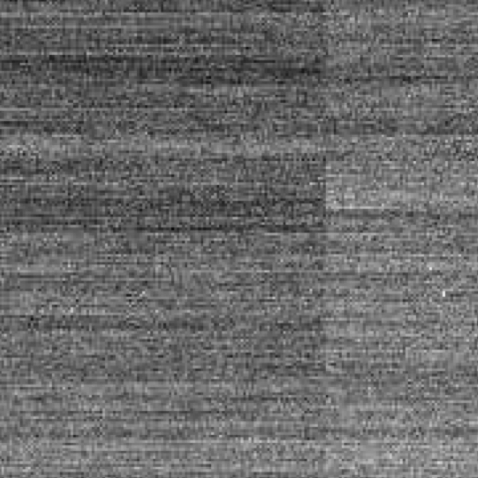
Correlated Noise
Noise correlations imprinted at multiple stages in the readout chain
Anisotropic correlations have the same symmetry as shear and are of concern for weak lensing.
We don’t have data yet for WFIRST detectors with flight-like electronics.
Rauscher (2015) PASP 127:1144

Slide 22
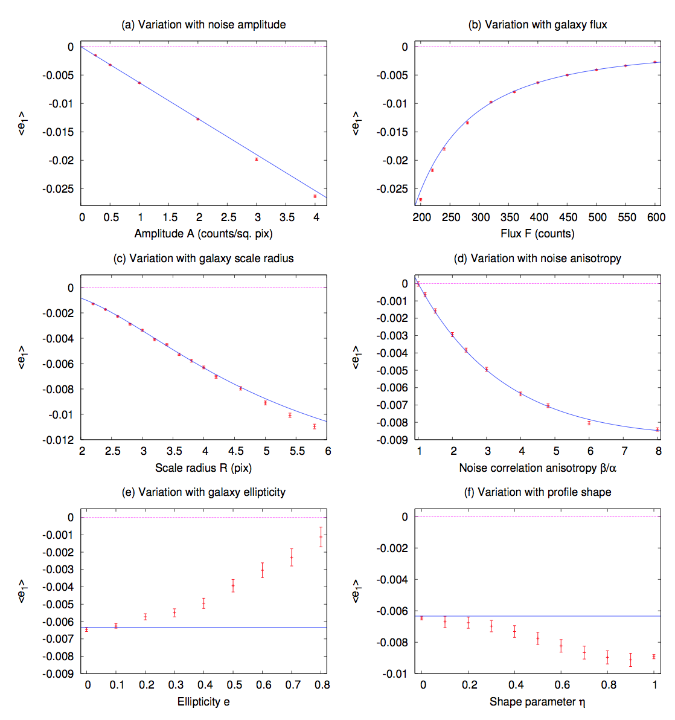
Semi-analytic model for the effects of correlated noise on shape measurement
We are using these models to set requirements on the knowledge of the noise correlation structure
blue = semi-analyic model
red = simulation

Slide 23
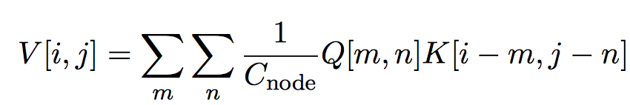
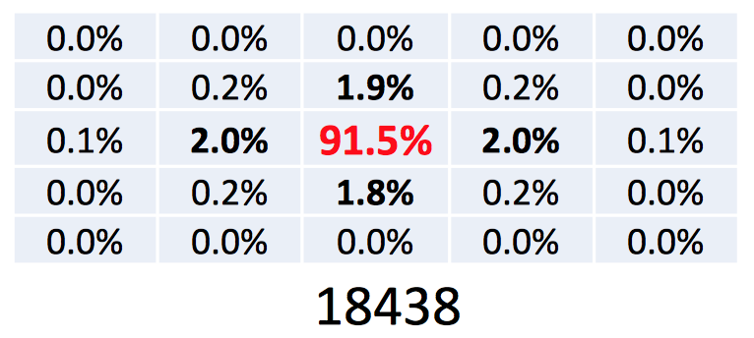
Inter-pixel capacitance (IPC)
Capacitive coupling between neighboring pixels, since in NIR detectors the pixels are read out in place.
Part of the effective PSF for signal, but not for noise.
For WFIRST, will have to know the IPC to 0.01% on scales down to ~500 pixels
  or absorb any errors at this level into ePSF model
Q₁
Q₂
Q₃
K = IPC kernel
See e.g. Kannawadi et al. (2016)
H4RG data from WFIRST Project Technology Report #4

Slide 24
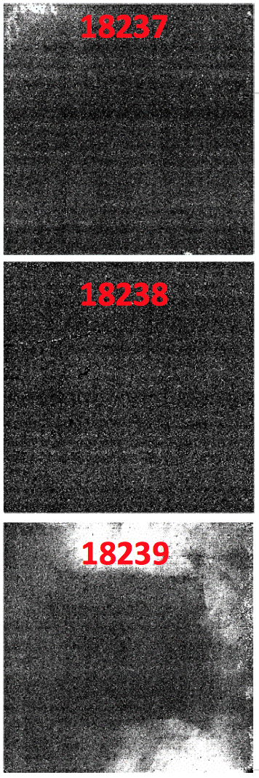
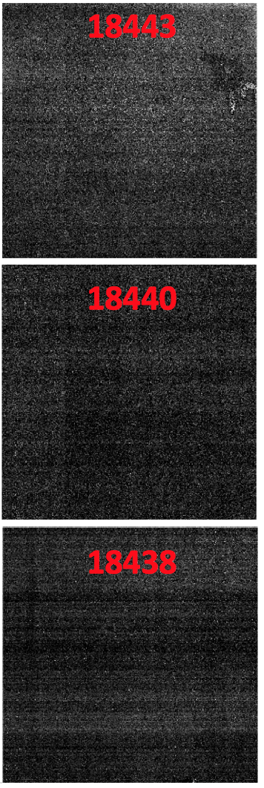
Persistence
Pixels in NIR detectors show excess current following exposure to a bright source.
Small effect as a fraction of stimulus, (in modern detectors) but of concern due to:
  High precision demanded of WFIRST
  Large dynamic range between science targets (galaxies) and bright stars
What effect on weak lensing?
  Approach thus far – treat unmasked persistence as a correlated noise field.
H4RG data from WFIRST Project Technology Report #4
Linear scale: 0 to 0.1% of full well from t = 150-300 s after 8xFW illumination

Slide 25
Persistence from Slews
No cold shutter in WFIRST, so detectors see a “streak” from every bright star during slews.
  Mask the worst stars (baseline: <9th mag) and accept remaining contamination
Semi-analytic estimates of the effect were completed this fall
  “Low” and “high” roughly correspond to regions seen on previous slide.
  Next steps are to optimize masking algorithms and insert slew persistence into pixel-level simulations.
Low model
High model
ACS error (arcsec rms per axis) | Masked pixel fraction | Systematic shear per component | Masked pixel fraction | Systematic shear per component
1.0 | 0.16% | 3.4E-5 | 0.68% | 8.6E-5
2.0 | 0.32% | 3.4E-5 | 1.31% | 8.6E-5
4.0 | 0.62% | 3.4E-5 | 2.58% | 8.6E-5

Slide 26
Summary
A weak lensing experiment is going to be very challenging, even from space.
  If history is a guide, that includes some systematics we haven’t considered yet.
  After you get rid of the atmosphere, the detectors are perhaps the scariest part of the problem.
Much recent progress on WFIRST detector development and characterization.
  More to come; the formulation science team received its first H4RG test data this year.
  Detector characterization plans and calibration plan are being formulated now – decisions made in the next 1—2 years will be critical.

