Slide 1
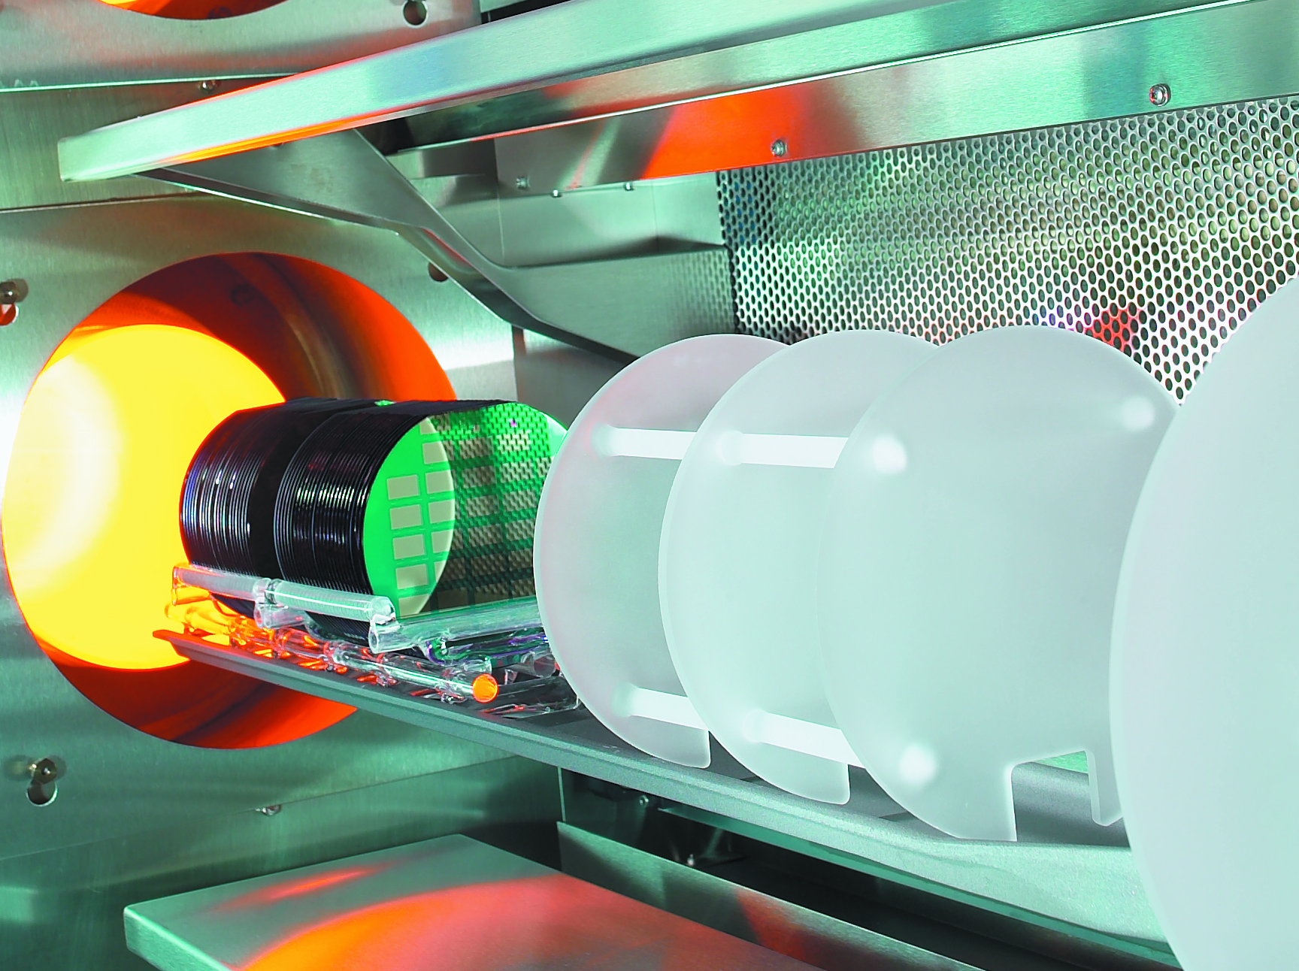
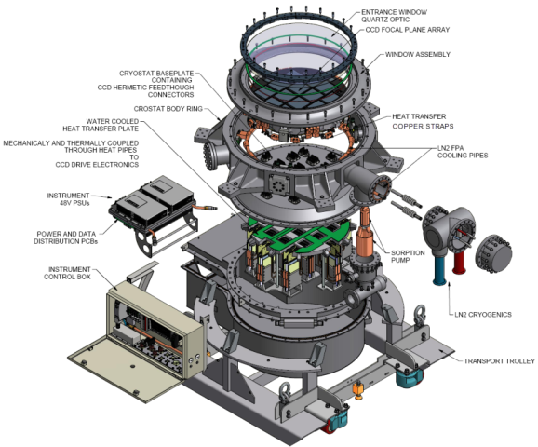
e2v CMOS (and CCD) sensors
(and systems) for astronomy
Paul Jorden
BNL PACCD2016 1 Dec 2016

Slide 2
Contents-1
E2v manufactures silicon sensors and systems for ground-based astronomy and space use
e2v designs and manufactures an increasing suite of CMOS imagers for high performance use
CMOS Sensors achieve maturity
  Custom Backthinned CMOS sensors for ground-based astronomy
  Custom CMOS sensors for space use
  Standard CMOS sensors
  CMOS developments
EM CCDs
  Standard L3Vision sensors
  Custom sensors for astronomy & science
Precision System assemblies
  The WUVS space sensor system
  KMTNet focal planes
  The J-PAS OAJ Cryocam system
Summary

Slide 3
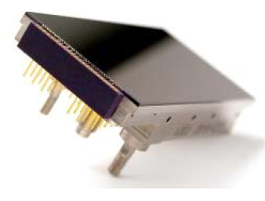
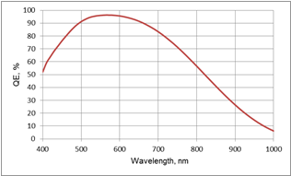
CMOS detectors-1
CIS113
Number of pixels | 1920 (H) × 4608 (V)
Pixel size | 16.0 µm square
Image area | 73.73m × 30.72 mm
Output ports | 8 (REF and SIG each)
Package size | 82.39 mm × 31.7 mm
Package format | 76 pin ceramic PGA attached to invar block
Focal plane height | 14.0 mm
Flatness | < 30 µm (peak - valley)
Conversion gain | 75 µV/e⁻
Readout noise | 3 e⁻ at 2 MP/s per ch.
Maximum pixel rate | 2 MP/s per channel
Maximum charge | 22,000 e⁻ per pixel
Dark signal | 70 e⁻/pixel/s (at 21 °C)
Frame rate | 2 fps (full frame mode) 20 fps (multiple ROI’s)
Developed for the TAOS-II project.
Development complete; production in progress; 10 delivered; full set of 40 due for completion by Jan 2017
Paper by Jérôme Pratlong, 9915, Tues am, S8

Slide 4
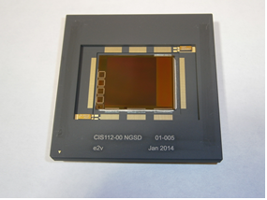
CMOS detectors-2
CIS112 (NGSD)
Number of pixels | 880 X 840
Pixel size | 24.0 µm square
Image area | 21.12 mm × 20.16 mm
Output | Digital; multiple parallel ADCs
Package format | Ceramic PGA
Readout noise | < 3 e⁻
Variants | > 85% at 589 nm
Maximum charge per pixel | 4,000 e⁻
Frame rate | > 700 fps
Developed for Adaptive Optics on large telescopes.
High frame rate and very low noise
Backthinned and red sensitive
Precursor of 1600 X 1600 sensor
See paper by Mark Downing, 9915, Tues am, S8

Slide 5
CMOS detectors-3
  Onyx EV76C664
Key Features
Standard product with low noise
Fully digital sensor with multiple modes
Frontside illuminated with micro-lens
Number of pixels | 1280 X 1024 (1.3 Megapixel)
Pixel size | 10.0 µm square
Shutter modes | Global and Rolling
Output | 8, 10, 12, 14 bit LVDS
Package format | Ceramic 67-pin PGA
Readout noise | 6 e⁻ (min, depending on mode)
Quantum Efficiency | Monochrome or sparse colour (with microlens)
Maximum charge | 16,000 e⁻ per pixel
See e2v.com for datasheet

Slide 6
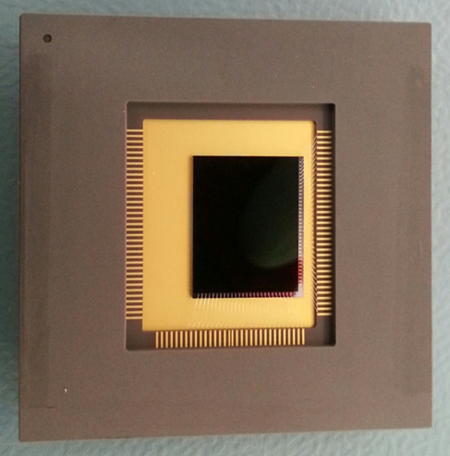
CMOS detectors-4
  CIS115
Number of pixels | 1504(H) × 2000(V)
Pixel size | 7.0 µm square
Number of output ports (reset and signal pins) | 4 pairs of analogue outputs
Package size | 48.26 mm square
Package format | 140 pin ceramic PGA
Flatness | < 10 µm (peak to valley)
Conversion gain | 35 µV/e⁻
Readout noise | 7 e⁻ (Rolling shutter)
Maximum pixel data rate | 8 MP/s per channel
Maximum charge per pixel | 55,000 e⁻
Frame rate | Up to 10 Hz
Minimum time to read one line at 6·2 MP/s | 66.25 µs
Frame rate at full resolution | Up to 7.5 fps
Backthinned sensor with low read-noise
Designed for space applications
Planned for JANUS (Juice) ESA mission
Being qualified for space use by end-2016
Samples available; FMs to follow

Slide 7
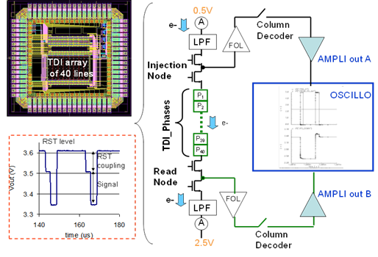
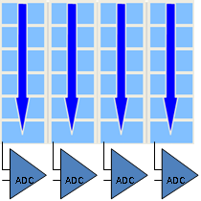
CMOS detectors-5
TDI CMOS development
Time-Delay-Integrate used for scanning space applications; eg GAIA uses TDI CCDs
TDI CMOS offers digital architecture & low power
Most promising technique is a CCD-like structure-
Charge summation along track
Good CTE after irradiation is important
Small test devices made & tested
Full sized device planned
See paper by F Mayer, IISW 2015 on e2v.com

Slide 8
CMOS detectors-6
CIS111 (MTG FCI)
Example of imager used for earth observation-
Offers higher frame rate and lower crosstalk than an equivalent CCD
CIS111 to be used on Meteosat Third Generation Flexible Combined Imager
5 independent imager blocks with in-package filters
Rhombus shaped pixels in outer blocks
Optimised for good transfer through large pixels and low lag
CIS111 architecture

Slide 9
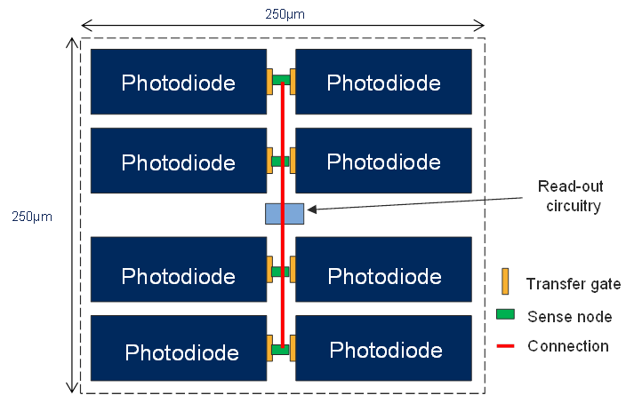
CMOS detectors-7
CIS116 (Metimage)
Custom test vehicle with 250 um square pixels
Each pixel has 8 photodiodes with a common sense node
Aims to optimise lag and Charge-Voltage-Factor
2.5 Me- peak signal; 84 dB dynamic range
Designed for backthinning
Test devices have been characterised
CIS116 pixels

Slide 10
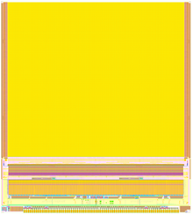
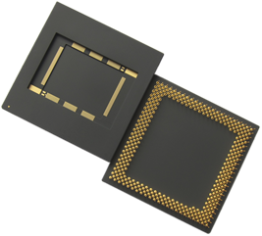
CMOS detectors-8
CIS120
Easy to use general purpose imager for space
Number of pixels: | 2048(H) × 2048(V)
Pixel size: | 10.0 µm square
Package format: | Ceramic-PGA or 3-side buttable option
Maximum charge per pixel: | 50,000 e⁻
Readout noise: | 4 e⁻ (Rolling shutter)
Conversion gain: | 45 µV/e⁻
Back-thinned QE: | 90% at 550 nm
Frame rate: | 30 fps @ 8 bit resolution
Power consumption: | 350 mV (full LVDS)
4 LVDS outputs | 8, 10, 12, 14 bits ADC
Rolling and global shutter; SPI programmable configuration
Digital outputs. Designed to be radiation tolerant
Front-illuminated samples due for test- Mar 2017
Back-illuminated samples due for test- 4Q 2017
Layout plot
Package example

Slide 11

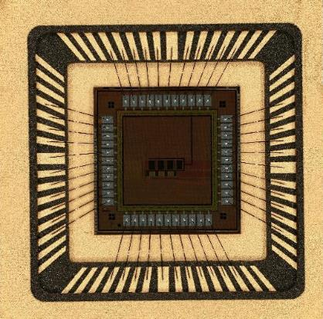
Fully Depleted, Monolithic PPD CMOS Image Sensor Using Reverse Substrate Bias
CMOS detectors-9 …
Konstantin Stefanov
Centre for Electronic Imaging (CEI)

Slide 12
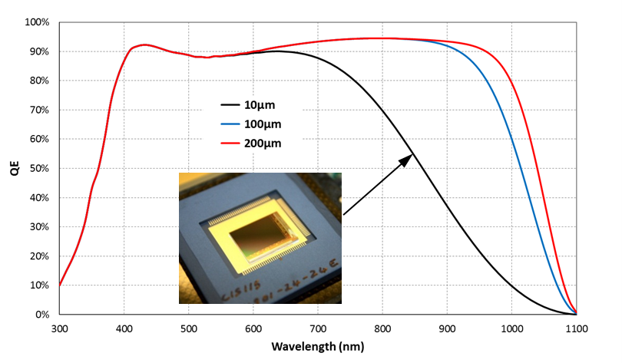
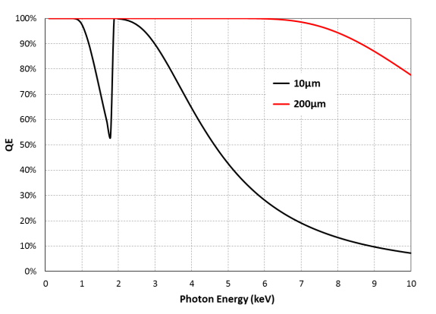
Background
Demand for thick (>100 µm), fully depleted CMOS sensors for high QE
Near-IR imaging for astronomy, Earth observation, hyperspectral imaging, high speed imaging, spectroscopy, microscopy and surveillance.
Soft X-ray (<10 keV) imaging at synchrotron light sources and free electron lasers requires substrate thickness >200 µm
Low voltage CMOS sensors normally have small depletion depths
e2v CIS115

Slide 13
Reverse biasing PPD pixels
P-wells
If reverse bias V_{reverse} is applied:
  p+/p/p+ resistor is formed, leakage current flows
  This has to be eliminated for a practical device
Pinch-off under the p-wells is needed at all times (merged depletion regions) to prevent leakage
The pinch-off condition depends on:
  Doping and junction depth
  Photodiode and p-well sizes
  Bias voltages
  Stored signal charge
P-wells should be narrow and shallow
Photodiodes should be deep
+Bias
+Bias
+Bias
Diode
Pinch-off
P-type epi/bulk Si
Backside p+ implant
–V_{reverse}

Slide 14
Substrate current suppression
If the p-wells are deep (as they are usually), pinch-off may not occur
The p-well should be made to be as narrow as possible, but this is not sufficient
The CMOS structure makes pinch-off harder to achieve than “high rho” CCDs
Additional n-type implant added:
  Under the p-wells
  Floating
  Not connected to anything
  Called Deep Depletion Extension (DDE)
Patent pending (owned by e2v Technologies)
Can be applied to any existing design
Simplified PPD pixel structure
Diode
p-well
Diode
p-well
Diode
Additional implants

Slide 15
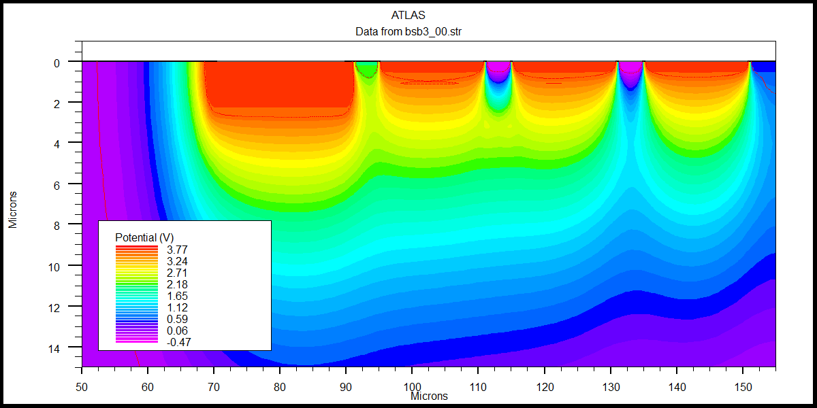
Potentials
Guard ring
p-well
Diode
p-well
Diode
p-well
Diode
DDE Implant
No implant
The DDE implant extends the diode depletion sideways under the p-wells

Slide 16
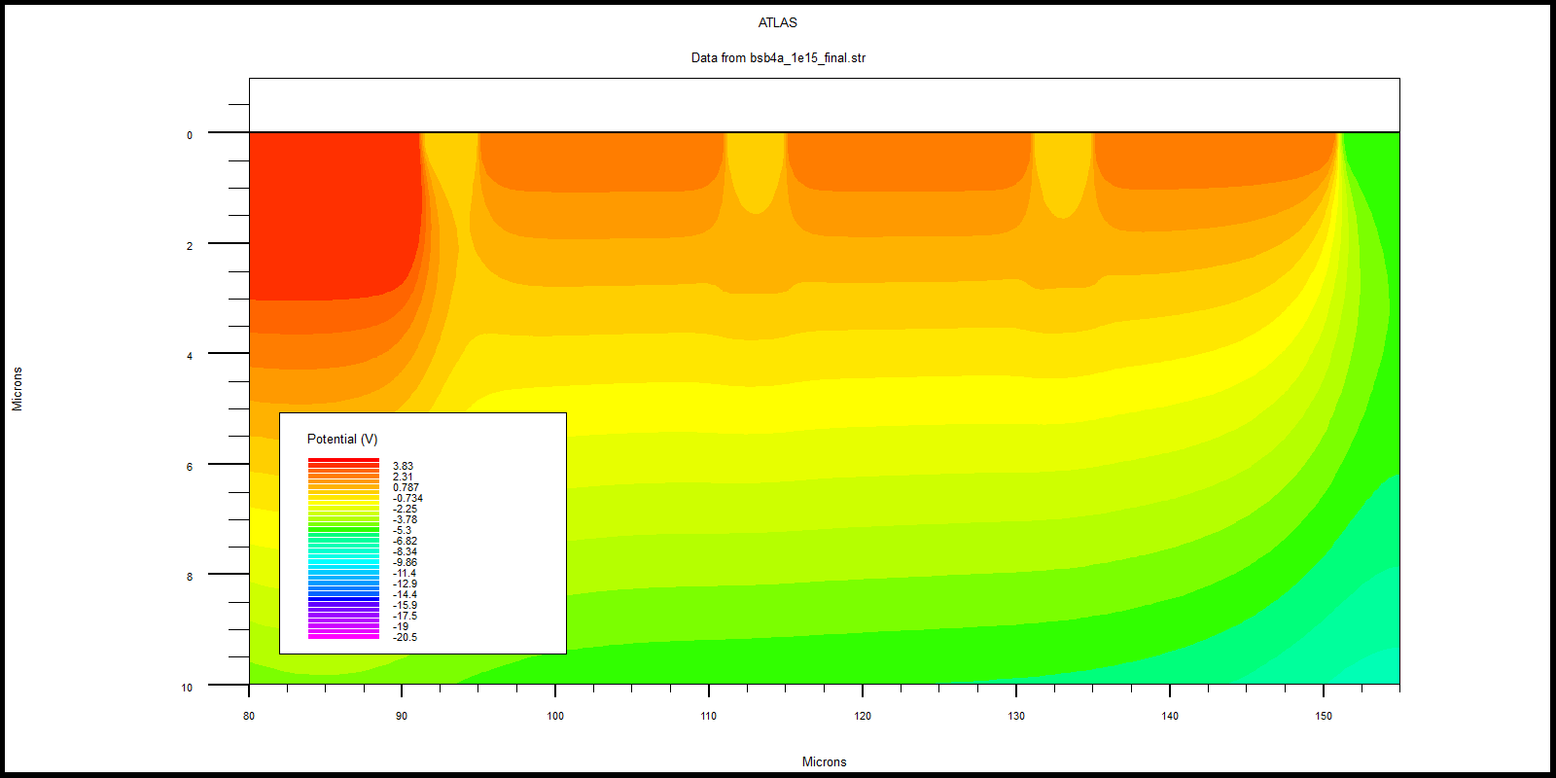
Potential profiles
Potential barrier along the cutline
  Barrier height ~1 V.
Incoming charge is re-directed either left or right
DDE implant is optimised:
  Low doping – doesn’t achieve pinch-off
  High doping – creates a potential pocket

Slide 17
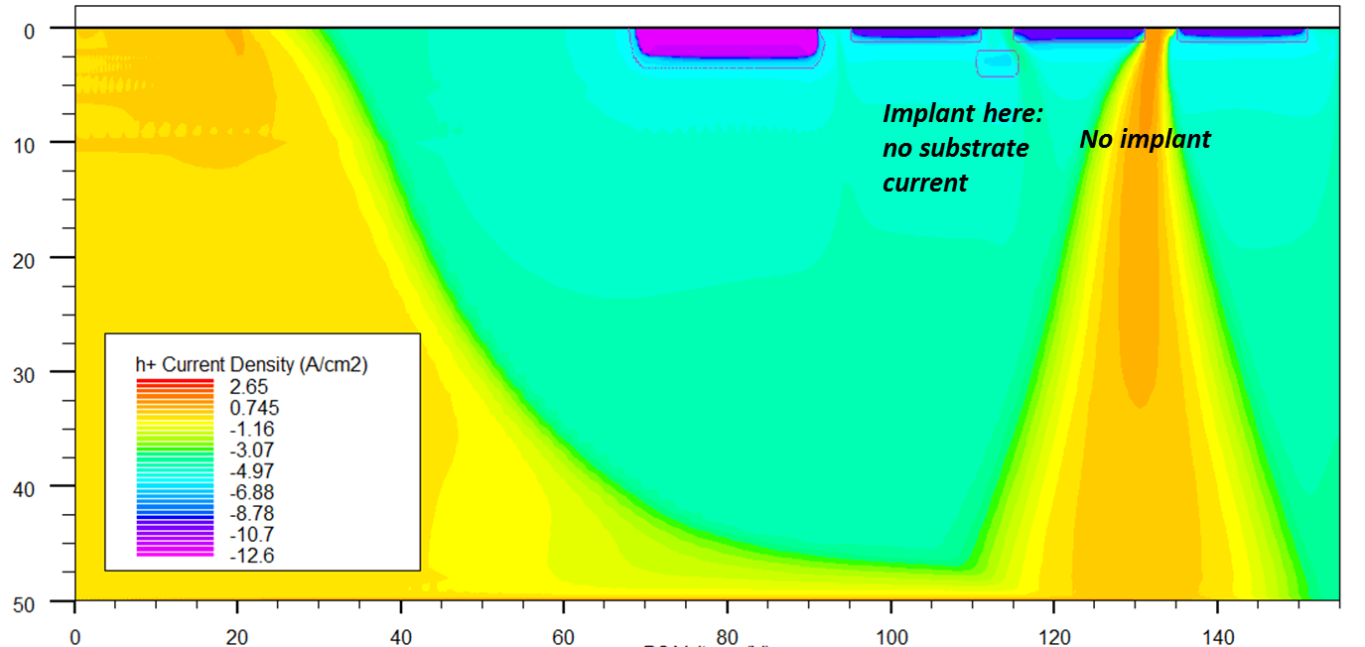
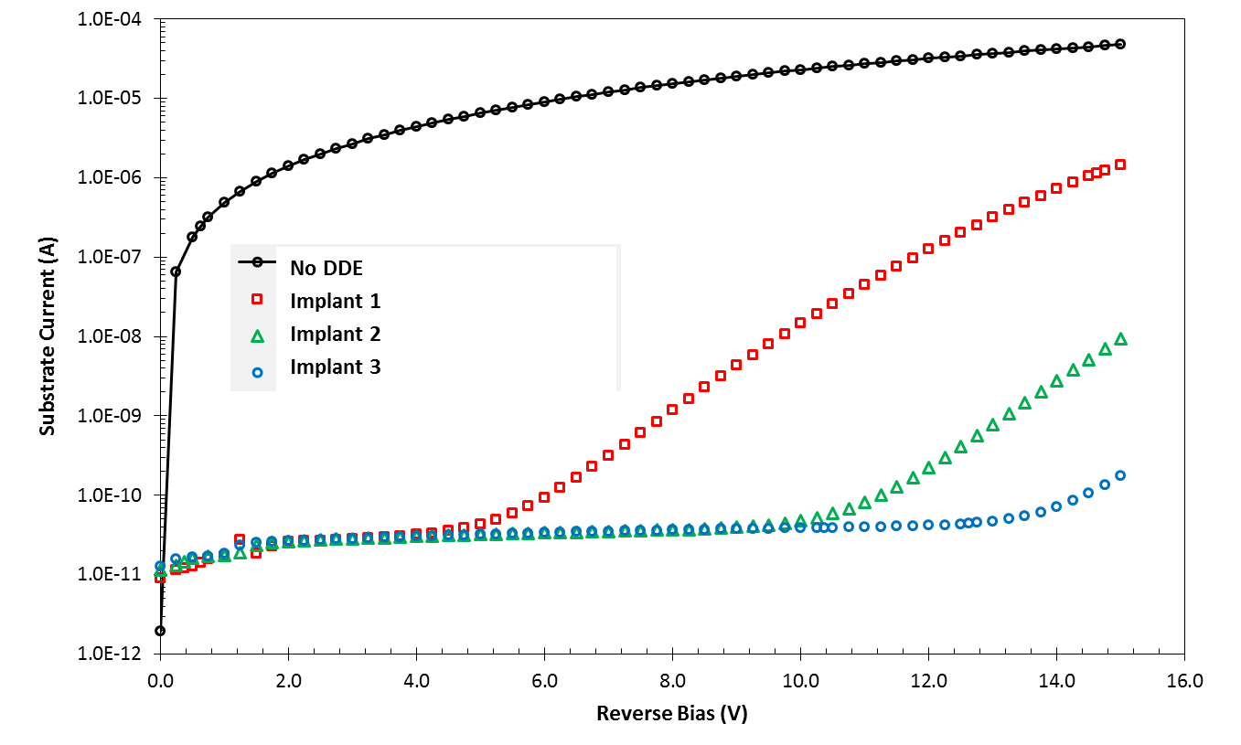
Substrate current
Not a traditional reverse biased diode
Different leakage mechanism
  Thermionic emission of holes over a potential barrier
  Not a breakdown
  Eventually leakage occurs, however it should be well above full depletion

Slide 18
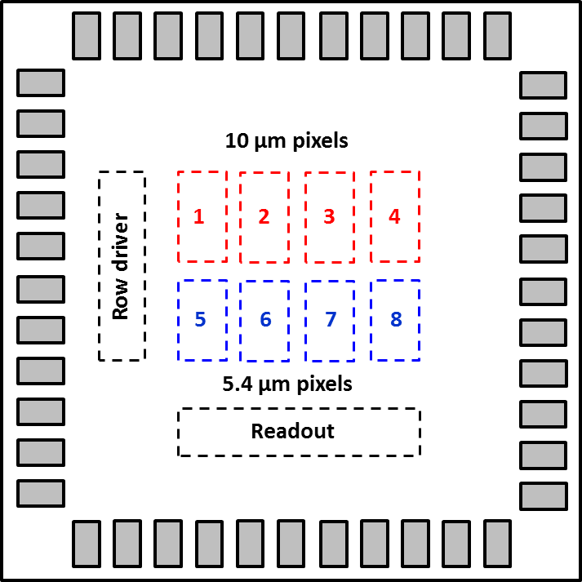
The first chip (BSB1)
Made on 18 µm 1 kΩ.cm epi, as a proof of principle
  This reverse bias method applies to any thickness
Prototyping 10 µm and 5.4 µm pixel designs
  8 pixel arrays of 32 (V) × 20 (H) pixels each
Each array explores different shape and size of the DDE implant
  One reference design without DDE (plain PPD pixel)
Custom ESD protection designed
Delivered in July 2016
Characterisation goals:
  Reverse bias and current, prove full depletion
  Gain, linearity, image lag; comparison with non-modified PPD pixel
  Over-illumination
  X-ray response

Slide 19
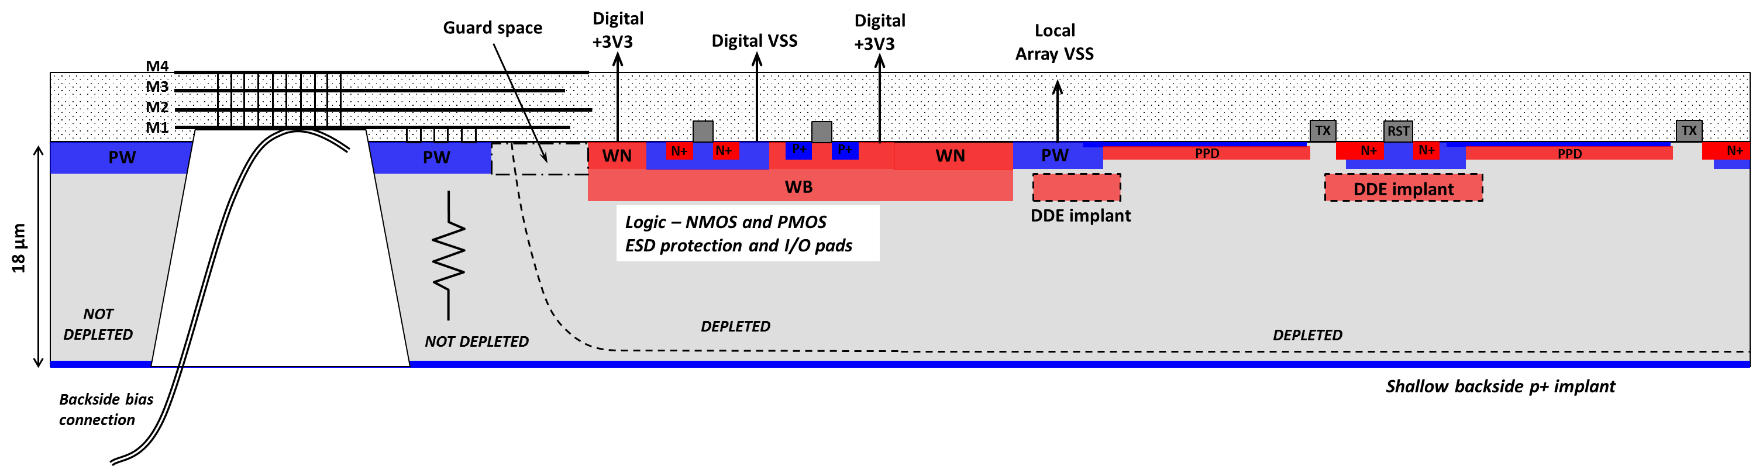
Whole sensor cross section
Backside biasing
Pixel array edge
Pixels
Main difference with the typical PPD CIS – all area outside the pixels is N-type implanted (N-well and deep N-well) and reverse biased
All non-pixel circuitry is on top of deep N-well
The exception is the backside bias region

Slide 20
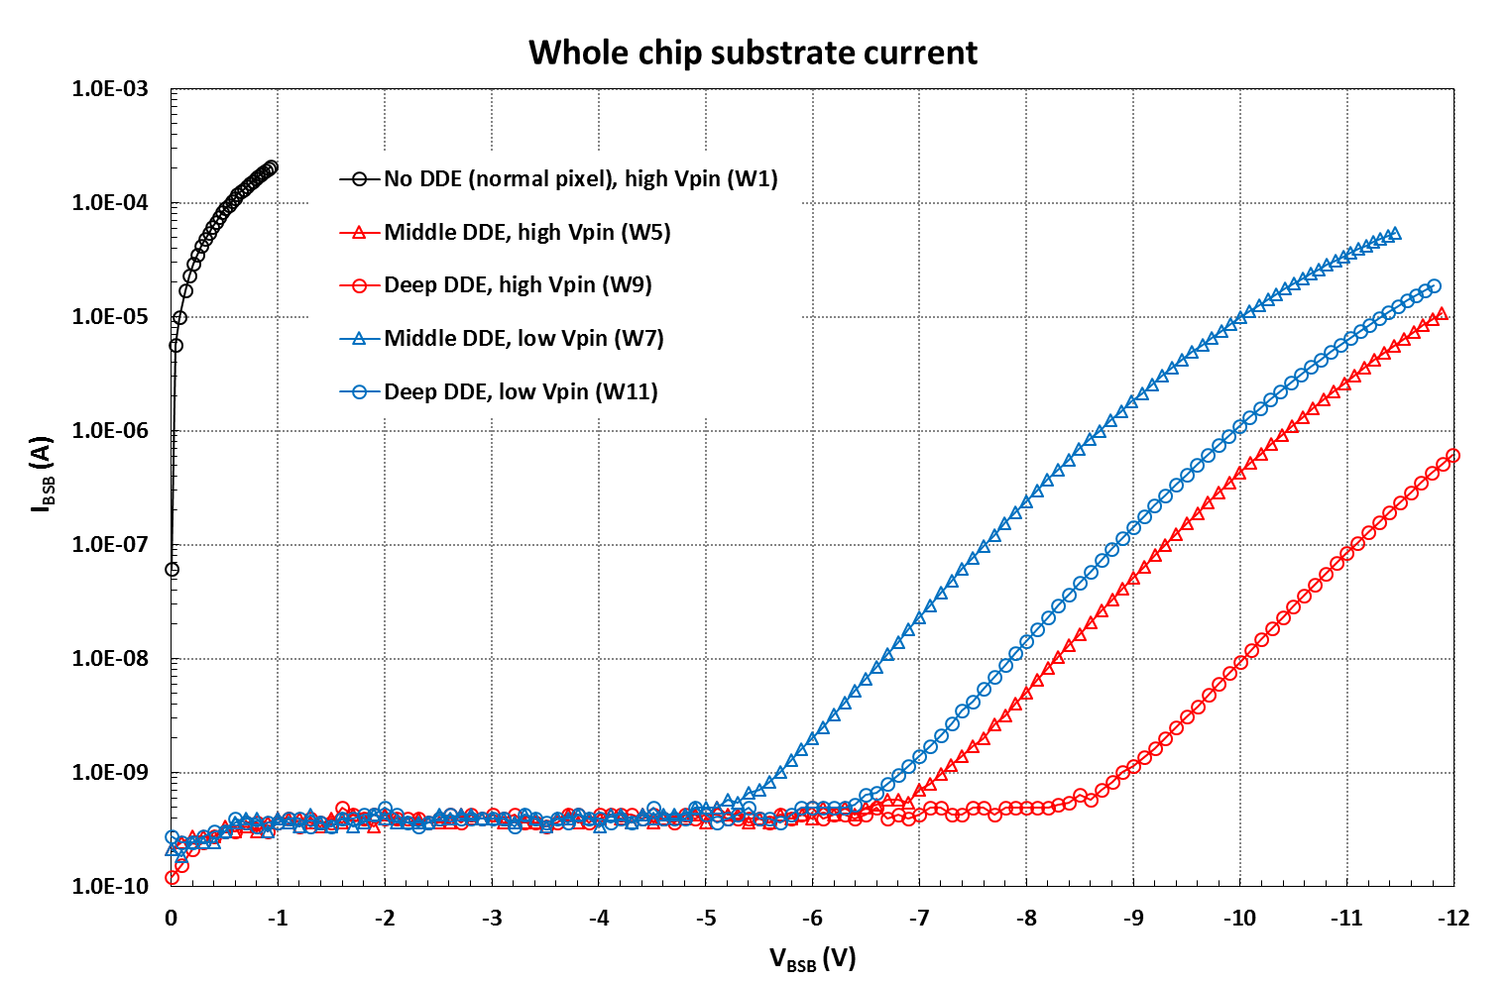
Reverse biasing
Measurement
Simulation for high Vpin
This shows the reverse current for the whole chip, including the logic and ESD pads
All pixel variants work
Reverse bias above -5V with no leakage means that any thickness can be depleted
  V_{BSB} = -4V fully depletes 18 µm thick epi, 1 kΩ.cm
Qualitative agreement with the simulations
  The measurement is for all 8 variants in parallel, simulation is for one variant only

Slide 21
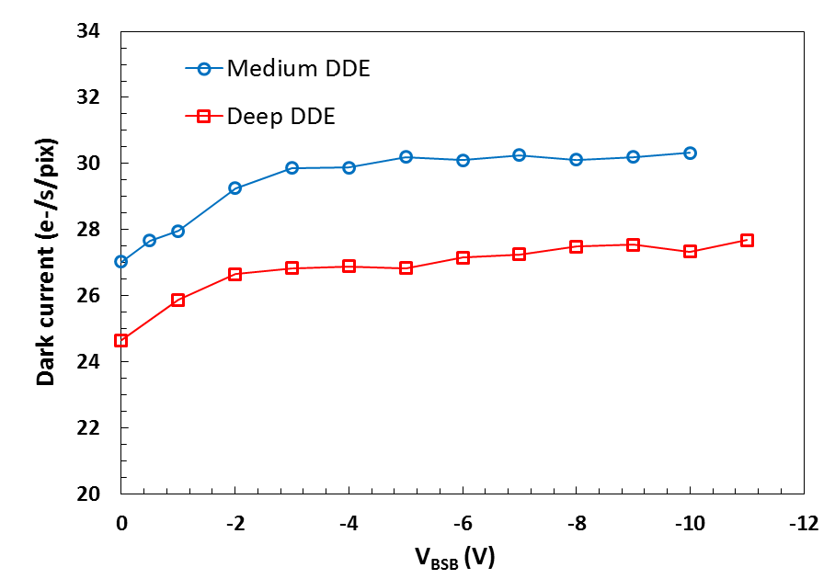
Full depletion
If there is no reverse current, the device should be fully depleted
  Guaranteed by design?
In front-side illuminated chips:
  Dark current should increase with the depletion depth
  Once depletion depth = epi thickness the dark current should level off
Presently a batch of wafers is being processed for backside illumination
  Optical measurements will be carried out
  Results is February 2017

Slide 22
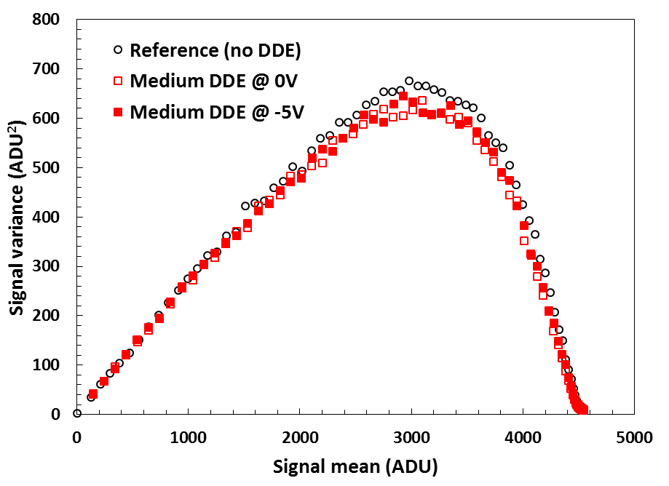
Electro-optical performance
Photon transfer curves taken under various conditions
10 µm pixel:
  CVF ≈ 80 µV/e- (design = 70 µV/e-)
  FWC ≈ 15 ke- (design = 20 ke-, limited by the sense node)
  Noise (in our system) ≈ 8 e- RMS
5.4 µm pixel:
  CVF ≈ 36 µV/e- (design = 33 µV/e-)
  FWC ≈ 15 ke- (design = 45 ke-, limited by the sense node and off-pixel circuits)
The new pixels appear identical to the “normal” pixels
The DDE implant and the reverse bias do not seem to affect the electro-optical performance – great!
10 µm pixel

Slide 23
Conclusions
New development of fully depleted monolithic PPD CMOS sensors using reverse substrate bias
  A paper in IEEE Electron Device Letters (in press)
Based on the idea of “depletion extension”
First prototype designed on 18 µm, 1 kΩ.cm epi as a proof of principle
  Can be scaled to much thicker epi/bulk substrates
  Front-face results shown here
  Back-thin (demo device) to be tested ~ March 2017
  Aim to design & make 40 um thick imager next……
Can be attractive to large number of applications
  High QE on a par with thick CCDs and hybrid CMOS
  Low noise, 4T architecture with minimum changes
Competitor to scientific CCDs?

Slide 24
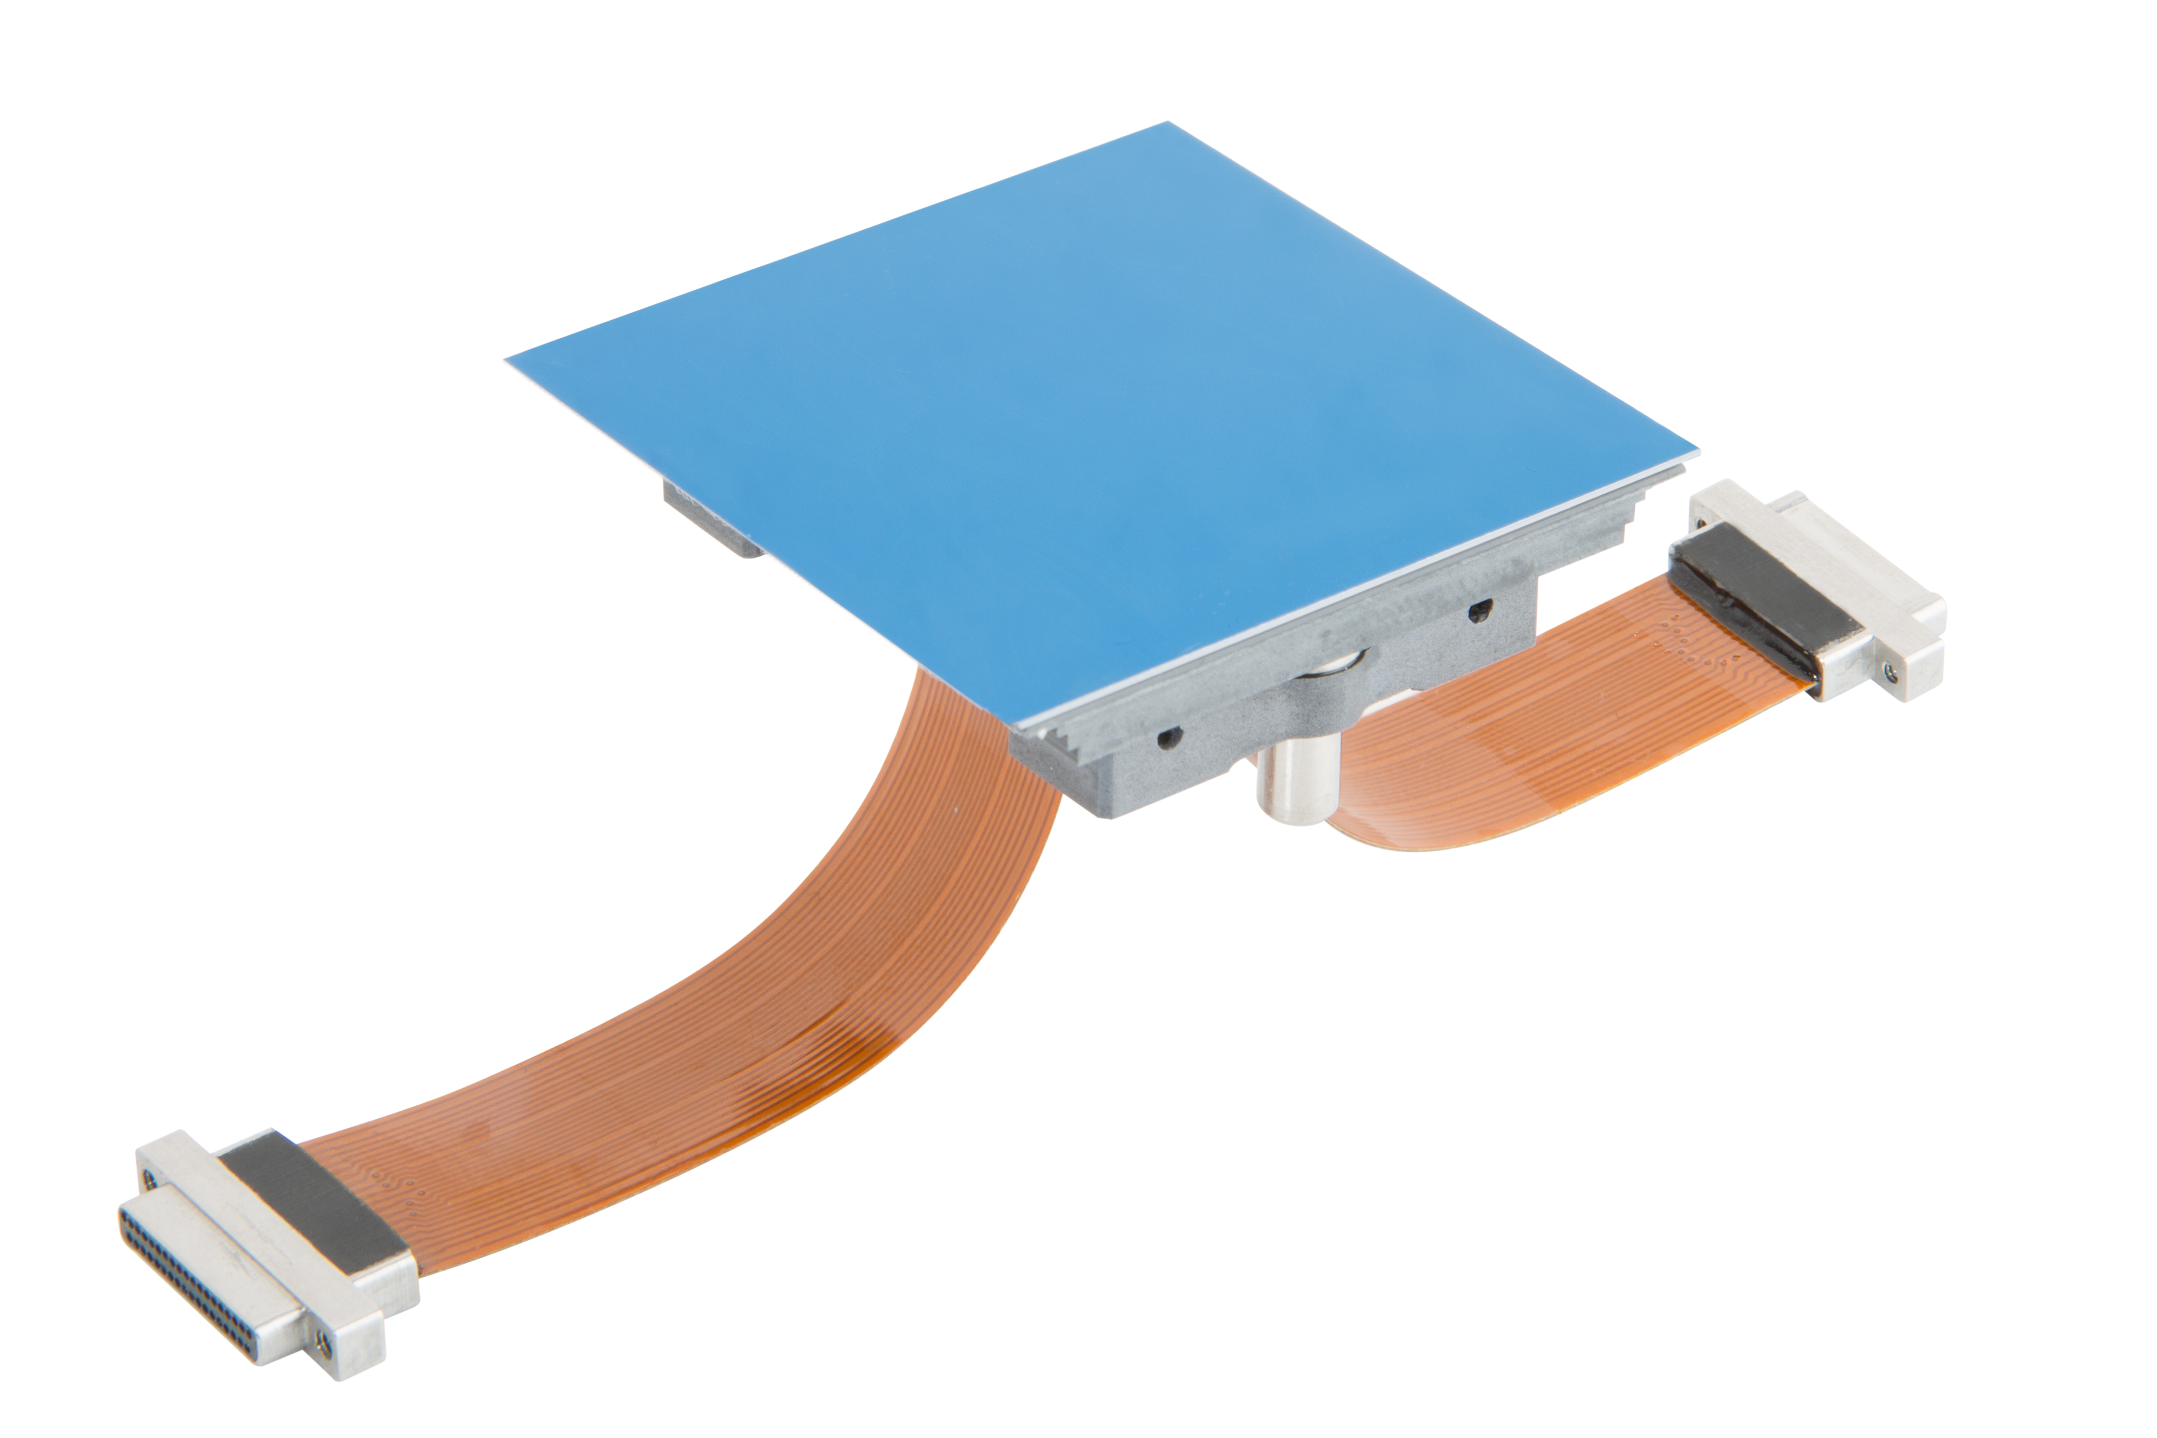
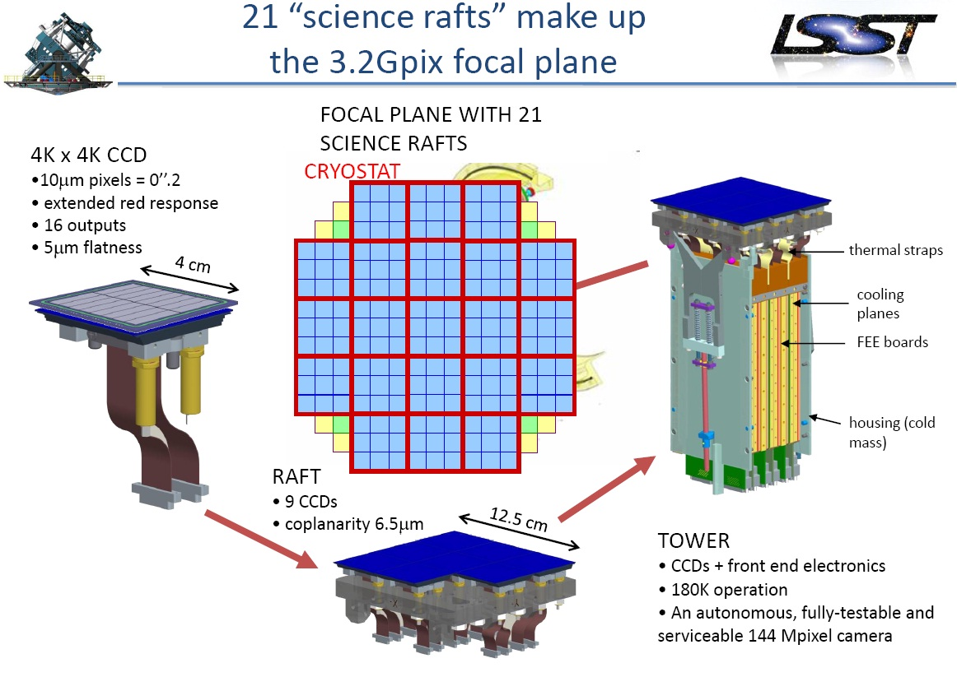
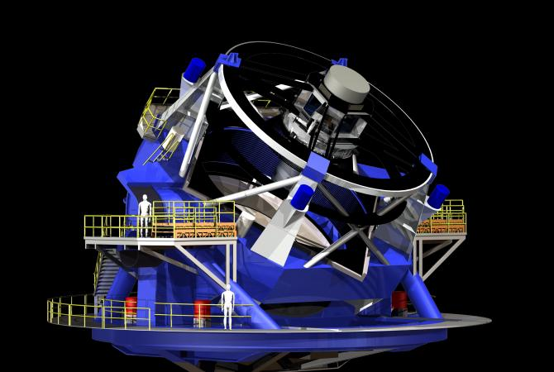
CCDs with high red sensitivity
LSST CCD250
4k X 4k 10 µm format
189 science sensors
100 µm thick; 5 um flat
High precision SiC buttable package
16 outputs; 2 s readout
5 e- read-noise
Pictures courtesy: LSST

Slide 25
Contents-2
We illustrate selected EMCCDs
Internal electron gain allows sub-electron read-noise
Combined with backthinned spectral response for very high sensitivity
Several formats and sizes available
Standard (non EMCCDs) are not discussed in this presentation- many are visible on e2v.com
2. EM CCDs
  Standard L3Vision sensors
  Custom sensors for astronomy & science

Slide 26
CCD sensors-1
CCD201
Standard product
1024 X 1024 pixels; 13 µm pixels
Larger format than CCD97 (512 X 512 pixels)
Widely used for commercial applications
Also useful for astronomy at low signal levels
Sub-electron read noise
Backthinned for high spectral response
Inverted mode dark current
Planned for Space use : NASA WFIRST Coronagraph
See e2v.com
for datasheet
Harding L, et al, “Technology advancement of the CCD201-20 EMCCD for the WFIRST-AFTA Coronagraph Instrument…,” JATIS 011007, (2016).
See poster by Nathan Bush, 9904, Tues pm

Slide 27
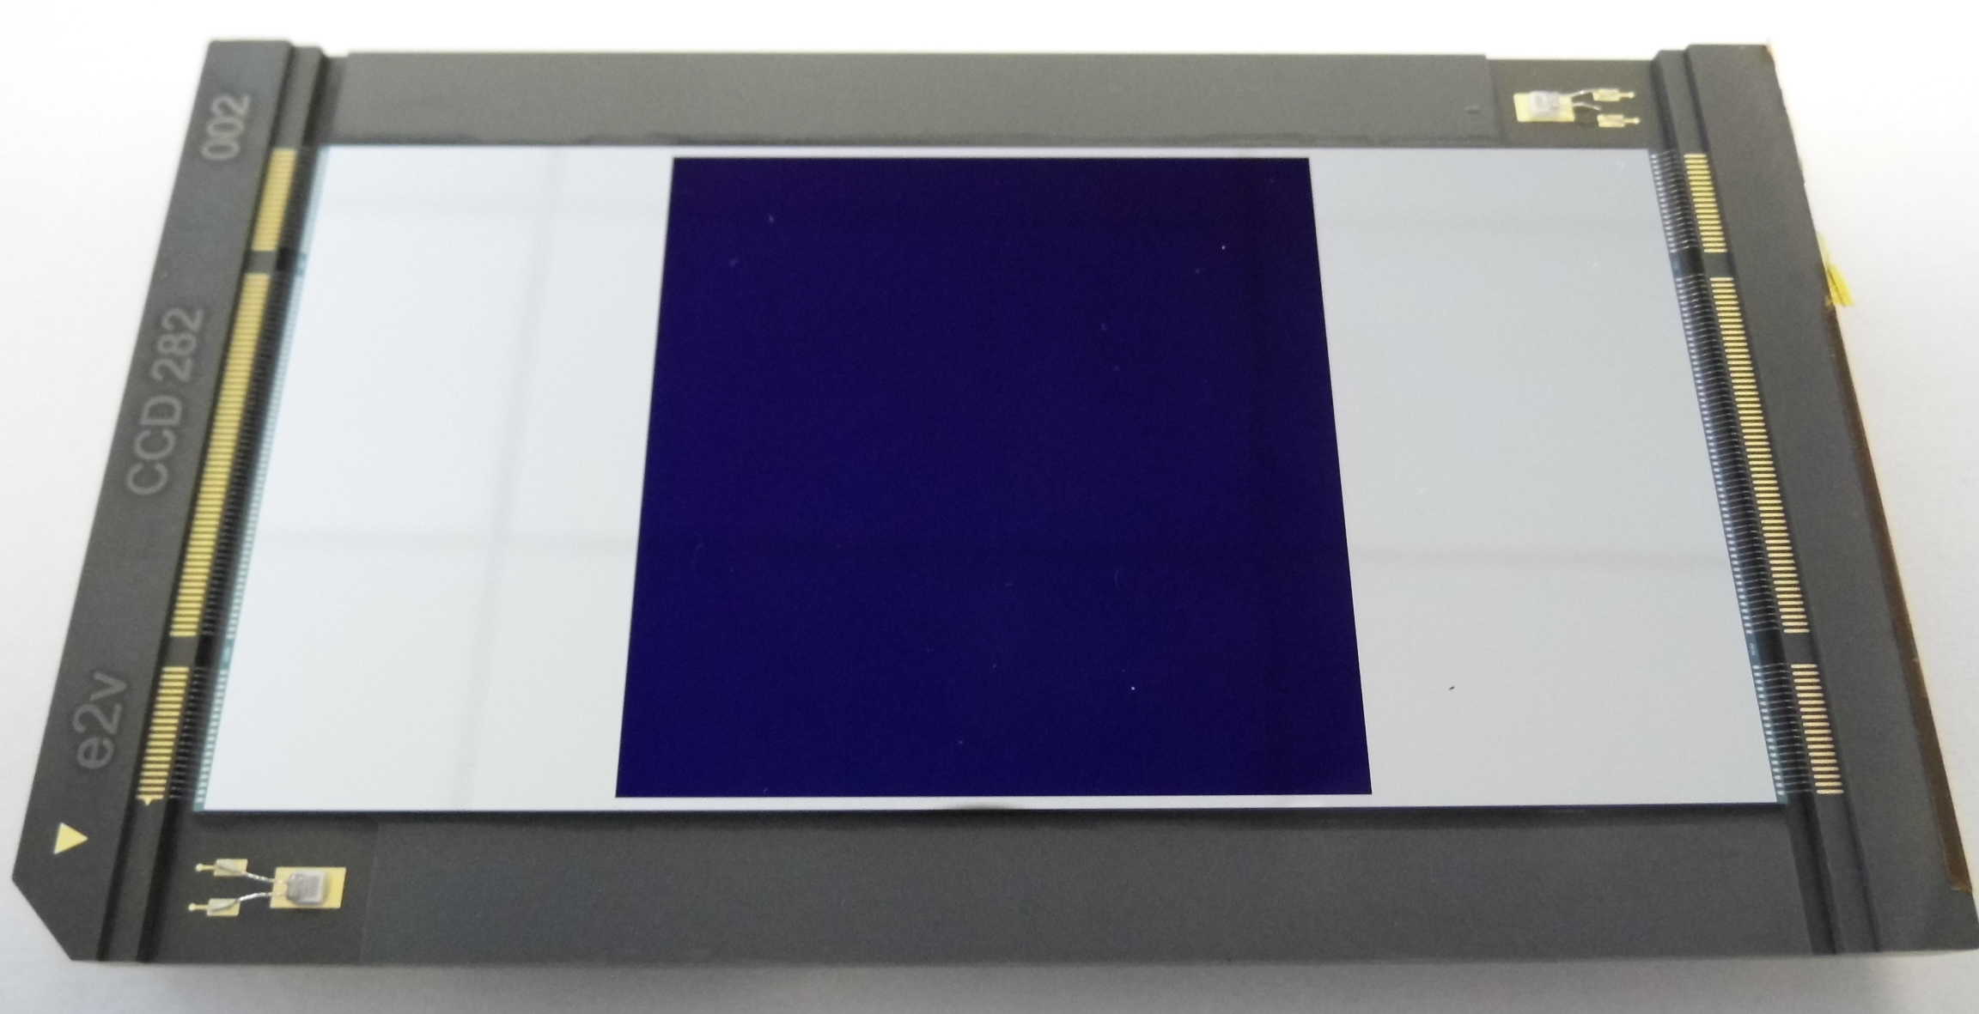
CCD sensors-2
CCD282
Largest EMCCD manufactured to date
4096 X 4096 pixel image area
Split frame-transfer read-out with 8 outputs
> 4 frames per second
Sub-electron read-noise
Backthinned for high Quantum Efficiency
Very low levels of clock-induced charge
Non-inverted operation at cryogenic temperatures
Development is complete; sensors have been delivered
Gach Jean-Luc, et al, “Development of a 4kx4k frame transfer electron multiplying CCD for scientific applications,” Proc SPIE 9154, (2014).

Slide 28
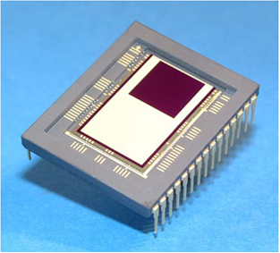
CCD sensors-3
CCD351
Standard product, for commercial use
L3Vision technology for sub-electron read-noise
Video rate readout
Backthinned spectral response
In standard production
Typical Performance
Image section | 1024 x 1024
Pixel size | 10 µm × 10 µm
Active image area | 10.24 × 10.24 mm
Package size | 22.86 × 28.00 mm
Amplifier responsivity | 3.5 µV/e−
Readout noise | < 1 e- (with EM gain)
Multiplication gain | 100-1000 typical
Output data rate | 37 MHz
Pixel charge storage | 35 ke-/pixel
Dark signal (18°C) | 100 e-/pixel/s
Package illustration (not final)

Slide 29
Contents-3
e2v develops sub-systems to complement its supply of sensors.
Bespoke systems are optimised for each application and use common modules where appropriate.
Performance of sensors combined with system can be guaranteed.
3. Precision System assemblies
  The WUVS space sensor system
  KMTNet focal planes
  The J-PAS OAJ Cryocam system

Slide 30
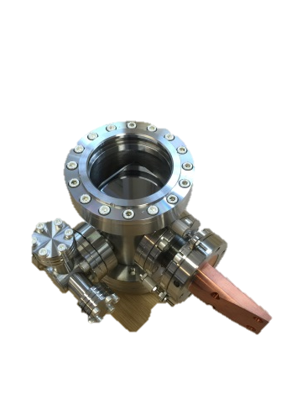
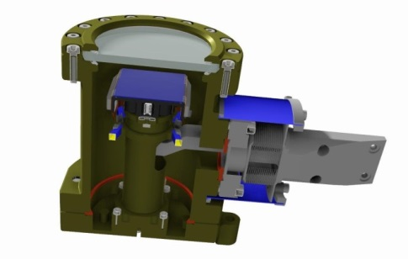
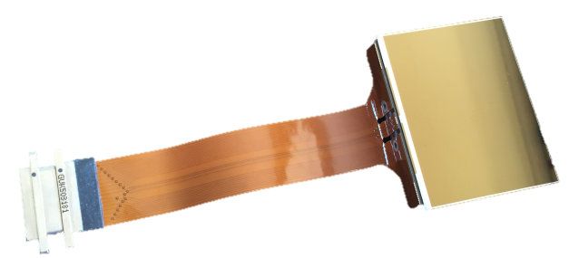
Precision System Assemblies-1
WUVS
World Space Observatory UV Spectrograph
115-310 nm range covered by three sensor channels
Custom sealed vacuum cryostat enclosures for 9 year life
with flight electronics (associated with RAL Space)
UV optimised custom CCD272 operated at -100°C
Components maintain alignment after shock & vibration of launch
Design and manufacture underway

Slide 31
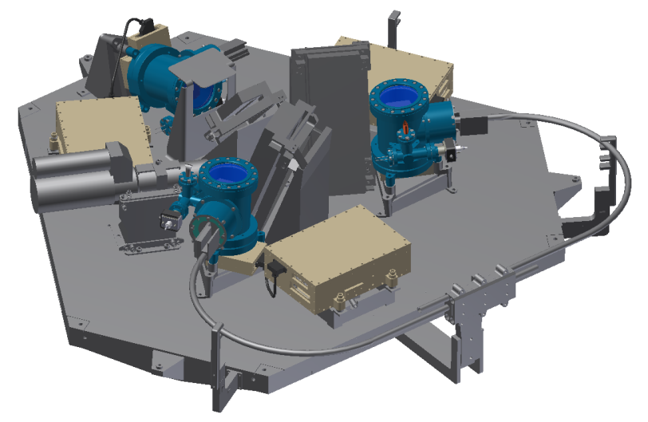
Precision System Assemblies-2
WUVS
Triple detector unit detector layout with camera electronics units
See Poster by Vladimir Panchuk, 9905, Sun pm

Slide 32
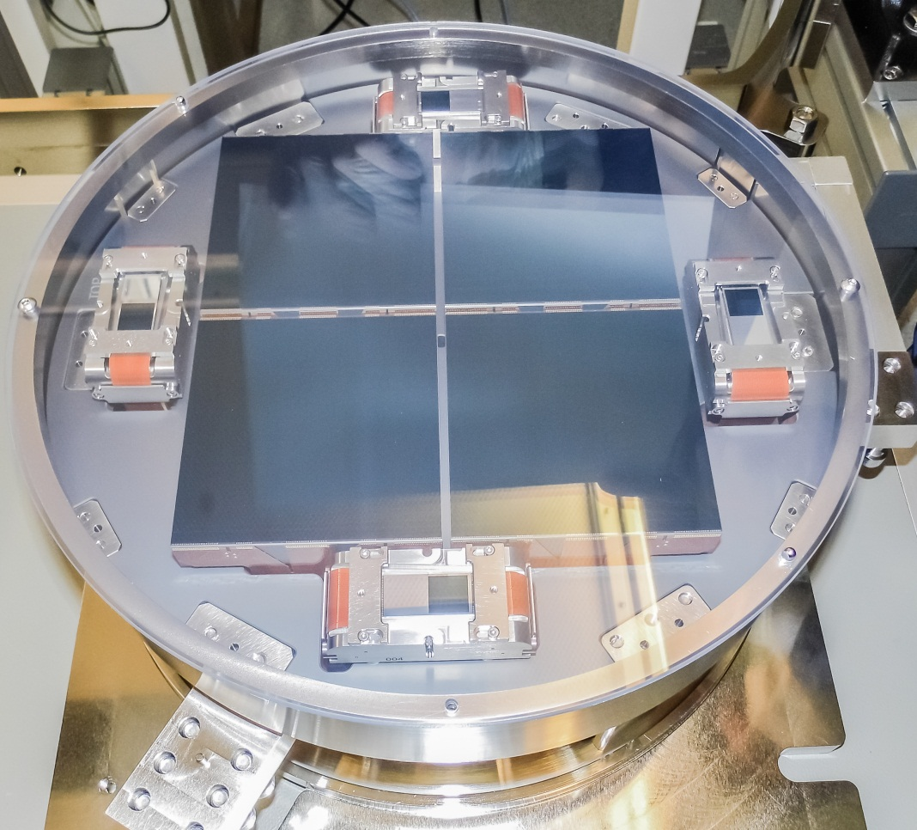
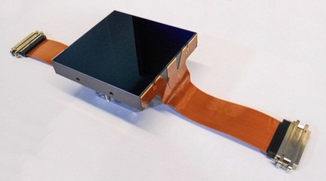
Precision System Assemblies-3
KMTNet focal planes
Korea Micro-lensing Telescope Network
3 telescopes each with its own camera; 350 mm focal plane; 340 MegaPixel each
Each camera had four CCD290 science sensors and four guide sensors; < 30 µm flatness
Focal planes are complete (e2v) , operational and installed in cameras (by Ohio State University)
See Poster by Dae-Sik Moon, 9906, Mon pm. Also see previous paper Jorden et al, SPIE 2014

Slide 33
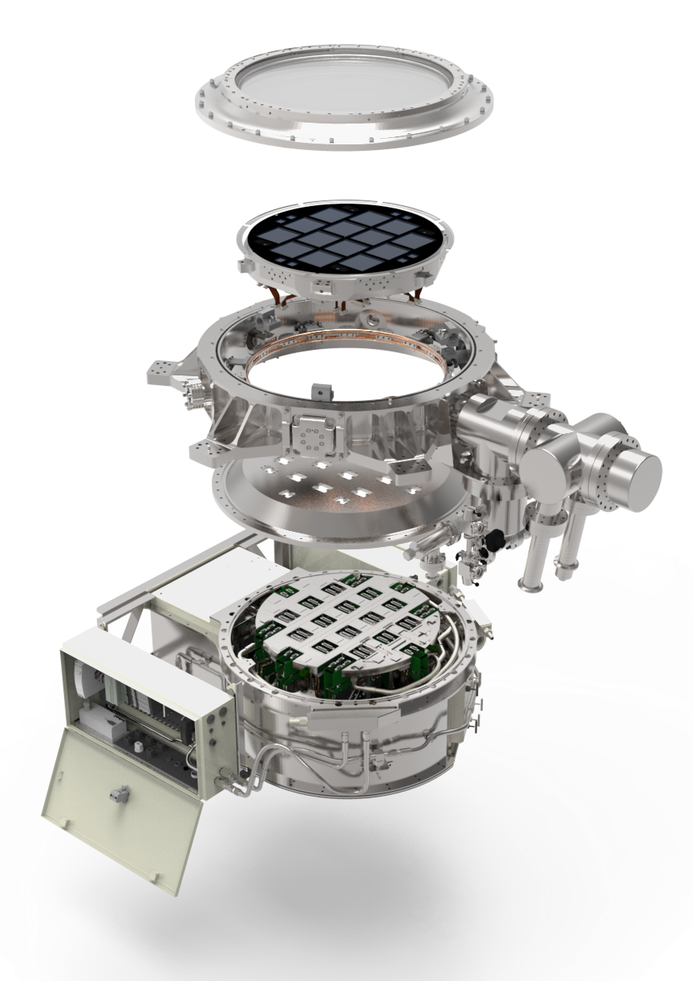
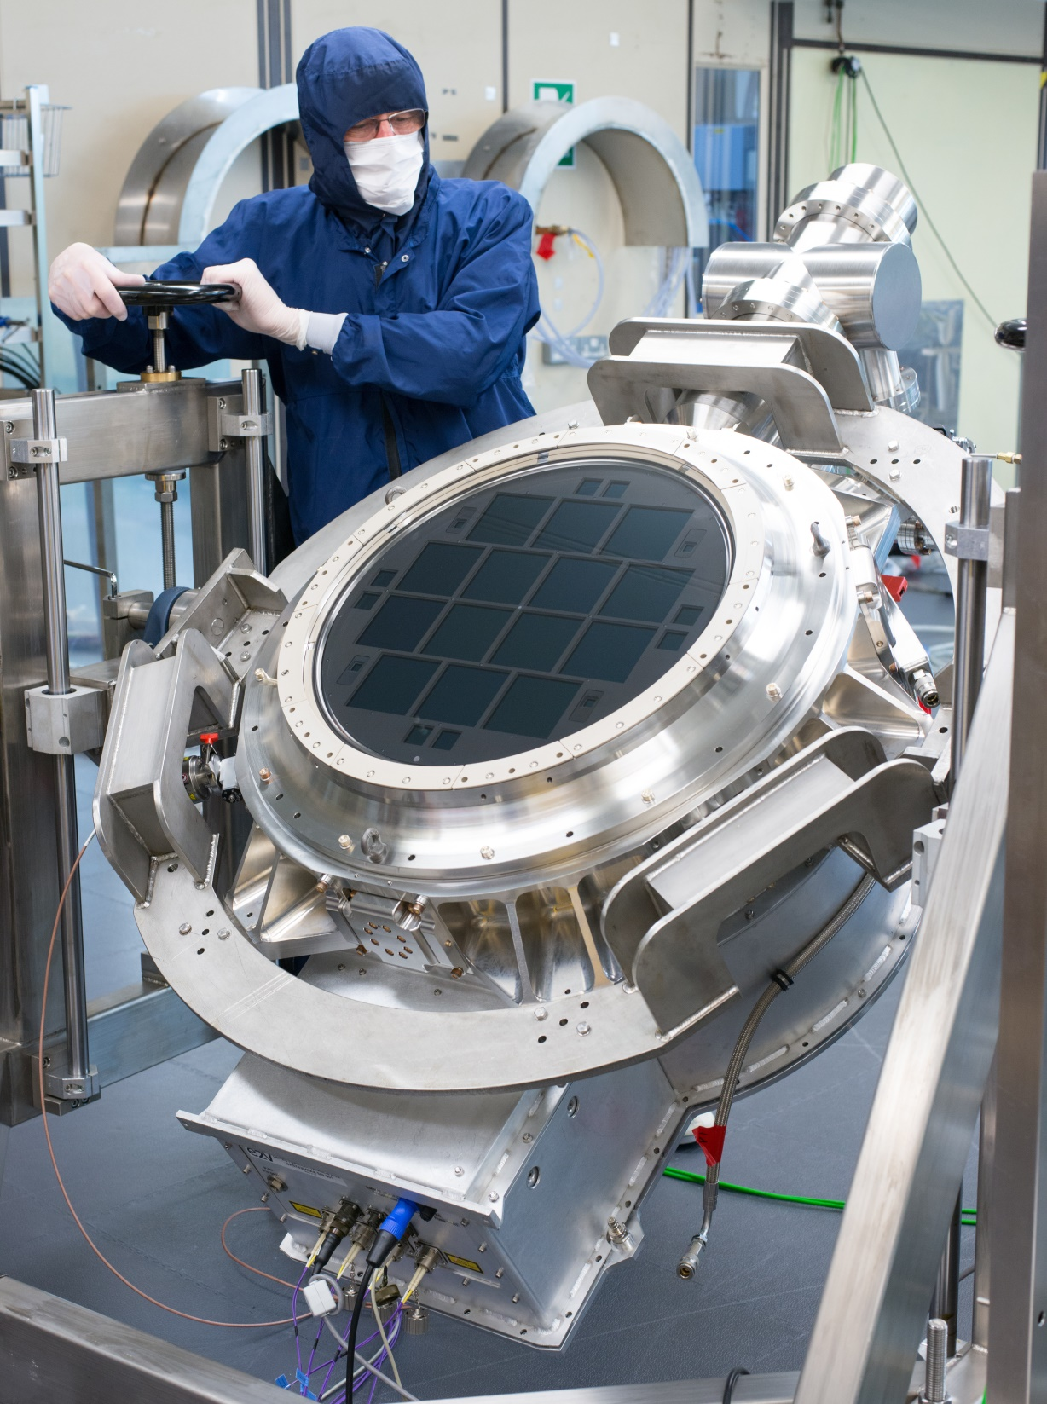
Precision System Assemblies-4
J-PAS Cryocam
A 1.2 Gigapixel cryocam for use on the 2.5m OAJ telescope for the J-PAS survey.
e2v has delivered (mid-2016) this important commercially-suppled astronomical camera

Slide 34
Precision System Assemblies-5
J-PAS Cryocam
Table of key features
450 mm focal plane diameter | -100ºC operating temperature | Stable to +/- 0.5ºC
27 µm peak-valley flatness | Measured at -100C | Stable against flexure
14 science CCD290-99 sensors: | 1.2 Gig pixels | 9K X 9K sensors
8 wavefront sensors: | CCD44-82 FT | Custom packages
4 guide sensors: | CCD47-20 FT | Custom packages
Integrated electronics | 224 science channels | < 5 e- read-noise at 400 kHz
Modular CCD drive units | Synchronized readout of science CCDs | Local frame stores
Complete LN2 cooling system | Integrated vacuum system | Post-delivery support
Cold light baffle | High Quantum Efficiency | minimum reflection AR coat
See paper by Mark Robbins, 9908, Tues 28 June 2016, am, S8
And K Taylor et al, JPCAM, JAI vol 3, 2014

Slide 35
Summary
An increasing number of sensors are being developed using CMOS architectures
Many of these are backthinned and offer low read-noise (comparable to CCDs)
CCDs continue to be used in larger quantities and with greater heritage
e2v offers custom system solutions including cryogenic cameras and electronic modules to complement its supply of sensors- and with guaranteed performance
Thank you for your attention

