Slide 1
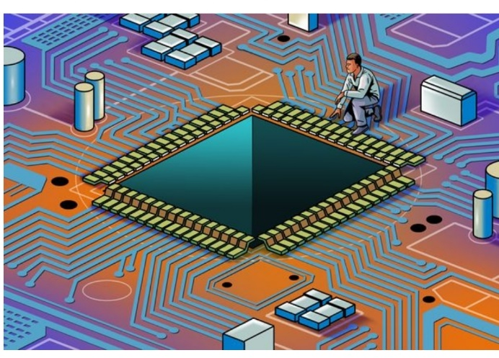
Experimental Nuclear Physics Division
Streaming Readout @Jefferson Lab
Fast Electronics & Data Acquisition Group

Slide 2
Overview
1. Brief History of Streaming ReadOut @ Jefferson Lab
2017 SRO consortium initiated
Established INDRA lab with dedicated hardware for SRO development
12GeV front end readout hardware designs were built on high speed Gigabit serial backplane format.
Progressive evolution has made the transition to streaming a reality
2. Present status of SRO
Hardware and experimental application examples
Progress to use CODA software on front end processor electronics
Beam test at DESY with calorimeter array
Forward Tagger in CLAS12
3. Future applications and experiment plans for SRO
CLAS12 – Many detector subsystems for 12GeV high luminosity program
VMM3 for uMegas upgrade and new uRWell MPGD
SoLID experiment program proposes SRO DAQ
ECAL channels will use VXS flash ADC boards
Summary
Important Links:
Detector Working Groups have started a spreadsheet for detector details such as cabling, channel counts, Electronic board counts etc. Please see:
Project Information - Electron-Proton/Ion Collider Experiment (bnl.gov)

Slide 3
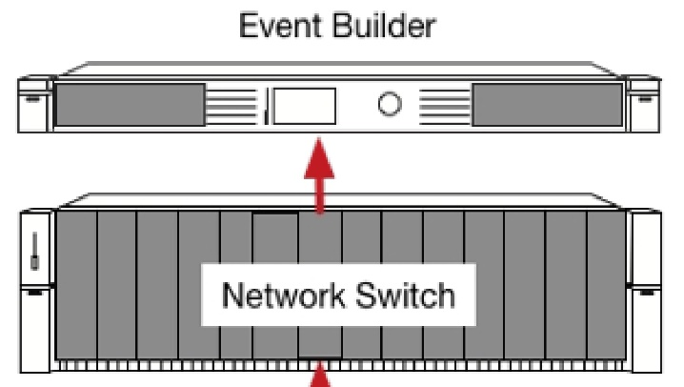
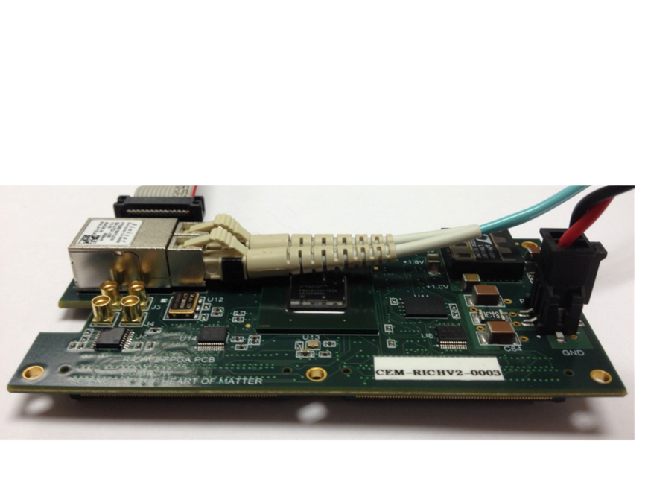
Streaming Without ‘Crates’
Readout/Control of ASIC <-->Network
FEDAQ Group
FPGA ReadOut & Control[ROC]
Develop interfaces with new ASIC:
Used MAROC3 for CLAS12 RICH and GlueX DIRC detectors
Petiroc 2A -> 32 Channel SiPM with Q and T conversion {10 bit ADC; 18ps timing[Prototype in development]
Xilinx Artix7
Fiber Optic
Arista Network Switch
Uses Xilinx FPGA
Innovation in Nuclear Data Readout and Analysis
INDRA Test Lab in CEBAF Center
Readout R&D lab for future 12GeV experiments
- TDIS
- SoLID
- Moeller
Development of new Software for managing streaming data storage
Developing Software Framework for processing tasks. i.e.) Calibration, monitoring, reconstruction.
Use new COTS {Aritsta} network gear that includes high level FPGA for control of data stream
Development of High Level Synthesis code for creating ‘virtual triggers’ from streaming data
JLAB FPGA Readout/Control Board
192 Channel Interface
Algorithms
1ns TDC
Scaler
Fixed Latency up to 8us
Optical Ethernet – Use Commercial 1Gbe
Finisar Transceiver capable of 10Gbps
Artix could run @3.125Gpbs
Mates to ASIC
+5VDC @1A

Slide 4
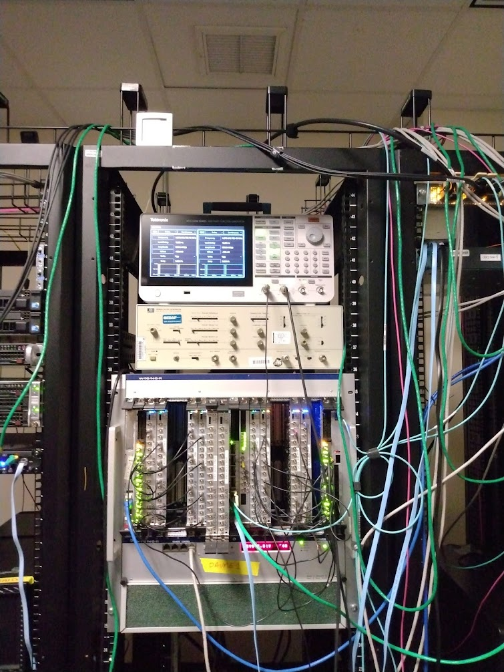
Streaming Without ‘Crates’
Readout/Control of ASIC <-->Network
FEDAQ Group
Beginning of the year we started with:
- 1 to 8 FADCs (left side of crate) to first 10Gbps TCP link
- 1 to 8 FADCs (left side of crate) to second 10Gbps TCP link
- Could achieve ~8Gbps per link: 125MHz hits for each crate half, or ~1MHz average channel hit rate (reporting charge & time)
Recent additions:
- Switched data format to be CODA EVIO compliant (allows various CODA tools/software to be useful)
- Added support arbitrary FADC slots -> Ethernet port mapping
- Added support for UDP and Jumbo packets. This uses much less resources on the VTP. Fixed various bugs in the UDP stack and now the server can reliably receive all packets with no loss.
- Can use at 4 ports on VTP, but need to optimize the processor to make them independent (currently they share a processor limiting the total performance)
Performance:
- Currently: 1x-2x TCP links ~8Gbps, 1x UDP ~9.5Gbps
- Soon expect to have all 4 ports running UDP in parallel for ~38Gbps total
- Single CPU core utilization ~50% for 9.5Gbps UDP (leaving many free CPUs for data processing and receiving additional streams)
INDRA FADC Streaming Setup
8x FADCs, 4x 10Gbps Ethernet links from VTP, 10G/100G switch to indra-s1 server (on 100Gbps)

Slide 5
Streaming Without ‘Crates’
Readout/Control of ASIC <-->Network
FEDAQ Group

Slide 6
SRO Examples - CODA Readout
FEDAQ Group

Slide 7
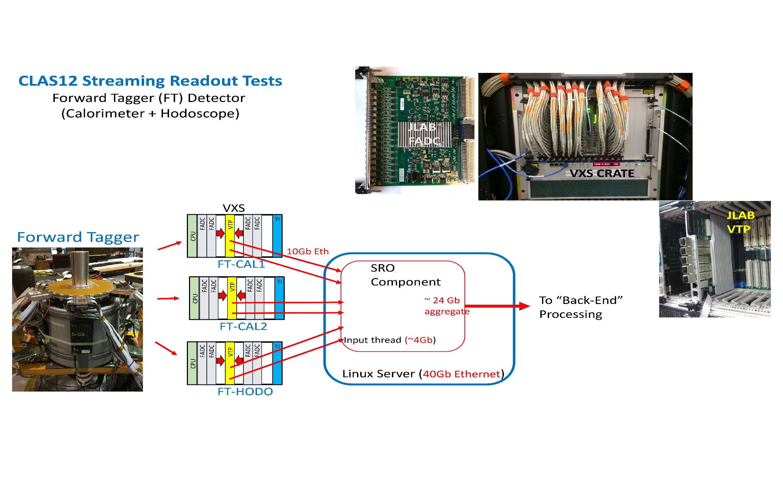
SRO Examples - CLAS12 Forward Tagger
FEDAQ Group

Slide 8
Future SRO Projects @JLAB
FEDAQ Group
We have a precision clock/synch distribution system at JLAB which is critical for the flexibility of the CODA Hybrid DAQ
Our VXS platform works extremely well with high reliability for the four experimental Halls.
We are in an excellent position and have used many ASIC Front-End Readout boards over the years that use FPGA to manage deterministic data streams
These Readout boards interface to many different detector types:
RICH => MAPMT
MPGD => GEM/uMegas/uRWell
Calorimetry=>PMT/SiPM
Of course we use many thousands of 250Msps ADC channels to interface to PMT and other readout devices where the converted data can be streamed efficiently.
Important Links:
Detector Working Groups have started a spreadsheet for detector details such as cabling, channel counts, Electronic board counts etc. Please see:
Project Information - Electron-Proton/Ion Collider Experiment (bnl.gov)

Slide 9
Future SRO Projects @JLAB
FEDAQ Group
Managing the data ‘streams’ is done deterministically with FPGA
We use a proprietary Bi-directional timing/communication fiber link
CLOCK, SYNCH, BUSY, TRIGGER(S)⬄
MTP Multi-fiber Gigabit links for data stream aggregation
FPGA – SoC(System on Chip) resources on the Readout boards provide:
Configuration and control of ASIC/electronics
READOUT path with ‘standard’ data format
1st Stage hardware stream aggregation
Important Links:
Detector Working Groups have started a spreadsheet for detector details such as cabling, channel counts, Electronic board counts etc. Please see:
Project Information - Electron-Proton/Ion Collider Experiment (bnl.gov)
SoC Examples:
VXS Trigger Processor [VTP]
FELIX⬄ PCIe Board
“Smart” Network Switch
SoC
FEE
ROC
Several Hardware Forms available:
PCIe
Stand Alone Chassis
VXS Board/Crate
FEE
ethernet
Server
FEE
FPGA
PCIe
Server
FEE

Slide 10
FEDAQ Group
Ben Raydo
David Abbott
FEDAQ Group

Slide 11
FEDAQ Group
Ben Raydo
David Abbott
Use other JLAB VXS Boards to Stream:
96 Channel Drift Chamber Readout board
Enormous tracking detector system
24,192 wires
96 Channel VETROC TDC Readout board
Forward ToF detector system
90 plastic scintillator panels/sector
Double sided PMT readout

Slide 12
FEDAQ Group
Near Future SRO - CLAS12 uRWell Read-Out
Xilinx
Virtex7
FPGA
VMM
ASiC
VMM
ASiC
VMM
ASiC
VMM
ASiC

Slide 13
FEDAQ Group
The Whole ‘Enchilada’- CLAS12 High Luminosity

Slide 14
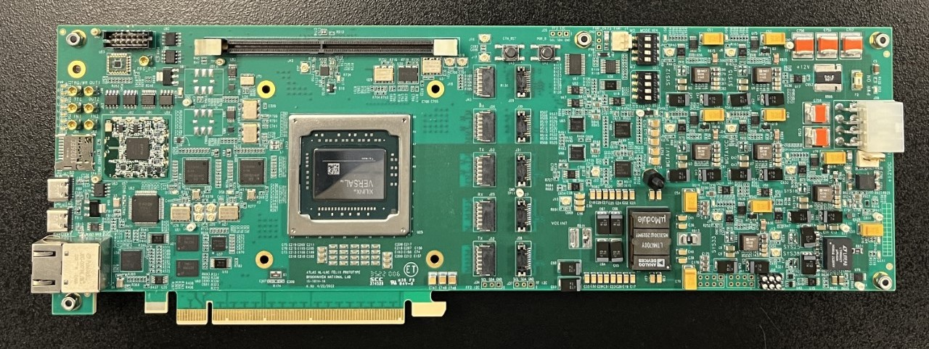
Future SRO - Applications
FEDAQ Group
FELIX 182
~10 boards were produced in early 2023.
JLAB FEDAQ Group has purchased 2 and they are on site now.
CODA ReadOut Control [ROC] ported to the board
Linux OS
Future plan for 48 channel version
Upgraded Versal FPGA
General technical support for the FELIX Hardware should be available through the end of HL-LHC operation. (i.e. into the late 2030s for Run 5)

Slide 15
Summary
Significant Streaming Readout application progress with our 12GeV front end electronics.
CODA DAQ software development effort for Streaming applications is also progressing well.
We have many options for Streaming implementation with VXS hardware, Front-End ASIC readout boards, smart switches and will continue plans with the FELIX 182 board with CODA [Linux ‘ROC’]
There will be several presentations at this workshop that will focus on ePIC/EIC applications and it is exciting to be involved with these projects as a partner lab.
What are your questions?

Slide 16
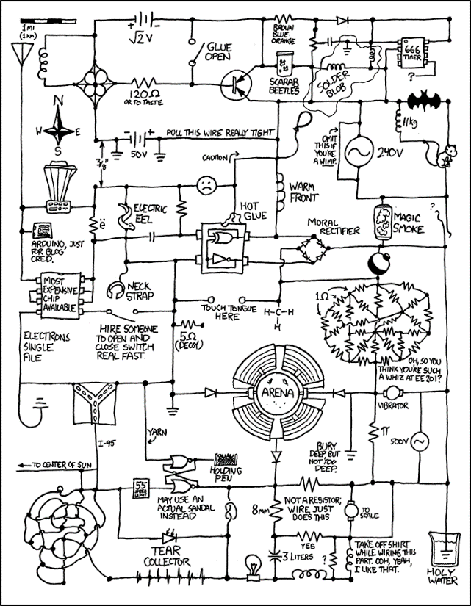
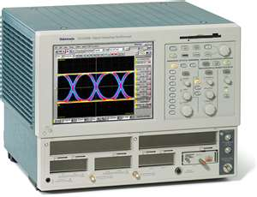
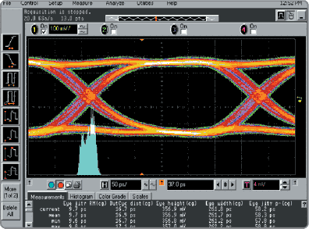
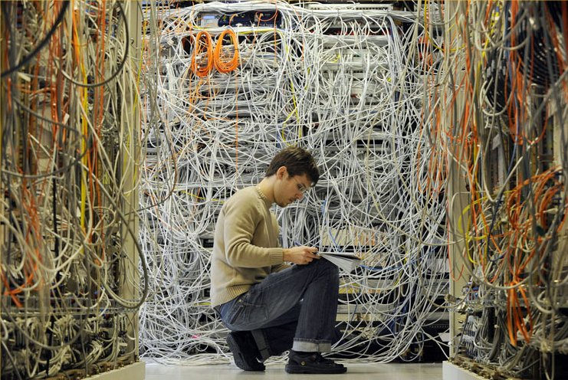
Backup slides
They said we were going “wireless”,,,
The Eye

Slide 17
More Examples of VXS Readout/Control of ASIC
C. Dickover
B. Raydo
CEA Saclay** INFN*
2.5Gbps line rate 16bit bus @ 125MHz for transmit and receive
RICH 25,000 pixels
2.5Gbps line rate 16bit bus @ 125MHz for transmit and receive
SBS GEM
+40K pads
APV25
FPGA MPD*
2.5Gbps line rate 16bit bus @ 125MHz for transmit and receive
DREAM
FPGA FEC**
MicroMegas
+20K strips
Forward Tracker
+3300 uMegas Strips
VME64x Readout Bandwidth [~200MBs]
OK Because Detector occupancy Is low (~1%)
Thomas Jefferson National Accelerator Facility

Slide 18
This Design will carry JLAB DAQ for another decade!!
Amazing Electronic Device!
Thomas Jefferson National Accelerator Facility

Slide 19
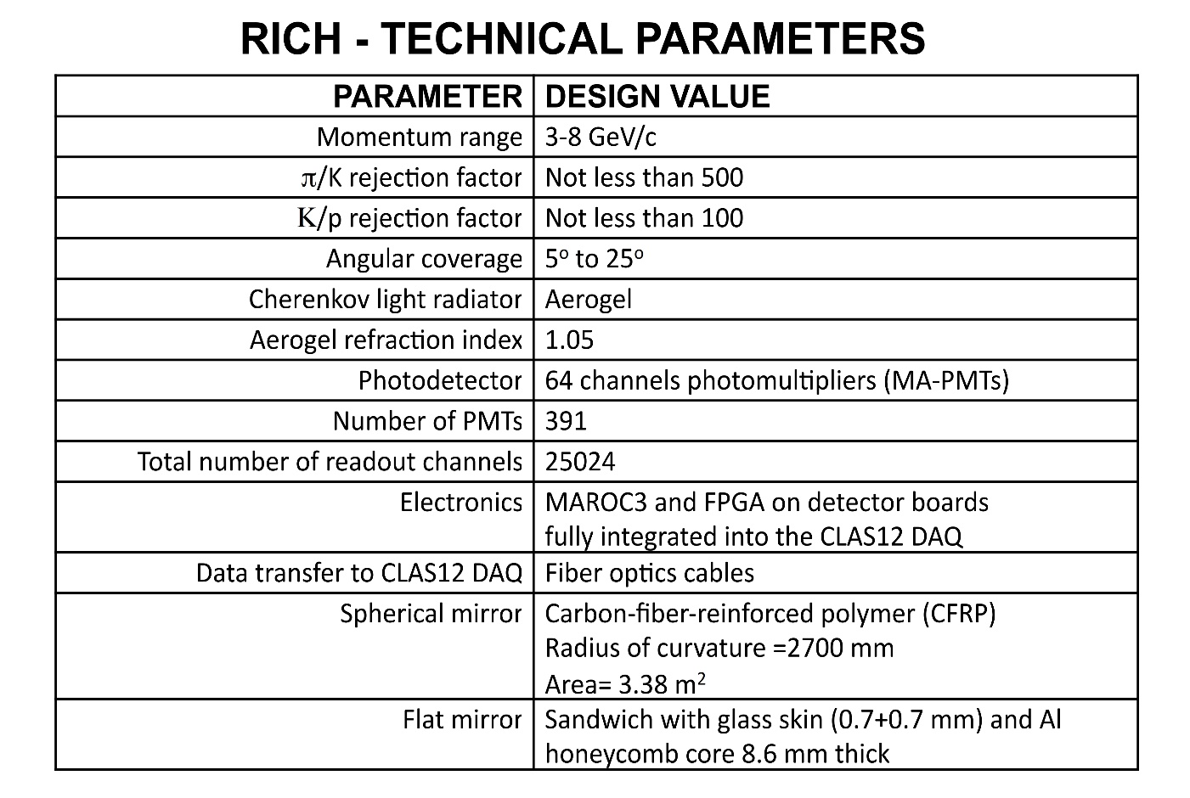
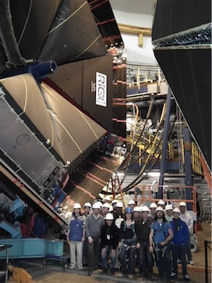
ePIC DAQ & Electronics Workshop
Brief 12GeV RICH detector example

Slide 20
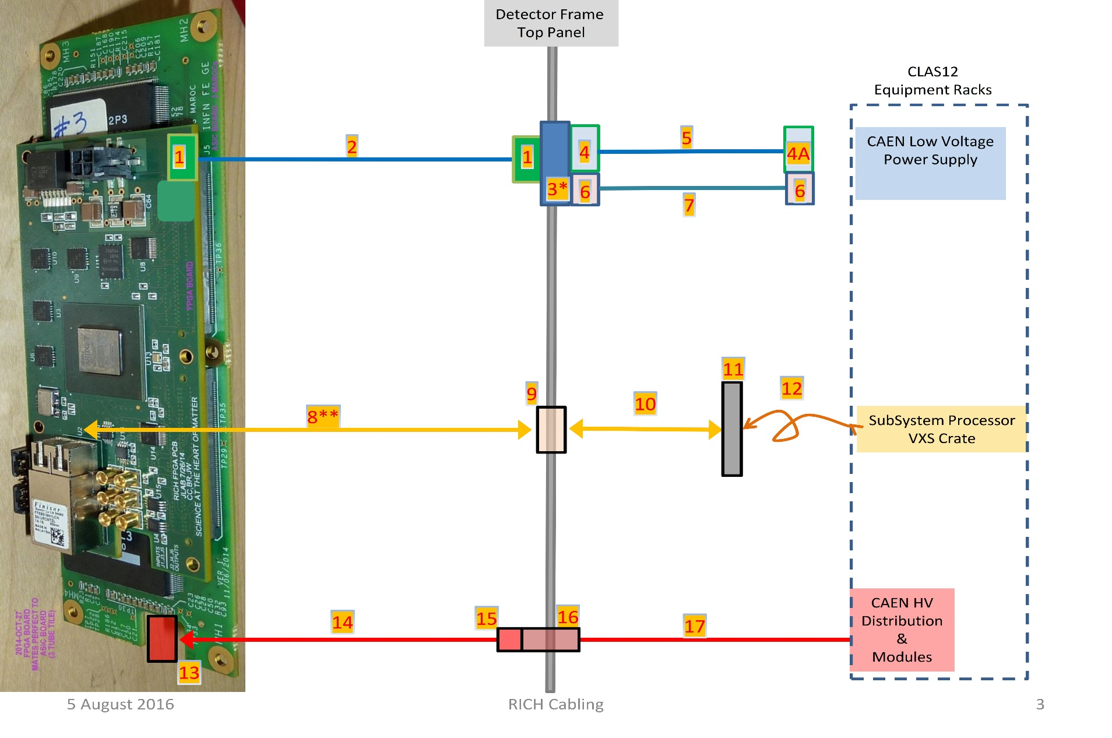
ePIC DAQ & Electronics Workshop
Brief 12GeV RICH detector example
64 Pixel
maPMT
64 Pixel
maPMT
64 Pixel
maPMT
192 “Channels”
MAROC3 +FPGA 1ns TDC

