Slide 1
EIC Front End Readout R&D Initiatives
Fernando Barbosa
L3 CAM WBS 6.10.08
Chief Electrical Engineer
Streaming Readout Workshop SRO-XI
Honolulu, HI
28 November – 2 December 2023

Slide 2
Outline
Streaming Readout at EIC
Chain, Channels
EIC ASIC & Electronics R&D Initiatives
ASIC & Discrete Developments
3rd Party ASIC Evaluations
Summary

Slide 3
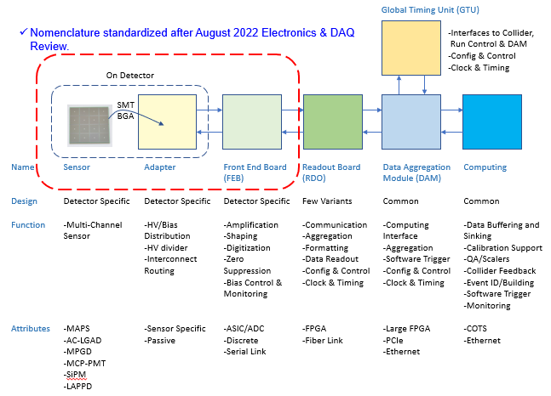
Streaming Readout - Chain

Slide 4
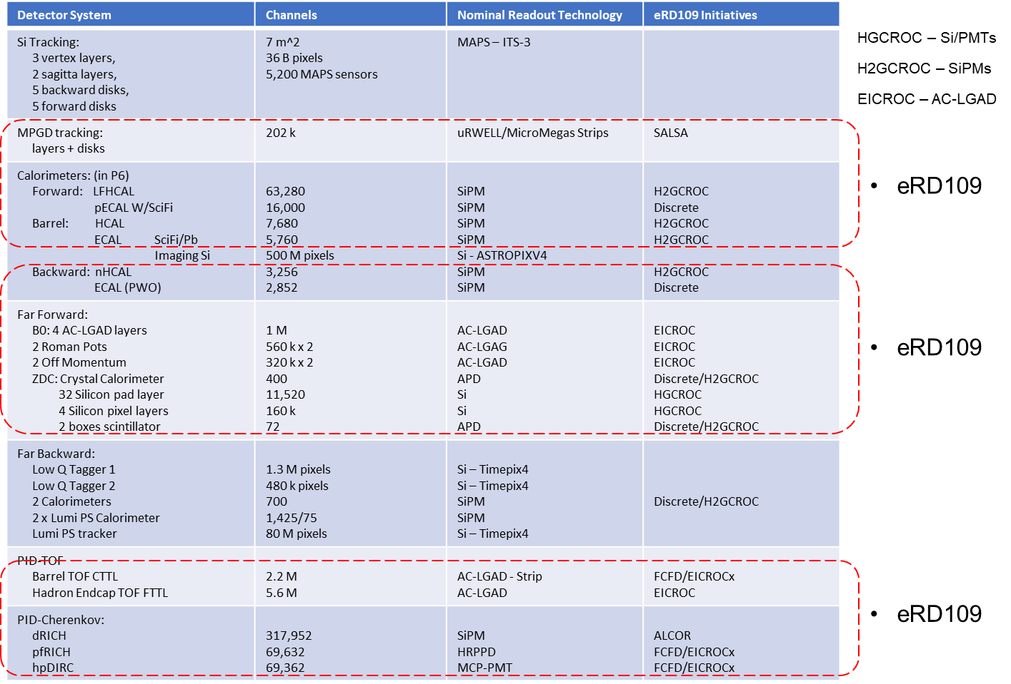
Streaming Readout - Channels – Scale & Technology

Slide 5
eRD109 Initiatives
Charge 1, 2
Addresses EIC ASIC and Electronics R&D needs.
Also includes Services Reduction and High Precision Timing.
FY23 Proposals - DAC R&D Review August 2022
FY24 Proposals - DAC R&D Review August 2023
ASIC & Discrete – Nominal Solutions:
Discrete/COTS – Calorimeters, SiPMs, 12-14 bit
H2GCROC (CALOROC, ePIROC) – Calorimeters, SiPMs, 10 bit *
EICROC - AC-LGAD, pixel *
FCFD – AC-LGAD, strip**
ALCOR – dRICH, SiPM, 1 p.e.
SALSA – MPGD.
3rd Party Evaluations:
HPSoC, HDSoC – NALU
ASROC – Anadyne
FAST - INFN
* Considerable commitment of resources by OMEGA/IN2P3.
** Considerable synergy with FNAL.

Slide 6
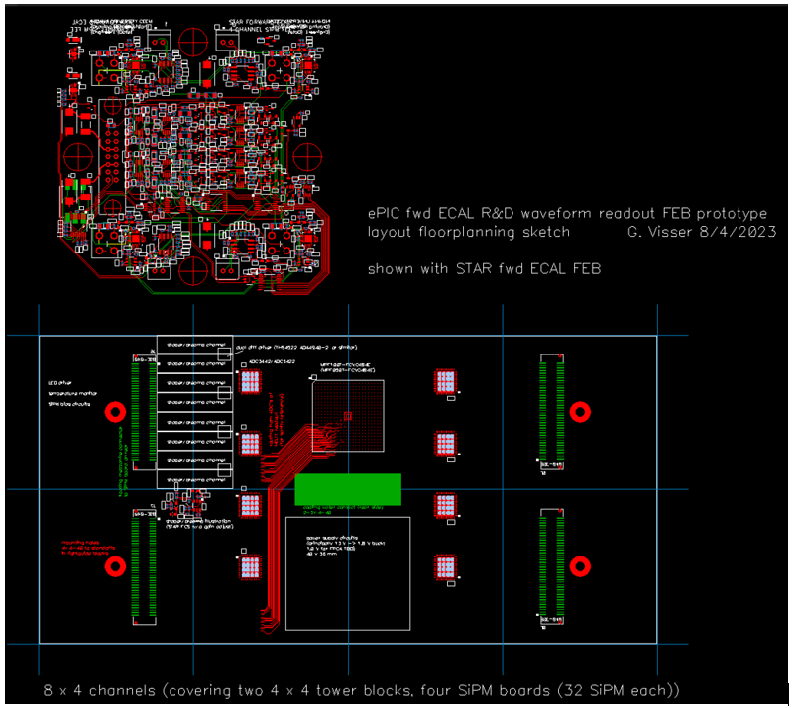
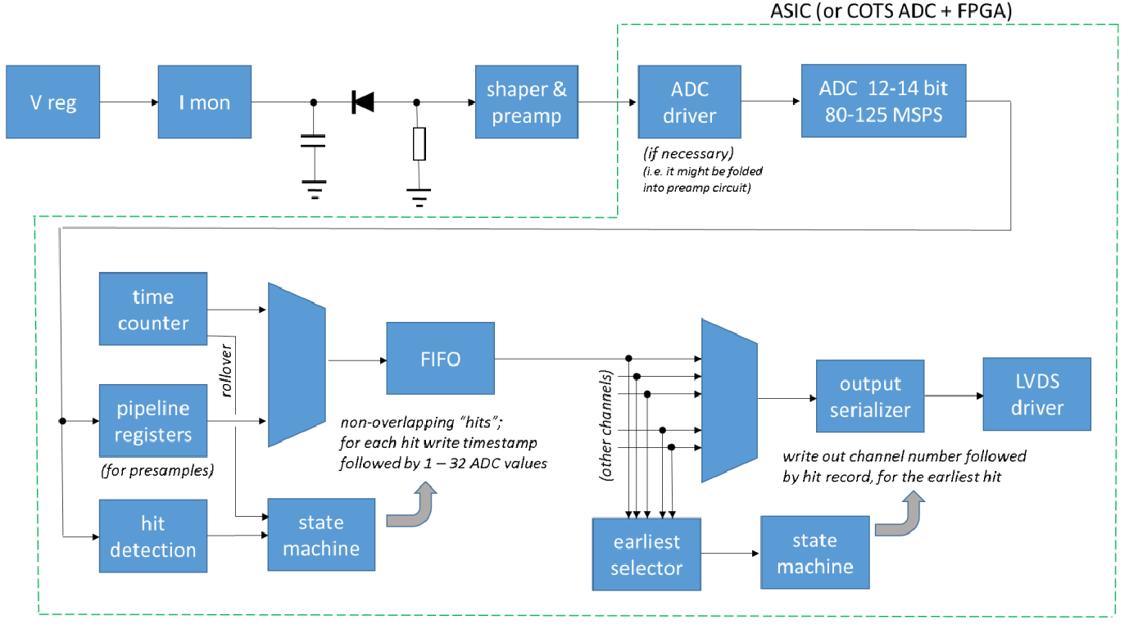
eRD109 – Discrete/COTS/ASIC (IU)
Calorimeters, SiPMs
FEB PCBs
Adapter PCB
Progress Summary:
Devices selected
DC/DC converters under tests – service reduction and baseline implementation.
PCB design is proceeding.
32 ch Waveform Digitizer
12/14-bit TI ADC3422
Microsemi MPF100T-FCVG484E Polarfire (radiation hard FPGA)
CERN DC/DC converter bPOL12V_V6 or LTC3601
Cabling, Power, Cooling, Packaging.
Design, Fab: FY23 –FY24
Tests + Beam: FY24 – FY25
Engineering Article: FY25
Production: FY25 – FY26

Slide 7
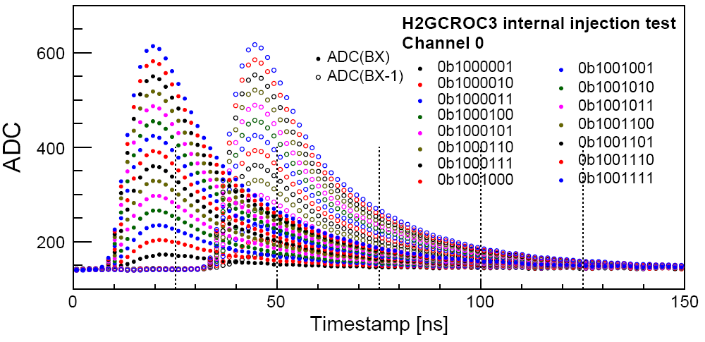
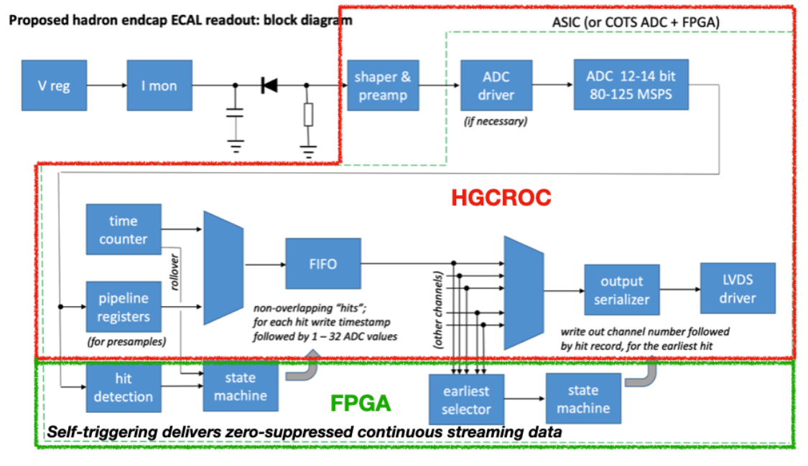
eRD109 – H2GCROC Studies (ORNL)
Calorimeters, SiPMs
Develop a readout solution for the calorimeters with SiPMs by:
Employing existing H2GCROCv3 ASIC
Developing PCBs for full readout chain
Developing cabling infrastructure
Triggered Tests,
N. Novitzky
FEB PCBs
Adapter PCBs
Progress Summary:
H2GCROC & PCBs from OMEGA with KCU105 FPGA eval kit – tests are on-going to validate streaming readout operation algorithms.
Tests confirm data from CMS operation.
Cabling studies for interconnects from FEBs to RDOs are progressing (SAMTEC connectors).
RDO PCBs

Slide 8
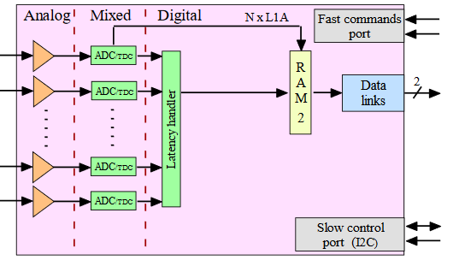
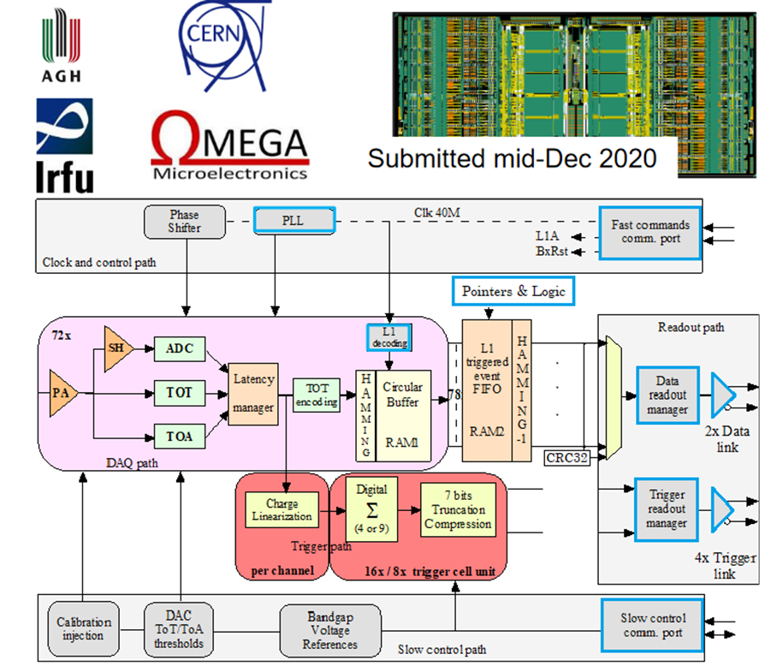
eRD109 – H2GCROC to CALOROC/ePIROC (OMEGA/IN2P3)
Calorimeters, SiPMs
H2GCROC (not Streaming Readout)
No Change
Modify trig, mem, CLK dist.
1D, 72 ch.
65 nm CMOS
Charge (ADC+TOT) + Time (TOA)
Cdin: 50-1000 pF
Dynamic Range: 1-320 pC
Timing: 100-120 ps
ADC: 10b
39.4 MHz operation from BX 98.5 MHz
Links: 1260.8 Mbps @ 39.4 MHz, multiple
Power: 10-15 mW/ch
Radiation tolerant
ASIC Progress Summary:
Preliminary specifications.
Re-design of backend is progressing:
Streaming Readout logic
Memory
Clock pre-scaling & distribution.
Design Backend: FY23 - FY24
H2GCROC (ePIROCv0): FY24 – FY25
H2GCROC (ePIROC): FY26

Slide 9
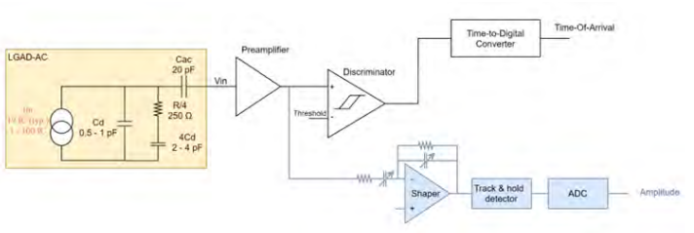
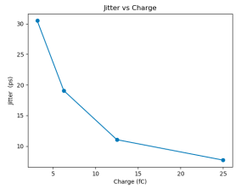
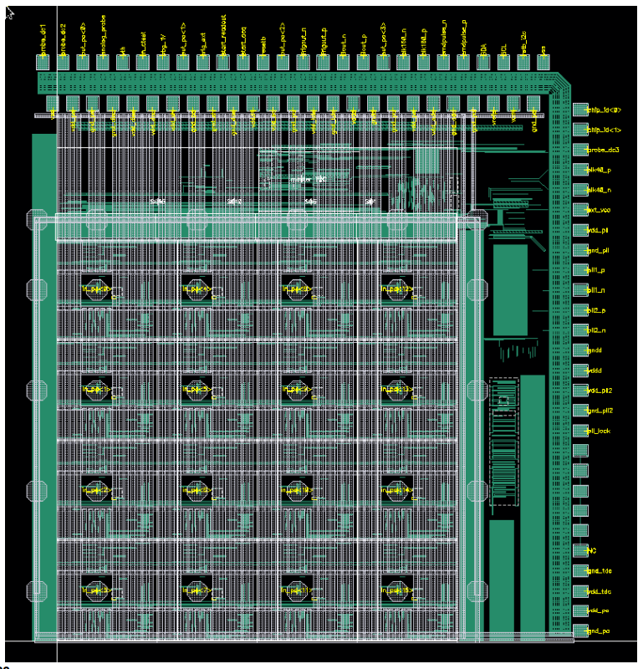
eRD109 – EICROC (OMEGA/IN2P3/IJCLab/CEA-IRFU/AGH)
AC-LGAD pixel
One pixel – EICROC0
2D, 32x32 pixel readout
65 nm CMOS
Preamp, Discriminator, TOA, ADC
Cdin: 1-5 pF
Dynamic Range: 1-50 fC
Timing: 15-20 ps
ADC: 8b
39.4 MHz operation from BX 98.5 MHz
Links: 1260.8 Mbps @ 39.4 MHz, multiple
Power: <1 mW/ch
Packaging: Bump+Wire bonds
Radiation tolerant
ASIC Progress Summary:
EICROC0 (4x4) characterization in progress.
Preamps, TDCs meet EIC requirements.
Noise coupling to ADCs is being investigated.
EICROC0_v1 – intermediate iteration to address noise coupling to be submitted soon.
Sensor
Plus backend of ePIROC
Wire
EICROC0: FY23
EICROC0_v1: FY23 – FY24
EICROC1: FY24 – FY25
EICROC2: FY26
Wire
Bump
4x4 500 um pixels

Slide 10
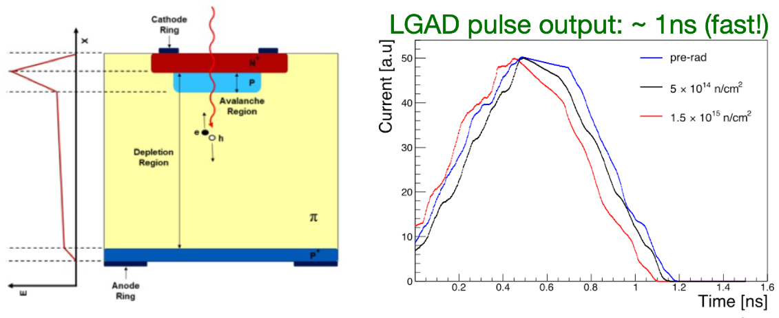
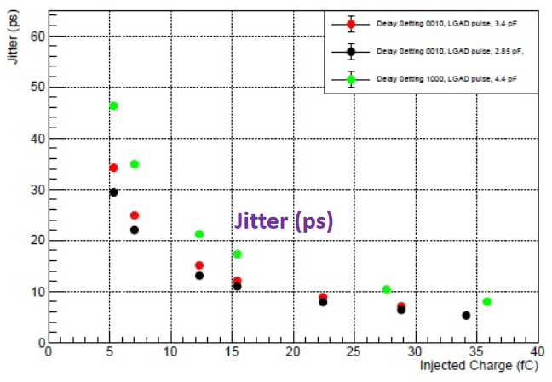
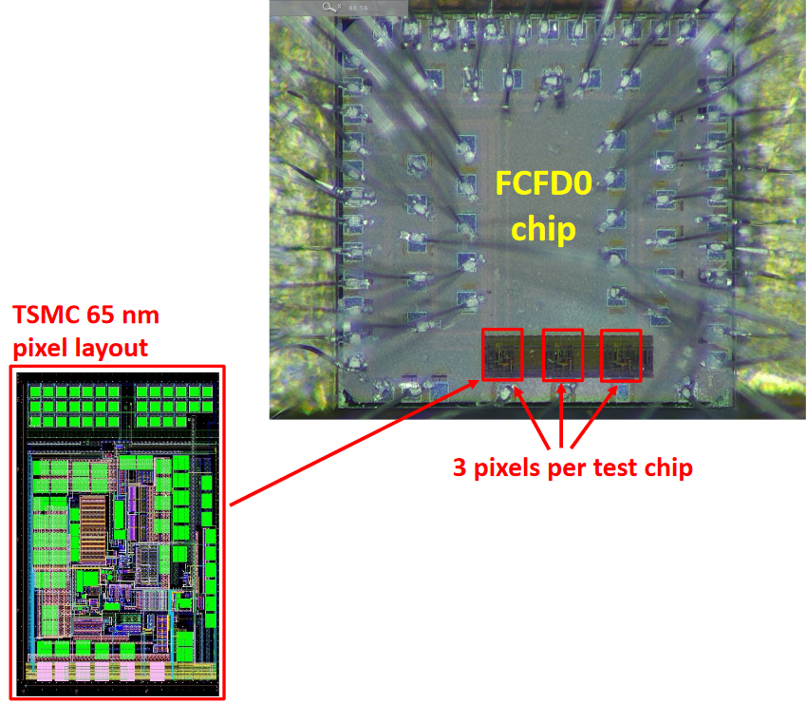
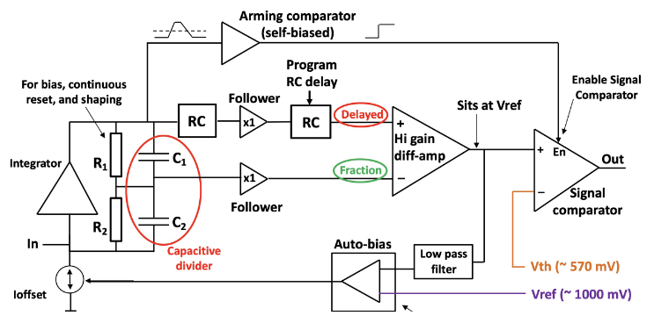
eRD109 – FCFD (FNAL)
AC-LGAD strip
128 ch strip readout
65 nm CMOS
Constant Fraction Discriminator
Plus TDC, ADC, interfaces
Cdin: <15 pF
Dynamic Range: 5-40 fC
Timing: 10-30 ps
Links: ~Gbps, multiple
ASIC Progress Summary:
FCFDv0 – characterization with charge injection, laser, beta, and proton beam.
<25 ps @ >6 fC timing.
FCFDv1 – 6 channel designed and submitted (August 2023).
Tests to start soon (December 2023).
FCFDv1: FY23
FCFDv2: FY24 – FY25
FCFDv3: FY25

Slide 11
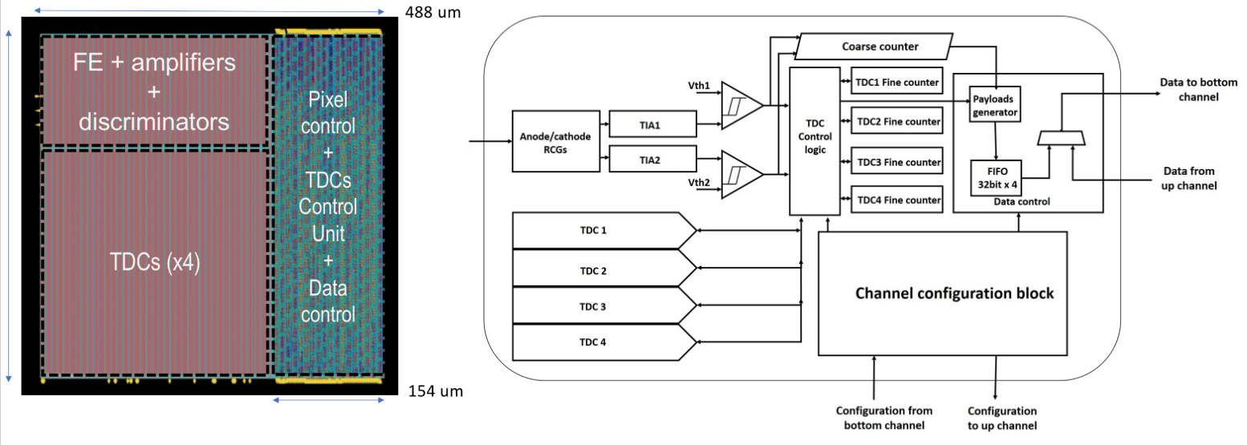
eRD109 – ALCOR (INFN)
dRICH – SiPMs, 1 p.e.
Originally developed by INFN for DARKSIDE.
2D 8x8 pixel readout
110 nm CMOS
Dual polarity, RCG Amplification, conditioning, inhibit , digitization.
Modes of operation: single-photon tagging or time and charge.
Triggerless and triggered operation.
25 ps TDCs, TOA+TOT, 5 MHz input
4 or 8x 640 Mbps LVDS links.
SPI configuration.
ASIC Progress Summary:
ALCOR v2: 32-pixel, TDC logic fix, improved gain, internal pulse generator supports both signal polarities, bias improved for reduced noise.
ALCOR v2 delivered in June 2023 and preliminary tests show promising results.
Fall 2023 beam tests with full dRICH prototype.
ALCOR v2 (32 pixel): FY23 (June 2023)
ALCOR v3: FY24 – FY26
ALCOR v4: FY26

Slide 12
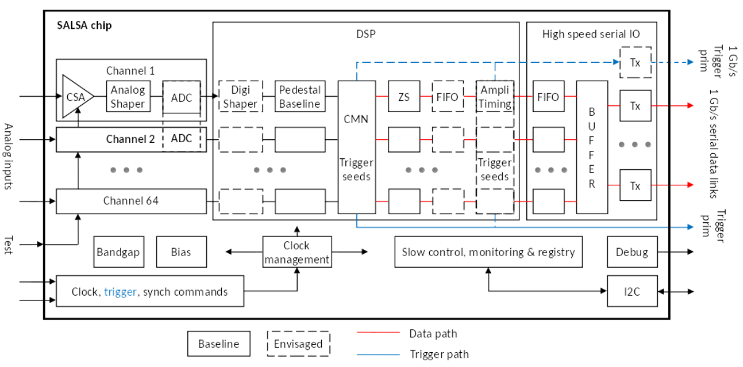
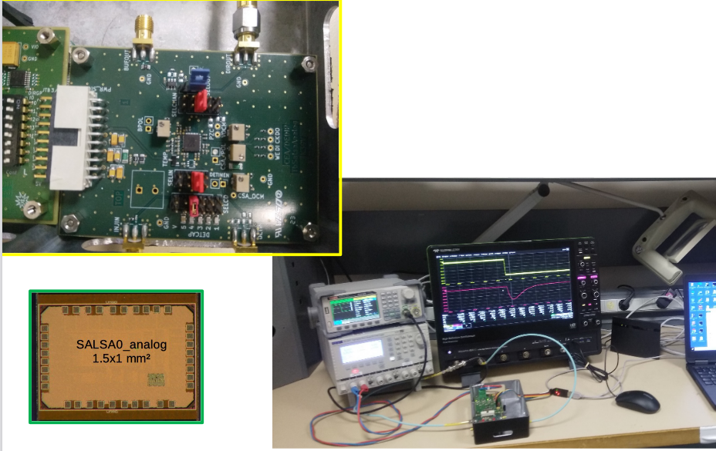
eRD109 – SALSA (CEA-Saclay, U. São Paulo)
MPGD
64 Ch
65 nm CMOS
Peaking time: 50 – 500 ns
Inputs: Cdin<200 pF; Dual polarity
Rates: ~100’s kHz
ADC: 12 bits, 5 – 50 MSPS.
Extensive data processing capabilities.
Triggerless and triggered operation.
Power: 15 mW/Ch
Several 1 Gbps links
I2C configuration
ASIC Progress Summary:
SALSA0_analog and SALSA0_digital blocks submitted and received June 2023.
SALSA0_analog performance in agreement with simulation. Some stability issues traced to PCB residues.
DSP IP block design in progress.
PLL block submitted July 2023.
SALSA0 (IP blocks): FY23 (June 2023)
SALSA1: FY23 – FY24
SALSA2: FY24
SALSAf: FY25 – FY26
SALSA: FY26

Slide 13
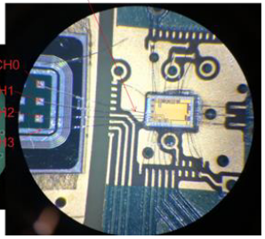
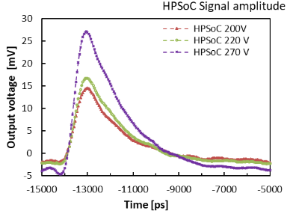
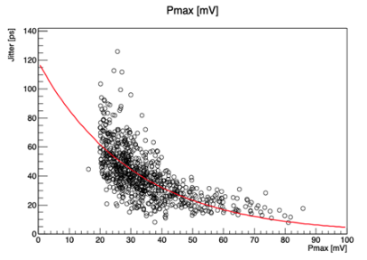
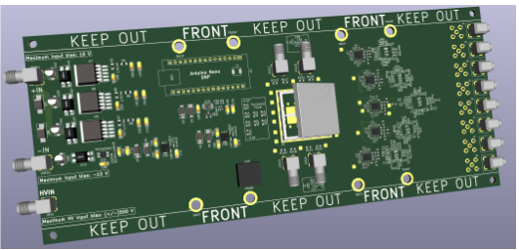
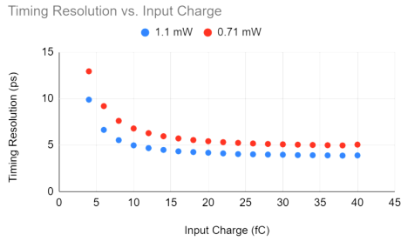
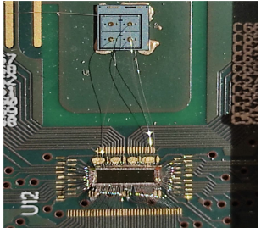
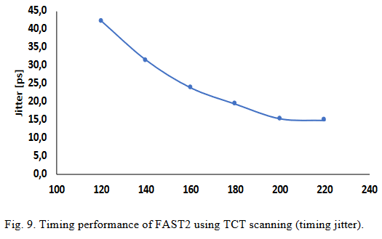
eRD109 – 3rd Party Evaluations (USC/SCIPP, JLab)
a) HPSoC (SCIPP) & HDSoc (Jlab) (NALU)
HPSoC – AC-LGAD
Waveform, 4 ch, 10 bit, 10 GSPS, 2 mW/ch, Timing precision: 10 ps – 20 ps.
HDSoC - SiPM
Waveform, 32/64 ch, 12 bit, 1 GSPS, 20-45 mW/ch, Timing precision: 80-120 ps.
b) ASROC (Anadyne)
Discriminator, SiGe BiCMOS, 16 ch, ~ 1 mW/ch, Timing precision: 5 ps – 15 ps.
c) FAST (INFN)
TDC, 110 nm CMOS, 16/20 ch, ~2 mW/ch, Timing precision: 15 ps – 45 ps.

Slide 14
Summary
ePIC is developing a streaming readout architecture, benefiting from resources within its collaboration and to meet the physics goals of the EIC.
Developing the readout electronics by building upon previous developments, with design re-use as a guiding principle:
Converging on readout and technology solutions.
Maximizing synergies.
Refining detector requirements and services to inform specifications towards final implementations.
Maturing design towards CD-2 and CD-3.
ASIC development timelines are within the R&D projected schedules but we must remain vigilant. There are no known supply-chain issues currently.
Developments are within the R&D, design, construction and installation schedules.

