Slide 1
ePIC Barrel ECal Meeting
August 22, 2023
Engineering Update

Slide 2
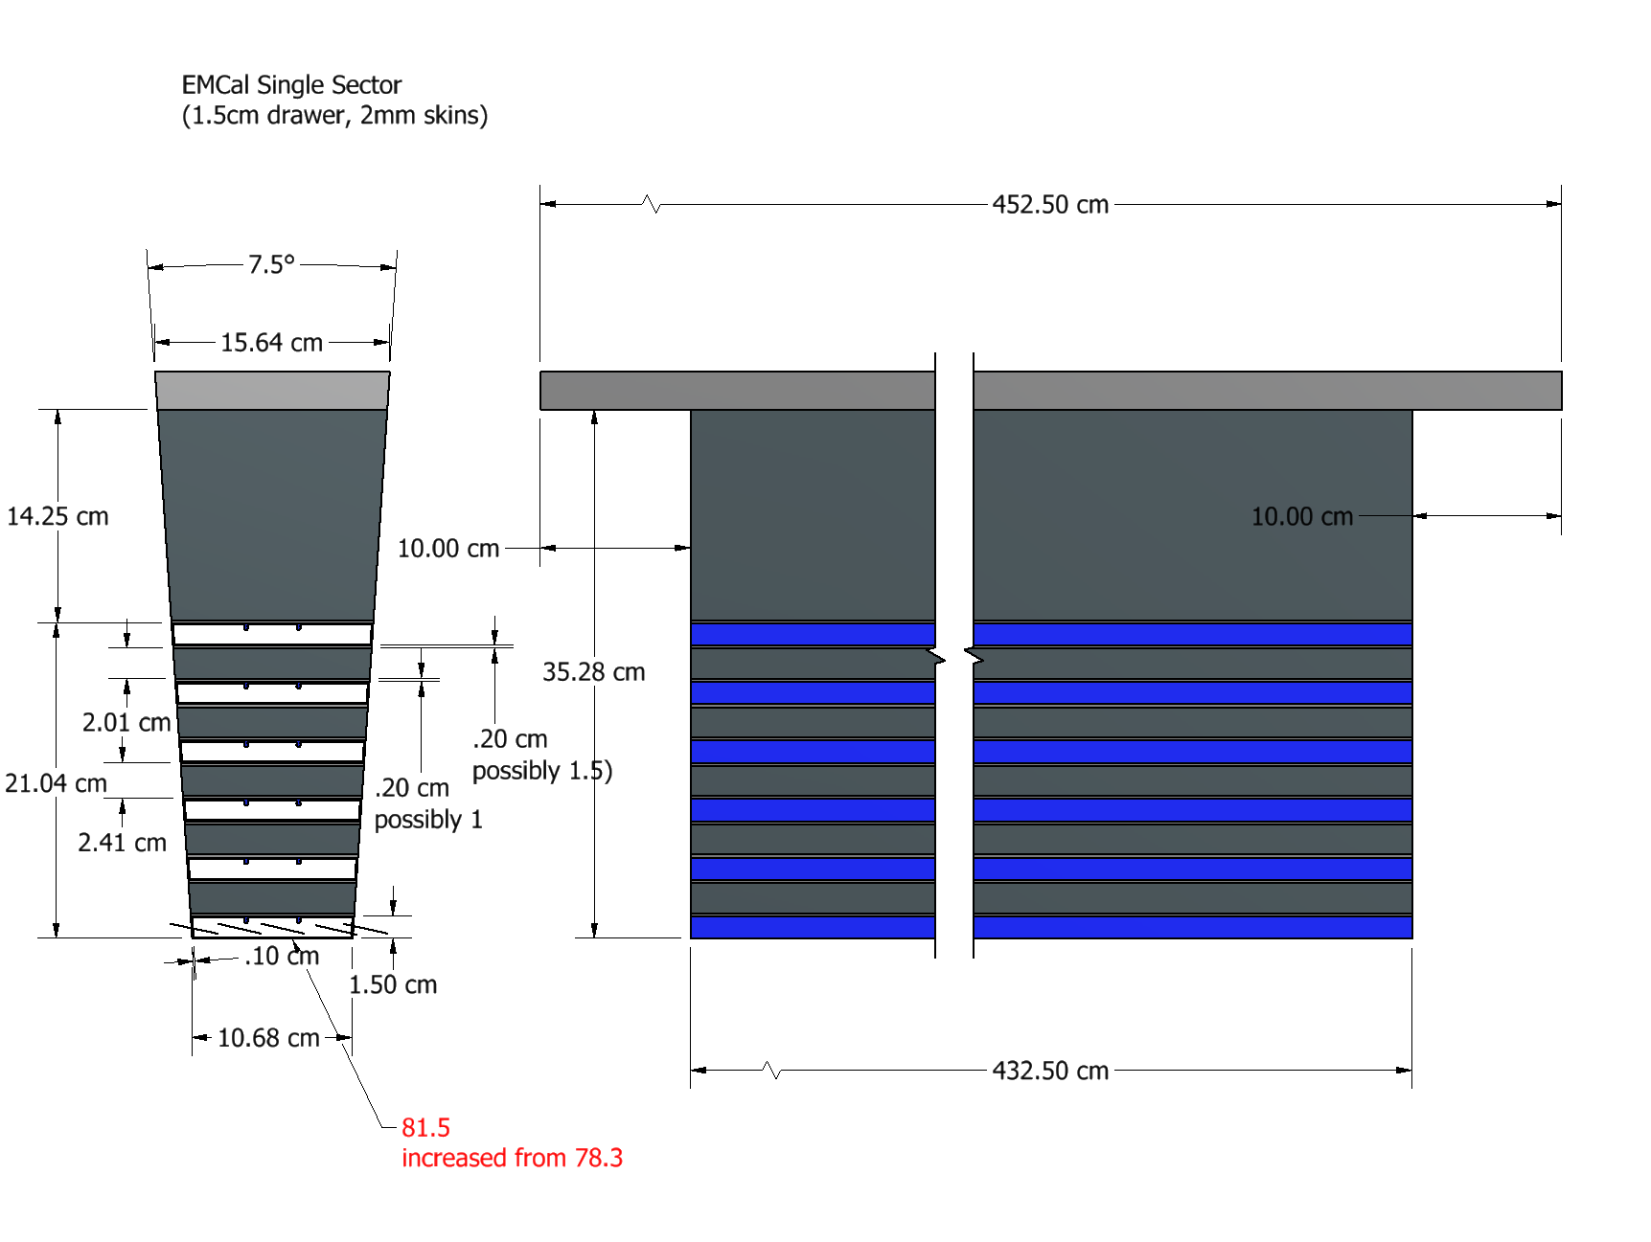
EM Cal Single Sector, Updated

Slide 3
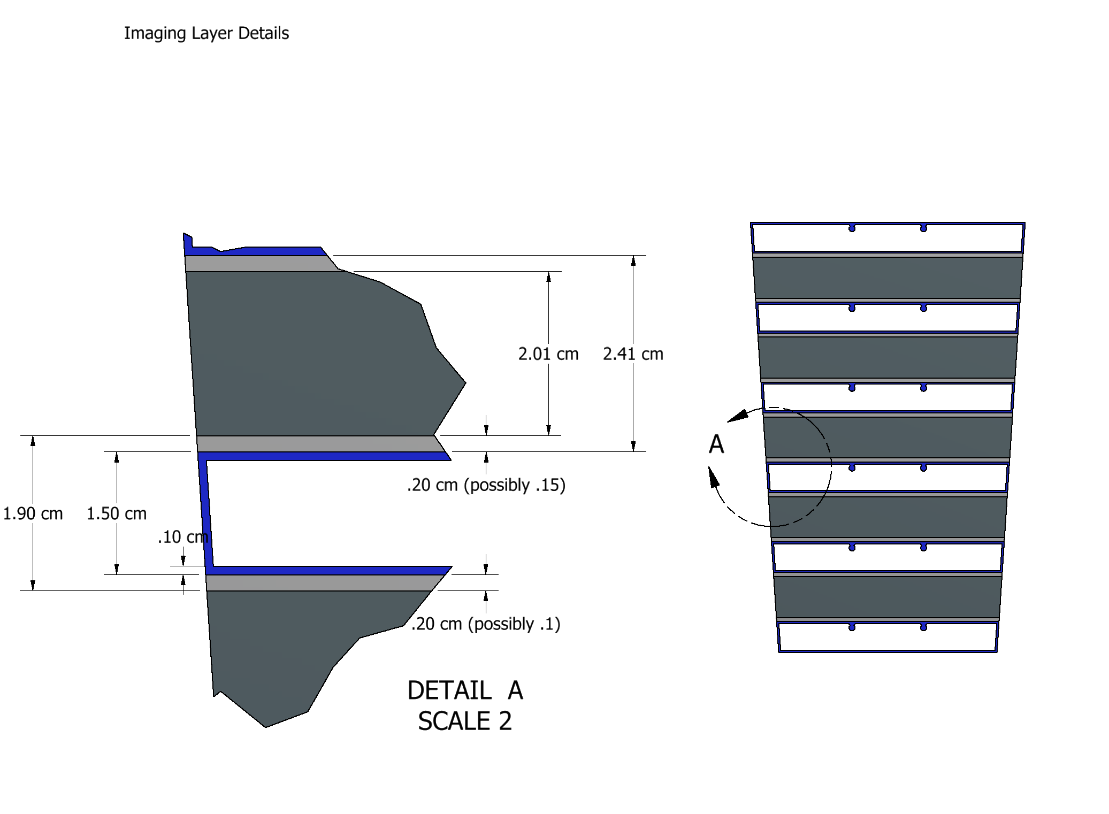
EM Cal Single Sector, Updated

Slide 4
ECal Design Changes:
Increased inner radius by 3.2cm
Reduced Astropix shelf height from 2cm to 1.5cm
Additional Al sheets for imaging Pb/SciFi layers. 2mm thick – for now
Continuous inner Astropix layer in question

Slide 5
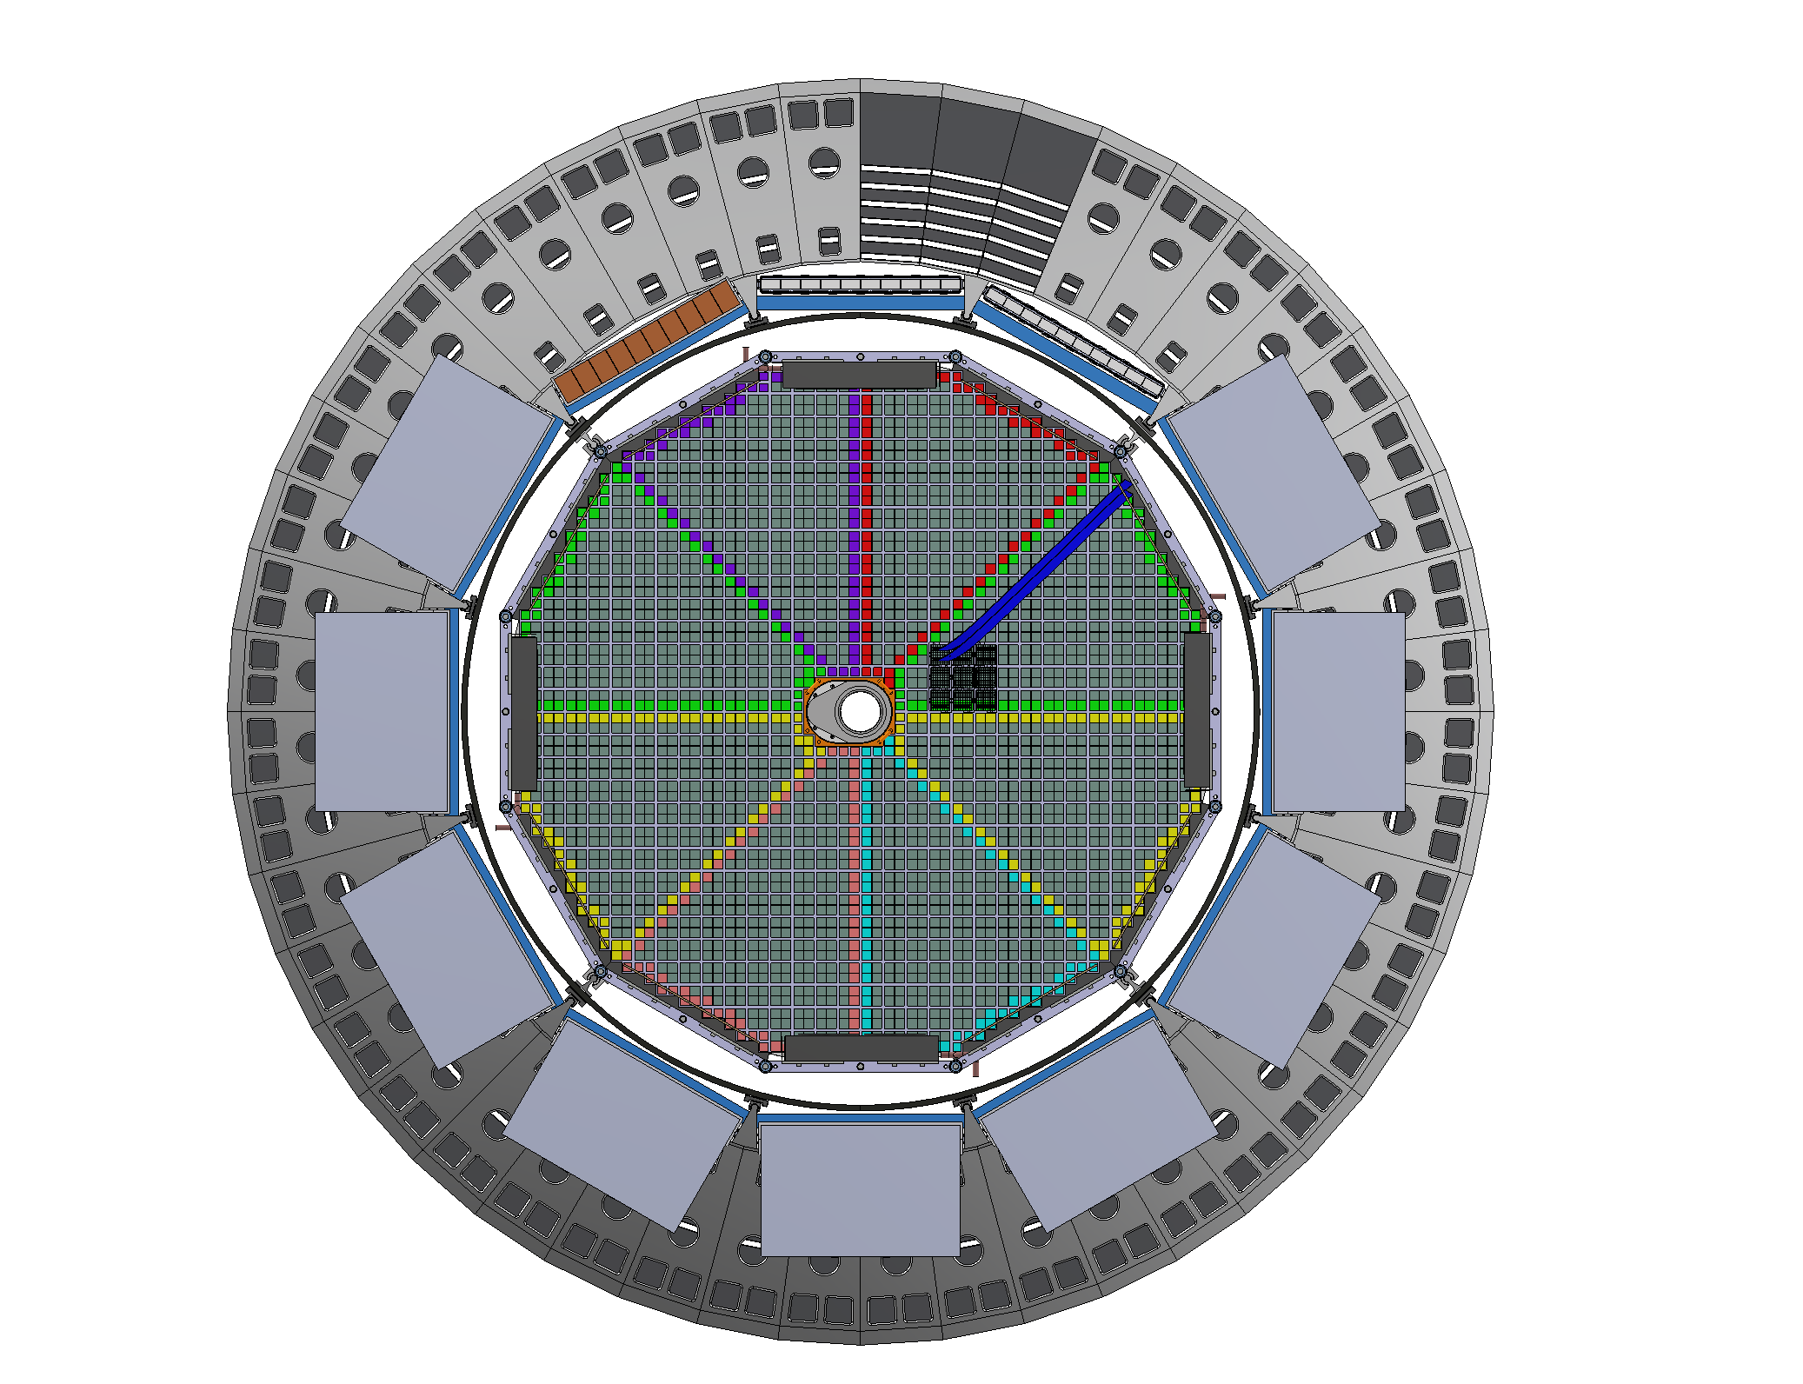
48 Sector Barrel EMCal

Slide 6
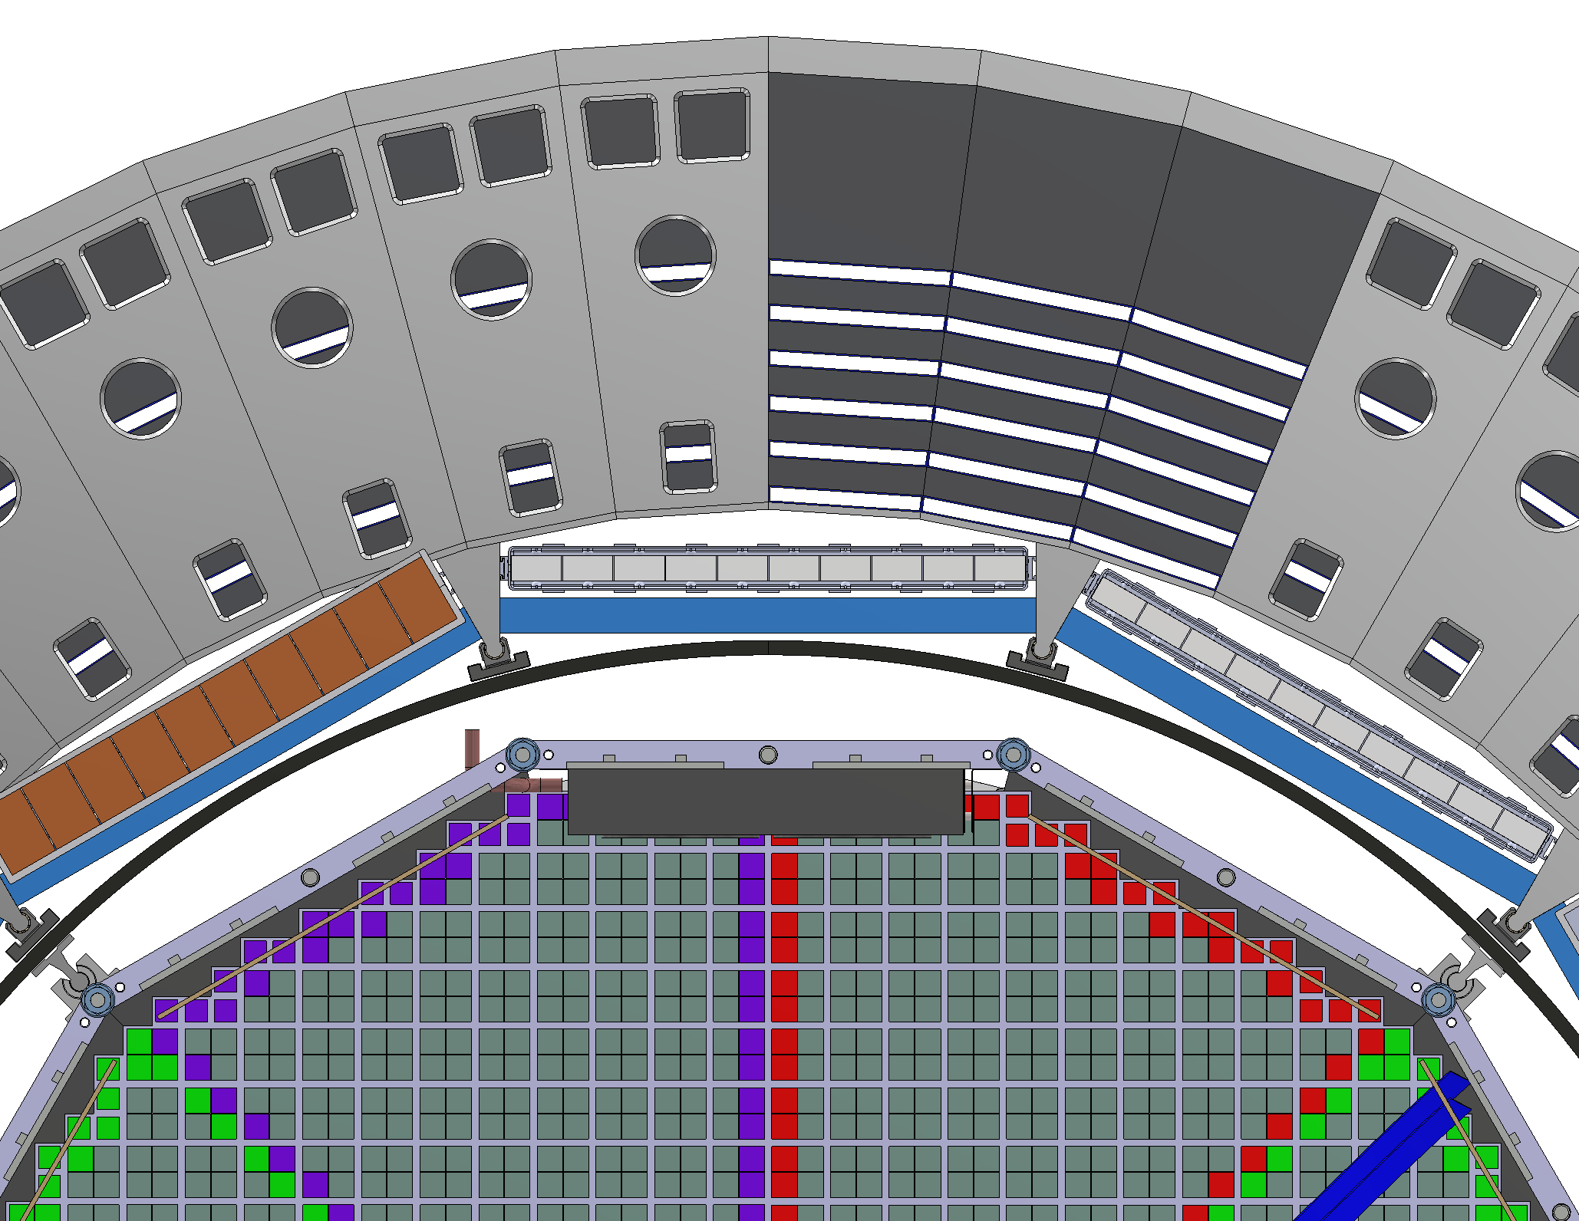
Inner Detector Mounting
81cm Inner Radius
Carbon Fiber
Tube

Slide 7
Inner Detector Mounting:
5mm plate on inside of inner astropix layer
Outer MPGD and DIRC Boxes mounted to sides of support rail
Carbon Fiber tube mounted to support rail
Inner detectors mounted to carbon tube
Design assumes closed inner astropix layer (not continuous coverage)
Design saves space and takes advantage of rigid Ecal to support inner detectors (not end mounted)

Slide 8
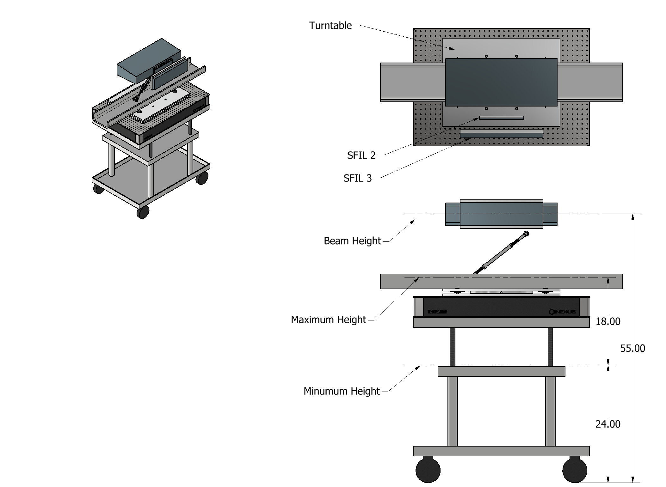
Beam Test Setup

Slide 9
Beam Test Setup:
Lifting Table/Breadboard ordered and received
Turntable identified for 10-degree(?) rotation
Astropix need to be added to configuration
Do Astropix and SFIL need to rotate?

