Slide 1
Update of INTT vs. other detectors (MBD,TPOT)
Maya SHIMOMURA

Slide 2
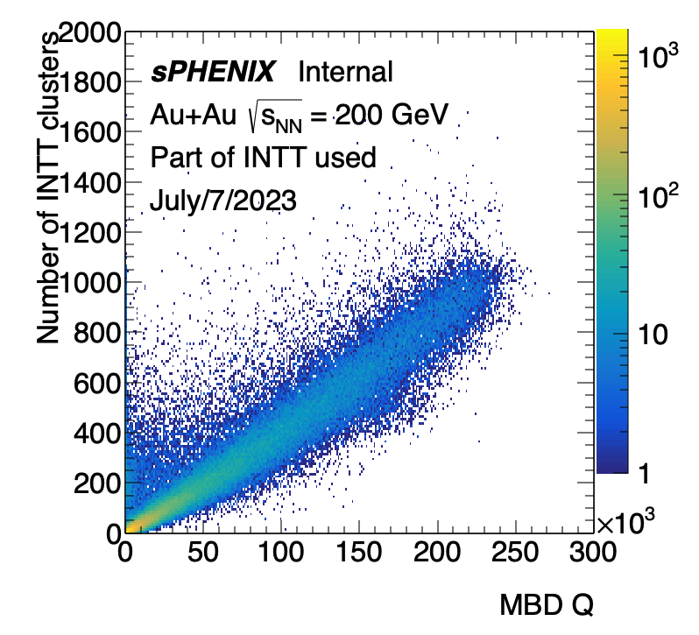
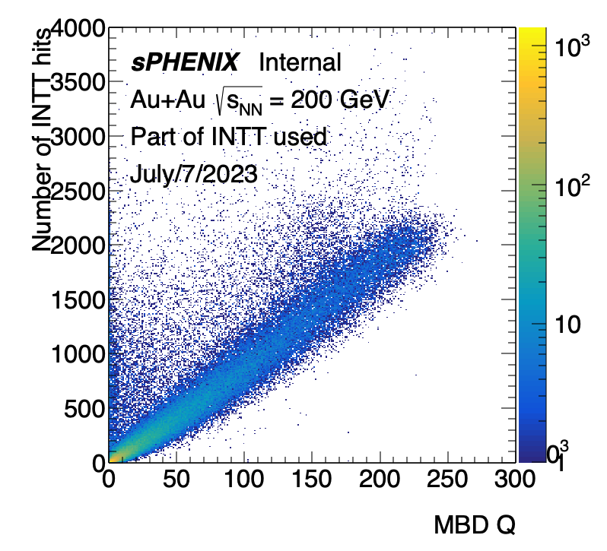
Multiplicity correlation, INTT vs. MBD
Run 20175
550K events
INTT4 only
We could see the correlation!
This is the first time we can see the correlation between Felix and DCM.

Slide 3
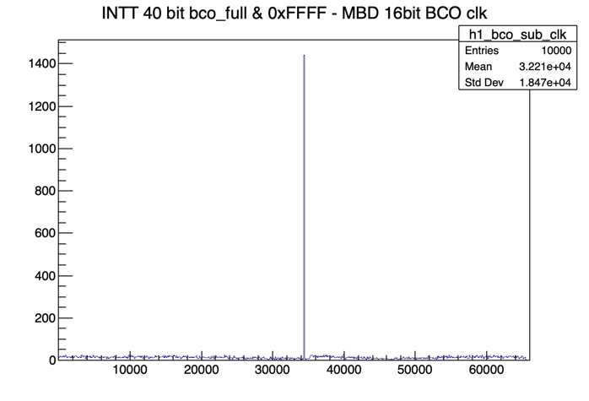
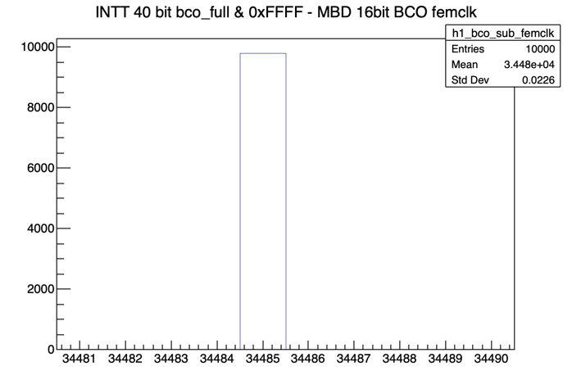
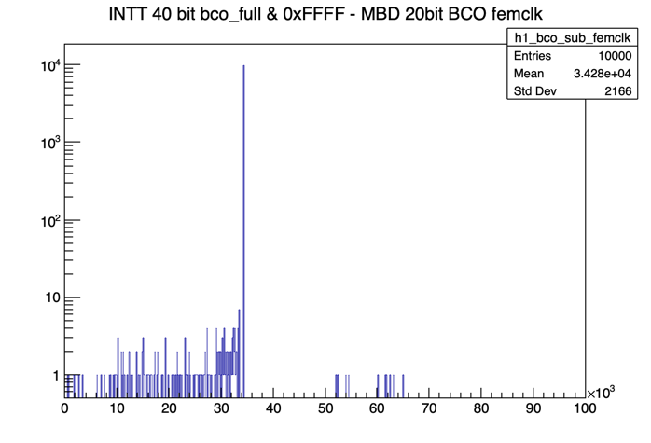
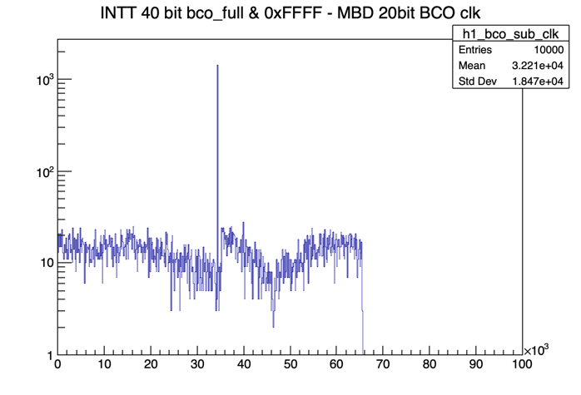
(INTT BCO_Full & 0xFFFF)- MBD (Fem)CLK
CLK
FEMCLK
FEMCLK
CLK
LOG
LOG
Almost one peak. CLK has more noise than FemCLK

Slide 4
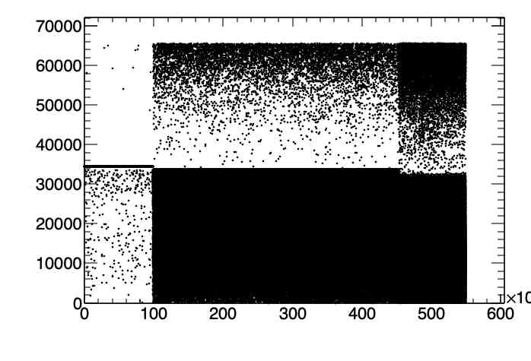
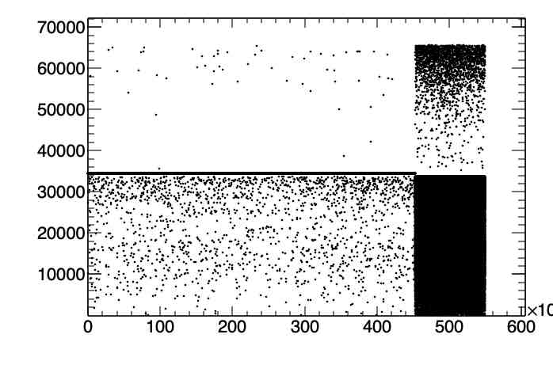
(INTT BCO_Full & 0xFFFF)- MBD FemCLK vs. event number
When I remove one event in INTT around 100K, then
It goes non-correlation around 100 K.

Slide 5
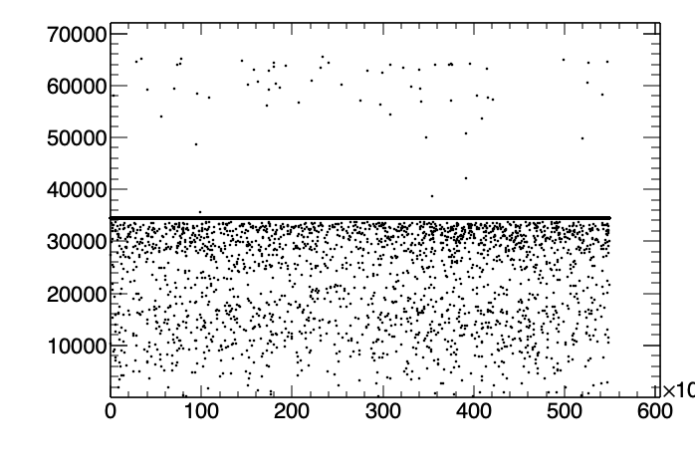
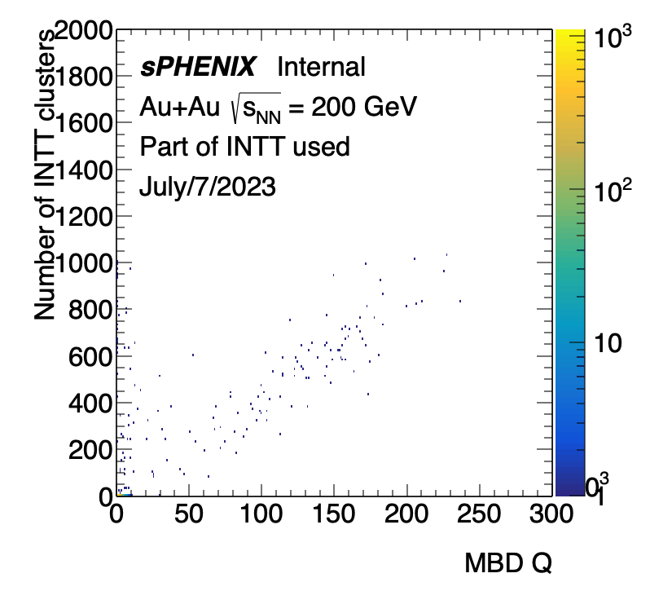
(INTT BCO_Full & 0xFFFF)- MBD FemCLK vs. event number
Even when femclk is not correlated with BCO full, events are still correlated.

Slide 6
INTT clusters/hits vs. TPOT clusters
Correlation!

Slide 7
Current status of the working INTT
Run #20885 taken on 2023/7/8
Zero Field run for INTT 0 to 7 (all)
Jaein worked for this
Intt0

Slide 8
Current status of the working INTT
Run #20885 taken on 2023/7/8
Zero Field run for INTT 0 to 7 (all)
Intt1
No signal : 1/364

Slide 9
Current status of the working INTT
Run #20885 taken on 2023/7/8
Zero Field run for INTT 0 to 7 (all)
Intt2
No signal : 1/364

Slide 10
Current status of the working INTT
Run #20885 taken on 2023/7/8
Zero Field run for INTT 0 to 7 (all)
Intt3
No signal : 10/364 due to the mask for no bias voltage chips

Slide 11
Current status of the working INTT
Run #20885 taken on 2023/7/8
Zero Field run for INTT 0 to 7 (all)
Intt4

Slide 12
Current status of the working INTT
Run #20885 taken on 2023/7/8
Zero Field run for INTT 0 to 7 (all)
Intt5
No signal : 16/364 due to the mask for no bias voltage chips

Slide 13
Current status of the working INTT
Run #20885 taken on 2023/7/8
Zero Field run for INTT 0 to 7 (all)
Intt6
No signal : 2/364

Slide 14
Current status of the working INTT
Run #20885 taken on 2023/7/8
Zero Field run for INTT 0 to 7 (all)
Intt7
Total 30/2912 =0.010

Slide 15
Back up

Slide 16
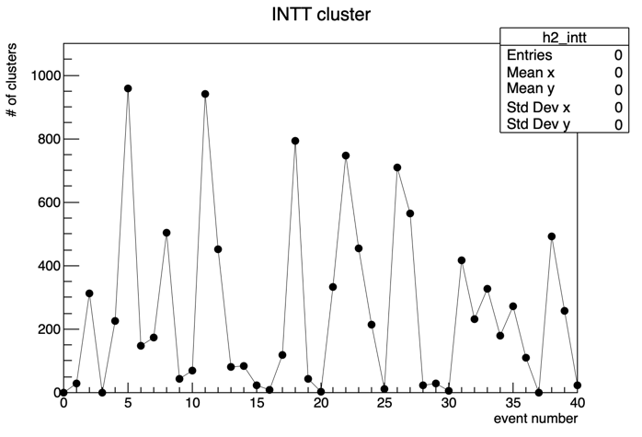
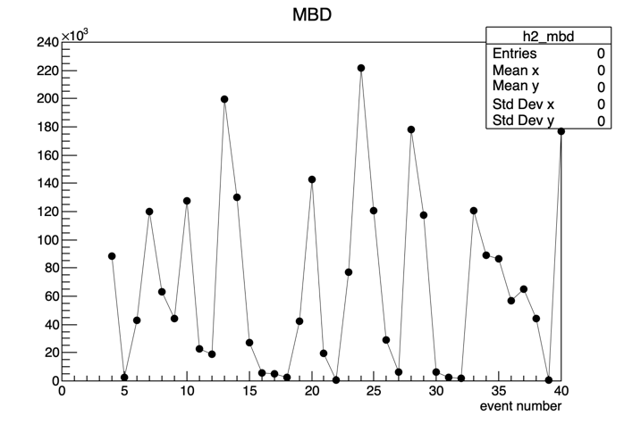
Event shifts
I check the events by eye, and found that 2 events are shifted. I should check if this offset is always 2 or not.

Slide 17
CLK and FEMCLK
CLK is a counter from the XMIT,
FEMCLK is a counter from the ADC.
One XMIT reads the data from two ADC’s. We have two XMITs, one for north (packet 1002) and one for south (packet 1001).

