Slide 1
eRD109 (ASICs/Electronics) EIC Project R&D – DAC Meeting
Fernando Barbosa (TJNAF)
L3, Chief Electrical Engineer
31 August 2023

Slide 2
Outline
Readout Channels
eRD109 – R&D Initiatives
FY23 Proposals - Progress Summary:
A – Calorimeters, SiPM - Discrete/COTS/ASIC
B – Calorimeters, SiPM – HGCROCv3
C – dRICH, SiPM – ALCOR
D - AC-LGAD – EICROC/FCFD/3rd party ASIC
E – MPGD - SALSA
FY24 Proposals & Costs
Timeline
Summary
Charge Questions:
Status, Progress, Milestones
Plans
eRD114 & eRD115
Further planning, outyears
Priorities

Slide 3
ePIC Readout Channels (w/ Project P6 updates in WBS 6.10.08)
Charge Questions: 1
Detector System | Channels | Nominal Readout Technology | eRD109 Initiatives
Si Tracking: 3 vertex layers, 2 sagitta layers, 5 backward disks, 5 forward disks | 7 m^2 36 B pixels 5,200 MAPS sensors | MAPS – ITS-3
MPGD tracking: layers + disks | 202 k | Strips | SALSA
Calorimeters: (in P6) Forward: LFHCAL pECAL Barrel: HCAL ECAL SciFi/Pb Imaging Si Backward: ECAL nHCAL | 63,280 19,000 1536 5760 500 M 3256 3240 | SiPM SiPM SiPM SiPM Si - ASTROPIXV4 SiPM SiPM | H2GCROC Discrete/H2GCROC H2GCROC H2GCROC Discrete H2GCROC
Far Forward: B0: 4 AC-LGAD layers 2 Roman Pots 2 Off Momentum ZDC: Crystal Calorimeter 32 Silicon pad layer 4 silicon pixel layers 2 boxes scintillator | 1 M 560 k x 2 320 k x 2 400 11520 160 k 72 | AC-LGAD AC-LGAG AC-LGAD APD Si AC-LGAD PMT/SiPM | EICROC EICROC EICROC Discrete/HGCROC/H2GCROC HGCROC EICROC Discrete/HGCROC/H2GCROC
Far Backward: Low Q Tagger 1 Low Q Tagger 2 2 Calorimeters | 1.3 M 480 k 700 | Si – Timepix4 Si – Timepix4 PMT/SiPM | Discrete/HGCROC/H2GCROC
PID-TOF Barrel TOF CTTL Hadron Endcap TOF FTTL | 2.2 M 5.6 M | AC-LGAD AC-LGAD | EICROCx/FCFD EICROC
PID-Cherenkov: dRICH pfRICH hpDIRC | 344,064 69632 69362 | SiPM HRPPD MCP-PMT/HRPPD | ALCOR HGCROC/EICROC/FCFD HGCROC/EICROC/FCFD
HGCROC – Si/PMTs
H2GCROC – SiPMs
EICROC – AC-LGAD
eRD109
eRD109
eRD109

Slide 4
ePIC Readout Electronics
Charge Questions: 1
EICROC and HGCROC families of ASICs have similar interfaces and follow similar developments at OMEGA/IN2P3.
Detector Group | Channels | AC-LGAD | SiPM/PMT | MPGD
 | MAPS | AC-LGAD, HRPPD | SiPM/PMT | MPGD
Tracking | 36 B |  |  | 202 k
Calorimeters | 88 M |  | 123 k
Far Forward | 300 M | 2.3 M | 170 k
Far Backward | 146 M |  | 2 k
PID |  | 7.8 M + 140k | 320 k
TOTAL | 36.5 B | 10.24 M | 615 k | 202 k
ASIC | ITS-3 | EICROC FCFD | Discrete/COTS HGCROC3 ALCOR | SALSA
HRPPD
eRD109

Slide 5
eRD109 – R&D Initiatives
Charge Questions: 1, 2
Addresses ASIC and Electronics R&D needs.
FY23 Proposals submitted in October 2022
Contract awards took longer than expected.
FY24 Proposals submitted in July 2023
Contract awards should now be in synch with FY funding
Continuation of previous work.
Duration of 4 Years.
ASIC & Electronics:
Discrete/COTS – Calorimeters, SiPMs, 12-14 bit
H2GCROC – Calorimeters, SiPMs, 10 bit
EICROC - AC-LGAD, pixel
FCFD – AC-LGAD, strip
ALCOR – dRICH, SiPM, 1 p.e.
SALSA – MPGD.
Summary follows and more details at DAC R&D Review 31 August 2023.

Slide 6
FY23 eRD109 Proposals
Charge Questions: 1
 | File | Authors | Sub-Detector | Sensor Type | Readout Solution
A | eRD109_pECAL_readout_prototype_FINAL | G. Visser (IU), et al. | Calorimeter | SiPM | Discrete, COTS
B | eRD109CalorimeterReadout | N. Novitzky (ORNL), et al. | Calorimeter | SiPM | ASIC (HGCROCv3)
C | eRD109-alcor | M. Ruspa (INFN), et al. | dRICH | SiPM | ASIC (ALCOR)
D | ACLGAD_ASIC_Electronics_FY23 | Z. Ye (UIC), et al. | Central, Far-Forward | AC-LGAD | ASIC (EICROC1, FCFD1) (2)
E | eRD109_SALSA_proposal_vfinal1 | D. Neyret (CEA), et al. | Micromegas, GEM, MicroRWell | MPGD | ASIC (SALSA)
Contract Awards – this took longer than expected.
 | Detector/Technology | Discrete/ASIC | Group | Awarded
A | Calorimeter | Discrete | IUCF | April 2023
B | Calorimeter | H2GCROC | ORNL | April 2023
C | dRICH | ALCOR | INFN | April 2023
D | AC-LGAD | EICROC | Omega/IN2P3 | See below
 |  | FCFD | FNAL | June 2023
 |  | Barrel L-M Serv. Hybrid | ORNL | April 2023
 |  | 3rd Party Evaluation | UCSC | Pending Legal
E | MPGD/µRWell | SALSA | CEA | May 2023
 |  |  | USP | May 2023
Considerable commitment of resources by OMEGA/IN2P3 will enable accelerated and targeted developments.

Slide 7
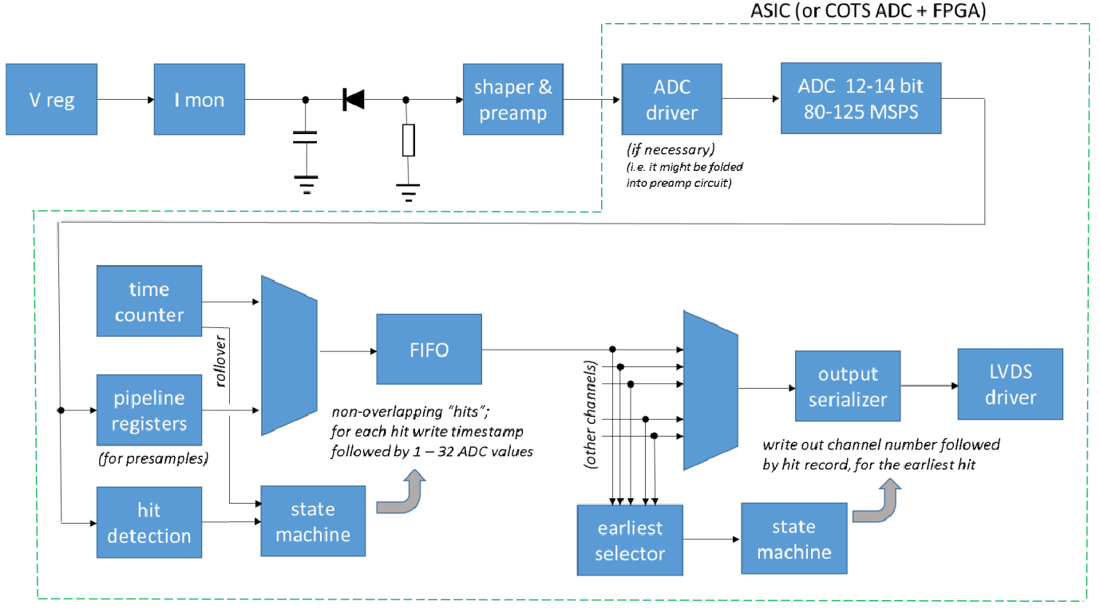
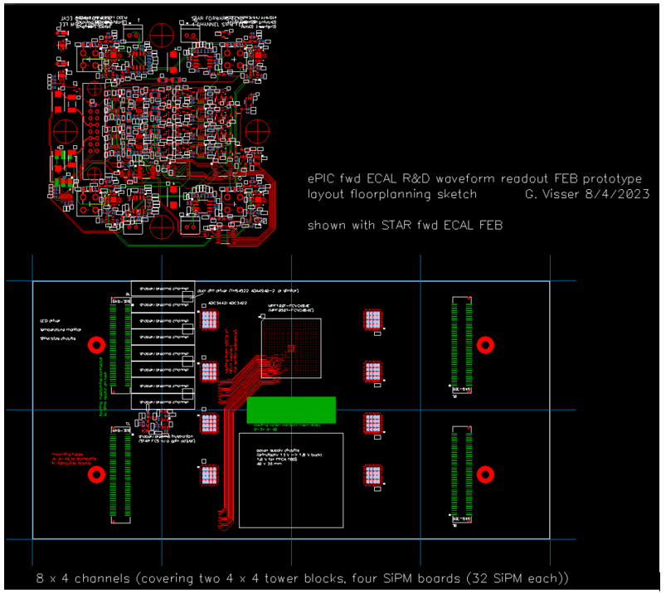
FY23 Progress
Charge Questions: 1, 2
Proposal A – Calorimeters, SiPMs – Discrete/COTS/ASIC (IU)
FEB PCBs
Adapter PCBs
32 ch Waveform Digitizer
12/14-bit TI ADC3422
Microsemi MPF100T-FCVG484E Polarfire (radiation hard FPGA)
CERN DC/DC converter bPOL12V_V6 or LTC3601
Cabling, Power, Cooling, Packaging.
Progress Summary:
Devices selected
DC/DC converters under tests – service reduction and baseline implementation.
PCB design is proceeding.
Design, Fab: FY23 –FY24
Tests + Beam: FY24 – FY25
Engineering Article: FY25
Production: FY25 – FY26

Slide 8
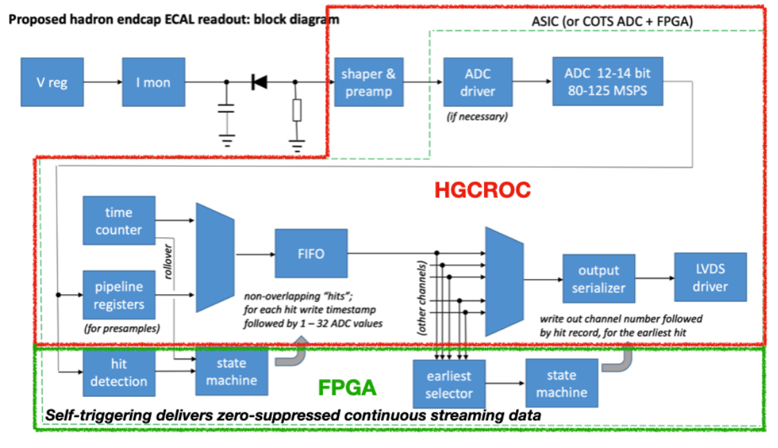
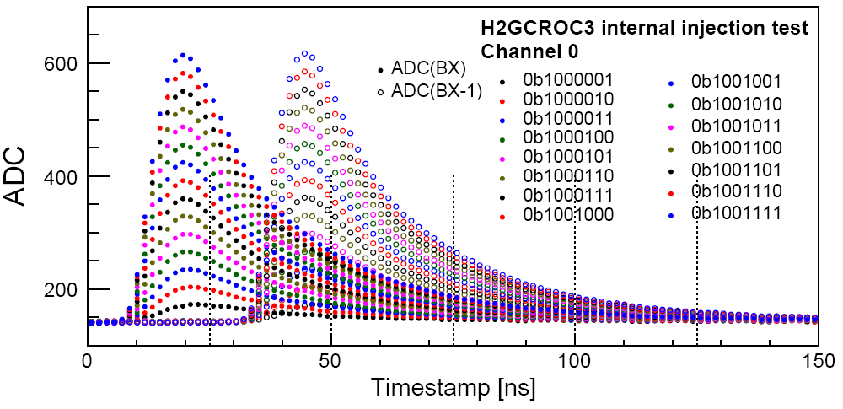
Proposal B – Calorimeters, SiPMs – H2GCROC (ORNL)
Charge Questions: 1, 2
Develop a readout solution for the calorimeters with SiPMs by:
Employing existing H2GCROCv3 ASIC
Developing PCBs for full readout chain
Developing cabling infrastructure
FEB PCBs
Adapter PCBs
Triggered Tests,
N. Novitzky
RDO PCBs
Progress Summary:
H2GCROC & PCBs from OMEGA with KCU105 FPGA eval kit – tests are on-going to validate streaming readout operation algorithms.
Tests confirm data from CMS operation.
Cabling studies for interconnects from FEBs to RDOs are progressing (SAMTEC connectors).

Slide 9
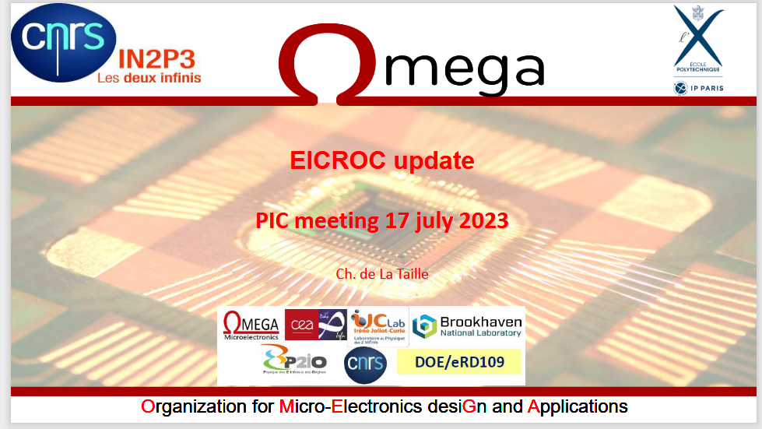
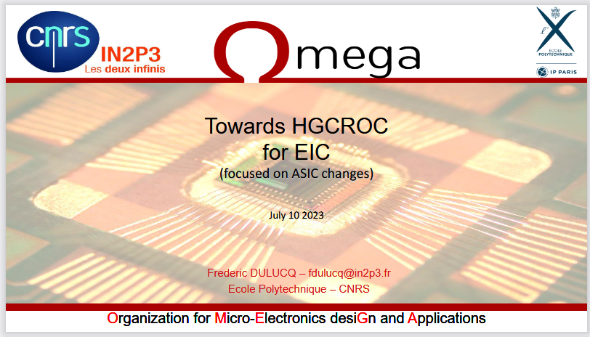
The ROC family of ASICs – a brief description – Omega/IN2P3
We have had a number of meetings with the OMEGA/IN2P3 designers – migration to streaming readout:
Charge Questions: 1, 2
Similar Interfaces, different frontends.
HGCROC - Si or PMT 72 Ch
Cd = 5-50 pF
Q = 1-10 pC
Tj = 25 ps
P = 10-15 mW/Ch
H2GCROC- SiPM 72 Ch -ePIROC?
Cd = 5-50 pF
Q = 1-10 pC
Tj = 100-120 ps
P = 15 - 20 mW/Ch
EICROC- AC-LGAD 32x32 Ch (pixel)
Cd = 1-5 pF
Q = 1-50 fC
Tj = 15-20 ps
P = <1 mW/Ch
Considerable commitment of resources by OMEGA/IN2P3 will enable accelerated and targeted developments of the H2GCROC variant and EICROC ASICs.

Slide 10
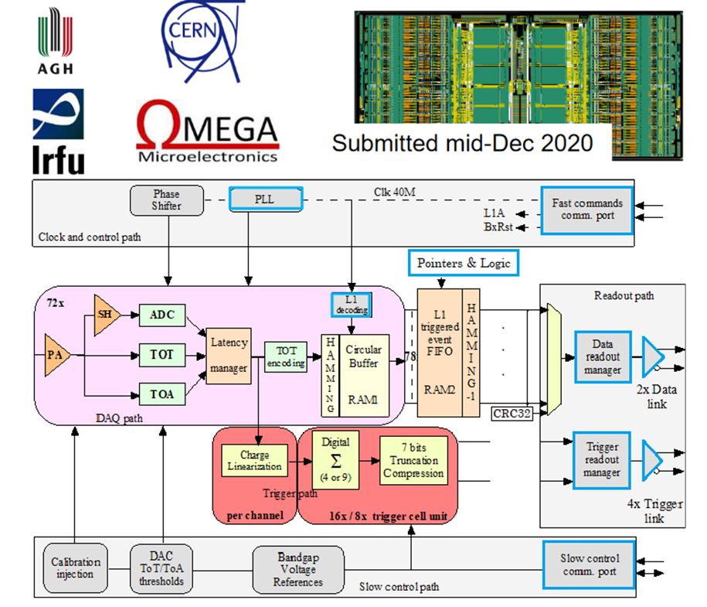
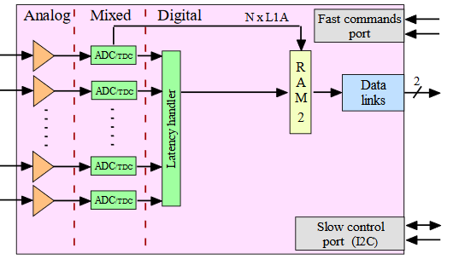
Calorimeters, SiPMs – from H2GCROC to ePIROC (OMEGA/IN2P3/ORNL)
Charge Questions: 1, 2
No Change
Modify trig, mem, CLK dist.
1D, 72 ch. (ePIC will use 64 ch of these)
65 nm CMOS
Charge (ADC+TOT) + Time (TOA)
Cdin: 5-50 pF
Dynamic Range: 1-10 pC
Timing: 100-120 ps
ADC: 10b
39.4 MHz operation from BX 98.5 MHz
Links: 1260.8 Mbps @ 40 MHz, multiple
Power: 10-15 mW/ch
Radiation tolerant
ASIC Progress Summary:
Preliminary specifications.
Re-design of backend is progressing:
Streaming Readout logic
Memory
Clock pre-scaling & distribution.
Design Backend: FY23 - FY24
H2GCROC (ePIROCv0): FY24 – FY25
H2GCROC (ePIROC): FY26

Slide 11
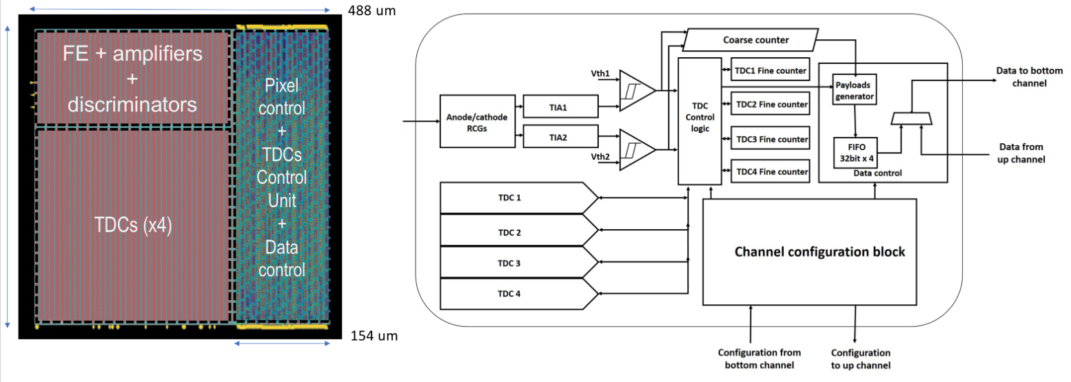
Proposal C - dRICH – SiPMs – ALCOR (INFN)
Charge Questions: 1, 2
Originally developed by INFN for DARKSIDE.
2D 8x8 pixel readout
110 nm CMOS
Dual polarity, RCG Amplification, conditioning, inhibit , digitization.
Modes of operation: single-photon tagging or time and charge.
Triggerless and triggered operation.
25 ps TDCs, TOA+TOT, 5 MHz input
4 or 8x 640 Mbps LVDS links.
SPI configuration.
ASIC Progress Summary:
ALCOR v2: 32-pixel, TDC logic fix, improved gain, internal pulse generator supports both signal polarities, bias improved for reduced noise.
ALCOR v2 delivered in June 2023 and preliminary tests show promising results.
Fall 2023 beam tests with full dRICH prototype.
ALCOR v2: FY23
ALCOR v3: FY24 – FY25
ALCOR v4: FY26

Slide 12
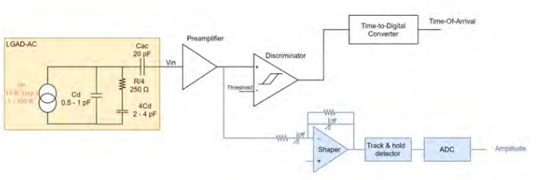
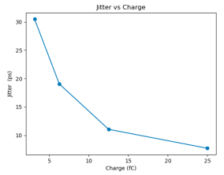
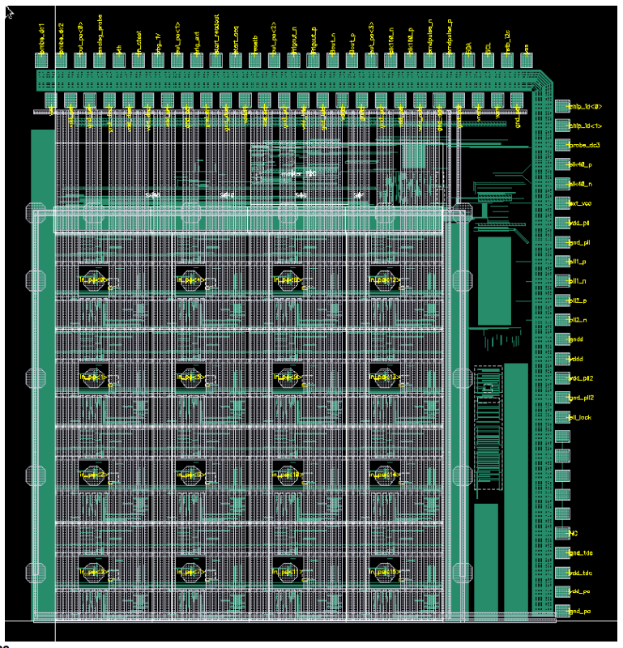
Proposal D - AC-LGAD pixel – EICROC (OMEGA/IN2P3/IJCLab/CEA-IRFU/AGH)
Charge Questions: 1, 2
2D, 32x32 pixel readout
65 nm CMOS
Preamp, Discriminator, TOA, ADC
Cdin: 1-5 pF
Dynamic Range: 1-50 fC
Timing: 15-20 ps
ADC: 8b
39.4 MHz operation from BX 98.5 MHz
Links: 1260.8 Mbps @ 40 MHz, multiple
Power: <1 mW/ch
Packaging: Bump+Wire bonds
Radiation tolerant
One pixel – EICROC0
Sensor
Plus backend of ePIROC
ASIC Progress Summary:
EICROC0 (4x4) characterization in progress.
Preamps, TDCs meet EIC requirements.
Noise coupling to ADCs is being investigated.
EICROC0_v1 – intermediate iteration to address noise coupling to be submitted soon.
Proposed ePIROC (based on H2GCROC3)
Wire
EICROC0: FY23
EICROC0_v1: FY23 – FY24
EICROC1: FY24 – FY25
EICROC2: FY26
Wire
Bump
4x4 500 um pixels

Slide 13
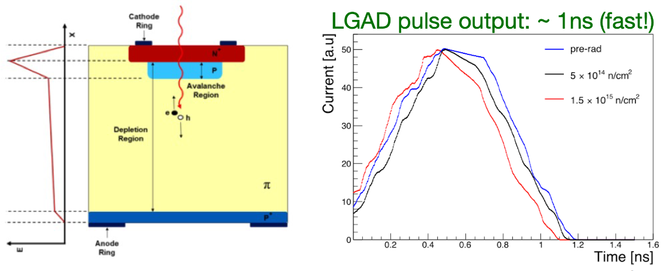
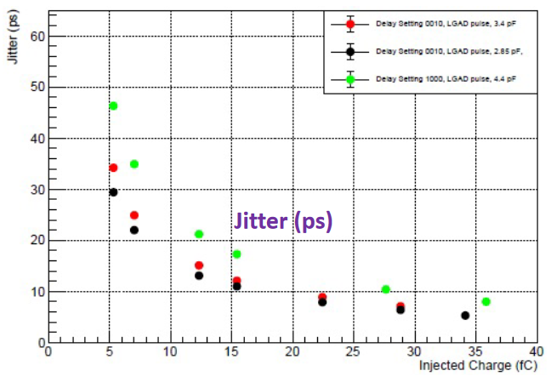
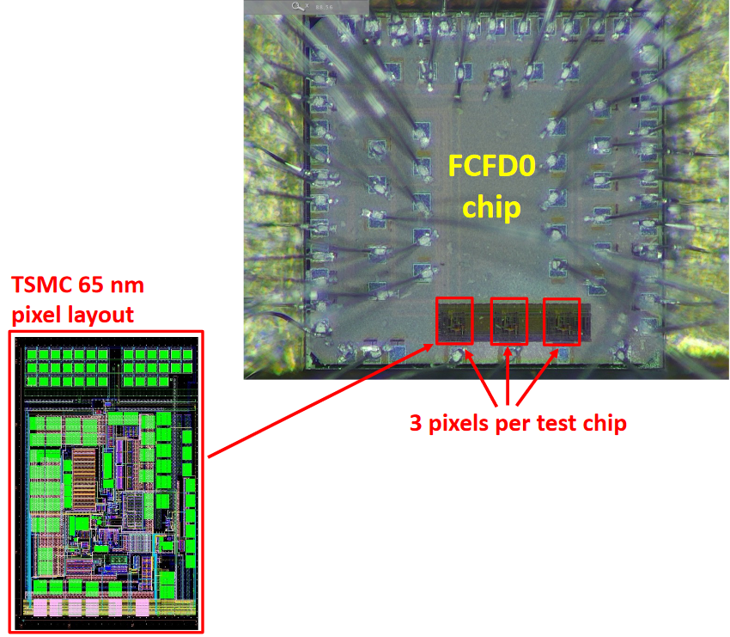
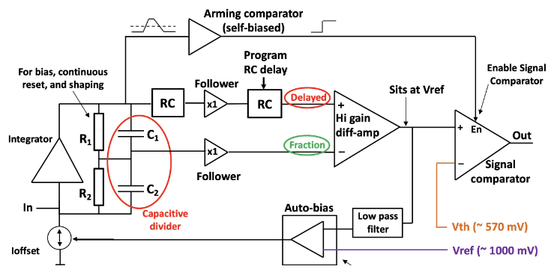
Proposal D - AC-LGAD strip – FCFD (FNAL)
Charge Questions: 1, 2
128 ch strip readout
65 nm CMOS
Constant Fraction Discriminator
Plus TDC, ADC, interfaces
Cdin: <15 pF
Dynamic Range: 5-40 fC
Timing: 10-30 ps
Links: ~Gbps, multiple
Considerable synergy with FNAL.
ASIC Progress Summary:
FCFDv0 – characterization with charge injection, laser, beta, and proton beam.
<25 ps @ >6 fC timing.
FCFDv1 – 6 channel designed and submitted (August 2023).
FCFDv1: FY23
FCFDv2: FY24 – FY25
FCFDv3: FY25

Slide 14
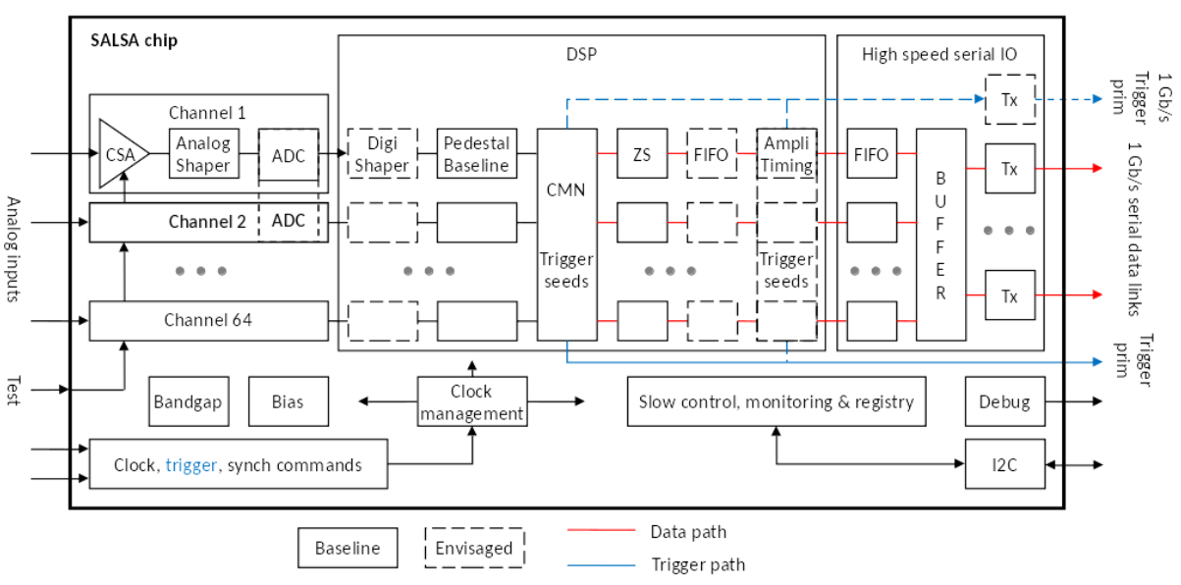
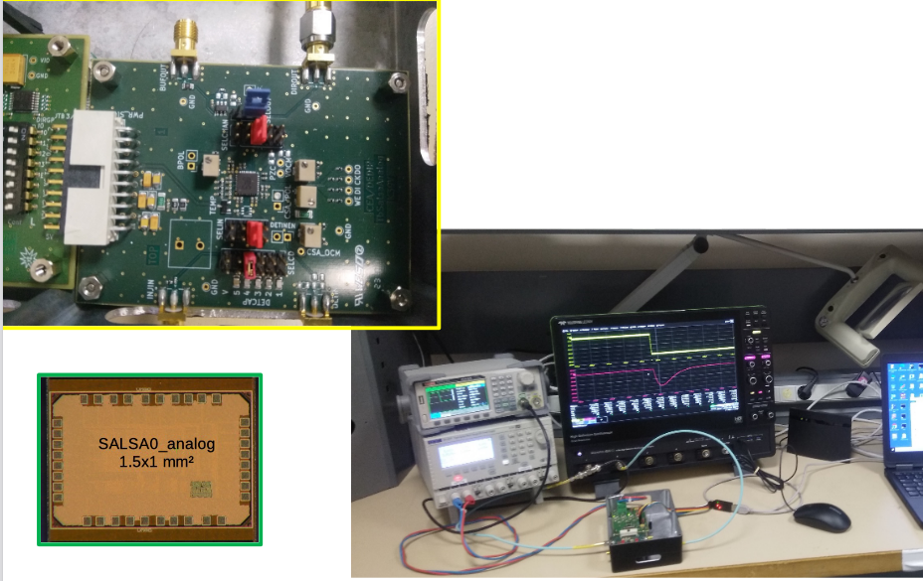
Proposal E - MPGD – SALSA (CEA-Saclay, U. Sao Paulo)
Charge Questions: 1, 2
64 Ch
65 nm CMOS
Peaking time: 50 – 500 ns
Inputs: Cdin<200 pF; Dual polarity
Rates: ~100’s kHz)
ADC: 12 bits, 5 – 50 MSPS.
Extensive data processing capabilities.
Triggerless and triggered operation.
Power: 15 mW/Ch
Several 1 Gbps links
I2C configuration
SALSA1: FY23
SALSA2: FY24
SALSAf: FY25 – FY26
SALSA: FY26
ASIC Progress Summary:
SALSA0_analog and SALSA0_digital blocks submitted and received June 2023.
SALSA0_analog performance in agreement with simulation. Some stability issues traced to PCB residues.
DSP IP block design in progress.
PLL block submitted July 2023.

Slide 15
FY24 eRD109 Proposals & Costs
Charge Questions: 2
Budget requests for each of the five (5) proposals:
 | File | Authors | FY24 ($k) | FY25 ($k) | Notes
A | eRD109_FY24_waveform_readout_prototype_Gerard | G. Visser (IU), et al. | 62 | 43
B | eRD109ProposalFY24_Norbert | N. Novitzky (ORNL), et al. | 84.4 | 82.4 | Note 1
C | eRD109-application_ALCOR_INFN_TO_BO_Michela | M. Ruspa (INFN), et al. | 60 | Not provided | Note 2
D | eRD109-FY24-20230710_Zhenyu | Z. Ye (UIC), et al. | 390 | Not provided | Note 3
E | eRD109_2024_SALSA_proposal_vfinal2_Damien | D. Neyret (CEA), et al. | 221 | 300 | Note 4
Note 1: ORNL $64 k; IJCLab $20.4 k.
Note 2: INFN-BO $20 k; INFN-TO $40 k.
Note 3: proposal D is further detailed as follows:
FY24 proposals continue the work started in FY23.
Plus realization of the 5 ps precision clock distribution with AC-LGAD+EICROC0.
 | ACLGAD_ASIC_Electronics_FY24 | FY24 ($k)
1 | EICROC ASIC (IJCLab) | 85
2 | FCFD ASIC | 40
3 | Barrel Low-Mass Service Hybrid (ORNL) | 45
4 | High Precision Clock Distribution (BNL/Rice/UIC) | 220
Mostly labor for development of associated PCBs, circuitry, etc. for readout.
High Precision Clock Distribution allocation: BNL $137 k; Rice $49 k; UIC $34 k.
Note 4: IRFU $157 k; USP $64 k.

Slide 16
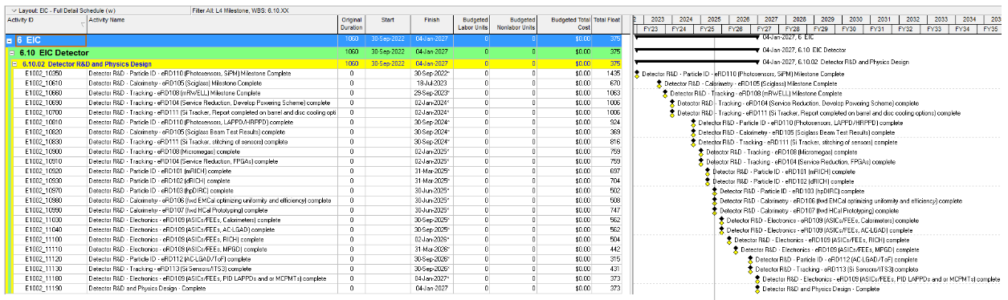
Timeline
Charge Questions: 1, 2
eRD109 schedules in P6 – from Thomas U. talk:
eRD109 in P6 End Date Readout
Calorimeters 9/30/2025 Discrete/H2GCROC
AC-LGAD 9/30/2025 EICROC/FCFD
dRICH 1/2/2026 ALCOR
MPGDs 3/31/2026 SALSA
LAPPD/MCPMT 1/4/2027 EICROC/FCFD
FCFD or a variant of the EICROC will address the readout needs of the Barrel TOF (AC-LGAD strips), pfRICH and hpDIRC (HRPPD/MCP-PMT).

Slide 17
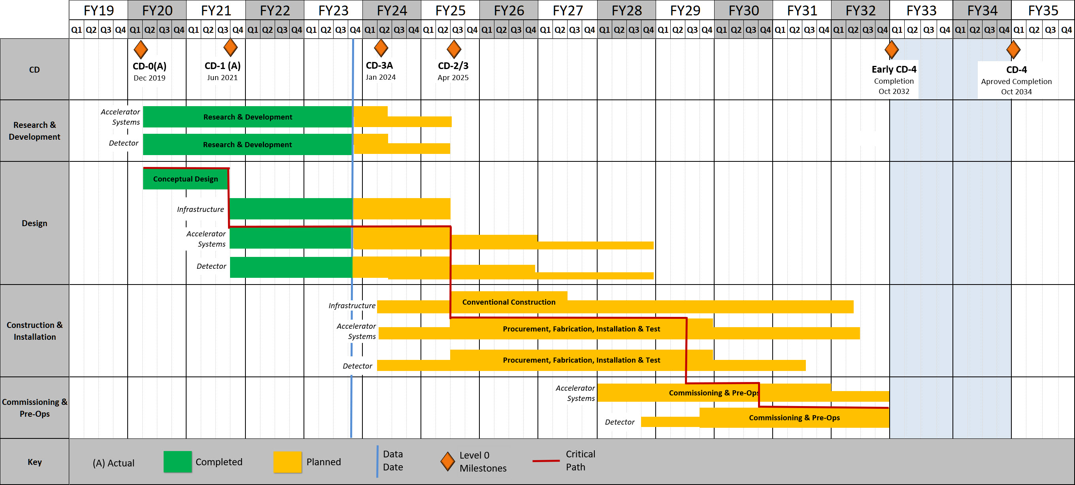
Timeline (continued)
Charge Questions: 1, 2
eRD109 and project timelines:
eRD109 until mid FY27
(refer to talk by Thomas U.)
ASIC Production mostly in FY26
R&D
Engineering Articles
Design until 9/2028
Construction
4/2025 to 4/2031
Bulk of Construction & Installation phase for Electronics: April 2025 – October 2029.
Installation of some items may be extended to April 2031.

Slide 18
Summary
There were delays in awarding FY23 eRD109 contracts, ~6 months relative to the start of the FY23 funding. However, there has been good progress overall.
FY24 eRD109 proposals submitted by 7 July 2023. Contract awards are more likely to coincide with FY24 funding (October 2023) and also due to continuation of FY23 efforts. This will help better align projects with funds and will allow projects to continue uninterrupted.
Continue gathering and refining detector requirements (ch rates, Cdin, etc.) and services to inform electronics specifications towards final implementations, ~Fall 2023.
Initial assessment of a 4-Year R&D cycle still applies and in agreement with “Assessment of R&D Needs for an EIC Detector” document.
These 5 proposals are distinct, cover and inform packing form-factors and integration into the various sub-detectors. These also address technical risk factors for the realization of the EIC and its physics reach.
Consideration for funding of these proposals is essential to ensure timely developments in agreement with the EIC project schedules.

