Slide 1
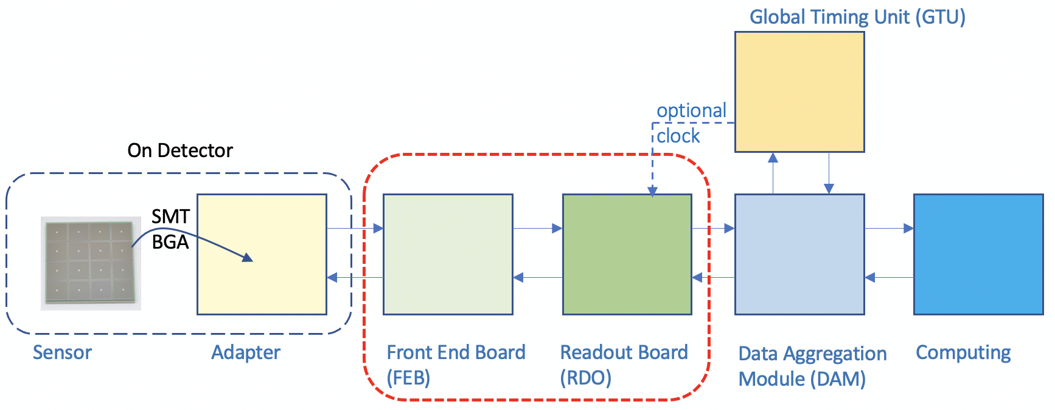
RDO Specifications/Guidance
Nominally 2.5 in² for common RDO components including FPGA and optical link options (for example if it is integrated on the same PCB as the FEB). For standalone RDO, allow for up to 4 in² to provide space for copper-based connectors to FEBs.
Power requirements: 3-5 Watts. Allow for at least two LV levels nominally 5V (for optics) and a lower voltage for FPGA power and ASIC signal management.
Consider using radiation tolerant switching voltage regulators (e.g. from CERN).
Multiple optical link interfaces allow for flexible implementation of the RDO as either a standalone readout solution or use with the DAM boards. They can also be used for accepting an alternative low-jitter clock input.
Samtec Firefly connectors are also a potential option as they have a footprint similar to VTRX and also provide MTP options.
2.5 “
SFP+ Cage
Connectors
Artix
Ultrascale+
2.5 “
VTRX+
4 “
4 “
Connectors

