Slide 1
eRD110 DAQ
Miklós CZELLER, Gábor NAGY
2023-07-19

Slide 2
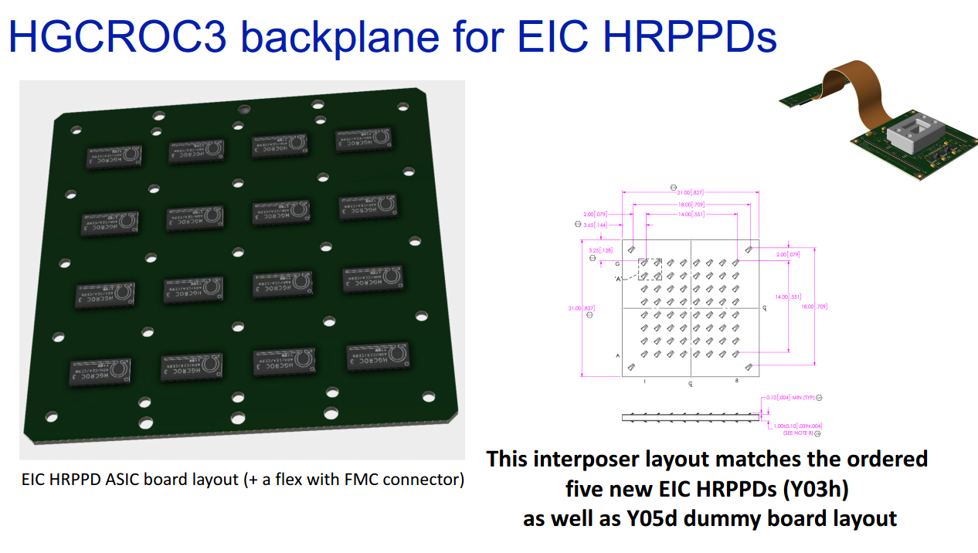
ASIC PCB

Slide 3
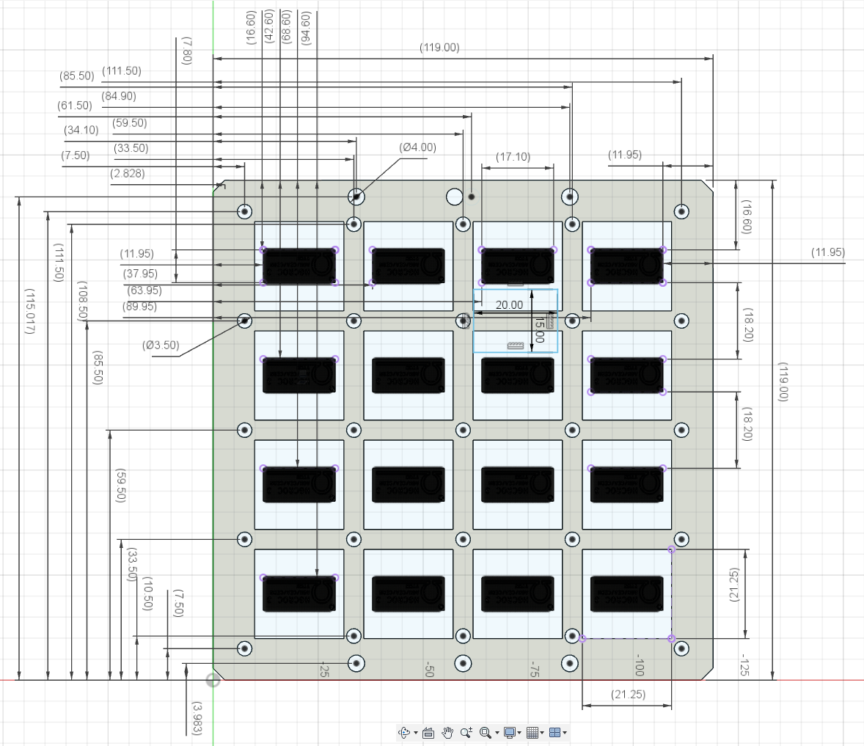
ASIC PCB - Dimensions

Slide 4
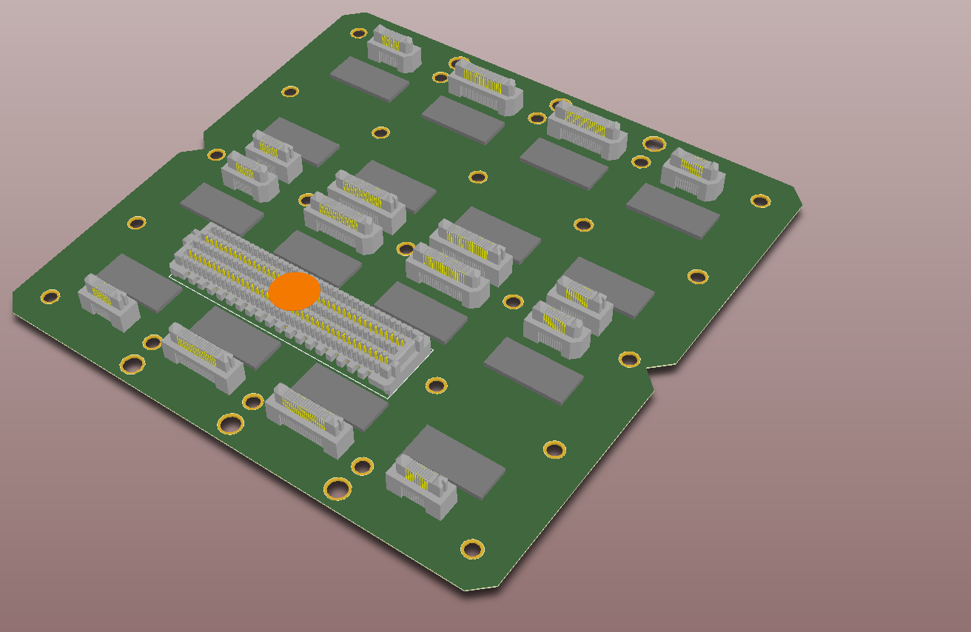
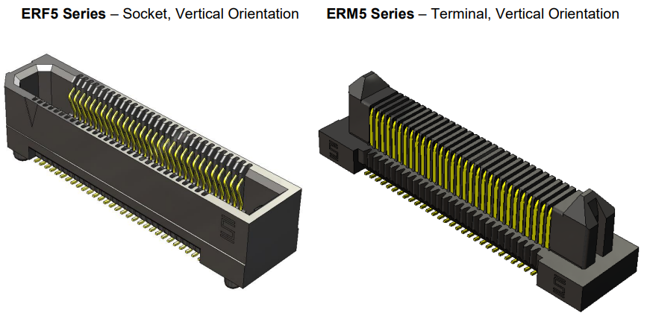
ASIC PCB - Dimensions
SAMTEC 0.50 mm Edge Rate®
Rugged High Speed Terminal
ERM5-020-05.0-L-DV-TR
ERM5-010-05.0-L-DV-TR

Slide 5
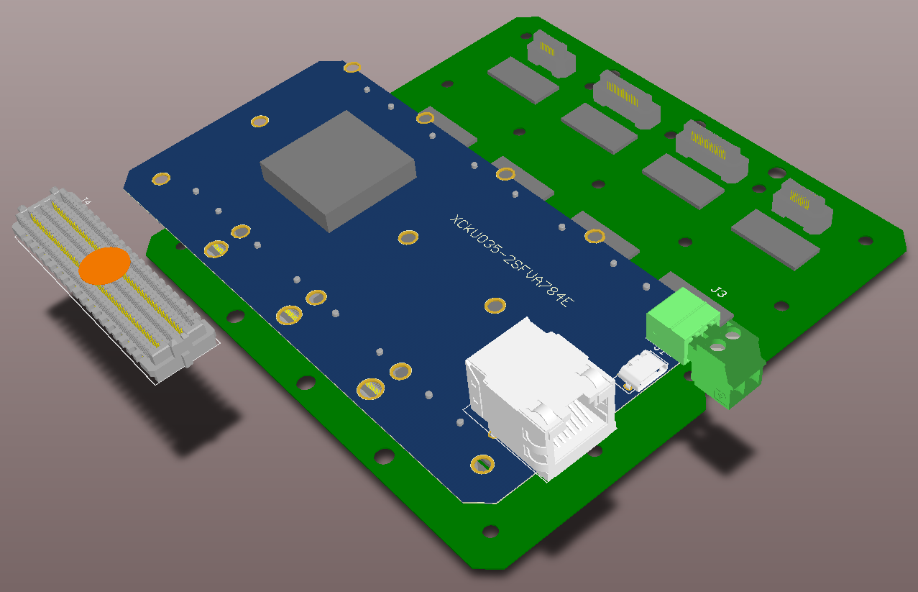
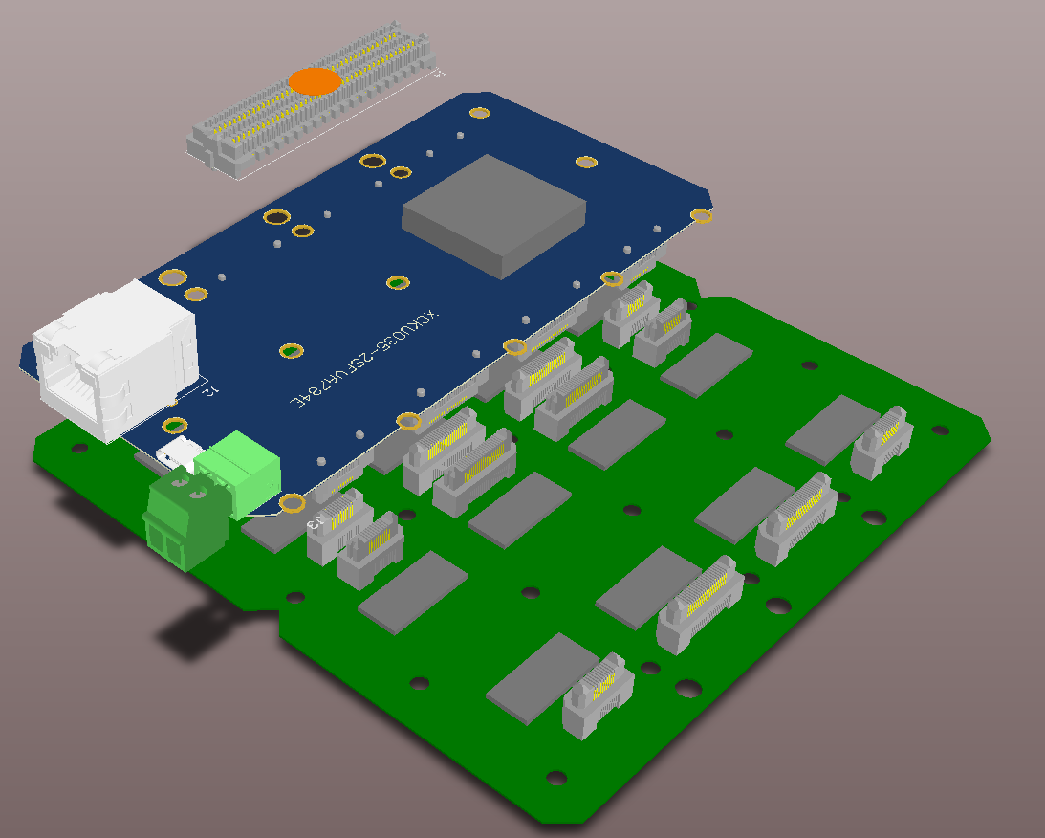
ASIC PCB - FPGA

Slide 6
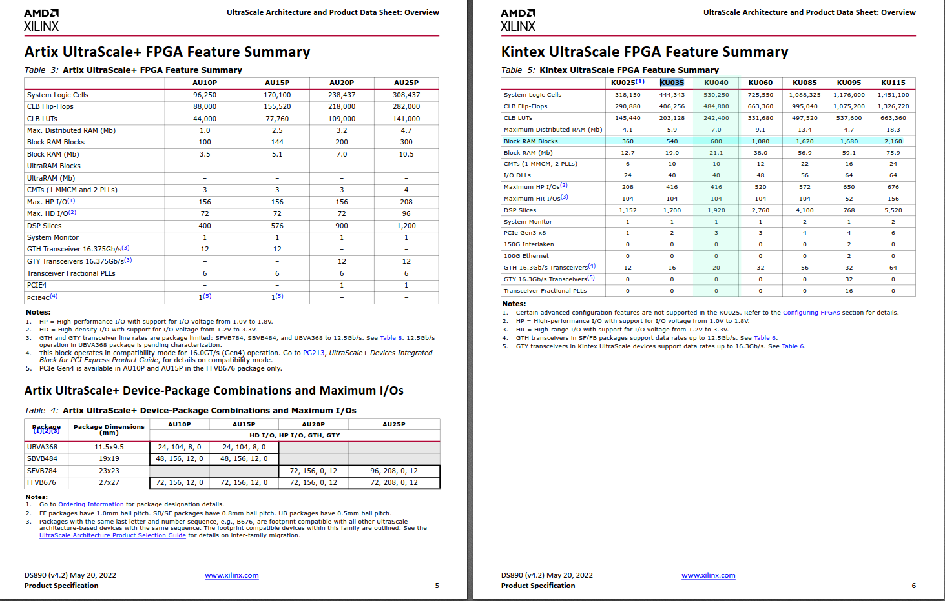
ASIC PCB - FPGA

Slide 7
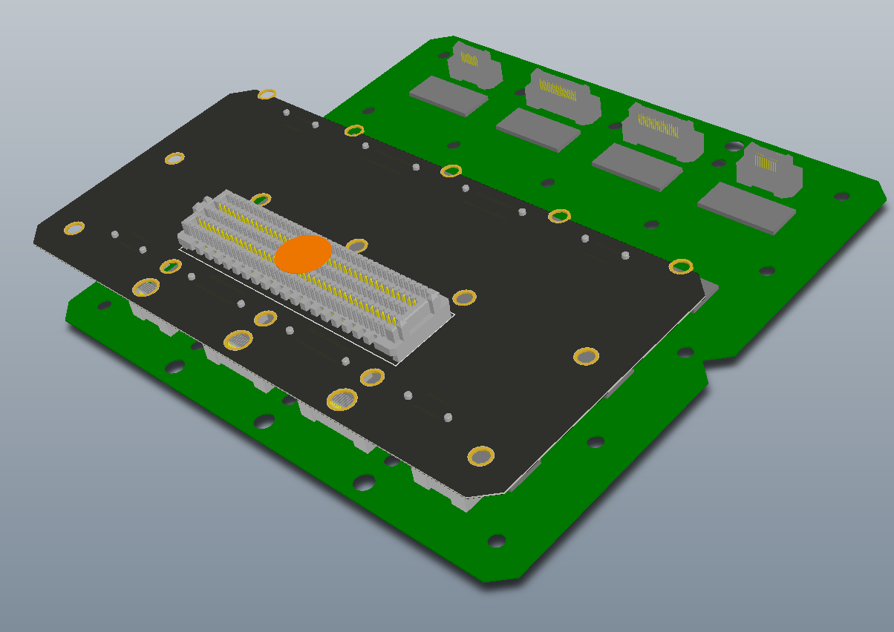
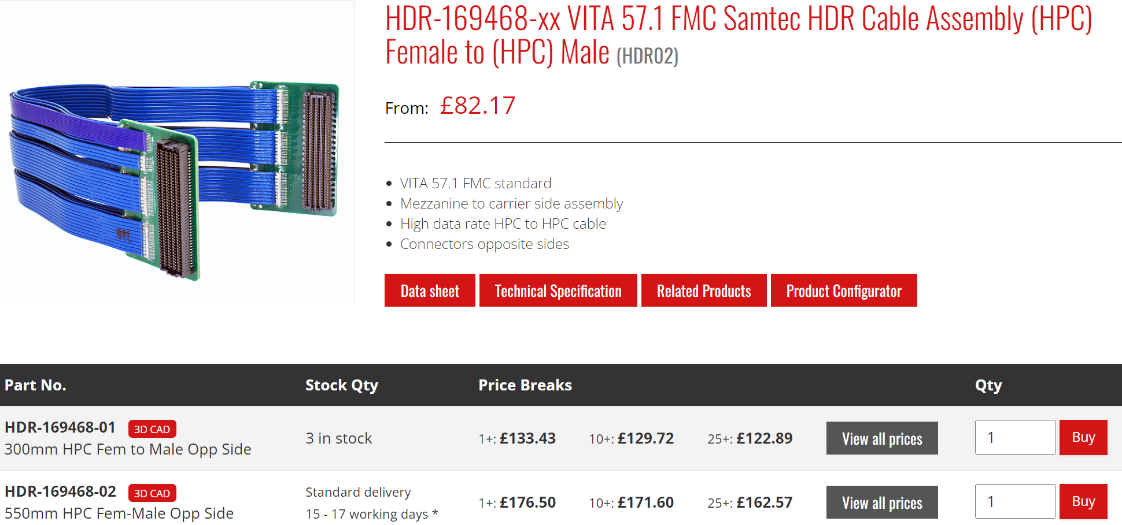
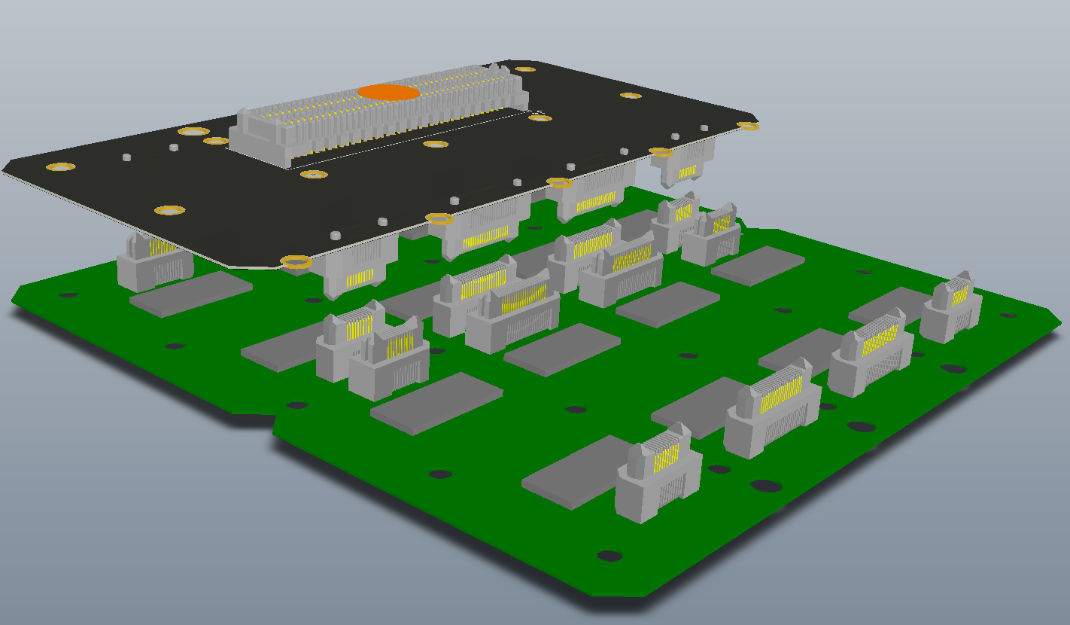
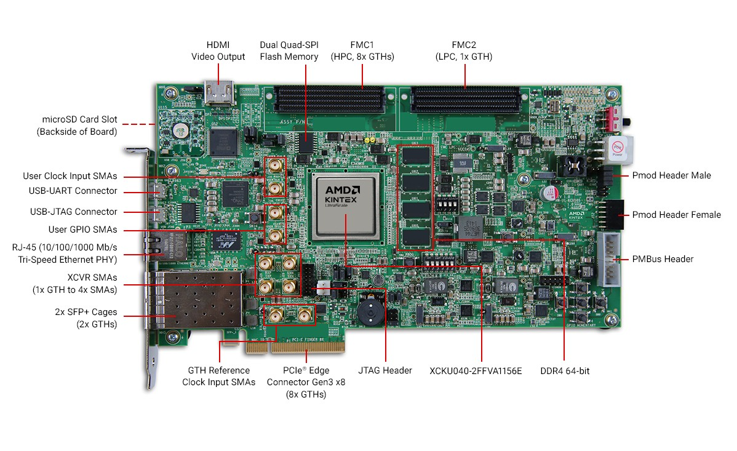
ASIC PCB - Backup

Slide 8
Notes
…

